Slide 1
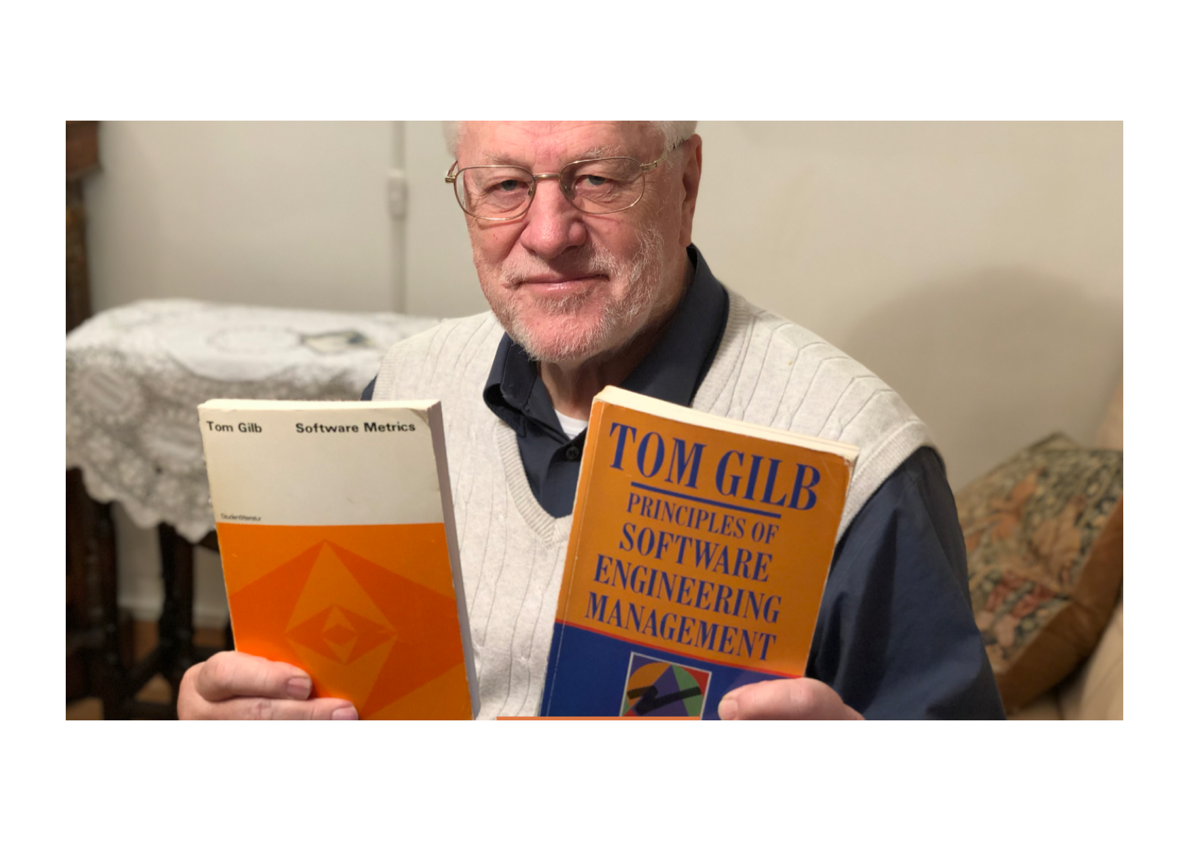
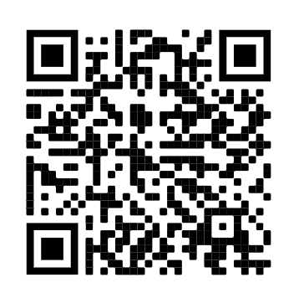
Serious Agile Requirements
Tom Gilb
Recorded Presentation for Agile Evangelistas
May 4 2021, 6PM UK Time.
Slides at https://www.dropbox.com/sh/e4smi7kb9k6rqua/AADgqx0ef84iBsmEpTWT4kV8a?dl=0
Paper at reference [2]
Tuesday, May 4, 2021
Serious Agile Requirements with Tom Gilb
Tuesday, May 4, 2021
6:00 PM to 7:30 PM GMT+1
Notes:
Tuesday, May 4, 2021
Serious Agile Requirements with Tom Gilb
Tuesday, May 4, 2021
6:00 PM to 7:30 PM GMT+1
Add to calendar
Online event
https://us02web.zoom.us/j/87595219349?pwd=MlcyZzlXQUV0eHg3a3luQ3ppeTFWQT09
Details
Serious Agile Requirements:
✨What kind of Requirements do we need to write, to really deliver a "measurable priority value-stream"?✨
Our question is, does "agile" software development require anything special
regarding requirements?
Let us assume that we are talking about Manifesto Agile, everything from Scrum to Disciplined Agile Delivery (DAD) to SAFe for example. The default option, though sometimes people deny they are ‘requirements’ is ‘User Stories’ [1] (and their Epics). Several agile methods encourage quantified ‘Non-Functional Requirements (NFR, bad term!). But I believe that the conventional methods used, are very primitive, compared with those I will discuss, and point to, here; especially from an ‘agile’ point of view.
In this webinar:
🌀 basic definition of ‘agile’ (or ‘Evo’, as I have always called it)
- Evolution
- On step results measurement and retreat possibility
- On minimizing failure risk, using feedback, correcting design errors
- What About ‘User Stories’
- the technical disciplines I recommend, for value requirement decomposition, for incremental agile value delivery:
👉 Stakeholder, decomposition and prioritization.
👉Top-Level Value requirements stated as a set of about 10 at a time
👉 Each Value Requirement has a defined Scale of measure
👉 DIMENSIONS: Each Scale of Measure can have many dimensions embedded in it [Scale Parameters]
👉 TARGETS: You can have a wide variety of requirement points on a Scale (Tolerable, Goal, Stretch)
👉 MICRO-DEADLINES: Each requirement point (like Goal) can have multiple targets in time, i.e. deadlines
👉 DIMENSION CONDITION COMBOS: Each requirement point can have any useful, priority set of conditions, derived from the [Scale Parameters], like whom where, and operational conditions.

Slide 2
Overview of Subjects
🌀 basic definition of ‘agile’ (or ‘Evo’, as I have always called it)
- Evolution
- On step results measurement and retreat possibility
- On minimizing failure risk, using feedback, correcting design errors
- What About ‘User Stories’
The technical disciplines I recommend, for value requirement decomposition, for incremental agile value delivery:
👉 Stakeholder, decomposition and prioritization.
👉Top-Level Value requirements stated as a set of about 10 at a time
👉 Each Value Requirement has a defined Scale of measure
👉 DIMENSIONS: Each Scale of Measure can have many dimensions embedded in it [Scale Parameters]
👉 TARGETS: You can have a wide variety of requirement points on a Scale (Tolerable, Goal, Stretch)
👉 MICRO-DEADLINES: Each requirement point (like Goal) can have multiple targets in time, i.e. deadlines
👉 DIMENSION CONDITION COMBOS: Each requirement point can have any useful, priority set of conditions, derived from the [Scale Parameters], like whom where, and operational conditions.

Slide 3

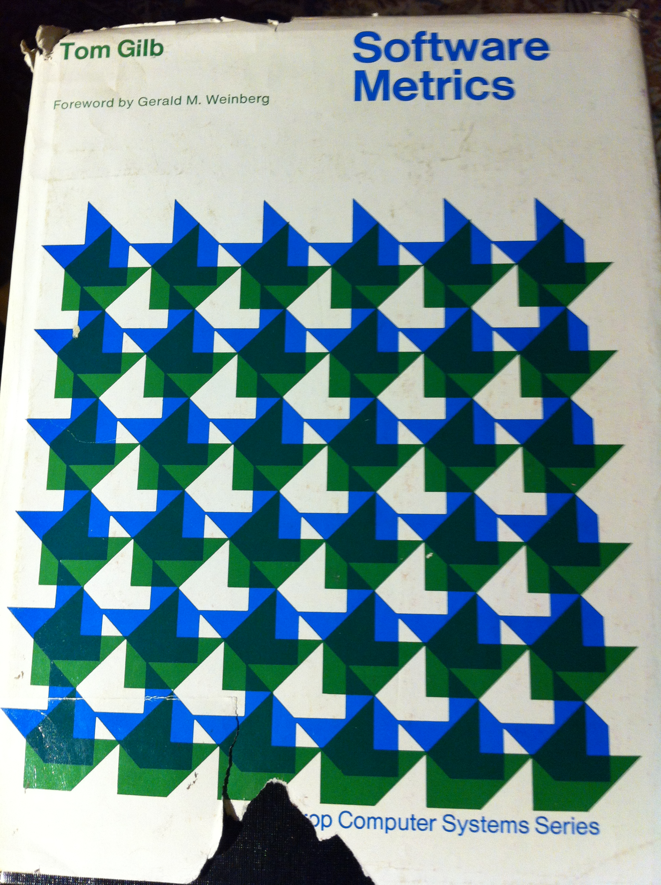
🌀 basic definition of ‘agile’ (or ‘Evo’, as I have always called it)
Can we agree on agile, ‘as it should be’?
Source: T. Gilb, Software Metrics, 1976, (Studentlitteratur/Winthrop).
'Evolution is a designed characteristic of a system development which involves gradual stepwise change.' (p. 214)
On step results measurement and retreat possibility
'A complex system will be most successful
if it is implemented in small steps
and if each step has a clear measure of successful achievement
as well as a "retreat" possibility to a previous successful step upon failure.' (p. 214)
On minimizing failure risk, using feedback, correcting design errors
'The advantage is that you cannot have large failures.
You have the opportunity of receiving some feedback from the real world before throwing in all resources intended for a system, and you can correct possible design errors before they become costly live systems.' (p. 214)
On total project time
'The disadvantage is that you may sometimes have to wait longer before the whole system is functioning. This is offset by the fact that some results are produced much earlier than they would be if you had to wait for total system completion.
It is also important to distinguish between a date for total system operation and a date for total "successful" system operation.' (p. 215)
Notes:
Source: T. Gilb, Software Metrics, 1976, (Studentlitteratur/Winthrop).
'Evolution is a designed characteristic of a system development which involves gradual stepwise change.' (p. 214)
On step results measurement and retreat possibility
'A complex system will be most successful
if it is implemented in small steps
and if each step has a clear measure of successful achievement
as well as a "retreat" possibility to a previous successful step upon failure.' (p. 214)
On minimizing failure risk, using feedback, correcting design errors
'The advantage is that you cannot have large failures.
You have the opportunity of receiving some feedback from the real world before throwing in all resources intended for a system, and you can correct possible design errors before they become costly live systems.' (p. 214)
On total project time
'The disadvantage is that you may sometimes have to wait longer before the whole system is functioning. This is offset by the fact that some results are produced much earlier than they would be if you had to wait for total system completion.
It is also important to distinguish between a date for total system operation and a date for total "successful" system operation.' (p. 215)
On the general applicability
'Many people claim that their system cannot be put into operation gradually.
It is all or nothing. This may conceivably be true in a few cases . . . I think we shall find that virtually all systems can be fruitfully put-in in more than one step, even though some must inevitably take larger steps than others.' (p. 215)
A measure of degree of evolution
'A metric for evolution is degree of change to system "S" during any time interval "t".' (p. 214)
On risk and predicting requirements
'Risk estimates plus/minus worst case are key to selection of step size', and 'Saving of analysis of future real world'. (p. 217)
The first remark is recognition that step sizing is determined by the need to control risk of failure.
It is not small steps in themselves which are important. A large step may be taken if the risk is under control; for example by using contract guarantees or known technology.
The second remark is recognition that the evolutionary method avoids the need to predict requirements and environments in the future; it allows us to wait until the future has arrived, to see the current requirements and the current environment.
On the scientific experiment analogy
'The concept of stability (where evolution is a technique for achieving stability) at individual levels of a system has the same usefulness as the concept of keeping all-factors-except-one constant in a scientific experiment. It allows systematic and orderly change of systems where the cause and effect may be more accurately measured without interfering factors, which may cause doubt as to the reason for good or bad results.' (p. 217)
'Systems may be specifically designed to go through a revolution in several phases, where only one level of the system is changed significantly at a time.' (pp. 217-8)
Evolutionary modularity design: conflict and priority
On p. 187 I raised the issue of 'Modularity division criteria', and gave six examples of rules for dividing software modules. Rule six was 'By calendar schedule of need of module' and the explanation for this rule was: 'Early implementation; evolutionary project develop.'
'Each rule can conflict with other modularization rules and with other design criteria. Resolution of the conflict can be achieved by a clearly stated set of priorities'.
This is a forerunner to the present perception of step design and selection being based on those elements of the total system which will contribute the greatest value towards stated objectives at the least development resource cost.
Later writings on the subject
The evolutionary idea was developed in my articles in the trade press:
'Evolutionary Planning and Delivery: an Alternative', Computer Weekly, 2 August 1979;
'Evolutionary Planning can prevent Failures', Computer Data, Canada, April 1979, p. 13;
'Realistic Time/Cost Data', Computer Weekly, 16 August 1979;
'Eleven Guidelines for Evolutionary Design and Implementation', Computer Weekly, 12 March 1981;
and 'The Seventh Principle of Technology Projects: Small Steps will Result in Earlier Success', Computer Weekly, 30 July 1981.
In all there were about 122 Gilb's Mythodology Columns in Computer Weekly (UK), which developed many of the ideas in this book.
Should any researchers wish copies of any of this, they are in my personal archives in NOrway. They were before internet of course. Let me know if you want to host copies of these for historic purposes.
Should any researchers wish copies of any of this, they are in my personal archives in Norway. They were before internet of course. Let me know if you want to host copies of these for historic purposes.

Slide 4
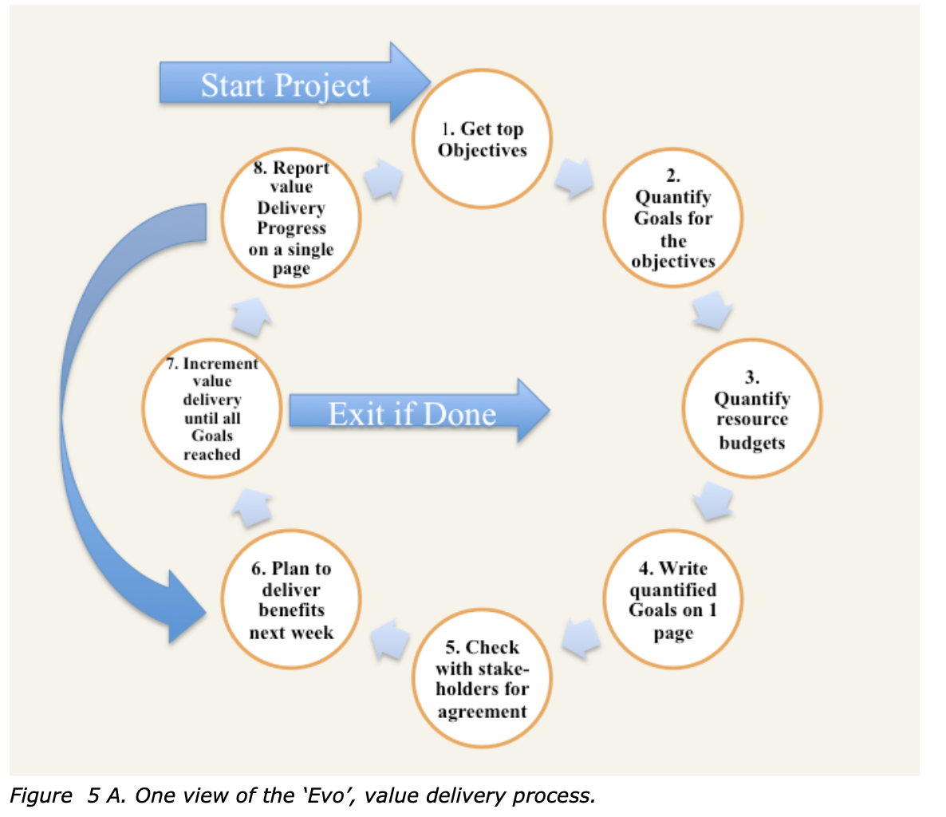

Slide 5

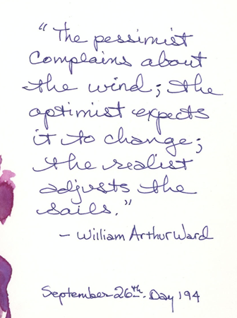
“Any set of tactics that
  enable a prioritised stream of useful results,
  in spite of a changing environment”
      TsG 7 June 2013, for a UK Bank Board of Directors.
Defining ‘Agile’
Agility is Realistic
Courtesy of my sister Tyra Gilb

Slide 6






Title
Values
Quantification
Strategy
Engineering
QMulti Value/Cost Step-Feedback
Your
enterprise agile methods
today
Quantified QC
tiny.cc/ManagilitySlides
Ref. [10] Slides and Videos
IT Agile
‘Managility’ is incremental improvement
in the direction of cost-effective quantified methods

Slide 7

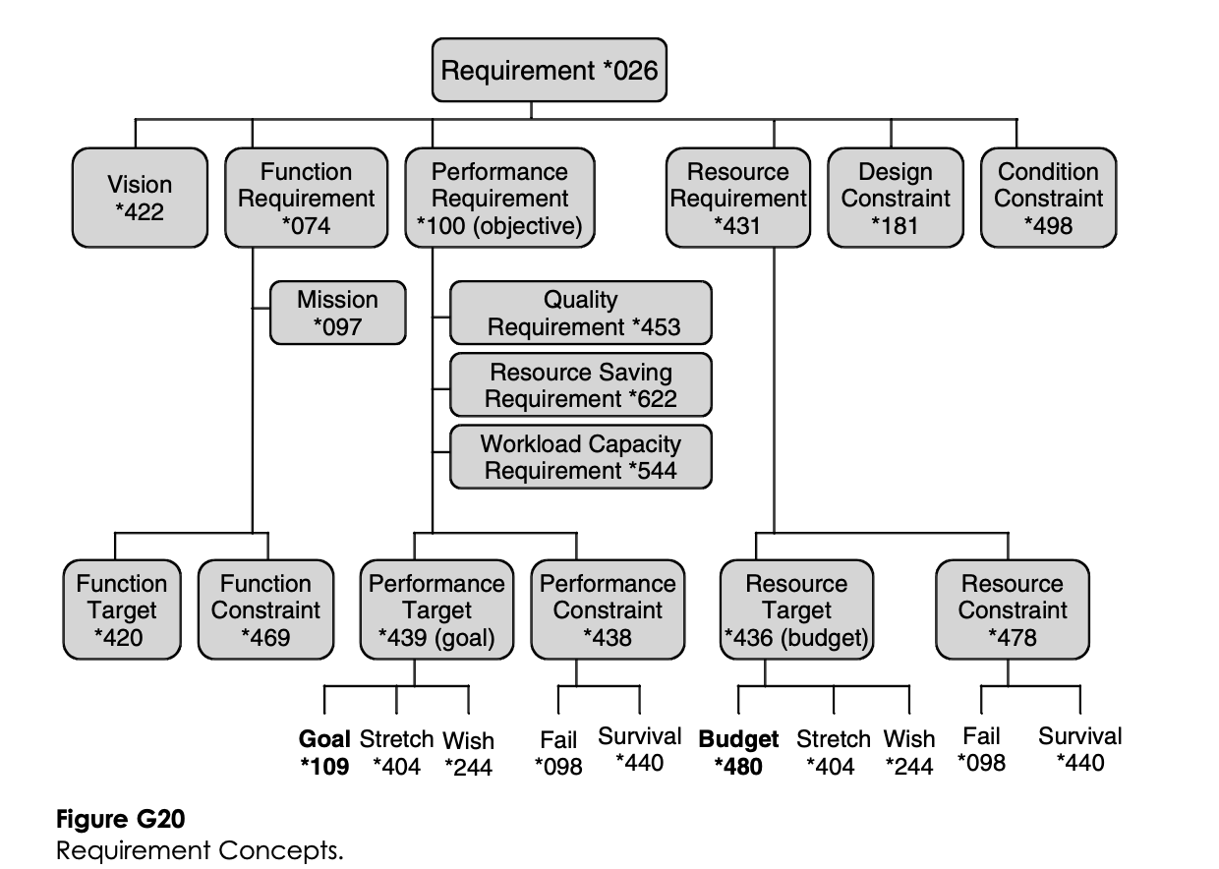
Planguage Requirements Definitions
Oct 2014 Full Planguage Concept Glossary
In Downloads/Gilb Essentials
http://www.gilb.com/dl830
Planguage Concept Glossary as edited in Competitive Engineering book 2005 (10% of Full Glossary)
http://www.gilb.com/DL387

Slide 8
- On step results measurement and retreat possibility
Done above
On step results measurement and retreat possibility
‘"A complex system will be most successful
if it is implemented in small steps
and if each step has a clear measure of successful achievement
as well as a "retreat" possibility to a previous successful step upon failure.’"

Slide 9
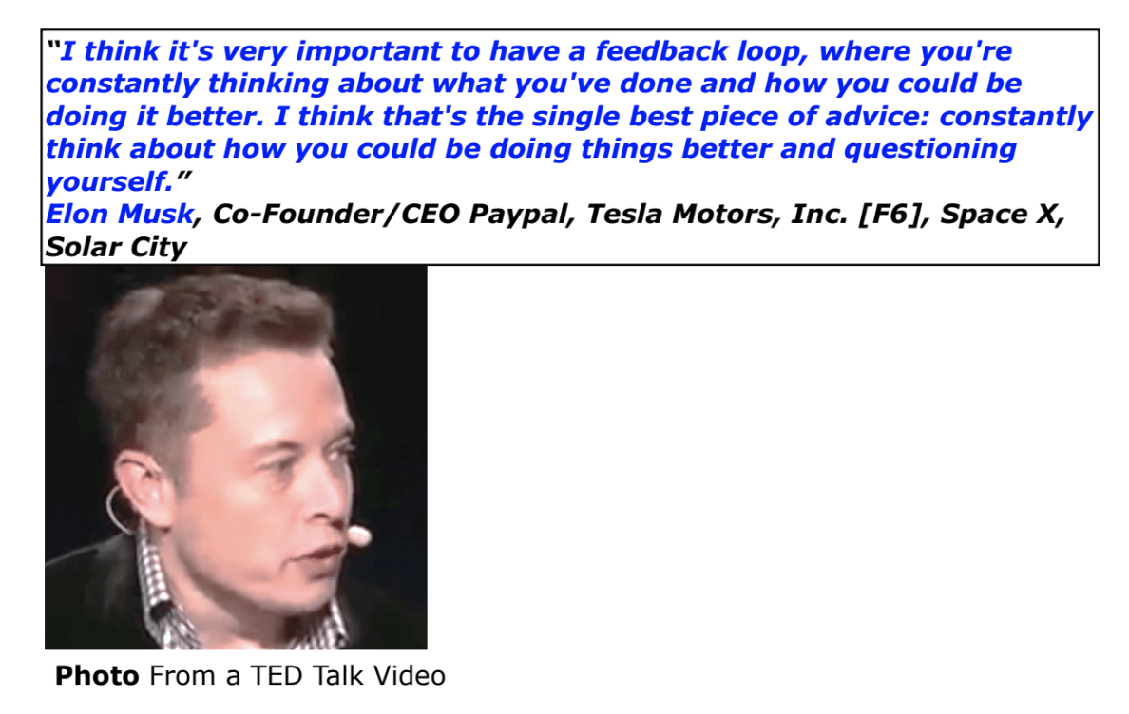
- On minimizing failure risk, using feedback, correcting design errors
Over 20 increments to Hw & Sw per week on a Tesla (EM, Joe Justice)
On minimizing failure risk, using feedback, correcting design errors
“
The advantage is that you cannot have large failures.
You have the opportunity of receiving some feedback from the real world before throwing in all resources intended for a system,
and you can correct possible design errors before they become costly live systems.”
https://businessagility.institute/learn/agile-hardware/514
Joe Justice and Tesla
Risk Management Chapter 7, (70 pages) VP Value Planning Book. https://tinyurl.com/RiskMgtVP

Slide 10
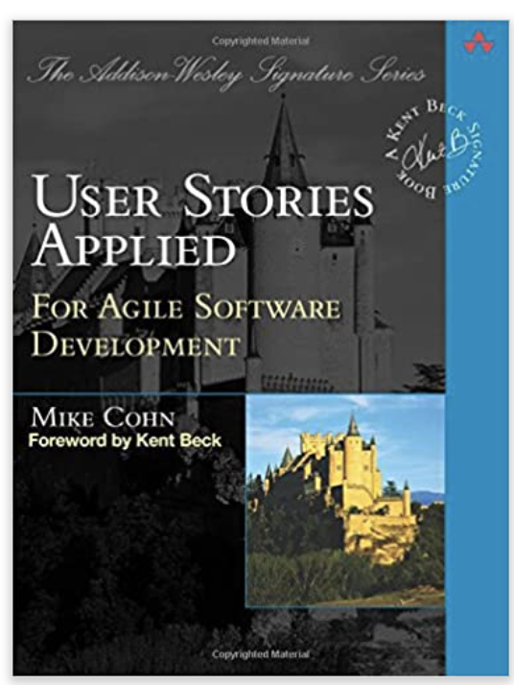
- What About ‘User Stories’
For example:
As Security Director I Need State-of-the-Art ‘AI’ Security Technology so that the Russians can’t hack into the government.
Now: “the Russians can’t hack into the government. ” is the ‘requirement. However ambiguous it is.
And “State-of-the-Art ‘AI’ Security Technology” is an ‘architecture’.
Notes:
This level of specification, if you do not already know from daily experience, is extremely common. For the manager Powerpoint decks, for things as big as this example. People do not bother to systematically analyze [9] these statements and see their shortcomings. They do not take the trouble, or have high standards of clarity, so they do not object to this fuzzy specification, and then clarify it [8].
In real companies, including those I am working with right now, these massively unclear ‘requirements’ and ‘designs’ are spouted in great volume (20 times per page [10]. And nobody even reacts to it, because it is so pervasive, and we do not have higher standards for clarity [5, see Rules].
But, lack of clarity (massive ambiguity) is not the main agile problem I want to take up here. Of course the lack of clarity, and few words, hides the real problem. Both the example requirement, and the architecture, are massive. They probably obscure years of effort and billions of Dollars. They may even be obscuring that the problem is not actually solvable at all (‘arms race’, ‘mutual escalation’). And we certainly are no longer talking about a Scrum team delivering this User Story in a 2 week sprint.
These objectives and architectures are the top level of any big project. Call them ‘epics’ if you like. But they are the things that determine failure and success of large projects.
Now of course, if you do not have absolute crystal clarity in a critical stakeholder objective like ‘Russian Hacking’, then:
You cannot ever decide what the preferred architecture really is
And if you can’t do that, you cannot have any knowledge of costs or time to delivery of an unknown or ambiguous ‘Cyber Security’ architecture..
And nobody can say you failed or succeed, because there is not clear definition of the security NFR (I think the term is silly), and nobody has even agreed to a clear Security definition.
And you cannot deliver increments of value delivery (of security) towards an undefined long term target level of security).

Slide 11
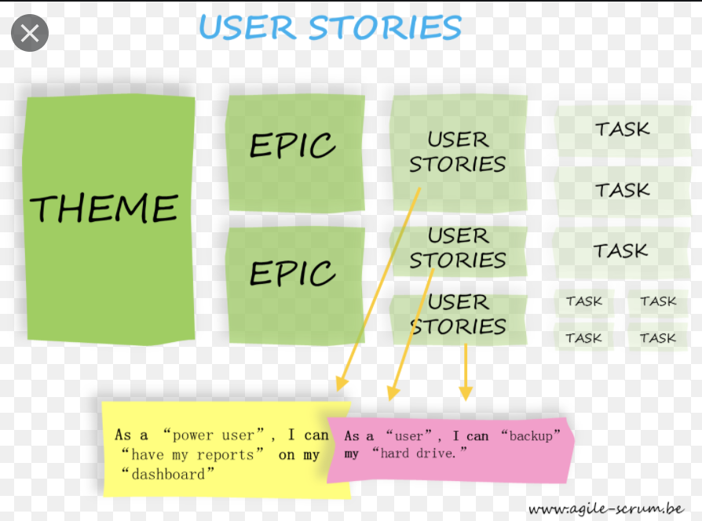

User Stories
My problem is, that I see user stories being used way beyond their ‘level of competence’, Needing to do too much, with too little.
  and I think user stories, as a primary requirements culture, are probably one initial cause of project failure.
Success and failure are not clearly defined by user stories; ever.
  the Value level ‘Tolerable level’, in Planguage, defines a failure border,
  and ‘Goal level ‘, in Planguage, defines success.
User stories just do not deal with values and qualities, (M.C. agrees)
  so we need more, (Cohn suggests Planguage)
  for controlling the system stakeholder results, values, and qualities.
Use User Stories as an ‘Ambition Level’ (a ‘headline’), a ‘starter’
  a simplified departure point, not pretending accuracy, quote the boss
  and then analyze what the exact, ‘value levels’ should be
  (derive a ‘Scale’ and a ‘Wish’ for example).
  See next slide
Source [ref. 3B] Value Requirement slides. VR Book [3A]15.1
Notes:
https://www.agile-scrum.be/wordpress/wp-content/uploads/2014/08/User-stories-Agile-Scrum-Belgium-Training.png

Slide 12

User Stories ? (Just a beginning)
Can ‘User Stories’ be used?
User stories do not contain enough information,
  to serve as ‘value’ requirements.
But you can add on that ‘value information’; to make values clearer.
User Stories have a useful structure: are good ‘summaries’. They contain:….
A stakeholder (narrowly called ’user’). ‘Stakeholder stories’!
A ‘story’, which functions as a sort of requirement. But is not detailed enough for serious purposes.
A justification for the story, which is good practice.
  But can be improved upon. Like, ‘what is the economic value?’
My initial advice for people who have to deal with User Stories is to
  write them up as a Planguage statement (see —->. )
  and then proceed to derive more-useful detail from it.
    Like risk, priority, costs, strategies, stakeholders, issues
Usability:
Type: Value Requirement.
User Story: As an expert user I want shortcuts to save me time. <- US030719.
Scale: Average cycle time in minutes for a [Task] by a [User].
Wish: 6 minutes,
    Deadline = End Next Year,
Task = Expert Complex Tasks,
User = Expert.
Source Ref. VR Slides [3B]
Notes:
(ref.
A, US)
http://vimeo.com/53159408
Smidig 2012 Talk Video Recording, English
8 Minutes
Published on Dec 15, 2012
Tom Gilb discusses the dangers of User Stories at Smidig 2012 (annual conference of Agile software development in Oslo.)
Originally shared by Smidigkonferansen on http://vimeo.com/53159408 - CC-By SA.
https://www.youtube.com/watch?v=-oDb9TUb_uQ
User Stories are overrated
“User Stories: A Skeptical View”
http://www.gilb.com/DL461
User Stories paper by Tom and Kai Gilb
In Gilbs' Mythodology Column, Agilerecord.com March 2011
www.agilerecord.com/agilerecord_06.pdf (whole issue)

Slide 13
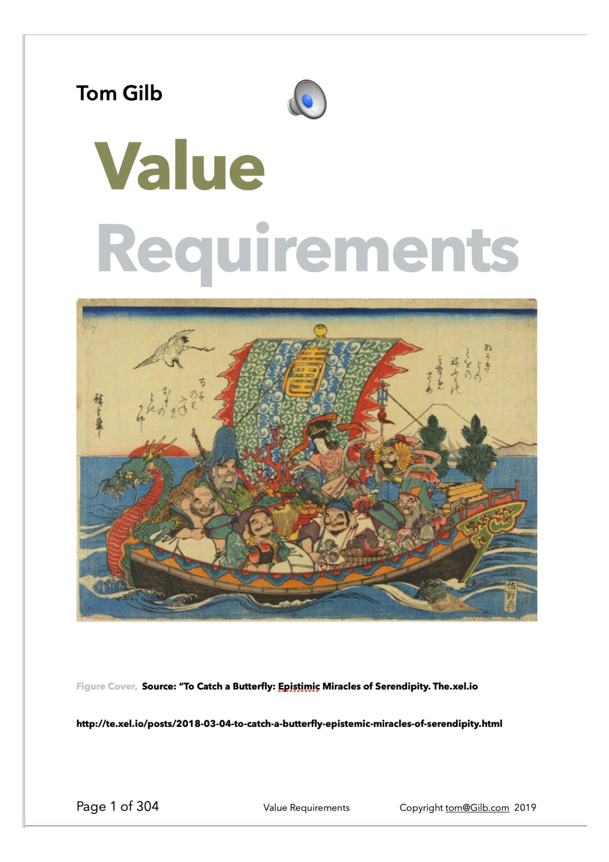
The ‘technical disciplines’ I recommend,
for value requirement decomposition, for incremental agile value delivery:
STAKEHOLDER: Stakeholder, decomposition and prioritization.
TOP 10: Top-Level Value requirements, stated as a set of about 10 at a time
SCALE: Each Value Requirement, has a defined Scale of measure
DIMENSIONS: Each Scale of Measure can have many dimensions embedded in it [Scale Parameters]
TARGETS: You can have a wide variety of requirement points on a Scale (Tolerable, Goal, Stretch)
MICRO-DEADLINES: Each requirement point (like Goal) can have multiple targets in time, i.e. deadlines
DIMENSION CONDITION COMBOS: Each requirement point can have any useful, priority set of conditions, derived from the [Scale Parameters], like whom where, and operational conditions.
Details in following slides
Ref. [3]

Slide 14
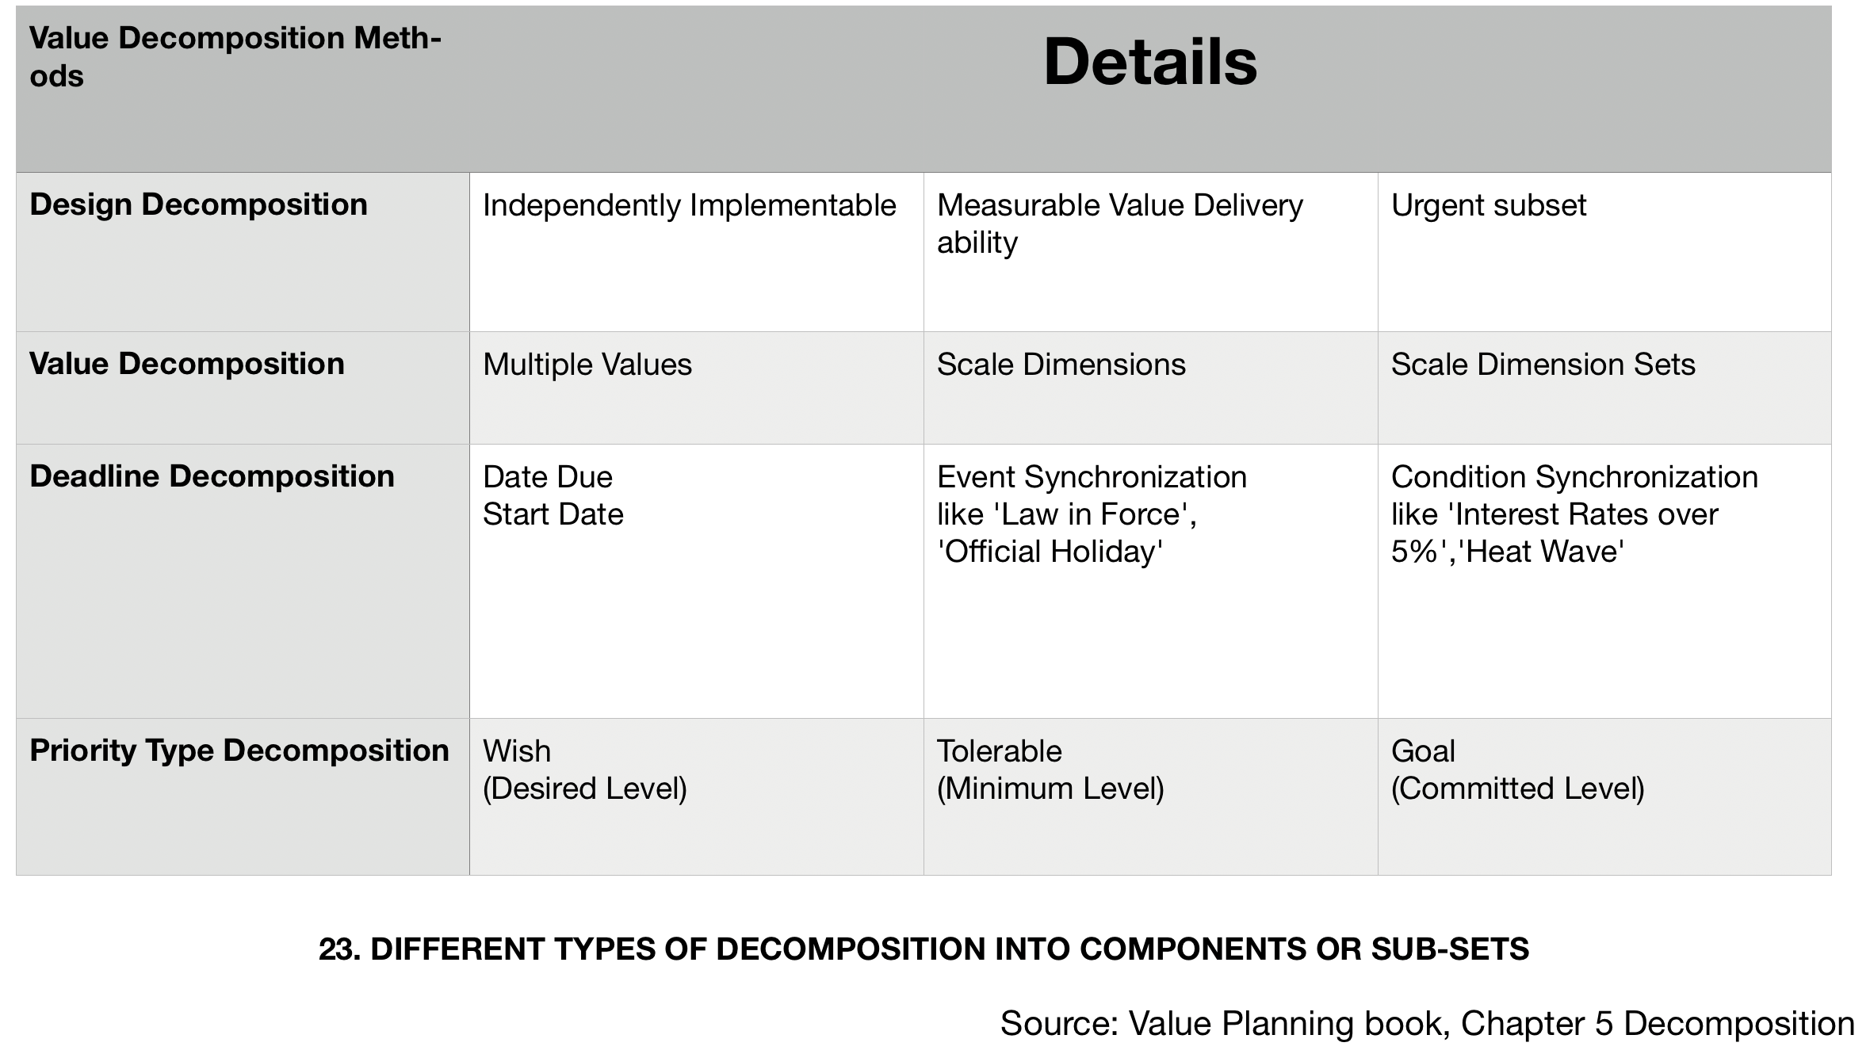

The technical disciplines I recommend, for value requirement decomposition, for incremental agile value delivery:
But, let me first assert that these 7 requirement specification techniques are
  all ‘decomposition’ methods.
  They each permit us to decompose a ‘big’ (epic level?) value requirement
  (and some of these techniques can help decompose other classes of requirements too)
  into quite small increments,
    of value delivery,
  increments of a value delivery stream,
  cumulating finally in achieving
    the longest-term Goal-levels for ‘everything’ we are considering.

Slide 15
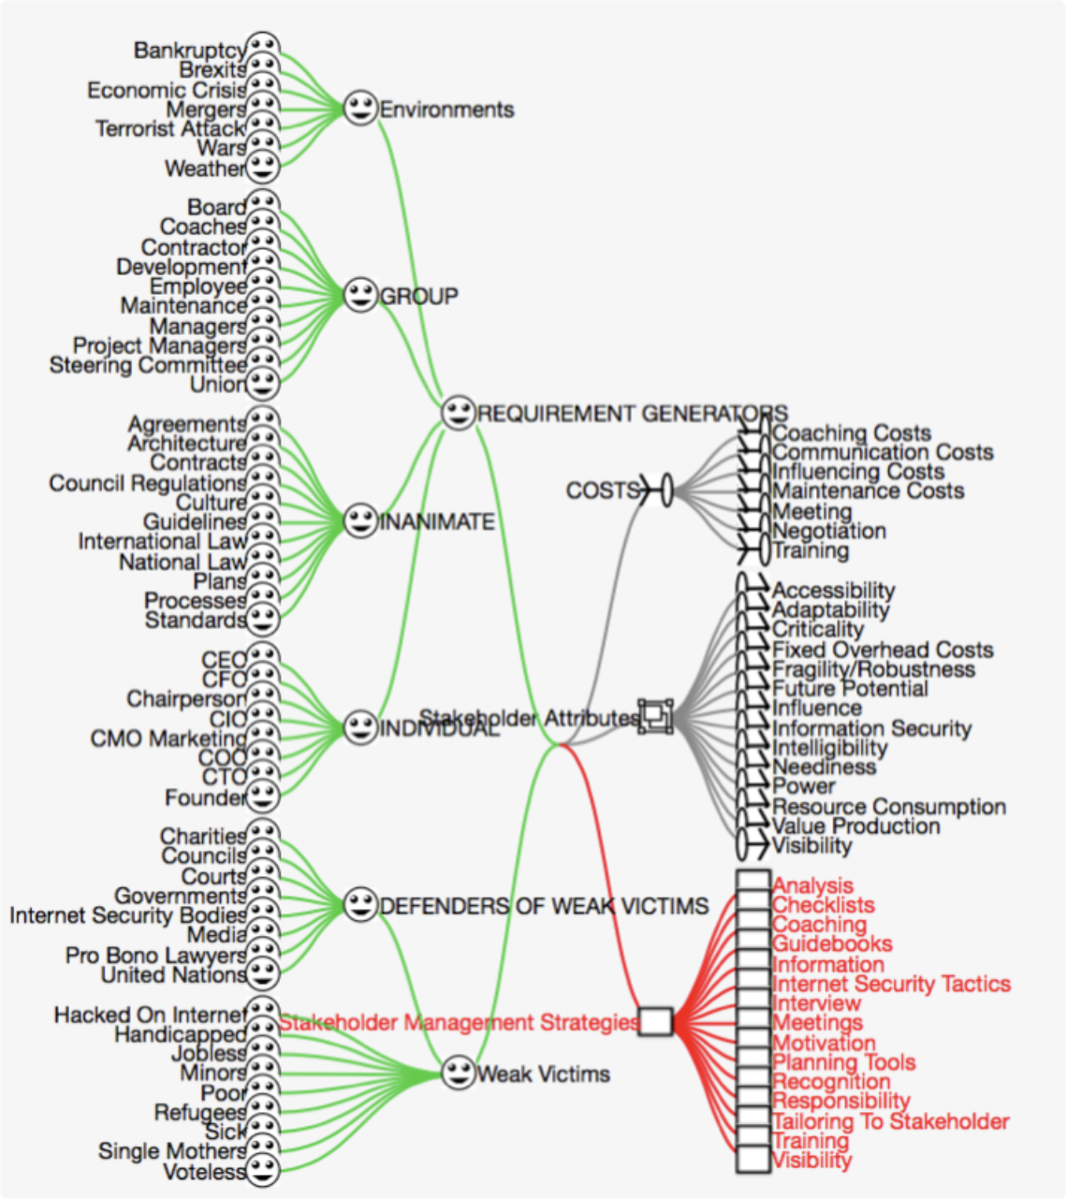
1. STAKEHOLDER: Stakeholder, decomposition and prioritization.
If 2 or more stakeholders, are interested in the same value requirement,
  for example User X, and User Y;
  we can decompose along stakeholder lines.
That means
  we can deliver to Stakeholder X, (if highest priority)
  and later Stakeholder Y.
If you have 50 stakeholders,
  which is normal on medium to large projects,
  you have immediately accomplished a 50-to-1 decomposition.
Source VR Ref. [3B] slide 101
A generic stakeholder pattern —>

Slide 16
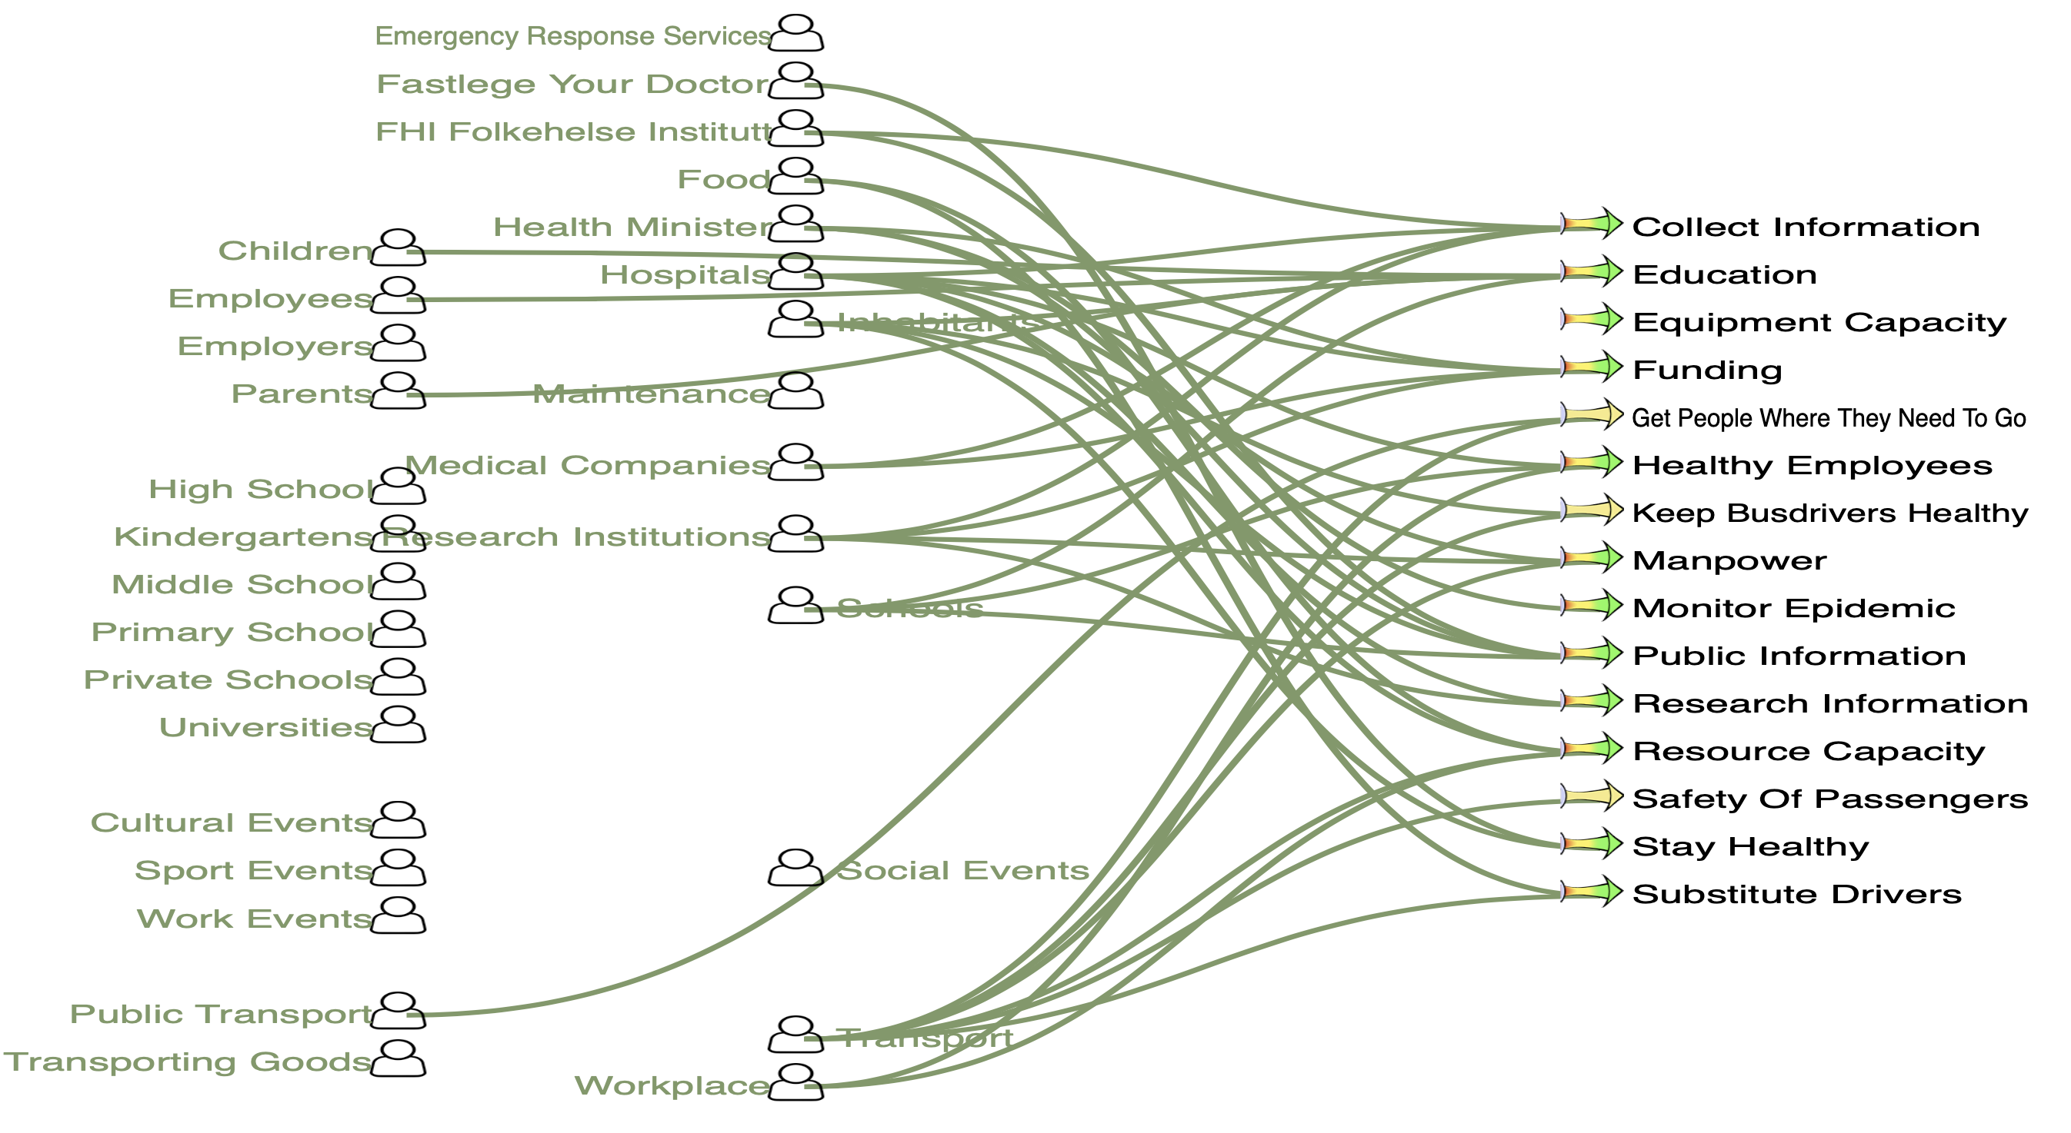
2. TOP 10:
Top-Level Value requirements,
stated as a set of about 10 at a time
On top of that (Stakeholder decomposition)
if you have selected the top-10 (highest immediate priority).
By ‘Top 10’ definition,
  you have already got two levels of decomposition.
    The Top 10
    (and the other less-critical value objectives).
You can now choose
  to sequence delivery of the higher-priority value objective first,
  followed by the other 9, one by one, or 2x2
    as Noah used as a strategy. :)
  You now have, theoretically, up to 1/500th potential steps
  (10 values x 50 stakeholders)
Source VR Ref. [3B] slide 4
A March 8 2020 Covid Planning exercise in Oslo
Using ValPlan to relate stakeholders and value requirements

Slide 17

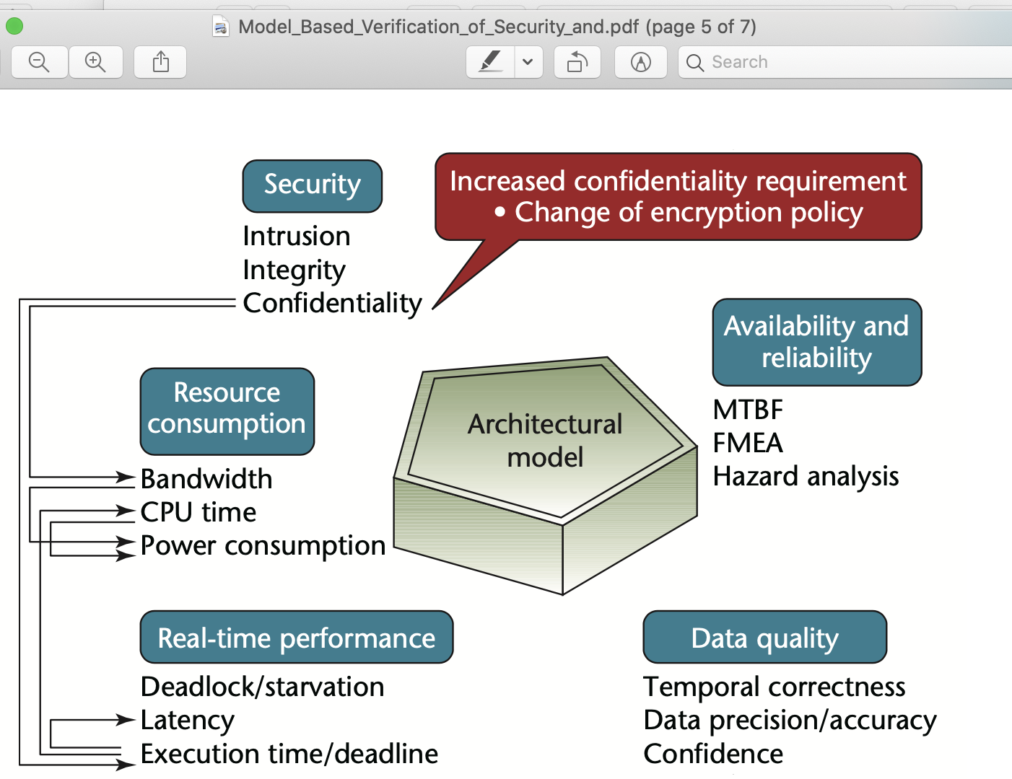
3. SCALE: Each Value Requirement, has a defined Scale of measure
Even when quality and performance requirements are clear,
There is the additional complication that they are in conflict with each other
There might be a decomposition of a major value like Security, into a number, like 10 sub-values.
For example Preventative Security, Detection Security, Analysis Security, Recovery Security.
Each will be defined by a separate Scale of measure, quite different from the other Scales. (Examples in CE Chapter 5, [5]).
So we can decide to sequence our incremental value delivery by the most critical of these first,
  for example ‘Analysis Security’.
  Let’s say we have 5 sub-values, so the resolution is 5x less than 1/500, or 1/2,500. Don’t take these numbers as more than ‘for example’. But keep in mind that Lean Startup and Devops, with multiple parallel teams, might really implement 60 increments per day to a system. So this resolution is in line with the opportunity presented this far.
https://www.academia.edu/13897730/Model_Based_Verification_of_Security_and_Non_Functional_Behavior_using_AADL?source=news_feed_share
Architectural Modeling to Verify Security and Nonfunctional Behavior

Slide 18
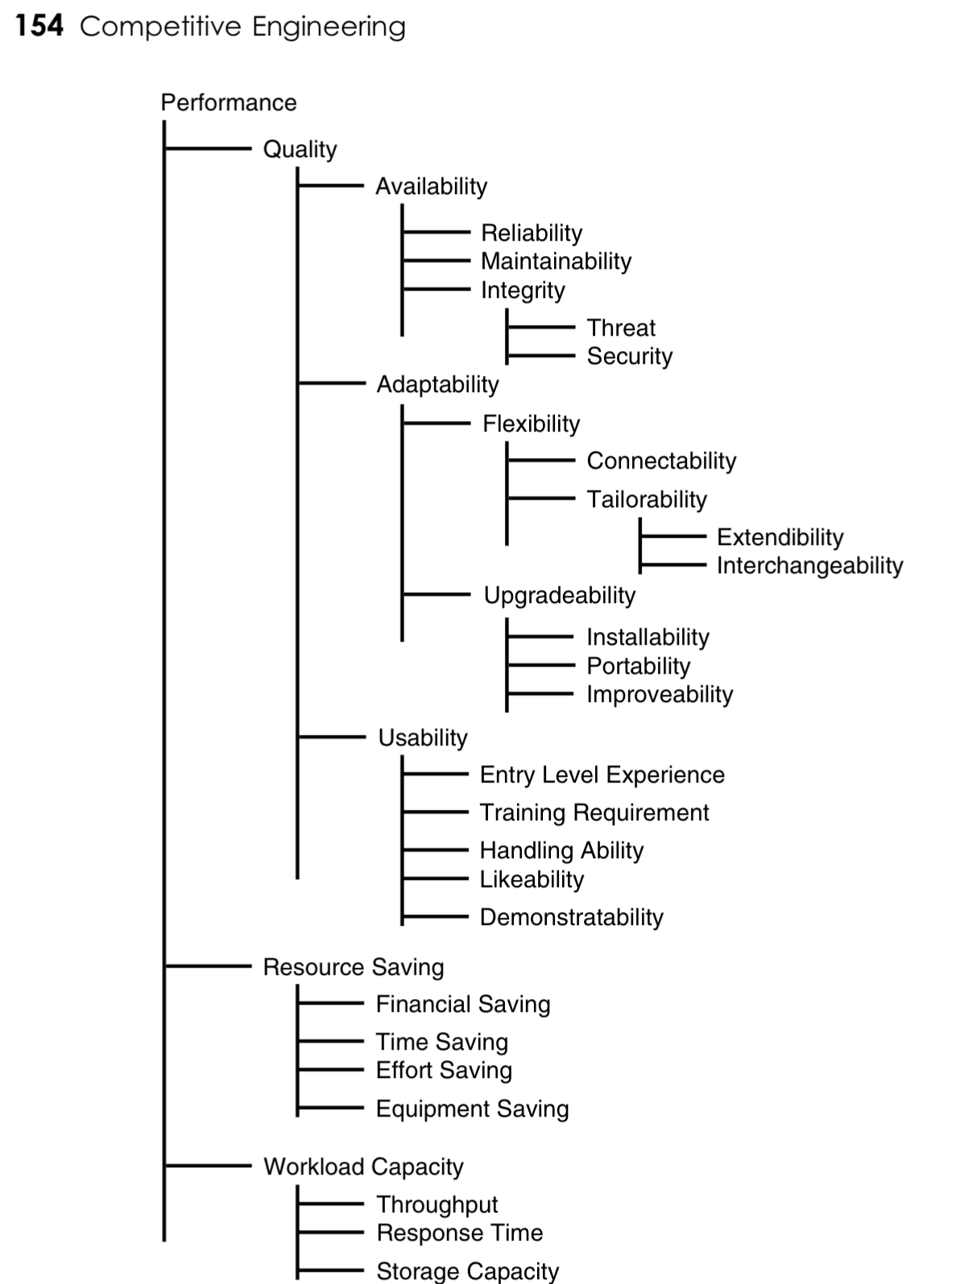
Knowing when to decompose a value into sub-values, using sub-scales.
There is an engineering heuristic that says
‘decompose the value you want to quantify
until ‘quantification is obvious’.
This works well.
Each detailed level is defined by its own tailored Scale of measure.
The root level (or, ‘set name’) is defined by
the ‘set’ of quantified detail elements.
CE book, Chapter 5: Scales of Measure:
http://www.gilb.com/DL26
Gives detailed examples of template Scales for everything in this diagram.
Notes:
3.12 in VR book
TSG 2020 I remember that I found this in. Chapter in Juran (Editor) Quality Control Handbook. Copy at my cabin. It is also in the bible Corinthians, definition of Agape (Love) as a decomposed set of love qualities. See my TEdX talk
Chapter 5: Scales of Measure:
http://www.gilb.com/DL26
Figure 1.22 : Examples of decomposition of higher level values into different-Scale sub-values.
Detailed examples of potential Scales of measure for these sub-values are given in the CE book. (1)
Some ‘values’ are simply ‘umbrella titles’ for a set of different values.
Sometimes, you have an option to decompose into sub-values, or to use Scale parameters to combine the value ideas into one generic scale. Sometimes that is just a matter of taste or convenience. The result might be the same

Slide 19
4. DIMENSIONS: Each Scale of Measure can have many dimensions embedded in it [Scale Parameters]
A ‘pattern’ with many dimensions
We usually specify a Scale with several dimensions, “[Scale Parameters]” ,
  like
Scale : % [Customer Type] doing [Customer Activity] under [Conditions] in [Area].
This amounts to a decomposition into 4 dimensions,
  each with its own set of conditions,
    and with a huge number of possible combinations, as further decomposition.

Slide 20
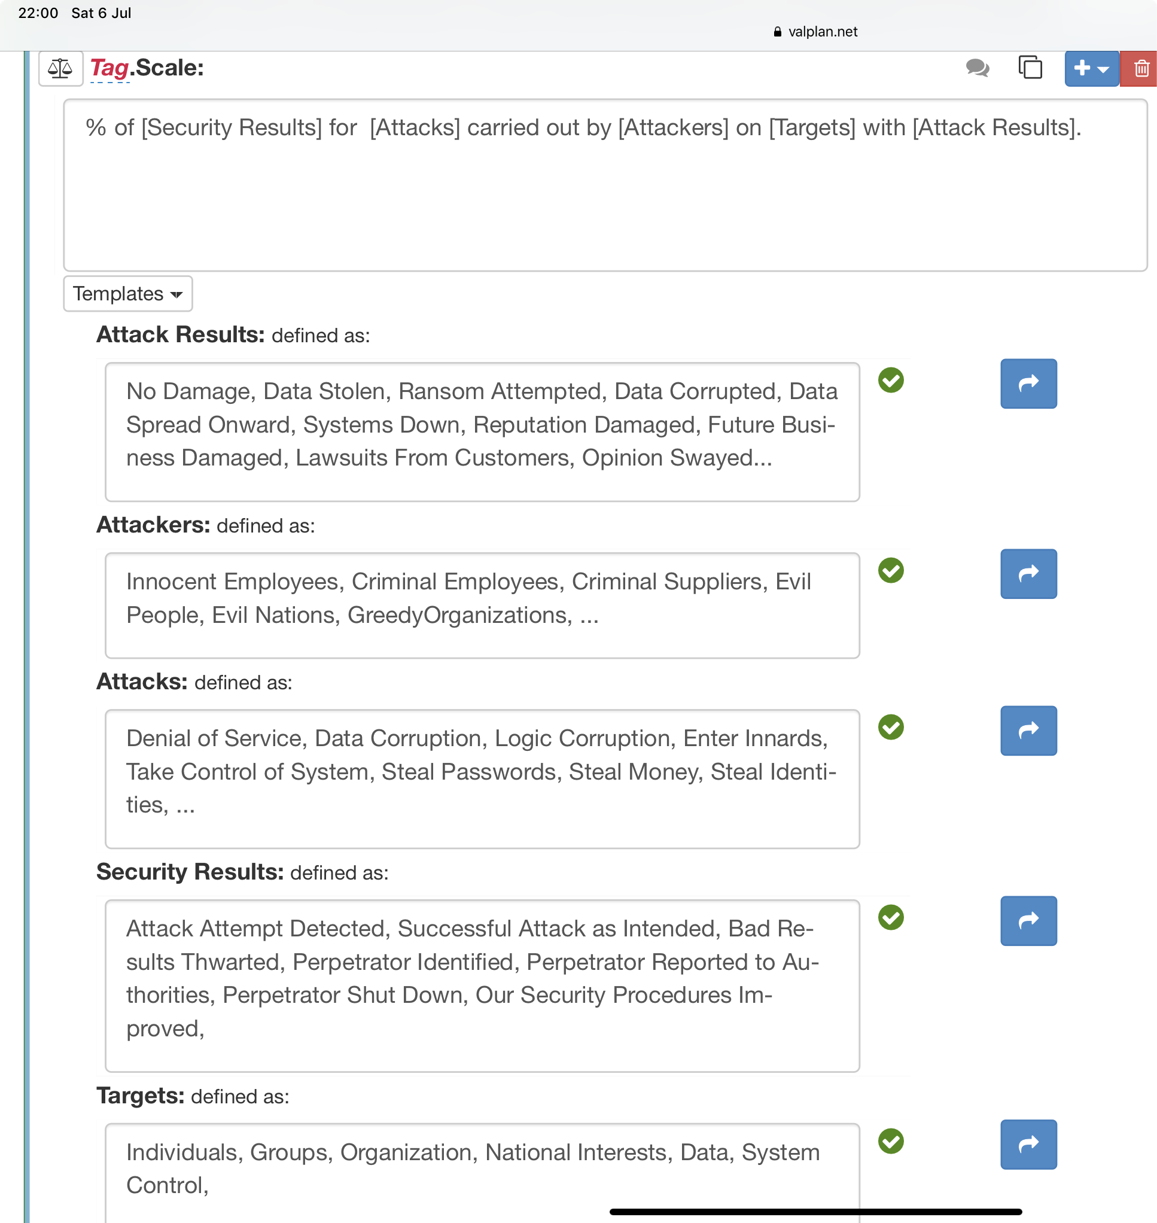
Clear Targets
Begin with clear Scales —->
For example: if the Stakeholder says:
Ambition: I want the best security, to fight hackers, and protect my customers and company.
Or
User Story: As a User I want good security, to fight bad guys.
These are simply unacceptable statements
  No defined scales
  No definitions
  No conditions [Scale Parameters]
  No levels (benchmarks, constraints, targets)
Notes:
Figure 1.40 : in this case I took the Ambition Level statement (“I want the best security to fight hackers and protect my customers and company”) , and created a Scale for Security with appropriate Scale Parameters (‘Attack Results’, etc.).
I then defined all 5 Scale parameters (Fig. 1.40) with a reasonable set of attributes. Anything forgotten can easily be added later, as we go.
Can you begin to see the need for detail in this Security problem?
The ‘Ambition Level’ hides all of it.

Slide 21
5. TARGETS: You can have a wide variety of requirement points on a Scale (Tolerable, Goal, Stretch)
Priority decomposition, in terms of criticality
You can also decompose the requirement by priority values:
Value X:
Scale: % ….
Tolerable 42%, Goal 84%, Stretch 99%
And using Techniques below (Deadlines, conditions) you can have many of each of these (Tolerable, Goal, Stretch).

Slide 22
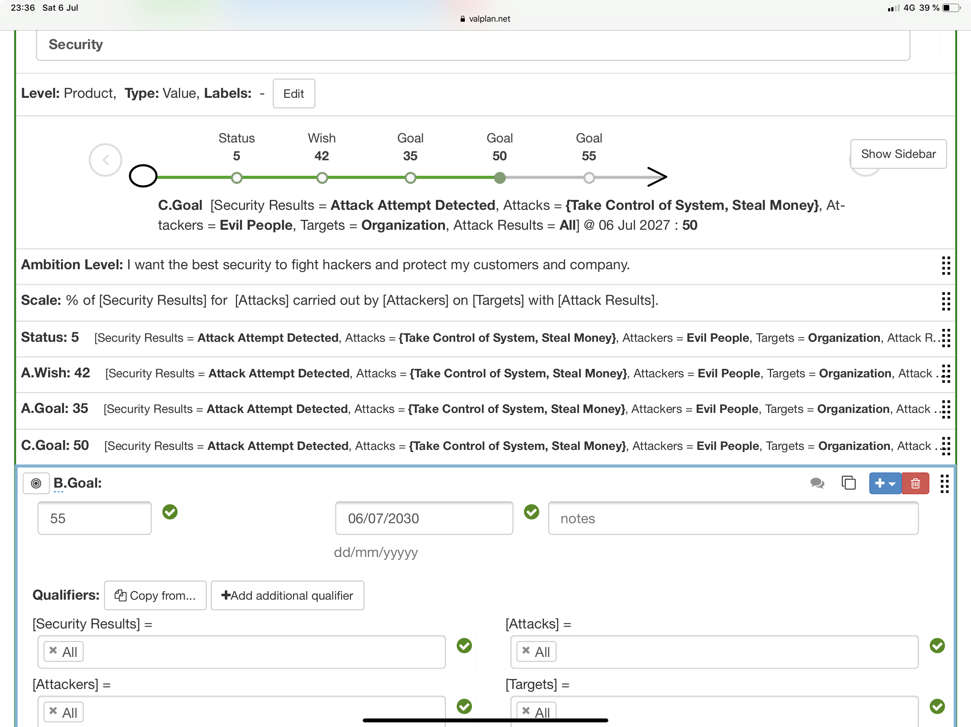
Many Goal statements
7.3 Comment on the Multiple Goal Example (Fig. 1.43).
I tagged both the Wish, and a corresponding Goal, with a tag ’A’, to make it more visible that they were related.
And by ‘Tagging’ any Planguage statement, I can more easily refer to it when presenting, or writing an analysis of the plans.
Bullet points don’t ‘make the cut’ (work well). Nor do ‘yellow stickies’ (kid stuff) in my world. Not even for early informal drafting of plans. We live in a complex integrated world and digital plans are the only reasonable tool for modeling it. Even just a Text editor!
It looks like we cannot achieve the A.Wish on time, but only a level of 35%. (A.Goal)
The good news is Goal ‘C’ (with exactly same Scale parameter attributes as A) we can achieve a higher than Wished for level of 55%, later, in 2027
And Goal B, the ultimate ‘All, All, All, All, All attributes’ Goal, all security problems which are included in the Scale parameter definitions (see above Scale detail), can be achieved in the year 2030. With current funding! If you want earlier results, you can cross my palm with silver.
The implication for all Goal statements is that we have done the necessary ‘homework’. That means we have found a suitable architecture or design, that will give the stated Goal level, by the stated deadline for the particular Goal level.
  We have in addition found that the ‘technology solution costs’ are within our ‘resource budgets’ (see later in the book, Chapter 12), when regard is paid to all other Goal commitments in the same time frame, or project. We know that, because otherwise we cannot commit a Goal.
Notes:
Figure 1.43 : Multiple Goal statements (tagged A, B and C).

Slide 23
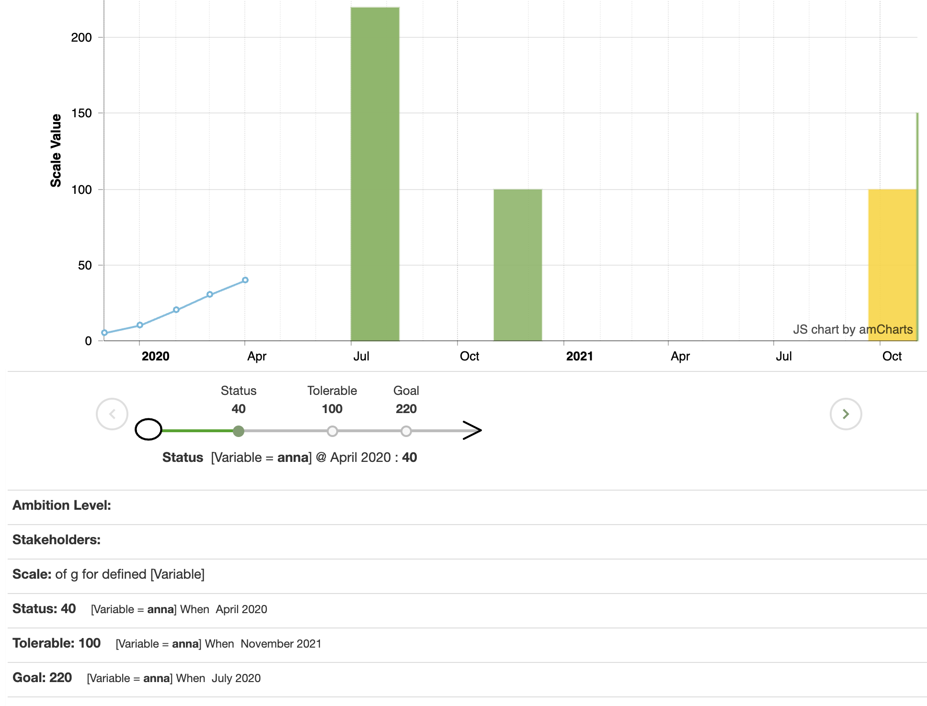
6. MICRO-DEADLINES: Each requirement point (like Goal) can have multiple targets in time, i.e. deadlines
Decompose in time increments
You can decompose the targets
  (Wish, Goal, Stretch) and
  constraint levels (Tolerable)
Goal
  2022 20%,
  2025 30%,
  2028 42%.
Into any arbitrary ‘sprint’ (value delivery increment) size, e.g. weeks, months, quarters, years. etc.
You are, using a series of points, to draw a planned curve of the future value delivery stream increments.

Slide 24
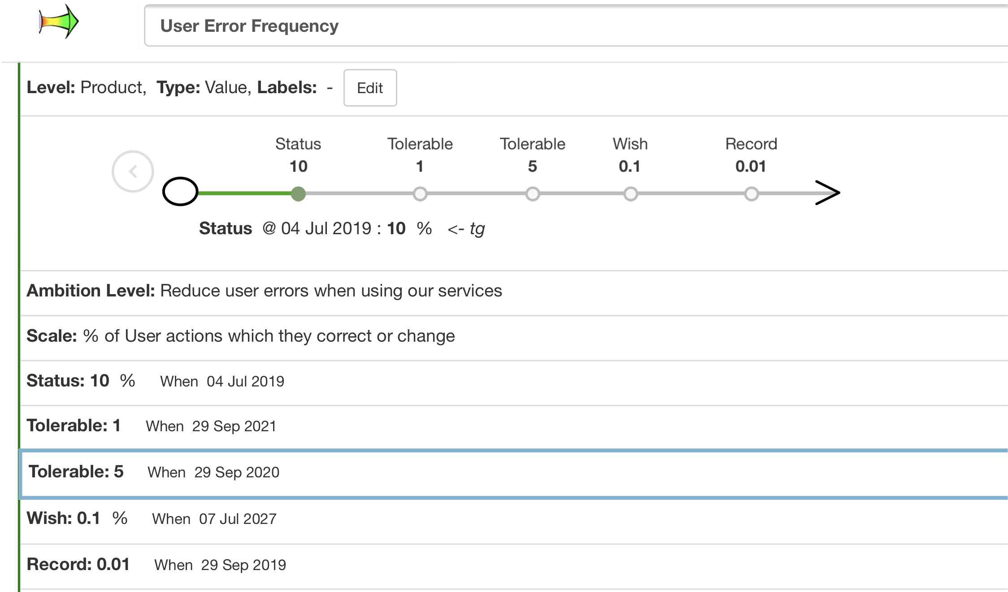



Multiple Levels
enriches planning and control and prioritisation
Several different statements of different ‘Tolerable’ levels
  or any other types of Scale levels
    like Tolerable, Wish, Past, Trend
  might be appropriate for different circumstances.
One single value type, might well need to concurrently specify a variety of different Tolerable levels, for different circumstances.
This avoids over-generalization of requirements,
  with consequent unnecessary costs for some circumstances.
  If you had to generalise, all ends, by using the higher level (worst case) for all sets of conditions
  This opens for smart decomposition of requirements,
    so that we can support smart value agile delivery sprints
Because ‘multiple level specification’ supports our need to focus on particularly critical circumstances early, delivering value to those circumstances early.
We are
Drawing
A
time curve
Notes:
6.4. in VR book
Figure 1.37: example with 2 Tolerable levels, with different deadlines.

Slide 25
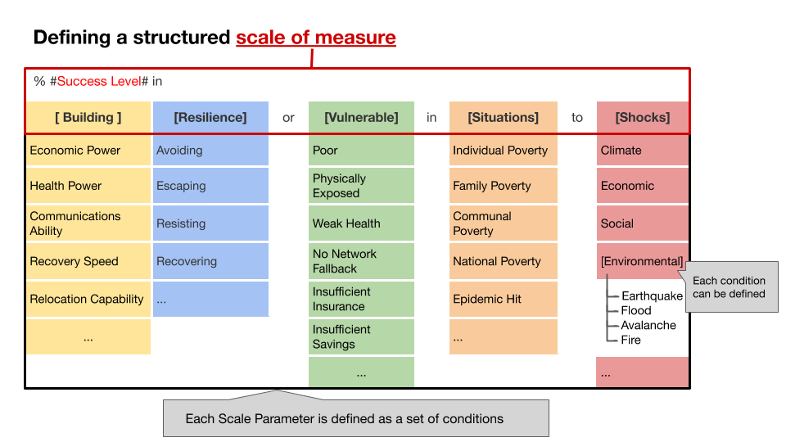

7. DIMENSION CONDITION COMBOS: Each requirement point can have any useful, priority set of conditions, derived from the [Scale Parameters], like whom where, and operational conditions.
Decomposition into increments using Scale Condition combinations
For example:
Increment 1; Goal 42%, by 2030, March
Customer Type = Retail, Internet Sales
Customer Activity = Dumping, Special Sales
Conditions = Market Panic, Pandemic
Area = Europe, Norway
————————————-
Increment 2: Goal 45%, by 2030, April
Customer Type = Wholesale , Boutique Displays
Customer Activity = new Product Introductions
Conditions = Normal Weekends
Area = EU, Norway, GB
[Scale Parameters]
Conditions
Source: Sustainability Planning V=270520.1828 pptx AS HELD slides

Slide 26
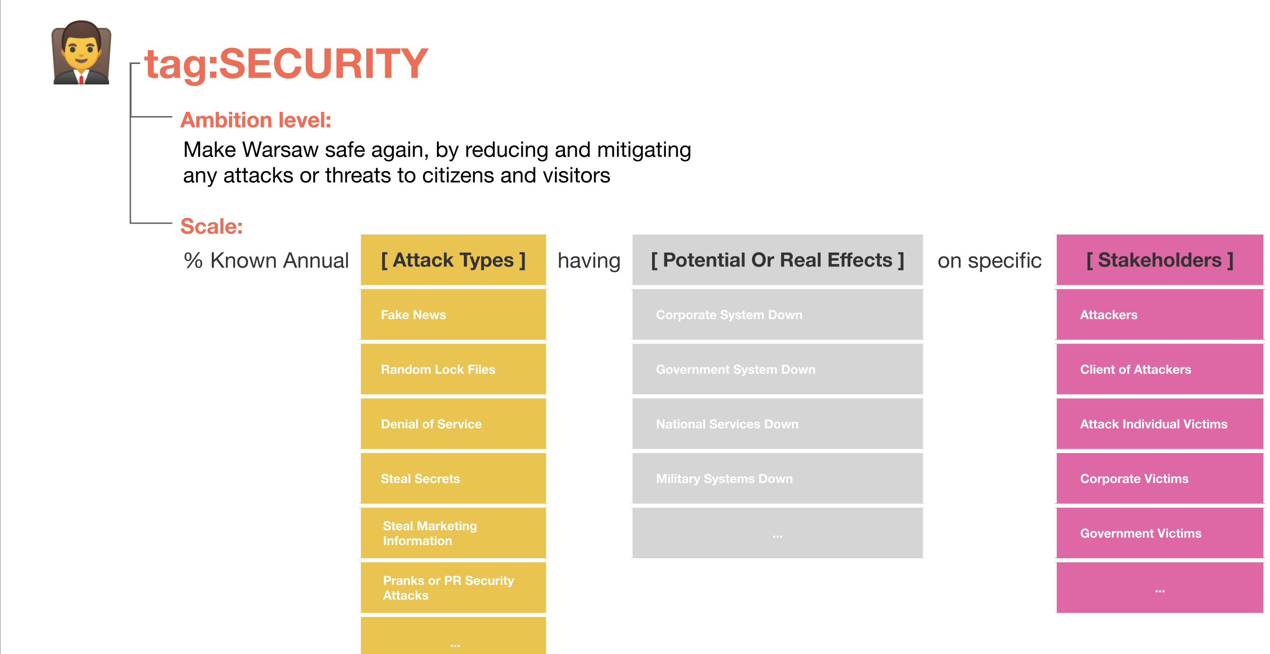
Scale [Parameters]
[Scale Parameters] might seem ‘complicated’ at first sight.
But it is in fact a way of simplifying very complex problems,
  by allowing us to carefully extract, something simple
  that we can work on, and
  deliver some value improvements early, for critical subsets. (Hint: ‘Agile as it should be’)
Early partial value delivery is also about
  ‘learning about complex realities’,
  …. before we commit to ‘scaling up’.
Vehicle Safety:
Scale: Star Rating number for [Person Type] and [Car Specs] for [Safety Equipment] with [Alternative Model Validity] for a [Publication Date] by a [Rating Agency].
Wish: 5 Stars, by Next Year,
Person Type = All,
Car Specs= {Tesla 3, RWD, 4 Door, 2019}, Safety Equipment= {Front Airbag, Belt Pretensioner, Belt Load Limiter, Knee Airbag, Side Head Airbag, ...},
Alternative Model Validity=Dual Motor AWD Model 3,
Publication Date =2019,
Rating Agency= All.
Notes:
Figure 1.13 : a clip from euroncap.com safety report, URL cited above, which shows the actual structure of the ‘Safety Equipment’ concept in reality.

Slide 27
Agile Decomposition of Requirements Principles
5 Basic options for creating priority agile value steps
Select increments to prioritized stakeholders
Select increment to prioritized values
Select prioritized value scale conditions
Select increments by time increments
Select incements based on priority levels (Tolerable, Goal, Stretch)

Slide 28
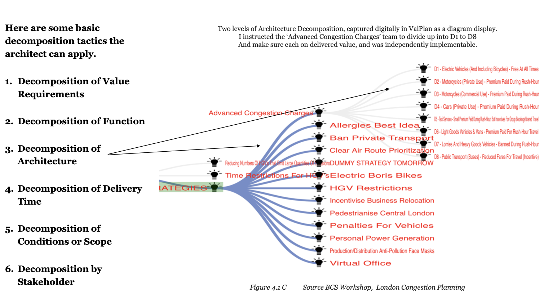
https://tinyurl.com/SysEntArchBook

Slide 29
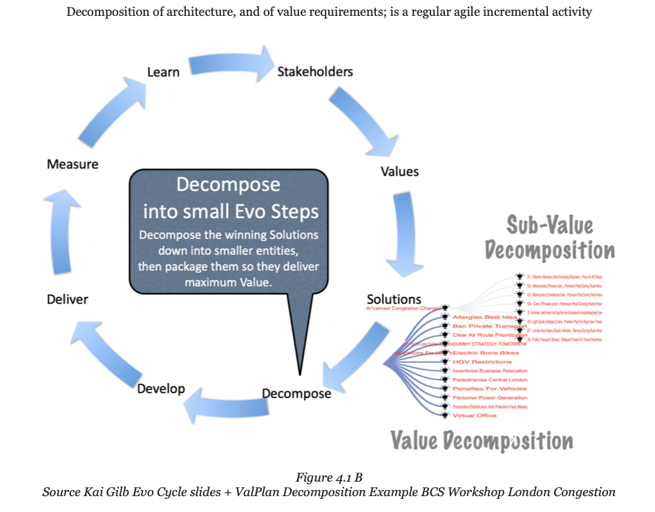
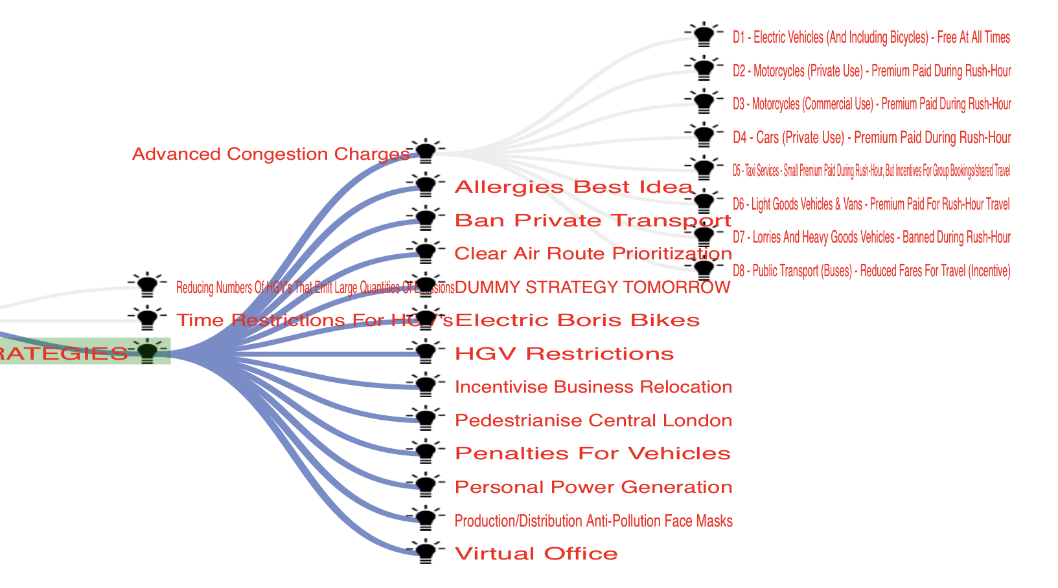
Summary
Decomposition, into suitably small incremental value delivery increments, can by enabled by decomposing by
Stakeholder
Value Requirement
Scale Conditions
Priorities
Deadlines
In addition, we can decompose the designs/strategies/architecture.
  To enable an agile value stream.
  But that is another technical subject
  [9] Decomposition,
    https://tinyurl.com/SysEntArchBook
Tom Gilb May 4 2021

Slide 30
References
[1] Gilb, T.: Scalable Requirements: One Size Can Fit All. IEEE Software, July-Aug. 2021 Manuscript pre pub. https://www.dropbox.com/sh/zpiy1lo4ayeoff0/AAAetdQFh5AAMHhYTS2W3WcEa?dl=0
[2] Gilb, T.: Serious Agile Requirements: What kind of Requirements do we need to write, to really deliver a ‘measurable priority value-stream’? Draft March 17 2021 for IEEE/S Gregory but Unpublished Paper, https://www.dropbox.com/sh/dr359tkbvu4q162/AADvsfIlXDiDe62oHrgJQxbma?dl=0
[3] Gilb, T.: [3A] Value Requirements, BOOK,
https://www.dropbox.com/s/hxg1rx9rzesw2id/Value%20RequirementsPDF%20BEST%20%2070MBQ%20011019%202245%202.pdf?dl=0
[3B] Value Requirements Slides , 3 Hour BCS course, 22 April 2020
Slides = http://concepts.gilb.com/dl970
[3C] Value Requirements Video course 3 hrs. https://www.youtube.com/watch?v=ZHrwQtG6IMw&list=PLKBhokJ0qd3_wlvr0j85YhmNfNj8ZJ8M-
[4] Gilb, T.: Competitive Engineering, 2005,(paper or digital 2005).
The definition of the Planguage. A Handbook and a Planguage standard.
https://www.gilb.com/p/competitive-engineering (free pdf)
and paper via Amazon (Kindle and paper)
https://www.amazon.com/dp/0750665076/ref=rdr_ext_sb_ti_sims_2
[5] Serious Agile Requirements, THIS TALK SLIDES
https://www.dropbox.com/sh/e4smi7kb9k6rqua/AADgqx0ef84iBsmEpTWT4kV8a?dl=0
[6] Gilb, T.: Value Agile, BOOK, slides, video,
Value Agile 2020
BOOK: https://tinyurl.com/ValueAgileBook
SLIDES: http://concepts.gilb.com/dl974
VIDEO https://www.gilb.com/blog/Agile-Tools-for-Value-Delivery-by-Tom-Gilb
[7] tiny.cc/ManagilitySlides, BCS SG Business Change, 2 Videos too.
[8] “User Stories: A Skeptical View”, http://www.gilb.com/DL461
[9] Systems Enterprise Architecture (SEA) BOOK, Free Download
https://tinyurl.com/SysEntArchBook (2020)
My 2021 Meetup Series Based on Systems Enterprise Architecture SEA Book (2020), Held in January Feb 2021 2x a week. 1 hours lecture + 30 minutes Q&A.
The videos are now published on the OSWA youtube channel. All are available on this link:
https://www.youtube.com/channel/UCb508f8y_d0PqRZKPCVVVxQ
[10] MANAGILITY, Management Agility, The next improvement steps for your ‘Enterprise Agile’ transformation, From ‘Management Mumbo-Jumbo’ to ‘Vision Engineering’, Which should dramatically increase your successful value/costs delivery (3x to 10x)
tiny.cc/ManagilitySlides
for BCS 14 Oct 2020, The Video Part I of the Talk, https://youtu.be/SxFwYfcDJLg
Part II Video in November, https://www.youtube.com/watch?v=nbf3Ngovg_0&list=PLKBhokJ0qd3_wlvr0j85YhmNfNj8ZJ8M-&index=9

Slide 31
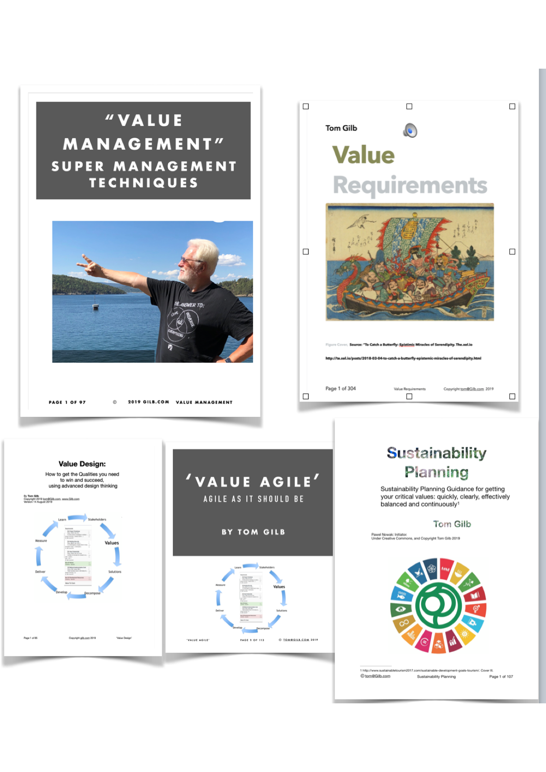
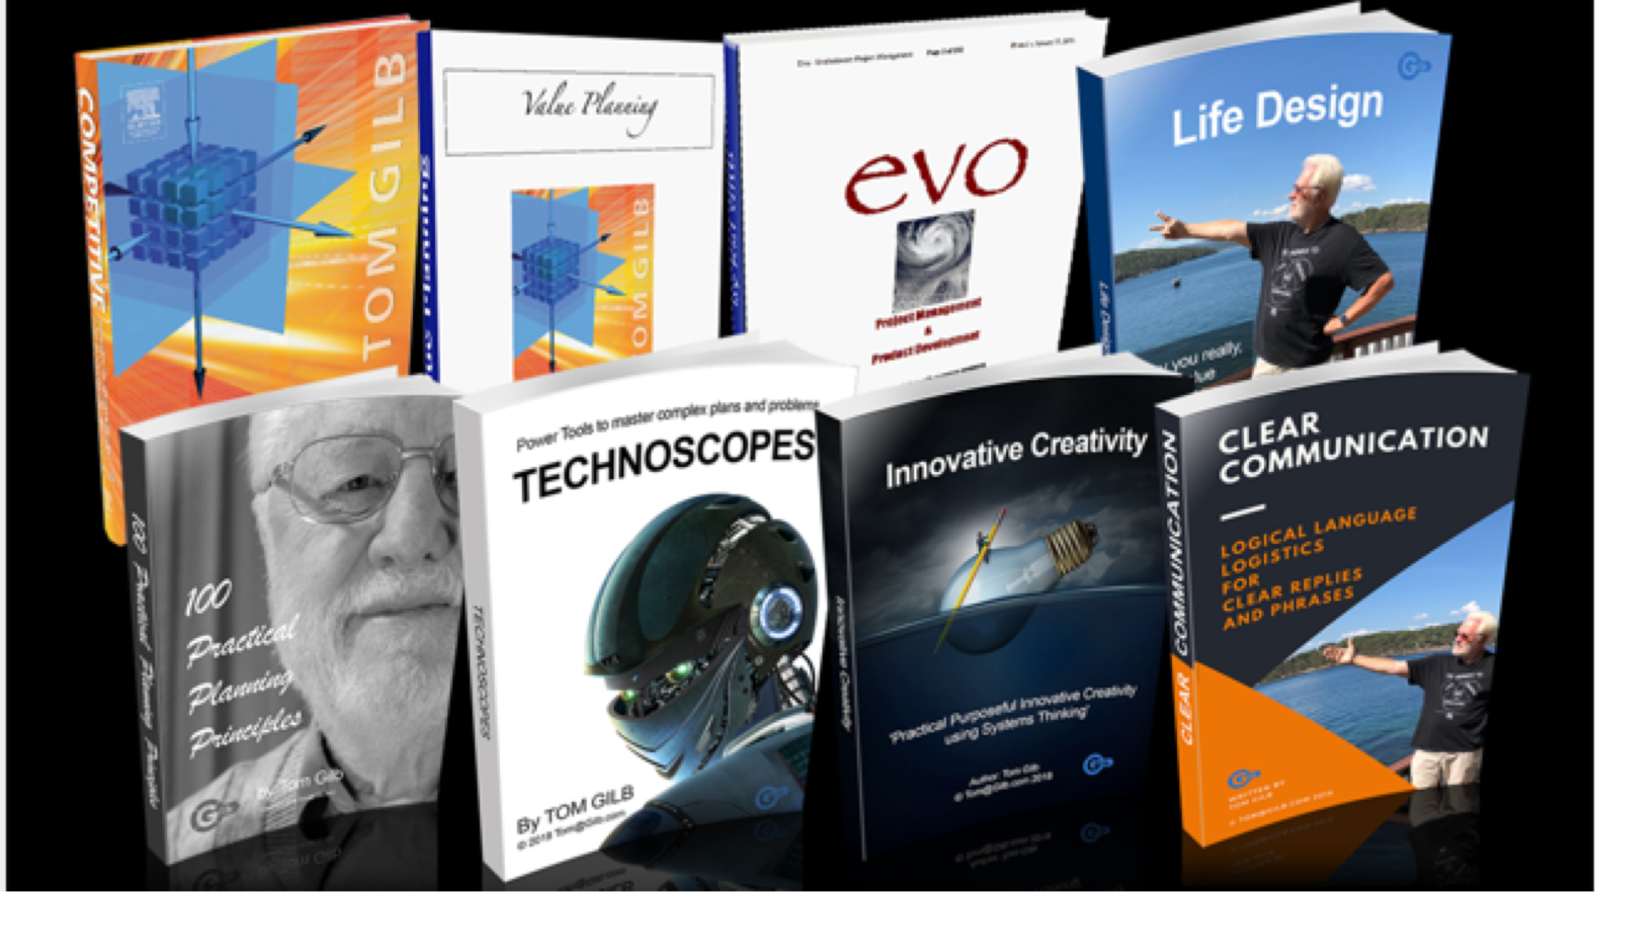
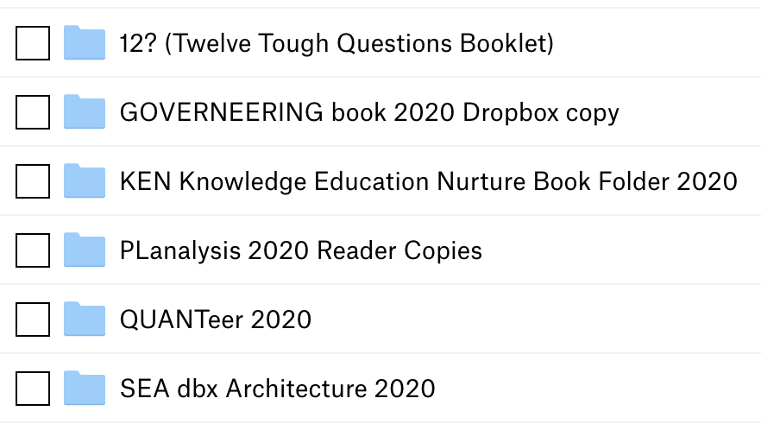
https://www.gilb.com/ scroll down to ‘Books’
For sale at modest prices
Digital, except CE book can be bought in paper.
FREE LINK TO 5 NEW DIGITAL BOOKS WRITTEN SUMMER 2019
https://tinyurl.com/GilbBooks2019
https://tinyurl.com/2020BooksGilb

Slide 32
Go back

