Slide 1
Defect Prevention Process DPP
Tom Gilb’s Raw Collection of DPP Related slides for future use in course materials lectures etc.

Slide 2

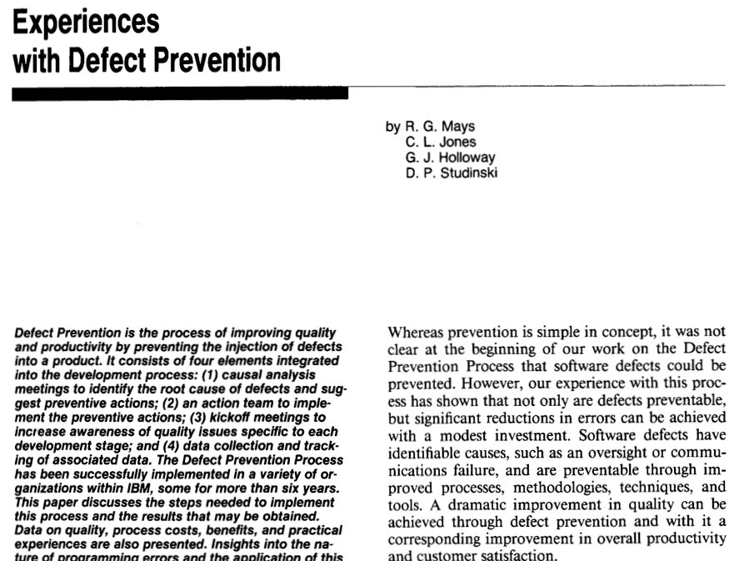
The 1990 IBM SJ paper: DPP
Notes:
THIS SET OF SLIDES PHOTOS FROM SOFTWARE INSPECTION BOOK WERE MADE 16 AUG 2014 TSG IPHONE 5S
THE PHOTO OF Robert Mays
at Duke Gardens, May 2014
From his website
http://selfconsciousmind.com/cvs.html
, at his suggestion aug 16 2014 by email to TsG
Robert Mays email 2014 mays@ieee.org
5622 Brisbane Dr
Chapel Hill, NC 27514-9689

Slide 3
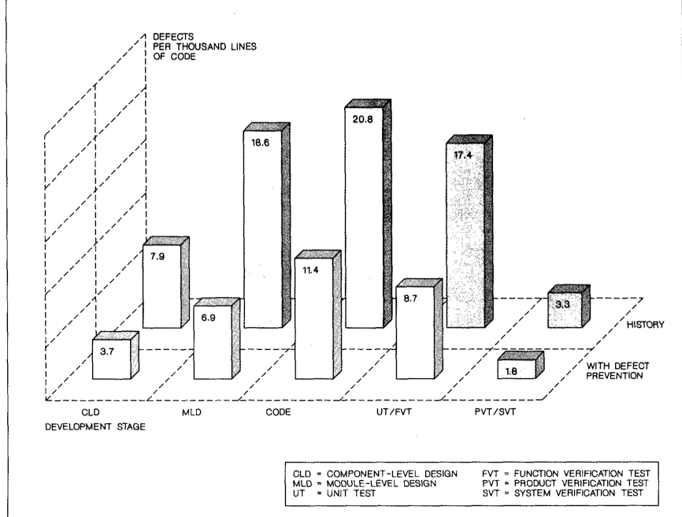
MAYS DEFECT RATE COMPARISON
Notes:
SOURCE, §EXPERIENCES WITH DEFECT PREVENTION’
PAGE 16, MAYS ET At
IBM SYSTEMS JOURNAL, VOL 29, NO 1, 1990

Slide 4
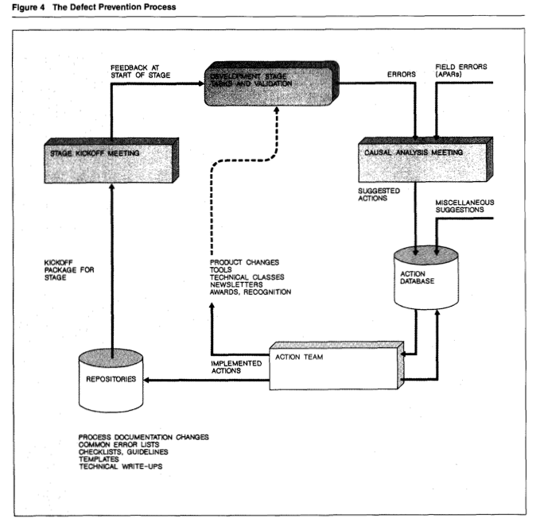
THE DEFECT PREVENTION PROCESS
Notes:
SOURCE, §EXPERIENCES WITH DEFECT PREVENTION’
PAGE 12, MAYS ET At
IBM SYSTEMS JOURNAL, VOL 29, NO 1, 1990

Slide 5
These are Photo copies from the Software Inspection book 1993
2 Chapters on DPP
  7 By Tom
  17 by Robert Mays
Notes:
THIS SET OF SLIDES PHOTOS FROM SOFTWARE INSPECTION BOOK WERE MADE 16 AUG 2014 TSG IPHONE 5S

Slide 6

2 Chapters on DPP 1993
Notes:
THIS SET OF SLIDES PHOTOS FROM SOFTWARE INSPECTION BOOK WERE MADE 16 AUG 2014 TSG IPHONE 5S

Slide 7
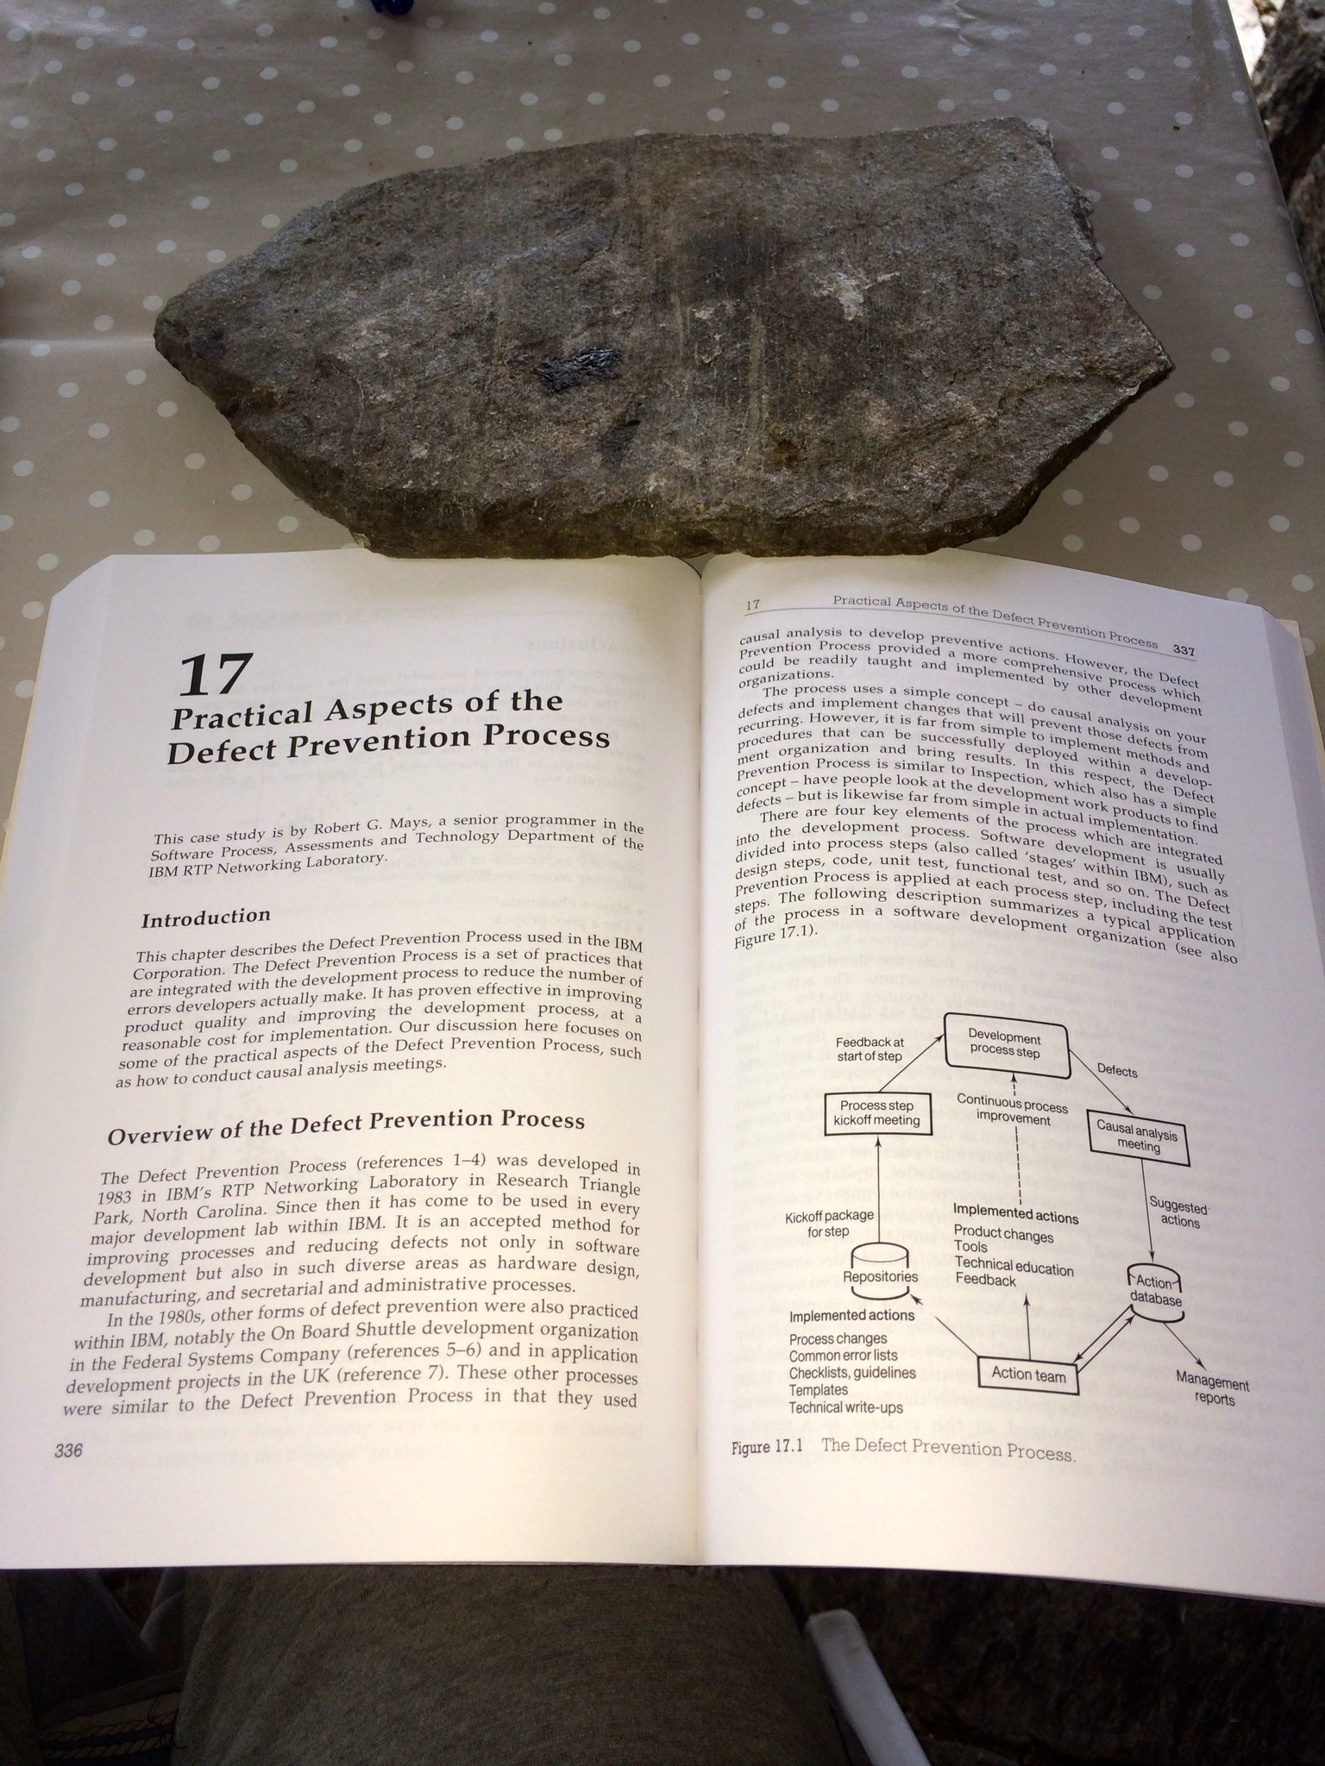
Chapter 17 Mays
Notes:
THIS SET OF SLIDES PHOTOS FROM SOFTWARE INSPECTION BOOK WERE MADE 16 AUG 2014 TSG IPHONE 5S
AND FILED IN
“DPP SLIDES MASTER 2014.PPTX IN TALKS SLIDES GILBS MAC

Slide 8
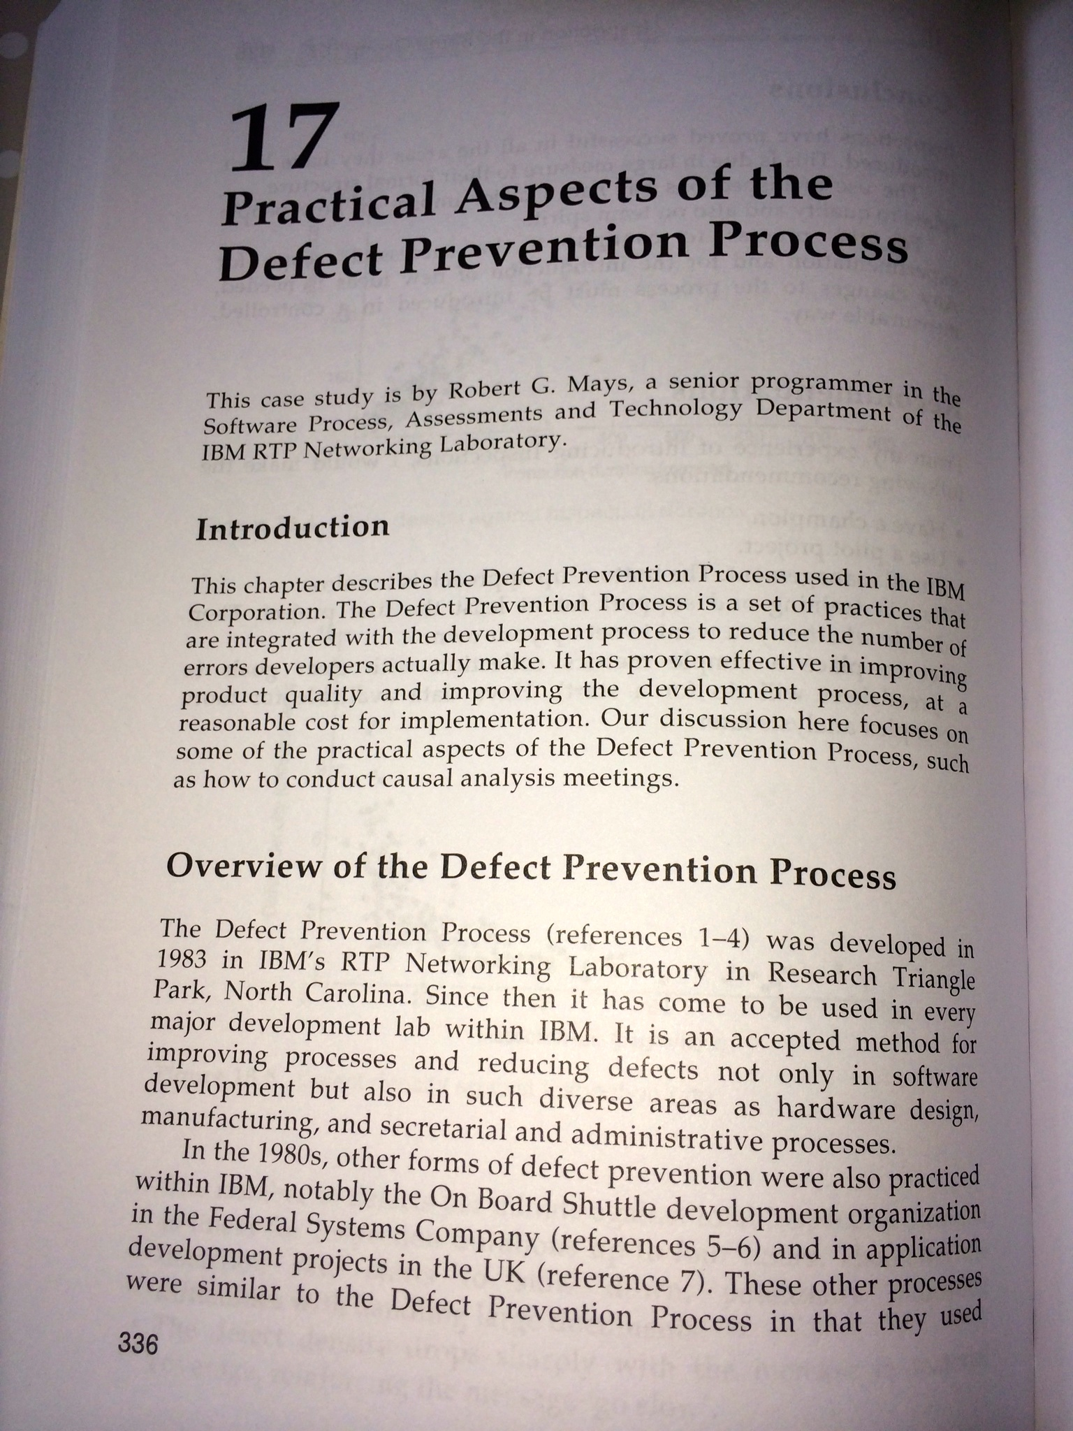
Chapter 17 Mays
Notes:
THIS SET OF SLIDES PHOTOS FROM SOFTWARE INSPECTION BOOK WERE MADE 16 AUG 2014 TSG IPHONE 5S
AND FILED IN
“DPP SLIDES MASTER 2014.PPTX IN TALKS SLIDES GILBS MAC

Slide 9
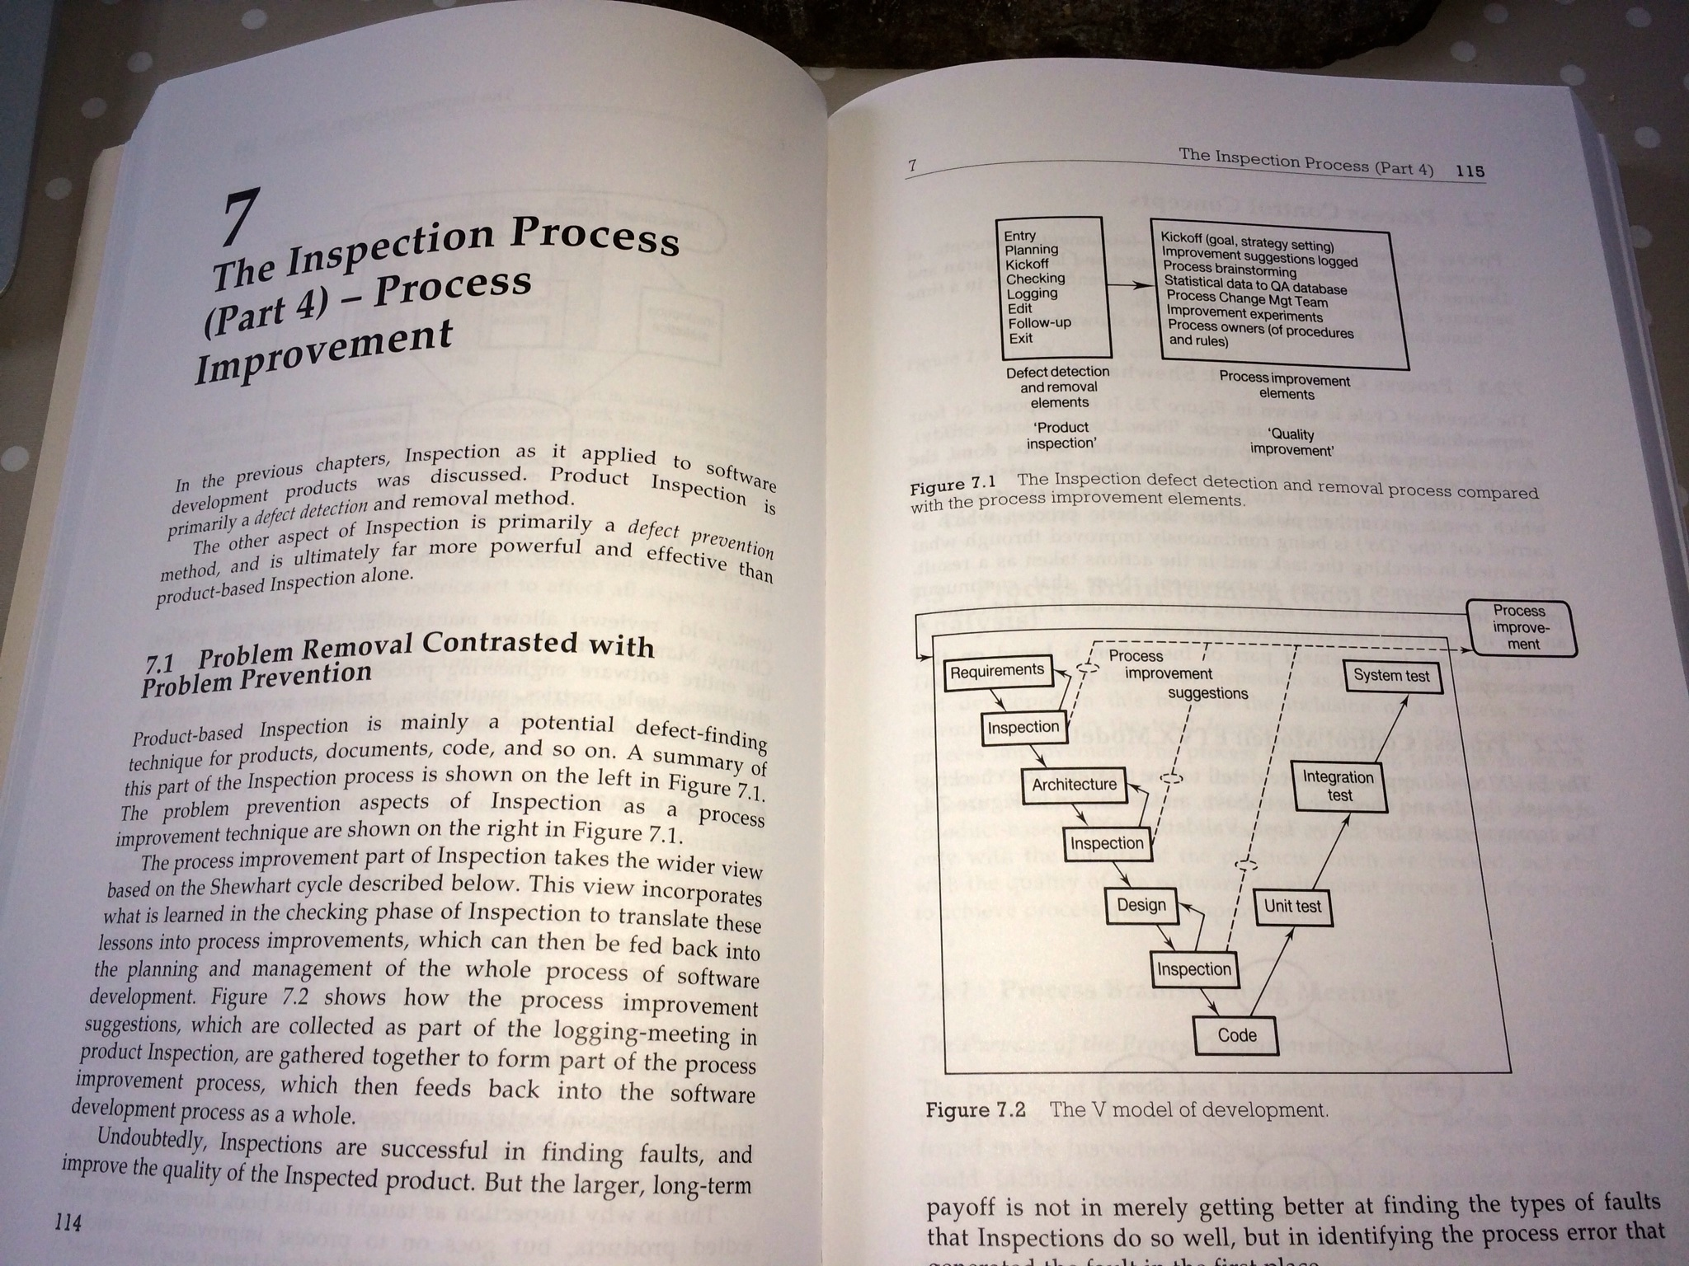
Chapter 7 Gilb/Graham
Notes:
THIS SET OF SLIDES PHOTOS FROM SOFTWARE INSPECTION BOOK WERE MADE 16 AUG 2014 TSG IPHONE 5S
AND FILED IN
“DPP SLIDES MASTER 2014.PPTX IN TALKS SLIDES GILBS MAC

Slide 10
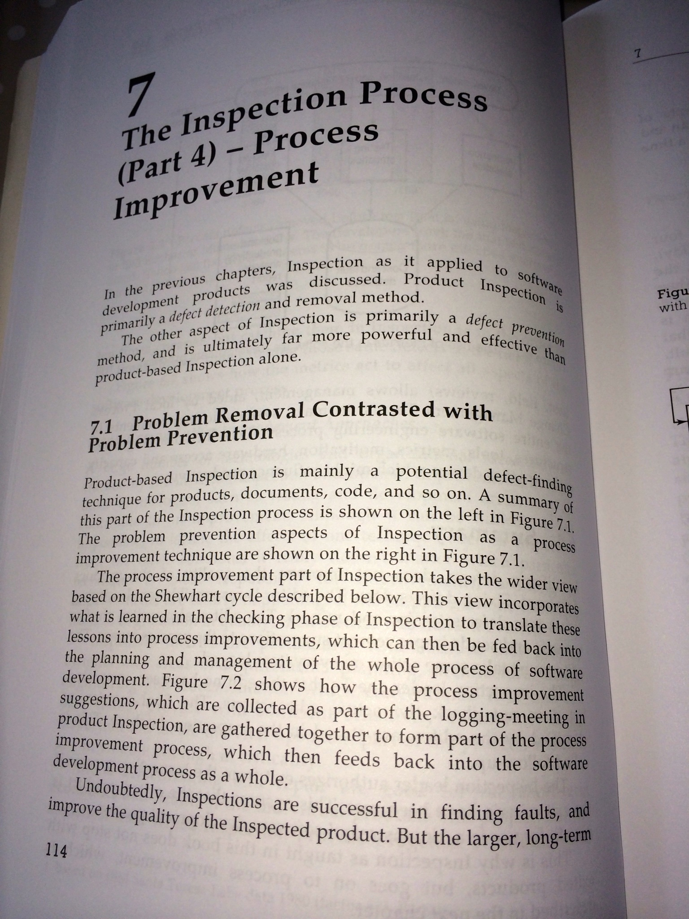
Chapter 7, The Inspection Process part 4: Process Improvement
Notes:
THIS SET OF SLIDES PHOTOS FROM SOFTWARE INSPECTION BOOK WERE MADE 16 AUG 2014 TSG IPHONE 5S
AND FILED IN
“DPP SLIDES MASTER 2014.PPTX IN TALKS SLIDES GILBS MAC

Slide 11
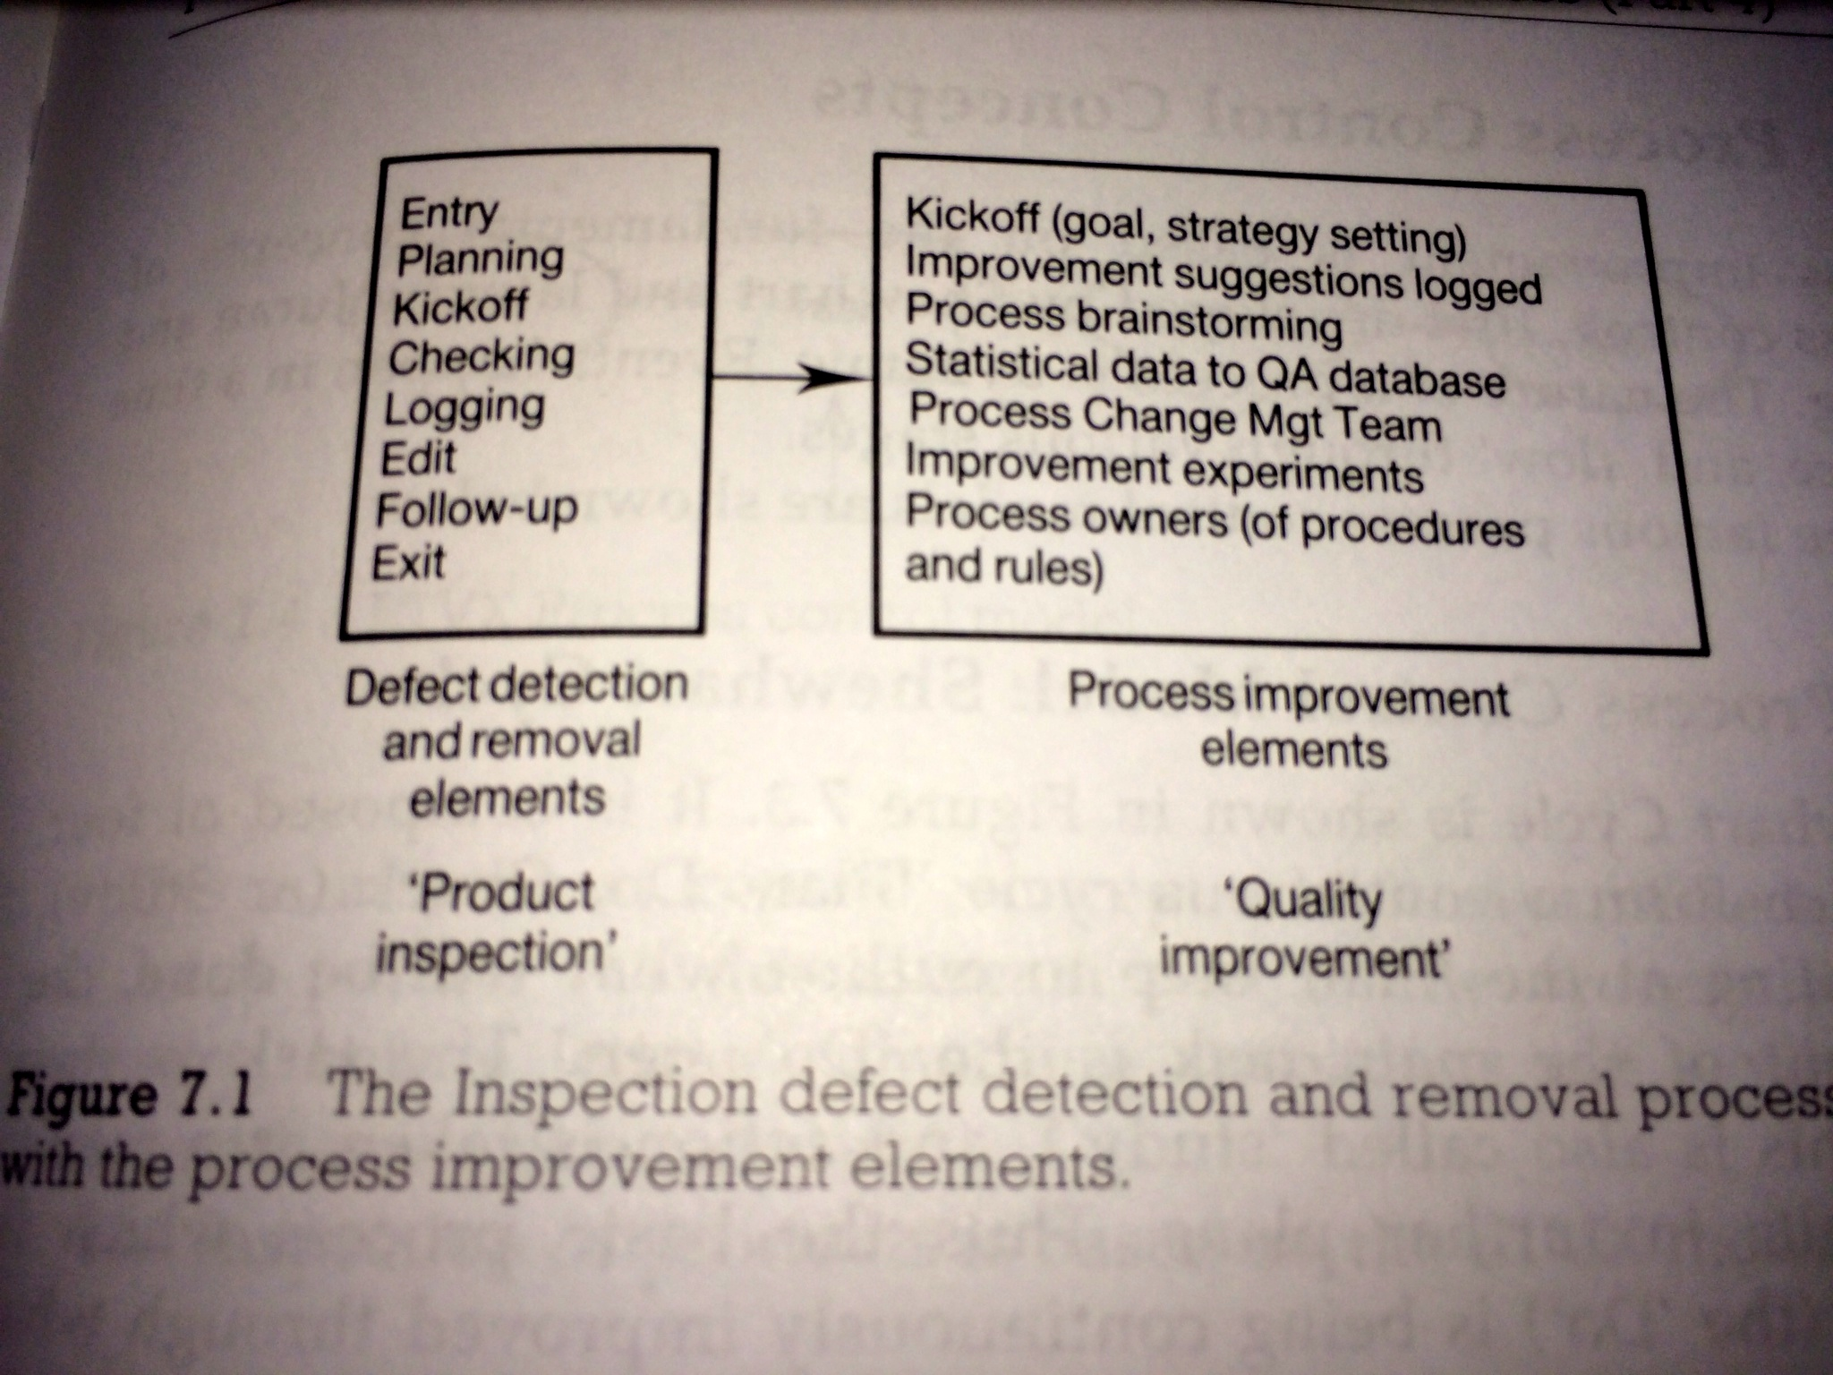
Figure 7.1 Process Improvement Elements
Notes:
THIS SET OF SLIDES PHOTOS FROM SOFTWARE INSPECTION BOOK WERE MADE 16 AUG 2014 TSG IPHONE 5S
AND FILED IN
“DPP SLIDES MASTER 2014.PPTX IN TALKS SLIDES GILBS MAC

Slide 12
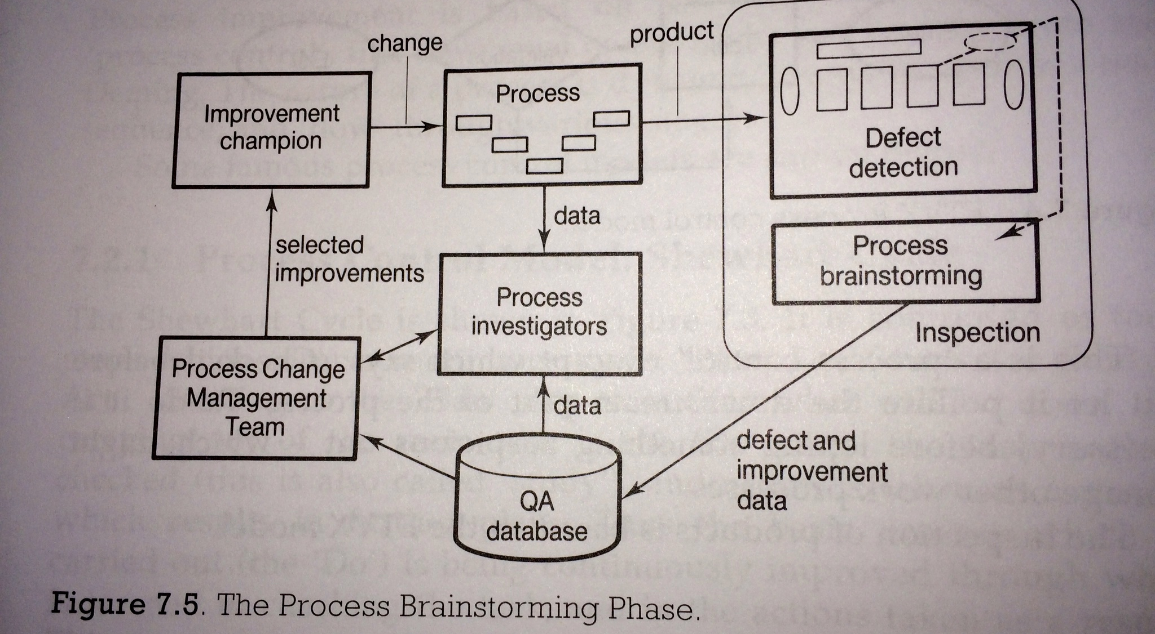
Fig. 7.5 The Process Brainstorming Phase
Notes:
THIS SET OF SLIDES PHOTOS FROM SOFTWARE INSPECTION BOOK WERE MADE 16 AUG 2014 TSG IPHONE 5S
AND FILED IN
“DPP SLIDES MASTER 2014.PPTX IN TALKS SLIDES GILBS MAC

Slide 13
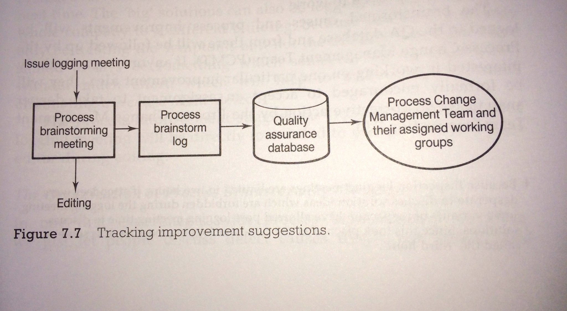
Fig 7.7 Tracking Improvement Suggestions
Notes:
THIS SET OF SLIDES PHOTOS FROM SOFTWARE INSPECTION BOOK WERE MADE 16 AUG 2014 TSG IPHONE 5S
AND FILED IN
“DPP SLIDES MASTER 2014.PPTX IN TALKS SLIDES GILBS MAC

Slide 14
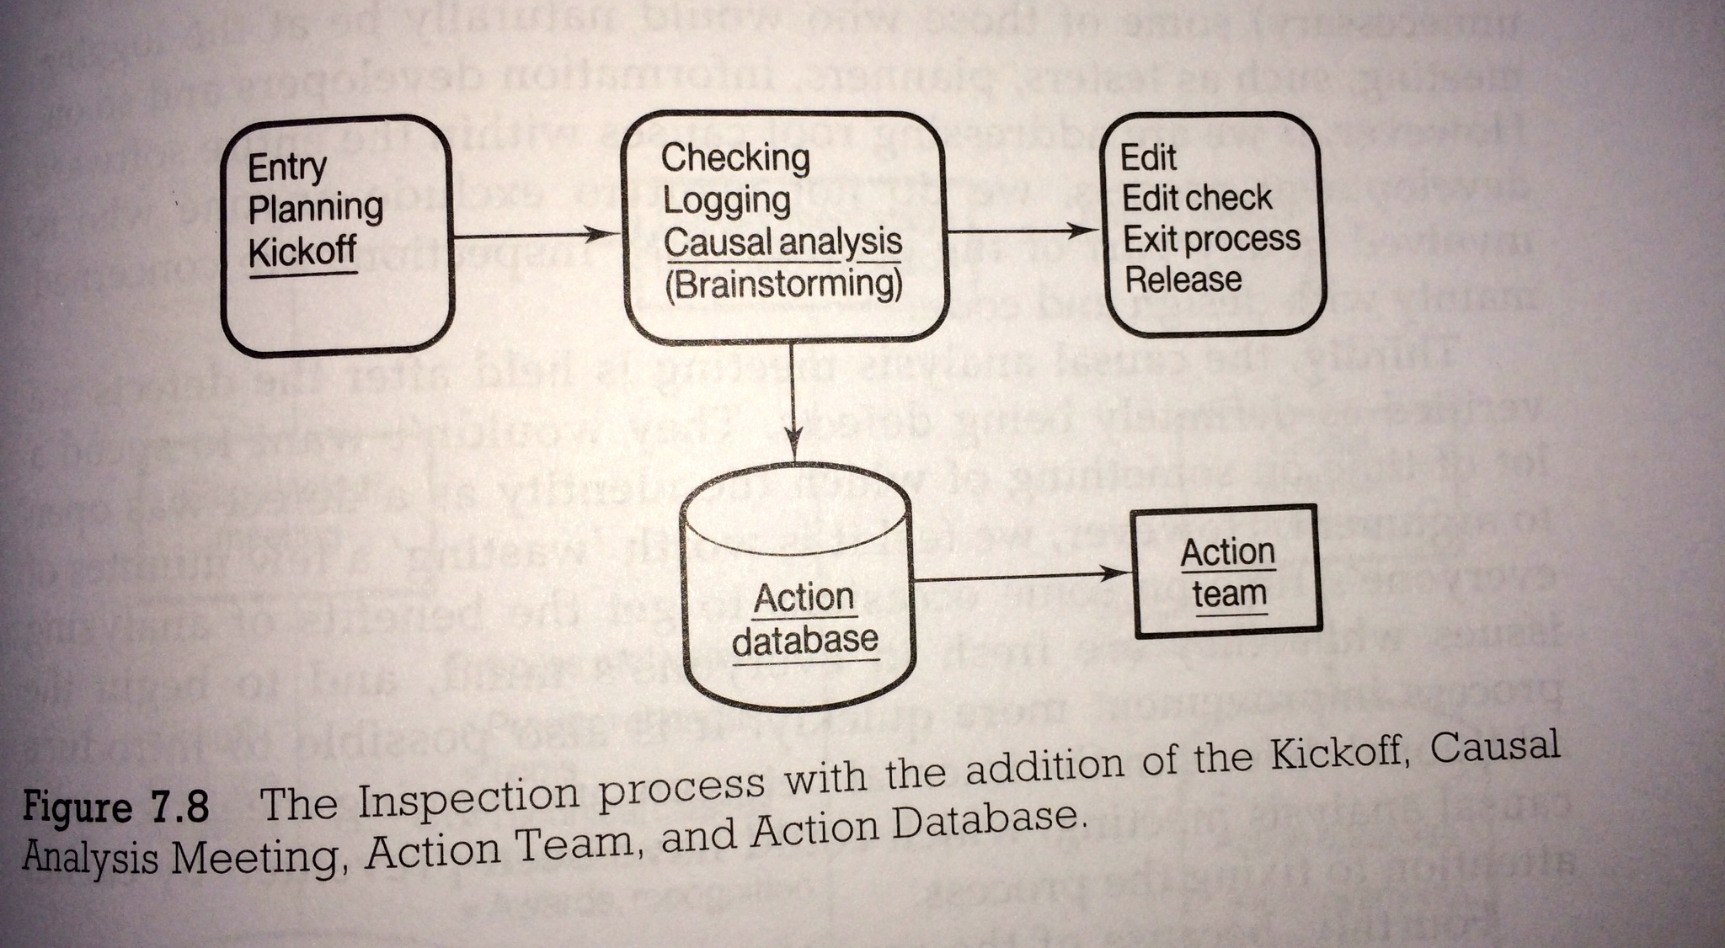
Fig. 7.8 Inspection + Causal Analysis etc.
Notes:
THIS SET OF SLIDES PHOTOS FROM SOFTWARE INSPECTION BOOK WERE MADE 16 AUG 2014 TSG IPHONE 5S
AND FILED IN
“DPP SLIDES MASTER 2014.PPTX IN TALKS SLIDES GILBS MAC

Slide 15
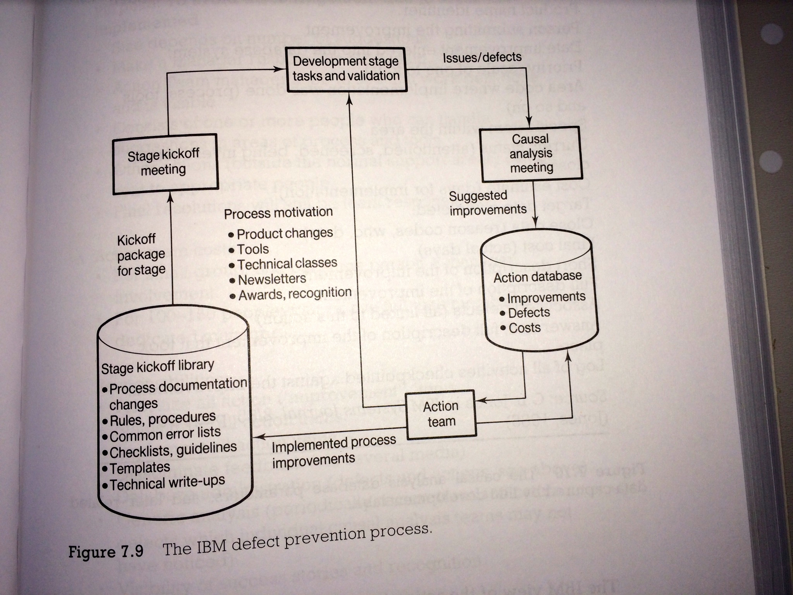
Figure 7.9 The IBM DPP
Notes:
THIS SET OF SLIDES PHOTOS FROM SOFTWARE INSPECTION BOOK WERE MADE 16 AUG 2014 TSG IPHONE 5S
AND FILED IN
“DPP SLIDES MASTER 2014.PPTX IN TALKS SLIDES GILBS MAC

Slide 16
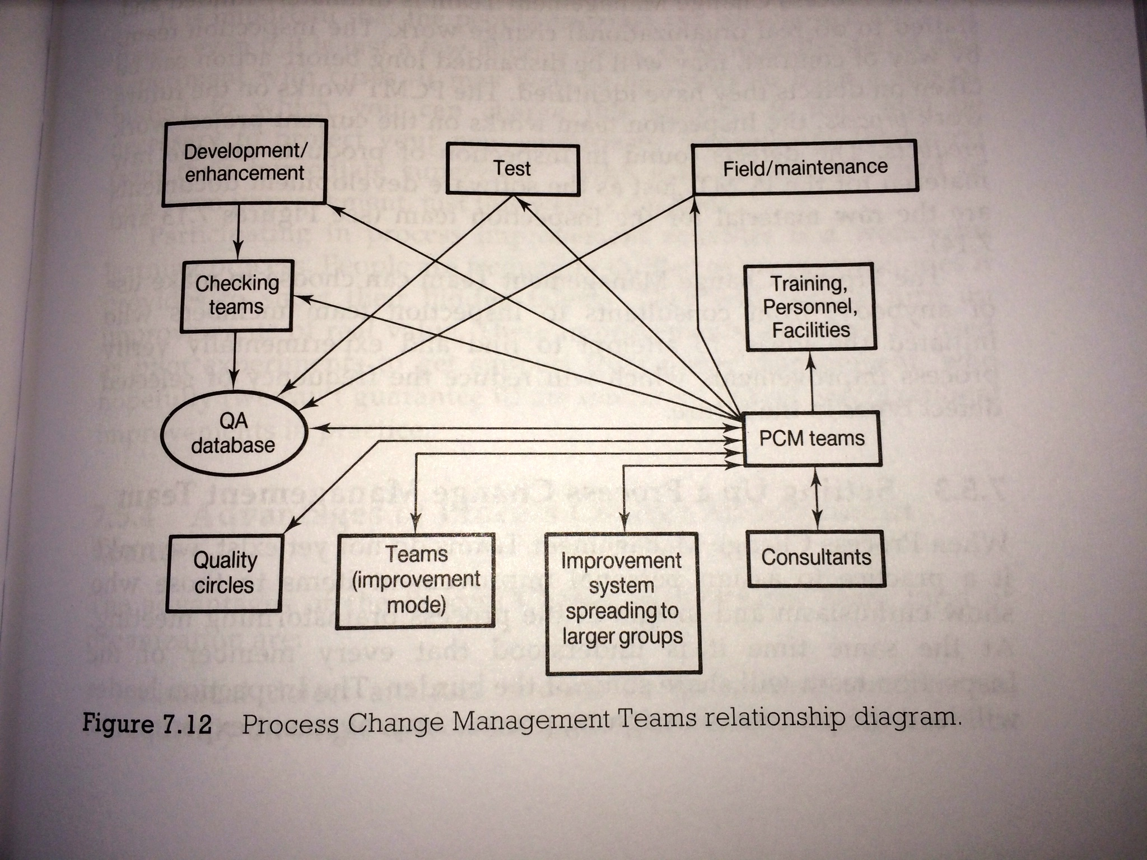
Fig 7.12 Process Change management Teams relationship diagram
Notes:
THIS SET OF SLIDES PHOTOS FROM SOFTWARE INSPECTION BOOK WERE MADE 16 AUG 2014 TSG IPHONE 5S
AND FILED IN
“DPP SLIDES MASTER 2014.PPTX IN TALKS SLIDES GILBS MAC

Slide 17
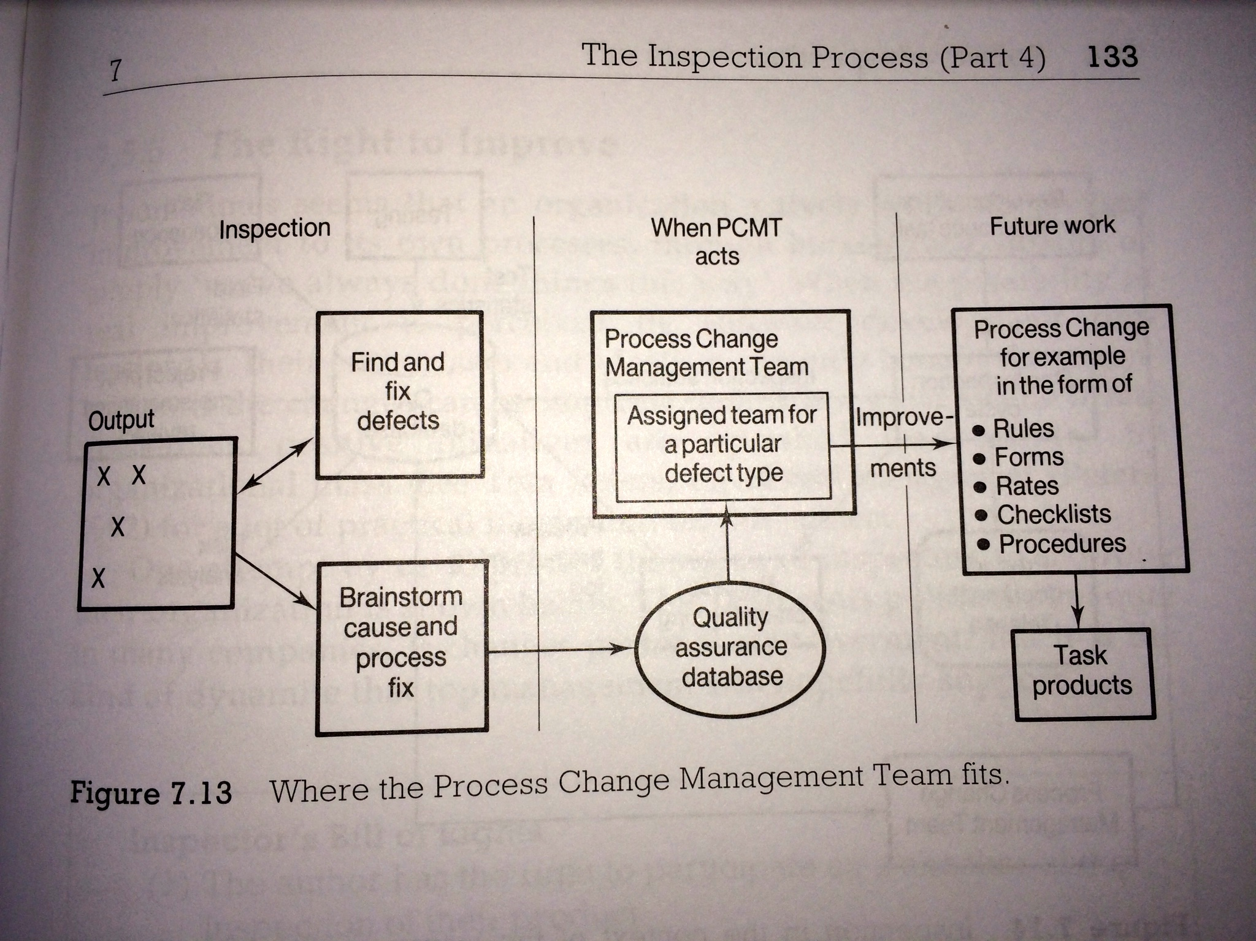
Fig 7.13 Where the Process Change Management Team fits
Notes:
THIS SET OF SLIDES PHOTOS FROM SOFTWARE INSPECTION BOOK WERE MADE 16 AUG 2014 TSG IPHONE 5S
AND FILED IN
“DPP SLIDES MASTER 2014.PPTX IN TALKS SLIDES GILBS MAC

Slide 18
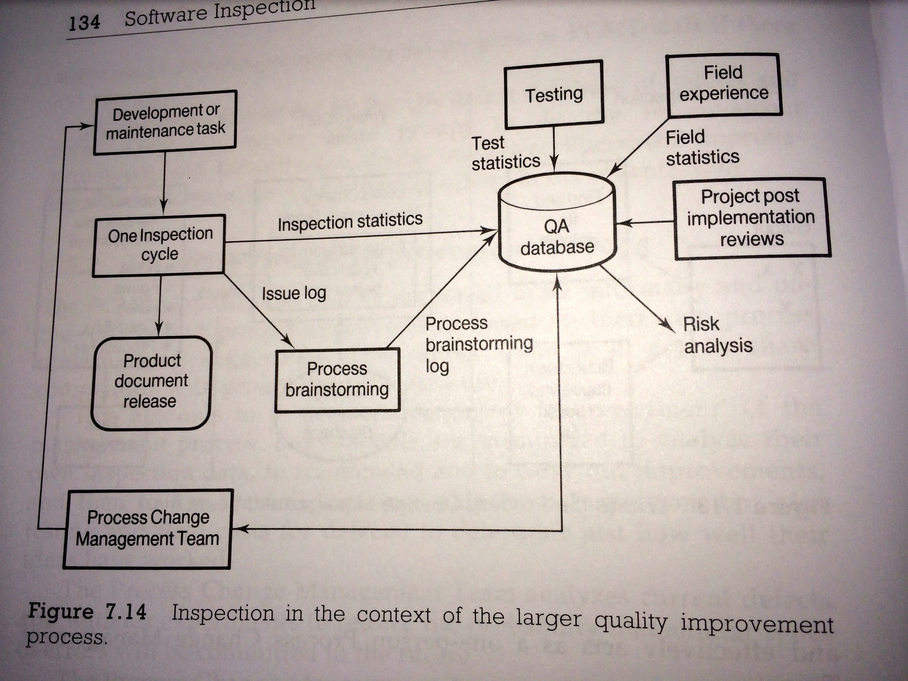
Fig 7.14 Inspection in the context of the larger quality improvement process
Notes:
THIS SET OF SLIDES PHOTOS FROM SOFTWARE INSPECTION BOOK WERE MADE 16 AUG 2014 TSG IPHONE 5S
AND FILED IN
“DPP SLIDES MASTER 2014.PPTX IN TALKS SLIDES GILBS MAC

Slide 19
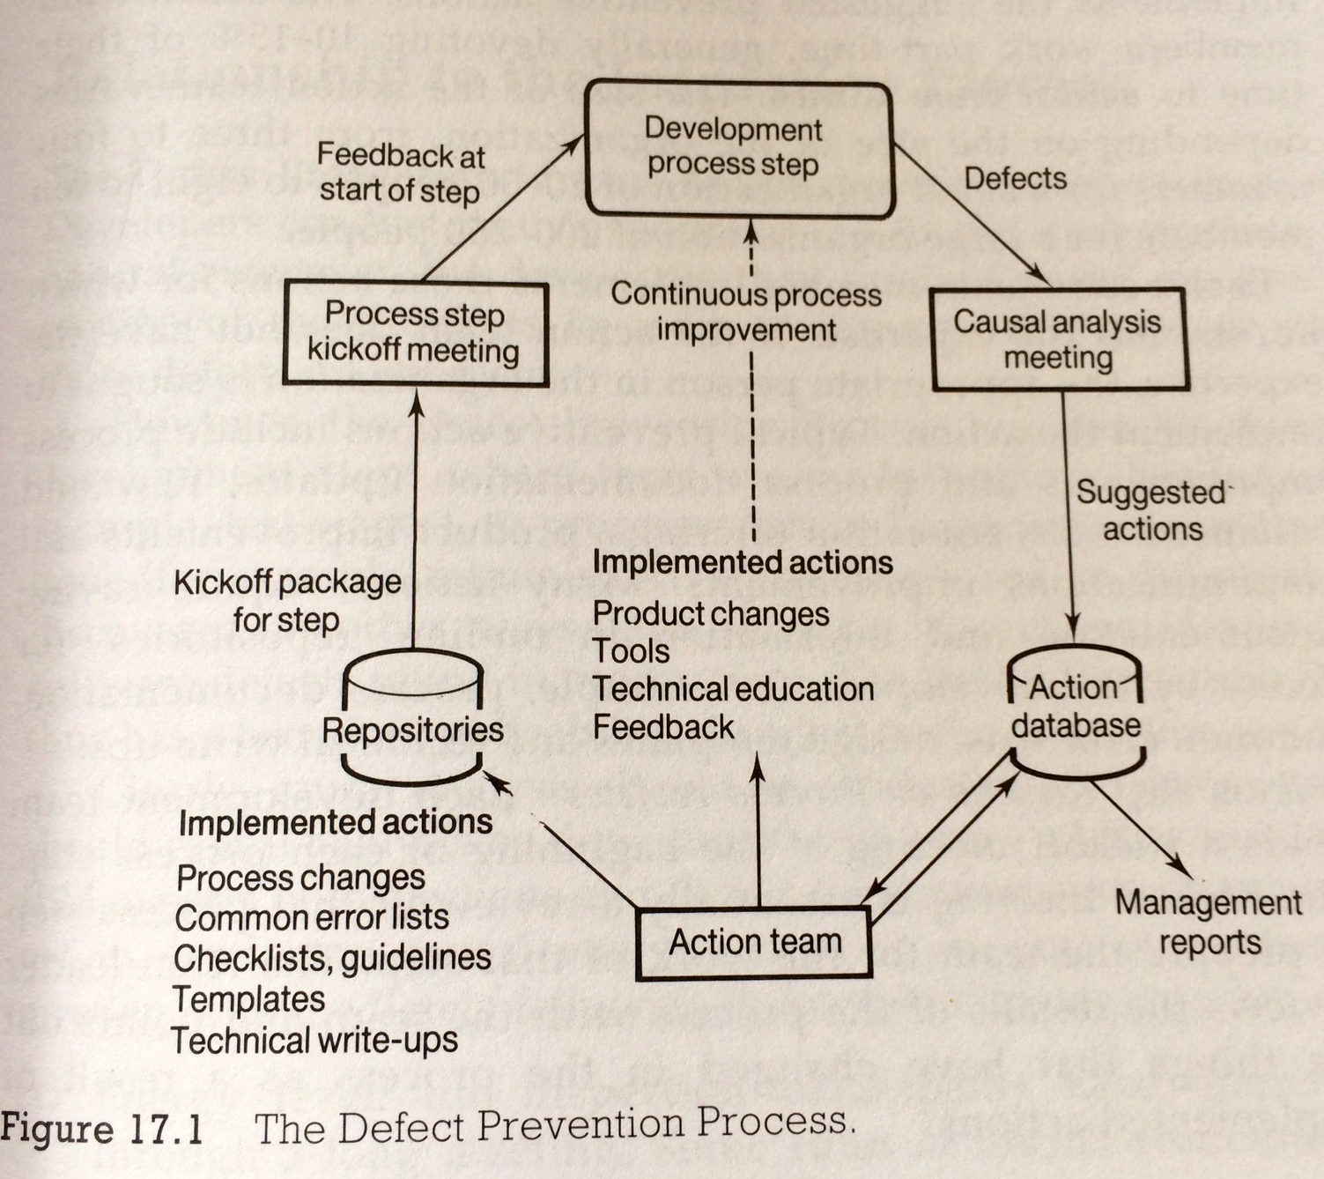
17 1 The Defect Prevention Process
Notes:
THIS SET OF SLIDES PHOTOS FROM SOFTWARE INSPECTION BOOK WERE MADE 16 AUG 2014 TSG IPHONE 5S
AND FILED IN
“DPP SLIDES MASTER 2014.PPTX IN TALKS SLIDES GILBS MAC

Slide 20
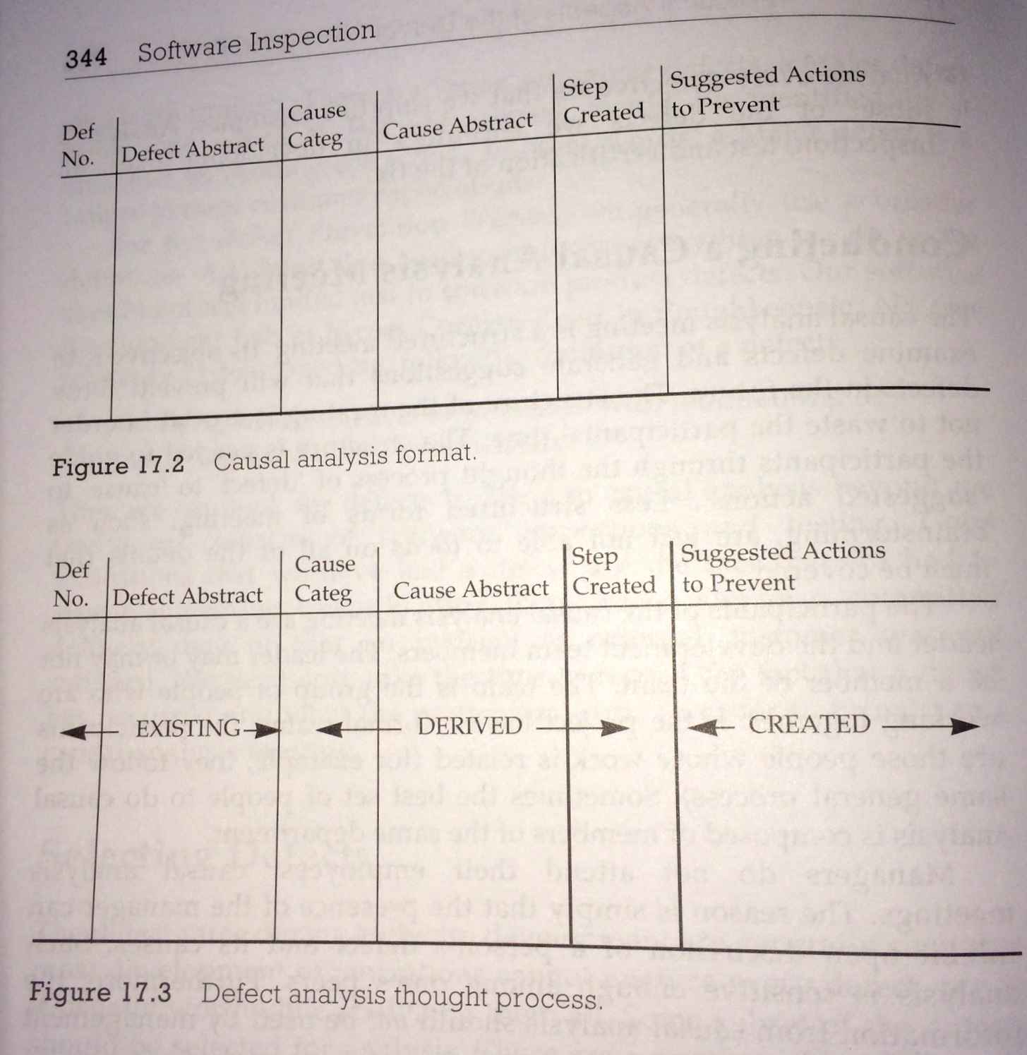
Fig 17.3 Defect Analysis Thought Process
Notes:
THIS SET OF SLIDES PHOTOS FROM SOFTWARE INSPECTION BOOK WERE MADE 16 AUG 2014 TSG IPHONE 5S
AND FILED IN
“DPP SLIDES MASTER 2014.PPTX IN TALKS SLIDES GILBS MAC

Slide 21
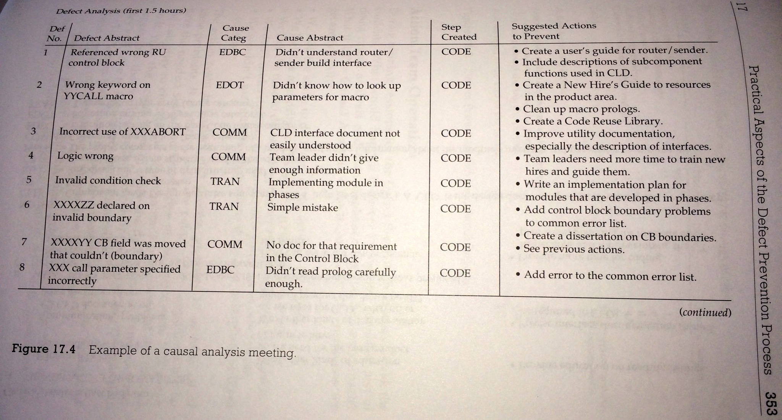
Fig. 17.4 Example of a Causal Analysis Meeting
Notes:
THIS SET OF SLIDES PHOTOS FROM SOFTWARE INSPECTION BOOK WERE MADE 16 AUG 2014 TSG IPHONE 5S
AND FILED IN
“DPP SLIDES MASTER 2014.PPTX IN TALKS SLIDES GILBS MAC

Slide 22
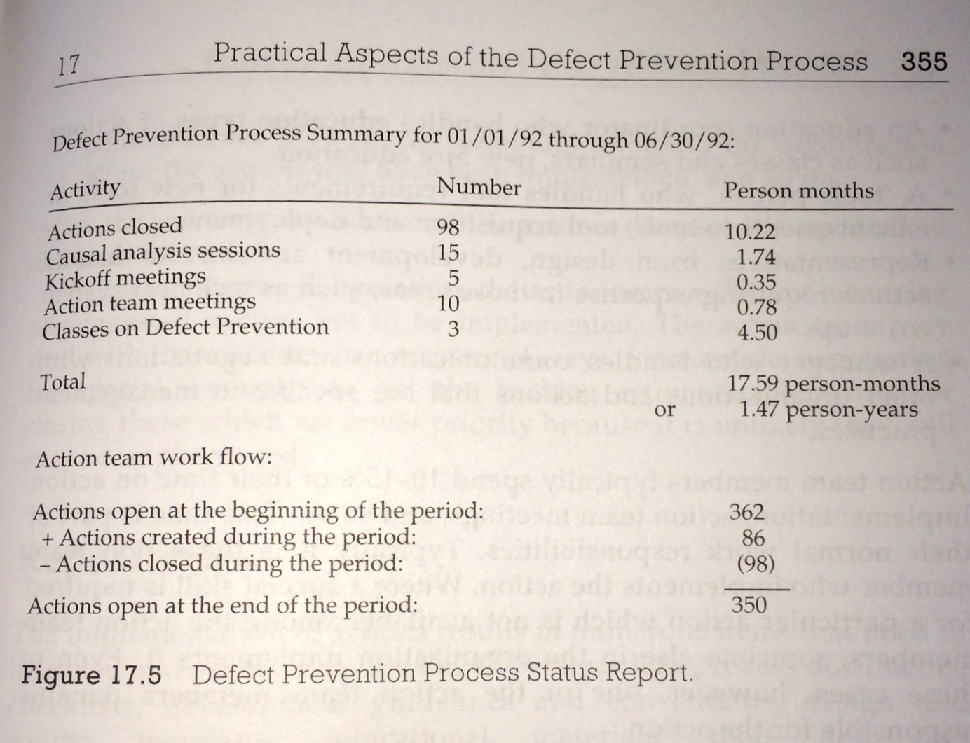
Figure 17.5 DPP Status Report
Notes:
THIS SET OF SLIDES PHOTOS FROM SOFTWARE INSPECTION BOOK WERE MADE 16 AUG 2014 TSG IPHONE 5S
AND FILED IN
“DPP SLIDES MASTER 2014.PPTX IN TALKS SLIDES GILBS MAC

Slide 23
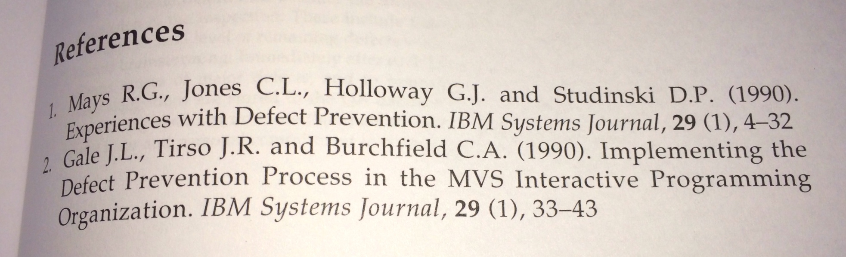
Mays DPP References 1/2
Notes:
THIS SET OF SLIDES PHOTOS FROM SOFTWARE INSPECTION BOOK WERE MADE 16 AUG 2014 TSG IPHONE 5S
AND FILED IN
“DPP SLIDES MASTER 2014.PPTX IN TALKS SLIDES GILBS MAC

Slide 24
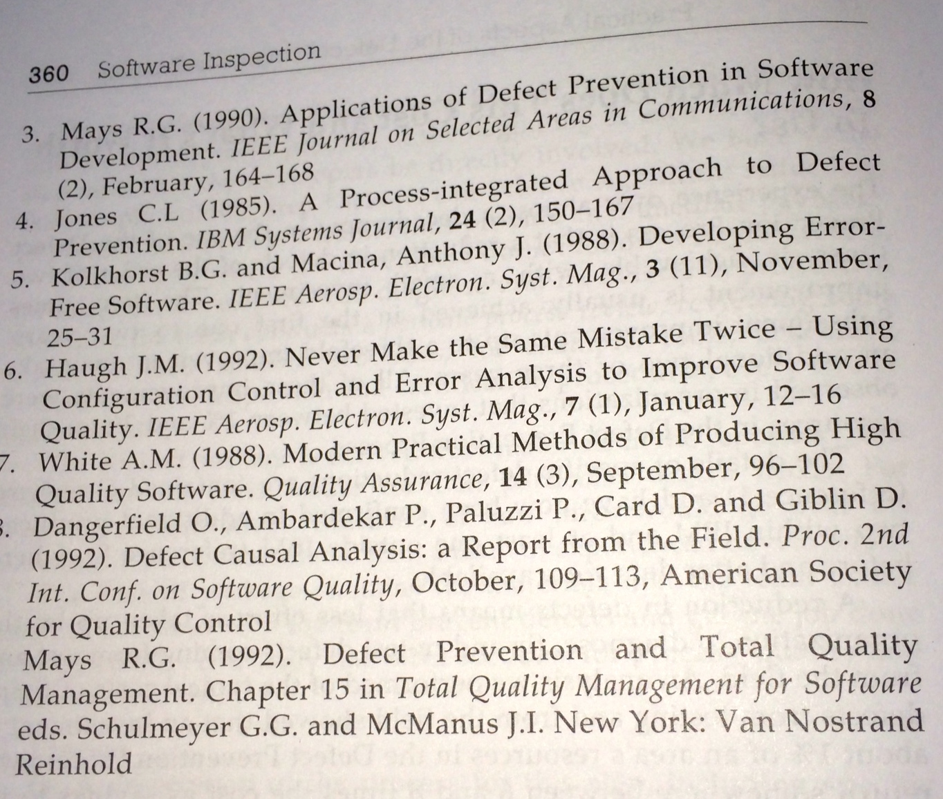
Mays DPP References 2/2
Notes:
THIS SET OF SLIDES PHOTOS FROM SOFTWARE INSPECTION BOOK WERE MADE 16 AUG 2014 TSG IPHONE 5S
AND FILED IN
“DPP SLIDES MASTER 2014.PPTX IN TALKS SLIDES GILBS MAC

Slide 25

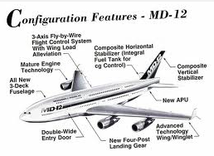

DPP case at McDonnell Douglas/Boeing
About 1989, El Segundo California
Successful Inspection on Engineering Drawings
Director (Mac) asks for more tricks from TG
Suggested DPP (recently learned from Mays IBM)
Got team of 4 young engineers
Problem: defects in engineering drawings
Initial suggestions: big automated project to do Engineering Orders better
KISS: Keep it simple
They came up with a form with cutouts and notes, for all 19 types of engineering order
Made in plastic and color for all 2500 engineers
With names of the 4 inventors
Mac had to protect the 4 engineers from their supervisors
Mac said: this is so simple, we could have done it decades ago: why not?
Tom: nobody ever asked the young engineers to think about the problem
  No empowerment!

Slide 26
Practical
Defect Prevention Process ‘DPP’:
Real Process Improvement
  early, frequently, measurably,
  in all projects.
Notes:
Copy of Lean QA slides 28 12 2012 after Capers slides added

Slide 27

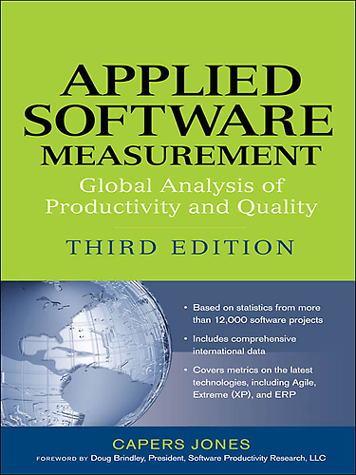
“Proven Methods for Preventing Software Defects” (paper)
, www.Namcook.com, Dec 2012
1. Joint Application Design (JAD)
2.. Quality function deployment (QFD)
3.. Certified reusable requirements, architecture, and design segments
4.. Certified reusable code
5.. Certified reusable test plans and test cases (regression tests)
6.. Kanban for software (mainly in Japan)
7.. Kaizen for software (mainly in Japan)
8.. Poka-yoke for software (mainly in Japan)
9.. Quality circles for software (mainly in Japan)
10.. Six Sigma for Software
11.. Achieving CMMI levels => 3 for critical projects
12.. Using quality-strong methodologies such as RUP and TSP
13.. Embedded users for small projects < 500 function points
14.. Formal estimates of defect potentials and defect removal before starting projects
15.. Formal estimates of cost of quality (COQ) and technical debt (TD) before starting
16.. Quality targets such as > 97% defect removal efficiency (DRE) in all contracts
17.. Function points for normalizing quality data
18.. Analysis of user-group requests or customer suggestions for improvement
Notes:
SOFTWARE DEFECT ORIGINS AND REMOVAL METHODS
Capers Jones, Vice President and Chief Technology Officer
Namcook Analytics LLC www.Namcook.com
Draft 4.0 December 27, 2012
The set of defect prevention methods can lower defect potentials from U.S. averages of about 5.00 per function point down below 2.00 per function point. Certified reusable materials are the most effective known method of defect prevention. A number of Japanese quality methods are beginning to spread to other countries and are producing good results. Defect prevention methods include:

Slide 28
Assertions about ‘DPP’ (IBM Mays and Jones Method)
DPP is similar in principle to Deming’s Plan Do Study Act – Statistical Process Control (SPC), and to Six Sigma (GE, Motorola).
DPP has a return on investment of about 13 to 1
DPP will reduce injected defects for any work process by 2/3 in the first year or two, and far more in the longer term (approaching zero defects)
DPP is far more cost effective than any known form of Inspection or Testing – in delivering quality

Slide 29
What is DPP?
Grass roots developers (checkers, testers) analyze frequent-type real bugs – concrete detailed instances that they have first hand knowledge about - or major defects
They develop local personal or group opinions about root causes, and potential ‘cures’ (changes in process, or anything that might reduce occurrence)
They try out their ideas in practice, locally (their project or product, and their process, as practiced by them)
Ideas that work, are picked up at a higher level of corporate process change, and implemented corporate wide
Story: Tom and the young Douglas Aircraft Engineers – the cut outs solution. Simple!

Slide 30
How does DPP work?
After an Inspection Process, Major defects are examined by the checking team. Half an hour sessions.
  They are looking at a colleagues work, colleague is there (the source of defects: knows why)
They arbitrarily select one, of a small group of recurrent types of defects, to work on (3 minutes each). 10 in 30 minutes.
They brainstorm root causes (organizational, not personal)
  Like: misleading training course information
They brainstorm possible ‘cures’
  Like: enhance slides, and tests to make the point clearer.
They may themselves, carry out the proposed changes and try them to see if they work. Keep it simple – prove concept works.
Successful changes are picked up at corporate quality level and instituted more widely and more properly.

Slide 31
Effects of DPP:
Grass roots wisdom
Systemic (due to ‘common cause’) defects are reduced quickly and in volume (2/3 in year)
The inside knowledge of local teams is exploited – how things really work in the real world – why the defects really occurred
The inside local understanding of socially acceptable changes is used: people will not suggest changes they would hate to do themselves
The feeling of ‘empowered creativity’ to find process improvements that really work, is very motivating to the grass roots professionals!
  Big costly ideas that never work, as often suggested by management, architects, and interested suppliers, are not imposed on the developers.
  Ideas that don’t work are discarded quickly, or re-tuned to work better.
Many small but practical improvements, quickly and cheaply deployed, 200-2,000 annually, add up to major measurable change in quality.
Any one group (like ‘test’, or a 4 person development team) can use this method on their own work, to prove how well it works – improving quality.

Slide 32
DPP Policy
All interested teams will be given regular opportunities to analyze their own defects using the DPP process.
They will be given the opportunity to try out their solutions; and measure the effects of their solutions.
Local successful solutions will be adopted more widely, by groups responsible for change and improvement (CTO level)
Local groups responsible for initially finding, and successfully trying out improvements will be suitably honoured and rewarded.
The minimum amount of annual investment in this activity is 5% of total work hours.
Failure to successfully invest in this each year, irrespective of excuses*, will be considered a serious management failure.
  * ‘meeting deadlines’ is an invalid excuse. Deadlines are a major reason for doing this properly. Defects destroy deadlines!
  Investments early in critical projects can easily save those projects.

Slide 33
Summary DPP
Defect Prevention is the smartest way to improve quality and to reduce time to market.
DPP is applicable to all work processes
DPP results are highly measurable
DPP results happen in the short term (this month) but take a few years to get full harvest. DPP should be continued eternally, in changing environments.
DPP avoids ‘great management failure’ changes
  Management exploits local know how and creativity forever
  People love to be listened to, and to see their ideas work and get spread to a larger organization.

Slide 34
Systematic Reduction of Defect Injection:
The Defect Prevention Process:
  how can we organise ourselves at the test level
  to analyse recurrent problems
  and implement practical changes to avoid them?

Slide 35
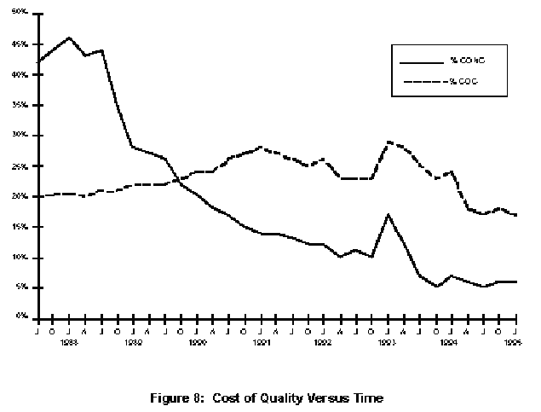


Cost of Quality over Time: Raytheon 95
43%
Start of Effort
The individual learning curve ??
Cost of Conformance
Bad
Process
Change
Cost of Rework
(non-conformance)
5%
End 1988
End 1994

Slide 36


‘Avoidable’ Costs of Non-conformance Items
Re-reviews
Re-tests
Fixing Defects (code, documentation)
Reworking any document.
Engineering Changes
Lab Equipment Costs of Retests
Updating Source Code
Patches to Internal Code
Patches to Delivered Code
External Failures
from Philip Crosby’s Model according to Raytheon95 Fig. 7
Source : Raytheon Report 1995
  http://www.sei.cmu.edu/pub/documents/95.reports/pdf/tr017.95.pdf
Notes:
Source : Raytheon Report 1995
http://www.sei.cmu.edu/pub/documents/95.reports/pdf/tr017.95.pdf

Slide 37
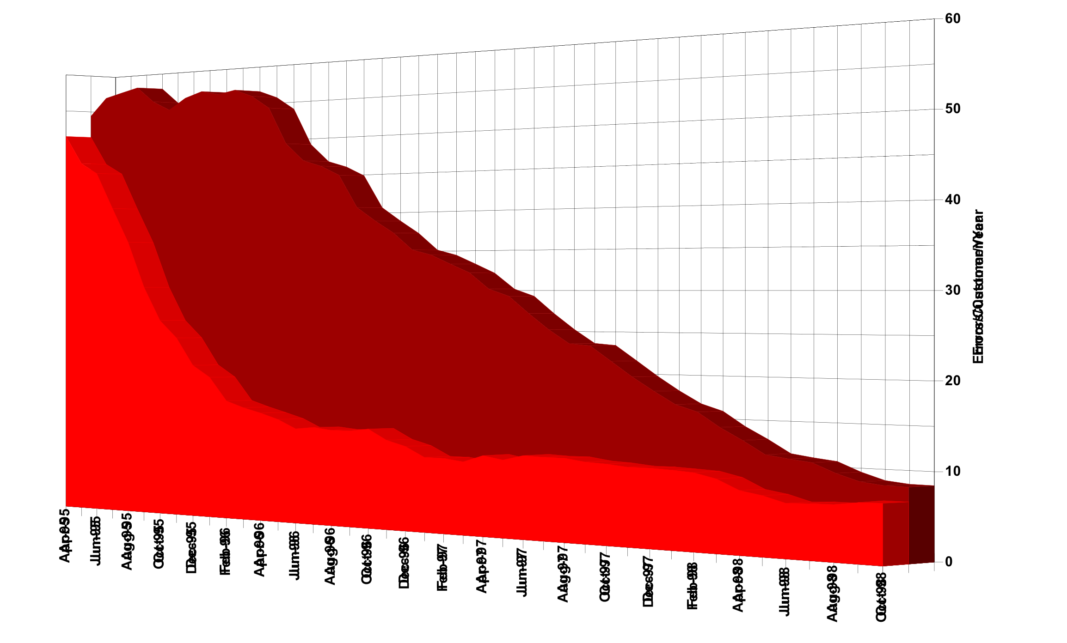
Improving the Reliability Attribute
Primark, London (Gilb Client) see case study Dick Holland, “Agent of Change” from Gilb.com
Using, Inspections, Defect Prevention, and Planguage for Management Objectives
Errors/
Customer/
Year
50
minors
Majors
5
1995
1998
Notes:
17
17
17

Slide 38
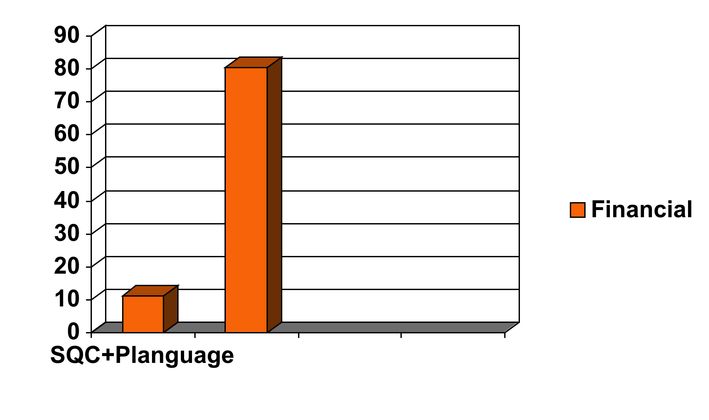
Defect Rates in 2003 Pilot Financial Shop, London, Gilb Client
Spec QC/Extreme Inspection + Planguage Requirements
Across 18 DV (DeVelopment) Projects using the new requirements method, the average major defect rate on first inspection is 11.2.
4 of the 18 DV projects were re-inspected after failing to meet the Exit Criteria of 10 major defects per page.
A sample of 6 DV projects with requirements in the ‘old’ format were tested against the rules set of:
  The requirement is uniquely identifiable
  All stakeholders are identified.
  The content of the requirement is ‘clear and unambiguous’
  A practical test can be applied to validate it’s delivery.
The average major defect rate in this sample was 80.4.
Major defects/page
on 1st Quality Control

Slide 39


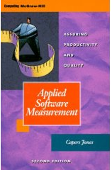
Defect Removal Effectiveness
Inspections and Tests
Capers Jones
Capers Jones,
http://www.spr.com/
Table 9: Software Defect Removal Effectiveness Ranges (Capers Jones)
Defect Removal Activity Ranges of Defect
Removal Effectiveness
Informal design reviews …………………………………………………………….25% to 40%
Formal design inspections ---------------------------------------------------- 45% to 65%
Informal code reviews 20% to 35%
Formal code inspections ------------------------------------------------------- 45% to 70%
Unit test ------------------------------------------------------------------------------15% to 50%
New function test 20% to 35%
Regression test 15% to 30%
Integration test 25% to 40%
Performance test 20% to 40%
System test ---------------------------------------------------------------25% to 55%
Acceptance test (1 client) 25% to 35%
Low-volume Beta test (< 10 clients) 25% to 40%
High-volume Beta test (> 1000 clients) 60% to 85%
Notes:
CONFLICT AND LITIGATION
BETWEEN SOFTWARE CLIENTS AND DEVELOPERS
Version 10 – April 13, 2001
By Capers Jones, Cjones@spr.com
It is obvious that no single defect removal operation is adequate by itself. This explains why “best in class” quality results can only be achieved from synergistic combinations of defect prevention, reviews or inspections, and various kinds of test activities. Between eight and 10 defect removal stages are normally required to achieve removal efficiency levels > 95%.
Jones, Capers; Applied Software Measurement; McGraw Hill, 2nd edition 1996; ISBN 0-07-032826-9; 618 pages.
Jones, Capers; Assessment and Control of Software Risks; Prentice Hall, 1994; ISBN 0-13-741406-4; 711 pages.
Jones, Capers; Patterns of Software System Failure and Success; International Thomson Computer Press, Boston, MA; December 1995; 250 pages; ISBN 1-850-32804-8; 292 pages.
Jones, Capers; Software Quality – Analysis and Guidelines for Success; International Thomson Computer Press, Boston, MA; ISBN 1-85032-876-6; 1997; 492 pages.
Jones, Capers; Estimating Software Costs; McGraw Hill, New York, NY; ISBN 0-07-9130941; 1998; 724 pages.
Jones, Capers; “Sizing Up Software;” Scientific American Magazine; December 1998; Vol. 279, No. 6; pp 74-79.
Jones, Capers; Software Assessments, Benchmarks, and Best Practices; Addison Wesley Longman, Boston, MA; May 2000; ISBN 0-201-48542-7; 700 pages.

Slide 40
No ‘Silver Bullet’ Solution
Machine Guns Kill Defects
Capers
Jones
“It is obvious that no single defect removal operation is adequate by itself.
This explains why
  “best in class” quality results can only be achieved from
    synergistic combinations of
      defect prevention,
      reviews or
      inspections,
      and various kinds of test activities.
Between eight and 10 defect removal stages are normally required to achieve removal efficiency (he means ‘effectiveness’) levels > 95%”.
    Jones, Capers; Applied Software Measurement; McGraw Hill, 2nd edition 1996; ISBN 0-07-032826-9; 618 pages.
Notes:
CONFLICT AND LITIGATION
BETWEEN SOFTWARE CLIENTS AND DEVELOPERS
Version 10 – April 13, 2001
By Capers Jones, Cjones@spr.com
It is obvious that no single defect removal operation is adequate by itself. This explains why “best in class” quality results can only be achieved from synergistic combinations of defect prevention, reviews or inspections, and various kinds of test activities. Between eight and 10 defect removal stages are normally required to achieve removal efficiency levels > 95%.
Jones, Capers; Applied Software Measurement; McGraw Hill, 2nd edition 1996; ISBN 0-07-032826-9; 618 pages.
Jones, Capers; Assessment and Control of Software Risks; Prentice Hall, 1994; ISBN 0-13-741406-4; 711 pages.
Jones, Capers; Patterns of Software System Failure and Success; International Thomson Computer Press, Boston, MA; December 1995; 250 pages; ISBN 1-850-32804-8; 292 pages.
Jones, Capers; Software Quality – Analysis and Guidelines for Success; International Thomson Computer Press, Boston, MA; ISBN 1-85032-876-6; 1997; 492 pages.
Jones, Capers; Estimating Software Costs; McGraw Hill, New York, NY; ISBN 0-07-9130941; 1998; 724 pages.
Jones, Capers; “Sizing Up Software;” Scientific American Magazine; December 1998; Vol. 279, No. 6; pp 74-79.
Jones, Capers; Software Assessments, Benchmarks, and Best Practices; Addison Wesley Longman, Boston, MA; May 2000; ISBN 0-201-48542-7; 700 pages.

Slide 41
Positive Motivation:
Personal Improvement
“We find an hour of doing Inspection is worth ten hours of company classroom training.”
A McDonnell-Douglas line manager
“Even if Inspection did not have all the other measurable quality and cost benefits which we are finding, then it would still pay off for the training value alone.”
A McDonnellDouglas Director
Defects/Page
100
“Gary” at
McDonnell-Douglas
80
80 Majors Found
(~160-240 exist!)
60
40
40
20
23
8
0
0
0
1
2
3
4
5
February
April
Inspections of Gary’s Designs
Notes:
Early defect removal also pays dividends in terms of personal skills. Take the case of “Gary” at McDonald Douglas. From a standing start, he participated in 5 successive Inspections of his own software designs (ignore the hard hat!). Note that, as Author of the 5 documents, he was required to join the Inspection team that was looking for his errors.
The first document revealed an average defect density of 80 majors per page – a frightening number, but actually quite typical. By the time he’d fixed them all, though, Gary had learnt so much about how to write good design documents, that his second Inspected design was only half as buggy. Each successive document was only half as buggy as its predecessors, and by the fifth – well, I had to cheat there, because the graphing tool wouldn’t let me graph an observation of zero, so I had to put in one spurious defect!
Here’s how McDonald-Douglas felt about the personal value of Inspections:

Slide 42
Defect Detection strategies versus Defect Prevention strategies
Defect detection
  (inspection, test, customer reports)
  Is ineffective for getting high bug-freeness into systems
  It is better than nothing
  Inspection is cheaper than test-and-debug
Defect Prevention - is at 2 levels
  process improvement
    (CMMI Level 5)
  individual capability improvement
    (50% per motivated cycle)
Defect prevention is BY FAR the smartest one

Slide 43
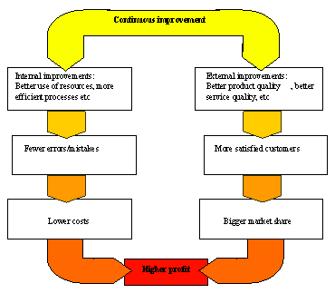
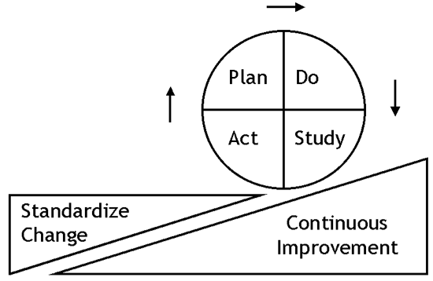
Prevention
Costs
Deming Cycle
5%, stable at 5%
  of development costs
  (Raytheon 1993)
0.5 % of development costs
  (Mays 1995)
Half-day Inspection Economics. Gilb@acm.org
Notes:
58

Slide 44


Defect Prevention Experiences:
Most defects can be prevented from getting in there at all
Cleanroom levels: approach zero def.
IBM MN 99.99%+ fixes:Key= "DPP"
90%
80%
70%
Mays 1993, User 1996 "72% in 2 years" <-tg
50%
Mays & Jones (IBM) 1990
% of usual defects prevented
1
2
3
4
5
6
Years of continuous improvement effort
North Carolina
IBM Research Triangle Park Networking Laboratory
Half-day Inspection Economics. Gilb@acm.org
Notes:
59

Slide 45
Prevention + Pre-test Detection is the most effective and efficient
\
100%
Use
95% cumulative detection
by Inspection (state of the art limit)
90%
80%
Test
70% Detection
by Inspection
70%
"Detected
Cheaply"
<- Mays 1993, 70% prevented
50%
"Prevented"
<-Mays & Jones 50% prevented(IBM) 1990
1
2
3
4
5
6
Prevention data based on state of the art prevention experiences (IBM RTP), Others (Space Shuttle IBM SJ 1-95) 95%+ (99.99% in Fixes)
Cumulative Inspection detection data based on state of the art Inspection (in an environment where prevention is also being used, IBM MN, Sema UK, IBM UK)
Half-day Inspection Economics. Gilb@acm.org
Notes:
60

Slide 46

IBM MN & NC DP Experience
2162 DPP Actions implemented
  between Dec. 91 and May 1993 (30 months)<-Kan
RTP about 182 per year for 200 people.<-Mays 1995
  1822 suggested ten years (85-94)
  175 test related
RTP 227 person org<- Mays slides
  130 actions (@ 0.5 work-years
  34 causal analysis meetings @ 0.2 work-years
  19 action team meetings @ 0.1work-years
  Kickoff meeting @ 0.1 work-years
  TOTAL costs 1% of org. resources
ROI DPP 10:1 to 13:1, internal 2:1 to 3:1
Defect Rates at all stages 50% lower with DPP
Half-day Inspection Economics. Gilb@acm.org
Notes:
61

Slide 47
Attacking the Stability Problem
By Tom for MC MH
April 13 2007

Slide 48
Hypothesis
The management response to the Stability Problem - and similar improvement problems requires a management structure consisting of at least the following elements
  DPP The Defect Prevention Process (see my recent slides on this) <-TG
    This will tackle the many small changes necessary to improve much of the way
  An Architecture Process (ArchP) - strong technical architects that can design to quality (“99.998%”)
    This will tackle the larger and long range changes that in practice are outside the scope of DPP
  A Management Process (MgtP)
    That will drive the DPP/ArchP, and any necessary additional things (permissions, budgets, prioritization)

Slide 49
Detail
The following slides give more detail for these processes
  DPP
  ArchP
  MgtP

Slide 50
DPP
We will limit the initial evolution and trial to a DPP process focused entirely on the Stability Problem.
This will be
  proof of concept,
  a model for similar efforts,
  teach us what we don’t yet know ,
  and hopefully lead to clear short term results with existing systems.

Slide 51
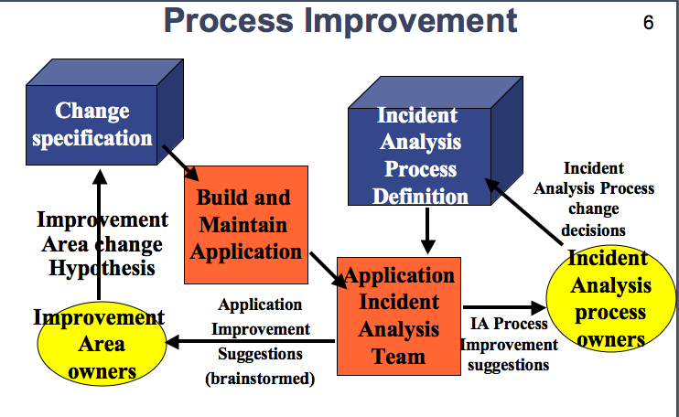
DPP Organization
Inputs:
  The incidents
  Prioritized by frequency, and duration
The Process

Slide 52
Process Improvement
Change
specification
Incident
Analysis
Process
Definition
Incident
Analysis Process change
decisions
Build and
Maintain
Application
or
environment
Improvement Area change Hypothesis
Incident
Analysis
process
owners
Application
Incident
Analysis
Team
Improvement
Team
Application
Improvement
Suggestions
(brainstormed)
IA Process
Improvement
suggestions
Notes:
Diagram made april 13 2007 for UHG by Tom@Gilb.com

Slide 53
The DPP [Stability] organization
Data about incidents is made available to the
  Application Incident Analysis Team (“AppIAT”) (2-5 people)
The AppIAT is composed of people near to the app (managers, designers, testers, maintainers).
  They have realistic insights about causes and cures that others do not have
They select interesting incidents (high frequency of similar type, high duration of outage) - their choice
  “problems worthy of attack, prove their worth by fighting back” (Piet Hein)
They make a set of buzz word guesses as to ‘Cause’,
  in less than 5 minutes total
They make a set of buzzword Guesses as to Cure,
  In less than 5 minutes total.

Slide 54
Collecting Incident Analysis Data
There is no intent to do deep investigative analysis at this stage
The IA team can
  suggest several incident root causes
  and several different, inconsistent and even ‘bad’ or ‘wrong’ cures (process or system improvements)
  their main job is to quickly provide local to incident insights - which get cumulated and handed to appropriate process and application owners (Improvement Teams)
  The Improvement Teams will take serious responsibility for analyzing the IA Team inputs. And doing something practical about them.

Slide 55
SOURCE (PDF SLIDES 2003)
Experiences in
Root Cause Analysis and Defect Prevention Methods
Kelly L. Lanier Raytheon Network Centric Systems klanier@raytheon.com

Slide 56
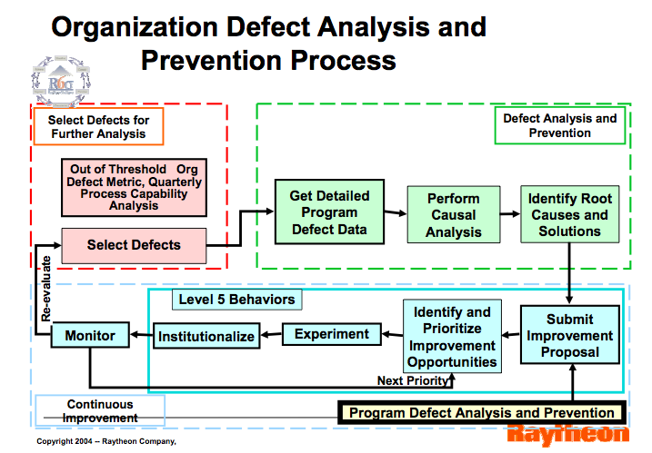
Notes:
SOURCE IS A PDF FILE I HAVE UNDER CASES RAYTHEON
Experiences in
Root Cause Analysis and Defect Prevention Methods
Kelly L. Lanier Raytheon Network Centric Systems klanier@raytheon.com
DPP ROOT CAUSE 2003 RAYTHEON.PDF = FILENAME

Slide 57
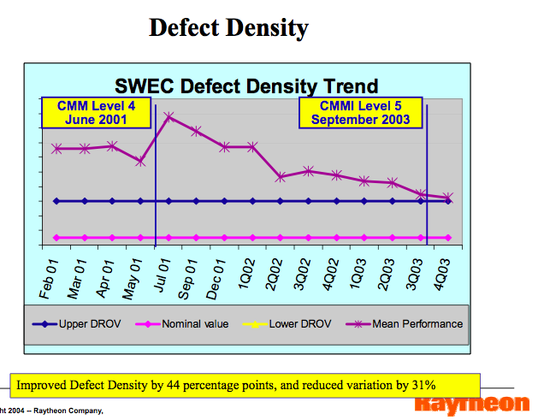
Notes:
SOURCE IS A PDF FILE I HAVE UNDER CASES RAYTHEON
Experiences in
Root Cause Analysis and Defect Prevention Methods
Kelly L. Lanier Raytheon Network Centric Systems klanier@raytheon.com
DPP ROOT CAUSE 2003 RAYTHEON.PDF = FILENAME

Slide 58
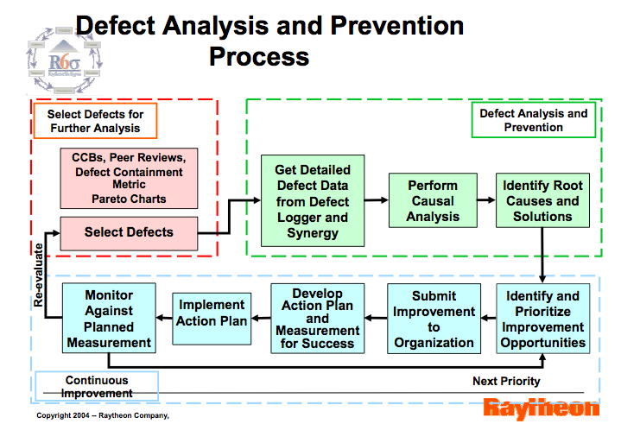
Notes:
SOURCE IS A PDF FILE I HAVE UNDER CASES RAYTHEON
Experiences in
Root Cause Analysis and Defect Prevention Methods
Kelly L. Lanier Raytheon Network Centric Systems klanier@raytheon.com
DPP ROOT CAUSE 2003 RAYTHEON.PDF = FILENAME

Slide 59
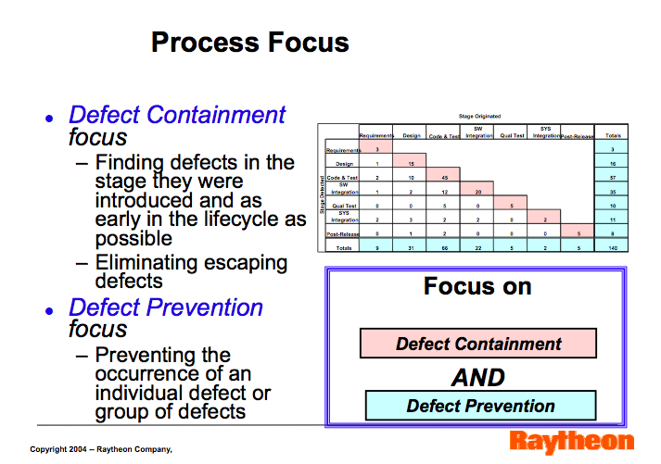
Notes:
SOURCE IS A PDF FILE I HAVE UNDER CASES RAYTHEON
Experiences in
Root Cause Analysis and Defect Prevention Methods
Kelly L. Lanier Raytheon Network Centric Systems klanier@raytheon.com
DPP ROOT CAUSE 2003 RAYTHEON.PDF = FILENAME

Slide 60
DPP
TOM GILB

Slide 61
Inspection Paths and Benefits
Product Requirements
Requirements Metrics
Product Requirements
Lessons Learned
Requirements Errors
Work Process
(including Checklists)
Process Metrics
Customer
Requirements
Process
Improvement
Process Errors
Product Standards Metrics
Updated
Standards
Product Standards
Maintenance
Product Standards Errors
Use of Product Standards
(n+2)
(n+1)
Deliverable
Definition
Deliverable
Development
Interpretation
of Data and
Improvement of
Work Processes
Updated
Checklists
Product
Technical Culture (OJT)
Deliverable (n)
Work
Process
Deliverable
Measurement
Error/Defect Analysis
Errors -
Standards
Products
Reqmts.
Inspection
Database
Deliverable
Error
Correction
Inspection
Review
Synergy
Defects
Product Release
Customer
Notes:
Source Lawrence Day Boeing slides ‘Software Inspection’ stored in Others slides/ Inspection/ Lawrence Day April 13 2002
Presented at ICS Test April 18 2002, "Day, Lawrence E" <lawrence.e.day@boeing.com>

Slide 62
Process Improvement
Product
Process
Definition
Inspection
Process
Definition
Generate
Product
(author)
Inspection
Process change
decisions
Product
Process change
decisions
Inspect
Product
(team)
Inspection
process
owners
Product
process
owners
Improvement
suggestions
Improvement
suggestions
Notes:
33

Slide 63
Process brainstorming
Use 0.5 hour to analyze why defects happened
Sample up to 10 real Major defects
Ask quick feeling as to cause;
  "time", "training"
Ask quick feeling as to work situation cure:
  "give us more time", "proper updated documents"
Don"t go deep. 3 minutes each defect.
  "Gut feel from grass roots" is the point here.
Notes:
57

Slide 64
Process Improvement
Defect Prevention Process (DPP)
Mays and Jones IBM RTP NC 1983 on.
Notes:
58

Slide 65
Defect Prevention Experiences:
Most errors can be prevented
90%
Space Shuttle level
80%
70%
Mays 1993
50%
Mays & Jones (IBM) 1990
% of usual defects prevented
1
2
3
4
5
6
Years of continuous improvement effort
North Carolina
IBM Research Triangle Park Networking Laboratory
Half-day Inspection Mechanics. Gilb@acm.org
Notes:
59

Slide 66
Defect Prevention Process (DPP)
Half-day Inspection Mechanics. Gilb@acm.org
Notes:
60

Slide 67
Defect Prevention Hierarchy
Deterrent
Product
Development
Modify
Deterrent
Prevent
Correct
Test/
Operations
Detect
Report
Notes:
Source Lawrence Day Boeing slides ‘Software Inspection’ stored in Others slides/ Inspection/ Lawrence Day April 13 2002
Presented at ICS Test April 18 2002, "Day, Lawrence E" <lawrence.e.day@boeing.com>

Slide 68
Defect Prevention Process
Plan
Work Process
Defect Detection
200->1000 improvements / year (IBM)
Do
Requirements Specs.
Checking
Design Specs.
Logging
Test planning
Sales, Marketing Administrative
Cost Analysis
Testing, Field Service
Study
Act
Defect Prevention
Process Improvement Phase
Defect Prevention
Analysis Phase
Process Brainstorming
Improvement Champions
Quality Database
Process Investigators
Pilot Project Process Changes
Process Change Management Team
"Pareto Analysis"
Half-day Inspection Mechanics. Gilb@acm.org
Notes:
61

Slide 69
Prevention + Pre-test Detection is the most effective and efficient
\
100%
Use
95% cumulative detection
by Inspection (state of the art limit)
90%
80%
Test
70% Detection
by Inspection
70%
"Detected
Cheaply"
<- Mays 1993, 70% prevented
50%
"Prevented"
<-Mays & Jones 50% prevented(IBM) 1990
1
2
3
4
5
6
Prevention data based on state of the art prevention experiences (IBM RTP), Others (Space Shuttle IBM SJ 1-95) 95%
Cumulative Inspection detection data based on state of the art Inspection (in an environment where prevention is also being used, IBM MN, Sema UK, IBM UK)
Half-day Inspection Mechanics. Gilb@acm.org
Notes:
62

Slide 70
Raytheon Productivity Using "Inspection" method and other process improvements
2.7X Productivity by end 1994
Source:Dion
IEEE Software July 1993
& CMU/SEI-95-TR-017
Half-day Inspection Mechanics. Gilb@acm.org
Notes:
63

Slide 71
The Road To Wisdom : Piet Hein
"The road to wisdom
is plain and simple to express,
to err, and err, and err again,
but,
less, and less, and less."
Piet Hein,
(Danish Philosopher, Scientist)
Half-day Inspection Mechanics. Gilb@acm.org
Notes:
64

Slide 72

Robin Olds, Fighter Pilot (& General) on Grass Roots Leadership
“Here’s what I learned over the years.
  Know the mission, what is expected of you and your people.
  Get to know those people, their attitudes and expectations.
  Visit all the shops and sections.
  Ask questions. Don’t be shy.
  Learn what each does, how the parts fit into the whole.
  Find out what supplies and equipment are lacking, what the workers need.
  To whom does each shop chief report? Does that officer really know the people under him, is he aware of their needs and training?
  Does that NCO supervise or just make out reports without checking the facts? Remember, those reports eventually come to you.
  Don’t try to bullshit the troops, but make sure they know the buck stops with you, that you’ll shoulder the blame when things go wrong.
Correct without revenge or anger.
Recognize accomplishment.
Reward accordingly.
Foster spirit through self –pride, not slogans, and never at the expense of another unit.
It won’t take you long, but only your genuine interest and concern, plus follow-up on your promises, will earn you respect. Out of that you gain loyalty and obedience. Your outfit will be a standout. But for God’s sake don’t ever try to be popular! That weakens your position, makes you vulnerable. Don’t have favorites. That breeds resentment. Respect the talents of your people. Have the courage to delegate responsibility and give authority to go with it. Again, make clear to the troops you are the one who’ll take the heat.”
There is a passage just above this
“ …respect, leaders like Dooey Spatz, Jimmy Doolittle, and many more. They all connected with their troops on a personal level and learned everything they could about every part of the organization“
Notes:
From my copy of Olds Fighter Pilot Keyed in from Photo of page 16 08 2014 tsg
Robin Olds, with Christina Olds and Ed Rasimus, “Fighter Pilor: The memiors of the Legendary Ace, Robin Olds”
There is a passage just above this
“ …respect, leaders like Dooey Spatz, Jimmy Doolittle, and many more. They all connected with their troops on a personal level and learned everything they could about every part of the organization“”

Slide 73
Software Process Improvement at Raytheon
Source : Raytheon Report 1995
  http://www.sei.cmu.edu/pub/documents/95.reports/pdf/tr017.95.pdf
  Search “Dion & Raytheon”
An excellent example of process improvement driven by measurement of improvement
Main Motor:
  “Document Inspection”, Defect Detection
Main Driver:
  “Defect Prevention Process” (DPP)

Slide 74
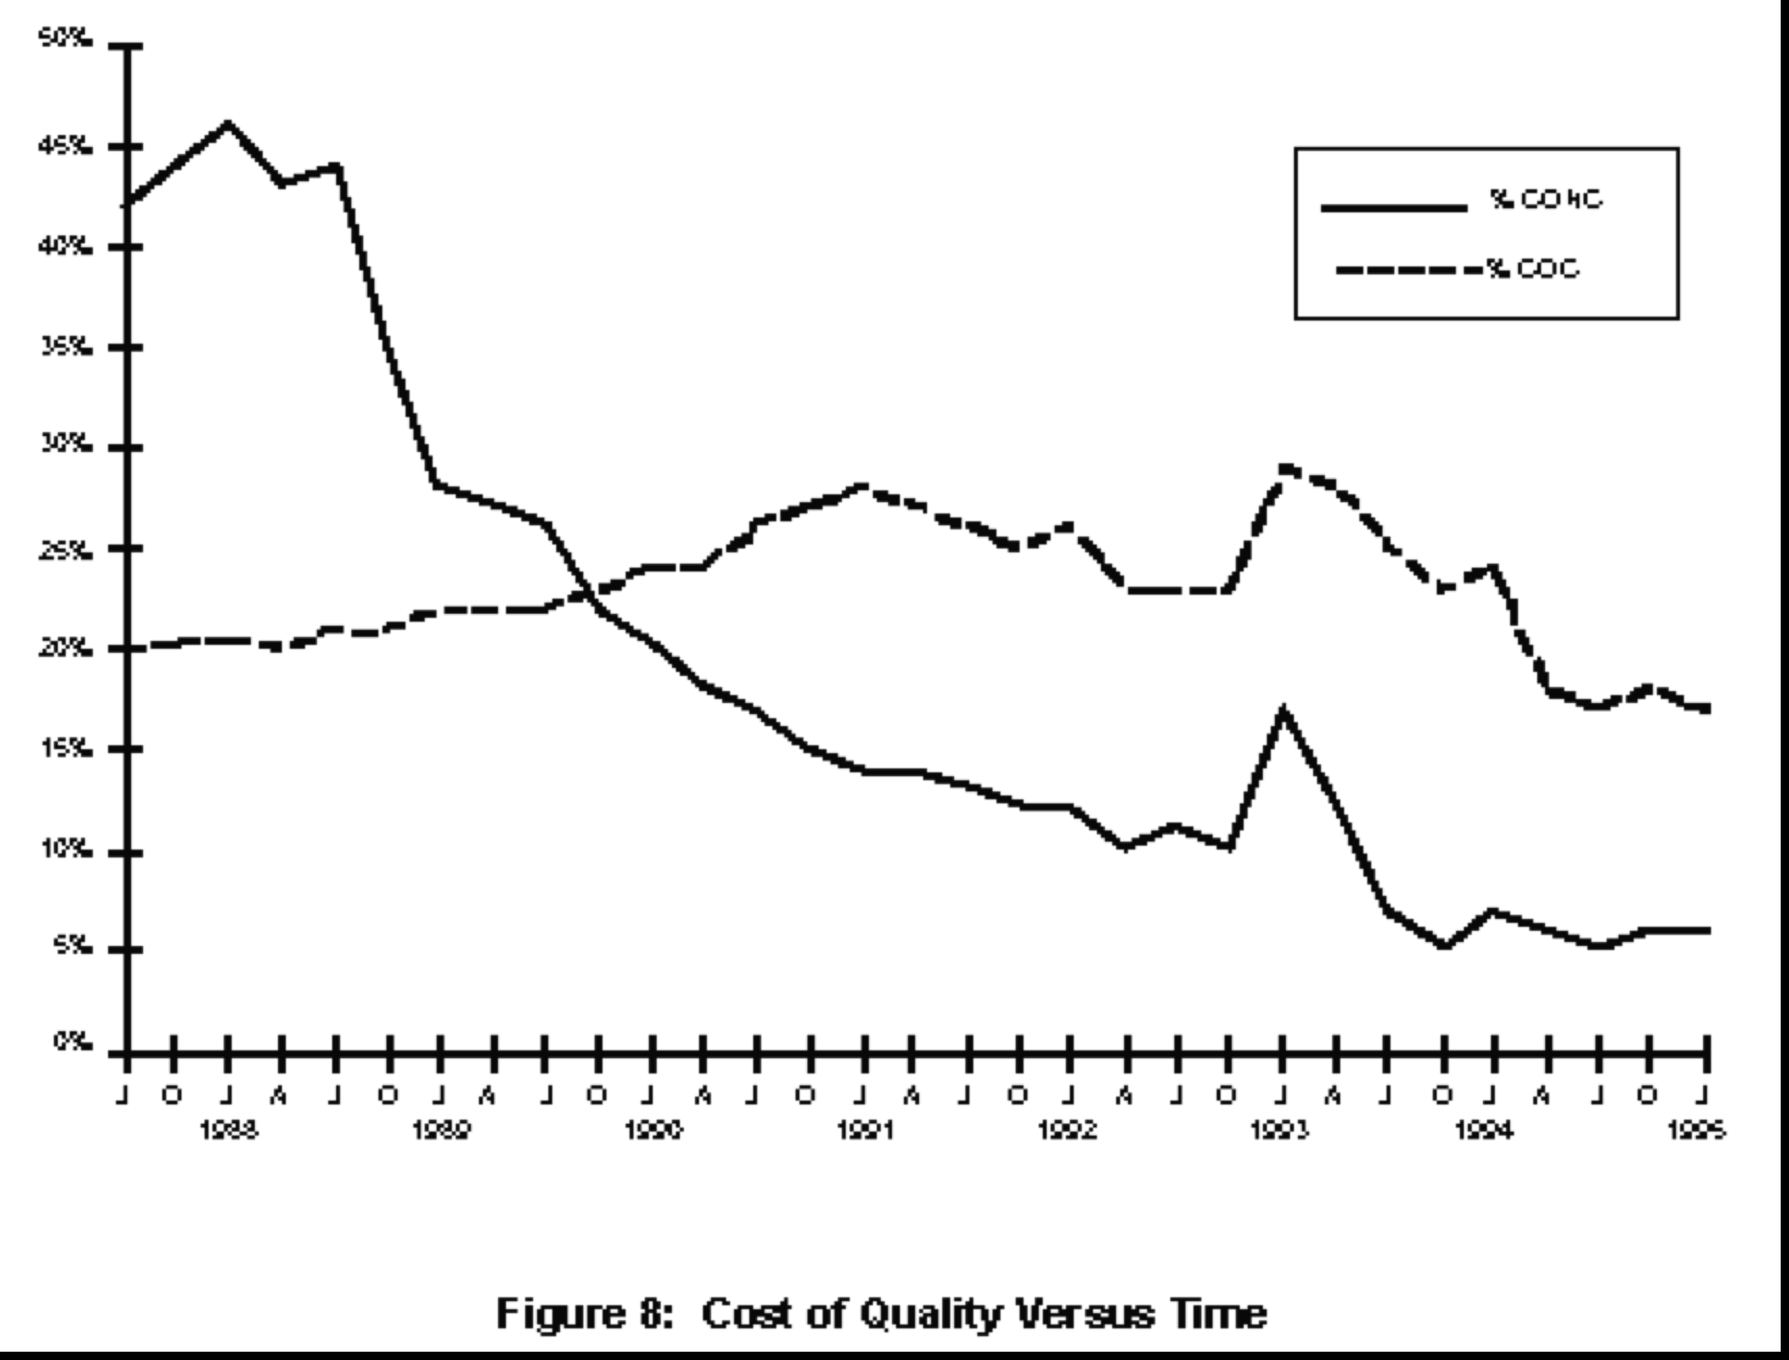
Cost of Quality over Time: Raytheon 95
43%
Start of Effort
The individual learning curve ??
Cost of Conformance
Bad
Process
Change
Cost of Rework
(non-conformance)
5%
End 1988
End 1994

Slide 75
The Cost of Software Quality at RES
start of
SEI initiative
at Level 1
total cost of SW quality
cost of conformance
(appraisal + prevention)
rework costs
CMM
Level 3
70
60
50
40
30
20
10
00
$15.8 million
saved through
the end of 1992
CMM
Level 4
reqmt
set
TCoSQ
% of
Total
Project
Costs
cost of conformance
rework
costs
87 88 89 90 91 92 93 94 95 96
Years
Raytheon ESD/RES, see Dion, 1992, 1993, and Haley, et al 1995,1996

Slide 76
Rework Cost:
Making a plan
Ambition:
  reduce by-half wasted development effort due to avoidable errors, if process improved.
Scale:
  % of total effort which is applied to handling {identifying, correcting, re-testing, reissuing} avoidable errors.
Past [Our test process, 2006]
  45%
Goal
  [Us, 2007 end] 30%,
  [End 2008]20%,
  [End 2009] 10%,
  End 2010] 5%

Slide 77
Project Cost
Cost of Quality
Cost of Performance
Cost of Conformance
Cost of NON-Conformance
see next slide
Appraisal Costs
Prevention Costs
Reviews, Inspections, Testing 1st time, IV&V (1st), Audits
Training, Methodologies, Policy & Procedures, Planning, Quality Improvement Projects, Data Gathering and Analysis, Fault Analysis, Root Cause Analysis, Quality Reporting.

Slide 78
Costs of Non-conformance Items
Re-reviews
Re-tests
Fixing Defects (code, documentation)
Reworking any document.
Engineering Changes
Lab Equipment Costs of Retests
Updating Source Code
Patches to Internal Code
Patches to Delivered Code
External Failures
from Crosby’s Model according to Raytheon95 Fig. 7

Slide 79
CoSQ: Categories
Requirements & Change management,
Standard SW Engineering Practices, SPI
Project and quality planning,
Audits
Technology upgrades
Training
Prevention
Efforts to prevent poor quality (“defects”).
Appraisal
Inspections / technical reviews,
Unit, Module, Integration and System Testing,
Standard testing process/practices
Field trials,
Quality audits
Efforts to “look” for defects.
Defect management,
Re-work,
Re-testing,
Cancelled projects
Internal
Problems detected prior to product release.
Re-Flashing phones,
Technical support,
Complaint investigation,
Claims, FFRs ...
External
Problems detected after product release.
Management
Efforts to manage quality program.
Define quality, Set quality goals, Standards, Metrics, Improvement efforts
Nokia San Diego View June 2000

Slide 80
CoSQ: Reduce Costs by Achieving Process Maturity
External
Internal
Appraisal
Prevention
NOW
Year 1
Year 2
Year 3
Year 5
Nokia San Diego View June 2000

Slide 81
40 Innovations From IBM

Slide 82
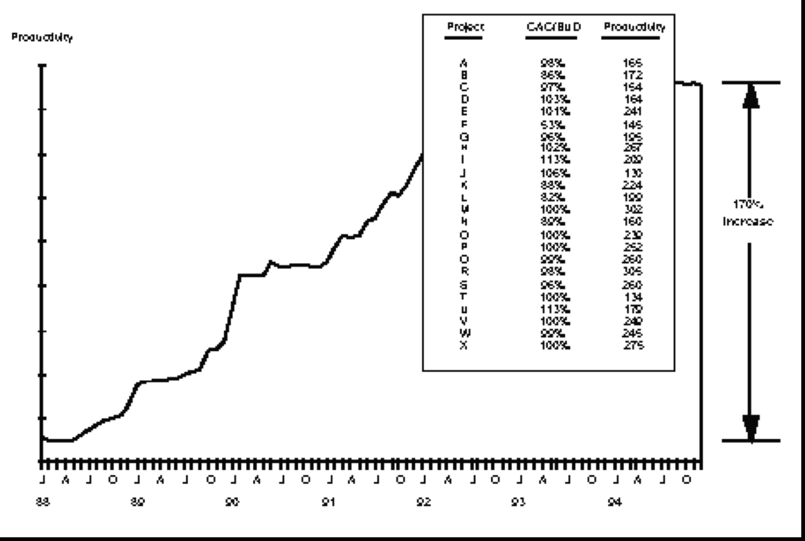
Raytheon 95 Software Productivity 2.7X better
Productivity
+
170%
1988
1994

Slide 83
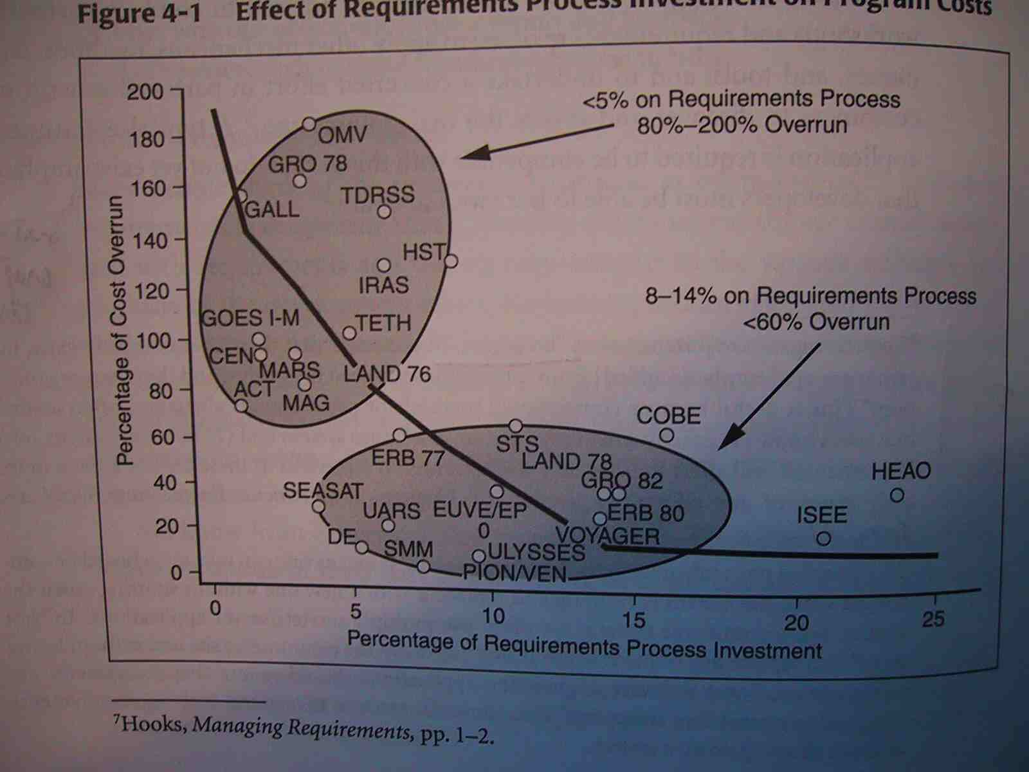
Investment in Requirements
Notes:
Source Young, Effective Requirements Practices, from Ivy Hooks , from NASA studies

Slide 84
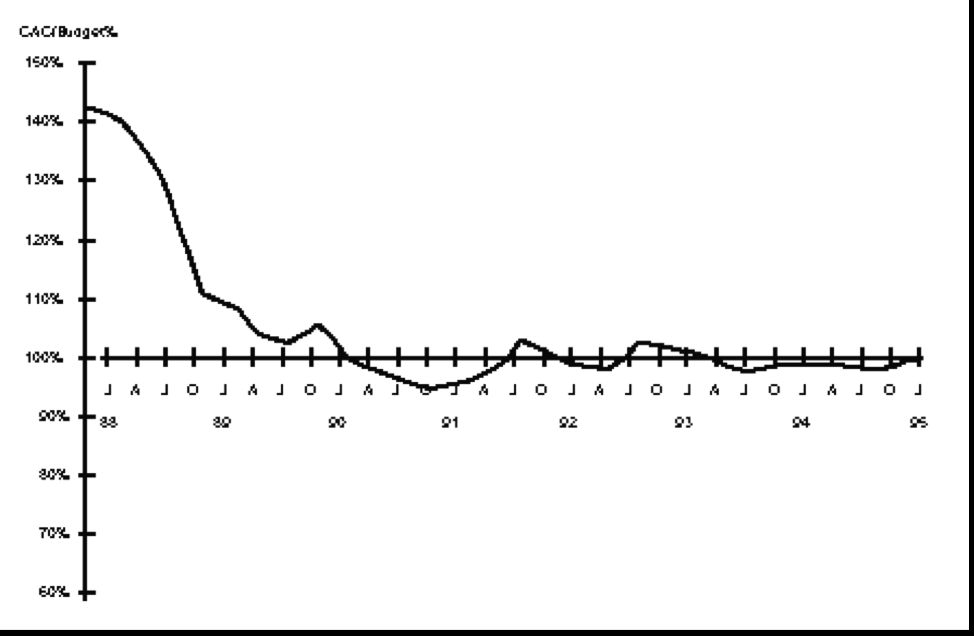
Achieving Project Predictability: Raytheon 95
Cost At Completion / Budget %
140%
100%
1988
1990
1994
SEE PPT NOTE FOR DEFINITION.
Notes:
7.3 Cost Performance Index
Another concern we had was whether we were really performing on projects. This issue was
addressed by collecting data on the project’s budgeted (predicted) cost and its actual cost at
completion (CAC). This cost performance index ratio (CAC/Budget) for each project was then
used to compute the monthly weighted average (again using the same approach as the cost
of quality) to yield a plot of this time-variant measure. The results were encouraging, showing
that the cost performance index was improved dramatically from about the 40% overrun range
prior to the start of the Initiative to the +3% range by late 1991 (when we achieved SEI Level
3) and continuing through the present time (see Figure 10). Recognizing that we would ideally
like this to be a 0% fluctuation, we are convinced that software process maturity carries with it
a fair amount of schedule and cost predictability, which is a fundamental goal of our process!

Slide 85
Examples of Process Improvements: Raytheon 95
Process Improvements Made
Erroneous interfaces during integration and test -
  Increased the detail required for interface design during the requirements analysis phase and preliminary design phase - Increased thoroughness of inspections of interface specifications
Lack of regression test repeatability -
  Automated testing - Standardized the tool set for automated testing - Increased frequency of regression testing
Inconsistent inspection process -
  Established control limits that are monitored by project teams - Trained project teams in the use of statistical process control - Continually analyze the inspection data for trends at the organisation level
Late requirements up-dates -
  Improved the tool set for maintaining requirements traceability - Confirm the requirements mapping at each process phase
Unplanned growth of functionality during Requirements Analysis
  - Improved the monitoring of the evolving specifications against the customer baseline - Continually map the requirements to the functional proposal baseline to identify changes in addition to the passive monitoring of code growth - Improved requirements, design, cost, and schedule tradeoffs to reduce impacts

Slide 86
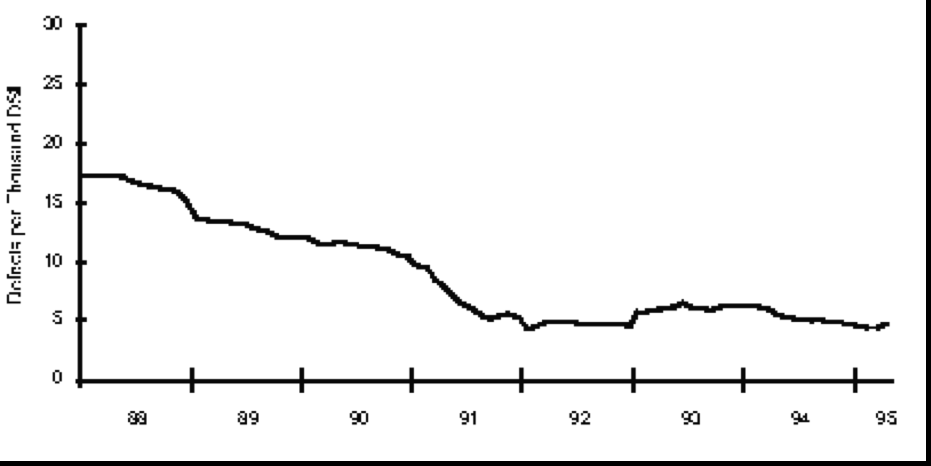
Overall Product Quality: Definition at Raytheon
Overall Product Quality
The primary measure used to assess overall product quality is the defect density in the final software products.
We measure this factor in “number of software trouble reports (STRs) per thousand lines of delivered source code (STRs/KDSI)” on an individual project basis.
The project defect densities are then combined to compute the monthly weighted average (using the same approach as the cost of quality described above) thus yielding a time-variant plot of our overall product quality measure.
As shown in next slide, data collected over the period of the initiative shows an improvement from an average of 17.2 STRs/KDSI to the current level of 4.0 STRs/KDSI.

Slide 87
Overall Product Quality: Raytheon 95
Defect Density Versus Time

Slide 88
Return On Investment at Raytheon about $10,000 per programmer/year
$7.70 per $1 invested at Raytheon
Sell your improvement program to top management on this basis
Set a concrete target for it
  Goal [Our Division, 2 years hence] 8 to 1

Slide 89
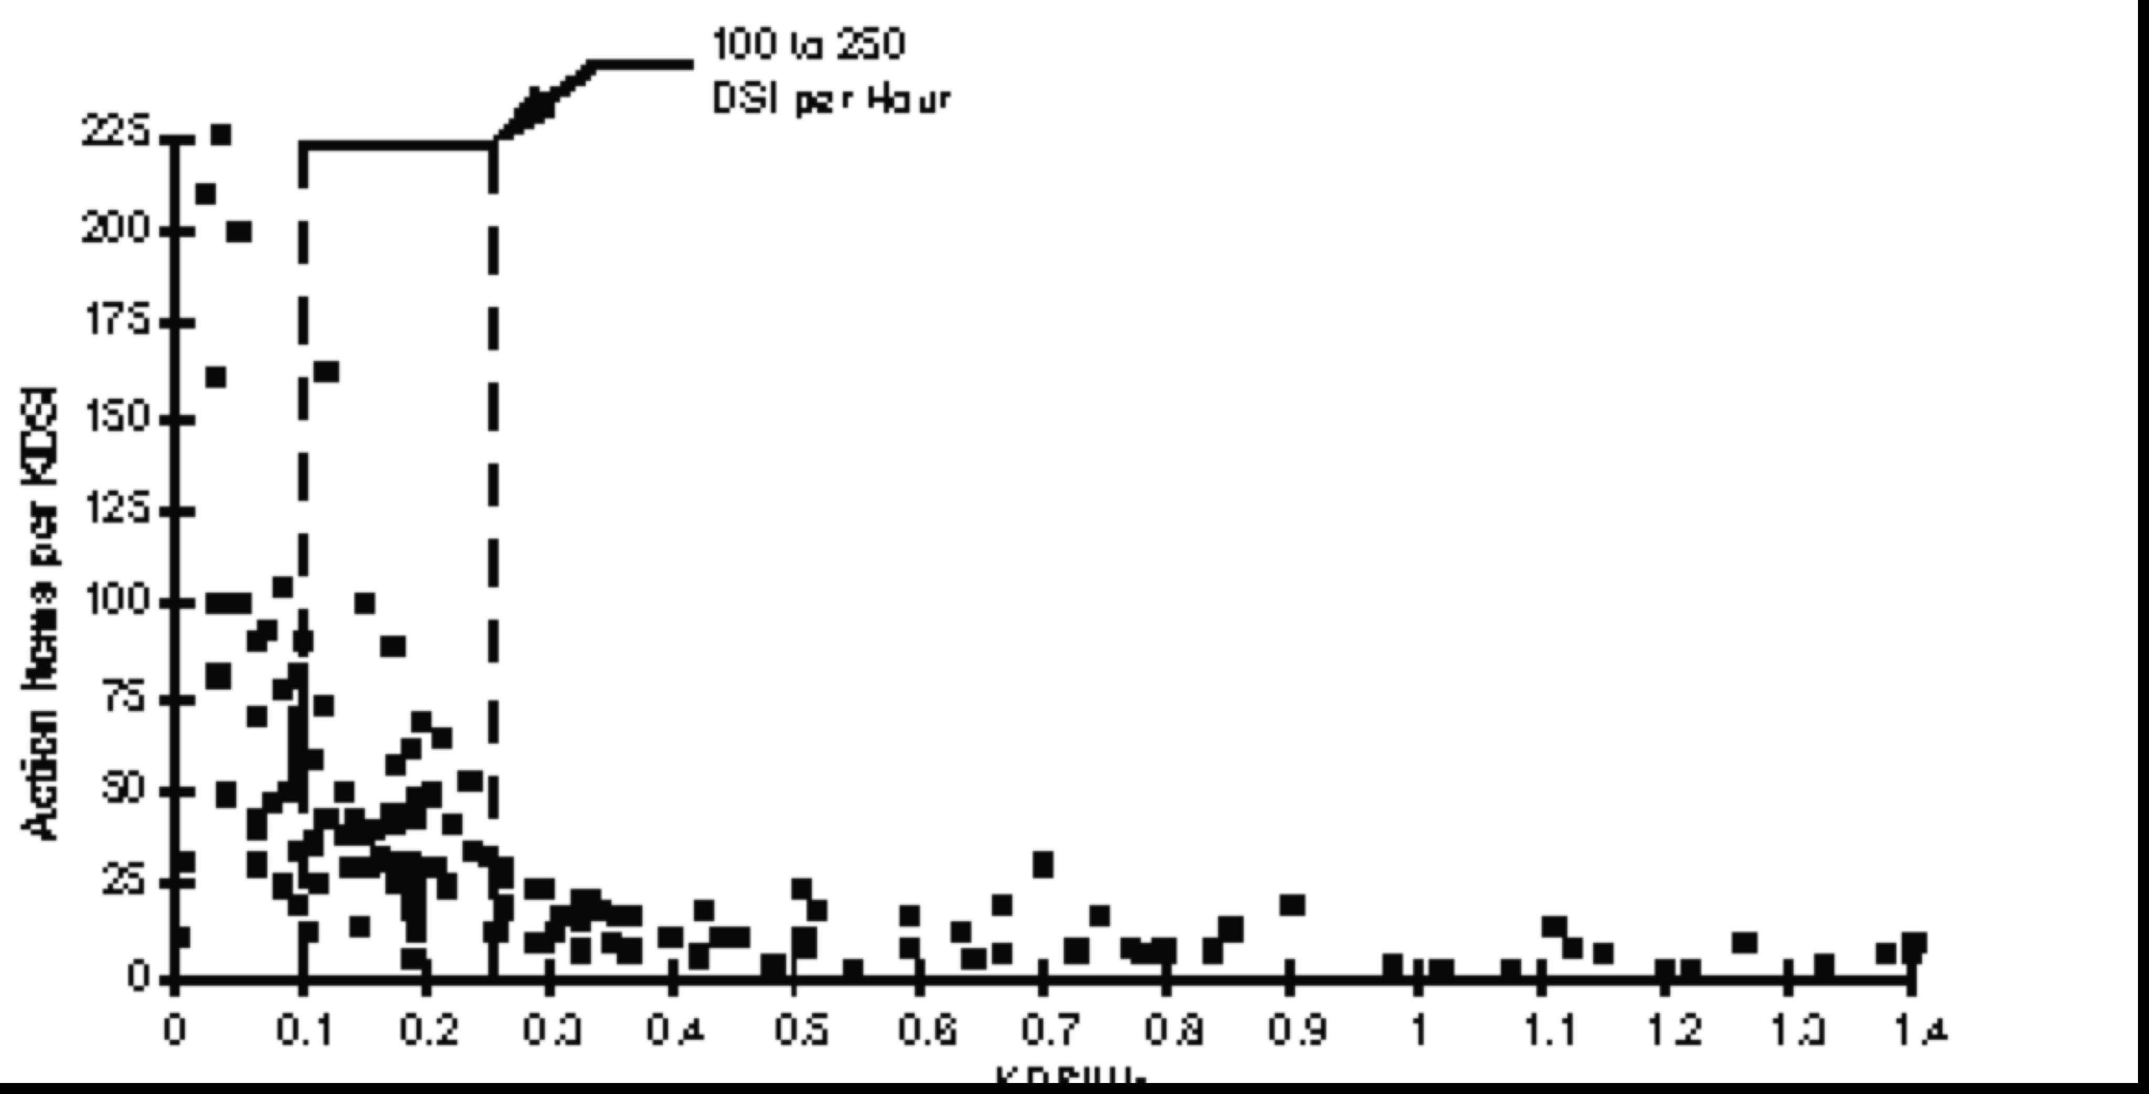
Fault Density versus Checking Rate: Raytheon 95
Defects Found/Kdsi
This area is the ‘illusion of quality”
Most defects escape detection
But many more could be detected if we slowed down the checking rate.
People are only human!
Too-quick reviews and inspections will not find the defects early, thus creating lots of work for testers later.
Over 1,000 Statements
Checked per hour
by a single checker
Real Optimum
Checking Rate

Slide 90
Great Case study book of software change
(similar to Raytheon story)
Craig Kaplan et al
Secrets of Software Quality
  40 innovations from IBM
  McGraw Hill
about 1995, maybe out of print but used copies at amazon.com $2.99
See Gilbs set of Kaplan slides!
  ckaplan@iqco.com
  http://www.iqco.com/
Notes:
Craig Kaplan
i.Q. Company founder, Craig Kaplan, has spent over 15 years developing information technology, including four years with IBM as a human factors scientist and Performance Improvement consultant.Dr. Kaplan earned his M.S. and Ph.D. degrees from Carnegie Mellon University, where he co-authored papers with Nobel Laureate in Economics, Herbert A Simon. In his book, Secrets of Software Quality: 40 Innovations from IBM, Dr. Kaplan describes the measurement system, deployment plan, technology systems, and best practices used by IBM to reach its performance improvement goals.
Dr. Kaplan is a member of ASQ, ACM, APA, IEEE, and the Scientific Research Society, Sigma Xi. In addition to authoring papers and patents, Dr. Kaplan speaks internationally on the topics of team-based assessment and performance improvement. Dr. Kaplan has provided technology and consulting to the US Air Force, the US Coast Guard, and the US Department of Energy in support of their performance improvement efforts. His company's software has also been used successfully by IBM, AT&T, Raychem, and many other industry, government, and non-profit organizations.

Slide 91
How DPP Works
defects
Causal Analysis Team
Ongoing Work
apply improvements, add feedback
suggested actions
Kickoff Meetings
Action Team
improvements
Centralized data collection and storage tools

Slide 92
Some DPP Success Factors
Need for DPP clear
Management commitment
DPP education for managers & developers
Prioritization by Action Team
Rotate Action Team Assignments
Administrative support for defect logging
Continuous improvement of DPP

Slide 93
40 Innovations From IBM

Slide 94
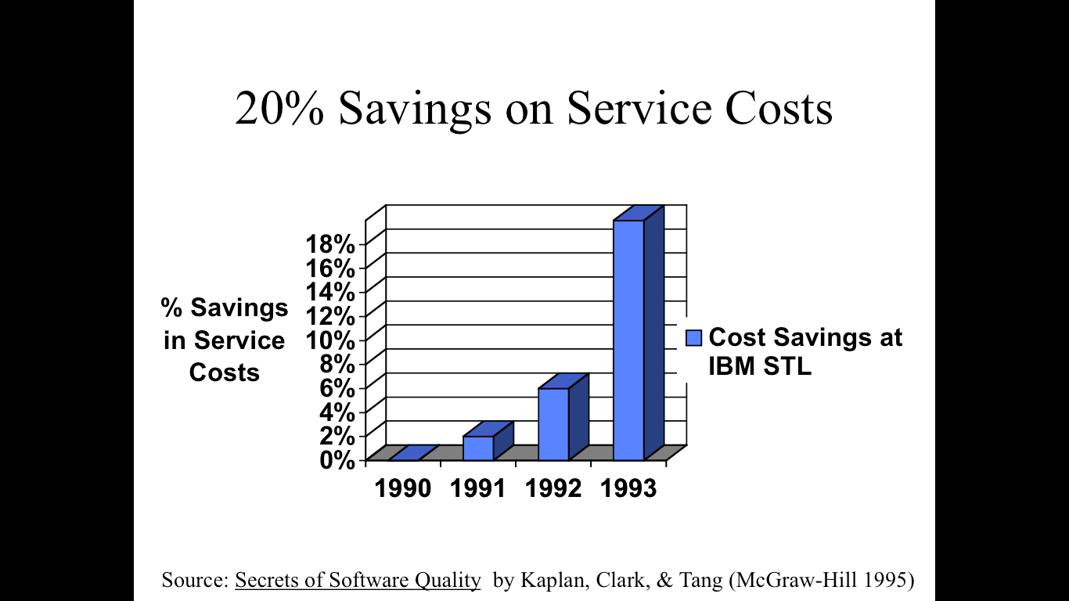

Slide 95
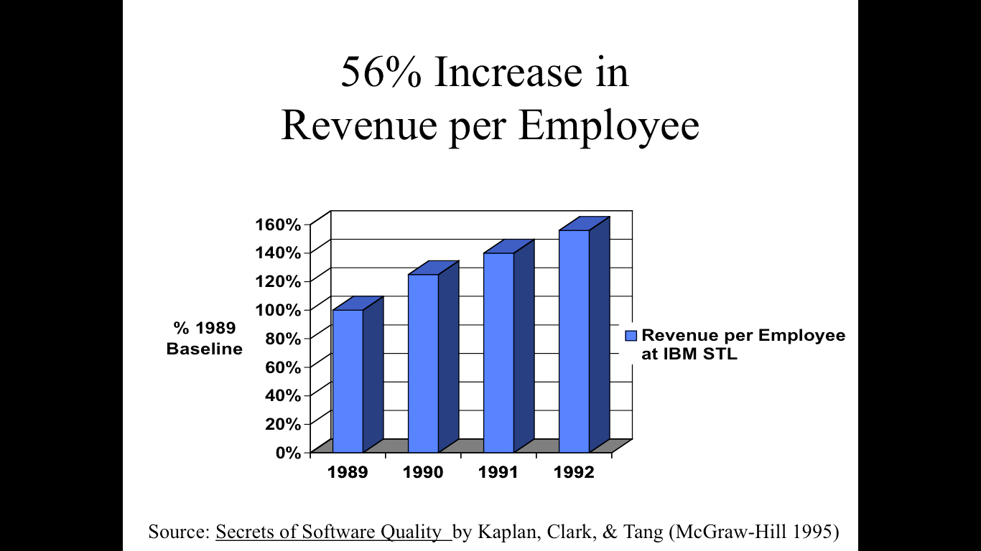

Slide 96
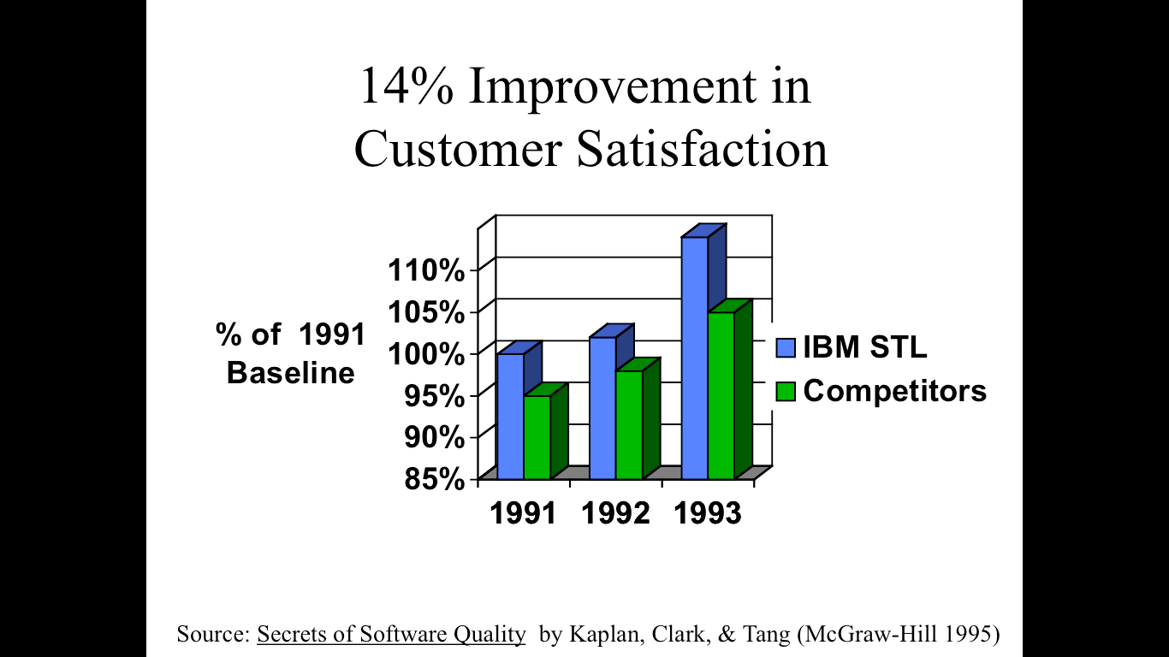

Slide 97
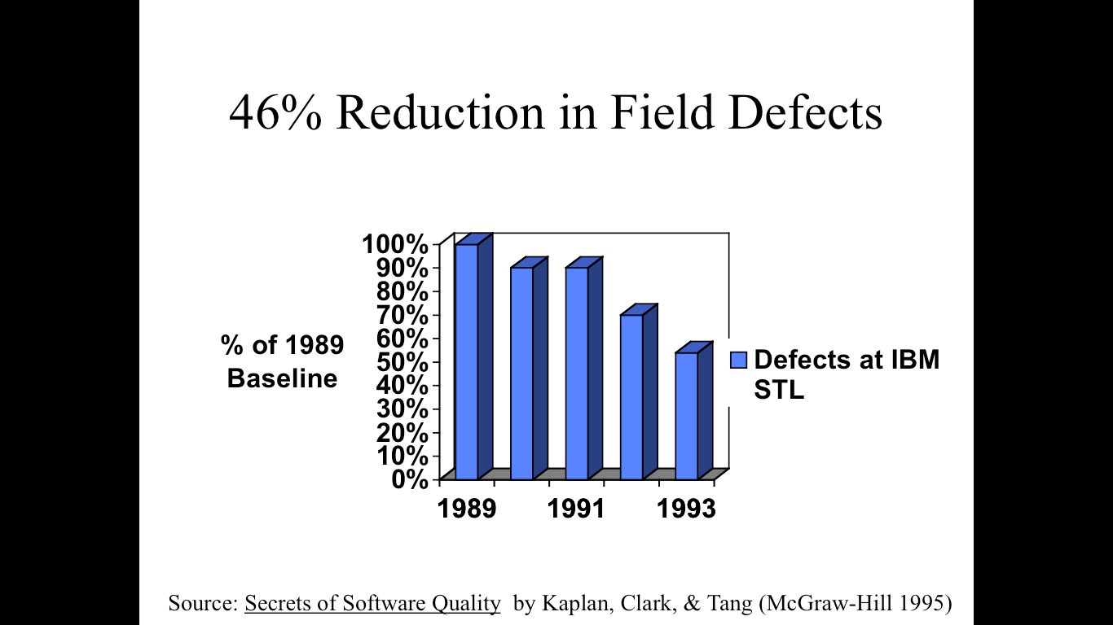

Slide 98
Four Stages of Quality Maturity
Awareness Coping Management Integration

Slide 99
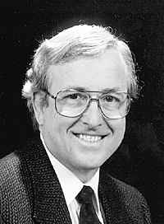
Table 3: Software Defect Prevention Circa 2015
Capers Jones:
‘SOFTWARE DEFECT ORIGINS AND REMOVAL METHODS’ www.Namcook.com
Joint Application Design (JAD)
Quality function deployment (QFD) for software
Using the SEMAT approach (Software Engineering Methods and Theory)
Certified reusable requirements, architecture, and design segments
Certified reusable code
Certified reusable test plans and test cases (regression tests)
Kanban for software (mainly in Japan but spreading globally)
Kaizen for software (mainly in Japan but spreading globally)
Poka-yoke for software (mainly in Japan but spreading globally)
Quality circles for software (mainly in Japan but spreading globally)
Six Sigma for Software
Achieving CMMI levels => 3 for critical projects
Using quality-strong methodologies such as RUP and TSP
Embedded users for small projects < 500 function points in agile projects
Formal estimates of defect potentials and defect removal before starting projects
Formal estimates of cost of quality (COQ) and technical debt (TD) before starting
Quality targets such as > 97% defect removal efficiency (DRE) in all outsource contracts
Function points for normalizing quality data
Analysis of user-group requests or customer suggestions for improvement
Formal inspections (leads to long-term defect reductions)
Pair programming (leads to long-term defect reductions)
Hardware architecture changes to increase security
Software architecture changes to increase security
Notes:
Capers Jones, Vice President and Chief Technology Officer
Namcook Analytics LLC
Email: Capers.Jones3@Gmail.com
Web: www.Namcook.com Blog: http://Namcookanalytics.com
Draft 12.0 March 7, 2015
Added May 26 2015, Paper just sent today from Capers and stored in Gilb, Others Papers, DPP

