Slide 1
Principles of Systems Environments
Based Mainly on a Talk by Pawel Nowak 26 June 2019,
GilbFest London
and with contributions and editing by Tom Gilb
1st draft unedited slides on 27 June 11:03

Slide 2
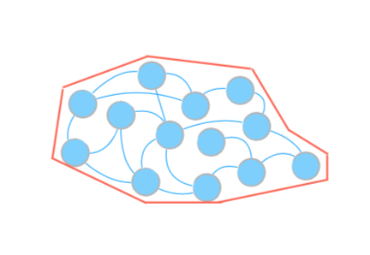
Principles of Systems Environments
1. Systems Environment (SEnv) definition clarity is a logical prerequisite to successful identification of relevant and critical stakeholders.

Slide 3
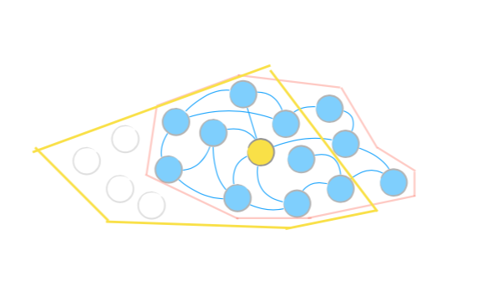
2. Defining the exact systems boundary might be impossible, but good approximations will be useful

Slide 4
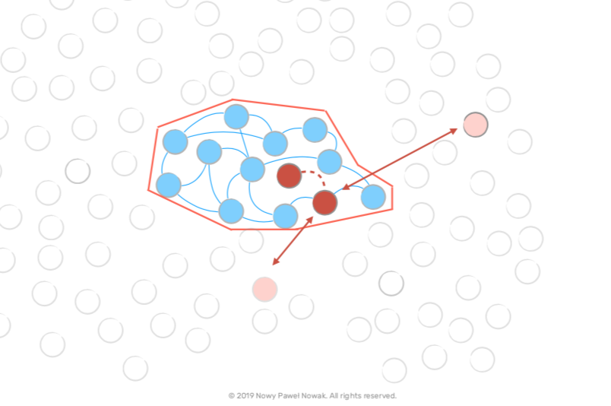
3. Entities outside our systems environment boundary, might have interesting or critical relationships to our environment: these outside relations are potentially worth explicit specification, and evaluation.

Slide 5
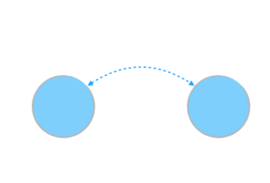
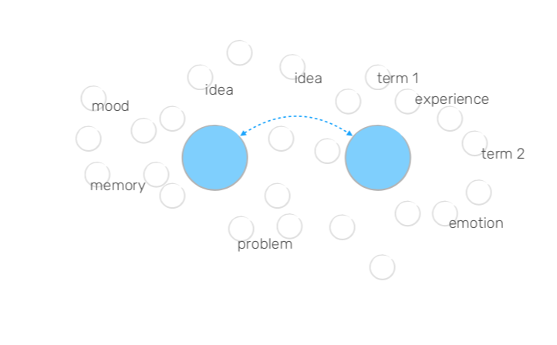
4. Parts of the system that interacts with each other actively produce and maintain and share context, so they can understand each other.

Slide 6
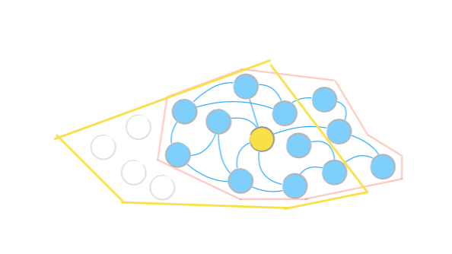
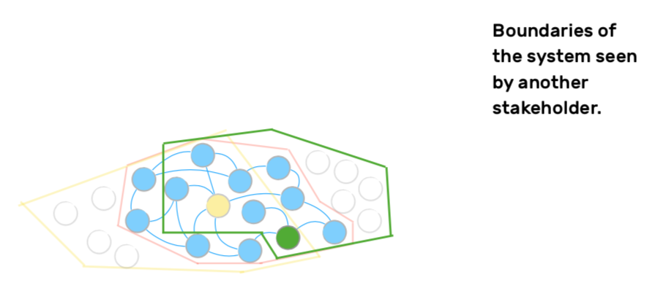
5. A particular stakeholder might see the boundaries of a defined system, from their point of view only, as a subset, or even including entities outside our defined boundaries.

Slide 7
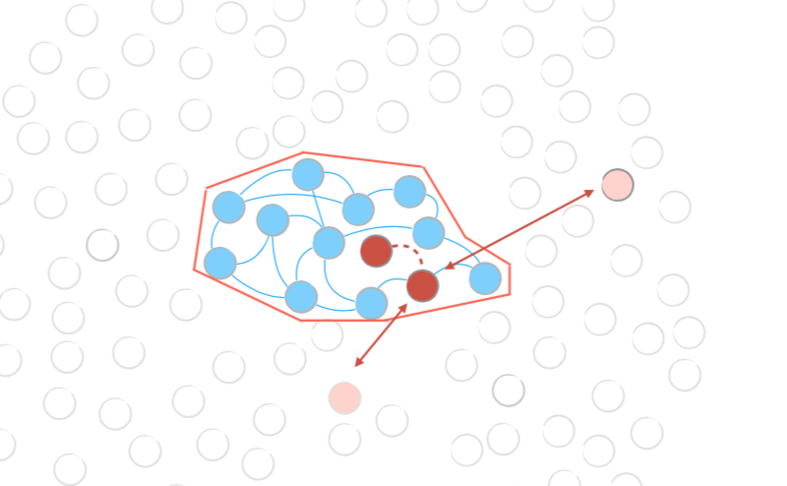
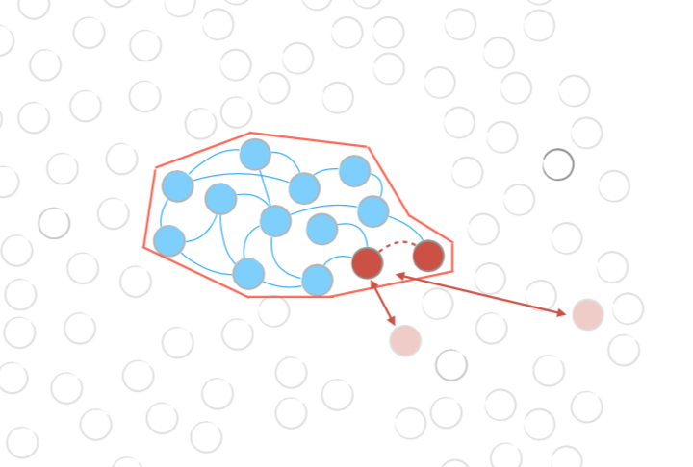
6. Cognitive economy:
Scope of the context factors is defined dynamically.

Slide 8
7.Context is the elusive notion...
Everything happens in the context, but also context arises when things are happening.
PN June 26 2019

Slide 9
8. Context analysis is a necessary logical step in developing quality requirements, their definition, their risks, their costs, and their priority.
TG

Slide 10
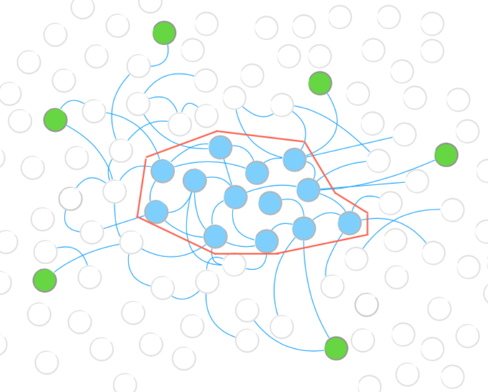
9. Parts inside and outside the system are still interconnected even if we define the boundary between them.

Slide 11
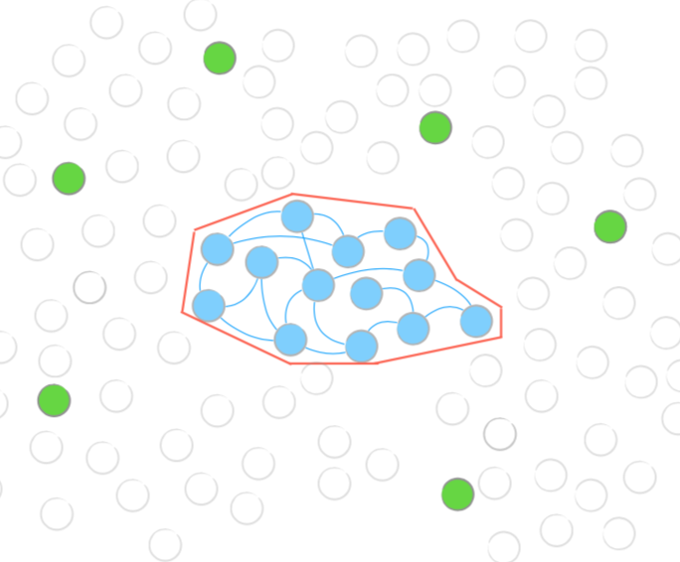
10. However, selection of parts included to the system and excluded from the system is arbitrary and difficult.

Slide 12
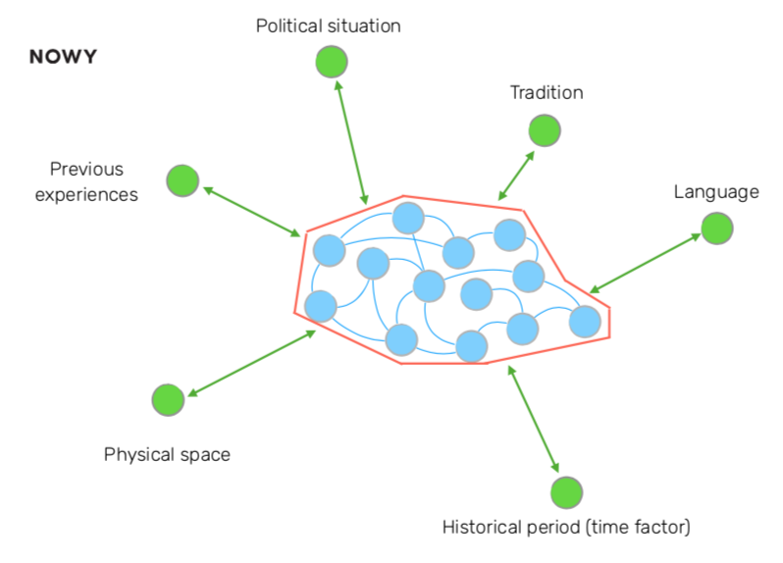
11. Context factors help to better understand the meaning of system’s activity.

Slide 13
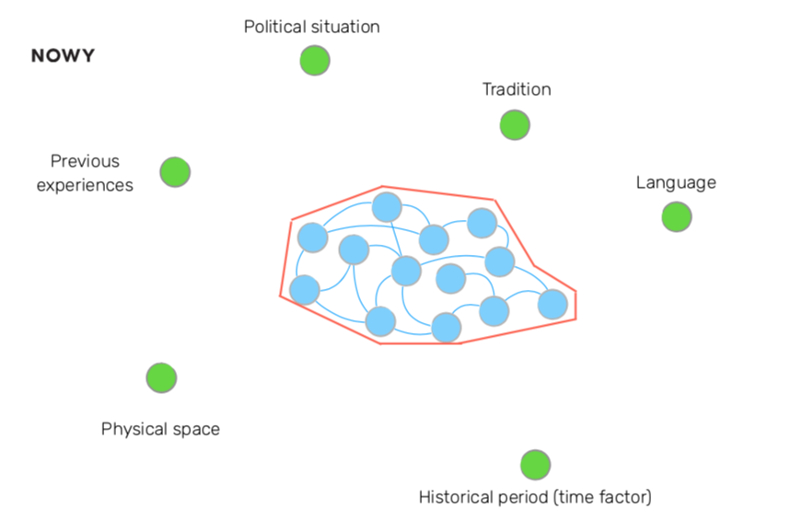
12. Contextualization
linking observations to a set of relevant facts, events, or points of view that make possible research and theory that form part of a larger whole
— Rousseau and Fried, 2001

Slide 14
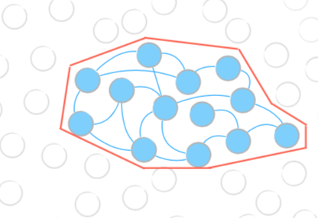
13. We can never see and understand the whole context, but we can look at the system through different lenses...

Slide 15
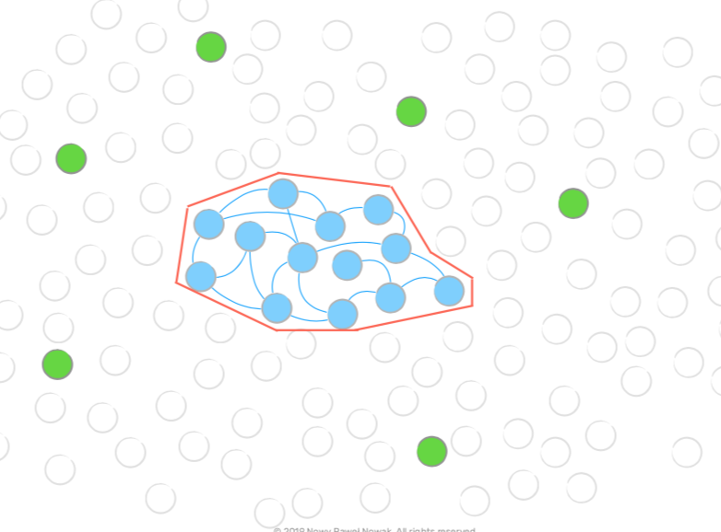
14. Context analysis does not equal analysis of the system’s environment. It is the analysis of the relationship between the state of the system in the given state of its environment in the given time (and space).

Slide 16
15. A system can be described by a set of factors, and their relationships

Slide 17
Sources.
1. Pawel Nowak, NOWY, “Context - between model and reality. My attempts to catch the elusive notion”.
Talk at GilbFest, London, June 26 2019
URL: ?????
2. Additional ideas by Tom Gilb 270619 at GilbFest during BB Talk

