Slide 1
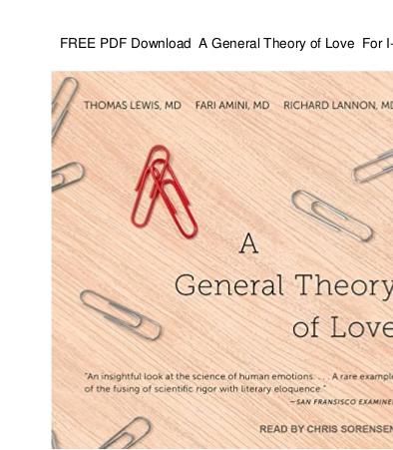
Gilb’s Grand Design Theory:
An Application for the Honour of being the first ‘General Grand Design Theory’
http://concepts.gilb.com/dl956
The Paper
Tom Gilb
for GilbFest June 2019,London
tom@Gilb.com.@ImTomGilb, www.Gilb.com
Thursday 27 June 2019, 0900

Slide 2
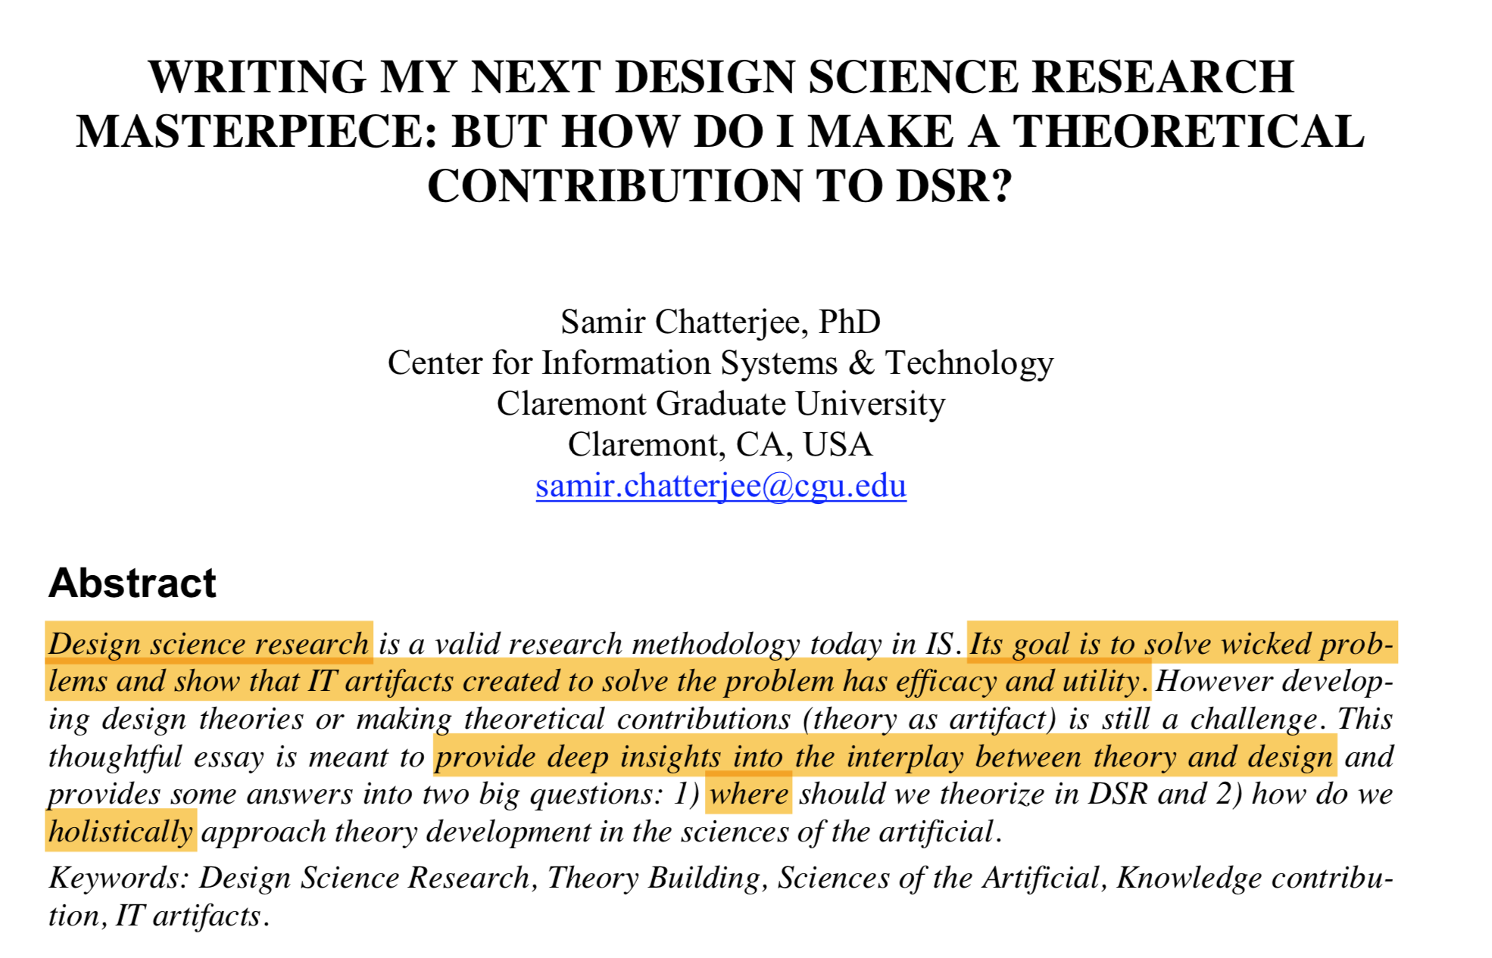
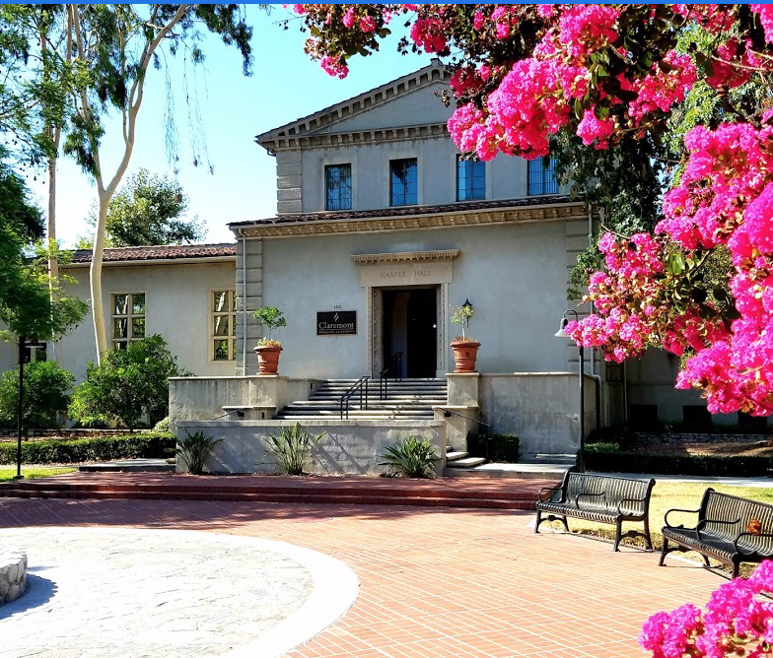
https://aisel.aisnet.org/cgi/viewcontent.cgi?referer=https://www.google.com/&httpsredir=1&article=1027&context=ecis2015_cr
Notes:
https://aisel.aisnet.org/cgi/viewcontent.cgi?referer=https://www.google.com/&httpsredir=1&article=1027&context=ecis2015_cr

Slide 3
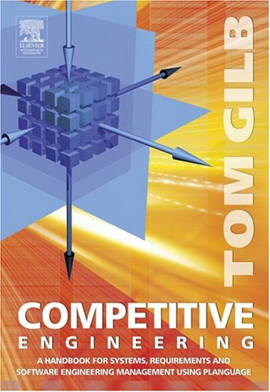
“A General Theory of Design: ‘Planguage’ “
http://concepts.gilb.com/dl956
Get a free e-copy of ‘Competitive Engineering’ book.
https://www.gilb.com/p/competitive-engineering

Slide 4
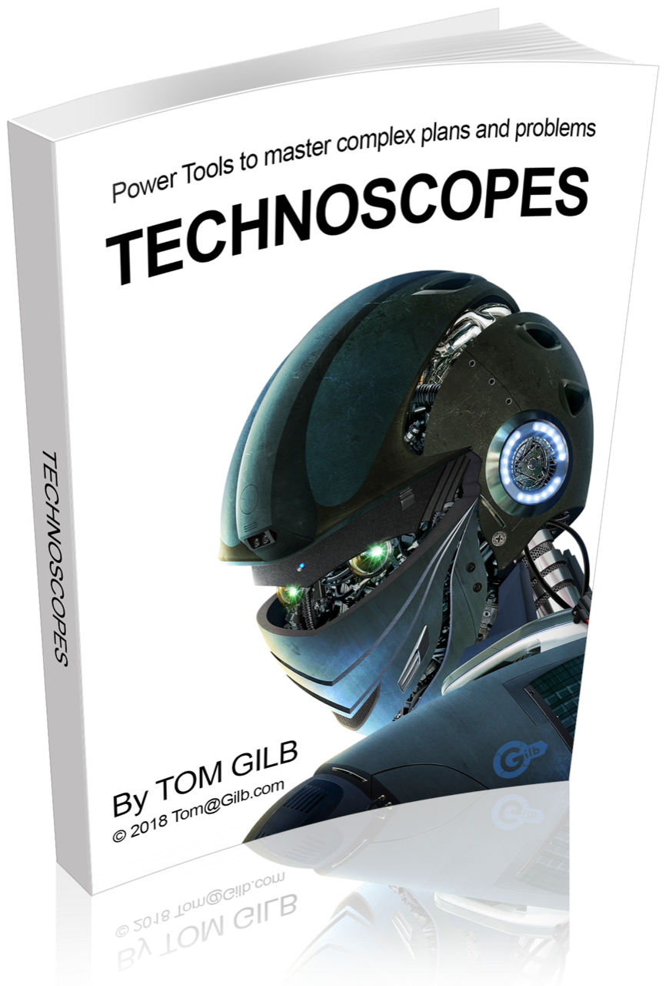
TECHNOSCOPES 100 Powerful Thinking Tools in Planguage. (Summer 2018)
https://www.gilb.com/offers/YYAMFQBH/checkout
FREE GIFT REVIEW COPY FOR GilbFest Participants ALONE.
“Its goal is to solve wicked problems
and show that IT artifacts created to solve the problem
has efficacy and utility.”
[1, Chatterjee)
100 Tools for understanding Wicked and Complex Systems.
Notes:
GILB, T. “TECHNOSCOPES”, https://www.gilb.com/offers/YYAMFQBH/checkout
Digital book, 2018. 100 Tools for understanding Wicked and Complex Systems.
TECHNOSCOPES 100 Powerful Thinking Tools in Planguage. https://www.gilb.com/offers/YYAMFQBH/checkout
FREE GIFT REVIEW COPY FOR YOU ALONE. NO COUPON CODE REQUIRED.

Slide 5
Independence of Implemention as design decomposition principle, permits scientific experiment incremental implementation and analysis of design.

Slide 6
Quantitative analysis of multiple designs and multiple system attributes gives a better understanding of complex interactions and side effects

Slide 7
Overview of
20 ‘Design Technoscopes’

Slide 8
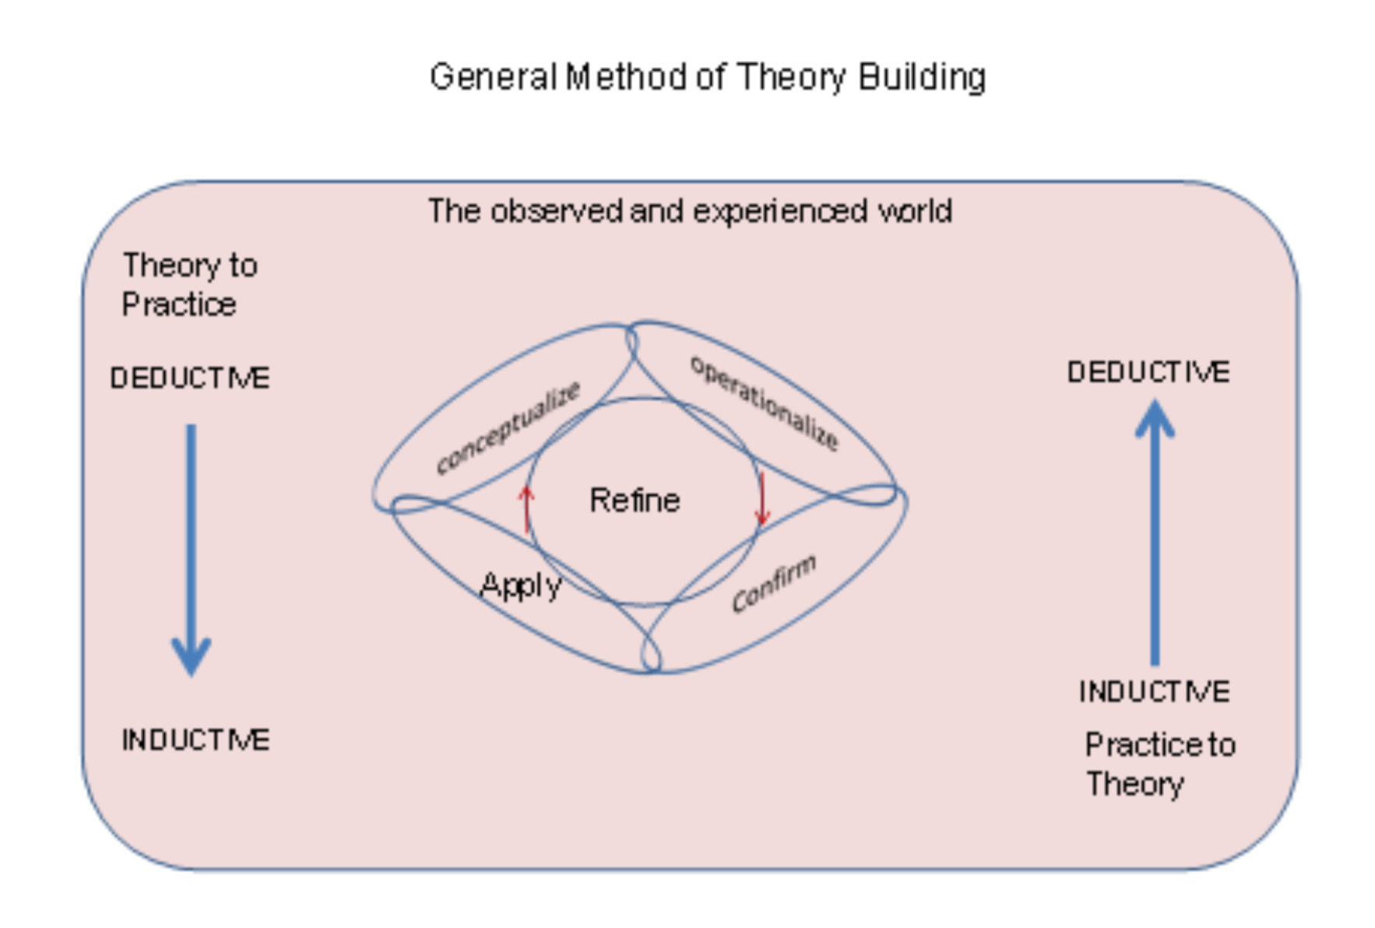
Source: Samir Chatterjees cited paper op cit

Slide 9
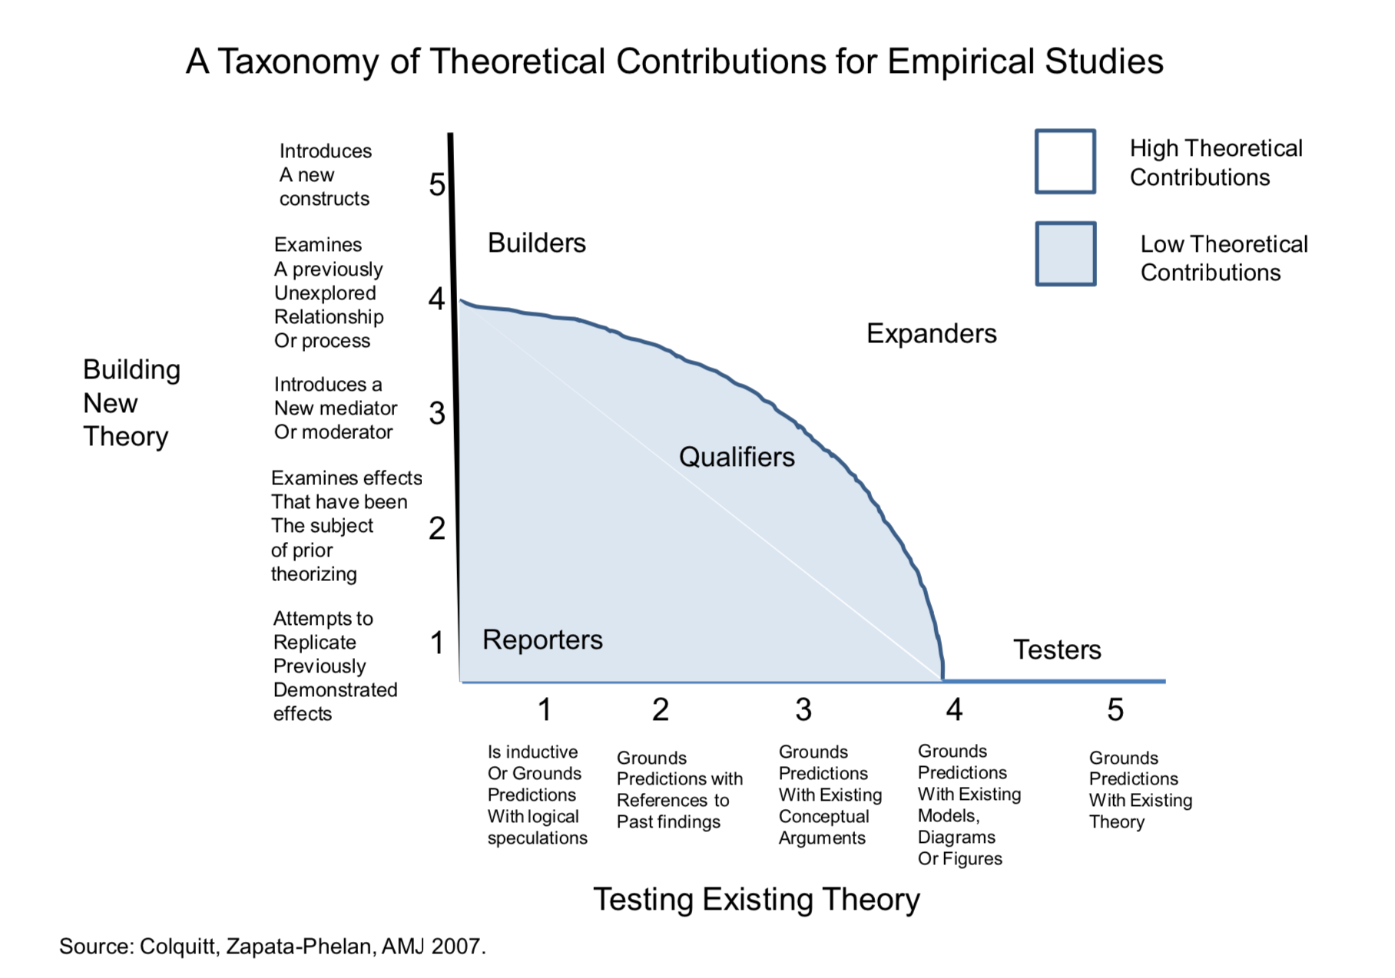

Slide 11
Means of Representation

Slide 12
Fundamental Design Ideas of Planguage.
Proposition 1: Design Attempt A ‘design’ (short form, noun, for ‘design idea’ a Planguage Concept)
attempts to improve the distance
towards a required level of performance*,
from a known performance status level (benchmark), to a required level of performance (target),
within resource constraints,
and meeting other specified constraints.
Performance Concept *434 June 5, 2003
System performance is an attribute set that describes measurably ‘how good’ the system is at delivering effectiveness to its stakeholders.
Benchmark Target O———-<———————->—————-> Stakeholder Value X, Scale
-
The Design Gap-
Figure 1a. The ‘design gap’ is an area of potential improvement, in the 'level of a stakeholder val- ue’, for example reliability on an MTBF Scale. It is the core mission of a ‘design’ to try to fill this gap. A design is as good as the degree to which it promises, and then in reality, fills the gap, and thus reaches (or exceeds) the target level, the ‘success level’.
The above illustration makes use of Planguage keyed icons described below, Part 7 and reference [7]
O———-< [Design A]———->—————-> Stakeholder Value X, Scale -The Design Gap- Remaining
Figure 1b. Design A is useful. It makes interesting, non-trivial progress towards our Target level. But, it is not sufficient. It can be (a.) re-specified to have greater impact, or (b.) replaced with an- other design, with sufficient impact, or (c.) we can add other designs - which increment the impact to the target, at least.

Slide 13
Evolutionary Delivery is driven by meeting Stakeholder Value & Product Quality Requirements
Each Evolutionary Cycle aiming to get closer to the Goals
Cycle 1
Intolerable
C 2
C 3
C 4
Tolerable
C 5
C 6
C 7
Success
Past
30 sec.
Tolerable/Fail
20 sec.
Goal
15 sec.
Speed
Scale: seconds to do task

Slide 14
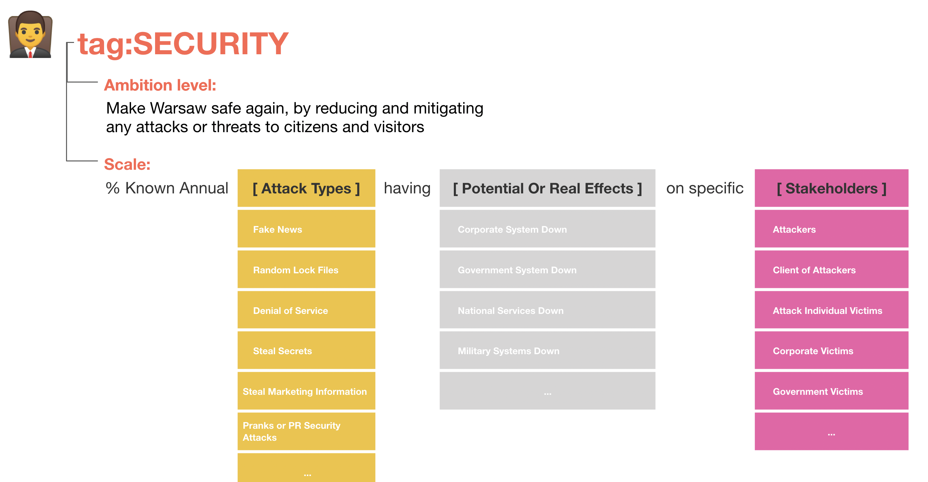
Three-Dimensional Design Space
Here is a visualization of the design space, into which we can attempt to find suitable designs for various requirement dimensions. Let me call this ‘3D-Design Thinking’.
The Value or resource attribute dimension (usually about 15 of these at top level)
The [Scale Parameter] Level dimension. Usually 3 to 7 of there per Scale.
The Scale Parameter Attribute level dimension. About 5 to 20 of these usually.
Source:
anna.maria.karlowska@gmail.com

Slide 15
a Total of 12 Design Propositions,
See the paper
http://concepts.gilb.com/dl956

Slide 16
“Constructs”
(we defined terms)

Slide 17
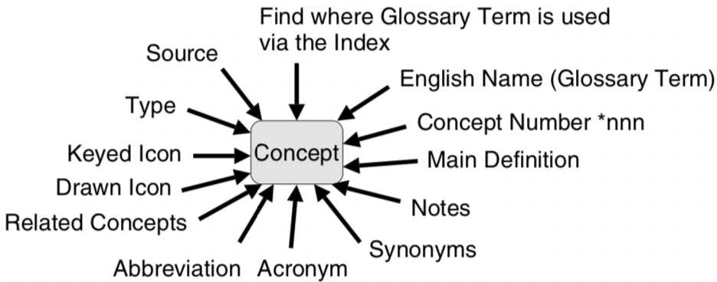
Part B.
The Planguage Concept Glossary [12]
www.gilb.com/DL386
Figure B1. The many pointers to a concept.
The Planguage Concept Glossary is the conceptual foundation for my design theory. It pins down about 800 related concepts, in an integrated way. That is, every concept is completely aware of all the others. In fact defined concepts are used to define other concepts, more accurately.
Notes:
12. Planguage Concept Glossary:
12a: The private master glossary, updated by Tom Gilb, and periodically shared at gilb.com. I will share on email request the latest version to serious researchers. http://www.gilb.com/DL386
12b Paper on the principles of the Concept Glossary.
“A Conceptual Glossary for Systems Engineering:
Define the Concept, don’t quibble about the terms.” Gilb. 2006 http://www.gilb.com/dl565
12c. Planguage Concept Glossary as edited in ‘Competitive Engineering’ [2] book 2005
http://www.gilb.com/DL387
This is about 10% of the detail of the full glossary (12a)
12d. Glossary at gilb.com website http://concepts.gilb.com/A?structure=Glossary&page_ref_id=126
This was and is an open source collective effort by students and friends. If you want to help build it up, please volunteer (kai@Gilb.com has organized this)
It is mainly based in the CE book Glossary [2]
12e. Glossary built into the app www.ValPlan.net
The app glossary is at 2 levels, at least
1. A short definition is displayed when the cursor is moved over a defined Planguage parame-
ter (like ‘Scale’).
2. A full, Competitive Engineering Glossary Concept is displayed on request in a side bar, for
the additional parameters which can be added to a specification window.
3. Many pragmatic concepts are defined or explained, as they come up, for example ‘Roles of
Stakeholders’. But not all of these are official Planguage. Some are defined on the fly as we expand the app by others than Tom Gilb. But at least they are consistently defined in the app.
12f. Glossary Build in www.ValPlan.net
ValPlan app can build user-tailored Glossaries in several ways:
a. User additions can be made to additional parameter libraries, such as defined Scales of Measure.
b. Local Definitions of Terms are automatically recognized and reused in a variety of ways: for eagle a ‘[Scale Parameter]’ not by a user in Scale definition automatically gives rise to a field just below the Scale where we can define it. Then in all possible Scale points (Benchmarks, Targets, Constraints) it is automatically made available for reuse as a list of Scale Parameters (Like [Cities] ) with their defined dimensions (like LA, NY, Oslo) ready for selection in a phase like ‘Wish 60% [City = Oslo.... ]’ .
c. Project Glossary: any term defined in project an be put into a project wide glossary.
d. Corporate Glossary: any project glossary term can be collected in a corporate wide glos-
sary.

Slide 18
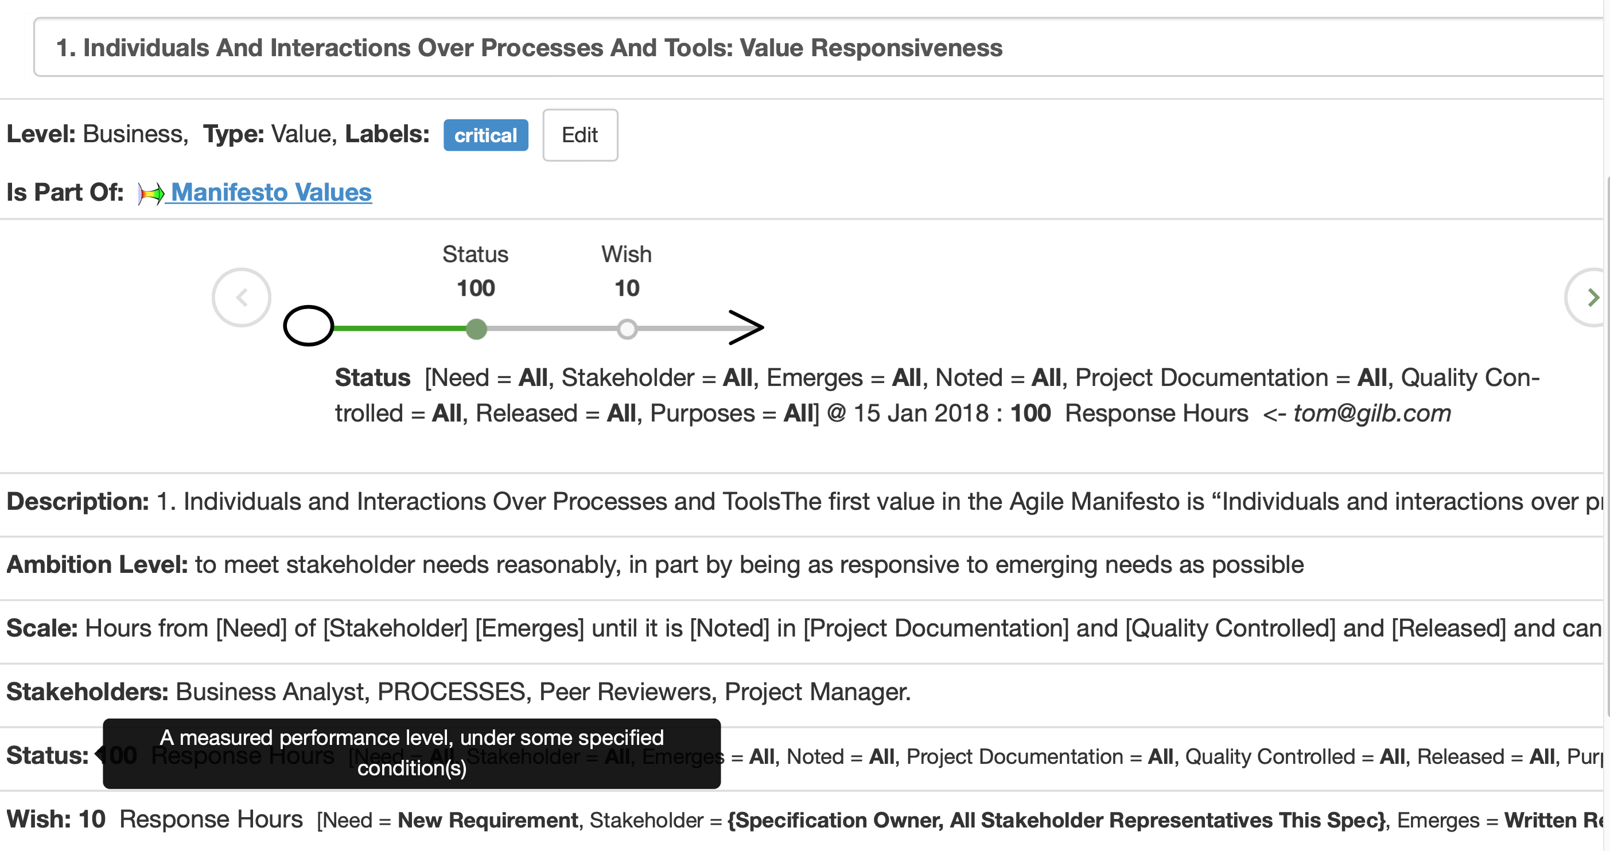
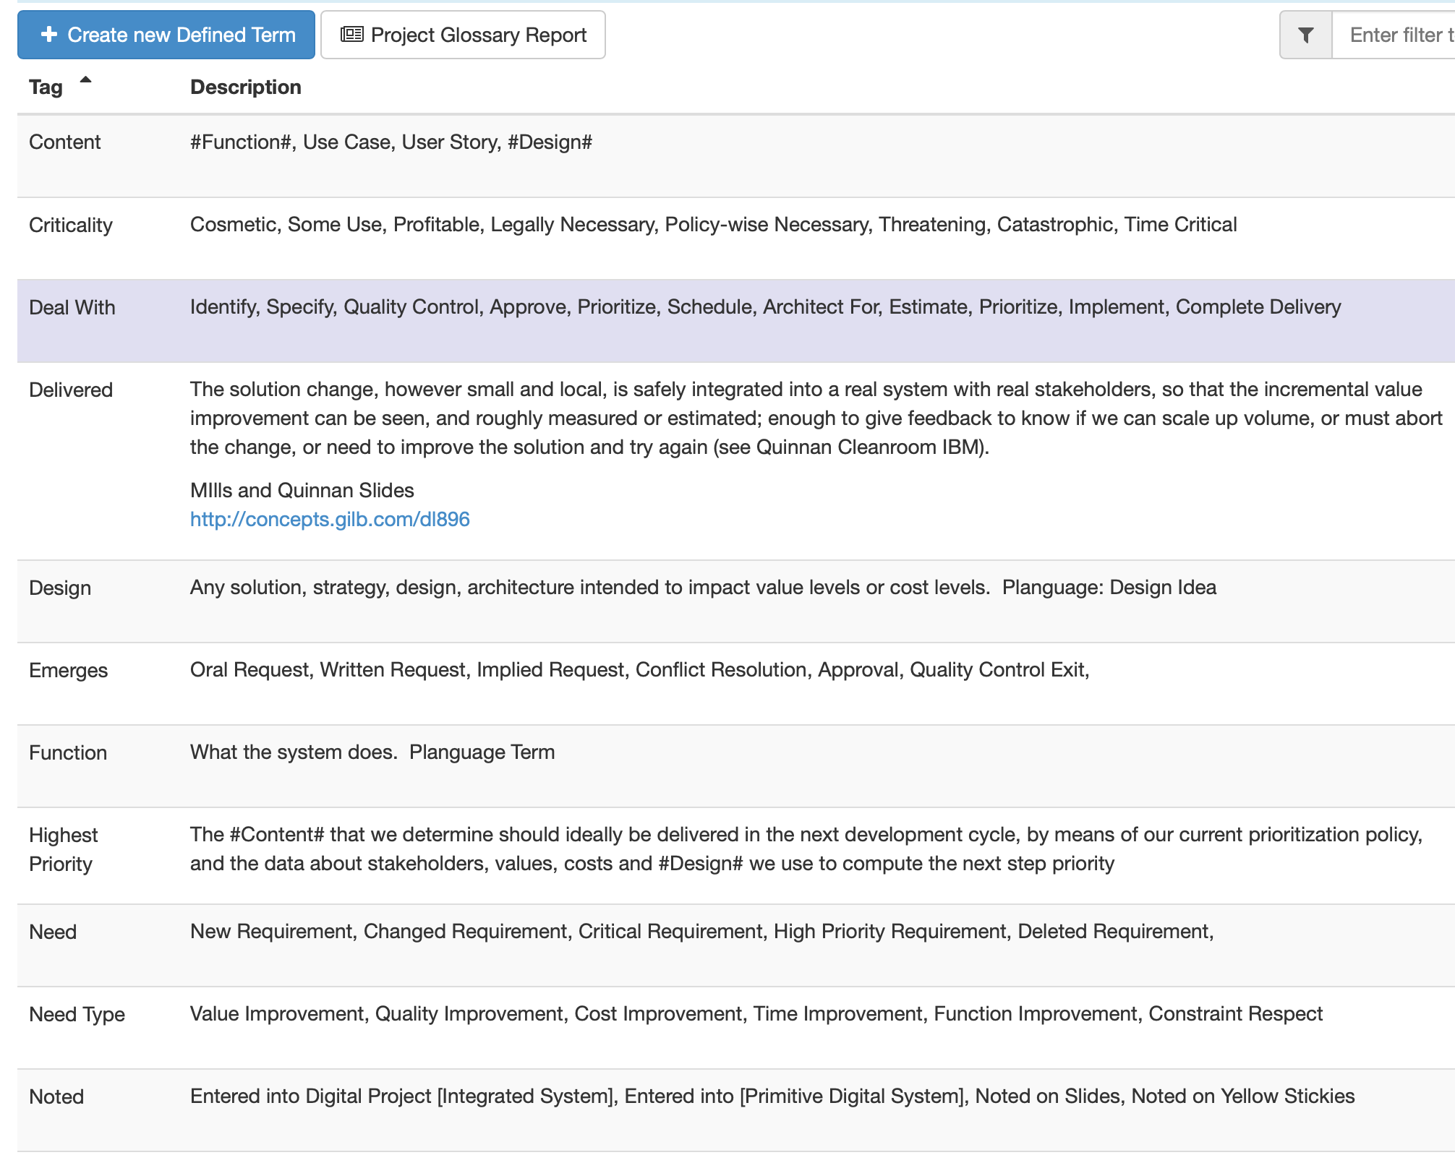
Glossary Build in www.ValPlan.net
ValPlan app can build user-tailored Glossaries in several ways:
ValPlan app can build user-tailored Glossaries in several ways:
User additions can be made to additional parameter libraries, such as defined Scales of Measure.
Local Definitions of Terms are automatically recognized, and reused in a variety of ways:
for example a ‘[Scale Parameter]’ not by a user in Scale definition, automatically gives rise to a field just below the Scale where we can define it.
Then, in all possible Scale points (Benchmarks, Targets, Constraints) it is automatically made available for reuse, as a ‘list of Scale Parameters’ (Like [Cities] ) with their defined dimensions (like LA, NY, Oslo) ready for selection in a phrase like ‘Wish 60% [City = Oslo…. ]’ .
Project Glossary: any term defined in project can be put into a project wide glossary.
Corporate Glossary: any project glossary term can be collected in a corporate wide glossary.

Slide 19
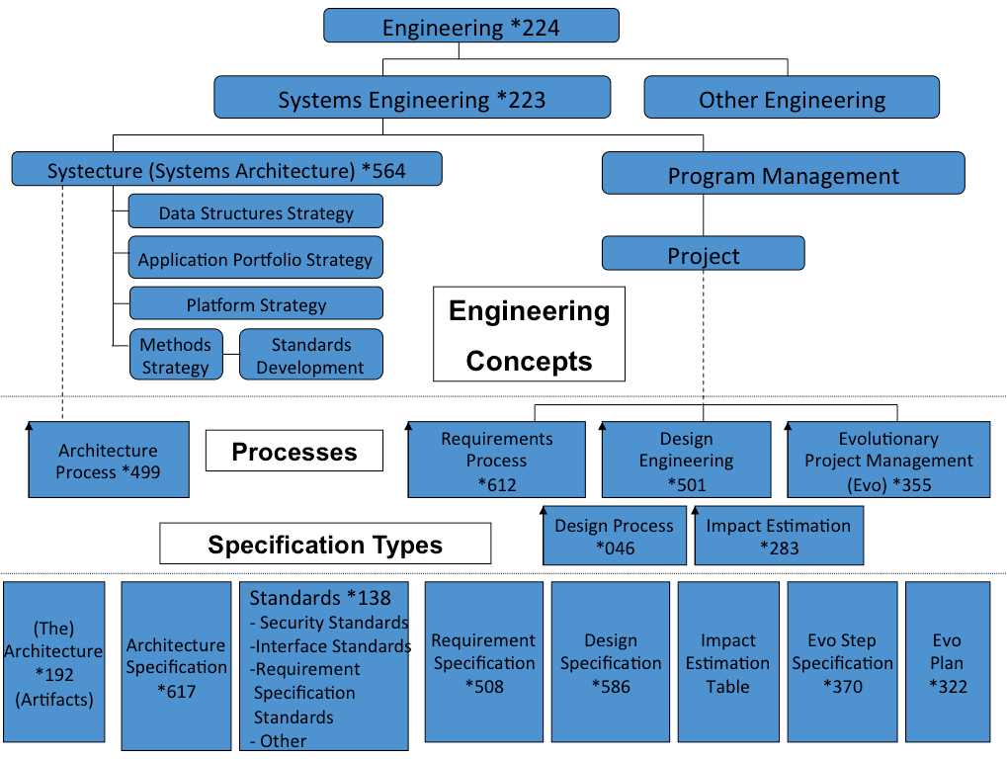
Part C. The Planning Language, ‘Planguage’
‘Planguage:
an 'engineering' language and process
for real software and systems engineering -
not ‘programming'
[http://www.gilb.com/dl831]
Notes:
17. PLanguage (PL)
‘17A. Planguage: an 'engineering' language and process for real software and Systems engineering - not 'programming'
http://www.gilb.com/dl831
Oct 18 2014 for
Book Chapter: originally intended for or “Software Engineering in the Systems Context” Lawson/Jacobson eds., but replaced by another paper. Not published yet

Slide 20
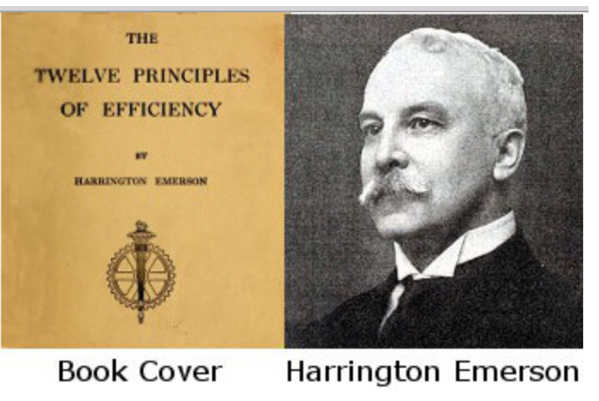
Part D. The Principles
[2, CE, 144 Principles], [18, See Presenter Notes or Paper]
Principles are short statements, which summarize wisdom.
Principles can
give strong guidance towards success
and for avoiding failure.
Good principles will be useful for a broad range of problems. Principles are sometimes called Engineering Heuristics [21, Koen ]
My own criteria for a principle is that
in addition to being ‘powerful’,
they are eternally true.
They have a very long ‘half life’.
They are independent of current technology.
I ask myself, would this principle have been valid in Egyptian Pyramid times, and Roman Aqueduct times ? Has this principle worked for me since 1958- to date? Do I see any reason why the principle would become invalid in 1,000 years time? If OK, then I would use them.
When I generate a principle, they are just a way of summarizing my own insights, experience and common sense. Of summarizing what I need to teach others.
But the rate at which I can do this ‘generation of principles’, usually surprises me. Who cares, as long as they work, and survive.
In this case my principles help to define, and support, my design theory.
“As to methods, there may be a million
and then some,
but principles are few.
The man who grasps principles
can successfully select his own methods”.
-Harrington Emerson
Notes:
[2],
[18]
18. Principles
18A http://www.gilb.com/dl352
INTRODUCTION: I made this collection primarily by cutting quotations from ‘Competitive Engineering’. Not least I hope that those who currently enjoy quoting principles on Twitter, will have better access to these ideas. J I also hope to put a focus on the concept of useful principles. In my 1988 book, Principles of Software Engineering Management (I suspect one of the few books with ‘principles’ in the title, that actually has some principles in it?), http://www.amazon.com/Principles-Software-Engineering-Management-Gilb/dp/0201192462 ), someone once counted that I had about 120-140 specific principles. I hope to, one day (soon? Encourage me), publish that collection on the web. I can tell the reader that when writing CE, I did not ‘peek’ at the PoSEM principles, hoping to enhance my own creativity. Have fun! TomINTRODUCTION: I made this collection primarily by cutting quotations from ‘Competitive Engineering’. Not least I hope that those who currently enjoy quoting principles on Twitter, will have better access to these ideas. J I also hope to put a focus on the concept of useful principles. In my 1988 book
n, Principles of Software Engineering Management (I suspect one of the few books with ‘principles’ in the title, that actually has some principles in it?), someone once counted that I had about 120-140 specific principles. I hope to, one day (soon? Encourage me), publish that collection on the web. I can tell the reader that when writing CE, I did not ‘peek’ at the PoSEM principles, hoping to enhance my own creativity. Have fun! Tom
http://www.gilb.com/DL352
18B. http://www.amazon.com/Principles-Software-Engineering-Management-Gilb/dp/0201192462
18C http://www.gilb.com/DL352
CE Principles Gilb and Others 8MB.
Extended Collection, Undergraduate basics Principles, Laws of Unreliability, Bill of Rights, Demarco and Gilb’s Law of Measurability, Risk Principles, Clinical Risks Slides, GILB’S INTERPRETATION OF ERICSSONS CORPORATE QUALITY
POLICY, Decomposition Principles (from CE 10), 12 Tough Questions,
18D: The Previously cited [5] Value planning book is primarily based on a set of 100 Principles of Planning. About 7 pages of text for each principle.
18E. The book ‘100 Practical Planning Principles’ is based on exactly the same set of principles as the value Planning book. https://www.gilb.com/store/4vRbzX6X, but is less than ⅕ the size.

Slide 21
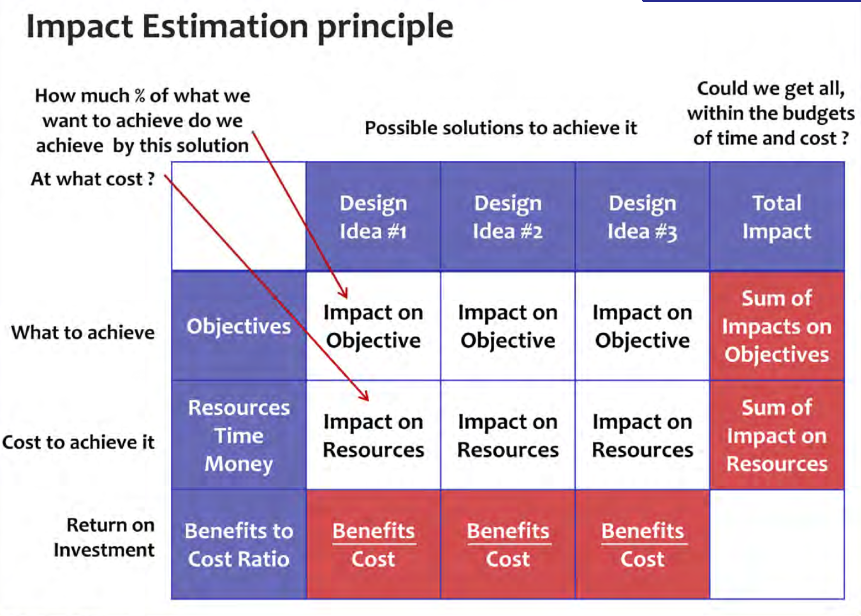
Part E. Quantification and Measurement
1.The entire Planguage method is pervasively based on quantification, estimation and measurement of all variable system factors: i.e. Values, Resources.
2. In particular there is a well-developed tool ‘IET’ for understanding the causal relationship between any level of design, and any subsequent level of requirements. The Impact Estimation Table (IET) is the basic method for both estimation, and followup measurement.
3. The IET contains a number of devices to help us document and understand the qualities of estimates and measures (eg ± uncertainty, evidence, sources, credibility level, Meter)
4. The structure of defined Scales of measure, with any useful number of Scale Parameters (eg [Task], which each can have any useful number of attributes (eg Task = Start, Work On, Complete, Retract, Correct) permits extremely-detailed modelling, of complex systems, and consequent very-detailed levels of resolution ,of measurement of any value. or any resource.

Slide 22
Part F. Case studies: Experiential Validation.
In addition to these above measurement (Past E) devices, built into Planguage,
we have several decades of published research, in Industry Publications, MSc, and PhD [22] level dissertations [19 HP, 20 Intel], regarding the observed industrial attributes of Planguage and related processes (Evo, SQC, CE [2]). (see Presenter Notes, or my Paper)
One example of method measurement is Terzakis [4, 2013], Intel studying requirements written in Planguage, and quality controlled using Spec QC,
with a reported 233% Engineering productivity increase.
Over 21,000 Intel engineers have been trained in our methods at Intel over 16+ Years.
Notes:
19. HP Evo experiences
A. The Evolutionary Development Model for Software
by Elaine L. May and Barbara A. Zimmer
August 1996 Hewlett-Packard Journal
WWW.Gilb.com/dl67
B. Evolutionary Fusion: A Customer- Oriented Incremental Life Cycle for Fusion
by Todd A
www.gilb.com/dl35
August 1996 Hewlett-Packard Journal
C. RAPID AND FLEXIBLE PRODUCT DEVELOPMENT: AN ANALYSIS OF SOFTWARE PROJECTS AT HEWLETT PACKARD AND AGILENT (2001)
by
Sharma Upadhyayula
www.gilb.com/dl65
M.S., Computer Engineering University of South Carolina, 1991
And
Massachusetts Institute of Technology
January 2001
D. Best Practices for Evolutionary Software Development
by
Darren Bronson
http://www.gilb.com/dl825
Submitted for: Master of Business Administration and Master of Science in Electrical Engineering and Computer Science
in conjunction with the Leaders for Manufacturing Program
At the Massachusetts Institute of Technology
June 1999
57 pages., 1999.
URI: http//hdl.handle.net/1721.1/80490
E. Note: these references focus on Evo part of Planguage. There is also a body of Literature for the HP Adoption of our Inspection method (alias Spec QC, in Planguage).
Grady, R. B. and Van Slack, T., “Key Lessons in Achieving Widespread Inspection Use”, IEEE Software, V. 11, N. 4, Month, 1994, pp. 46-57
http://dl.acm.org/citation.cfm?id=140207 (paid download)
20 . Intel Planguage Experiences
A. 2011 Intel Report on SQC (Gilb methods used here <- E Simmons)
‘The Impact of a Requirements Specification on Software Defects and Other Quality Indicators’ by john.terzakis (CONFERENCE TALK SLIDES)
http://selab.fbk.eu/re11_download/industry/Terzakis.pdf
B. Intel Experience with Planguage and SQC 2011
Erik Simmons, Intel, 2011, 21st -Century Requirements Engineering: A Pragmatic Guide to Best Practices, Erik Simmons PNSQC 2011 (Pacific Northwest Software Quality Conference)
http://www.uploads.pnsqc.org/2011/slides/Simmons_21st_Century_Requirements_slides.pdf
C. John Terzakis. 2013 Conference Paper
"The impact of requirements on software quality across three product generations,"
2013 21st IEEE International Requirements Engineering Conference (RE), Rio de Janeiro, 2013, pp. 284-289.
https://www.thinkmind.org/download.php?articleid=iccgi_2013_3_10_10012

Slide 23
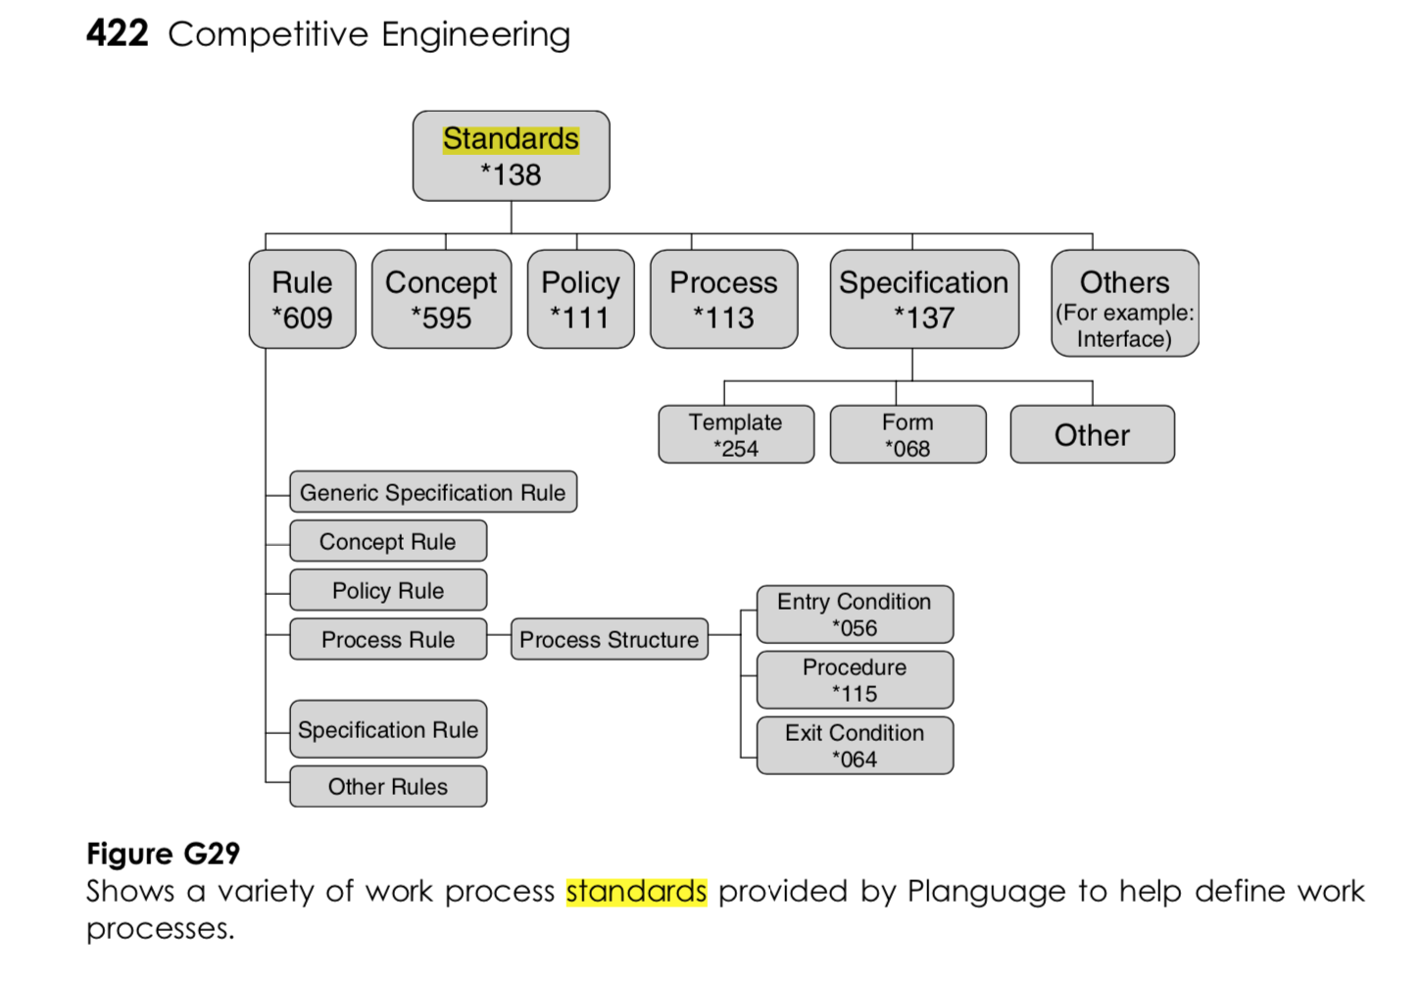
Part G. ‘Means of Representation’
Planguage Designed for Computer Intelligibility
Planguage has always been developed with computer intelligibility in mind, and many tools to support it have been made [8].
Concept Glossary
The key to this is the well-developed Planguage Concept Glossary [2] where not only are design and planning concepts well-defined, and stable; but concepts are ‘well aware’ of all of the other concepts, both in the Planguage Concept Glossary, and in any project-related, or organizational- related extensions of the concepts. Absolutely all concepts, and user definitions (design objects for example) have unique hierarchical ‘Tags’. We mandate (Planguage Rules) reuse of concepts from a ‘master version’.
Planguage Standards
Planguage has a large number of ‘Standards’ defining it [2], among them ‘Rules’ (for best practice specification) and Design Processes. In addition there are well-‘defined Entry and Exit Conditions to all processes. These enable both human understanding consistently, and computer application automation.
Plicons: Symbolic Notation
Many Planguage Concepts can be accessed from a defined set of symbolic notation [www.gilb.com/DL37].
These are designed in 2 formats: Drawn Icons, and Keyed Icons. Which are reasonably consistent with each other.
This idea was originally inspired by Blisssymbolics/Semantography (a universal language) but Plicons are a restricted set, to the domain of planning and designing systems.
These Plicons are used in teaching concepts (very useful for teaching theory of design!), in books [2] and in the tools [8]. There are numerous examples of keyed plicons used in this paper above.
I have attempted to define Planguage concepts (ideally the whole Planguage) by using the Plicons as a language. But this needs more work, and has more ‘scientific and theory’ interest, than my daily practical ‘design project’ use. So it awaits ‘academic development’. But it is potentially a form of systems mathematical notation. A great subject for a PhD in my opinion.
Digital Planguage Standards
The Planguage tools, particularly ValPlan.net, essentially build a ‘digital project database’ containing a large number of design and requirements specifications, and ‘background information (like who are the stakeholders, and spec owners for a design).
Notes:
7. T. Gilb, ‘Plicons: A Graphic Planning Language for Systems Engineering’
(Plicons Paper)
http://www.gilb.com/DL37
This symbolic language is ‘human language’ independent, like musical notes or electrical symbols. I have actually attempted to define Planguage using these symbols, but this area needs further rigorous work for elegant development.
8. www.Valplan.net : An advanced planning tool (app) based on Planguage.
This is a publicly available (many tools were made for in house use only by our clients, example 2 levels of tools by Confirmit AS, 2003-2005), rich, tool based on Planguage as defined in Competitive Engineering [2] built by Richard Smith (UK).
Planguage was designed by Gilbs, with automation in mind. There have been a series of automated tools built for decades, starting about 1979 with the ‘Aspect Engine’ (reported in Gilb, Principles of Software Engineering Management, 1988), constructed by Prof. Lech Krzanik (Finland), for his PhD Thesis (Krakow, Poland). Kai Gilb built a predecessor tool from Spreadsheets, used in consulting and training practice, for decades (1993-2016), until superseded by ‘Needsandmeanscoms’ (now rebranded ValPlan.net) and marked by Kai Gilb. The tool has undergone about 4 years of field Beta-testing (about 2014-2019) before being released for commercial application (May 20 2019).

Slide 24
Gibson, Bechtel, ‘graphMetrix’ [10]
Gibson, Bechtel, ‘graphMetrix’ [10]
In 2015, Fredrik Gibson, a formally trained architect, working at Bechtel in San Francisco, contacted me.
He said he had read my Competitive Engineering [2] book 3 times, and found that Planguage was a good framework for his building advanced AI tools for the construction industry.
In fact he had already built tools using Planguage ideas, at Bechtel. And he demonstrated them for me over the internet. But these were for Bechtel internal use.
‘You could have blown me over with a feather’, as they say. This came ‘out of the blue’, quite unexpected. But it did demonstrate the universal design application of Planguage ideas.
Today, (June 2019) Gibson has built his own startup, graphMetrix, and is far advanced with this Construction Industry tool building.
Kai Gilb is very active in furthering the relationship. Go to the site [10] and be amazed.
https://graphmetrix.com/web/

Slide 25
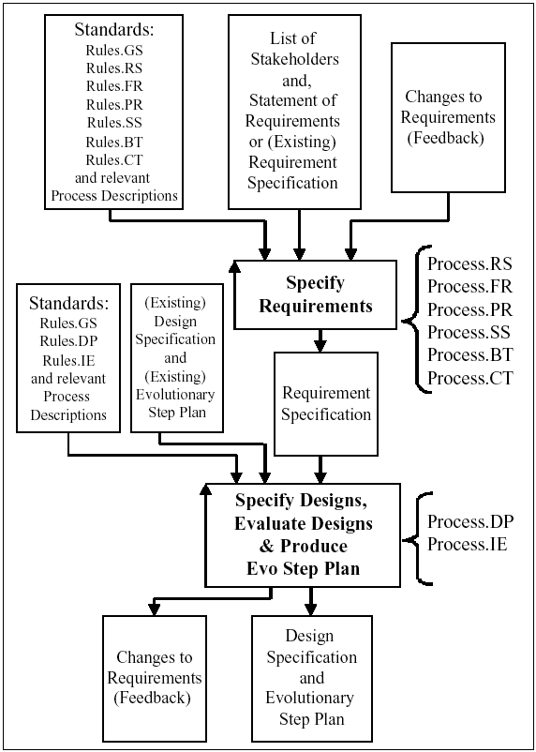
Part I. Statements of Relationship*
Part I. Statements of Relationship*
There are a large quantity of relationships defined in Planguage.
Some of these are generic and static: they belong to the Planguage Concept Glossary definitions. For example ‘Stakeholders have Values’.
Others are specific relationships defined in a projects: for example: The Stakeholder for Value X, are S1, S2, and S3.

Slide 26
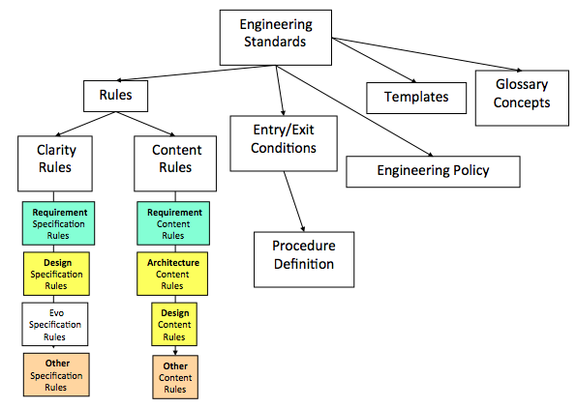
Standards Relationships

Slide 27
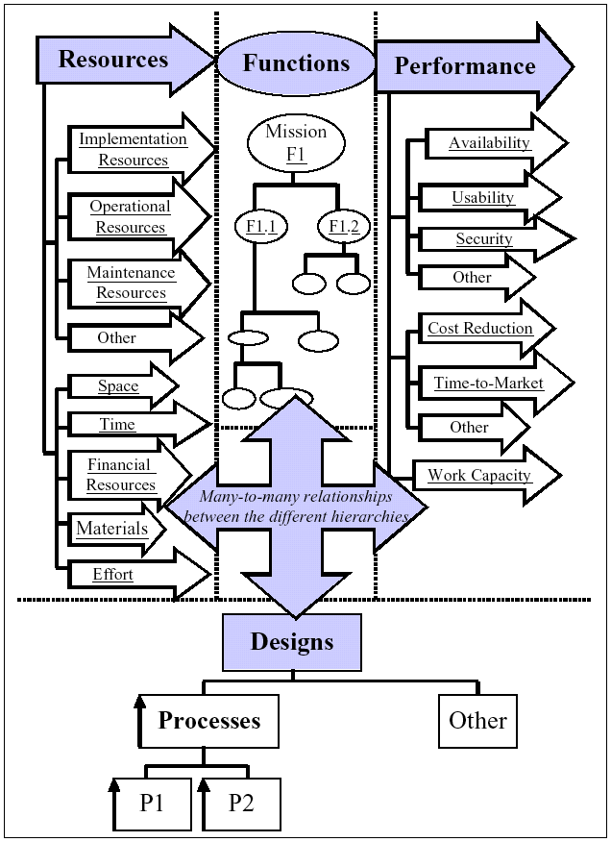
Specification Type Relationships

Slide 28
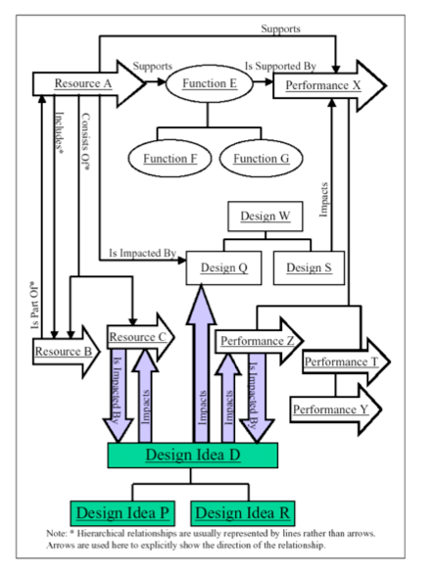
Impact and sub-set relationships

Slide 29
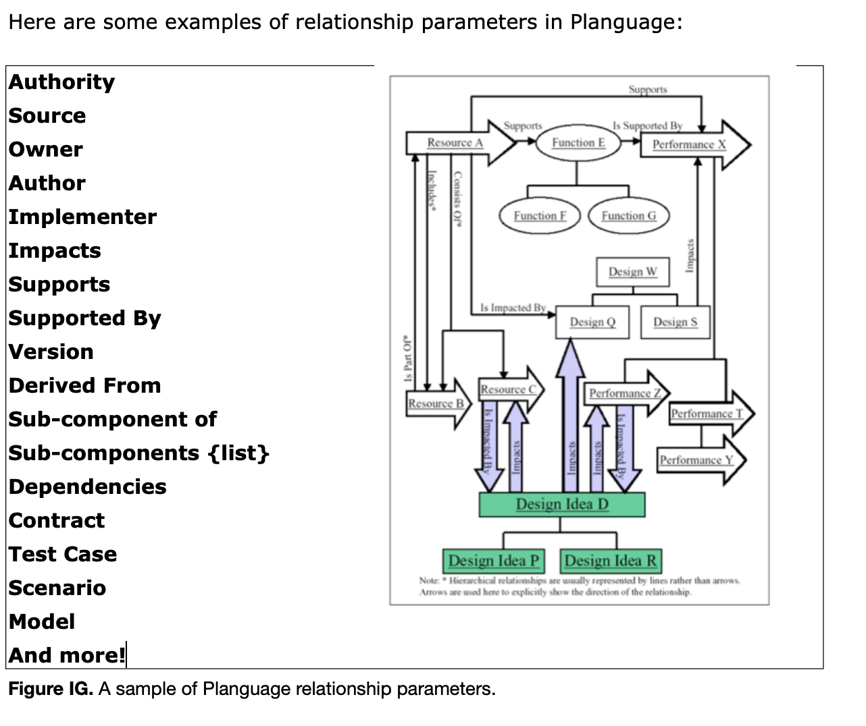
Relationship Parameters

Slide 30
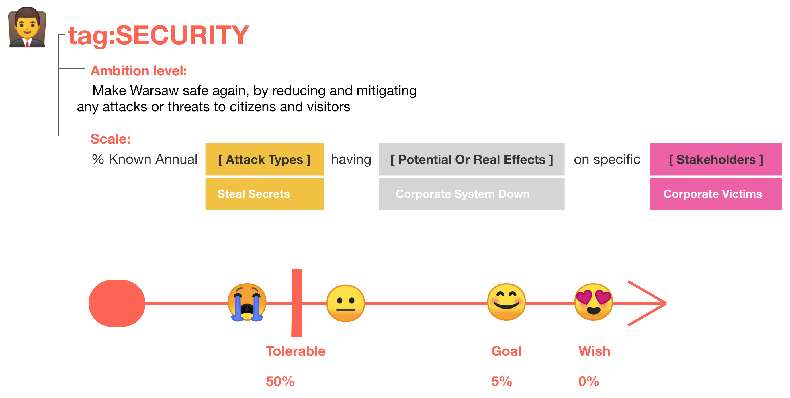
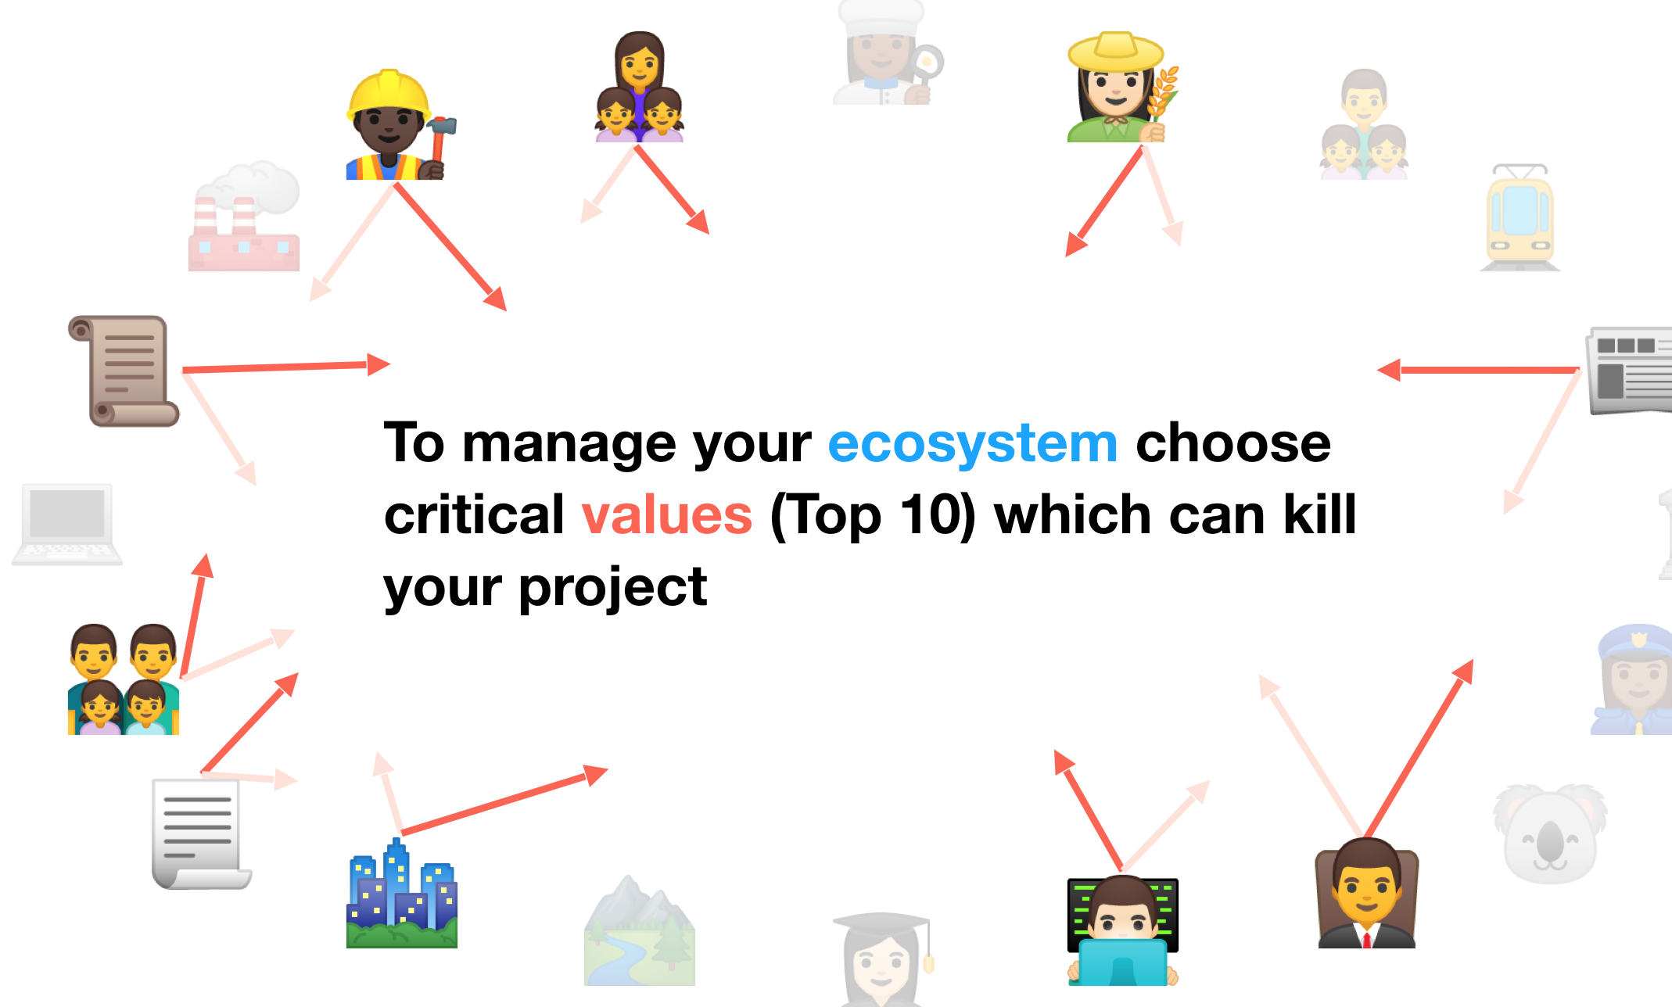
Part J. Scope*
The Scope of Planguage is
Any planning of any future.
For any ‘system’.
Real world measured feedback versus plans, in order to control processes or projects towards objectives, within constraint.
I am unsure as to how to handle this Scope subject. Maybe it is covered in all the above descriptions.
But, There are very many scope-defining tools in Planguage, as detailed above, and in the references below, like Value Planning [5 ]
However I would like to refer to one detail, among many, already described several times: the [Scale Parameter] definition. It is a powerful tool for defining the exact multidimensional scope of a requirement, and thus also a design’s impact on the defined scope of that requirement.
Linkedin.com/in/anna-karlowska-70a3912
Notes:
linkedin.com/in/anna-karlowska-70a3912
5. Tom Gilb,
“Value Planning. Practical Tools for Clearer Management Communication”
Digital Only Book. 2016-2019, 893 pages, €10
https://www.gilb.com/store/2W2zCX6z
This book is aimed at management planning. It is based on the Planguage standards in ‘Competitive Engineering’ (2005). It contains detailed practical case studies and examples, as well as over 100 basic planning principles. It also contains more than 200 references to freely downloadable case studies, papers and slides.

