Slide 1
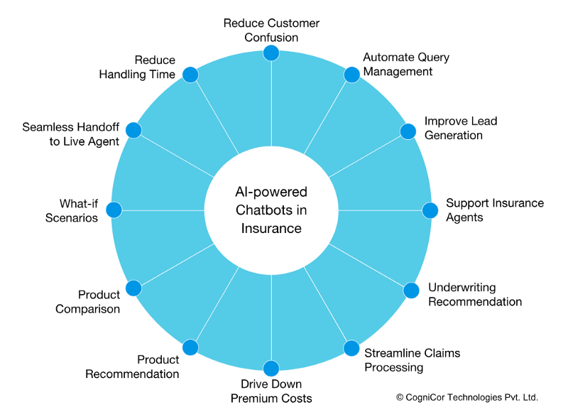
‘XAI’
“eXplaining A.I.”
A Serious ‘Multi-dimensional Metrics Attack’ on
Poor AI ‘Academic and Standards’ Thinking & Planning
I like this figure
because it shows the
MEASURABLE
POTENTIAL
AI Values IN A
PARTICULAR DOMAIN
(Insurance)
Tom Gilb
tom@Gilb.com
For Gilbfest London 25th June 2019, at 15:50- 16:35
Notes:
https://www.cognicor.com/blog/12-ways-advanced-ai-powered-chatbots-are-transforming-the-insurance-sector
https://en.wikipedia.org/wiki/Explainable_artificial_intelligence

Slide 2
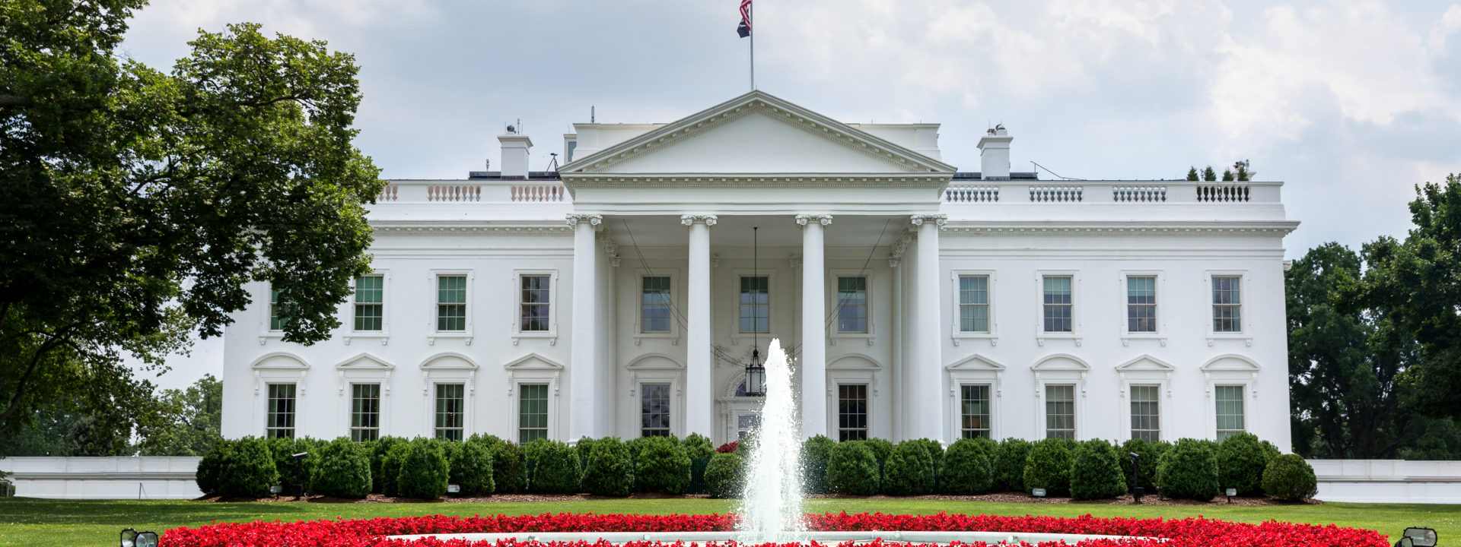
‘Principles’ = ‘Qualities’ !
With the usual lack of quantified definition

Slide 3
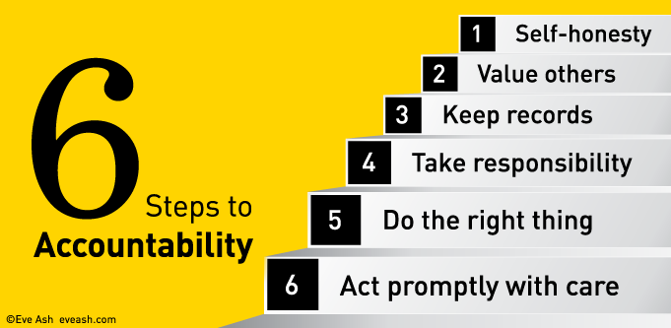
AI Accountability
https://www.smartcompany.com.au/people-human-resources/the-a-list-six-steps-to-accountability-in-your-business/
Notes:
https://www.smartcompany.com.au/people-human-resources/the-a-list-six-steps-to-accountability-in-your-business/

Slide 4
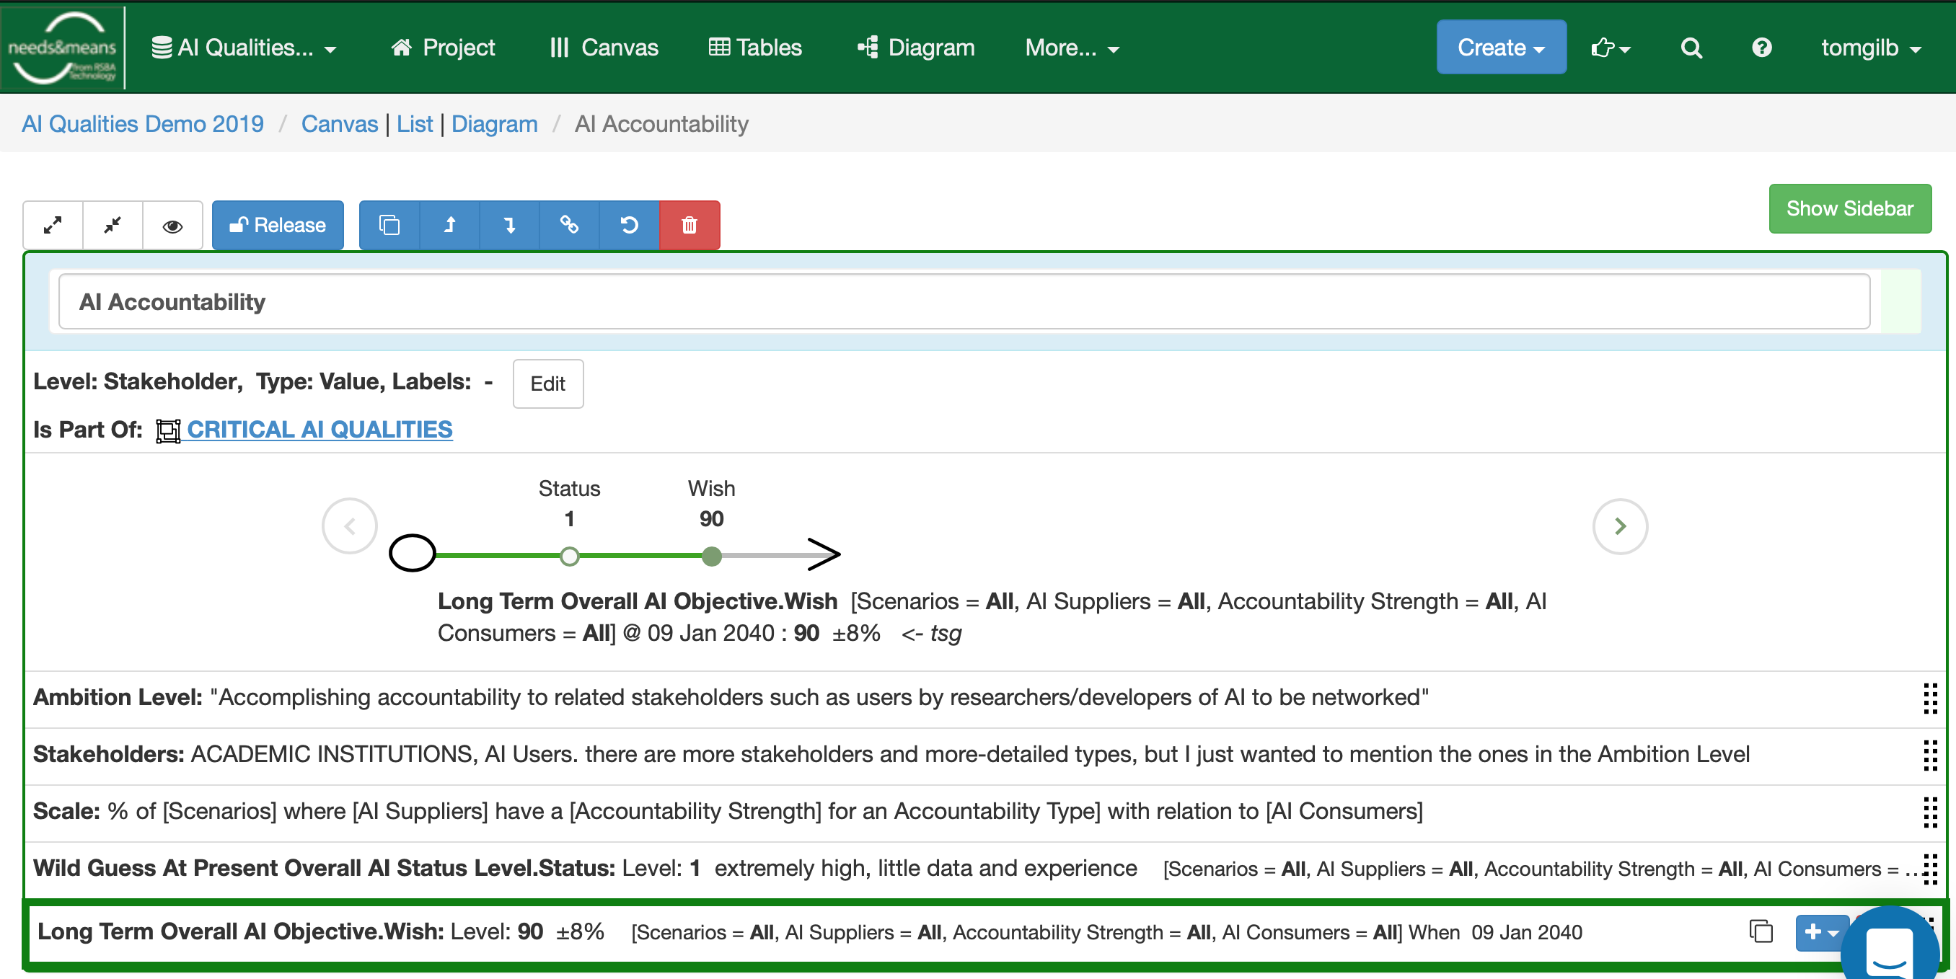
AI Accountability Defined
Fuzziness -> Quantified. Structured, Enriched
Name Tag
Simple Graphic of the Required Improvement
The well intended statement
Defining qualities quantitatively

Slide 5
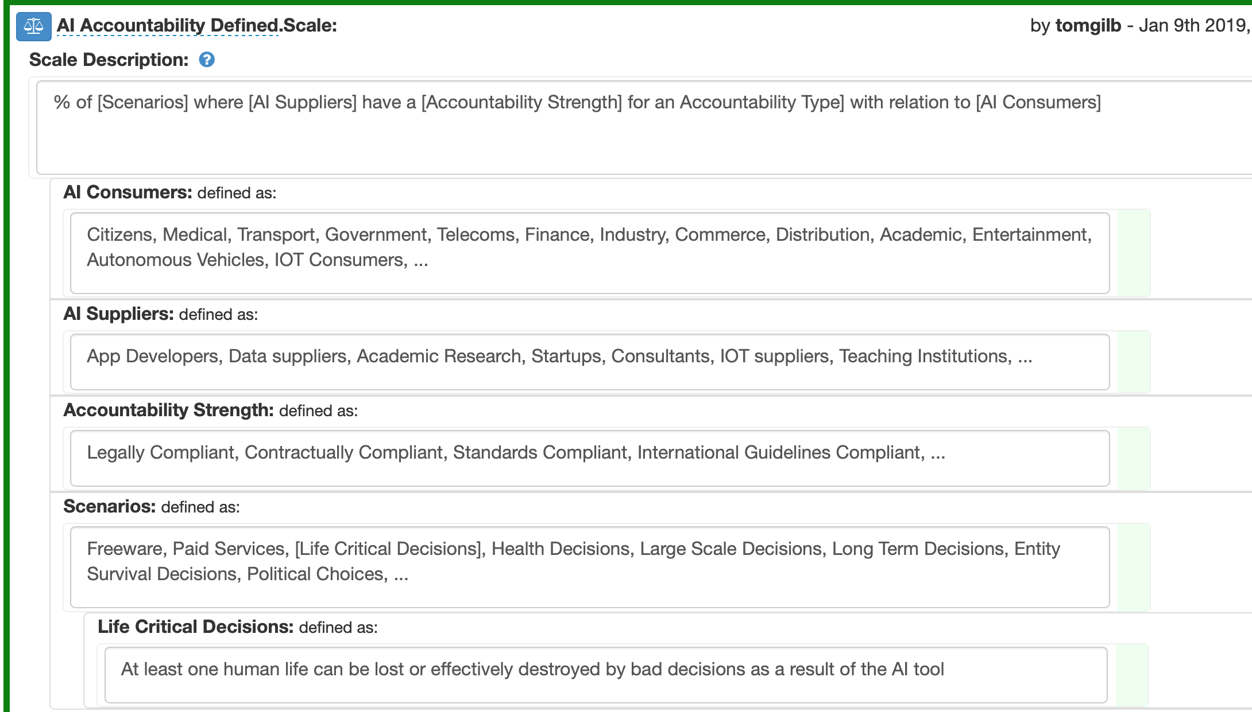
AI Accountability Scale
Detailed Scale Parameters
Why is this Useful?
Slide error note: lack of [Accountability Type]

Slide 6
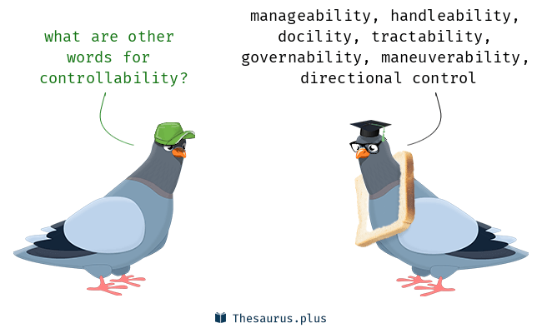
AI Controllability
Notes:
http://www.wordlistresearch.com/2018/11/277-words-related-to-controllability-controllability-synonyms-controllability-antonyms/

Slide 7
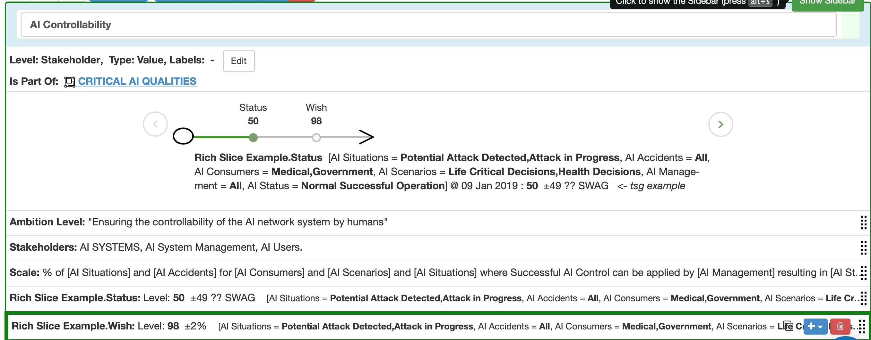
AI Controllability: Quantified
The current level of ‘Controllability’
Quantified
The desired and valued level of ‘Controllability’

Slide 8
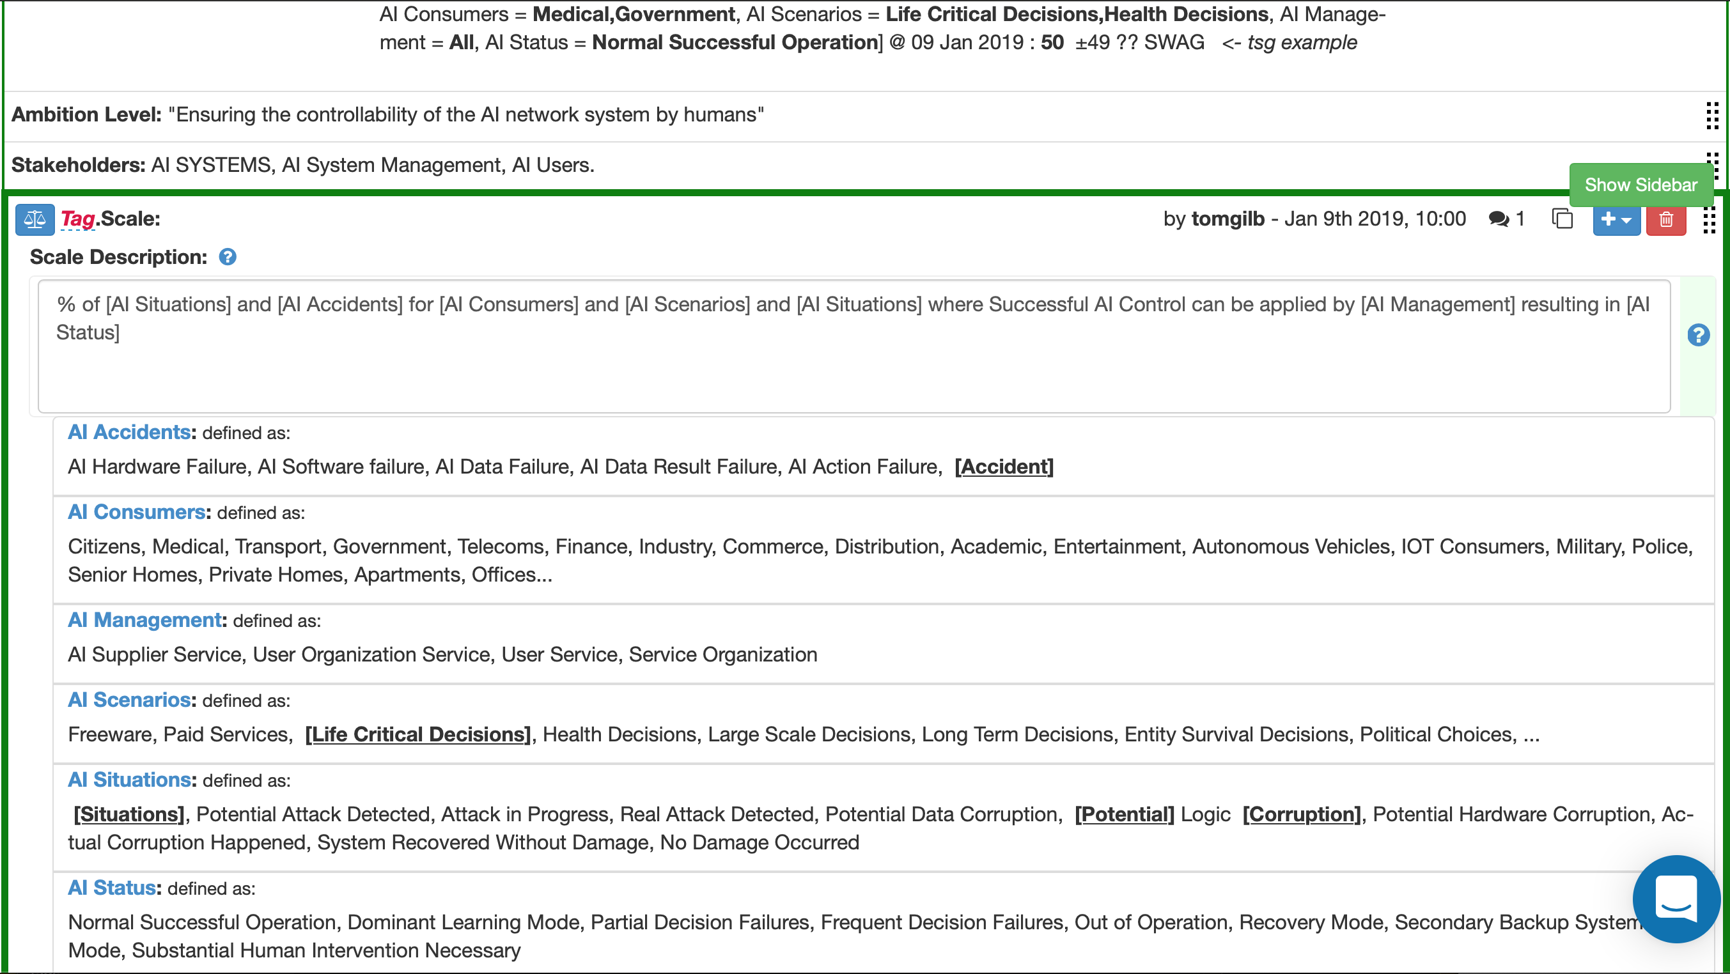
AI Controllability: Scale of Measure Detail
[Scale Parameters]
= Critical Dimensions of
Controllability
Critically or usefully different
conditions or aspects
of AI Scenarios

Slide 9
AI Ethicality
Notes:
https://medium.com/salesforce-ux/how-to-build-ethics-into-ai-part-i-bf35494cce9

Slide 10
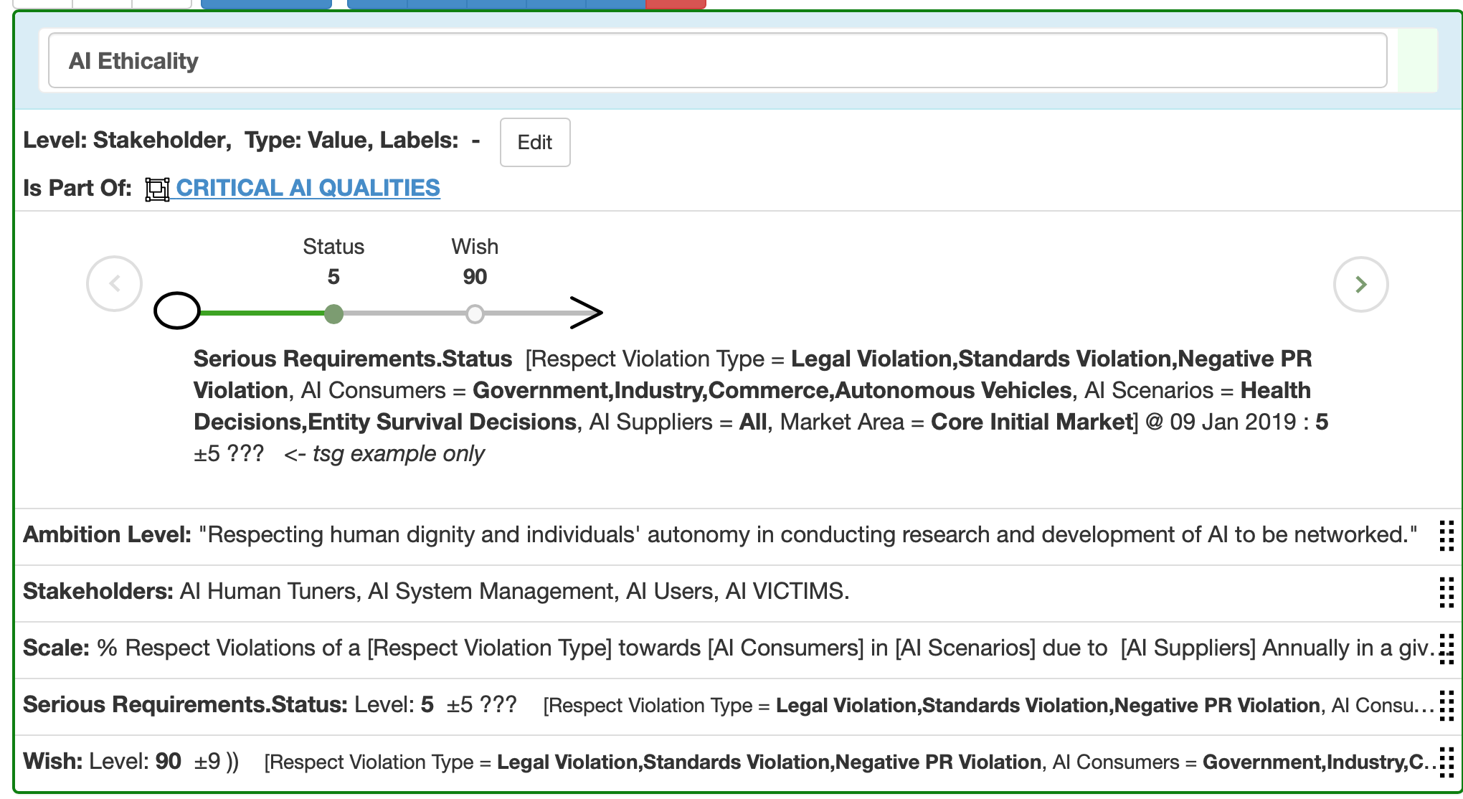
AI Ethicality: Quantfied

Slide 11
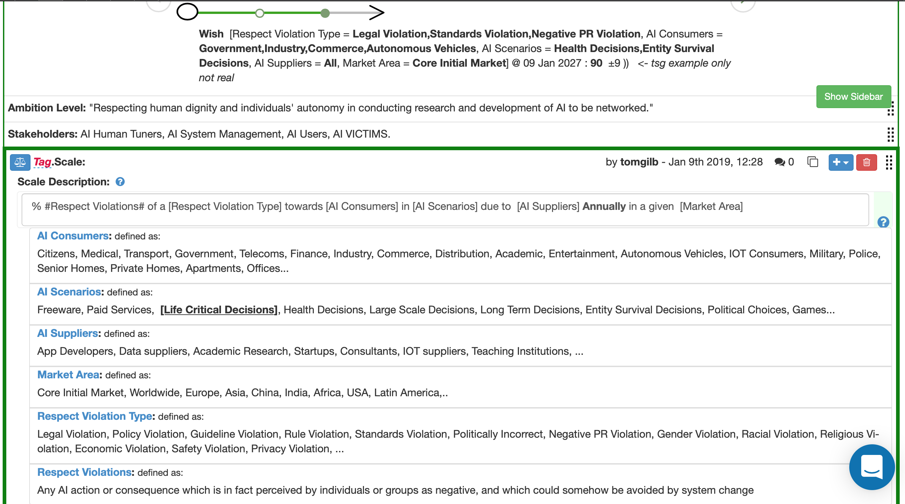
AI Ethicality:
Summary and Ethicality Scale of Measure
6 Dimensions
time (deadline)
for each of many Value Dimensions
Structure
DEFINITION
[Scale Parameters]

Slide 12
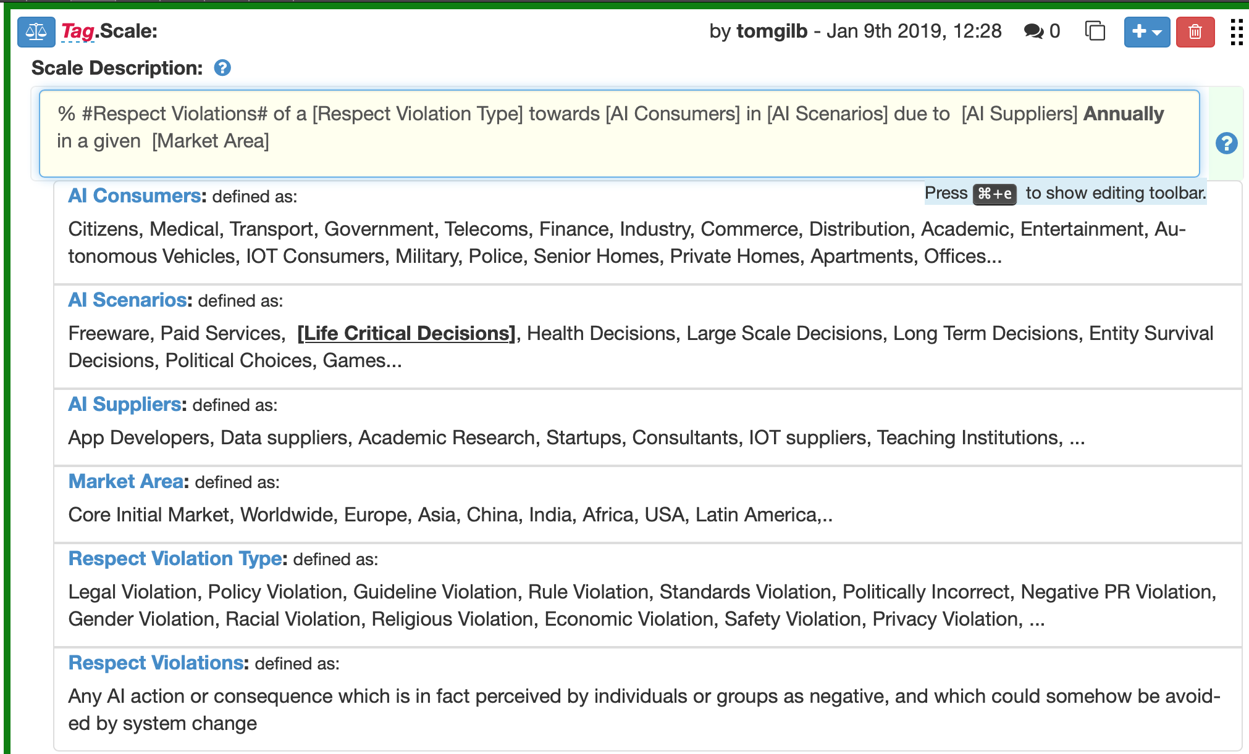
AI Ethicality: Scale Parameter Detail
Real life critical dimensions
Easily understood by all stakeholders
Allow us to select and prioritize agile value delivery sprints early and continuously in small increments

Slide 13
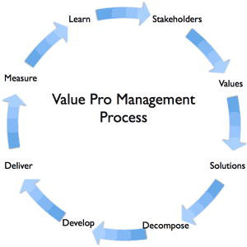
AI Ethicality: Summary of the ‘WISH LEVEL’
Here is an example of selecting a prioritized, critical, part of the action,
maybe in practice 1/50 of total budget, and 1/50 total time to deadline (a ‘sprint’ if you like)
Value delivered early, design experiments possible, feedback and correction possible quickly
FREE GIFT REVIEW COPY FOR YOU ALONE. NO COUPON CODE REQUIRED.

Slide 14
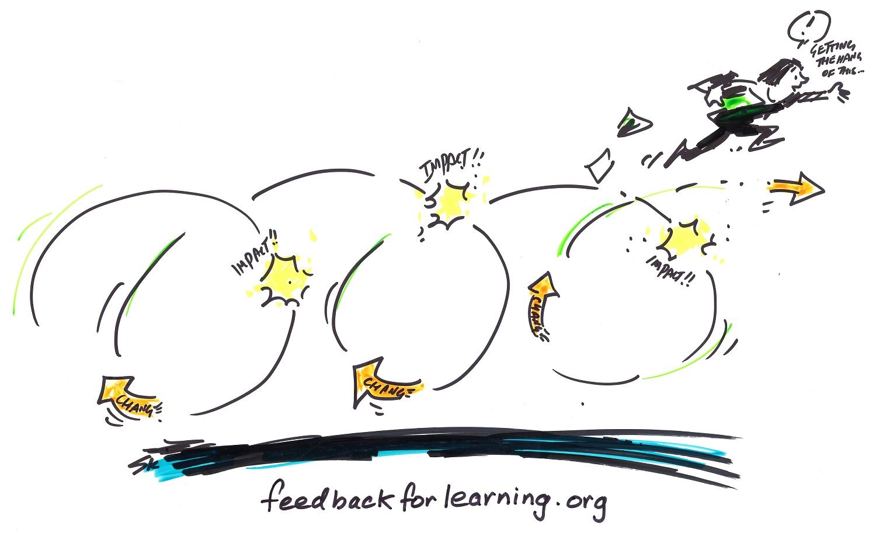
AI Learning Performance

Slide 15
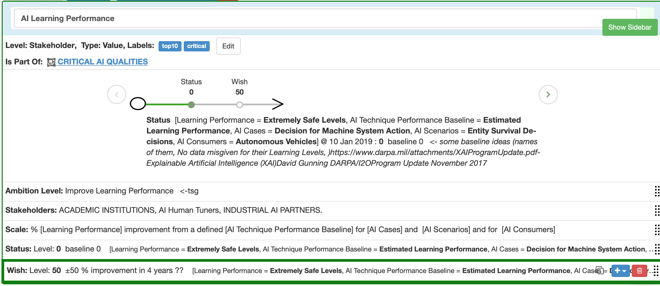
AI Learning Performance:
Overview of a structured quantified requirement
Unique Spec Object Tag, for reuse and cross reference
Spec Type = ‘Value’
Understanding relations to higher levels
Summary
The BS level and its source (power, respect, derive clearer version below)
Stakeholders: your local steering committee
Defining ‘Learning Performance’ as a ‘Metric’
Baseline, systems analysis
Target, acknowledging stakeholder value

Slide 16
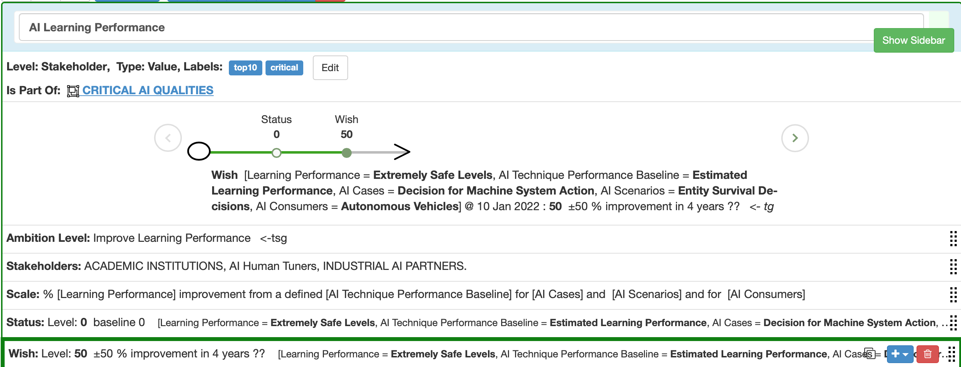
AI Learning Performance:
Wish Level
Graphical Summary
One liner
summaries

Slide 17
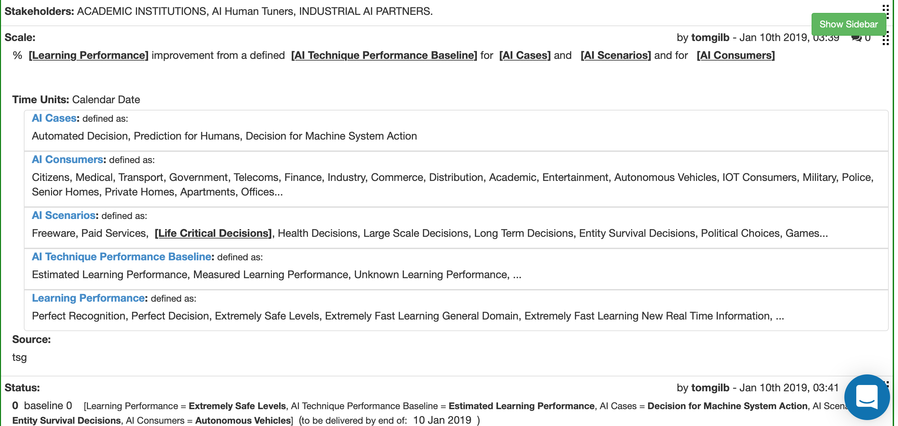
AI Learning Performance:
Status Level
Defining a Scale of Measure for
‘Learning Performance’
by means of [Scale Parameter] conditions

Slide 18
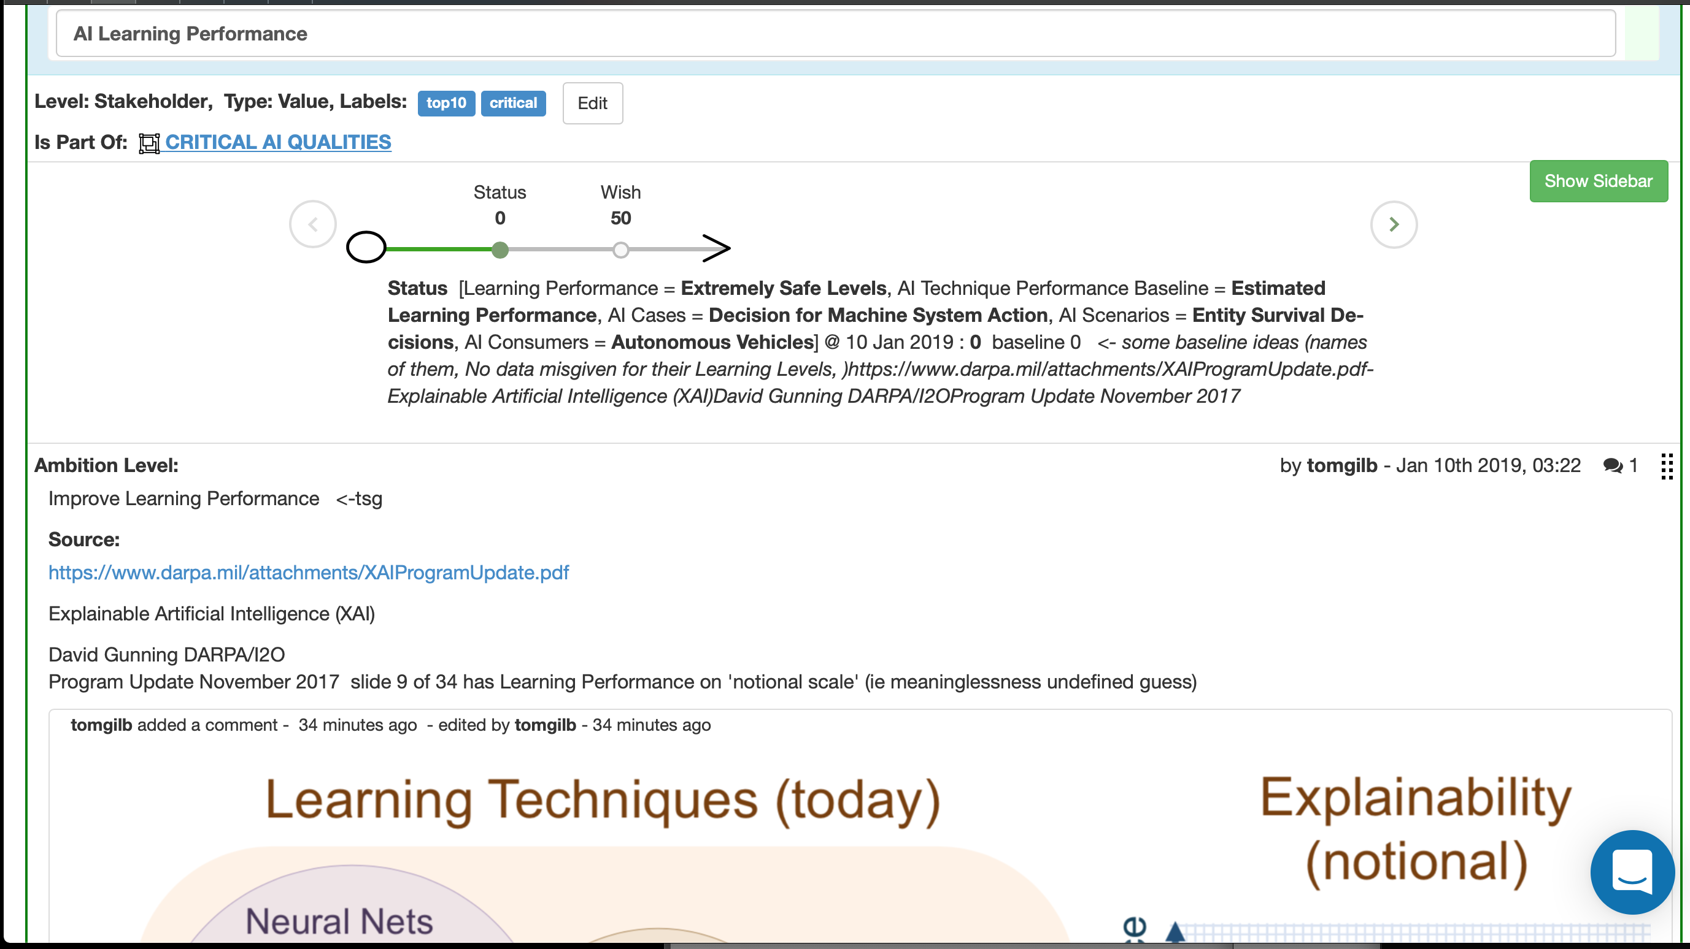
AI Learning Performance:
Darpa Source Level Spec: example of source.
Source:
Permits Credibility, Quality Control, Authority, Stimulates better sources (to achieve higher
‘Credibility’ scores in IETs)

Slide 19
AI Privacy
Notes:
https://www.census.gov/privacy/

Slide 20
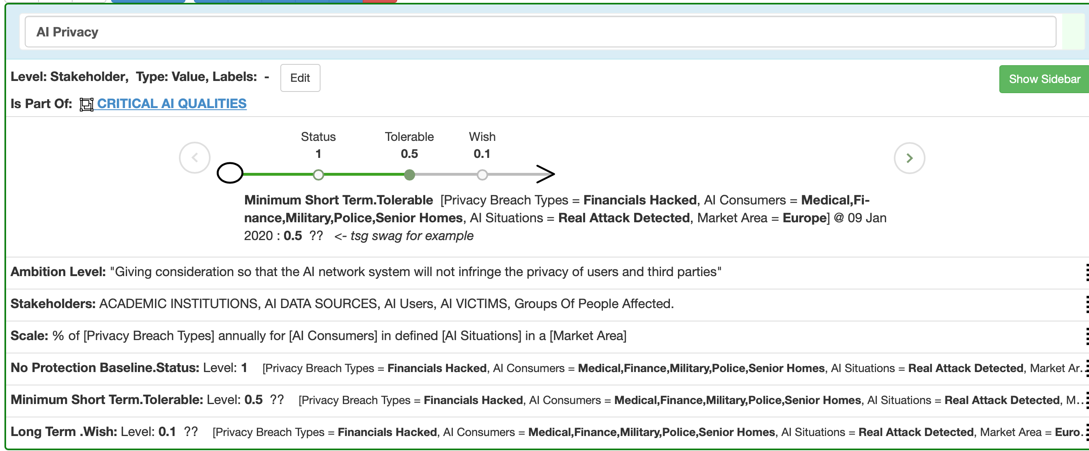
AI Privacy
Setting a ‘scalar constraint’
The ‘Tolerable’ Level
The ‘worst acceptable level’ of quality

Slide 21
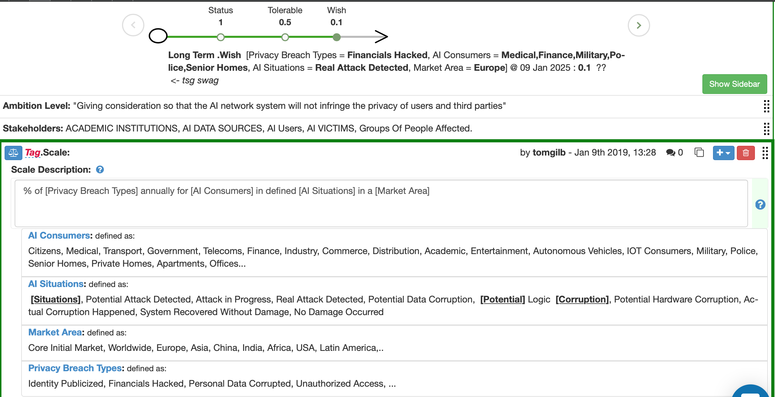
AI Privacy
Tolerable
Useful [Dimensions] of ‘Privacy’
We can have as many as we need to model AI Privacy.
This is just a quick draft to show possibilities.

Slide 22
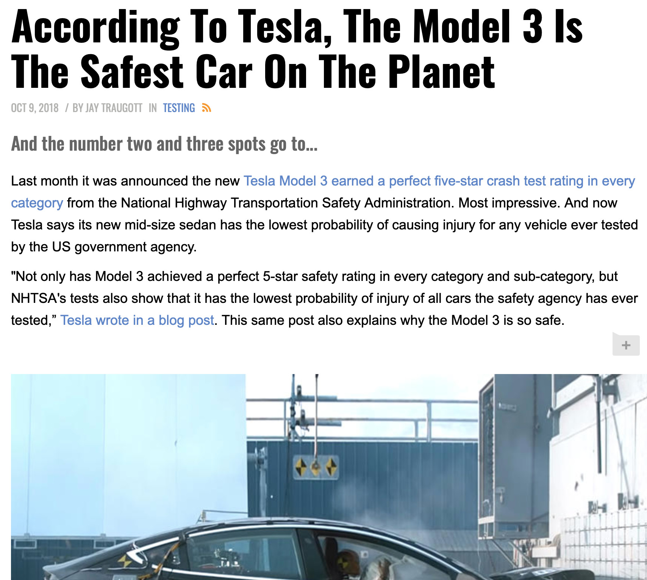
AI Safety

Slide 23
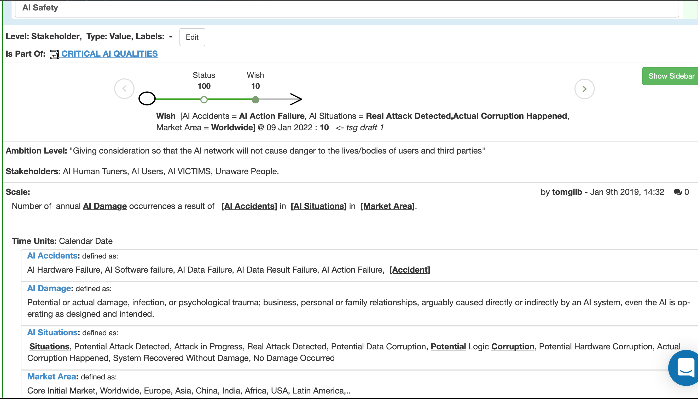
AI Safety
Is your family safety worth quantifying?
or is ‘Make My Family Safe Again’ Good enough ?

Slide 24
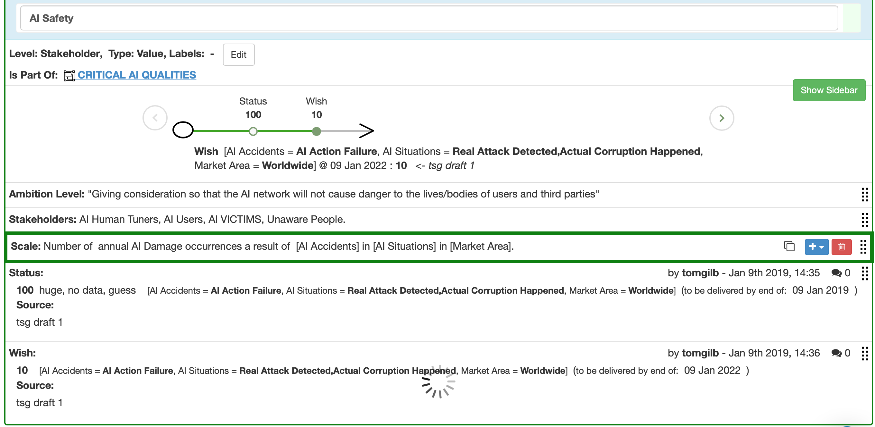
AI Safety
So here is an example of quantification of Safety.
Why don’t the AI Standards groups INSIST on quantification of Critical AI Attributes?
Maybe… they do not intellectually understand ‘quantification’: they are more-po

Slide 25
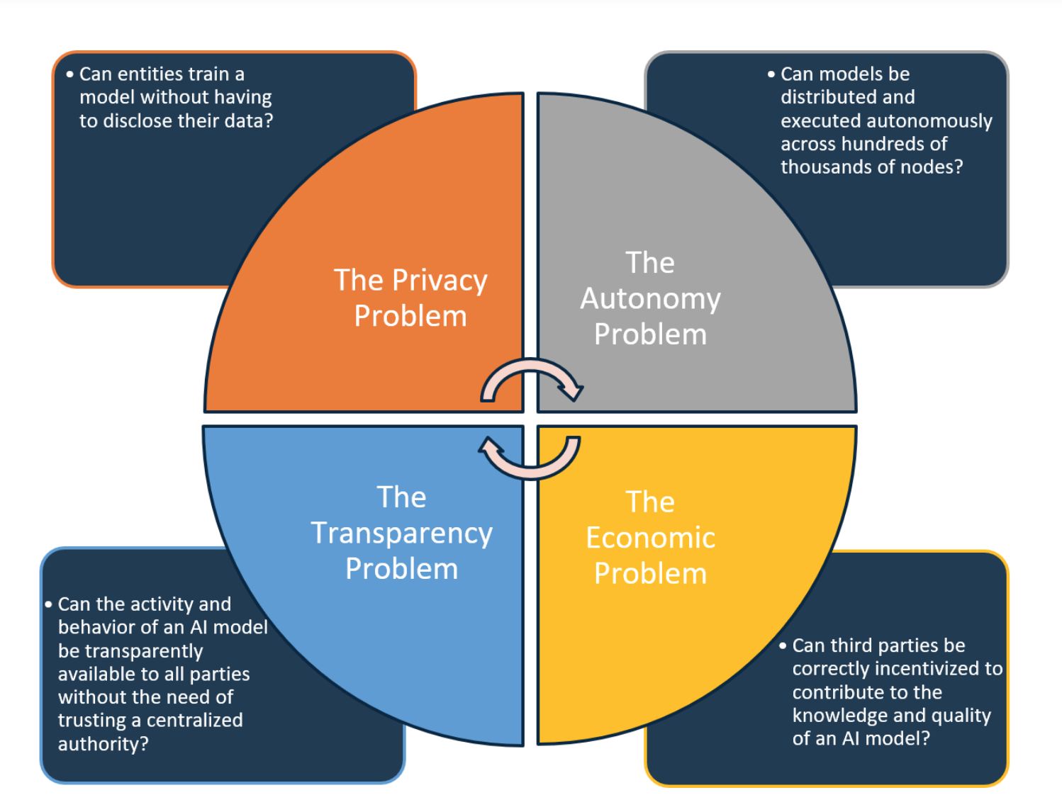
AI Transparency
Notes:
https://towardsdatascience.com/everything-you-need-to-know-about-decentralized-ai-3abdb052324b

Slide 26
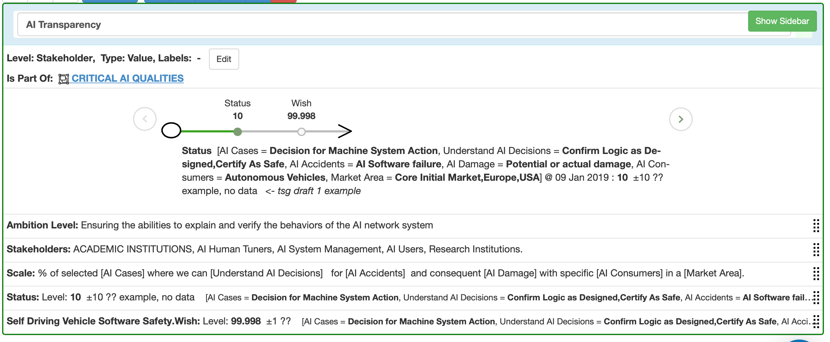
AI Transparency
Tags on various scale levels are useful, since we can have a many
levels of each type (Wish etc=) as we need

Slide 27
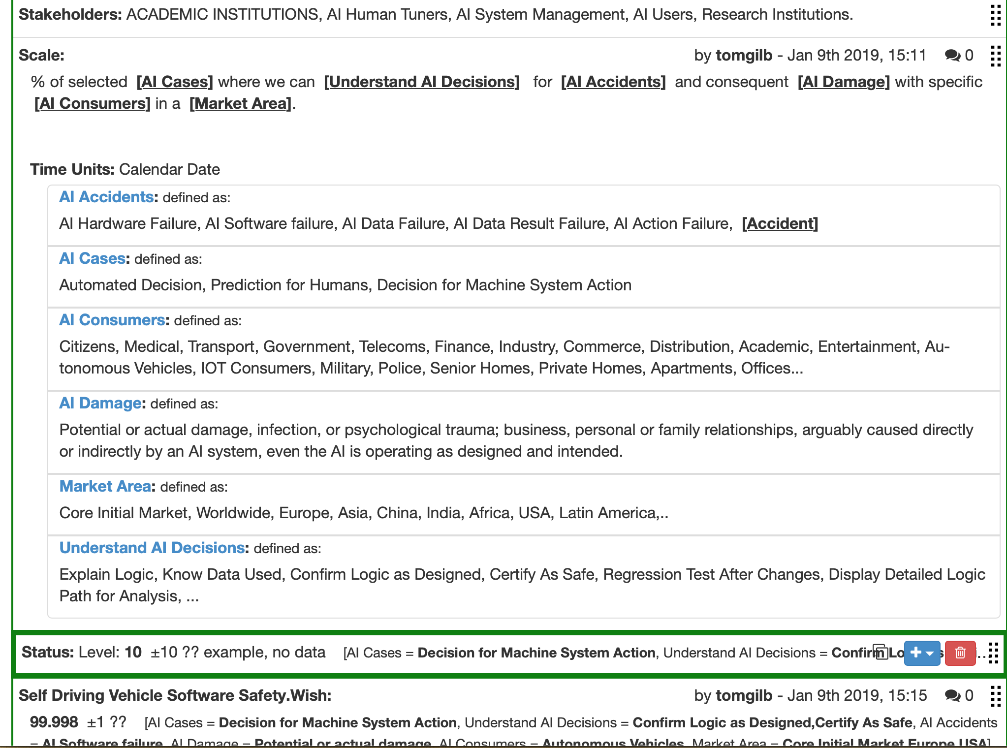
AI Transparency
Do you remember the fuzzy Ambition Level previous slide ?
Useless: shame for doing it in public!

Slide 28
AI Usability
Notes:
https://thekevinscott.com/usability-heuristics-for-bots/

Slide 29
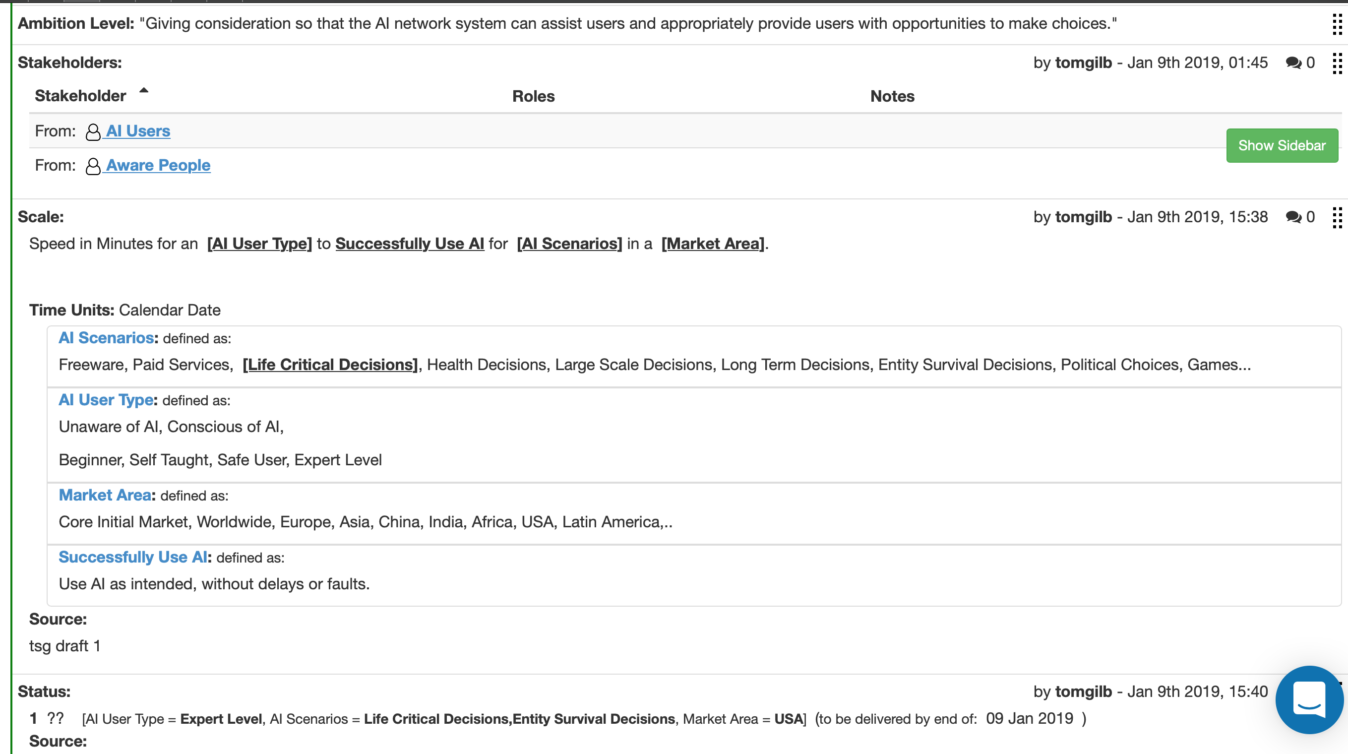
AI Usability

Slide 30
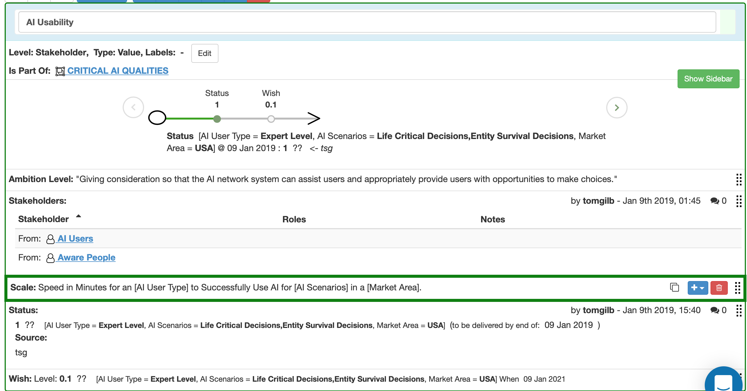
AI Usability

Slide 31
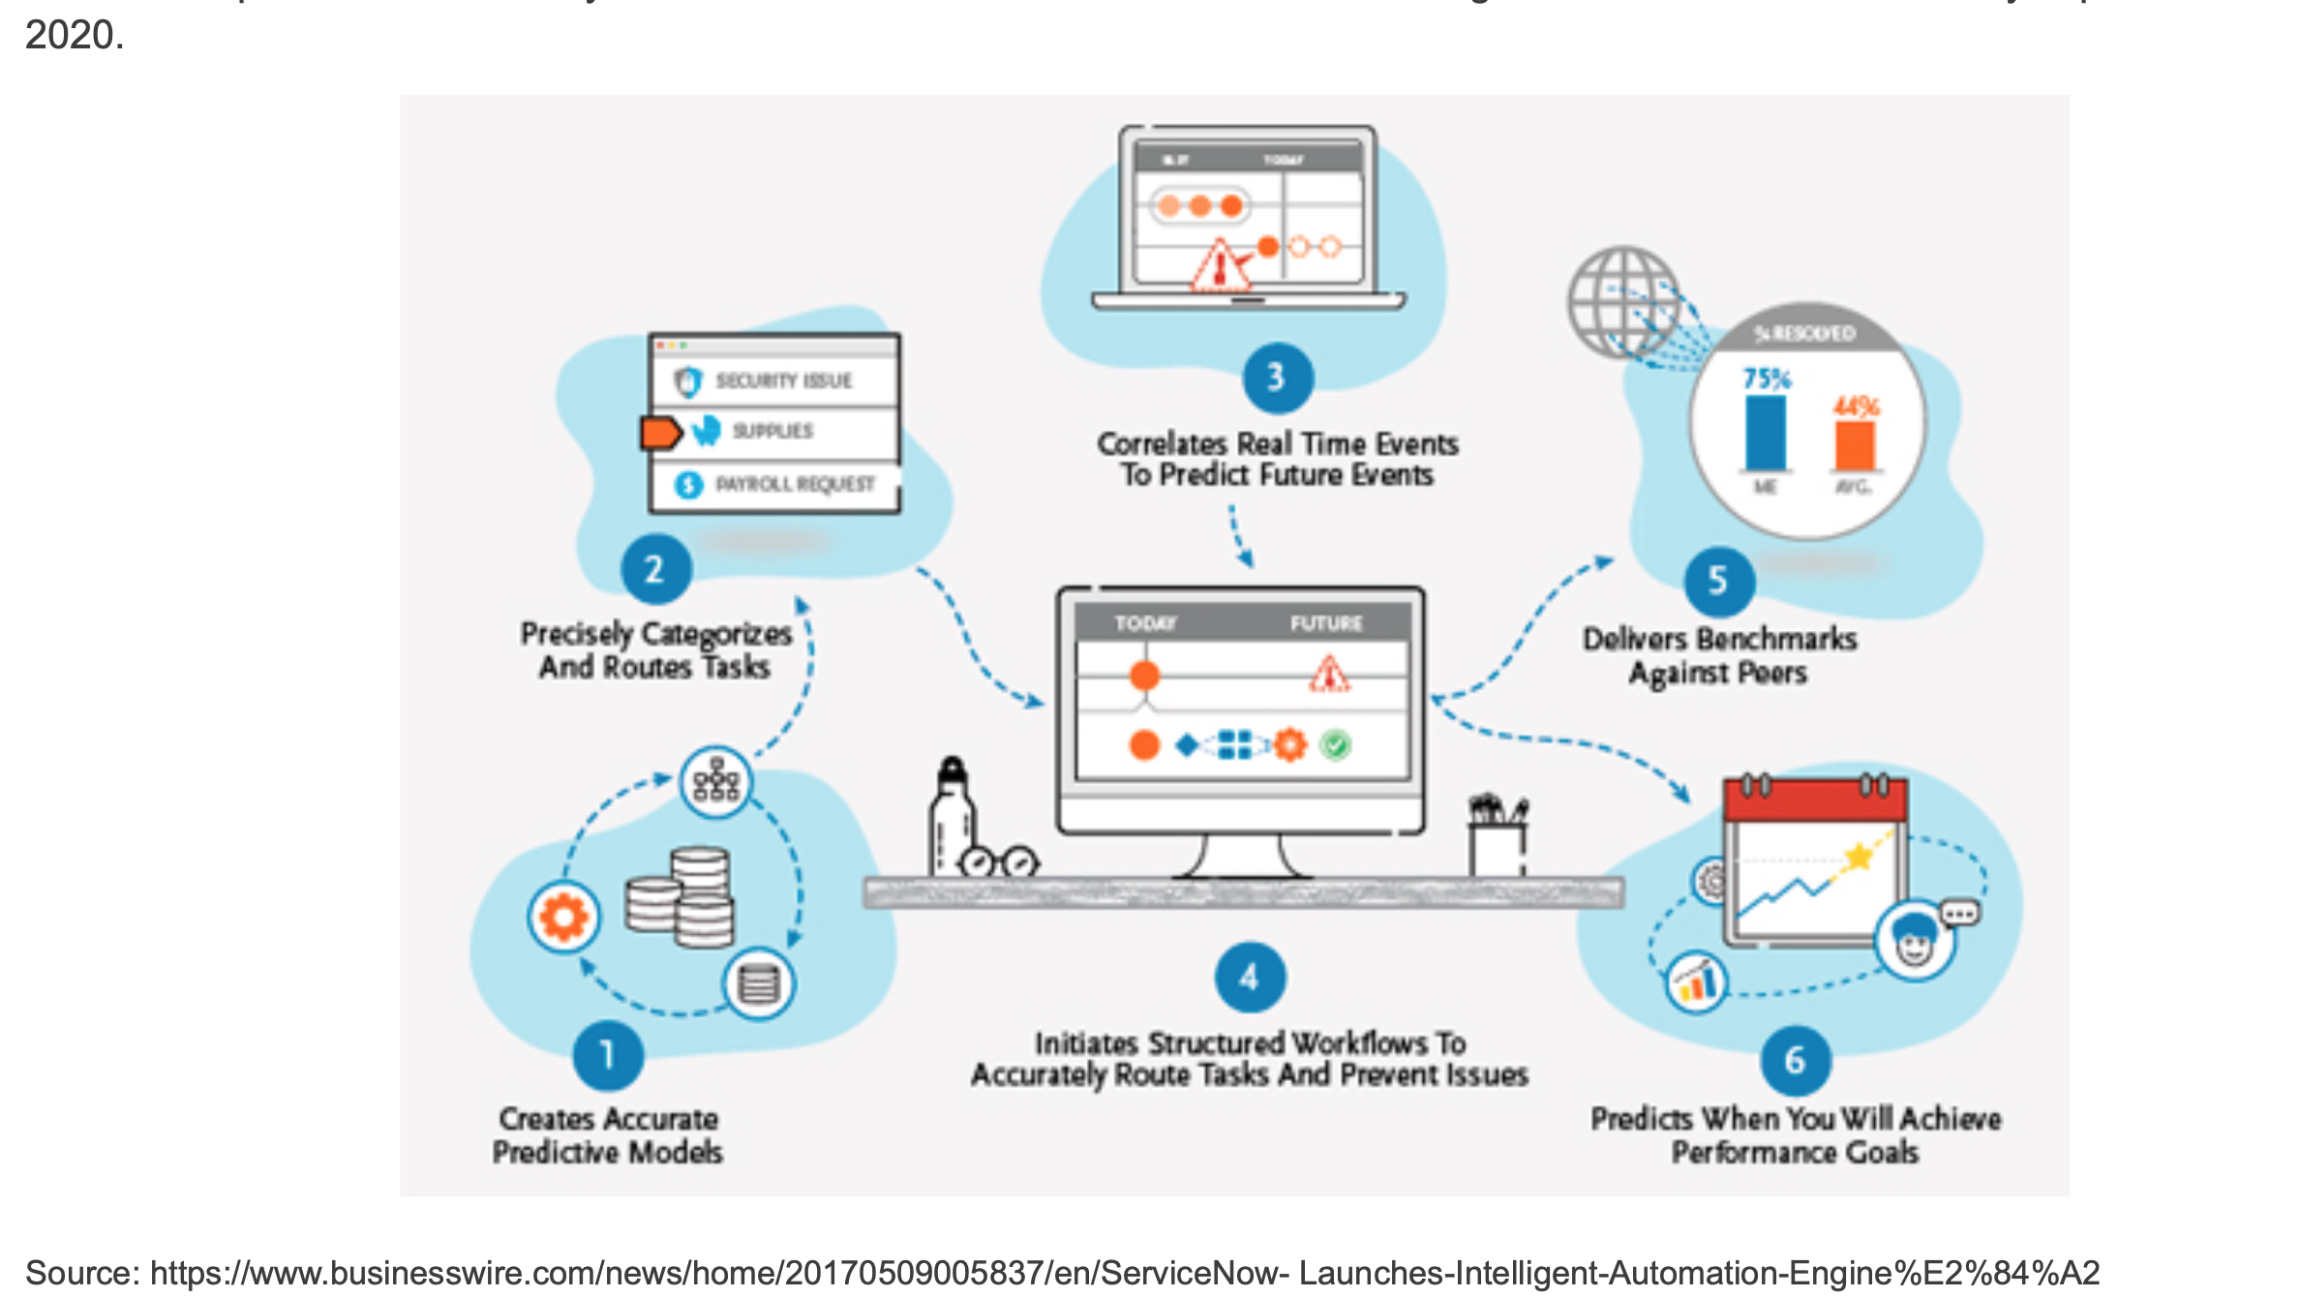
Other Viewpoints

Slide 32
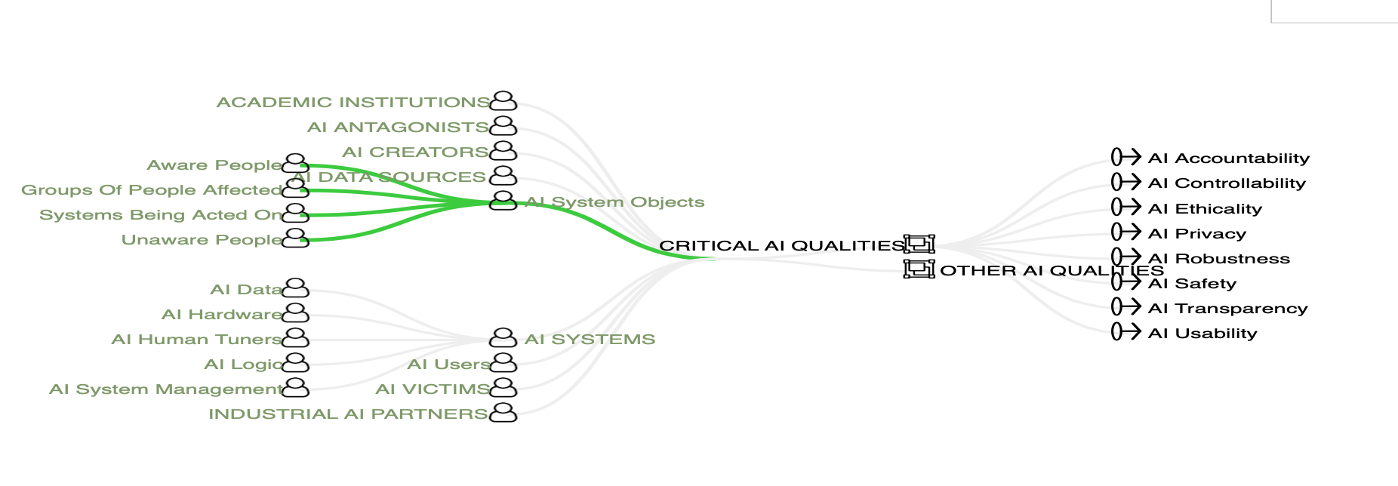
Diagram: AI Stakeholders
& AI ‘Qualities’ (Principles)

Slide 33
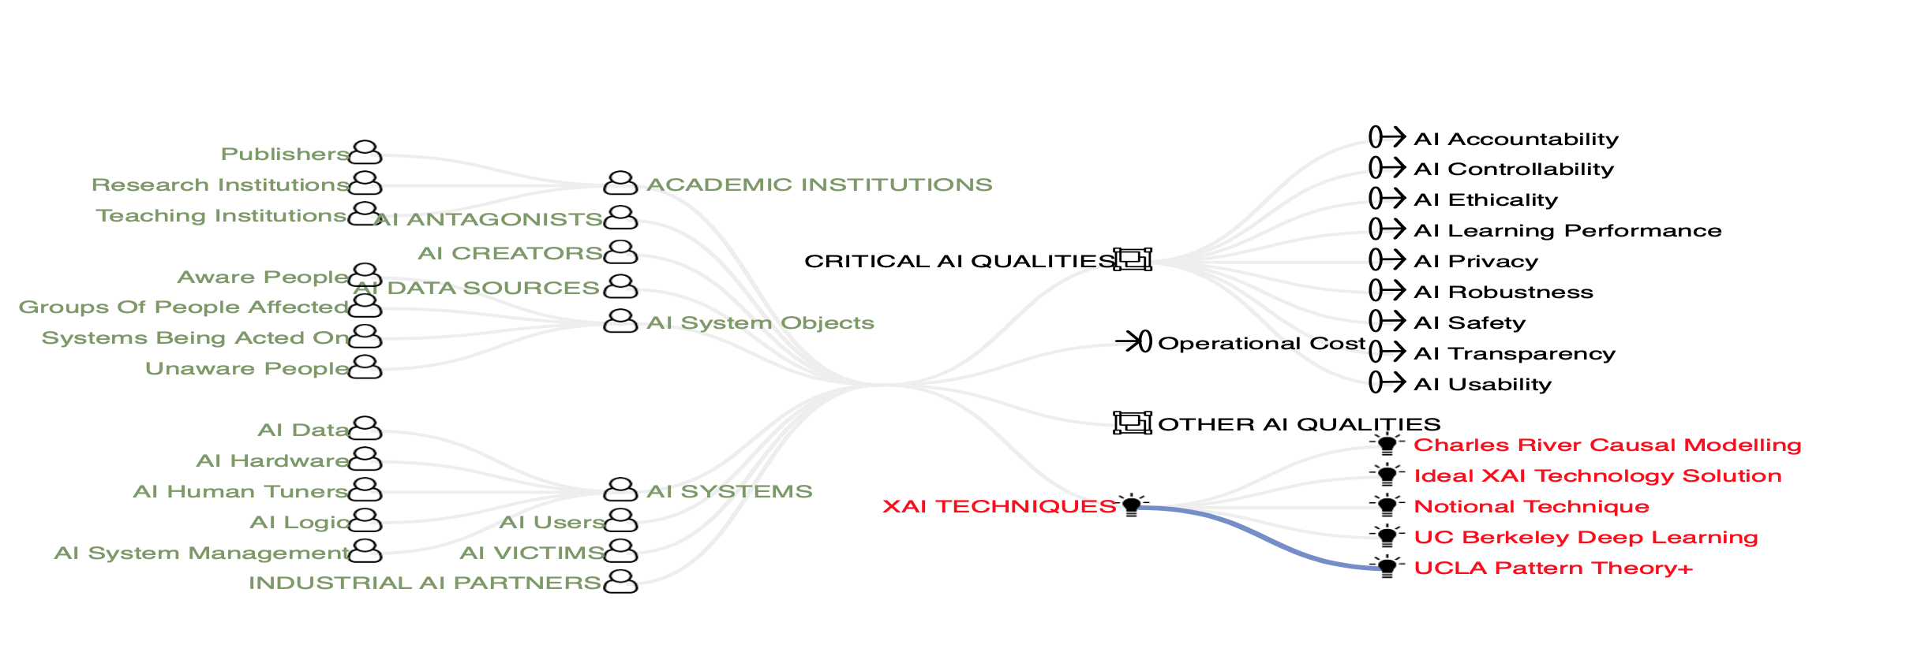
Diagram:
Stakeholders, Qualities,
Some ‘XAI Techniques’

Slide 36
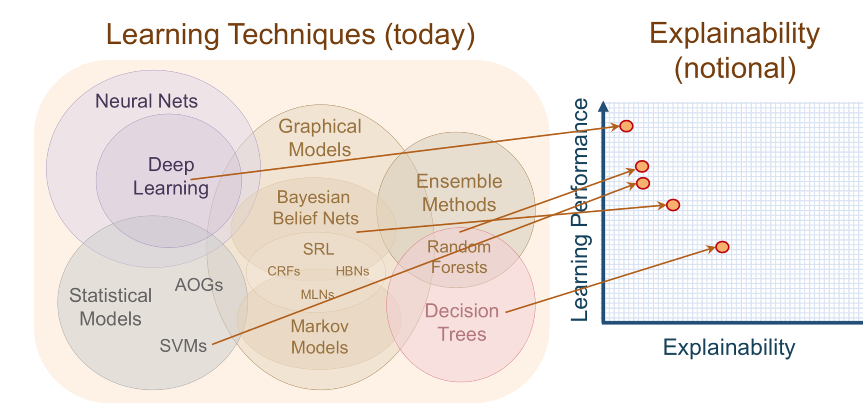
Explainability of Learning Techniques

Slide 37
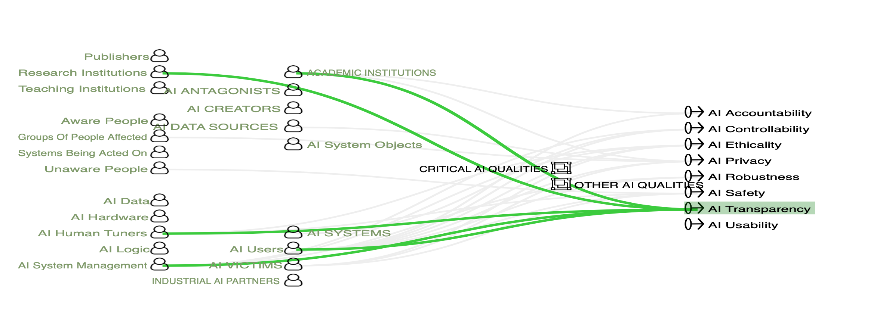
Relationship Diagram
AI Transparency and its stakeholders

Slide 38
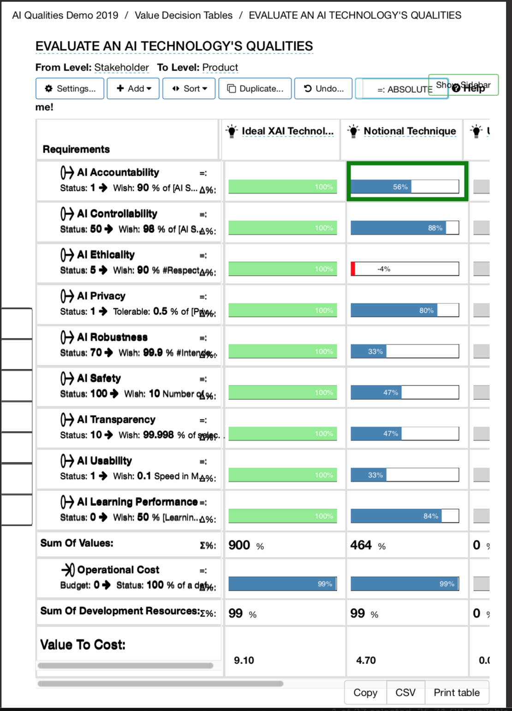
Can we evaluate AI Technology Qualities against
9 AI Qualities and some Costs?

Slide 39
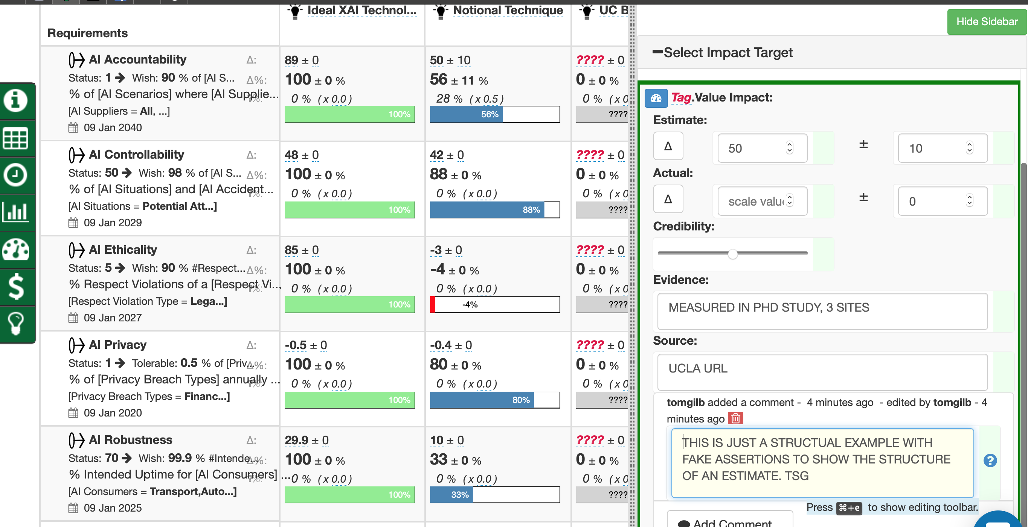
AI Technique Evaluation using
with objective evidence, sources uncertainty
small diagram problem: the selected window is not shown. 230619 tsg

Slide 40
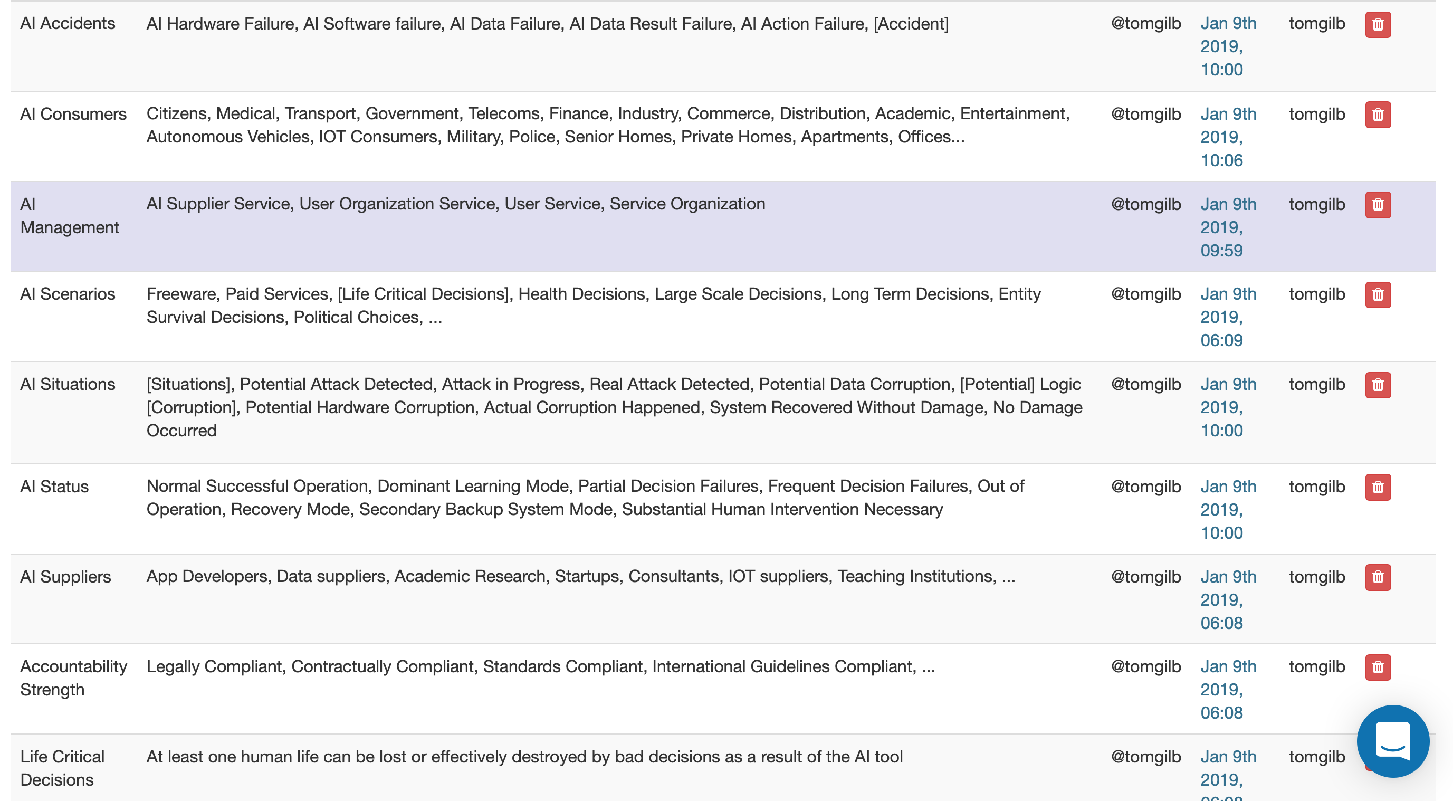
Defined Concepts: Not least for [Scale Parameters]
‘

Slide 41
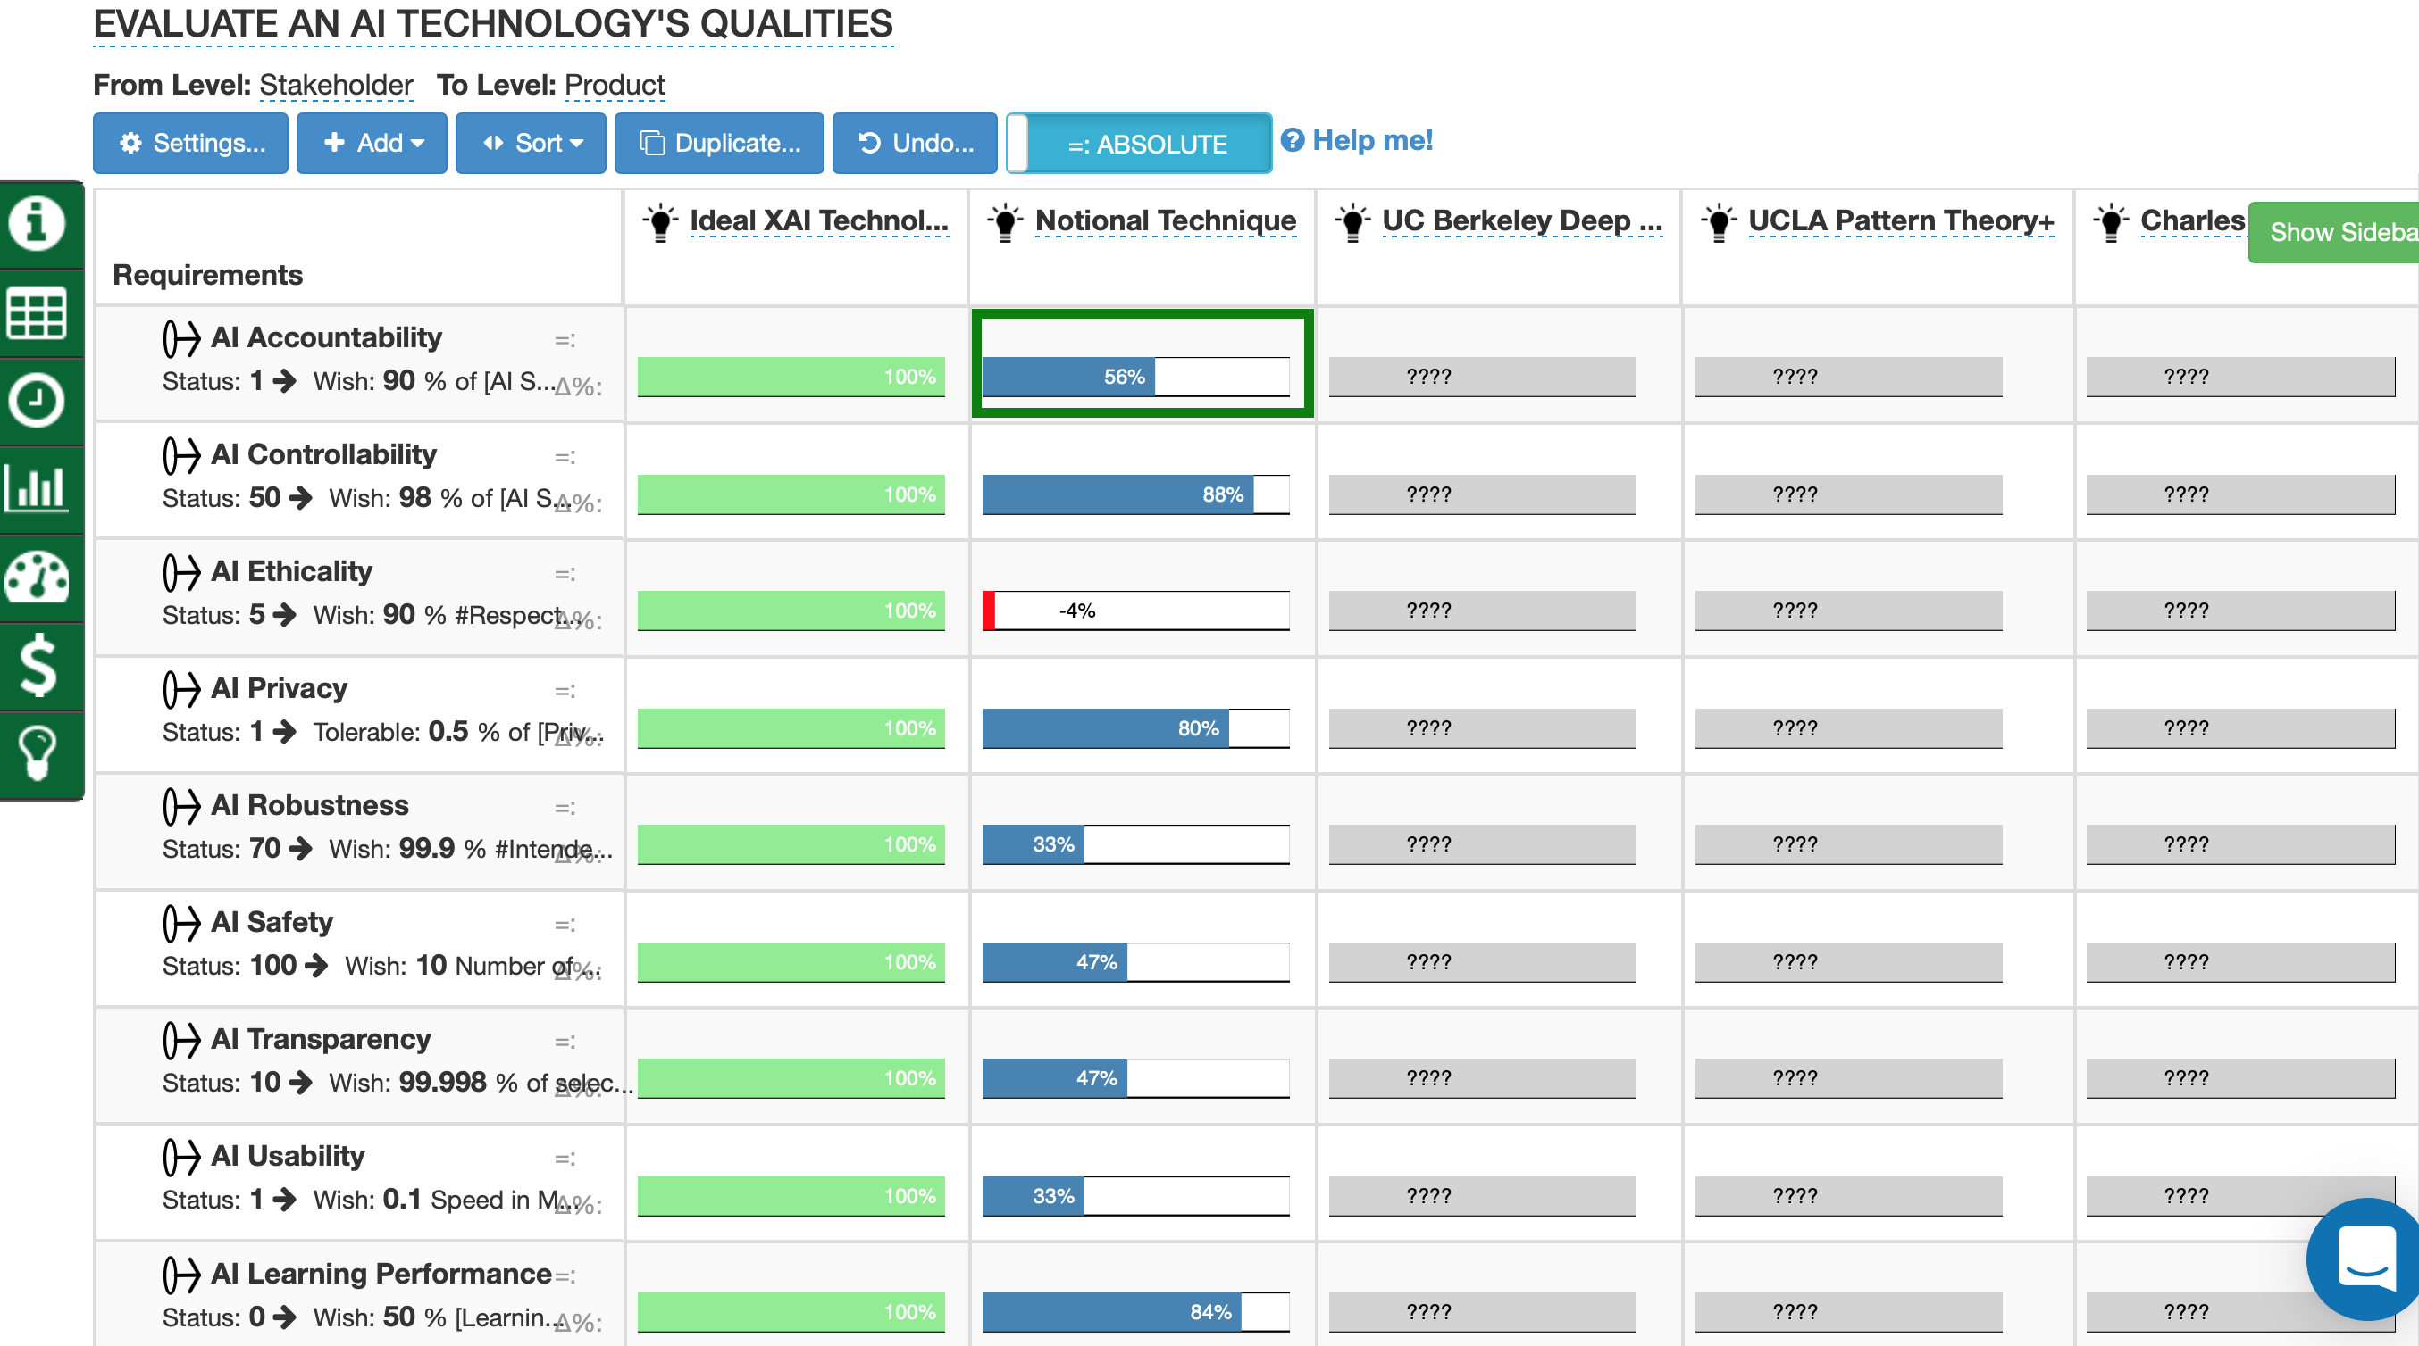
Quantitative Evaluation of
AI Technology Qualities using ‘Impact Estimation Tables’
This is a quick mockup without real data:
to show the potential for evaluating AI Techniques
and their effects on
AI Values (or ‘Qualities’)

Slide 42
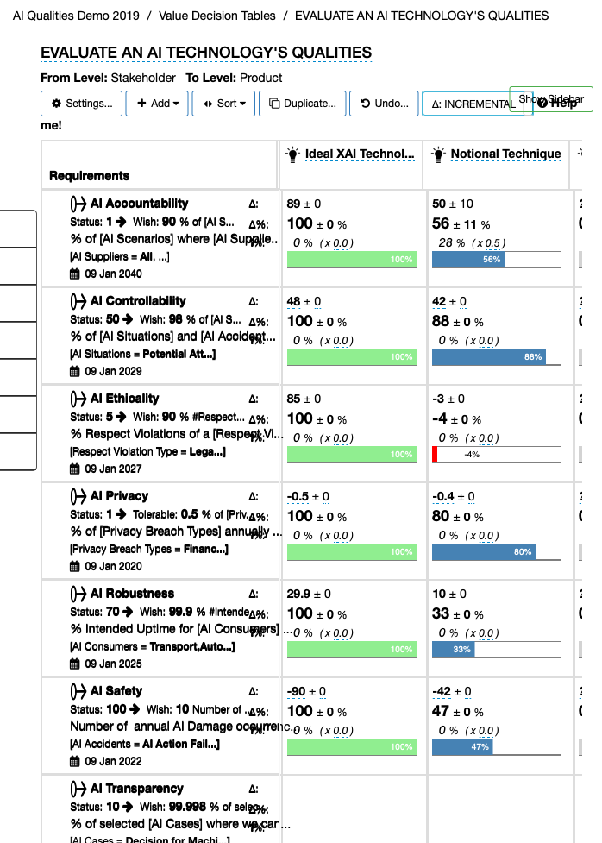
A more detailed example of
rating ‘uncertainty’ (±10)
and
Credibility
56% x 0.5 = 28%
Mock example

Slide 43
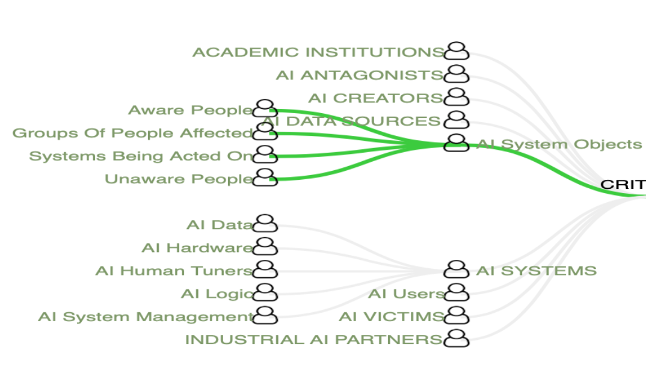
My (TSG) Observations and Conclusions
The most fundamental obstacle to AI Standards progress is WE NEED TO QUANTIFY AND STRUCTURE-RICHLY all CRITICAL STAKEHOLDER VALUES (ALL > 8)
Next: we need much-deeper, more-comprehensive identification, and consensus, and detailed knowledge (their values and constraints) about AI/ AI STANDARDS STAKEHOLDERS

Slide 44
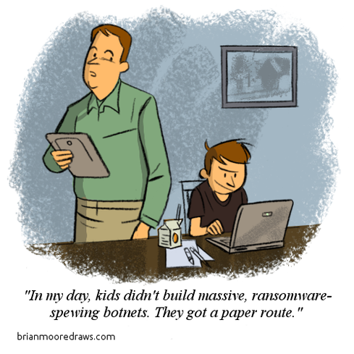
end slide
Notes:
used with credit not permission

