Slide 1
Agile communication, efficient teams
(45 min, including Q&A).
12:00 TO 12:45 MAY 22 2019 ,WEDNESDAY
Sector 3.0 Conference, Warsaw
‘Small Problems’ Workshop
Tom Gilb, Norway
tom@Gilb.com
@ImTomGilb
gilb.com
Tom Gilb
at Katowice
Masterclass, 2018
https://nowy.me/gilb/
Notes:
based on CC book
ps get pawel to make brochures
put masterclass link in all slides
workshop so
Ambiguity test
mafia offer (priorities)
Brainstorm top 10 critical values
write values so can be unambiguously tested
sqc count defects
you predicted/estimated you would get 95% availability, for a weeks delivery cycle. The cycle feedback is that you get only 90% availability and it took 3 weeks. What do you need to do?
nb this is billed as seminar, and you are thinking of doing a series of exercises
PROPOSED BY SECTOR 3.0
For the seminar session (we’ve already sent some suggestions earlier), we thought of the following topic and talking points (45 min, including Q&A).
Agile communication, efficient team
- Scrum, kanban, sprint and retro – why agile management works in an organization?
- Discover the secrets of agile communication
- Increase teamwork efficiency
12:00 TO 12:45 MAY 22 2019 ,WEDNESDAY

Slide 2
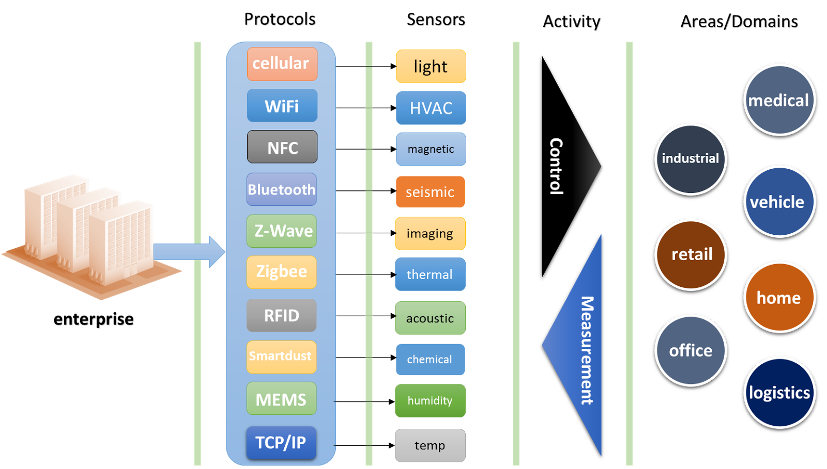
‘Ambiguity’ Game
‘Extremely Advanced App Security’
Ambiguity Game
“Extremely Advanced App Security”
clarify this requirement in 10 words or less, in english
when I point to you, please loudly announce what you wrote
I will take 5 to 10 samples
timing: 5 to 10 minutes

Slide 3
“Extremely Advanced App Security”
(some interpretations) WAW May 2019
Ambiguity Game
???

Slide 4
“Extremely Advanced App Security”
Some Questions We Need to Discuss
Ambiguity Game
Why do we get so many highly different interpretations?
What is the ‘communications’ consequence for a development team if this is the ‘requirement’, and all requirements are so ambiguous?
What can we do about this in Practice?

Slide 5
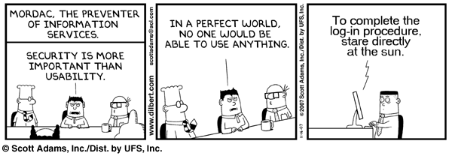
Quantification Game
Quantify: “State of the Art Usability”
Quantification Game
That means, express this requirement with a numeric, trackable, testable number
Limit your answer to 10 words of less.
For example:
’60% people learn to do X within 5 minutes’
‘maximum 5% get their attempt wrong’
I will ask a few people to announce their answers.
Estimated time 10 minutes

Slide 6
Quantification Game
Quantify: “State of the Art Usability”
Quantification Game
ANSWERS…..
…

Slide 7
Quantification Game
Quantify: “State of the Art Usability”
Some Questions To Ponder and Discuss
Quantification Game
Why does everybody have a different answer?
Are their any ’standards’ for quantified qualities (like there are for time, and weight, and electrical power and current)
What would a really strong and useful answer look like in practice?
To what degree is there ‘one right answer’, or
To what degree does the answer need a lot of local domain tailoring ?

Slide 8
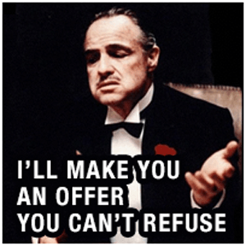
‘Mafia Offer’ Game
‘Best available encryption technology’ OR ‘Best Security ‘
Mafia Offer Game
if you say your requirement is
‘Best available encryption technology’
and I then give you a choice:
“Do you want the
Best available encryption technology
OR
The ‘Best Available Security Level’ ?
WHAT SHOULD THEY CHOOSE?
ENCRYPTION
SECURITY
DEPENDS
NONE OF THE ABOVE
estimated game time 10 minutes

Slide 9
‘Mafia Offer’ Game
The Voting
Mafia Offer Game
ENCRYPTION
SECURITY
DEPENDS
NONE OF THE ABOVE

Slide 10
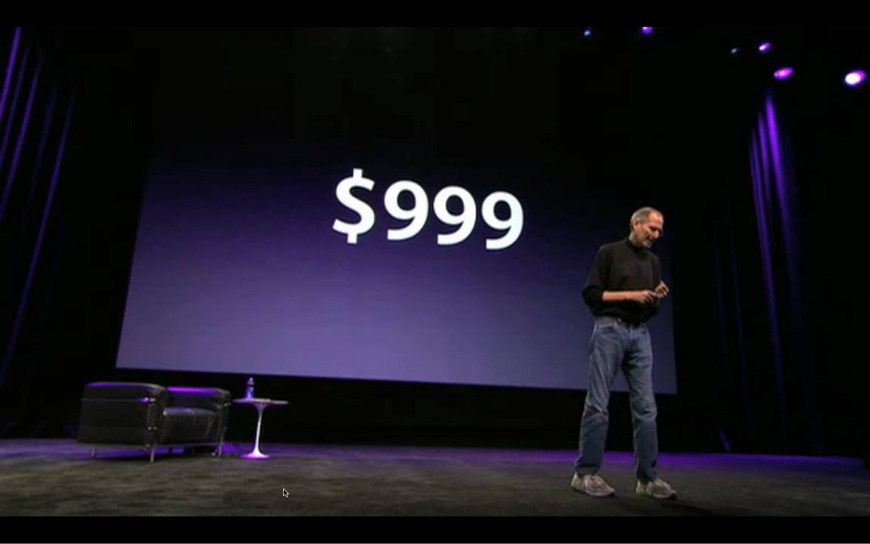
‘Mafia Offer’ Game
Some Questions
Mafia Offer Game
Why would we give our stakeholders a ‘mafia offer’?
What is the underlying problem, with the initial ‘Encryption’ requirement ?
can Mafia Offers be used as a clear communications tool in other connections ?
Another key ingredient borrowed from smart marketeers in the Mafia Offering is price anchoring. When Steve Jobs introduced the iPad to the big public he compared the price of the iPad to that of a Netbook. At the moment of the introduction of the iPad, Netbooks were sold for $999.
The iPad was introduced at “just” $499 instead of the $999. The audience applaused spontaneously and enthousiastically when they heard this “bargain” price. But is $499 such a bargain?
Notes:
http://scalemybusiness.com/mafia-offer/

Slide 11
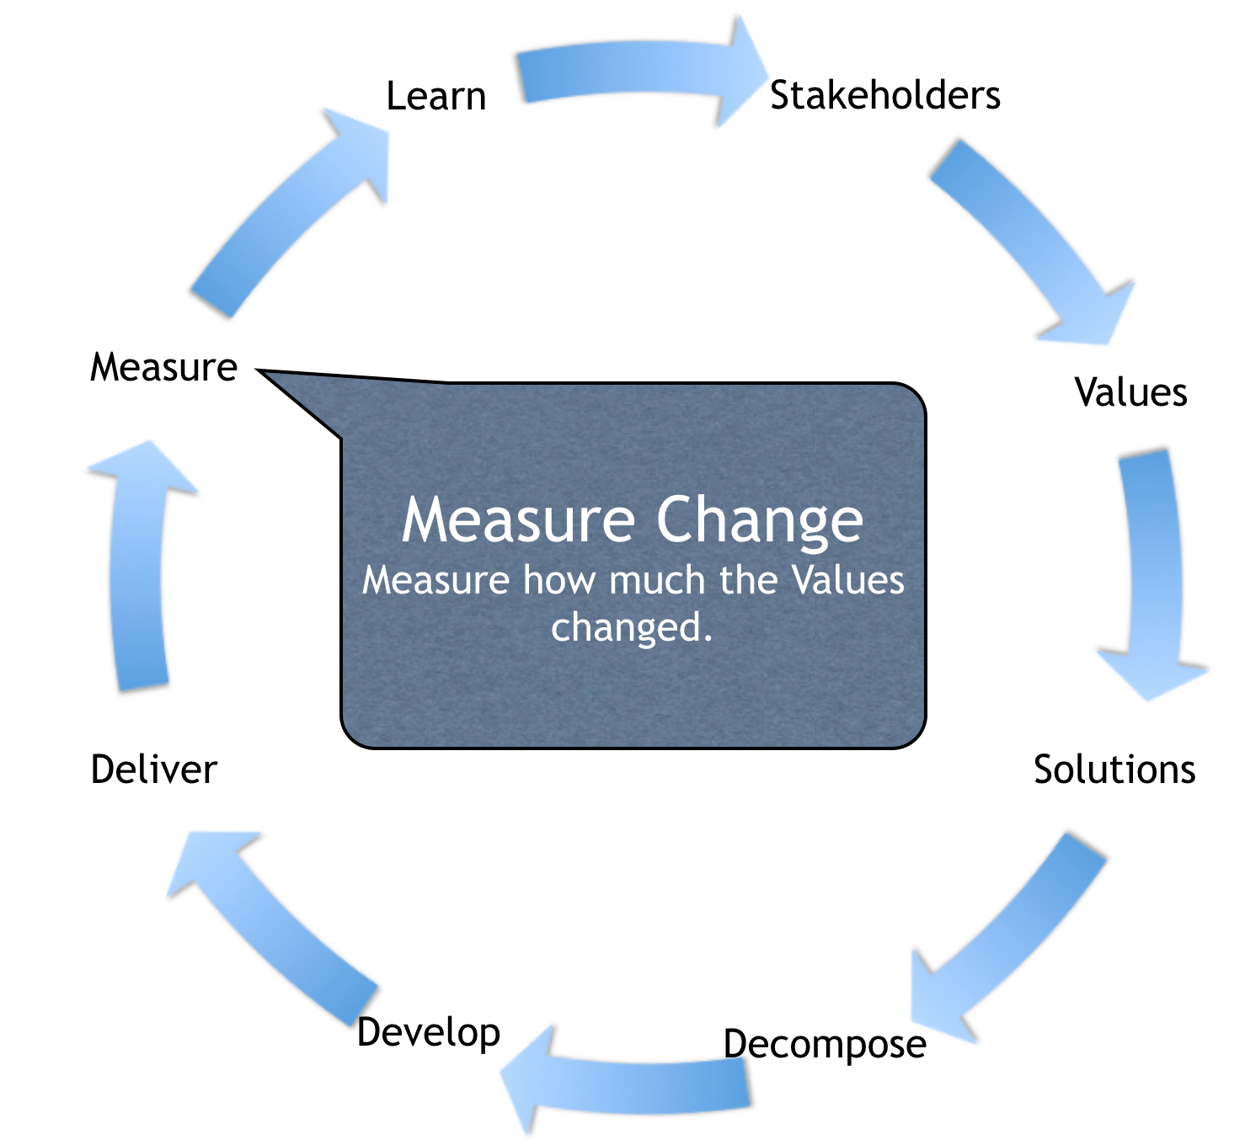
‘Agile Numeric Feedback’ Game
‘Agile Numeric Feedback’ Game
You estimated that Security Level would increase to 42%, from 30%, at the next agile delivery step
You measured that you only got 33%
What action would an Agile developer recommend?
Try Again
Redesign Security
Express your regrets to client
Try to hide the 33% fact
Claim victory: Security got better !
2. http://concepts.gilb.com/dl896
Notes:
Mills, H. 1980. The management of software engineering: part 1: principles of software engineering. IBM Systems Journal 19, issue 4 (Dec.):414-420.
Direct Copy
http://trace.tennessee.edu/cgi/viewcontent.cgi?article=1004&context=utk_harlan
Includes Mills, O’Niell, Linger, Dyer,Quinnan p- 466 on
Got link 2016 via Graham Matthews Australia.
MIlls and Quinnan Slides
http://concepts.gilb.com/dl896
Put in 12 3 17)

Slide 12
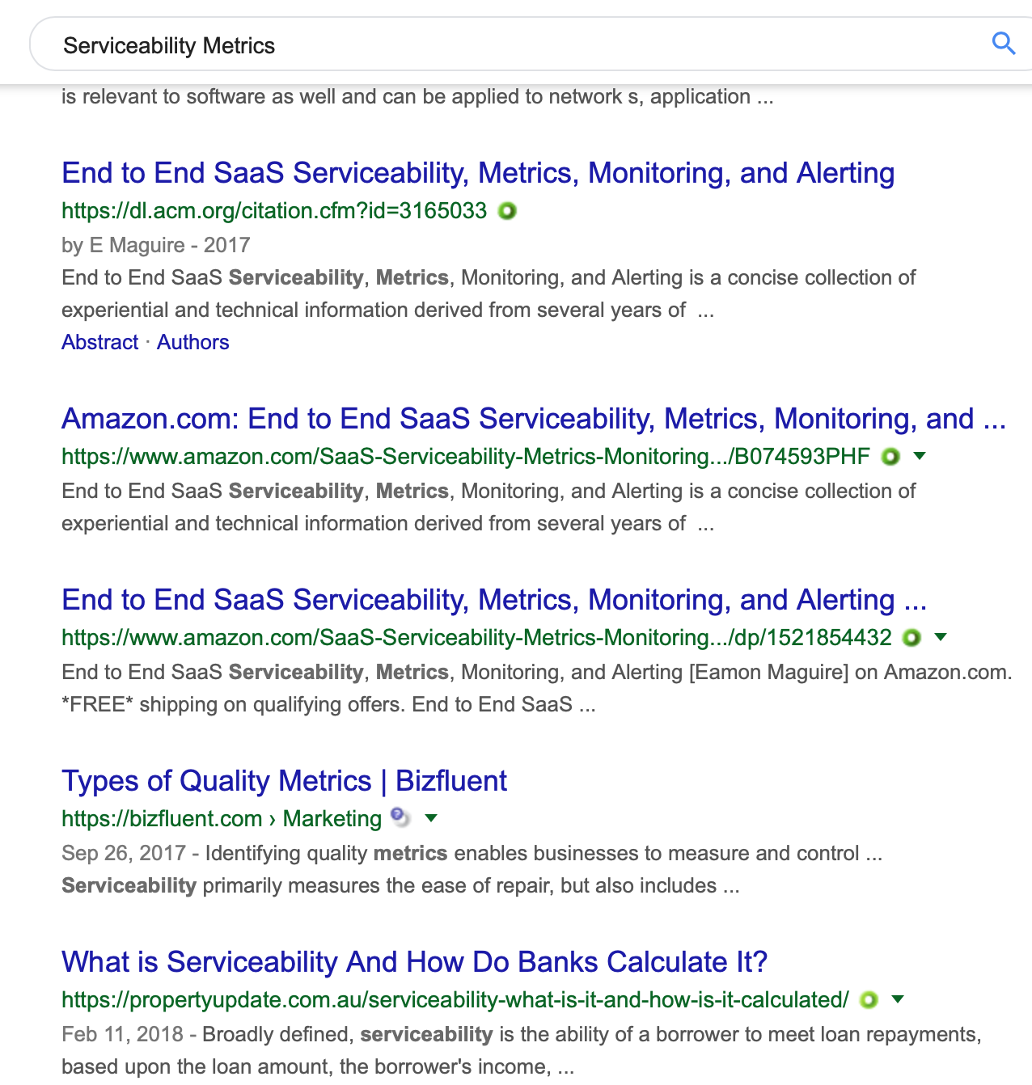
Quantification Knowledge Game
Quantification Knowledge Game
Pick your hottest quality or value, ending with ‘-ity’
Flexibility, Portability, Usability, Security, Availability, Serviceability, etc. anything else
insert it in your browser, with the word ‘metrics’
like ‘Serviceability Metrics’
Does this demonstrate that almost all ‘qualities’ can be quantified?
and that there are plenty of people willing to share the knowledge with us?

Slide 13
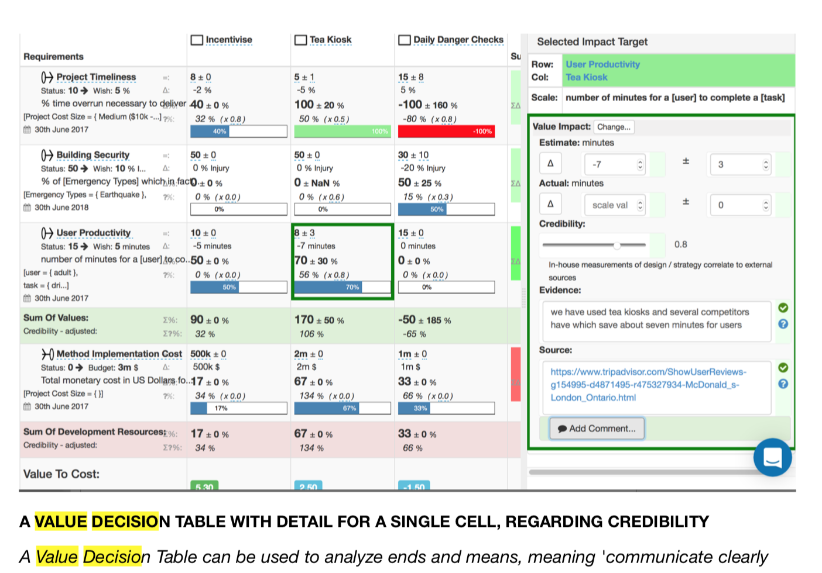
Where do these ideas lead us to?
‘Highly-structured, quantified, clarity
for complex systems’

Slide 14
Here is a textbook on ‘Agile Communication’
‘Do you want it free?
Or would you prefer to pay €14?’
Clear Communication. https://www.gilb.com/offers/Y36JRL6g/checkout
FREE GIFT REVIEW COPY FOR YOU participants at the Sector 3.0 Seminar. NO COUPON CODE REQUIRED.
This is a photo of the author, at his Oslo Fjord
Summer Cabin, where this book was written 2018
The T-Shirt was a Gift from my Polish friends
42 is the rank of Poland in ‘World Happiness Index’ survey 2018
Notes:
https://countryeconomy.com/demography/world-happiness-index/poland
2018 #42. Good to note 2019 #40
https://www.usnews.com/news/best-countries/poland
#33 in Quality of Life
https://www.usnews.com/news/best-countries

