Slide 1
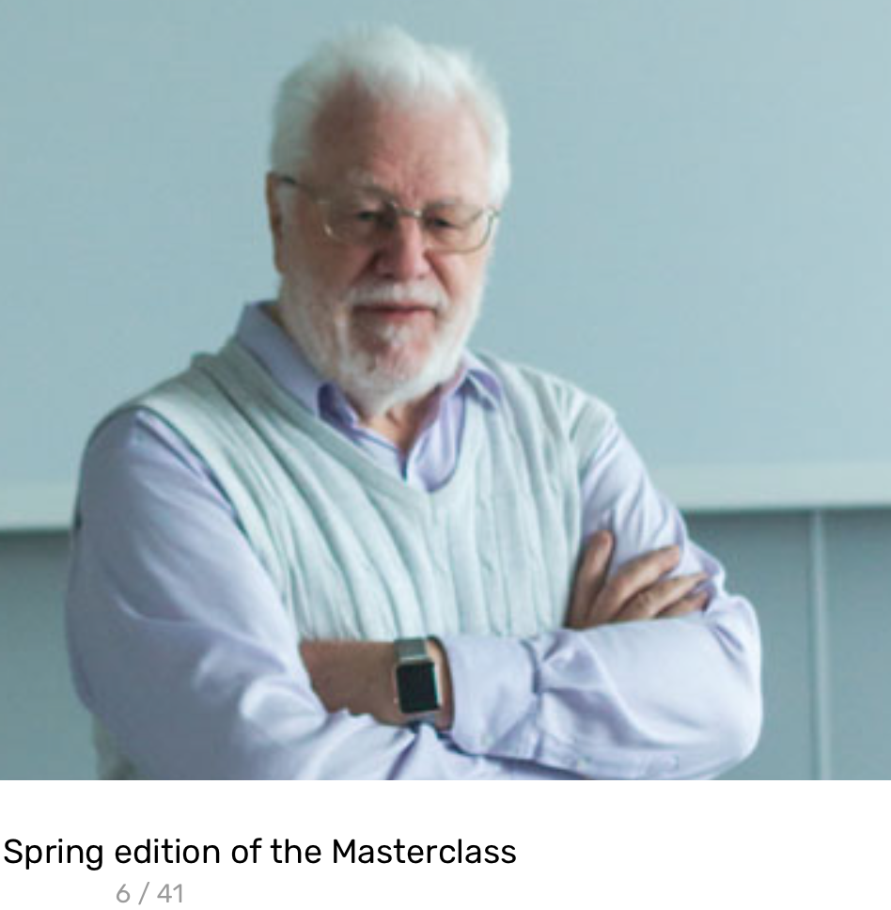
Evidence-based Dynamic Investment
or 'Agile Investment’
Tom @ Gilb . com
Investor Breakfast Club X
25th April 2019
09:15 to 09:30 (15 minutes)

Slide 2
BS filter Quantifying
Avoid the trap of accepting, believing, and misinterpreting ‘sales talk’.
Decide to be fact-based, evidence-based.
Notes:
12 tough questions

Slide 3
Twelve tough questions
1. Why isn't the improvement quantified?
2. What is degree of the risk or uncertainty and why?
3. Are you sure?
If not, why not?
4. Where did you get that from? How can I check it out?
5. How does your idea affect my goals, measurably?
6. Did we forget anything critical to survival?
7. How do you know it works that way? Did it before?
8. Have we got a complete solution? Are all objectives satisfied?
9. Are we planning to do the 'profitable things' first?
10. Who is responsible for failure or success?
11. How can we be sure the plan is working, during the project, early?
12. Is it ‘no cure, no pay’ in a contract? Why not?
http://www.gilb.com/dl24 © tom@Gilb.com 2002-2019 | There is a detailed paper on these questions at www.result-planning.com
Notes:
2 Tough questions questions paper
http://www.gilb.com/dl24
see also 20 Tough Questions 2016
http://concepts.gilb.com/dl876
http://concepts.gilb.com/dl876
20 Tough Technical Questions about requirements and designs
for Keynote Intel April 2016
see also 20 Tough Questions 2016
http://concepts.gilb.com/dl876

Slide 4
Do not check/test/measure the ‘technology’ itself - measure the Outcomes
(The really critical business values).

Slide 5
Creating Competitive Value Visions,
quantitatively
The core of your effort must be,
the critical few value requirements
They must be quantified, no exceptions
EXAMPLE: clarity, tracking, responsibility, motivation,
sync with designs, priority
More detail: see your ‘Innovative Creativity’ book Chapter 1 “Setting Creativity Objectives”
Notes:
this slide created by tsg 29 March 2019 for the Innovative Creativity lecture Bærum Intnl Club
possible cases I can use for slides
ghana oslo
loowatt
the finnish triba
the nhs case

Slide 6
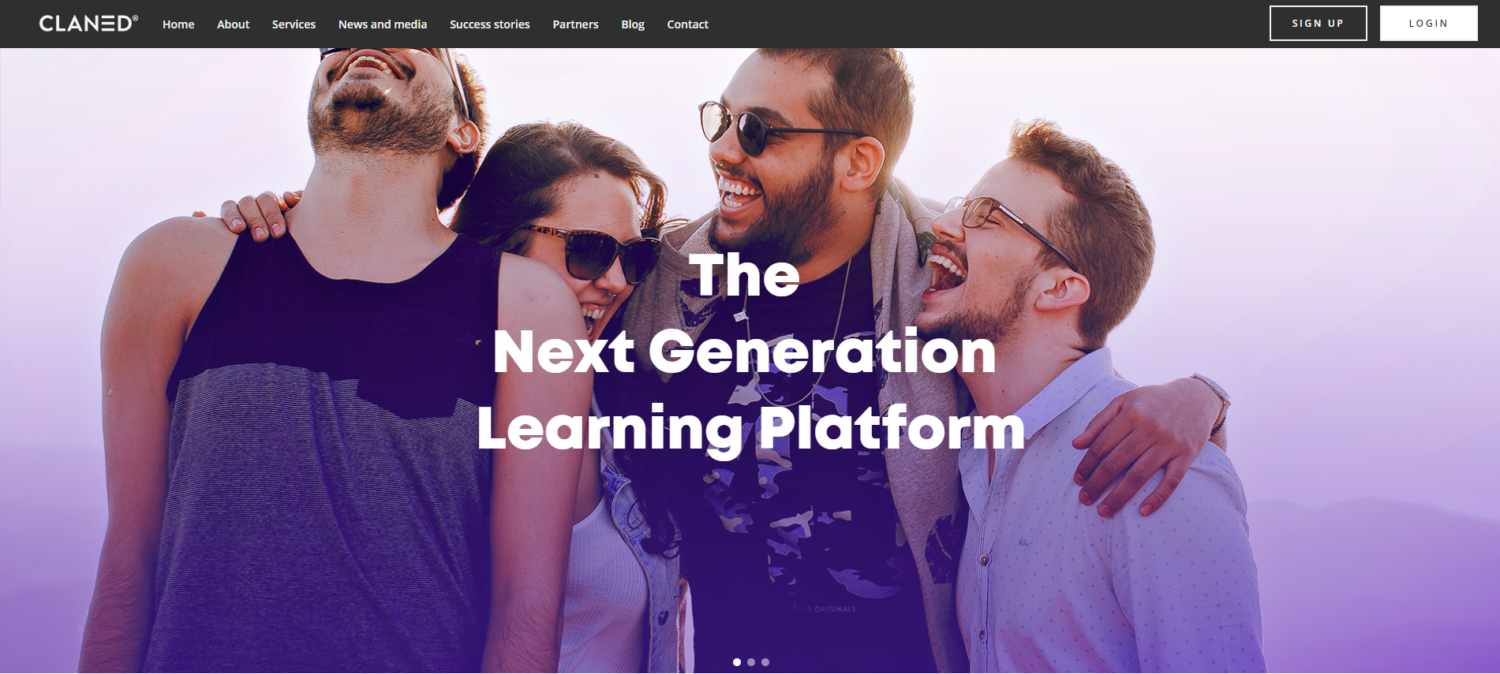
EXAMPLE:
Triba/claned.com | Startup Helsinki 2014
Today 2019
Notes:
this slide created by tsg 29 March 2019 for the Innovative Creativity lecture Bærum Intnl Club
possible cases I can use for slides
ghana oslo
loowatt
the finnish triba
the nhs case

Slide 7
EXAMPLE:
Triba/claned.com | Real ‘Critical Values’
Effectiveness: Understand the Effectiveness
of their Teaching
Drop Out Rate
Profitability
Scope: of content
Employability
Distance Capability
Tool Real Deployment
Visibility of Learning: Transparency
Ranking Effect
Collaboration Capability
Competitive Differentiation
Personal Adaptability
User Experience
Usability
Notes:
this slide created by tsg 29 March 2019 for the Innovative Creativity lecture Bærum Intnl Club
possible cases I can use for slides
ghana oslo
loowatt
the finnish triba
the nhs case

Slide 8
EXAMPLE:
Triba/claned.com | Quantification of a Critical Value
COMPETITIVE DIFFERENTIATION
Type: Complex Top Level University Objective
Version: 18.03.2014 11:38
Owner: CEO (Mervi)
Ambition: “disrupt the education industry” <- Vesa (Founder) 18.3.14
Includes: <subattributes>
Market Penetration Rate
User Growth Rate
Relative Share Price
Bottom Up Adoption
Education Policy Changes
Change of Education Methods
A N D …
Customer Value
Notes:
this slide created by tsg 29 March 2019 for the Innovative Creativity lecture Bærum Intnl Club
possible cases I can use for slides
ghana oslo
loowatt
the finnish triba
the nhs case

Slide 9
EXAMPLE:
Triba/claned.com | Quantification of a Critical Value
COMPETITIVE DIFFERENTIATION
CUSTOMER VALUE
“probably complex but not now”
Type: Elementary ? Objective.
Ambition: <customer delighted long term> <- Vesa (Founder) 18.3.14
Scale: % of defined [Customers/Users/Institutions] who retain or improve on defined [Delight Level] for defined [Periods]
Meter [Universities, Introduction Year] Sampling surveys at least 20% of Users
Notes:
this slide created by tsg 29 March 2019 for the Innovative Creativity lecture Bærum Intnl Club
possible cases I can use for slides
ghana oslo
loowatt
the finnish triba
the nhs case

Slide 10
EXAMPLE:
Triba/claned.com | Quantification of a Critical Value
COMPETITIVE DIFFERENTIATION
CUSTOMER VALUE
Scale: % of defined [Customers/Users/Institutions] who retain or improve on defined [Delight Level] for defined [Periods]
Meter [Universities, Introduction Year] Sampling surveys at least 20% of Users
TOLERABLE at least 70% ?? <- SWAG TG | G1: GOAL at least 90% ?? <- SWAG TG
[Institution = University, Mode = Virtual, Subject = Maths, Size = 100,000, Funding = For Profit, Users = Students, Delight level = Upper 25%, Period = at least 3 years, Deadline = By End 2015 ??, Market = Saudi ]
Notes:
this slide created by tsg 29 March 2019 for the Innovative Creativity lecture Bærum Intnl Club
possible cases I can use for slides
ghana oslo
loowatt
the finnish triba
the nhs case

Slide 11
Elon Musk’s Objectives
Save Human Race
Move Humans to Mars
Save the Earth
Reduce Bad Emissions
Solar Energy
Energy Storage
Force Auto Electrification
Cheaper Attractive El-cars
Car designed for manufacturing
Car designed for extreme safety
Hierarchy of Objectives
Lower short-term objectives support upper longer-term objectives
Usually clear about roadmap, numbers, dates
Track record of accomplishing it
WATCH: https://www.youtube.com/watch?v=u0-pfzKbh2k
Notes:
1 april 2019 as I awoke from sleep idea, add this.

Slide 12
Due diligence doubtful:
Rely on incremental value measures - EVO Earned Value Optimization
Instead of looking at the past, and hoping it tells you about the future, you focus on the measured reality of a complex product/service as it emerges in a realistic practical environment.
With the opportunity to correct the technical design, so as to improve value and save costs.
And to finally stop the investment, when you lose control of current increments.

Slide 13
Creating Competitive Value Visions,
quantitatively
All potential design ideas need to be evaluated quantitatively
their impact on your value requirements
and their costs
Why? *
reduce failures
get results faster
agile prioritization
learning step by step
* claims based on documented experiences such as at Confirmit, NHS and others.
More detail: see your Innovative Creativity book Chapter 5 “Evaluating Strategies… using Impact Estimation Tables”
Notes:
this slide created by tsg 29 March 2019 for the Innovative Creativity lecture Bærum Intnl Club
possible cases I can use for slides
ghana oslo
loowatt
the finnish triba
the nhs case

Slide 14
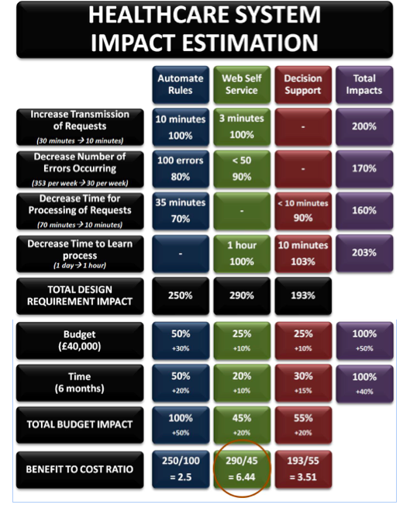
EXAMPLE:
NHS Case: Man-Chie Tse & Ravinder Singh Kahlon
Real NHS Case: Man-Chie Tse & Ravinder Singh Kahlon
see slide notes for links. Gilbfest slides.
Benefit to cost ratio of ‚Web Self Service solution is estimated for
290/45 = 6.44
Notes:
ehealth Lecture 4 Nov 2014 FOR 2017 USE.key
https://www.slideshare.net/IKTNorge/4-b-gilb
Title of 2013 SQM paper:
The principles and application of Planguage for Managing System Innovation
http://www.gilb.com/dl582
Great real pharmaceutical hospital case with real improvements.
up 5 Sept 2013
slides at http://www.gilb.com/dl583
co author and i think on my bcs courses, Mddx student
Man-Chie Tse
London, UK
Man-Chie@dkode.co
www.dkode.co
MORE ON EI TABLES AT
Tom Gilb
Estimating Efficiency of Means for Ends: A Dummies Guide to Impact Estimation Tables
http://concepts.gilb.com/dl937 (Tested link 30 march 2019)

Slide 15
Value Requirements > Solutions > Values to Stakeholders
VALUES
STARTUP TEAM
SOLUTIONS
EVALUATIONS
STAKEHOLDERS
The quantified stakeholder value set is input to the development team.
The team suggests solutions, that they hope will deliver the value levels.
The solutions are evaluated initially on the Value Table,
and when prioritized (based on value, costs, risks),
the team will attempt to deliver the solutions to stakeholders
after which we will measure actual values, costs, and possibly
decide to change the solutions to better deliver values, at lower costs, before
repeating the changed solutions for better effects,
or scaling up (using the solutions more extensively)
Notes:
1 april 2019 as I awoke from sleep idea, add this.

Slide 16
Make an EVO Investment Contract: Small early frequent investment stages based on pre-agreed measurable results
Earned Value Optimization there are 2 technical prerequisites for this, and most people are not trained in how to do them:
ability to quantify all critical values and qualities
2. ability to de-compose large chunks of system building into INDEPENDENTLY IMPLEMENTABLE, AND VALUE DELIVERING smaller incremental deployment steps.

Slide 17
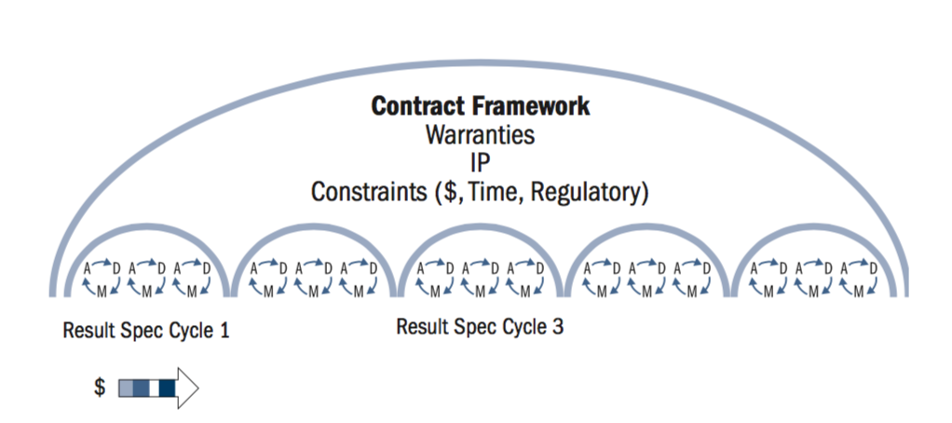
Contract Framework

Slide 18
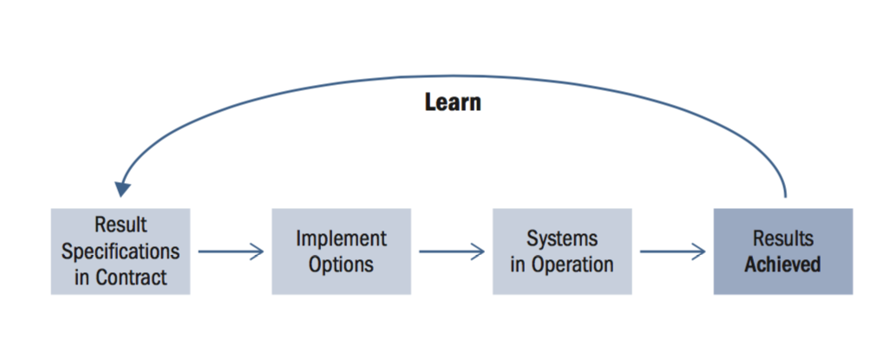
Result Contract Structure

Slide 19
What is a flexible contract?
A ‘flexible contract’ is an adaptive, outcome-based contract, which is intended to maximize the delivery of customer value. It achieves this in several ways:
The contract focuses on outcomes (that is, business objectives), which are less susceptible to change than output (such as features).
The fees (or at least part of the fees) should be payable on the achievement of target outcomes.
The contract is structured as a master services agreement for the full version, or the ‘lite’ version using the Terms and Conditions, under which short-term statements of target outcomes (SOTOs) are called off.
Tom@Gilb.com
Notes:
www.flexiblecontracts.com

Slide 20
What is a flexible contract?
Define what you want, as you go, in small increments.
Learn what works.
Focus on business results, not ‘code’.
Pay for real value delivered.
Prioritize high value results early.
Very low risk.
Not tied in to suppliers who cannot deliver.
Tom@Gilb.com
Notes:
www.flexiblecontracts.com

Slide 21
Your investment contract needs to be based on numeric values, and motivational investments
This is an unusual form of contracting, and investment. Most conventional thinking pays for effort, or a fixed price. It might be obvious that ideally we pay for real value as it emerges in practice, but the question is how to organize that.
The main key is to be able to quantify and measure the critical and high level values.
The second planning capability is dividing large efforts (months and years) into smaller value delivery packages. Many people give up. They cannot see how. So they fall back on paying for effort or a fixed price.
If you can pay as value emerges, then people are motivated to find out how to deliver that value, instead of inflating your costs, and failing 19 of 20 startups.

Slide 22
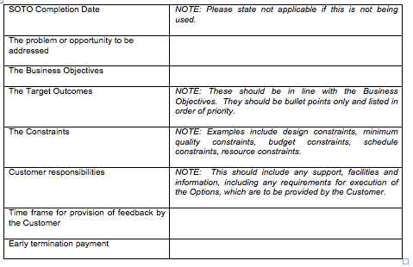
(from contract template) short-term Statements Of Target Outcomes
SOTO Specification
Tom@Gilb.com
Notes:
www.flexiblecontracts.com

Slide 23
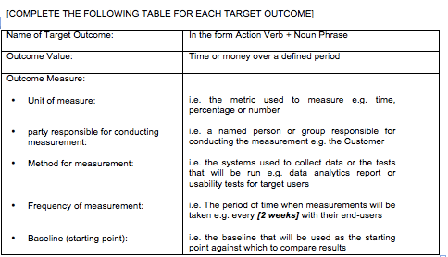
SOTO Specification
(from contract template) short-term Statements Of Target Outcomes
Tom@Gilb.com
Notes:
www.flexiblecontracts.com

Slide 24
Decompose the problem into smaller critical value increments: do the best value-to-cost increments first
We are not talking about any arbitrary decompositions, such as bill of materials.
The decomposition must be at the SYSTEMS LEVEL for a component.
That means the increment must contain all necessary elements to actually deliver our value: hardware, data, logic, internet, trained people, motivation, support systems, maintenance capability, and more.
Most everybody needs guidance, coaching, training at this decomposition form: but I find that smart people learn quickly, same day, or same hour, how to do it.
But they never learned it at a university.

Slide 25
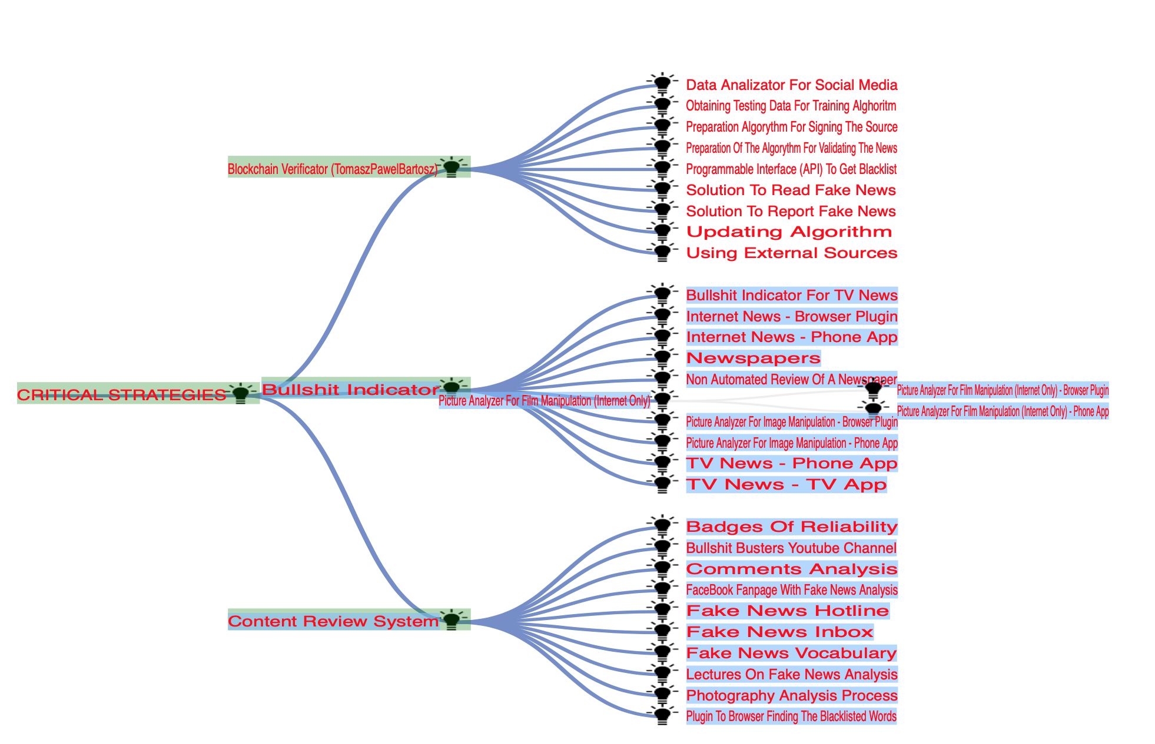
Decomposing
EXAMPLE: FAKE NEWS CONTROL (needandmeans.com), 2018
to big
to
priority immediate value delivery
Notes:
The Value Planning Decomposition Chapter
Here’s a link to “Ch 5 Decomposition by Value” in my Dropbox:
https://tinyurl.com/VPDecomposition
source of diagram Polish FAKE NEWS CONTROL Leadership In Industry Gilb.com 2018

Slide 26
Decomposing ‘too big’
all ‘big designs’ can and should be decomposed into small (weekly) implementations
the most critical values/costs designs should be implemented early
if you do not know how to do this, it is a teachable discipline*.
Smart people can do it without being taught,
perseverance, imagination, and domain knowledge works well.
* https://tinyurl.com/VPDecomposition and ‘Innovative Creativity’ book Chapter 6, “Decomposition”
Notes:
The Value Planning Decomposition Chapter
Here’s a link to “Ch 5 Decomposition by Value” in my Dropbox:
https://tinyurl.com/VPDecomposition
source of diagram Polish FAKE NEWS CONTROL Leadership In Industry Gilb.com 2018

Slide 27
Decomposing ‘too big’ – why?
values/costs should be very good immediately
failed ideas can be corrected early (‘lean’)
visible results for shareholders/funders
clear value/money attracts capital investment
learning fast, and ‘tuning forward plans’ fast
‘startup-on-shoestring’ is possible
sub-contractor control value/money
19/20 startup failure is structurally impossible (if you shut down, after failed delivery steps)
Notes:
The Value Planning Decomposition Chapter
Here’s a link to “Ch 5 Decomposition by Value” in my Dropbox:
https://tinyurl.com/VPDecomposition
source of diagram Polish FAKE NEWS CONTROL Leadership In Industry Gilb.com 2018

Slide 28
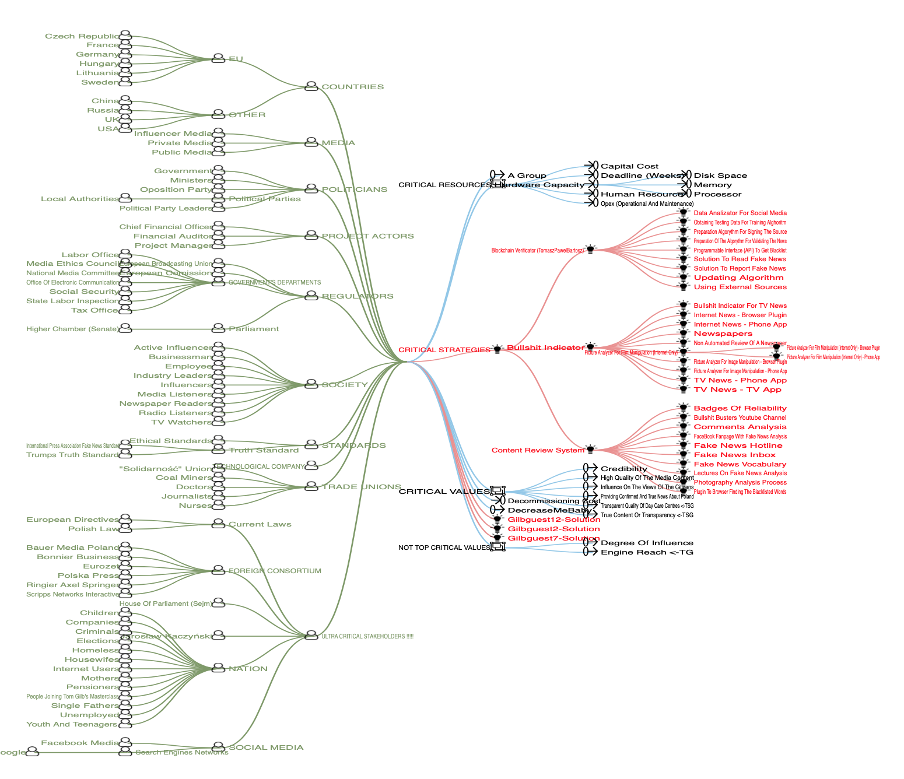
Some decomposition Options
EXAMPLE: FAKE NEWS CONTROL (needandmeans.com), 2018
Notes:
source Polish FAKE NEWS CONTROL Leadership In Industry Gilb.com 2018
Slide explanation:
There are several types of system component that we can decompose, in order to extract smaller parts of the system to evaluate (values/costs) and to prioritize for earlier implementation.
Stakeholders: deliver to one stakeholder at a time
Values, deliver one value increment for one value at a time (2 tricks here)
Strategies (Solutions, designs) deliver a single distinct solution at a time.
1 April 2019

Slide 29
Stakeholders
EXAMPLE: FAKE NEWS CONTROL (needandmeans.com), 2018
Notes:
source Polish FAKE NEWS CONTROL Leadership In Industry Gilb.com 2018
Slide explanation:
There are several types of system component that we can decompose, in order to extract smaller parts of the system to evaluate (values/costs) and to prioritize for earlier implementation.
Stakeholders: deliver to one stakeholder at a time
Values, deliver one value increment for one value at a time (2 tricks here)
Strategies (Solutions, designs) deliver a single distinct solution at a time.
1 April 2019

Slide 30
Values
EXAMPLE: FAKE NEWS CONTROL (needandmeans.com), 2018
Notes:
source Polish FAKE NEWS CONTROL Leadership In Industry Gilb.com 2018
Slide explanation:
There are several types of system component that we can decompose, in order to extract smaller parts of the system to evaluate (values/costs) and to prioritize for earlier implementation.
Stakeholders: deliver to one stakeholder at a time
Values, deliver one value increment for one value at a time (2 tricks here)
Strategies (Solutions, designs) deliver a single distinct solution at a time.
1 April 2019

Slide 31
Solutions
EXAMPLE: FAKE NEWS CONTROL (needandmeans.com), 2018
Notes:
source Polish FAKE NEWS CONTROL Leadership In Industry Gilb.com 2018
Slide explanation:
There are several types of system component that we can decompose, in order to extract smaller parts of the system to evaluate (values/costs) and to prioritize for earlier implementation.
Stakeholders: deliver to one stakeholder at a time
Values, deliver one value increment for one value at a time (2 tricks here)
Strategies (Solutions, designs) deliver a single distinct solution at a time.
1 April 2019

Slide 32
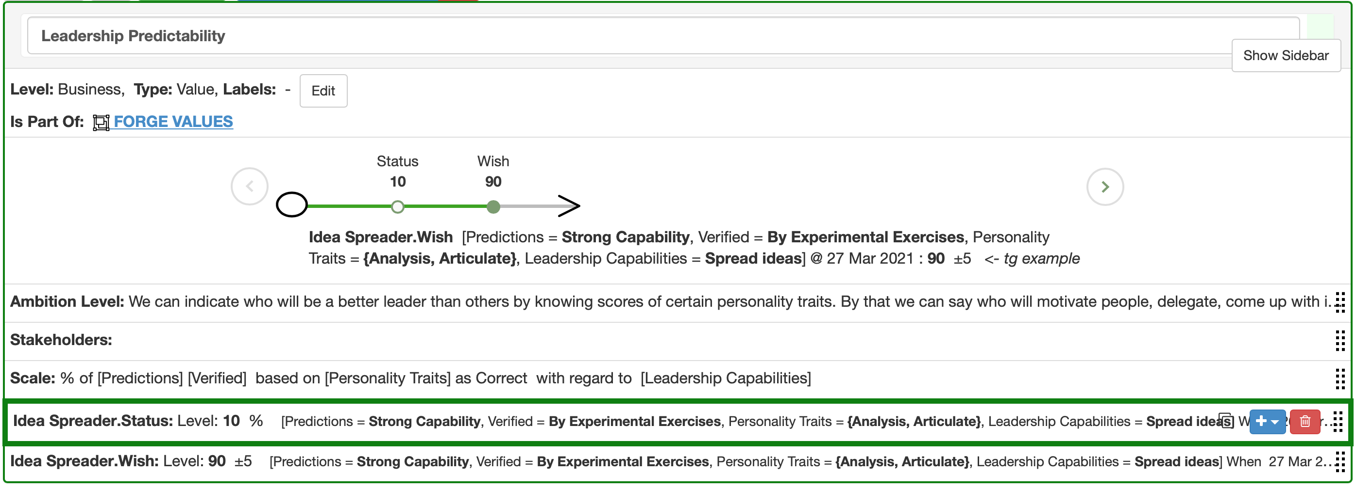
Decomposition of a Value, by using 4 ‘Scale Parameters’
EXAMPLE: Cognition Forge Startup Oslo March 2019
This target is a narrow slice but a critical slice of value delivery
Notes:
mr.sarnecki@gmail.com worked with me to develop this non-confidential initial example for his startup, which evaluates professional capabilities such as Leadership ability
March 2019

Slide 33
Decomposition technique, value level
EXAMPLE: Cognition Forge Startup Oslo March 2019
“Leadership Predictability” scale parameters,
with sub-dimensions.
Notes:
mr.sarnecki@gmail.com worked with me to develop this non-confidential initial example for his startup, which evaluates professional capabilities such as Leadership ability
March 2019

Slide 34
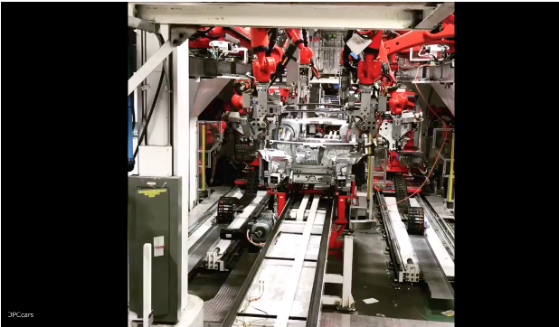
Tesla: “20 production improvements per week” = Agile Car Manufacturing
(50% Hardware) . This is the same as our ‘Evo’, Dynamic Design to cost
of which the Startup week is the first planning step.
Elon Reeve Musk - Chairman & Chief Executive Officer Tesla.
“Okay, I think that's a pretty open-ended questions, but – we have a philosophy of just continuous improvements, so every week there are approximately 20 engineering changes made to the car.
So it's not nearly as discrete as you're alluding to. With other manufacturers, they tend to sort of bundle everything together in a model year.
In our case, it's a series of rolling changes. So model year doesn't mean as much. There are cases where that step change may be a little higher than normal as, for example, with having the Autopilot camera, radar, and ultrasonics.
But we try to actually keep those step changes as small as possible.
And so that – I mean, essentially like the common questions that I get is from friends, they say, "when should I buy a Model S?" and my answer's always "right now," because – and they say, "well, aren't you going to make a better one in six months?" I'm like, yeah, of course.
But if their goal is to only buy a Model S when there aren't significant improvements happening, then they will never buy one."
Source Gilb, Value Planning book, Quote 5.3 A. Musk on eternal continuous Tesla improvement.20/week x 50 weeks = 1,000 improvements per year. Source: http://seekingalpha.com/article/3642146-tesla-motors-tsla-elon-reeve-musk-on-q3-2015-results-earnings-call-transcript?page=2&p=qanda&l=last
November 3 2015.
The point here
is about
1. very small incremental value delivery steps
2. decomposition into such small steps
Actual Video on Next slide
Musk says in this video
Model 3 has 10,000 parts
Notes:
https://www.youtube.com/watch?v=ukthS5yjYRU

Slide 35
Use a Value ‘Investment Estimation Table’ to analyze your options, and track your payback
A Value Investment EstimationTable (VIET) gives you a systematic overview over all critical values, and all proposed technical solutions, together with the effectiveness of the solutions on all values, and all their costs short term and long term.
Think of a VIET as a budgeting, auditing, and accounting system for technical values and costs, of a complex system.
The VIE Table really does what the Balanced Scorecard tried to do but failed to do
(for lack of quantification of the ‘other side of the scorecard’) www.gilb.com/DL135
Notes:
Value Analysis table Investment model tool
What is Wrong with Balanced Scorecard, slides
http://www.gilb.com/DL135

Slide 36
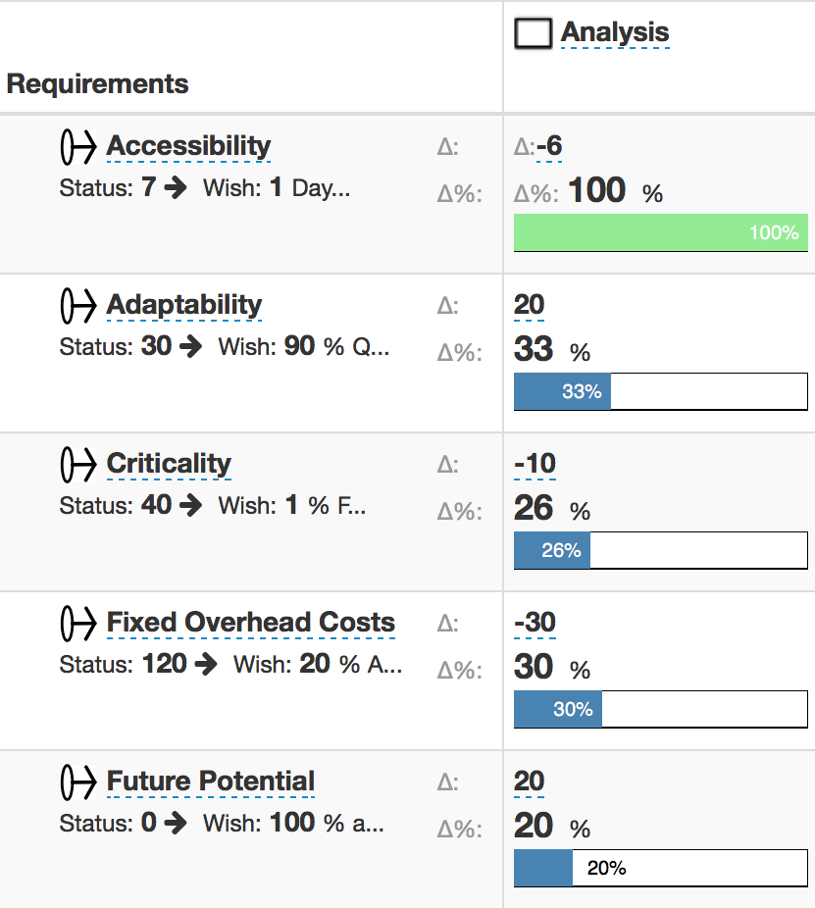
Estimation of potential benefits from implementing the ‘Analysis’ solution
Value Investment Estimation Table
IMPACTS
main effect
side effects
Delta - 6 means we estimate an improvement beyond the baseline of 6
20% means, we estimate it gets us 20% of the way to our desired benefit level by deadline

Slide 37
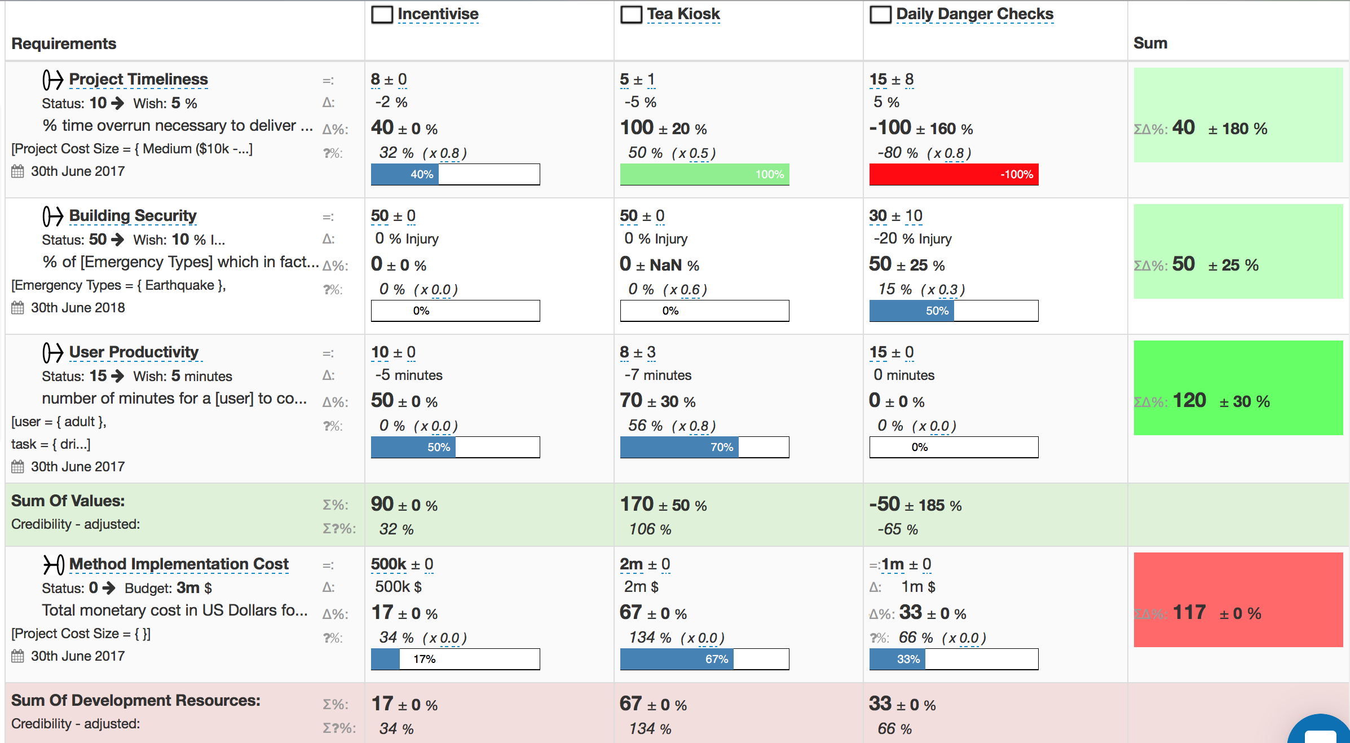
The numeric relation between ends and means
Basic Structure of a Value
Investment Estimation Table
MEANS
ENDS

Slide 38
Investment Management
Consequences of a Value Table tool
It is possible to estimate the benefits we can expect from our strategies.
We can include various best-available degrees of credibility.
‘Eexperts’ and opinionated people are forced to take responsibility for their suggested ‘means’.
We can use these estimates to prioritize delivery of best benefits for resources wt risks.
We have another method for decomposition into smaller benefits deliverables (Values x Strategies numbers = decomposition density).
We are ‘forced’ to see the side effects of strategies, and their costs.
This is ‘benefits management engineering’ in practice.
Then next step is to feed back incremental measures of benefits achieved and track progress.
Notes:
slide created 9 sept 2017 tsg

Slide 39
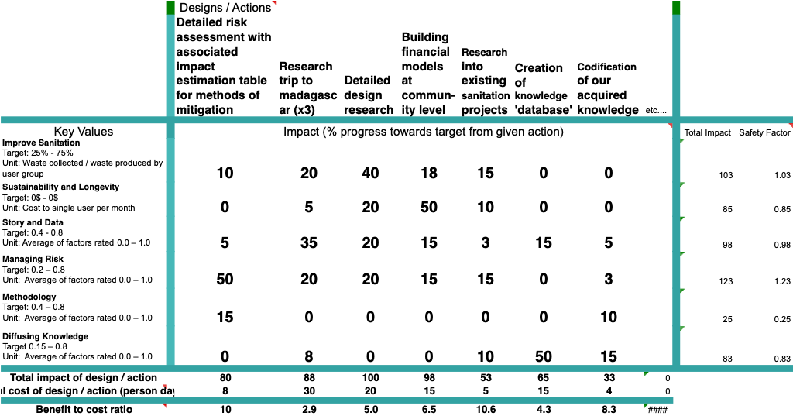
An Energy Producing Waterless Toilet System
EXAMPLE: Impact Estimation Table for Gates GCE Project
Notes:
TEDx
So, Kai and I volunteered a day, to guide the team into quantifying their objectives and strategies, on an impact estimation table
Nick told me later that they felt that this clarification had helped the team keep the big picture focussed.
Recently (End June 2013) he told me that this Loowatt team had spread the word to the many sister projects that this way of thinking was valuable, and it was spreading

Slide 40
Feedback from Loowatt
They continued to use the planning method throughout the 14 month project
”because it helped keep them on track to the real critical objectives.
They highly recommended to their 20 parallel incubator projects, that they should also use these methods, for planning their startups
Notes:
The Value Planning Decomposition Chapter
Here’s a link to “Ch 5 Decomposition by Value” in my Dropbox:
https://tinyurl.com/VPDecomposition
source of diagram Polish FAKE NEWS CONTROL Leadership In Industry Gilb.com 2018

Slide 41
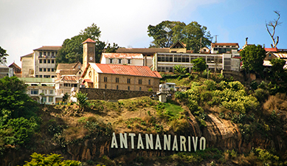
Winners - 13.09.2013
The Bill & Melinda Gates Foundation has awarded Loowatt Ltd a $1 million grant to expand its pioneering waterless toilet systems in Madagascar and Sub-Saharan Africa.
Notes:
The Value Planning Decomposition Chapter
Here’s a link to “Ch 5 Decomposition by Value” in my Dropbox:
https://tinyurl.com/VPDecomposition
source of diagram Polish FAKE NEWS CONTROL Leadership In Industry Gilb.com 2018

Slide 42
Large Investment Failure is impossible if you have Incremental Investment, and can stop when increments fail to deliver value
If your investment carries out about 50 weekly incremental value delivery steps per year: and steps 1 to 30 are delivered as expected; but the last 3 steps totally failed to delivery value - then ask yourself how much more you want to invest when the startup team is clearly ‘out of their depth’
Your own rule of when to stop investing, will determine how much money you can lose. You are on a path with ‘diminishing returns on investment’.
Remember what Einstein said about the definition of ‘Investment Insanity’ ?
see the slide presenter notes for some thoughts on what to do when your steps fail, and you feel continuing is a bad investment
Notes:
Zero fail investment
How do you get restarted?
try an entirely different technology or solution
make the development team win back trust be succeeding at their own cost of time, if they want your continued investment
do root cause analysis of why it is failing
keep in mind that , by design, you are choosing to do the highest value for money, and least risky steps: so if they totally fail, there are no better options to continue with (if you have understood technology and stakeholders correctly).

Slide 43
”
The definitione of insanity is doing the same thing over and over again and expecting different results.
- Albert Einstein
Notes:
Zero fail investment
How do you get restarted?
try an entirely different technology or solution
make the development team win back trust be succeeding at their own cost of time, if they want your continued investment
do root cause analysis of why it is failing
keep in mind that , by design, you are choosing to do the highest value for money, and least risky steps: so if they totally fail, there are no better options to continue with (if you have understood technology and stakeholders correctly).

Slide 44
whats your stopping rule?

Slide 45
You can compute the next Investment Increment based on your own value/cost/risk priorities
If you are feeling rich and lucky, you can prioritize steps based on value alone.
If you need to manage resources, you can use the Values/Costs ratio to prioritized next investment steps.
If you want to reduce risk, you will take into account the ± uncertainty of the estimates, and the credibility level of the estimates too.
Your choice.

Slide 46
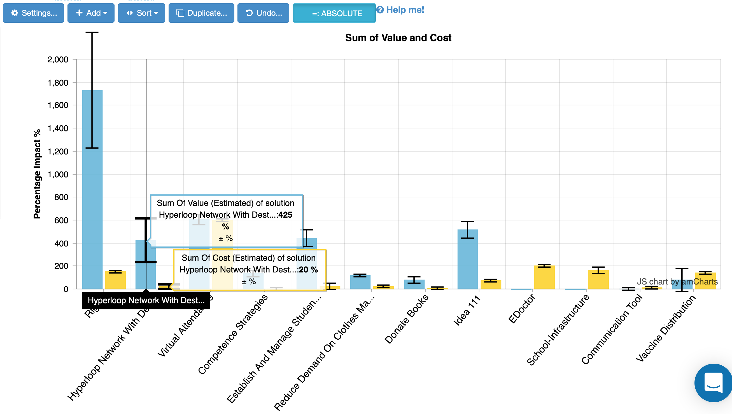
Presenting ‘Design Value-and-cost impacts’, with risks
EXAMPLE: The bar chart is from 2017 OSWA Workshop and using tool needsandmeans.com,
Project called = Global Education and Health
Sorted by High Value/cost wrt worst case
Notes:
source is Katowice version of IET for Dummies
The bar chart is from 2017 OSWA Workshop and using tool needsandmeans.com, Project called = Global Education and Health
Sorted by High Value/cost wrt worst case
Tom Gilb
Estimating Efficiency of Means for Ends: A Dummies Guide to Impact Estimation Tables
http://concepts.gilb.com/dl937 (Tested link 30 march 2019)

Slide 47
You can set the stage for Incremental Investment with a One Week Project Startup
One week should allow you to quantify values, estimate effects of strategies, and find early investment increments to get some experience with delivering value and investing.

Slide 48
The One-Week Project-Startup Process to launch real value delivery
We practice a 1 week project startup
follow by weeks of value stream delivery
of increments of the value objectives
day 1, the top 10 critical value objectives are drafted
day 4 the next week value delivery ‘sprint’ is planned
www.gilb.com/dl568

Slide 49
The ´Evo´ Planning Week at DoD
Monday
Define top Ten critical objectives, quantitatively
Agree that thee are the main points of the effort/project
Tuesday
Define roughly the top ten most powerful strategies for enabling us to reach our objectives on time
Wednesday
Make an Impact Estimation Table for Objectives/Strategies
Sanity Test: do we seem to have enough powerful strategies to get to our Goals, with a reasonable safety margin?
A tool for decomposing the value steps and seeing best value for resources
Thursday
Divide into rough delivery steps (annual, quarterly)
Derive a delivery step for ‘Next Week’
Friday
Present these plans to approval manager (Brigadier General Pellicci)
get approval to deliver next week
(they can´t resist results next week!
Notes:
Added to Evo slides by TG April 8 2008 Krakow
http://a52.g.akamaitech.net/f/52/827/1d/www.space.com/template_images/top10/spc_top10_mainimg_440.jpg
http://farm2.static.flickr.com/1236/1373197020_6eab10997a_o.jpg

Slide 50
”
Life is pretty simple:
You do some stuff. Most fails. Some works. You do more of what works. If it works big, others quickly copy it.
- Leonardo da Vinci

Slide 51
For more detailed follow-up
Innovative Creativity
https://www.gilb.com/offers/FnExtaw9
FREE GIFT REVIEW COPY FOR YOU ALONE.
NO COUPON CODE REQUIRED.

Slide 52
Value Vision Validation - The Investment Model
I. VALUE VISIONS WEEK
Startup Startup: Objectives, Strategies, Effects Estimation, Decomposition, Prioritization, GO/NOGO
II. VISION DELIVERY WEEK
Create Sub.strategy
Increment the Sub-strategy
Measure Value increment & costs
III. REWARD VISION DELIVERY
% Payment, for main planned value
Notes:
drawings resulted from google ‘setting visions and goals’ 2 april 2019

Slide 53
Value Vision Validation - The Investment Model
IV. EVALUATE NEXT VISION DELIVERY STEP
Update Value Table & Costs
Adjust Strategy Specs (experience, new ideas)
Compute Sub-strategy effects
Prioritize Next Step
Repeat Step 2
or stop and declare victory,
if no profitable enough steps available
or if all Goal levels reached.
V. VICTORY WALTZ
Stop the product development effort, until new Visions (then 1)
Continue selling what is developed.
Notes:
drawings resulted from google ‘setting visions and goals’ 2 april 2019

