Slide 1
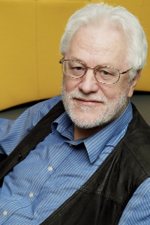
Verdi som prosjektfokus:
Smidig verdileveranse, ikke ‘kodeleveranse’
or
‘Value Driven Agile Project Management’
Innleder: Tom Gilb, selvstendig konsulent og foredragsholder. www.gilb.com, Tom@Gilb.com
Bankene, som mange andre organisasjoner, er gått lei av IT fiaskoer,
og gått lei av av smidig fokus på «IT leveranser» (ikke fokus på ‘bank resultater’).
Flere internasjonale banker har på bestemt seg for å bli kvitt den «teknologiske» tankegang.
I stedet skal fokus være på smidig forbedring av kompetanse.
Innlegget ser på hvordan er dette verdi-skifte gjort, og hva siste utvikling på området er.
‘Smidig utvikling og prosjektledelse'
NFP Temamøtet avholdes i Dr. Maudsgate 15, 1. etasje, 8. mars 2019 kl 09-12
Denne gangen vil bank/finans dele sine erfaringer og synspunkter
This talk 30-35 minutes (1 minute per slide average)
Most slides are in english, but I expect to hold the talk in NOrwegian,and their are a few slides in Norwegian.
Tom
fra Kolbotn
Version 050319, added Scale Free 3.3 kopi på http://tinyurl.com/NFP8MARS

Slide 2
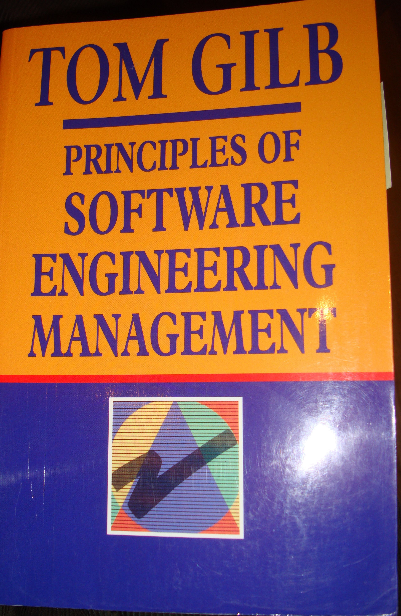
Agile Credibility
Agile ‘Grandfather’ (Tom)
Practicing ‘Agile’ IT Projects since 1960 (Dobloug, Oslo)
Preaching Agile since 1970’s (Computer World column UK)
Acknowledged Pioneer by Agile Manifesto Gurus, and Research
See Presenter’s Notes to this slide for detail
Agile Practice
IT: decades (Kai and Tom)
Organisations: Decades. Some selected examples.
Citigroup, JP Morgan, Deutsche Bank, UBS, Credit Suisse,
Intel, HP, Boeing, Confirmit AS 2003, Universitetsforlaget 1968, Ericsson, NTNU IT, Philips
Books:
‘Software Metrics’ (1976)
‘Principles of Software Engineering Management’ (1988)
‘Competitive Engineering’ (2005)
‘Evo’: (Kai, evolving, 55 iterations)
‘Value Planning’ (2014-2019)
5 Books in 2018 (see gilb.com):
LD, IC, 100 PPP, Technoscopes, Clear Communication
See this slide’s Presenter Notes for more detail,
even 1976 SM book quotes), LIKE
'A complex system will be most successful, if it is implemented in small steps,
and if each step has a clear measure of successful achievement, as well as a "retreat" possibility
to a previous successful step, upon failure.' (SM BOOK 1976 p. 214)
© Gilb.com
UPDATE 010319
Notes:
Agile References: per 1 March 2019 (see end for quotes from my 1976 and 1988 books on ‘agile’.)
"Tom Gilb invented Evo, arguably the first Agile process. He and his son Kai have been working with me in Norway to align what they are doing with Scrum.
Kai has some excellent case studies where he has acted as Product Owner. He has done some of the most innovative things I have seen in the Scrum community."
Jeff Sutherland, co-inventor of Scrum, 5Feb 2010 in Scrum Alliance Email.
“Tom Gilb's Planguage referenced and praised at #scrumgathering by Jeff Sutherland. I highly agree" Mike Cohn, Tweet, Oct 19 2009
“I’ve always considered Tom to have been the original agilist. In 1989, he wrote about short iterations (each should be no more than 2% of the total project schedule). This was long before the rest of us had it figured out." Mike Cohn http://blog.mountaingoatsoftware.com/?p=77
Mike Cohn says: January 16, 2009 at 9:41 pm
Tom does, indeed, have excellent advice on non-functional requirements (as well as every other type of requirement). I’d encourage everyone to read his Competitive Engineering book as well as his Principles of Software Engineering Management book. By the way, my company is named after his “Mountain Goat” principle in that book:
@RonJeffries “I think tom gilb's evo pre-dated scrum."
Comment of Kent Beck on Tom Gilb’s book , “Principles of Software Engineering Management”: “ A strong case for evolutionary delivery – small releases, constant refactoring, intense dialog with the customer”. (Beck, page 173).
In a mail to Tom, Kent wrote: “I'm glad you and I have some alignment of ideas. I stole enough of yours that I'd be disappointed if we didn't :-), Kent” (2003)
"But if you really want to take a step up, you should read Tom Gilb. The ideas expressed in Principles of Software Engineering Management aren’t quite fully baked into the ADD-sized nuggets that today’s developers might be used to, but make no mistake, Gilb’s thinking on requirements definition, reliability, design generation, code inspection, and project metrics are beyond most current practice." Corey Ladas http://leansoftwareengineering.com/2007/12/20/tom-gilbs-evolutionary-delivery-a-great-improvement-over-its-successors/
Jim Highsmith (an Agile Manifesto signatory) commented: “Two individuals in particular pioneered the evolution of iterative development approached in the 1980’s – Barry Boehm with his Spiral Model and Tom Gilb with his Evo model. I drew on Boehm’s and Gilb’s ideas for early inspiration in developing Adaptive Software Development. …. Gilb has long advocated this more explicit (quantitative) valuation in order to capture the early value and increase ROI” (Cutter It Journal: The Journal of Information Technology Management, July 2004page 4, July 2004).
Ward Cunningham wrote April 2005: “Tom -- Thanks for sharing your work. I hope you find value in ours. I'm also glad that the agile community is paying attention to your work. We know (now) that you were out there ahead of most of us. Best regards. – Ward”, http://c2.com
Robert C. Martin (Agile Manifesto initial signatory, aka Uncle Bob): "Tom and I talked of many things, and I found myself learning a great deal from him. The item that sticks most prominently in my mind is the definition of progress.", "Tom has invented a planning formalism that he calls Planguage that captures this idea of customer need. I think I'm going to spend some serious time investigating this. " from http://www.butunclebob.com/ArticleS.UncleBob.TomGilbVisit
'1985: perhaps the first explicitly named, incremental alternative to the “waterfall” approach is Tom Gilb’s Evolutionary Delivery Model, nicknamed “Evo” '
http://guide.agilealliance.org/timeline.html
Gilb T. (1985). "Evolutionary Delivery versus the "waterfall model" " ACM SIGSOFT, http://dl.acm.org/citation.cfm?id=1012490
Mary Poppendieck, 2012
In 1988, Tom Gilb wrote the book Principles of Software Engineering Management, which is now in its 20th printing. One of the earliest advocates of evolutionary development, he has recently reiterated the elements of good software engineering in an article in Agile Record[2], from which I quote liberally
http://poppendieck.blogspot.com/2010/12/product-owner-problem.html
"By the way you should know I call you, Jerry Weinberg, and Tom DeMarco the “grandfathers of Software Agile Development” :)"
- Mike Beedle (7.Jan2016) RIP 2018
Mike Beedle is the author of the first Scrum book (with Ken Schwaber), the author of the first Scrum paper published (with Jeff Sutherland, Ken Schwaber, Martine Devos and Yonat Sharon), and co-author of the Agile Manifesto. He is also the author of the Enterprise Scrum Definition and the upcoming Enterprise Scrum book.
Agile History…
Historical Roots of Agile Methods:
Where did “Agile Thinking” Come from?
Noura Abbas, Andrew M Gravell, Gary B Wills
School of Electronics and Computer Science, University of Southampton
Southampton, SO17 1BJ, United Kingdom
( Oct 10 2008)
http://eprints.ecs.soton.ac.uk/16606/1/xp2008camera_ready.pdf
"Agile ideas appeared in old development processes as well. In 1985, Tom Gilb wrote “Evolutionary Delivery versus the ‘Waterfall model’”. In this paper Gilb introduce the EVO method as an alternative of the waterfall which he considered as “unrealistic and dangerous to the primary objectives of any software project”. Gilb based EVO on three simple principles [17]:
• Deliver something to the real end-user
• Measure the added-value to the user in all critical dimensions
• Adjust both design and objectives based on observed realities “
----------------------------------------------------
A "Must Read" Book, February 24, 2006
By Scott W. Ambler "Author, Agile Database Techn... (Toronto, Canada) - See all my reviews
Tom Gilb, the father of the Evo methodology, shares his practical, real-world experience for enabling effective collaboration between developers, managers, and stakeholders in this book. Although the book describes in detail Planguage, a specification language for systems engineering, the methodological advice alone is worth the price of the book. Evo is one of the truly underappreciated agile methodologies and as a result Gilb's thought-provoking work isn't as well known as it should be, although I suspect that this will change with this book. The book describes effective practices for requirements and design specification that are highly compatible with the principles and practices of Agile Modeling, yet it goes on to address planning activities, quality, and impact estimation. I suspect that this book will prove to be one of the "must read" software development books of 2006.
Jan 13 2008:
http://leansoftwareengineering.com/2007/12/20/tom-gilbs-evolutionary-delivery-a-great-improvement-over-its-successors/
"But if you really want to take a step up, you should read Tom Gilb.
The ideas expressed in Principles of Software Engineering Management aren’t quite fully baked into the ADD-sized nuggets that today’s developers might be used to, but make no mistake, Gilb’s thinking on requirements definition, reliability, design generation, code inspection, and project metrics are beyond most current practice." Corey Ladas
----------------------------
and link to
https://www.dropbox.com/sh/n7f96zfchf4vivp/AABzsPD52DAxoxZsNauc5Zrga?dl=0
If you want to read our Gilb Mythodology columns in Agile Record.
about 11 short papers on various Agile subjects.
———————
Apparently I am credited as a general source of Ideas in Prince2 Agile, My ideas around value, quantification, according to Keith Richards (2015, 2017). 9.4.2 Defining Benefits and Value.
http://www.brendanmartin.com/prince2-agile-booklist/
Roko Roic 2016
https://youtu.be/8C5ePOs3Rok
Credits me 1976 SM book and 1988 PoSEM book
----------------------------------
GARTNER GROUP RECOGNIZES THE ROOTS OF AGILE
diagram won’t paste here so see
https://twitter.com/imtomgilb
og google Gartner Group TheAgile Family Tree
OUR WEBSITE FOR ALL DOWNLOADS
http://concepts.gilb.com/file24
This will contain all old papers, slides etc and newer ones than this
----------------------------------------------------------------------------
HERE ARE SOME REFERENCES TO MY EARLY ‘AGILE’ IDEAS FROM MY 1976 BOOK AND PUBLISHED ARTICLES
Source: T. Gilb, Software Metrics, October 1976, (Winthrop).
'Evolution is a designed characteristic of a system development which involves gradual stepwise change.' (p. 214)
On step results measurement and retreat possibility
'A complex system will be most successful if it is implemented in small steps and if each step has a clear measure of successful achievement as well as a "retreat" possibility to a previous successful step upon failure.' (p. 214)
On minimizing failure risk, using feedback, correcting design errors
'The advantage is that you cannot have large failures.
You have the opportunity of receiving some feedback from the real world before throwing in all resources intended for a system, and you can correct possible design errors before they become costly live systems.' (p. 214)
On total project time
'The disadvantage is that you may sometimes have to wait longer before the whole system is functioning. This is offset by the fact that some results are produced much earlier than they would be if you had to wait for total system completion.
It is also important to distinguish between a date for total system operation and a date for total "successful" system operation.' (p. 215)
On the general applicability
'Many people claim that their system cannot be put into operation gradually. It is all or nothing. This may conceivably be true in a few cases . . . I think we shall find that virtually all systems can be fruitfully put-in in more than one step, even though some must inevitably take larger steps than others.' (p. 215)
A measure of degree of evolution
'A metric for evolution is degree of change to system "S" during any time interval "t".' (p. 214)
On risk and predicting requirements
'Risk estimates plus/minus worst case are key to selection of step size', and 'Saving of analysis of future real world'. (p. 217)
The first remark is recognition that step sizing is determined by the need to control risk of failure. It is not small steps in themselves which are important. A large step may be taken if the risk is under control; for example by using contract guarantees or known technology. The second remark is recognition that the evolutionary method avoids the need to predict requirements and environments in the future; it allows us to wait until the future has arrived, to see the current requirements and the current environment.
On the scientific experiment analogy
'The concept of stability (where evolution is a technique for achieving stability) at individual levels of a system has the same usefulness as the concept of keeping all-factors-except-one constant in a scientific experiment. It allows systematic and orderly change of systems where the cause and effect may be more accurately measured without interfering factors, which may cause doubt as to the reason for good or bad results.' (p. 217)
'Systems may be specifically designed to go through a revolution in several phases, where only one level of the system is changed significantly at a time.' (pp. 217-8)
Evolutionary modularity design: conflict and priority
On p. 187 I raised the issue of 'Modularity division criteria', and gave six examples of rules for dividing software modules. Rule six was 'By calendar schedule of need of module' and the explanation for this rule was: 'Early implementation; evolutionary project develop.'
'Each rule can conflict with other modularization rules and with other design criteria. Resolution of the conflict can be achieved by a clearly stated set of priorities'.
This is a forerunner to the present perception of step design and selection being based on those elements of the total system which will contribute the greatest value towards stated objectives at the least development resource cost.
Later writings on the subject
The evolutionary idea was developed in my articles in the trade press:
'Evolutionary Planning and Delivery: an Alternative', Computer Weekly, 2 August 1979;
'Evolutionary Planning can prevent Failures', Computer Data, Canada, April 1979, p. 13;
'Realistic Time/Cost Data', Computer Weekly, 16 August 1979;
'Eleven Guidelines for Evolutionary Design and Implementation', Computer Weekly, 12 March 1981;
and 'The Seventh Principle of Technology Projects: Small Steps will Result in Earlier Success', Computer Weekly, 30 July 1981.
In all there were about 122 Gilb's Mythodology Columns in Computer Weekly (UK), which developed many of the ideas in this book.
Should any researchers wish copies of any of this, they are in my personal archives in NOrway. They were before internet of course. Let me know if you want to host copies of these for historic purposes.
POSEM
As referenced above, my 1988 PoSEM book was full of my Evo ideas. Here is 1 chapter where I surveyed the history, and you can still buy the book if you want the full picture.
Gilb: Principles of Software Engineering Management, (1988)
Pearson.
Chapt 15 Deeper Perspectives on Evolutionary Delivery
www.gilb.com/dl561

Slide 3
Gartner Group 2018
Gilb
Notes:
added 1 march 2019 tsg

Slide 4
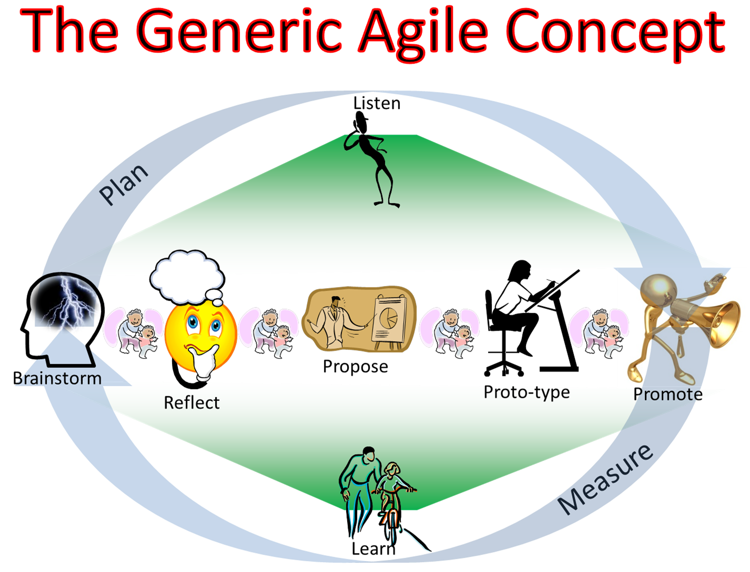
Defining ‘Agile’
Smidig =
Alle tiltak som muliggjør
høye prioriterte resultater
til tross for
stadige endringer i alt mulig
“Any set of tactics that enable a prioritised stream of useful results, in spite of a changing environment”
TsG 7 June 2013, for UK Bank Board (SLC)
A focus on ‘Agile’,
is the wrong level of focus.
Using agile tactics that ‘work’, is a good idea.
Focus on results, no matter what
Agile ‘means’, to improve the results ‘ends’,
are only as good as the improvement
in results
that are a consequence of using agile.
m.a.o.
Smidige metoder er bare ett middel,
blant mange,
for å levere prosjekt-resultater.
de skal bare brukes
når de gir ‘nytteverdi’: -
ikke ‘alltid’ i alle prosjekter
© Gilb.com
Notes:
http://www.google.com/imgres?imgurl=http://keepingagile.files.wordpress.com/2012/06/genericagileconceptideogram.png&imgrefurl=http://keeping-agile.com/&h=1088&w=1426&sz=439&tbnid=wlLdDxB_sXa_VM:&tbnh=82&tbnw=108&zoom=1&usg=__XS_KE8RhixHHbCmLa3CJiUKdiHA=&docid=YErwU0C8H4LOJM&sa=X&ei=HSayUaX5CYbj4QTpqoC4Aw&ved=0CFEQ9QEwCg&dur=1002
edited 2 march 2019

Slide 5
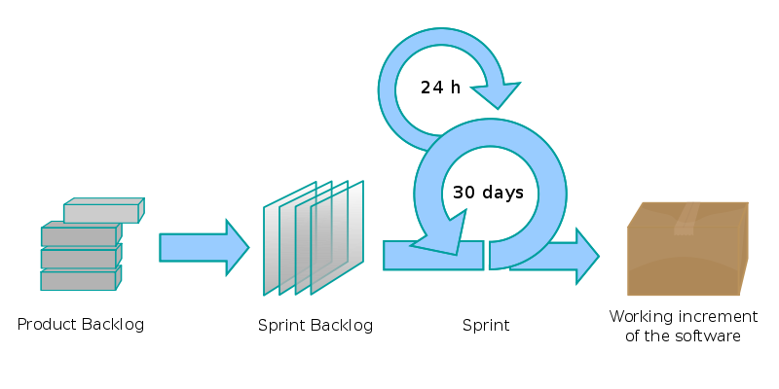
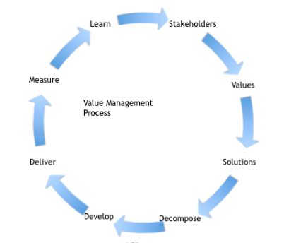
‘Traditional Agile’ and ‘Value Agile’
surely they are joking?
Traditional Agile for IT (Scrum, XP, etc.)
Is unfortunately not ‘tuned in’ to delivering business value
It tries to speed up (‘velocity’) code production
As it is now, ‘traditional Agile’ is not at all useful for business purposes.
They are simply not really managing ‘values’. They ‘talk’ about values, but they do not quantify and manage them. They do not ‘walk the talk’.
The ‘Value Agile’ Model that we recommend (‘Evo’)
Is focussed on business value delivery
Is used to co-ordinate IT work, to deliver measurable business value
Deutsche Bank made ‘Evo’ their standard for managing all other Business ‘Agile’ work (Paul Fields, 2013-19)*
Evo ‘connects’ the ‘business with IT’ efforts, and all other improvement efforts.
Evo is a systems project management method: not about code or IT alone. It is about people, organisation, motivation, data, hardware, and, ‘sometimes’, about software.
* see presenter note for details on adoption
© Gilb.com
Notes:
edited 1 march 2019 tsg, edited more 2 March 2019
“It was true that DB had 3 Agile standards (for people to choose - and potentially use all 3): Evo for business value; Scrum for how to run a team; XP for development teams and technical practices. And we used the document you wrote for Evo, The Scrum Guide (Jeff Sutherland and Ken Schwaber) and a PDF version of http://www.extremeprogramming.org/ (with permission).
The standards were recommended by the Agile Community of Practice (and there weren't any other standards at the time).
I have no idea if this is still true (probably not - just because everything changes!).” Epost 1March2019 from Paul Fields

Slide 6
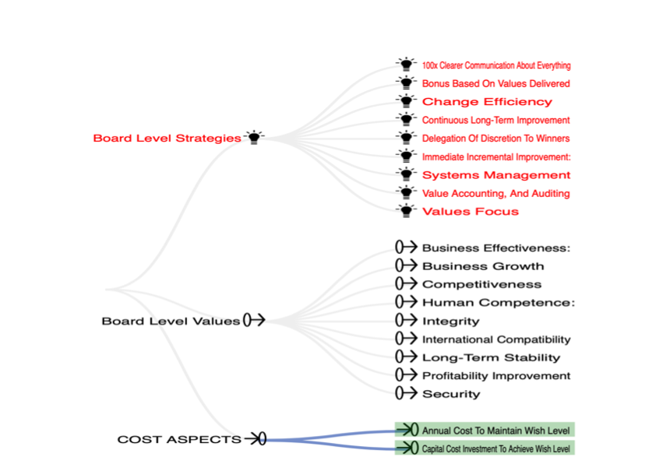
Example of Change-Process ‘Values’ and ‘Strategies’

Slide 7
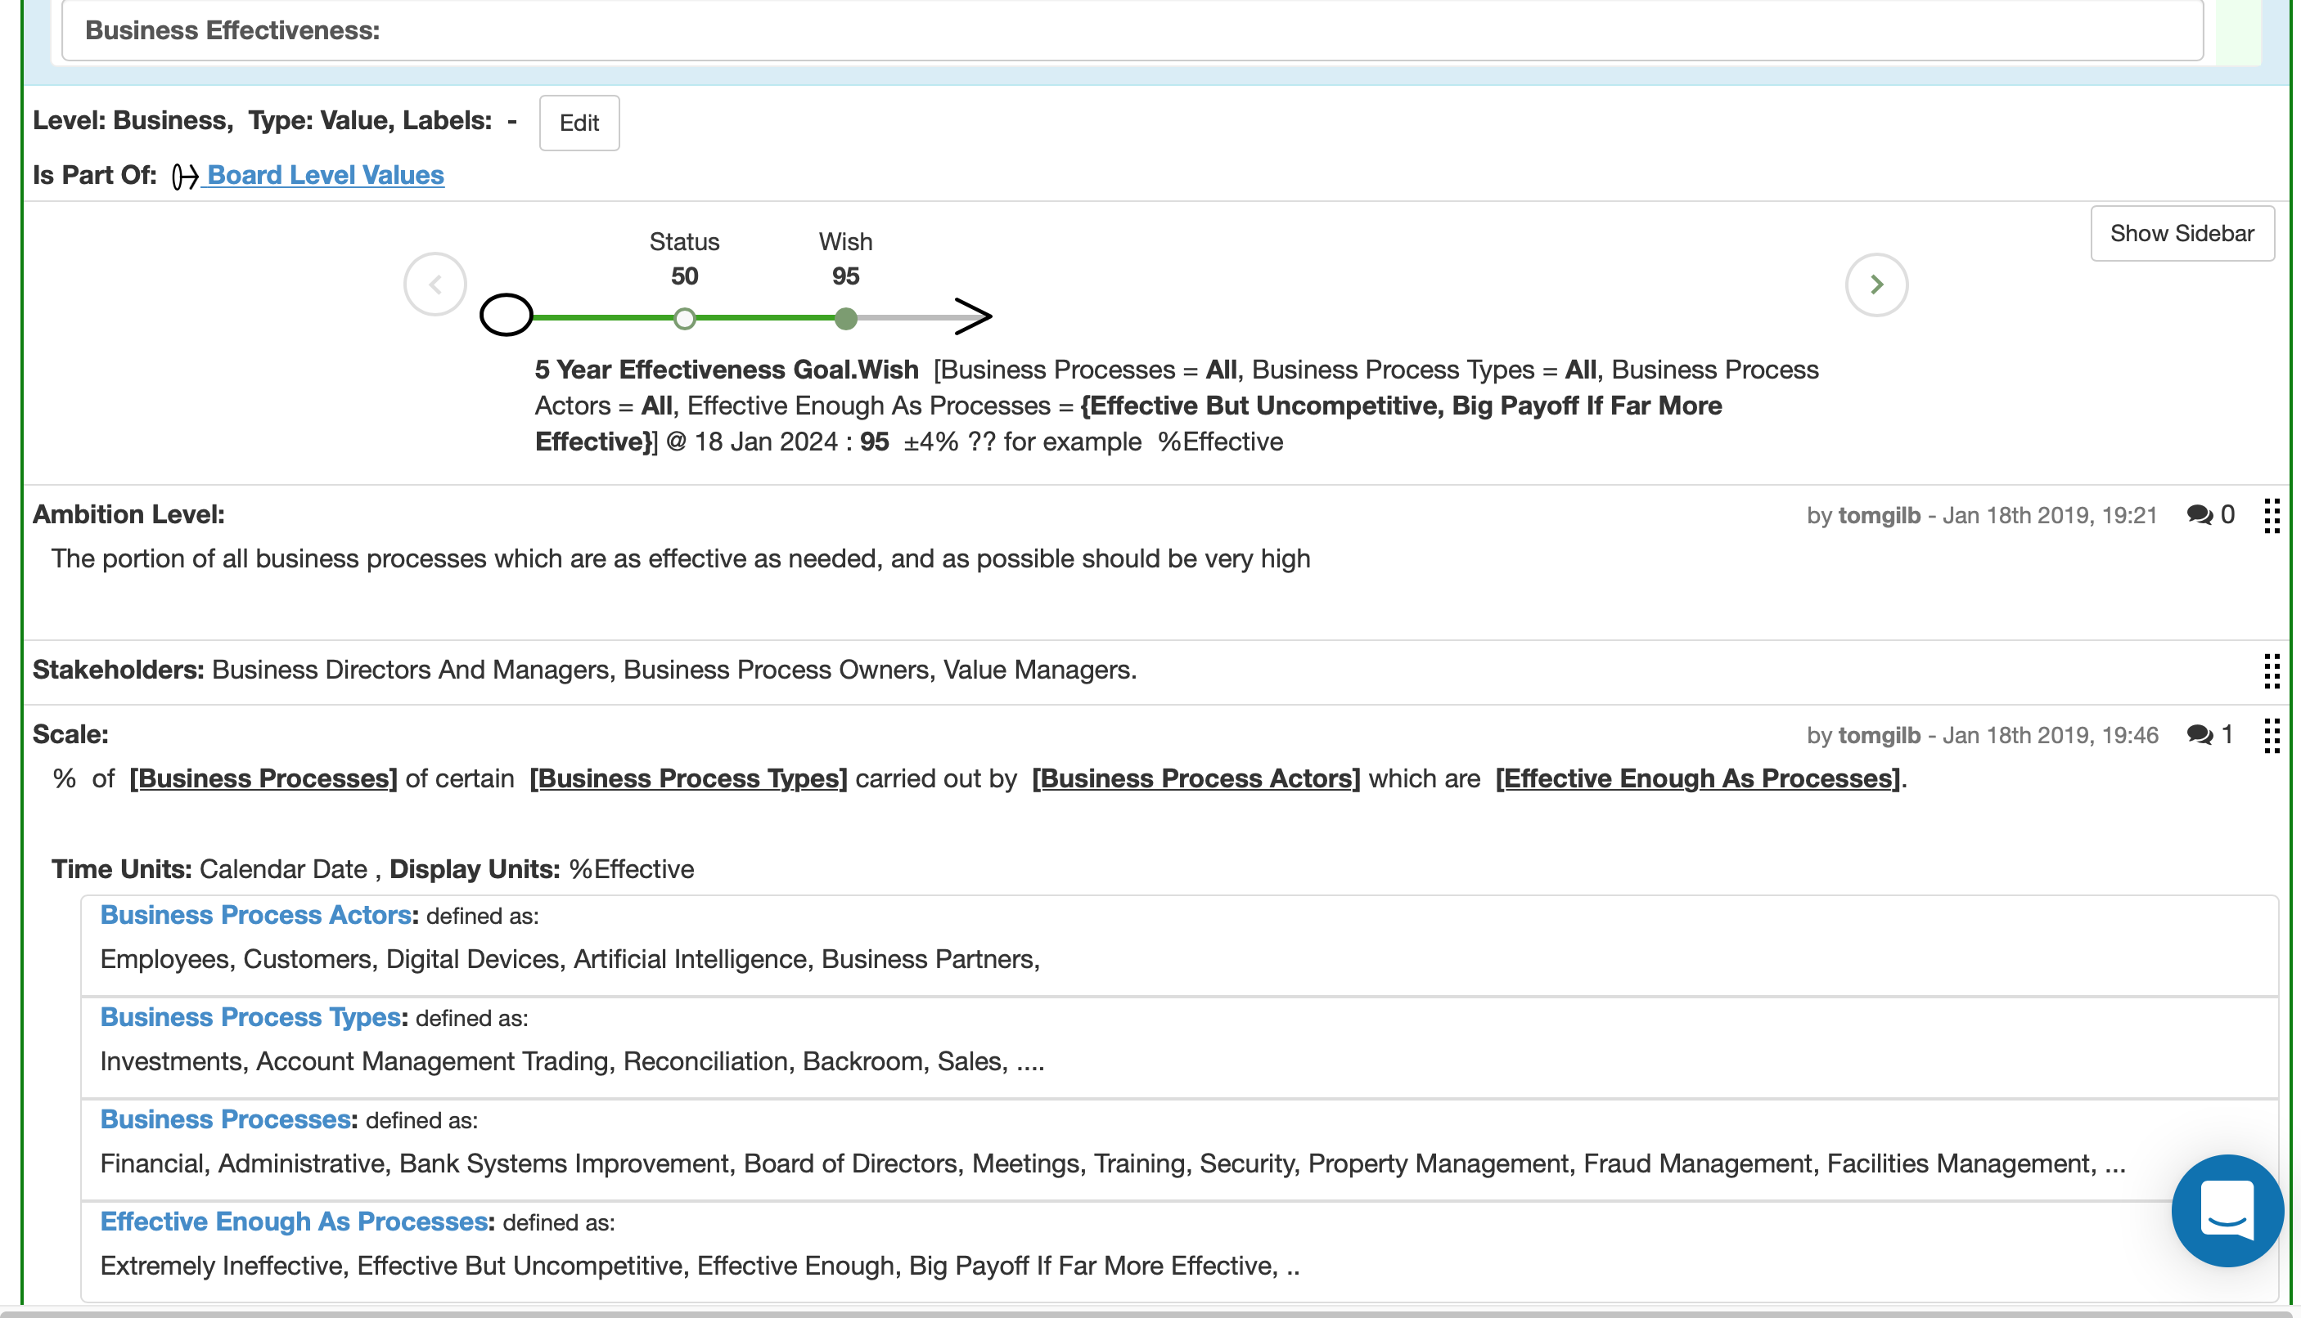
Quantifying ‘Business Effectiveness’: a Scale

Slide 8
Learn
Stakeholders
Agile Value Cycle
Measure
Values
Value Management Process
Deliver
Solutions
Develop
Decompose
NORSK TEKST EKSEMPLER
http://concepts.gilb.com/dl931
in english: detailed practice
http://concepts.gilb.com/dl931
© Gilb.com
5
Copyright: Kai@Gilb.com
Notes:
Comment: this is the Evo version of an Agile Cycle. But it is a variation on the classic Deming/Shewhart Plan Do Study Act clycle from Statistical Process Control. TSg June 7 2013

Slide 9
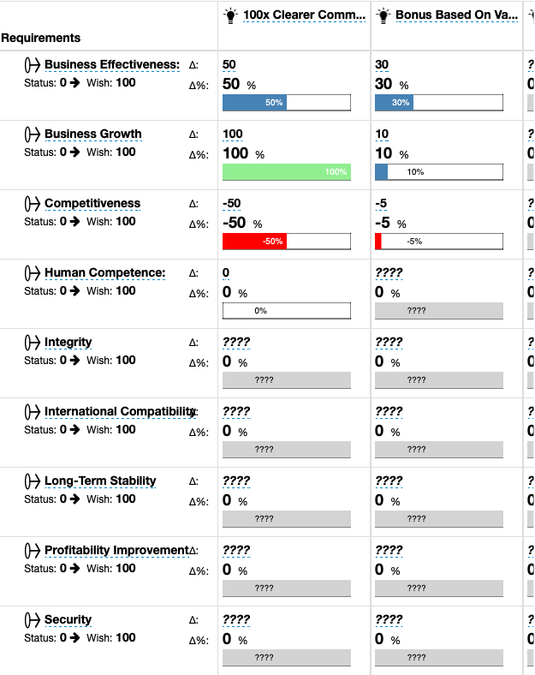
A Value Decision Table
Strategies/Architectures/Designs
Effect
Values
On
Value
helps us analyse
how good any strategy is expected to be
for meeting our entire set of critical objectives
so, we can ‘prioritize’ based on effectiveness
and by adding budgets, we can base decisions on Cost-Effectiveness
Helps us decompose to agile value delivery steps
Can be used to get step value feedback measurement, and ‘be agile’ if necessary
Notes:
edited 2 March 2019 tsg

Slide 10
Re-defining Manifesto Values
(the ‘objectives’ of projects)
Individuals and Interactions Over Processes and Tools
2. Working Software Over Comprehensive Documentation.
3. Customer Collaboration Over Contract Negotiation
4. Responding to Change Over Following a Plan.
Stakeholder Values first.
Deliver real measurable stakeholder values.
Zero failures, to deliver values.
Change the architecture fast, if it does not deliver values.
PS I have, for fun, quantified all these ‘manifesto’ values as objectives, in Planguage.
Ask me for them if you are interested in going so deep (tom@gilb.com).
The quantification in Planguage makes it clear that the above is highly ambiguous B***hit. Billions of possible interpretations. Do you think the Manifesto writers had a clear common understanding of these values? (no way)
'How Well Does the Agile Manifesto Align with Principles that Lead to Success in Product Development?’
https://www.ppi-int.com/wp-content/uploads/2018/02/SyEN_62.pdf
Notes:
'How Well Does the Agile Manifesto Align with Principles that Lead to Success in Product Development?’ by Tom Gilb
and
• 'Why Agile Product Development Systematically Fails, and What to Do About It!' by Kai Gilb
and quite a few links to our other books and papers.
26 Feb 2018 in SyEN
https://www.ppi-int.com/wp-content/uploads/2018/02/SyEN_62.pdf
This is an edited version of the paper below (How well does agile…)
Tom Gilb:
"How well does the Agile Manifesto align with the principles that lead to success in product development?”
Paper
January 8 2018
and
http://concepts.gilb.com/dl921
https://www.gilb.com/blog/how-well-does-the-agile-manifesto-align-with-principles-that-lead-to-success-in-product-development
AND
https://goo.gl/pC9cvd
Value First Manifesto
http://concepts.gilb.com/dl898
Jan 7 2018
Kai and tom Gilb

Slide 11
Re-defining Manifesto Principles (1->5)
(the ‘means’ to attain the ‘values’
1. Our highest priority is to satisfy the customer through early and continuous delivery of valuable software.
2. Welcome changing requirements, even late in development. Agile processes harness change for the customer's competitive advantage.
3. Deliver working software frequently, from a couple of weeks to a couple of months, with a preference to the shorter timescale.
4. Business people and developers must work together daily throughout the project.
5. Build projects around motivated individuals. Give them the environment and support they need, and trust them to get the job done.
1. Development efforts should attempt to deliver, measurably and cost-effectively, a well defined set of prioritized stakeholder value levels, as early as possible.
See 2018 book’100 Practical Project Planning Principles’ (gilb.com)
2. Development processes must be able to discover and incorporate changes in stakeholder requirements, as soon as possible, and to understand their priority, their consequences to other stakeholders, to system architecture plans, to project plans, and contracts.
3. Plan to deliver some measurable degree of improvement to planned and prioritized stakeholder value requirements, as soon, and as frequently, as resources permit.
4. All parties to a development effort (stakeholders), need to have a relevant voice for their interests (requirements), and an insight on the parts of the effort that they will potentially impact, or which can impact them, on a continuous basis, including into operations and decommissioning of a system.
5. Motivate stakeholders and developers, by agreeing their high-level priority objectives, and give them freedom to find the most cost-effective solutions.
'How Well Does the Agile Manifesto Align with Principles that Lead to Success in Product Development?’
https://www.ppi-int.com/wp-content/uploads/2018/02/SyEN_62.pdf

Slide 12
Re-defining Manifesto Principles (6->10)
(the ‘means’ to attain the ‘values’
6. Enable face-to-face interactions.
7. Working software is the primary measure of progress.
8. Agile processes promote sustainable development. The sponsors, developers, and users should be able to maintain a constant pace indefinitely.
9. Continuous attention to technical excellence and good design enhances agility.
10. Simplicity--the art of maximizing the amount of work not done--is essential.
6. Enable crystal clear communication, in writing, in a common project database. Enable collection and prioritization and continuous updates of all considerations about requirements, designs, economics, constraints, risks, issues, dependencies and prioritization.
See 2018 Book ‘Clear Communication’ at gilb.com
7. The primary measures of development progress is the degree of actual stakeholder-delivered planned value levels with respect to planned resources such as budgets and deadlines.
8. We believe that a wide variety of strategies, adapted to current local cultures, can be used to maintain a reasonable workload for developers and other stakeholders; so that stress and pressures which result in failed systems need not occur.
9. Quality must be quantified, supporting designs for quality must be estimated and measured.
10. We need to learn and apply methods, of which there are many, to help us understand complex systems and complex relations and succeed in meeting our goals in spite of them.
See 2018 ‘Technoscopes’ book at Gilb.com
'How Well Does the Agile Manifesto Align with Principles that Lead to Success in Product Development?’
https://www.ppi-int.com/wp-content/uploads/2018/02/SyEN_62.pdf

Slide 13
Learn
Stakeholders
Design
Measure
Values
Value Management Process
Scrum
Build
Deliver
Solutions
Develop
Decompose
© Gilb.com
6
Copyright: Kai@Gilb.com
Copyright: Kai@Gilb.com
Notes:
Comment: Scrum or other Agile IT methods, are at best a part of the business solution. They must be managed carefully, and quantitatively so they give real busness results, not just dubious IT systems. TsG June 7 2013

Slide 14
HOVEDPOENG
Verdileveranse er hovedpoenget
‘smidig’ er kun et middel
for å levere verdier tidlig og kontinuerlig
smidighet benyttes som verktøy:
for å reagerer og endre kurs,
når ‘målte leverte verdier’ avviker fra ‘forventede verdier’
tenk seiltur
‘Stakeholder value delivery’ is the point,
nice - if ‘agile’ can make it better and faster!
http://myephemerae.com/tag/williamfife
Notes:
first made 1 March 2019 tsg for NFP 8.3.19 lecture

Slide 15
Mine Hovedprinsipper for Prosjektplanlegging: Verdi-prioritering
1. Det er de mest kritiske interessenter som bestemmer ‘verdiene’ som vi må ta hensyn til.
2. Alle verdier kan uttrykkes med tall, og de behøver ikke ‘oversettes’ til penger.
3. Vi leverer verdiene ved hjelp av passende ‘arkitektur’ (aka ‘strategier, midler osv.).
4. De verdi-nivåene, man kan faktisk levere, bestemmes av flere ting; arkitektur, tidspunkt, og ressurser.
5. Påkrevde verdi-nivåene for samme egenskap (‘Sikkerhet’, ‘Brukervennlighet’), kan variere, avhengig av prioritetene til interessenter, tidspunkt, og sted.
6. En målbar verdi-strøm kan leveres nesten umiddelbart, hyppig, og med prioritet for de største leverbare verdi-nivåene, i forhold til de tilgjengelige ressursene.
7. Verdi-leveranser kan kumuleres, beholdes, og forbedres, fra dagens nivå.
(Det er ikke nødvendig å ha langvarige investeringer for å oppnå det).
8. Helt nye prioriterte interessent-verdier blir oppdaget underveis, gjennom erfaring, og eksterne forandringer.
9. Vi kan først estimere, og siden måle, de flerfoldige verdier som gitte strategier og arkitekturer kan bidra med.
10. Din faktisk fremgang, og din faktisk evne til å levere prioriterte verdier, vil nødvendigvis tiltrekke seg flere ressurser.
(ENGLISH TRANSLATION IN THE PRESENTER NOTES FOR THIS SLIDE)
Copyright Tom@Gilb.com 2014-2019
Notes:
NORWEGIAN VERSION 25 FEB 2014 FOR SOFTWARE 2014 OSLO evening lyntale. Edited for clarity 1 March 2019 forNFP lecture.
1. Critical Stakeholders determine the values
2. Values can and must be quantified
3. Values are supported by Value Architecture
4. Value levels are determined by timing, architecture effect, and resources
5. Value levels can differ for different scopes (where, who)
6. Value can be delivered early
7. Value can be locked in incrementally
8. New Values can be discovered (external news, experience)
9. Values can be evaluated as a function of architecture (Impact Estimation)
10. Value delivery will attract resources.

Slide 16
Gilb’s ‘Value Driven Planning’ Principles: ‘Prioritize Value’
1. Critical Stakeholders determine the values
2. Values can and must be quantified
3. Values are supported by Value Architecture
4. Value levels are determined by timing, architecture effect, and resources
5. Value levels can differ for different scopes (where, who)
6. Value can be delivered early
7. Value can be locked in incrementally
8. New Values can be discovered (external news, experience)
9. Values can be evaluated as a function of architecture
(Impact Estimation)
10. Value delivery will attract resources.
SEE ALSO concepts.gilb.com/dl137
Notes:
A second set of my value principles will be found in the paper , INCOSE 2008.
“Value Delivery in Systems Engineering” available at www.gilb.com
Unpublished paper concepts.gilb.com/dl137 (link tested 1.3.2019)
The Value Principles:
1. Value can always be articulated quantitatively, so that we can understand it, agree to it, track it, contract for it and understand it in relation to costs.
2. Value is a result, delivered to a real set of stakeholders.
3. Value must be seen in light of lifetime total cost aspects, and must be as profitable as alternative investments.
4. Value occurs through time, as a stakeholder experience: it is not delivered when a system to enable it is delivered – only when that system is successfully used to extract the value.
5. Value can be delivered early, and for part of one stakeholder’s domain. This proves the value potential, and actually improves the real organization.
6. There is never a really sufficient reason to put off value delivery until large-scale long-term investments are made. This is just a common excuse from the many weak, ignorant, cowards who would like to spend a lot of money before being held to account.
7. People who cannot deliver a little value early, in practice, cannot be entrusted to deliver a lot of value for a larger investment.
8. The top management must be primarily responsible for making value delivery happen in their organization. The specialist managers will never in practice take the responsibility, unless they are aiming to take over the top job.
9. Value is a multiplicity of improvements, and certainly not all related to money or savings – but we still need to quantify the value proposition in order to understand it, and manage it.
10. If we prioritize highest value for money first, then we should normally experience an immediate and continuous flow of dramatic results, that the entire organization can value and relate to. Be deeply suspicious of long-term visions with no short-term proof.

Slide 17
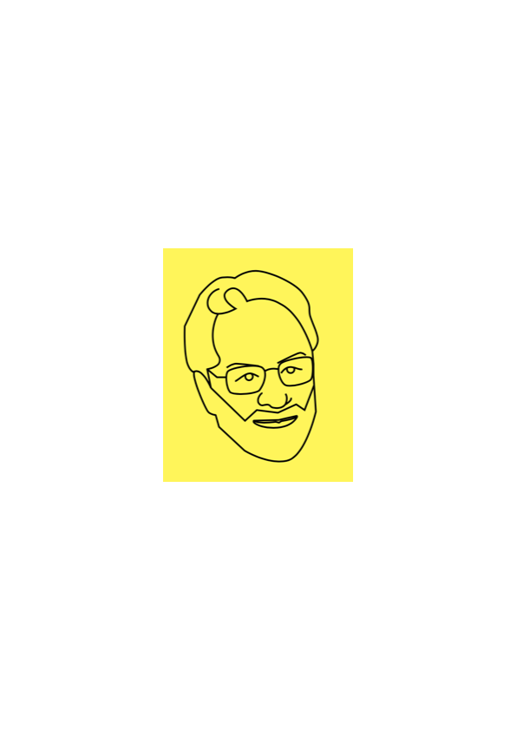
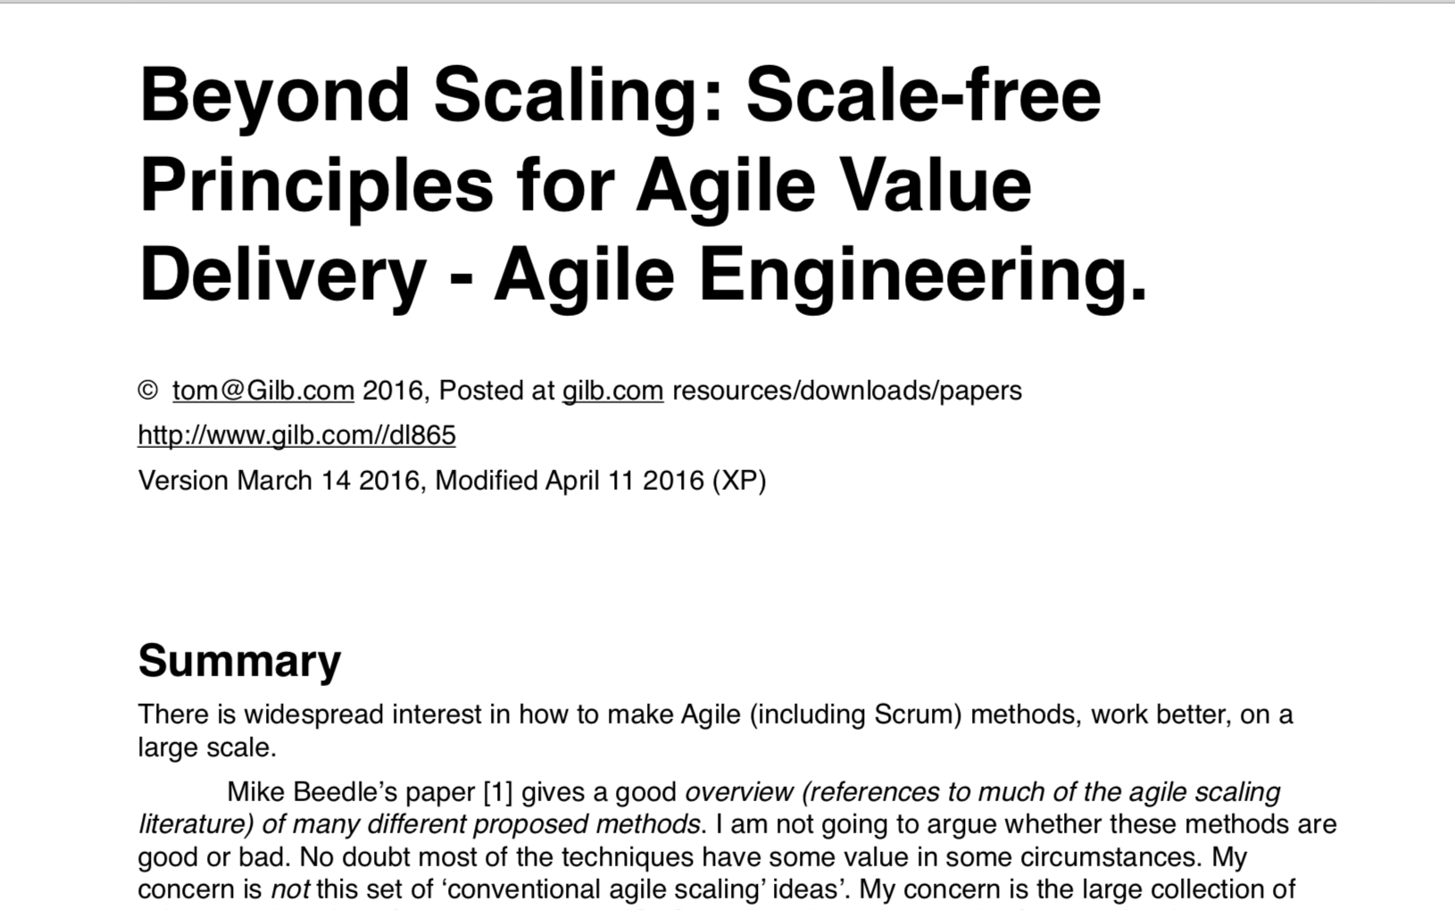
I wrote a paper on Agile Scaling in 2016
Notes:
SCALE-FREE:
Practical Scaling Methods
for Industrial Systems Engineering”
lecture slides
http://concepts.gilb.com/dl892
Tom Gilb
for ALSSE
Norsec, Oslo
Monday 12 September 2016
“Beyond Scaling: Scale-free Principles for Agile Value Delivery - Agile Engineering”
http://www.gilb.com/dl865 (Paper)
(Jan 8 2016)
Scalability Metrics:
An Engineering Structure,
and
Principles, for an Agile World
for June 5 2018 DND/SINTEF Conference
http://concepts.gilb.com/dl930
(up 310818)
Scalability Metrics:
An Engineering Structure,
and
Principles, for an Agile World
for
Smidig skalerbarhet
Nettverksmøte 5. juni 2018 i Oslo
Et seminar om håndtering av skalerbarhet i smidig utvikling
http://concepts.gilb.com/dl930

Slide 18
Scale-free Agile Principles
Value Planning https://www.gilb.com/offers/SN2UR7vu/checkout
FREE GIFT REVIEW COPY FOR YOU ALONE. NO COUPON CODE REQUIRED.
the VP ref. below
Keep focus on measurable delivery of critical values and their costs. [3, 4, 5, 6, 9, 10, 12, VP (20) Part 1, VP 10.6 ]
Deliver value early, quickly and regularly: in roughly 2% increments. [14, 11, VP Ch.4, 2, 5 ]
Do NOT focus on code delivery; focus on overall system value and costs. [ VP Ch.4, 10D, 10F, 13, VP 3.4, VP 2.10, VP 9.8, 4, 12]
Focus on quantified critical stakeholder values. [19, VP 3.4, VP 3.7, VP 3.9, VP 3.10 VP 4.2, 10 ]
Synchronize all teams in terms of measurable value delivery. [VP 3.3, VP 3.4, VP Part 1, VP 3.6, VP 3.8, VP 8.4 , 11, 12, 13 ]
Solve big problems through ingenious architecture; not through coding faster. [VP 4.5, VP 5.1, VP 5.3, VP 7.2, 15 ]
Decompose the large problems by incremental value deliveries: not code deliveries. [7, VP Ch. 5, VP 5.1, VP 5.6 , 10, 11, 13, 15]
The software component needs to be integrated into the total system of hardware, data, people, culture. [ VP 5.2, 10 ]
If your team cannot deliver small increments of real value early, frequently, and predictably; they are incompetent and need to be abandoned for those who can deliver. [7, VP 2.8, 10]
Never commit to contracts for work done or code delivered alone: there must always be a sufficiently large contractual protection, of paying for measurable value delivered. [12, 15 ].
Slide source: Scalability Metrics:
An Engineering Structure, and Principles, for an Agile World
for June 5 2018 DND/SINTEF Conferencehttp://concepts.gilb.com/dl930
Notes:
SCALE-FREE:
Practical Scaling Methods
for Industrial Systems Engineering”
lecture slides
http://concepts.gilb.com/dl892
Tom Gilb
for ALSSE
Norsec, Oslo
Monday 12 September 2016
“Beyond Scaling: Scale-free Principles for Agile Value Delivery - Agile Engineering”
http://www.gilb.com/dl865 (Paper)
(Jan 8 2016)
Scalability Metrics:
An Engineering Structure,
and
Principles, for an Agile World
for June 5 2018 DND/SINTEF Conference
http://concepts.gilb.com/dl930
(up 310818)
Scalability Metrics:
An Engineering Structure,
and
Principles, for an Agile World
for
Smidig skalerbarhet
Nettverksmøte 5. juni 2018 i Oslo
Et seminar om håndtering av skalerbarhet i smidig utvikling
http://concepts.gilb.com/dl930

Slide 19
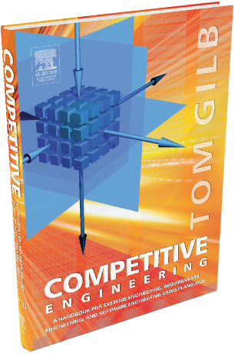
Erik Simmons, Intel 20 years Experience Scaling
“ Instead, I believe that the majority of what you have included for ideas, principles, etc. from CE and VP are in fact scale-free.
They are not dependent on project or organization size.
They are good heuristics for almost any project,
and nearly universally applicable
(nearly universal because I hear Koen in my head, and all is heuristic).
So, CE and VP are not about scaling
so much as they should be taught and understood as scale-free.
Size is not a reason to choose (or not choose) to use Competitive Engineering, Evo, Planguage, etc.
As you quoted me in the paper – this stuff works.
It works on small projects. It works on large projects.
Evo on a 5-person team is not really much different than Evo on a 100-person team, except there are more people.
The principles apply without alteration (or “scaling”).
Anyone who sees a random page of your new paper would probably not guess the topic is scaling (unless you happen to mention that in the text on that particular page).
‘Competitive Engineering’ does not scale. It doesn’t need to.”
erik.simmons@construx.com
SOURCE: SCALE-FREE:
Practical Scaling Methods
for Industrial Systems Engineering”
lecture slides
http://concepts.gilb.com/dl892
Get a free e-copy of ‘Competitive Engineering’ book.
https://www.gilb.com/p/competitive-engineering
Notes:
SCALE-FREE:
Practical Scaling Methods
for Industrial Systems Engineering”
lecture slides
http://concepts.gilb.com/dl892
Tom Gilb
for ALSSE
Norsec, Oslo
Monday 12 September 2016
“Beyond Scaling: Scale-free Principles for Agile Value Delivery - Agile Engineering”
http://www.gilb.com/dl865 (Paper)
(Jan 8 2016)
Scalability Metrics:
An Engineering Structure,
and
Principles, for an Agile World
for June 5 2018 DND/SINTEF Conference
http://concepts.gilb.com/dl930
(up 310818)
Scalability Metrics:
An Engineering Structure,
and
Principles, for an Agile World
for
Smidig skalerbarhet
Nettverksmøte 5. juni 2018 i Oslo
Et seminar om håndtering av skalerbarhet i smidig utvikling
http://concepts.gilb.com/dl930

Slide 20
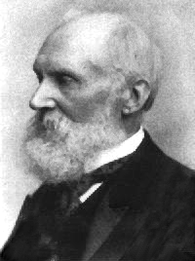
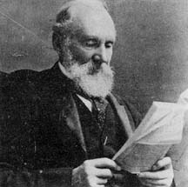
Kvantifiserings visdom
”Jeg har ofte sagt at når du klarer å måle det du snakker om, og uttrykke det med tall, så vet du noe om emnet; …”
” I often say that when you can measure what you are speaking about, and express it in numbers, you know something about it;”
Lord Kelvin, 1893
From http://zapatopi.net/kelvin/quotes.html
© Gilb.com
Notes:
Thank you for the lecture you gave at OGI. It gave me much food for thought
and action, particularly in the realm of requirements specification. Much
to learn, much to apply.
As for your Lord Kelvin quote, it prompted an immediate google search. I
found a fuller version of the quote at
http://zapatopi.net/kelvin/quotes.html, which reads,
"In physical science the first essential step in the direction of learning any subject is to find principles of numerical reckoning and practicable methods for measuring some quality connected with it.
I often say that when you can measure what you
are speaking about, and express it in numbers, you know something about it;
but when you cannot measure it, when you cannot express it in numbers, your
knowledge is of a meagre and unsatisfactory kind; it may be the beginning of
knowledge, but you have scarcely in your thoughts advanced to the state of
Science, whatever the matter may be." While his full quote is more narrow
in scope (physical science) I think your extension of the idea to
"requirements science" arena equally applicable.
Benjamin Ward
---Benjamin Ward-----
Work: 503.232.7053 / mailto:benjamin.ward@tek.com
Home: 503.232.7053 / mailto:ben_ward@northwest.com
------------------------- June 1 contribution Michael Jackson, London
George Miller, the psychologist
> usually credited with the magic number seven, plus or minus
> two, wrote: "In truth, a good case could be made that if
> your knowledge is meagre and unsatisfactory, the last thing
> in the world you should do is make measurements. The chance
> is negligible that you will measure the right thing
> accidentally." Meagre and unsatisfactory knowledge about
> separability can't be improved by measuring anything, or
even by thinking about what you might measure.
=========== end MJ quote

Slide 21
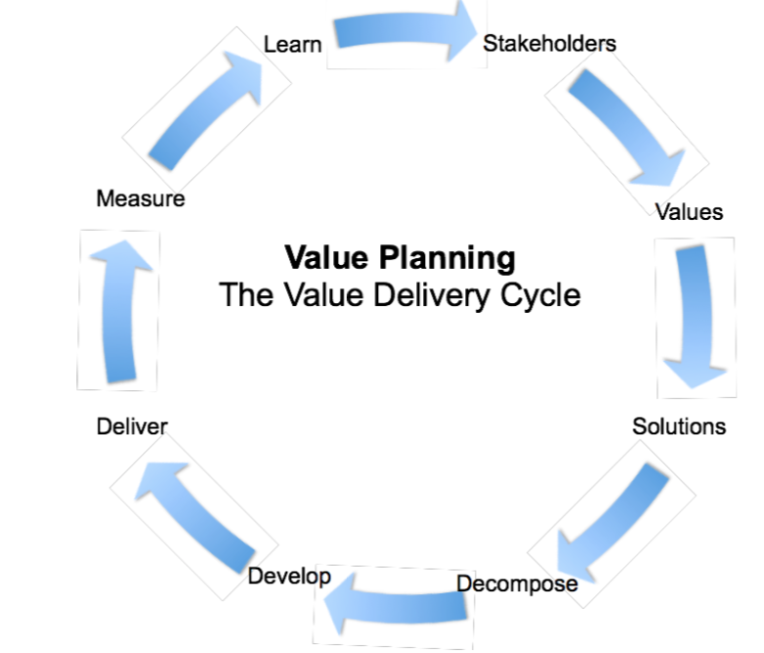
CHANGE
means
Value Improvement
tom@Gilb.com
24 Jan 2019
For XXXX Bank, London
An invited presentation to COO and CIO Level,
in their Boardroom,
responsible for £2 Billion/annual ‘Change’ programmes

Slide 22
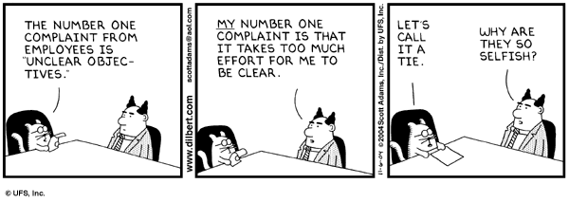
Unclear Objectives
SEE ALSO 4 CANDLES https://www.youtube.com/watch?v=Ozpek_FrOPs
28 March 2015
© Gilb.com

Slide 23
∑
1. Focus on delivering BANK values, quantified.
2. Plan a week, then start the value delivery stream
3. Resources are given for quantified bank Value improvements
4. Continued resources are dependent on actual measurable delivery levels
5. Shift from ‘IT’ focus to Bank Systems Focus (IT is a tool, Agile is a tool)
6. Do this at all levels of management, starting starting with this Change project
7.Pilot some ‘IT’ projects with Value Planning
A. SOME OLD PROJECTS. WHICH ARE STUCK
B.SOME NEW PROJECTS (like AFC)

Slide 24
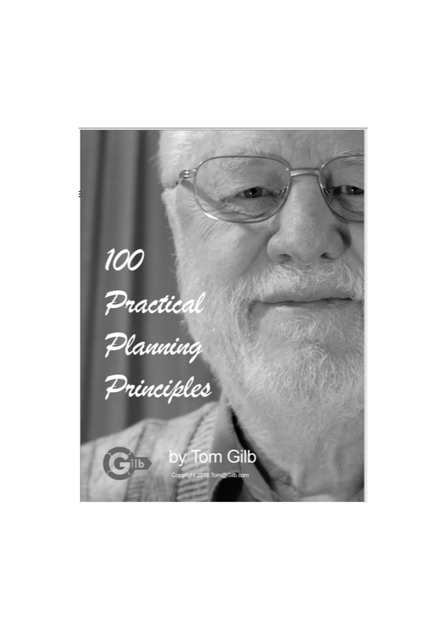
Jeg antar at jeg ikke kommer lengere på mine 30 minutter enn ca. her
derfor er neste slide ‘den siste’
Men jeg legger ved, flere detaljerte praktiske eksempler av plansjer, for de som ønsker mye mer tekniske detaljer for ‘bank smidig’
Har jeg mer tid, så kjører jeg et stykke
inne i eksemplene som fortsetter.
Og jeg kan sikkert overtales
til å holde ett lengere innlegg
et annet sted og tid.
Kurs i Oslo holdes ved Tekna, og OSWA Meetup

Slide 25
We have written down the details for our ‘Value Agile’
‘100 Practical Planning Principles'.
https://www.gilb.com/offers/Shju4Zqn/checkout
FREE GIFT REVIEW COPY FOR YOU ALONE. NO COUPON CODE REQUIRED.
Be my guest
But it demands hard work of smart people
But ‘This Stuff Works!” (E.S. Intel. CE book foreword.
Hvis du vil oversette til Norsk, ‘be my gjest’
Ekspert/Lærer detaljer er i Value Planning boka.
For deltagere her. 50%
https://goo.gl/XGMgwg
Code: WS50

Slide 26
Case: Multinational Bank 2011 Critical Project Objectives ‘not clear’
28 March 2015
© Gilb.com
Notes:
Slide made 14 May 2012
CTO = M AR

Slide 27
Case: Multinational Bank 2011 Critical Project Objectives ‘not clear’
A sample of about 6 projects, showed that none of them had clear quantified project top level critical requirements, yet
The CTO commissioned us to look at his own selected sample of large troubled projects, wrt their requirements (2 days)
The sample showed that they did not have clear quantified top level requirements
But that their team was easily able to write quantified requirements, same day. When coached.
28 March 2015
© Gilb.com
Notes:
Slide made 14 May 2012
CTO = M AR

Slide 28
Case: Multinational Bank 2011 Critical Project Objectives ‘not clear’
The CTO concluded that none of their 100s of projects had clear enough objectives, or primary improvement requirements, at their base.
28 March 2015
© Gilb.com
Notes:
Slide made 14 May 2012
CTO = M AR

Slide 29
Case: Multinational Bank 2011 Critical Project Objectives ‘not clear’
The CTO asked Tom,
“This is so simple and obvious! Why don’t we do it?”
Tom replied:
“Universities don’t teach it.
You don’t teach it in house
You as CTO have not required it to be done
before giving funding”.
28 March 2015
© Gilb.com
Notes:
Slide made 14 May 2012
CTO = M AR

Slide 30
Case: Multinational Bank 2011 Critical Project Objectives ‘not clear’
What about You ?
28 March 2015
© Gilb.com
Notes:
Slide made 14 May 2012
CTO = M AR

Slide 31
ENKEL KVALITETSSIKRING
AV BANK PROSJEKT HOVEDVERDIER

Slide 32
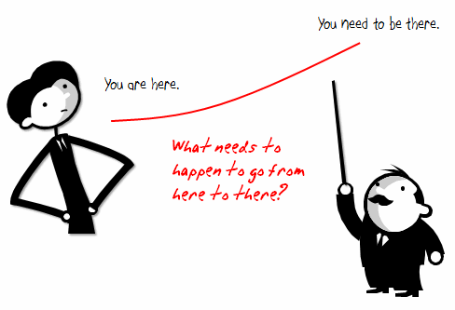
WHY are we doing this? Part of Platform Rationalisation Initiative, with below Main Objectives.
• Rationalize into a smaller number of core processing platforms. This cuts technology spend on duplicate platforms, and creates the opportunity for operational saves. Expected 60%-80% reduction in processing cost to Fixed Income Business levies.
• International Securities on one platform, Fixed Income and Equities (Institutional and PB).
• Global Processing consistency with single Operations In-Tray and associated workflow.
• Consistent financial processing on one Accounting engine, feeding a single sub-ledger across products.
• First step towards evolution of “Big Ideas” for Securities.
• Improved development environment, leading to increased capacity to enhance functionality in future.
• Removes duplicative spend on two back office platforms in support of mandatory message changes, etc.
www.Gilb.com
Notes:
http://www.articulate.com/rapid-elearning/wp-content/uploads/2008/11/here2there.gif

Slide 33
LINK WORDS: OBJECTIVE:ARCHITECTURE RULE 4. No Design/Architecture
• Rationalize into a smaller number of core processing platforms. This cuts technology spend on duplicate platforms, and creates the opportunity for operational saves. Expected 60%-80% reduction in processing cost to Fixed Income Business lines.
• International Securities on one platform, Fixed Income and Equities (Institutional and PB).
• Global Processing consistency with single Operations In-Tray and associated workflow.
• Consistent financial processing on one Accounting engine, feeding a single sub-ledger across products.
• First step towards evolution of “Big Ideas” for Securities.
• Improved development environment, leading to increased capacity to enhance functionality in future.
• Removes duplicative spend on two back office platforms in support of mandatory message changes, etc.
www.Gilb.com
Notes:
http://www.umaine.edu/link/Images/chain.jpg

Slide 34
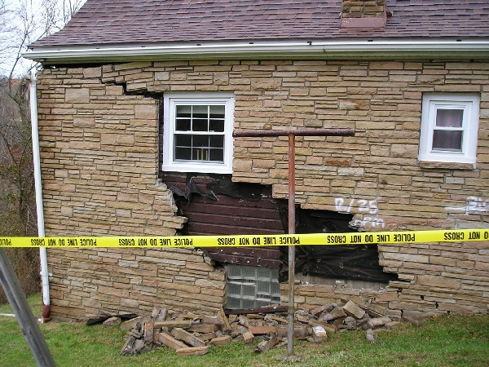
Agile Spec QC Results
Estimated appx. Total defects found by a small team (2-4 people) = 36±6
2x highest found.
Estimated appx. Total Majors in the 110 words = 100±10
(3x group total. 30% effectiveness of team)
Estimated approximate total defects in normalized page (300 words) = 280±20
(Majors in 110 words x 3)
Reported major defects =
Last week: 15, 17, 21
Today =18, 15, 15, 13 others less
www.Gilb.com

Slide 35
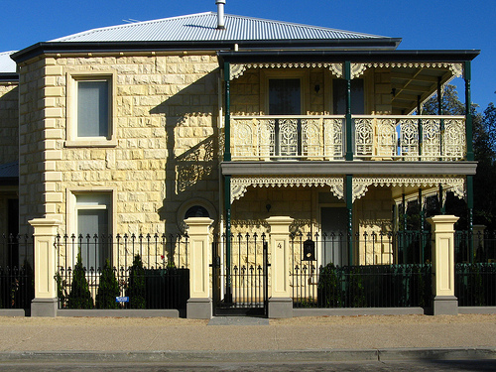
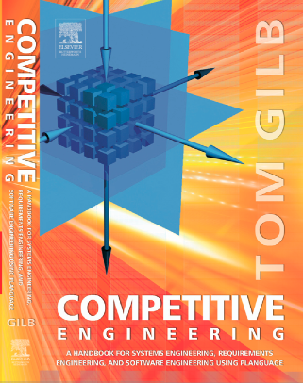
How can we improve such bad specification? (‘Planguage’)
Development Capacity:
Version: 3 Sept 2009 16:26
Type: Main <Complex/Elementary> Objective for a project.
Ambition Level: radically increase the capacity for developers to do defined tasks. <- Tsg
Scale: the Calendar Time for defined [Developers] to Successfully carry out defined [Tasks].
Owner: Tim Fxxx
Calendar Time: defined as: full working days within the start to delivery time frame.
Past [ 2009, {Bxx, Lxx, Gxx}, If QA Approved Processes used, Developer = Architect, Task = Draft Architecture ] 15 days ±4 ?? <- Rob
Goal[ 2011, { Bxx, Lxx, Gxx }, If QA Approved Processes used, Developer = Architect, Task = Draft Architecture ] 1.5 days ± 0.4 ?? <- Rob
Justification: Really good architects are very scarce so we need to optimize their use.
Risks: we use effort that should be directed to really high volume or even more critical areas (like Main Objective).
www.Gilb.com
Notes:
http://www.photographyblogcentral.com/wp-content/uploads/2009/07/Sandsont-brick-house.jpg

Slide 36
Defect Rates in 2003 Citigroup, London, Gilb Client Spec QC/Extreme Inspection + Planguage Requirements
Across 18 DV (DeVelopment) Projects using the new requirements method, the average major defect rate on first inspection is 11.2.
4 of the 18 DV projects were re-inspected after failing to meet the Exit Criteria of 10 major defects per page.
A sample of 6 DV projects with requirements in the ‘old’ format were tested against the rules set of:
The requirement is uniquely identifiable
All stakeholders are identified.
The content of the requirement is ‘clear and unambiguous’
A practical test can be applied to validate it’s delivery.
The average major defect rate in this sample was 80.4.
Major defects/page
on 1st Quality Control
www.Gilb.com

Slide 37
EXAMPLE OF
BANK ‘CHANGE PROCESS’
BOARD LEVEL
‘VALUES’ AND ‘STRATEGIES’

Slide 38
Example of Change Process Values and Strategies

Slide 39
Quantifying ‘Business Effectiveness’: a Scale

Slide 40
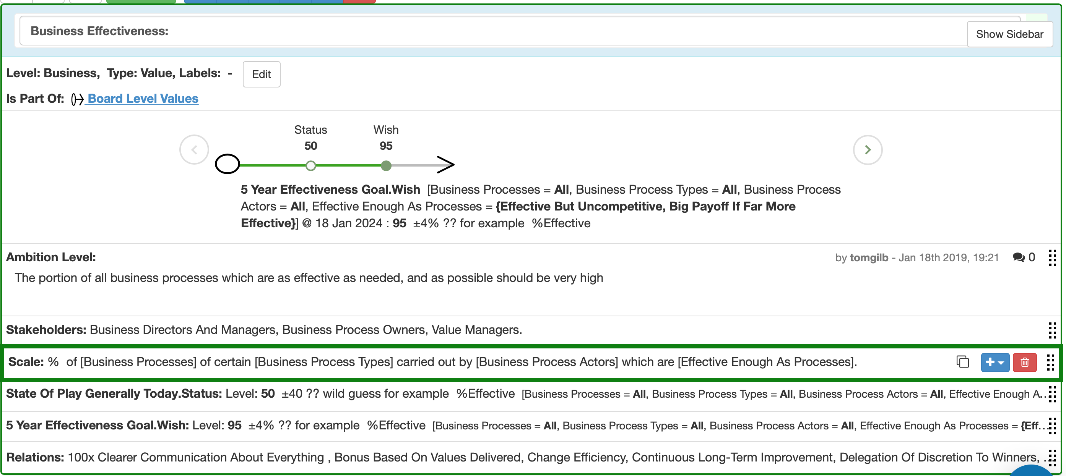
Specifying Numeric Objectives for ‘Business Effectiveness’

Slide 41
A Value Decision Table
helps us analyse
how good any strategy is expected to be
for meeting our entire set of critical objectives
so, we can ‘prioritize’ based on effectiveness
and by adding budgets, we can base decisions on Cost-Effectiveness
Helps us decompose to agile value delivery steps
Can be used to get step value feedback measurement, and ‘be agile’ if necessary

Slide 42
notice how ‘bank’ these requirements are !

Slide 43
Our Focus is
Values First

Slide 44
Everything will be evaluated on ‘Critical Values delivered’.
This implies: (some core strategies for change and improvement)
Leaders will plan value improvements, manage value improvements, expect rapid value improvements, reward value improvements: themselves be judged on actual delivery of critical value levels.
Values are the ‘multiplicity of enablers for profitable banking’: for example speed, quality of information, reputation, and employee competence. See suggested DB Board-level values 3 slides below.
Every business unit, for every project, process, improvement effort - will continuously determine their own top-few critical values, at any one moment: and focus their energy on improving those critical values, rapidly.
These critical values must be ‘the ones that determine’ our competitiveness, and our profitability. They must be ‘impact’ aligned with financials.

Slide 45
Practical Tactics for Value Management.
(Everyday practical action.)
All critical values will be articulated unambiguously, clearly, quantitatively, & measurably.
All projects, efforts, strategies, investments, and organizational change will primarily be defined and evaluated in terms of these values, and their measurable delivery.
All levels of responsibility are to be defined in terms of the sets of values which they are responsible for, and have really accomplished, to date. The 1-page Value Interface.
Organizational Effectiveness is to be defined and understood in terms of these values.
Organizational Efficiency is to be understood in terms of these values/their costs.
The assumption is that our ‘value levels’ enable and determine profitability: but our choice of values must constantly be adjusted so that we are always working towards relevant values for the bottom line.

Slide 46
Practical Change Consequences:
Management must be trained to deal with ‘quantified organizational values’.
Staff and Suppliers must be trained, and coached, to deal with their quantified values.
All current change programs, projects and investments need to be reformulated in terms of value delivery (not ‘system construction')
All current projects which cannot, or do not, focus on ‘values for consequent profitability’ are to be denied resources. Don’t throw good money after bad.
All change and improvement projects are expected to deliver immediate regular continuous improvement in values:
Long-term investments with ‘years and months’ of ‘no improvement’ will not be tolerated.
Delay of results is not ‘inevitable’, it is IMHO ‘incompetent unimaginative’ planning (TSG).
Projects which show exceptional ability to deliver ‘value-level improvement’ will be prioritized with additional necessary resources, on the fly (Beyond Budgeting), and visa versa (quick cuts).

Slide 47
Board Level Corporate Values: (a draft example, without consultation)
Profitability Improvement:
Business Growth:
Human Competence:
Competitiveness:
Integrity:
Security:
International Compatibility:
Business Effectiveness:
Long-Term Stability:
(naturally, setting example for others, all these will be quantified and well-defined)

Slide 48
Board-level Strategies:
(for reaching our quantified clear critical objectives)
Values Focus:
Immediate Incremental Improvement: (decomposing too-big stuff, to deliver priority parts fast)
Change Efficiency:
Delegation of Discretion to Winners: (Beyond Budgeting, Bill of Rights…)
Continuous Long-Term Improvement (DPP, Lean, Waste Reduction)
100x Clearer Communication about everything (SQC etc)
Business Innovation (20%…)
Bonus Based on Values Delivered
Value Accounting, and Auditing
(naturally, all these will be well-defined. Their potential will be estimated wrt our Board Values, and their progress tracked. Any strategies found wanting, will quickly be adjusted or discarded. New and better strategies will be brought on board quickly.)

Slide 49
TWELVE TOUGH QUESTIONS
1. Why isn't the improvement quantified?
2. What is degree of the risk or uncertainty and why?
3. Are you sure? If not, why not?
4. Where did you get that from? How can I check it out?
5. How does your idea affect my goals, measurably?
6. Did we forget anything critical to survival?
7. How do you know it works that way? Did it before?
8. Have we got a complete solution? Are all objectives satisfied?
9. Are we planning to do the 'profitable things' first?
10. Who is responsible for failure or success?
11. How can we be sure the plan is working, during the project, early?
12. Is it ‘no cure, no pay’ in a contract? Why not?
http://www.gilb.com/dl24 is a paper on 12 tough questions
http://www.gilb.com/dl24 paper
http://www.gilb.com/dl24
see also 20 Tough Questions 2016
http://concepts.gilb.com/dl876
Notes:
12 Tough questions questions paper
http://www.gilb.com/dl24
see also 20 Tough Questions 2016
http://concepts.gilb.com/dl876

Slide 50
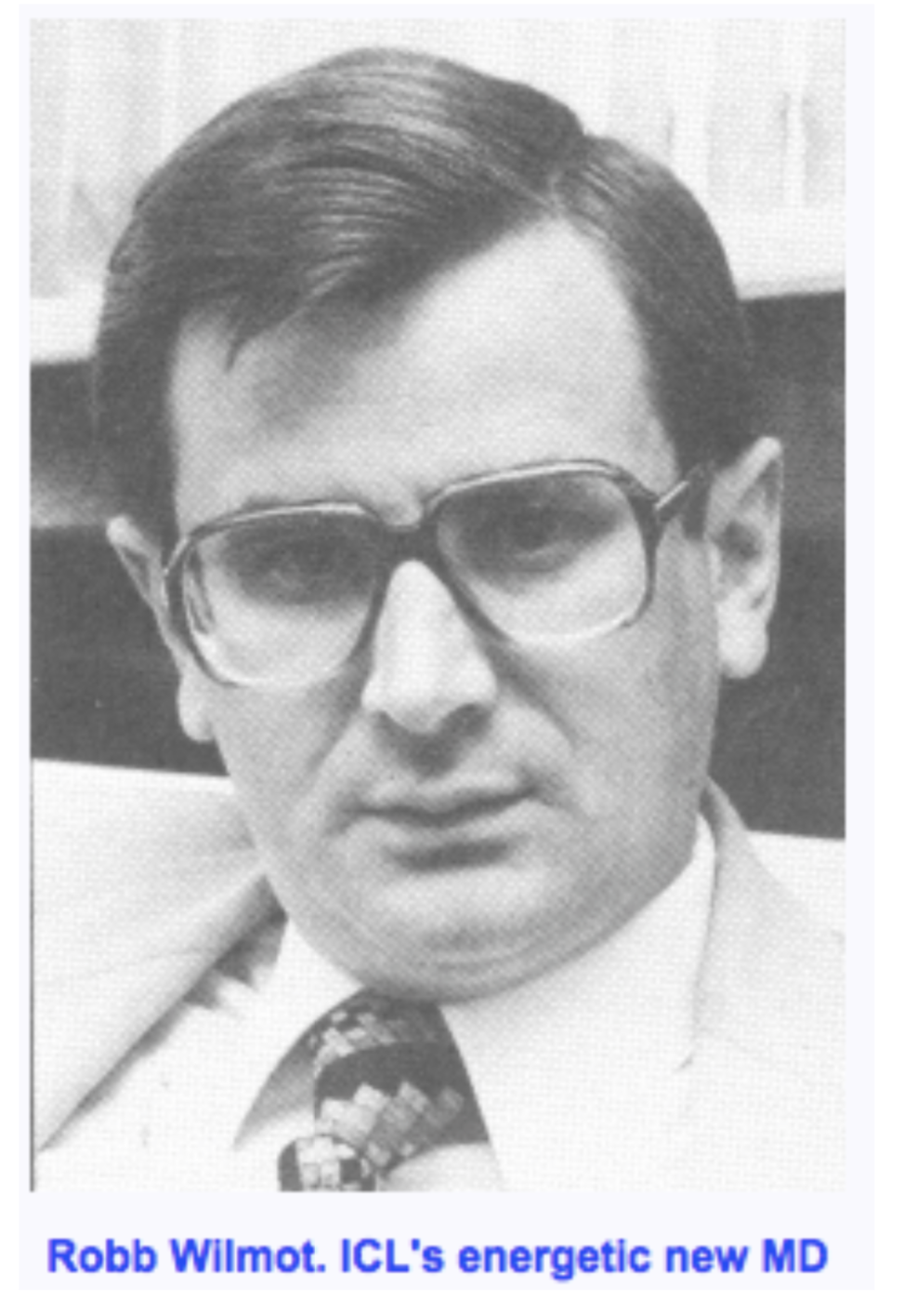
The Bill of Rights
for Company Communication
(written by Tom)
1. You have a right to know precisely what is expected of you.
2. You have a right to clarify things with colleagues,
anywhere in the organization.
3. You have a right to initiate clearer definitions
of objectives and strategies.
4. You have a right to get objectives presented
in measurable, quantified formats.
5. You have a right to change your objectives and strategies,
for better performance.
6. You have the right to try out new ideas
for improving communication.
007. You have the right to fail when trying,
but also to kill failures quickly.
8. You have a right to constructively challenge
higher-level objectives and strategies.
9. You have a right to be judged objectively
on your performance against measurable objectives.
10. You have a right to offer constructive help
to colleagues to improve communication.
PS ICL went into profit for next 15 years, after 7 years in red

Slide 51
Our Internal Client’s Vision, Values, Objectives:
Anti-Financial Crime (AFC) Department Mission Statement:
Be a trusted and respected independent control function that aims to protect the bank from financial crime risk. Establish a proactive framework to prevent, detect, and report financial crime risk events.
<- PV, Head of Anti-Financial Crime
Our Vision: Anti-Financial Crime Technology: “To provide XXXX Bank the best possible capability to prevent, detect, and report possible financial crime, in-line with the expectations of our global regulators.” <- SC

Slide 52
Report of AFC Project Results Jan 2019, 3 Sub-projects
Using Gilb’s Value Driven Methods

Slide 53
Diagram over AFC Planning

Slide 54
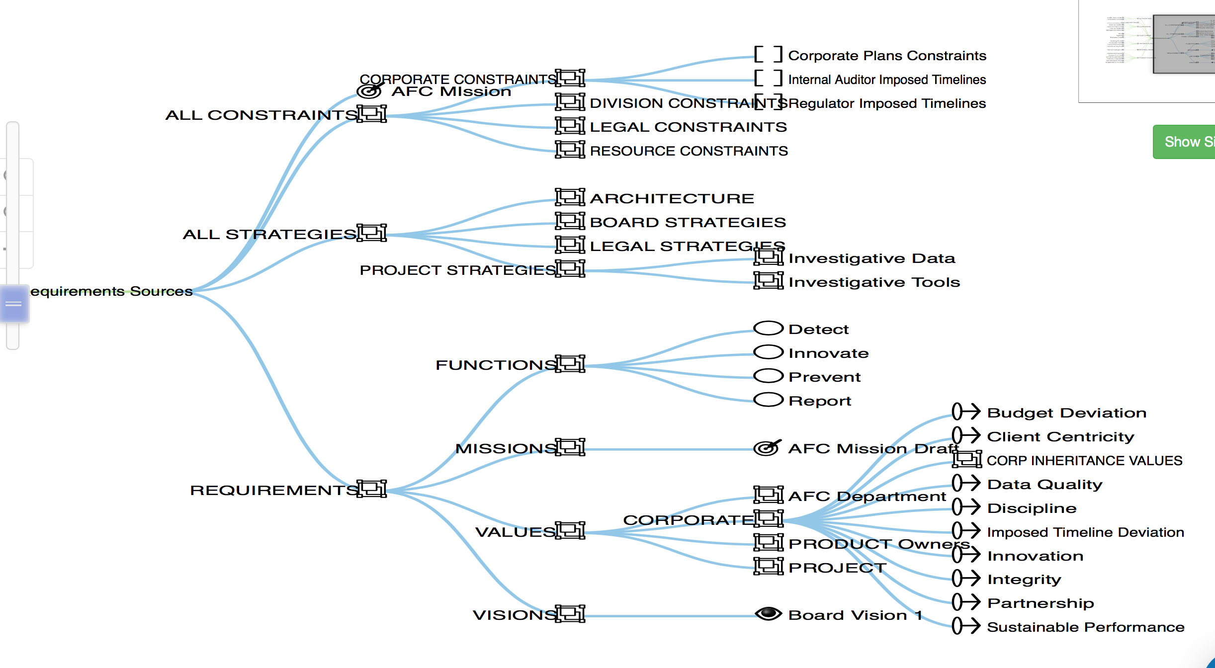
AFC Requirements Constraints and ‘Architecture’Overview

Slide 55
AFC Requirements
(focus on 4 types, detail for Values))

Slide 56
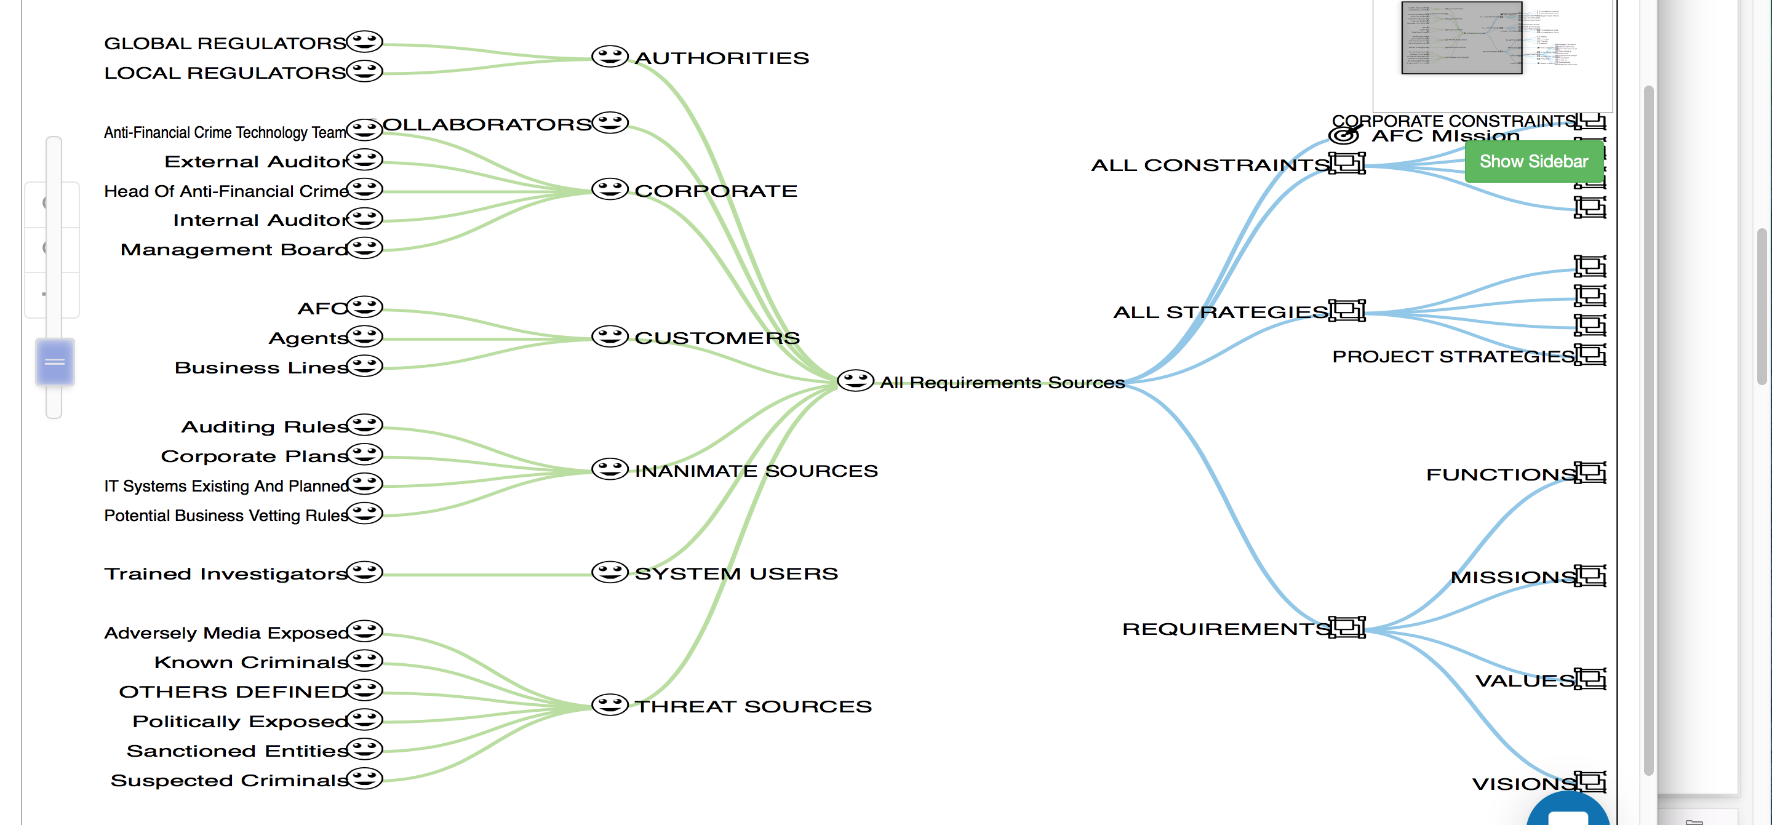
Stakeholders AFC

Slide 57
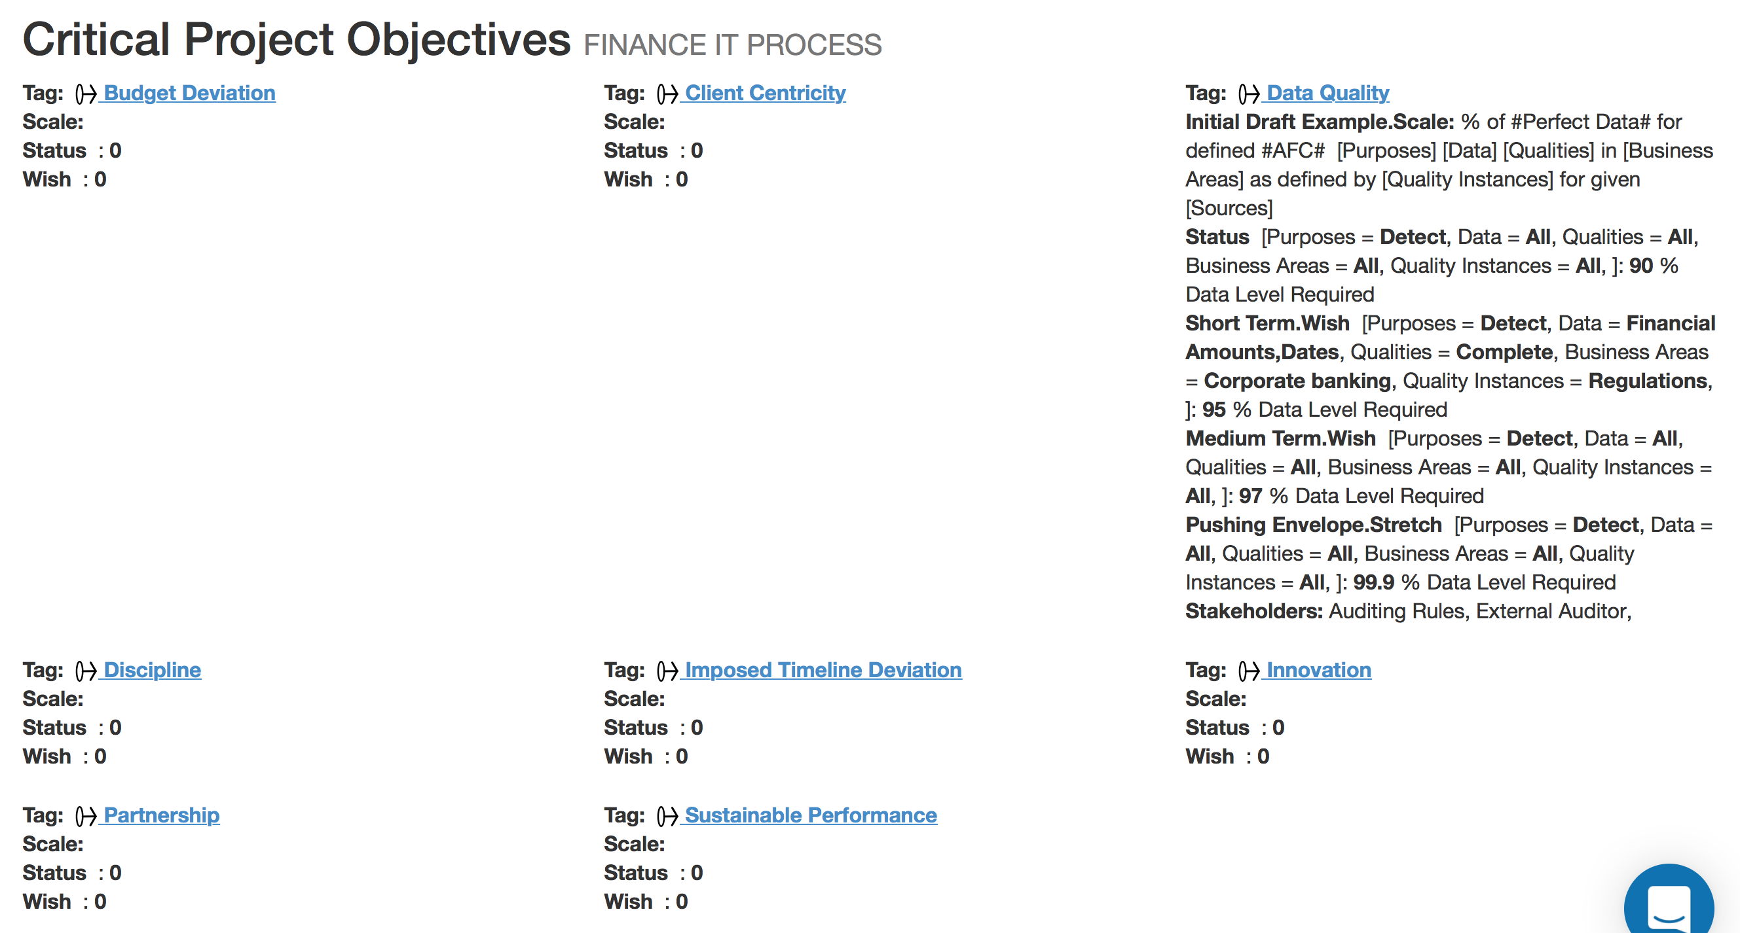
Critical set of AFC Objectives

Slide 58
Corporate Objectives AFC

Slide 59
Structuring AFC

Slide 60
Data Quality
Value Quantified

Slide 61
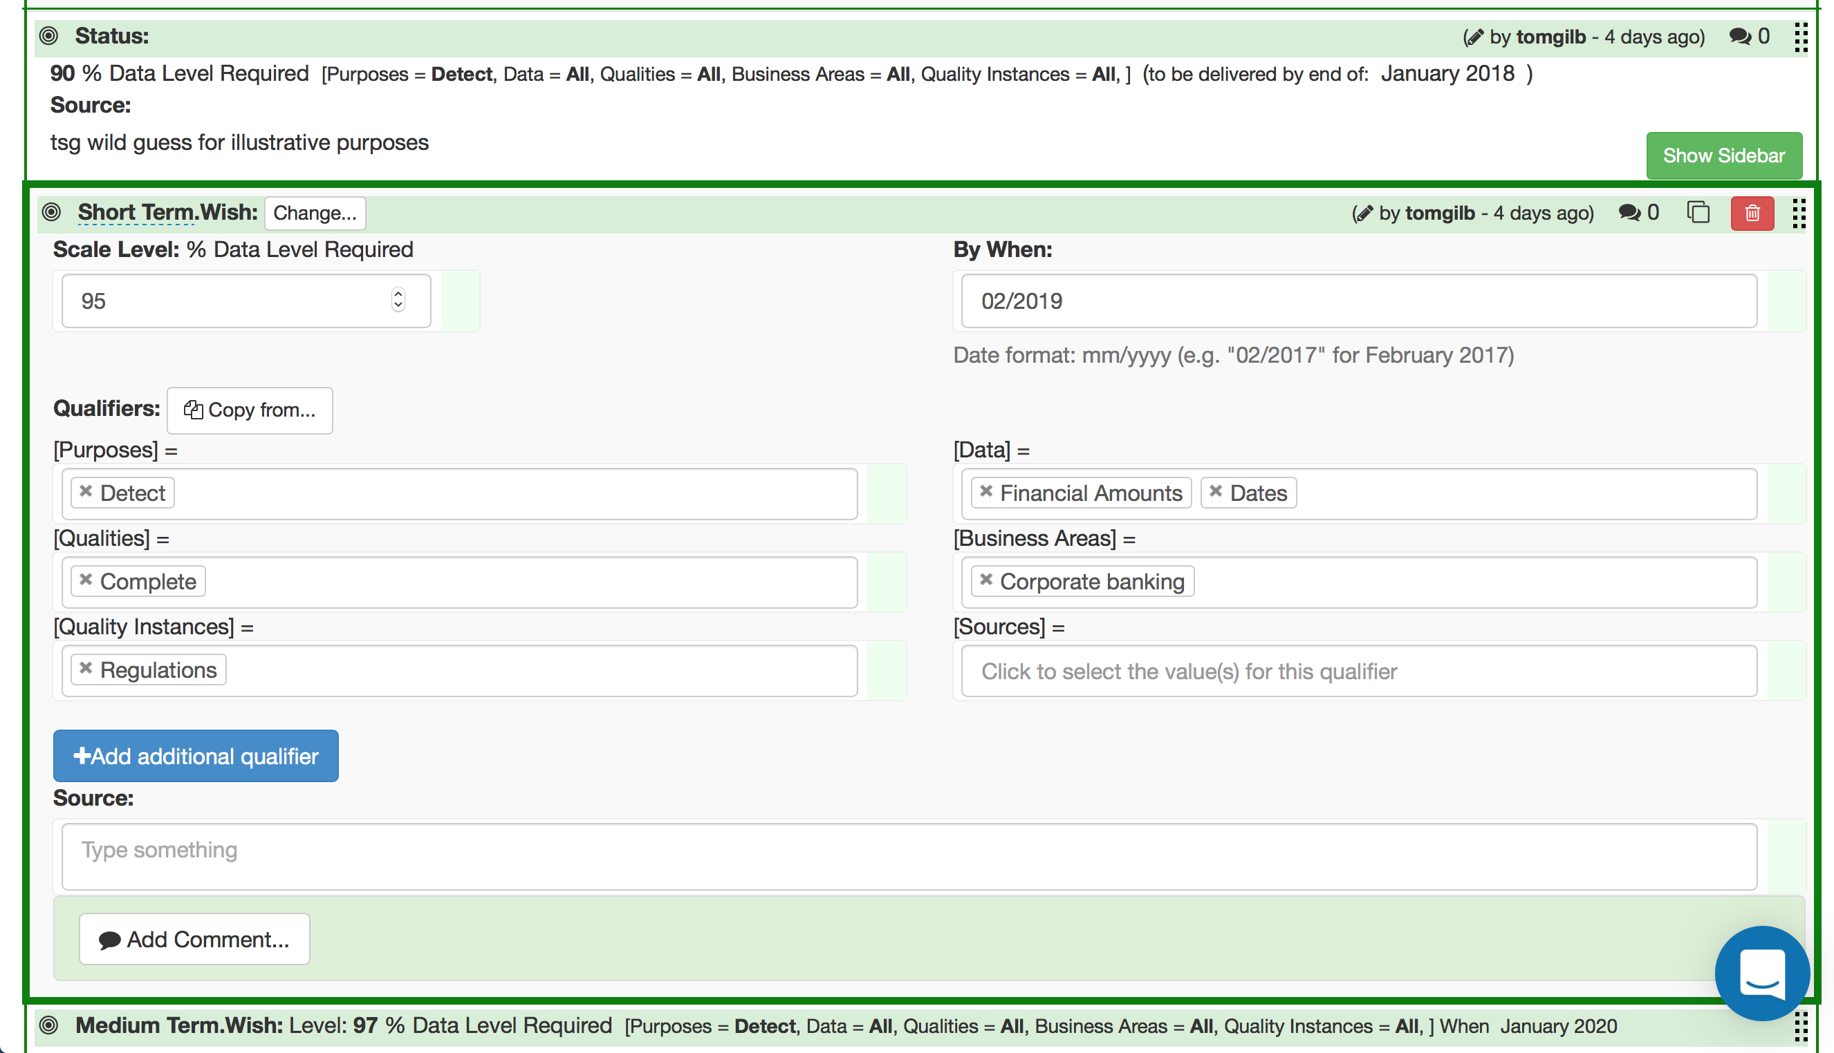
Data Quality (?)
A ‘Wish’ requirement detail

Slide 62
A Stretch level
requirement detail

Slide 63
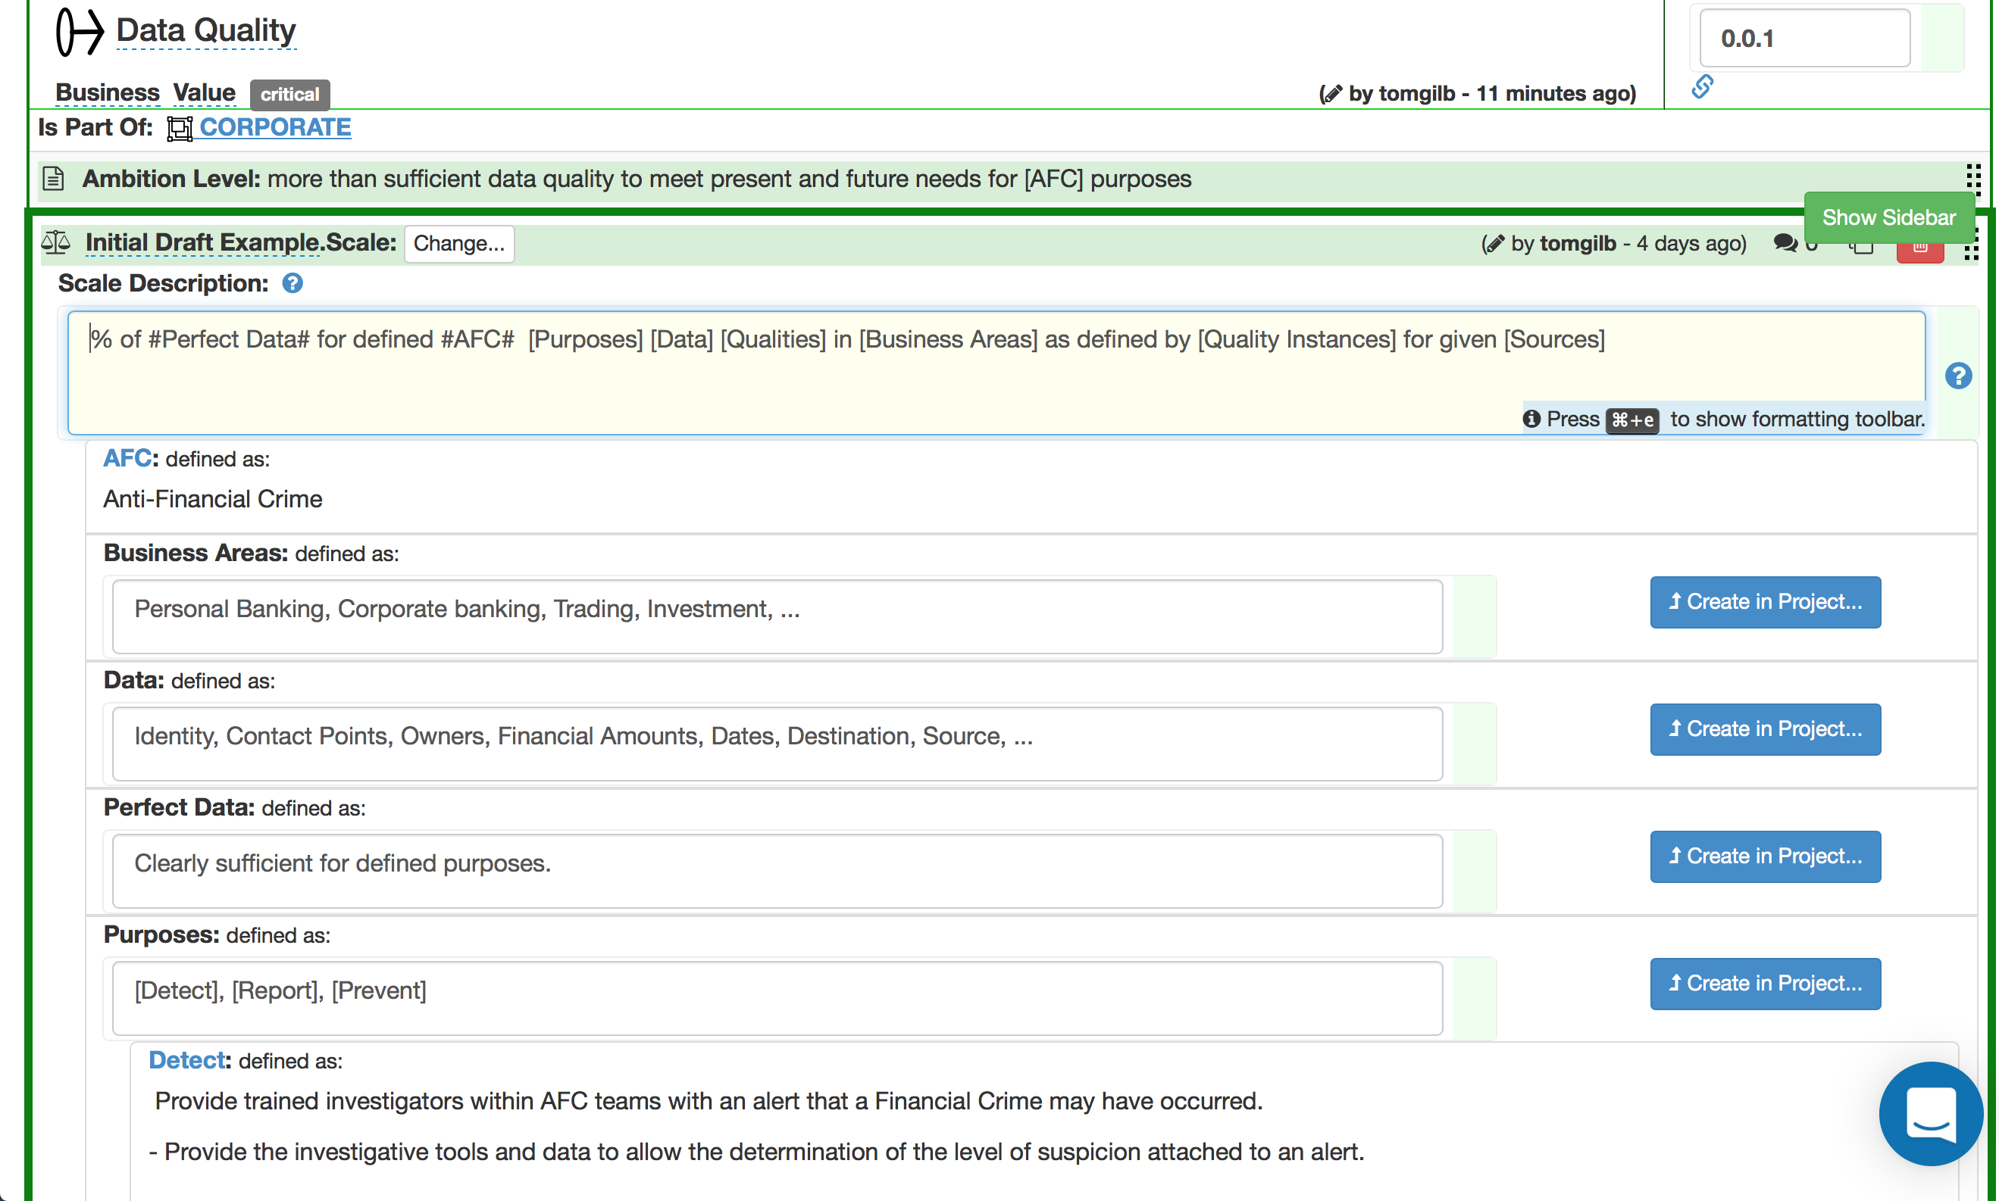
‘Data Quality’
the ‘Scale of Measure’ definition detail

Slide 64
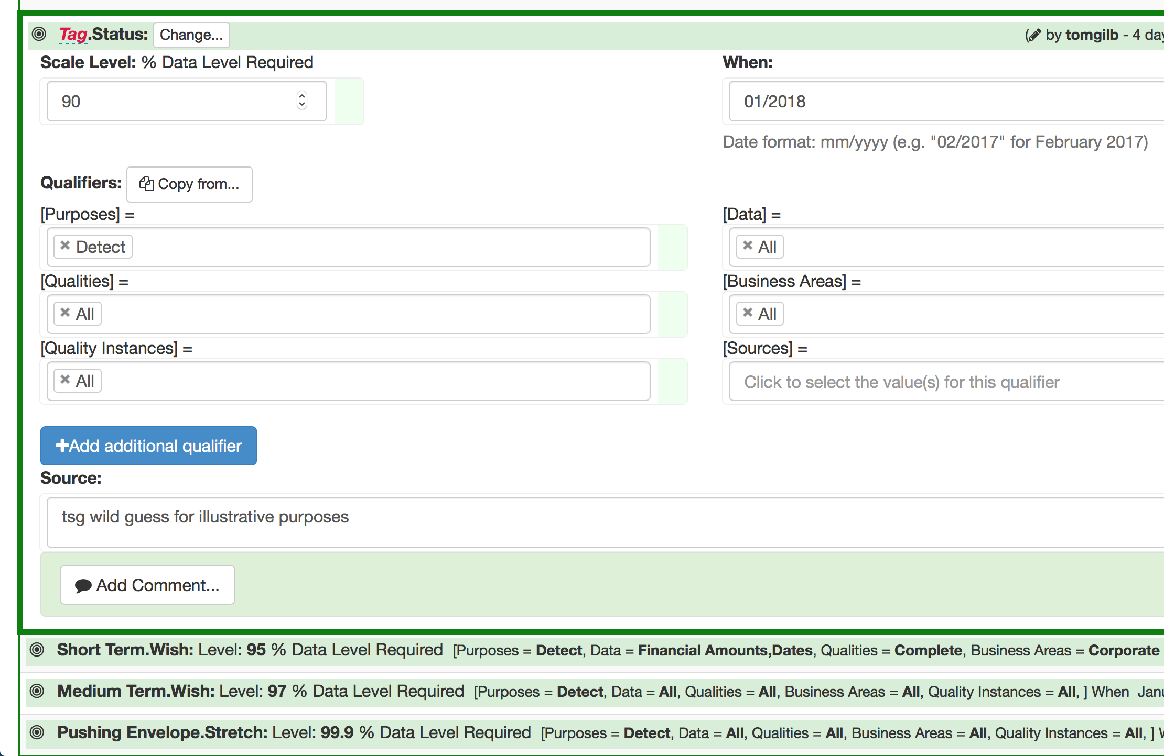
The ‘Status Level’ of Data Quality (detail)

Slide 65
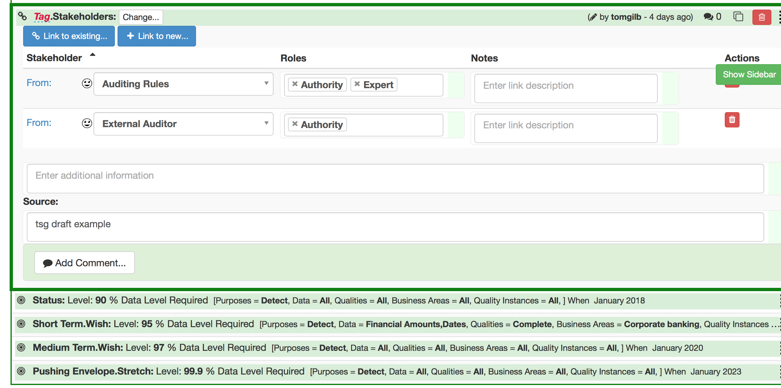
Stakeholders
(direct association with Values)

Slide 66
Startup Week
AN AGILE START TO AN AGILE VALUE-DELIVERY PROCESS

Slide 67
Evo Startup Week: Formal Process
5. Present to Management and Get OK, try to deliver value next week
3. Estimate Power and Costs of Strategies, for reaching our Goals
2. Pick Most Powerful Strategies
4. Decompose Strategies and find something doable next week
1. Quantify Critical Few Objectives
Notes:
Slide created for CP book 9.10 by tsg sept 3 2014

Slide 68
Evo Startup Week: What is behind the process steps?
3. Evaluate the cost effectiveness of our chosen means
5. Get management OK to get practical, and deliver value next week
2. Decide the main means to deliver those values
4. Select a very high value sub-strategy to try out shortly for real
1. Clarify your critical values
Notes:
Slide created for CP book 9.10 by tsg sept 3 2014

Slide 69
Every Monday: Set this cycle’s Goals
1.1 Brainstorm Top Ten Critical Objectives
1.5 TARGETS: work out Wish/Goal, and possible Stretch
1.2 Work out Ambition Level for Each one
1.5 CONSTRAINTS: Work out a Tolerable and or OK Level for given time, place, and conditions
1.3 Work out A Scale or set of Scales for each one
1.4 Work out a Past Level for given time, place, and conditions
Notes:
Slide created for CP book 9.10 by tsg sept 3 2014

Slide 71
Real Bank Project : Project Progress Testability Quantification of the most-critical project objectives on day 1
P&L-Consistency&T P&L: Scale: total adjustments btw Flash/Predict and Actual (T+1) signed off P&L. per day. Past 60 Goal: 15
Speed-To-Deliver: Scale: average Calendar days needed from New Idea Approved until Idea Operational, for given Tasks, on given Markets. Past [2009, Market = EURex, Task =Bond Execution] 2-3 months ? Goal [Deadline =End 20xz, Market = EURex, Task =Bond Execution] 5 days
Operational-Control: Scale: % of trades per day, where the calculated economic difference between OUR CO and Marketplace/Clients, is less than “1 Yen”(or equivalent). Past [April 20xx] 10% change this to 90% NH Goal [Dec. 20xy] 100%
Operational-Control.Consistent: Scale: % of defined [Trades] failing full STP across the transaction cycle. Past [April 20xx, Trades=Voice Trades] 95% Past [April 20xx, Trades=eTrades] 93% Goal [April 20xz, Trades=Voice Trades] <95 ± 2%> Goal [April 20xz, Trades=eTrades] 98.5 ± 0.5 %
Operational-Control.Timely.End&OvernightP&L Scale: number of times, per quarter, the P&L information is not delivered timely to the defined [Bach-Run]. Past [April 20xx, Batch-Run=Overnight] 1 Goal [Dec. 20xy, Batch-Run=Overnight] <0.5> Past [April 20xx, Batch-Run= T+1] 1 Goal [Dec. 20xy, Batch-Run=End-Of-Day, Delay<1hour] 1
Operational-Control.Timely.IntradayP&L Scale: number of times per day the intraday P&L process is delayed more than 0.5 sec.
Operational-Control.Timely.Trade-Bookings Scale: number of trades per day that are not booked on trade date. Past [April 20xx] 20 ?
Front-Office-Trade-Management-Efficiency Scale: Time from Ticket Launch to trade updating real-time risk view Past [20xx, Function = Risk Mgt, Region = Global] ~ 80s +/- 45s ?? Goal [End 20xz, Function = Risk Mgt, Region = Global] ~ 50% better?
Managing Risk – Accurate – Consolidated – Real Time
Risk.Cross-Product Scale: % of financial products that risk metrics can be displayed in a single position blotter in a way appropriate for the trader (i.e. – around a benchmark vs. across the curve). Past [April 20xx] 0% 95%. Goal [Dec. 20xy] 100%
Risk.Low-latency Scale: number of times per day the intraday risk metrics is delayed by more than 0.5 sec. Past [April 20xx, NA] 1% Past [April 20xx, EMEA] ??% Past [April 20xx, AP] 100% Goal [Dec. 20xy] 0%
Risk.Accuracy
Risk. user-configurable Scale: ??? pretty binary – feature is there or not – how do we represent? Past [April 20xx] 1% Goal [Dec. 20xy] 0%
Operational Cost Efficiency Scale: <Increased efficiency (Straight through processing STP Rates )>
Cost-Per-Trade Scale: % reduction in Cost-Per-Trade Goal (EOY 20xy, cost type = I 1 – REGION = ALL) Reduce cost by 60% (BW) Goal (EOY 20xy, cost type = I 2 – REGION = ALL) Reduce cost by x % Goal (EOY 20xy, cost type = E1 – REGION = ALL) Reduce cost by x % Goal (EOY 20xy, cost type = E 2 – REGION = ALL) Reduce cost by 100% Goal (EOY 20xy, cost type = E 3 – REGION = ALL) Reduce cost by x %
ONE PAGE PROJECT REQUIREMENTS QUANTIFIED
Operational-Control:
Scale: % of trades per day, where the calculated economic difference between OUR CO and Marketplace/Clients, is less than “1 Yen”(or equivalent).
Past [April 20xx] 10%
Goal [Dec. 20xy] 100%
ONE PAGE PROJECT REQUIREMENTS QUANTIFIED
28 March 2015
© Gilb.com
Notes:
These are real 20xx one page summary objectives. They were made from scratch ib 2 days and this set was extracted from about 10 pages of detailed objectives to give a one page summary. They were evolved in the next few months, and these no longer represent current objectives. This is a non confidential set. Some numbers are changed at random, but the example is the same.

Slide 72
Tuesday: Identify Most-Effective Strategies
2.1 Brainstorm a list of the intuitively most powerful strategies for reaching all goals within resources
2.4 Product is about 1 page each strategy
2.2 Detail the top 10 strategies, into independently implementable sub-strategies
2.3 Complete the strategy template, with issues, experts, impact relationships (S1->O3)
Notes:
Slide created for CP book 9.10 by tsg sept 3 2014

Slide 73
Defining a Design/Solution/Architecture/Strategy (Planguage, CE Design Template) 1. enough detail to estimate, 2. some impact assertion, 3. Assumptions, Risks, Issues
Orbit Application Base: (formal Cross reference Tag)
Type: Primary Architecture Option
============ Basic Information ==========
Version: Nov. 30 20xx 16:49, updated 2.Dec by telephone and in meeting. 14:34
Status: Draft
Owner: Brent Barclays
Expert: Raj Shell, London
Authority: for differentiating business environment characteristics, Raj Shell, Brent Barclays(for overview)
Source: <Source references for the information in this specification. Could include people>. Various, can be done later BB
Gist: risk and P/L aggregation service, which also provides work flow/adjustment and outbound and inbound feed support. Currently used by Rates ExtraBusiness, Front Office and Middle Office, USA & UK.
Description: <Describe the design idea in sufficient detail to support the estimated impacts and costs given below>.
D1: ETL Layer. Rules based highly configurable implementation of the ETL Pattern, which allows the data to be onboarded more quickly. Load and persist new data very quickly. With minimal development required. -> Business-Capability-Time-To-Market, Business Scalability
D2: high performance risk and P/L aggregation processing (Cube Building). -> Timeliness, P/L Explanation, Risk & P/L Understanding, Decision Support, Business Scalability, Responsiveness.
D3: Orbit supports BOTH Risk and P/L -> P/L Explanation, Risk & P/L Consistency, Risk & P/L Understanding, Decision Support.
D4: a flexible configurable workflow tool, which can be used to easily define new workflow processes -> Books/Records Consistency, Business Process Effectiveness, Business Capability Time to Market.
D5: a report definition language, which provides 90+% of the business logic contained with Orbit, allows a quick turnaround of new and enhanced reports with minimal regression testing and release procedure impact. -> P/L Explanation, Risk & P/L Understanding, Business Capability Time to Market, Business Scalability.
D6: Orbit GUI. Utilizes an Outlook Explorer metaphor for ease of use, and the Dxx Express Grid Control, to provide high performance Cube Interrogation Capability. -> Responsiveness, People Interchangeability, Decision Support, Risk & P/L Understanding.
D7: downstream feeds. A configurable event-driven data export service, which is used to generate feeds . -> Business Process Effectiveness, Business Capability Time to Market.
===================== Priority and Risk Management =====================
Assumptions: <Any assumptions that have been made>.
A1: FCCP is assumed to be a part of Orbit. FCxx does not currently exist and is Dec 20xx 6 months into Requirements Spec. <- Picked up by TsG from dec 2 discussions AH MA JH EC.
Consequence: FCxx must be a part of the impact estimation and costs rating.
A2: Costs, the development costs will not be different. All will base on a budget of say $nn mm and 3 years. The o+
costs may differ slightly, like $n mm for hardware. MA AH 3 dec
A3:Boss X will continue to own Orbit. TSG DEC 2
A4: the schedule, 3 years, will constrained to a scope we can in fact deliver, OR we will be given additional budget. If not “I would have a problem” <- BB
A5: the cost of expanding Orbit will not be prohibitive. <- BB 2 dec
A6: we have made the assumption that we can integrate Oribit with PX+ in a sensible way, even in the short term <- BB
Dependencies: <State any dependencies for this design idea>.
D1: FCxx replaces Px+ in time. ? tsg 2.12
Risks: <Name or refer to tags of any factors, which could threaten your estimated impacts>.
R1. FCxx is delayed. Mitigation: continue to use Pxx <- tsg 2.12
R2: the technical integration of Px+ is not as easy as thought & we must redevelop Oribit
R3: the and or scalability and cost of coherence will not allow us to meet the delivery.
R4: scalability of Orbit team and infrastructure, first year especially <- BB. People, environments, etc.
R5: re Cross Desk reporting Requirement, major impact on technical design. Solution not currently known. Risk no solution allowing us to report all P/L
Issues: <Unresolved concerns or problems in the specification or the system>.
I1: Do we need to put the fact that we own Orbit into the objectives (Ownership). MA said, other agreed this is a huge differentiator. Dec 2.
I2: what are the time scales and scope now? Unclear now BB
I3: what will the success factors be? We don’t know what we are actually being asked to do. BB 2 dec 20xx
I4: for the business other than flow options, there is still a lack of clarity as to what the requirements are and how they might differ from Extra and Flow Options. BB
I5: the degree to which this option will be seen to be useful without Intra Day. BB 2 dec
Presented Oslo Sw Arch Meetup © Gilb.com
Notes:
Based on real solution spec Done Dec 20xx London, but modified here for confidentiality. Tom Gilb

Slide 74
Design Spec Enlarged 1 of 2
Spec Headers
Detailed Description and -> Impacted Objectives
Orbit Application Base: (formal Cross reference Tag)
Type: Primary Architecture Option
==== Basic Information ==========
Version: Nov. 30 20xx 16:49, updated 2.Dec by telephone and in meeting. 14:34
Status: Draft (PUBLIC EXAMPLE EDIT)
Owner: Brent Barclays
Expert: Raj Shell, London
Authority: for differentiating business environment characteristics, Raj Shell, Brent Barclays(for overview)
Source: <Source references for the information in this specification. Could include people>. Various, can be done later BB
Gist: risk and P/L aggregation service,
which also provides work flow/adjustment and outbound and inbound feed support. Currently used by Rates Extra Business, Front Office and Middle Office, USA & UK.
Description: <Describe the design idea in sufficient detail to support the estimated impacts and costs given below>.
D1: ETL Layer. Rules based highly configurable implementation of the ETL Pattern, which allows the data to be onboarded more quickly. Load and persist new data very quickly. With minimal development required. -> Business-Capability-Time-To-Market, Business Scalability
D2: high performance risk and P/L aggregation processing (Cube Building). -> Timeliness, P/L Explanation, Risk & P/L Understanding, Decision Support, Business Scalability, Responsiveness.
D3: Orbit supports BOTH Risk and P/L -> P/L Explanation, Risk & P/L Consistency, Risk & P/L Understanding, Decision Support.
D4: a flexible configurable workflow tool, which can be used to easily define new workflow processes -> Books/Records Consistency, Business Process Effectiveness, Business Capability Time to Market.
D5: a report definition language, which provides 90+% of the business logic contained with Orbit, allows a quick turnaround of new and enhanced reports with minimal regression testing and release procedure impact. -> P/L Explanation, Risk & P/L Understanding, Business Capability Time to Market, Business Scalability.
D6: Orbit GUI. Utilizes an Outlook Explorer metaphor for ease of use, and the Dxx Express Grid Control, to provide high performance Cube Interrogation Capability. -> Responsiveness, People Interchangeability, Decision Support, Risk & P/L Understanding.
D7: downstream feeds. A configurable event-driven data export service, which is used to generate feeds . -> Business Process Effectiveness, Business Capability Time to Market.

Slide 75
Design Spec Enlarged 2 of 2
==== Priority & Risk Management ========
Assumptions: <Any assumptions that have been made>.
A1: FCCP is assumed to be a part of Orbit. FCxx does not currently exist and is Dec 20xx 6 months into Requirements Spec. <- Picked up by TsG from dec 2 discussions AH MA JH EC.
Consequence: FCxx must be a part of the impact estimation and costs rating.
A2: Costs, the development costs will not be different. All will base on a budget of say $ nn mm and 3 years. The ops costs may differ slightly, like $n mm for hardware. MA AH 3 dec
A3:Boss X will continue to own Orbit. TSG DEC 2
A4: the schedule, 3 years, will constrained to a scope we can in fact deliver, OR we will be given additional budget. If not “I would have a problem” <- BB
A5: the cost of expanding Orbit will not be prohibitive. <- BB 2 dec
A6: we have made the assumption that we can integrate Oribit with PX+ in a sensible way, even in the short term <- BB
Dependencies: <State any dependencies for this design idea>.
D1: FCxx replaces Px+ in time. ? tsg 2.12
Risks: <Name or refer to tags of any factors, which could threaten your estimated impacts>.
R1. FCxx is delayed. Mitigation: continue to use Pxx<- tsg 2.12
R2: the technical integration of Px+ is not as easy as thought & we must redevelop Oribit
R3: the and or scalability and cost of coherence will not allow us to meet the delivery.
R4: scalability of Orbit team and infrastructure, first year especially <- BB. People, environments, etc.
R5: re Cross Desk reporting Requirement, major impact on technical design. Solution not currently known. Risk no solution allowing us to report all P/L
Issues: <Unresolved concerns or problems in the specification or the system>.
I1: Do we need to put the fact that we own Orbit into the objectives (Ownership). MA said, other agreed this is a huge differentiator. Dec 2.
I2: what are the time scales and scope now? Unclear now BB
I3: what will the success factors be? We don’t know what we are actually being asked to do. BB 2 dec 20xx
I4: for the business other than flow options, there is still a lack of clarity as to what the requirements are and how they might differ from Extra and Flow Options. BB
I5: the degree to which this option will be seen to be useful without Intra Day. BB 2 dec

Slide 76
Wednesday: Build Impact Estimation Table
3.1 Insert tags of Goals on left column, with Past <-> Goal numbers
3.8 Calculate total impact of all strategies on a single Goal, including safety margin
3.2 Insert Tags of Strategies across top row
3.7 Calculate total values/costs for each strategy
3.3 Estimate % (and or real units of impact) for each G:S intersection
3.7 Estimate Costs for each strategy
3.4 Estimate ± Uncertainty for each
3.6 Assign Credibility (0.0 to 1.0) to each
3.5 Note Evidence and Source for each
Notes:
Slide created for CP book 9.10 by tsg sept 3 2014

Slide 77
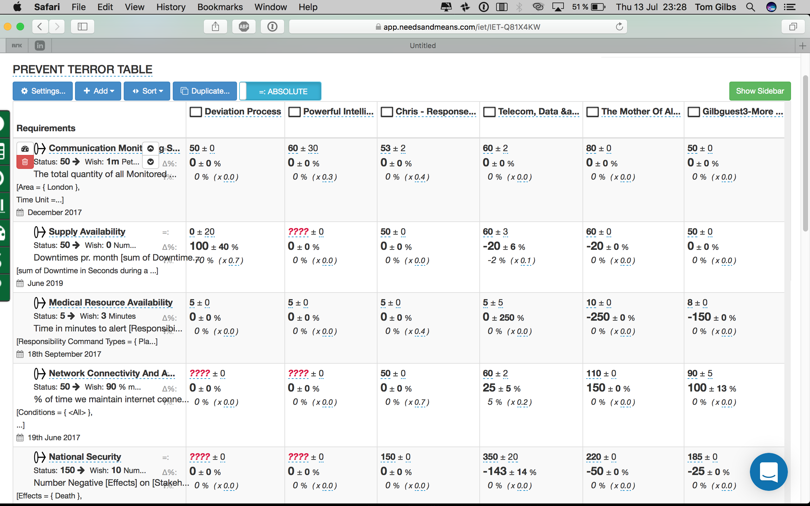
Impact Estimation Table
develops raw data about how effective and costly the architecture is estimated to be for all objectives and costs
Notes:
Originated July 13 2017 based on BCS Class exercise June 2017 on Terrorist Prevention Tom Gilb

Slide 78
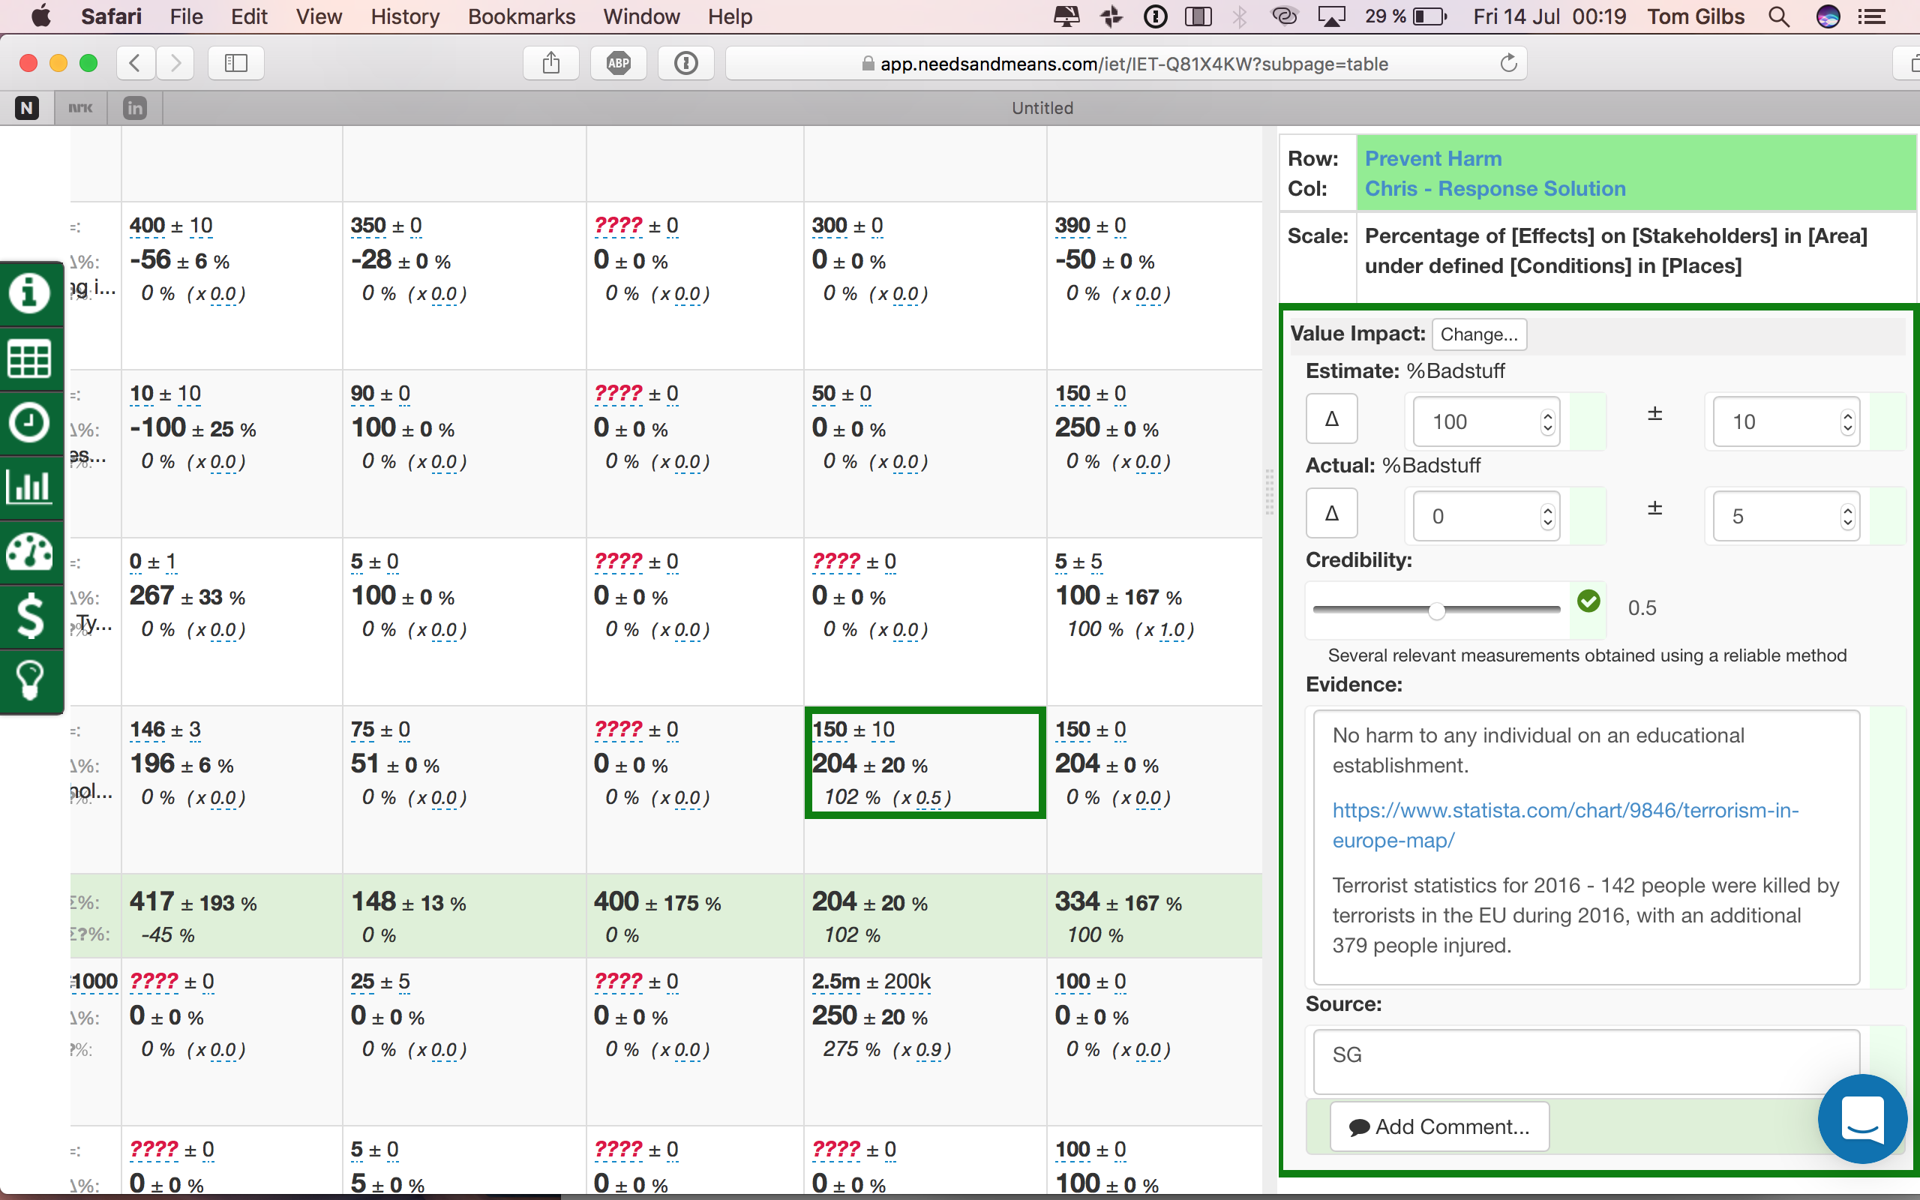
Architecture Impact Uncertainty and Evidence determine priority
Notes:
Originated July 13 2017 based on BCS Class exercise June 2017 on Terrorist Prevention Tom Gilb

Slide 79
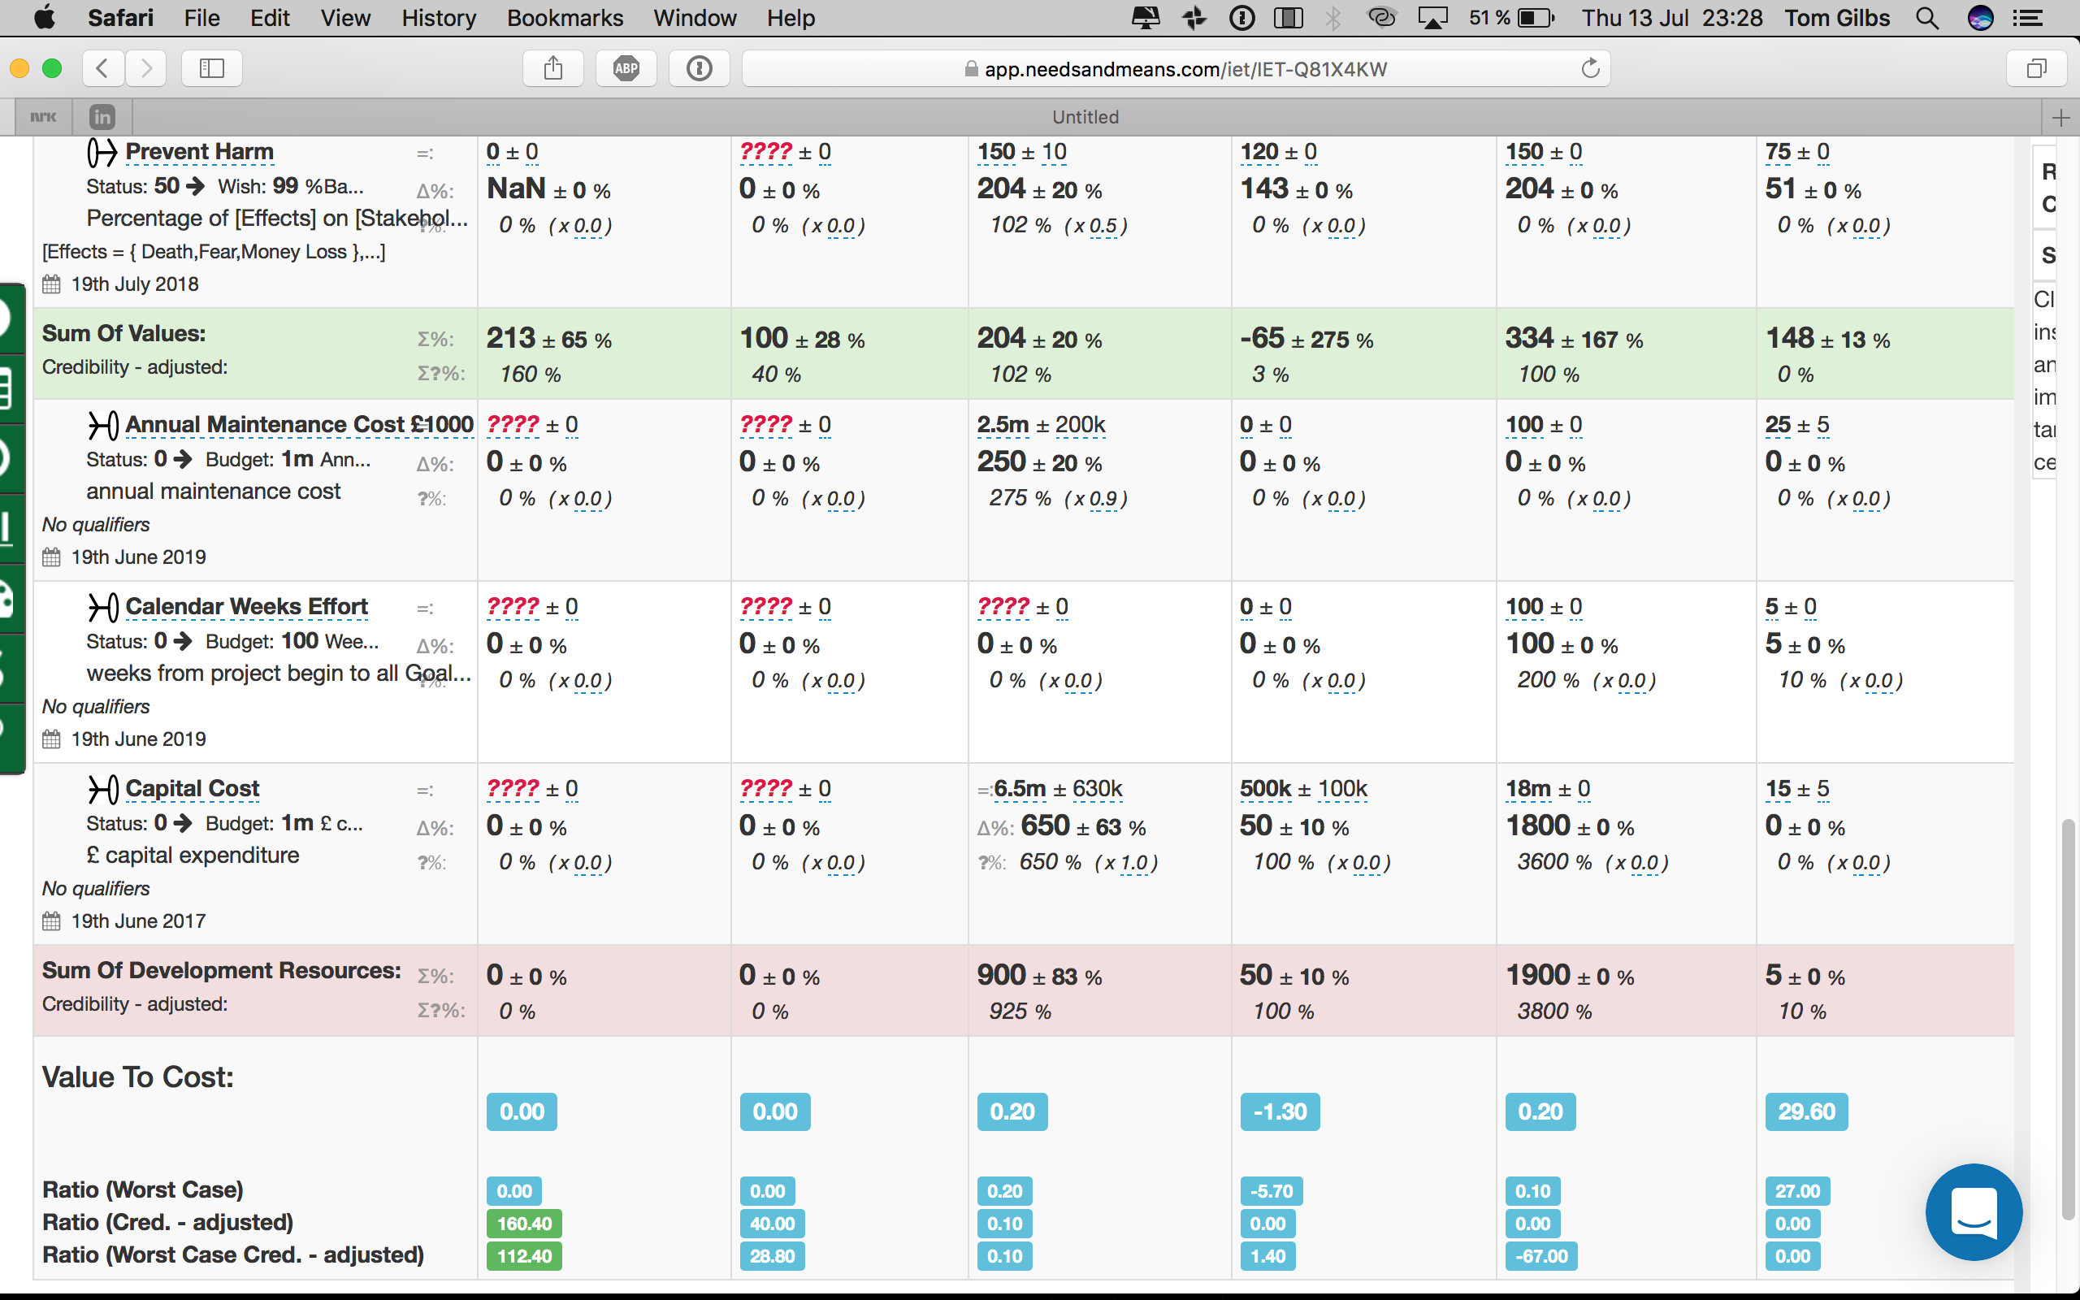
Overall Value rating /
Overall Resource need:
determines priority
Notes:
Originated July 13 2017 based on BCS Class exercise June 2017 on Terrorist Prevention Tom Gilb

Slide 80
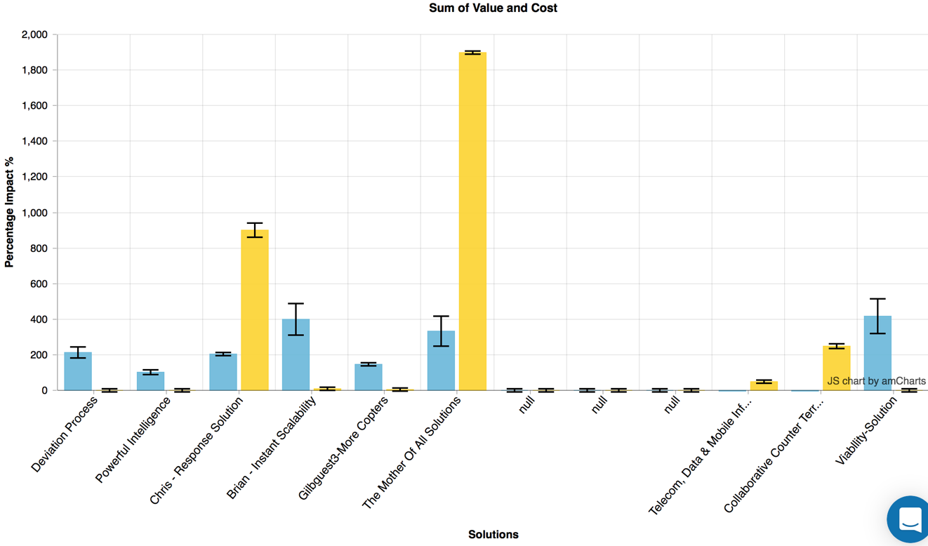
We can sort (prioritize next sprint) architecture solutions by estimated value/cost and riskiness
I: is the ± uncertainty.
Best/worst case
Notes:
Originated July 13 2017 based on BCS Class exercise June 2017 on Terrorist Prevention Tom Gilb

Slide 81
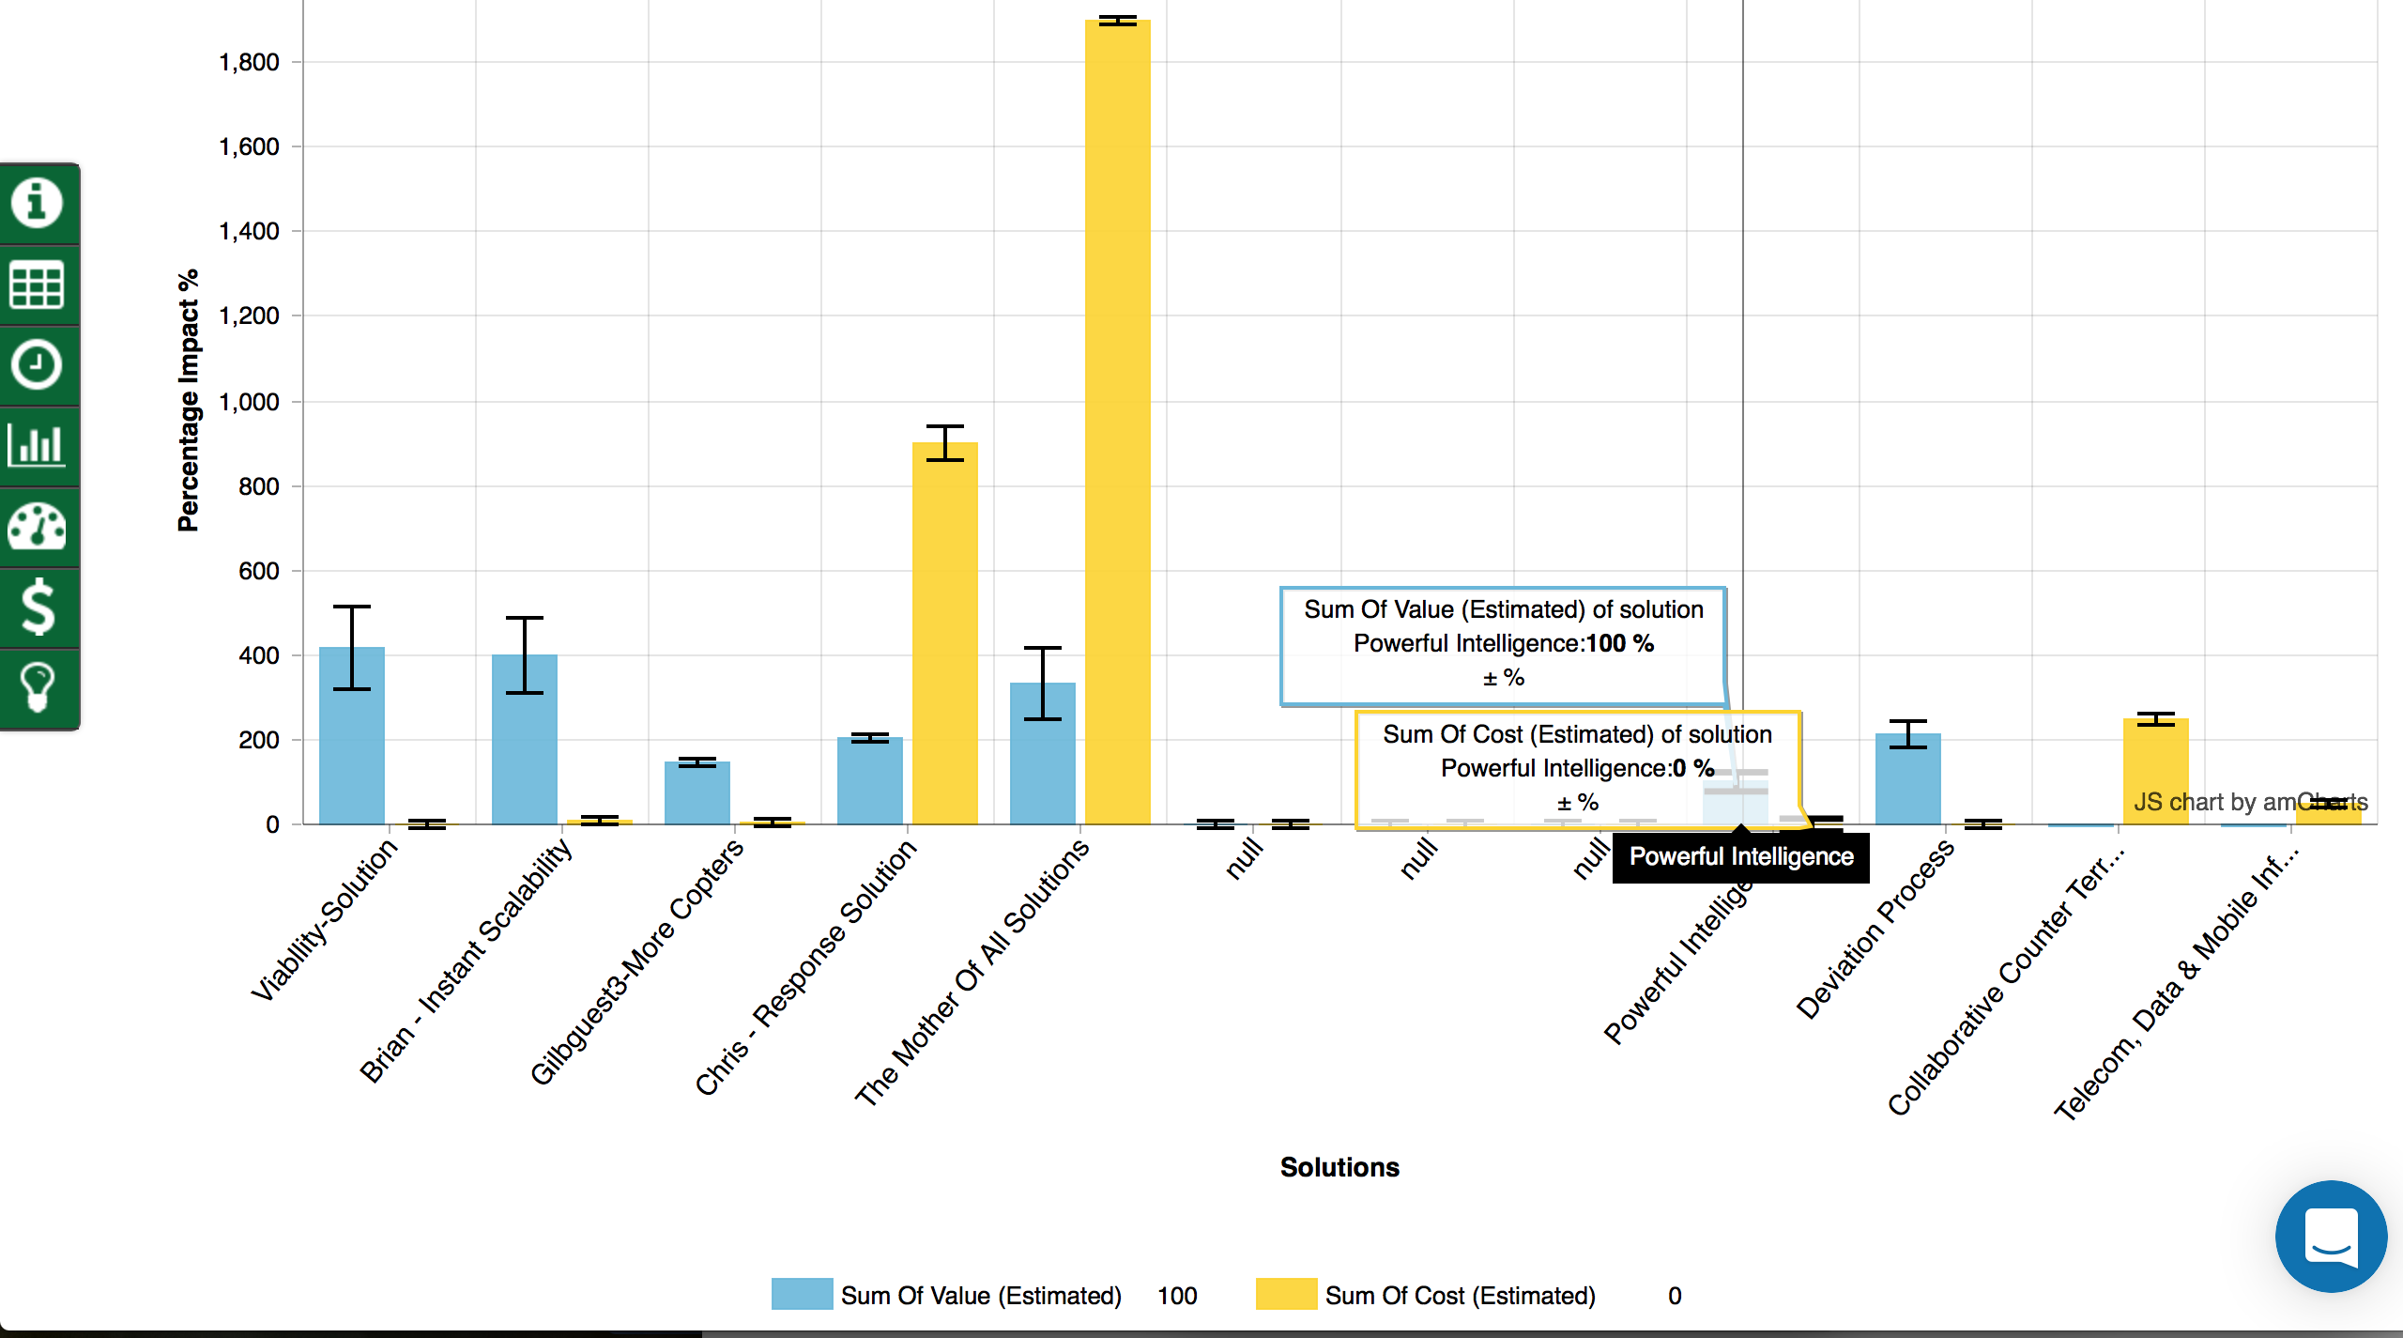
Architecture options
sorted by value and cost
Notes:
Originated July 13 2017 based on BCS Class exercise June 2017 on Terrorist Prevention Tom Gilb

Slide 82
Thursday: Find what we can deliver next week
4.1 Look at most values/costs strategy
4.5 Option: several parallel deliveries, parallel teams
4.2 Decompose it if necessary into 1 or more weekly implementations
4.4 Agree to one value delivery next week
4.3 Estimate which one of several options would give best effect
Notes:
Slide created for CP book 9.10 by tsg sept 3 2014

Slide 83
Friday : Get Management Approval to try to deliver real measurable value next week
5.1 Present the 4 days of planning to management
5.5 Ask them if, most all weeks deliver value in practice, we can keep on delivering until Goals are reached
5.2 Ask if they agree to the plans: the objectives, the strategies, the estimations; at least roughly OK
5.4 Ask them to formally approve only next week, as a trial.
5.3 Ask if they like the plan for what to do next week, or have other ideas?
Notes:
Slide created for CP book 9.10 by tsg sept 3 2014

Slide 84
20 Sept, 2011 Report on Gilb Evo method (Richard Smith, Citigroup)
http://rsbatechnology.co.uk/blog:8
Back in 2004, I was employed by a large investment bank in their FX e-commerce IT department as a business analyst.
The wider IT organisation used a complex waterfall-based project methodology that required use of an intranet application to manage and report progress.
However, it's main failings were that it almost totally missed the ability to track delivery of actual value improvements to a project's stakeholders, and the ability to react to changes in requirements and priority for the project's duration.
The toolset generated lots of charts and stats that provided the illusion of risk control. but actually provided very little help to the analysts, developers and testers actually doing the work at the coal face.
The proof is in the pudding;
I have used Evo (albeit in disguise sometimes) on two large, high-risk projects in front-office investment banking businesses, and several smaller tasks.
On the largest critical project, the original business functions & performance objective requirements document, which included no design, essentially remained unchanged over the 14 months the project took to deliver,
but the detailed designs (of the GUI, business logic, performance characteristics) changed many many times, guided by lessons learnt and feedback gained by delivering a succession of early deliveries to real users.
In the end, the new system responsible for 10s of USD billions of notional risk, successfully went live over one weekend for 800 users worldwide, and was seen as a big success by the sponsoring stakeholders.
“ I attended a 3-day course with you and Kai whilst at Citigroup in 2006”
28 March 2015
© Gilb.com
Notes:
Yes, Richard was trained in Requirements by you and Kai while he was at Citi.
From: Tom Gilb [mailto:tom@gilb.com]
Sent: 26 February 2009 15:16
To: Dick Holland
Hi Tom,
I am honoured to be in contact with you again! I attended a 3-day course with you and Kai whilst at Citigroup in 2006 (I worked in the FX e-commerce front-office team at the time). You may be interested to know that I wrote a detailed business requirements spec (no design, just requirements) adopting many of your ideas shortly after the course including key quantified requirements. This spec ended up staying largely stable for a year as we did an evo – like development process, at the end of which we successfully went live with a brand-new FX order management system in a global big-bang release to 800 Citi users in 20 locations.
I hope to continue to use and expand competitive engineering practises at my new home here at LZ, with Dick’s help!
Many regards,
Richard.
Hi Tom,
Thought you might like to know I have just completed a review of Competitive Engineering on my own company's blog:
http://rsbatechnology.co.uk/blog:8
As I tried to do when I worked with Dick at LatentZero, I continue to try and spread the word to a world of (initial) unbelievers! I actually have an interesting opportunity right now to demonstrate the benefits of early & often delivery of value to stakeholders in a couple of new projects. Look forward to meeting you and Kai again sometime ...
Regards,
Richard Smith.sept 10 2011

Slide 85
Richard Smith
“ I attended a 3-day course with you and Kai whilst at Citigroup in 2006”
28 March 2015
© Gilb.com
Notes:
Yes, Richard was trained in Requirements by you and Kai while he was at Citi.
From: Tom Gilb [mailto:tom@gilb.com]
Sent: 26 February 2009 15:16
To: Dick Holland
Hi Tom,
I am honoured to be in contact with you again! I attended a 3-day course with you and Kai whilst at Citigroup in 2006 (I worked in the FX e-commerce front-office team at the time). You may be interested to know that I wrote a detailed business requirements spec (no design, just requirements) adopting many of your ideas shortly after the course including key quantified requirements. This spec ended up staying largely stable for a year as we did an evo – like development process, at the end of which we successfully went live with a brand-new FX order management system in a global big-bang release to 800 Citi users in 20 locations.
I hope to continue to use and expand competitive engineering practises at my new home here at LZ, with Dick’s help!
Many regards,
Richard.
Hi Tom,
Thought you might like to know I have just completed a review of Competitive Engineering on my own company's blog:
http://rsbatechnology.co.uk/blog:8
As I tried to do when I worked with Dick at LatentZero, I continue to try and spread the word to a world of (initial) unbelievers! I actually have an interesting opportunity right now to demonstrate the benefits of early & often delivery of value to stakeholders in a couple of new projects. Look forward to meeting you and Kai again sometime ...
Regards,
Richard Smith.sept 10 2011

Slide 86
Previous PM Methods: No ‘Value delivery tracking’. No change reaction ability
Richard Smith
“However, (our old project management methodology) main failings were that
it almost totally missed the ability to track delivery of actual value improvements to a project's stakeholders,
and the ability to react to changes
in requirements and
priority
for the project's duration”
28 March 2015
© Gilb.com
Notes:
Yes, Richard was trained in Requirements by you and Kai while he was at Citi.
From: Tom Gilb [mailto:tom@gilb.com]
Sent: 26 February 2009 15:16
To: Dick Holland
Hi Tom,
I am honoured to be in contact with you again! I attended a 3-day course with you and Kai whilst at Citigroup in 2006 (I worked in the FX e-commerce front-office team at the time). You may be interested to know that I wrote a detailed business requirements spec (no design, just requirements) adopting many of your ideas shortly after the course including key quantified requirements. This spec ended up staying largely stable for a year as we did an evo – like development process, at the end of which we successfully went live with a brand-new FX order management system in a global big-bang release to 800 Citi users in 20 locations.
I hope to continue to use and expand competitive engineering practises at my new home here at LZ, with Dick’s help!
Many regards,
Richard.
Hi Tom,
Thought you might like to know I have just completed a review of Competitive Engineering on my own company's blog:
http://rsbatechnology.co.uk/blog:8
As I tried to do when I worked with Dick at LatentZero, I continue to try and spread the word to a world of (initial) unbelievers! I actually have an interesting opportunity right now to demonstrate the benefits of early & often delivery of value to stakeholders in a couple of new projects. Look forward to meeting you and Kai again sometime ...
Regards,
Richard Smith.sept 10 2011

Slide 87
We only had the illusion of control. But little help to testers and analysts
Richard Smith
“The (old) toolset generated lots of charts and stats
that provided the illusion of risk control.
But actually provided very little help to the analysts, developers and testers actually doing the work at the coal face.”
28 March 2015
© Gilb.com
Notes:
Yes, Richard was trained in Requirements by you and Kai while he was at Citi.
From: Tom Gilb [mailto:tom@gilb.com]
Sent: 26 February 2009 15:16
To: Dick Holland
Hi Tom,
I am honoured to be in contact with you again! I attended a 3-day course with you and Kai whilst at Citigroup in 2006 (I worked in the FX e-commerce front-office team at the time). You may be interested to know that I wrote a detailed business requirements spec (no design, just requirements) adopting many of your ideas shortly after the course including key quantified requirements. This spec ended up staying largely stable for a year as we did an evo – like development process, at the end of which we successfully went live with a brand-new FX order management system in a global big-bang release to 800 Citi users in 20 locations.
I hope to continue to use and expand competitive engineering practises at my new home here at LZ, with Dick’s help!
Many regards,
Richard.
Hi Tom,
Thought you might like to know I have just completed a review of Competitive Engineering on my own company's blog:
http://rsbatechnology.co.uk/blog:8
As I tried to do when I worked with Dick at LatentZero, I continue to try and spread the word to a world of (initial) unbelievers! I actually have an interesting opportunity right now to demonstrate the benefits of early & often delivery of value to stakeholders in a couple of new projects. Look forward to meeting you and Kai again sometime ...
Regards,
Richard Smith.sept 10 2011

Slide 88
The proof is in the pudding;
Richard Smith
“The proof is in the pudding;
I have used Evo
(albeit in disguise sometimes)
on two large, high-risk projects in front-office investment banking businesses,
and several smaller tasks. “
28 March 2015
© Gilb.com
Notes:
Yes, Richard was trained in Requirements by you and Kai while he was at Citi.
From: Tom Gilb [mailto:tom@gilb.com]
Sent: 26 February 2009 15:16
To: Dick Holland
Hi Tom,
I am honoured to be in contact with you again! I attended a 3-day course with you and Kai whilst at Citigroup in 2006 (I worked in the FX e-commerce front-office team at the time). You may be interested to know that I wrote a detailed business requirements spec (no design, just requirements) adopting many of your ideas shortly after the course including key quantified requirements. This spec ended up staying largely stable for a year as we did an evo – like development process, at the end of which we successfully went live with a brand-new FX order management system in a global big-bang release to 800 Citi users in 20 locations.
I hope to continue to use and expand competitive engineering practises at my new home here at LZ, with Dick’s help!
Many regards,
Richard.
Hi Tom,
Thought you might like to know I have just completed a review of Competitive Engineering on my own company's blog:
http://rsbatechnology.co.uk/blog:8
As I tried to do when I worked with Dick at LatentZero, I continue to try and spread the word to a world of (initial) unbelievers! I actually have an interesting opportunity right now to demonstrate the benefits of early & often delivery of value to stakeholders in a couple of new projects. Look forward to meeting you and Kai again sometime ...
Regards,
Richard Smith.sept 10 2011

Slide 89
Experience: if top level requirements are separated from design, the ‘requirements’ are stable!
Richard Smith
“On the largest critical project,
the original business functions & performance objective requirements document,
which included no design,
essentially remained unchanged
over the 14 months the project took to deliver,….”
“ I attended a 3-day course with you and Kai whilst at Citigroup in 2006”, Richard Smith
28 March 2015
© Gilb.com
Notes:
Yes, Richard was trained in Requirements by you and Kai while he was at Citi.
Thi was I believe a book rviewputon Amazon for CE book.
From: Tom Gilb [mailto:tom@gilb.com]
Sent: 26 February 2009 15:16
To: Dick Holland
Hi Tom,
I am honoured to be in contact with you again! I attended a 3-day course with you and Kai whilst at Citigroup in 2006 (I worked in the FX e-commerce front-office team at the time). You may be interested to know that I wrote a detailed business requirements spec (no design, just requirements) adopting many of your ideas shortly after the course including key quantified requirements. This spec ended up staying largely stable for a year as we did an evo – like development process, at the end of which we successfully went live with a brand-new FX order management system in a global big-bang release to 800 Citi users in 20 locations.
I hope to continue to use and expand competitive engineering practises at my new home here at LZ, with Dick’s help!
Many regards,
Richard.
Hi Tom,
Thought you might like to know I have just completed a review of Competitive Engineering on my own company's blog:
http://rsbatechnology.co.uk/blog:8
As I tried to do when I worked with Dick at LatentZero, I continue to try and spread the word to a world of (initial) unbelievers! I actually have an interesting opportunity right now to demonstrate the benefits of early & often delivery of value to stakeholders in a couple of new projects. Look forward to meeting you and Kai again sometime ...
Regards,
Richard Smith.sept 10 2011

Slide 90
Dynamic (Agile, Evo) design testing: not unlike ‘Lean Startup’
Richard Smith
“… but the detailed designs
(of the GUI, business logic, performance characteristics)
changed many many times,
guided by lessons learnt
and feedback gained by
delivering a succession of early deliveries
to real users”
“ I attended a 3-day course with you and Kai whilst at Citigroup in 2006”, Richard Smith
28 March 2015
© Gilb.com
Notes:
Yes, Richard was trained in Requirements by you and Kai while he was at Citi.
From: Tom Gilb [mailto:tom@gilb.com]
Sent: 26 February 2009 15:16
To: Dick Holland
Hi Tom,
I am honoured to be in contact with you again! I attended a 3-day course with you and Kai whilst at Citigroup in 2006 (I worked in the FX e-commerce front-office team at the time). You may be interested to know that I wrote a detailed business requirements spec (no design, just requirements) adopting many of your ideas shortly after the course including key quantified requirements. This spec ended up staying largely stable for a year as we did an evo – like development process, at the end of which we successfully went live with a brand-new FX order management system in a global big-bang release to 800 Citi users in 20 locations.
I hope to continue to use and expand competitive engineering practises at my new home here at LZ, with Dick’s help!
Many regards,
Richard.
Hi Tom,
Thought you might like to know I have just completed a review of Competitive Engineering on my own company's blog:
http://rsbatechnology.co.uk/blog:8
As I tried to do when I worked with Dick at LatentZero, I continue to try and spread the word to a world of (initial) unbelievers! I actually have an interesting opportunity right now to demonstrate the benefits of early & often delivery of value to stakeholders in a couple of new projects. Look forward to meeting you and Kai again sometime ...
Regards,
Richard Smith.sept 10 2011

Slide 91
It looks like the stakeholders liked the top level system qualities, on first try
Richard Smith
“ In the end, the new system responsible for 10s of USD billions of notional risk,
successfully went live
over one weekend
for 800 users worldwide,
and was seen as a big success
by the sponsoring stakeholders.”
“ I attended a 3-day course with you and Kai whilst at Citigroup in 2006” , Richard Smith
28 March 2015
© Gilb.com
Notes:
Yes, Richard was trained in Requirements by you and Kai while he was at Citi.
From: Tom Gilb [mailto:tom@gilb.com]
Sent: 26 February 2009 15:16
To: Dick Holland
Hi Tom,
I am honoured to be in contact with you again! I attended a 3-day course with you and Kai whilst at Citigroup in 2006 (I worked in the FX e-commerce front-office team at the time). You may be interested to know that I wrote a detailed business requirements spec (no design, just requirements) adopting many of your ideas shortly after the course including key quantified requirements. This spec ended up staying largely stable for a year as we did an evo – like development process, at the end of which we successfully went live with a brand-new FX order management system in a global big-bang release to 800 Citi users in 20 locations.
I hope to continue to use and expand competitive engineering practises at my new home here at LZ, with Dick’s help!
Many regards,
Richard.
Hi Tom,
Thought you might like to know I have just completed a review of Competitive Engineering on my own company's blog:
http://rsbatechnology.co.uk/blog:8
As I tried to do when I worked with Dick at LatentZero, I continue to try and spread the word to a world of (initial) unbelievers! I actually have an interesting opportunity right now to demonstrate the benefits of early & often delivery of value to stakeholders in a couple of new projects. Look forward to meeting you and Kai again sometime ...
Regards,
Richard Smith.sept 10 2011

Slide 92
∑
1. Focus on delivering BANK values, quantified.
2. Plan a week, then start the value delivery stream
3. Resources are given for quantified bank Value improvements
4. Continued resources are dependent on actual measurable delivery levels
5. Shift from ‘IT’ focus to Bank Systems Focus (IT is a tool, Agile is a tool)
6. Do this at all levels of management, starting starting with this Change project
7.Pilot some ‘IT’ projects with Value Planning
A. SOME OLD PROJECTS. WHICH ARE STUCK
B.SOME NEW PROJECTS (like AFC)

Slide 93
We have written down the details for our ‘Value Agile’
100 Practical Planning Principles.
https://www.gilb.com/offers/Shju4Zqn/checkout
FREE GIFT REVIEW COPY FOR YOU ALONE. NO COUPON CODE REQUIRED.
Be my guest
But it demands hard work of smart people
But ‘This Stuff Works!” (E.S. Intel. CE book foreword.
Hvis du vil oversette til Norsk, ‘be my gjest’
Ekspert/Lærer detaljer er i Value Planning boka.
For deltagere her. 50%
https://goo.gl/XGMgwg
Code: WS50

