Slide 1
How to Plan
for the Unknown
this talk is at https://tinyurl.com/WUDGILB
and later at http://concepts.gilb.com/file24
40 minute 10-10-40
LECTURE WUD 2018 BY
Tom Gilb
tom@gilb.com
Katowice, Poland
Specific Practical Tactics for dealing with the Good, the Bad and the Ugly
in Your Project Planning Environment.
With frequent reference to the User Design and UX situation.
‘UX Engineering’

Slide 2
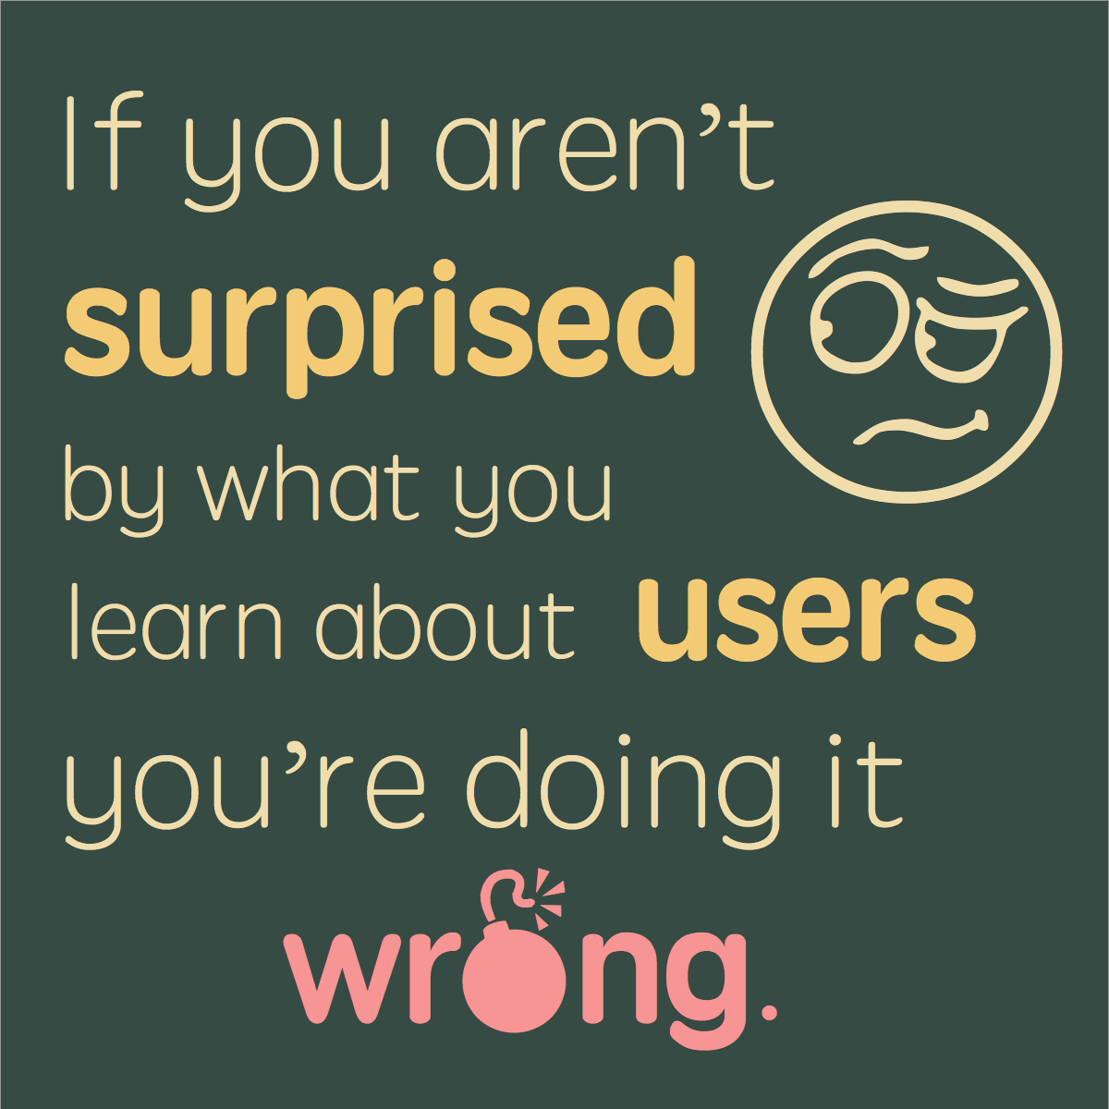
Some Unknowns
for a User Designer
New User Types
New User Functions
Weak Users
Non-Professional Users
New Devices
New Technology Available
Competitor Improvements
New Laws
Scandal Pressure
Age Group Surprises
https://axbom.com/slaying-5-ux-myths-good-mankind/
Notes:
https://axbom.com/slaying-5-ux-myths-good-mankind/
A person focusing solely on interaction design can create something that is appealing and easy to use, but UX infers an obligation to look at the bigger picture. To create something valuable it must also fit with
business goals,
available personnel and resources,
as well as investments in other channels and touchpoints.

Slide 3
Development Method Unknowns
Unkown Language (Japanese)
Unknown Real Method (inside Toyota)
Unknown Motivation (Beat USA, Save Japan)
Unknown Results of Method, there and Here)
= UNKNOWN RESULTS IF YOU USE ‘LEAN’ AND ‘SCRUM’

Slide 4
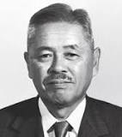
He is considered to be the father of the Toyota Production System,
which became Lean Manufacturing in the U.S.
He devised the seven wastes (or muda in Japanese) as part of this system.
page 99
Thanks to Lukasz Szostek for Finding this source Nov. 2018
Notes:
Taiichi Ohno
From Wikipedia, the free encyclopedia
Jump to navigationJump to search
Taiichi Ohno
Taiichi Ohno.jpeg
Born February 29, 1912
Dalian, China
Died May 28, 1990 (Age: 78)
Toyota City, Japan
Taiichi Ohno (大野耐一 Ōno Taiichi, February 29, 1912 – May 28, 1990) was a Japanese industrial engineer and businessman. He is considered to be the father of the Toyota Production System, which became Lean Manufacturing in the U.S. He devised the seven wastes (or muda in Japanese) as part of this system. He wrote several books about the system, including Toyota Production System: Beyond Large-Scale Production.
Born in 1912 in Dalian, China, and a graduate of the Nagoya Technical High School (Japan), he joined the Toyoda family's Toyoda Spinning upon graduation in 1932 during the Great Depression thanks to the relations of his father to Kiichiro Toyoda, the son of Toyota's founding father Sakichi Toyoda.[1] He moved to the Toyota motor company in 1943 where he worked as a shop-floor supervisor in the engine manufacturing shop of the plant, and gradually rose through the ranks to become an executive. In what is considered to be a slight, possibly because he spoke publicly about the production system, he was denied the normal executive track and was sent instead to consult with suppliers in his later career.[citation needed]
Ohno's principles influenced areas outside of manufacturing, and have been extended into the service arena. For example, the field of sales process engineering has shown how the concept of Just In Time (JIT) can improve sales, marketing, and customer service processes.[2][3]
Ohno was also instrumental in developing the way organisations identify waste, with his "Seven Wastes" model which have become core in many academic approaches.[4] These wastes are:
1. Delay, waiting or time spent in a queue with no value being added
2. Producing more than you need
3. Over processing or undertaking non-value added activity
4. Transportation
5. Unnecessary movement or motion
6. Inventory
7. Defects in the Product.
Ohno is also known for his "Ten Precepts" to think and act to win.[5]
You are a cost. First reduce waste.
First say, "I can do it." And try before everything.
The workplace is a teacher. You can find answers only in the workplace.
Do anything immediately. Starting something right now is the only way to win.
Once you start something, persevere with it. Do not give up until you finish it.
Explain difficult things in an easy-to-understand manner. Repeat things that are easy to understand.
Waste is hidden. Do not hide it. Make problems visible.
Valueless motions are equal to shortening one's life.
Re-improve what was improved for further improvement.
Wisdom is given equally to everybody. The point is whether one can exercise it.

Slide 5
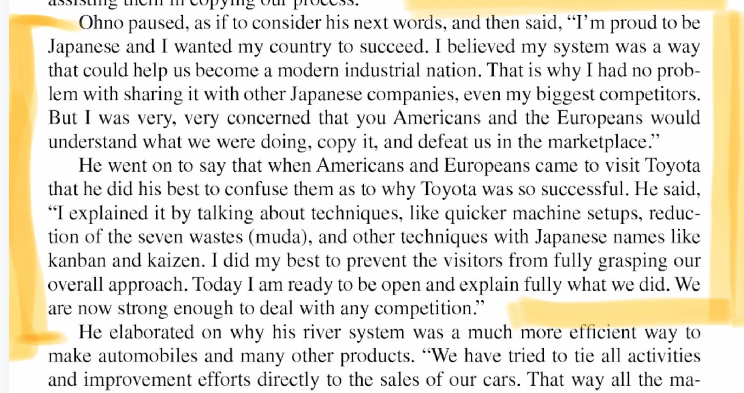
The Lean Methods Conspiracy
to Destroy (Poland and The USA)
Thanks to Lukasz Szostek for Finding this source Nov. 2018
Source: Profitability with No Boundaries:
Notes:
Is described on page 99 of the book:
Profitability with No Boundaries: Optimizing Toc and Lean-Six Sigma
by Reza M. Pirasteh, Robert E. Fox

Slide 6
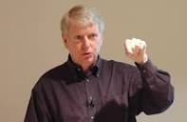
Jeff Sutherland
(Warsaw ABE Lecturer, Scrum 19% Failures)
https://www.scruminc.com/takeuchi-and-nonaka-roots-of-scrum/

Slide 7
1. The 'Value Vision' Focus:
Summary: Resist the urge to lead with implementation.
Once you know what the need is, you’ll know what to build.
One of the biggest traps in product planning is focusing on outputs
over outcomes —
that is, discussing what to build before clearly defining its purpose.
(As Jakob Nielsen said, a wonderful interface to the wrong features will fail,
so even if you build that thing well, it won’t succeed.)
KEEP YOUR SIGHTS ON THE HIGH-LEVEL STAKEHOLDER VALUES: QUANTIFY THEM
DO NOT GET HUNG UP IN ANY PARTICULAR DESIGN OPTIONS
THE BEST DESIGNS ARE THE ONES THAT ‘FIT’ THE TOP LEVEL CRITICAL VALUE REQUIREMENTS
Notes:
No, UX is by no means limited to the digital space. On the contrary it is an understanding of all the touchpoints of an organization that will bring you insights enabling you to contribute to a coherent experience.
https://axbom.com/slaying-5-ux-myths-good-mankind/
https://www.nngroup.com/articles/outcomes-vs-features/
https://www.nngroup.com/articles/the-myth-of-the-genius-designer/

Slide 8
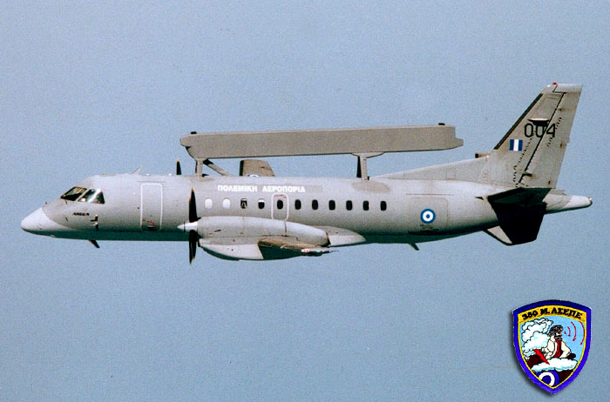
Erieye ‘SPYPLANE’ Intuitiveness Requirement
Defining a Critical UX Value Quantitatively
INTUITIVE: USAB.INTUITIVENESS
Ambition: High probability in % that operator will <immediately> within a specified time from deciding the need to perform the task (without reference to handbooks or help facility) find a way to accomplish their desired task.
Scale: Probability that an <intuitive>, TRAINED operator will find a way to do whatever they need to do, without reference to any written instructions (i.e. on paper or on-line in the system, other than help or guidance instructions offered by the system on the screen during operation of the system) within 1 second of deciding that there is a necessity to perform the task. <-- MAB "I'm not sure if 1 second is acceptable or realistic, it's just a guess"
Meter: To be defined. Not crucial this 1st draft ⬅- TG
Past [GRAPES] 80% ? ⬅ LN
Record [MAC] 99%? ⬅ TG
Fail [TRAINED, RARETASKS [{<1/week,<1/year}] ] 50 - 90%?⬅ MAB
Goal [TASKS DONE [<1/week (but more than 1/Month)]] 99% ?⬅ LN
[TASKS DONE [<1/year]] 20% ? ⬅- JB
[Turbulence, TASKS DONE [<1/year] ] 10% ? ⬅- TG

Slide 9
Quantifying Usability (Erieye C&C System)
QUALITY
USABILITY
AVAILABILITY
ADAPTABILITY
WORK-CAPACITY
INTUITIVENESS
INTELLIGIBILITY
AND MORE!
Intelligibility
GIST: Super ease of immediate understanding
SCALE:% OK interpretations.
METER: 10 ops., 100 infos, 15 mins.
P:PAST[20 ops., 300 info, 30 min.]99%
RECORD [P] 99.0%
Fail [DELIVERY[1]]99.0%<-MAB
[ACCEPTANCE] 99.5%
Goal [M1] 99.9% <-LN
Intuitiveness
GIST: Great intuitive capability
SCALE: Probability that intuitive guess right.
METER: <100 observations.>
PAST [GRAPES] 80% <-LN
RECORD [MAC] 9%?<-TG
Fail [TRAINED, RARE] 50-90%
Goal [TASKS] 99% <-LN
TRAINED: DEFINED:C&Ctl. operator, approved course, 200 hours duration.
RARE: DEFINED: types of tasks performed less than once a week per op.
TASKS: DEFINED: onboard operator distinct tasks carried out.
ACCEPTANCE: DEFINED: formal acceptance testing via customer contract.
DELIVERY: DEFINED: Evolutionary delivery cycle, integrated and useful.
2017
© www.gilb.com

Slide 10
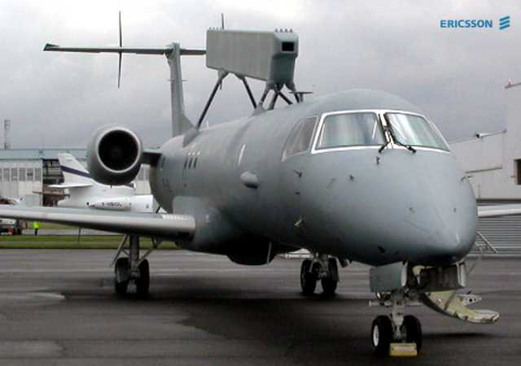
Leif Nyberg: Erieye Project Manager
“We have worked a lot on getting better requirements
e.g. by educating the customer, educating project members etc. on how important the quality of these requirements are.
This has been possible to do by using results, and metrics, from earlier deliveries, and showing this to them”.
2017
© www.gilb.com
Notes:
Left photo
Erieye 1HAF Embraer 145H during the trials in Sweden
http://hafcphotos.cs.net/photo_viewer_detail.cfm?photoid=141959

Slide 11
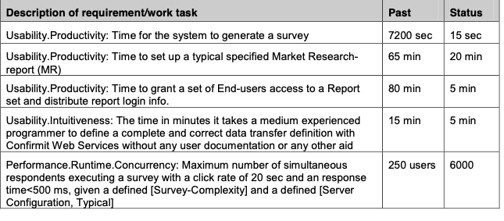
Rea User Result Improvements in 3 months
“Confirmit’ Case Oslo
Only highlights of the 25 quality requirement impacts are listed here
© www.gilb.com

Slide 12
Device Interoperability
decomposed into 10 Sub-qualities
London 2016 Client Exercise
Next slide
detail
Notes:
London 2016 Client Exercise

Slide 13
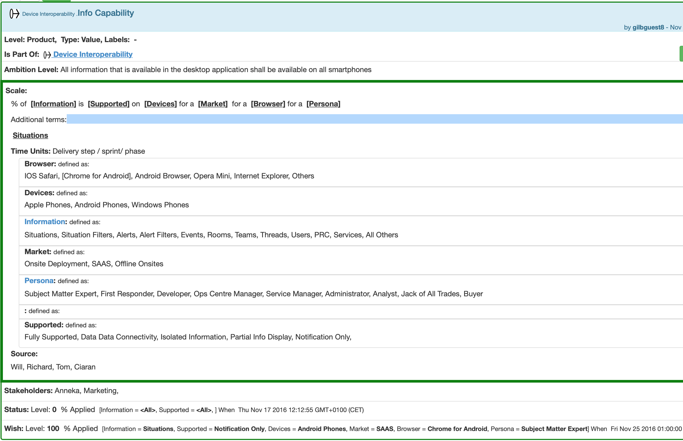
‘Info Capability’
With very advanced Scale Definition
Notes:
London 2016 Client Exercise

Slide 14
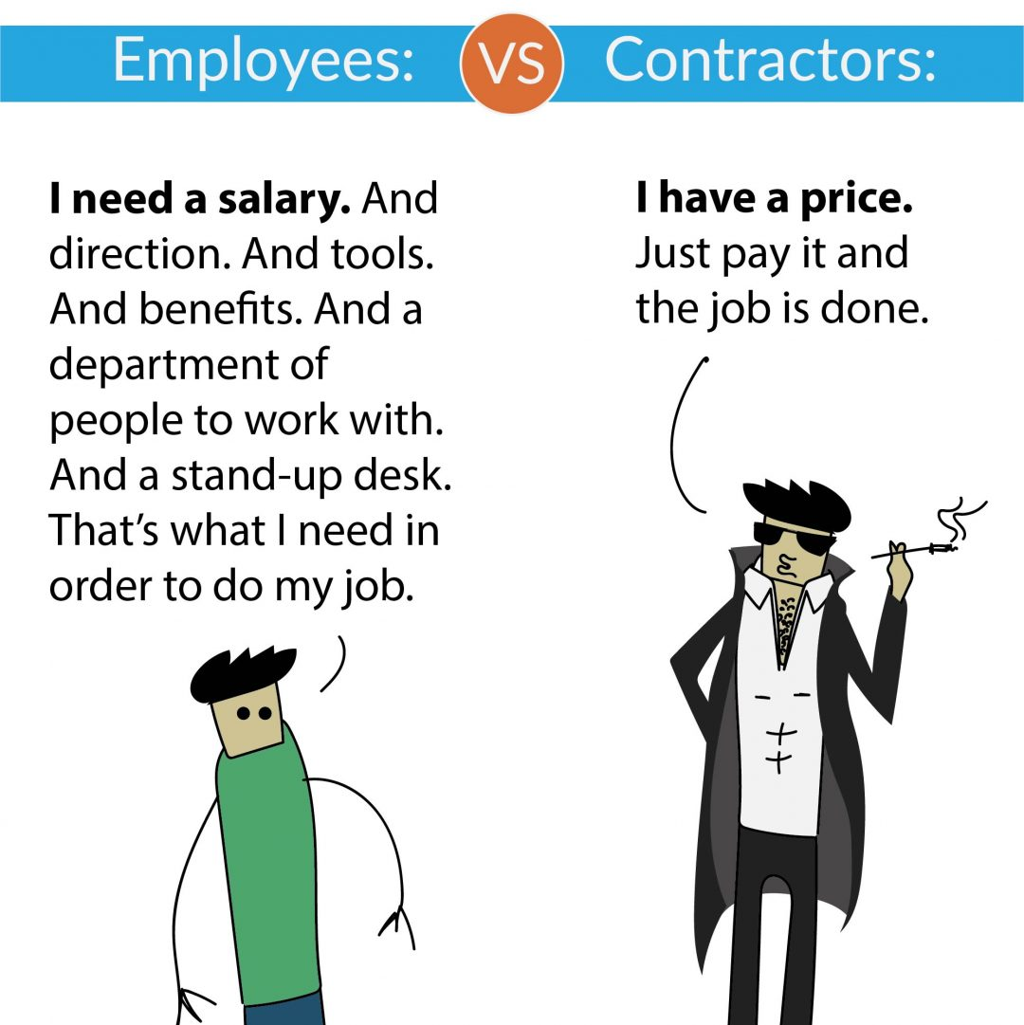
2. No Cure, No Pay Contracting.
This is part of ‘keeping focus on Critical Values’
Write contracts with bonus, or all payment dependent of the Value Results
100% of payment if 100% of Goal for Value delivered within deadline
This tactic removes quite a few unknowns, in favour of the critical high level result
costs (money, human resources, and time)
probability of meeting your goal
This motivates the professional contractor to identify and remove many unknowns in order to get paid.
https://jeffreykranz.com/contractor-vs-employee/
Notes:
https://jeffreykranz.com/contractor-vs-employee/
Unknowns removed by this method
the cost of getting valued results
the probability that you will get the results you want

Slide 15
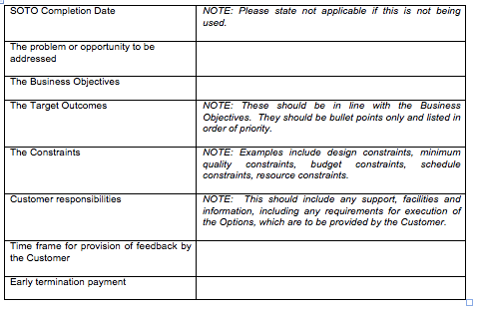
SOTO Specification (from contract template) short-term Statements Of Target Outcomes
Productivity, Overhead Savings
Productivity Up 200% within 2 years
Overhead Savings 50% per year
26 May 2015
Tom@Gilb.com
Notes:
www.flexiblecontracts.com

Slide 16
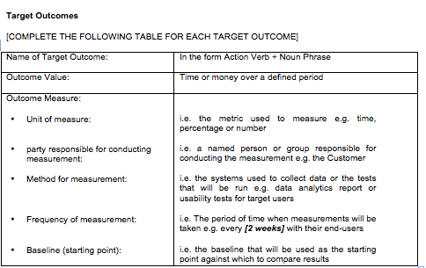
Specification of Measurement Process
and Economic Value for reaching Value Level
Notes:
www.flexiblecontracts.com

Slide 17
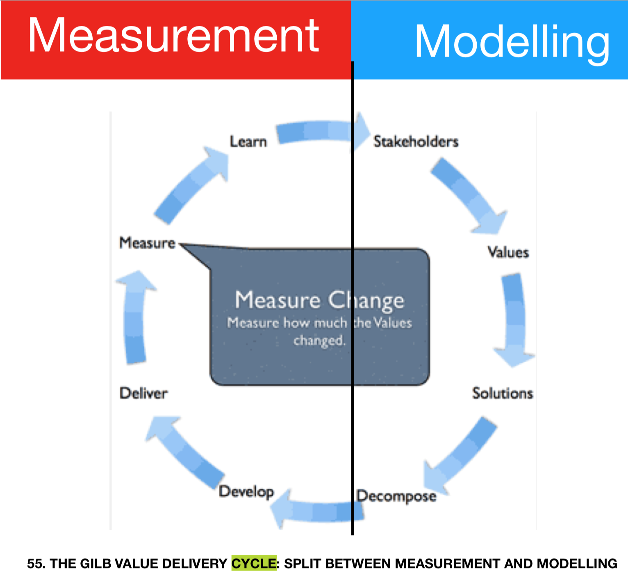
3. Evolutionary Feedback and Rapid Lean Learning
The ‘unknown’ about how stakeholders react to any increment of design, can be resolved by measuring that increment immediately (same week, before release)
There is plenty of time to ‘Learn’ (that ‘this does not work’) and to find something better that does work measurably
The underlying tactic here is quantification and measurement, early
Let me put this a different way: you must never implement designs or solutions without
quantified, high-level value goals
& a process of short-term measurement, testing, learning, improvement of design
otherwise you risk getting unknown bad results, delivered to the field, and embedded in systems with high technical debt. Fail fast.
put gilb cycle

Slide 18
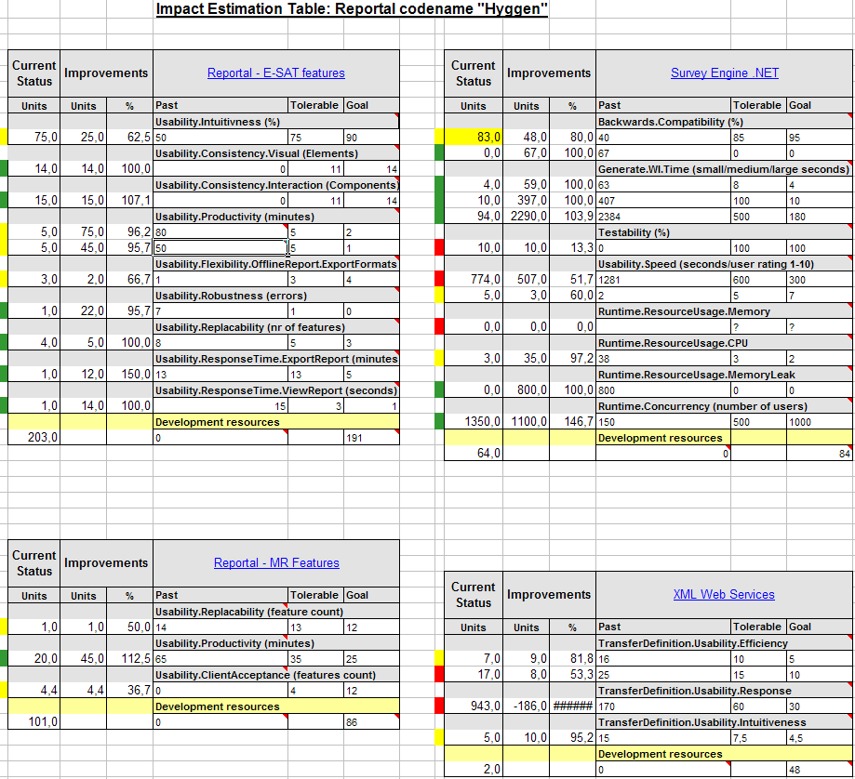
EVO Plan Confirmit 8.5
4 more product areas were attacked concurrently
Real Case (Confirmit, Oslo)
25 Simultaneous Values, where 10 are ‘Usability’ Values
This is the feedback from value delivery cycle 9 of 12
(Before release to customers every Quarter)
There are four 4-person parallel teams,
managing their own design ideas to reach the Value Level requirements.
The ‘Improvements’ column is the weekly progress feedback.
The traffic lights colours are a suggestion as to next-step’s priority.

Slide 19
4. Adjustable Interface Design
There are several levels of ‘adjustable interface design’
Individual adjustable
Stakeholder adjustable
Supplier adjustable
for all users
for specific users
Adjustable means using parameters or data, not changing the code.
This will help deal with unknowns of
complicated sets of user preferences
very small % needs, that would not pay off to build in directly
Notes:
https://www.transifex.com/blog/2015/localization-friendly-ui-design-part-1/

Slide 20
Nielsen and Molich's User Interface Design Guidelines
Match between system and the real world. Designers should endeavor to mirror the language and concepts users would find in the real world based on who their target users are
User control and freedom. Offer users a digital space where backward steps are possible, including undoing and redoing previous actions.
Flexibility and efficiency of use. With increased use comes the demand for less interactions that allow faster navigation. This can be achieved by using abbreviations, function keys, hidden commands and macro facilities. Users should be able to customize or tailor the interface to suit their needs so that frequent actions can be achieved through more convenient means.
Notes:
https://www.interaction-design.org/literature/article/user-interface-design-guidelines-10-rules-of-thumb

Slide 21
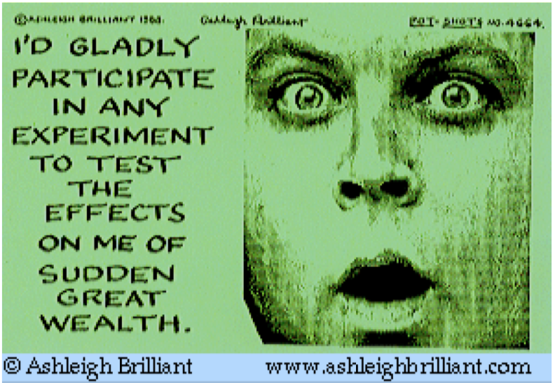
5. Dynamic Design and Architecture
One type of unknown is how different designs actually operate when put together, like in cooking, chess and chemistry.
There are such a large number of combinations, and also of multiple results (several quality and cost dimensions) that nobody can reliably predict what will happen
So, we are left with the idea of using a process of adding each ingredient, one at a time and observing the results: same as scientific experiment
The right answers will only be learned incrementally.
Winners can increment and learn rapidly.
They will also make very good initial guesses based on estimating multiple results and risks initially (good starting position), using Impact Estimation Tables.
To improve quality, use iterative design
and polish each round
through usability evaluation.
https://www.nngroup.com/articles/the-myth-of-the-genius-designer/
Notes:
Each new solution is an experiment that can be learned from to create the next solution.
https://www.linkedin.com/pulse/what-ux-definition-eludes-us-per-axbom/
Potshots are used with specific written and paid permission from Ashleigh Brilliant to Tom Gilb.

Slide 22
1976: Mills Published this
on ‘dynamic design to cost’
The ‘known unknowns he is dealing with are system qualities, cost and project duration
Notes:
added 11 nov 2018 from Larmans slides on agie history
I told CL about Mills in 2003 or so

Slide 23
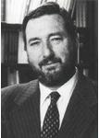
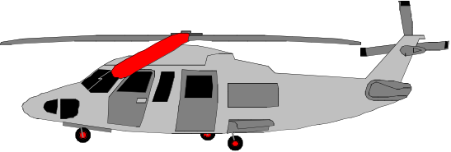
In the Cleanroom Method,
developed by IBM’s Harlan Mills (1980) they reported:
“Software Engineering began to emerge in FSD” (IBM Federal Systems Division, from 1996 a part of Lockheed Martin Marietta) “some ten years ago [Ed. about 1970] in a continuing evolution that is still underway:
Ten years ago general management expected the worst from software projects – cost overruns, late deliveries, unreliable and incomplete software
Today [Ed. 1980!], management has learned to expect on-time, within budget, deliveries of high-quality software. A Navy helicopter ship system, called LAMPS, provides a recent example. LAMPS software was a four-year project of over 200 person-years of effort, developing over three million, and integrating over seven million words of program and data for eight different processors distributed between a helicopter and a ship in 45 incremental deliveries [Ed. Note 2%!]s. Every one of those deliveries was on time and under budget
A more extended example can be found in the NASA space program,
- Where in the past ten years, FSD has managed some 7,000 person-years of software development, developing and integrating over a hundred million bytes of program and data for ground and space processors in over a dozen projects.
- There were few late or overrun deliveries in that decade, and none at all in the past four years.”
in 45 incremental deliveries
Agile!
were few late or overrun deliveries in that decade, and none at all in the past four years
wow! normal agile fails 19% (Scrum) to 40%: Jeff Sutherland
© Gilb.com 2017
Notes:
A time or cost estimate, once it becomes a deadline or a budget respectively, is a ‘limited resource’. One of the smartest ways to deal with limited resources is intelligent prioritization (Gilb and Maier 2005). Instead of implementing all your designs in a ‘big bang’ manner, and hoping to meet all the requirements and resource (time and cost) estimates, we suggest you deliver the project value a little bit at a time, and see how each of the designs actually works, and what they each actually cost. ‘A little bit at a time’ should be interpreted as delivering evolutionary steps of approximately 2% of the overall project timescales (say weekly, fortnightly or monthly cycles), and hopefully about 2% of the project financial budget.
Planguage’s impact estimation (IE) method (Gilb 1988; Gilb 2005) is helpful in identifying the designs that give the estimated best stakeholder value for their costs. We implement designs incrementally so that we can get acceptable feedback on costs, and value delivery (in terms of meeting requirements). With a bit of luck, stakeholders then receive interesting value very early, and what works and what doesn’t is learned in practice. If a deadline is hit, or if the budget runs out (possibly because of a deadline being moved up earlier or a budget cut!), then at least there is still a complete live real system with delivered high-value. In such situations, the whole concept of the project-level estimates, the deadlines and the budgets is not so important any more.
Nobody does it better! Harlan Mills told me that they had to solve the persistent problem of cost overruns, in relation to the contracted estimates, because the government was getting smarter, and using fixed-price contracts (as opposed to cost plus). If the project ran over, IBM lost its own profit. If IBM did not find a better way, they could just as well leave the business (Personal Communication).
Notice the “45 deliveries” Mills cites. That means 2% delivery cycles. IBM was using intelligent feedback and learning. They actually had very sophisticated estimation technology based on a thorough collection of experiences (Walston and Felix 1977). But this did not give them the accuracy they needed to avoid losing money. Lets us say they had a 40% profit margin, and they could be wrong by 40% to 200% (The NASA range, see earlier Figure 3). They would still lose money on most contracts. So, they had to compensate for their estimation inaccuracy by incremental feedback, and necessary change, to come in ‘on time and under budget every time’. Mills’ colleague, Quinnan describes their process of intelligent dynamic prioritization in detail in (Mills 1980 in IBM SJ 4-1980).
A thorough explanation of systems development processes helping achieve intelligent prioritization is found in (Gilb 2005). See also Figure 9. Nothing less will suffice for large and complex systems (that is, for project involving hundreds of staff, years of effort, and sometimes $100 million or more in cost). For smaller systems (small teams over a few months), several organizations have made good simple practical adaptations (Upadhyayula 2001 (Study of Evo at HP in 1990s); Johansen and Gilb 2005) of the essential ‘Evo’ development process ideas (Evo itself predating later ‘Agile’ methods)[Denning 2010, p.129] & [Gilb 2010c].
The agile community has adopted small iterative cycles (Gilb 2010c), but they have failed to adopt the notion of measurement of value and quality – which is essential for larger projects, and some smaller ones. Without explicit absolute quality requirement and design impact metrics, the value prioritization is ambiguous and too subjective (Gilb 2010c; Gilb and Brodie 2010).

Slide 24
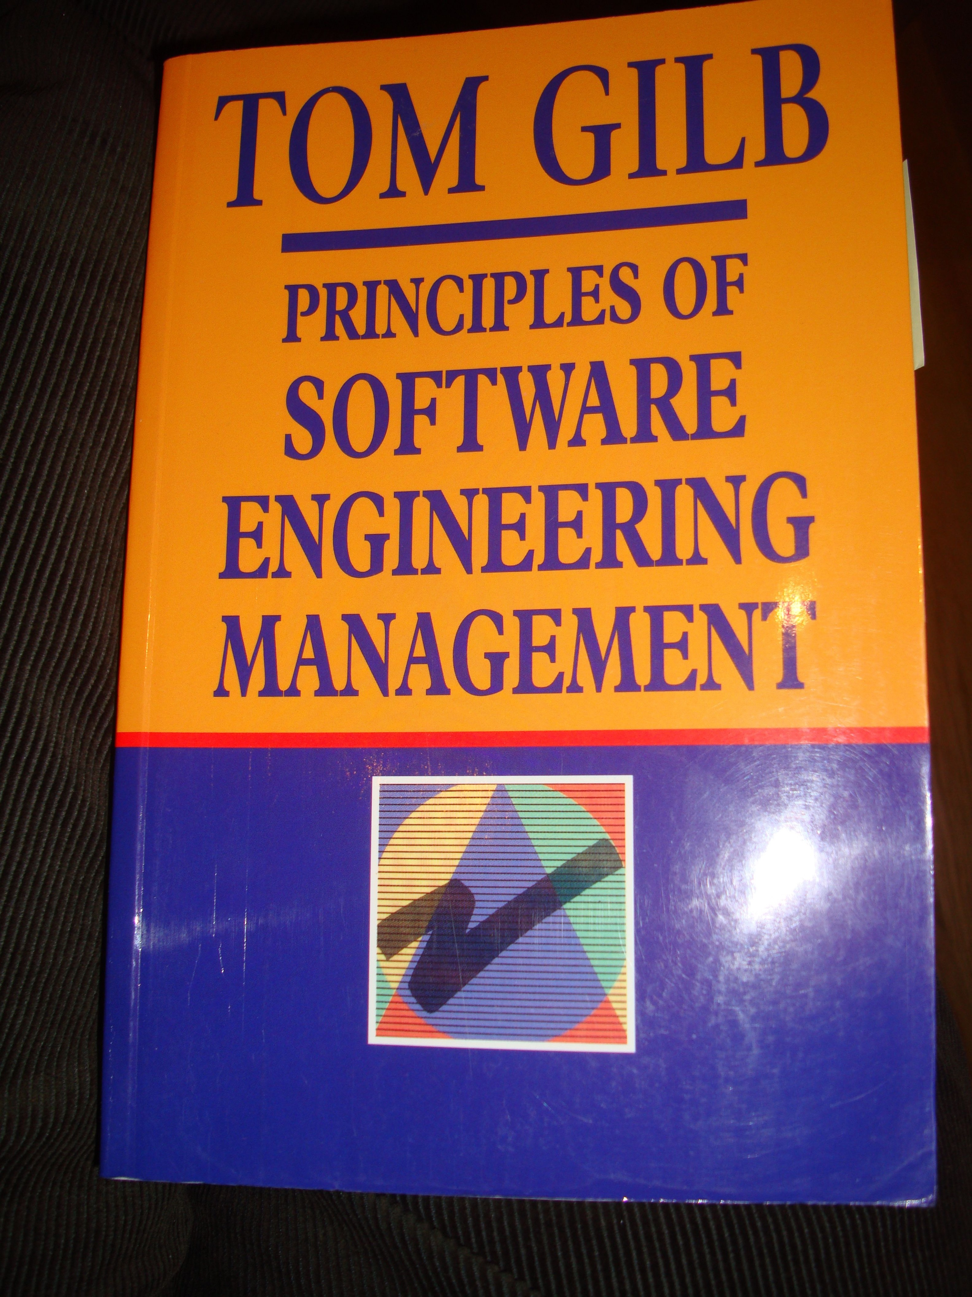
Quinnan: IBM FSD Cleanroom Dynamic Design to Cost
but they iterate through a series of increments,
thus reducing the complexity of the task,
and increasing the probability of learning from experience
Quinnan describes the process control loop used by IBM FSD to ensure that cost targets are met.
'Cost management. . . yields valid cost plans linked to technical performance. Our practice carries cost management farther by introducing design-to-cost guidance. Design, development, and managerial practices are applied in an integrated way to ensure that software technical management is consistent with cost management. The method [illustrated in this book by Figure 7.10] consists of developing a design, estimating its cost, and ensuring that the design is cost-effective.' (p. 473)
He goes on to describe a design iteration process trying to meet cost targets by either redesign or by sacrificing 'planned capability.' When a satisfactory design at cost target is achieved for a single increment, the 'development of each increment can proceed concurrently with the program design of the others.'
'Design is an iterative process in which each design level is a refinement of the previous level.' (p. 474)
It is clear from this that they avoid the big bang cost estimation approach. Not only do they iterate in seeking the appropriate balance between cost and design for a single increment, but they iterate through a series of increments, thus reducing the complexity of the task, and increasing the probability of learning from experience, won as each increment develops, and as the true cost of the increment becomes a fact.
'When the development and test of an increment are complete, an estimate to complete the remaining increments is computed.' (p. 474)
Source: Robert E. Quinnan, 'Software Engineering Management Practices', IBM Systems Journal, Vol. 19, No. 4, 1980, pp. 466~77
This text is cut from Gilb: The Principles of Software Engineering Management, 1988
16 August 2014
Copyright Tom@Gilb.com 2013
Notes:
Slide developed Oct 6 2013 tsg for London Software Architecture Conference Talk 9 Oct 2013
15.1.18 Quinnan
Source: Robert E. Quinnan, 'Software Engineering Management Practices', IBM Systems Journal, Vol. 19, No. 4, 1980, pp. 466~77
Robert E. Quinnan: The Management of Software Engineering. Part V: Software Engineering Management Practices. IBM Systems Journal 19(4): 466-477 (1980)
Quinnan describes the process control loop used by IBM FSD to ensure that cost targets are met.
'Cost management. . . yields valid cost plans linked to technical performance. Our practice carries cost management farther by introducing design-to-cost guidance. Design, development, and managerial practices are applied in an integrated way to ensure that software technical management is consistent with cost management. The method [illustrated in this book by Figure 7.10] consists of developing a design, estimating its cost, and ensuring that the design is cost-effective.' (p. 473)
He goes on to describe a design iteration process trying to meet cost targets by either redesign or by sacrificing 'planned capability.' When a satisfactory design at cost target is achieved for a single increment, the 'development of each increment can proceed concurrently with the program design of the others.'
'Design is an iterative process in which each design level is a refinement of the previous level.' (p. 474)
It is clear from this that they avoid the big bang cost estimation approach. Not only do they iterate in seeking the appropriate balance between cost and design for a single increment, but they iterate through a series of increments, thus reducing the complexity of the task, and increasing the probability of learning from experience, won as each increment develops, and as the true cost of the increment becomes a fact.
'When the development and test of an increment are complete, an estimate to complete the remaining increments is computed.' (p. 474)
This article is far richer than our few selected quotations can show, with regard to concepts of cost estimation and control.

Slide 25
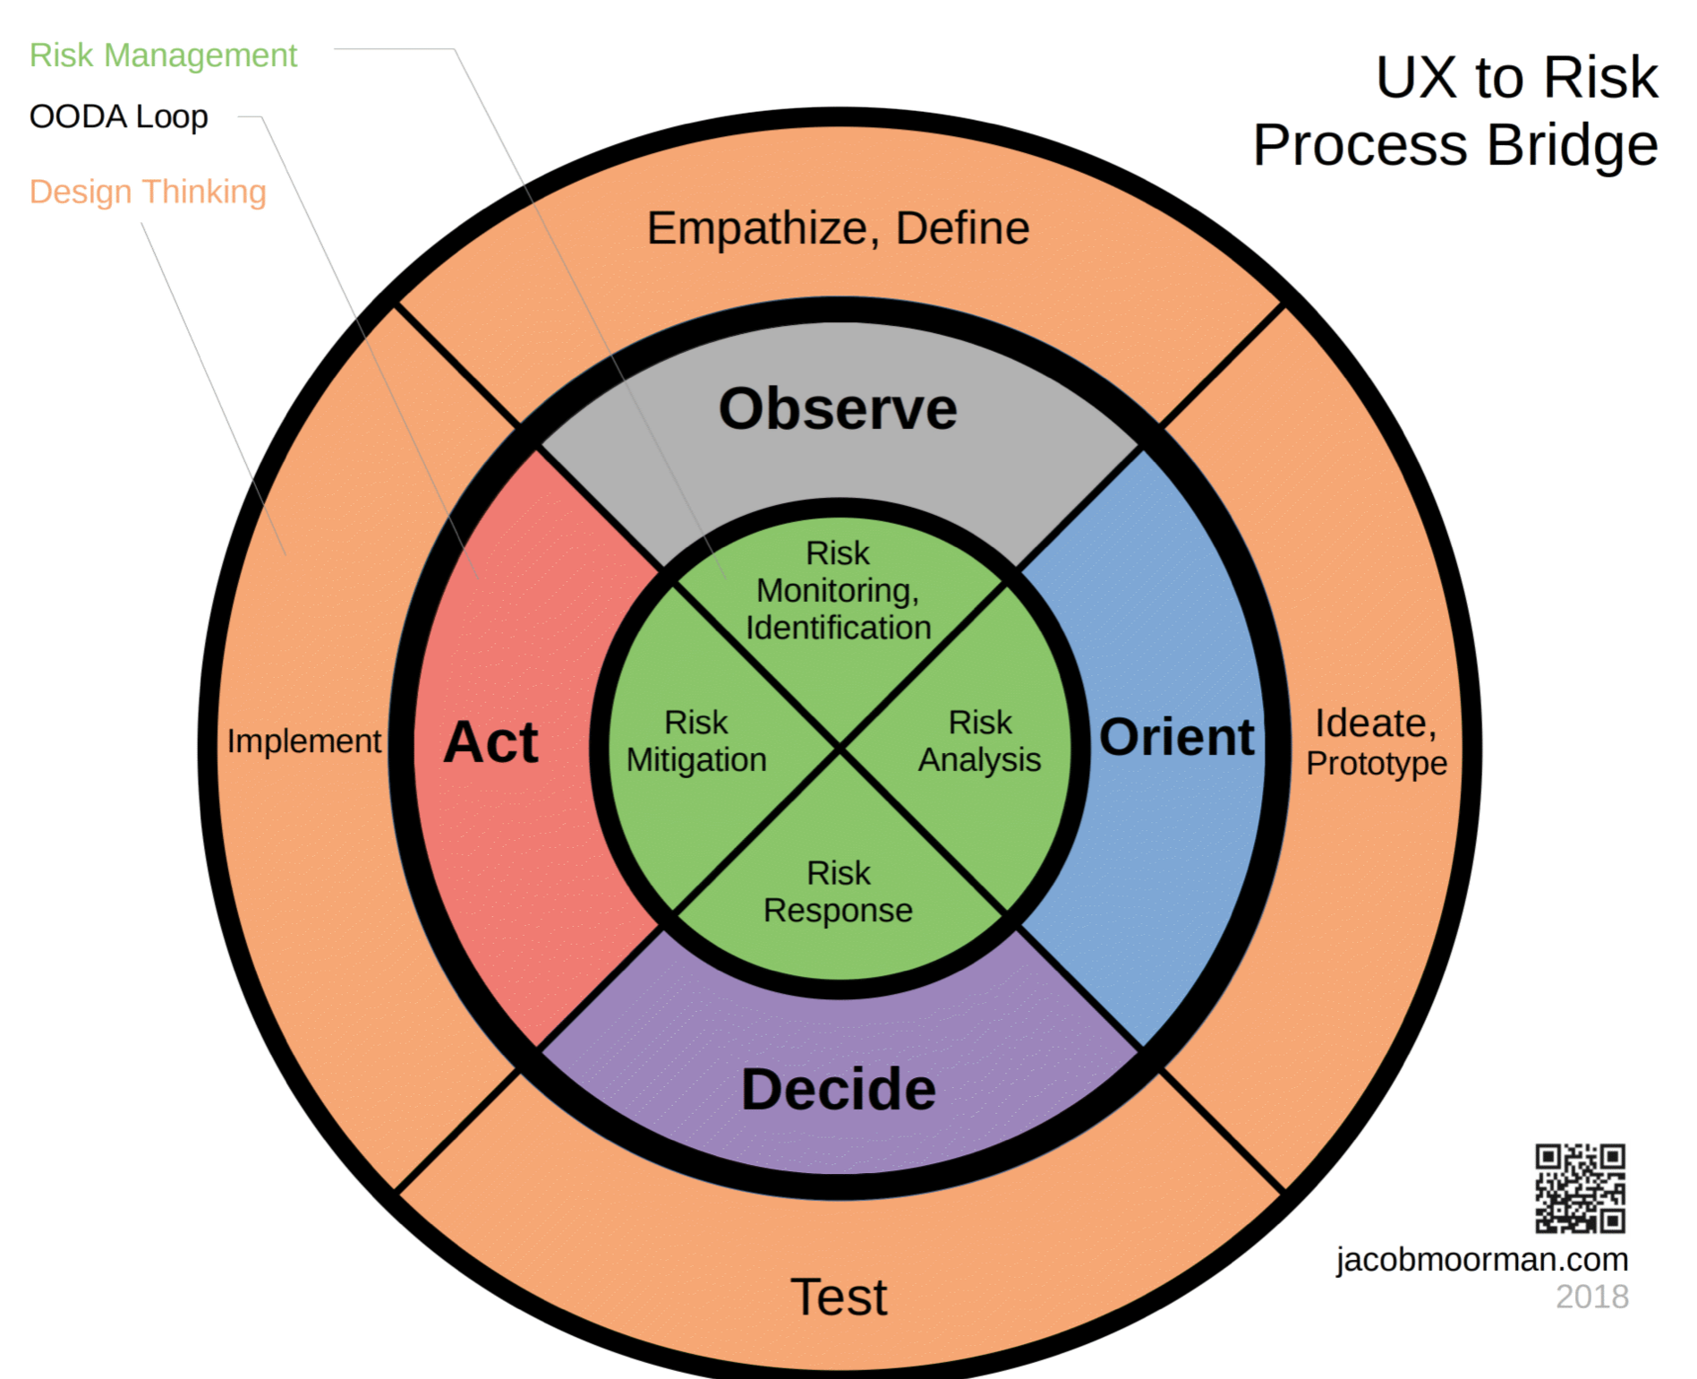
6. Risk Evaluation
Risks = Unknowns
Maybe: ‘Known Unknowns ?
But, you can now the names of risks, their possibility
the degree of risk
to test or experiment for risks
And
you can design risks out
design risk mitigation in
To reduce risk,
ensure that your designer works from usability data,
rather than guesses.
https://www.nngroup.com/articles/the-myth-of-the-genius-designer/
Notes:
https://www.nomensa.com/blog/2017/using-ux-design-reduce-risk-innovation-failure

Slide 26
When ‘Built in’ mitigation is successful: the attack is stopped, there is no ‘risk’ of damage
Mitigation
Success
Mitigation
Threats
Fail
Attacks
Built-in error avoidance is smarter than rework and cleaning up of bad work (42% Rework at Raytheon Software)
Notes:
Designed series 20 aug 2014 Tom Gilb, at Digerud

Slide 27
Risk-related Definitions
A ‘Threat’ is something that can potentially cause some degree of project failure, lack of success or negative consequences.
Attacks are Threats activated.
Mitigation, is any Strategy which is intended to deal with a Threat (potential Attack), or an actual Attack, within the system, or by being added on after the Threat has successfully penetrated the system (Attack has occurred).
The Risk is determined as a combination of a Threat (or Attack) and a Mitigation
Robustness is a system attribute that defines how well it resists Attacks
Damage is the negative consequences of successful Attacks to a system

Slide 28
Real Banking Design Spec: Risks
==== Priority & Risk Management ========
Assumptions: <Any assumptions that have been made>.
A1: FCCP is assumed to be a part of Orbit. FCxx does not currently exist and is Dec 20xx 6 months into Requirements Spec. <- Picked up by TsG from dec 2 discussions AH MA JH EC.
Consequence: FCxx must be a part of the impact estimation and costs rating.
A2: Costs, the development costs will not be different. All will base on a budget of say $ nn mm and 3 years. The ops costs may differ slightly, like $n mm for hardware. MA AH 3 dec
A3:Boss X will continue to own Orbit. TSG DEC 2
A4: the schedule, 3 years, will constrained to a scope we can in fact deliver, OR we will be given additional budget. If not “I would have a problem” <- BB
A5: the cost of expanding Orbit will not be prohibitive. <- BB 2 dec
A6: we have made the assumption that we can integrate Oribit with PX+ in a sensible way, even in the short term <- BB
Dependencies: <State any dependencies for this design idea>.
D1: FCxx replaces Px+ in time. ? tsg 2.12
Risks: <Name or refer to tags of any factors, which could threaten your estimated impacts>.
R1. FCxx is delayed. Mitigation: continue to use Pxx<- tsg 2.12
R2: the technical integration of Px+ is not as easy as thought & we must redevelop Oribit
R3: the and or scalability and cost of coherence will not allow us to meet the delivery.
R4: scalability of Orbit team and infrastructure, first year especially <- BB. People, environments, etc.
R5: re Cross Desk reporting Requirement, major impact on technical design. Solution not currently known. Risk no solution allowing us to report all P/L
Issues: <Unresolved concerns or problems in the specification or the system>.
I1: Do we need to put the fact that we own Orbit into the objectives (Ownership). MA said, other agreed this is a huge differentiator. Dec 2.
I2: what are the time scales and scope now? Unclear now BB
I3: what will the success factors be? We don’t know what we are actually being asked to do. BB 2 dec 20xx
I4: for the business other than flow options, there is still a lack of clarity as to what the requirements are and how they might differ from Extra and Flow Options. BB
I5: the degree to which this option will be seen to be useful without Intra Day. BB 2 dec
Risks specification:
• shares group risk knowhow
• permits redesign to mitigate the risk
• allows relistic estimates of cost and impacts
ASSUMPTIONS:
• broadcasts critical factors for present and future re-examination
• helps risk analysis
• are an integral part of the design specifiction
Issues:
• when answered can turn into a risk
• shares group knowledge
• makes sure we don’t forget to analyze later
DEPENDENCIES:
21 August 2014
© Gilb.com
Notes:
Planguage Case *309: The 4 concepts Assumption, Dependencies, Risks, and Issues are used when analyzing a design, to trigger the identification of ideas or instances, that may need further analysis (what are consequences, mitigations, frequency etc.). It is in practice immaterial to us which category is selected to note the concern, or even if the categories are ‘correct’. The important idea is that we have triggered people to recognize, and specify for further consideration, things that potentially need more planning. (added 21Aug2014)
Source
Slides Banking Experiences
Real client work done at a London International Bank, using the Competitive Engineering book Design template.

Slide 29
Specifying Risks Explicitly
as part of a requirement
Objective 1:
Scale: Market Share in defined [Markets]
Goal [Next 5 Years, Market = {Europe & Americas}] 30%
Threat: Market Downturn.
Cause [T1]: International Economics
Cause: Power Struggle in East Europe
Mitigation: Shift Investment Focus to South America, and Upmarket.
a simplified example of the principles of working out a plan to deal with Threats, with analysable cause chains. Once some root causes are suggested, it is easier to think of credible strategies for dealing with them. Since we believe we cannot directly affect the causes, we have to avoid the threat, by moving elsewhere.
Notes:
Value Planning Book Planguage 7.8

Slide 30
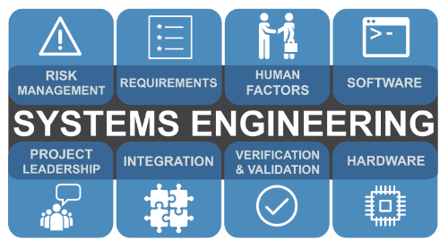
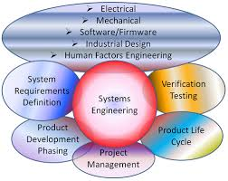
7. Big Picture, Systems Engineering
UX User Experience Design requires looking at
all critical stakeholders
all critical improvement value objectives
all constraints
all resources
all solutions (designs, strategies)
and how they fit together
theoretically
in practice
in the long term
as things change, as years go by
so as to find a ‘reasonable balance’
Notes:
It is not the search for the new and ultramodern, however, that should be the driving force behind UX work but rather the search for solutions that do the job well. They should prove powerful and superior, but within their own context and not always in comparison to media’s high-praised apps.
https://axbom.com/slaying-5-ux-myths-good-mankind/
UX professionals make sense of data about people and match this with organizational objectives and resources.
https://www.linkedin.com/pulse/what-ux-definition-eludes-us-per-axbom/

Slide 31
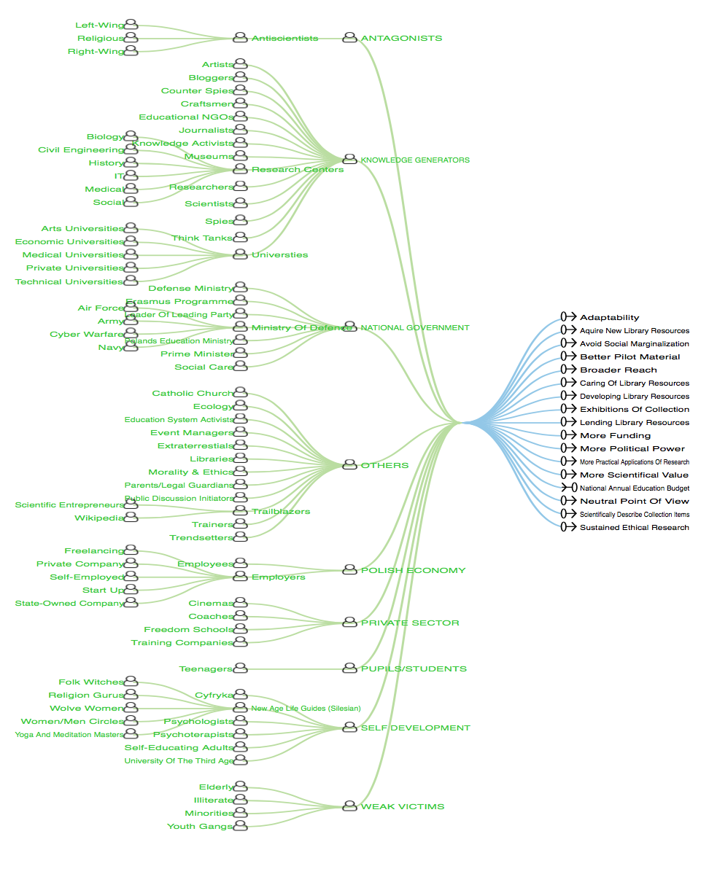
<—- Stakeholder Map
‘Knowledge in Poland’
(Masterclass Spring 2018 Katowice)
The Top Level Critical <—— Objectives
Notes:
source
KNOWLEDGE IN POLAND 2018 MASTERCLASS NM CLIPS = file name in Cases/NeedsandMeans

Slide 32
User Story Analysis
Quantify the UX Value, Estimate the Design Impact
Story
“ As IC I
want to to use keyboard (functional keys, arrows, etc.)
to easily navigate through the application.”
Source: Warsaw Nov. 2018
See TG Files Cases/Needsandmeans/User Story

Slide 33
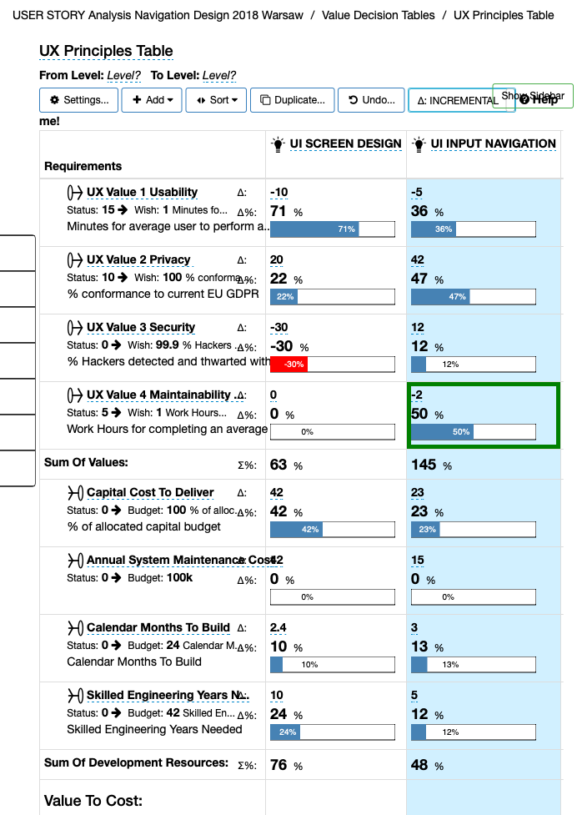
Example of
UX Values and Costs quantified
with UI Design for them estimated
as to effect of design on UX Values and Costs
=
UX Engineering
Notes:
developed 30 11 18 for WUD Conference Lecture 31 Nov Katowice Poland by Tom@Gilb.com

Slide 34
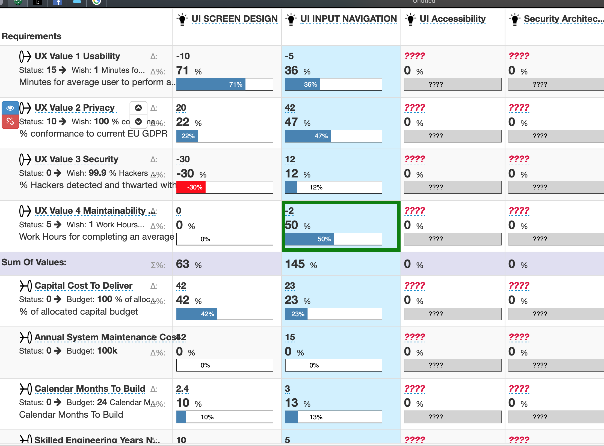
UX Values
UX Designs
???? Means nobody has estimated the impacts of these designs yet.
= “Known Unknowns”
(Confucius:
Highest Wisdom)
UX Design Effectiveness
UX Design COSTS
Notes:
developed 30 11 18 for WUD Conference Lecture 31 Nov Katowice Poland by Tom@Gilb.com

Slide 35
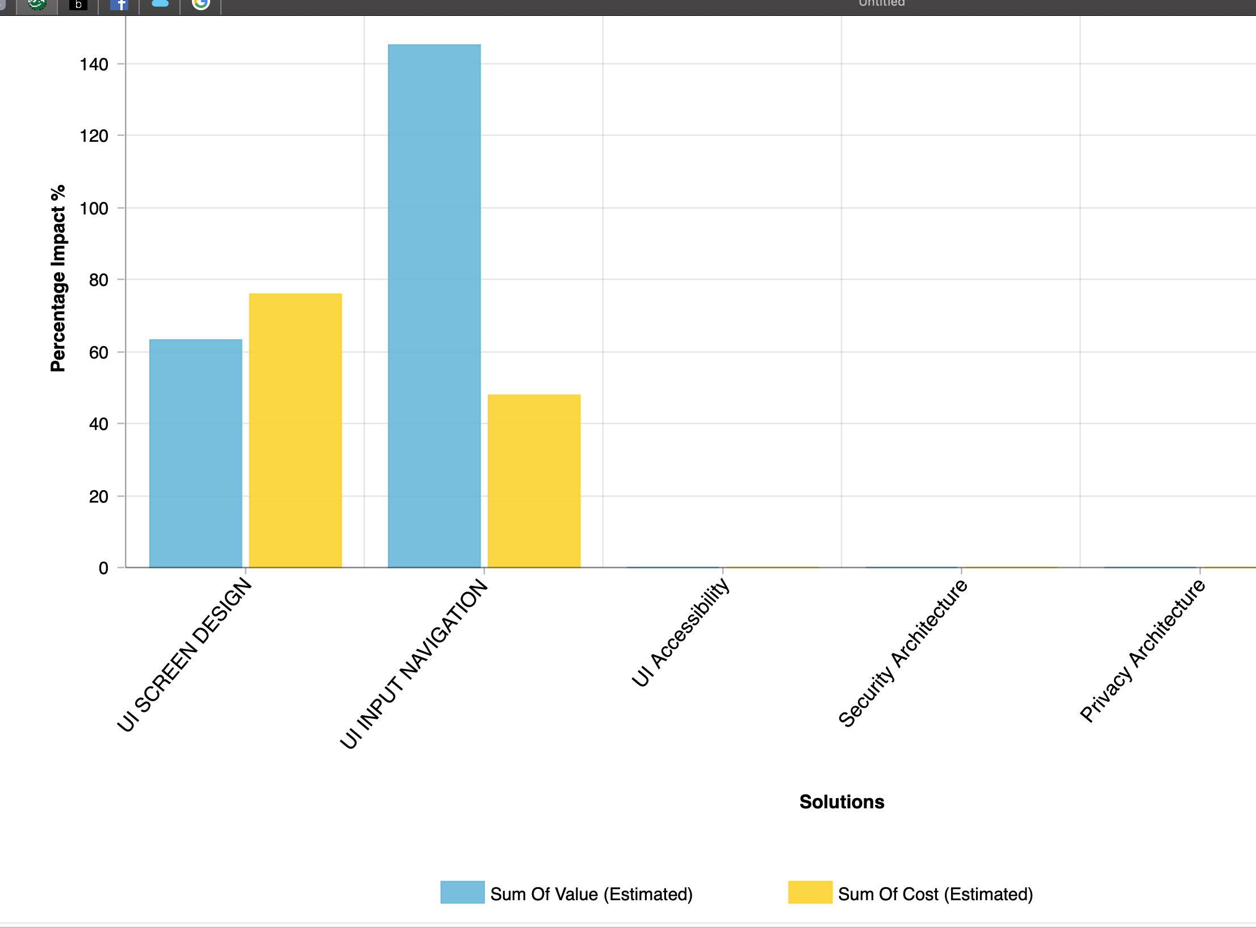
The complex table can be presented simply as a Barchart.
Left= Sum of ALL values (UX Overview)
Right = Sum of ALL Costs types
(UX Resources overview
These designs are not yet evaluated
so these are big ‘known unknowns’ (RISKS)
Notes:
developed 30 11 18 for WUD Conference Lecture 31 Nov Katowice Poland by Tom@Gilb.com

Slide 36
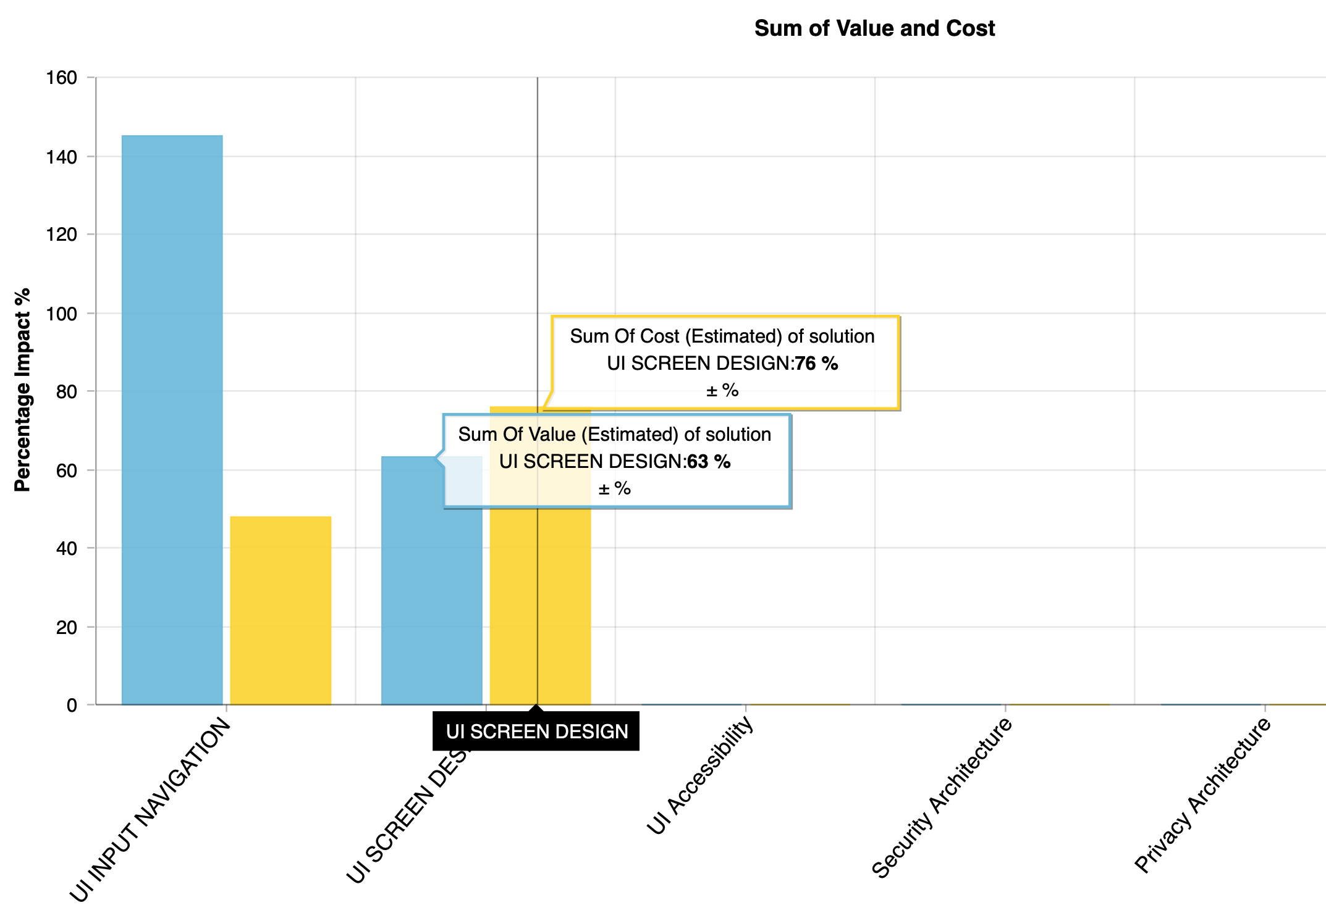
1st Sprint
We sorted the designs
to sequence the highest values/costs at Left
“PRIORITIZATION”
2nd Sprint
Notes:
developed 30 11 18 for WUD Conference Lecture 31 Nov Katowice Poland by Tom@Gilb.com

Slide 37
Here is a more-realistic example, with “calculated risks”
Source: 5 Day Masterclass, Katowice 2018,
Class project: spreading knowledge in poland
Notes:
developed 30 11 18 for WUD Conference Lecture 31 Nov Katowice Poland by Tom@Gilb.com

Slide 38
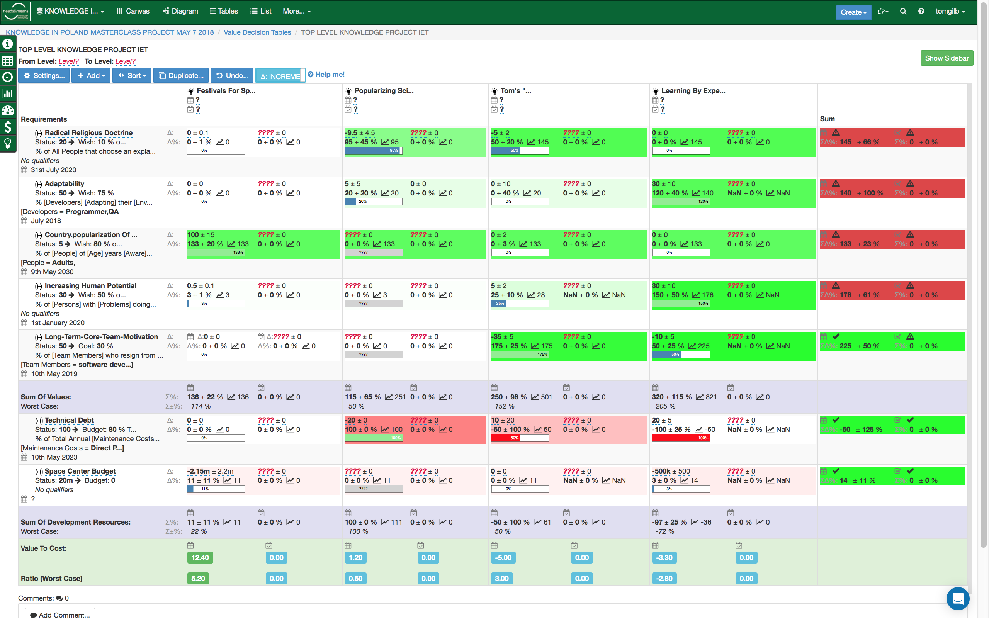
Overview Ends & Means
Known Unknowns
Notes:
source
KNOWLEDGE IN POLAND 2018 MASTERCLASS NM CLIPS = file name in Cases/NeedsandMeans

Slide 39
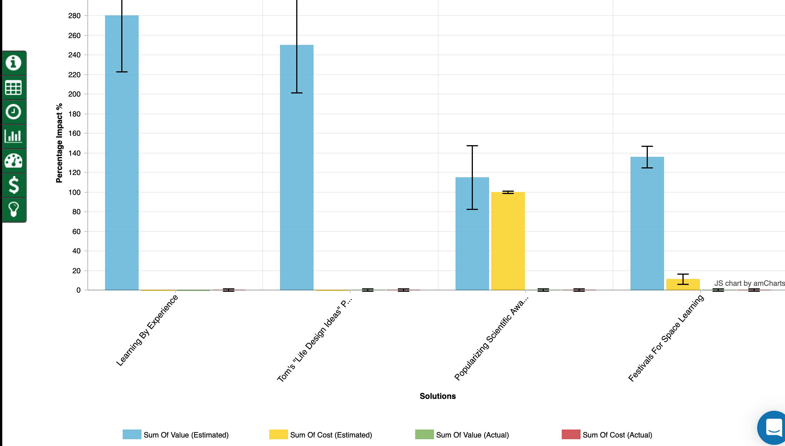
Bar Diagram of Overview Table: Value Total, Cost Total, Uncertainty
Decomposed
Next slide

Slide 40
‘Learning By Experience’ Decomposed: a Sub-Table
Notes:
source
KNOWLEDGE IN POLAND 2018 MASTERCLASS NM CLIPS = file name in Cases/NeedsandMeans

Slide 41
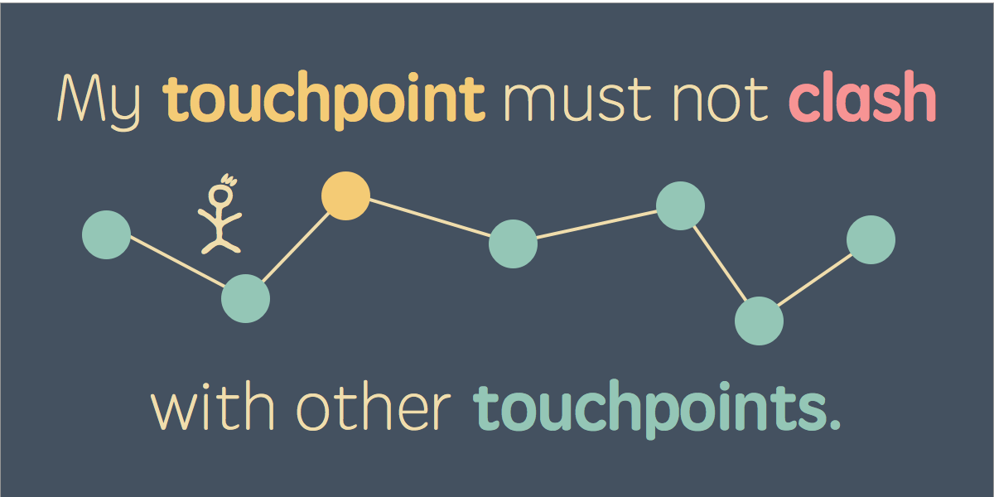
8. Stakeholder, and Stakeholder Value Analysis
Unknown Stakeholders, mean
Unknown Requirements, mean
Failure to Design for them, =
Unhappy Stakeholders. =
Failed Systems
https://www.nngroup.com/articles/collaborating-stakeholders/
Notes:
https://www.nngroup.com/articles/collaborating-stakeholders/
https://axbom.com/slaying-5-ux-myths-good-mankind/
Touchpoints as stakeholders!
I will most certainly speak up about how the different touchpoints should be engineered to work together, albeit I may not as a consultant have the mandate to affect them all. My understanding of the others will impact how I design but also how I interpret the results of user research.
As an advocate of UX I see it as my mission to share my insights and help others see what the concept of user experience means for organizations with many touchpoints and how they all work together to form the complete experience.
When I say clash with the other touchpoints, this can happen in any number of ways: with regards to design, tone of voice, faulty links, how passwords are handled, having to enter the same information on multiple occasions, expectations put forward by information in other channels, how customer service responds to queries and so on.
I will most certainly speak up about how the different touchpoints should be engineered to work together, albeit I may not as a consultant have the mandate to affect them all. My understanding of the others will impact how I design but also how I interpret the results of user research.

Slide 42
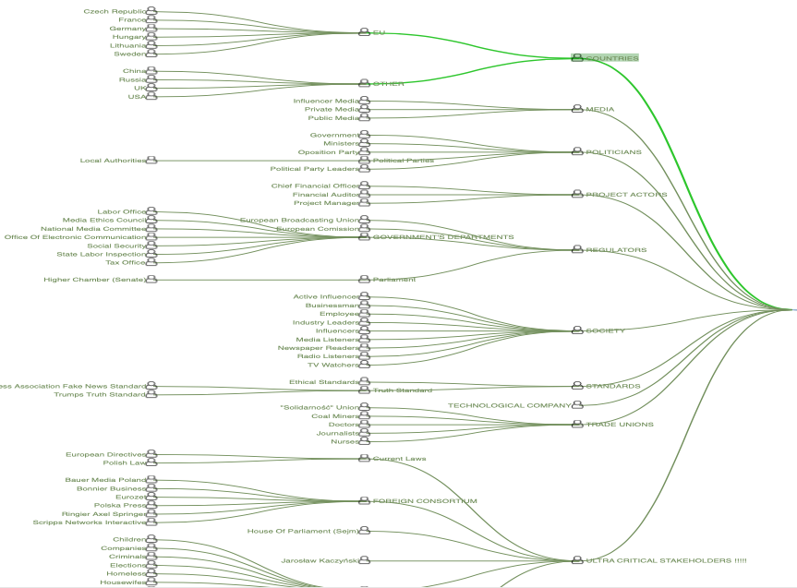
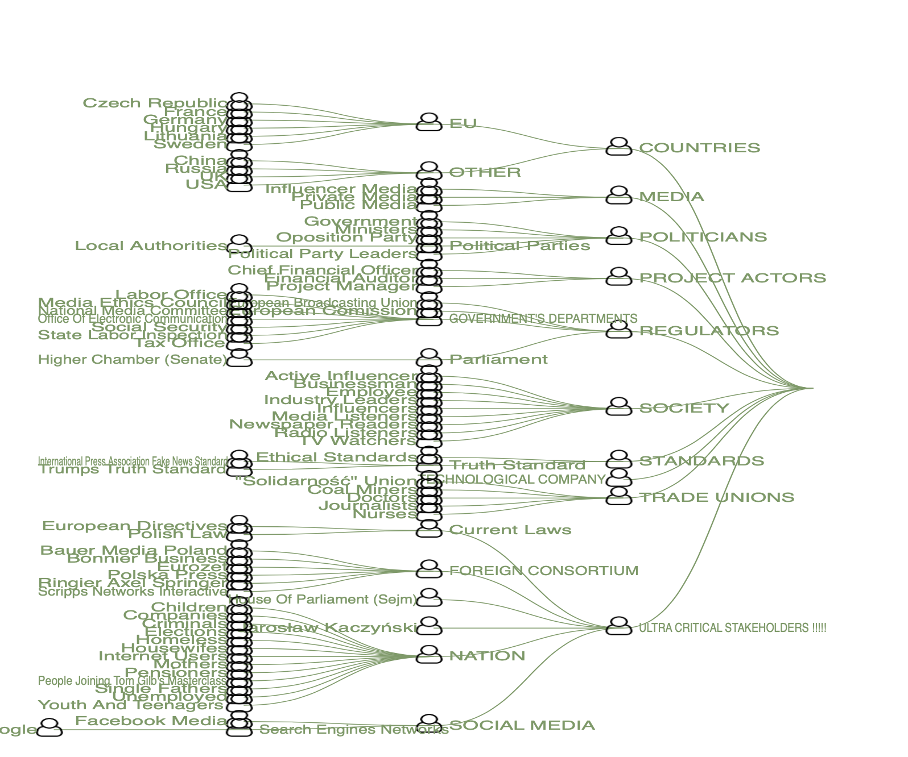
Structured Stakeholder Diagram: ‘Polish Fake News Control Project’. at Masterclass Warsaw November 2018

Slide 43
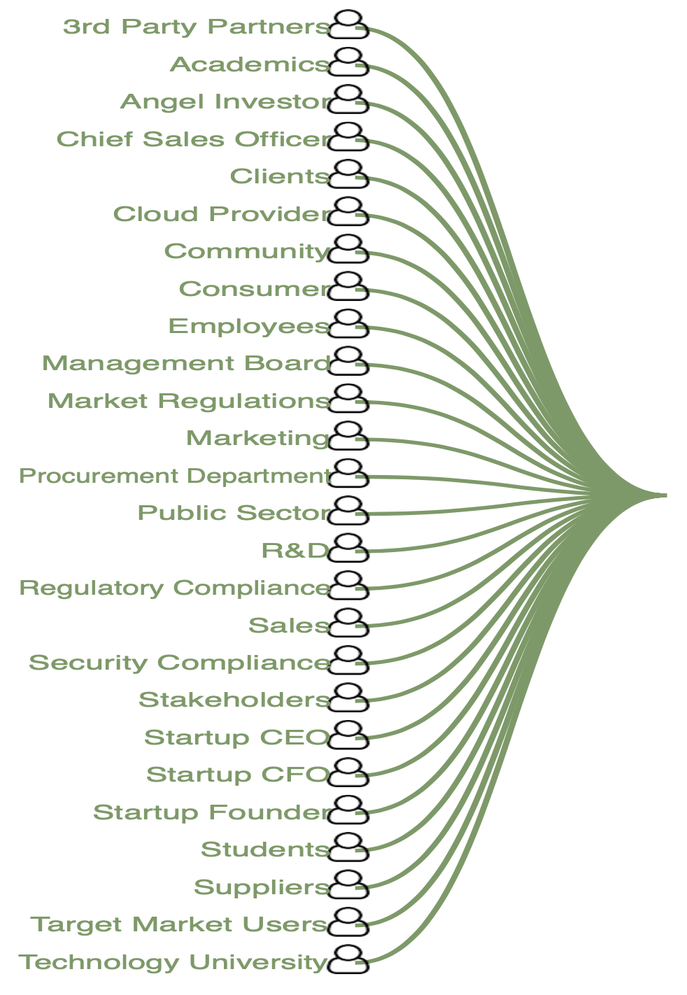
Polish Startup Export Project
Warsaw 2017

Slide 44
9. Rich digital detail about critical requirements or objectives.
Vague wordy objectives =
real objective unknown
real objective not agreed
Objectives need supporting detail
otherwise we have unknowns about
stakeholders
issues
risks
priorities
Notes:
http://www.savagechickens.com/images/chickenprodqualiciency.jpg
used without permission

Slide 45
Specification Levels of Value and Quality Requirements

Slide 47
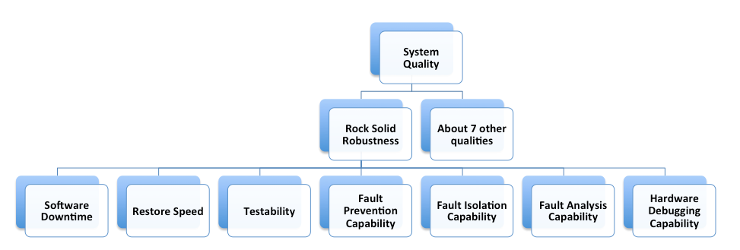
Decomposition of a Complex Requirement

Slide 48
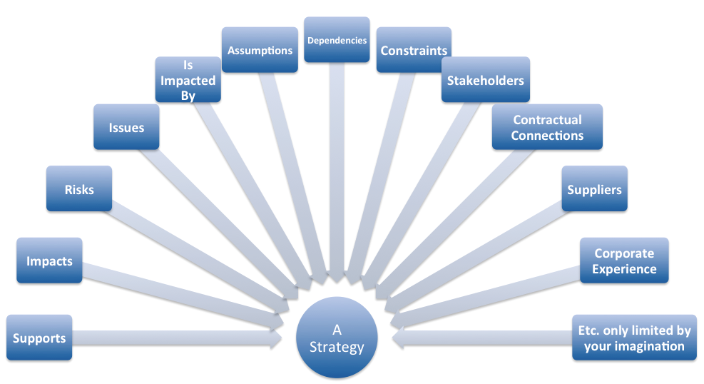
Some Requirement Data

Slide 49
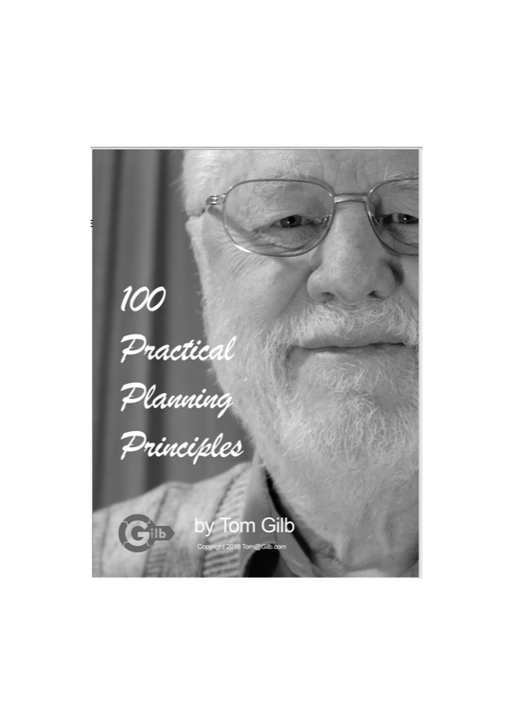
10. Free Booklet:
“100 Practical Planning Principles”
100 Practical Planning Principles. https://www.gilb.com/offers/Shju4Zqn/checkout
FREE GIFT REVIEW COPY FOR YOU ALONE.
NO COUPON CODE REQUIRED.
Permission to share with your best friends.

Slide 50
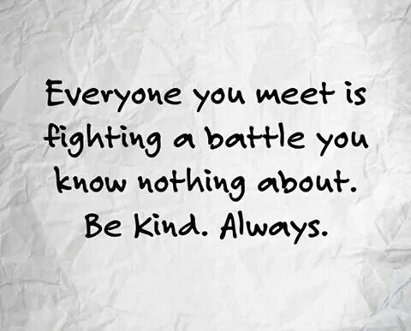
Principles For Fighting The Unknowns
Assume there are even more critical unknowns
Never give up in trying to find critical unknowns
Document known unknowns
Use tables to explore multiple relationships (the ?????)
Quantify, estimate, measure
Take small change steps, measure against expectations
Go deep into your 50 stakeholders
Contract out risk for unknowns
Design easy local modification in
Everybody trained to deal with risks everywhere, at all times
© tom@Gilb.com November 2018
Notes:
https://30ontap.com/2016/07/27/reminder-were-all-fighting-battles/

Slide 51
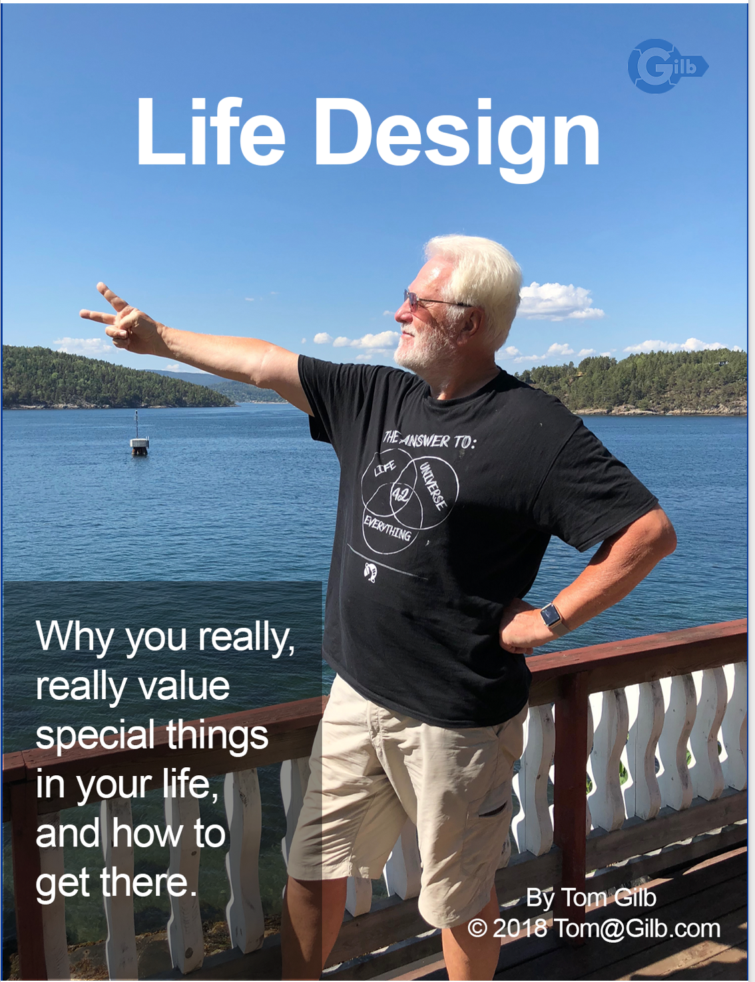
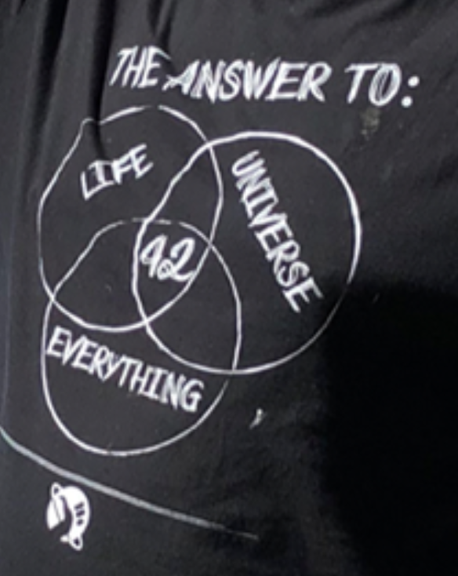

Slide 52
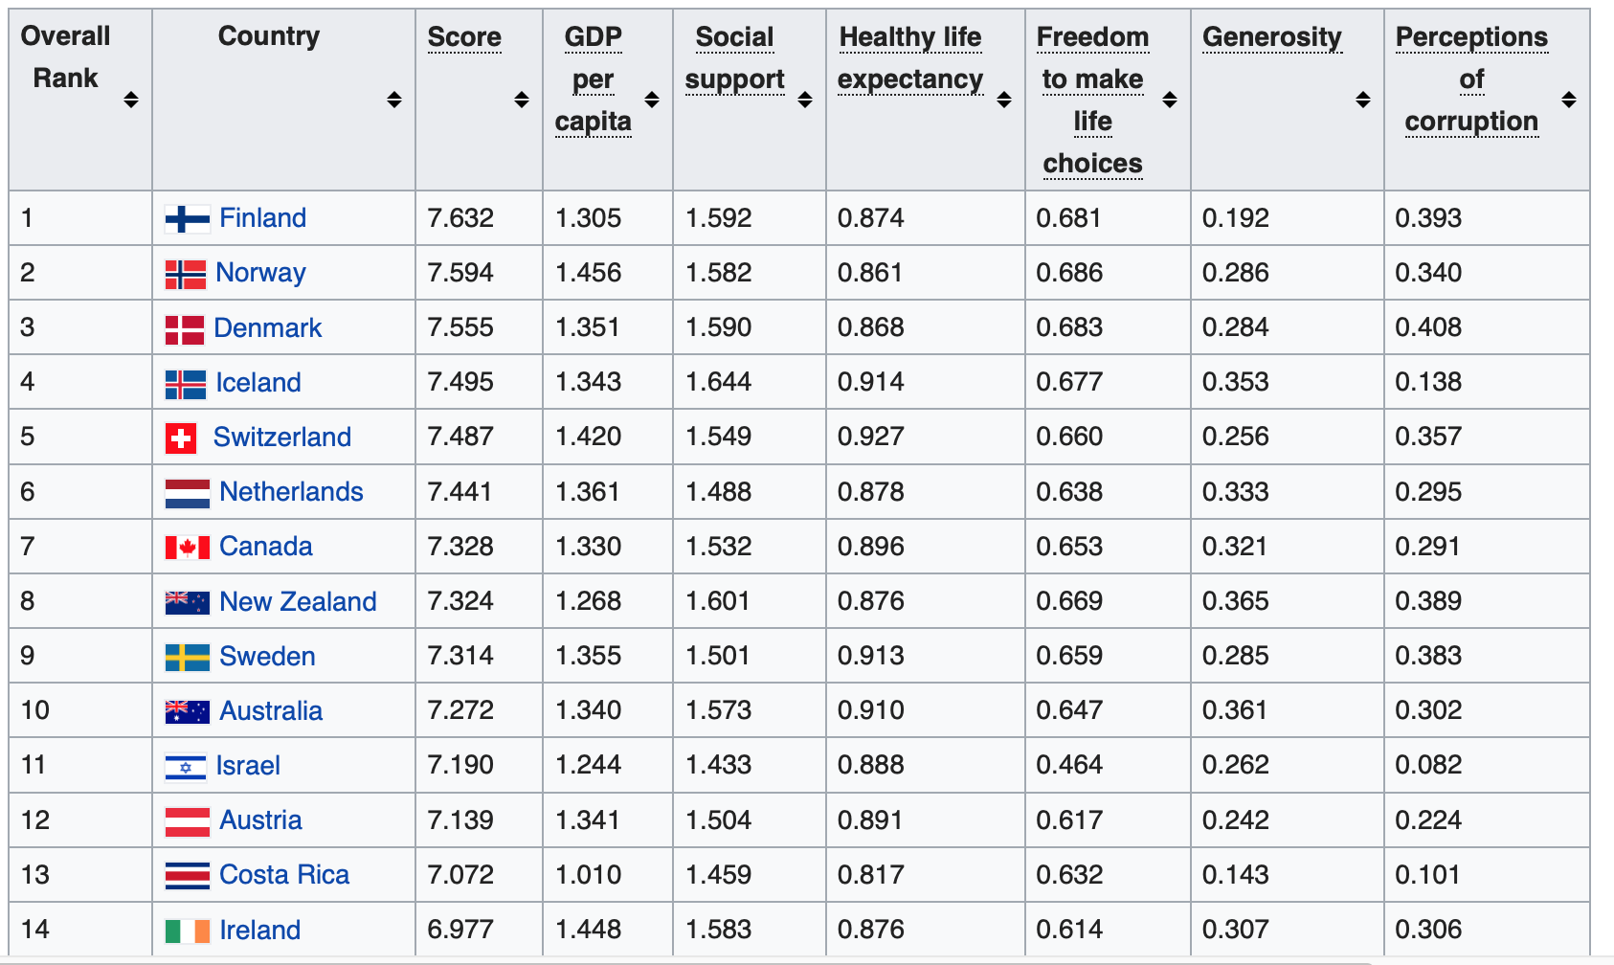
https://en.wikipedia.org/wiki/World_Happiness_Report#2016_World_Happiness_Report
Where I chose to live
leaving USA and UK

Slide 53
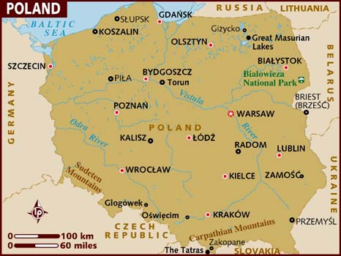
Which place is Poland,
on the Happiness Index?

Slide 54
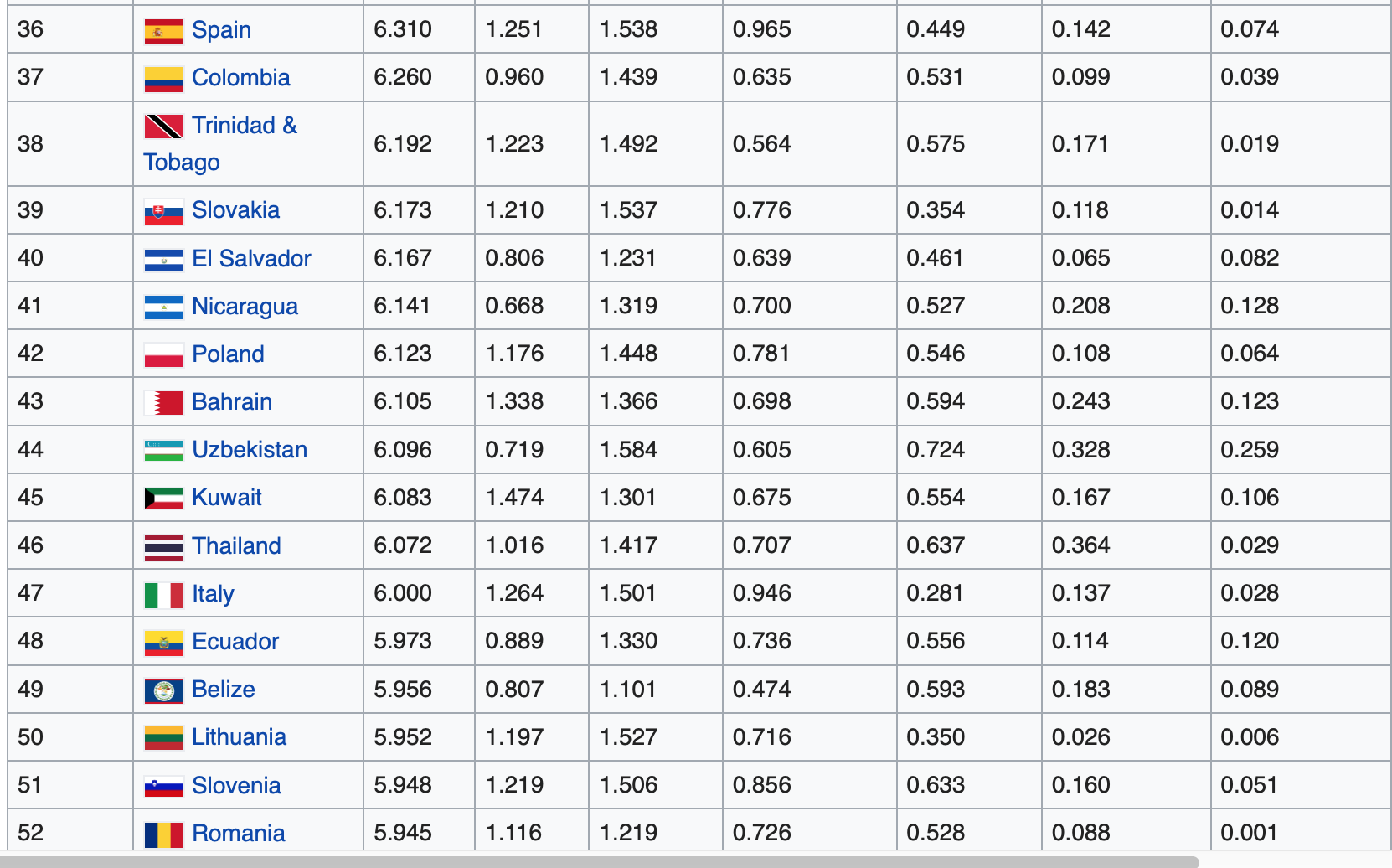
https://en.wikipedia.org/wiki/World_Happiness_Report#2016_World_Happiness_Report
Obviously
The right answer

Slide 55
end: have fun at WUD !
this talk is at https://tinyurl.com/WUDGILB
and later at http://concepts.gilb.com/file24
TAKE A PHOTO OF THIS ON THE SCREEN!
My 2017 lecture from WUD Silesia conference is online: https://youtu.be/TlDCwmVgDJQ
slides http://concepts.gilb.com/dl911

