Slide 1
10 praktiske triks for konsulenter ved klient kommunikasjon.
10 Practical tricks for consultants
when
communicating with clients
Intellectual Superpowers give you especially powerful abilities to analyze, communicate, present, and decide
Tom Gilb
Ciber, Oslo
6 Februar 2018, 15-17:30 (150 minutes)
tom@Gilb.com, www.Gilb.com, @ImTomGilb
Notes:
These ‘tricks’ use ‘Quality Engineering’
: to really manage quality we must change our culture to engineering.
Software quality is a much bigger area than program bugs. It contains very many types of quality simultaneously such as security, usability, maintainability, and a wide range of qualities and values which are interesting to the domain. For example nurses effectiveness in a medical system, or trading risk management in a banking system.
Software quality is not simply about algorithm quality, but is very much about the qualities of the other soft components such as databases, work processes, documentation, instruction in use of the system; and for most systems, we need to take a system wide view which includes the people, the hardware, the services and the economics. This means we have to think of Systems Engineering for Qualities.
Scope. Technical and Management solutions.
Value for the audience:
The value is that:
1. they will greatly enlarge their understanding of the multiple qualities necessity.
2. they will get free access to a number of useful tools for managing qualities
3. some will be inspired to improve the scope of what their organization does about quality
Problems addressed:
what are the technical methods or tools we need in order to master the qualities of software?
What education or training is needed to delivery multiple qualities, within acceptable costs?
What can an individual participant do in the short term about the challenge.
Tom Gilb has mainly worked within the software engineering community, but since 1983 with Corporate Top Management problems, and since 1988 with large-scale systems engineering (Aircraft, Telecoms and Electronics). He is an independent teacher, consultant and writer. He has published nine books, including the early coining of the term "Software Metrics" (1976). He wrote "Principles of Software Engineering Management" (1988, in 2006 in 20th printing), and "Software Inspection" (1993, about 14th printing).
In 2016 Tom released his new management planning book, ‘Value Planning’, in digital format only. He is recognized as the founder or major driver of several technical disciplines such as ‘software metrics’ and ‘evolutionary project management’. His methods are widely and officially adopted by many organizations such as IBM, Nokia, Ericsson, HP, Intel, Citigroup - and many other large and small organizations.

Slide 2
Here is one view of
what a ‘superpower’ is:
First, these are the cultural aspects of the superpowers:
most people have not learned them yet
most people do not do them intuitively
many people will deny that it is possible to do them
other people will argue they are too difficult to do
most university teachings totally ignore these methods
most books, talks, and papers do not teach these methods
In other words, they are rare:
less than 1 out of 100 people can do them.
If you can do them you are in the upper 1% of capability in this area, at least.

Slide 3
Here are the teaching and learning aspects of these superpowers:
they are relatively quick to learn, within an hour or day each
almost anybody in the professional area can learn to do them
whole organizations can make them part of their culture
they can be added one-by-one to the capabilities of any individual (yes, YOU)
they can be added to any larger methods or processes, one by one
it is easy to teach and coach them
they can be taught 'on the fly', as you work and discuss or plan.
the methods are described in detail, in cheap, or free, sources (gilb.com)
Notes:
http://slideplayer.com/slide/6301596/21/images/12/What+is+Six+Sigma…as+a+Goal.jpg
5 Feb 2018 tsg

Slide 4
Here are the expected results of using these superpowers:
10x: order-of-magnitude improvements in saving time and money
scale free: the methods work at any scale of problem or project
lean: the powers help deal with problems upstream, early and to prevent problems.
agile: the superpower methods work in agile value delivery cycles, and support them.

Slide 5
10 Consultant Skill Superpowers
Quantify value
Decompose solutions
Quantify and measure the quality of technical specs
Estimate solution attributes
Identify good solutions
Learn numerically what works
Prioritise fact-based solutions and requirements dynamically.
Quantify risks
Understand stakeholders
Communicate clearly
Notes:
https://www.openlearning.com/courses/thinklikeanengineer
feb 5 2018 tsg

Slide 6
Talk Outline
1. Quantification of Values and Qualities
2. Estimation of multiple attributes of methods and strategies
3. Evo and Advanced Agile: Multiple Measures, and Dynamic Design to Cost Estimation
4. Measuring Development Specifications Quality:
Lean Quality Assurance

Slide 7
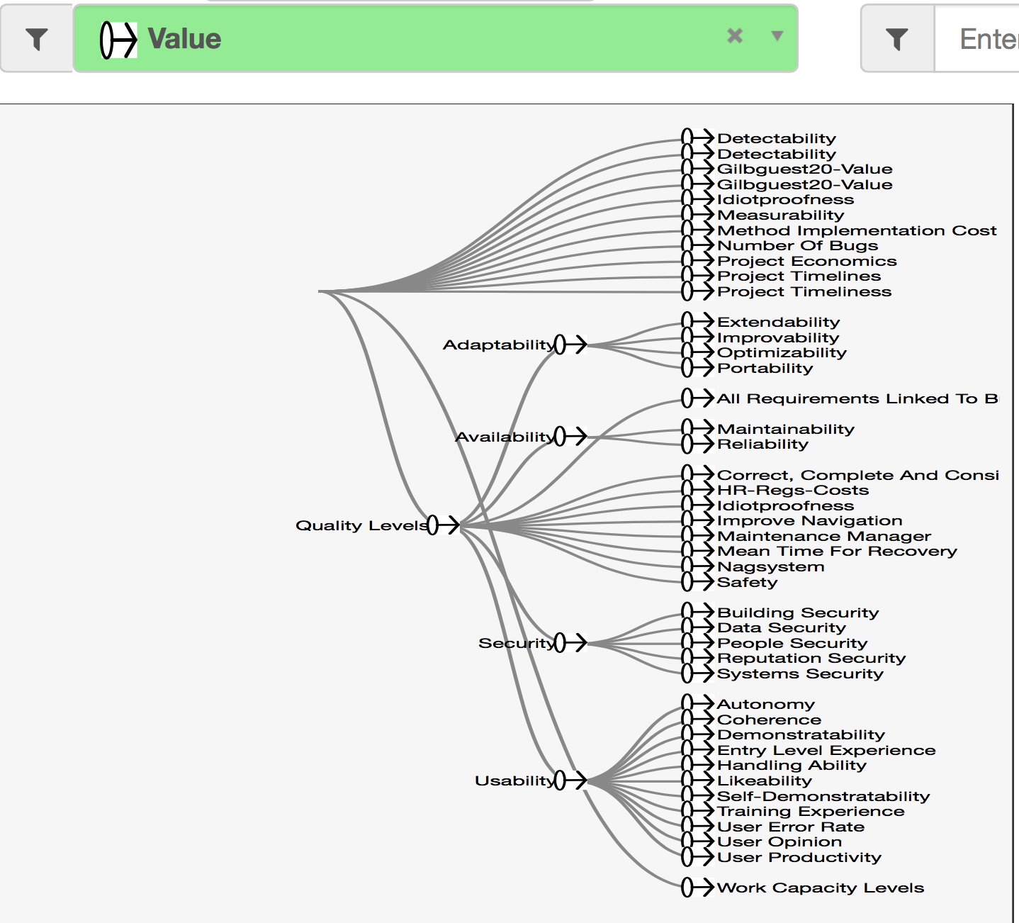
1. Quantification of Values and Qualities
Tool Credit:
www.NeedsandMeans.com
Richard Smith, London

Slide 8
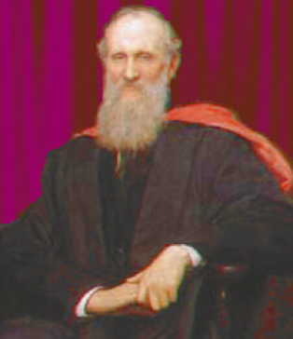
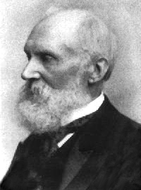
The Principle Of 'Quality Quantification’ The Words of a ‘Lord’
“All qualities can be expressed quantitatively,
'qualitative' does not mean unmeasurable”. (Gilb)
http://tinyurl.com/GilbTedx
"In physical science the first essential step in the direction of learning any subject is to find principles of numerical reckoning and practicable methods for measuring some quality connected with it.
I often say that when you can measure what you are speaking about, and express it in numbers, you know something about it;
but when you cannot measure it, when you cannot express it in numbers, your knowledge is of a meagre and unsatisfactory kind;
it may be the beginning of knowledge, but you have scarcely in your thoughts advanced to the state of Science, whatever the matter may be.”
Lord Kelvin, 1893, Lecture to the Institution of Civil Engineers, 3 May 1883 From http://zapatopi.net/kelvin/quotes.html
© Gilb.com
Born: 26 June 1824; Belfast, Ireland
Died 1907.
Notes:
PHOTO SOURCE: http://www.todayinsci.com/cgi-bin/indexpage.pl?http://www.todayinsci.com/K/Kelvin_Lord/Kelvin_Lord.htm
http://www.todayinsci.com/cgi-bin/indexpage.pl?http://www.todayinsci.com/K/Kelvin_Lord/Kelvin_Lord.htm
HAS AN EXCELLENT BIO
Thank you for the lecture you gave at OGI. It gave me much food for thought
and action, particularly in the realm of requirements specification. Much
to learn, much to apply.
As for your Lord Kelvin quote, it prompted an immediate google search. I
found a fuller version of the quote at
http://zapatopi.net/kelvin/quotes.html, which reads,
"In physical science the first essential step in the direction of learning any subject is to find principles of numerical reckoning and practicable methods for measuring some quality connected with it.
I often say that when you can measure what you
are speaking about, and express it in numbers, you know something about it;
but when you cannot measure it, when you cannot express it in numbers, your
knowledge is of a meagre and unsatisfactory kind; it may be the beginning of
knowledge, but you have scarcely in your thoughts advanced to the state of
Science, whatever the matter may be." While his full quote is more narrow
in scope (physical science) I think your extension of the idea to
"requirements science" arena equally applicable.
Benjamin Ward
---Benjamin Ward-----
Work: 503.232.7053 / mailto:benjamin.ward@tek.com
Home: 503.232.7053 / mailto:ben_ward@northwest.com
------------------------- June 1 contribution Michael Jackson, London
George Miller, the psychologist
> usually credited with the magic number seven, plus or minus
> two, wrote: "In truth, a good case could be made that if
> your knowledge is meagre and unsatisfactory, the last thing
> in the world you should do is make measurements. The chance
> is negligible that you will measure the right thing
> accidentally." Meagre and unsatisfactory knowledge about
> separability can't be improved by measuring anything, or
even by thinking about what you might measure.
=========== end MJ quote

Slide 9
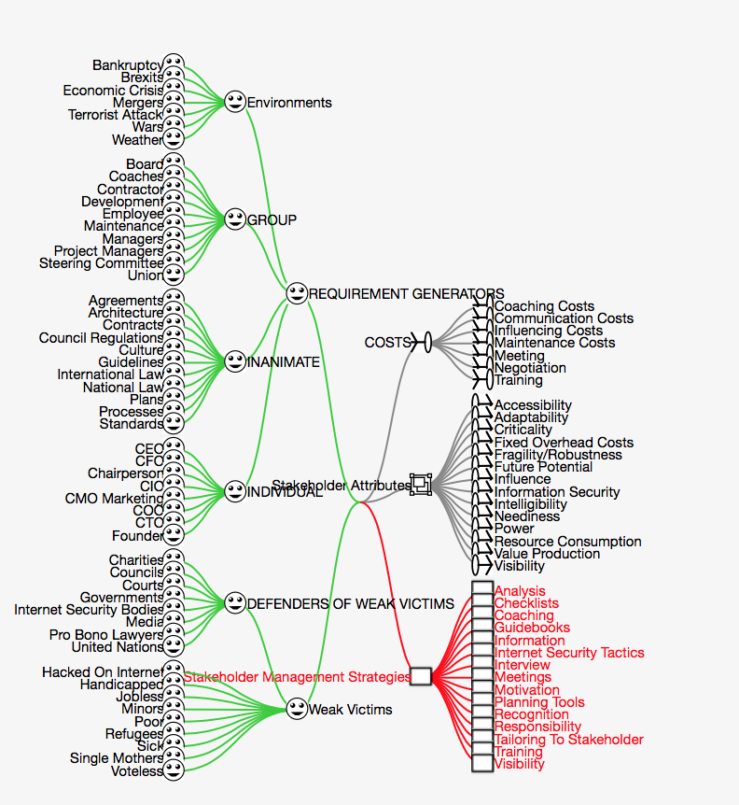
Stakeholders Needs and Means diagram
Main idea with this example
is to notice
the rich stakeholder structure
Notes:
source project in public needsandmeans.com
Tom Gilb's STAKEHOLDER ANALYSIS
project 2017
slide made 9 sept 2017

Slide 10
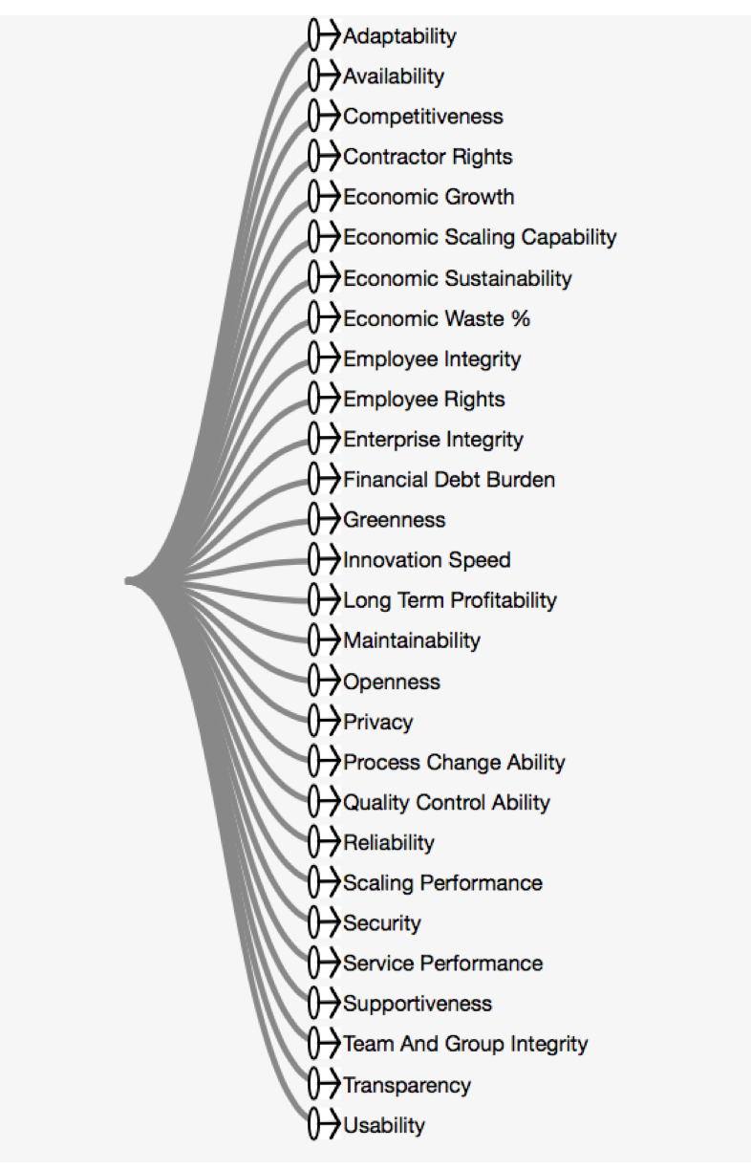
Direct Quantification of all benefits,
so they are
unambiguous clear;
and trackable
in agile delivery steps.
Every one of these values can
be expressed as
numeric improvements

Slide 11
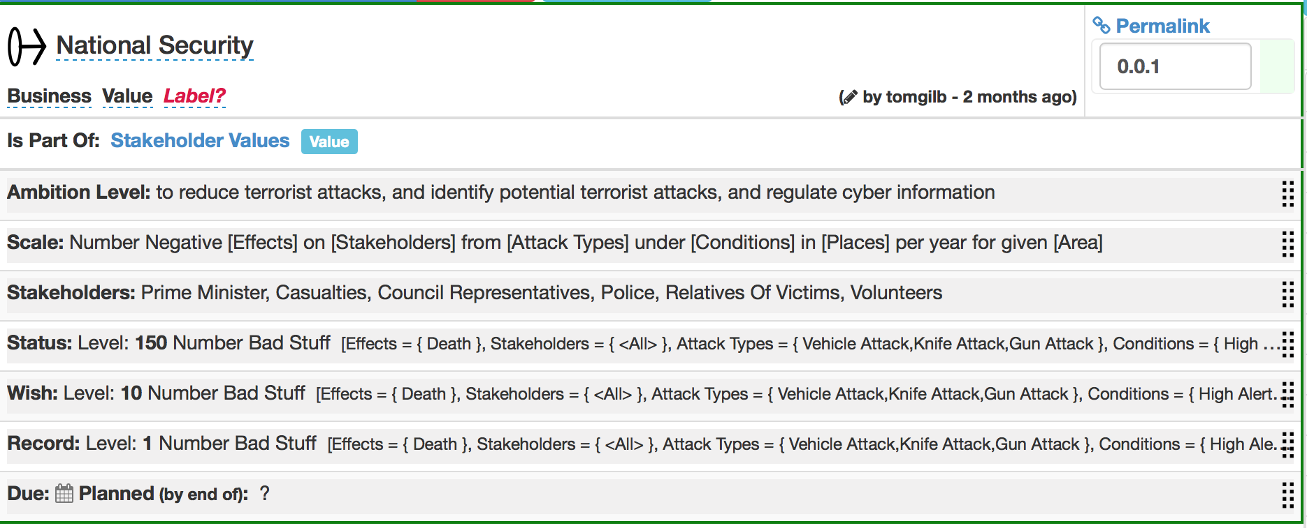
Security Value Quantification
with Stakeholders
All values and qualities
can be expressed quantitatively
Bullshit level
This structure
of requirements is in ‘Planguage’.
Which is specified in books
‘Competitive Engineering’
and
‘Value Planning’
Notes:
source Prevent terrorist Attacks
slide made 9 sept 2017

Slide 12
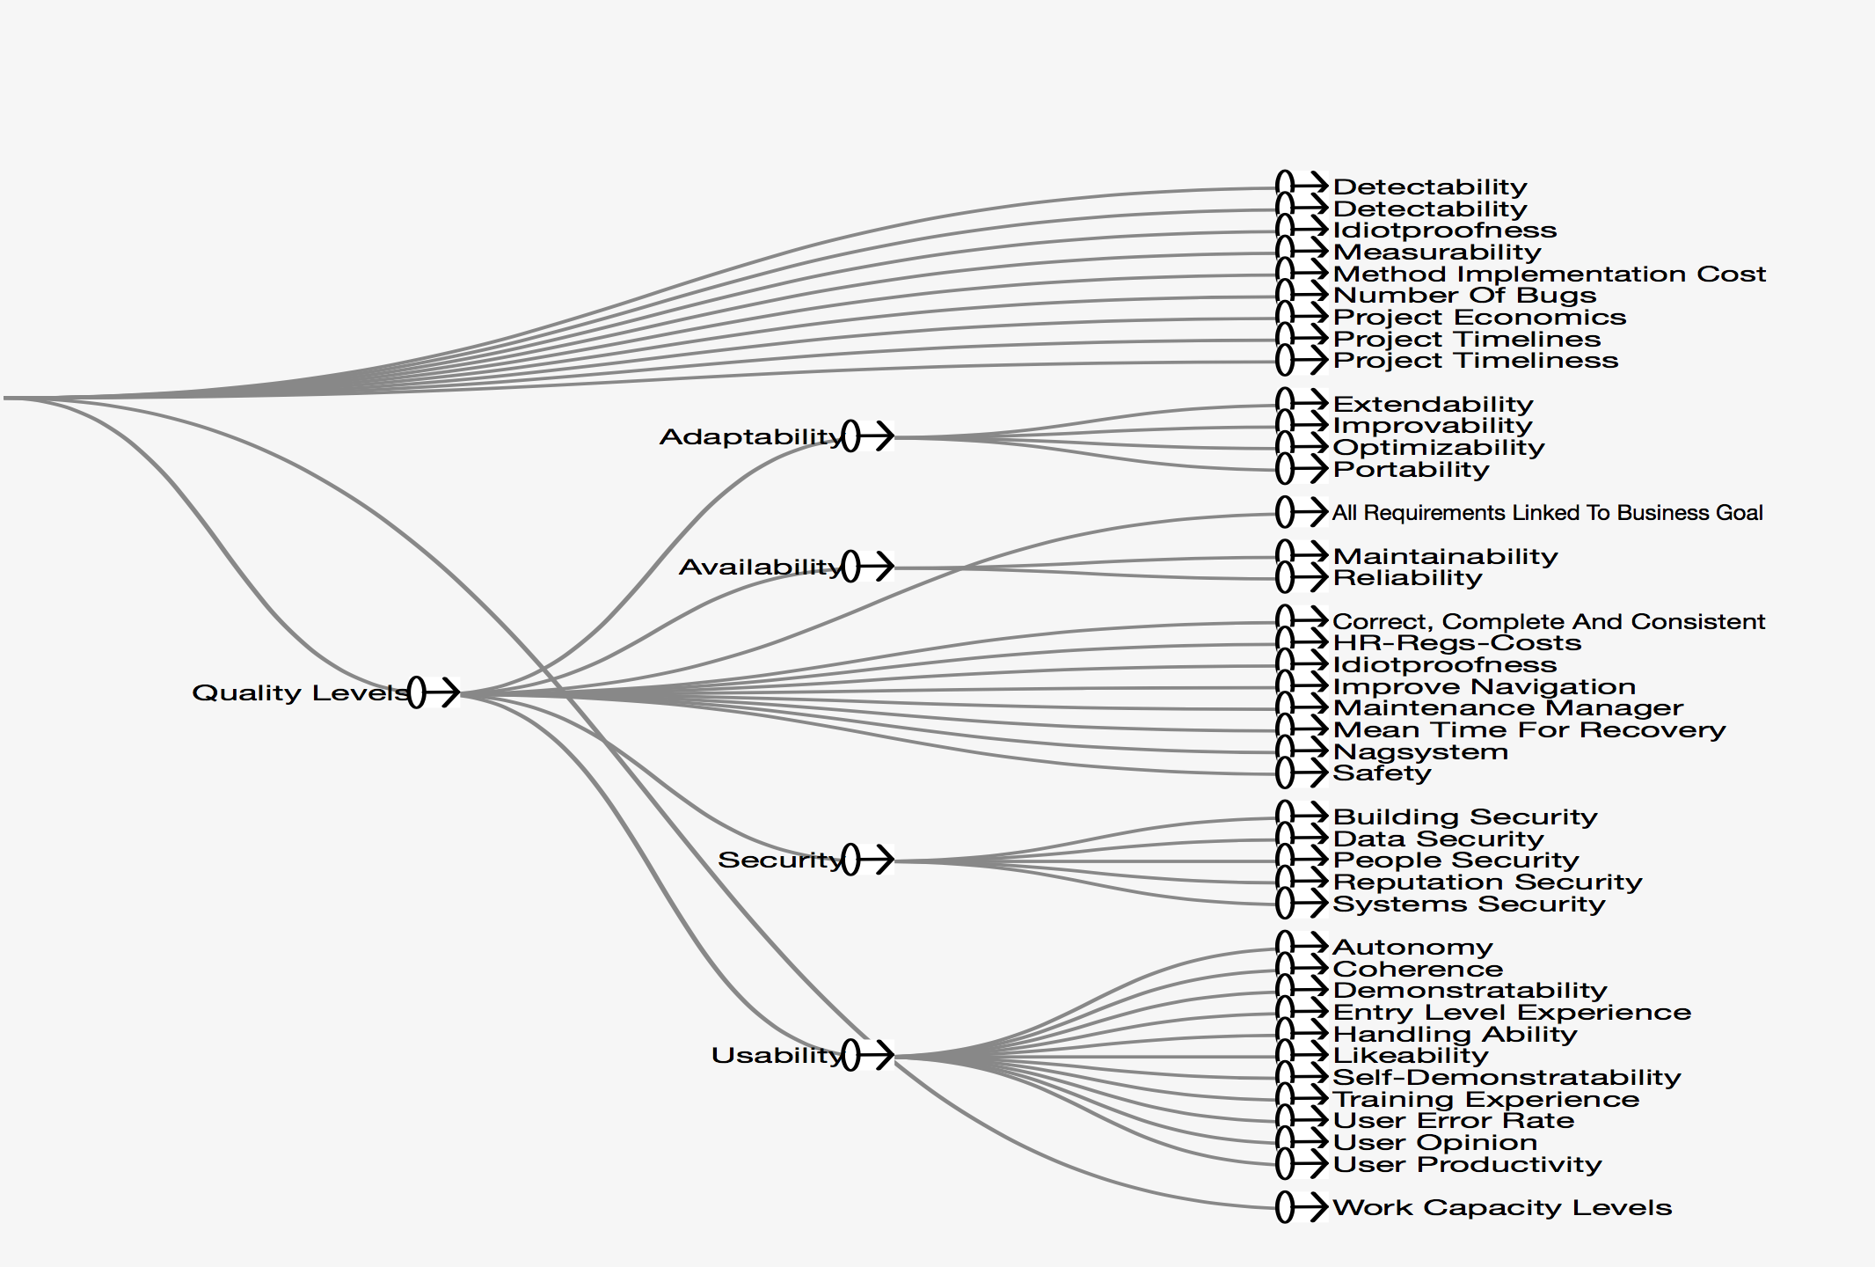
Stakeholder Values
All of which are quantified
and
used as basis for
Method suitability
notice the ‘decomposition
of complex qualities to sub-qualities
Cartesian analysis

Slide 13
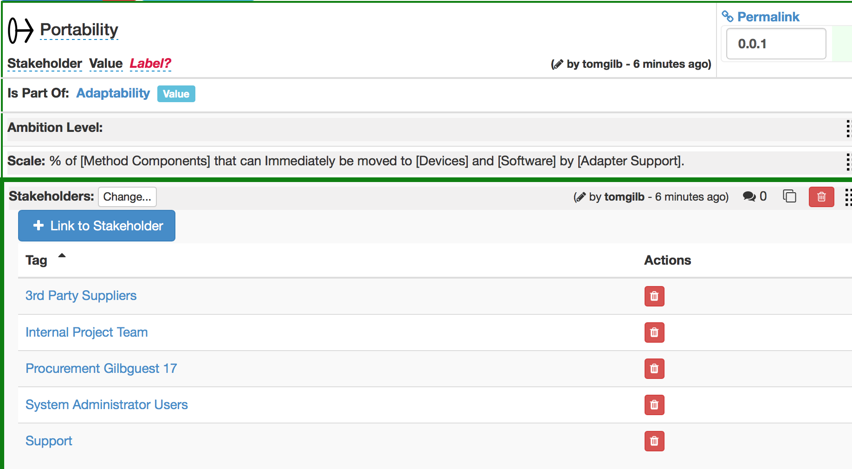
Example: Quantifying ‘Portability’
Stakeholders —>
Requirement Sources

Slide 14
Example: Quantifying ‘Portability’
<- The ‘Portability’ is the name or ‘tag of the specification’
This documents where in a hierarchy the spec belongs
and what type of spec (Value) it is
Management BS Level
Slogan or Headline
Many specs stop at this level.
We use this as a platform to develop much more precise requirements
Quantified, and
Decomposed to varied-value components

Slide 15
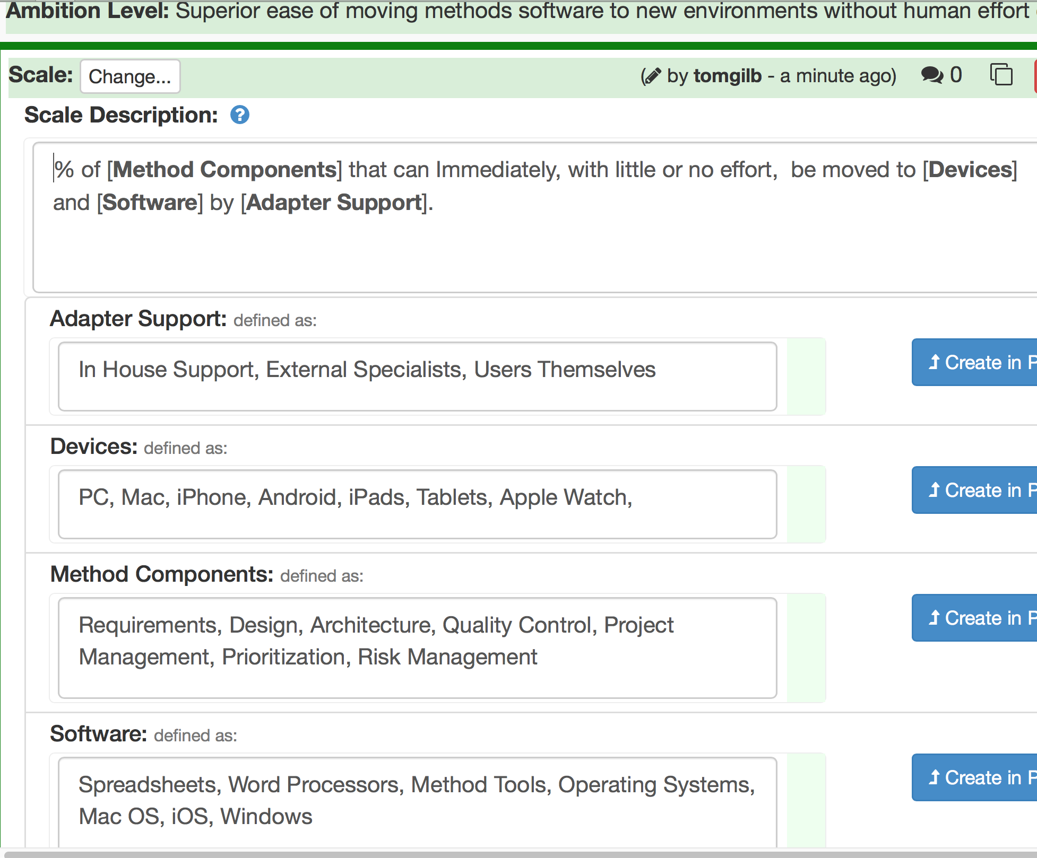
Example: Quantifying ‘Portability’ THE SCALE DEFINITION
with [Scale Parameters] decomposition: 2 levels
[Scale Parameters] decomposition: 1st level
Second-Level Decomposition
<—————
very detailed ‘modelling’ of the system

Slide 16
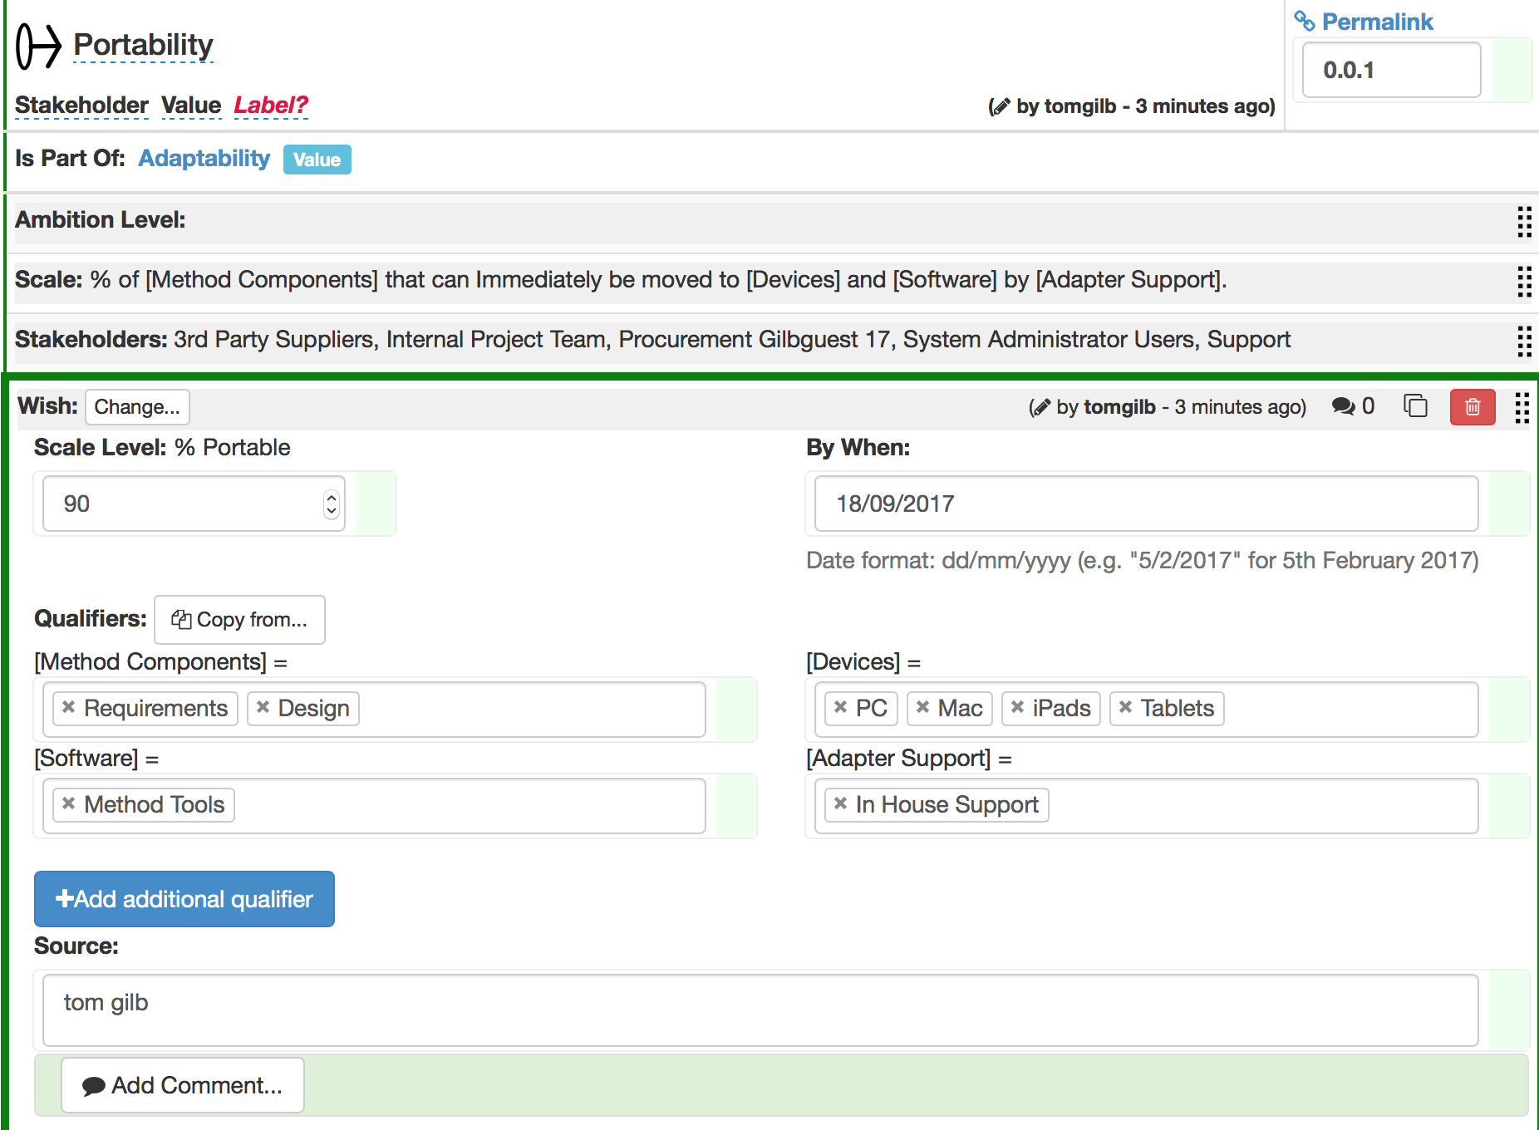
Example: Quantifying ‘Portability’
<- Wish level (90) expresses a need or desire of a stakeholder
The ‘Wish level’ here, refers only to the defined Scale parameters below:
Requirements, Design… Method Tools…. PC Mac iPads Tablets ,,, In house Support

Slide 17
how can a consultant,
over a beer, in 45 minutes,
quantify a top-level (CEO) objective
that nobody has clarified
for 8 years
of a failed* 90-person project?
the project failed to deliver ‘robustness’
and 7 other CEO requirements which were equally ‘fuzzy’

Slide 18
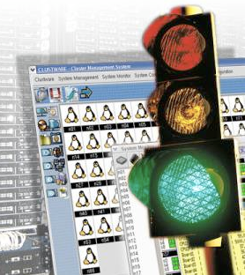
A ‘Bad’ Requirement “Rock solid robustness”
“While robustness is an essential H-project requirement in all its uses, it is especially critical in our applications where the much longer job durations afford software defects (e.g. memory leaks) a greatly expanded opportunity to surface.
In this regard,
H-project will provide the following features or attributes:
Minimal down-time
A critical H-project objective is to have minimal downtime due to software failures.
This objective includes:
Mean time between forced restarts > 14 days
H-project’s goal for mean time between forced restarts is greater than 14 days.
Comment: This figure does not include restarts caused by hardware problems, e.g. poorly seated cards or communication hardware that locks up the system. MTBF for these items falls under the domain of the hardware groups.
Restore system state < 10 minutes
Log scripts and test scripts, subsystem tests
Built-in testability
H-project will provide the following features and attributes to facilitate testing.
Tool simulators ….”
GILB COMMENT:
For once a reasonable attempt was made to quantify the meaning of the requirement!
But is could be done much better
As usual the set of designs to meet the requirement do not belong here.
And none of the designs make any assertion about how well (to what degree) they will meet the defined numeric requirements.
And as usual another guarantee of eternal costs in pursuit of a poorly defined requirement is most of the content.
© Tom@Gilb.com www.gilb.com
Real case of requirement for project costing over $100,000,000 without delivering testable results
Notes:
While robustness is an essential HORROR requirement in all its uses, it is especially critical in OUR applications where the much longer job durations afford software defects (e.g. memory leaks) a greatly expanded opportunity to surface. In this regard, HORROR will provide the following features or attributes:

Slide 19
Better ‘Testable’ Definition of the Requirement:
(‘Decomposition’ is a key to small agile delivery steps in practice)
Rock Solid Robustness:
Type: Complex Product Quality Requirement.
Includes: { Software Downtime, Restore Speed, Testability, Fault Prevention Capability, Fault Isolation Capability, Fault Analysis Capability, Hardware Debugging Capability}.
© Tom@Gilb.com www.gilb.com
Notes:
http://img2.travelblog.org/Photos/17776/71146/t/761917-Some-of-the-famous-granite-rocks-1.jpg

Slide 20
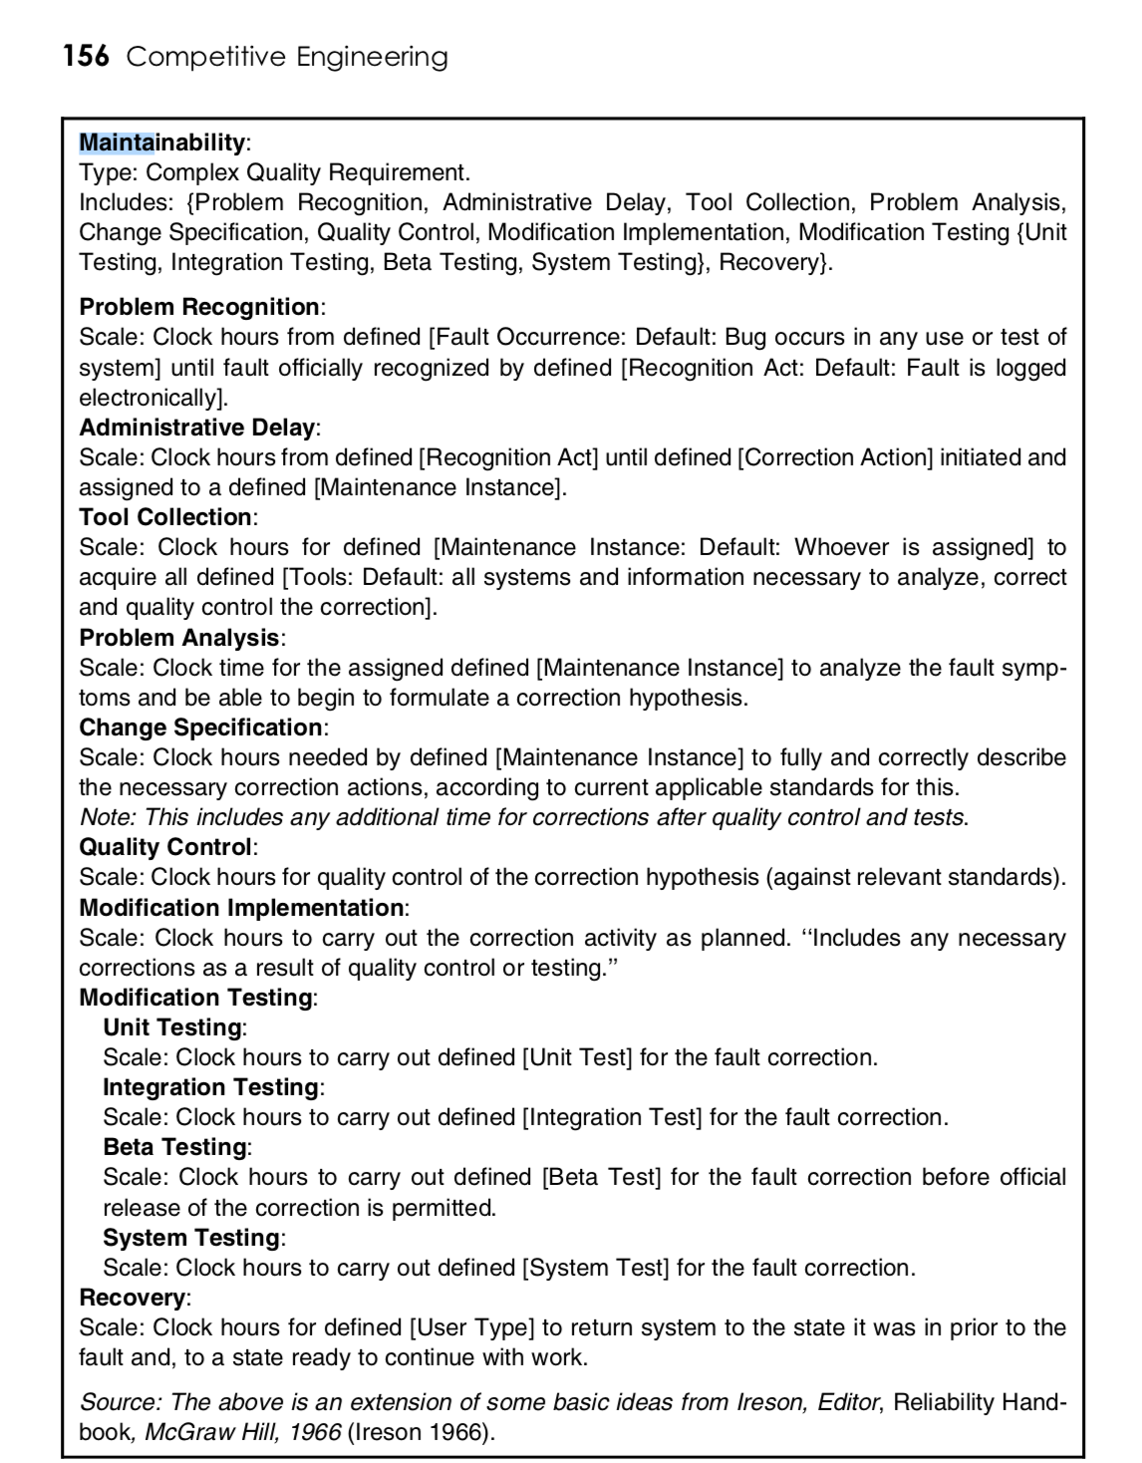
I made use of this pattern

Slide 21
Defining One Component Clearly:
Software Downtime:
Type: Software Quality Requirement.
Ambition: to have minimal downtime due to software failures <- HFA 6.1
Issue: does this not imply that there is a system wide downtime requirement
Scale: <mean time between forced restarts for defined [Activity], for a defined [Intensity].>
Fail [Any Release or Evo Step, Activity = Recompute, Intensity = Peak Level] 14 days <- HFA 6.1.1
Goal [By 2008?, Activity = Data Acquisition, Intensity = Lowest level] : 300 days ??
Stretch: 600 days
© Tom@Gilb.com www.gilb.com
Notes:
Edited Planguage 4 oct 2011 tsg

Slide 22
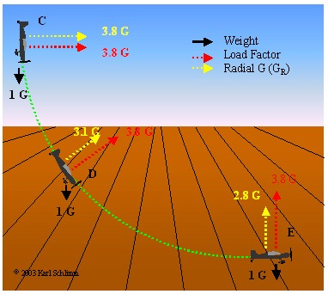
Defining a Second Component Clearly:
Restore Speed:
Type: Software Quality Requirement.
Ambition: Should an error occur (or the user otherwise desire to do so), Horizon shall be able to restore the system to a previously saved state in less than 10 minutes. <-6.1.2 HFA.
Scale: Duration, from Initiation of Restore, to Complete and verified state of a defined [Previous: Default = Immediately Previous] saved state.
Initiation: defined as {Operator Initiation, System Initiation. Default = Any.
Goal [ Initial and all subsequent released and Evo steps] 1 minute?
Fail [ Initial and all subsequent released and Evo steps] 10 minutes. <- 6.1.2 HFA
Catastrophe: 100 minutes.
© Tom@Gilb.com www.gilb.com
Notes:
http://www.apstraining.com/images/69.jpg

Slide 23
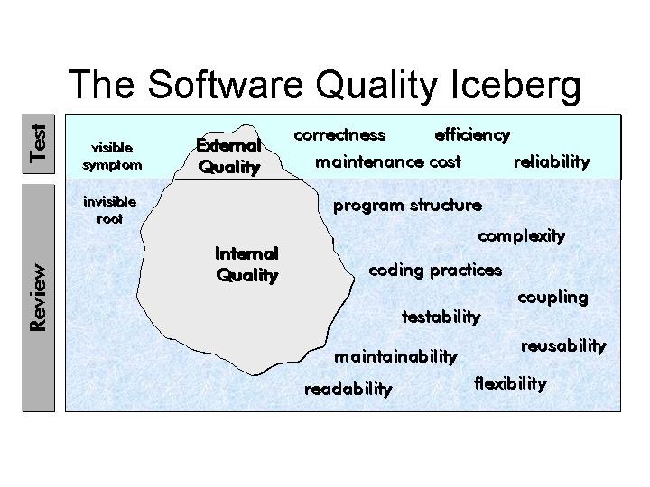
Testability:
Testability:
Type: Software Quality Requirement.
Version: 20 Oct 2006-10-20
Status: Demo draft,
Stakeholder: {Operator, Tester}.
Ambition: Rapid-duration automatic testing of <critical complex tests>, with extreme operator setup and initiation.
Scale: the duration of a defined [Volume] of testing, or a defined [Type], by a defined [Skill Level] of system operator, under defined [Operating Conditions].
Goal [All Customer Use, Volume = 1,000,000 data items, Type = WireXXXX Vs DXX, Skill = First Time Novice, Operating Conditions = Field, {Sea Or Desert}. <10 mins.
Design Hypothesis: Tool Simulators, Reverse Cracking Tool, Generation of simulated telemetry frames entirely in software, Application specific sophistication, for drilling – recorded mode simulation by playing back the dump file, Application test harness console <-6.2.1 HFA
www.Gilb.com
Notes:
http://users.skynet.be/ronnydewinter/SQA-img/TheSoftwareQualityIceberg.jpg
So once again, what is testability, exactly? Although testability is mentioned in the abstract of the recent WCAG 2.0 working draft documents and expanded in the “Conformance” section, a full definition sits not in the glossary but in the Requirements for WCAG 2.0 Checklists and Techniques, dated 7 February, 2003. Within this document, you will find the only definition of testability as it applies to WCAG 2.0. Here’s that definition:Definition: Testable: Either Machine Testable or Reliably Human Testable.Definition: Machine Testable: There is a known algorithm (regardless of whether that algorithm is known to be implemented in tools) that will determine, with complete reliability, whether the technique has been implemented or not. Probabilistic algorithms are not sufficient.Definition: Reliably Human Testable: The technique can be tested by human inspection and it is believed that at least 80% of knowledgeable human evaluators would agree on the conclusion. The use of probabilistic machine algorithms may facilitate the human testing process but this does not make it machine testable.Definition: Not Reliably Testable: The technique is subject to human inspection but it is not believed that at least 80% of knowledgeable human evaluators would agree on the conclusion.

Slide 24
can a consultant help quantify all critical objectives for a customer project in a single day, using the bank’s own people?
here is an example of doing it for real that Kai and I did in London

Slide 25
top ten quantified on Monday (Real at a London Bank)
https://www.slideshare.net/assocpm/tom-gilb-project-management-driven-by-the-top-ten-critical-improvements-quantified-bcs-apm-15-april-2013

Slide 26
how can a consultant
in a single day
help a client to see 100 relationships (10 x 10)
between 10 objectives
and
their 10 strategies/architecture?

Slide 27
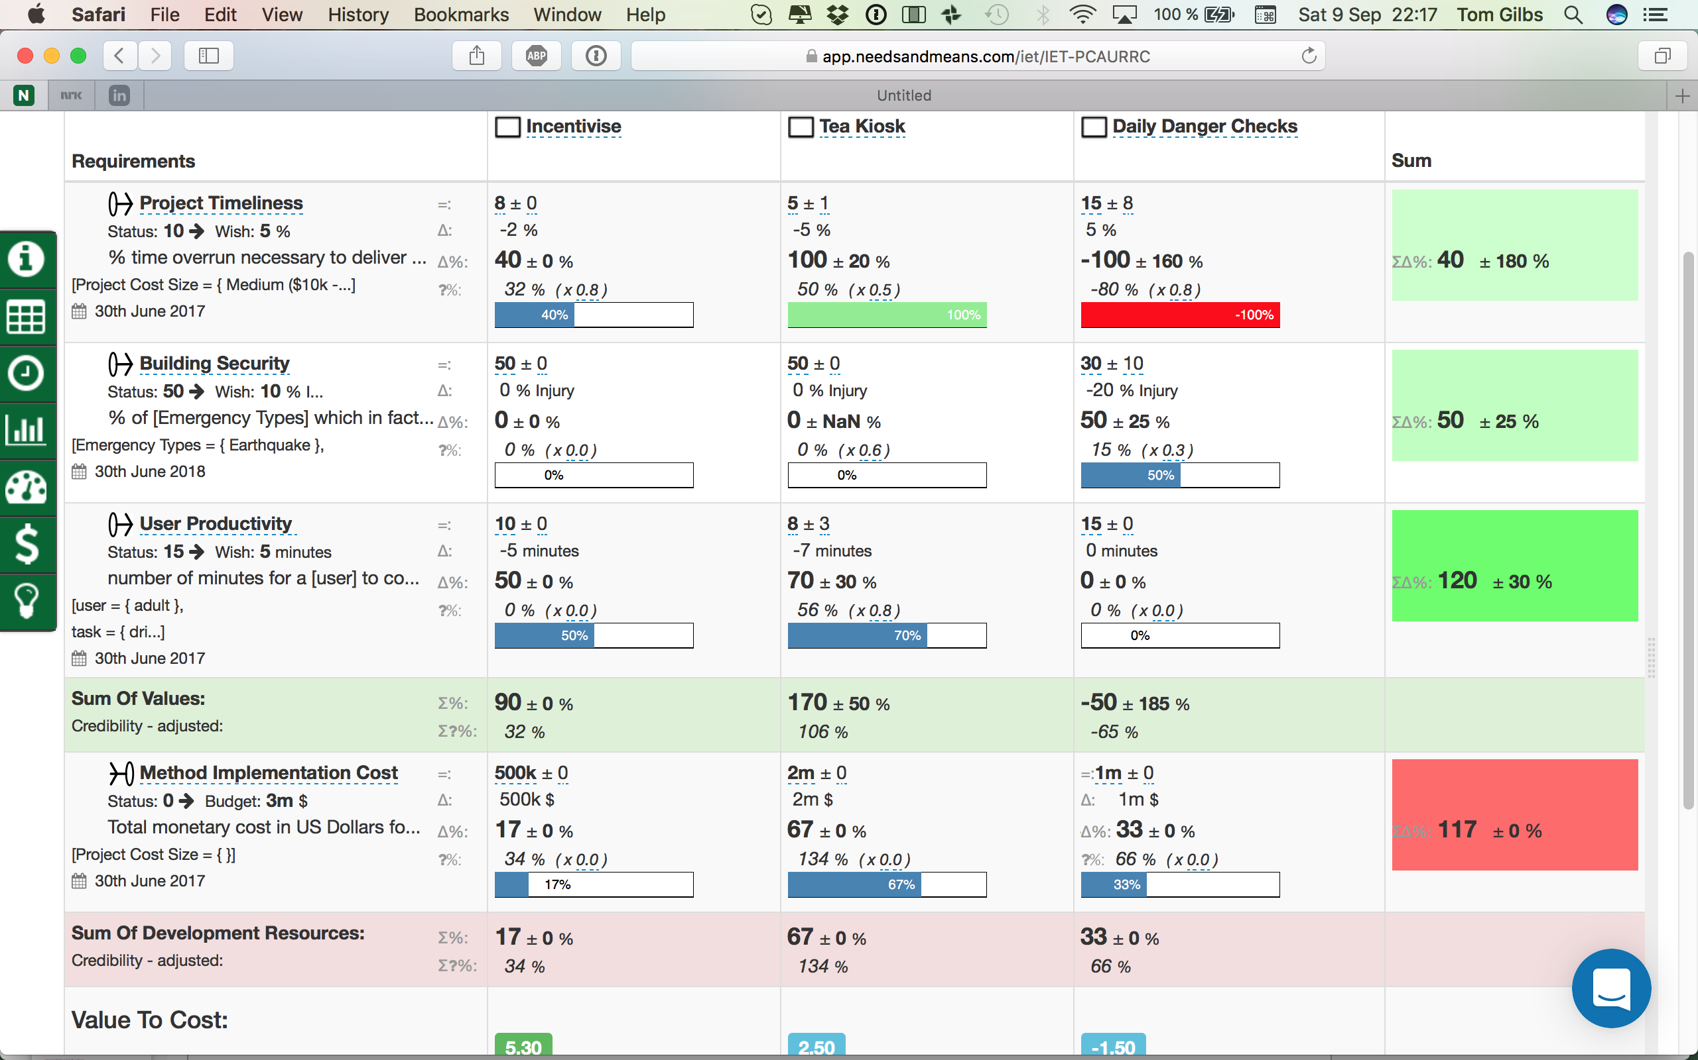
2. Estimation of multiple attributes of methods and strategies
Quantifying Design/Architecture/Strategic Planning
Moving towards an engineering discipline.

Slide 28
― Confucius, Sayings of Confucius
“True wisdom is knowing what you don't know”
― Confucius, Sayings of Confucius
What intellectual tools do you have
that will help you
to be more conscious of
exactly what
you do NOT know enough about?
Donald Rumsfeld, the then US Secretary of State for Defence, stated at a Defence Department briefing: 'There are known knowns. There are things we know that we know.
© Gilb.com
Notes:
May 30 2013 in connection w Lean qa course Raid Glasgow reminder
Useful for IET and Templates
Known knowns, known unknowns, unknown unknowns and the propagation of scientific enquiry. In February 2002, Donald Rumsfeld, the then US Secretary of State for Defence, stated at a Defence Department briefing: 'There are known knowns. There are things we know that we know.

Slide 29
The numeric relation between ends and means.
Designs ->
What items here help us to
know what we do not know?
Basic Structure of an Impact Estimation Table

Slide 30
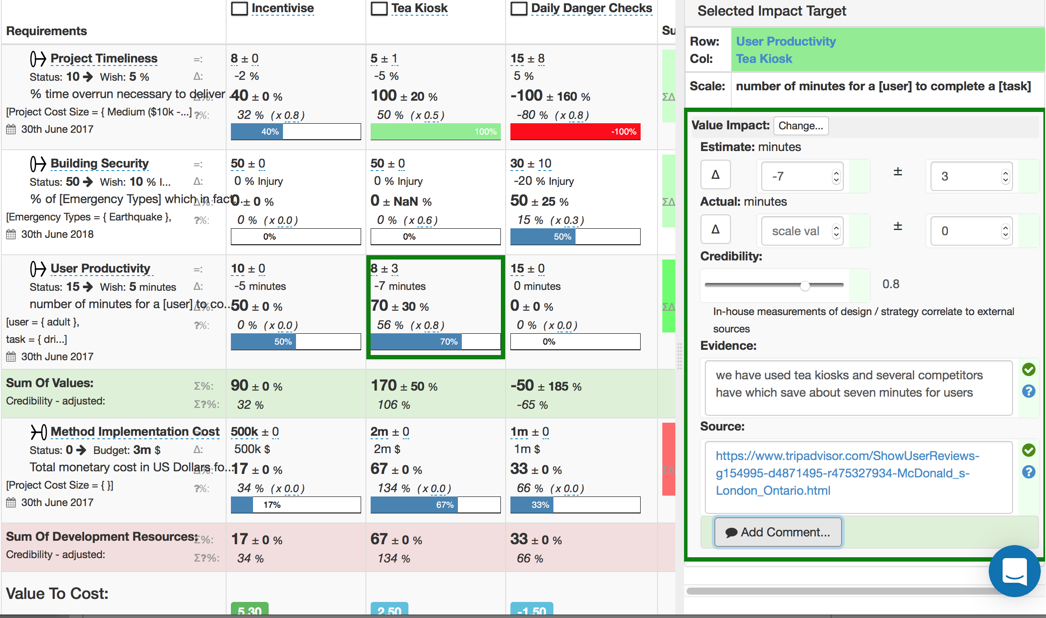
We estimate benefits based on facts, evidence, and consider ‘uncertainty’ (10±6)
see needsandmeans.com, Beta app

Slide 31
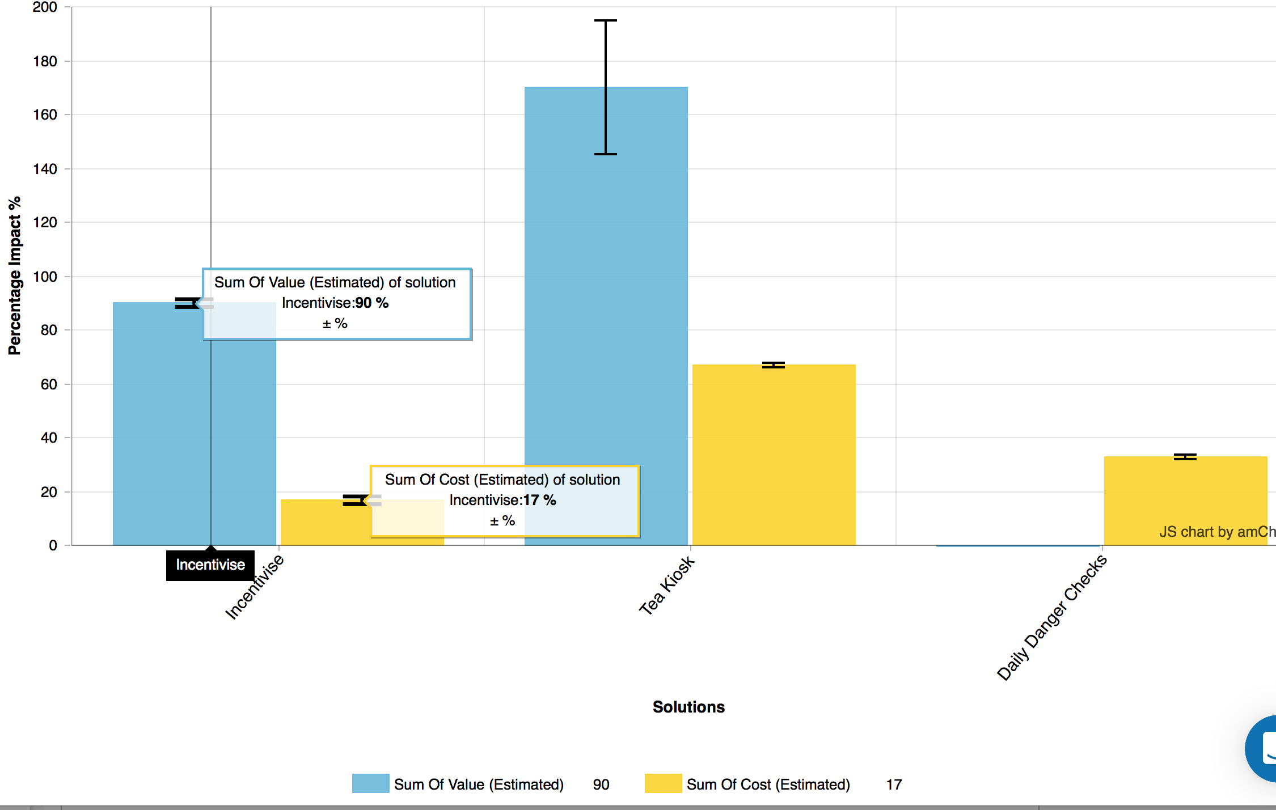
Overall ‘Potential Values / Costs’
of 3 options or (if you need them all)
complimentary ‘benefit drivers’ = strategies = solutions = means’
Simple presentation
og overall value for costs
of each
strategy or design

Slide 32
now here is an agile way to prove
that you as a consultant
can really produce customer results
(not just ‘code’)
in the short term
it is called ‘Evo’
it is ‘agile’ with numbers
or agile result engineering

Slide 33
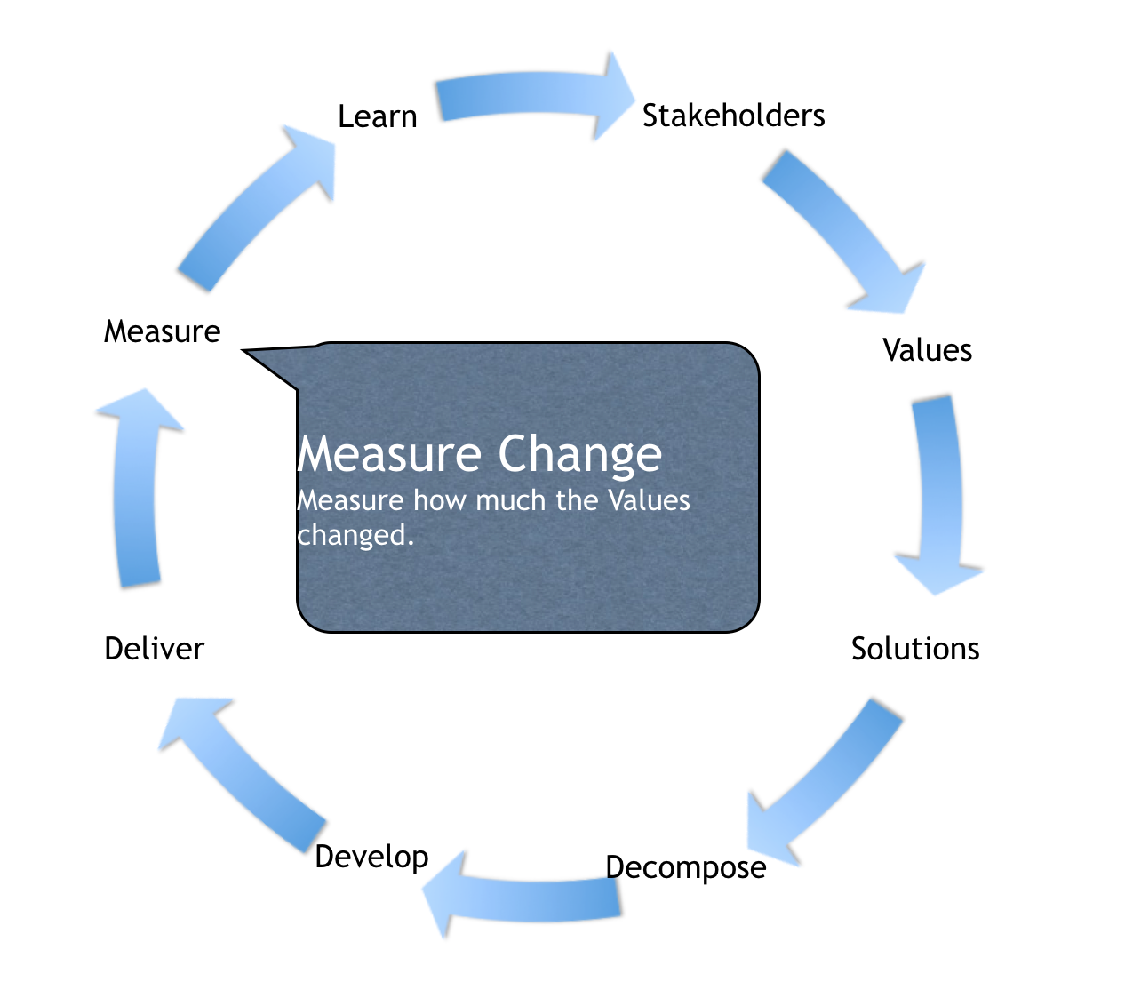
3. Evo and Advanced Agile:
Multiple Measures, and Dynamic Design to Cost Estimation
Deming
An advanced, Deming, ‘Plan Do Study Act’ cycle
(Statistical Process Control)
and it is all about numbers
This is ‘Evo’ (Evolutionary Value Optimization)

Slide 34
Identify your
critical stakeholders
the ones that have
one or more critical needs,
that if you fail to deliver them,
your project/product
might well fail
Learn
Stakeholders
Measure
Values
Deliver
Solutions
Develop
Decompose

Slide 35
Learn
Stakeholders
Which numeric improvements do stakeholders need, critically?
We can,
and must always,
express their values
with
well-defined numbers
Measure
Values
Define both failure
and
success numerically
and
keep learning what
those
critical numbers are
continuously
Deliver
Solutions
Develop
Decompose

Slide 36
Solutions
(designs, architectures, strategies)
must be identified
and their total impacts on critical objectives
and
constraints
must be estimated
reasonably
(order of magnitude)
Learn
Stakeholders
Measure
Values
Deliver
Solutions
Impact Estimation Tables
(Planguage)
are a tool for doing estimates
of potential solutions
and how good they might be
Develop
Decompose

Slide 37
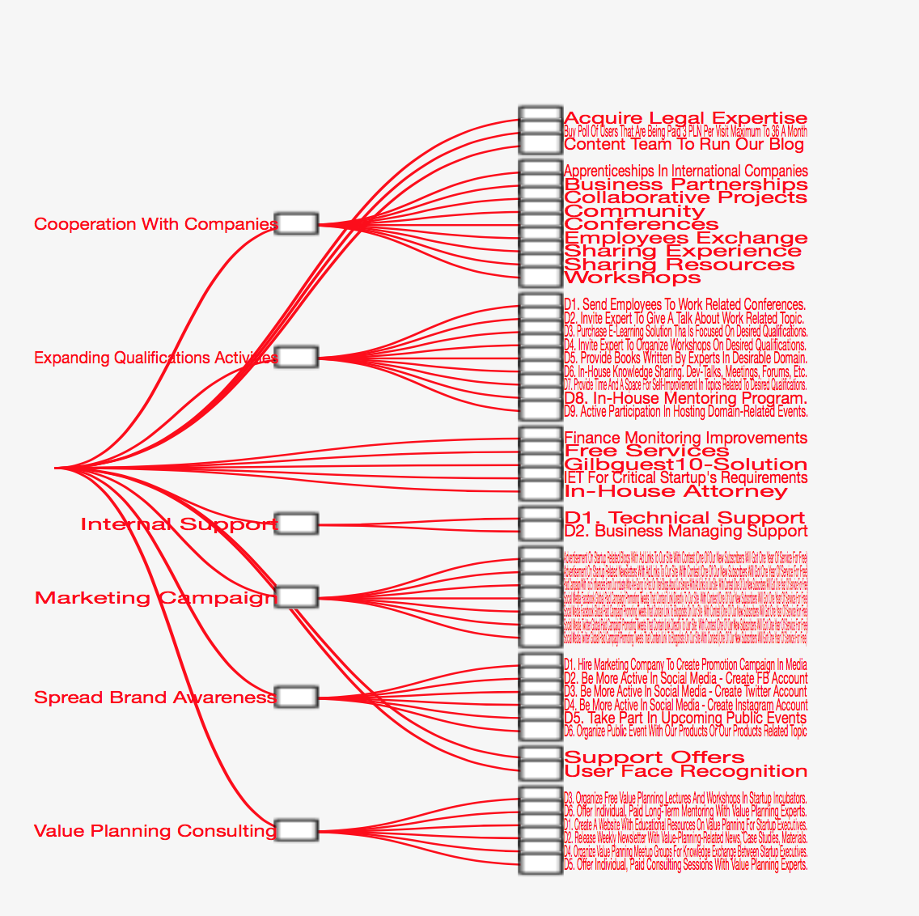
The solutions can be decomposed
by 10x or 100x
And we can estimate the solution sub-component
value and cost,
so as to prioritize the best value/cost
for short term delivery
Learn
Stakeholders
Measure
Values
Deliver
Solutions
Develop
Decompose
Notes:
source of examples on 24 oct 20177 as the polish startup export student exercise from Warsaw in house course 12-13 oct 2017

Slide 38
Solution Decomposition Example
2017 Polish Export Example

Slide 39
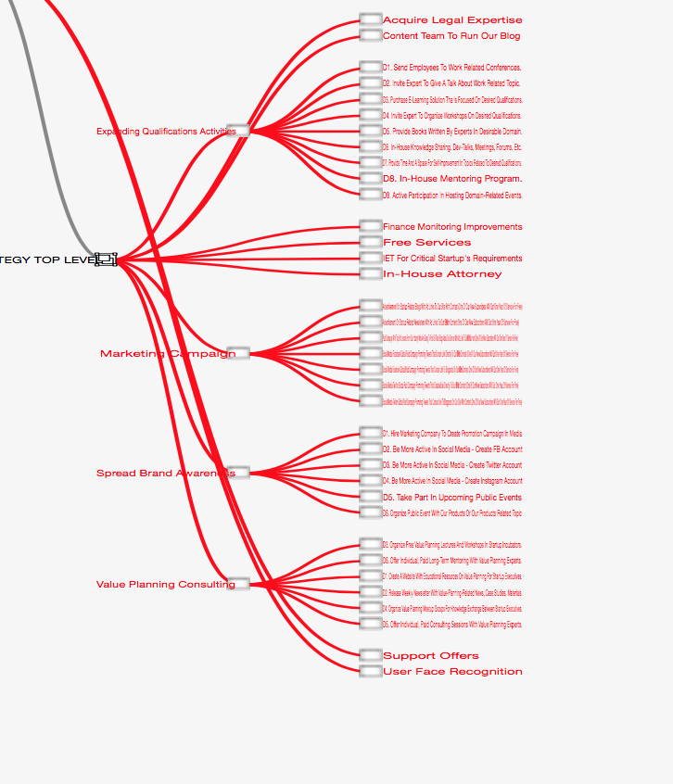
Several Solution Decompositions

Slide 40
Detail of 1 Solution Decomposition
Criteria for Decomposition
Each decomposition will deliver measure value to at least 1 stakeholder requirement
Any decomposition (D1… Dn) can be delivered independently of any other.

Slide 41
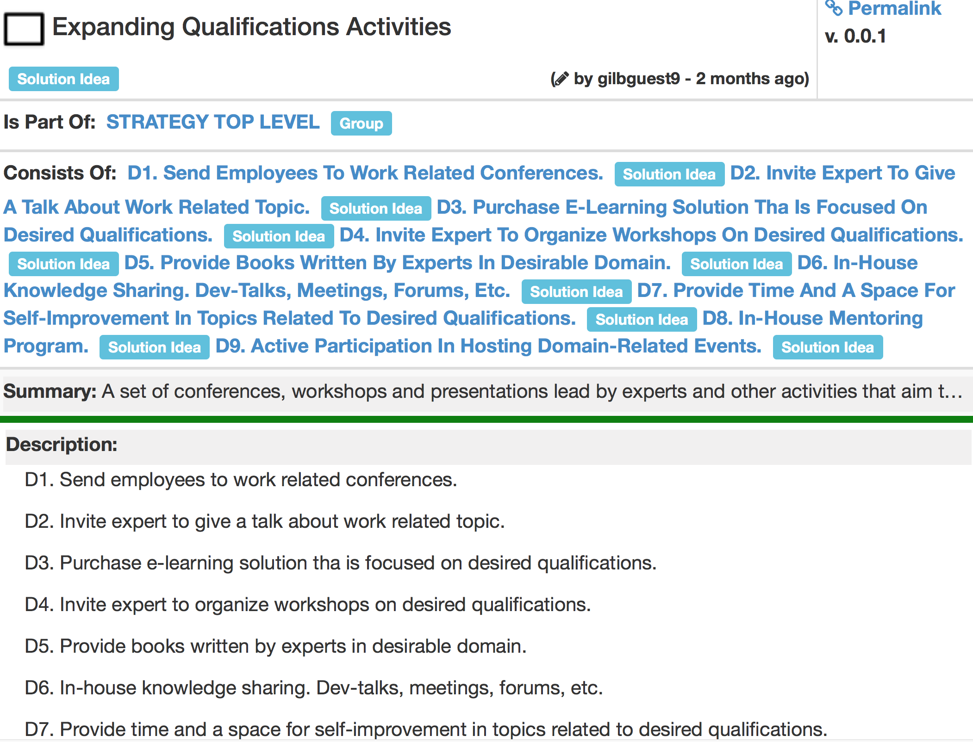

Slide 42
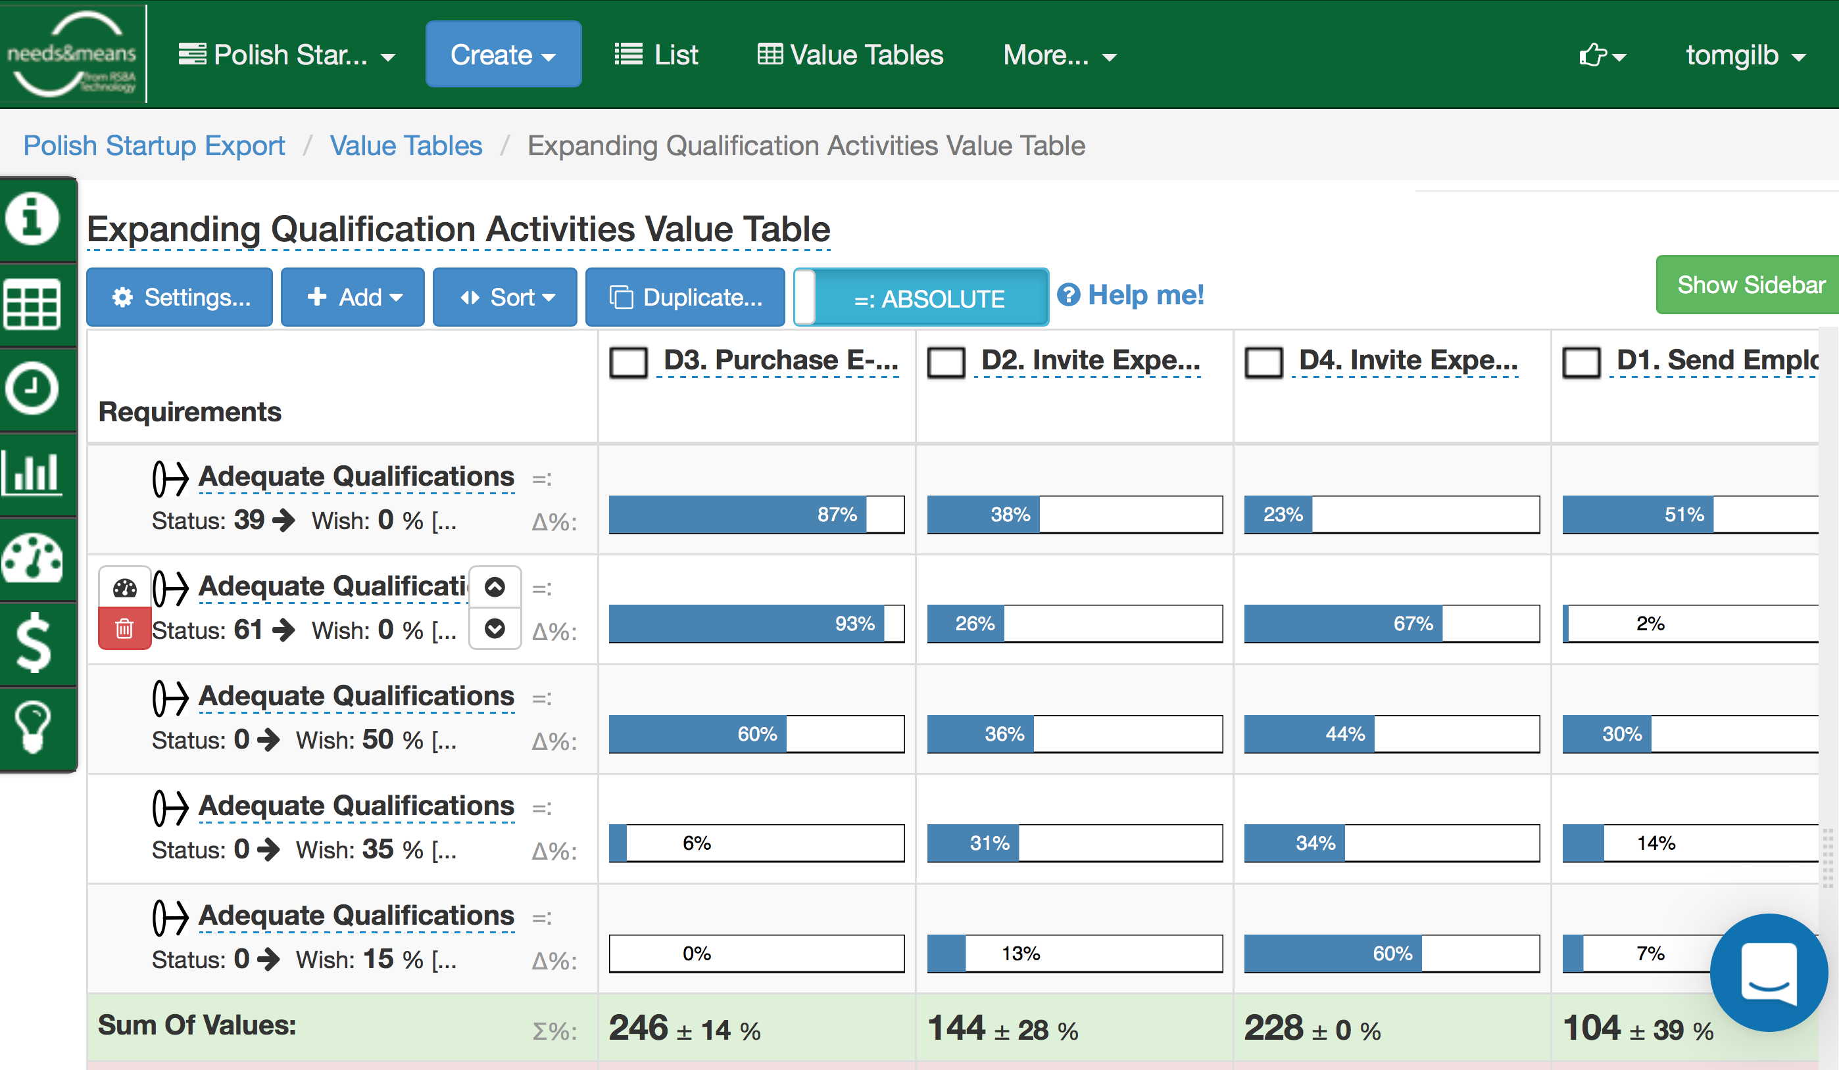
the decomposed strategies can be prioritized numerically

Slide 43
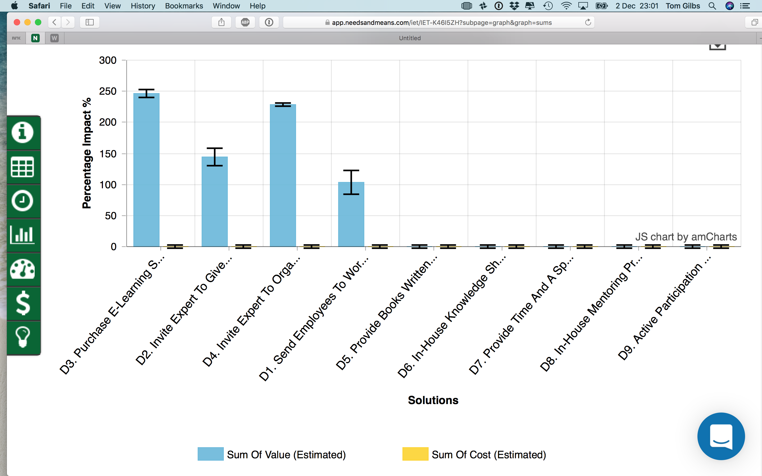
and we can show the relative value of the decamposed strategies like this

Slide 44
Learn
Stakeholders
Measure
Values
Deliver
Solutions
The sub-solutions are made ready (developed) for delivery to real stakeholders,
next week and every week.
Or in about 2% of budget/deadline increments
Develop
Decompose

Slide 45
Learn
Stakeholders
Measure
Values
The sub-solutions are delivered
to real stakeholders,
in order to experiment,
to test, to pilot, to get reactions,
NUMERICALLY
and to allow for potential corrections in design, in implementation process, and in lower-priority requirements
Deliver
Solutions
Develop
Decompose

Slide 46
The sub-solutions are measured as to effect
on
all the
top
stakeholder
critical
objectives,
and
on their critical cost increments,
with a view to improving prediction of
final cumulative costs
Learn
Stakeholders
Measure
Values
Deliver
Solutions
Develop
Decompose

Slide 47
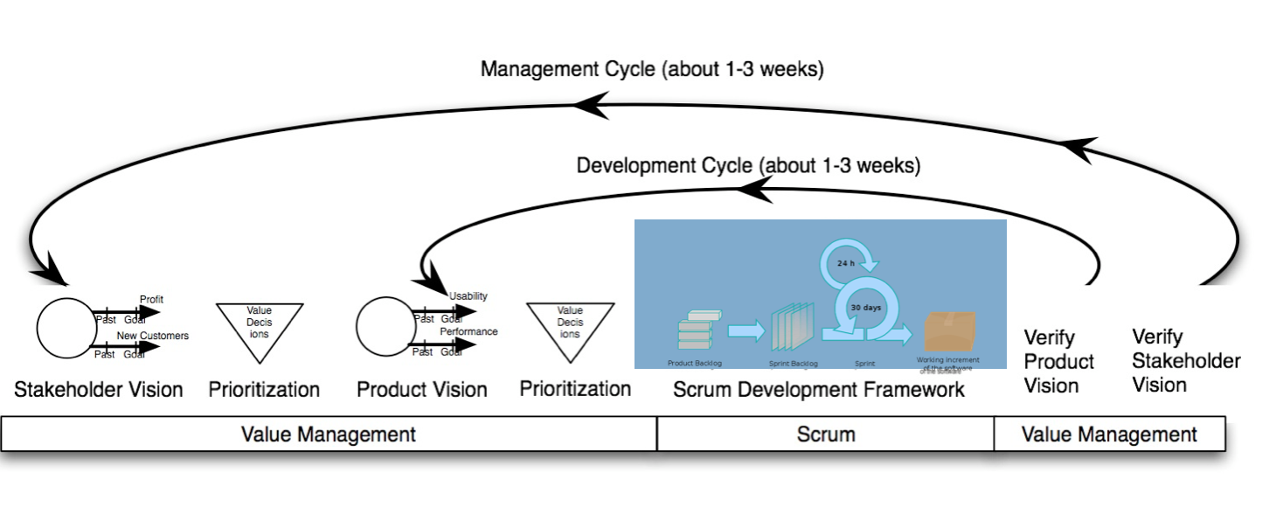
From the measurements,
and
other feedback
from stakeholders
Learn what you need to do
to avoid failure
and to succeed
Learn
Stakeholders
Measure
Values
Deliver
Solutions
Develop
Decompose
These 2 diagrams are © kai@Gilb.com
2012-18, as well as several other illustrations
used in this talk

Slide 48
Business Analyst
Learn
Stakeholders
Reality
(Business/Architecture/Engineering/Development)
Measure
Values
Value Management Learning Process
Architecture /
Engineering
Deliver
Solutions
Evo Development / Scrum
Develop
Decompose
© Kai@Gilb.com
© 2008 Kai Gilb

Slide 49
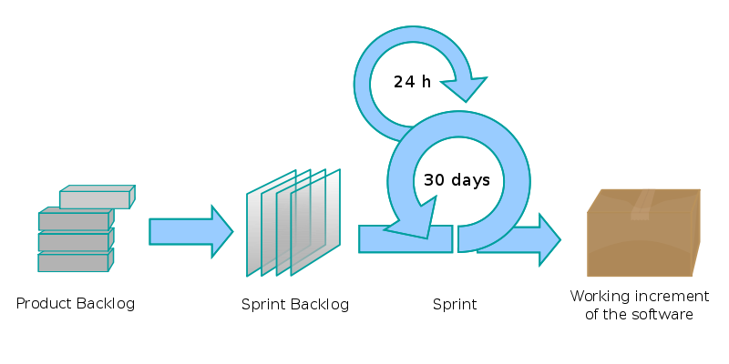
We need to add: ‘Value Management’:
Quantified, Engineering, Not just ‘coding’
ADD
ADD
Copyright: Kai@Gilb.com
23
Notes:
From Kai Gilb
Bring Case (gilb.com)
www.gilb.com/tiki-download_file.php?fileId=277

Slide 50
Did you know that perfect agile project management was achieved decades ago?

Slide 51
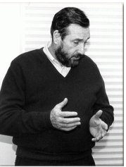
‘Cleanroom Method’
at IBM Federal Systems Division (1980)
Dr. Harlan D. Mills
(May 14, 1919 – January 8, 1996)
Copyright Tom@Gilb.com 2018
Notes:
Mills, H. 1980. The management of software engineering: part 1: principles of software engineering. IBM Systems Journal 19, issue 4 (Dec.):414-420.
http://trace.tennessee.edu/utk_harlan/18/
Mills, Harlan D.; Dyer, M.; and Linger, R. C., "Cleanroom Software Engineering" (1987). The Harlan D. Mills Collection. http://trace.tennessee.edu/utk_harlan/18
Photo
race.tennessee.edu/utk_harlan/?utm_source=trace.tennessee.edu%2Futk_harlan%2F18&utm_medium=PDF&utm_campaign=PDFCoverPages
http://trace.tennessee.edu/cgi/viewcontent.cgi?article=1017&context=utk_harlan
http://trace.tennesssee.edu/cgi/view?article=1004&content=utk_harlan
Harlan D. Mills (May 14, 1919 – January 8, 1996) was Professor of Computer Science at the Florida Institute of Technology and founder of Software Engineering Technology, Inc. of Vero Beach, Florida (since acquired by Q-Labs). Mills' contributions to software engineering have had a profound and enduring effect on education and industrial practice. Since earning his Ph.D. in Mathematics at Iowa State University in 1952, Mills led a distinguished career.
As an IBM research fellow, Mills adapted existing ideas from engineering and computer science to software development. These included automata theory, the structured programming theory of Edsger Dijkstra, Robert W. Floyd, and others, and Markov chain-driven software testing. His Cleanroom software development process emphasized top-down design and formal specification. Mills contributed his ideas to the profession in six books and over fifty refereed articles in technical journals.
Dr. Mills was termed a "super-programmer", a term which would evolve to the concept in IBM of a "Chief Programmer."

Slide 52
quality is designed in, not tested in
“The first guarantee of quality in design is in well-informed, well-educated, and well-motivated designers.
Quality must be built into designs, and cannot be inspected in or tested in.
Nevertheless, any prudent development process verifies quality through inspection and testing.
Inspection by peers in design, by users or surrogates, by other financial specialists concerned with cost, reliability, or maintainability not only increases confidence in the design at hand, but also provides designers with valuable lessons and insights to be applied to future designs.
The very fact that designs face inspections motivates even the most conscientious designers to greater care, deeper simplicities, and more precision in their work.” Harlan Mills, IBM
inIBM sj 4 80 p.419
In
Mills, H. 1980. The management of software engineering: part 1: principles of software engineering. IBM Systems Journal 19, issue 4 (Dec.):414-420.
Direct Copy
http://trace.tennessee.edu/cgi/viewcontent.cgi?article=1004&context=utk_harlan
Library header
http://trace.tennessee.edu/utk_harlan/5/

Slide 53
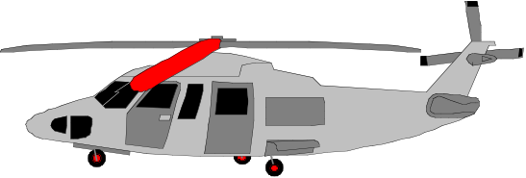
In the Cleanroom Method, developed by IBM’s Harlan Mills (1980) they reported:
“Software Engineering began to emerge in FSD” (IBM Federal Systems Division, from 1996 a part of Lockheed Martin Marietta) “some ten years ago [Ed. about 1970] in a continuing evolution that is still underway:
Ten years ago general management expected the worst from software projects – cost overruns, late deliveries, unreliable and incomplete software
Today [Ed. 1980!], management has learned to expect on-time, within budget, deliveries of high-quality software. A Navy helicopter ship system, called LAMPS, provides a recent example. LAMPS software was a four-year project of over 200 person-years of effort, developing over three million, and integrating over seven million words of program and data for eight different processors distributed between a helicopter and a ship in 45 incremental deliveries [Ed. Note 2%!]s. Every one of those deliveries was on time and under budget
A more extended example can be found in the NASA space program,
- Where in the past ten years, FSD has managed some 7,000 person-years of software development, developing and integrating over a hundred million bytes of program and data for ground and space processors in over a dozen projects.
- There were few late or overrun deliveries in that decade, and none at all in the past four years.”
© Gilb.com 2018
Notes:
A time or cost estimate, once it becomes a deadline or a budget respectively, is a ‘limited resource’. One of the smartest ways to deal with limited resources is intelligent prioritization (Gilb and Maier 2005). Instead of implementing all your designs in a ‘big bang’ manner, and hoping to meet all the requirements and resource (time and cost) estimates, we suggest you deliver the project value a little bit at a time, and see how each of the designs actually works, and what they each actually cost. ‘A little bit at a time’ should be interpreted as delivering evolutionary steps of approximately 2% of the overall project timescales (say weekly, fortnightly or monthly cycles), and hopefully about 2% of the project financial budget.
Planguage’s impact estimation (IE) method (Gilb 1988; Gilb 2005) is helpful in identifying the designs that give the estimated best stakeholder value for their costs. We implement designs incrementally so that we can get acceptable feedback on costs, and value delivery (in terms of meeting requirements). With a bit of luck, stakeholders then receive interesting value very early, and what works and what doesn’t is learned in practice. If a deadline is hit, or if the budget runs out (possibly because of a deadline being moved up earlier or a budget cut!), then at least there is still a complete live real system with delivered high-value. In such situations, the whole concept of the project-level estimates, the deadlines and the budgets is not so important any more.
Nobody does it better! Harlan Mills told me that they had to solve the persistent problem of cost overruns, in relation to the contracted estimates, because the government was getting smarter, and using fixed-price contracts (as opposed to cost plus). If the project ran over, IBM lost its own profit. If IBM did not find a better way, they could just as well leave the business (Personal Communication).
Notice the “45 deliveries” Mills cites. That means 2% delivery cycles. IBM was using intelligent feedback and learning. They actually had very sophisticated estimation technology based on a thorough collection of experiences (Walston and Felix 1977). But this did not give them the accuracy they needed to avoid losing money. Lets us say they had a 40% profit margin, and they could be wrong by 40% to 200% (The NASA range, see earlier Figure 3). They would still lose money on most contracts. So, they had to compensate for their estimation inaccuracy by incremental feedback, and necessary change, to come in ‘on time and under budget every time’. Mills’ colleague, Quinnan describes their process of intelligent dynamic prioritization in detail in (Mills 1980 in IBM SJ 4-1980).
A thorough explanation of systems development processes helping achieve intelligent prioritization is found in (Gilb 2005). See also Figure 9. Nothing less will suffice for large and complex systems (that is, for project involving hundreds of staff, years of effort, and sometimes $100 million or more in cost). For smaller systems (small teams over a few months), several organizations have made good simple practical adaptations (Upadhyayula 2001 (Study of Evo at HP in 1990s); Johansen and Gilb 2005) of the essential ‘Evo’ development process ideas (Evo itself predating later ‘Agile’ methods)[Denning 2010, p.129] & [Gilb 2010c].
The agile community has adopted small iterative cycles (Gilb 2010c), but they have failed to adopt the notion of measurement of value and quality – which is essential for larger projects, and some smaller ones. Without explicit absolute quality requirement and design impact metrics, the value prioritization is ambiguous and too subjective (Gilb 2010c; Gilb and Brodie 2010).

Slide 54
In the Cleanroom Method, developed by IBM’s Harlan Mills (1980) they reported:
“Software Engineering began to emerge in FSD” (IBM Federal Systems Division, from 1996 a part of Lockheed Martin Marietta) “some ten years ago [Ed. about 1970] in a continuing evolution that is still underway:
Ten years ago general management expected the worst from software projects – cost overruns, late deliveries, unreliable and incomplete software
Today [Ed. 1980!], management has learned to expect on-time, within budget, deliveries of high-quality software. A Navy helicopter ship system, called LAMPS, provides a recent example. LAMPS software was a four-year project of over 200 person-years of effort, developing over three million, and integrating over seven million words of program and data for eight different processors distributed between a helicopter and a ship in 45 incremental deliveries [Ed. Note 2%!]s. Every one of those deliveries was on time and under budget
A more extended example can be found in the NASA space program,
- Where in the past ten years, FSD has managed some 7,000 person-years of software development, developing and integrating over a hundred million bytes of program and data for ground and space processors in over a dozen projects.
- There were few late or overrun deliveries in that decade, and none at all in the past four years.”
in 45 incremental deliveries
were few late or overrun deliveries in that decade, and none at all in the past four years
Notes:
A time or cost estimate, once it becomes a deadline or a budget respectively, is a ‘limited resource’. One of the smartest ways to deal with limited resources is intelligent prioritization (Gilb and Maier 2005). Instead of implementing all your designs in a ‘big bang’ manner, and hoping to meet all the requirements and resource (time and cost) estimates, we suggest you deliver the project value a little bit at a time, and see how each of the designs actually works, and what they each actually cost. ‘A little bit at a time’ should be interpreted as delivering evolutionary steps of approximately 2% of the overall project timescales (say weekly, fortnightly or monthly cycles), and hopefully about 2% of the project financial budget.
Planguage’s impact estimation (IE) method (Gilb 1988; Gilb 2005) is helpful in identifying the designs that give the estimated best stakeholder value for their costs. We implement designs incrementally so that we can get acceptable feedback on costs, and value delivery (in terms of meeting requirements). With a bit of luck, stakeholders then receive interesting value very early, and what works and what doesn’t is learned in practice. If a deadline is hit, or if the budget runs out (possibly because of a deadline being moved up earlier or a budget cut!), then at least there is still a complete live real system with delivered high-value. In such situations, the whole concept of the project-level estimates, the deadlines and the budgets is not so important any more.
Nobody does it better! Harlan Mills told me that they had to solve the persistent problem of cost overruns, in relation to the contracted estimates, because the government was getting smarter, and using fixed-price contracts (as opposed to cost plus). If the project ran over, IBM lost its own profit. If IBM did not find a better way, they could just as well leave the business (Personal Communication).
Notice the “45 deliveries” Mills cites. That means 2% delivery cycles. IBM was using intelligent feedback and learning. They actually had very sophisticated estimation technology based on a thorough collection of experiences (Walston and Felix 1977). But this did not give them the accuracy they needed to avoid losing money. Lets us say they had a 40% profit margin, and they could be wrong by 40% to 200% (The NASA range, see earlier Figure 3). They would still lose money on most contracts. So, they had to compensate for their estimation inaccuracy by incremental feedback, and necessary change, to come in ‘on time and under budget every time’. Mills’ colleague, Quinnan describes their process of intelligent dynamic prioritization in detail in (Mills 1980 in IBM SJ 4-1980).
A thorough explanation of systems development processes helping achieve intelligent prioritization is found in (Gilb 2005). See also Figure 9. Nothing less will suffice for large and complex systems (that is, for project involving hundreds of staff, years of effort, and sometimes $100 million or more in cost). For smaller systems (small teams over a few months), several organizations have made good simple practical adaptations (Upadhyayula 2001 (Study of Evo at HP in 1990s); Johansen and Gilb 2005) of the essential ‘Evo’ development process ideas (Evo itself predating later ‘Agile’ methods)[Denning 2010, p.129] & [Gilb 2010c].
The agile community has adopted small iterative cycles (Gilb 2010c), but they have failed to adopt the notion of measurement of value and quality – which is essential for larger projects, and some smaller ones. Without explicit absolute quality requirement and design impact metrics, the value prioritization is ambiguous and too subjective (Gilb 2010c; Gilb and Brodie 2010).

Slide 55
Mills on ‘Design to Cost’
“To meet cost/schedule commitments based on imperfect estimation techniques, a software engineering manager must adopt a manage-and-design-to-cost/schedule process.
That process requires a continuous and relentless rectification of design objectives with the cost/schedule needed to achieve those objectives.”
in IBM System Journal, No. 4 1980 p.420, see Links below
Mills, H. 1980. The management of software engineering: part 1: principles of software engineering. IBM Systems Journal 19, issue 4 (Dec.):414-420.
Direct Copy
http://trace.tennessee.edu/cgi/viewcontent.cgi?article=1004&context=utk_harlan
Library header
http://trace.tennessee.edu/utk_harlan/5/
Notes:
in IBM sj 4 80 p.420
In
Mills, H. 1980. The management of software engineering: part 1: principles of software engineering. IBM Systems Journal 19, issue 4 (Dec.):414-420.
Direct Copy
http://trace.tennessee.edu/cgi/viewcontent.cgi?article=1004&context=utk_harlan
Library header
http://trace.tennessee.edu/utk_harlan/5/

Slide 56
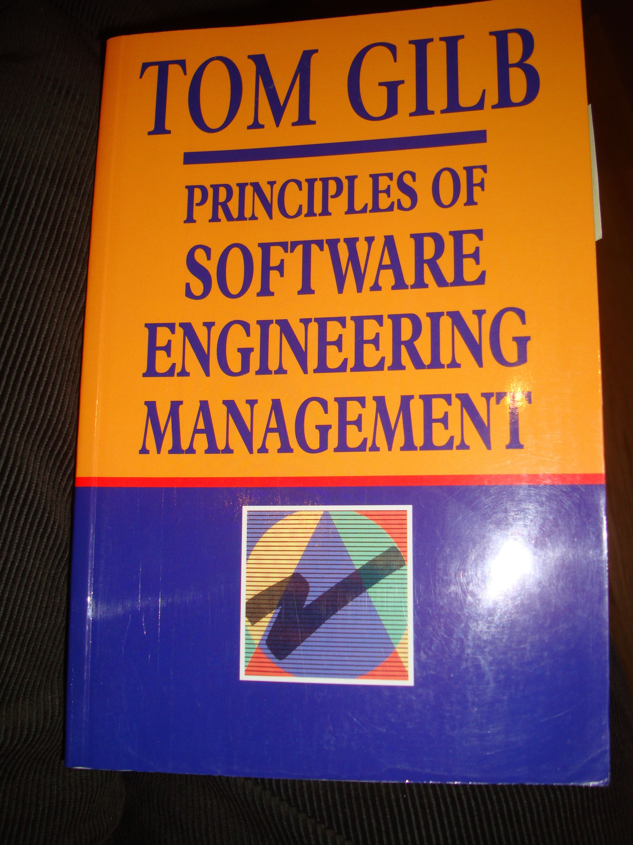
Robert E. Quinnan (-2015):
IBM FSD Cleanroom Dynamic Design to Cost
Quinnan describes the process control loop used by IBM FSD to ensure that cost targets are met.
'Cost management. . . yields valid cost plans linked to technical performance. Our practice carries cost management farther by introducing design-to-cost guidance. Design, development, and managerial practices are applied in an integrated way to ensure that software technical management is consistent with cost management. The method [illustrated in this book by Figure 7.10] consists of developing a design, estimating its cost, and ensuring that the design is cost-effective.' (p. 473)
He goes on to describe a design iteration process trying to meet cost targets by either redesign or by sacrificing 'planned capability.' When a satisfactory design at cost target is achieved for a single increment, the 'development of each increment can proceed concurrently with the program design of the others.'
'Design is an iterative process in which each design level is a refinement of the previous level.' (p. 474)
It is clear from this that they avoid the big bang cost estimation approach. Not only do they iterate in seeking the appropriate balance between cost and design for a single increment, but they iterate through a series of increments, thus reducing the complexity of the task, and increasing the probability of learning from experience, won as each increment develops, and as the true cost of the increment becomes a fact.
'When the development and test of an increment are complete, an estimate to complete the remaining increments is computed.' (p. 474)
Source: Robert E. Quinnan, 'Software Engineering Management Practices', IBM Systems Journal, Vol. 19, No. 4, 1980, pp. 466~77
This text is cut from Gilb: The Principles of Software Engineering Management, 1988
Notes:
Slide developed Oct 6 2013 tsg for London Software Architecture Conference Talk 9 Oct 2013
15.1.18 Quinnan
Source: Robert E. Quinnan, 'Software Engineering Management Practices', IBM Systems Journal, Vol. 19, No. 4, 1980, pp. 466~77
Robert E. Quinnan: The Management of Software Engineering. Part V: Software Engineering Management Practices. IBM Systems Journal 19(4): 466-477 (1980)
Quinnan describes the process control loop used by IBM FSD to ensure that cost targets are met.
'Cost management. . . yields valid cost plans linked to technical performance. Our practice carries cost management farther by introducing design-to-cost guidance. Design, development, and managerial practices are applied in an integrated way to ensure that software technical management is consistent with cost management. The method [illustrated in this book by Figure 7.10] consists of developing a design, estimating its cost, and ensuring that the design is cost-effective.' (p. 473)
He goes on to describe a design iteration process trying to meet cost targets by either redesign or by sacrificing 'planned capability.' When a satisfactory design at cost target is achieved for a single increment, the 'development of each increment can proceed concurrently with the program design of the others.'
'Design is an iterative process in which each design level is a refinement of the previous level.' (p. 474)
It is clear from this that they avoid the big bang cost estimation approach. Not only do they iterate in seeking the appropriate balance between cost and design for a single increment, but they iterate through a series of increments, thus reducing the complexity of the task, and increasing the probability of learning from experience, won as each increment develops, and as the true cost of the increment becomes a fact.
'When the development and test of an increment are complete, an estimate to complete the remaining increments is computed.' (p. 474)
This article is far richer than our few selected quotations can show, with regard to concepts of cost estimation and control.

Slide 57
Quinnan: IBM FSD Cleanroom Dynamic Design to Cost
Quinnan describes the process control loop used by IBM FSD to ensure that cost targets are met.
'Cost management. . . yields valid cost plans linked to technical performance. Our practice carries cost management farther by introducing design-to-cost guidance. Design, development, and managerial practices are applied in an integrated way to ensure that software technical management is consistent with cost management. The method [illustrated in this book by Figure 7.10] consists of developing a design, estimating its cost, and ensuring that the design is cost-effective.' (p. 473)
He goes on to describe a design iteration process trying to meet cost targets by either redesign or by sacrificing 'planned capability.' When a satisfactory design at cost target is achieved for a single increment, the 'development of each increment can proceed concurrently with the program design of the others.'
'Design is an iterative process in which each design level is a refinement of the previous level.' (p. 474)
It is clear from this that they avoid the big bang cost estimation approach. Not only do they iterate in seeking the appropriate balance between cost and design for a single increment, but they iterate through a series of increments, thus reducing the complexity of the task, and increasing the probability of learning from experience, won as each increment develops, and as the true cost of the increment becomes a fact.
'When the development and test of an increment are complete, an estimate to complete the remaining increments is computed.' (p. 474)
Source: Robert E. Quinnan, 'Software Engineering Management Practices', IBM Systems Journal, Vol. 19, No. 4, 1980, pp. 466~77
This text is cut from Gilb: The Principles of Software Engineering Management, 1988
of developing a design, estimating its cost, and ensuring that the design is cost-effective
Notes:
Slide developed Oct 6 2013 tsg for London Software Architecture Conference Talk 9 Oct 2013
15.1.18 Quinnan
Source: Robert E. Quinnan, 'Software Engineering Management Practices', IBM Systems Journal, Vol. 19, No. 4, 1980, pp. 466~77
Robert E. Quinnan: The Management of Software Engineering. Part V: Software Engineering Management Practices. IBM Systems Journal 19(4): 466-477 (1980)
Quinnan describes the process control loop used by IBM FSD to ensure that cost targets are met.
'Cost management. . . yields valid cost plans linked to technical performance. Our practice carries cost management farther by introducing design-to-cost guidance. Design, development, and managerial practices are applied in an integrated way to ensure that software technical management is consistent with cost management. The method [illustrated in this book by Figure 7.10] consists of developing a design, estimating its cost, and ensuring that the design is cost-effective.' (p. 473)
He goes on to describe a design iteration process trying to meet cost targets by either redesign or by sacrificing 'planned capability.' When a satisfactory design at cost target is achieved for a single increment, the 'development of each increment can proceed concurrently with the program design of the others.'
'Design is an iterative process in which each design level is a refinement of the previous level.' (p. 474)
It is clear from this that they avoid the big bang cost estimation approach. Not only do they iterate in seeking the appropriate balance between cost and design for a single increment, but they iterate through a series of increments, thus reducing the complexity of the task, and increasing the probability of learning from experience, won as each increment develops, and as the true cost of the increment becomes a fact.
'When the development and test of an increment are complete, an estimate to complete the remaining increments is computed.' (p. 474)
This article is far richer than our few selected quotations can show, with regard to concepts of cost estimation and control.

Slide 58
Quinnan: IBM FSD Cleanroom Dynamic Design to Cost
Quinnan describes the process control loop used by IBM FSD to ensure that cost targets are met.
'Cost management. . . yields valid cost plans linked to technical performance. Our practice carries cost management farther by introducing design-to-cost guidance. Design, development, and managerial practices are applied in an integrated way to ensure that software technical management is consistent with cost management. The method [illustrated in this book by Figure 7.10] consists of developing a design, estimating its cost, and ensuring that the design is cost-effective.' (p. 473)
He goes on to describe a design iteration process trying to meet cost targets by either redesign or by sacrificing 'planned capability.' When a satisfactory design at cost target is achieved for a single increment, the 'development of each increment can proceed concurrently with the program design of the others.'
'Design is an iterative process in which each design level is a refinement of the previous level.' (p. 474)
It is clear from this that they avoid the big bang cost estimation approach. Not only do they iterate in seeking the appropriate balance between cost and design for a single increment, but they iterate through a series of increments, thus reducing the complexity of the task, and increasing the probability of learning from experience, won as each increment develops, and as the true cost of the increment becomes a fact.
'When the development and test of an increment are complete, an estimate to complete the remaining increments is computed.' (p. 474)
Source: Robert E. Quinnan, 'Software Engineering Management Practices', IBM Systems Journal, Vol. 19, No. 4, 1980, pp. 466~77
This text is cut from Gilb: The Principles of Software Engineering Management, 1988
iteration process trying to meet cost targets by either redesign or by sacrificing 'planned capability’
Notes:
Slide developed Oct 6 2013 tsg for London Software Architecture Conference Talk 9 Oct 2013
15.1.18 Quinnan
Source: Robert E. Quinnan, 'Software Engineering Management Practices', IBM Systems Journal, Vol. 19, No. 4, 1980, pp. 466~77
Robert E. Quinnan: The Management of Software Engineering. Part V: Software Engineering Management Practices. IBM Systems Journal 19(4): 466-477 (1980)
Quinnan describes the process control loop used by IBM FSD to ensure that cost targets are met.
'Cost management. . . yields valid cost plans linked to technical performance. Our practice carries cost management farther by introducing design-to-cost guidance. Design, development, and managerial practices are applied in an integrated way to ensure that software technical management is consistent with cost management. The method [illustrated in this book by Figure 7.10] consists of developing a design, estimating its cost, and ensuring that the design is cost-effective.' (p. 473)
He goes on to describe a design iteration process trying to meet cost targets by either redesign or by sacrificing 'planned capability.' When a satisfactory design at cost target is achieved for a single increment, the 'development of each increment can proceed concurrently with the program design of the others.'
'Design is an iterative process in which each design level is a refinement of the previous level.' (p. 474)
It is clear from this that they avoid the big bang cost estimation approach. Not only do they iterate in seeking the appropriate balance between cost and design for a single increment, but they iterate through a series of increments, thus reducing the complexity of the task, and increasing the probability of learning from experience, won as each increment develops, and as the true cost of the increment becomes a fact.
'When the development and test of an increment are complete, an estimate to complete the remaining increments is computed.' (p. 474)
This article is far richer than our few selected quotations can show, with regard to concepts of cost estimation and control.

Slide 59
Quinnan: IBM FSD Cleanroom Dynamic Design to Cost
Design is an iterative process
Quinnan describes the process control loop used by IBM FSD to ensure that cost targets are met.
'Cost management. . . yields valid cost plans linked to technical performance. Our practice carries cost management farther by introducing design-to-cost guidance. Design, development, and managerial practices are applied in an integrated way to ensure that software technical management is consistent with cost management. The method [illustrated in this book by Figure 7.10] consists of developing a design, estimating its cost, and ensuring that the design is cost-effective.' (p. 473)
He goes on to describe a design iteration process trying to meet cost targets by either redesign or by sacrificing 'planned capability.' When a satisfactory design at cost target is achieved for a single increment, the 'development of each increment can proceed concurrently with the program design of the others.'
'Design is an iterative process in which each design level is a refinement of the previous level.' (p. 474)
It is clear from this that they avoid the big bang cost estimation approach. Not only do they iterate in seeking the appropriate balance between cost and design for a single increment, but they iterate through a series of increments, thus reducing the complexity of the task, and increasing the probability of learning from experience, won as each increment develops, and as the true cost of the increment becomes a fact.
'When the development and test of an increment are complete, an estimate to complete the remaining increments is computed.' (p. 474)
Source: Robert E. Quinnan, 'Software Engineering Management Practices', IBM Systems Journal, Vol. 19, No. 4, 1980, pp. 466~77
This text is cut from Gilb: The Principles of Software Engineering Management, 1988
Notes:
Slide developed Oct 6 2013 tsg for London Software Architecture Conference Talk 9 Oct 2013
15.1.18 Quinnan
Source: Robert E. Quinnan, 'Software Engineering Management Practices', IBM Systems Journal, Vol. 19, No. 4, 1980, pp. 466~77
Robert E. Quinnan: The Management of Software Engineering. Part V: Software Engineering Management Practices. IBM Systems Journal 19(4): 466-477 (1980)
Quinnan describes the process control loop used by IBM FSD to ensure that cost targets are met.
'Cost management. . . yields valid cost plans linked to technical performance. Our practice carries cost management farther by introducing design-to-cost guidance. Design, development, and managerial practices are applied in an integrated way to ensure that software technical management is consistent with cost management. The method [illustrated in this book by Figure 7.10] consists of developing a design, estimating its cost, and ensuring that the design is cost-effective.' (p. 473)
He goes on to describe a design iteration process trying to meet cost targets by either redesign or by sacrificing 'planned capability.' When a satisfactory design at cost target is achieved for a single increment, the 'development of each increment can proceed concurrently with the program design of the others.'
'Design is an iterative process in which each design level is a refinement of the previous level.' (p. 474)
It is clear from this that they avoid the big bang cost estimation approach. Not only do they iterate in seeking the appropriate balance between cost and design for a single increment, but they iterate through a series of increments, thus reducing the complexity of the task, and increasing the probability of learning from experience, won as each increment develops, and as the true cost of the increment becomes a fact.
'When the development and test of an increment are complete, an estimate to complete the remaining increments is computed.' (p. 474)
This article is far richer than our few selected quotations can show, with regard to concepts of cost estimation and control.

Slide 60
Quinnan: IBM FSD Cleanroom Dynamic Design to Cost
Quinnan describes the process control loop used by IBM FSD to ensure that cost targets are met.
'Cost management. . . yields valid cost plans linked to technical performance. Our practice carries cost management farther by introducing design-to-cost guidance. Design, development, and managerial practices are applied in an integrated way to ensure that software technical management is consistent with cost management. The method [illustrated in this book by Figure 7.10] consists of developing a design, estimating its cost, and ensuring that the design is cost-effective.' (p. 473)
He goes on to describe a design iteration process trying to meet cost targets by either redesign or by sacrificing 'planned capability.' When a satisfactory design at cost target is achieved for a single increment, the 'development of each increment can proceed concurrently with the program design of the others.'
'Design is an iterative process in which each design level is a refinement of the previous level.' (p. 474)
It is clear from this that they avoid the big bang cost estimation approach. Not only do they iterate in seeking the appropriate balance between cost and design for a single increment, but they iterate through a series of increments, thus reducing the complexity of the task, and increasing the probability of learning from experience, won as each increment develops, and as the true cost of the increment becomes a fact.
'When the development and test of an increment are complete, an estimate to complete the remaining increments is computed.' (p. 474)
Source: Robert E. Quinnan, 'Software Engineering Management Practices', IBM Systems Journal, Vol. 19, No. 4, 1980, pp. 466~77
This text is cut from Gilb: The Principles of Software Engineering Management, 1988
but they iterate through a series of increments,
thus reducing the complexity of the task,
and increasing the probability of learning from experience
Notes:
Slide developed Oct 6 2013 tsg for London Software Architecture Conference Talk 9 Oct 2013
15.1.18 Quinnan
Source: Robert E. Quinnan, 'Software Engineering Management Practices', IBM Systems Journal, Vol. 19, No. 4, 1980, pp. 466~77
Robert E. Quinnan: The Management of Software Engineering. Part V: Software Engineering Management Practices. IBM Systems Journal 19(4): 466-477 (1980)
Quinnan describes the process control loop used by IBM FSD to ensure that cost targets are met.
'Cost management. . . yields valid cost plans linked to technical performance. Our practice carries cost management farther by introducing design-to-cost guidance. Design, development, and managerial practices are applied in an integrated way to ensure that software technical management is consistent with cost management. The method [illustrated in this book by Figure 7.10] consists of developing a design, estimating its cost, and ensuring that the design is cost-effective.' (p. 473)
He goes on to describe a design iteration process trying to meet cost targets by either redesign or by sacrificing 'planned capability.' When a satisfactory design at cost target is achieved for a single increment, the 'development of each increment can proceed concurrently with the program design of the others.'
'Design is an iterative process in which each design level is a refinement of the previous level.' (p. 474)
It is clear from this that they avoid the big bang cost estimation approach. Not only do they iterate in seeking the appropriate balance between cost and design for a single increment, but they iterate through a series of increments, thus reducing the complexity of the task, and increasing the probability of learning from experience, won as each increment develops, and as the true cost of the increment becomes a fact.
'When the development and test of an increment are complete, an estimate to complete the remaining increments is computed.' (p. 474)
This article is far richer than our few selected quotations can show, with regard to concepts of cost estimation and control.

Slide 61
Quinnan: IBM FSD Cleanroom Dynamic Design to Cost
Quinnan describes the process control loop used by IBM FSD to ensure that cost targets are met.
'Cost management. . . yields valid cost plans linked to technical performance. Our practice carries cost management farther by introducing design-to-cost guidance. Design, development, and managerial practices are applied in an integrated way to ensure that software technical management is consistent with cost management. The method [illustrated in this book by Figure 7.10] consists of developing a design, estimating its cost, and ensuring that the design is cost-effective.' (p. 473)
He goes on to describe a design iteration process trying to meet cost targets by either redesign or by sacrificing 'planned capability.' When a satisfactory design at cost target is achieved for a single increment, the 'development of each increment can proceed concurrently with the program design of the others.'
'Design is an iterative process in which each design level is a refinement of the previous level.' (p. 474)
It is clear from this that they avoid the big bang cost estimation approach. Not only do they iterate in seeking the appropriate balance between cost and design for a single increment, but they iterate through a series of increments, thus reducing the complexity of the task, and increasing the probability of learning from experience, won as each increment develops, and as the true cost of the increment becomes a fact.
'When the development and test of an increment are complete, an estimate to complete the remaining increments is computed.' (p. 474)
Source: Robert E. Quinnan, 'Software Engineering Management Practices', IBM Systems Journal, Vol. 19, No. 4, 1980, pp. 466~77
This text is cut from Gilb: The Principles of Software Engineering Management, 1988
an estimate to complete the remaining increments is computed.
Notes:
Slide developed Oct 6 2013 tsg for London Software Architecture Conference Talk 9 Oct 2013
15.1.18 Quinnan
Source: Robert E. Quinnan, 'Software Engineering Management Practices', IBM Systems Journal, Vol. 19, No. 4, 1980, pp. 466~77
Robert E. Quinnan: The Management of Software Engineering. Part V: Software Engineering Management Practices. IBM Systems Journal 19(4): 466-477 (1980)
Quinnan describes the process control loop used by IBM FSD to ensure that cost targets are met.
'Cost management. . . yields valid cost plans linked to technical performance. Our practice carries cost management farther by introducing design-to-cost guidance. Design, development, and managerial practices are applied in an integrated way to ensure that software technical management is consistent with cost management. The method [illustrated in this book by Figure 7.10] consists of developing a design, estimating its cost, and ensuring that the design is cost-effective.' (p. 473)
He goes on to describe a design iteration process trying to meet cost targets by either redesign or by sacrificing 'planned capability.' When a satisfactory design at cost target is achieved for a single increment, the 'development of each increment can proceed concurrently with the program design of the others.'
'Design is an iterative process in which each design level is a refinement of the previous level.' (p. 474)
It is clear from this that they avoid the big bang cost estimation approach. Not only do they iterate in seeking the appropriate balance between cost and design for a single increment, but they iterate through a series of increments, thus reducing the complexity of the task, and increasing the probability of learning from experience, won as each increment develops, and as the true cost of the increment becomes a fact.
'When the development and test of an increment are complete, an estimate to complete the remaining increments is computed.' (p. 474)
This article is far richer than our few selected quotations can show, with regard to concepts of cost estimation and control.

Slide 62
So, ‘perfect software project management’
is
1. Agile 2% value delivery steps
2. Measuring results actually delivered
3. Changing the design if it does not ‘work’
(‘work’ = deliver quality in time and budget)

Slide 63
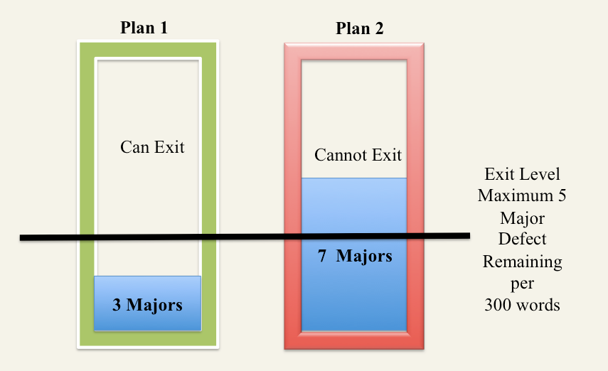
4. Measuring Development Specifications Quality: Lean Quality Assurance
Notes:
Diagram © kai@gilb.com 2017 & earlier
??

Slide 64
you can measure the quality of any customer input, like requirements
in less than a one hour meeting

Slide 65
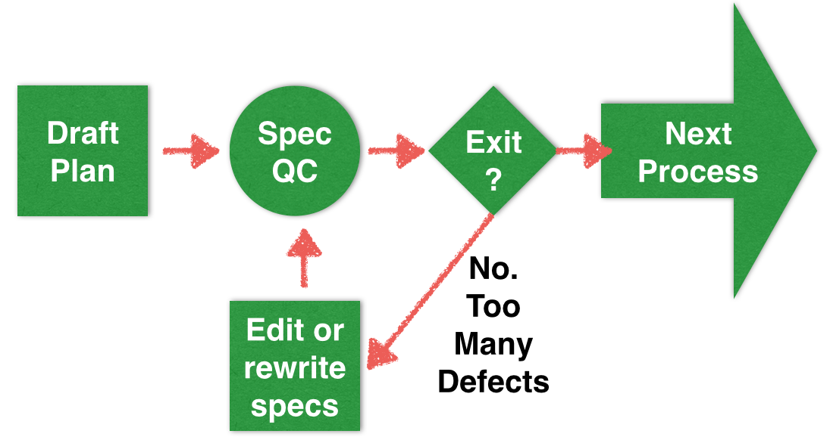
The Agile Specification Quality Control process
for lean (early, prevents defect injection) measurement of quality of requirements,
architecture specs, and contracts
Our IT planning documents are heavily polluted
with dozens of ‘major defects’ per page
we need to measure defects by sampling
and we need to refuse to ‘exit’ garbage out
this lean approach can improve productivity 2x and 3x (Intel)

Slide 66
How much practical
proof of your capability
as a consultant
can you squeeze into
a 1 hour meeting?

Slide 67
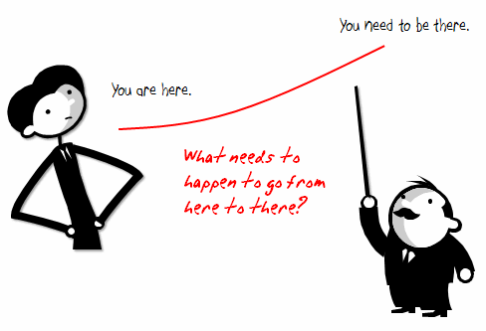
WHY are we doing this? Part of Platform Rationalisation Initiative, with below Main Objectives.
• Rationalize into a smaller number of core processing platforms. This cuts technology spend on duplicate platforms, and creates the opportunity for operational saves. Expected 60%-80% reduction in processing cost to Fixed Income Business levies.
• International Securities on one platform, Fixed Income and Equities (Institutional and PB).
• Global Processing consistency with single Operations In-Tray and associated workflow.
• Consistent financial processing on one Accounting engine, feeding a single sub-ledger across products.
• First step towards evolution of “Big Ideas” for Securities.
• Improved development environment, leading to increased capacity to enhance functionality in future.
• Removes duplicative spend on two back office platforms in support of mandatory message changes, etc.
www.Gilb.com
Notes:
http://www.articulate.com/rapid-elearning/wp-content/uploads/2008/11/here2there.gif

Slide 68
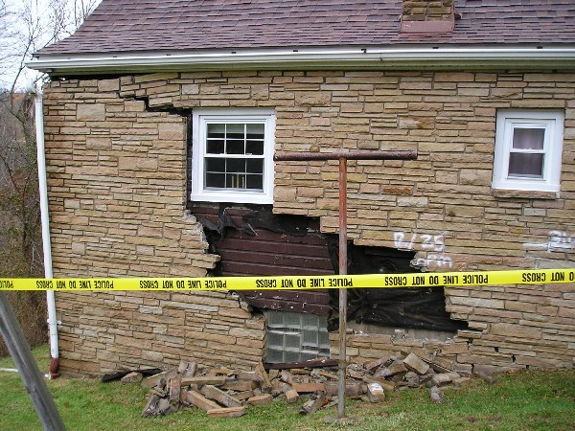
QC Rules for Top Level Objectives
CLEAR: Every word and phrase should be clear enough to allow objective test of a delivery. (we need to know exactly what is required and expected)
UNAMBIGUOUS: Every word and phrase should be unambiguous to all potential intended readers. (no different than intended interpretations should be possible)
QUANTIFIED QUALITY: all qualities (good things we want to improve) shall be expressed quantitatively.
After we started the exercise I regretted not adding the usual rule:
4. NO DESIGN: objectives shall not be expressed in terms of a design or architecture
(a ‘means’ to reach the ‘real’ objective), when it is possible and is our real intent, to express the improvements in terms of quality, performance, and cost that are expected, instead.
Potential consequence
of major defects
in architecture specs
www.Gilb.com

Slide 69
COUNT MAJOR ‘DEFECTS’ (RULES VIOLATIONS) Rules Reminder: 1. Clear, 2. Unambiguous, 3. Quantified Qualities, 4. No Design/Architecture
• “Rationalize into a smaller number of core processing platforms. This cuts technology spend on duplicate platforms, and creates the opportunity for operational saves. Expected 60%-80% reduction in processing cost to Fixed Income Business lines.
• International Securities on one platform, Fixed Income and Equities (Institutional and PB).
• Global Processing consistency with single Operations In-Tray and associated workflow.
• Consistent financial processing on one Accounting engine, feeding a single sub-ledger across products.
• First step towards evolution of “Big Ideas” for Securities.
• Improved development environment, leading to increased capacity to enhance functionality in future.
• Removes duplicative spend on two back office platforms in support of mandatory message changes, etc.”
www.Gilb.com
Notes:
http://www.ealing-surveyor.co.uk/images/subsidence.jpg

Slide 70
LINK WORDS: OBJECTIVE:ARCHITECTURE RULE 4. No Design/Architecture
• Rationalize into a smaller number of core processing platforms. This cuts technology spend on duplicate platforms, and creates the opportunity for operational saves. Expected 60%-80% reduction in processing cost to Fixed Income Business lines.
• International Securities on one platform, Fixed Income and Equities (Institutional and PB).
• Global Processing consistency with single Operations In-Tray and associated workflow.
• Consistent financial processing on one Accounting engine, feeding a single sub-ledger across products.
• First step towards evolution of “Big Ideas” for Securities.
• Improved development environment, leading to increased capacity to enhance functionality in future.
• Removes duplicative spend on two back office platforms in support of mandatory message changes, etc.
www.Gilb.com
Notes:
http://www.umaine.edu/link/Images/chain.jpg

Slide 71
Agile Spec QC Results
Estimated appx. Total defects found by a small team (3 people) = 42±6
2x highest found. 2 X 21 = 42
Estimated appx. Total Majors in the 110 words = about 120
(3x group total. 33% effectiveness of team)
Estimated approximate total defects in normalized page (300 words) = 360±36
Maximum we should allow about 10
as achieved at Citigroup
down from 82/Page 6 months earlier
so this is a ridiculous, bad result: Project threatening
and the boss agreed, and drew that conclusion himself
Reported major defects =
WITH BANK PROGRAMME DIRECTOR
15, 17, 21
www.Gilb.com

Slide 72
so I had 20 minutes left of my meeting with the boss
and he said
“What can we do in practice?”
I said “choose a small part of the requirements”
he chose
“Improved Development Capacity”
so for the last 20 minutes
with their help
I clarified and quantified the requirement
like this…

Slide 73
How can we improve such bad specification? (‘Planguage’)
Development Capacity:
Version: 3 Sept 2009 16:26
Type: Main <Complex/Elementary> Objective for a project.
Ambition Level: radically increase the capacity for developers to do defined tasks. <- Tsg
Scale: the Calendar Time for defined [Developers] to Successfully carry out defined [Tasks].
Owner: Tim Fxxx
Calendar Time: defined as: full working days within the start to delivery time frame.
Past [ 2009, {Bxx, Lxx, Gxx}, If QA Approved Processes used, Developer = Architect, Task = Draft Architecture ] 15 days ±4 ?? <- Rob
Goal[ 2011, { Bxx, Lxx, Gxx }, If QA Approved Processes used, Developer = Architect, Task = Draft Architecture ] 1.5 days ± 0.4 ?? <- Rob
Justification: Really good architects are very scarce so we need to optimize their use.
Risks: we use effort that should be directed to really high volume or even more critical areas (like Main Objective).
www.Gilb.com
Notes:
http://www.photographyblogcentral.com/wp-content/uploads/2009/07/Sandsont-brick-house.jpg

Slide 74
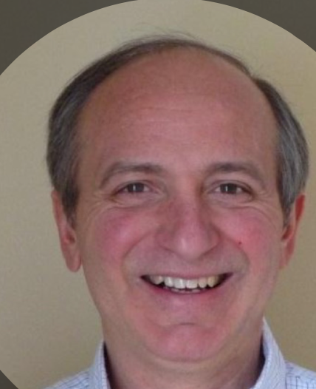
50x Higher quality at Intel
Terzakis
Source Eric Simmons, erik.simmons@construx.com
See Terzakis research reports.
Application of ‘Specification Quality Control’ and ‘Planguage requirements (Gilb methods) by an Intel software team, resulted in the following defect-density reduction, in requirements over several months:
Rev. | # of Defects | # of Pages | Defects/ Page (DPP) | % Change in DPP
0.3 | 312 | 31 | 10.06
0.5 | 209 | 44 | 4.75 | -53%
0.6 | 247 | 60 | 4.12 | -13%
0.7 | 114 | 33 | 3.45 | -16%
0.8 | 45 | 38 | 1.18 | -66%
1.0 | 10 | 45 | 0.22 | -81%
Overall % change in DPP revision 0.3 to 1.0: |  |  |  | -98%
Downstream benefits:
Scope delivered at the Alpha milestone increased 300%, released scope up 233%
SW defects reduced by ~50%
Defects that did occur were resolved in far less time on average
Notes:
These slides contributed as non confidential experience, by Eric Simmons, hoofdwerk@gmail.com for my Construx Summit lecture 25 Oct 2011 Seattle
This incident was from Summer 2011 (3 months earlier than Oct)
see also Terzakis papers Rio 2013
J. Terzakis,
"The impact of requirements on software quality across three product generations,"
2013 21st IEEE International Requirements Engineering Conference (RE), Rio de Janeiro, 2013, pp. 284-289.
https://www.thinkmind.org/download.php?articleid=iccgi_2013_3_10_10012
This link gives Terzakis full Rio 2013 paper (Gilb annotated) and slides.
https://www.dropbox.com/sh/cs9hke3uvgg4gp3/AACadHeI95lZpHzVqGKXSXDra?dl=0
Gilbs Dropbox (let me know if link broken ) Tested July 2017

Slide 75
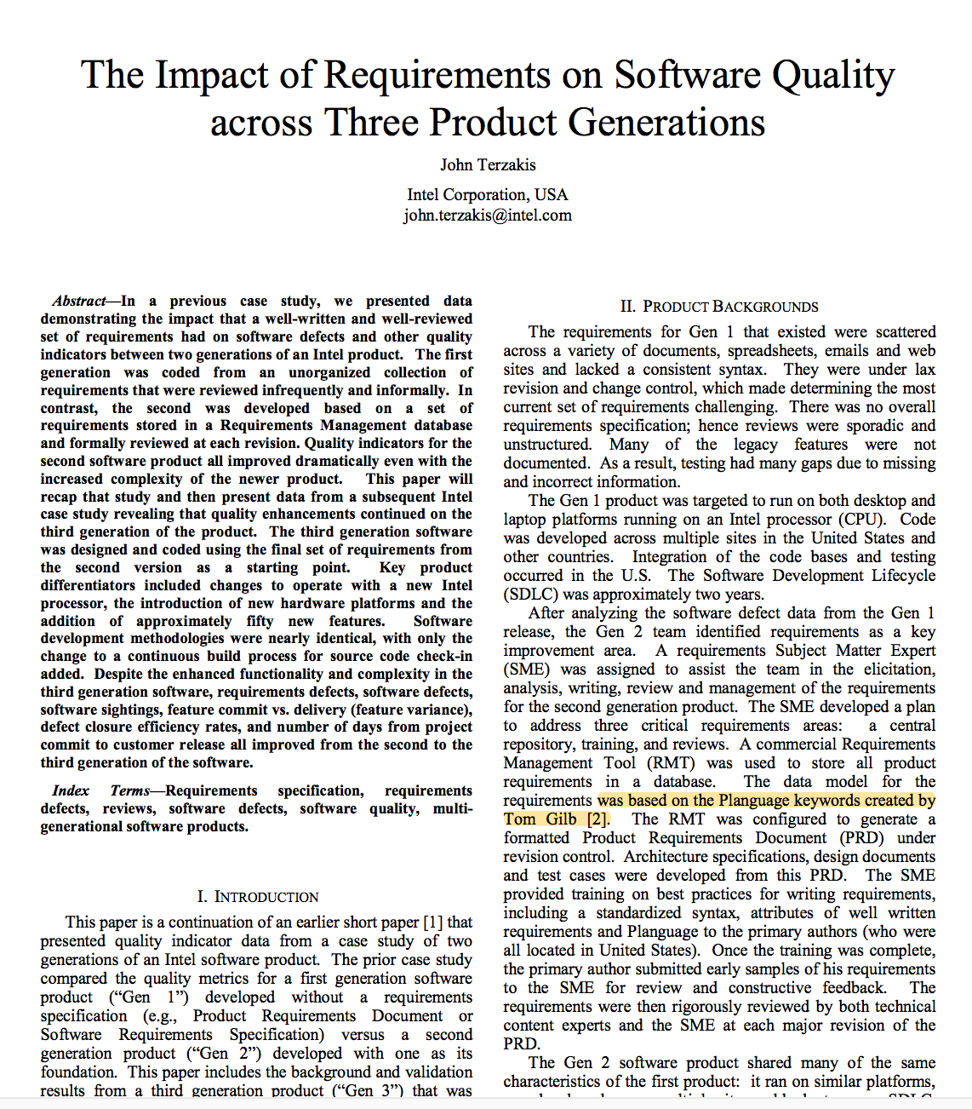
Industrial Studies of Planguage and SQC to measure quality of requirements
2013 Rio Paper
https://www.thinkmind.org/download.php?articleid=iccgi_2013_3_10_10012
Notes:
J. Terzakis,
"The impact of requirements on software quality across three product generations,"
2013 21st IEEE International Requirements Engineering Conference (RE), Rio de Janeiro, 2013, pp. 284-289.
https://www.thinkmind.org/download.php?articleid=iccgi_2013_3_10_10012

Slide 76
12 Tough questions:© Tom Gilb
http://www.gilb.com/DL24
1. Numbers Why isn’t the improvement quantified? 2. Risk What is the degree of risk or uncertainty, and why? 3. Doubt Are you sure? If not, why not? 4. Source Where did you get that information? How can I check it out? 5. Impact How does your idea effect my goals and budgets, measurably? 6. All critical factors Did we forget anything critical to survival?
7. Evidence How do you know it works that way? Did it ‘ever’? 8. Enough Have we got a complete solution? Are all requirements satisfied? 9. Profitability first Are we planning to do the ‘profitable things’ first? 10. Commitment Who is responsible for failure, or success? 11. Proof How can we be sure the plan is working, during the project, early? 12. No cure, no pay Is it ‘no cure, no pay’ in a contract? Why not?
see also 20 Tough Questions 2016
http://concepts.gilb.com/dl876
© www.gilb.com
Notes:
© Tom Gilb
A full paper on this is available at www.Gilb.com
http://www.gilb.com/DL24
These are also cited in Competitive Engineering book
see also 20 Tough Questions 2016
http://concepts.gilb.com/dl876

Slide 77
So, what are my main messages to you?
You can expand your current use of metrics to include QUALITY, and VALUE metrics
Quantification of values is useful, even without measurement. Quantification itself is useful for clearer communication about critical objectives
Estimation of ‘multiple critical impacts' of any design/architecture/strategy, is useful for intelligent prioritization of value delivery, and for considering risks
You can manage costs and deadlines by agile feedback and correction; the ‘dynamic design to cost’ process
We can and should measure the quality of upstream planning, and code, specs, in order to motivate people, to follow high standards of specification, and to avoid downstream bugs and delays
Get a free e-copy
of ‘Competitive Engineering’ book.
https://www.gilb.com/p/competitive-engineering
50% off VP Book
https://goo.gl/XGMgwg
Code: WS50

