Slide 1
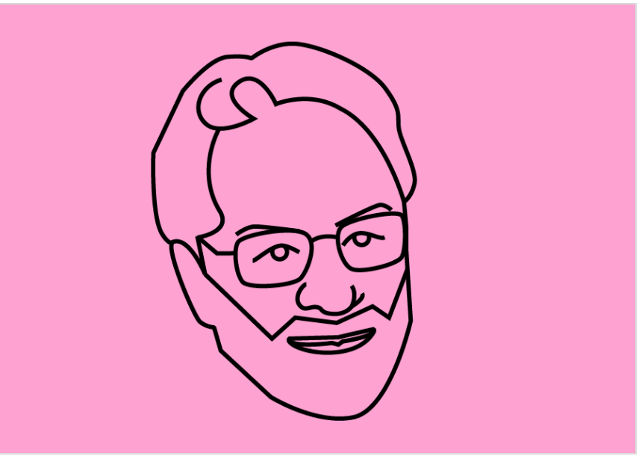
"A Bill of Rights for Testers “
Closing Keynote: by Tom Gilb
tom@Gilb.com
www.Gilb.com
@ImTomGilb
60 minutes
TestCon, Vilnius, Thursday 18 Oct. 2017, 16:30 to 17:30
© www.Gilb.com

Slide 2
Talk Outline:
Testers should not be debuggers
Testers should not get bad work dumped on them.
Even if you don’t believe we should be kind to testers; the entire project will take less time, and have more quality, if we do not mistreat the test function.
We must not make testers the scapegoat for our upstream bad development processes.
To clarify this position I offer a
–Testers Bill of Rights.
Derived from my Company Communication Bill of Rights, page 23, Principles of Software Engineering Management, 1988. Developed for CEO Wilmott, ICL, UK, 1982
© www.Gilb.com
Notes:
ICL CASE Study from (International Computers Limited)
Interesting Top Mgt. Consulting Experience
BCS June 12 Lecture 2015
Slides
http://www.gilb.com/dl846

Slide 3
Testers Bill of Rights:
1. Testers have the right to sample their process inputs, and reject poor quality work (no entry).
2.
3.
Testers have the right to unambiguous and clear requirements. Testers have the right to test evolutionarily; early as the
system increments.
Testers have the right to integrate their test specifications into the other technical specifications.
Testers have the right to be a party to setting the quality levels they will test to.
Testers have the right to adequate resources to do their job professionally.
7.
8.
Testers have the right to an even workload, and to have a life. Testers have the right to specify the consequences of products
that they have not been allowed to test properly.
Testers have the right to review any specifications that might impact their work.
Testers have the right to focus on testing of agreed quality products, and to send poor work back to the source.
© www.Gilb.com

Slide 5
Why should testers have any rights?
Main Argument:
–Because it will reduce total costs, time and increase quality at the same time.
Real Reason (hidden agenda):
–To make other project members do their own work properly in the first place.
Altruistic Reason:
to make their workday more meaningful,
and to show them some due respect.
© www.Gilb.com

Slide 6
What are testers
going to do with their ‘rights’?
Use them to negotiate service agreements with the rest of the project
Use them to train testers in rational expectations
Use them to set their own test process entry and exit standards
Use them to enhance their own defined processes
Use them as a starting argument;
– when they are ‘mistreated’ by other project members
© www.Gilb.com

Slide 7
Tester Objectives
To determine that a software product actually meets all formal requirements.
To determine that a software product does not have unexpected or dangerous behavior
To provide data to allow release determination
© www.Gilb.com

Slide 8
Not Tester Objectives
To debug
To deal with poor requirements
–Guessing their intent
© www.Gilb.com

Slide 9
1. Testers have the right to sample their process inputs, and reject poor quality work (‘no entry’ to test planning).
Requirements need to have an agreed standard of less than 1 Major defects per page
Typical requirements today have 50 to 300 Majors per page
–(a major defect can lead to wrong test)
It takes about 15-30 minutes to take a 1 page sample and check it according to standards
–Like ‘unambiguous’, ‘clear enough to test’.
If 1 or more defects are found - that work should be rejected as substandard
–Useful to have agreed Entry levels in advance
–The argument is that total cost is less, if requirements are clean.
© www.Gilb.com

Slide 10
“Rules”:
Best Practice Strong Advice
Three simple rules for inspecting a requirements document:
Three Rules for Requirements:
1. Unambiguous to intended Readership
Including test planners
2. Clear enough to test.
3. No Design specs (= ‘how to- be good’) mixed in
Mixed up in the Requirements
(Reqts. = ‘how good - to be’) not how to be good!
MARK Design as “D”
Except if it is a conscious Design Constraint (which is a requirement type)
© www.Gilb.com

Slide 11
Report for sample page 82
(reported inspection results on requirements document, 4 other managers)
Total Majors
Defects, alone
•
M+m M Design
---------------------------
41, 24, D=1
33, 15, D=5
44, 30, D=10
24, 3, D=5
Team would log unique Majors; about 2x30 = 60
– total unique majors for the group
Which is about 30% of total actually in document, so total this page is about 180 Majors (about 120 not identified yet)
If we attempt to fix the 60 we log, and correctly fix 5/6, then 10 are failed fixes, so:
The total remaining after inspection and editing = 10+120 =130 Majors per page.
© www.Gilb.com

Slide 12
Extrapolation to
Total Majors in Whole Document
Page 81: 120 majors/p
Page 82: 180 Majors/p
Average 150 Majors/page x 82 page = 12,300 Majors in the document.
-----------------
If a Major has 1/3 chance of causing loss
And each loss is average 10 hours then total project Rework cost is about 41,000 hours loss.
(This project was over a year late)
– 1 year = 2,000 hour 10 people
© www.Gilb.com

Slide 13
Notes:
Source Erik Simmons slides 2011 21st Century Requirements Engineering.
I got these from Erik June 2014 they are in my files

Slide 14
Let me translate this, Intel Experience with my methods, for testers
0.2 Majors/page (maximum)
Compared to the 100 M/P you currently suffer
Means 500 times fewer major defects to work with
It means 170 times fewer bugs to contend with than you probably have today
Did you notice the productivity went up by factor 2.3 to 3x at Intel?
There were 50% fewer bugs than Intel had, before they used my methods
This means that correct writing of test cases will be that much better
And that wasted test execution and rework is that much better
J. Terzakis,
"The impact of requirements on software quality across three product generations,"
2013 21st IEEE International Requirements Engineering Conference (RE), Rio de Janeiro, 2013, pp. 284-289.
https://www.thinkmind.org/download.php?articleid=iccgi_2013_3_10_10012

Slide 15
2. Testers have the right to unambiguous and clear requirements.
It is the job of requirements writers to write perfectly clear requirements
It is NOT the job of the testers to ‘guess’ what an unclear requirement intends to say
If requirements are poor, the tester needs to hand them back immediately for quality controlled rewrite (not guess or ask).
If the requirement is not good enough for the tester, it is not good enough for any other purpose on the project (like estimating, design)
If there is a systemic problem with bad requirements, then test management must work towards systemic improvement (standards and Quality Control).
© www.Gilb.com

Slide 16
Is this good enough to test for the Usability sub-quality ‘Intelligibility’ for a spy plane?
“High ability for an operator to correctly interpret the meaning of given information.”
How would you test this?
© www.Gilb.com

Slide 17
A clear real specification in ‘Planguage’
Usability.Intelligibility:
Ambition: High ability for an operator to <correctly> interpret the meaning of given information.
Scale: Percentage Probability of <objectively correct> interpretation(s) of a defined [Set of <Inputs>] by a defined [Individual Person: Default: Trained Operator] within a defined [Time Period].
Meter [Acceptance]: Use about 10 Trained Operators, and use about 100 <representative sets of information per operator within 15 minutes?> <- MAB.
Comment [Meter]: "Not sure if the 15 minutes are realistic" <- MAB. Comment [Meter]: "This is a client & contract determined detail" <- MAB.
M1: Past: [XXX, 20 Trained Operators, 300 <data sets>, 30 minutes]: 99.0% <- Acceptance Test Report from XXX, MAB.
Record [XXX]: 99.0%. "None other than XXX known by me" <- MAB.
Fail [First Delivery Step]: 99.0%? <- MAB. Fail [Acceptance]: 99.5%? <- MAB.
Goal [XXX, 20 Trained Operators, 300 <data sets>, 30 minutes] 99.9% <- LN.
========== More User Defined Terms ================
Acceptance: Defined As: Formal Acceptance Test as defined by our contract with Customer XXX.
First Delivery Step: Defined As: By end of November this year (The results of the first evolutionary result cycle will be integrated into the system and will be producing useful results).
© www.Gilb.com

Slide 18
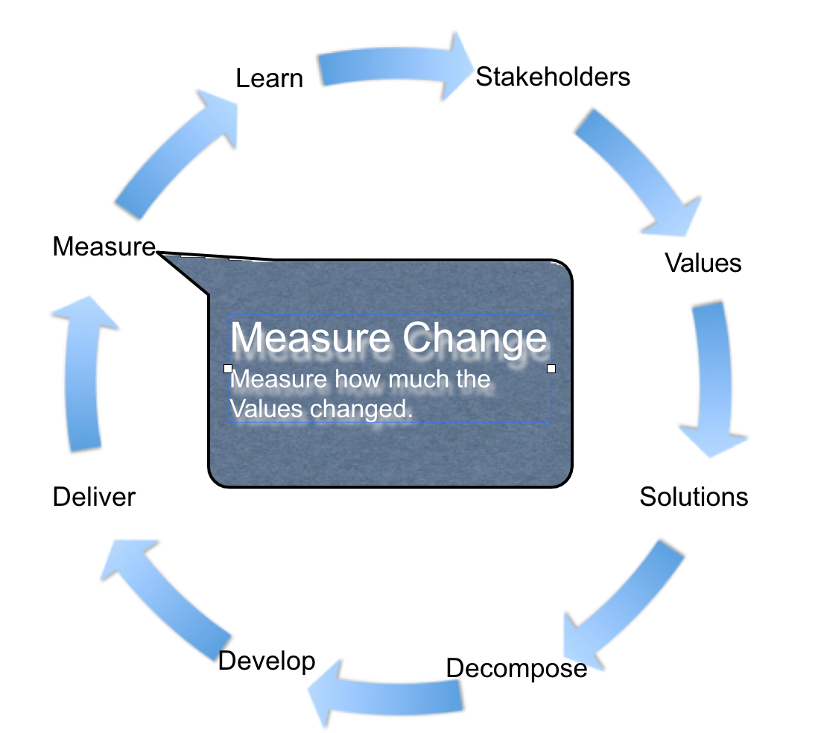
3. Testers have the right to test evolutionarily; early, as the system increments.
Testing should not be dumped on testers at the end of a (late) project
Testers should be involved in Evolutionary* (agile) integration testing early and frequently
–Like every week of the project!
–Like daily
* Evo = Test + Analyze + Change
© www.Gilb.com
Notes:
Value cycle by Kai Gilb

Slide 19
Milestone Control (Ms)
“Mike Conte, a senior program manager for Office
“We actually break our development into three separate milestones.
They might be six week milestones, [or] they might be ten-week milestones …
At the end of the milestone our goal is to get all the features for that milestone that have been implemented … for that milestone at zero bugs….
And then, when we get to the point where we get to ‘ship quality’, we can move on to the next milestone.
The point of this is that we never get so totally out of control that we’re at the end of a project and we have so many thousands of bugs that we can’t ever tell when we’re going to finish it.”
Source:Microsoft Secrets page 200
© www.Gilb.com

Slide 20
Multiple Levels of Microsoft Evo
Office 2004 Level
Vital 3rd
Vital 3rd
6->10 Weeks
6->10 Weeks
© www.Gilb.com
Home

Slide 21
2003 Report from Microsoft (Craig Larman 28 Feb 2003)
“However, MS does do more-or-less pure incremental dev, I discovered.
A typical lifecycle is a big up-front req + des step, followed by 3-4 iterations of dev, each of 3 or 4 months in length.
It is not pure incremental dev, as the later (long) iterations are not fully specified,
but it is close to pure incremental dev.”
© www.Gilb.com
Home

Slide 22
ARE DAILY BUILDS FOR WIMPS?
“Evo does relatively continuous integration, but as a communicator you should know that “continuous integration” has a relatively precise technical meaning in the software dev community these days:
it is now understood as defined in XP (http://www.martinfowler.com/articles/ continuousIntegration.html )
and then fully automated by a couple of guys at ThoughtWorks in the open source tool called CruiseControl http://cruisecontrol.sourceforge.net/
Now in software dev, it means to have a separate build machine running 24/7 with a daemon process (CruiseControl) that wakes every N minutes (usually around 15 min).
This kicks off an Ant task that queries the source control system, and if any new check-ins, then it pulls across the entire configuration to the build machine, then
1) compiles it all, 2) runs all automated unit tests, 3) creates the composite app server files, 4) bounces the app server, 5) loads the app into the server, 6) runs all automated acceptance and integration tests.
Note the elapsed time between total system integration is usually in the 5-15 min range, making it much more “continuous.”
So, now the software dev community has a saying: “Daily builds are for wimps.” ;) meaning daily is not nearly frequent enough.
If at any point, there is failure, CruiseControl automatically sends email to the new code contributors informing them of failure. Then it updates the continuous integration web page with the build time, results, and contributor names.”
CRAIGLARMAN.COM 14 MARCH 2003
© www.Gilb.com
Home

Slide 23
Continuous Integration with Cruise Control or Anthill
CruiseControl or Anthill: Free OSS CI tools
martinfowler.com/articles/continuousIntegration.html
<<JVM process>>
:BuildStatusWebServer
:SCMServer
:BuildServer
<<JVM process>>
:CruiseControl
<<JVM process>>
:UnitTester
<<JVM process>>
:AppServer
Developer
Developer
© www.Gilb.com
Home

Slide 24
4. Testers have the right to integrate their test specifications
into the other technical specifications.
So that the right hand knows what the left one is doing - in spite of the change process
Specifically, we need to be able to put test info in requirements and design specifications
At least as a detailed cross reference
For each individual requirement and design
Why?
To sense absence of test planning for some specs
To sense need of change in test plans when reviewing changes in specs
To give testers constant access to all upstream detail and change
So the right hand knows what the left one is doing
© www.Gilb.com

Slide 25
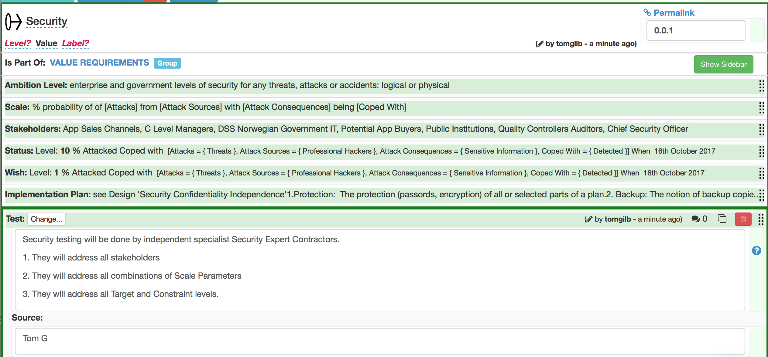
EXAMPLE OF INTEGRATION OF TEST SPECS IN REQUIREMENTS

Slide 26
Integration of Test Planning:
A simple quality requirement
without integration of test information
Availability:
Version: December 24th 2017.
Scale: % uptime.
Goal [Initial Delivery, Pilots] 99%
Goal [Major Customers,Contracted] 99.9%
© www.Gilb.com

Slide 27
Integration of Test Planning specs
(can you see the problem now?)
Availability:
Version: December 24th 2017.
Scale: % uptime.
Meter: built-in software log computes and reports availability.
Test Plan: Test Plan [Availability, June 7 2018].
Test Cases: Test Scripts [Availability, Oct.8 2018].
Goal [Initial Delivery, Pilots] 99%.
Goal [Major Customers,Contracted] 99.9%.
© www.Gilb.com
Home

Slide 28
5. Testers have the right to be a party to setting the quality levels they will test to.
The depth of testing determines the resources needed to do the job.
Test cannot have a level of testing imposed on it when it is not given adequate people, time and machine resources to do the job properly
Testers are the experts on these costs, and on the levels of testing we can get, for our resources
So - testers must be a party to the decisions about resources needed for certain levels of quality of testing - under defined conditions
Like high quality requirements as input.
Test also has to shout loudly when
planned resources are not available
Defined conditions are not true (bad requirements etc.)
© www.Gilb.com

Slide 29
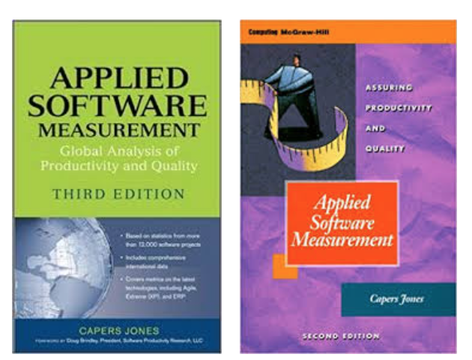
HOW QUALITY Upstream AFFECTS SOFTWARE COSTS
Pathological
Technical debt
COST
Healthy
Poor quality is cheaper until
the end of the coding phase.
After that, high quality is
cheaper.
TIME
Notes:
SOURCE SLIDES: SOFTWARE QUALITY IN 2014:
A SURVEY OF THE STATE OF THE ART
Capers Jones, VP and CTO
FILE NAME JONES SQA2014.KEY
Web: www.Namcook.com
Blogs: http://Namcookanalytics.com
Email: Capers.Jones3@GMAILcom

Slide 30
DEFECTS AND SOFTWARE METHODOLGOIES
(Data Expressed in Terms of Defects per Function Point
For projects nominally 10,000 function points in size)
Defect Removal Delivered
Software methods Potential Effectiveness Defects
Waterfall 7.00 75% 1.75
Iterative 6.25 82% 1.13
Object-Oriented 5.75 85% 0.86
Agile with scrum 5.50 87% 0.72
Rational Unified Process (RUP) 5.50 90% 0.55
PSP and TSP 5.00 94% 0.30
Model-based 4.00 96% 0.15
85% Certified reuse 2.25 96% 0.09
Notes:
SOURCE SLIDES: SOFTWARE QUALITY IN 2014:
A SURVEY OF THE STATE OF THE ART
Capers Jones, VP and CTO
FILE NAME JONES SQA2014.KEY
Web: www.Namcook.com
Blogs: http://Namcookanalytics.com
Email: Capers.Jones3@GMAILcom

Slide 31
RANGES OF DEFECT REMOVAL Effectiveness
Lowest Median Highest
1 Requirements review (informal) 20% 30% 50%
2 Top-level design reviews (informal) 30% 40% 60%
3 Detailed functional design inspection 30% 65% 85%
4 Detailed logic design inspection 35% 65% 75%
5 Code inspection or static analysis 35% 60% 90%
6 Unit tests 10% 25% 50%
7 New Function tests 20% 35% 65%
8 Integration tests 25% 45% 60%
9 System test 25% 50% 65%
10 External Beta tests 15% 40% 75%
CUMULATIVE EFFICIENCY 75% 98% 99.99%
Notes:
SOURCE SLIDES: SOFTWARE QUALITY IN 2014:
A SURVEY OF THE STATE OF THE ART
Capers Jones, VP and CTO
FILE NAME JONES SQA2014.KEY
Web: www.Namcook.com
Blogs: http://Namcookanalytics.com
Email: Capers.Jones3@GMAILcom

Slide 32
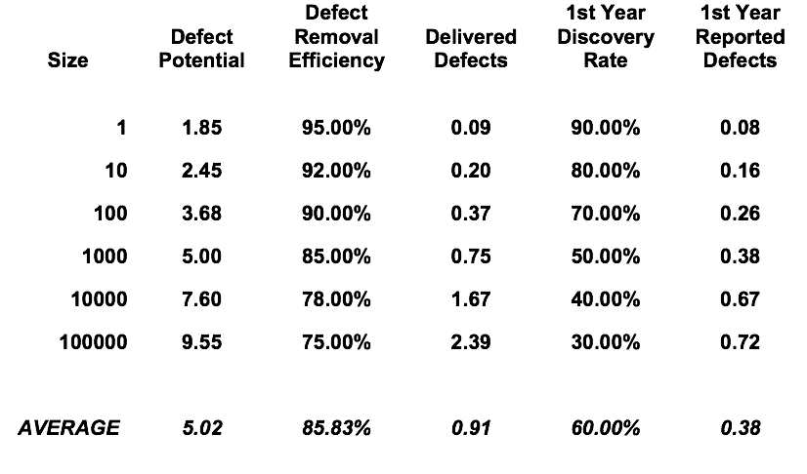
SOFTWARE SIZE VS DEFECT REMOVAL Effectiveness
(Data Expressed in terms of Defects per Function Point)
Notes:
SOURCE SLIDES: SOFTWARE QUALITY IN 2014:
A SURVEY OF THE STATE OF THE ART
Capers Jones, VP and CTO
FILE NAME JONES SQA2014.KEY
Web: www.Namcook.com
Blogs: http://Namcookanalytics.com
Email: Capers.Jones3@GMAILcom

Slide 33
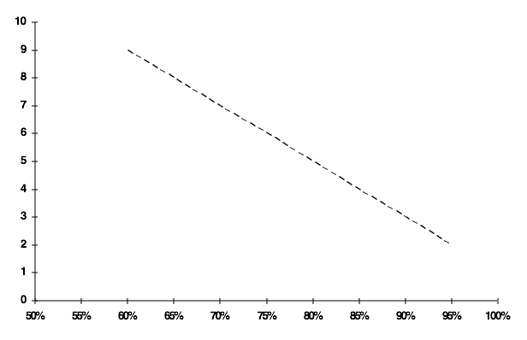
SOFTWARE QUALITY IMPROVEMENT
Defects per FP
.
Bungled outsource contracts
Malpractice
Programmed stock trade software
Local taxes, property assessments
Billing and retail
.
ERP packages
Energy
Manufacturing
U.S. Average
Open-source
Finance
Large outsource
Commercial
.
Systems
Embedded
Telecom
Medical
Best in Class
Avionics
Weapons systems
Defect Removal Efficiency
Notes:
SOURCE SLIDES: SOFTWARE QUALITY IN 2014:
A SURVEY OF THE STATE OF THE ART
Capers Jones, VP and CTO
FILE NAME JONES SQA2014.KEY
Web: www.Namcook.com
Blogs: http://Namcookanalytics.com
Email: Capers.Jones3@GMAILcom

Slide 34
CONCLUSIONS ON SOFTWARE QUALITY (CAPERS JONES)
No single quality method is adequate by itself.
Formal inspections, static analysis, models are effective
Inspections + static analysis + testing > 99% efficient.
Defect prevention + removal best overall
QFD, models, inspections, & six-sigma prevent defects
Higher CMMI levels, TSP, RUP, Agile, XP are effective
Quality excellence has ROI > $15 for each $1 spent
High quality benefits schedules, productivity, users
Notes:
SOURCE SLIDES: SOFTWARE QUALITY IN 2014:
A SURVEY OF THE STATE OF THE ART
Capers Jones, VP and CTO
FILE NAME JONES SQA2014.KEY
Web: www.Namcook.com
Blogs: http://Namcookanalytics.com
Email: Capers.Jones3@GMAILcom

Slide 35
Setting the acceptable levels
Entry Condition to Test Planning
– “Requirements will not exceed 1 major defect per page (300 NC Words) when sampled.”
© www.Gilb.com

Slide 36
6. Testers have the right to adequate resources to do their job professionally.
It is the responsibility of the test group to know what resources are in fact needed to do their work to an agreed standard.
–Give project management a menu - with prices
It their right to point out the limitations and risks that apply if they are forced to live with less than adequate resources
–And make sure the resource providers, not test, take responsibility for the problems that might occur.
© www.Gilb.com

Slide 37
100%
Don’t compromise on resources to do the job right Make resource suppliers aware that they can only get what they are willing to pay for.
Quality of
Test
Resources for Test
¥
0
© www.Gilb.com

Slide 38
7. Testers have the right to an even workload, and to have a life.
It is unnecessary and unfair to get the delayed work of other developers, before a fixed deadline - and then get unreasonable pressure to finish on time
The solution is organizational. The development and test process must be EVOLUTIONARY (weekly increments)
–Test and iterative integration is an early and frequent process.
–Probably daily, weekly increments throughout the project
© www.Gilb.com

Slide 39
Iterative Development
User test
Determine adjustments and
new functionality
Retest adjustments
Implement adjustments and
new functionality
Adjust
if required by integration
Source: Dutch Army Case NATO Evo Conf Bonn Sept. 2002
Integration test
© www.Gilb.com

Slide 40
The Unified Software Development Process/ RUP SE
Inception
Elaboration
Construction
Transition
Business Modeling
Requirements
Analysis and Design
Implementation
Test
Deployment
Config. & Change Management
Project Management
Environment
Organization along Content
Source:
P. Kruchten, The Rational Unified Process , Addison-Wesley, Reading, MA, 1998.
preliminary iteration
iter. iter. iter. iter. iter. #1 #2 #n #n+1 #n+2
iter. #m
iter. #m+1
Organization along Time
© www.Gilb.com
Home

Slide 41
8. Testers have the right to specify the consequences, of products that they have
not been allowed to test properly.
Testers in fact have a professional obligation to send clear early written warning signals to project management about consequences.
–For example:
bug rate predictions at customer sites, if released now
Load of work at help desks
Load of work doing bug fixing and regression testing
All consequent problems fleshed out - with concrete suggestion about what to do in practice about it.
© www.Gilb.com

Slide 42
Projections Based on Experience Models: Radice.
Release 2
Release 3
Case Study Release
25
20
15
10
5
0
I1
I2 UT
FVT
I0
ST
Misc
FFV
B/R
CT
http://www.gilb.com/DL240
© www.Gilb.com

Slide 43
25
20
15
10
5
0
Release 2
Release 3
Case Study Release
Real Example Projection
(Ron Radice: IBM)
FFV
I0
I1 I2 UT FVT
B/R CT ST
Misc
“Since our objective was to get the overrun in defects removed as soon as possible, we began to build a case which would use a subset of the recommended 25.9 KLOC as a sample to determine the remaining error density.
Based on where the product was at this point in the test cycle, we had projected a remaining defect volume of 24/KLOC.
This is to say that there was a latency of this amount in the product.
We now needed to prove that this projection was credible.
We argued that if the sample re-inspection would find ten errors per KLOC against the projected 24, the effectiveness would be 41% or about what it apparently was for the primary Inspections in this release.
If we would find 12, it would be 50% effective.
If it would find 16, it would be 67% effective, which was the best this product had historically been able to show.
We, of course, had no way to pre-determine the effectiveness of these re- inspections.
An effectiveness higher than 41% would be suspect, however, without reasons to demonstrate it should be higher. “
http://www.gilb.com/DL240
© www.Gilb.com

Slide 44
Bull AZ: Defect Removal Experience
Phase Inj Est
ASD Cumul Actual Removal Cumul Inj Est
Phase Expected Removal Cumul Expected Removal
Phase Actual Removal Cumul Inj Est 10-6
800
700
600
500
400
300
200
100
0
Defects
10-6 size re-estimate
Current
Timeline
Ana
HLD
LLD
Code Unit Int-1
Int-2
System
Beta
ES/GS
Development Phase
Source: Ed Weller: Practical Applications of Statistical Process Control
© www.Gilb.com

Slide 45
The increased cost of fixing bugs at later stages
Ed Weller: edwardfwelleriii@msn.com
https://www.stickyminds.com/article/calculating-economics-software-inspections
Notes:
https://www.stickyminds.com/article/calculating-economics-software-inspections
Figure 1. Comparative Defect Removal Costs The x-axis represents development stage of requirements, analysis, high-level design, low-level (detail) design, code, and test stages. Although it may look like a "waterfall" development representation, this representation only requires that the development activity be recognized as the "source" of the defect. There are several conclusions that can be drawn from this chart: First, the cost of defect removal without inspections can be substantial, with up to 5:1 savings in System Test compared to a 70 percent defect removal in inspections; Second, there is also a significant savings if the inspection effectiveness can be raised from 50 to 70 percent. The numbers are easier to see when the total cost is displayed cumulatively, as seen in Figure 2.

Slide 46
9. Testers have the right to content review any specifications that might impact their work.
Testers need to be in on requirements and design reviews
–Including changes to these
Testers need to be in on project budget and estimation plan reviews
Testers need to be in on the Evolutionary delivery loop so that they constantly see the stakeholder experience with what they have allowed to be released at each Evo cycle.
© www.Gilb.com

Slide 47
Testers ‘Content Review’
Combined with other reviews or against Test’s own standards
Budgets Time Plans
Require- ments
Design
OK
For Test
Review
Test Plans
Architecture
© www.Gilb.com

Slide 48
Example of Design/Architecture Content Review Standard
Design and Architecture will:
–Contain interfaces to facilitate automated testing
–Contain provision to capture system state and transactions in case of failure
–Contain annotation regarding any level of testing requirements for the design that is planned, contracted, or envisaged.
–Contain annotation regarding previously known testing degree of any component planned, in any internal or external situation.
© www.Gilb.com

Slide 49
10. Testers have the right to focus on
testing of agreed-quality products, and to send poor work back to the source.
Any work, even discovering sub-standard quality inputs to test must be charged back as a cost and delay, due to the developers who are not meeting defined exit conditions for their work
Management needs to see who is really causing the delays!
KEY TOOL IS SPEC QC + EXIT LEVEL AND + ENTRY CONDITIONS
© www.Gilb.com

Slide 50
Quality Control before Test Work
Test can’t use your requirements, they have more than 10 Major defects/page. The limit is 1.
So you are holding up testing, until you do your work to the agreed standard!
© www.Gilb.com

Slide 51
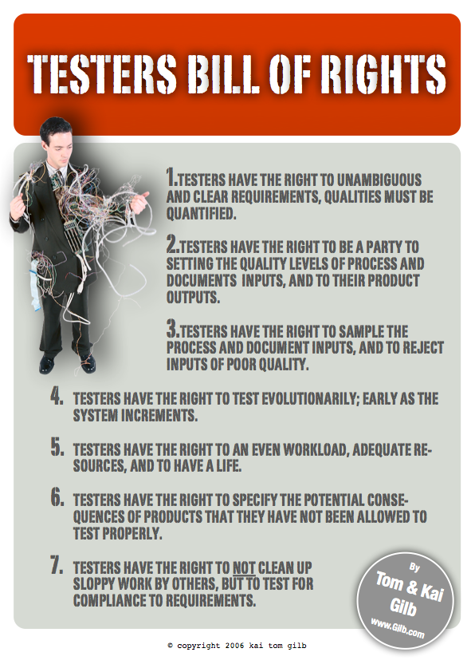

Slide 52
Last Slide
If I have forgotten some testers rights
–Remind me!
–Tom@Gilb.com
© www.Gilb.com

