Slide 1
Dynamic Architecture Prioritization in the ‘Evo’ Agile ‘Planguage’ Framework July 17 2017, 11:20 TO 12:30
‘A deep dive into advanced
architecture theory and practice’
Enterprise Architecture,
Conference, #BCSEASG
Specialist Interest Group, BCS
Tom Gilb, Hon. FBCS
Tom@Gilb.com, www.Gilb.com, @ImTomGilb
Author of ‘Competitive Engineering’, and ‘Value Planning’
Norway and London
Notes:
to do list
and finally
update at gilb.com
twitter
linked in
dropbox for conference
hashtag for conference
link to slides

Slide 2
Planguage Prioritization
Based on some examples
This is from a non-confidential BCS Student exercise June 2017.
It is not complete, and it is not up to top standard.
But, it illustrates the concepts.
The theme was Terror Prevention.

Slide 3
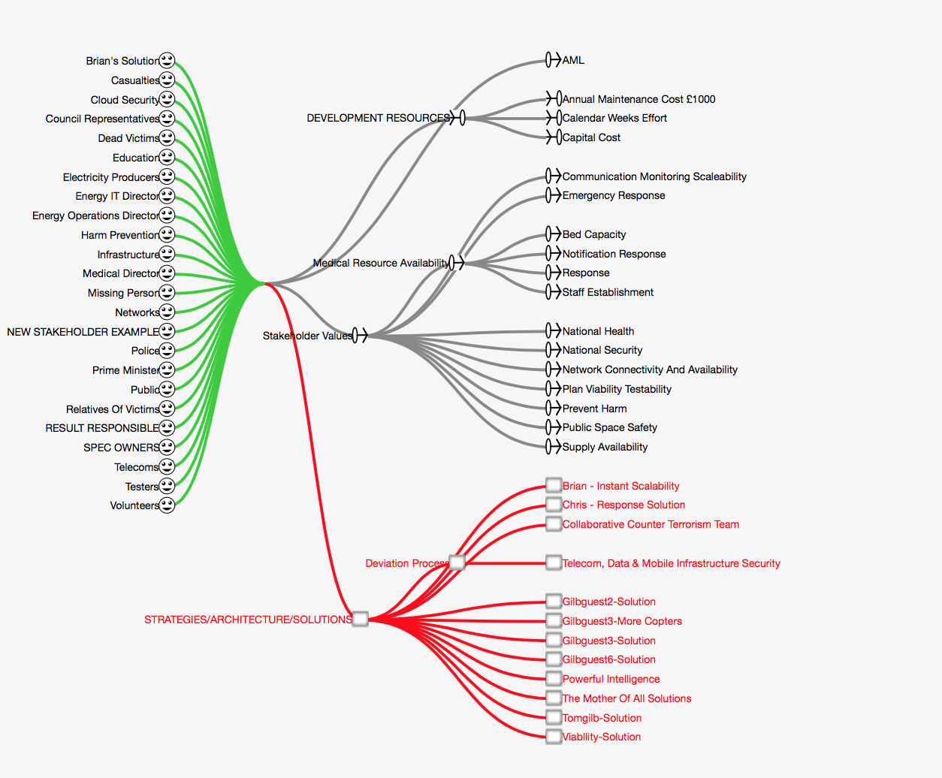
We prioritize the sets of specifications we make:
Stakeholders, Value Objectives, Solutions and Resources
Notes:
Originated July 13 2017 based on BCS Class exercise June 2017 on Terrorist Prevention Tom Gilb

Slide 4
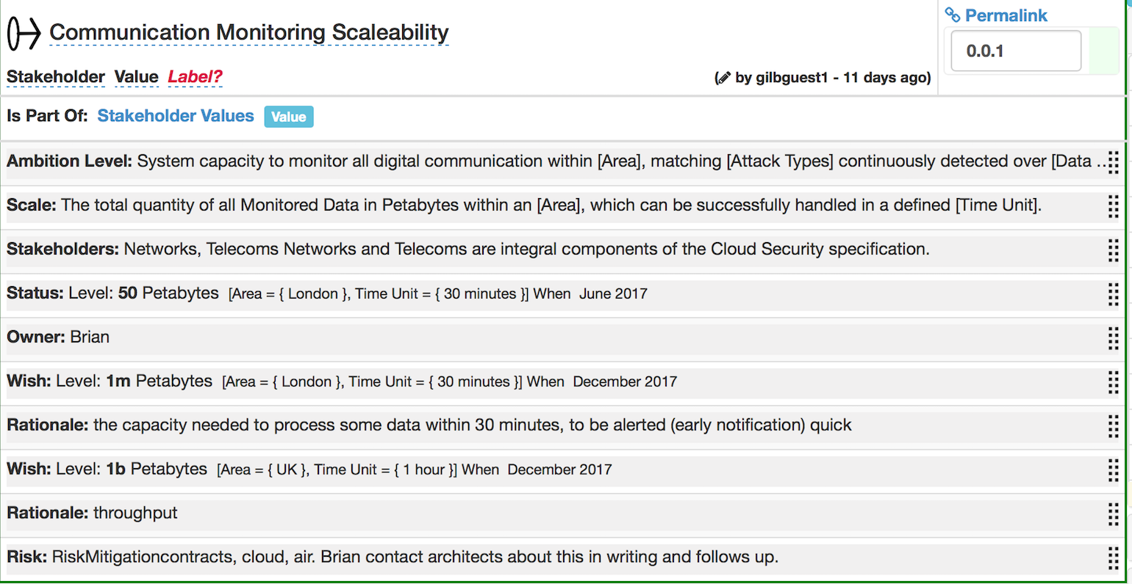
Requirement Detail determines priorities: Example ‘Stakeholders’ considered
Notes:
Originated July 13 2017 based on BCS Class exercise June 2017 on Terrorist Prevention Tom Gilb

Slide 5
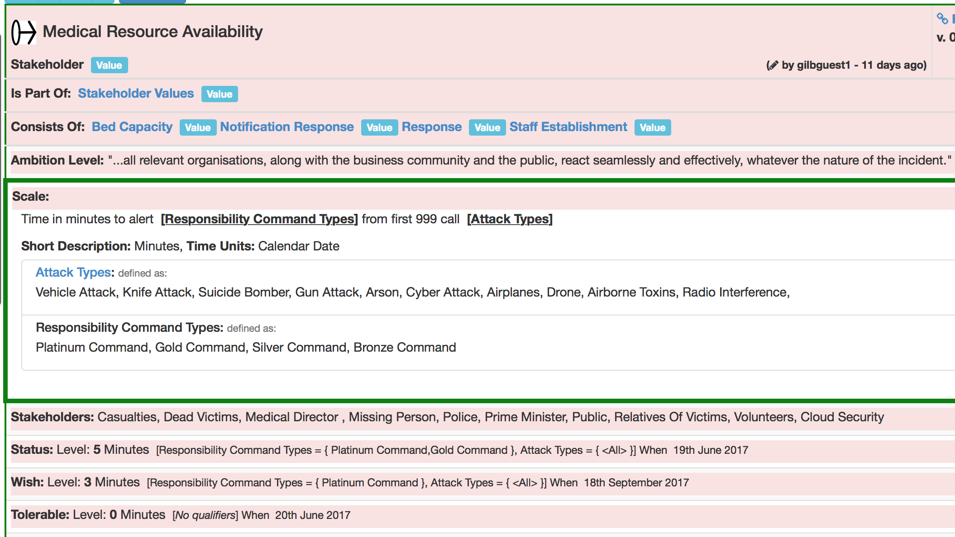
The exact Scale Parameters used in Wish levels, determines the real and effective priority you are planning for: in this case “Platinum command” and “All” Attack Types

Slide 6
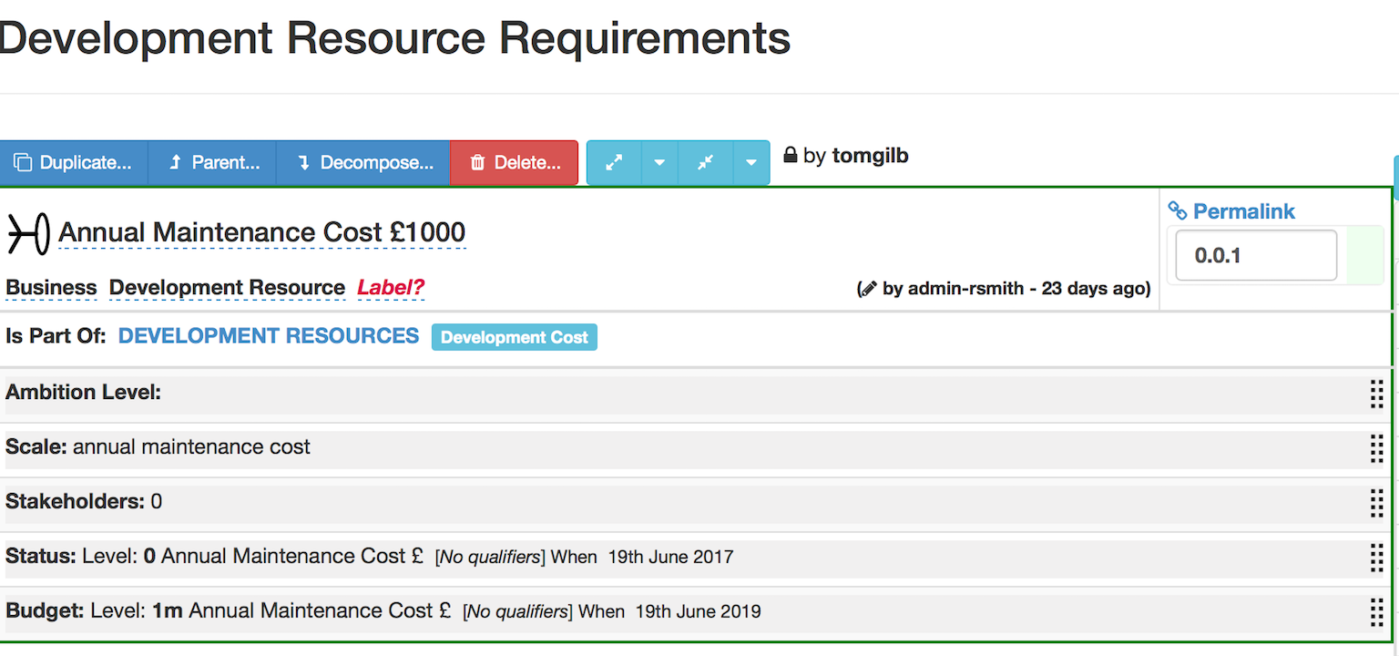
The Scalar resources considered determine priorities: limits architecture choice
Notes:
Originated July 13 2017 based on BCS Class exercise June 2017 on Terrorist Prevention Tom Gilb

Slide 7
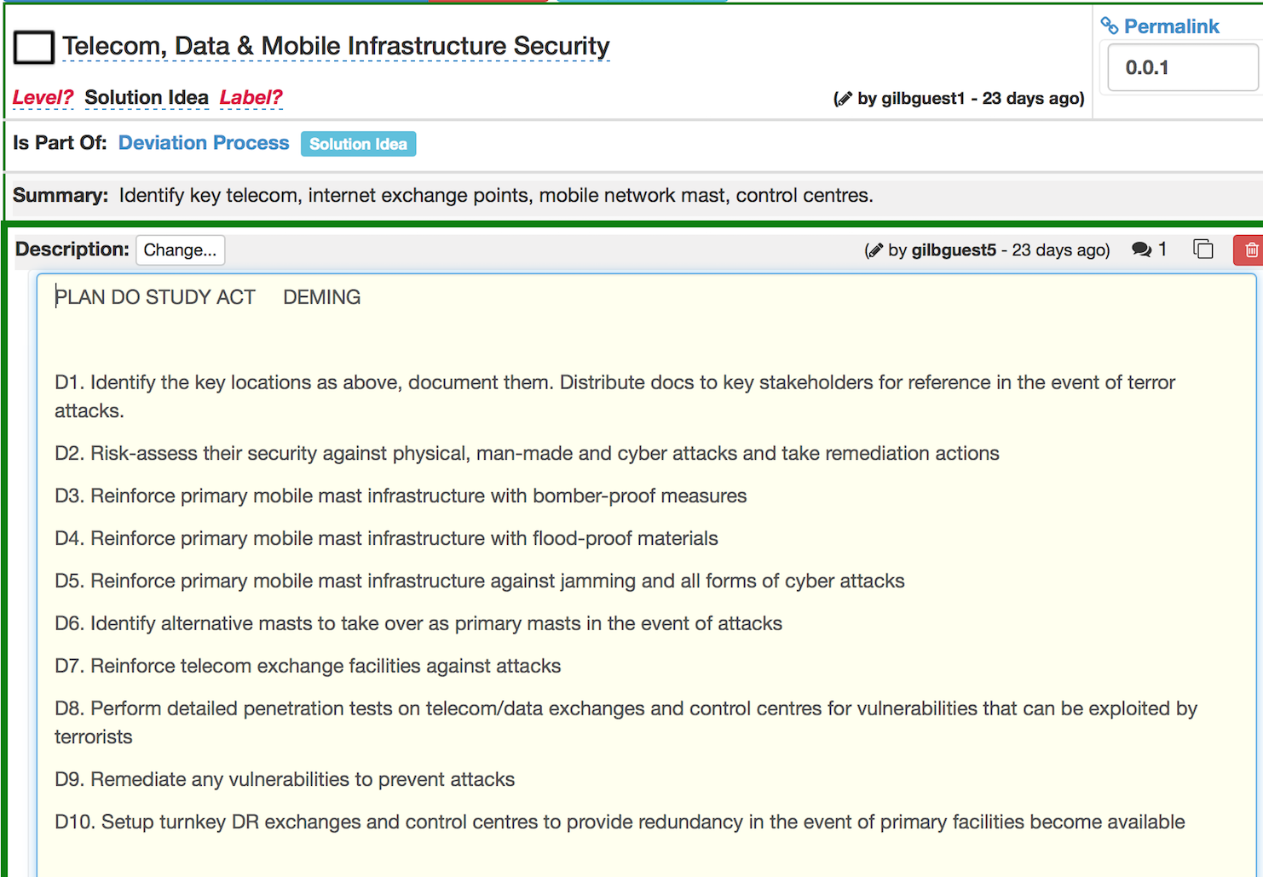
Choice of, and detailed specification of, architecture -
limit your priority choices to actual specifications:
you cannot prioritize what you have not defined

Slide 8
Design Process
Design Suggestions
Impacts to Cost Evaluation
 | A | B | C | D
Goal 1 | 30% | 10%’ | -10% | 80%
Cost | 10 | 50 | 1 | 20
G/C | 3:1 | 1:5 | ? | 4:1
Design A
Design B
Design C
Design D
Notes:
First made 31 3 2017 for Agile Record Mythodology May 2017 tsg

Slide 9
Design Process: The winner
Design Suggestions
Impacts to Cost Evaluation
 | A | B | C | D
Goal 1 | 30% | 10%’ | -10% | 80%
Cost | 10 | 50 | 1 | 20
G/C | 3:1 | 1:5 | ? | 4:1
Design A
Design B
Design C
Design D
Notes:
First made 31 3 2017 for Agile Record Mythodology May 2017 tsg

Slide 10
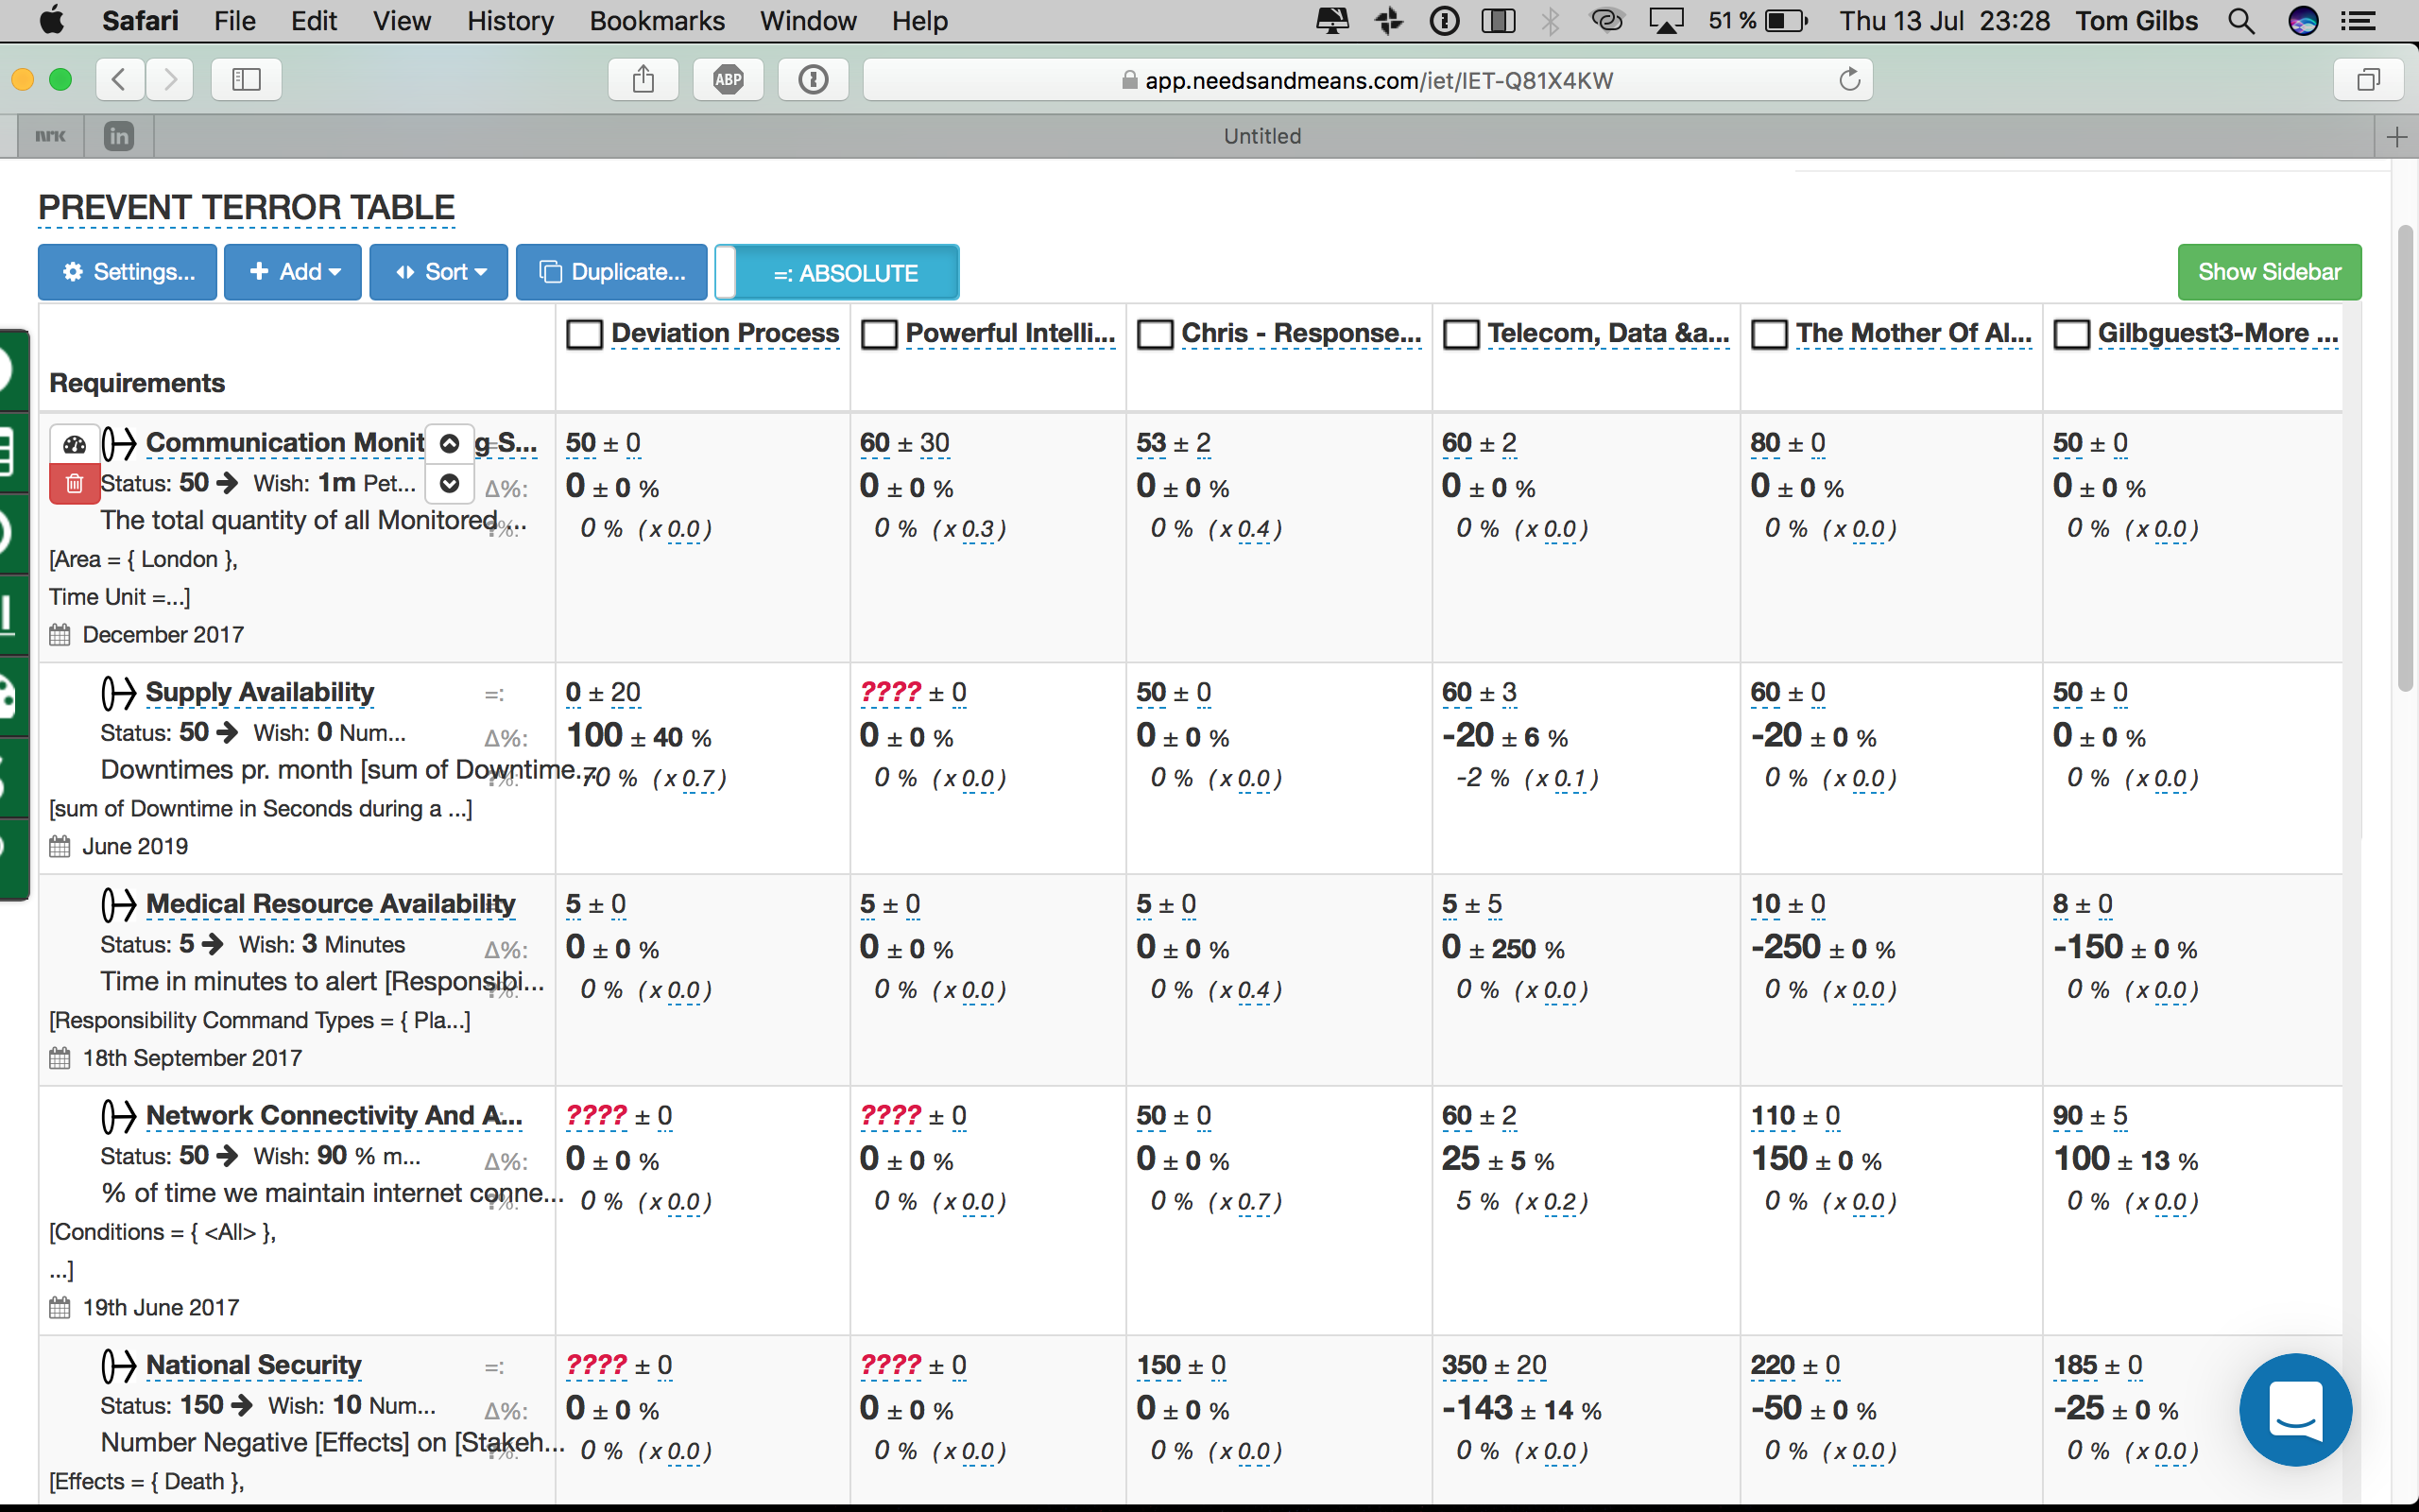
Impact Estimation Table
develops raw data about how effective and costly the architecture is estimated to be for all objectives and costs
Notes:
Originated July 13 2017 based on BCS Class exercise June 2017 on Terrorist Prevention Tom Gilb

Slide 11
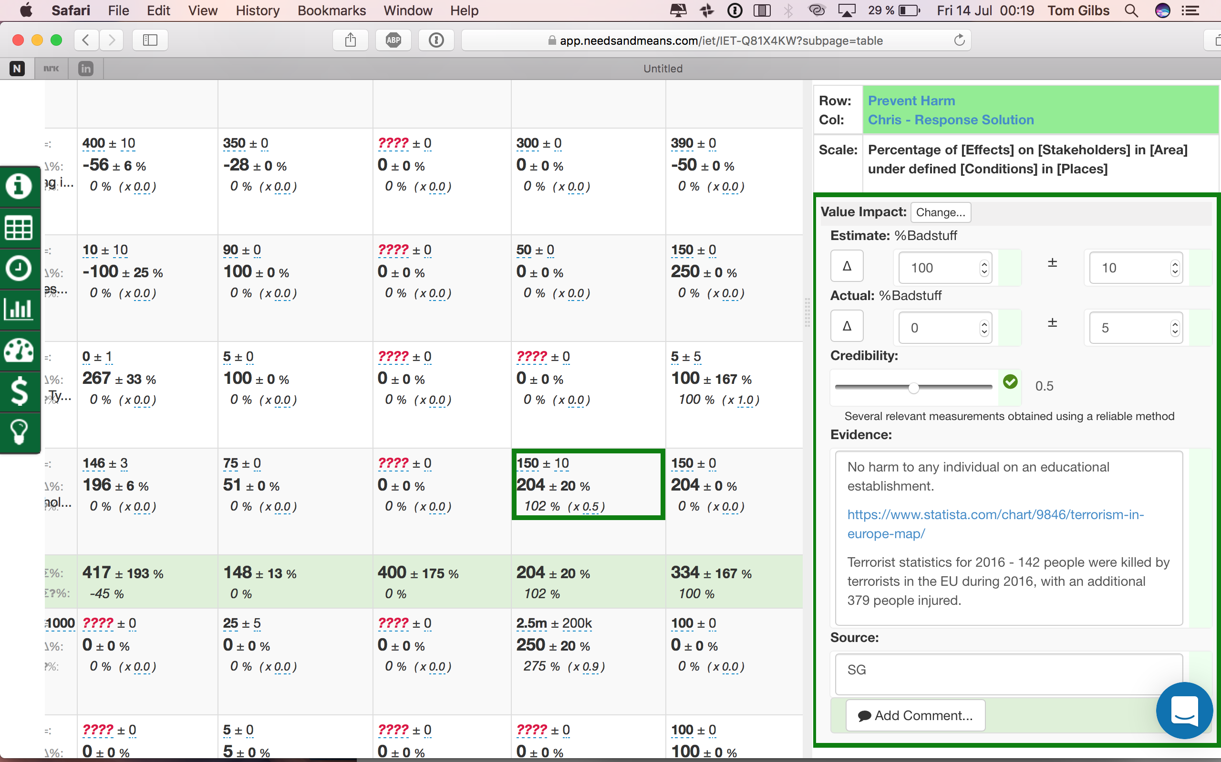
Architecture Impact Uncertainty and Evidence determine priority
Notes:
Originated July 13 2017 based on BCS Class exercise June 2017 on Terrorist Prevention Tom Gilb

Slide 12
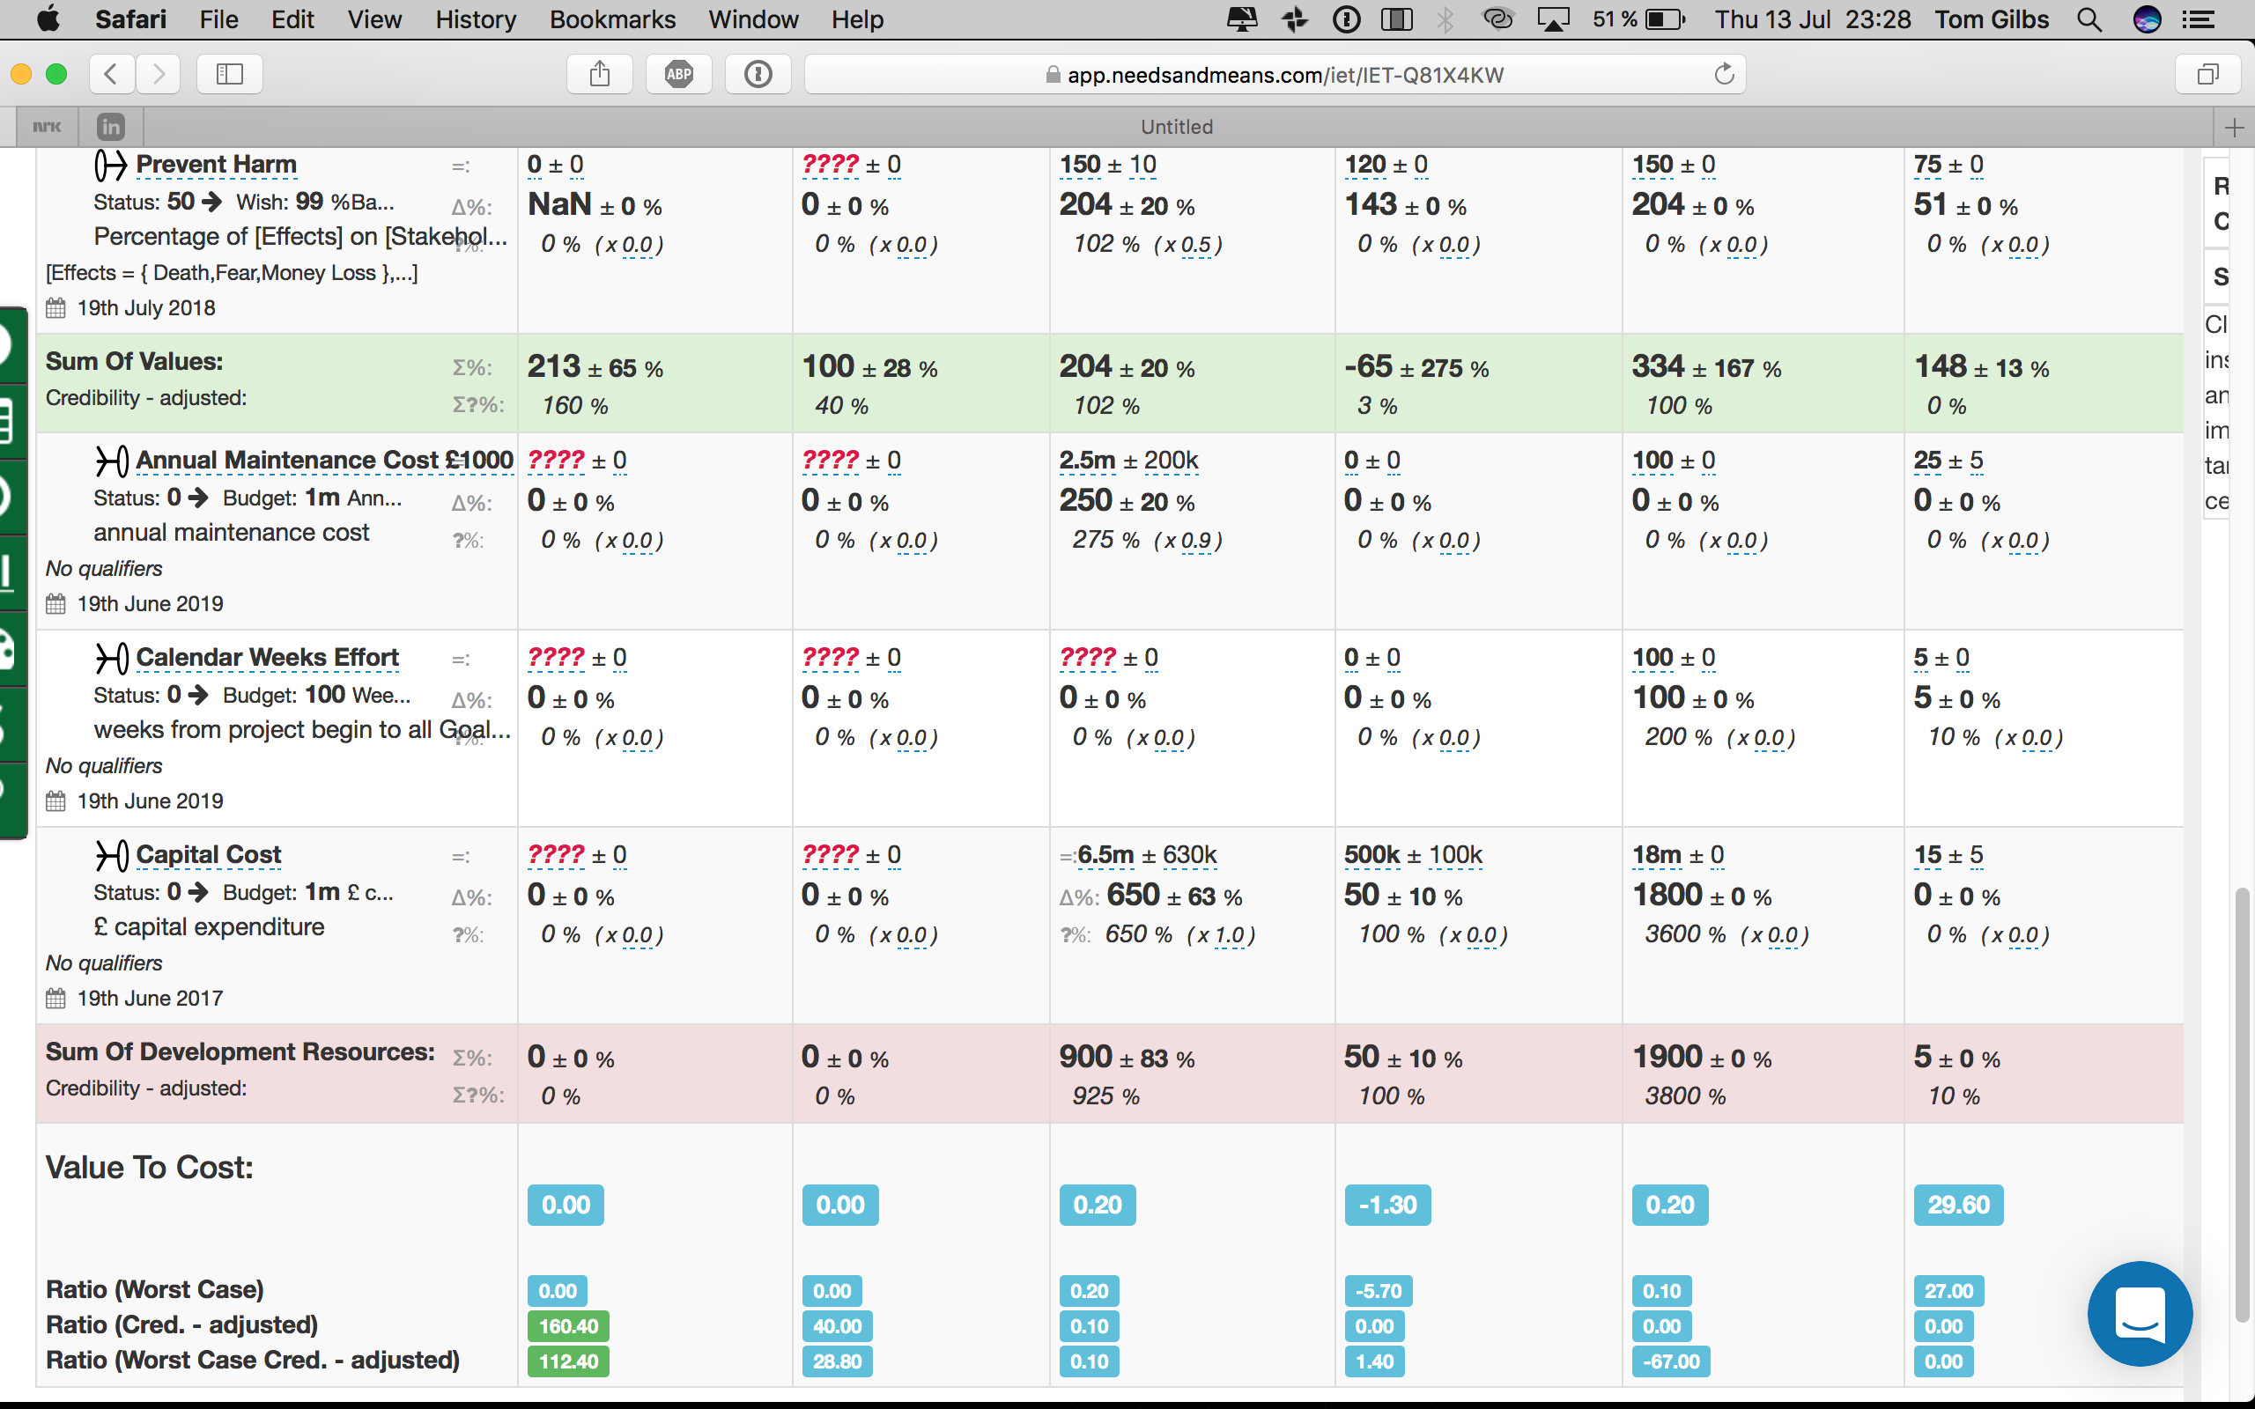
Overall Value rating /
Overall Resource need:
determines priority
Notes:
Originated July 13 2017 based on BCS Class exercise June 2017 on Terrorist Prevention Tom Gilb

Slide 13
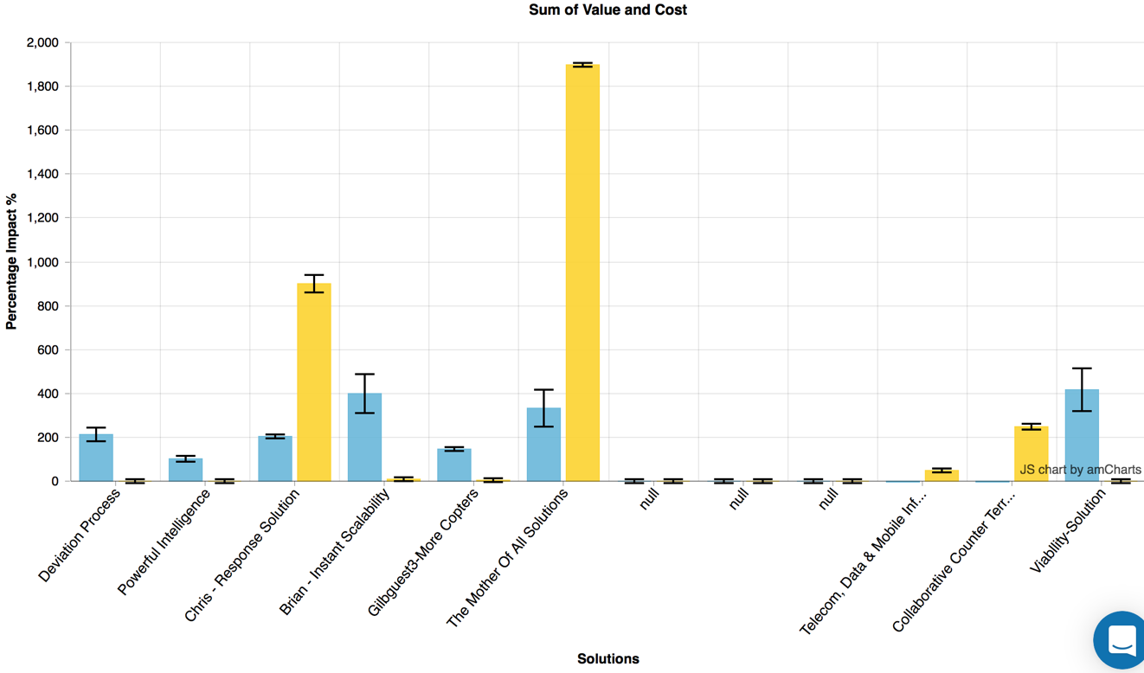
We can sort (prioritize next sprint) architecture solutions by estimated value/cost and riskiness
I: is the ± uncertainty.
Best/worst case
Notes:
Originated July 13 2017 based on BCS Class exercise June 2017 on Terrorist Prevention Tom Gilb

Slide 14
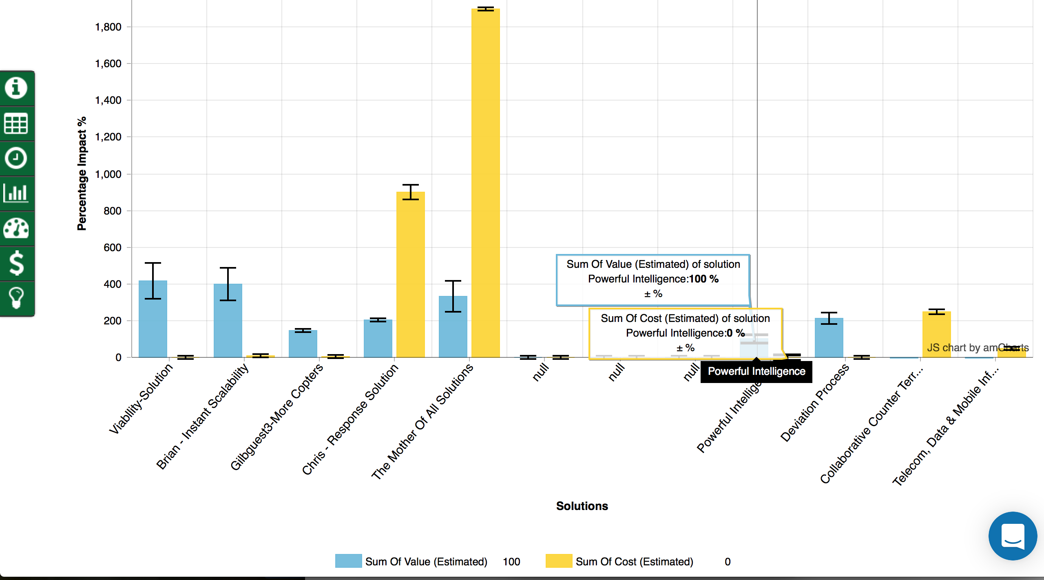
Architecture options
sorted by value and cost
Notes:
Originated July 13 2017 based on BCS Class exercise June 2017 on Terrorist Prevention Tom Gilb

Slide 15
Tom’s
Theory of Prioritisation

Slide 16
Prioritization Method Basis
1. Incremental Delivery invites a different approach to Architecture
2. We can, and should, measure the costs and effects of different architecture ideas, before committing to specific ideas, and scaling up.
3. Software Metrics: a pre-requisite
4. We need to specify performance (quality) requirements, and cost budgets numerically
5. We need to estimate the multiple impacts of design components in advance, as the basis for prioritization
6. We need to deliver architecture components incrementally, and measure their actual effects in practice.
7. We need to replace or modify architecture components that fail expectations
REMARKS
This is an ‘engineering’ approach.
This is a scientific approach
This is a risk management method
17 July 2017
Copyright Tom@Gilb.com 2017
Notes:
Remember
confirmit
Mills quinnan
Evo standards

Slide 17
The highest priority for human survival is:
Water
Air
Food

Slide 18
Did you answer the ‘right question’?
If you answered ‘air’
You were probably answering the question:
“Which of these 3 things, if totally denied would kill a human fastest”
That was not the question!
Rule One:
Listen to the Question
Make sure you understood it
Answer the question asked
The highest priority for human
1
survival is:
•
Water
•
Air
•
Food

Slide 19
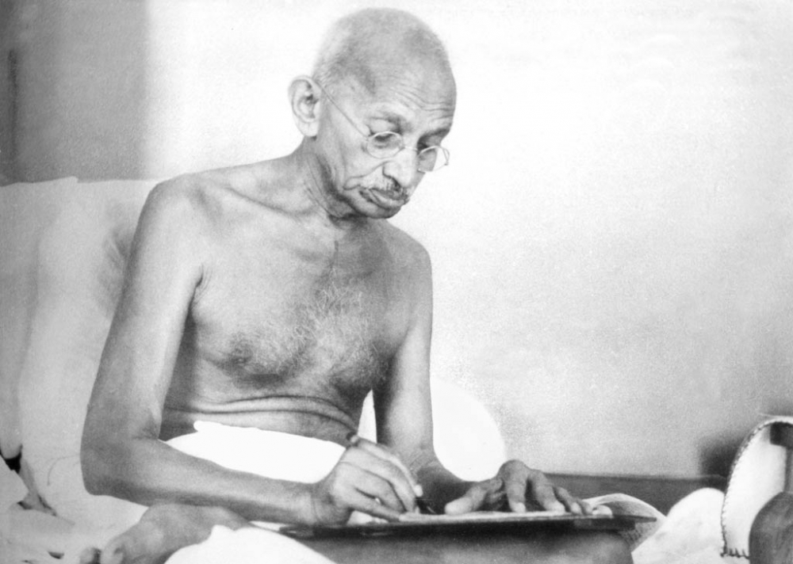
Is your ‘AIR’ answer valid if:
We are in the Death Valley Desert
And we have enough air, but have no water and ate the rest of our food 5 days ago?
You are on a hunger strike (Gandhi) in the 43rd Day and Nehru is worried?
Notes:
Suresh Kurl: Chief Theresa Spence and the difference between a ...
www.straight.com - 1000 × 712 - Search by image
by ‪Suresh Kurl‬
IMAGE ADDED ** 2017

Slide 20
Problems with the Question
No information was given on ‘Constraints
the ‘survival level’, or the ‘Fail level’
Suffocation, gasping for breath
No information was given on degree of satisfaction of the requirements.
‘Goal level’
(when we don’t have to think about breathing)
Notes:
Edit ** 2017 tsg

Slide 21
Problems with your mode of answering:
You answered without asking necessary information
(requirements, degree of satisfaction)
Your ‘wrong’ answer might be mistaken as an authoritative demand
(you are the manager, you did not hesitate to give a clear answer)
You did not even ask ‘why the question was asked’
My answer: to trick you into unreasonable, dangerous behavior in public!
Next time your enemy might pull this trick!

Slide 22
Problems with your answer content:
Based on insufficient information ABOUT
Needs (requirements, objectives)
Satisfaction degree (up to now)
Resources available (to satisfy all needs)
No limits stated as to:
resources to be used for this one need
time to satisfy the need before ‘death’ (TTM!)
degree of satisfaction of your ‘priority’ choice
You risk over-satisfaction (no ‘added value’)
At the expense of other vital needs (food, water)

Slide 23
General observations on ‘priorities’
They are multiple Critical Factors simultaneously
Critical Factor’s needs - vary from project to project
CF’s ‘degree of satisfaction’ varies as time goes by
The ‘biggest gap’ must get our scarce resources
Otherwise we risk exhausting scarce resources before ‘survival’ levels are achieved for some critical factors
The ‘real’ (‘Fundamental Objectives’) priority is: SURVIVAL
Food, water, air are the ‘Strategic Objectives’

Slide 24
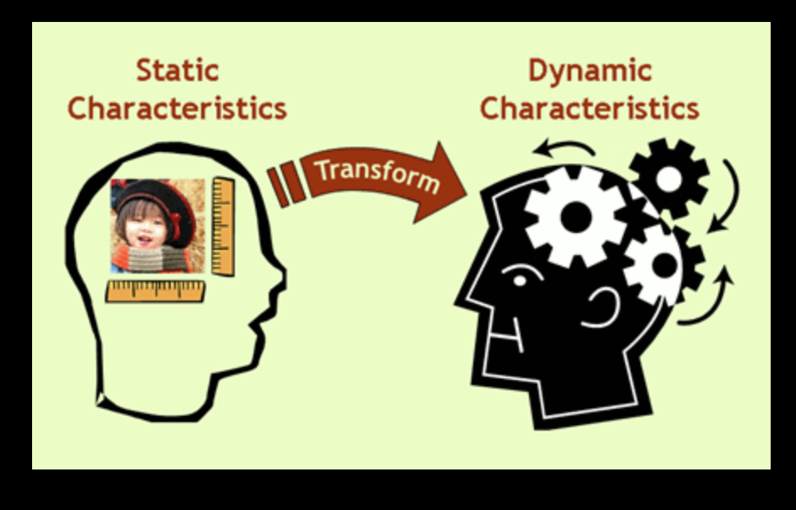
Static versus Dynamic Priority
Dynamic
(Intelligent, Fact based, Agile, Lean)
Priority is computed after each value delivery step
Your priority policy can be adjusted at any step to satisfy changing circumstances
When Goals are all satisfied, we can stop delivering additional solutions: under budget, before deadlines
Value Planning book, Chapter 6 Prioritization
https://www.dropbox.com/home/A%20VALUE%20PLANNING%20MAIN%20WEB%20COPY%20850PAGE%20%20AND%20SUBSETS%202017/****%20VP%20Chapter%20Modules/Ch%206%20Prioritization%20Evaluation?preview=VP+Chapter+6.+Prioritization%2C+Evaluation+BestQ.pdf
Managing Priority (paper)
http://www.gilb.com/DL60
Notes:
created July 15 2017 tsg onboard Norwegian to London for BCS Arch con 17July
A. Managing Priority (paper)
http://www.gilb.com/DL60
B. Choice and Priority Using Planguage:
A wide variety of specification devices and analytical tools. (paper)
http://www.gilb.com/DL48
C. Value Planning book, Chapter 6 Prioritization
https://www.dropbox.com/home/A%20VALUE%20PLANNING%20MAIN%20WEB%20COPY%20850PAGE%20%20AND%20SUBSETS%202017/****%20VP%20Chapter%20Modules/Ch%206%20Prioritization%20Evaluation?preview=VP+Chapter+6.+Prioritization%2C+Evaluation+BestQ.pdf

Slide 25
Dynamic Priority is also decided by Scale Levels
All TOLERABLE VALUE LEVELS MUST FIRST BE MET (SURVIVAL CONDITION)
THEN WE CAN GO FOR ALL GOAL LEVELS (WE PROMISE/COMMIT TO GOAL LEVELS)
IF RESOURCES REMAIN, WHEN GOALS MET, THEN ‘STRETCH’ LEVELS CAN BE ATTEMPTED
WHEN ALL USED UP RESOURCES EXCEED ‘INTOLERABLE’ LEVELS, THERE ARE NO RESOURCES left, TO DELIVER VALUE IMPROVEMENTS.
Money
Usability
Intolerable
Cycle 1
C 2
C 4
Tolerable
Cycle 1
C 5
C 6
C 7
C 8
Success
C 2
Success
C 4
C 5
C 6
C 7
C 8
Tolerable
Intolerable
Past
Budget
Tolerable
Past
Tolerable/Fail
Goal
Speed
Stretch
Cycle 1
Intolerable
C 2
C 3
C 4
Tolerable
Cycle 1
Success
C 5
C 6
C 7
Success
C 2
C 3
C 4
C 5
C 6
C 7
Tolerable
Intolerable
Engineers
Past
30 sec.
Budget
15 sec.
Tolerable/Fail
20 sec.
Past
30 sec.
Tolerable/Fail
20 sec.
Goal
15 sec.

Slide 26
Now we have basis for ‘Prioritisation’
Prioritisation: defined
Prioritisation Policies
‘Making a choice of alternatives, based on their potential ability to serve our defined needs’
We might prioritize a trial, or experiment,
so that we can measure and see if the alternatives really do meet needs as expected
Prioritisation must be based on a your chosen prioritisation policy, at any given moment
like ‘Value/money wrt risk’
but these rules can vary from time to time
Basic policies include the concepts of
Effectiveness
Efficiency (Cost effectiveness)
Cost-Effectiveness wrt Risks
Copyright Tom@Gilb.com 2017
Notes:
edited a lot July 16 2017 tsg

Slide 27
Prioritization Principles
EFFICIENCY: In the Long Run: we should prioritise so that we maximize the stakeholder values delivered for limited resources
RISK: In the short term: we can prioritise in order to explore high value, but high risk, options.
POLITICS: We can consciously prioritise in order to maximise one particular objective
SURVIVAL: But in the medium term, we must prioritise so that all system capabilities and costs avoid violating constraints
BALANCE: And in the long term, we need to prioritise so that all top level critical objectives are met
Copyright Tom@Gilb.com 2017
Notes:
Originated 5 October 2017 by Tom@Gilb.com
Copyright

Slide 28
Prioritization Policies
Change the priority decision rules to satisfy certain stakeholders.
Please the major project funders
Please your boss
Please the market
2. Change priority rules to satisfy emerging events
1. Stop prioritising designs, that improve performance attributes, that have already reached their Goal levels.
2. Start choosing designs that use resources, which are currently far more available than others
3. Apply rules that consider explicit risk for a design:
1. ± uncertainty of results (wide range of experience)
2. Credibility level (evidence for effects, sources of effects)
Copyright Tom@Gilb.com 2017

Slide 29
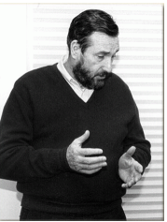
Cleanroom - for software
(DYNAMIC ARCHITECTURE PRIORITIZATION)
Harlan Mills
Copyright Tom@Gilb.com 2017
Notes:
Mills, H. 1980. The management of software engineering: part 1: principles of software engineering. IBM Systems Journal 19, issue 4 (Dec.):414-420.
http://trace.tennessee.edu/utk_harlan/18/
Mills, Harlan D.; Dyer, M.; and Linger, R. C., "Cleanroom Software Engineering" (1987). The Harlan D. Mills Collection. http://trace.tennessee.edu/utk_harlan/18
Photo
race.tennessee.edu/utk_harlan/?utm_source=trace.tennessee.edu%2Futk_harlan%2F18&utm_medium=PDF&utm_campaign=PDFCoverPages
http://trace.tennessee.edu/cgi/viewcontent.cgi?article=1017&context=utk_harlan
http://trace.tennesssee.edu/cgi/view?article=1004&content=utk_harlan

Slide 30
http://trace.tennessee.edu/cgi/viewcontent.cgi?article=1004&context=utk_harlan
Notes:
http://trace.tennessee.edu/cgi/viewcontent.cgi?article=1004&context=utk_harlan
link tested July 16 2017 tsg
Mills, H. 1980. The management of software engineering: part 1: principles of software engineering. IBM Systems Journal 19, issue 4 (Dec.):414-420.
Direct Copy
http://trace.tennessee.edu/cgi/viewcontent.cgi?article=1004&context=utk_harlan
Library header , Citation Page
http://trace.tennessee.edu/utk_harlan/5/

Slide 31
The first guarantee of quality.
Experts, Design it in, Spec Quality Control
“The first guarantee of quality in design, is in well-informed, well-educated, and well-motivated designers.
Quality must be built into designs, and cannot be inspected in or tested in.
Nevertheless, any prudent development process verifies quality through inspection and testing.
Inspection by peers in design, by users or surrogates, by other financial specialists concerned with cost, reliability, or maintainability not only increases confidence in the design at hand, but also provides designers with valuable lessons and insights to be applied to future designs.
The very fact that designs face inspections motivates even the most conscientious designers to greater care, deeper simplicities, and more precision in their work.”
http://trace.tennessee.edu/cgi/viewcontent.cgi?article=1004&context=utk_harlan
Notes:
inIBM sj 4 80 p.419
In
Mills, H. 1980. The management of software engineering: part 1: principles of software engineering. IBM Systems Journal 19, issue 4 (Dec.):414-420.
Direct Copy
http://trace.tennessee.edu/cgi/viewcontent.cgi?article=1004&context=utk_harlan
Library header
http://trace.tennessee.edu/utk_harlan/5/

Slide 32
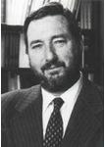
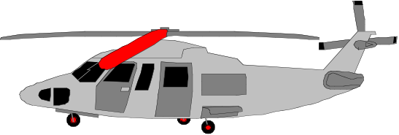
In the ‘Cleanroom Method’, developed by IBM’s Harlan Mills (IBM SJ No. 4/1980) they reported:
“Software Engineering began to emerge in FSD” (IBM Federal Systems Division, from 1996 a part of Lockheed Martin Marietta) “some ten years ago [Ed. about 1970] in a continuing evolution that is still underway:
Ten years ago general management expected the worst from software projects – cost overruns, late deliveries, unreliable and incomplete software
Today [Ed. 1980!], management has learned to expect on-time, within budget, deliveries of high-quality software.
A Navy helicopter ship system, called LAMPS, provides a recent example. LAMPS software was a four-year project of over 200 person-years of effort, developing over three million, and integrating over seven million words of program and data for eight different processors distributed between a helicopter and a ship in 45 incremental deliveries [Ed. Note 2%!].
Every one of those deliveries was on time and under budget
A more extended example can be found in the NASA space program,
- Where in the past ten years, FSD has managed some 7,000 person-years of software development, developing and integrating over a hundred million bytes of program and data for ground and space processors in over a dozen projects.
There were few late or overrun deliveries in that decade, and none at all in the past four years.”
© Gilb.com 2017
Notes:
A time or cost estimate, once it becomes a deadline or a budget respectively, is a ‘limited resource’. One of the smartest ways to deal with limited resources is intelligent prioritization (Gilb and Maier 2005). Instead of implementing all your designs in a ‘big bang’ manner, and hoping to meet all the requirements and resource (time and cost) estimates, we suggest you deliver the project value a little bit at a time, and see how each of the designs actually works, and what they each actually cost. ‘A little bit at a time’ should be interpreted as delivering evolutionary steps of approximately 2% of the overall project timescales (say weekly, fortnightly or monthly cycles), and hopefully about 2% of the project financial budget.
Planguage’s impact estimation (IE) method (Gilb 1988; Gilb 2005) is helpful in identifying the designs that give the estimated best stakeholder value for their costs. We implement designs incrementally so that we can get acceptable feedback on costs, and value delivery (in terms of meeting requirements). With a bit of luck, stakeholders then receive interesting value very early, and what works and what doesn’t is learned in practice. If a deadline is hit, or if the budget runs out (possibly because of a deadline being moved up earlier or a budget cut!), then at least there is still a complete live real system with delivered high-value. In such situations, the whole concept of the project-level estimates, the deadlines and the budgets is not so important any more.
Nobody does it better! Harlan Mills told me that they had to solve the persistent problem of cost overruns, in relation to the contracted estimates, because the government was getting smarter, and using fixed-price contracts (as opposed to cost plus). If the project ran over, IBM lost its own profit. If IBM did not find a better way, they could just as well leave the business (Personal Communication).
Notice the “45 deliveries” Mills cites. That means 2% delivery cycles. IBM was using intelligent feedback and learning. They actually had very sophisticated estimation technology based on a thorough collection of experiences (Walston and Felix 1977). But this did not give them the accuracy they needed to avoid losing money. Lets us say they had a 40% profit margin, and they could be wrong by 40% to 200% (The NASA range, see earlier Figure 3). They would still lose money on most contracts. So, they had to compensate for their estimation inaccuracy by incremental feedback, and necessary change, to come in ‘on time and under budget every time’. Mills’ colleague, Quinnan describes their process of intelligent dynamic prioritization in detail in (Mills 1980 in IBM SJ 4-1980).
A thorough explanation of systems development processes helping achieve intelligent prioritization is found in (Gilb 2005). See also Figure 9. Nothing less will suffice for large and complex systems (that is, for project involving hundreds of staff, years of effort, and sometimes $100 million or more in cost). For smaller systems (small teams over a few months), several organizations have made good simple practical adaptations (Upadhyayula 2001 (Study of Evo at HP in 1990s); Johansen and Gilb 2005) of the essential ‘Evo’ development process ideas (Evo itself predating later ‘Agile’ methods)[Denning 2010, p.129] & [Gilb 2010c].
The agile community has adopted small iterative cycles (Gilb 2010c), but they have failed to adopt the notion of measurement of value and quality – which is essential for larger projects, and some smaller ones. Without explicit absolute quality requirement and design impact metrics, the value prioritization is ambiguous and too subjective (Gilb 2010c; Gilb and Brodie 2010).

Slide 33
In the Cleanroom Method,
developed by IBM’s Harlan Mills (1980)
they reported:
“Software Engineering began to emerge in FSD” (IBM Federal Systems Division, from 1996 a part of Lockheed Martin Marietta) “some ten years ago [Ed. about 1970] in a continuing evolution that is still underway:
Ten years ago general management expected the worst from software projects – cost overruns, late deliveries, unreliable and incomplete software
Today [Ed. 1980!], management has learned to expect on-time, within budget, deliveries of high-quality software. A Navy helicopter ship system, called LAMPS, provides a recent example. LAMPS software was a four-year project of over 200 person-years of effort, developing over three million, and integrating over seven million words of program and data for eight different processors distributed between a helicopter and a ship in 45 incremental deliveries [Ed. Note 2%!]s. Every one of those deliveries was on time and under budget
A more extended example can be found in the NASA space program,
- Where in the past ten years, FSD has managed some 7,000 person-years of software development, developing and integrating over a hundred million bytes of program and data for ground and space processors in over a dozen projects.
- There were few late or overrun deliveries in that decade, and none at all in the past four years.”
in 45 incremental deliveries
doing ‘agile’ !
were few late or overrun deliveries in that decade, and none at all in the past four years
© Gilb.com 2011
wow! normal agile fails 19% (Scrum) to 40%: Jeff Sutherland
Notes:
A time or cost estimate, once it becomes a deadline or a budget respectively, is a ‘limited resource’. One of the smartest ways to deal with limited resources is intelligent prioritization (Gilb and Maier 2005). Instead of implementing all your designs in a ‘big bang’ manner, and hoping to meet all the requirements and resource (time and cost) estimates, we suggest you deliver the project value a little bit at a time, and see how each of the designs actually works, and what they each actually cost. ‘A little bit at a time’ should be interpreted as delivering evolutionary steps of approximately 2% of the overall project timescales (say weekly, fortnightly or monthly cycles), and hopefully about 2% of the project financial budget.
Planguage’s impact estimation (IE) method (Gilb 1988; Gilb 2005) is helpful in identifying the designs that give the estimated best stakeholder value for their costs. We implement designs incrementally so that we can get acceptable feedback on costs, and value delivery (in terms of meeting requirements). With a bit of luck, stakeholders then receive interesting value very early, and what works and what doesn’t is learned in practice. If a deadline is hit, or if the budget runs out (possibly because of a deadline being moved up earlier or a budget cut!), then at least there is still a complete live real system with delivered high-value. In such situations, the whole concept of the project-level estimates, the deadlines and the budgets is not so important any more.
Nobody does it better! Harlan Mills told me that they had to solve the persistent problem of cost overruns, in relation to the contracted estimates, because the government was getting smarter, and using fixed-price contracts (as opposed to cost plus). If the project ran over, IBM lost its own profit. If IBM did not find a better way, they could just as well leave the business (Personal Communication).
Notice the “45 deliveries” Mills cites. That means 2% delivery cycles. IBM was using intelligent feedback and learning. They actually had very sophisticated estimation technology based on a thorough collection of experiences (Walston and Felix 1977). But this did not give them the accuracy they needed to avoid losing money. Lets us say they had a 40% profit margin, and they could be wrong by 40% to 200% (The NASA range, see earlier Figure 3). They would still lose money on most contracts. So, they had to compensate for their estimation inaccuracy by incremental feedback, and necessary change, to come in ‘on time and under budget every time’. Mills’ colleague, Quinnan describes their process of intelligent dynamic prioritization in detail in (Mills 1980 in IBM SJ 4-1980).
A thorough explanation of systems development processes helping achieve intelligent prioritization is found in (Gilb 2005). See also Figure 9. Nothing less will suffice for large and complex systems (that is, for project involving hundreds of staff, years of effort, and sometimes $100 million or more in cost). For smaller systems (small teams over a few months), several organizations have made good simple practical adaptations (Upadhyayula 2001 (Study of Evo at HP in 1990s); Johansen and Gilb 2005) of the essential ‘Evo’ development process ideas (Evo itself predating later ‘Agile’ methods)[Denning 2010, p.129] & [Gilb 2010c].
The agile community has adopted small iterative cycles (Gilb 2010c), but they have failed to adopt the notion of measurement of value and quality – which is essential for larger projects, and some smaller ones. Without explicit absolute quality requirement and design impact metrics, the value prioritization is ambiguous and too subjective (Gilb 2010c; Gilb and Brodie 2010).

Slide 34
Mills on ‘Design to Cost’
“Architecture to Cost” ?
“To meet cost/schedule commitments based on imperfect estimation techniques, a software engineering manager must adopt a
manage-and-design-to-cost/schedule process.
That process requires a
continuous and relentless rectification of design objectives
with the cost/schedule needed to achieve those objectives.”
in IBM Systems Journal, 4/80 p.420
http://trace.tennessee.edu/cgi/viewcontent.cgi?article=1004&context=utk_harlan
Library header
http://trace.tennessee.edu/utk_harlan/5/
Notes:
in IBM sj 4 80 p.420
In
Mills, H. 1980. The management of software engineering: part 1: principles of software engineering. IBM Systems Journal 19, issue 4 (Dec.):414-420.
Direct Copy
http://trace.tennessee.edu/cgi/viewcontent.cgi?article=1004&context=utk_harlan
Library header
http://trace.tennessee.edu/utk_harlan/5/

Slide 35
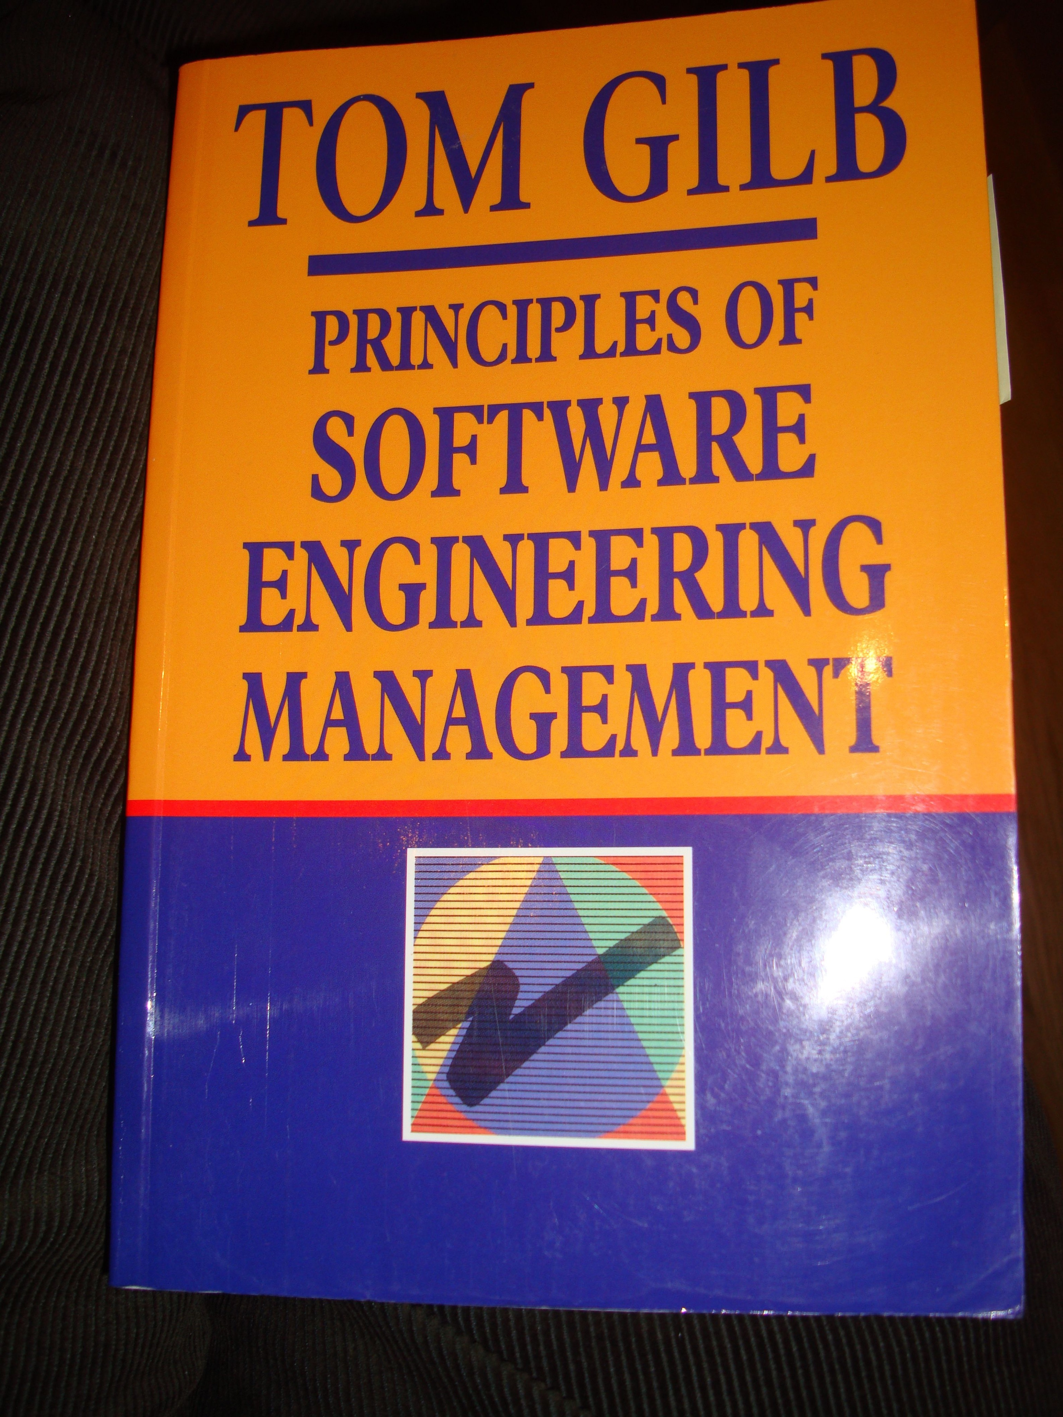
Robert Quinnan: IBM FSD Cleanroom Dynamic Design to Cost
Quinnan describes the process control loop used by IBM FSD to ensure that cost targets are met.
'Cost management. . . yields valid cost plans linked to technical performance. Our practice carries cost management farther by introducing design-to-cost guidance. Design, development, and managerial practices are applied in an integrated way to ensure that software technical management is consistent with cost management. The method [illustrated in this book by Figure 7.10] consists of developing a design, estimating its cost, and ensuring that the design is cost-effective.' (p. 473)
He goes on to describe a design iteration process trying to meet cost targets by either redesign or by sacrificing 'planned capability.' When a satisfactory design at cost target is achieved for a single increment, the 'development of each increment can proceed concurrently with the program design of the others.'
'Design is an iterative process in which each design level is a refinement of the previous level.' (p. 474)
It is clear from this that they avoid the big bang cost estimation approach. Not only do they iterate in seeking the appropriate balance between cost and design for a single increment, but they iterate through a series of increments, thus reducing the complexity of the task, and increasing the probability of learning from experience, won as each increment develops, and as the true cost of the increment becomes a fact.
'When the development and test of an increment are complete, an estimate to complete the remaining increments is computed.' (p. 474)
Source: Robert E. Quinnan, 'Software Engineering Management Practices', IBM Systems Journal, Vol. 19, No. 4, 1980, pp. 466~77
This text is cut from Gilb: The Principles of Software Engineering Management, 1988
Died 2015
Copyright Tom@Gilb.com 2017
Notes:
Slide developed ** 2017 tsg for London Software Architecture Conference Talk 9 Oct 2017
15.1.18 Quinnan
Source: Robert E. Quinnan, 'Software Engineering Management Practices', IBM Systems Journal, Vol. 19, No. 4, 1980, pp. 466~77
Robert E. Quinnan: The Management of Software Engineering. Part V: Software Engineering Management Practices. IBM Systems Journal 19(4): 466-477 (1980)
Quinnan describes the process control loop used by IBM FSD to ensure that cost targets are met.
'Cost management. . . yields valid cost plans linked to technical performance. Our practice carries cost management farther by introducing design-to-cost guidance. Design, development, and managerial practices are applied in an integrated way to ensure that software technical management is consistent with cost management. The method [illustrated in this book by Figure 7.10] consists of developing a design, estimating its cost, and ensuring that the design is cost-effective.' (p. 473)
He goes on to describe a design iteration process trying to meet cost targets by either redesign or by sacrificing 'planned capability.' When a satisfactory design at cost target is achieved for a single increment, the 'development of each increment can proceed concurrently with the program design of the others.'
'Design is an iterative process in which each design level is a refinement of the previous level.' (p. 474)
It is clear from this that they avoid the big bang cost estimation approach. Not only do they iterate in seeking the appropriate balance between cost and design for a single increment, but they iterate through a series of increments, thus reducing the complexity of the task, and increasing the probability of learning from experience, won as each increment develops, and as the true cost of the increment becomes a fact.
'When the development and test of an increment are complete, an estimate to complete the remaining increments is computed.' (p. 474)
This article is far richer than our few selected quotations can show, with regard to concepts of cost estimation and control.

Slide 36
Quinnan: IBM FSD Cleanroom Dynamic Design to Cost
Quinnan describes the process control loop used by IBM FSD to ensure that cost targets are met.
'Cost management. . . yields valid cost plans linked to technical performance. Our practice carries cost management farther by introducing design-to-cost guidance. Design, development, and managerial practices are applied in an integrated way to ensure that software technical management is consistent with cost management. The method [illustrated in this book by Figure 7.10] consists of developing a design, estimating its cost, and ensuring that the design is cost-effective.' (p. 473)
He goes on to describe a design iteration process trying to meet cost targets by either redesign or by sacrificing 'planned capability.' When a satisfactory design at cost target is achieved for a single increment, the 'development of each increment can proceed concurrently with the program design of the others.'
'Design is an iterative process in which each design level is a refinement of the previous level.' (p. 474)
It is clear from this that they avoid the big bang cost estimation approach. Not only do they iterate in seeking the appropriate balance between cost and design for a single increment, but they iterate through a series of increments, thus reducing the complexity of the task, and increasing the probability of learning from experience, won as each increment develops, and as the true cost of the increment becomes a fact.
'When the development and test of an increment are complete, an estimate to complete the remaining increments is computed.' (p. 474)
Source: Robert E. Quinnan, 'Software Engineering Management Practices', IBM Systems Journal, Vol. 19, No. 4, 1980, pp. 466~77
This text is cut from Gilb: The Principles of Software Engineering Management, 1988
of developing a design, estimating its cost, and
ensuring that the design is cost-effective
Copyright Tom@Gilb.com 2017
Notes:
Slide developed ** 2017 tsg for London Software Architecture Conference Talk 9 Oct 2017
15.1.18 Quinnan
Source: Robert E. Quinnan, 'Software Engineering Management Practices', IBM Systems Journal, Vol. 19, No. 4, 1980, pp. 466~77
Robert E. Quinnan: The Management of Software Engineering. Part V: Software Engineering Management Practices. IBM Systems Journal 19(4): 466-477 (1980)
Quinnan describes the process control loop used by IBM FSD to ensure that cost targets are met.
'Cost management. . . yields valid cost plans linked to technical performance. Our practice carries cost management farther by introducing design-to-cost guidance. Design, development, and managerial practices are applied in an integrated way to ensure that software technical management is consistent with cost management. The method [illustrated in this book by Figure 7.10] consists of developing a design, estimating its cost, and ensuring that the design is cost-effective.' (p. 473)
He goes on to describe a design iteration process trying to meet cost targets by either redesign or by sacrificing 'planned capability.' When a satisfactory design at cost target is achieved for a single increment, the 'development of each increment can proceed concurrently with the program design of the others.'
'Design is an iterative process in which each design level is a refinement of the previous level.' (p. 474)
It is clear from this that they avoid the big bang cost estimation approach. Not only do they iterate in seeking the appropriate balance between cost and design for a single increment, but they iterate through a series of increments, thus reducing the complexity of the task, and increasing the probability of learning from experience, won as each increment develops, and as the true cost of the increment becomes a fact.
'When the development and test of an increment are complete, an estimate to complete the remaining increments is computed.' (p. 474)
This article is far richer than our few selected quotations can show, with regard to concepts of cost estimation and control.

Slide 37
Quinnan: IBM FSD Cleanroom Dynamic Design to Cost
Quinnan describes the process control loop used by IBM FSD to ensure that cost targets are met.
'Cost management. . . yields valid cost plans linked to technical performance. Our practice carries cost management farther by introducing design-to-cost guidance. Design, development, and managerial practices are applied in an integrated way to ensure that software technical management is consistent with cost management. The method [illustrated in this book by Figure 7.10] consists of developing a design, estimating its cost, and ensuring that the design is cost-effective.' (p. 473)
He goes on to describe a design iteration process trying to meet cost targets by either redesign or by sacrificing 'planned capability.' When a satisfactory design at cost target is achieved for a single increment, the 'development of each increment can proceed concurrently with the program design of the others.'
'Design is an iterative process in which each design level is a refinement of the previous level.' (p. 474)
It is clear from this that they avoid the big bang cost estimation approach. Not only do they iterate in seeking the appropriate balance between cost and design for a single increment, but they iterate through a series of increments, thus reducing the complexity of the task, and increasing the probability of learning from experience, won as each increment develops, and as the true cost of the increment becomes a fact.
'When the development and test of an increment are complete, an estimate to complete the remaining increments is computed.' (p. 474)
Source: Robert E. Quinnan, 'Software Engineering Management Practices', IBM Systems Journal, Vol. 19, No. 4, 1980, pp. 466~77
This text is cut from Gilb: The Principles of Software Engineering Management, 1988
iteration process
trying to meet cost targets by
either redesign
or by
sacrificing 'planned capability’
Copyright Tom@Gilb.com 2017
Notes:
Slide developed ** 2017 tsg for London Software Architecture Conference Talk 9 Oct 2017
15.1.18 Quinnan
Source: Robert E. Quinnan, 'Software Engineering Management Practices', IBM Systems Journal, Vol. 19, No. 4, 1980, pp. 466~77
Robert E. Quinnan: The Management of Software Engineering. Part V: Software Engineering Management Practices. IBM Systems Journal 19(4): 466-477 (1980)
Quinnan describes the process control loop used by IBM FSD to ensure that cost targets are met.
'Cost management. . . yields valid cost plans linked to technical performance. Our practice carries cost management farther by introducing design-to-cost guidance. Design, development, and managerial practices are applied in an integrated way to ensure that software technical management is consistent with cost management. The method [illustrated in this book by Figure 7.10] consists of developing a design, estimating its cost, and ensuring that the design is cost-effective.' (p. 473)
He goes on to describe a design iteration process trying to meet cost targets by either redesign or by sacrificing 'planned capability.' When a satisfactory design at cost target is achieved for a single increment, the 'development of each increment can proceed concurrently with the program design of the others.'
'Design is an iterative process in which each design level is a refinement of the previous level.' (p. 474)
It is clear from this that they avoid the big bang cost estimation approach. Not only do they iterate in seeking the appropriate balance between cost and design for a single increment, but they iterate through a series of increments, thus reducing the complexity of the task, and increasing the probability of learning from experience, won as each increment develops, and as the true cost of the increment becomes a fact.
'When the development and test of an increment are complete, an estimate to complete the remaining increments is computed.' (p. 474)
This article is far richer than our few selected quotations can show, with regard to concepts of cost estimation and control.

Slide 38
Quinnan: IBM FSD Cleanroom Dynamic Design to Cost
Quinnan describes the process control loop used by IBM FSD to ensure that cost targets are met.
'Cost management. . . yields valid cost plans linked to technical performance. Our practice carries cost management farther by introducing design-to-cost guidance. Design, development, and managerial practices are applied in an integrated way to ensure that software technical management is consistent with cost management. The method [illustrated in this book by Figure 7.10] consists of developing a design, estimating its cost, and ensuring that the design is cost-effective.' (p. 473)
He goes on to describe a design iteration process trying to meet cost targets by either redesign or by sacrificing 'planned capability.' When a satisfactory design at cost target is achieved for a single increment, the 'development of each increment can proceed concurrently with the program design of the others.'
'Design is an iterative process in which each design level is a refinement of the previous level.' (p. 474)
It is clear from this that they avoid the big bang cost estimation approach. Not only do they iterate in seeking the appropriate balance between cost and design for a single increment, but they iterate through a series of increments, thus reducing the complexity of the task, and increasing the probability of learning from experience, won as each increment develops, and as the true cost of the increment becomes a fact.
'When the development and test of an increment are complete, an estimate to complete the remaining increments is computed.' (p. 474)
Source: Robert E. Quinnan, 'Software Engineering Management Practices', IBM Systems Journal, Vol. 19, No. 4, 1980, pp. 466~77
This text is cut from Gilb: The Principles of Software Engineering Management, 1988
Design is an iterative process
Copyright Tom@Gilb.com 2017
Notes:
Slide developed ** 2017 tsg for London Software Architecture Conference Talk 9 Oct 2017
15.1.18 Quinnan
Source: Robert E. Quinnan, 'Software Engineering Management Practices', IBM Systems Journal, Vol. 19, No. 4, 1980, pp. 466~77
Robert E. Quinnan: The Management of Software Engineering. Part V: Software Engineering Management Practices. IBM Systems Journal 19(4): 466-477 (1980)
Quinnan describes the process control loop used by IBM FSD to ensure that cost targets are met.
'Cost management. . . yields valid cost plans linked to technical performance. Our practice carries cost management farther by introducing design-to-cost guidance. Design, development, and managerial practices are applied in an integrated way to ensure that software technical management is consistent with cost management. The method [illustrated in this book by Figure 7.10] consists of developing a design, estimating its cost, and ensuring that the design is cost-effective.' (p. 473)
He goes on to describe a design iteration process trying to meet cost targets by either redesign or by sacrificing 'planned capability.' When a satisfactory design at cost target is achieved for a single increment, the 'development of each increment can proceed concurrently with the program design of the others.'
'Design is an iterative process in which each design level is a refinement of the previous level.' (p. 474)
It is clear from this that they avoid the big bang cost estimation approach. Not only do they iterate in seeking the appropriate balance between cost and design for a single increment, but they iterate through a series of increments, thus reducing the complexity of the task, and increasing the probability of learning from experience, won as each increment develops, and as the true cost of the increment becomes a fact.
'When the development and test of an increment are complete, an estimate to complete the remaining increments is computed.' (p. 474)
This article is far richer than our few selected quotations can show, with regard to concepts of cost estimation and control.

Slide 39
Quinnan: IBM FSD Cleanroom Dynamic Design to Cost
Quinnan describes the process control loop used by IBM FSD to ensure that cost targets are met.
'Cost management. . . yields valid cost plans linked to technical performance. Our practice carries cost management farther by introducing design-to-cost guidance. Design, development, and managerial practices are applied in an integrated way to ensure that software technical management is consistent with cost management. The method [illustrated in this book by Figure 7.10] consists of developing a design, estimating its cost, and ensuring that the design is cost-effective.' (p. 473)
He goes on to describe a design iteration process trying to meet cost targets by either redesign or by sacrificing 'planned capability.' When a satisfactory design at cost target is achieved for a single increment, the 'development of each increment can proceed concurrently with the program design of the others.'
'Design is an iterative process in which each design level is a refinement of the previous level.' (p. 474)
It is clear from this that they avoid the big bang cost estimation approach. Not only do they iterate in seeking the appropriate balance between cost and design for a single increment, but they iterate through a series of increments, thus reducing the complexity of the task, and increasing the probability of learning from experience, won as each increment develops, and as the true cost of the increment becomes a fact.
'When the development and test of an increment are complete, an estimate to complete the remaining increments is computed.' (p. 474)
Source: Robert E. Quinnan, 'Software Engineering Management Practices', IBM Systems Journal, Vol. 19, No. 4, 1980, pp. 466~77
This text is cut from Gilb: The Principles of Software Engineering Management, 1988
but they iterate through a series of increments,
thus reducing the complexity of the task,
and increasing the probability of learning from experience
Copyright Tom@Gilb.com 2017
Notes:
Slide developed ** 2017 tsg for London Software Architecture Conference Talk 9 Oct 2017
15.1.18 Quinnan
Source: Robert E. Quinnan, 'Software Engineering Management Practices', IBM Systems Journal, Vol. 19, No. 4, 1980, pp. 466~77
Robert E. Quinnan: The Management of Software Engineering. Part V: Software Engineering Management Practices. IBM Systems Journal 19(4): 466-477 (1980)
Quinnan describes the process control loop used by IBM FSD to ensure that cost targets are met.
'Cost management. . . yields valid cost plans linked to technical performance. Our practice carries cost management farther by introducing design-to-cost guidance. Design, development, and managerial practices are applied in an integrated way to ensure that software technical management is consistent with cost management. The method [illustrated in this book by Figure 7.10] consists of developing a design, estimating its cost, and ensuring that the design is cost-effective.' (p. 473)
He goes on to describe a design iteration process trying to meet cost targets by either redesign or by sacrificing 'planned capability.' When a satisfactory design at cost target is achieved for a single increment, the 'development of each increment can proceed concurrently with the program design of the others.'
'Design is an iterative process in which each design level is a refinement of the previous level.' (p. 474)
It is clear from this that they avoid the big bang cost estimation approach. Not only do they iterate in seeking the appropriate balance between cost and design for a single increment, but they iterate through a series of increments, thus reducing the complexity of the task, and increasing the probability of learning from experience, won as each increment develops, and as the true cost of the increment becomes a fact.
'When the development and test of an increment are complete, an estimate to complete the remaining increments is computed.' (p. 474)
This article is far richer than our few selected quotations can show, with regard to concepts of cost estimation and control.

Slide 40
Quinnan: IBM FSD Cleanroom Dynamic Design to Cost
Quinnan describes the process control loop used by IBM FSD to ensure that cost targets are met.
'Cost management. . . yields valid cost plans linked to technical performance. Our practice carries cost management farther by introducing design-to-cost guidance. Design, development, and managerial practices are applied in an integrated way to ensure that software technical management is consistent with cost management. The method [illustrated in this book by Figure 7.10] consists of developing a design, estimating its cost, and ensuring that the design is cost-effective.' (p. 473)
He goes on to describe a design iteration process trying to meet cost targets by either redesign or by sacrificing 'planned capability.' When a satisfactory design at cost target is achieved for a single increment, the 'development of each increment can proceed concurrently with the program design of the others.'
'Design is an iterative process in which each design level is a refinement of the previous level.' (p. 474)
It is clear from this that they avoid the big bang cost estimation approach. Not only do they iterate in seeking the appropriate balance between cost and design for a single increment, but they iterate through a series of increments, thus reducing the complexity of the task, and increasing the probability of learning from experience, won as each increment develops, and as the true cost of the increment becomes a fact.
'When the development and test of an increment are complete, an estimate to complete the remaining increments is computed.' (p. 474)
Source: Robert E. Quinnan, 'Software Engineering Management Practices', IBM Systems Journal, Vol. 19, No. 4, 1980, pp. 466~77
This text is cut from Gilb: The Principles of Software Engineering Management, 1988
an estimate
to complete the remaining increments
is computed.
Copyright Tom@Gilb.com 2017
Notes:
Slide developed ** 2017 tsg for London Software Architecture Conference Talk 9 Oct 2017
15.1.18 Quinnan
Source: Robert E. Quinnan, 'Software Engineering Management Practices', IBM Systems Journal, Vol. 19, No. 4, 1980, pp. 466~77
Robert E. Quinnan: The Management of Software Engineering. Part V: Software Engineering Management Practices. IBM Systems Journal 19(4): 466-477 (1980)
Quinnan describes the process control loop used by IBM FSD to ensure that cost targets are met.
'Cost management. . . yields valid cost plans linked to technical performance. Our practice carries cost management farther by introducing design-to-cost guidance. Design, development, and managerial practices are applied in an integrated way to ensure that software technical management is consistent with cost management. The method [illustrated in this book by Figure 7.10] consists of developing a design, estimating its cost, and ensuring that the design is cost-effective.' (p. 473)
He goes on to describe a design iteration process trying to meet cost targets by either redesign or by sacrificing 'planned capability.' When a satisfactory design at cost target is achieved for a single increment, the 'development of each increment can proceed concurrently with the program design of the others.'
'Design is an iterative process in which each design level is a refinement of the previous level.' (p. 474)
It is clear from this that they avoid the big bang cost estimation approach. Not only do they iterate in seeking the appropriate balance between cost and design for a single increment, but they iterate through a series of increments, thus reducing the complexity of the task, and increasing the probability of learning from experience, won as each increment develops, and as the true cost of the increment becomes a fact.
'When the development and test of an increment are complete, an estimate to complete the remaining increments is computed.' (p. 474)
This article is far richer than our few selected quotations can show, with regard to concepts of cost estimation and control.

Slide 41
Confirmit
Copyright Tom@Gilb.com 2017

Slide 42
The Confirmit Case Study 2003-2009
See paper on this case at www.gilb.com
Papers/Cases/Slides, Gilb Library,
value slide w… http://www.gilb.com/tiki-download_file.php?fileId=152
ppr wrong ag… http://www.gilb.com/tiki-download_file.php?fileId=50
Paper Firm http://www.gilb.com/tiki-download_file.php?fileId=32
And see papers (IEEE Software Fall 2006) by Geir K Hanssen, SINTEF
Their product =
Chief Storyteller =
Trond Johansen
© Tom@Gilb.com www.gilb.com

Slide 43
Customer Successes in Corporate Sector
© Tom@Gilb.com www.gilb.com

Slide 44
Real Example of 1 of the 25 Quality Requirements
Usability.Productivity (taken from Confirmit 8.5, performed a set of predefined steps, to produce a standard MR Report.
development)
Scale for quantification: Time in minutes to set up a typical specified Market Research-report
Past Level [Release 8.0]: 65 mins.,
Tolerable Limit [Release 8.5]: 35 mins.,
Goal [Release 8.5]: 25 mins.
Note: end result was actually 20 minutes ☺
Meter [Weekly Step]: Candidates with Reportal experience, and with knowledge of MR-specific reporting features
Trond Johansen
© Tom@Gilb.com www.gilb.com

Slide 45
Shift: from Function to Quality
Our new focus is on the day-to-day operations of our Market Research users,
not a list of features that they might or might not like. 50% never used!
We KNOW that increased efficiency, which leads to more profit, will please them.
The ‘45 minutes actually saved x thousands of customer reports’
= big $$$ saved
After one week we had defined more or less all the requirements for the next version (8.5) of Confirmit.
© Tom@Gilb.com www.gilb.com

Slide 46
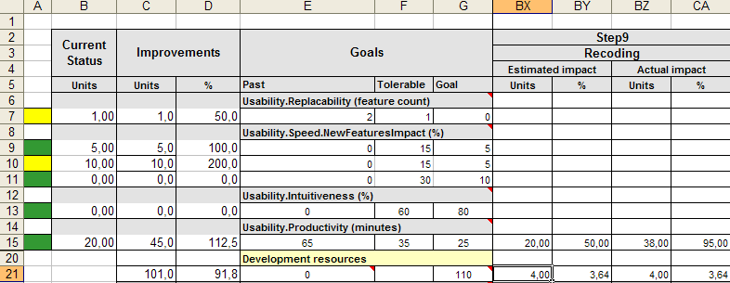
FIRM (Future Information Research Management, Norway) project step planning and accounting: using an Impact Estimation Table
IET for MR Project – Confirmit (<-FIRM Product Brand) 8.5
Solution: Recoding
Make it possible to recode variable on the fly from Reportal.
Estimated effort: 4 days
Estimated Productivity Improvement: 20 minutes (50% way to Goal)
actual result 38 minutes (95% progress towards Goal)
Trond Johansen
© Tom@Gilb.com www.gilb.com

Slide 47
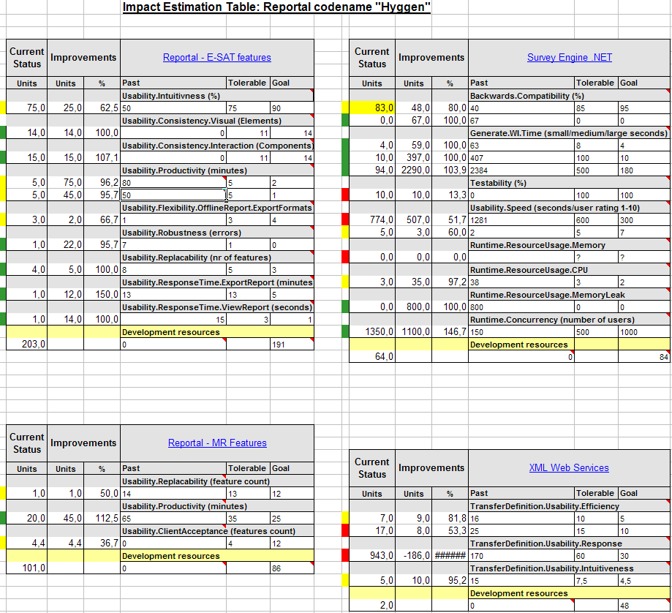
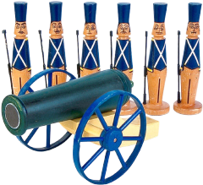
EVO Plan Confirmit 8.5 in Evo Step Impact Measurement 4 product areas were attacked in all: 25 Qualities concurrently, one quarter of a year. Total development staff = 13
9
8
3
3
© Tom@Gilb.com www.gilb.com

Slide 48
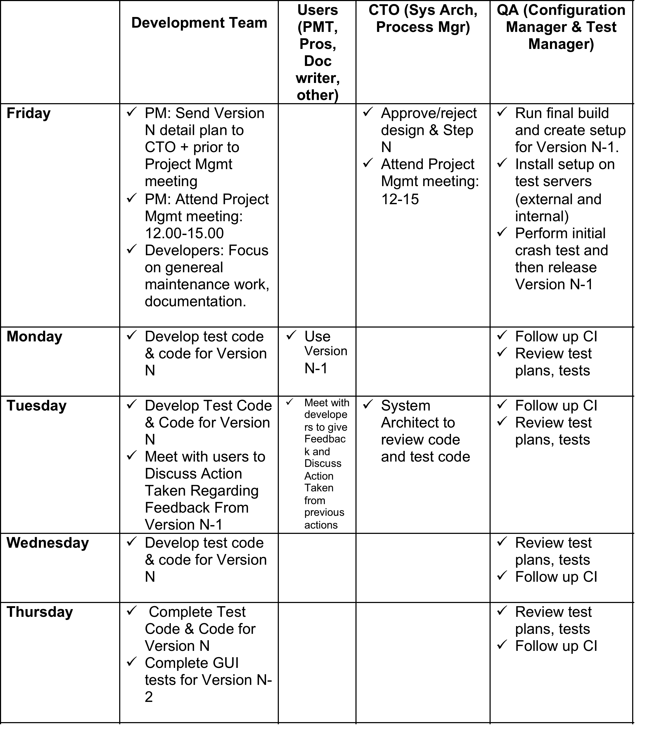
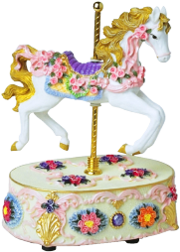
Confirmit Evo Weekly Value Delivery Cycle
© Tom@Gilb.com www.gilb.com

Slide 49
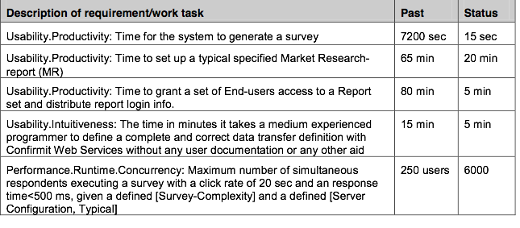
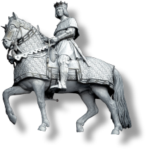
Evo’s impact on Confirmit product qualities 1st Qtr
Only 5 highlights of the 25 impacts are listed here
Release 8.5
© Tom@Gilb.com www.gilb.com

Slide 50
Initial Experiences and conclusions
EVO has resulted in
increased motivation and
enthusiasm amongst developers,
it opens up for empowered creativity
Developers
embraced the method and
saw the value of using it,
even though they found parts of Evo difficult to understand and execute
© Tom@Gilb.com www.gilb.com
Trond Johansen
Notes:
Project leaders feel:
Defining good requirements can be hard.
It was hard to find meters which were practical to use, and at the same time measure real product qualities.
Sometimes we would like to spend more than a day on designs, but this was not right according to our understanding of Evo. (Concept of backroom activity was new to us)
Sometimes it takes more than a week to deliver something of value to the client. (Concept of backroom activity was new to us)
We launched our first major release based on Evo in May 2004 (Rel. 8.5)
and we have already gotten feedback from users on some of the leaps in product qualities.
E.g. the time for the system to generate a complex survey has gone from 2 hours (=wait for the system to do work) to 15 seconds!

Slide 51
Evo’s impact on Confirmit product qualities - 1
The impact described is based on:
Internal usability test, productivity tests ++
Performance tests carried out at Microsoft Windows ISV laboratory in Redmond USA
Direct customer feedback
“I just wanted to let you know how appreciative we are of the new “entire report” export functionality you recently incorporated into the Reportal.
It produces a fantastic looking report, and the table of contents is a wonderful feature.
It is also a HUGE time saver.” <- Customer
“These leaps in product qualities would not have been achieved without Evo”. <- TJ
© Tom@Gilb.com www.gilb.com
Trond Johansen

Slide 52
Conclusions -
The method’s positive impact on Confirmit product qualities has convinced us that
Evo is a better suited development process than our former waterfall process, and
we will continue to use Evo in the future.
What surprised us the most was
the method’s power of focusing on delivering value for clients versus cost of implementation.
Evo enables you to re-prioritize the next development-steps based on the weekly feedback.
What seemed important
at the start of the project
may be replaced by other solutions
based on knowledge gained from previous steps.
The method has
high focus on measurable product qualities, and
defining these clearly and testably, requires training and maturity.
It is important to believe that everything can be measured,
and to seek guidance if it seems impossible.
© Tom@Gilb.com www.gilb.com
Trond Johansen

Slide 53
Initial Customer Feedback on the new Confirmit 9.0
November 24th, 2004
© Tom@Gilb.com www.gilb.com
Notes:
You may assume so :-)
-----Original Message-----From: Tom Gilb [mailto:tom@gilb.com] Sent: 25. november 2004 17:54To: Kjell ｯystein ｯksendalCc: Trond JohansenSubject: Re: Initial customer feedback on Confirmit 9.0may I assume I can show this to conferences like this Friday? :)Best Wishes Tom

Slide 54
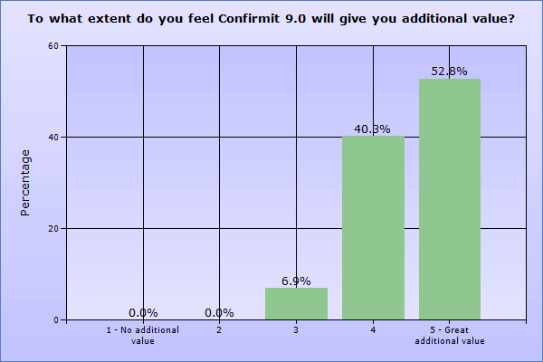
Initial perceived value of the new release (Base 73 people)
Base: 73
© Tom@Gilb.com www.gilb.com
Notes:
You may assume so :-) -----Original Message-----From: Tom Gilb [mailto:tom@gilb.com] Sent: 25. november 2004 17:54To: Kjell ｯystein ｯksendalCc: Trond JohansenSubject: Re: Initial customer feedback on Confirmit 9.0may I assume I can show this to conferences like this Friday? :)Best Wishes Tom

Slide 55
Evo’s impact on Confirmit 9.0 product qualities Results from the second quarter of using Evo. 1/2
Product quality
Description
Customer value
Intuitiveness
Probability that an inexperienced user can intuitively figure out how to set up a defined Simple Survey correctly.
Probability increased by 175%
Productivity
Time reduced by
38%
Time in minutes for a defined advanced user, with full knowledge of 9.0 functionality, to set up a defined advanced survey correctly.
Product quality
Description
Customer value
Productivity
Time (in minutes) to test a defined survey and identify 4 inserted script errors, starting from when the questionnaire is finished to the time testing is complete and is ready for production. (Defined Survey: Complex survey, 60 questions, comprehensive JScripting.)
Time reduced by 83% and
error tracking increased by 25%
October 6, 2017
© Tom@Gilb.com www.gilb.com

Slide 56
Evo’s impact on Confirmit 9.0 product qualities Results from the second quarter of using Evo. 2/2
Product quality
Description
Customer value
Performance
Max number of panelists that the system can support without exceeding a defined time for the defined task, with all components of the panel system performing acceptable.
Number of panelists increased by 1500%
Scalability
Ability to accomplish a bulk-update of X panelists within a timeframe of Z second
Number of panelists increased by 700%
Performance
Number of responses a database can contain if the generation of a defined table should be run in 5 seconds.
Number of responses increased by 1400%
Do you report such results in real released products in your second quarter of using a new lean or agile method like Scrum?
October 6, 2017
© Tom@Gilb.com www.gilb.com

Slide 57
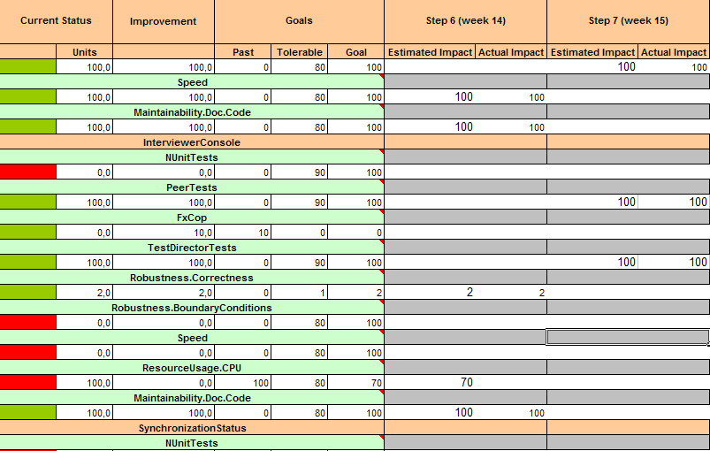
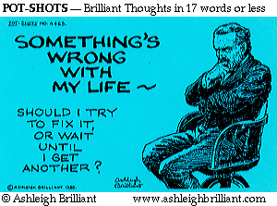
Code quality – ”green” week Confirmit (2005) Norway decided to design ‘ease of change’ in, to a legacy system, in one-week delivery-cycles, per month, using ‘Evo’ Agile ‘Refactoring to reduce technical debt’ -> Re-Engineering
In these ”green” weeks, some of the deliverables will be less visible for the end users, but more visible for our QA department.
We manage code quality through an Impact Estimation table.
Speed
Maintainability
Nunit Tests
PeerTests
TestDirectorTests
Robustness.Correctness
Robustness.Boundary Conditions
ResourceUsage.CPU
Maintainability.DocCode
SynchronizationStatus
Notes:
I think he said these were every 4th or 5th week, TG May 7 2005
Edited March 27 2017

Slide 58
The Monthly ‘Green Week’
Developer
Week 4
User Week 1
User Week 2
User Week 3
Select a Goal
Select a Goal
Select a Goal
Select a Goal
Brainstorm Designs
Brainstorm Designs
Brainstorm Designs
Brainstorm Designs
Estimate Design Impact/Cost
Estimate Design Impact/Cost
Estimate Design Impact/Cost
Estimate Design Impact/Cost
Pick best design
Pick best design
Pick best design
Pick best design
Implement design
Implement design
Implement design
Implement design
Test design
Test design
Test design
Test design
Update Progress to Goa
Update Progress to Goa
Update Progress to Goa
Update Progress to Goal
Notes:
First made 31 3 2017 for Agile Record Mythodology May 2017 tsg

Slide 59
The ‘Evo’ start-up Week
A 1 week ‘feasibility study’
Before starting real delivery of improved value to stakeholders
6 October 2017
Copyright Tom@Gilb.com 2017

Slide 60
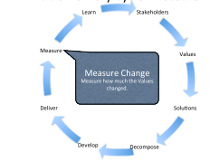
The Evo Startup Process a practical example
The ‘standards for Startup are at
Evo Startup Standard, Jan 12 2017
http://www.gilb.com/dl562
Evo Project Management Standard, Jan 12 2017
http://www.gilb.com/dl563
Presented ACCU Bristol © Gilb.com

Slide 61
Startup Process Day 1 and 2
Day 1: Project Objectives: The top few critical objectives quantified.
Objective: Determine, clarify, agree critical few project objectives – results – end states
Process:
Analyze current documentation and slides, for expressed or implied objectives (often implied by designs or lower level objectives)
Develop list of Stakeholders and their needs and values
Brainstorm ‘top ten’ critical objectives names list. Agree they are top critical few.
Detail definition in Planguage – meaning quantify and define clearly, unambiguously and in detail (a page)
Quality Control Objectives for Clarity: Major defect measurement. Exit if less than 1.0 majors per page
Quality Control Objectives for Relevance: Review against higher level objectives than project for alignment.
Define Constraints: resources, traditions, policies, corporate IT architecture, hidden assumptions.
Define Issues – yet unresolved
Note we might well choose to several things in parallel.
Output: A solid set of the top few critical objectives in quantified and measurable language. Stakeholder data specified.
Participants: anybody who is concerned with the business results, the higher the management level the better.
End of Day Process: meet 30 minutes with any responsible interested managers to present the outputs, and to get preliminary corrections and go-ahead.
Note: this process is so critical and can be time consuming, so if necessary it can spill over to next day. Perhaps in parallel with startup of the strategy identification. Nothing is more critical or fundamental than doing this well.
Day 2: Project Strategies and Architecture: the top few critical strategies for reaching the critical objectives
Objective: to identify the top ‘ten’ most critical strategic decisions or architectures; the ones that will contribute or enable us most, to reach our primary objective goal levels on time.
Process:
Analysis of current documentation and slides to identify candidate strategies, implied or expressed.
Brainstorming of the ‘names’ of the specific strategy list, the top ten and a set of less powerful ideas (say 11-30)
Detail each top ten strategy sufficiently to understand impacts (on objectives, time and costs)
Specify, for each strategy all critical related information (like stakeholders, risks, assumptions, constraints, etc.)
Quality Control for clarity – correct unclear items. Exit based on defect level, or not.
Likely that work will need to be done in parallel in order to do ten strategies to a rich level of specification.
Output: A formal strategy specification, ready for evaluation, and decomposition and delivery of partial value results.
Participants: system architects, project architects, strategy planners. And members of the project team who will be in on the entire weeks process. The major input here is technical and organizational strategy (the means to reach the objectives)
End of Day Process: : meet 30 minutes with any responsible interested managers to present the outputs, and to get preliminary corrections and go-ahead.
Presented ACCU Bristol © Gilb.com

Slide 62
Startup Process Day 3 and 4
Day 3: Evaluation of Strategies using Impact Estimation: our best estimates with experience and risk. How sure are of the major strategy decisions.
Objective: to estimate to primary effects and all side effects of all top critical strategies on all top critical objectives, and on some resources (time, cost, effort). The estimates will be backed up by evidence, or their credibility will be rated low.
Process:
Using the objectives and strategies developed on first 2 days as inputs
Populate an Impact Estimation table (aka Value Decision Table) with estimates of the expected result of deploying defined strategies. Estimate main intended impacts
And all side effects (on other core objectives)
And on all resources (time, money. Effort)
Estimate ± ranges
Specify evidence and sources for estimates
Determine Credibility level
Quality Control the IE table against standards (Rules for IE in CE book), for possible ‘exit’ (meets standards)
Lots of parallel work needed and expected to do a good job.
Output:
A fairly decent Impact Estimation table, possibly a several level set of them.
This will tell us if it is safe to proceed (we have good enough strategies)
And it will help us prioritize high value deliveries soon.
Participants: architects, planners, anybody with strong views on any of the strategies. The team for the week.
Note: it might be necessary and desirable, now or later, to do this impact estimation process at 2 or 3 related levels (Business, Stakeholder, IT System) in order to see the Business-IT relationship clearly. This might exceed time limits and be done parallel or later.
End of Day Process: meet 30 minutes with any responsible interested managers to present the outputs, and to get preliminary corrections and go-ahead.
Day 4: Evolutionary Step Decomposition: what are the high value short term value delivery steps we can execute.
Objective: to identify near team candidates for real value delivery to real stakeholders. What can we do for real next week!
Process:
Identify highest value (to costs) strategies and sub-sets of strategies
Decompose into doable subsets in weekly to monthly cycles of result delivery
Plan the near steps (1 or more) in detail so that we are ready to execute the step in practice.
Who does it, main responsible, team.
Expected measurable results and costs
Stakeholder involved in receiving
Test process (for value)
Output: 1 or more potential steps for value delivery to some stakeholders, a plan good enough to approve and execute in practive.
Participants: Project Management, architects prepared to decompose architecture in practice. The weeks team for this start up study.
End of Day Process: meet 30 minutes with any responsible interested managers to present the outputs, and to get preliminary corrections and go-ahead.
Presented ACCU Bristol © Gilb.com

Slide 63
Day 5
Boss approves doing the next week

Slide 64
111111
The Unity Method 111111
for decomposition into iterative value delivery steps
By Tom@Gilb.com
Slides at www.gilb.com/downloads
http://www.gilb.com/dl451
6 October 2017
© Gilb.com
Notes:
http://www.mindmapinspiration.com/unity/
©©©
Originally made as
10 minute lightening talk, 10:05 to 11 session
Oslo, Radisson BLU Hotel, Holbergs Plass
111111 Unity Method of Decomposition into weekly increments of value delivery. (10 min slides)
http://www.gilb.com/DL451
www.smidig.no
Smidig 2010

Slide 65
´1´ 4 U2
6 October 2017
© Gilb.com

Slide 66
One Bono U2
© Gilb.com
Notes:
48 seconds
Recorded from Utube off my Apple TV November 2010

Slide 67
´One´ lyrics
Is it getting better?
Or do you feel the same?
Will it make it easier on you now?
You got someone to blame
You say, one love, one life
When it's one need in the night
One love, we get to share it
Leaves you baby if you don't care for it
One love, one blood
One life, you got to do what you should
One life, with each other
Sisters, brothers
One life but we're not the same
We get to carry each other, carry each other
One
One
© POLYGRAM INT. MUSIC PUBL. B.V.;
© Gilb.com

Slide 68
A True War Story 111111 in practice
How we found a value delivery step ´next week´
a week of value delivery beat 11 years of waterfall method
© Gilb.com
Notes:
http://bbsnews.net/bbsn_photos/topics/US_Iraq_War/030322iraq_war_map.sized.jpg

Slide 69
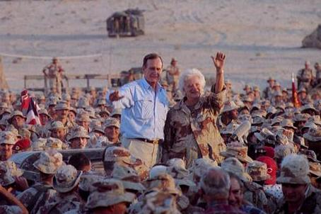
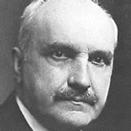
The Persinscom IT System Case
Commanding General
Norman Schwartzkopf
´Stormin´ Norman´
He who does not learn from history
Is doomed to repeat it
A Man Who understood that
“a bird in the hand is worth two in the Bush” <-tsg
6 October 2017
© Gilb.com
Notes:
news.bbc.co.uk/1/ hi/england/2309205.stm
http://www.lclark.edu/~krauss/culturecapsulessp2001/AlUsaimiweb/images/map-pop-kuwait.gif
George Santayana (1863 - 1952)Quotes:> George Santayana (1863 - 1952), was Spanish writer and philosopher. He was, however, raised and educated in the United States and both studied and taught at Harvard. As a philosopher, he wrote 'The Sense of Beauty' , 'The Life of Reason' and 'The Realms of Being'.
A Man Who understood that a bird in the hand is worth ten in the BUsh
http://www.psywarrior.com/BushGulfWar.jpg

Slide 70
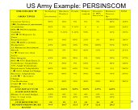
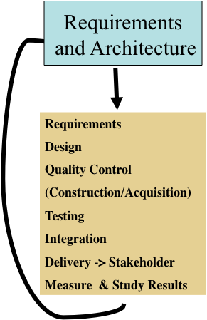
The ´Evo´ Planning Week at DoD
Monday
Define top Ten critical objectives, quantitatively
Agree that thee are the main points of the effort/project
Tuesday
Define roughly the top ten most powerful strategies
for enabling us to reach our objectives on time
Wednesday
Make an Impact Estimation Table for Objectives/Strategies
Sanity Test: do we seem to have enough powerful strategies to get to our Goals, with a reasonable safety margin?
A tool for decomposing the value steps and seeing best value for resources
Thursday
Divide into rough delivery steps (annual, quarterly)
Derive a delivery step for ‘Next Week’
Friday
Present these plans to approval manager (Brigadier General Pellicci)
get approval to deliver next week
(they can´t resist results next week!
6 October 2017
© Gilb.com
Notes:
Added to Evo slides by TG April 8 2008 Krakow
http://a52.g.akamaitech.net/f/52/827/1d/www.space.com/template_images/top10/spc_top10_mainimg_440.jpg
http://farm2.static.flickr.com/1236/1373197020_6eab10997a_o.jpg

Slide 71
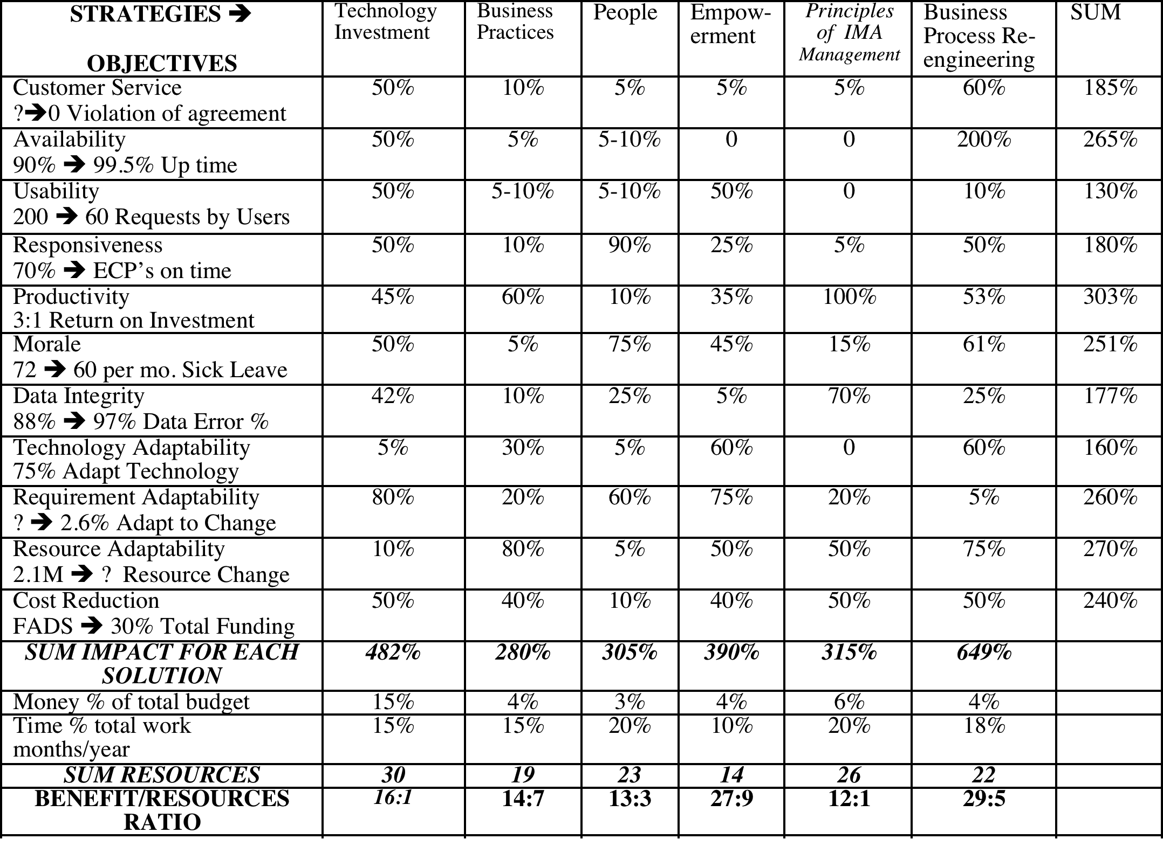
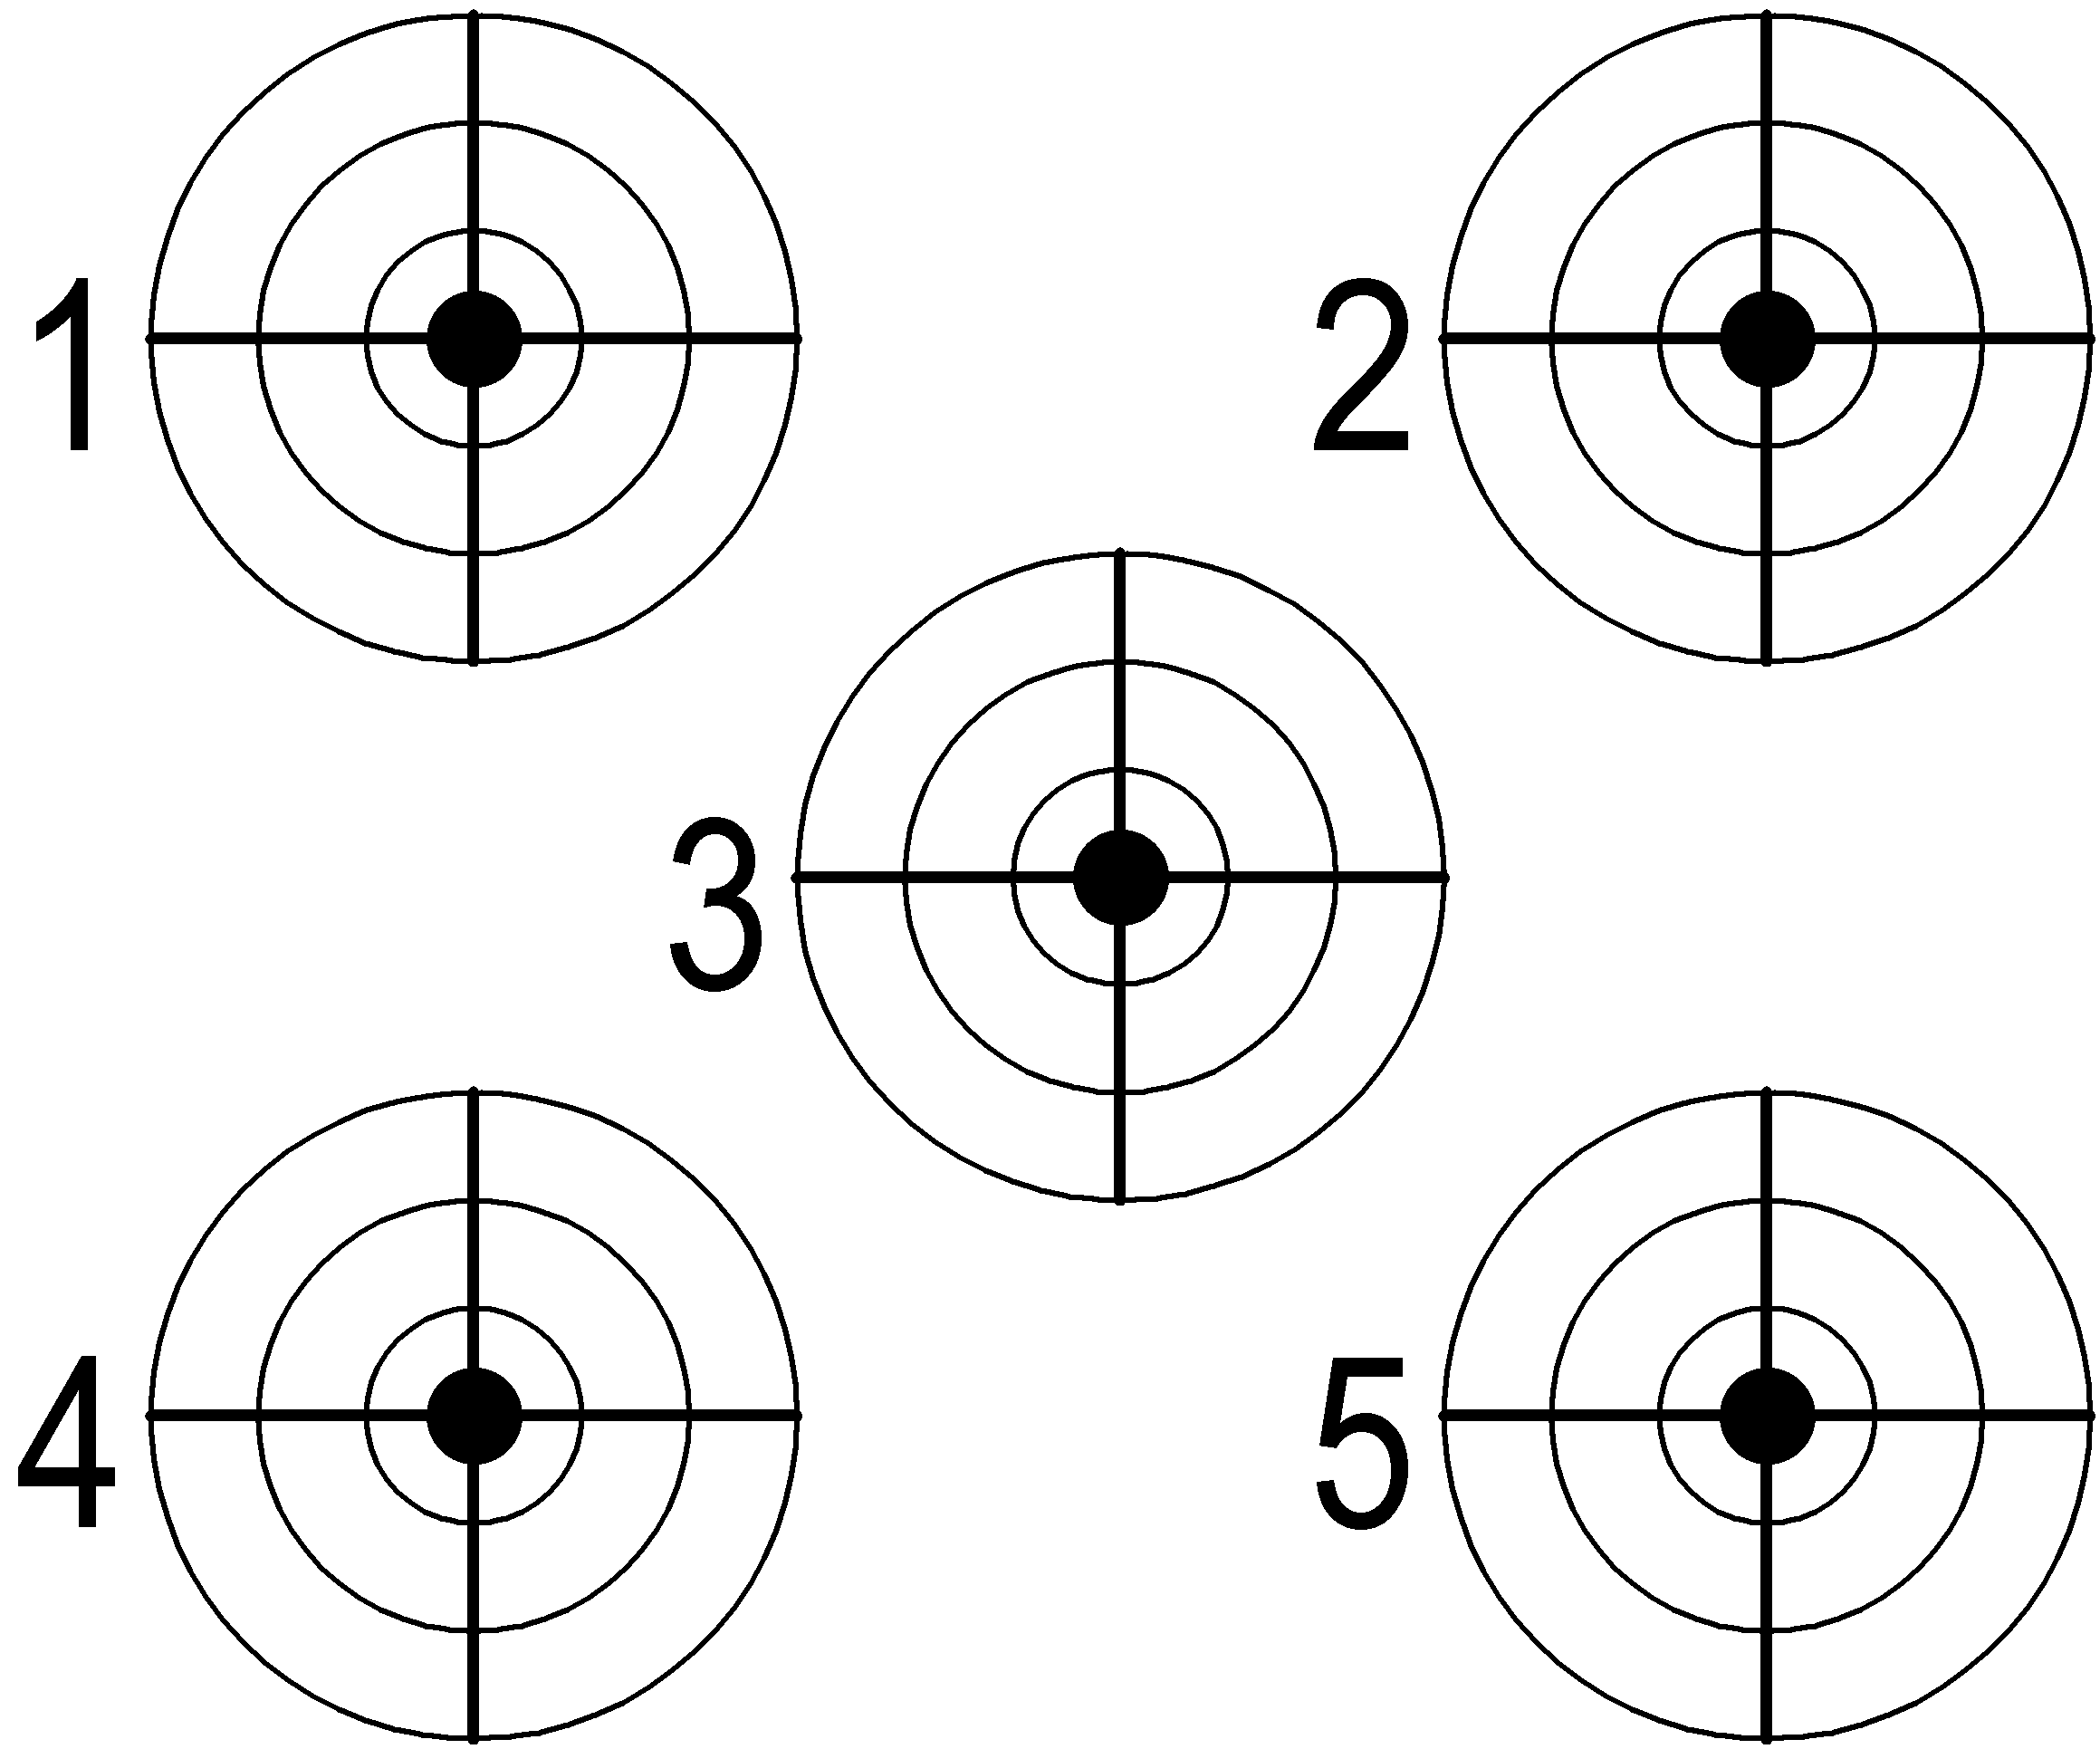
US Army Example: PERSINSCOM: Personnel System
Monday
←The Top Ten
Critical Objectives
Were decided
6 October 2017
© Gilb.com

Slide 72
Sample of Objectives/Strategy definitions US Army Example: PERSINSCOM: Personnel System
Example of one of the Objectives:
Customer Service:
Type: Critical Top level Systems Objective
Gist: Improve customer perception of quality of service provided.
Scale: Violations of Customer Agreement per Month.
Meter: Log of Violations.
Past [Last Year] Unknown Number ⬅State of PERSCOM Management Review
Record [NARDAC] 0 ? ⬅ NARDAC Reports Last Year
Fail : <must be better than Past, Unknown number> ⬅CG
Goal [This Year, PERSINCOM] 0 “Go for the Record” ⬅ Group SWAG
.
6 October 2017
© Gilb.com

Slide 73
US Army Example: PERSINSCOM: Personnel System
Tuesday
The Top Ten
Critical Strategies
For reaching the
←objectives
Were decided
© Gilb.com

Slide 74
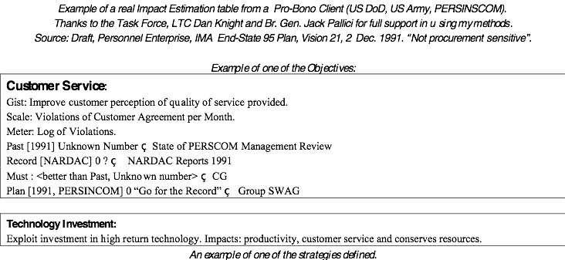
Sample of Objectives/Strategy definitions US Army Example: PERSINSCOM: Personnel System
A Strategy (Top Level of Detail)
Technology Investment:
Gist: Exploit investment in high return technology.
Impacts: productivity, customer service and conserves resources.
© Gilb.com

Slide 75
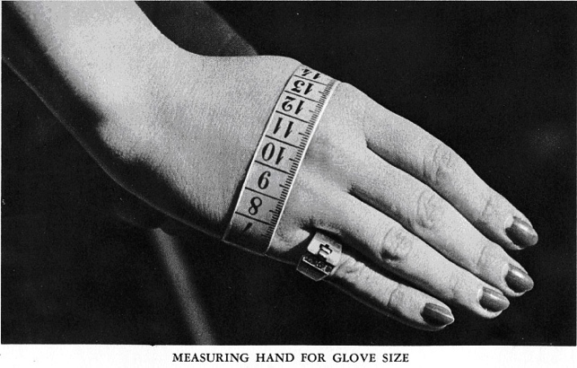
Wednesday: Sanity Check Day 3 of 5 of ‘Feasibility Study
We made a rough evaluation
of how powerful our strategies might be
in relation to our objectives
Impact Estimation Table
0% Neutral, no ± impact
100% Gets us to Goal level on time
50% Gets us half way to Goal at deadline
-10% has 10% negative side effect
© Gilb.com
Notes:
http://vintagesewing.info/1950s/50-hmg/hmg-02.html

Slide 76
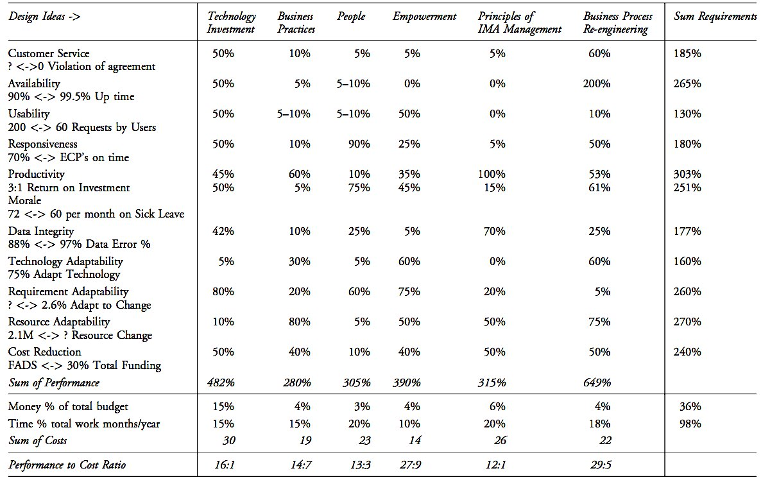
US DoD. Persinscom Impact EstimationTable:
Designs
Requirements
Estimated Impact of
Design
-> Requirements
29.5 :1
Sunday, 6 October 13
© Tom@Gilb.com Top10 Method
Notes:
Source CE book page 284. Persinscom US Army Personnel System.

Slide 77
US Army Example: PERSINSCOM: Personnel System
29.5 :1
Sunday, 6 October 13
© Tom@Gilb.com Top10 Method

Slide 78
Impact Estimation: Value-for-Money Delivery Table
29.5 : 1
6 October 2017
© Gilb.com
Notes:
29.5 to 1 fixed and 2 rectangles moved to right 12 3 2017 stockholm

Slide 79
Thursday: Day 4 of 5 of ‘Feasibility Study
We looked for a way to deliver some stakeholder results, next week
1 1 1 1 1 1 Unity
1% increase at least
1 stakeholder
1 quality/value
1 week delivery cycle
1 function focus
1 design used
6 October 2017
© Gilb.com
Notes:
http://vintagesewing.info/1950s/50-hmg/hmg-02.html

Slide 80
Next weeks Evo Step??
“You won’t believe we never thought of this, Tom!’
The step:
When the Top General Signs in
Move him to the head of the queue
Of all people inquiring on the system.
Can you deliver it next week?
Its already done: If General, move to head of queue’
© Tom@Gilb.com Top10 Method
Notes:
Added April 8 2008 Krakow TG
http://www.picturehistory.com/images/products/1/3/0/prod_13087.jpg
Added text
Can you deliver it next week?
Its already done: If General, move to head of queue
March 12 2017 Stockholm

Slide 81
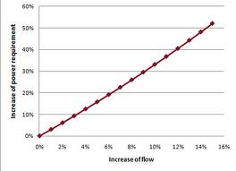
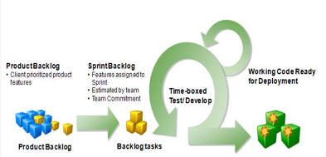
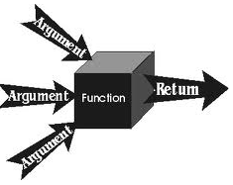
1 1 1 1 1 1 Unity
1% increase at least
1 stakeholder
1 quality or value
1-week delivery cycle
1 function focus
1 design used
6 October 2017
© Gilb.com

Slide 82
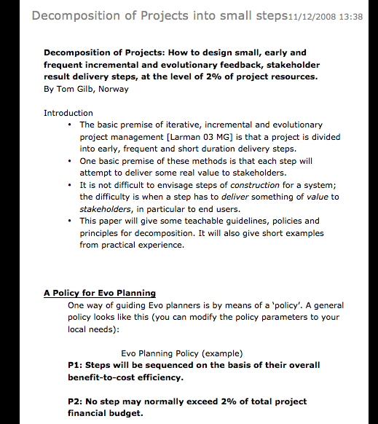
Decomposition Principles A Teachable Discipline
How to decompose systems into small evolutionary steps:
some principles to apply:
1• Believe there is a way to do it, you just have not found it yet!
2• Identify obstacles, but don't use them as excuses: use your imagination to get rid of them!
3• Focus on some usefulness for the user or customer, however small.
4• Do not focus on the design ideas themselves, they are distracting, especially for small initial cycles. Sometimes you have to ignore them entirely in the short term!
5• Think; one customer, tomorrow, one interesting improvement.
6• Focus on the results (which you should have defined in your goals, moving toward target levels).
7• Don't be afraid to use temporary-scaffolding designs. Their cost must be seen in the light of the value of making some progress, and getting practical experience.
8• Don't be worried that your design is inelegant; it is results that count, not style.
9• Don't be afraid that the customer won't like it. If you are focusing on results they want, then by definition, they should like it. If you are not, then do!
10• Don't get so worried about "what might happen afterwards" that you can make no practical progress.
11• You cannot foresee everything. Don't even think about it!
12• If you focus on helping your customer in practice, now, where they really need it, you will be forgiven a lot of ‘sins’!
13• You can understand things much better, by getting some practical experience (and removing some of your fears).
14• Do early cycles, on willing local mature parts of your user community.
15• When some cycles, like a purchase-order cycle, take a long time, initiate them early, and do other useful cycles while you wait.
16• If something seems to need to wait for ‘the big new system’, ask if you cannot usefully do it with the ‘awful old system’, so as to pilot it realistically, and perhaps alleviate some 'pain' in the old system.
17• If something seems too costly to buy, for limited initial use, see if you can negotiate some kind of ‘pay as you really use’ contract. Most suppliers would like to do this to get your patronage, and to avoid competitors making the same deal.
18• If you can't think of some useful small cycles, then talk directly with the real ‘customer’ or end user. They probably have dozens of suggestions.
19• Talk with end users in any case, they have insights you need.
20• Don't be afraid to use the old system and the old ‘culture’ as a launching platform for the radical new system. There is a lot of merit in this, and many people overlook it.
I have never seen an exception in 33 years of doing this with many varied cultures. Oh Ye of little faith!
http://www.gilb.com/tiki-download_file.php?fileId=41
6 October 2017
© Gilb.com
Notes:
Decomposition of Projects: How to Design Small Incremental Steps INCOSE 2008
http://www.gilb.com/tiki-download_file.php?fileId=41
http://www.gilb.com/tiki-download_file.php?fileId=350
Decomposition Slides Aug 2010

Slide 83
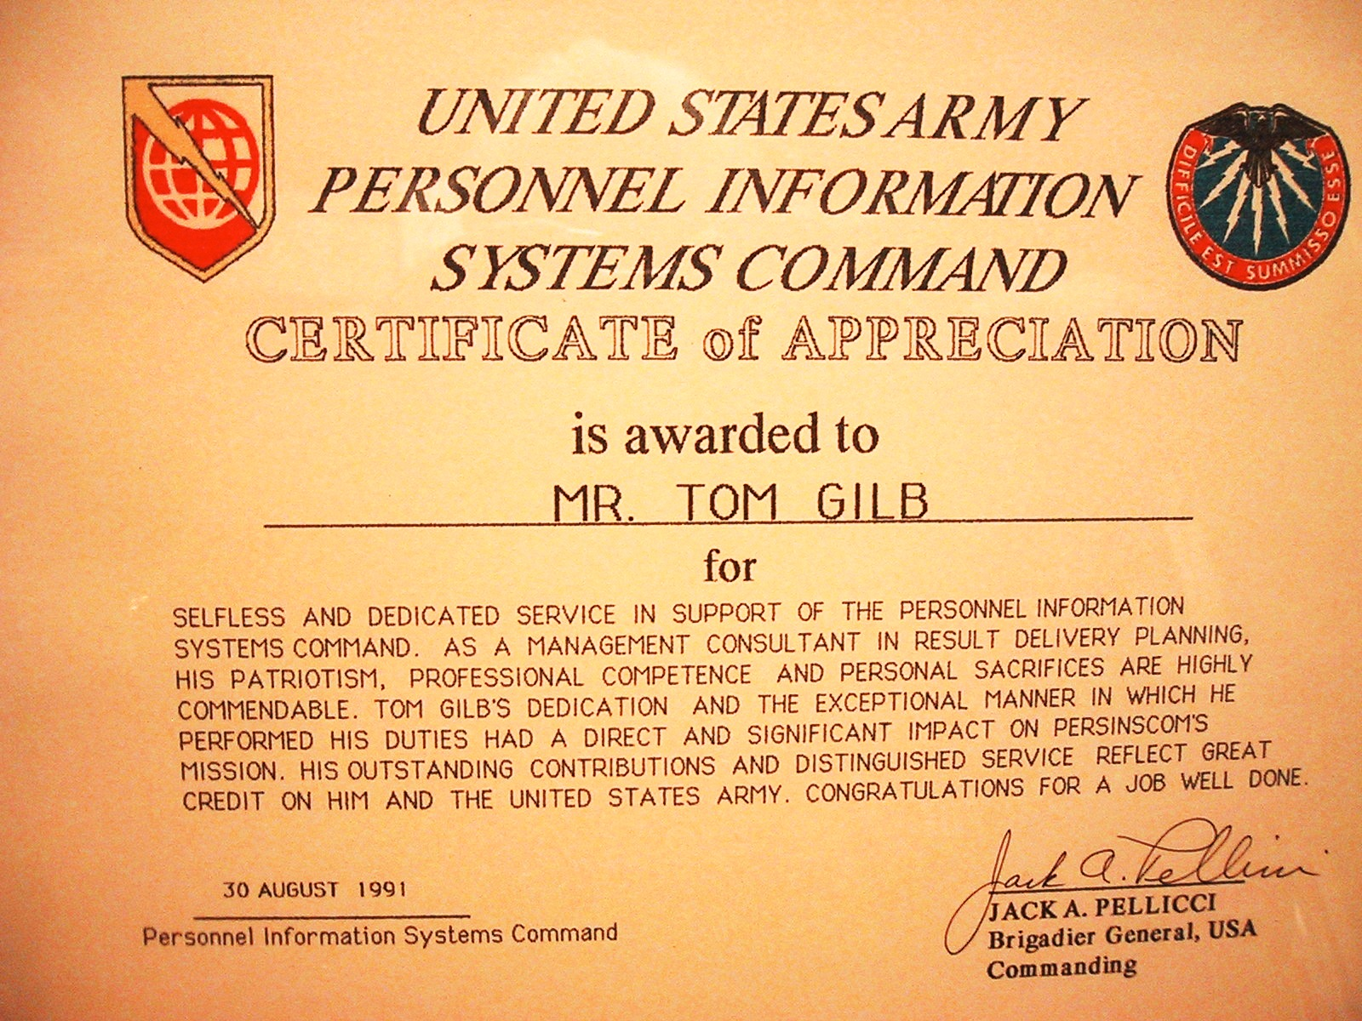
My Payoff

Slide 84
Rene Descartes on Focus
“We should bring the whole force of our minds
to bear upon the most minute and simple details
and to dwell upon them for a long time
so that we become accustomed to perceive the truth clearly and distinctly.”
Rene Descartes, Rules for the Direction of the Mind, 1628
© Gilb.com
Notes:
Added January 5 2003 TG from quotations from Ben Shneiderman
url www.cals.ncsu.edu for Descartes
Rene Descartes was a mediocre scientist, a great mathematician and an even greater philosopher. He is considered to be the father of modern philosophy. His thought affected educational theory in the following manner:
1. EDUCATION A NATURAL RIGHT OF MAN. Since knowledge is attained through the reasoning processes, every man has the right to develop the innate faculties of his soul. Although men learn at different paces, education is possible for all.
2. IMPORTANCE OF DOUBTING AUTHORITATIVE PROPOSITIONS. It is necessary for man to doubt everything prior to asserting any definite truths. This act of doubt leads the mind to the rational assertion of a self-evident principle that cannot be doubted. Therefore, it is possible to infer the right of each man to think for himself.
3. CLEAR AND CERTAIN TRUTHS. Man ought to accept no statement as true, unless it appears clear and certain to his intellect.
4. PSYCHOLOGICAL PRINCIPLES OF KNOWLEDGE. In the act of knowing, the mind proceeds from what is already known to the unknown, This infers the need for a teacher to base learning upon the intellectual experience of each pupil. Descartes asserted the principle that the mind moves from the concrete to the abstract, the simple to the more complex. These principles underlie the organization of

Slide 85
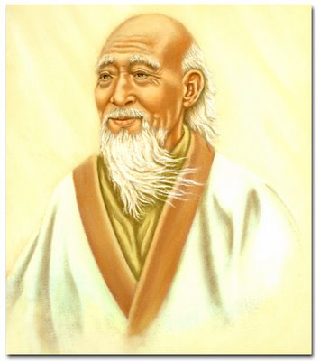
Tao Te Ching (500BC)
That which remains quiet, is easy to handle.
That which is not yet developed is easy to manage.
That which is weak is easy to control.
That which is still small is easy to direct.
Deal with little troubles before they become big.
Attend to little problems before they get out of hand.
For the largest tree was once a sprout,
the tallest tower started with the first brick,
and the longest journey started with the first step.
From Lao Tzu in Bahn, 1980 (also quoted in Gilb, Principles of Software Engineering Management page 96), Penguin book
© Gilb.com
Notes:
lao_tzu_tao_te_ching.jpg
355 × 400 - Tao Te Ching ...
bodymindheartspirit.ning.com
Similar ‑ More sizes
Website for this image
edepot.com
daodejing1.jpg
350 × 467 - Tao and First Line of Tao Te Ching
edepot.com

Slide 86
“Evo” Project Management
Evo is short for Evolutionary
But
We have played with acronyms
Evolutionary
Value
Optimization
Copyright Tom@Gilb.com 2017

Slide 87
The Simplest and Best Agile Project Method
Background:
A number of ‘agile’ methods have appeared, trying to simplify project management and systems implementation.
They have all missed the central point,
namely evolutionary project management (Evo),
using quantified feedback about central goals and budgets
which would allow them complete freedom to simplify, and to succeed.
Here is my suggestion for ultimate agility.
Notes:
Tag: Agile Project. Version: January 28, 2003. Owner: Tom@Gilb.com. Status: Draft.

Slide 88
The Simplest and Best Agile Project Method (1 pg ∑)
Process Description
1. Gather from all the key stakeholders the top few (5 to 20) most critical goals that the project needs to deliver.
Give each goal a reference name (a tag).
2. For each goal, define a scale of measure and a ‘final’ goal level.
For example: Reliable: Scale: Mean Time Before Failure, Goal: >1 month.
3. Define approximately 4 budgets for your most limited resources
(for example, time, people, money, and equipment).
4. Write up these plans for the goals and budgets
(Try to ensure this is kept to only one page).
5. Negotiate with the key stakeholders to formally agree the goals and budgets.
6. Plan to deliver some benefit
(that is, progress towards the goals)
in weekly (or shorter) increments (Evo steps).
7. Implement the project in Evo steps.
Report to project sponsors after each Evo step (weekly, or shorter) with your best available estimates or measures, for each performance goal and each resource budget.
On a single page, summarize the progress to date towards achieving the goals and the costs incurred.
8. When all Goals are reached: ‘Claim success and move on’
a. Free remaining resources for more profitable ventures

Slide 89
Agile project Management Policy
Policy
The project manager, and the project, will be judged exclusively on
the relationship of progress towards achieving the goals
versus the amounts of the budgets used.
The project team will do anything legal and ethical to deliver the goal levels within the budgets.
The team will be paid and rewarded for
benefits delivered
in relation to cost.
The team will find their own work process and their own design.
As experience dictates, the team will be free to suggest to the project sponsors (stakeholders) adjustments to ‘more realistic levels’ of the goals and budgets.

Slide 90
A Management Policy for Architecture Prioritisation
“Choose architecture that delivers early measurable stakeholder value, as defined by our top critical numeric objectives.”
Copyright Tom@Gilb.com 2017
Notes:
** 2017 Tom@gilb.com

Slide 91
An Architecture Policy
“Evaluate architecture in relation to all critical stakeholder targets and constraints,
estimate impacts with regard to risk,
deliver best impact designs early,
drop architecture early with low impact to cost ratio.”
Copyright Tom@Gilb.com 2017
Notes:
** 2017 tom@gilb.com for London Sw Arch Conf talk 9 Oct 2017

Slide 92
Concluding Remarks
“PRIORITISE EFFICIENT ARCHITECTURE DYNAMICALLY”
A. Managing Priority (paper)
http://www.gilb.com/DL60
B. Choice and Priority Using Planguage:
A wide variety of specification devices and analytical tools. (paper)
http://www.gilb.com/DL48
C. Value Planning book, Chapter 6 Prioritization
https://www.dropbox.com/home/A%20VALUE%20PLANNING%20MAIN%20WEB%20COPY%20850PAGE%20%20AND%20SUBSETS%202017/****%20VP%20Chapter%20Modules/Ch%206%20Prioritization%20Evaluation?preview=VP+Chapter+6.+Prioritization%2C+Evaluation+BestQ.pdf
Copyright Tom@Gilb.com 2017

Slide 93
#BCSEASG
https://www.gilb.com/store/2W2zCX6z
GILB COURSES AT BCS
http://www.bcs.org/category/10136
https://www.gilb.com/p/competitive-engineering
needsandmeans.com = the tool
THESE SLIDES = tinyurl.com/Gilb17July,
or see concepts.gilb.com/file24
Notes:
so this is the last slide and it can rest on the projector. People can photo it or get it from the slides, later.

Slide 94
“The End”
That is the end of this slides. You need read no more.
But I included an ‘appendix’, in case anyone would like more detail!
Here it is.

Slide 95
APPENDIX!
If we re running short of time on the talk, we will skip this
But we include the slides for you to study later
References in Notes of this slide
Notes:
[POSEM] Tom Gilb: Principles of Software Engineering Management, Addison-Wesley, 1988.
[CE] Tom Gilb, Competitive Engineering: A Handbook for Systems Engineering, Requirements Engineering & Software Engineering using Planguage, Elsevier 2005
[Gerstner] (Louis V. Gerstner, Jr. Retired Chairman and CEO, IBM, “Who Says Elephants Can't Dance? Inside IBM's Historic Turnaround”)
[WWW] www.Gilb.com
[Times] "A survey of 1,027, mainly private sector, IT projects published in the 2001 British Computer Society Review showed that only 130 (12.7 per cent) succeeded." is an article online at Web address: http://www.BCS.org.UK/review/2001/html/p061.htm under the title "IT projects sink or swim" To see the online report in all its HTML glory, go to http://www.BCS.org.uk/review/2001/html/p061.htm
[Standish] Turning CHAOS into SUCCESS By Jim Johnson, SOFTWAREmag.com*, December 1999: http://www.softwaremag.com/archive/1999dec/Success.html.
[Larman] Agile and Iterative Development: A Manager's Guide Craig Larman Addison-Wesley, 2003 http://www.amazon.com/exec/obidos/ASIN/0131111558/qid%3D1055614131/sr%3D 11-1/ref%3Dsr%5F11%5F1/104-5178070-9819101 www.craiglarman.com
[Basili & Larman] IEEE Computer paper June 2003, A History of Iterative and Incremental Development, Craig Larman, Chief Scientist, Valtech, USA, craig@craiglarman.com. Dr. Victor R. Basili, Professor, Dept. of Computer Science, University of Maryland, basili@cs.umd.edu

Slide 96
I will comment on the process definition, statement by statement.

Slide 97
‘The Simplest and Best Agile Project Method’
The Gilb Agile Process (“GAP” of course) is ‘simplest method because of its sharp focus at a ‘high level’, on the ‘end results’.
This allows us to avoid distracting management attention
with the supporting processes, designs and requirements, needed to deliver the results.
The supporting processes, designs, and requirements do need to exist of course,
but our GAP process is neutral,
and in fact encourages competition and selection
of the fittest supporting processes at any step.
This is essentially different from making user-driven lists of functions to program into the system – typical of conventional Agile methods.
It focuses on the main outcome, for example high security, ease of use, or flexibility.
GAP is the ‘Best’ Agile process because it focuses on numerically defined and tracked critical business or technical goals of a project.
This numeric focus is in sharp contrast to the non-numeric ‘yellow sticky’ mentality of Conventional Routine Agile Processes.

Slide 98
Richard Smith
“ I attended a 3-day course with you and Kai whilst at Citigroup in 2006”
© Gilb.com
Notes:
Yes, Richard was trained in Requirements by you and Kai while he was at Citi.
From: Tom Gilb [mailto:tom@gilb.com]
Sent: 26 February 2009 15:16
To: Dick Holland
Hi Tom,
I am honoured to be in contact with you again! I attended a 3-day course with you and Kai whilst at Citigroup in 2006 (I worked in the FX e-commerce front-office team at the time). You may be interested to know that I wrote a detailed business requirements spec (no design, just requirements) adopting many of your ideas shortly after the course including key quantified requirements. This spec ended up staying largely stable for a year as we did an evo – like development process, at the end of which we successfully went live with a brand-new FX order management system in a global big-bang release to 800 Citi users in 20 locations.
I hope to continue to use and expand competitive engineering practises at my new home here at LZ, with Dick’s help!
Many regards,
Richard.
Hi Tom,
Thought you might like to know I have just completed a review of Competitive Engineering on my own company's blog:
http://rsbatechnology.co.uk/blog:8
As I tried to do when I worked with Dick at LatentZero, I continue to try and spread the word to a world of (initial) unbelievers! I actually have an interesting opportunity right now to demonstrate the benefits of early & often delivery of value to stakeholders in a couple of new projects. Look forward to meeting you and Kai again sometime ...
Regards,
Richard Smith.sept 10 2011

Slide 99
Previous PM Methods: No ‘Value delivery tracking’. No change reaction ability
Richard Smith
“However, (our old project management methodology) main failings were that
it almost totally missed the ability to track delivery of actual value improvements to a project's stakeholders,
and the ability to react to changes
in requirements and
priority
for the project's duration”
© Gilb.com
Notes:
Yes, Richard was trained in Requirements by you and Kai while he was at Citi.
From: Tom Gilb [mailto:tom@gilb.com]
Sent: 26 February 2009 15:16
To: Dick Holland
Hi Tom,
I am honoured to be in contact with you again! I attended a 3-day course with you and Kai whilst at Citigroup in 2006 (I worked in the FX e-commerce front-office team at the time). You may be interested to know that I wrote a detailed business requirements spec (no design, just requirements) adopting many of your ideas shortly after the course including key quantified requirements. This spec ended up staying largely stable for a year as we did an evo – like development process, at the end of which we successfully went live with a brand-new FX order management system in a global big-bang release to 800 Citi users in 20 locations.
I hope to continue to use and expand competitive engineering practises at my new home here at LZ, with Dick’s help!
Many regards,
Richard.
Hi Tom,
Thought you might like to know I have just completed a review of Competitive Engineering on my own company's blog:
http://rsbatechnology.co.uk/blog:8
As I tried to do when I worked with Dick at LatentZero, I continue to try and spread the word to a world of (initial) unbelievers! I actually have an interesting opportunity right now to demonstrate the benefits of early & often delivery of value to stakeholders in a couple of new projects. Look forward to meeting you and Kai again sometime ...
Regards,
Richard Smith.sept 10 2011

Slide 100
We only had the illusion of control. But little help to testers and analysts
Richard Smith
“The (old) toolset generated lots of charts and stats
that provided the illusion of risk control.
But actually provided very little help to the analysts, developers and testers actually doing the work at the coal face.”
© Gilb.com
Notes:
Yes, Richard was trained in Requirements by you and Kai while he was at Citi.
From: Tom Gilb [mailto:tom@gilb.com]
Sent: 26 February 2009 15:16
To: Dick Holland
Hi Tom,
I am honoured to be in contact with you again! I attended a 3-day course with you and Kai whilst at Citigroup in 2006 (I worked in the FX e-commerce front-office team at the time). You may be interested to know that I wrote a detailed business requirements spec (no design, just requirements) adopting many of your ideas shortly after the course including key quantified requirements. This spec ended up staying largely stable for a year as we did an evo – like development process, at the end of which we successfully went live with a brand-new FX order management system in a global big-bang release to 800 Citi users in 20 locations.
I hope to continue to use and expand competitive engineering practises at my new home here at LZ, with Dick’s help!
Many regards,
Richard.
Hi Tom,
Thought you might like to know I have just completed a review of Competitive Engineering on my own company's blog:
http://rsbatechnology.co.uk/blog:8
As I tried to do when I worked with Dick at LatentZero, I continue to try and spread the word to a world of (initial) unbelievers! I actually have an interesting opportunity right now to demonstrate the benefits of early & often delivery of value to stakeholders in a couple of new projects. Look forward to meeting you and Kai again sometime ...
Regards,
Richard Smith.sept 10 2011

Slide 101
The proof is in the pudding;
Richard Smith
“The proof is in the pudding;
I have used Evo
(albeit in disguise sometimes)
on two large, high-risk projects in front-office investment banking businesses,
and several smaller tasks. “
© Gilb.com
Notes:
Yes, Richard was trained in Requirements by you and Kai while he was at Citi.
From: Tom Gilb [mailto:tom@gilb.com]
Sent: 26 February 2009 15:16
To: Dick Holland
Hi Tom,
I am honoured to be in contact with you again! I attended a 3-day course with you and Kai whilst at Citigroup in 2006 (I worked in the FX e-commerce front-office team at the time). You may be interested to know that I wrote a detailed business requirements spec (no design, just requirements) adopting many of your ideas shortly after the course including key quantified requirements. This spec ended up staying largely stable for a year as we did an evo – like development process, at the end of which we successfully went live with a brand-new FX order management system in a global big-bang release to 800 Citi users in 20 locations.
I hope to continue to use and expand competitive engineering practises at my new home here at LZ, with Dick’s help!
Many regards,
Richard.
Hi Tom,
Thought you might like to know I have just completed a review of Competitive Engineering on my own company's blog:
http://rsbatechnology.co.uk/blog:8
As I tried to do when I worked with Dick at LatentZero, I continue to try and spread the word to a world of (initial) unbelievers! I actually have an interesting opportunity right now to demonstrate the benefits of early & often delivery of value to stakeholders in a couple of new projects. Look forward to meeting you and Kai again sometime ...
Regards,
Richard Smith.sept 10 2011

Slide 102
Experience: if top level requirements are separated from design, the ‘requirements’ are stable!
Richard Smith
“On the largest critical project,
the original business functions & performance objective requirements document,
which included no design,
essentially remained unchanged
over the 14 months the project took to deliver,….”
“ I attended a 3-day course with you and Kai whilst at Citigroup in 2006”, Richard Smith
© Gilb.com
Notes:
Yes, Richard was trained in Requirements by you and Kai while he was at Citi.
Thi was I believe a book rviewputon Amazon for CE book.
From: Tom Gilb [mailto:tom@gilb.com]
Sent: 26 February 2009 15:16
To: Dick Holland
Hi Tom,
I am honoured to be in contact with you again! I attended a 3-day course with you and Kai whilst at Citigroup in 2006 (I worked in the FX e-commerce front-office team at the time). You may be interested to know that I wrote a detailed business requirements spec (no design, just requirements) adopting many of your ideas shortly after the course including key quantified requirements. This spec ended up staying largely stable for a year as we did an evo – like development process, at the end of which we successfully went live with a brand-new FX order management system in a global big-bang release to 800 Citi users in 20 locations.
I hope to continue to use and expand competitive engineering practises at my new home here at LZ, with Dick’s help!
Many regards,
Richard.
Hi Tom,
Thought you might like to know I have just completed a review of Competitive Engineering on my own company's blog:
http://rsbatechnology.co.uk/blog:8
As I tried to do when I worked with Dick at LatentZero, I continue to try and spread the word to a world of (initial) unbelievers! I actually have an interesting opportunity right now to demonstrate the benefits of early & often delivery of value to stakeholders in a couple of new projects. Look forward to meeting you and Kai again sometime ...
Regards,
Richard Smith.sept 10 2011

Slide 103
Dynamic (Agile, Evo) design testing: not unlike ‘Lean Startup’
Richard Smith
“… but the detailed designs
(of the GUI, business logic, performance characteristics)
changed many many times,
guided by lessons learnt
and feedback gained by
delivering a succession of early deliveries
to real users”
“ I attended a 3-day course with you and Kai whilst at Citigroup in 2006”, Richard Smith
© Gilb.com
Notes:
Yes, Richard was trained in Requirements by you and Kai while he was at Citi.
From: Tom Gilb [mailto:tom@gilb.com]
Sent: 26 February 2009 15:16
To: Dick Holland
Hi Tom,
I am honoured to be in contact with you again! I attended a 3-day course with you and Kai whilst at Citigroup in 2006 (I worked in the FX e-commerce front-office team at the time). You may be interested to know that I wrote a detailed business requirements spec (no design, just requirements) adopting many of your ideas shortly after the course including key quantified requirements. This spec ended up staying largely stable for a year as we did an evo – like development process, at the end of which we successfully went live with a brand-new FX order management system in a global big-bang release to 800 Citi users in 20 locations.
I hope to continue to use and expand competitive engineering practises at my new home here at LZ, with Dick’s help!
Many regards,
Richard.
Hi Tom,
Thought you might like to know I have just completed a review of Competitive Engineering on my own company's blog:
http://rsbatechnology.co.uk/blog:8
As I tried to do when I worked with Dick at LatentZero, I continue to try and spread the word to a world of (initial) unbelievers! I actually have an interesting opportunity right now to demonstrate the benefits of early & often delivery of value to stakeholders in a couple of new projects. Look forward to meeting you and Kai again sometime ...
Regards,
Richard Smith.sept 10 2011

Slide 104
It looks like the stakeholders liked the top level system qualities, on first try
Richard Smith
“ In the end, the new system responsible for 10s of USD billions of notional risk,
successfully went live
over one weekend
for 800 users worldwide,
and was seen as a big success
by the sponsoring stakeholders.”
“ I attended a 3-day course with you and Kai whilst at Citigroup in 2006” , Richard Smith
© Gilb.com
Notes:
Yes, Richard was trained in Requirements by you and Kai while he was at Citi.
From: Tom Gilb [mailto:tom@gilb.com]
Sent: 26 February 2009 15:16
To: Dick Holland
Hi Tom,
I am honoured to be in contact with you again! I attended a 3-day course with you and Kai whilst at Citigroup in 2006 (I worked in the FX e-commerce front-office team at the time). You may be interested to know that I wrote a detailed business requirements spec (no design, just requirements) adopting many of your ideas shortly after the course including key quantified requirements. This spec ended up staying largely stable for a year as we did an evo – like development process, at the end of which we successfully went live with a brand-new FX order management system in a global big-bang release to 800 Citi users in 20 locations.
I hope to continue to use and expand competitive engineering practises at my new home here at LZ, with Dick’s help!
Many regards,
Richard.
Hi Tom,
Thought you might like to know I have just completed a review of Competitive Engineering on my own company's blog:
http://rsbatechnology.co.uk/blog:8
As I tried to do when I worked with Dick at LatentZero, I continue to try and spread the word to a world of (initial) unbelievers! I actually have an interesting opportunity right now to demonstrate the benefits of early & often delivery of value to stakeholders in a couple of new projects. Look forward to meeting you and Kai again sometime ...
Regards,
Richard Smith.sept 10 2011

Slide 105
‘Evo’ Process Description
http://www.gilb.com/dl487
The Evo ‘Standard’ Process Description
Evo Chapter in CE Book
http://www.gilb.com/DL77
Notes:
** 2017 added
http://www.gilb.com/DL77
link tested July 15 2017

Slide 106
1. Gather from all the key stakeholders the top few (5 to 20) most critical goals that the project needs to deliver. Give each goal a reference name (a tag).
Projects need to learn to focus on all stakeholders that arguably can affect the success or failure.
The needs of these stakeholders must be determined – by any useful methods – and converted into project requirements.
By contrast the Conventional Agile Model
focuses on a User/Customer (‘in the next room’).
Good enough if they were the only stakeholder.
But disastrous for most real projects,
where the critical stakeholders are more varied in type and number.
Conventional Agile processes, due to this dangerously narrow requirements focus, risk outright failure,
even if the ‘Customer’ gets all their needs fulfilled.

Slide 107
Real Bank Project : Project Progress Testability Quantification of the most-critical project objectives on day 1
P&L-Consistency&T P&L: Scale: total adjustments btw Flash/Predict and Actual (T+1) signed off P&L. per day. Past 60 Goal: 15
Speed-To-Deliver: Scale: average Calendar days needed from New Idea Approved until Idea Operational, for given Tasks, on given Markets. Past [2009, Market = EURex, Task =Bond Execution] 2-3 months ? Goal [Deadline =End 20xz, Market = EURex, Task =Bond Execution] 5 days
Operational-Control: Scale: % of trades per day, where the calculated economic difference between OUR CO and Marketplace/Clients, is less than “1 Yen”(or equivalent). Past [April 20xx] 10% change this to 90% NH Goal [Dec. 20xy] 100%
Operational-Control.Consistent: Scale: % of defined [Trades] failing full STP across the transaction cycle. Past [April 20xx, Trades=Voice Trades] 95% Past [April 20xx, Trades=eTrades] 93% Goal [April 20xz, Trades=Voice Trades] <95 ± 2%> Goal [April 20xz, Trades=eTrades] 98.5 ± 0.5 %
Operational-Control.Timely.End&OvernightP&L Scale: number of times, per quarter, the P&L information is not delivered timely to the defined [Bach-Run]. Past [April 20xx, Batch-Run=Overnight] 1 Goal [Dec. 20xy, Batch-Run=Overnight] <0.5> Past [April 20xx, Batch-Run= T+1] 1 Goal [Dec. 20xy, Batch-Run=End-Of-Day, Delay<1hour] 1
Operational-Control.Timely.IntradayP&L Scale: number of times per day the intraday P&L process is delayed more than 0.5 sec.
Operational-Control.Timely.Trade-Bookings Scale: number of trades per day that are not booked on trade date. Past [April 20xx] 20 ?
Front-Office-Trade-Management-Efficiency Scale: Time from Ticket Launch to trade updating real-time risk view Past [20xx, Function = Risk Mgt, Region = Global] ~ 80s +/- 45s ?? Goal [End 20xz, Function = Risk Mgt, Region = Global] ~ 50% better?
Managing Risk – Accurate – Consolidated – Real Time
Risk.Cross-Product Scale: % of financial products that risk metrics can be displayed in a single position blotter in a way appropriate for the trader (i.e. – around a benchmark vs. across the curve). Past [April 20xx] 0% 95%. Goal [Dec. 20xy] 100%
Risk.Low-latency Scale: number of times per day the intraday risk metrics is delayed by more than 0.5 sec. Past [April 20xx, NA] 1% Past [April 20xx, EMEA] ??% Past [April 20xx, AP] 100% Goal [Dec. 20xy] 0%
Risk.Accuracy
Risk. user-configurable Scale: ??? pretty binary – feature is there or not – how do we represent? Past [April 20xx] 1% Goal [Dec. 20xy] 0%
Operational Cost Efficiency Scale: <Increased efficiency (Straight through processing STP Rates )>
Cost-Per-Trade Scale: % reduction in Cost-Per-Trade Goal (EOY 20xy, cost type = I 1 – REGION = ALL) Reduce cost by 60% (BW) Goal (EOY 20xy, cost type = I 2 – REGION = ALL) Reduce cost by x % Goal (EOY 20xy, cost type = E1 – REGION = ALL) Reduce cost by x % Goal (EOY 20xy, cost type = E 2 – REGION = ALL) Reduce cost by 100% Goal (EOY 20xy, cost type = E 3 – REGION = ALL) Reduce cost by x %
ONE PAGE PROJECT REQUIREMENTS QUANTIFIED
6 October 2017
© Gilb.com
Notes:
These are real 20xx one page summary objectives. They were made from scratch ib 2 days and this set was extracted from about 10 pages of detailed objectives to give a one page summary. They were evolved in the next few months, and these no longer represent current objectives. This is a non confidential set. Some numbers are changed at random, but the example is the same.

Slide 108
Real Bank Project : Project Progress Testability Quantification of the most-critical project objectives on day 1
P&L-Consistency&T P&L: Scale: total adjustments btw Flash/Predict and Actual (T+1) signed off P&L. per day. Past 60 Goal: 15
Speed-To-Deliver: Scale: average Calendar days needed from New Idea Approved until Idea Operational, for given Tasks, on given Markets. Past [2009, Market = EURex, Task =Bond Execution] 2-3 months ? Goal [Deadline =End 20xz, Market = EURex, Task =Bond Execution] 5 days
Operational-Control: Scale: % of trades per day, where the calculated economic difference between OUR CO and Marketplace/Clients, is less than “1 Yen”(or equivalent). Past [April 20xx] 10% change this to 90% NH Goal [Dec. 20xy] 100%
Operational-Control.Consistent: Scale: % of defined [Trades] failing full STP across the transaction cycle. Past [April 20xx, Trades=Voice Trades] 95% Past [April 20xx, Trades=eTrades] 93% Goal [April 20xz, Trades=Voice Trades] <95 ± 2%> Goal [April 20xz, Trades=eTrades] 98.5 ± 0.5 %
Operational-Control.Timely.End&OvernightP&L Scale: number of times, per quarter, the P&L information is not delivered timely to the defined [Bach-Run]. Past [April 20xx, Batch-Run=Overnight] 1 Goal [Dec. 20xy, Batch-Run=Overnight] <0.5> Past [April 20xx, Batch-Run= T+1] 1 Goal [Dec. 20xy, Batch-Run=End-Of-Day, Delay<1hour] 1
Operational-Control.Timely.IntradayP&L Scale: number of times per day the intraday P&L process is delayed more than 0.5 sec.
Operational-Control.Timely.Trade-Bookings Scale: number of trades per day that are not booked on trade date. Past [April 20xx] 20 ?
Front-Office-Trade-Management-Efficiency Scale: Time from Ticket Launch to trade updating real-time risk view Past [20xx, Function = Risk Mgt, Region = Global] ~ 80s +/- 45s ?? Goal [End 20xz, Function = Risk Mgt, Region = Global] ~ 50% better?
Managing Risk – Accurate – Consolidated – Real Time
Risk.Cross-Product Scale: % of financial products that risk metrics can be displayed in a single position blotter in a way appropriate for the trader (i.e. – around a benchmark vs. across the curve). Past [April 20xx] 0% 95%. Goal [Dec. 20xy] 100%
Risk.Low-latency Scale: number of times per day the intraday risk metrics is delayed by more than 0.5 sec. Past [April 20xx, NA] 1% Past [April 20xx, EMEA] ??% Past [April 20xx, AP] 100% Goal [Dec. 20xy] 0%
Risk.Accuracy
Risk. user-configurable Scale: ??? pretty binary – feature is there or not – how do we represent? Past [April 20xx] 1% Goal [Dec. 20xy] 0%
Operational Cost Efficiency Scale: <Increased efficiency (Straight through processing STP Rates )>
Cost-Per-Trade Scale: % reduction in Cost-Per-Trade Goal (EOY 20xy, cost type = I 1 – REGION = ALL) Reduce cost by 60% (BW) Goal (EOY 20xy, cost type = I 2 – REGION = ALL) Reduce cost by x % Goal (EOY 20xy, cost type = E1 – REGION = ALL) Reduce cost by x % Goal (EOY 20xy, cost type = E 2 – REGION = ALL) Reduce cost by 100% Goal (EOY 20xy, cost type = E 3 – REGION = ALL) Reduce cost by x %
ONE PAGE PROJECT REQUIREMENTS QUANTIFIED
Operational-Control:
Scale: % of trades per day, where the calculated economic difference between OUR CO and Marketplace/Clients, is less than “1 Yen”(or equivalent).
Past [April 20xx] 10%
Goal [Dec. 20xy] 100%
ONE PAGE PROJECT REQUIREMENTS QUANTIFIED
6 October 2017
© Gilb.com
Notes:
These are real 20xx one page summary objectives. They were made from scratch ib 2 days and this set was extracted from about 10 pages of detailed objectives to give a one page summary. They were evolved in the next few months, and these no longer represent current objectives. This is a non confidential set. Some numbers are changed at random, but the example is the same.

Slide 109
2. For each goal, define a scale of measure and a ‘final’ goal level. For example: Reliable: Scale: Mean Time Before Failure, Goal: >1 month.
In the Gilb Agile Process, the project is initially defined in terms of clearly stated, quantified, critical objectives.
During the project, these long-term (Project completion term)
objectives can be changed, and tuned,
based on practical experience and feedback,
from each Evo step.
They are not cast in concrete, even though they are extremely clear.
Conventional Agile methods do not have any such quantification concept.
Conventional vague ideas, un-measurable, un-testable, un-quantified, and un-deadlined requirements, do not count as true long term goals, in our view.

Slide 110
Acer: Very Top Level Project Strategies
Note: These very top level project strategies specify how we are going to achieve the top level project goals.
Identify Binding Compliance Requirements Strategy:
Gist: Identify all officially binding security administration requirements with which we must become compliant both from THE CORP and Regulatory Authorities.
System Control Strategy:
Gist: a formal system or process we can use to decide what characteristics a [system; default = appication] has with regard to our compliance, performance, availability and cost goals
Note: an inspection process, for instance
Define and implement inspection for security administration-related business requirements specifications
Define and implement inspection for [systems; default = applications] which already exist in CitiTech environments
Note: systems include applications, databases, data service and machines. Project ACER ought to be extensible.
System Implementation Strategy:
Gist: a formal system or process we can use to actually change a [system; default = application] so that it meets our compliance, performance, availability and cost goals
All systems ought to feed EERS
Publish best practices for developing security administration requirement specifications
Publish a security administration requirement specification template
Application technology managers are service providers in the formal change process, that are required to meet all project goals within defined timescales
Find Services That Meet Our Goals Strategy:
Gist: a formal system or process we can use to evaluate security administration services offered by internal and external services providers so that we can meet our defined goals
Note: this strategy avoids pre-supposition that one solution is the only option (EG all applications must migrate to RSA and that RSA is the only security administration services offering)
Use The Lowest Cost Provider Strategy:
Gist: use the services provider that meets all signed-off project goals for the lowest $US cost.
Note: if all project goals can be met by more than one services provider, the provider offering the lowest $US cost for meeting the goals and no more than the goals ought to be used
How much do these strategies cost?
How much impact on our 4 Goals
do these strategies have?
6 October 2017
© Gilb.com
Notes:
Made 13 May 2012 tsg

Slide 111
3. Define approximately 4 budgets for your most limited resources (for example, time, people, money, and equipment).
Conventional methods
do not seem to directly, and in detail, manage the array of limited resources we have.
But admittedly there are some such devices in place in the Conventional Agile methods,
such as the incremental weekly (or so) development cycle.
the Evo method sets an explicit numeric budget for any useful set of limited resources – but it does not stop there!
Our Evo cycles will both
estimate,
record actual resource use,
and analyze the deviation, on every Evo cycle,
in order to understand and control the economics of the project –
concurrently with the performance characteristics.
This is the essential distinction between incremental and evolutionary development methods.
Implementation Money
Implementation Time
Operational Cost
Operational Work Hours

Slide 112
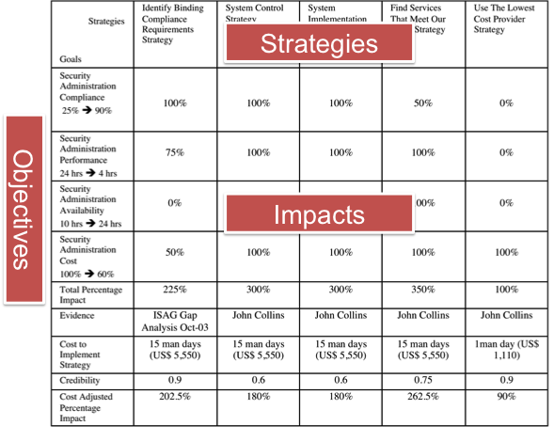
4. Write up these plans for the goals and budgets (Try to ensure this is kept to only one page).
all these key quantified performance targets, and resource budgets, are presented simultaneously on a single overview page.
additional detail about them can, of course, be captured off of this one ‘focus’ page.
this set of top level objectives is not frozen.
It can be updated as the result of
both internal Evolutionary (Evo) step learning,
or of external pressures and insights.

Slide 113
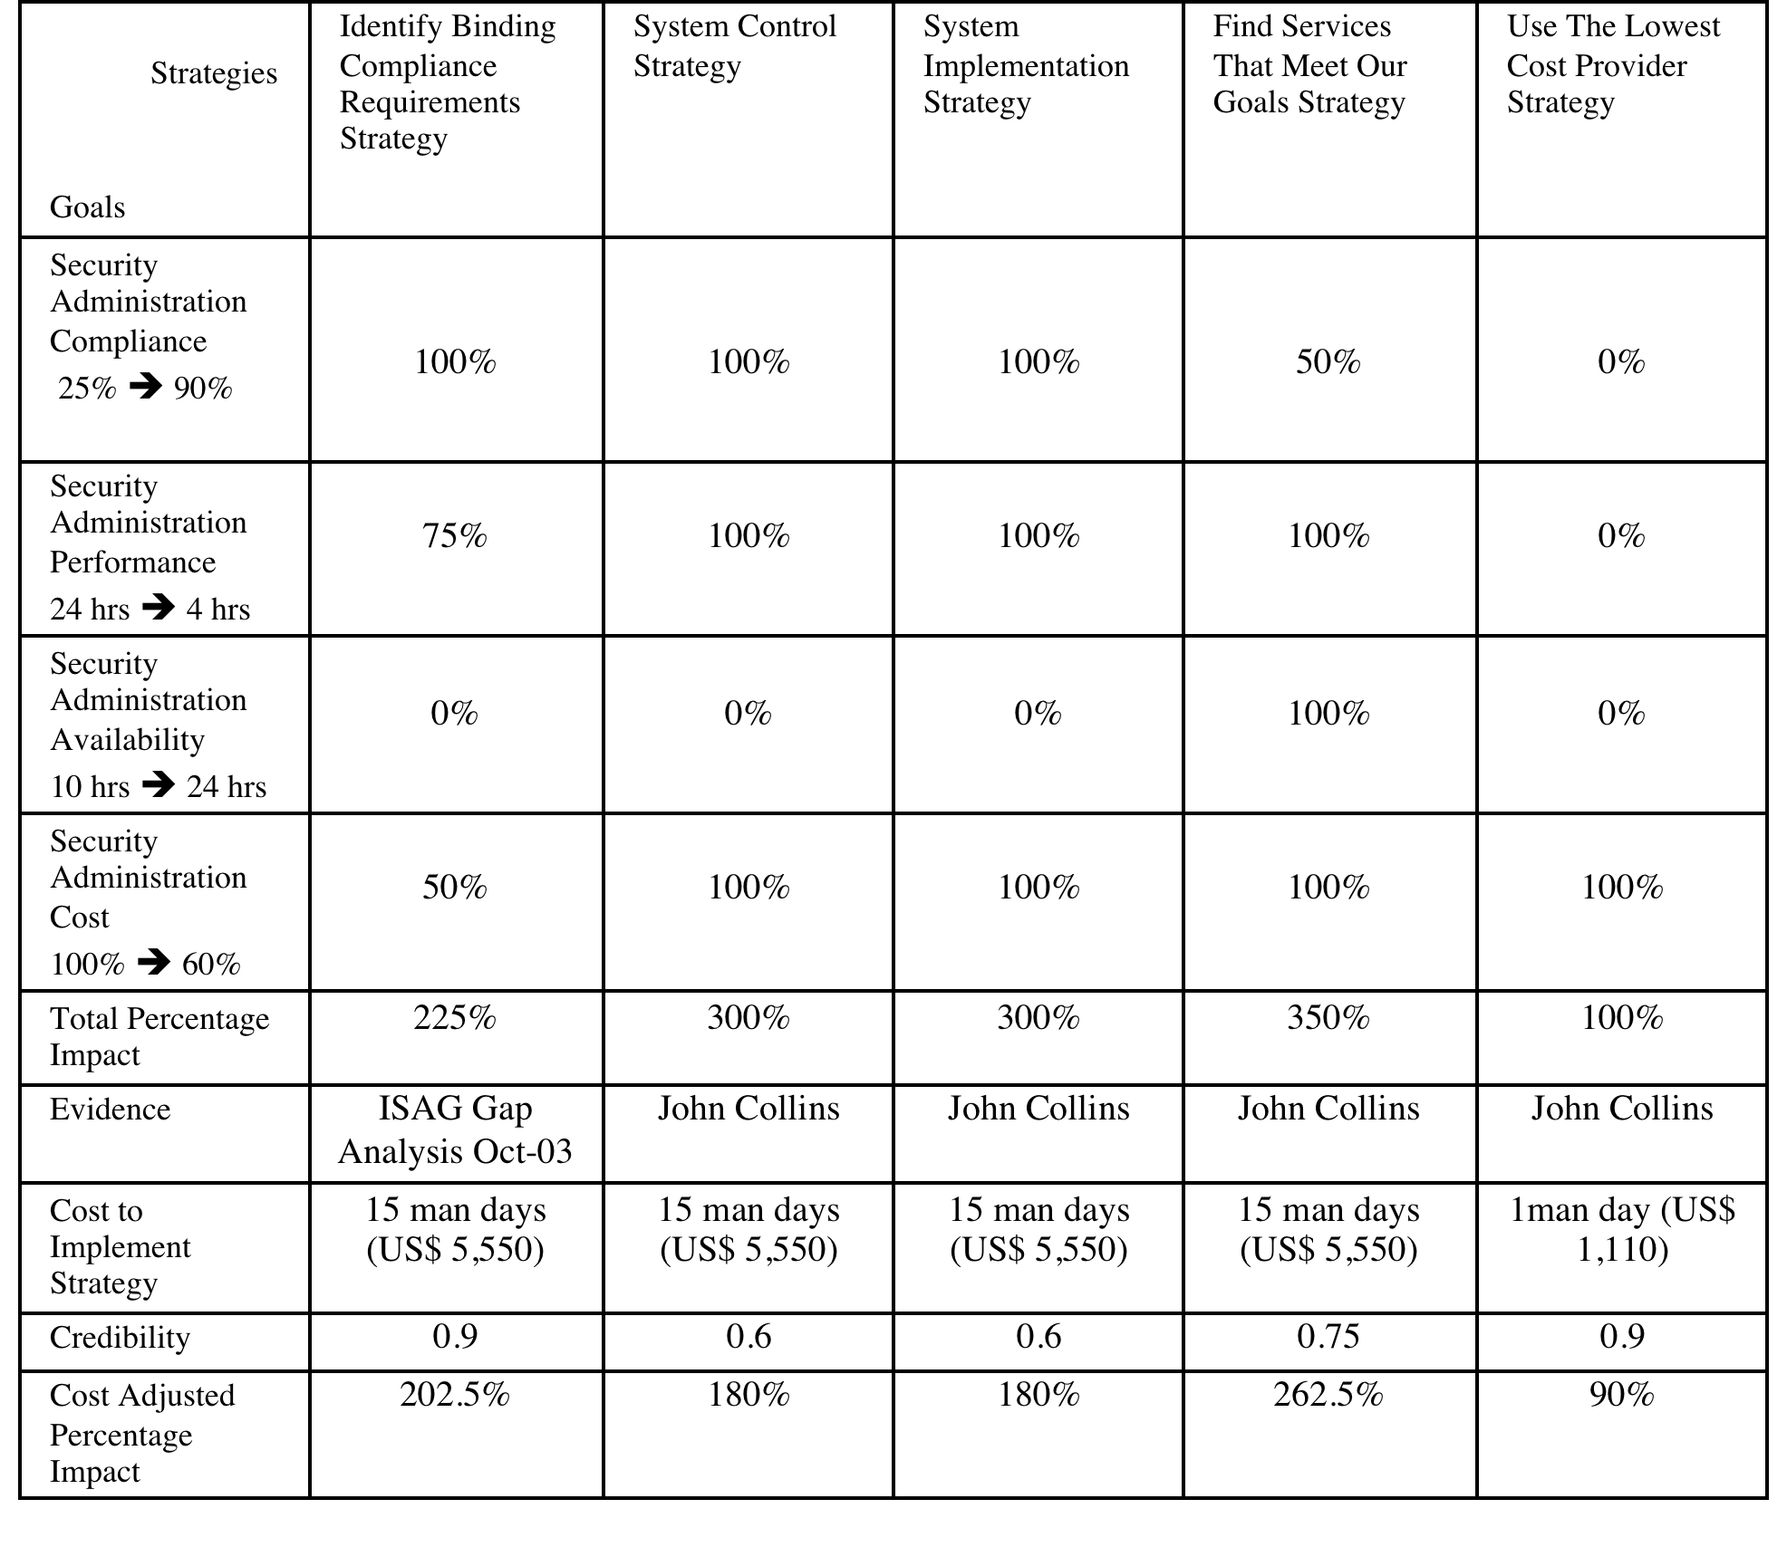
Acer Project: Impact Estimation Table
Strategies
Objectives
Impacts
6 October 2017
© Gilb.com
Notes:
These Acer sides made first in May 2012 tsg
Details of objectives in slides for Finance and Testing conf 16 May 2012 London
And details of Strategies in Bank Case/Collins
Impact Estimation Table
Notes:
The table below shows the estimated impacts of each of our top level strategies on our top level goals
The % estimated impact of a strategy is on a scale where 100% means the strategy brings us to the stated goal level on time and 0% means there is no impact. The estimated impact ought to be based on a benchmark, such as a previous system state or the view of a qualified commentator
Total % impact shows which of our strategies brings us most benefit in terms of achieving all of our defined goals
Evidence is the source of the facts used to make the impact estimate - a person of authority in the matter or a document for example
Cost is the USD amount that is known or estimated for implementation of the strategy. The degree to which the cost estimate is certain is reflected in the credibility rating
Credibility is a rating between 0 and 1 of the quality of the basis for the estimate, where credibility = 1 means that the basis of the estimate is regarded to be completely reliable and credibility = 0 means the basis of the estimate is completely unreliable. The rating is used as a multiplier
Very Top Level Project Strategies
Note: These very top level project strategies specify how we are going to achieve the top level project goals.
Identify Binding Compliance Requirements Strategy:
Gist: Identify all officially binding security administration requirements with which we must become compliant both from THE CORP and Regulatory Authorities.
System Control Strategy:
Gist: a formal system or process we can use to decide what characteristics a [system; default = appication] has with regard to our compliance, performance, availability and cost goals
Note: an inspection process, for instance
Define and implement inspection for security administration-related business requirements specifications
Define and implement inspection for [systems; default = applications] which already exist in CitiTech environments
Note: systems include applications, databases, data service and machines. Project ACER ought to be extensible.
System Implementation Strategy:
Gist: a formal system or process we can use to actually change a [system; default = application] so that it meets our compliance, performance, availability and cost goals
All systems ought to feed EERS
Publish best practices for developing security administration requirement specifications
Publish a security administration requirement specification template
Application technology managers are service providers in the formal change process, that are required to meet all project goals within defined timescales
Find Services That Meet Our Goals Strategy:
Gist: a formal system or process we can use to evaluate security administration services offered by internal and external services providers so that we can meet our defined goals
Note: this strategy avoids pre-supposition that one solution is the only option (EG all applications must migrate to RSA and that RSA is the only security administration services offering)
Use The Lowest Cost Provider Strategy:
Gist: use the services provider that meets all signed-off project goals for the lowest $US cost.
Note: if all project goals can be met by more than one services provider, the provider offering the lowest $US cost for meeting the goals and no more than the goals ought to be used

Slide 114
5. Negotiate with the key stakeholders to formally agree the goals and budgets.
once the objectives, the version derived from our developer’s understanding of stakeholder needs, are clearly articulated –
we need to go back to the real stakeholders
and check that they agree with our ‘clear’ (but potentially incorrect or outdated) interpretation.
it is certainly a wise precaution to check back later,
during the project evolution,
with the specific stakeholders
that will be impacted with a particular Evo step, - as to how they feel about a particular choice of step content (design) - (that impacts the performance and cost aspect estimates): - are estimates realistic in the real implementation environment?, - and to check for any new insights regarding the long term objectives.
Notes:
Negotiation and mediation techniques for natural resource management
www.fao.org - 500 × 309 - Search by image
Ill added ** 2017 tsg

Slide 115
Evolutionary Delivery is driven by meeting Stakeholder Value & Product Quality Requirements
Intolerable
Tolerable
Success
Past
30 sec.
Tolerable/Fail
20 sec.
Goal
15 sec.
Speed
Scale: seconds to do task
Notes:
Tolerable synonym = Fail

Slide 116
Evolutionary Delivery is driven by meeting Stakeholder Value & Product Quality Requirements
Each Evolutionary Cycle aiming to get closer to the Goals
Cycle 1
Intolerable
C 2
C 3
C 4
Tolerable
C 5
C 6
C 7
Success
Past
30 sec.
Tolerable/Fail
20 sec.
Goal
15 sec.
Speed
Scale: seconds to do task

Slide 117
Evolutionary Delivery is driven by meeting Stakeholder Value & Product Quality Requirements
Each Evolutionary Cycle integrated into a ‘working’ system
Cycle 1
Intolerable
C 2
C 3
C 4
Tolerable
C 5
C 6
C 7
Success
Past
30 sec.
Tolerable/Fail
20 sec.
Goal
15 sec.
Speed
Scale: seconds to do task
Notes:
If conservative we can hand over to only 1 of 100 traders.
Proceed with all necessary and due caution.
We got to be able to reverse the last step.
We the developers are inn there with them ready to pull the plug.
Balanced with taking some risk to get high profit

Slide 118
Evolutionary Delivery is driven by meeting Stakeholder Value & Product Quality Requirements
Learning from each Evolutionary Cycle
Cycle 1
Intolerable
C 2
C 3
C 4
Tolerable
C 5
C 6
C 7
Success
Past
30 sec.
Tolerable/Fail
20 sec.
Goal
15 sec.
Speed
Scale: seconds to do task
Notes:
Comparing with the estimates done at the beginning of the cycle.
Deviation from estimates are opportunities to a. step back, or, b. move ahead.

Slide 119
Evolutionary Delivery is driven by meeting Stakeholder Value & Product Quality Requirements
Deciding on the next Cycle, based on what we learned from the previous Cycle
Cycle 2 ?
Cycle 1
C 2
C 3
C 4
Tolerable
Intolerable
C 5
C 6
C 7
Success
Past
30 sec.
Tolerable
20 sec.
Goal
15 sec.
Speed
Scale: seconds to do task
Notes:
We can make a plan with several cycles ahead, but the next step that is actually done is decided in the beginning of every cycle.
The question is; How rapidly can you learn from what you did last week? Not next year, not next project, but, within this project right now.

Slide 120
Evolutionary Delivery is driven by meeting Stakeholder Value & Product Quality Requirements Simultaneously
Usability
Intolerable
Cycle 1
C 2
C 4
C 5
Tolerable
C 6
C 7
C 8
Success
Past
30 sec.
Goal
15 sec.
Speed
Cycle 1
Intolerable
C 2
C 3
C 4
Tolerable
C 5
C 6
C 7
Success
Past
30 sec.
Tolerable/Fail
20 sec.
Goal
15 sec.

Slide 121
Each Evolutionary Cycle uses a constrained budget of Development Resources
Money
Usability
Intolerable
Cycle 1
C 2
C 4
Tolerable
Cycle 1
C 5
C 6
C 7
C 8
Success
C 2
Success
C 4
C 5
C 6
C 7
C 8
Tolerable
Intolerable
Past
Budget
Tolerable
Past
Tolerable/Fail
Goal
Speed
Cycle 1
Intolerable
C 2
C 3
C 4
Tolerable
Cycle 1
Success
C 5
C 6
C 7
Success
C 2
C 3
C 4
C 5
C 6
C 7
Tolerable
Intolerable
Engineers
Past
30 sec.
Budget
15 sec.
Tolerable/Fail
20 sec.
Past
30 sec.
Tolerable/Fail
20 sec.
Goal
15 sec.

Slide 122
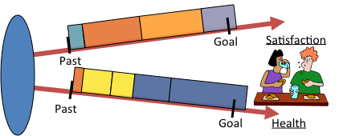
6. Plan to deliver some benefit (that is, ‘progress towards the goals’) in weekly (or shorter) increments (Evo steps).
the weekly delivery cycle is adopted by Conventional Agile methods – good.
but the notion of measurement, on multiple performance and resource objectives, is absent.
the Conventional notion of agreeing with a user, about function to be built, during that weekly cycle is healthy, but
the Evo method is focused on
systematic, weekly cycle, measured delivery
towards long-range higher-level objectives, w
ithin numeric, multiple, resource-constraints.
this means that the Evo method is more clearly focused on
the wider stakeholder set values,
and on the total resource cost management.
the Evo method is NOT focused on system ‘construction’ (‘we are programmers, therefore we write code’).
the Evo method is focused on delivering useful results from an organically whole system.
This means that we are not focused on ‘writing code’. we reuse, buy, or exploit existing code just as happily as to write our own.
We build databases, train and motivate users, improve hardware, telecommunications, websites, improve working environment, improve motivation.
So we become more like systems engineers (‘any technology to deliver the results!’), than programmers (‘what can we code for you today?’).

Slide 123
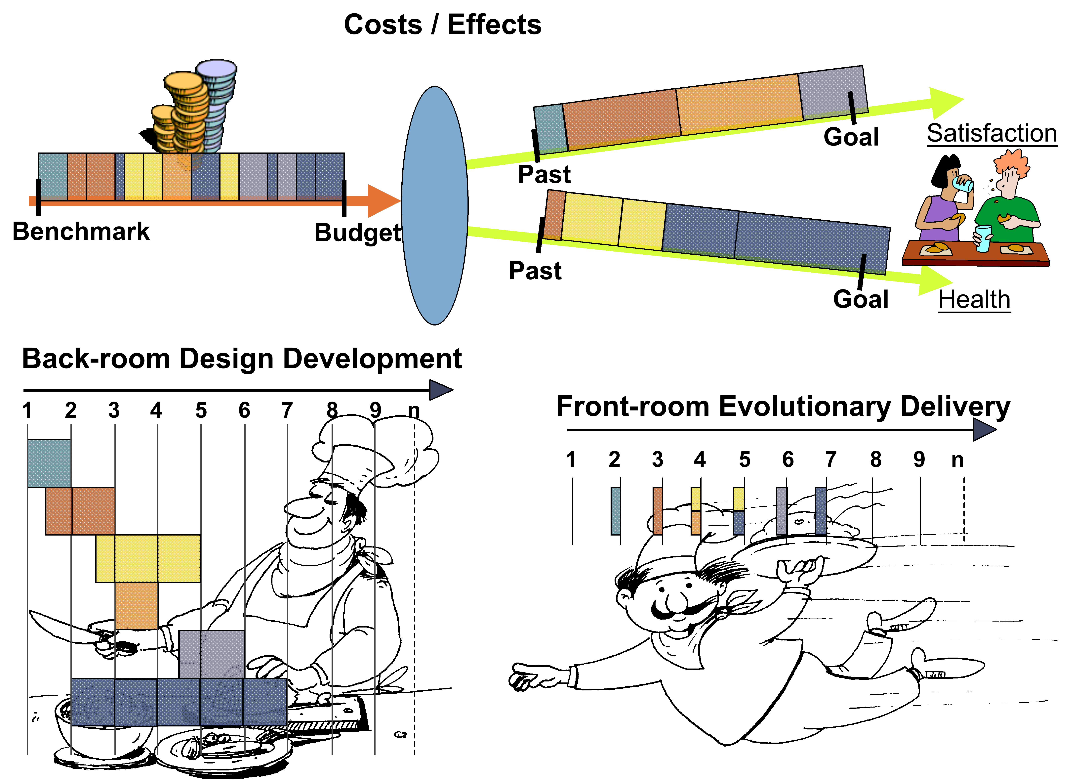
Figure: Evolutionary result delivery takes system components readied for integration in the ‘backroom’ using arbitrary acquisition duration (as in kitchens), and presents them to stakeholders in frequent short Evolutionary result delivery cycles (as in the dining room). (Ill. By Kai Gilb)

Slide 124
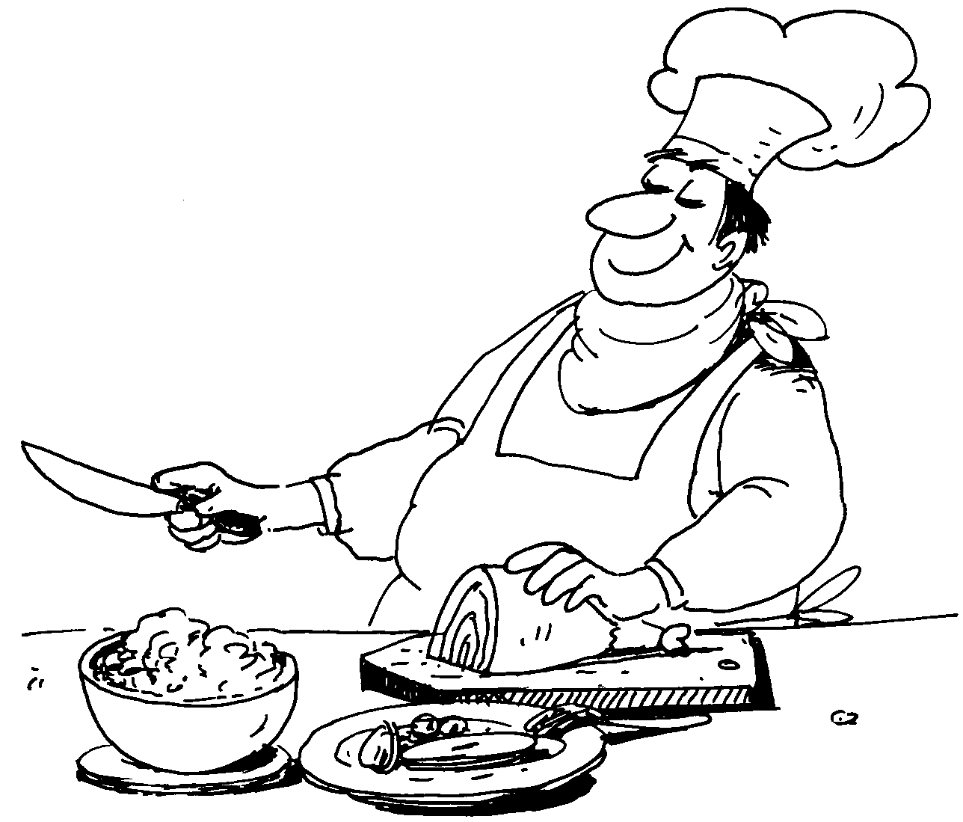
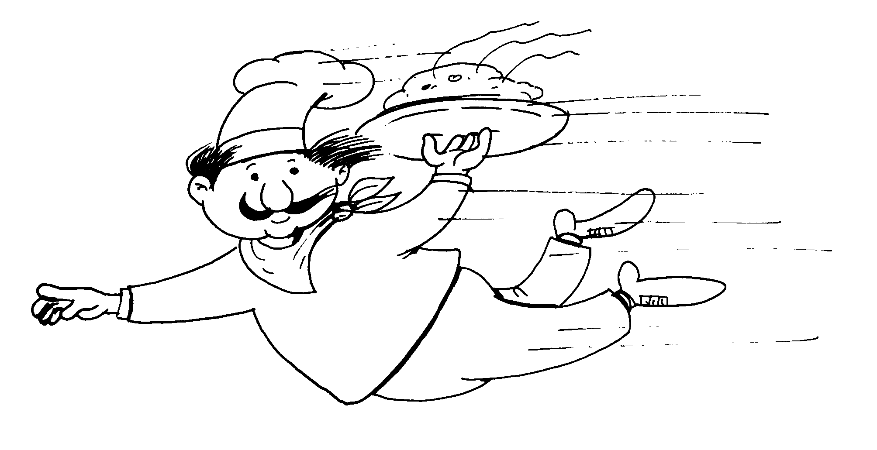
Back Room Front Room 2
Costs / Effects
Goal
Satisfaction
Past
Benchmark
Budget
Past
Goal
Health
Back-room Design Development
1
2
3
4
5
6
7
8
9
n
Front-room Evolutionary Delivery
1
2
3
4
5
6
7
8
9
n

Slide 125
7. Implement the project in Evo steps. Report to project sponsors after each Evo step (weekly, or shorter) with your best available estimates or measures, for each performance goal and each resource budget. On a single page, summarize the progress to date towards achieving the goals and the costs incurred.
All agile methods agree that the development needs to be done in short, frequent, delivery cycles.
the Evo method, specifically insists that the closed loop control of each cycle is: - done by numeric pre-cycle estimates, - end-cycle measurements, - analysis of deviation from estimates, - and appropriate change to immediate planned cycles, - to estimates, - and to stakeholder expectation management
(‘this is going to late, if we don’t do X’).

Slide 126
Value Delivery Cycle: Measure
Learn
Stakeholders
Measure
Values
Measure Change
Measure how much the Values changed.
Deliver
Solutions
Develop
Decompose
© Gilb.com
99
Copyright: Kai@Gilb.com

Slide 127
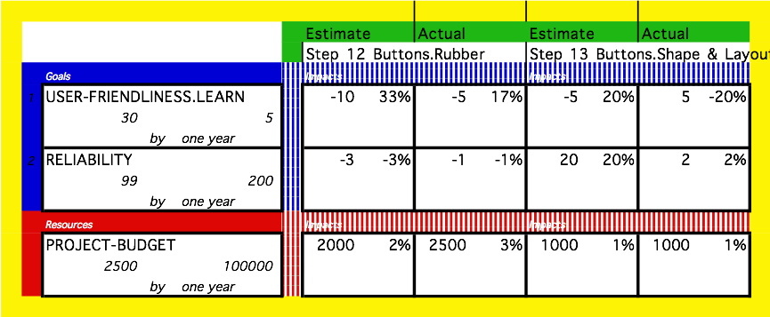
Figure: the use of an Impact Estimation table [CE, POSEM, Gilb.com] to plan and track critical performance and cost characteristics of a system (ill. courtesy Kai Gilb).
The pair of numbers in the three left hand columns (30, 5 etc.) are defined benchmarks (30, 99, 2500) and Goal levels (5, 200, 100,000).
The ‘%’ figures are the real scale impacts (like 20) converted to a % of the way from benchmark to the Goal levels (like 20% of the distance from benchmark to Goal).

Slide 128
8. When all Goals are reached: ‘Claim success and move on’ [Gerstner] Free remaining resources for more profitable ventures.
one advantage with numeric Goal levels,
compared to a stream of yellow stickies from users,
is that it is quite clear when your objective is reached.
No additional effort should be expended to improve upon it,
unless a new improved target level is set.
the numeric goal level is the success level,
success is well defined formally in advance.
a ‘Fail’ level (a ‘constraint’, not a ‘target’) can also be set,
in each required objective’s specification,
to announce a lower limit (constraint).
Fail levels define an ‘acceptable’ (if not yet ‘successful’) range of each performance and cost characteristic.
Fail and Goal levels can be used to manage project decisions [CE].
projects need to be evaluated on performance delivered in relation to resources used.
This is a measure of project management ‘efficiency’.
When targets are reached,
we need to avoid misusing resources to deliver more than is required.
Perfect performance and quality costs infinite resources.

Slide 129
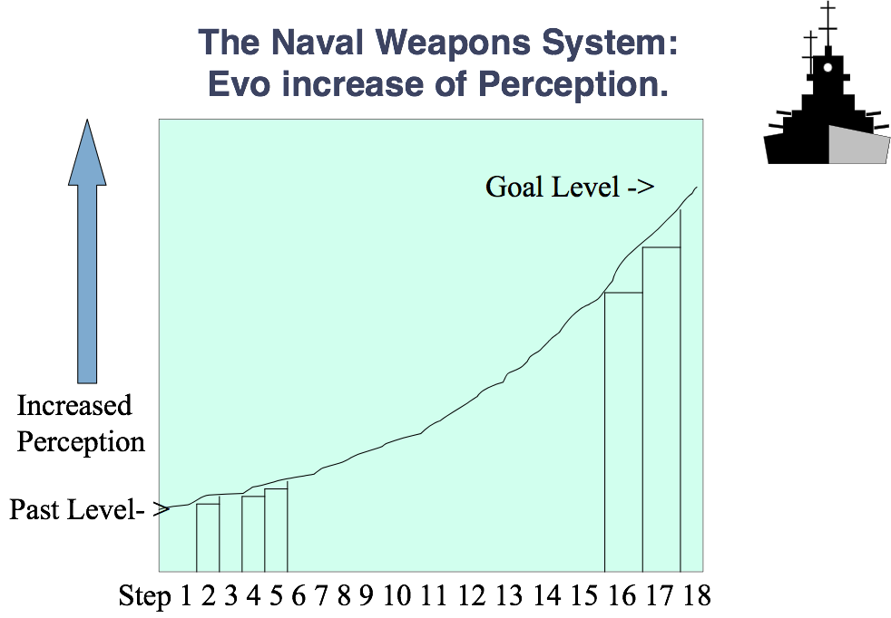
Results are cumulated numerically step by step until the Goal level is reached.
In a UK Radar system I planned, the system was delivered by gradually building database info about plans and ships, tuning recognition logic, and tuning the radar hardware.

Slide 130
Policy • The project manager, and the project, will be judged exclusively on the relationship of progress towards achieving the goals versus the amounts of the budgets used. The project team will do anything legal and ethical to deliver the goal levels within the budgets.
Projects need to be judged primarily
on their ability to meet critical performance characteristics,
in a timely and profitable way.
This cannot be expected if the project team is paid ‘by effort expended’.

Slide 131
The team will be paid and rewarded for benefits delivered in relation to cost.
Teams need to be paid be results delivered in relationship to costs. By their project efficiency.
Even if this means that super efficient teams get terribly rich! And failure teams go ‘bankrupt’. Long live the capitalist free market mechanism!
When only 13% of 1500 IT projects are ‘successful’ [Times],
we clearly need to find better mechanisms for rewarding success,
and for not rewarding failure.
I suggest that sharp numeric definition of success levels
(Goal [China, End 2015] 65%),
and consequent rewards for reaching them,
is minimum appropriate behavior for any software project.

Slide 132
POLICY “The team will find their own work process and their own design”.
Conventional Agile processes believe we need to reduce unnecessarily cumbersome corporate mandated processes.
I agree.
They also believe in empowering the project team to find the processes, designs and methods that really work for them locally.
I heartily agree!
But I believe that
sharp numeric definition of objectives,
coupled with frequent estimation and measurement of progress,
is a clearly superior mechanism
for enabling this empowerment.
The price for this,
a few estimates
and measures weekly,
seems a small price to pay
for superior control over project efficiency.

Slide 133
POLICY “As experience dictates, the team will be free to suggest to the project sponsors (stakeholders) adjustments to ‘more realistic levels’ of the goals and budgets. “
No project team should be
‘stuck’ with trying to satisfy unrealistic
or conflicting stakeholder dreams
within constrained resources.
The project team can only be charged with reasonable capability
to deliver inside ‘state of the art’ performance levels
and deliver inside ‘state of the art’ costs.

Slide 134
The 12 Tough Questions
Based on Competitive Engineereing - Planguage concepts
From a simplified management and common sense point of view
Are you getting problems because you and your people do not ask these questions
And demand good answers?
Paper on 12 ?s at www.gilb.com
http://www.gilb.com/tiki-download_file.php?fileId=24

Slide 135
1. NUMBERS
Why isn’t the improvement quantified?

Slide 136
2. RISK
What’s degree of the risk or uncertainty and why?

Slide 137
3. DOUBT
Are you sure?
If not, Why not?

Slide 138
4. SOURCE
Where did you get that from?
How can I check it out?

Slide 139
5. IMPACT
How does your idea affect my goals, measurably?

Slide 140
6. ALL CRITICAL FACTORS
Did we forget anything critical to survival?

Slide 141
7. EVIDENCE
How do you know it works that way?
Did it before?

Slide 142
8. ENOUGH
Have we got a complete solution?
Are all objectives satisfied?

Slide 143
9. PROFITABILITY FIRST
Are we planning to do the profitable things first?

Slide 144
10. COMMITMENT
Who’s Responsible for failure or success?

Slide 145
11. PROOF
How can we be sure the plan is working, during the project, early?

Slide 146
12. NO CURE
Is it ‘no cure, no pay’, in the contract?
Why not?
No cure
No pay!

Slide 147
Concluding Remarks
“PRIORITISE EFFICIENT ARCHITECTURE DYNAMICALLY”
A. Managing Priority (paper)
http://www.gilb.com/DL60
B. Choice and Priority Using Planguage:
A wide variety of specification devices and analytical tools. (paper)
http://www.gilb.com/DL48
C. Value Planning book, Chapter 6 Prioritization
https://www.dropbox.com/sh/34llx1a7ckyagxl/AAA0pDzSxN5WmoP9lOKR0Mpca?dl=0
6 October 2017
Copyright Tom@Gilb.com 2017

Slide 148
#BCSEASG
https://www.gilb.com/store/2W2zCX6z
GILB COURSES AT BCS
http://www.bcs.org/category/10136
https://www.gilb.com/p/competitive-engineering
needsandmeans.com = the tool
THESE SLIDES = tinyurl.com/Gilb17July,
or see concepts.gilb.com/file24
Notes:
so this is the last slide and it can rest on the projector. People can photo it or get it from the slides, later.

