Slide 1
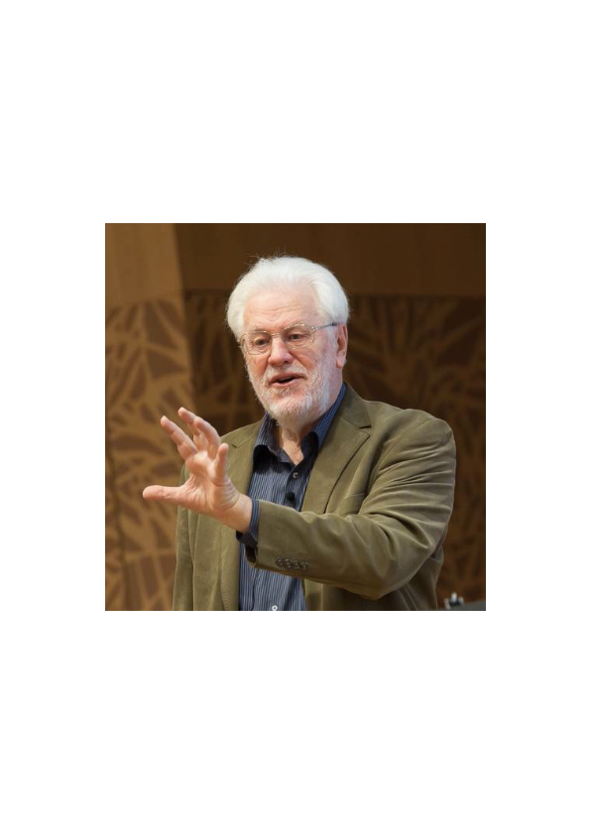
'Commercial Risk;
Legal, Social, Ethical and Professional Issues in IT Project Management'
by
Tom Gilb, Hon. Fellow BCS
March 27, 2017
London Metropolitan University
3rd Invited Lecture
Slides will be at Downloads gilb.com
tom@Gilb.com
This is expected to be videoed by LMU and made public
Lecture 1:https://hml.londonmet.ac.uk/Play/4555
Lecture 2: http://concepts.gilb.com/dl891
Slides Olly as of present date.
All text © tom@Gilb.com, may be reused with credit.
Notes:
(1) Financial risk assumed by a seller when extending credit without any collateral or recourse. (2) All risks other than the Political Risk.
Read more: http://www.businessdictionary.com/definition/commercial-risk.html
Commercial risk, defined as the risk a company takes by offering credit with no collateral, is a common term in the business world. Any time a company offers credit, be it trade credit, credit terms like 2/10 net 30, or other, they are essentially offering financing with no collateral
Thinking about the 27 March session which you graciously agreed to do:
How about this topic: 'Commercial Risk; Legal, Social, Ethical and Professional Issues in IT Project Management'
Timing: 12.00-1.30pm okay?
Thank you.
Best regards,
Sahithi
--
-------------------------------------
Dr Sahithi P Siva
Computer Science and Applied Computing

Slide 2
Areas of IT Project Management Risks
Stakeholder Analysis
Requirements Analysis and Specification
Architecture Selection, Specification and Analysis
Prioritization of Delivery Steps
Quality Assurance
Quality Control
Contracting
Motivation
Notes:
https://play.google.com/store/apps/details?id=com.emak.project.management

Slide 3
10 Commandments of Ethical Risk Management
identify all critical stakeholders
identify all critical stakeholder’s values and constraints (‘ends’)
collect and specify stakeholder relationships to requirements
all ‘means’ to satisfy requirements must estimate effects on all requirements and resources
decompose all large means into small 2% of resources value deliveries
measure delivery results and change plans to succeed better.
Attack project risks upstream, and prevent them: test is too late and too costly.
Continuously analyse recurring problem causes and tune organisation continuously
Keep focus on delivery of real measurable value in early continuous stream to stakeholders
Contract for measurable results, not work time spent. © gilb.com 2017

Slide 4
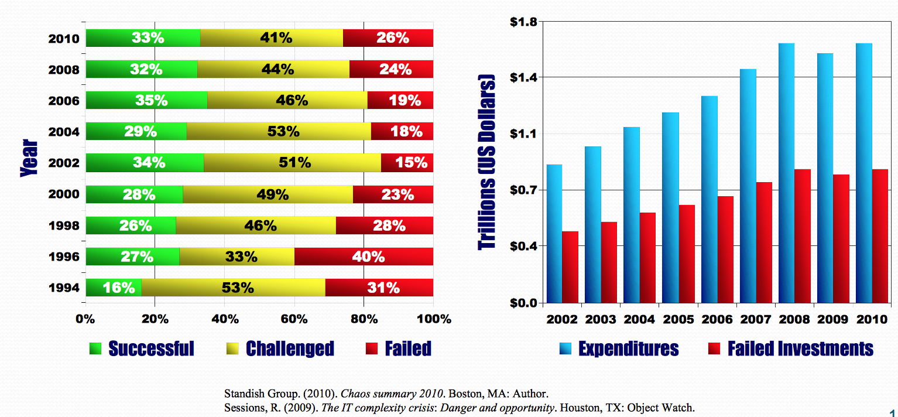
Here is the situation
Your IT stakeholders
are not trained to defend themselves against IT problems.
You, the IT professional,
are their only hope,
to avoid the ’30%+’
total failure rate.

Slide 5
Here is what I propose for the IT Professional Ethical Code
We will always work towards the best value-for-money of our clients, and stakeholders.
We will always try to discover the real higher-intent of our customers, rather than their initial statements of what they want.
We will get confirmation and feedback on our interpretations of what our stakeholders really require
We will deliver priority value, early and measurably, to our critical stakeholders.
We will not expect payment for mere work and construction: but get paid for measurable stakeholder results.
When we screw up, we will take full public responsibility, and fix the root causes.
Notes:
http://www.capsafood.com/company/ethics-based-corporate-governance/
The code points are originated by tom@Gilb.com 2017 for this talk. Use with credit to tom@Gilb.com 2017

Slide 6
PERSONAL ETHICS:
Here is what I think you might want to do personally:
I do!
Learn the craft of ‘doing things right’. (next slide)
Refuse time pressure, financial pressure and management pressure, to do ethically wrong things.
Move to situations where doing the right things is profitable, and doing wrong things is considered unprofitable
If you can’t avoid greedy people and companies, start your own ethical, IT-eco company
Help colleagues under ethical pressure to do the right things
Argue in your company or organisation for the long-term view, and building a good reputation for ethical value-delivery IT
If you find yourself in unethical situations, walk away, perhaps quietly, perhaps whistle blowing, perhaps with a gentle written note of consequences to the higher levels: but do not get made responsible for the bad results that follow.
Notes:
Difference Between Personal and Professional Ethics | Muhammad ...
https://www.linkedin.com/.../difference-between-personal-professional-ethics-muham...
Mar 3, 2016 - Personal ethics refers to the sense of rights and wrongs of a person whereas professional ethics refers to the guidelines that are imposed on employees within the industrial setting. ... Sometimes clashes between personal ethics and professional ethics can occur resulting a dilemma within the individual.
https://www.linkedin.com/pulse/difference-between-personal-professional-ethics-muhammad-asim-zia
MONKEYS MPVETHICS.COM
ETHIS CIRCLE
https://yuqian911907.wordpress.com/2014/09/15/ethical-leadership-for-individual-and-organization/

Slide 7
The craft of Doing things Right
THINGS TO MASTER - THE CRAFTS
Stakeholder analysis
Levels of concern: Business/Stakeholders/IT Systems
Quantifying all critical values and qualities
Quantifying multiple dimensions of architecture, strategies, designs (‘Means’)
Estimation of resources for implementing means and strategies
Decomposition of too-big ideas into 2% value delivery steps
Risk analysis, identification, specification and mitigation
Textbooks: Gilb: Value Planning 2016-7
Free digital copy (100% discount code) to all who promise to me to read it all in a month. leanpub.com/ValuePlanning or gilb.com

Slide 8
Examples
Real Stakeholder Value
The Agile Manifesto and other similar IT Cultures expect only to deliver value to ‘Customers and Users’ and primarily through ‘Working Code’
You need to dig deeper and find dozens of critical stakeholders.
You need to deliver real measurable value to the stakeholders, even if no working code is involved
Notes:
https://www.gov.uk/government/publications/nda-value-framework-how-we-make-decisions/explaining-the-value-framework

Slide 9
Plan their real needs, not perceived means: ask WHY?
The customer stipulates as requirements “a decentralized modern digital solution”
You recognize this as a technical means, not their real ends, and ask what they expect as a result.
Their answer, example ‘more efficient services’ , is closer to their real needs.
So help them make this official, and defined, and quantify their real values, to drive the IT Project

Slide 10
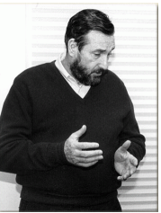
Do not Mess with Estimates and Lowest Bidders
Fixed Price estimates for iT projects are a joke. They are an arbitrary amount, that might be low enough to win a contract. But they probably bear no relation to a future truth.
They positively invite cheating and consequent client unhappiness.
What seems to work, is using ‘agile’ delivery cycles to deliver high-value, early and often. And to learn early what causes excessive costs, and change things.
This was perfected industrially by IBM in the Cleanroom Method (IBM SJ 4/80 and VP book), where when IBM won the fixed price contract, they managed to deliver on time and under budget for year on end.
“To meet cost/schedule commitments based on imperfect estimation techniques, a software engineering manager must adopt a manage-and-design-to-cost/schedule process.
That process requires a continuous and relentless rectification of design objectives with the cost/schedule needed to achieve those objectives.”
in IBM Systems Journal, 4/80 p.420. Harlan Mills

Slide 11
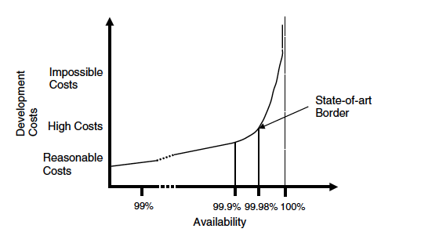
How much will ‘High Availability’ Cost?
© Gilb.com 2011
February 14, 2013
Notes:
Costs are a result of the designs you deploy, in order to meet your requirements. In particular the cost-driving designs relate directly to the required levels of performance and quality requirements. Costs are not quite so sensitive to functions or size – although there is a linear relationship there too.
It has long been understood, for example COCOMO (Boehm et al. 2000), that there are a large number (dozens) of software cost drivers, such as availability. In one case, the 5ESS project (Lucent 1980), had a major objective of improving the availability of a previous generation system (The 5ESS actually replaced the 1AESS, which was AT&T's first electronic (program controlled) switching system (Personal Communication from David Long 2010)) from 99.90% to 99.98%. In other words, that meant a change of 00.08% in the level of one single quality. However that represents 80% of the way to perfection. Perfection costs infinity. The project took 8 years, using 2,000 to 3,000 people. Now assuming this is correct and realistic – even roughly so – we would need the fourth digit (xx.x0 to xx.x8%) to signal that our project might cost 24,000 work-years (Personal Communication from David Long 2010). COCOMO for example does not try to operate at this level of precision.
One organization (Personal Communication, Client) contracted for one year of effort, for 100 developers, fixed price, and promised to deliver airplane telephone switching software with 99.999% availability. They contractually promised 99.999% without ever having achieved such a result in the entire history of the Corporation, and without consulting their Technical Director. The CEO acknowledged that they had taken an unwarranted risk, big enough to put their company out of business. This was of course an organizational problem, management needed to make sure that they knew what they were contracting for.

Slide 12
Don’t accept Management BS
Real IT Project Top Level Goals
Vague statements of major objectives is quite widespread. Then the great leap to save the world by building an IT system begins.
The ethical action is to help people clarify these ideals, so that they are quantified and unambiguously clear.
This is always possible, if you know the craft. But the shortest path is to Google it: like
‘User Friendly METRICS’ or
‘IT Security MTERICS’
Rationalize into a smaller number of core processing platforms. This cuts technology spend on duplicate platforms, and creates the opportunity for operational saves. Expected 60%-80% reduction in processing cost to Fixed Income Business levies.
• International Securities on one platform, Fixed Income and Equities (Institutional and PB).
• Global Processing consistency with single Operations In-Tray and associated workflow.
• Consistent financial processing on one Accounting engine, feeding a single sub-ledger across products.
• First step towards evolution of “Big Ideas” for Securities.
• Improved development environment, leading to increased capacity to enhance functionality in future.
• Removes duplicative spend on two back office platforms in support of mandatory message changes, etc.

Slide 13
How can we improve such bad specification? (‘Planguage’) “Improved development environment” (20 mins. draft)
Development Capacity:
Version: 3 Sept 2009 16:26
Type: Main <Complex/Elementary> Objective for a project.
Ambition Level: radically increase the capacity for developers to do defined tasks. <- Tsg
Scale: the Calendar Time for defined [Developers] to Successfully carry out defined [Tasks].
Owner: Tim Fxxx
Calendar Time: defined as: full working days within the start to delivery time frame.
Past [ 2009, {Bxx, Lxx, Gxx}, If QA Approved Processes used, Developer = Architect, Task = Draft Architecture ] 15 days ±4 ?? <- Rob
Goal[ 2011, { Bxx, Lxx, Gxx }, If QA Approved Processes used, Developer = Architect, Task = Draft Architecture ] 1.5 days ± 0.4 ?? <- Rob
Justification: Really good architects are very scarce so we need to optimize their use.
Risks: we use effort that should be directed to really high volume or even more critical areas (like Main Objective).
www.Gilb.com
Notes:
http://www.photographyblogcentral.com/wp-content/uploads/2009/07/Sandsont-brick-house.jpg

Slide 14
backup slides for more examples of practices

Slide 15
Case Study 3 – Results
Over a series of SQC applications, the team was able to reduce defect density dramatically
Rev. | # of Defects | # of Pages | Defects/ Page (DPP) | % Change in DPP
0.3 | 312 | 31 | 10.06
0.5 | 209 | 44 | 4.75 | -53%
0.6 | 247 | 60 | 4.12 | -13%
0.7 | 114 | 33 | 3.45 | -16%
0.8 | 45 | 38 | 1.18 | -66%
1.0 | 10 | 45 | 0.22 | -81%
Overall % change in DPP revision 0.3 to 1.0: |  |  |  | -98%
Copyright © 2014 Intel Corporation. All rights reserved. No part of this presentation may be reproduced without written permission of Intel Corporation.

Slide 16
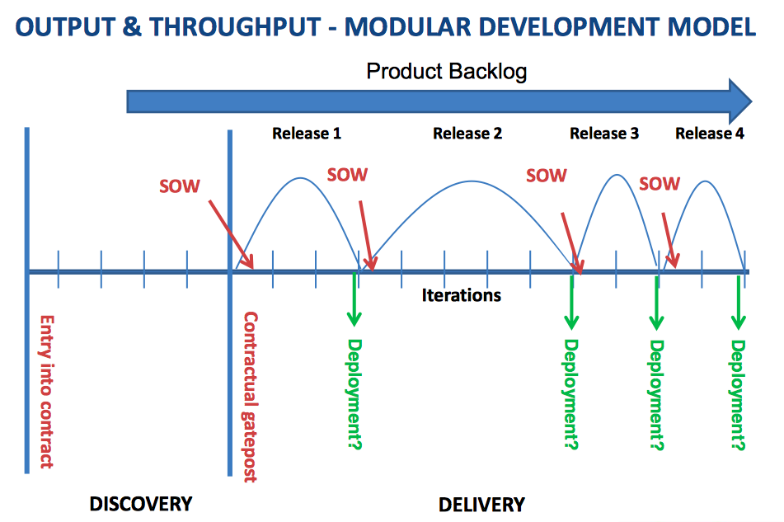
Agile code stuff and pray
29 October 2014
Tom@Gilb.com
Notes:
http://static.squarespace.com/static/52c7ec69e4b0b1f6fe574925/t/52cbe4e8e4b044c86b7f7271/1389094120966/2012%20Intellect%20-%20How%20to%20contract%20for%20Agile.pdf

Slide 17
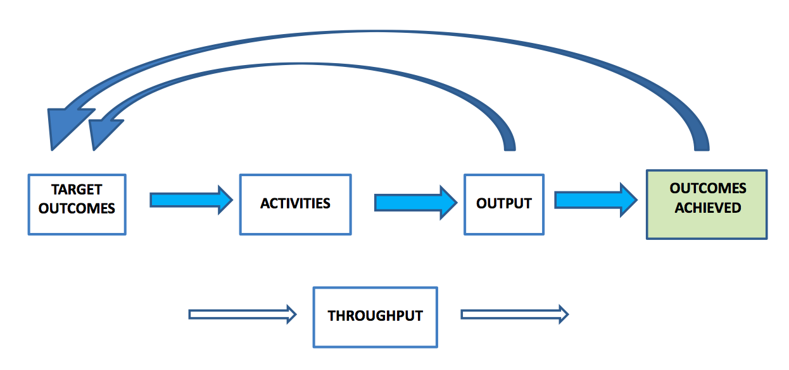
Outcome-driven view of contract metrics: If you didn’t really deliver value, try again
29 October 2014
Tom@Gilb.com
Notes:
The Problem with Agile & Contracts Agile Business Conference 9 October 2013
Susan Atkinson Keystone Law
Downloaded from
www.flexiblecontracts.com

Slide 18
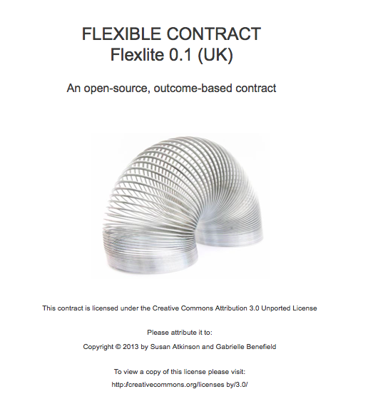
Contract Templates available for free
29 October 2014
Tom@Gilb.com
Notes:
www.flexiblecontracts.com

Slide 19
WHAT IS A FLEXIBLE CONTRACT? These details are in the contract template
WHAT IS A FLEXIBLE CONTRACT?
A ‘flexible contract’ is an adaptive, outcome-based contract, which is intended to maximize the delivery of customer value. It achieves this in several ways:
The contract focuses on outcomes (that is, business objectives), which are less susceptible to change than output (such as features). By focusing on outcomes the contract also creates shared goals between the customer and supplier, which helps to align their interests and motivation.
The supplier is given the freedom to achieve the target outcomes in any way it deems effective as long as it honors the terms of the contract and stays within any constraints specified by the customer.
The fees (or at least part of the fees) should be payable on the achievement of target outcomes. The supplier is incentivized to achieve the target outcomes in the most cost-effective way, which is also of benefit to the customer.
The contract is structured as a master services agreement for the full version, or the ‘lite’ version using the Terms and Conditions, under which short-term statements of target outcomes (SOTOs) are called off. SOTOs work in the same way as a Statement of Work, but instead of ‘work’ in the form of outputs and activities, we measure outcomes achieved. The parties can respond to acquired knowledge and changes in the environment in subsequent SOTOs.
In respect of each SOTO the supplier addresses each target outcome by means of short feedback cycles. So the parties can learn rapidly what works and what doesn’t by measuring outcomes achieved progressively.
The contract adopts lightweight contractual provisions. This is made possible because the parties only commit to one SOTO at a time, so the financial exposure of the customer to the supplier is minimized. This in turn means that the contract is easier to understand and requires less administrative cost, both to create and to manage. The contract is deliberately NOT focused on the activities of the supplier or the technical processes by which this value is delivered.
29 October 2014
Tom@Gilb.com
Notes:
www.flexiblecontracts.com

Slide 20
WHAT IS A FLEXIBLE CONTRACT?
Define what you want, as you go, in small increments.
Learn what works
Focus on business results, not ‘code’
Pay for real value delivered
Prioritize high value results early.
Very low risk
Not tied in to suppliers who cannot deliver
WHAT IS A FLEXIBLE CONTRACT?
A ‘flexible contract’ is an adaptive, outcome-based contract, which is intended to maximize the delivery of customer value. It achieves this in several ways:
The contract focuses on outcomes (that is, business objectives), which are less susceptible to change than output (such as features). By focusing on outcomes the contract also creates shared goals between the customer and supplier, which helps to align their interests and motivation.
The supplier is given the freedom to achieve the target outcomes in any way it deems effective as long as it honors the terms of the contract and stays within any constraints specified by the customer.
The fees (or at least part of the fees) should be payable on the achievement of target outcomes. The supplier is incentivized to achieve the target outcomes in the most cost-effective way, which is also of benefit to the customer.
The contract is structured as a master services agreement for the full version, or the ‘lite’ version using the Terms and Conditions, under which short-term statements of target outcomes (SOTOs) are called off. SOTOs work in the same way as a Statement of Work, but instead of ‘work’ in the form of outputs and activities, we measure outcomes achieved. The parties can respond to acquired knowledge and changes in the environment in subsequent SOTOs.
In respect of each SOTO the supplier addresses each target outcome by means of short feedback cycles. So the parties can learn rapidly what works and what doesn’t by measuring outcomes achieved progressively.
The contract adopts lightweight contractual provisions. This is made possible because the parties only commit to one SOTO at a time, so the financial exposure of the customer to the supplier is minimized. This in turn means that the contract is easier to understand and requires less administrative cost, both to create and to manage. The contract is deliberately NOT focused on the activities of the supplier or the technical processes by which this value is delivered.
29 October 2014
Tom@Gilb.com
Notes:
www.flexiblecontracts.com

Slide 21
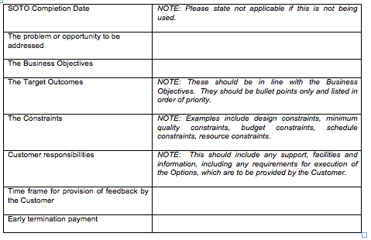
SOTO Specification (from contract template) short-term Statements Of Target Outcomes
29 October 2014
Tom@Gilb.com
Notes:
www.flexiblecontracts.com

Slide 22
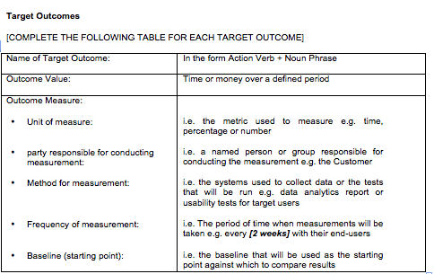
(from contract template)
29 October 2014
Tom@Gilb.com
Notes:
www.flexiblecontracts.com

Slide 23
last slide

