Slide 1
‘Lean’ Quality Assurance
January 21 2016
Quality Days, Workshop
Vienna
by Tom Gilb
Copyright: © Gilb 2016,
Tom@Gilb.com @imtomgilb
www.gilb.com
These slides will be at:
http://www.gilb.com/
Notes:
Evans Edit 6 sept 2010
Tom edit 6 sept 2010

Slide 2
Main Take-away Points
Quality Assurance is far more than ‘test’,
and it can be far more cost-effective
‘Quality’ is far more than ‘bugs’
You probably have a lot to learn,
if you want real competitive quality
Notes:
Tg sept 6 2010 drafted 3 points

Slide 3
Begin: Quality Assurance is far more than ‘test’
and it can be far more cost-effective

Slide 4
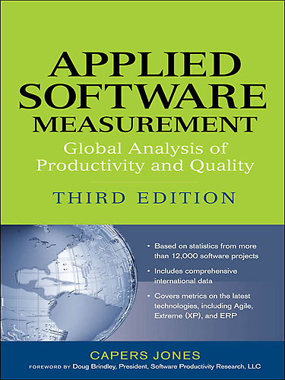
Inspection Effectiveness
Latest book -→
Capers Jones
Notes:
Defect Removal Effectiveness Inspections and Tests A REMINDER OF HOW BAD TEST & INSPECTION METHODS ARE
CONFLICT AND LITIGATION
BETWEEN SOFTWARE CLIENTS AND DEVELOPERS
Version 10 – April 13, 2001
By Capers Jones, Cjones@spr.com
It is obvious that no single defect removal operation is adequate by itself. This explains why “best in class” quality results can only be achieved from synergistic combinations of defect prevention, reviews or inspections, and various kinds of test activities. Between eight and 10 defect removal stages are normally required to achieve removal efficiency levels > 95%.
Jones, Capers; Applied Software Measurement; McGraw Hill, 2nd edition 1996; ISBN 0-07-032826-9; 618 pages.
Jones, Capers; Assessment and Control of Software Risks; Prentice Hall, 1994; ISBN 0-13-741406-4; 711 pages.
Jones, Capers; Patterns of Software System Failure and Success; International Thomson Computer Press, Boston, MA; December 1995; 250 pages; ISBN 1-850-32804-8; 292 pages.
Jones, Capers; Software Quality – Analysis and Guidelines for Success; International Thomson Computer Press, Boston, MA; ISBN 1-85032-876-6; 1997; 492 pages.
Jones, Capers; Estimating Software Costs; McGraw Hill, New York, NY; ISBN 0-07-9130941; 1998; 724 pages.
Jones, Capers; “Sizing Up Software;” Scientific American Magazine; December 1998; Vol. 279, No. 6; pp 74-79.
Jones, Capers; Software Assessments, Benchmarks, and Best Practices; Addison Wesley Longman, Boston, MA; May 2000; ISBN 0-201-48542-7; 700 pages.

Slide 5
Regression test ?
15% to 30%
Notes:
How Effective do you think test is

Slide 6
Integration test ?
25% to 40%
Notes:
How Effective do you think test is

Slide 7
Unit test 15% to 50%
New function test 20% to 35%
Performance test 20% to 40%
System test 25% to 55%
Acceptance test (1 client) 25% to 35%
Low-volume Beta test (< 10 clients) 25% to 40%
High-volume Beta test (> 1000 clients) 60% to 85%
Notes:
How Effective do you think test is

Slide 8
Inspections?
Informal design reviews 25% to 40%
Formal design inspections 45% to 65%
Informal code reviews 20% to 35%
Formal code inspections 45% to 70%
Notes:
How Effective do you think test is

Slide 9
All Defects
Prevention
Best Practice Testing Combined
Inspection
Quality in
Design
Remaining Defects
Notes:
“It is obvious that no single defect removal operation is adequate by itself.
This explains why
“best in class” quality results can only be achieved from
synergistic combinations of
defect prevention,
reviews or
inspections,
and various kinds of test activities.

Slide 10
Little hope of ‘zero defects’
“Between 8 and 10 defect removal stages required to achieve removal effectiveness of 95%”
Notes:
Source of quote
Jones, Capers; Applied Software Measurement; McGraw Hill, 2nd edition 1996; ISBN 0-07-032826-9; 618 pages
CONFLICT AND LITIGATION
BETWEEN SOFTWARE CLIENTS AND DEVELOPERS
Version 10 – April 13, 2001
By Capers Jones, Cjones@spr.com
It is obvious that no single defect removal operation is adequate by itself. This explains why “best in class” quality results can only be achieved from synergistic combinations of defect prevention, reviews or inspections, and various kinds of test activities. Between eight and 10 defect removal stages are normally required to achieve removal efficiency levels > 95%.
Jones, Capers; Applied Software Measurement; McGraw Hill, 2nd edition 1996; ISBN 0-07-032826-9; 618 pages.
Jones, Capers; Assessment and Control of Software Risks; Prentice Hall, 1994; ISBN 0-13-741406-4; 711 pages.
Jones, Capers; Patterns of Software System Failure and Success; International Thomson Computer Press, Boston, MA; December 1995; 250 pages; ISBN 1-850-32804-8; 292 pages.
Jones, Capers; Software Quality – Analysis and Guidelines for Success; International Thomson Computer Press, Boston, MA; ISBN 1-85032-876-6; 1997; 492 pages.
Jones, Capers; Estimating Software Costs; McGraw Hill, New York, NY; ISBN 0-07-9130941; 1998; 724 pages.
Jones, Capers; “Sizing Up Software;” Scientific American Magazine; December 1998; Vol. 279, No. 6; pp 74-79.
Jones, Capers; Software Assessments, Benchmarks, and Best Practices; Addison Wesley Longman, Boston, MA; May 2000; ISBN 0-201-48542-7; 700 pages.

Slide 11
Testing Capability (C. Jones)
%
In Field
Test

Slide 12
Defect Detection Capability (C. Jones)
%
In Field
Test
Inspection

Slide 13
IBM Defect Avoidance Experience
%
In Field
Test
Inspection
Defect Prevention Effectiveness
Notes:
Prevention data based on state of the art prevention experiences (IBM RTP), Others (Space Shuttle IBM SJ 1-95) 95%+ (99.99% in Fixes)
Cumulative Inspection detection data based on state of the art Inspection (in an environment where prevention is also being used, IBM MN, Sema UK, IBM UK)

Slide 14
End of Introduction: Quality Assurance is far more than ‘test’
and, QA can be far more cost-effective.
Now for some more practical detail about what and how to do QA

Slide 15
Quality is far more than ‘bugs’

Slide 16
The Lean Quality Assurance Methods
Everything ‘not adding value to the Customer’ is considered to be waste.
This includes:
unnecessary code and functionality
Delay in the software development process
Unclear requirements
Bureaucracy
Slow internal communication
Amplify Learning
The learning process is sped up by usage of short iteration cycles – each one coupled with refactoring and integration testing. Increasing feedback via short feedback sessions with Customers helps when determining the current phase of development and adjusting efforts for future improvements.
Decide as late as possible
Deliver as fast as possible
Empower the team (Power to the Programmers gilb.com/dl821)
Build integrity in
separate components work well together as a whole with balance between flexibility, maintainability, efficiency, and responsiveness.
See the whole
“Think big, act small, fail fast; learn rapidly”
Notes:
“Power to The Programmers”, as held Krakow ACE Conference June 2014
Video: http://vimeo.com/98733453
Slides at ACE Conf
http://www.gilb.com/dl821
“Power to The Programmers”
Held at Javazone, Oslo September 1 2014
ahttp://vimeo.com/105888902
http://www.gilb.com/dl841
PtP Zagreb 2015

Slide 17
7 Competitive Lean QA methods to Learn

Slide 18
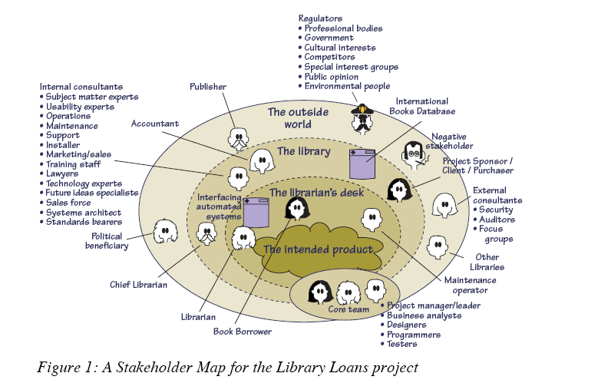
Stakeholders Decide Qualities
1.
Suzanne Robertson & James Robertson
Notes:
Copyright The Atlantic Systems Guild, Used with Kind Permission.
http://www.requirementsnetwork.com/sites/requirementsnetwork.com/files/Volere_Requirements-A_Socio_Technical_Discipline.pdf
Requirements – A Socio Technical Discipline
This is the fourth article in a series that explains the
thinking behind the Volere1 requirements techniques.
Subsequent articles will explore various aspects of
applying these techniques in your environment.
by
Suzanne Robertson & James Robertson
The Atlantic Systems Guild
February 2009
A Combination of Perspectives
On 8 Apr 2009, at 11:00, Suzanne Robertson wrote:Tom,Yes, with the usual copyright acknowledgements. What do you want to use it for?Have a happy EasterSuzanne

Slide 19
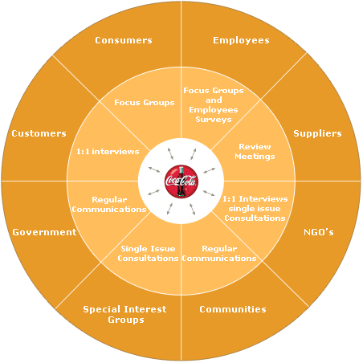
Stakeholder: Concept *233 .
‘Stakeholders’ are:
Any person, group or thing
that can determine our systems degree of success or failure,
by having an opinion about
system performance characteristics and
system lifecycle constraints

Slide 20
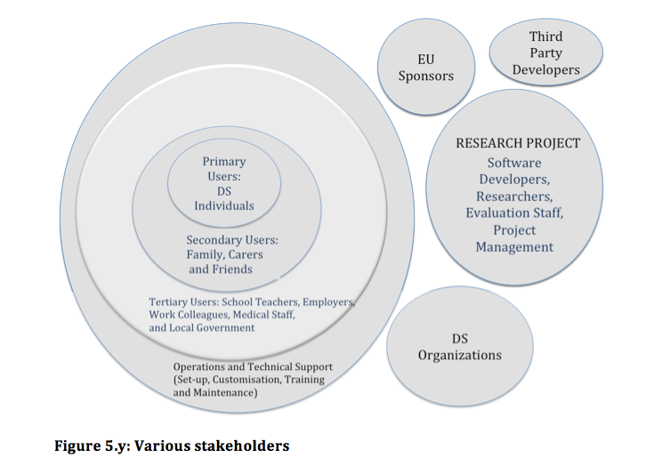
Brodie’s Stakeholder Map 2014 PhD
Notes:
2. The stakeholders
The stakeholders identified to date include:
Primary users (PU) - Down’s Syndrome individuals
children
teenagers
adults (19% work and 23% attend a day centre)
Secondary users (SU) - carers
Family or care home (85% + 3%)
Monitoring (as opposed to living alongside) (12%)
Tertiary users (TU) – friends (Note: in their own right some could additionally be primary users)
Tertiary users (TU) - teachers (including day centre staff) (23% attend a day centre + x% at school)
Tertiary users (TU) - employers (19% work)
Tertiary users (TU) - health-related staff (doctors, nurses, dentists, nutritionists, etc.)
Down’s Syndrome organizations
Project system developers
Technical support
Operations
Researchers
EU project sponsors
Legislation
Third party developers
Project management
Research organizations
Industrial partners.

Slide 21
Brodie’s Stakeholder Map 2014 PhD
2. The stakeholders
The stakeholders identified to date include:
Primary users (PU) - Down’s Syndrome individuals
children
teenagers
adults (19% work and 23% attend a day centre)
Secondary users (SU) - carers
Family or care home (85% + 3%)
Monitoring (as opposed to living alongside) (12%)
Tertiary users (TU) – friends (Note: in their own right some could additionally be primary users)
Tertiary users (TU) - teachers (including day centre staff) (23% attend a day centre + x% at school)
Tertiary users (TU) - employers (19% work)
Tertiary users (TU) - health-related staff (doctors, nurses, dentists, nutritionists, etc.)
Down’s Syndrome organizations
Project system developers
Technical support
Operations
Researchers
EU project sponsors
Legislation
Third party developers
Project management
Research organizations
Industrial partners.
Notes:
2. The stakeholders
The stakeholders identified to date include:
Primary users (PU) - Down’s Syndrome individuals
children
teenagers
adults (19% work and 23% attend a day centre)
Secondary users (SU) - carers
Family or care home (85% + 3%)
Monitoring (as opposed to living alongside) (12%)
Tertiary users (TU) – friends (Note: in their own right some could additionally be primary users)
Tertiary users (TU) - teachers (including day centre staff) (23% attend a day centre + x% at school)
Tertiary users (TU) - employers (19% work)
Tertiary users (TU) - health-related staff (doctors, nurses, dentists, nutritionists, etc.)
Down’s Syndrome organizations
Project system developers
Technical support
Operations
Researchers
EU project sponsors
Legislation
Third party developers
Project management
Research organizations
Industrial partners.

Slide 22
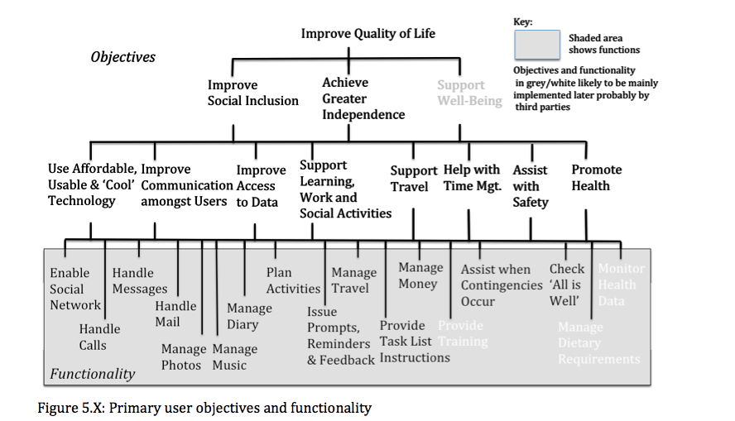
Down’s Syndrome Case Objectives, Functions: Brodie PhD Case 2014
Notes:
3. The quality requirements
The quality requirements in the project documentation are at a high-level of abstraction and are not quantified. They are also very ambitious. While being ambitious is essential for research, the researcher considered that identifying a minimum design solution that provided basic functionality for daily use by the primary users could help by providing a focus for some of the research activity. With that in mind, an initial ‘top ten’ set of quality requirements was drawn up and some scales of measure were specified.
The main aim of the set of ‘top ten’ requirements is to help project planning ensure useful features are delivered. In addition, the measures provide a means of keeping track of project progress and they help define project success. The initial ideas for the ‘top ten’ requirements relate to key aspects of Prototype 1, and they include:
Supporting more primary users to make mobile calls unaided
Helping primary users plan in advance local journeys
Supporting primary users send messages unaided
Improve the location tracking of primary users when outdoors
Enable the monitoring of the emotional wellbeing of the primary users
Ensure the setup time for a system user is practical
Ensure the system reliability is sufficient
Monitor the number, type and severity of system defects
Ensure the awareness of third party developers
Measure customer satisfaction with the system.
Different or more measures than the initial ‘top ten’ suggested above could be specified. Once any target measure is achieved, an additional replacement measure should be considered. Suggestions for additional measures include:
Reduction in the amount of time spent by secondary users assisting primary users organize their school/work/learning
Reduction in the amount of time spent by secondary users helping primary users with usage of technology
Increase in the frequency of productive use of technology by the primary user
Reduction in time spent by tertiary user in supporting primary user to complete tasks (reduction in repetition of instructions, prompting over the next step, etc.).

Slide 23
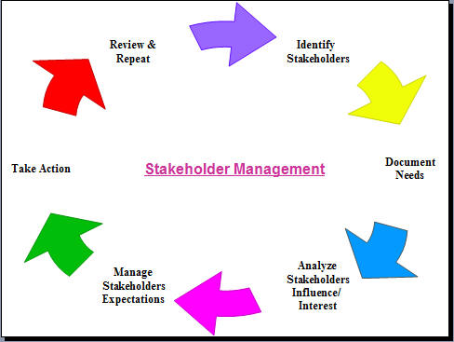
Stakeholder Interests
For example they might have an interest in
1. Setting the objectives for a process.
2. Evaluating the quality of the product
3. Using the product or system, even indirectly
4. Avoiding problems for themselves as a result of our product or system.
.Being compatible with another machine or software component.
.Determining constraints on development, operation or retirement of the system.

Slide 24
Project failures due to poor stakeholder engagement in US
In contrast to these successful projects, the GAO has regularly reported on instances of project failures due to poor stakeholder engagement.
Examples include:
The Federal Emergency Management Agency (FEMA),
where end users were not sufficiently involved in defining requirements for the National Flood Insurance Program’s insurance policy and claims management system.
The program was canceled in final end-user testing after seven years of development and a budget of $40m, forcing the agency to continue to rely on an outdated 30 year-old system.
The Department of Homeland Security (DHS)
which did not allow sufficient time for stakeholder involvement in its planning and had no consistent method for identifying stakeholder roles and incorporating their feedback.
The 2010 US Census
where lack of local user involvement in software testing hindered local governments’ ability to accurately update address lists and maps.
Sources:
{U.S. Government Accountability Office June 2011 #38}
{U.S. Government Accountability Office 15/09/2011 #209: 28}
{U.S. Government Accountability Office 14/06/2007 #210}
Kilde: Wernham Agile Project Management for Government, 2012
Notes:
slides from Werhams book , brian.wernham@gmail.com, Agile Project Management for Government ™
2012

Slide 25
UK Revenue and Customs 2007-2011
In contrast, a major project by the UK Revenue and Customs had delivered 4% uptake of salaried employee tax returns over the period 2007-11
with effective stakeholder engagement applied during a phased implementation of online services.
Each stakeholder group was identified and assigned a ‘champion’ to act as a single point of contact,
and consultative groups were set up to liaise with tax agents and industry representatives.
Customer concerns were researched and face-to-face events were held to help small businesses and individuals understand the new processes.
Requirements for the new services were prioritized according to stakeholder concerns.
For example, as a response to these concerns mandatory filing was delayed, which gave rise to the opportunity to reduce the overall budget of £373m by about 10%.
New requirements were proposed and implemented.
Example of these were free entry-level software for small businesses, and soft landings of non-mandatory solutions that allowed customers to familiarize them-selves with online filing without fear of penalties.
Third-party tax and accounting software developers were also identified as important stakeholders and targeted technical information was sent to them to assist them in developing compatible systems.
Source: {UK NAO 09/11/2011 #207} in Wernham Agile Project Management for Government, 2012
Notes:
slides from Werhams book , brian.wernham@gmail.com, Agile Project Management for Government ™
2012

Slide 26
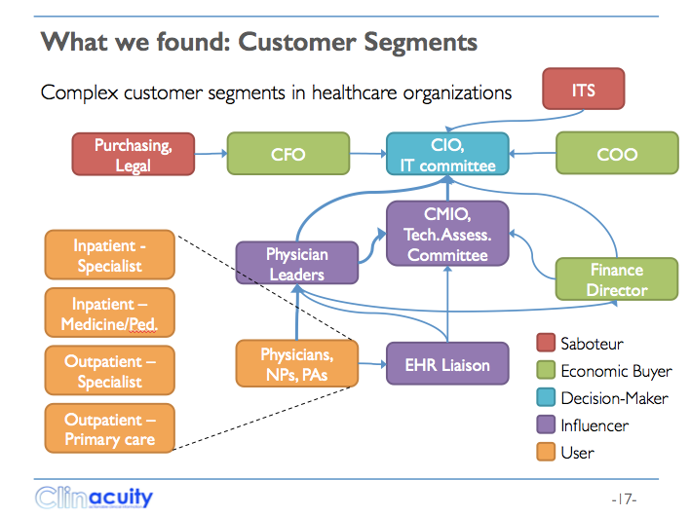
Complex Stakeholders
http://www.slideshare.net/tomgilb1/savedfiles?s_title=clinacuity-icorpsnih-121014&user_login=sblank
Notes:
http://www.slideshare.net/tomgilb1/savedfiles?s_title=clinacuity-icorpsnih-121014&user_login=sblank
Made Dec 18 2014 tom gilb

Slide 27
Interviewing 100 Stakeholders
http://www.slideshare.net/tomgilb1/savedfiles?s_title=clinacuity-icorpsnih-121014&user_login=sblank
Notes:
http://www.slideshare.net/tomgilb1/savedfiles?s_title=clinacuity-icorpsnih-121014&user_login=sblank
Made Dec 18 2014 tom gilb

Slide 28
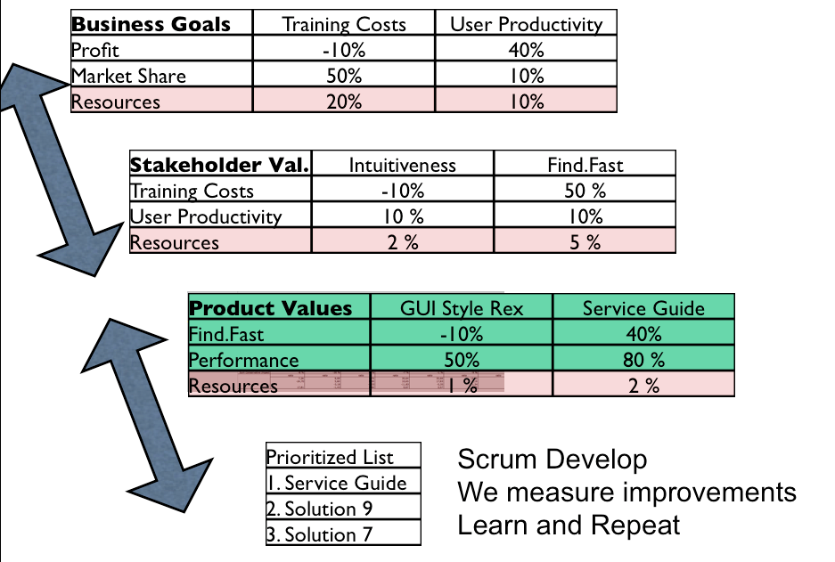
Modeling Multi-level Stakeholder Relations Quantitatively using IE Tables
In order to save a large IT Scrum project that failed initially, (the new system drastically killed sales!). Kai modelled the (obviously, ‘it failed’) ‘wicked system’. He built one Impact Estimation Table (aka Value Decision Table) for the top level of the Bring (Norwegian Post Office essentially) organization. This succeeded to resurrect the system, because it mapped the connection between technology and the higher levels of organizational objectives. The IT Development team was then instructed to focus on developing things that led to business (sales!) success.
Business Goals: The top management stakeholder level has problems, like Increase Profit and Market Share. Solutions have been identified (reduce Training Costs, and improve User Productivity). The expected, estimated, impact of these solutions on the (elsewhere, see Figure W4 for ‘how it looks’) quantified Problems, is given by the numbers estimated (later ‘measured as a result) at their intersection. For example Training Costs reduction, if the solution works as expected, promised to move us 50% of the way towards our Market Share objective (the Problem,
Stakeholder Value: These solutions become the the Problem at the next level. The Stakeholder level. Think of these as the 30 or so individual transport companies that had been bought and merged to form Bring. It looks like the Solution named ‘Intuitiveness’ is estimated to contribute 10% of the progress we need towards the User Productivity problem objective. All objectives are of course quantified, elsewhere.
Product Val.:At the third level (Product Values), ‘Find.Fast’ (one of the Stakeholder solutions, is considered an IT System objective (a problem statement).
It looks like ‘Service Guide’ is a solution that is expected to contribute 40% towards the ‘Find.Fast’ Problem solution. And ‘Service Guide’ also is expected to contribute 80% towards a Performance problem.
Scrum Level: The Service Guide solution will be developed and implemented by the Scrum Team. Hopefully its impact will be approximately as expected, and will impact several levels up towards the Business Goals.
Notes:
slide made Jan 10 2016 tsg based on text in Wicked paper I made

Slide 29
PPG’s Framework for Responding to Wicked Issues
PPG Industries develops strategies
after seeking and documenting stakeholders’ assumptions, preferences, and alternate views.
It evaluates the appropriateness of the strategies it draws up against its statement of identity and continually scans the environment and tests assumptions to see if it needs to change course.
The assessment of possible scenarios helps PPG formulate new options,
and its managers apply Pareto analysis to identify a small number of actions that are likely to have a large impact.
Notes:
www.ppg.com/
source Strategy as a Wicked Problem by John C. Camillus
FROM THE MAY 2008 ISSUE
John C. Camillus (camillus@pitt.edu) is the Donald R. Beall Professor of Strategic Management at the University of Pittsburgh’s Joseph M. Katz Graduate School of Business.
https://hbr.org/2008/05/strategy-as-a-wicked-problem
slides made Jan 9 2016 Tom Gilb

Slide 30
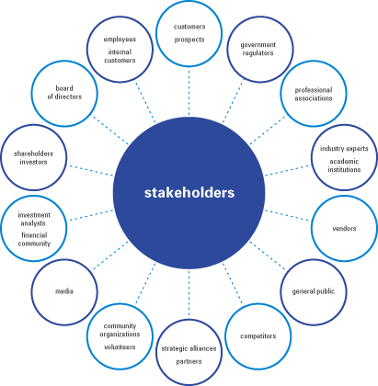
No Stakeholder?
No Stakeholder: no requirements
No requirements: nothing to do
No requirements: nothing to test
If you find a requirement without a Stakeholder:
Either the requirement isn’t a requirement
Or, you haven’t determined the Stakeholder yet
If you don’t know the Stakeholder:
Who’s going to pay you for your work?
How do you know that you are doing the right thing?
When are you ready?
N R Malotaux
Consultancy
Notes:
http://macinnismarketing.files.wordpress.com/2009/07/stakeholders.gif

Slide 31
2. Quality and Value Quantification

Slide 32
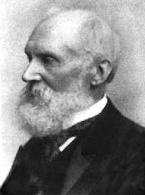
Quantify the Quality to ‘Assure’ It
I often say that
when you can measure what you are speaking about,
and express it in numbers,
you know something about it;
but when you cannot measure it,
when you cannot express it in numbers,
your knowledge is of a meagre and unsatisfactory kind;
- Lord Kelvin, 1893
Notes:
Thank you for the lecture you gave at OGI. It gave me much food for thought
and action, particularly in the realm of requirements specification. Much
to learn, much to apply.
From http://zapatopi.net/kelvin/quotes.html
As for your Lord Kelvin quote, it prompted an immediate google search. I
found a fuller version of the quote at
http://zapatopi.net/kelvin/quotes.html, which reads,
"In physical science the first essential step in the direction of learning any subject is to find principles of numerical reckoning and practicable methods for measuring some quality connected with it.
I often say that when you can measure what you
are speaking about, and express it in numbers, you know something about it;
but when you cannot measure it, when you cannot express it in numbers, your
knowledge is of a meagre and unsatisfactory kind; it may be the beginning of
knowledge, but you have scarcely in your thoughts advanced to the state of
Science, whatever the matter may be." While his full quote is more narrow
in scope (physical science) I think your extension of the idea to
"requirements science" arena equally applicable.
Benjamin Ward
---Benjamin Ward-----
Work: 503.232.7053 / mailto:benjamin.ward@tek.com
Home: 503.232.7053 / mailto:ben_ward@northwest.com
------------------------- June 1 contribution Michael Jackson, London
George Miller, the psychologist
> usually credited with the magic number seven, plus or minus
> two, wrote: "In truth, a good case could be made that if
> your knowledge is meagre and unsatisfactory, the last thing
> in the world you should do is make measurements. The chance
> is negligible that you will measure the right thing
> accidentally." Meagre and unsatisfactory knowledge about
> separability can't be improved by measuring anything, or
even by thinking about what you might measure.
=========== end MJ quote

Slide 33
Stakeholders: How to find out about, and confirm, their requirements
1. Identify all critical and profitable STAKE-HOLDERS
2. Identify All critical and profitable stakeholder REQUIRE-MENTS
3. Detail and clarify requirements (Scale +Benchmarks+Targets)
4. Validate and agree these requirements with stakeholders
5. Select most profitable requirements to deliver first (Evolutionary delivery)
6. Learn new requirements evolutionarily as result of experience feedback and time (new technology, markets and cost levels)

Slide 34
Setting Quality Goals
Usability.Learn
Scale: average time to Learn how to operate the computer, from .. to ..
Status [today] 3 hours
Goal [next year] 10 min.

Slide 35
PLANGUAGE SAMPLE
Expectations [The desired rewards
Motivation
Control
EFFORT
PERFORMANCE
Design Skill
Scale & Meter
Target & Benchmark
Requirements
Resources
Goal Clarity
Time
Reduce time on placing stock away
[2013-2014] Custom Monthly Report + Observation
Target: 5 minutes
[Q3 – 2013]:
Constraint: 30minutes
[2012]: 120 minutes
←Observation measures & report
Decrease time taken to process order request
[2013] Audit Paper Analysis & Custom Monthly Report
Target: 5 minutes
[2013]:
Constraint: 15 minutes per day
[2013]: 30 minutes per day
←Physical audit analysis
[2012]: 120 Minutes
←Report in August & September
Decrease time taken to picking order request
[2013] Custom Monthly Report + Observation
Target: 5 minutes
[2013]:
Constraint: 15 minutes per day
Reduce manual requirement for process
[2014] Observation
Target: 40%
Constraint: 85%
[2013]: 100%
←Training Log Report
Increase volume of transactions per day
[2013] Custom Report
Target: 50 items
Constraint: 70 items
[2012]: 387
←Based on Observation &
[2012]: 2960 per year +
←Report in August & September
Reduce time required to validate items picked
[2013] Audit paper analysis
Target: 250 per year thereafter
[2013]: Constraint: 1000
Decrease Time to Learn Process
[2013] Procedure file log
Target: 60 minutes
Constraint: 120 minutes
[2012]: 180 minutes
←Training Log Report
Reduce the volume of loss productivity
[2012] Custom report
Target: 40 days
Constraint: 80 days
[2012]: 162 days
←Based on absence report
Notes:
Planguage:
Objectives & Requirements
Gilb Fest 2014
23rd - 27th June 2014 , London, UK
Man-Chie Tse &
Ravinder Singh Kahlon
{Man-Chie, Ravi}@dkode.co
dkode Limited, London, United Kingdom.
University of Ulster, Northern Ireland, United Kingdom

Slide 36
Some potentially quantifiable Quality dimensions of Music
gilb.com/dl517
Examples in Planguage
Brainstormed by Steve F. and Rachel D. At lunch
Music.Moving:
Type: primary music quality attribute
Ambition Level: the majority of listeners feel moved to tears or strong physical emotional reactions.
Scale: the % of defined [Listeners] hearing defined [Music] under defined [Environments] who reports a defined [Emotion] at a defined [Strength]
Goal [1st UK Release, Music = Hip Hop, Environment = Itunes, Emotion = {Tears, Sadness}, Strength = Powerful] 50% ± 20% ?
In tune
Applause
Moving
Encores
Repeat Gigs
Busking Hat Collection
MRI Brain Scan
Downloads
Utube Reviews
Royalties
… (many more!!)
1 July 2014
© Tom@Gilb.com 2014
Notes:
Steve Freeman
Rachel Davies
http://www.gilb.com/dl517
Quantifying Music Slides 2012
http://skillsmatter.com/podcast/agile-testing/lightning-talk-tom-gilb-quantifying-music
Video of 5 minute Q Music Talk

Slide 37
How to Quantify any Qualitative Requirement
Diagram from ‘Competitive Engineering.’ book.
1 July 2014
© Tom@Gilb.com 2014

Slide 38
Quality Quantification Methods #1
Common Sense, Domain Knowledge
Decompose “until quantification becomes obvious”.
Then use Planguage specification:
Scale: define a measurement scale
Meter: define a test or process for measuring on the scale
Past: define benchmarks, old system, competitors on the scale
Goal: define a committed level of future stakeholder quality, on your scale.
1 July 2014
© Tom@Gilb.com 2014
Notes:
Jan 16 2013

Slide 39
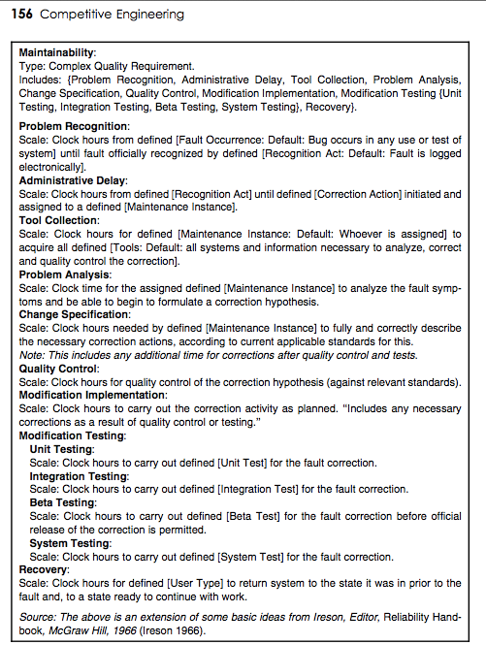
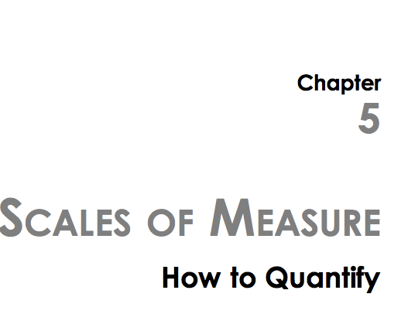
Quality Quantification Methods #2, Look it up in a book
1 July 2014
© Tom@Gilb.com 2014
Notes:
Jan 16 2013

Slide 40
Quality Quantification Methods #2, Look it up in a book
Tool Collection: Scale: Clock hours for defined [Maintenance Instance: Default: Whoever is assigned] to acquire all defined [Tools: Default: all systems and information necessary to analyze, correct and quality control the correction].
1 July 2014
© Tom@Gilb.com 2014
Notes:
Jan 16 2013

Slide 41
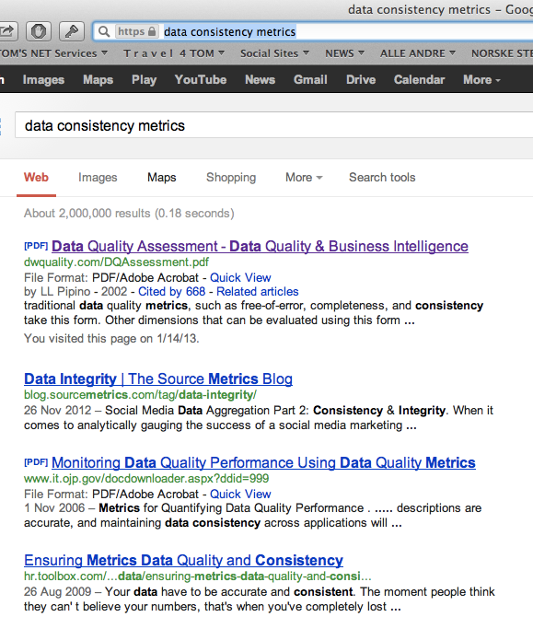
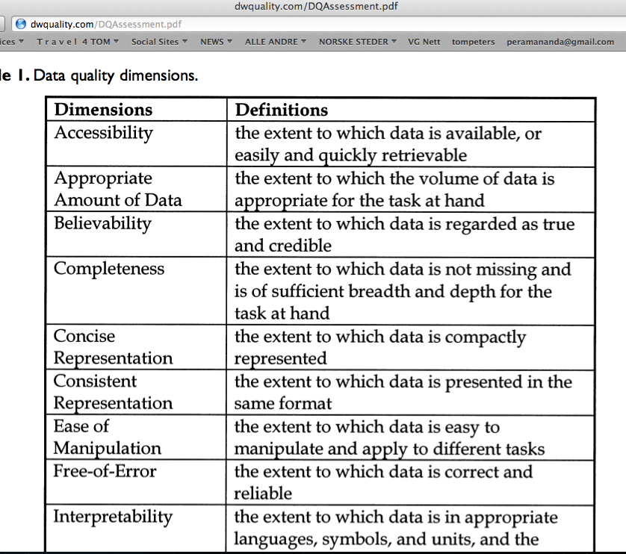
Quality Quantification Methods #3, Google It
1 July 2014
© Tom@Gilb.com 2014

Slide 42
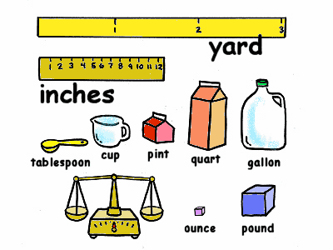
Summary of Top ‘8’ Project Objectives
Real Example of Lack of Scales
Defined Scales of Measure:
Demands comparative thinking.
Leads to requirements that are unambiguously clear
Helps Team be Aligned with the Business
1. Central to The Corporations business strategy is to be the world’s premier integrated <domain> service provider.
2. Will provide a much more efficient user experience
3. Dramatically scale back the time frequently needed after the last data is acquired to time align, depth correct, splice, merge, recompute and/or do whatever else is needed to generate the desired products
4. Make the system much easier to understand and use than has been the case for previous system.
5. A primary goal is to provide a much more productive system development environment than was previously the case.
6. Will provide a richer set of functionality for supporting next-generation logging tools and applications.
7. Robustness is an essential system requirement (see rewrite in example below)
8. Major improvements in data quality over current practices
This lack of clarity cost them $100,000, 000
1 July 2014
© Tom@Gilb.com 2014
Notes:
http://www.chariho.k12.ri.us/curriculum/MIsmart/matter/matter.html

Slide 43
“Rock Solid Robustness” Defined Clearly in Planguage over a beer
Rock Solid Robustness:
Type: Complex Product Quality Requirement.
Includes: { Software Downtime, Restore Speed, Testability, Fault Prevention Capability, Fault Isolation Capability, Fault Analysis Capability, Hardware Debugging Capability}.
1 July 2014
© Tom@Gilb.com 2014
Notes:
http://img2.travelblog.org/Photos/17776/71146/t/761917-Some-of-the-famous-granite-rocks-1.jpg

Slide 44
Software Downtime:
Software Downtime:
Type: Software Quality Requirement.
Ambition: to have minimal downtime
due to software failures <- HFA 6.1
Issue: does this not imply that there is a system wide downtime requirement?
Scale: <mean time between forced restarts for defined [Activity], for a defined [Intensity].>
Fail [Any Release or Evo Step, Activity = Recompute, Intensity = Peak Level] 14 days <- HFA 6.1.1
Goal [By 2008?, Activity = Data Acquisition, Intensity = Lowest level] : 300 days ??
Stretch: 600 days
1 July 2014
© Tom@Gilb.com 2014

Slide 45
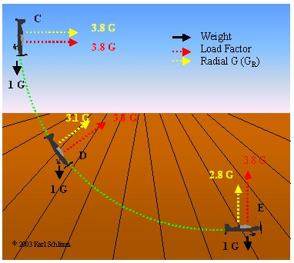
Restore Speed:
Restore Speed:
Type: Software Quality Requirement.
Ambition: Should an error occur (or the user otherwise desire to do so), Horizon shall be able to restore the system to a
previously saved state in less than 10 minutes. <-6.1.2 HFA.
Scale: Duration from Initiation of Restore to Complete and verified state of a defined [Previous: Default = Immediately Previous]] saved state.
Initiation: defined as {Operator Initiation, System Initiation, ?}. Default = Any.
Goal [ Initial and all subsequent released and Evo steps] 1 minute?
Fail [ Initial and all subsequent released and Evo steps] 10 minutes. <- 6.1.2 HFA
Catastrophe: 100 minutes.
1 July 2014
© Tom@Gilb.com 2014
Notes:
http://www.apstraining.com/images/69.jpg

Slide 46
Testability:
Testability:
Type: Software Quality Requirement.
Version: 20 Oct 2006-10-20
Status: Demo draft,
Stakeholder: {Operator, Tester}.
Ambition: Rapid-duration automatic testing of <critical complex tests>, with extreme operator setup and initiation.
Scale: the duration of a defined [Volume] of testing, or a defined [Type], by a defined [Skill Level] of system operator, under defined [Operating Conditions].
Goal [All Customer Use, Volume = 1,000,000 data items, Type = WireXXXX Vs DXX, Skill = First Time Novice, Operating Conditions = Field, {Sea Or Desert}. <10 mins.
Design Hypothesis: Tool Simulators, Reverse Cracking Tool, Generation of simulated telemetry frames entirely in software, Application specific sophistication, for drilling – recorded mode simulation by playing back the dump file, Application test harness console <-6.2.1 HFA
1 July 2014
© Tom@Gilb.com 2014
Notes:
http://users.skynet.be/ronnydewinter/SQA-img/TheSoftwareQualityIceberg.jpg
So once again, what is testability, exactly? Although testability is mentioned in the abstract of the recent WCAG 2.0 working draft documents and expanded in the “Conformance” section, a full definition sits not in the glossary but in the Requirements for WCAG 2.0 Checklists and Techniques, dated 7 February, 2003. Within this document, you will find the only definition of testability as it applies to WCAG 2.0. Here’s that definition:Definition: Testable: Either Machine Testable or Reliably Human Testable.Definition: Machine Testable: There is a known algorithm (regardless of whether that algorithm is known to be implemented in tools) that will determine, with complete reliability, whether the technique has been implemented or not. Probabilistic algorithms are not sufficient.Definition: Reliably Human Testable: The technique can be tested by human inspection and it is believed that at least 80% of knowledgeable human evaluators would agree on the conclusion. The use of probabilistic machine algorithms may facilitate the human testing process but this does not make it machine testable.Definition: Not Reliably Testable: The technique is subject to human inspection but it is not believed that at least 80% of knowledgeable human evaluators would agree on the conclusion.

Slide 47
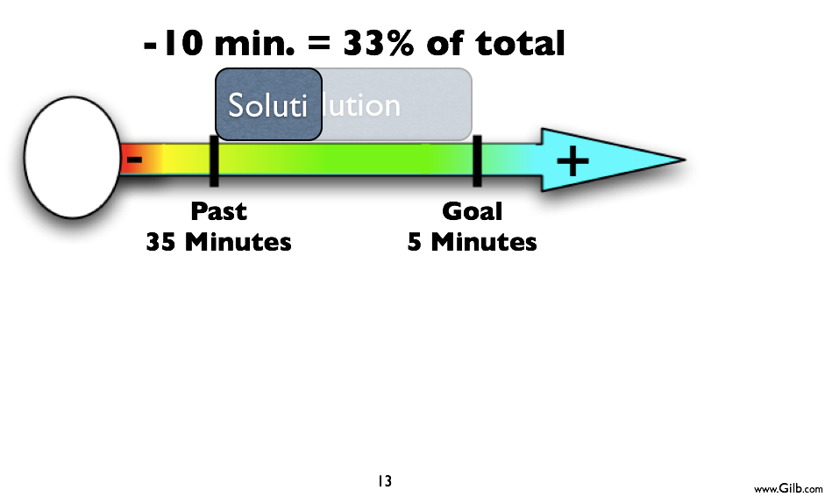
Assuring that Designs give Qualities
3.
Usability
Notes:
Tsg sept 8 2010

Slide 48
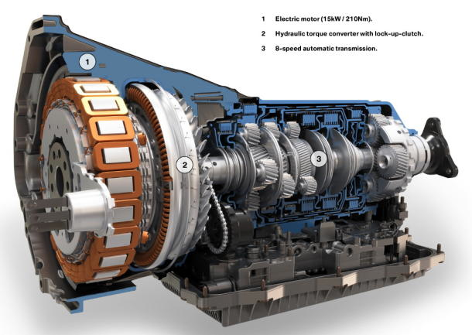
Design Quality In

Slide 49
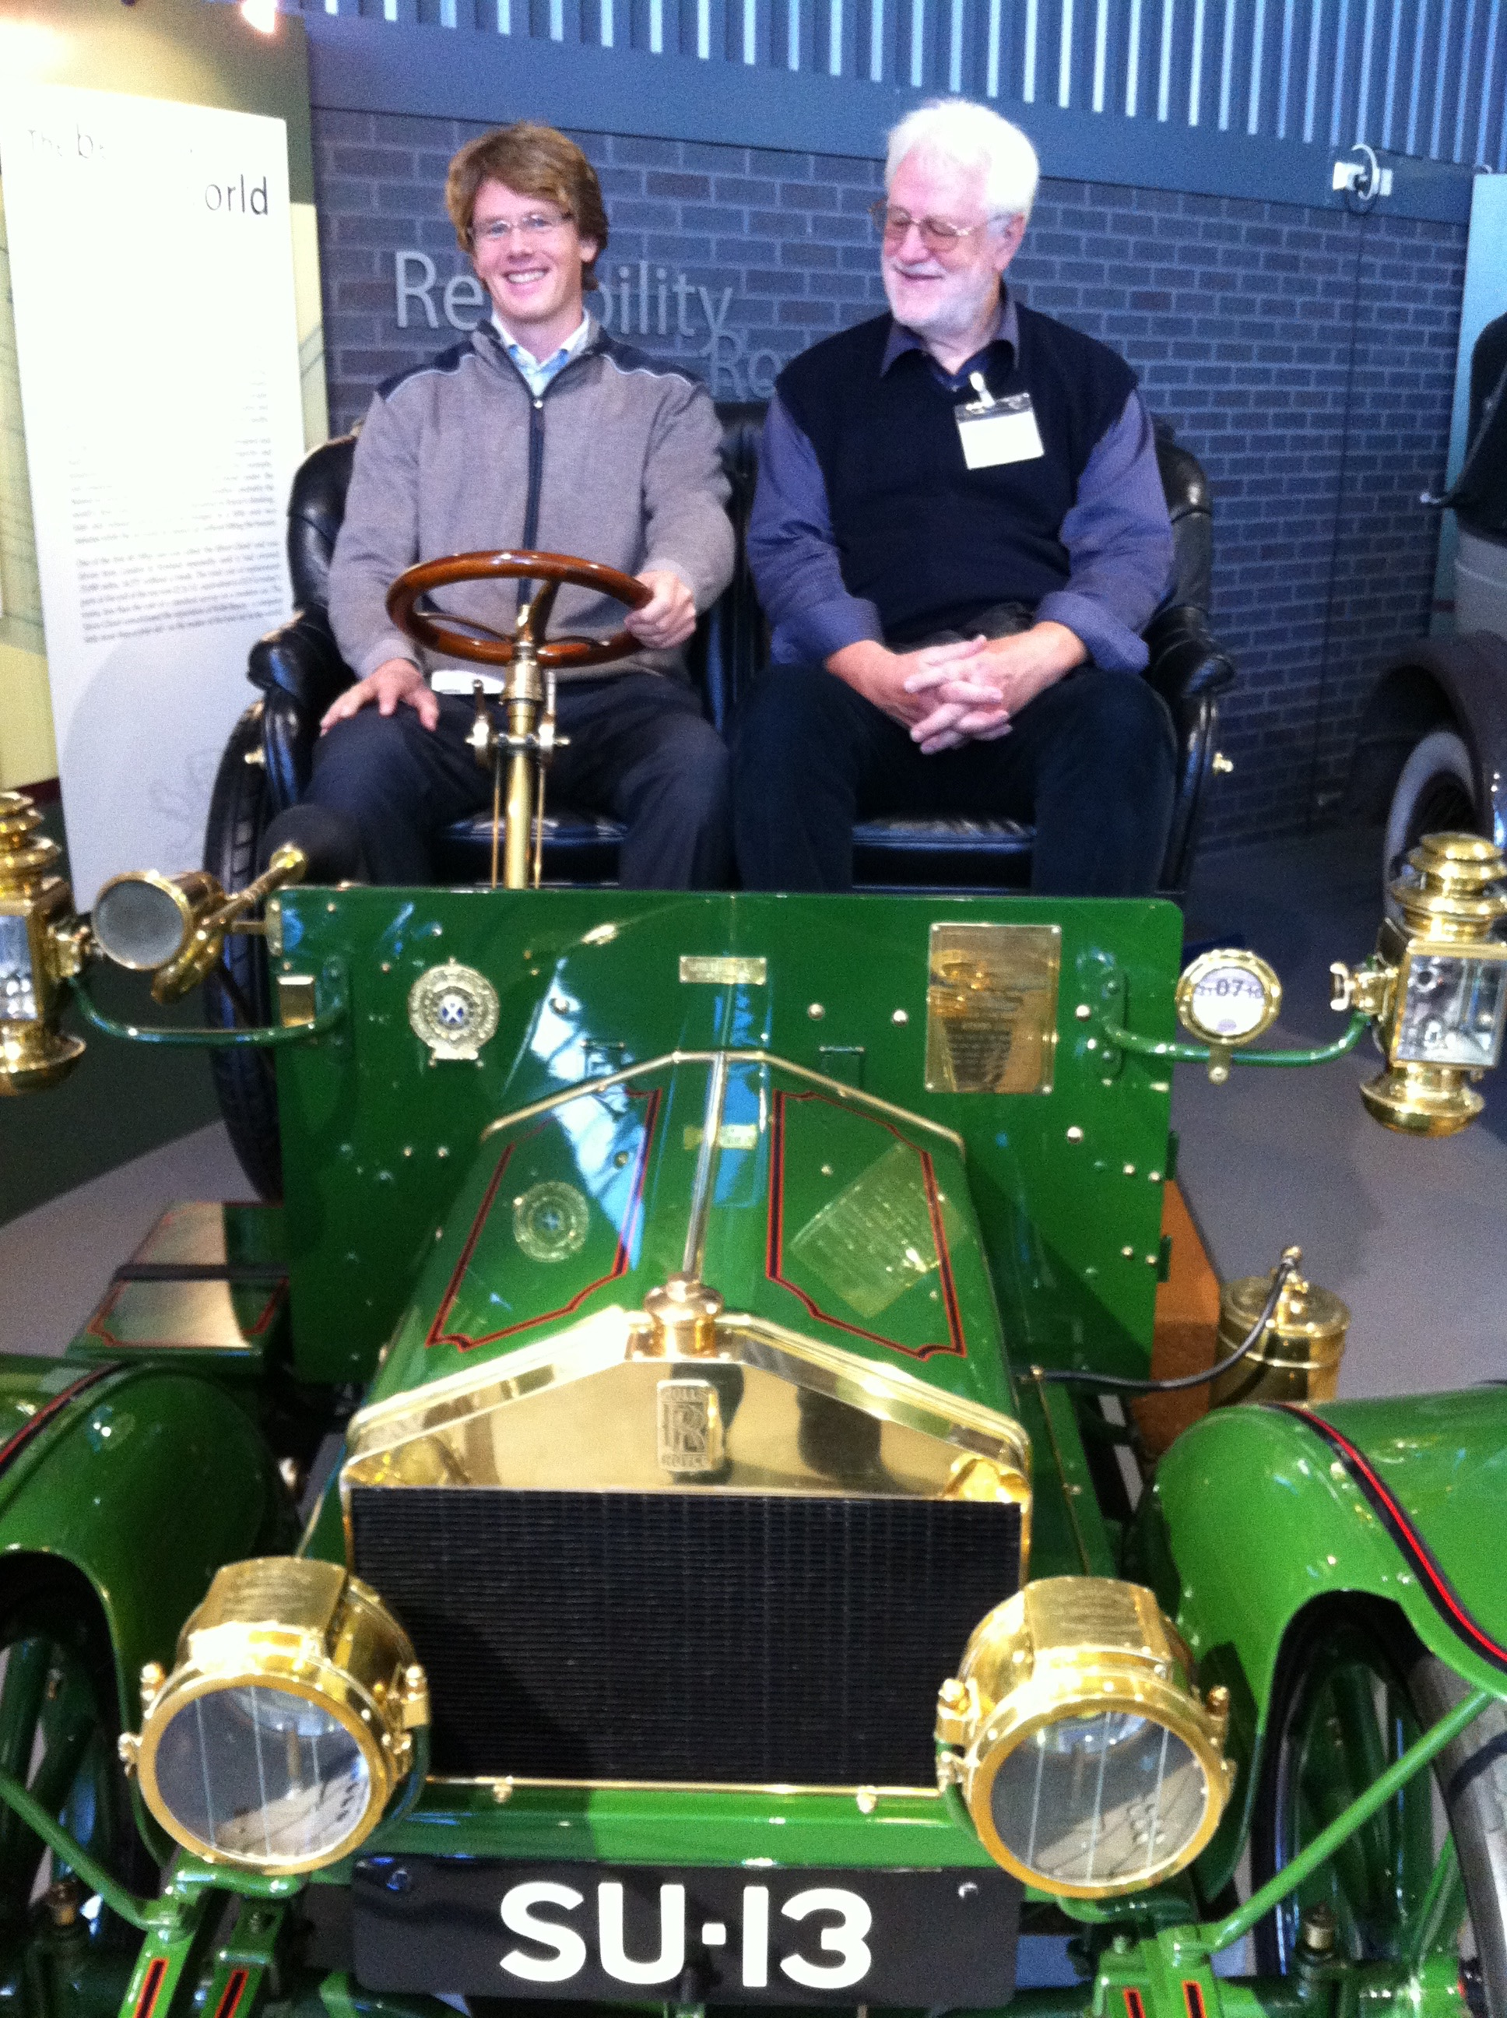

Slide 50
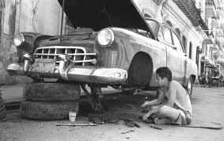
You don’t get quality by testing it in
Notes:
You need to design it in
Can you estimate the quality levels you will get from designs, strategies, and architectures?
Or are you flying blind until landing? ☺

Slide 51
but by ‘Engineering’ Quality In
Reliability
Performance
Work hours
Security
$ € Kr.
Usability
Maintenance
Notes:
Designers/’Architects’ need to
‘engineer’ their designs
and measure design effectiveness
in all critical quality and cost dimensions

Slide 52
Niels Malotaux
Notes:
“What has an Architect to do with planning?”
www.malotaux.nl/doc.php?id=98
added 11 sept 2015

Slide 53
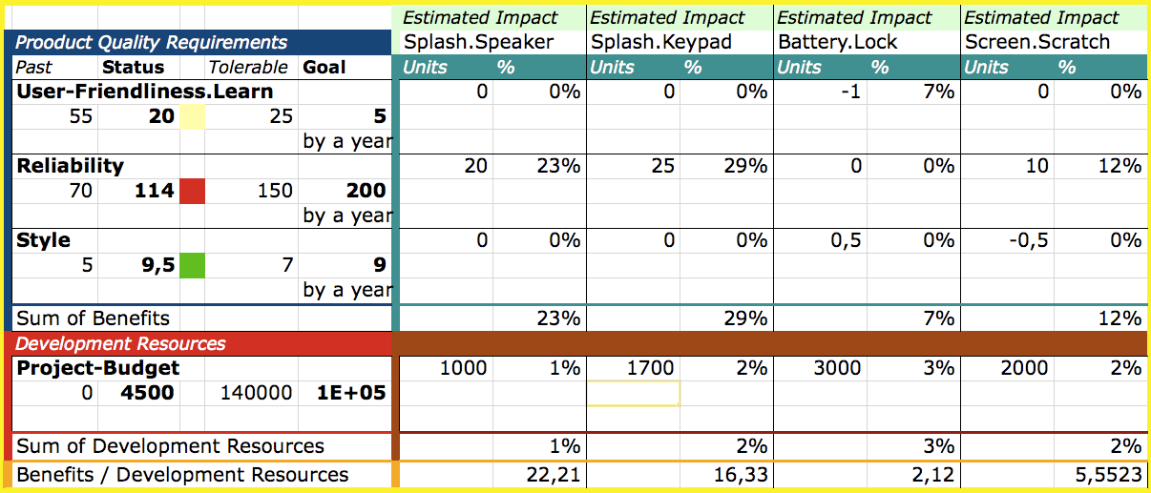
Designing to meet Quality within Costs
Design Ideas
Qualities
€ $

Slide 54
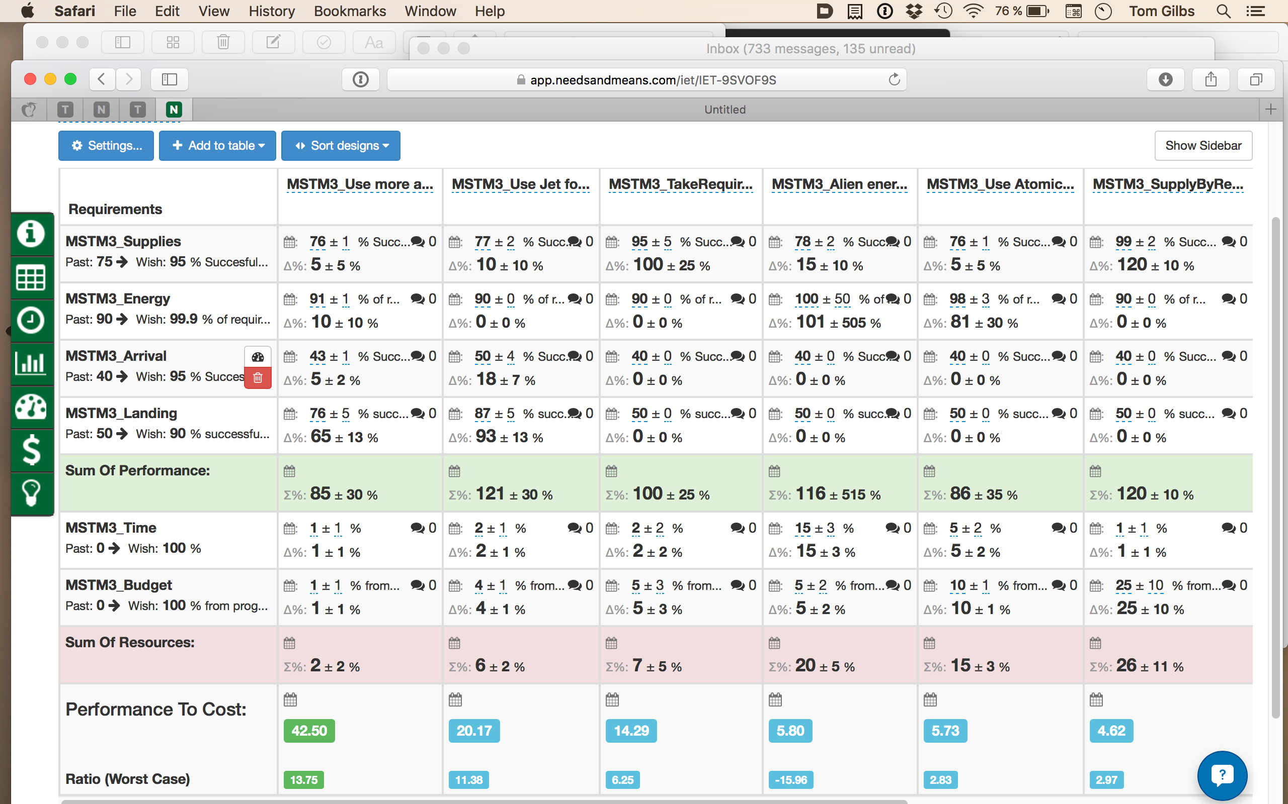
Notes:
Made 17 Nov 2015 based on student work at Lviv Business School Class exercise Mars Mission.

Slide 55
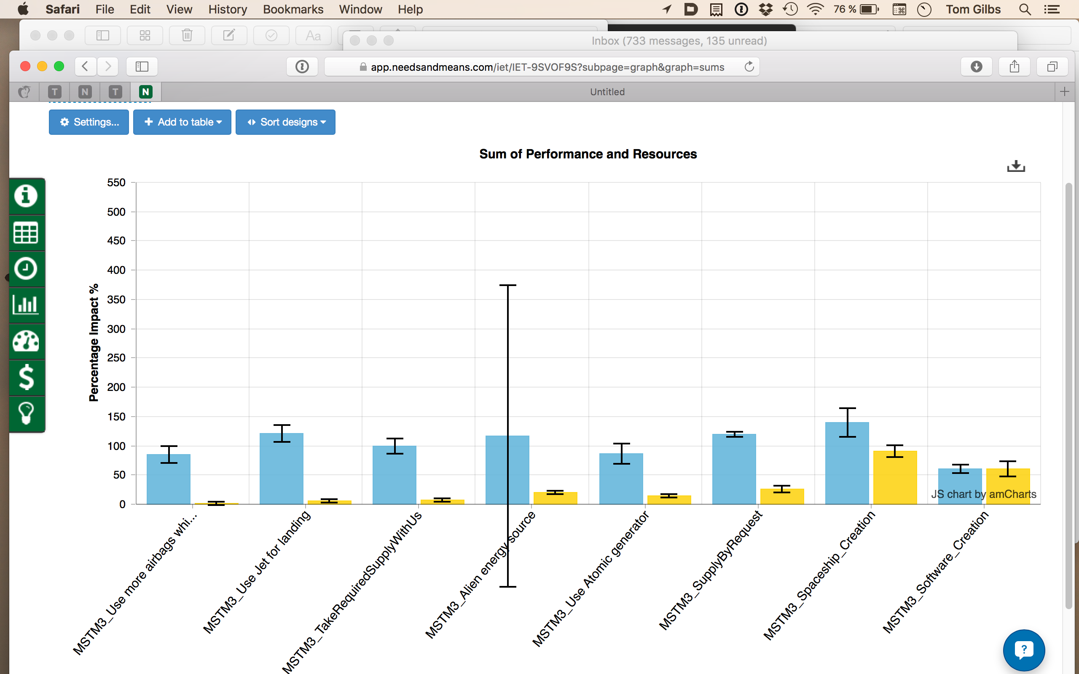
Notes:
Made 17 Nov 2015 based on student work at Lviv Business School Class exercise Mars Mission.

Slide 56
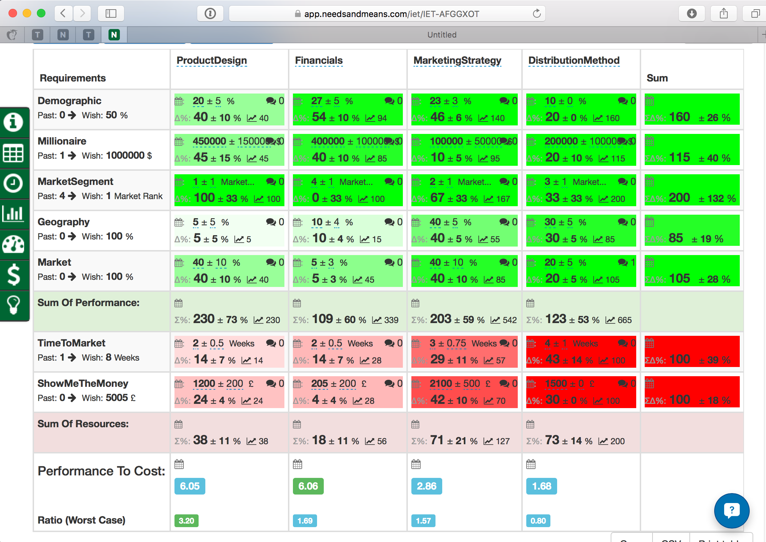
Notes:
MyBusinessPerspective
IET-AFGGXOT
BCS Geoff Cooper Cyber startup project 12 November 2015 London
Non Confidential Student Planning work on BCS Startup Planning Course
Led by Tom Gilb

Slide 57
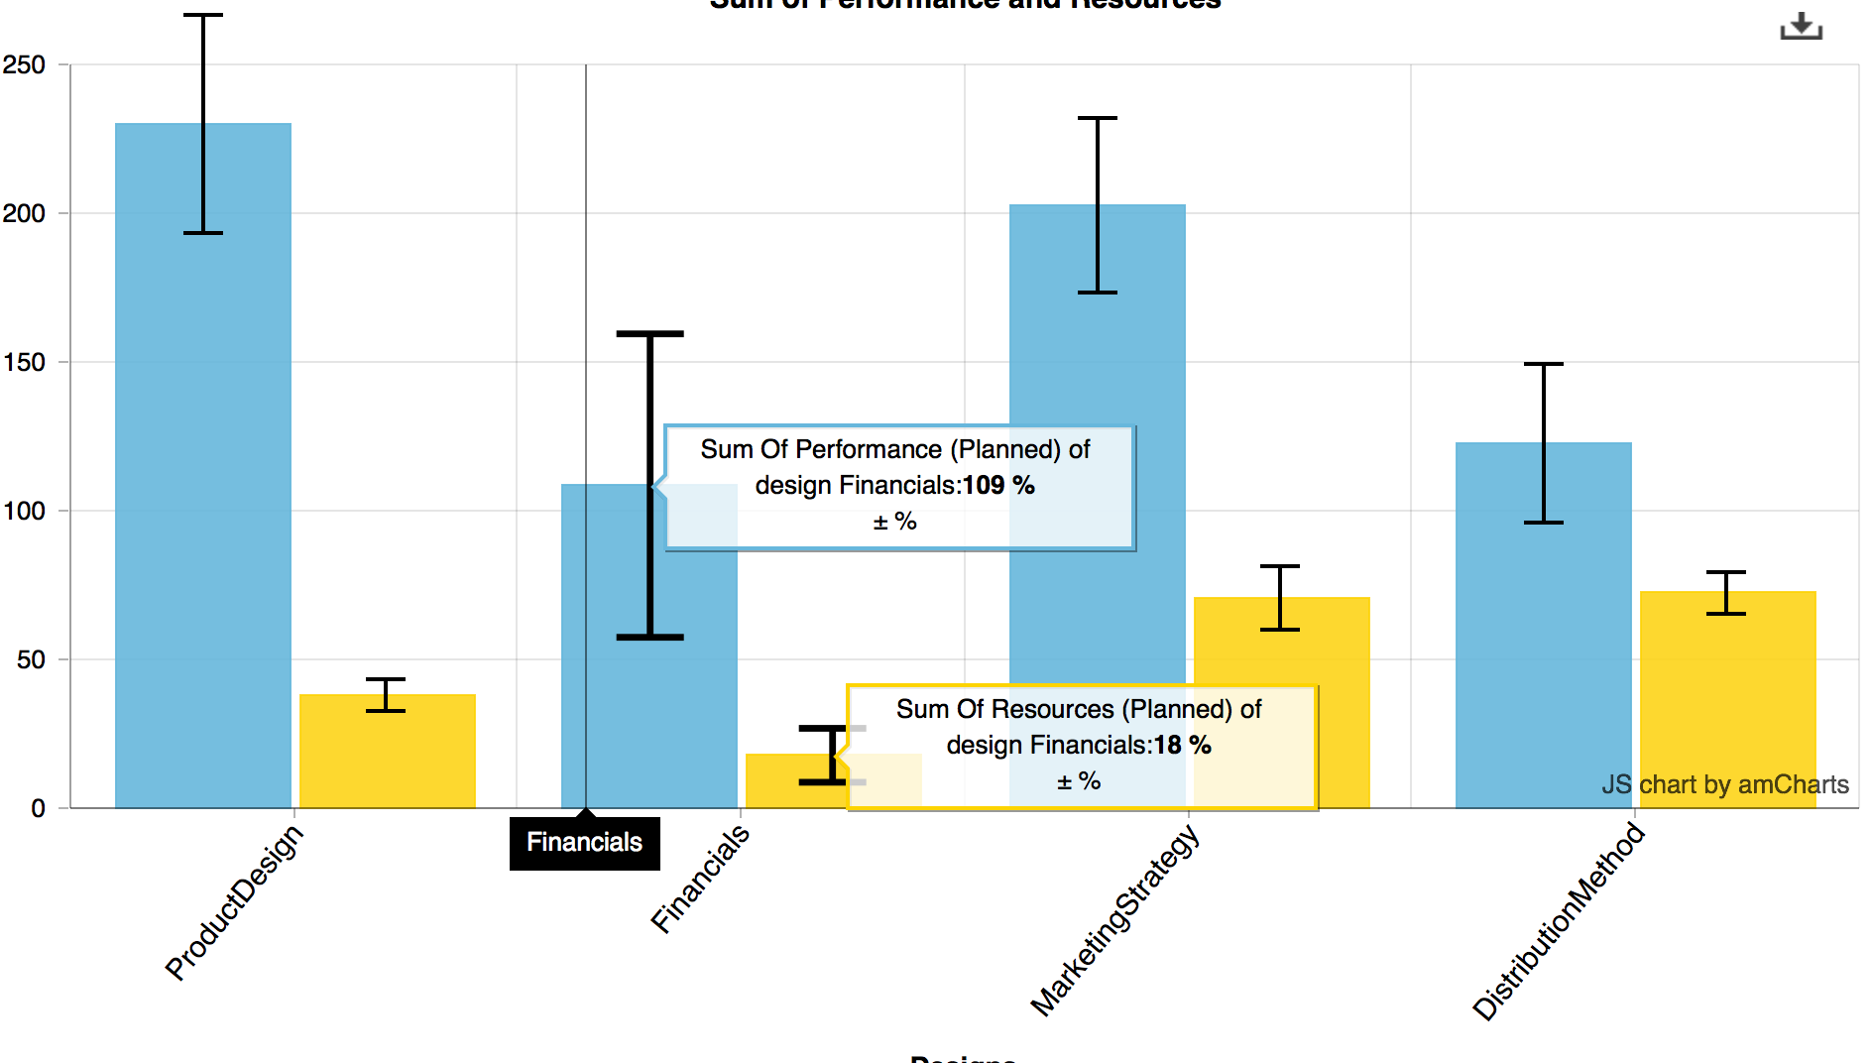
Notes:
MyBusinessPerspective
IET-AFGGXOT
BCS Geoff Cooper Cyber startup project 12 November 2015 London
Non Confidential Student Planning work on BCS Startup Planning Course
Led by Tom Gilb

Slide 58
Measure Quality Levels in Specifications with Inspection
4.
Notes:
Critical documents are checked for conformance to ‘rules’
Rule violation = ‘defects’ (law violation = illegal acts)
We sample large documents, to avoid high cost of measurement
We try to measure ‘defect density’
Major defects per page
We accept documents that meet our ‘exit conditions’
Like: “Maximum 1.0 Majors/page remaining”
The result is ‘no garbage out’, ‘no garbage in’
Not because we remove ‘garbage’!
But because people are really strongly motivated to follow the best practices, in the rules.
Otherwise, they are clearly Not doing acceptable professional work
and they want to feed their kids

Slide 59
Defect Rates in 2003 Pilot Financial Shop, London, Gilb Client Spec QC/Extreme Inspection + Planguage Requirements
Across 18 DV (DeVelopment) Projects using the new requirements method, the average major defect rate on first inspection is 11.2.
4 of the 18 DV projects were re-inspected after failing to meet the Exit Criteria of 10 major defects per page.
A sample of 6 DV projects with requirements in the ‘old’ format were tested against the rules set of:
The requirement is uniquely identifiable
All stakeholders are identified.
The content of the requirement is ‘clear and unambiguous’
A practical test can be applied to validate it’s delivery.
The average major defect rate in this sample was 80.4.
Major defects/page
on 1st Quality Control
November 26, 2012
www.Gilb.com

Slide 60
An Advanced Example
Source Erik Simmons, erik.simmons@intel.com 25 Oct 2011
Personal Public Communication
Application of Specification Quality Control by a SW team resulted in the following defect density reduction in requirements over several months:
Rev. | # of Defects | # of Pages | Defects/ Page (DPP) | % Change in DPP
0.3 | 312 | 31 | 10.06
0.5 | 209 | 44 | 4.75 | -53%
0.6 | 247 | 60 | 4.12 | -13%
0.7 | 114 | 33 | 3.45 | -16%
0.8 | 45 | 38 | 1.18 | -66%
1.0 | 10 | 45 | 0.22 | -81%
Overall % change in DPP revision 0.3 to 1.0: |  |  |  | -98%
Downstream benefits:
Scope delivered at the Alpha milestone increased 300%, released scope up 233%
SW defects reduced by ~50%
Defects that did occur were resolved in far less time on average
10
Notes:
These slides contributed as non confidential experience, by Eric Simmons, erik.simmons@intel.com, for my Construx Summit lecture 25 Oct 2011 Seattle
This incident was from Summer 2011 (3 months earlier than Oct)
See Paper by John Terzakis
Intel Corporation john.terzakis@intel.com
in Cases Intel here

Slide 61
Case: Real Inspection
of System Requirements Specification (SRS) of 82 pages for a major US corporation.

Slide 62
This presentation shows
how we carried out a short specification quality control process
with senior/middle managers.

Slide 63
The purpose is to
make managers aware that they play a key-role in creating projects delays
by approving poor quality of requirements specifications.

Slide 64
The results shown in this real-life example successfully predicted a
project delay of at least 2 calendar years.

Slide 65
Poor quality marketing requirements documents prove time and again to be
a good predictor of project delays.

Slide 66
The clue is that
requirements documents
with a high defect density
are an indicator of
a truly unprofessional engineering culture.

Slide 67
Framework
Demonstration of power of Inspection
8 Managers
2 hours
4 real requirements specifications offered ,
1 used

Slide 68
We Introduced best practice Rules
for Requirements
1. Unambiguous to intended Readership
2. Clear enough to test.
3. No unintentional Design

Slide 69
We Explained the definition of Defect
A Specification Defect is a violation of a Specifciation Rule (a ‘standard’)
Note: If there are 10 ambiguous terms in a single requirement
then there are 10 defects!

Slide 70
Explain the definition of Major defect
Major:
a Defect that potentially
costs more
to find and fix
later in the development process
than it would cost now.
We need to get rid of it NOW!

Slide 71
Agree with Management on Exit level
Is 1,000 Majors per page OK
100, 10, 1
?
• Exit Conditions: (when Requirements can go forward to Design, Test etc with little risk)
Maximum 1 Major Defect/ (Logical) Page
Logical Page = 300 Non commentary words.

Slide 72
the Job
You have up to 30 minutes
check 1 sample requirements page (from an 82 page document)
Count all potential Rule Violations
= Defects
Classify Defects as Major or minor

Slide 73
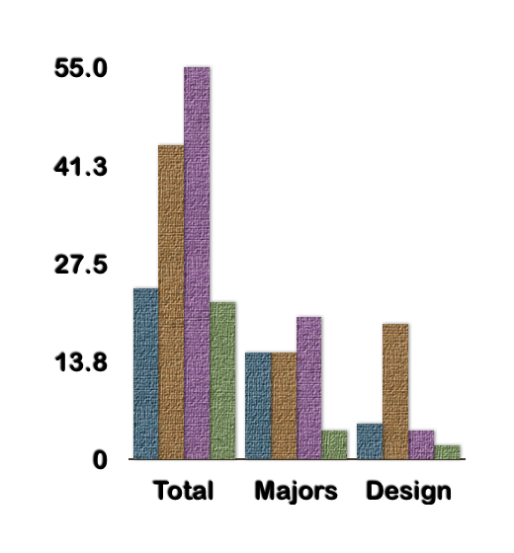
Report Page 81
Total, Majors, Design
24, 15, 5
44, 15, 19
55, 20, 4
22, 4, 2

Slide 74
Defect Density Estimation
Total for group (page 81)
20 x 2 = 40 Majors
assume 40 are unique
If 33.333% effective,
total in page = 3x 40= 120
Of which 2/3 or 80 were not yet found. .
If we fix all we found (40),
then the estimated remainder of Majors would be 80 (not found)
+8 “not fixed for correctly”
= 88 Majors remaining.
Tot., Majors, Design
24, 15, 5
44, 15, 19
55, 20, 4
22, 4, 2

Slide 75
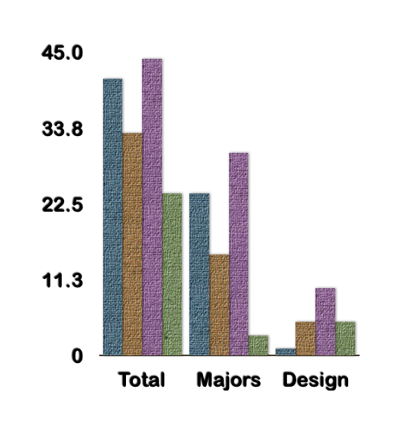
Report Page 82
Total, Majors, Design
41, 24, 1
33, 15, 5
44, 30, 10
24, 3, 5

Slide 76
Defect Density Estimation
Total for group (page 82)
30 x 2 = 60 Majors
assume are unique.
If 33.333% effective,
total in page = 3x 60 =180
Of which 2/3 or 120 were not yet found.
. If we fix all we found (60),
then the estimated remainder of Majors would be 120 (not found)
+10 “not fixed correctly”
= 130 Majors remaining.
Total, Majors, Design
41, 24, 1
33, 15, 5
44, 30, 10
24, 3, 5
60
180
120
Notes:
Team would (we estimate) log unique Majors about 2x30=60 actually found
Which is 1/3rd of total existing , so estimated total this page is about 180 Majors
About 2/3, = 120 Majors , were not found by the team during the agile spec QC process.
Not all 180 spec defects (only 25%-35%) would actually become product defects, before testing.
We don’t know which ones in advance: it depends on human interpretation, on the day.
Many (only 25%-35%) of these Major spec defects would cause product defects (bugs in product, not just spec)
These would be found later in test,and product use as bugs or major defects
The product defect rework would cause serious project (product development) delay
No human review process is better, even when continuously improved for years, than 60% (source code record) to 88% (the ‘logic spec’ record) at defect identification. <- IBM MN.
If we attempt to fix the 60 defects we logged, and correctly fix 5/6 of them; then 10 defects are ‘failed fixes’, so:
The total remaining after inspection and editing = 10+120 =130 Majors per page.
10 failed fixed +
120 not detected major defects
= 130 Major defects per page ( 300 non commentary words) remaining after the review and fixing process - before text.

Slide 77
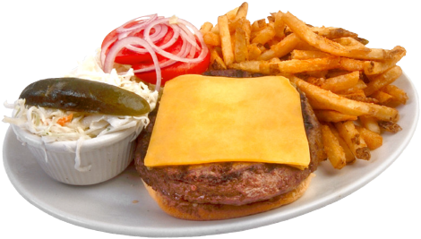
Conclusions
Human defect removal by Inspections/reviews/SQC is
a hopeless cause: not worth it.
Spec QC can be used, in spite of imperfect effectiveness,
to accurately estimate major defect level density.
This measurement can be used to motivate engineers to
dramatically (100x! Over about 7 learning cycles)
reduce their defect insertion (rule violation)
to a practical exit level
(like less than 1.0 Majors/page)

Slide 78
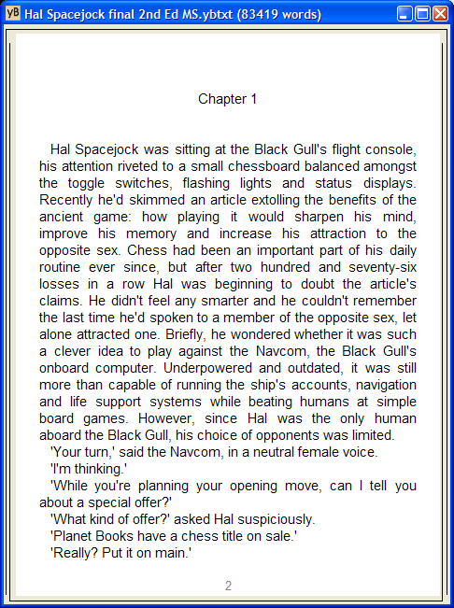
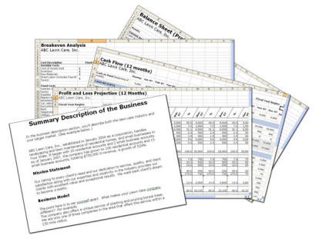
Extrapolation to Whole Document
Average: 150 Majors/page
Page 81: 120 majors/page
Page 82: 180 Majors/page
Total in whole document:
12,300 Majors
150 Majors/page x 82 pages.

Slide 79
Estimated Project Loss
If a Major has
1/3 chance of causing loss
And each loss caused by a Major is
avg. 10 hours
then total project Rework cost is
about 41,000 hours loss.
(This project was over a year late)
1 year = 2,000 hours x 10 people

Slide 80
Feedback on this “simple “formula
Tom Since returning from the QAI Conference in Orlando, I've been attempting to lay the foundation for our product team to develop clear requirements and implement productive inspections as opposed to just going through empty motions. It's definitely been an uphill effort.
One bright moment was my use of the formula that you provided me to
estimate the # of high-severity bugs still in a software product.
I applied it to our product's Test Pass 1 and then forwarded the estimated
number of remaining bugs after Test Pass 1 to the count estimated to
still be in the product when we began Test Pass 2.
This provided me with
a prediction of the number of high-severity bugs that would be found which was within 5% of the number actually found during Test Pass 2. :-)
I can't tell you how much that relatively simple activity buoyed my spirits. Thank you for the time you spent with me in Orlando.
Thanks, Jeff Finn, CSTE, CQA, Microsoft SharePoint Portal Server, 425-703-4213
jfinn@exchange.microsoft.com, May 22 2001

Slide 81
Details of a Real Process Definition for Agile Inspection
We do not expect to lecture with these slides. They are background information.

Slide 82
Extreme Inspection. Version:January 12, Originated 2003
Authors: Tom Gilb Tom@Gilb.com & Kai Gilb Kai@Gilb.com
Intended Purpose:
Extreme Inspection <client> Variation:
a simple but powerful version of inspection (Specification Quality Control – SQC) that <CLIENT> can install immediately at low cost.
November 26, 2012
www.Gilb.com

Slide 83
Rules
The primary Rules we check against are the same Rules that writers will use when writing specifications.
Initially they will be Clarity, Unambiguousness, Consistency, Traceability, separation of requirements and solutions, and separation of Performance, Functions and Designs.
See separate document: “Rules for Specification Writers.”
November 26, 2012
www.Gilb.com

Slide 84
Extreme Inspection Outcome
The outcome of this type of inspection is to give a fair measure of Major defect density.
November 26, 2012
www.Gilb.com

Slide 85
Intent of Outcome
The intents of the Major defect density measure are:
Clean: to make sure that polluted specifications do not enter the next working processes.
Learn: to motivate specification writers to learn and follow <CLIENT> best practice specification rules.
November 26, 2012
www.Gilb.com

Slide 86
Internal Extreme Inspection Goals
“The expected effects of rigorously carrying out this process are:”
Density:
Scale: Estimated remaining Major defect density per logical page (300 Non Commentary words)
Past [December 2002] 50-100 Majors/Page <- Multiple sample inspections
Goal [Jan 2003] less than 10 Majors/Page
Goal [Jan 2004 or sooner if feasible!] less than 1 Major/Page
November 26, 2012
www.Gilb.com

Slide 87
External Extreme Inspection Goals
Project Efficiency
Scale: Total project time to successfully complete a project
Past [Dec 2002] ???
Goal [Dec 2003] = 70% of Past [Dec 2002]
Goal [Dec 2004] = 50% of Past [Dec 2002]
Comment:
This will be accomplished by
less back and forth,
and reviewing of requirement documents,
and by shorted coding and test times,
and by less effort when work is contracted out of country or to sub-suppliers.
More time at the requirement stage is expected.
November 26, 2012
www.Gilb.com

Slide 88
Process Management of Extreme Inspection: 1
1. Inspection Outcome Justification
The outcome of this variation on conventional Inspection processes is to determine ‘specification exit’ by measuring and estimating Major defect density. The outcome is NOT (as with conventional inspection) to ‘clean up’ bad work.
The result of this outcome limitation is that many of the time honored conventions of Inspections (as in Gilb & Graham: Software Inspection) are NOT necessary or desirable. We only need to do whatever gives a reasonable measure of defect density. We only need to focus on determining that the specification is exit-able or NOT.
So we do not need to get maximum effectiveness by having a large team or by using one hour per page or by looking at all pages (we can sample in 10-40 minutes and use one or 2 people).
In simple terms if we find (checker detects) one or more Majors in a page, it is NOT exit-able, because the real estimated quantity of majors actually there, exceeds the Exit limit of ‘one per page’. If we find less than one major defect on 4 pages, it probably is economic to exit the spec.
Economic is the key word. We are trying to determine if it pays off to exit now, or to rewrite the spec to a cleaner level now.
November 26, 2012
www.Gilb.com

Slide 89
2. Inspection Cost Charging.
All costs for the writer, the checker and a possible process guide, will be
charged to the project the writer is working on,
and to the QC process costs specifically.
Rationale: so we can track the true costs of doing this and the degree to which it is done.
November 26, 2012
www.Gilb.com

Slide 90
3. Auditing this process:
The Inspection (Spec QC) process must be regularly (monthly) audited
to make sure it is really conducted according to intent
and is not corrupted or misunderstood.
This includes double checks on audits
to see if the conclusions of the check and the audit are reasonably consistent.
Frequent audits are necessary in the beginning and with newcomers.
Auditing will be done by the process owners.
November 26, 2012
www.Gilb.com

Slide 91
Process Management of Extreme Inspection
4. Process Improvement
The process needs to be continuously updated
mainly in the tools kit which defines and supports the inspection process:
the checklists,
the process definitions,
the computer data collection support
by the official process owner.
November 26, 2012
www.Gilb.com

Slide 92
5. Process Ownership
There must be an official process owner to champion (and to manage ‘local’ champions),
spread,
audit,
and improve the process,
as experience and insight dictates.
This can be a group.
November 26, 2012
www.Gilb.com

Slide 93
6. Process Sponsorship
The executive sponsor of this process should be official and visible
November 26, 2012
www.Gilb.com

Slide 94
7. Confidentiality
The checker shall never reveal the numeric result of an Inspection to anyone else except the writer.
The writer may reveal the results if they want to, but they are not obliged to do so even to their direct manager (who should not even ask!).
The results of an inspection, as recorded in the Specification Quality Control Database, are never to be released, revealed or reported with the name of the writer or information (such as document ID) that can lead to their identification.
Rationale:
to prevent fear of defamation leading to false reporting of results.
To emphasize that the process is there to help the writer reach the corporate quality level required.
It is not in any way of time to be used for personal job performance evaluation.
Evaluation should be based on EXITED specifications, and their timeliness only.
Managers need to be informed and reminded of this cultural paradigm by the process owners.
November 26, 2012
www.Gilb.com

Slide 95
Process Management of Extreme Inspection: 3
8. Expected Effectiveness
We expect that the Major defect finding effectiveness of the checking process will be in the range of 10% to 35% of the actual real Majors present in a specification.
This is quite sufficient to estimate the actual total number of majors actually present.
We can then estimate with sufficient accuracy (say ±20%) determine levels of Majors in entire spec and in spec after correction of listed (by checkers) defects.
November 26, 2012
www.Gilb.com

Slide 96
Defect Rates (repeat of earlier slide intentional) Here is what really happened afterwards in 2003 Pilot Financial Shop, London, Gilb Client Spec QC/Extreme Inspection + Planguage Requirements
Across 18 DV (DeVelopment) Projects using the new requirements method, the average major defect rate on first inspection is 11.2.
4 of the 18 DV projects were re-inspected after failing to meet the Exit Criteria of 10 major defects per page.
A sample of 6 DV projects with requirements in the ‘old’ format were tested against the rules set of:
The requirement is uniquely identifiable
All stakeholders are identified.
The content of the requirement is ‘clear and unambiguous’
A practical test can be applied to validate it’s delivery.
The average major defect rate in this sample was 80.4.
Major defects/page
on 1st Quality Control
November 26, 2012
www.Gilb.com

Slide 97
9. True Measure of Inspection Progress.
The correct and relevant measure of how effective the Inspection process is working, is NOT as many would assume the quantity of Major defects found and fixed by an Inspection.
In fact we strongly recommend that this measure is well hidden from public view! (It has its uses!).
The true measure is the average level of Major defects/Page which we can consistently release.
We need to move from about 100 Majors/Page down towards about less than one per page.
This cannot be achieved by finding and fixing defects (because we cannot find a large percentage at all)!
It can only be achieved in practice by motivating writers to reduce defects actually injected in their work, from 100, and move them down towards one maximum injected/page.
This is the ‘individual defect injection learning rate’.
Individuals seem capable of reducing their own defect injection by about half ( 50% fewer for each cycle of learning (write, inspect and rewrite with 50% less cycle).
The measure of real progress is the released defect density, and it is this measure which will most closely correlate with later statistics on quality and productivity of projects.
November 26, 2012
www.Gilb.com

Slide 98
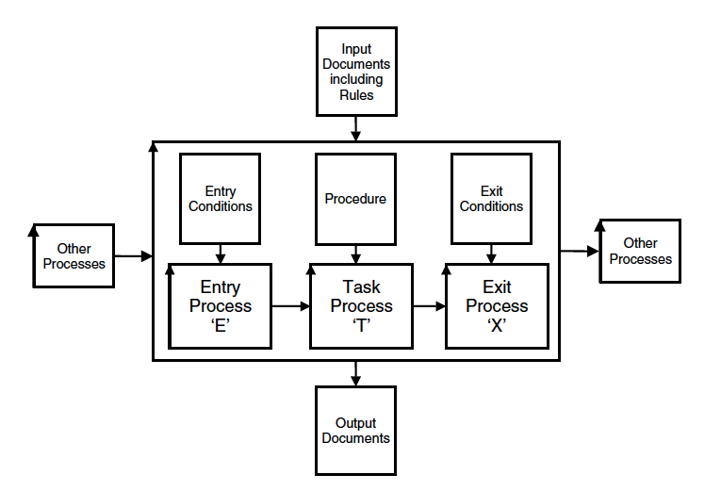
Numeric Quality Gateways
5a.
Notes:
Source Competitive Engineering book ill. 1.4 sept 8 2010 tg

Slide 99
Numeric Quality Gateways Improve Quality of work
5a.
Defects/Page
100
“Gary” at McDonnell-Douglas
80
80 Majors Found
(~160-240 exist!)
60
40
40
20
23
8
0
0
0
1
2
3
4
5
February
April
Inspections of Gary’s Designs
Notes:
Early defect removal also pays dividends in terms of personal skills. Take the case of “Gary” at McDonald Douglas. From a standing start, he participated in 5 successive Inspections of his own software designs (ignore the hard hat!). Note that, as Author of the 5 documents, he was required to join the Inspection team that was looking for his errors.
The first document revealed an average defect density of 80 majors per page – a frightening number, but actually quite typical. By the time he’d fixed them all, though, Gary had learnt so much about how to write good design documents, that his second Inspected design was only half as buggy. Each successive document was only half as buggy as its predecessors, and by the fifth – well, I had to cheat there, because the graphing tool wouldn’t let me graph an observation of zero, so I had to put in one spurious defect!
Here’s how McDonald-Douglas felt about the personal value of Inspections:

Slide 100
An Advanced Example
Source Erik Simmons, erik.simmons@intel.com 25 Oct 2011
Personal Public Communication
Application of Specification Quality Control by a SW team resulted in the following defect density reduction in requirements over several months:
Rev. | # of Defects | # of Pages | Defects/ Page (DPP) | % Change in DPP
0.3 | 312 | 31 | 10.06
0.5 | 209 | 44 | 4.75 | -53%
0.6 | 247 | 60 | 4.12 | -13%
0.7 | 114 | 33 | 3.45 | -16%
0.8 | 45 | 38 | 1.18 | -66%
1.0 | 10 | 45 | 0.22 | -81%
Overall % change in DPP revision 0.3 to 1.0: |  |  |  | -98%
Downstream benefits:
Scope delivered at the Alpha milestone increased 300%, released scope up 233%
SW defects reduced by ~50%
Defects that did occur were resolved in far less time on average
10
Notes:
These slides contributed as non confidential experience, by Eric Simmons, erik.simmons@intel.com, for my Construx Summit lecture 25 Oct 2011 Seattle
This incident was from Summer 2011 (3 months earlier than Oct)
See Paper by John Terzakis
Intel Corporation john.terzakis@intel.com
in Cases Intel here

Slide 101
EI Entry Conditions
November 26, 2012
www.Gilb.com

Slide 102
EI.E1:
At least one of the participants
has done a well conducted successful inspection once before,
or been briefed by a competent practitioner,
or will be guided through the process by a competent guide (ideally an expert in this process).
Rationale: people need to have some reasonable sense of how to do this process, otherwise it can become corrupted. We believe we can avoid formal training in the method, but we need some knowledge and experience of it in place.
November 26, 2012
www.Gilb.com

Slide 103
EI.E2:
The specification writer sincerely believes that
the defect level is low enough to exit.
They have done personal checking against the rules themselves and find no defects.
Rationale: the writer should
take the trouble to make sure the spec is as clean as possible before inspections.
They should not misuse people and time to compensate for sloppy work.
November 26, 2012
www.Gilb.com

Slide 104
EI.E3:
Exited copies of all source specifications are available.
Rationale: there is little point in checking consistency against highly polluted source specifications.
(example by using bad Business Requirements to check new System Requirements).
November 26, 2012
www.Gilb.com

Slide 105
EI.E4:
An updated ‘Inspection Toolkit’ (with specification Rules, Checklists (for learning to apply the rules in practice), Process descriptions, forms, electronic support, intended readership role information) is available and is understood by the participants.
Rationale: This tool kit is the real definition of the Inspection process. This really determines correct use of the method.
November 26, 2012
www.Gilb.com

Slide 106
Ex In Procedure
November 26, 2012
www.Gilb.com

Slide 107
EI.P1:
The specification writer (‘writer’)
finds one other person (called a Checker)
to (help) carry out the QC (Quality Control) of their specification.
November 26, 2012
www.Gilb.com

Slide 108
EI.P2:
a meeting time, with maximum duration 1.0 hour is agreed.
(if the Checker is experienced, they can in fact do their checking at any time, alone, and report their results to the writer.)
November 26, 2012
www.Gilb.com

Slide 109
EI.P3:
The writer makes sure the checker is knowledgeable about the following:
the spec’s intended readership and their uses of the spec.
the specification Rules that apply (and their practical interpretation)
The definition of Major defect, and how to spot them
the purpose of the Spec QC process ( to help the writer get to real exit-able level of defect density).
November 26, 2012
www.Gilb.com

Slide 110
EI.P4:
The writer and the checker will each select the same one logical page ‘at random’ (300 Non-commentary words) sample to check.
The writer is now performing the role of a ‘checker’ on their own work.
They should agree that the page selected is representative of the quality of the rest of the document.
November 26, 2012
www.Gilb.com

Slide 111
EI.P5:
checking will be done individually
(but maybe in same room)
November 26, 2012
www.Gilb.com

Slide 112
EI.P6:
the initial checking time will be 10 minutes.
If NO Major defects are found by either checker.
The checking process will continue for another 30 minutes.
Even if no further Majors are found.
November 26, 2012
www.Gilb.com

Slide 113
EI.P7:
If any Major defect is found
(and acknowledged by the writer as a real Major defect)
in the first 10 minutes of checking,
then this will be considered a sign that the spec contains many more major defects.
The writer will consider whether they want to stop the QC process and improve the spec,
or whether they want to continue for another 30 minutes to gather more Major defect cases
(to better signal what they need to rewrite).
November 26, 2012
www.Gilb.com

Slide 114
EI.P8:
At the end of the checking time,
the writer
(or the checker if they decide to take reporting responsibility)
will calculate the estimated Majors/Page in the current document
(using formulas or tools supplied)
and will report (on a form or to a database)
all time used and results
(Majors found,
Majors/page estimated,
decision to Exit or not, etc.)
November 26, 2012
www.Gilb.com

Slide 115
EI Exit Conditions
November 26, 2012
www.Gilb.com

Slide 116
EI.X1: Defect Density Condition:
Estimated Major Defects remaining per page is less than 1 per 300 Non commentary words (initially until end 2003 10 Majors, to get a lenient start).
FORMULA FOR ESTIMATION:
Assume 33% effectiveness of the 2-checker checking-process.
Total Unique Majors acknowledged by writer, found in the sample logical page, times 3, gives a reasonable estimate of Majors/Page. This is before writer correction of known Majors.
Note: the effectiveness for a 3 checker group is slightly higher say about 40%. This figure needs to be determined by your own measurement.
OPTION: we might manage the exit level at an individual writer level to gradually motivate them to improve by about 50% (defect injection) less per iteration of the write and check cycle. <- KM idea – TG likes it!
NOTE: THE 33% effectiveness is based on experience, but it could vary, for example depending on the rate of checking used. The rate is controlled here because the time and the volume ( a logical page) are controlled in the process.
November 26, 2012
www.Gilb.com

Slide 117
EI.X2:
Writer Veto
The specification cannot exit if the spec writer wants more time to improve it.
November 26, 2012
www.Gilb.com

Slide 118
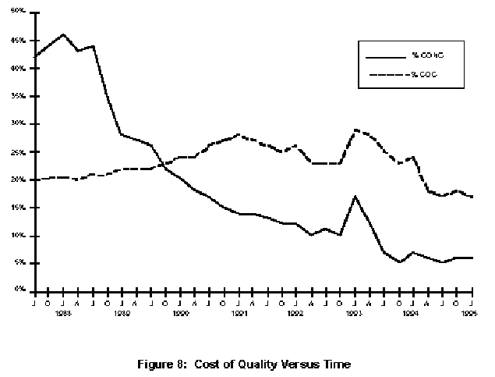
DPP Improves Quality by 10x: Raytheon
6
43%
Start of Effort
% CONC
40%
% COC
The individual learning curve ??
35%
COC Cost of Conformance
30%
25%
20%
15%
CONC Cost of Rework
(non-conformance)
10%
Bad Process Change
5%
5%
0%
1st year
2nd year
4rd year
5th year
6th year
7th year
8th year
www.sei.cmu.edu/publications/documents/95.reports/95.tr.017.html
Notes:
www.sei.cmu.edu/publications/documents/95.reports/95.tr.017.html
Fixed remove %20 Nov 3 2010 suggested by Gojko Adzic at Unicom conference

Slide 119
Defect Detection strategies versus Defect Prevention strategies
Defect detection
(inspection, test, customer reports)
Is ineffective for getting high bug-freeness into systems
It is better than nothing
Inspection is cheaper than test-and-debug
Defect Prevention - is at 2 levels
process improvement
(CMMI Level 5)
individual capability improvement
(50% per motivated cycle)
Defect prevention is BY FAR the smartest one
© Tom@Gilb.com www.gilb.com
203
04/03/13

Slide 120
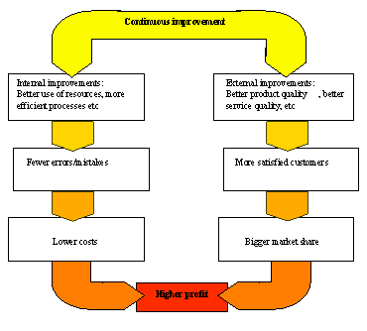
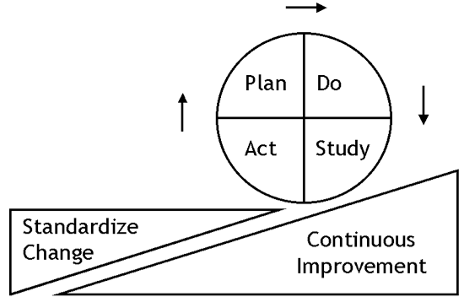
Prevention Costs
Deming Cycle
5%, stable at 5%
of development costs
(Raytheon 1993)
0.5 % of development costs
(Mays 1995)
© Tom@Gilb.com www.gilb.com
Half-day Inspection Economics. Gilb@acm.org
04/03/13
204

Slide 121
Defect Prevention Experiences: Most defects can be prevented from getting in there at all
Cleanroom levels: approach zero def.
IBM MN 99.99%+ fixes:Key= "DPP"
90%
80%
70%
Mays 1993, User 1996 "72% in 2 years" <-tg
50%
Mays & Jones (IBM) 1990
% of usual defects prevented
1
2
3
4
5
6
Years of continuous improvement effort
North Carolina
IBM Research Triangle Park Networking Laboratory
© Tom@Gilb.com www.gilb.com
Half-day Inspection Economics. Gilb@acm.org
04/03/13
205

Slide 122
Prevention + Pre-test Detection is the most effective and efficient
100%
Use
95% cumulative detection
by Inspection (state of the art limit)
90%
80%
Test
70% Detection
by Inspection
70%
"Detected
Cheaply"
<- Mays 1993, 70% prevented
\
50%
"Prevented"
<-Mays & Jones 50% prevented(IBM) 1990
1
2
3
4
5
6
Prevention data based on state of the art prevention experiences (IBM RTP), Others (Space Shuttle IBM SJ 1-95) 95%+ (99.99% in Fixes)
Cumulative Inspection detection data based on state of the art Inspection (in an environment where prevention is also being used, IBM MN, Sema UK, IBM UK)
© Tom@Gilb.com www.gilb.com
Half-day Inspection Economics. Gilb@acm.org
04/03/13
206

Slide 123
IBM MN & NC DP Experience
2162 DPP Actions implemented
between Dec. 91 and May 1993 (30 months)<-Kan
RTP about 182 per year for 200 people.<-Mays 1995
1822 suggested ten years (85-94)
175 test related
RTP 227 person org<- Mays slides
130 actions (@ 0.5 work-years
34 causal analysis meetings @ 0.2 work-years
19 action team meetings @ 0.1work-years
Kickoff meeting @ 0.1 work-years
TOTAL costs 1% of org. resources
ROI DPP 10:1 to 13:1, internal 2:1 to 3:1
Defect Rates at all stages 50% lower with DPP
© Tom@Gilb.com www.gilb.com
Half-day Inspection Economics. Gilb@acm.org
04/03/13
207

Slide 124
Frequent feedback and improvement assure quality
7a
Stake-holders
Realized
Value
Stake-holders
Potential Value
Plan Do
Act Study
Perceived-Value Info
Realized-Value Information
Stake-holders
Stake-holders
Stake-holders
Stake-holders
Other
Critical
Factors
2 Kinds of Feedback from Stakeholders, when value increment is really exploited in practice after delivery.
Combined with other information from the relevant environment. Like budget, deadline, technology, politics, laws, marketing changes.

Slide 125
7b
Learn
Stakeholders
Measure
Values
Value Management Process
Deliver
Solutions
Develop
Decompose
Notes:
KAI

Slide 126
7b
Learn
Stakeholders
Measure
Values
Identify Stakeholders
Who and what cares about the outcome of our project?
Deliver
Solutions
Develop
Decompose

Slide 127
7b
Learn
Stakeholders
Measure
Values
Value Capturing
Find & specify quantitatively Stakeholder Values, Product Qualities & Resource improvements.
Deliver
Solutions
Develop
Decompose

Slide 128
7b
Learn
Stakeholders
Measure
Values
Solution Prioritization
Find, Evaluate & Prioritize Solutions to satisfy Requirements.
Deliver
Solutions
Develop
Decompose

Slide 129
7b
Learn
Stakeholders
Measure
Values
Evo Cycles
Decompose the winning Solutions down into smaller entities, then package them so they deliver maximum Value.
Deliver
Solutions
Develop
Decompose

Slide 130
7b
Learn
Stakeholders
Measure
Values
Develop
Develop the packages that deliver the Value.
Deliver
Solutions
Develop
Decompose

Slide 131
7b
Learn
Stakeholders
Measure
Values
Deliver
Deliver to Stakeholders improved Value. (not always a thing or code)
Deliver
Solutions
Develop
Decompose

Slide 132
7b
Learn
Stakeholders
Measure
Values
Measure Change
Measure how much the Values changed.
Deliver
Solutions
Develop
Decompose

Slide 133
7b
Learn
Stakeholders
Measure
Values
Learn & Change
Learning is defined as a change in behavior.
Deliver
Solutions
Develop
Decompose

Slide 134
7b
Learn
Stakeholders
Measure
Values
Value Management Process
Deliver
Solutions
Develop
Decompose

Slide 135
End 7 Competitive Lean QA methods to Learn

Slide 136
What you can do immediately
Identify the 5 most critical qualities of your system.
Quantify the 5 qualities.
For each quality,
set a Current level
and a Goal level
Notes:
List the top 2 methods to assure that you get the qualities you want.
Estimate the cost of getting the quality levels you want,
and estimate the long term value of getting them

Slide 137
Main Take-away Points
Quality Assurance is far more than ‘test’,
and it can be far more cost-effective
‘Quality’ is far more than ‘bugs’
You probably have a lot to learn,
if you want real competitive quality
Notes:
Tg sept 6 2010 drafted 3 points

Slide 138
The Lean Quality Assurance Methods
Everything ‘not adding value to the Customer’ is considered to be waste.
This includes:
unnecessary code and functionality
Delay in the software development process
Unclear requirements
Bureaucracy
Slow internal communication
Amplify Learning
The learning process is sped up by usage of short iteration cycles – each one coupled with refactoring and integration testing. Increasing feedback via short feedback sessions with Customers helps when determining the current phase of development and adjusting efforts for future improvements.
Decide as late as possible
Deliver as fast as possible
Empower the team (Power to the Programmers gilb.com/dl821)
Build integrity in
separate components work well together as a whole with balance between flexibility, maintainability, efficiency, and responsiveness.
See the whole
“Think big, act small, fail fast; learn rapidly”

Slide 139
Thanks!
Tom@Gilb.com
Mobile: +47 920 66 705
www.Gilb.com
@ImTomGilb
Copy of these slides will be in Downloads/Slides:
http://gilb.com/tiki-list_file_gallery.php?galleryId=14
For details on all subjects see my new E Book
leanpub.com/ValuePlanning (frree core, cheap rest)
Notes:
Photo of Tom Taken Brussels IAHV Meet November 2009

