Slide 1
Simplicity
“Simple Simplicity Principles”
Tom Gilb
GilbFest 2016
June 21 2016, at 12:10 to 13:00 edited until 1300 same day
Deutsche Bank Local, London
Notes:
2 spell edits made after talk
initially held parts of it ACCU 5 min Lightening Talk 15 April 2011

Slide 2
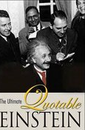
How Far should we go?
“Everything should be made as simple as possible, but no simpler.”
Attributed to A E but not verified

Slide 3
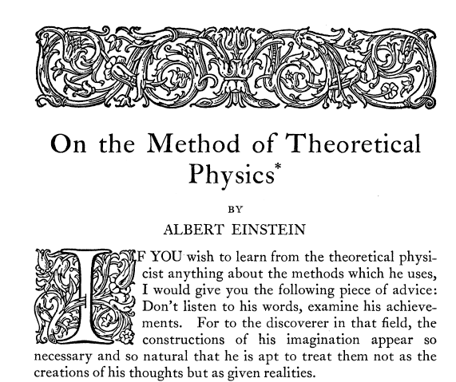
Spencer 1933 LectureMethod
Notes:
Source
http://www.jstor.org/pss/184387

Slide 4
What He Really Said!

Slide 5
Marvin Minsky
Marvin Minsky
Scientist
Marvin Lee Minsky was an American cognitive scientist in the field of artificial intelligence,
co-founder of the Massachusetts Institute of Technology's AI laboratory,
and author of several texts on AI and philosophy.
Like “Society of Mind” where he quoted ‘Things should be as simple as possible’
Born: August 9, 1927, New York City, New York, United States
Died: January 24, 2016, Boston, Massachusetts, United States

Slide 6
Marvin Minsky MIT
On Sun, Jun 6, 2010 at 5:13 PM, Tom Gilb <tomsgilb@gmail.com> wrote:
Prof Minsky
I just started rereading Society of Mind. I realized that your Eienstein quotation is probaby not correct and attributable to a checkable written source. I made the mistake myself.
See the Caprice book Eiensteins Quotation for her conclusion.
What is this reference? Can you tell me her conclusion?
When my book came out, an Einstein archive in Jerusalem asked me for the source, because they could not find it.
I replied that I did not recall where I had heard it, but that I had known Einstein when I was at Princeton in 1950-1954, and perhaps had heard him say that -- or something like that. Also, I could have made a mistake, because I had trouble understanding his very foreign accent.
So perhaps he said something simpler, but not much simpler.
(Alice replied, Minsky was humble because he could have taken credit for hearing it said)

Slide 7
Simple Simplicity Principles
© Tom Gilb 2010-2016 edited after talk
Simplicity is a defined view of a complex system
Simplicity can be measured in several ways, tailored to specify problems
You can design systems to be simple to quantified degrees, of defined kinds of simplicity
A consequence of making a system simple, from one stakeholder’s viewpoint, might be extreme complexity from another viewpoint
One man’s simple is another man’s ‘Complex’ (Rolf)
Notes:
Originated by Tom Gilb at ACCU 15 April 2011 for a lightening talk
Simplicity can be measured in several ways, tailored to specify problems

Slide 8
Simple Simplicity Principles
© Tom Gilb 2011-2016
6. The simplest simplicity principle is that simplicity might be complex
7. Simplicity is a design tactic to achieve some other aim (such as usability, portability, maintainability)
8. You cannot know how how simple your design must be until you know the required level of system qualities, that are your ‘simplicity drivers’
9. The cost of simplicity is the cost of the design for simplicity
10. Simplicity might cost more than the benefits of the objectives you have stated as requirements.
Notes:
Originated by Tom Gilb at ACCU 15 April 2011 for a lightening talk

Slide 9
The Unifying Simplicity Principle
Simplicity
might be
complex
Notes:
Originated by Tom Gilb at ACCU 15 April 2011 for a lightening talk
UK Gov Digital services principle do the hard work to make it simple

