Slide 1
"Principles of Software Engineering”
tom@Gilb.com
45 minutes, 2 PM
Dec. 9 2016
Department of Computer Science and Creative Technologies,
School of Computing,
London Metropolitan University,
166-220 Holloway Road, London N7 8DB, UK.
Engineering: Koens definition.
The Impact EstimationTable. The core tool
Quantified Top Level Critical Requirements
Evolutionary agile project management
Objective Quality Control of all SE Specs
Key Principles of Software Engineering

Slide 2
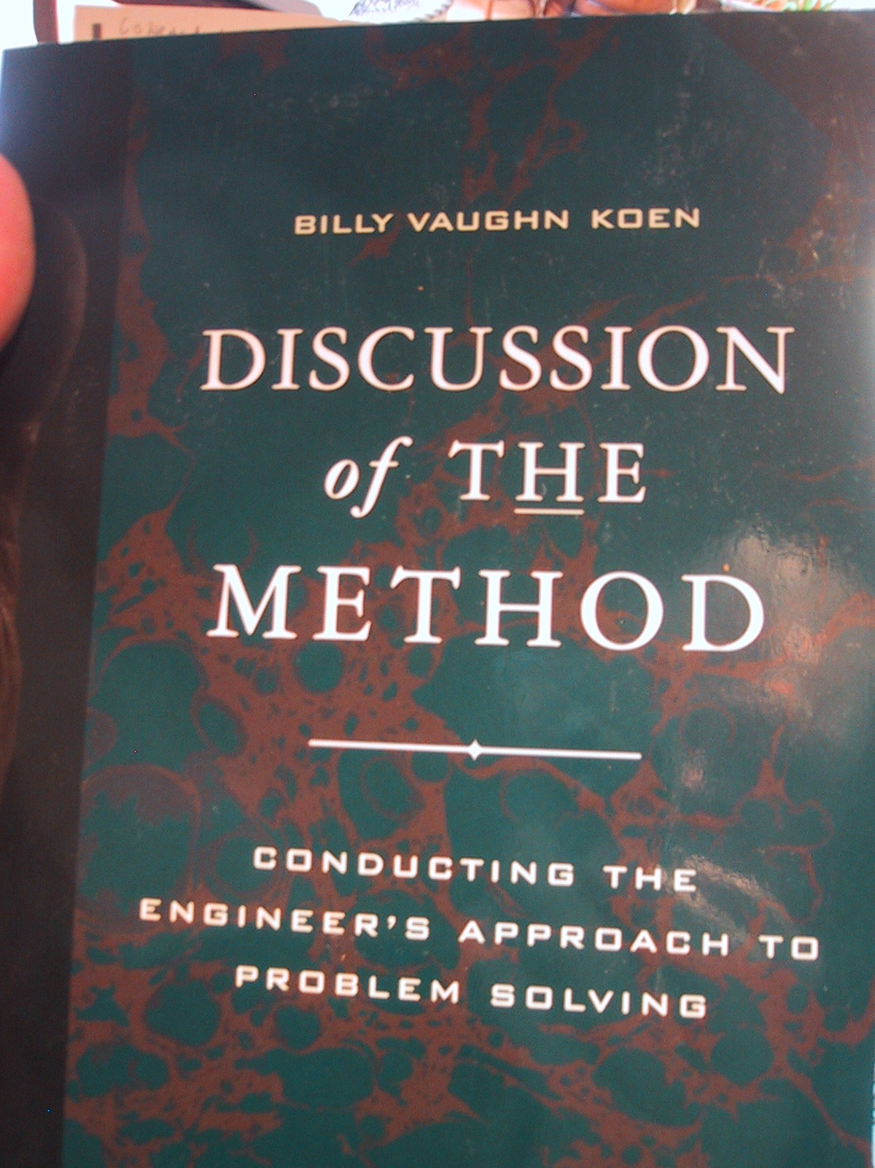
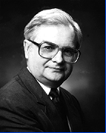
Koen on Risk Control
Make small changes in the sota:
‘Sota’ = Engineering State Of The Art Heuristics <-Koen, Discussion, p. 48
Always give yourself a chance to retreat; and
Use feedback to stabilize the design process
Notes:
Source Billy Koen: Discussion of the Method 2003, page 73
Added May 23 2003
Koen’s quotes were also captured in
Gilb: Principles of Software Engineering Management (1988), Chapter 19
Based on a paper (in CE Bibliography) http://www.ic2.org/jimt/research.htm
THE PAPER ON HEURISTICS
http://www.utexas.edu/
His name is Dr. Billy Vaughn KOEN
http://www.ic2.org/jimt/research.htm
THE PAPER ON HEURISTICS 1999 KAI FOUND AND ON MY OTHERS papers
mac file
Koen, Billy V Prof
2604 Harris Blvd AUSTIN, TX 78703
512-472-1798
HOME ADDR
Contact:
ETC 5.134B
Mechanical Engineering Department
The University of Texas at Austin
Austin, Texas 78712
(512) 471-3086 Email: koen@uts.cc.utexas.edu
Fax: (512) 471-8727
-o-
2604 Harris Blvd.
Austin, Texas 78703
(512) 472-1798
Marital Status: Married
Wife's Name:
Deanne Rollins Koen
Children:
Kent Vaughn Koen
Douglas Branch Koen
Nationality: American
Position: Professor of Mechanical Engineering
Languages: Fluent in French
Education:
Sc.D., Nuc. Eng.: Massachusetts Institute of Technology, 1968
Diplôme d'Ingénieur en Génie Atomique:L'Institut National des Sciences et
Techniques Nucléaires, Saclay, FRANCE, 1963
S.M., Nuc. Eng.:Massachusetts Institute of Technology, 1962
B.S., Chem.E.:The University of Texas at Austin, 1961
B.A., Chemistry:University of Texas at Austin, 1960
Registration: Professional Engineer, Texas
Professional Experience:
The University of Texas at Austin:
Undergraduate Advisor 1988-1992
Full Professor 1982-present
Associate Professor, 1971-1982
Assistant Professor, 1968-1971
Director, Bureau of Engineering Teaching, 1973-1976
Tokyo Institute of Technology, O-okayama, Meguro-ku, Tokyo,
Japan:Visiting Professor, June-August, 1994
Ecole Centrale, Paris, France: Visiting Professor, January, 1983
Dr. Koen received B.A., Chemistry and B.S., Chemical Engineering degrees
from the University of Texas at Austin. He received a Diplome d'Ingenieur
en Genie Atomique from L'Institut National des Sciences et Techniques
Nucleaires, Saclay, France in 1963 and M.S. and ScD. degrees in Nuclear
Engineering in 1962 and 1968 from the Massachusetts Institute of
Technology. He has been a professor at the University of Texas at Austin
since 1968.
He was a pioneer in the application of artificial intelligence to nuclear
reactor reliability. After 20 years of research in the theory of engineering
design, Dr. Koen produced a widely acclaimed definition of the engineering
method. Dr. Koen also introduced to engineering education and developed a
method of self-paced instruction. Since its introduction in 1969, it has
become an accepted alternate means of teaching.
Billy Koen has consulted for ten companies, organizations and institutions.
He is a member of ten professional societies and nine honor societies
including Phi Beta Kappa and Tau Beta Pi. He is listed in 18 directories
including Who's Who in America and International Who's Who in
Engineering . Dr. Koen has written or contributed to six books, has more
than 100 technical publications and has presented 97 invited lectures.
Professor Koen served from 1988-1993 as Vice President for Public
Affairs for the American Society for Engineering Education. In this capacity
he presided over an increase in funded projects from $4 million to $54
million. He has held 25 different Society positions and is a Fellow of the
Society.
Dr. Koen has received 14 local, state and national teaching-based awards
including the Standard Oil of Indiana Award for Teaching Excellence, the
national Chester F. Carlson Award for Innovation in Engineering Education,
and in 1992 the national W. Leighton Collins Award which is the highest
American Society for Engineering Education award for service to education
in engineering. In 1993 he was one of 175 engineering educators, who have
had a significant and lasting impact on engineering education or engineering
technology education, selected world-wide to receive the Centennial
Medallion from the American Society for Engineering Education.
In 1980, he was honored by the Minnie Stevens Piper Foundation of San
Antonio as one of the ten outstanding professors from all institutions of
higher learning in Texas.
He is married and has two sons.

Slide 3
The engineering method
The engineering method is
the use of engineering heuristics
to cause the best change in a poorly understood situation
within the available resources.
Source: Toward a definition of the engineering method (Engineering Education, Dec. 1984). Billy V Koen, U of Austin TX

Slide 4
Tom’s Rewrite of Koen’s
Engineering Concept *224 June 28, 2003
Engineering is
• an Evolutionary Process,
• using practical Principles,
• in order to determine,
• and identify the Means to deliver,
• the best achievable Performance and Cost levels balance,
• for optimal Stakeholder satisfaction,
• in a complex risk-filled environment.

Slide 5
Koen’s Heuristics
Make small changes in the sota:
‘Sota’ = Engineering State Of The Art Heuristics <-Koen, Discussion, p. 48
Always give yourself a chance to retreat; and
Use feedback to stabilize the design process

Slide 6
Niels Malotaux
Notes:
“What has an Architect to do with planning?”
www.malotaux.nl/doc.php?id=98
added 11 sept 2015

Slide 7
From Scales to Solutions
Solution 1
Solution 2
Solution n
Total Impacts
Impact on Objective
Impact on Objective
Impact on Objective
Total Impact on Objective
Objective
Impact on Budget
Impact on Budget
Impact on Budget
Total Impact on Budget
Resources
Benefits-to-Cost Ratio
Ratio
Ratio
Ratio
Courtesy Rolf Goetz
Notes:
Courtesy Rolf Goetz 2016 for his audio https://voice.adobe.com/a/P0BaZ/
yodaearth@googlemail.com

Slide 8
From Scales to Solutions
Solution 1
Solution 2
Solution n
Total Impacts
Impact on Objective
Impact on Objective
Impact on Objective
Total Impact on Objective
Objective
Impact on Budget
Impact on Budget
Impact on Budget
Total Impact on Budget
Resources
Benefits-to-Cost Ratio
Ratio
Ratio
Ratio
Courtesy Rolf Goetz
Notes:
Courtesy Rolf Goetz 2016 for his audio https://voice.adobe.com/a/P0BaZ/
yodaearth@googlemail.com

Slide 9
Impacts on Objectives
Facebook
Profiler
Umantis BM
Total Impacts on Objectives
Attract Talents
271 -> 700
70%
± 10%
0% ±10%
50% ±5%
120% ±25%
Win Talents
53 -> 100
30%
± 20%
50%
± 10%
30%
± 10%
110% ±40%
Perfect Match
25% -> 75%
10%
± 10%
30%
± 10%
30%
± 10%
70% ±30%
Total Impact of Solutions
110%
± 40%
80%
± 30%
110%
± 25%
Courtesy Rolf Goetz
Notes:
Courtesy Rolf Goetz 2016 for his audio https://voice.adobe.com/a/P0BaZ/
yodaearth@googlemail.com

Slide 10
Impacts on Resources and Totals
Facebook
Profiler
Umantis BM
Total Impacts on Objectives
Money
100.000€
70%
± 10%
0% ±10%
50% ±5%
120% ±25%
Time
12 months
30%
± 20%
50%
± 10%
30%
± 10%
110% ±40%
Total Impact of Solutions
100%
± 30%
50%
± 20%
80%
± 15%
110/100
=1.1
Best 2.1
Worst 0.5
80 / 50
= 1.6
Best 3.7
Worst 0.7
110 / 80
= 1.4
Best 2.1
Worst 0.9
Benefit/Cost
Courtesy Rolf Goetz
Notes:
Courtesy Rolf Goetz 2016 for his audio https://voice.adobe.com/a/P0BaZ/
yodaearth@googlemail.com

Slide 11
Mars Mission Business School Project Lviv, Ukraine

Slide 12
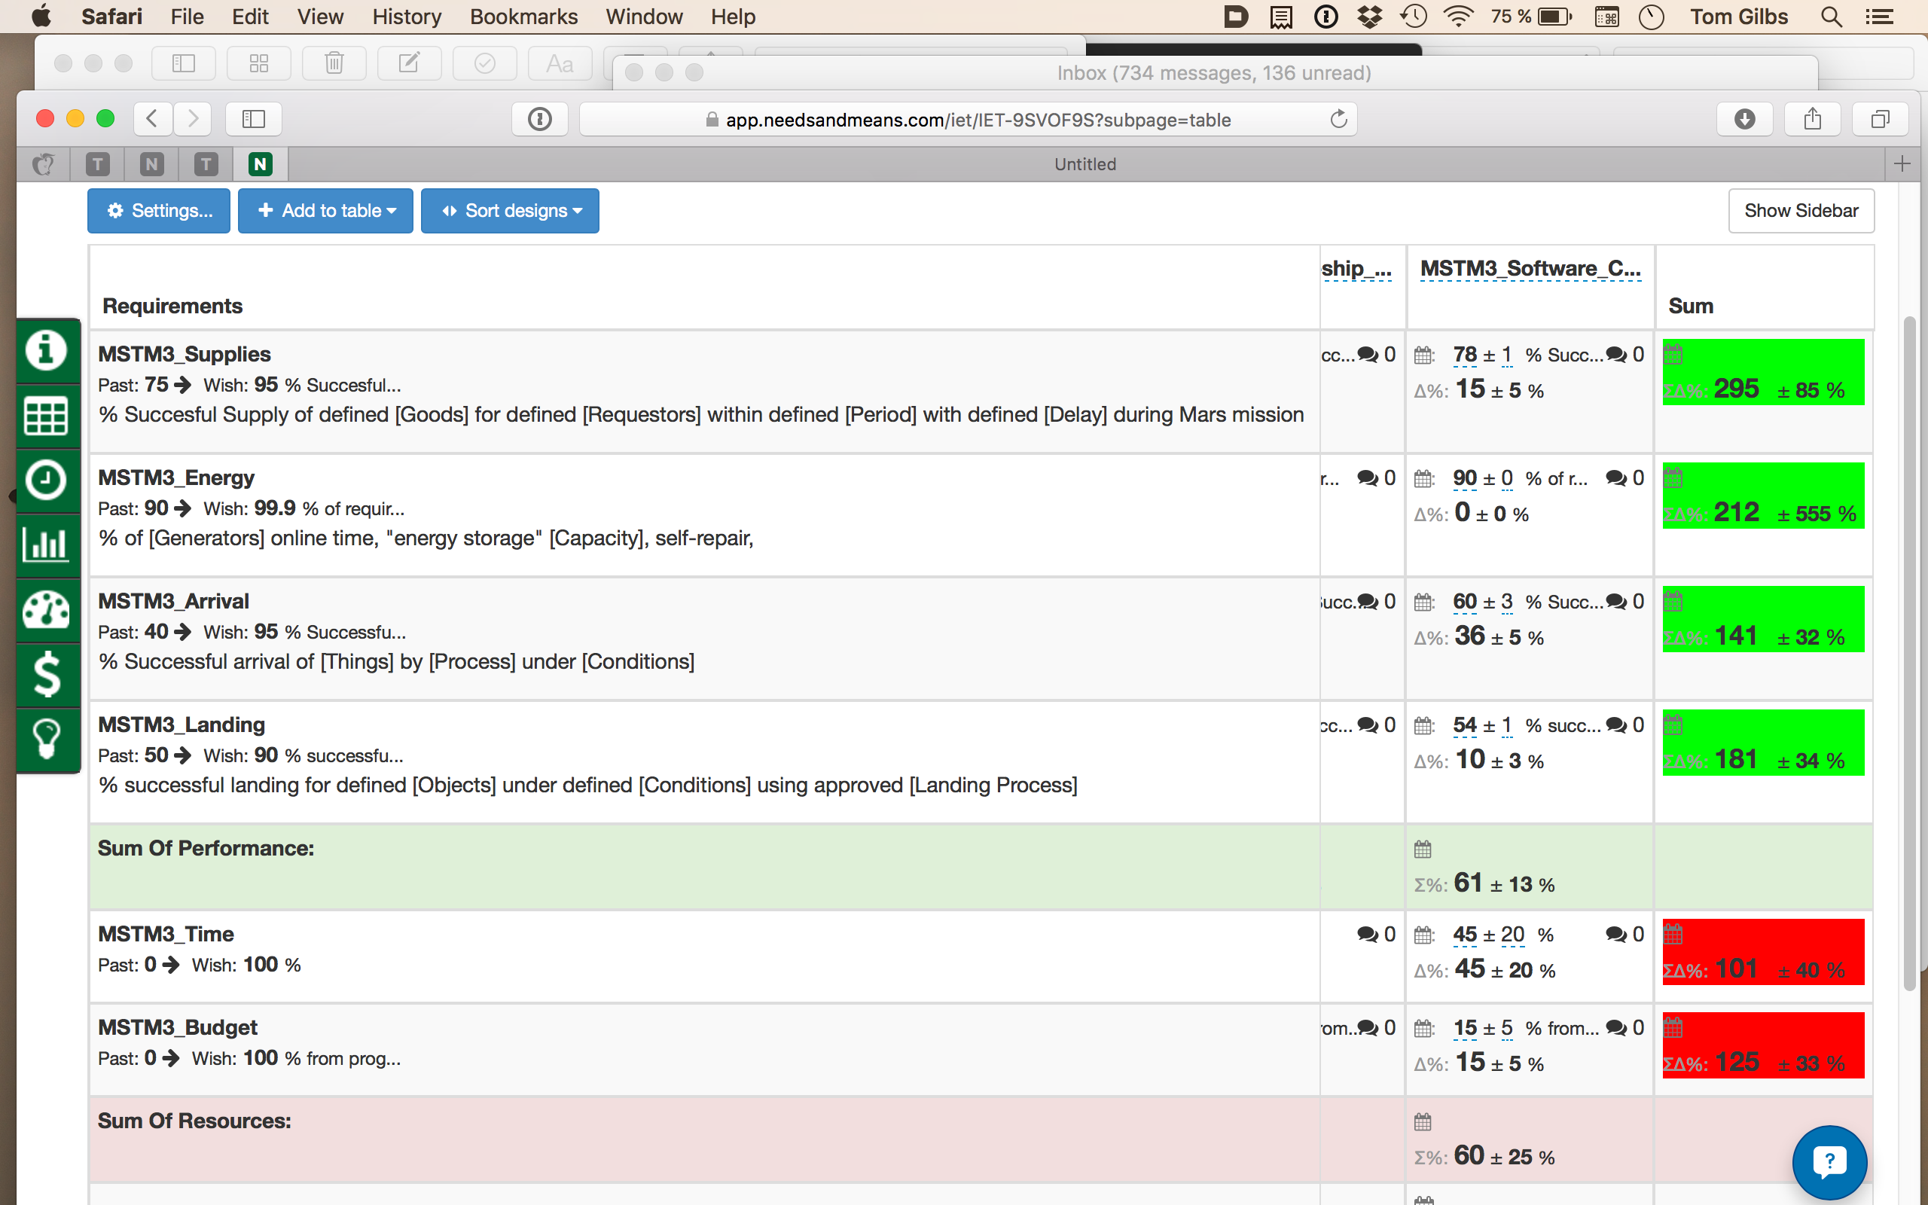
Notes:
Made 17 Nov 2015 based on student work at Lviv Business School Class exercise Mars Mission.

Slide 13
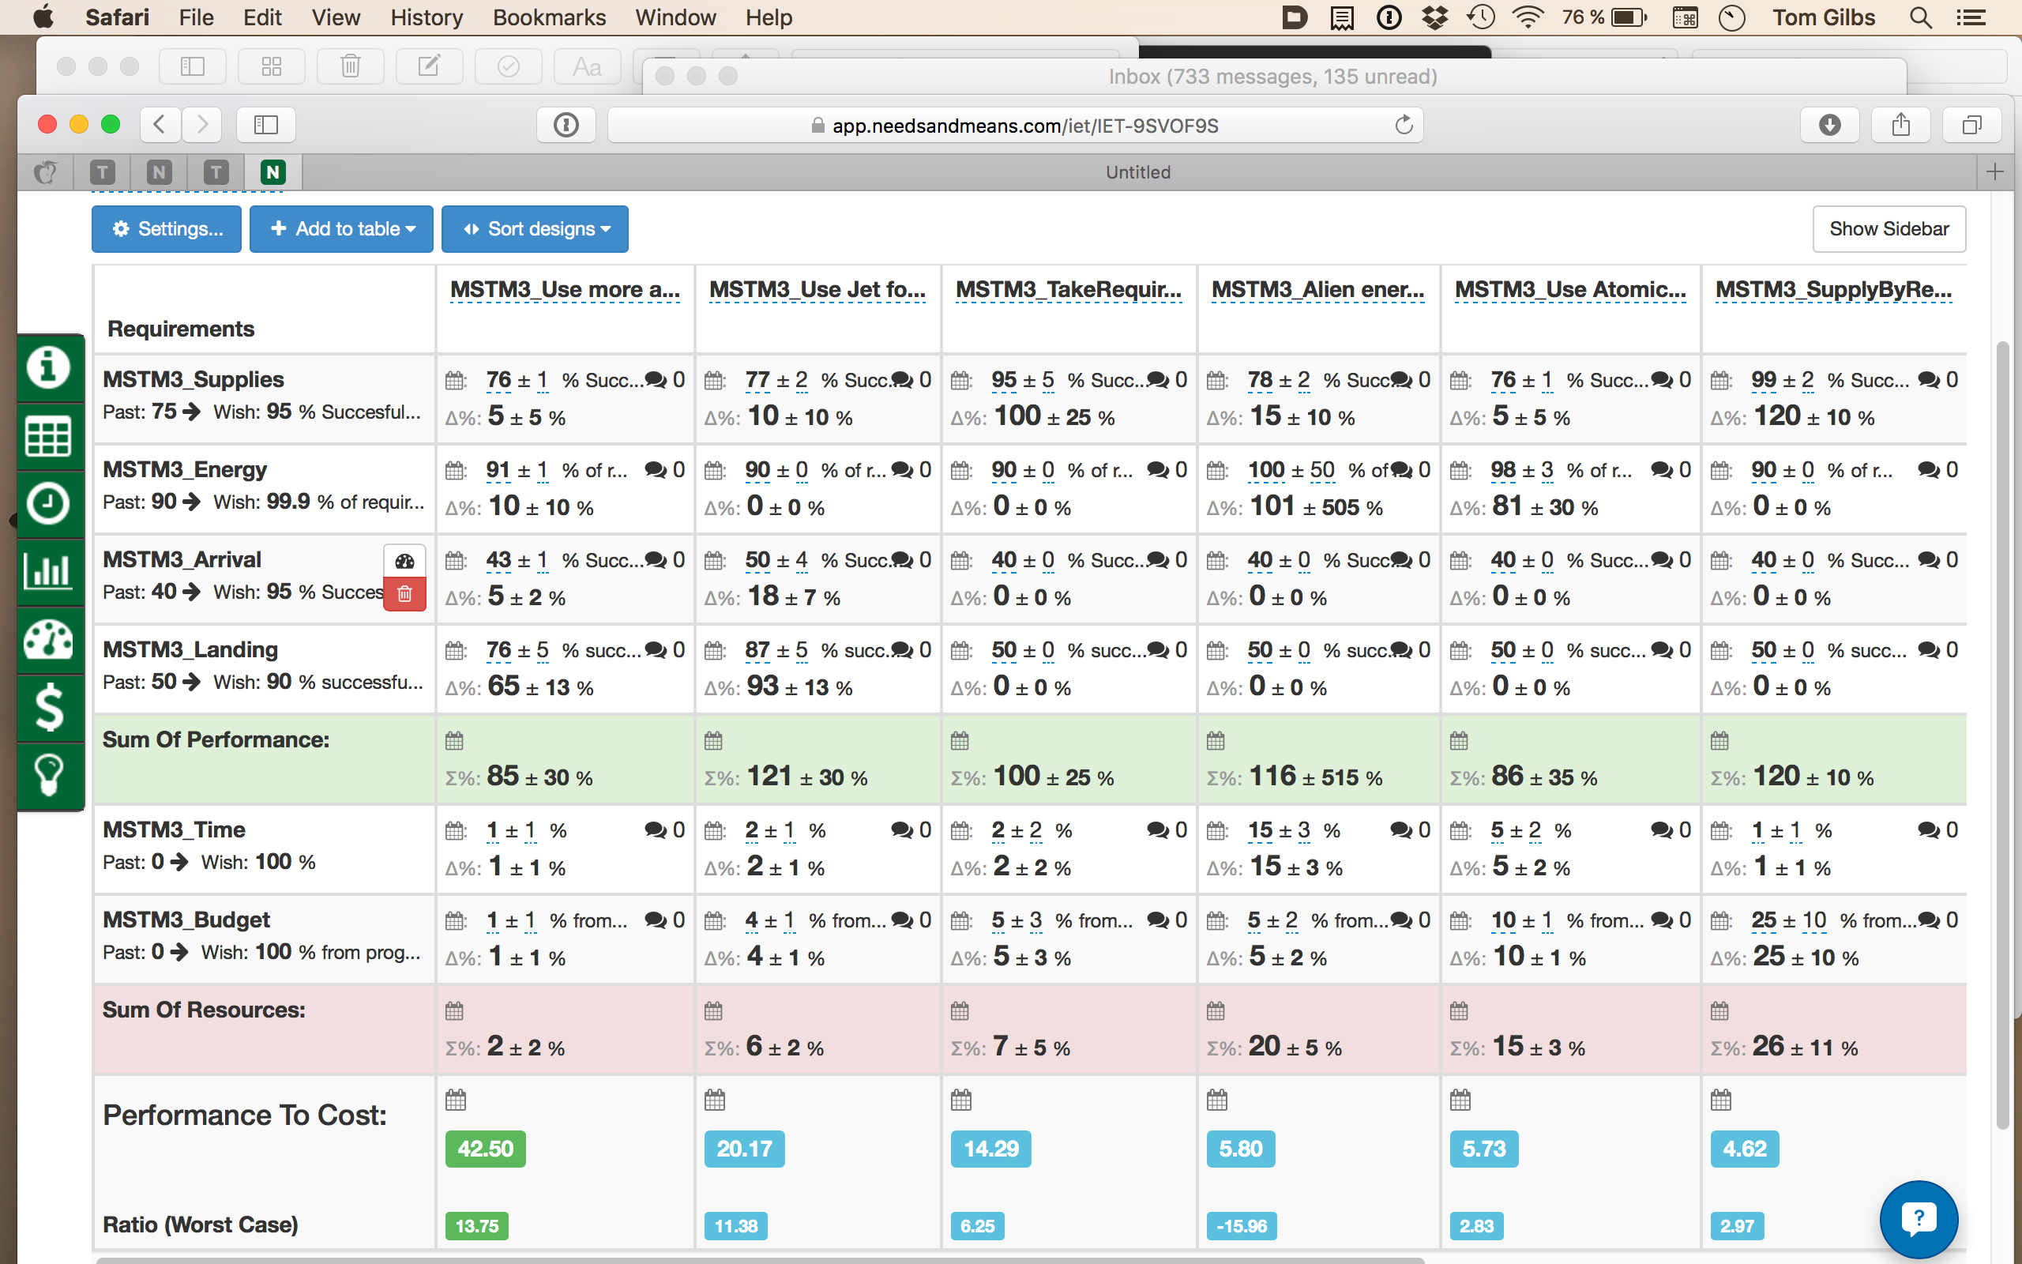
Notes:
Made 17 Nov 2015 based on student work at Lviv Business School Class exercise Mars Mission.

Slide 14
Notes:
MARS MISSION TABLE OVERVIEW 2015 LVBSMade 17 Nov 2015 based on student work at Lviv Business School Class exercise Mars Mission.

Slide 15
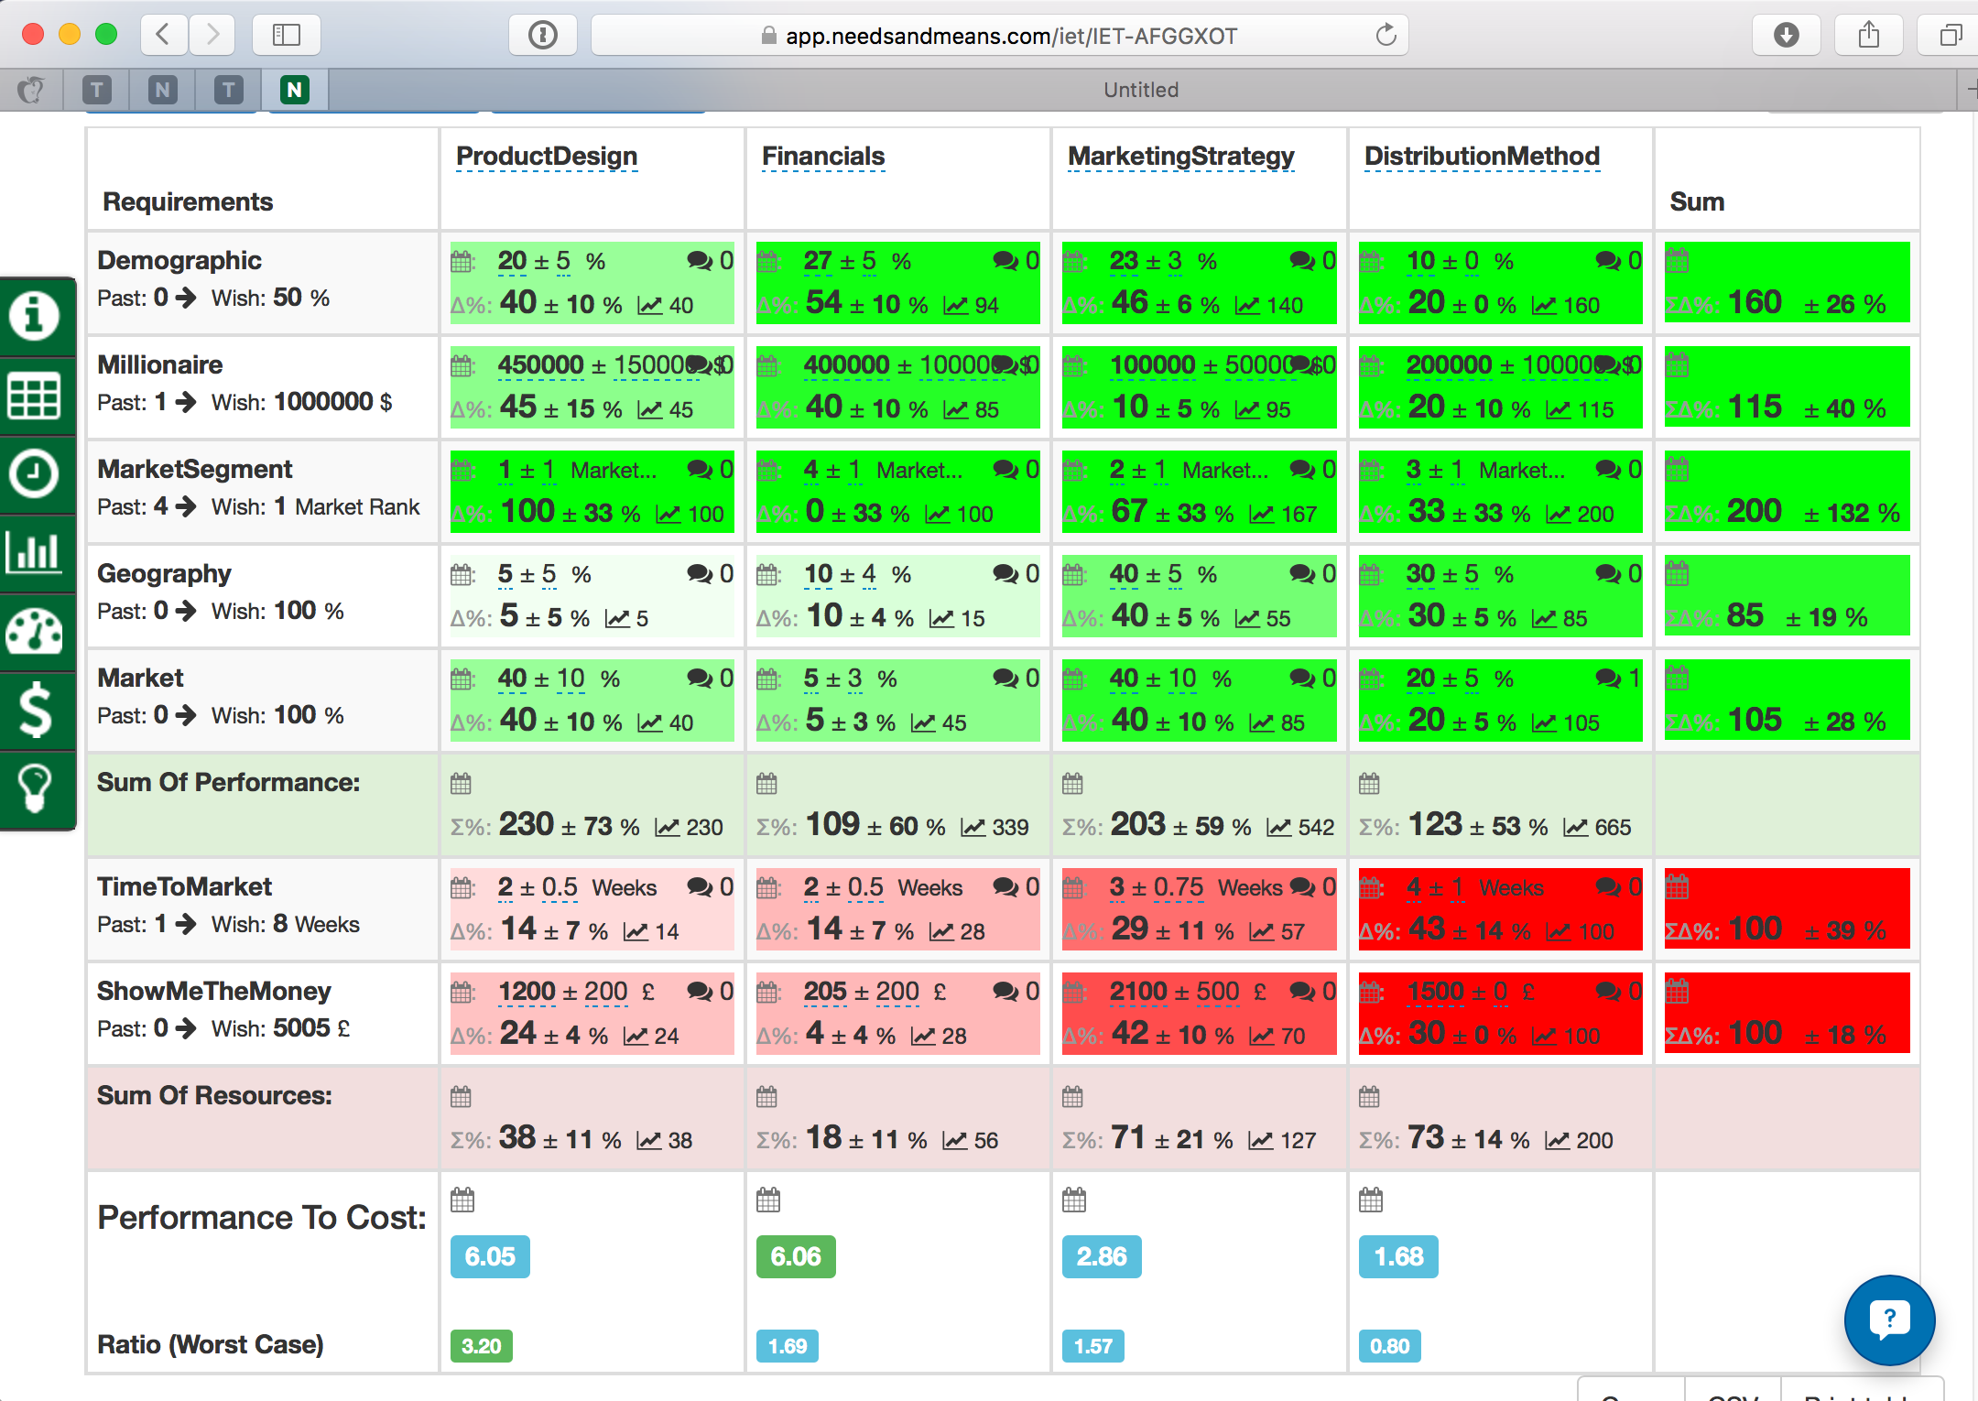
Notes:
MyBusinessPerspective
IET-AFGGXOT
BCS Geoff Cooper Cyber startup project 12 November 2015 London
Non Confidential Student Planning work on BCS Startup Planning Course
Led by Tom Gilb

Slide 16
157/49 = 3.2
Notes:
MyBusinessPerspective
IET-AFGGXOT
BCS Geoff Cooper Cyber startup project 12 November 2015 London
Non Confidential Student Planning work on BCS Startup Planning Course
Led by Tom Gilb

Slide 17
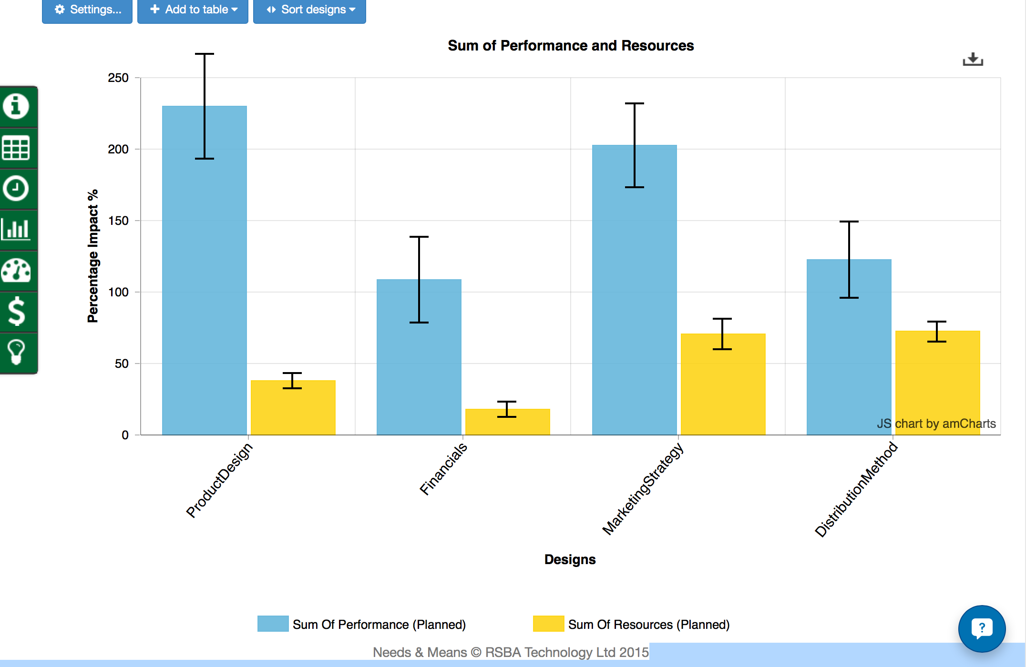
Notes:
MyBusinessPerspective
IET-AFGGXOT
BCS Geoff Cooper Cyber startup project 12 November 2015 London
Non Confidential Student Planning work on BCS Startup Planning Course
Led by Tom Gilb

Slide 18
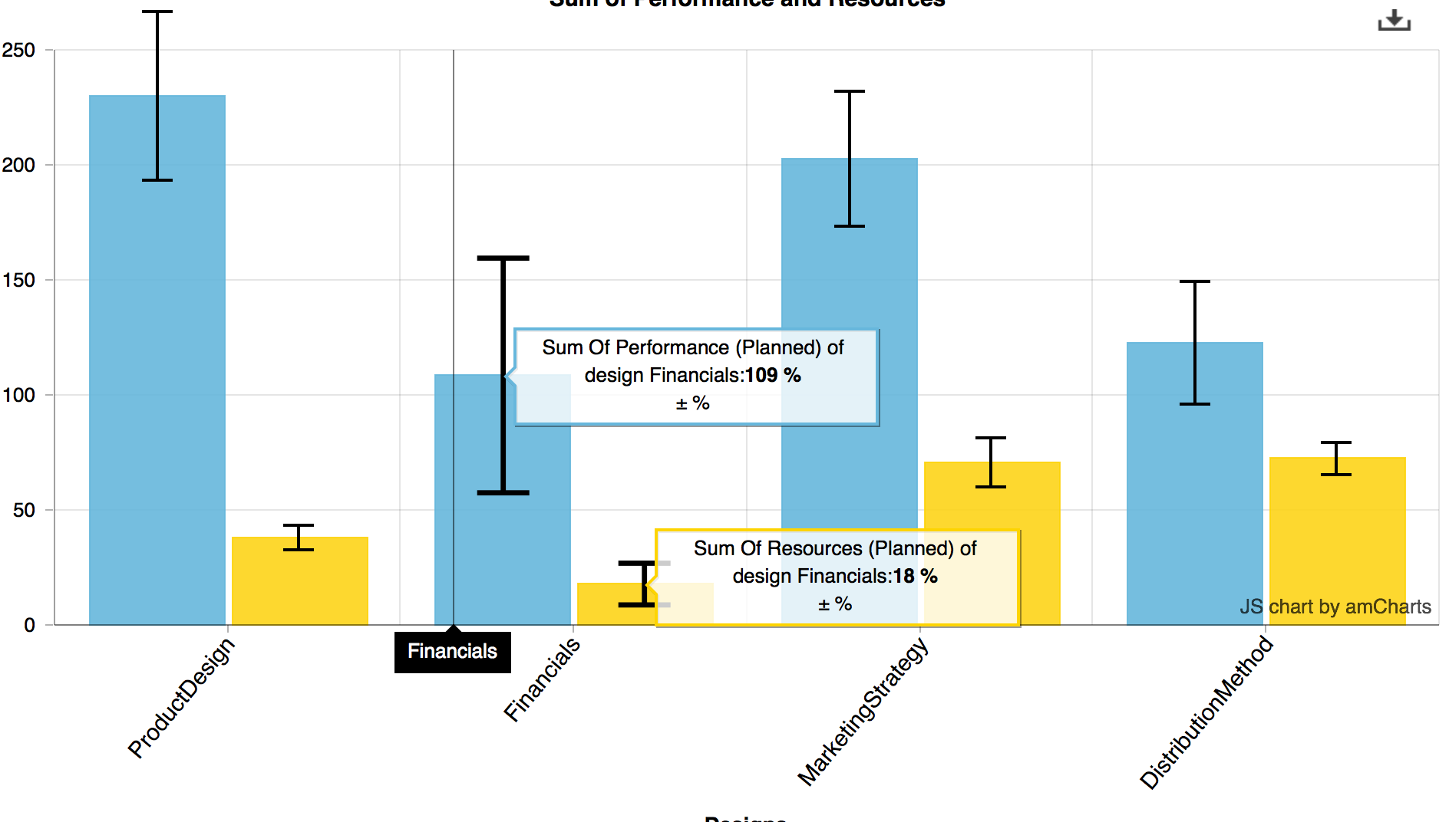
Notes:
MyBusinessPerspective
IET-AFGGXOT
BCS Geoff Cooper Cyber startup project 12 November 2015 London
Non Confidential Student Planning work on BCS Startup Planning Course
Led by Tom Gilb

Slide 19
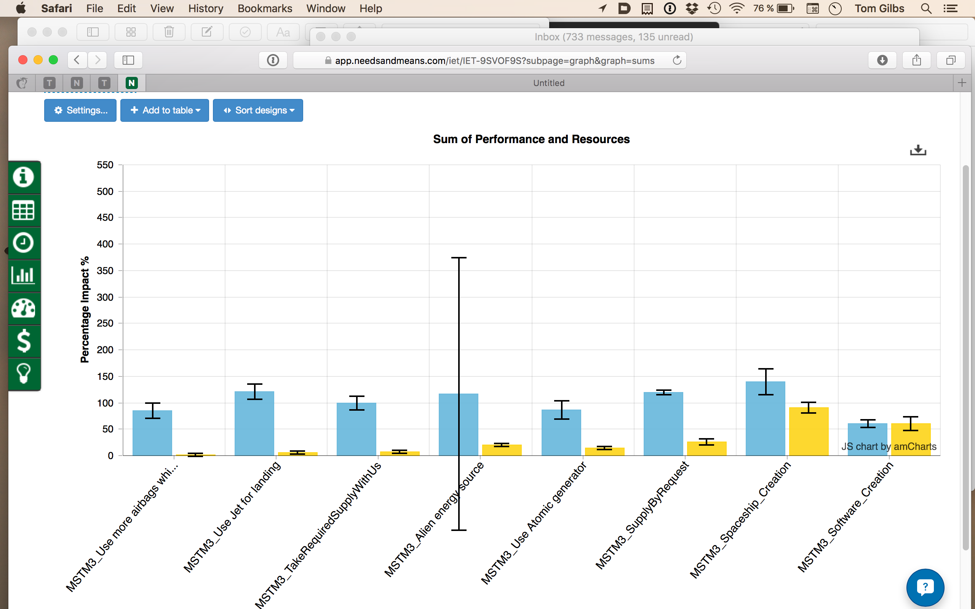
Notes:
Made 17 Nov 2015 based on student work at Lviv Business School Class exercise Mars Mission.

Slide 20
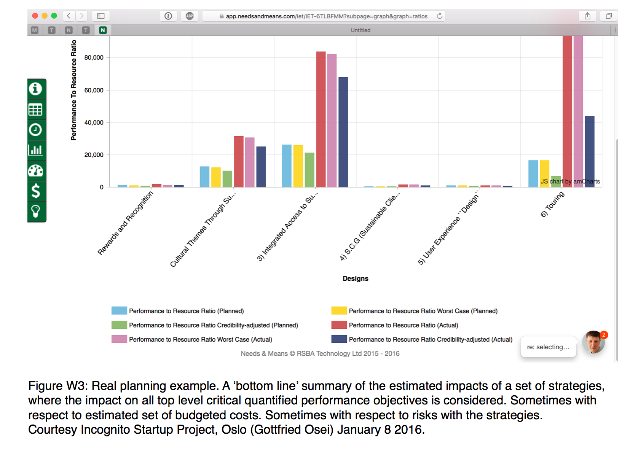
Notes:
illustration for my Jan 2016 paper on Wicked problems (title fluid)
gottfriedosei.ofei@gmail.com
Figure 6.5 E Real planning example. A ‘bottom line’ summary of the estimated impacts of a set of strategies, where the cumulative impact on all top-level critical quantified performance objectives is calculated. Sometimes with respect to the estimated set of budgeted costs. Sometimes with respect to risks (evidence, sources, ± uncertainty ranges) with the strategies. The bar chart is automatically generated from the IE Table information using the Needs and Means tool made by Richard Smith, London [URL73]
Courtesy Incognito Startup Project, Oslo (Gottfried Osei) January 8 2016.

Slide 21
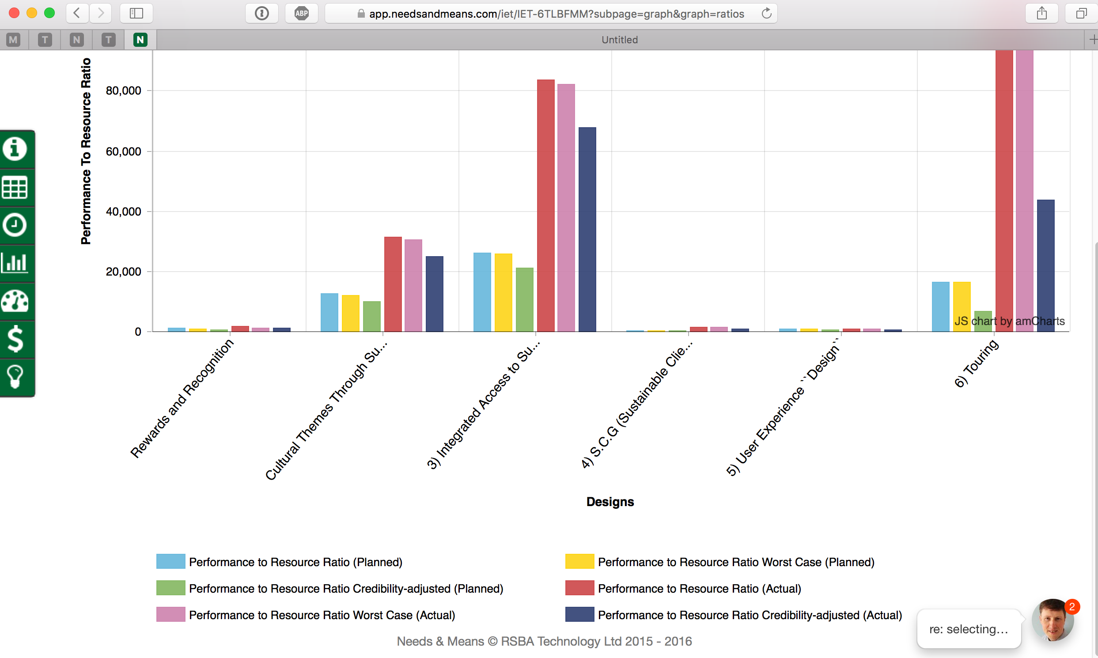
Notes:
Figure W3: Real planning example. A ‘bottom line’ summary of the estimated impacts of a set of strategies, where the impact on all top level critical quantified performance objectives is considered. Sometimes with respect to estimated set of budgeted costs. Sometimes with respect to risks with the strategies.
Courtesy Incognito Startup Project, Oslo (Gottfried Osei) January 8 2016.
gottfriedosei.ofei@gmail.com
Figure 6.5 E Real planning example. A ‘bottom line’ summary of the estimated impacts of a set of strategies, where the cumulative impact on all top-level critical quantified performance objectives is calculated. Sometimes with respect to the estimated set of budgeted costs. Sometimes with respect to risks (evidence, sources, ± uncertainty ranges) with the strategies. The bar chart is automatically generated from the IE Table information using the Needs and Means tool made by Richard Smith, London [URL73]
Courtesy Incognito Startup Project, Oslo (Gottfried Osei) January 8 2016.

Slide 22
Quantification of Qualities and Values

Slide 23
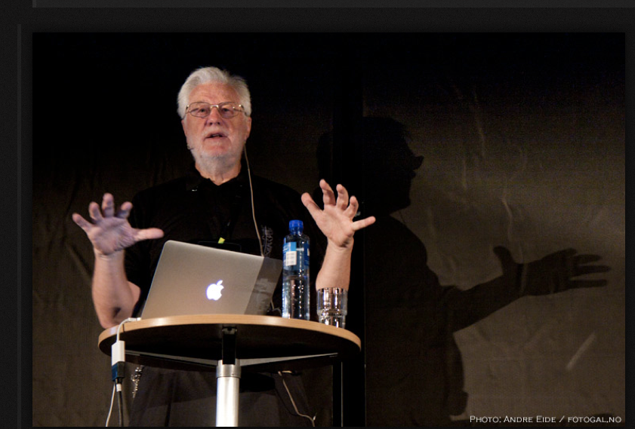
Quantifying Music

Slide 24
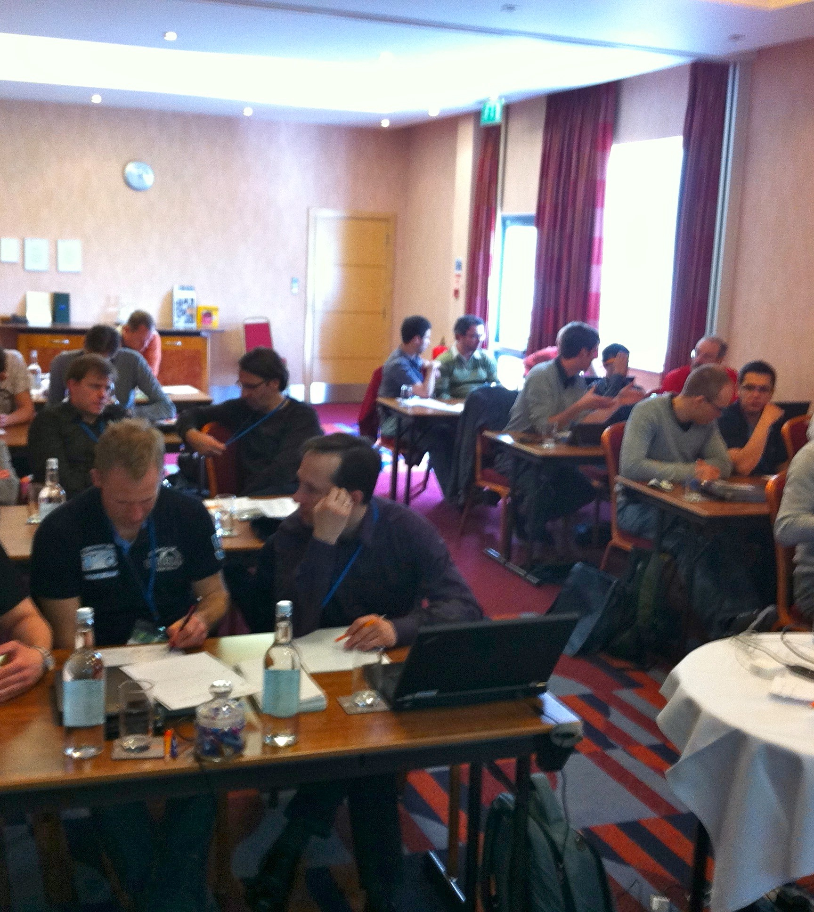
Lean QA Audience at ACCU 2012 “Surely you cannot quantify ‘Music’ ?”
I claimed
we can quantify any variable quality of any system
I replied:
I’ll do it in a lightening talk here at ACCU
1 July 2014
© Tom@Gilb.com 2014

Slide 25
What is the problem, in quantifying music?
Can you quantify this music?
1 July 2014
© Tom@Gilb.com 2014

Slide 26
Black-Eyed Peas song ”I gotta Feeling” gets 8.9 of 10 from Hit Song Science software
1 July 2014
© Tom@Gilb.com 2014
Notes:
It'http://en.wikipedia.org/wiki/I
October 12, 2009 - Many of us like to believe that there's a little magic behind the making of a hit single. Take a song like "I Gotta Feeling" by The Black Eyed Peas. That's a good song, judging by sales: _Gotta_Feelings on top of the Billboard pop chart. David Meredith, CEO of Music Intelligence Solutions, says there's no magic in that; it's math. His software, called Hit Song Science, gave the song a hit score of 8.9 out 10.
"[It's] a series of algorithms that we use to look at what's the potential of a song to be sticky with a listener," Meredith says. "To have those patterns in the music that would correspond with what human brain waves would find pleasing."
Meredith says his software found that hits have certain common patterns of rhythm, harmony, chord progression, length and lyrics. A study conducted by the Harvard Business School found that the software was accurate 8 out of 10 times.
This summer, Music Intelligence launched a Web site for songwriters called Uplaya. David Bell, of the hip-hop duo the Block Scholars, paid $90 to use it.
"To me, it's an unbiased validation of your music," Bell says. "It's not your family turning around and saying, 'Oh, you got a great song.' "
The computer told Bell he had a 7.1 — good, but not great. So he went back to the studio and remixed. He got his score up to 7.6 — good for a platinum rating. He could hold his head up.
"We can use Uplaya as a tool to figure out what song we want to put in a demo to send to these labels and stuff," Bell says.
Against The Machine
"From an artist's standpoint, a songwriter's standpoint, it's horrifying to me," says independent singer-songwriter Kym Tuvim. Tuvim says that she can't stand the star-making machine behind popular songs, and that she hates the idea of artists trying to fit songs into algorithms.
"You'll find a decreasing amount of any kind of surprises in music," Tuvim says. "This just becomes a tool to make that narrowing of the field more accessible."
Tuvim says her songs come from a mysterious place in her unconscious. She might not love the computer, but the computer loves her song "Flood." It got a 7.3 — that's platinum.
Breaking The Mold
It doesn't surprise New Yorker music critic Sasha Frere-Jones that a computer can predict hits, but he says it can't predict all the hits. Sometimes, songs come along that don't fit the mold.
"I think of a song like 'Da Da Da' by Trio, which people love," Jones says. "They just love that song. And I can't imagine that at the time, in '80-'81, that the software would have given that a very high rating. It was sonically very small. It sounded like a kids' song. They might have told the band, 'No. No. No. No. No. Beef it up.' "
The software still doesn't think it's a hit: "Da Da Da" got a 6. Jones worries that, if Hit Song Science plays too big a role in the music industry, a lot of good songs will never see the light of day.
Music Intelligence Solutions CEO Meredith calls his software a democratizing force in music — sort of a computerized American Idol. If an unknown, unconnected artist gets a high score, it could get a leg up. Then, his company could help promote the artist with record labels.
"We'll shine a spotlight on you," Meredith says. "You'll get recognized, and we'll get the word out, and that's probably a good way for the industry to work relative to it being, 'Who do you know?' It's more about what kind of talent level that you have."
Meredith also notes that his software isn't writing the songs. Human beings do that — at least for now.
http://www.npr.org/templates/story/story.php?storyId=113673324
http://www.google.co.uk/search?client=safari&rls=en&q=i+gotta+feeling&ie=UTF-8&oe=UTF-8&redir_esc=&ei=XLiZT6etEqeH4gSy8pDFBg

Slide 27
“There's no magic in that; it's math”
"[It's] a series of algorithms that we use
to look at what's the potential of a song
to be sticky with a listener ...
To have those patterns in the music that would
correspond with what human brain waves would find pleasing” CEO David Meredith
A study conducted by the Harvard Business School found that the software was accurate 8 out of 10 times.http://www.npr.org/templates/story/story.php?storyId=113673324
1 July 2014
© Tom@Gilb.com 2014

Slide 28
Measurable Attributes of Hits
Meredith says his software evaluates songs over sixty elements including
Melody
Harmony
Tempo
Pitch
Octave
Beat
Rhythm
Fullness of sound
Noise
Brilliance
Chord progression
http://edition.cnn.com/2008/WORLD/europe/03/07/spiritof.music/
1 July 2014
© Tom@Gilb.com 2014

Slide 29
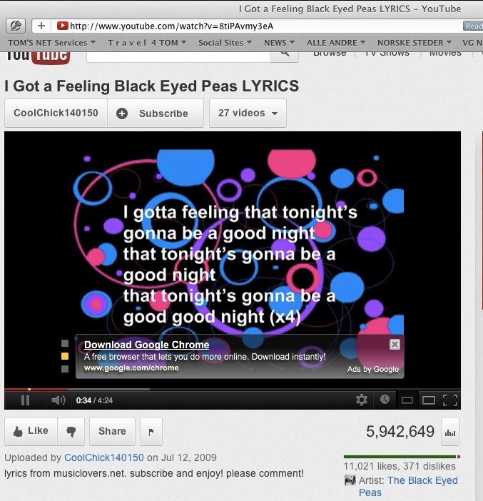
YouTube Measures
Number of Likes and Dislikes
11,021 Likes, 371 Dislikes (April 26, 2012)
Number of times video has been viewed
5,942.649 Views (April 26, 2012)
1 July 2014
© Tom@Gilb.com 2014

Slide 30
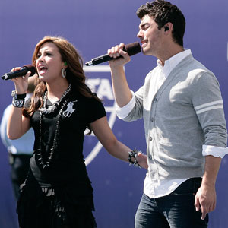
By Survey: Most Wanted Attributes
Yudkin reports on a web-based survey into American musical tastes conducted by Komar and Melamid in 1996
If you want to please the greatest number of Americans (72% ± 12%) consider
Male and female solo voices
R&B with a love theme
Small ensemble of musicians
Length of about 5 minutes
Moderate pitch, tempo and volume
http://www.bu.edu/cfa/music/faculty/yudkin/
1 July 2014
© Tom@Gilb.com 2014

Slide 31
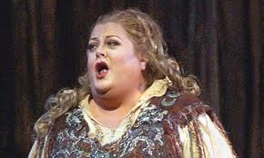
Most Unwanted Attributes
To appeal to only about 200 Americans
Extreme length
Wide range of dynamics, tempo and pitch in abrupt succession
An operatic soprano singing atonally
A cowboy song with political slogans
A children’s choir singing holiday songs
Large orchestra featuring harp, accordion and bagpipes
http://www.bu.edu/cfa/music/faculty/yudkin/
There are samples of two songs written by David Soldier with lyrics by Nina Mankin to these wanted and unwanted guidelines about 19 minutes into Yudkin’s lecture
1 July 2014
© Tom@Gilb.com 2014
Notes:
This slide go ta big sustainedlaugh from the ACCU audience 27 April 2012

Slide 32
Some potentially quantifiable Quality dimensions of Music
Examples in Planguage
Brainstormed by Steve F. and Rachel D. At lunch
Music.Moving:
Type: primary music quality attribute
Ambition Level: the majority of listeners feel moved to tears or strong physical emotional reactions.
Scale: the % of defined [Listeners] hearing defined [Music] under defined [Environments] who reports a defined [Emotion] at a defined [Strength]
Goal [1st UK Release, Music = Hip Hop, Environment = Itunes, Emotion = {Tears, Sadness}, Strength = Powerful] 50% ± 20% ?
In tune
Applause
Moving
Encores
Repeat Gigs
Busking Hat Collection
MRI Brain Scan
Downloads
Utube Reviews
Royalties
… (many more!!)
1 July 2014
© Tom@Gilb.com 2014
Notes:
Steve Freeman
Rachel Davies

Slide 33
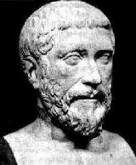
Philolaus on Numbers
Over four hundred years BC,
a Greek by the name of
Philolaus of Tarentum said :
” Actually, everything that can be known has a Number;
for it is impossible to grasp anything with the mind or to recognize it without this (number).”
Best regards (Aug 2005), N.V.Krishnawww.microsensesoftware.com
1 July 2014
© Tom@Gilb.com 2014
Notes:
Photo 2013

Slide 34
How to Quantify any Qualitative Requirement
Diagram from ‘Competitive Engineering.’ book.
1 July 2014
© Tom@Gilb.com 2014

Slide 35
Quality Quantification Methods #1
Common Sense, Domain Knowledge
Decompose “until quantification becomes obvious”.
Then use Planguage specification:
Scale: define a measurement scale
Meter: define a test or process for measuring on the scale
Past: define benchmarks, old system, competitors on the scale
Goal: define a committed level of future stakeholder quality, on your scale.
1 July 2014
© Tom@Gilb.com 2014
Notes:
Jan 16 2013

Slide 36
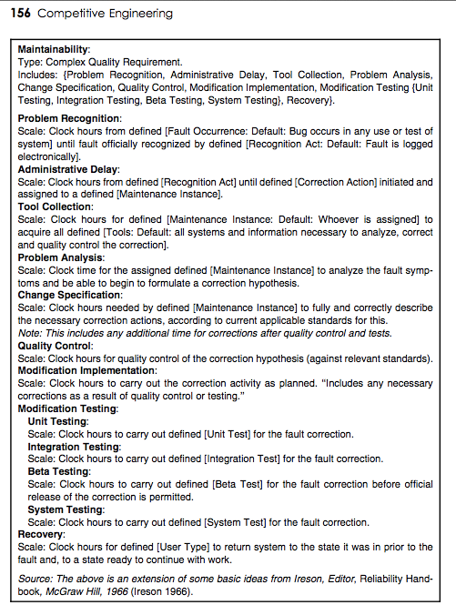
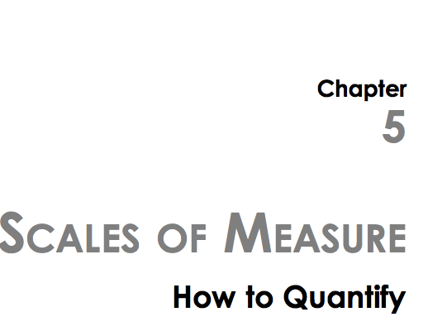
Quality Quantification Methods #2, Look it up in a book
1 July 2014
© Tom@Gilb.com 2014
Notes:
Jan 16 2013

Slide 37
Quality Quantification Methods #2, Look it up in a book
Tool Collection: Scale: Clock hours for defined [Maintenance Instance: Default: Whoever is assigned] to acquire all defined [Tools: Default: all systems and information necessary to analyze, correct and quality control the correction].
1 July 2014
© Tom@Gilb.com 2014
Notes:
Jan 16 2013

Slide 38
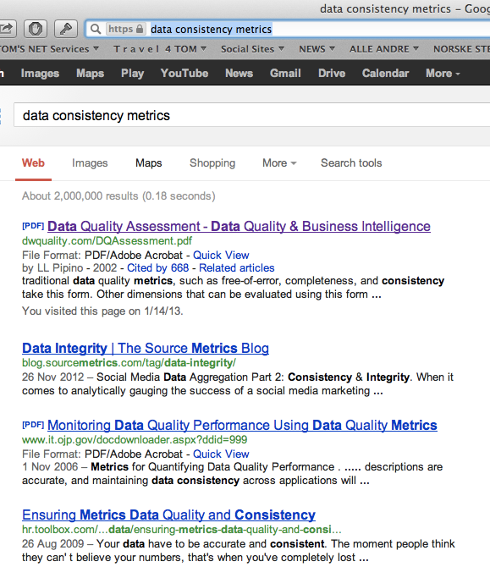
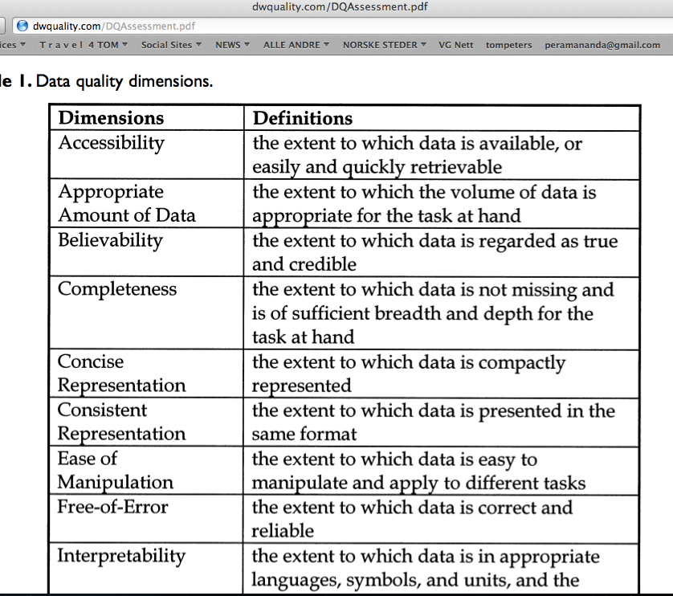
Quality Quantification Methods #3, Google It
1 July 2014
© Tom@Gilb.com 2014

Slide 39
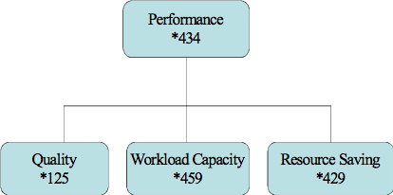
Quality: the concept, the noun Planguage Concept *125, Version: March 20, 2003
A ‘quality’ is
a scalar attribute -|-|-|-|- (Scale symbol)
reflecting ‘how well’ ------Past Level<----------->
a system functions. (Fn)------Past Level<-------->
How good
How well
How much
How much saved

Slide 40
Quality is characterized by these traits (from CE book)
Quality describes ‘how well’ a function is done.
Quality describes the partial effectiveness of a function (as do all other performance attributes).
Quality is valued to some degree by some stakeholders of the system
More quality is generally valued by stakeholders; especially if the increase is free, or lower cost, than the value of the increase.
Quality attributes can be articulated independently of the particular means (designs) used for reaching a specific quality level –
even though all quality levels depend on the particular designs used to achieve them.
A particular quality can be a described in terms of a complex concept, consisting of multiple elementary quality concepts.
Quality is variable (along a definable scale of measure: as are all scalar attributes).
Quality levels are capable of being specified quantitatively (as are all scalar attributes).
Quality levels can be measured in practice.
Quality levels can be traded off to some degree; with other system attributes valued more by stakeholders.
Quality can never be perfect (100%), in the real world.
There are some levels of a particular quality that may be outside the state of the art; at a defined time and circumstance.
When quality levels increase towards perfection, the resources needed to support those levels tend towards infinity.
1 July 2014
© Tom@Gilb.com 2014
Notes:
Added Feb 8 2003 after edit in CE book glossary ”Quality’

Slide 41
Quality is characterized by these traits
Quality describes ‘how well’ a function is done.
Quality describes the partial effectiveness of a function (as do all other performance attributes).
Quality is valued to some degree by some stakeholders of the system
More quality is generally valued by stakeholders; especially if the increase is free, or lower cost, than the value of the increase.
Quality attributes can be articulated independently of the particular means (designs) used for reaching a specific quality level –
even though all quality levels depend on the particular designs used to achieve them.
A particular quality can be a described in terms of a complex concept, consisting of multiple elementary quality concepts.
Quality is variable (along a definable scale of measure: as are all scalar attributes).
Quality levels are capable of being specified quantitatively (as are all scalar attributes).
Quality levels can be measured in practice.
Quality levels can be traded off to some degree; with other system attributes valued more by stakeholders.
Quality can never be perfect (100%), in the real world.
There are some levels of a particular quality that may be outside the state of the art; at a defined time and circumstance.
When quality levels increase towards perfection, the resources needed to support those levels tend towards infinity.
9. Quality levels are capable of being specified quantitatively (as are all scalar attributes).
1 July 2014
© Tom@Gilb.com 2014
Notes:
Added Feb 8 2003 after edit in CE book glossary ”Quality’

Slide 42
Love Quantification a 4.5 minute lightening Talk at ACCU Conference, Oxford April 15 2010

Slide 43
Class Exercise: Aspects of Love, or Love is a many splendored thing!
METHOD
Make a list of love’s many aspects
Quantify one random requirement, for love
To show that all of the aspects can be similarly quantified
See note for Sutra
Notes:
The Daily Sutra
Love cannot be proved or disproved. Someone's actions and behavior is not proof for love. Many movie actors, actresses they all exhibit a lot of love---romance in the movie, but not a drop of romance or love would be there inside. They can just show it.
Sri Sri Ravi Shankar: The Discipline of Yoga
Translations and Previous Sutras: http://www.artofliving.org/DS.asp?MailingDate=2/11/2003

Slide 44
Love Attributes: Brainstormed By Dutch Engineers
Kissed-ness
Care
Sharing
Respect
Comfort
Friendship
Sex
Understanding
Trust
Support
Attention
Passion
Satisfaction
...
...
...
Notes:
http://shopping.yahoo.com/p_musicals_music_1921064813_formatinfohttp://shopping.yahoo.com/p_musicals_music_1921064813_formatinfo
See ‘there is more to love’ (song)
Lloyd Webber: Aspects of Love (musical)
==========================
http://www.digitallyobsessed.com/showreview.php3?ID=4654
Love is a Many-Splendored Thing(1955)"'Tis ye, 'tis your estranged faces that miss the many-splendored thing."- Mark Elliott (William Holden)Review By: Jeff Rosado Published: May 04, 2003Stars: William Holden, Jennifer JonesOther Stars: Torin Thatcher, Isobel Elsom, Virginia Gregg, Phillip Ahn, Murray Matheson, Jorja Cutright,Donna Martell, Richard Loo, Soo Young, Leonard Strong,Candace Lee, Herbert HeyesDirector: Henry KingManufacturer: DVCCMPAA Rating: Not Rated for (nothing objectionable)Run Time: 01h:41m:51sRelease Date: May 06, 2003UPC: 024543060970Genre: romanceFind other reviews in this genre

Slide 45
Trust Defined
Love.Trust.Truthfulness
Ambition: No lies.
Scale:
Average Black lies/month from [defined sources].
Meter:
independent confidential log from sample of the defined sources.
Past Lie Level:
Past [My Old Mate, 2004] 42 <-Bart
Goal
[My Current Mate, Year = 2005] Past Lie Level/2
Black: Defined: Non White Lies
Other aspects of Trust:
1. ‘Truthfulness’
2. Broken Agreements
3. Late Appointments
4. Late delivery
5. Gossiping to Others

Slide 46
Camaraderie (Real Case UK)
Ambition: to maintain an exceptionally high sense of good personal feelings and co-operation amongst all staff: family atmosphere, corporate patriotism. In spite of business change and pressures.
Scale: probability that individuals enjoy the working atmosphere so much that they would not move to another company for less than 50% pay rise.
Meter: Apparently real offer via CD-S
Past [September 2001] 60+ % <- R & CD
Goal [Mid 2002] 10%, [End 2002] <1% <- R & CD
Rationale:
maintain staff number, and morale as core of business and business predictability for customers.
1 July 2014
© Tom@Gilb.com 2014

Slide 47
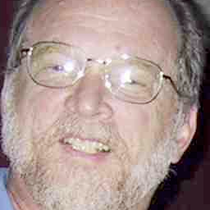
My ‘Christian’ Friend
Lawrence Day. Seattle Washington
“Love is not quantifiable”
Not in Bible
Little guidance from God and Jesus
1 July 2014
© Tom@Gilb.com 2014

Slide 48
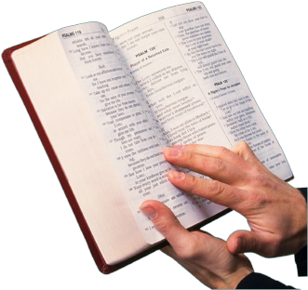
Love: Biblical Dimensions <- Lawrence Day, Boeing
A person who loves acts the following way toward the person being loved:
1. suffereth long
2. is kind
3. envieth not
4. vaunteth not itself, vaunteth...:
or, is not rash (Vaunt = extravagant self praise)
5. is not puffed up
6. Doth not behave itself unseemly
7. seeketh not her own
8. is not easily provoked
9. thinketh no evil
10. Rejoiceth not in iniquity (=an unjust act)
11. rejoiceth in the truth
12. Beareth all things
13. believeth all things
14. hopeth all things
15. endureth all things
16. never faileth
The biblical citation (Book of First Corinthians, Chapter 13) I included gives the quantification of the term "love" (agape in Greek). The ‘quantification’ for love would be as follows:
------------>
Notes:
The actual passage reference in the Bible is the First Corinthians Chapter 13
Please click on the link below.
Many thanks.
http://www.biblegateway.com/passage/?search=1+Corinthians+13&version=KJV
Thanks to Bishop Lawrence E. Day, Seattle August 22 2003
The biblical citation(Book of First Corinthians) I included gives the quantification of the term "love" (agape in Greek). The numbers beside the words reference words in Strong's Exhaustive Concordance. The quantification for love would be as follows:
A person who loves acts the following way toward the person being loved:
1. suffereth long
2. is kind
3. envieth not
4. vaunteth not itself, vaunteth...: or, is not rash
5. is not puffed up
6. Doth not behave itself unseemly
7. seeketh not her own
8. is not easily provoked
9. thinketh no evil
10. Rejoiceth not in iniquity
11. rejoiceth in the truth
12. Beareth all things
13. believeth all things
14. hopeth all things
15. endureth all things
16. never faileth
So, using these 16 quantifications for "love", a person could examine the long-term consistent behavioral actions of one person towards another and determine whether there was real agape love in the heart of the one claiming to love. Thus the quality of agape love can be measured by these quantified behaviors.
So, my point is two fold. The first being that I support your contention that all qualities that humans deal with are quantifiable. The second is that the hardest of all, true selfless unconditional love, has been in fact quantified since antiquity. The definition and the measurement of the same has also been largely ignored by the world. I wonder if there's a correlation here. It may be that people like to have "qualities" unquantified, both professionally and personally. It leaves them more wiggle room.
Dr. Lawrence E. Day, CQA, PMP
---------------------------
While at the London conference, after you had emphasized the necessity of applying the skill of quantifying a quality, one of the participants told me that he did not believe you. One time after he had asserted to his boss that "you can't mange what you can't measure", his boss said what about trust. Trust is needed to successfully manage but you can't measure it. At the time, I didn't have the opportunity to dialog further, and he seemed pretty convinced of his position. So, basically, I've just dwelled upon the statement occasionally, and I have come to the conclusion that he is wrong. Basically, there are a set of behaviors that the "boss" would consider indicators that trust should or should not be conferred. Therefore trust can be quantified. An example might be that always completely filling out expense reports with all receipts attached and no errors might be one of the boss' measurable indicators of trust. Another might be that work is always done on time and meets the desired objective. So these quantifiers, although usually not documented are measurable indicators that make up the quality of trust.
As I thought about it more, I came to the realization that probably the most difficult quality of all, "love", has been quantified for 2000 years. Here it is in the Bible in the Book of First Corinthians.
(1Co 13:4) Charity26 suffereth long3114, and is kind5541; charity26 envieth2206 not3756; charity26 vaunteth4068, 0 not3756 itself4068, is5448, 0 not3756 puffed up5448, vaunteth...: or, is not rash
(1Co 13:5) Doth807, 0 not3756 behave itself unseemly807, seeketh2212 not3756 her own1438, is3947, 0 not3756 easily provoked3947, thinketh3049 no3756 evil2556;
(1Co 13:6) Rejoiceth5463 not3756 in1909 iniquity93, but1161 rejoiceth4796 in the truth225; in the truth: or, with the truth
(1Co 13:7) Beareth4722 all things3956, believeth4100 all things3956, hopeth1679 all things3956, endureth5278 all things3956.
(1Co 13:8) Charity26 never3763 faileth1601: . fail: Gr. vanish away
There is further breakdowns that can occur, since many of the descriptive words, such as "kind", can be further quantified. What this does do, is make possessing the attribute of "love" an observable behavior that can be measured against these parameters. Are you easily angered at someone? If so, then that is observable quantifiable evidence that you don't truly love that person.
So, in summary, I am more convinced than ever that the ability and need to quantify qualities is essential to the accomplishment of desired goals.
Best Regards,
Dr. Lawrence E. Day, CQA, PMP -Seattle WA, USA
AUGUST 2003
"Day, Lawrence E" <lawrence.e.day@boeing.com>

Slide 49
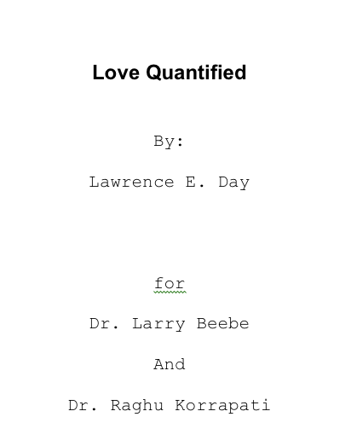
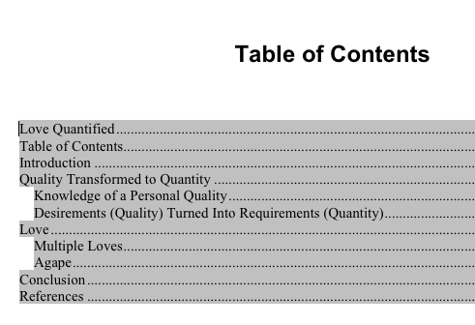
A Paper on ‘Love Quantified’ http://www.gilb.com/tiki-download_file.php?fileId=335

Slide 50
The ‘Evo’ Agile method: Value Focus

Slide 51
Evolutionary Delivery is driven by meeting Stakeholder Value & Product Quality Requirements
Intolerable
Tolerable
Success
Past
30 sec.
Tolerable/Fail
20 sec.
Goal
15 sec.
Speed
Scale: seconds to do task
Notes:
Tolerable synonym = Fail

Slide 52
Evolutionary Delivery is driven by meeting Stakeholder Value & Product Quality Requirements
Each Evolutionary Cycle aiming to get closer to the Goals
Cycle 1
Intolerable
C 2
C 3
C 4
Tolerable
C 5
C 6
C 7
Success
Past
30 sec.
Tolerable/Fail
20 sec.
Goal
15 sec.
Speed
Scale: seconds to do task

Slide 53
Evolutionary Delivery is driven by meeting Stakeholder Value & Product Quality Requirements
Each Evolutionary Cycle integrated into a ‘working’ system
Cycle 1
Intolerable
C 2
C 3
C 4
Tolerable
C 5
C 6
C 7
Success
Past
30 sec.
Tolerable/Fail
20 sec.
Goal
15 sec.
Speed
Scale: seconds to do task
Notes:
If conservative we can hand over to only 1 of 100 traders.
Proceed with all necessary and due caution.
We got to be able to reverse the last step.
We the developers are inn there with them ready to pull the plug.
Balanced with taking some risk to get high profit

Slide 54
Evolutionary Delivery is driven by meeting Stakeholder Value & Product Quality Requirements
Learning from each Evolutionary Cycle
Cycle 1
Intolerable
C 2
C 3
C 4
Tolerable
C 5
C 6
C 7
Success
Past
30 sec.
Tolerable/Fail
20 sec.
Goal
15 sec.
Speed
Scale: seconds to do task
Notes:
Comparing with the estimates done at the beginning of the cycle.
Deviation from estimates are opportunities to a. step back, or, b. move ahead.

Slide 55
Evolutionary Delivery is driven by meeting Stakeholder Value & Product Quality Requirements
Deciding on the next Cycle, based on what we learned from the previous Cycle
Cycle 2 ?
Cycle 1
C 2
C 3
C 4
Tolerable
Intolerable
C 5
C 6
C 7
Success
Past
30 sec.
Tolerable
20 sec.
Goal
15 sec.
Speed
Scale: seconds to do task
Notes:
We can make a plan with several cycles ahead, but the next step that is actually done is decided in the beginning of every cycle.
The question is; How rapidly can you learn from what you did last week? Not next year, not next project, but, within this project right now.

Slide 56
Evolutionary Delivery is driven by meeting Stakeholder Value & Product Quality Requirements Simultaneously
Usability
Intolerable
Cycle 1
C 2
C 4
C 5
Tolerable
C 6
C 7
C 8
Success
Past
30 sec.
Goal
15 sec.
Speed
Cycle 1
Intolerable
C 2
C 3
C 4
Tolerable
C 5
C 6
C 7
Success
Past
30 sec.
Tolerable/Fail
20 sec.
Goal
15 sec.

Slide 57
Each Evolutionary Cycle uses a constrained budget of Development Resources
Money
Usability
Intolerable
Cycle 1
C 2
C 4
Tolerable
Cycle 1
C 5
C 6
C 7
C 8
Success
C 2
Success
C 4
C 5
C 6
C 7
C 8
Tolerable
Intolerable
Past
Budget
Tolerable
Past
Tolerable/Fail
Goal
Speed
Cycle 1
Intolerable
C 2
C 3
C 4
Tolerable
Cycle 1
Success
C 5
C 6
C 7
Success
C 2
C 3
C 4
C 5
C 6
C 7
Tolerable
Intolerable
Engineers
Past
30 sec.
Budget
15 sec.
Tolerable/Fail
20 sec.
Past
30 sec.
Tolerable/Fail
20 sec.
Goal
15 sec.

Slide 58
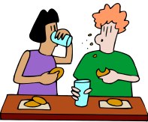
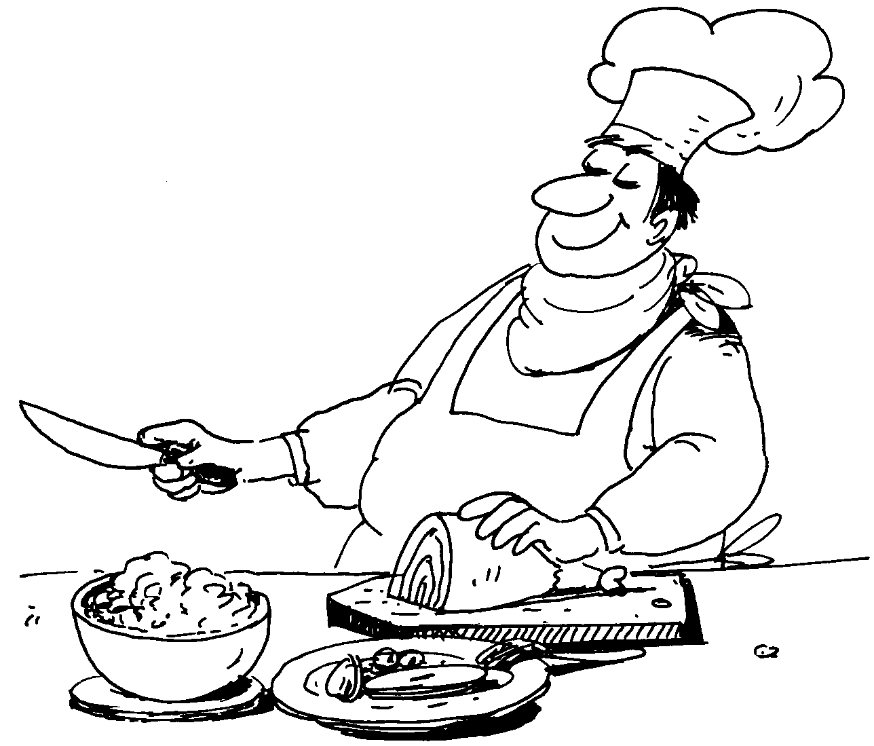
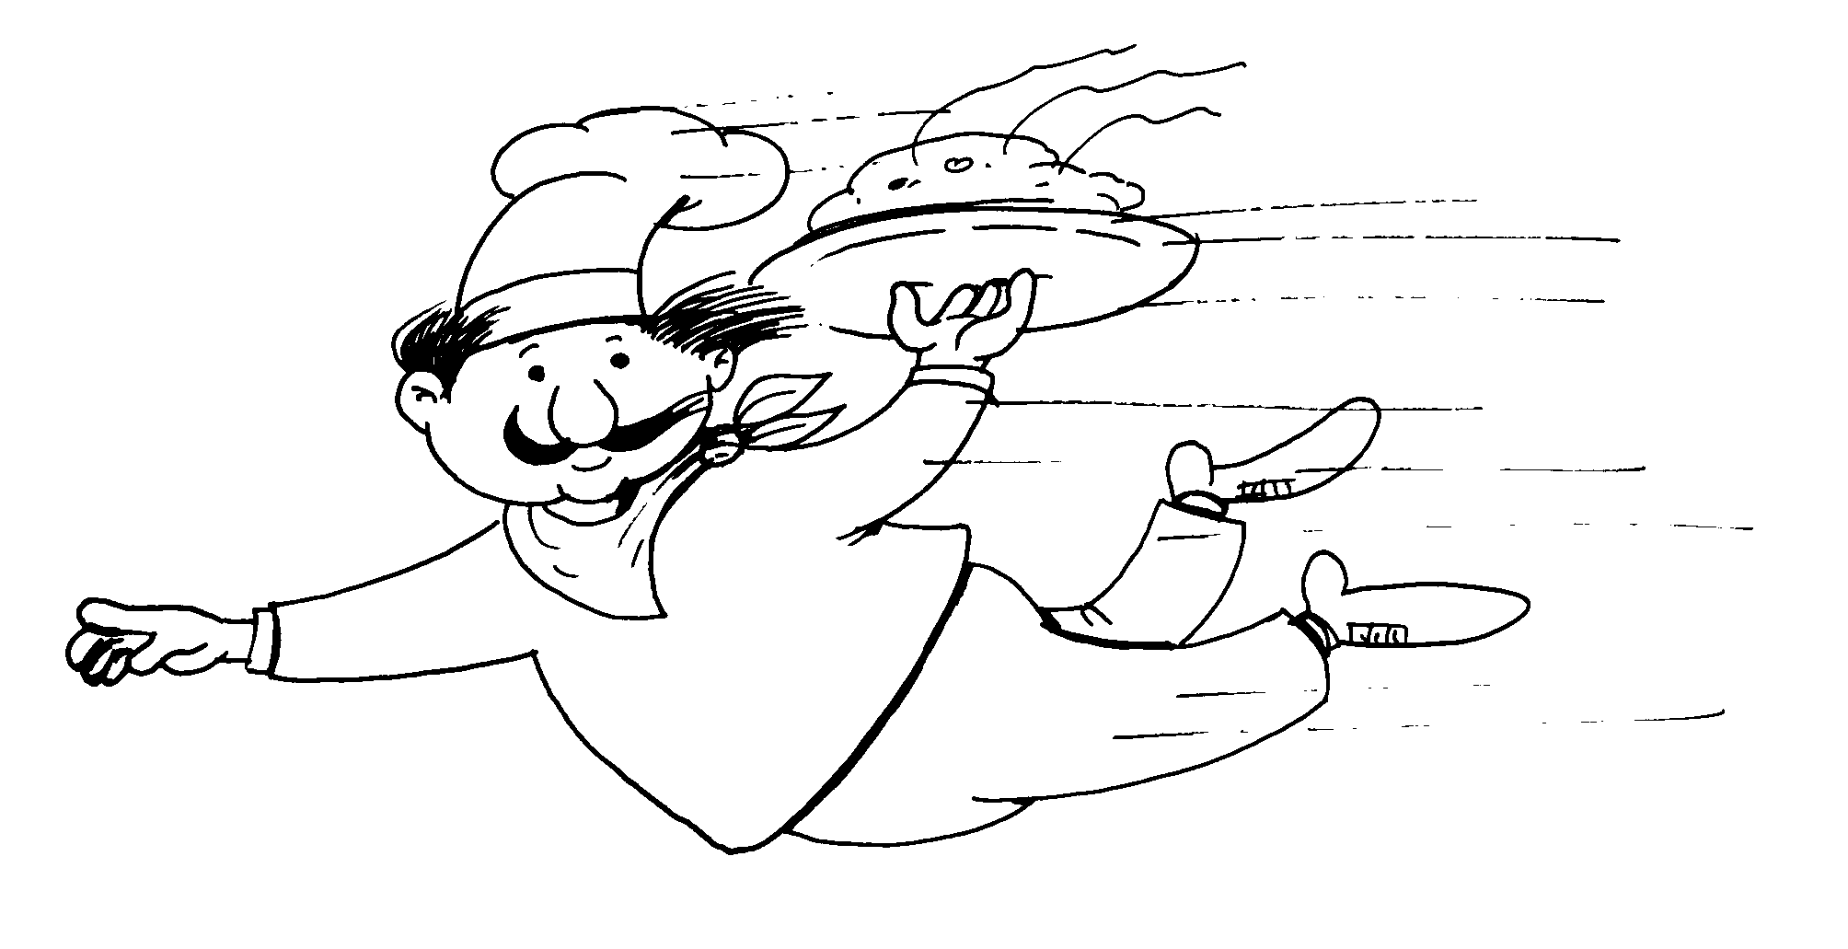
Back Room Front Room 2
Costs / Effects
Goal
Satisfaction
Past
Past
Budget
Past
Goal
Health
Back-room Design Development
1
2
3
4
5
6
7
8
9
n
Front-room Evolutionary Delivery
1
2
3
4
5
6
7
8
9
n

Slide 59
Back Room Front Room 2
Costs / Effects
Goal
Satisfaction
Past
Past
Budget
Past
Goal
Health
Back-room Design Development
1
2
3
4
5
6
7
8
9
n
Front-room Evolutionary Delivery
1
2
3
4
5
6
7
8
9
n

Slide 60
Spec QC

Slide 61
A Recent Example
Source Eric Simmons, hoofdwerk@gmail.com 25 Oct 2011
Personal Public Communication
Application of Specification Quality Control by a SW team resulted in the following defect density reduction in requirements over several months:
Rev. | # of Defects | # of Pages | Defects/ Page (DPP) | % Change in DPP
0.3 | 312 | 31 | 10.06
0.5 | 209 | 44 | 4.75 | -53%
0.6 | 247 | 60 | 4.12 | -13%
0.7 | 114 | 33 | 3.45 | -16%
0.8 | 45 | 38 | 1.18 | -66%
1.0 | 10 | 45 | 0.22 | -81%
Overall % change in DPP revision 0.3 to 1.0: |  |  |  | -98%
Downstream benefits:
Scope delivered at the Alpha milestone increased 300%, released scope up 233%
SW defects reduced by ~50%
Defects that did occur were resolved in far less time on average
Notes:
These slides contributed as non confidential experience, by Eric Simmons, erik.simmons@intel.com, for my Construx Summit lecture 25 Oct 2011 Seattle
This incident was from Summer 2011 (3 months earlier than Oct)

Slide 62
Software Engineering
Principles

Slide 63
Software Engineering Principles
Real engineering is about rigorous quantified models of the problem and solutions
All critical objectives and resource constraints must be quantified
Agile (Evo) value delivery is the main point, not ‘programming
all projects have several simultaneous critical quantifiable objectives
all design ideas have many quantifiable, estimable, measurable attributes, that can be managed by an engineering
Copyright: 2016 tom@Gilb.com

