Slide 1
Software Engineering Complexity
and
Challenges of Software Engineering
Quality Days, Vienna, Talk
Wednesday 18 January 2017
45 minutes from 10:55 Track A
By
Tom Gilb, Norway
tom@Gilb.com
www.Gilb.com
@ImTomGilb
https://2017.software-quality-days.com/en/
Copyright tom@Gilb.com, 2017
Permission to share with friends, granted freely, with this copyright notice

Slide 2
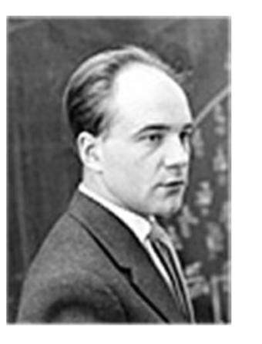
The 10 Properties
of
Wicked Problems
In 1973, Horst W.J. Rittel and Melvin M. Webber, two Berkeley professors, published an article in Policy Sciences introducing the notion of “wicked” social problems.
The article, “Dilemmas in a General Theory of Planning,” named 10 properties that distinguished wicked problems from hard but ordinary problems.
Horst W.J. Rittel
Notes:
Horst Rittel (born in 1930) has been a practicing urban designer and professor of design at a number of universities, including the Ulm School of Design in his native Germany; the University of California, Berkeley; Washington University; and the University of Stuttgart. He conceived of IBIS (Issue-Based Information System) in 1968. It’s a method to guide the design process and to reinforce deliberation and argumentation.
These kinds of design problems are what urban planner Horst Rittel dubbed “Wicked Problems” over 40 years ago: they are seemingly intractable, complex and deeply embedded in social and po- litical context (Who’s on first? Who is in charge? Who gets to decide? What are their motivations?) In the early 1970’s, Horst Rittel and his colleagues discovered and documented a class of problems that were ill-suited to the linear systems analysis approach that was then (and still is) used for design and planning. “He found traditional planning methods inadequate for the ill-structured problems he encountered in city planning,” Conklin writes. As an antidote, Rittel and his colleagues invented the Issue-Based Information System (IBIS) structure that Jeff Conklin uses as the basis for his Dialogue Mapping.

Slide 4
Wicked Problems Characteristics
think: Urban Planning, Not ‘Chess’
1. There is no definitive formulation of a wicked problem.
2. Wicked problems have no stopping rule.
3. Solutions to wicked problems are not true-or-false, but good-or-bad.
4. There is no immediate and no ultimate test of a solution to a wicked problem.
5. Every solution to a wicked problem is a "one-shot operation"; because there is no opportunity to
learn by trial-and-error, every attempt counts significantly.
6. Wicked problems do not have an enumerable (or an exhaustively describable) set of potential
solutions, nor is there a well-described set of permissible operations that may be incorporated into
the plan.
7. Every wicked problem is essentially unique.
8. Every wicked problem can be considered to be a symptom of another problem.
9. The existence of a discrepancy in representing a wicked problem can be explained in numerous
ways. The choice of explanation determines the nature of the problem's resolution.
10. The planner (designer) has no right to be wrong.
“As We May Think”, In July 1945 formulated a vision
that inspired J.C.R. Licklider, Doug Engelbart and Ted Nelson (Werner Kuntz and Horst Rittel, the designers of IBIS)
Dino Karabeg, OMS Group, Department of Informatics, University of Oslo
Notes:
made 10 jan 2016 tsg
source
http://heim.ifi.uio.no/~dino/SSW-KF/L10/Conklin-DialogueMapping.pdf

Slide 5
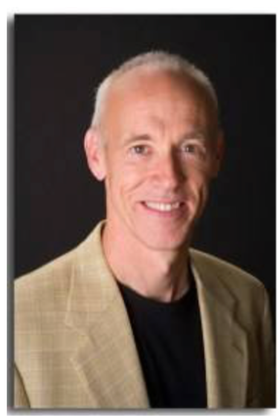
“A tame problem:
Has a well-defined and stable problem statement;
Has a definite stopping point, i.e., when the solution is reached;
Has a solution that can be objectively evaluated as right or wrong;
Belongs to a similar class of problems that are all solved in the same similar way;
Has solutions that can be easily tried and abandoned;
Comes with a limited set of alternative solutions.”
Jeff Conklin
http://cognexusgroup.com/wp-content/uploads/2013/07/Using-Dialogue-Mapping-to-Address-Wicked-Problems-05-23-2013.pdf
Notes:
Jeff Conklin
http://cognexusgroup.com/wp-content/uploads/2013/07/Using-Dialogue-Mapping-to-Address-Wicked-Problems-05-23-2013.pdf
Jan 10 2016 tsg
Dr. Jeff Conklin, teacher of Issue Mapping, creator of Dialogue Mapping and founder of the CogNexus Institute and CogNexus Group. He is perhaps best known for his work with the Issue Based Information System (IBIS) method and extensions of it, such as research tools ("gIBIS") and commercial products ("CM/1TM", "QuestMapTM") that support IBIS. He is advisor to the Compendium Institute, which distributes the open source Compendium mapping tool.
Dr. Conklin also developed the Dialogue MappingTM facilitation technique, a radically inclusive approach to knowledge management that allows groups to capture and make sense of unstructured knowledge during project meetings. Dr. Conklin has taught Dialogue MappingTM to thousands of people all over the world.

Slide 6
Degrees of Wickedness
“It turns out there's a slippery linguistic trap in the name 'wicked problem,'
because the name implies there's a 'solution.’
It's more accurate to talk about the degree of 'wickedness' in a situation (or perhaps how messy a given 'mess' is).
(Framing the challenge in this way might help to break our addiction to racing around creating and exacerbating 'problems' with our 'solutions.')
The truth is that a wicked problem is a set of interlocking issues across many domains (i.e. political, environmental, economic, etc.),
and any attempt to bound the scope of the challenge is arbitrary.
Moreover, only a tame problem can be ‘solved'—
wicked problems can only be managed more or less effectively, more or less efficiently.
The best we can do is to find more elegant and expedient interventions,
but ultimately the human condition is that there's no getting away from the 'Whac-a-mole' phenomenon that even the most elegant intervention on a wicked problem will make some issue(s) more wicked for some stakeholder(s).”
Jeff Conklin
http://cognexusgroup.com/wp-content/uploads/2013/07/Using-Dialogue-Mapping-to-Address-Wicked-Problems-05-23-2013.pdf
Notes:
Jeff Conklin
http://cognexusgroup.com/wp-content/uploads/2013/07/Using-Dialogue-Mapping-to-Address-Wicked-Problems-05-23-2013.pdf
Jan 10 2016 tsg
Dr. Jeff Conklin, teacher of Issue Mapping, creator of Dialogue Mapping and founder of the CogNexus Institute and CogNexus Group. He is perhaps best known for his work with the Issue Based Information System (IBIS) method and extensions of it, such as research tools ("gIBIS") and commercial products ("CM/1TM", "QuestMapTM") that support IBIS. He is advisor to the Compendium Institute, which distributes the open source Compendium mapping tool.
Dr. Conklin also developed the Dialogue MappingTM facilitation technique, a radically inclusive approach to knowledge management that allows groups to capture and make sense of unstructured knowledge during project meetings. Dr. Conklin has taught Dialogue MappingTM to thousands of people all over the world.

Slide 7
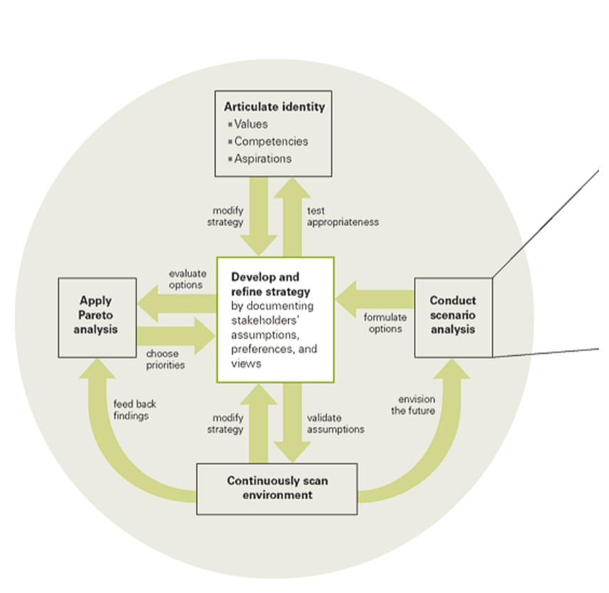
PPG’s Framework
for Responding to
Wicked Issues
Notes:
www.ppg.com/
Chemicals company PPG Industries is an American American Fortune 500 company and American supplier of paints, coatings, specialty materials, chemicals, glass, and fiberglass. Wikipedia Headquarters: Pittsburgh, Pennsylvania, United States CEO: Charles Bunch Founder: John Baptiste Ford Founded: 1883 Subsidiaries: Glidden, Transitions Optical, more Ppg's Vision, Mission, Strategy And Values
Our vision is to be the world’s leading coatings company by consistently delivering high-quality, innovative and sustainable solutions that customers trust to protect and beautify their products and surroundings. This vision will guide us on our journey toward our common goals and principles.
John C. Camillus (camillus@pitt.edu) is the Donald R. Beall Professor of Strategic Management at the University of Pittsburgh’s Joseph M. Katz Graduate School of Business.
https://hbr.org/2008/05/strategy-as-a-wicked-problemsource Strategy as a Wicked Problem by John C. Camillus
FROM THE MAY 2008 ISSUE
John C. Camillus (camillus@pitt.edu) is the Donald R. Beall Professor of Strategic Management at the University of Pittsburgh’s Joseph M. Katz Graduate School of Business.
https://hbr.org/2008/05/strategy-as-a-wicked-problem
slides made Jan 9 2016 Tom Gilb

Slide 10
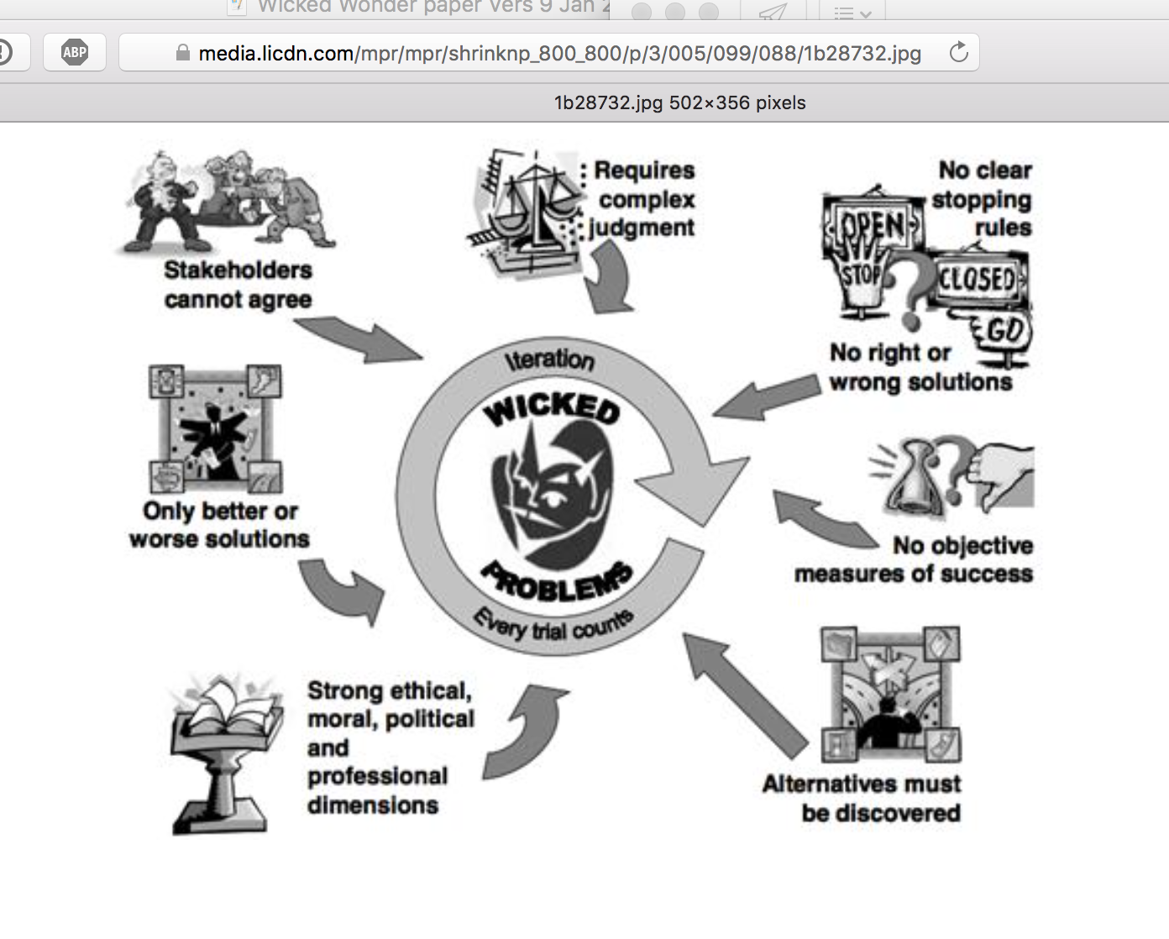

Slide 11
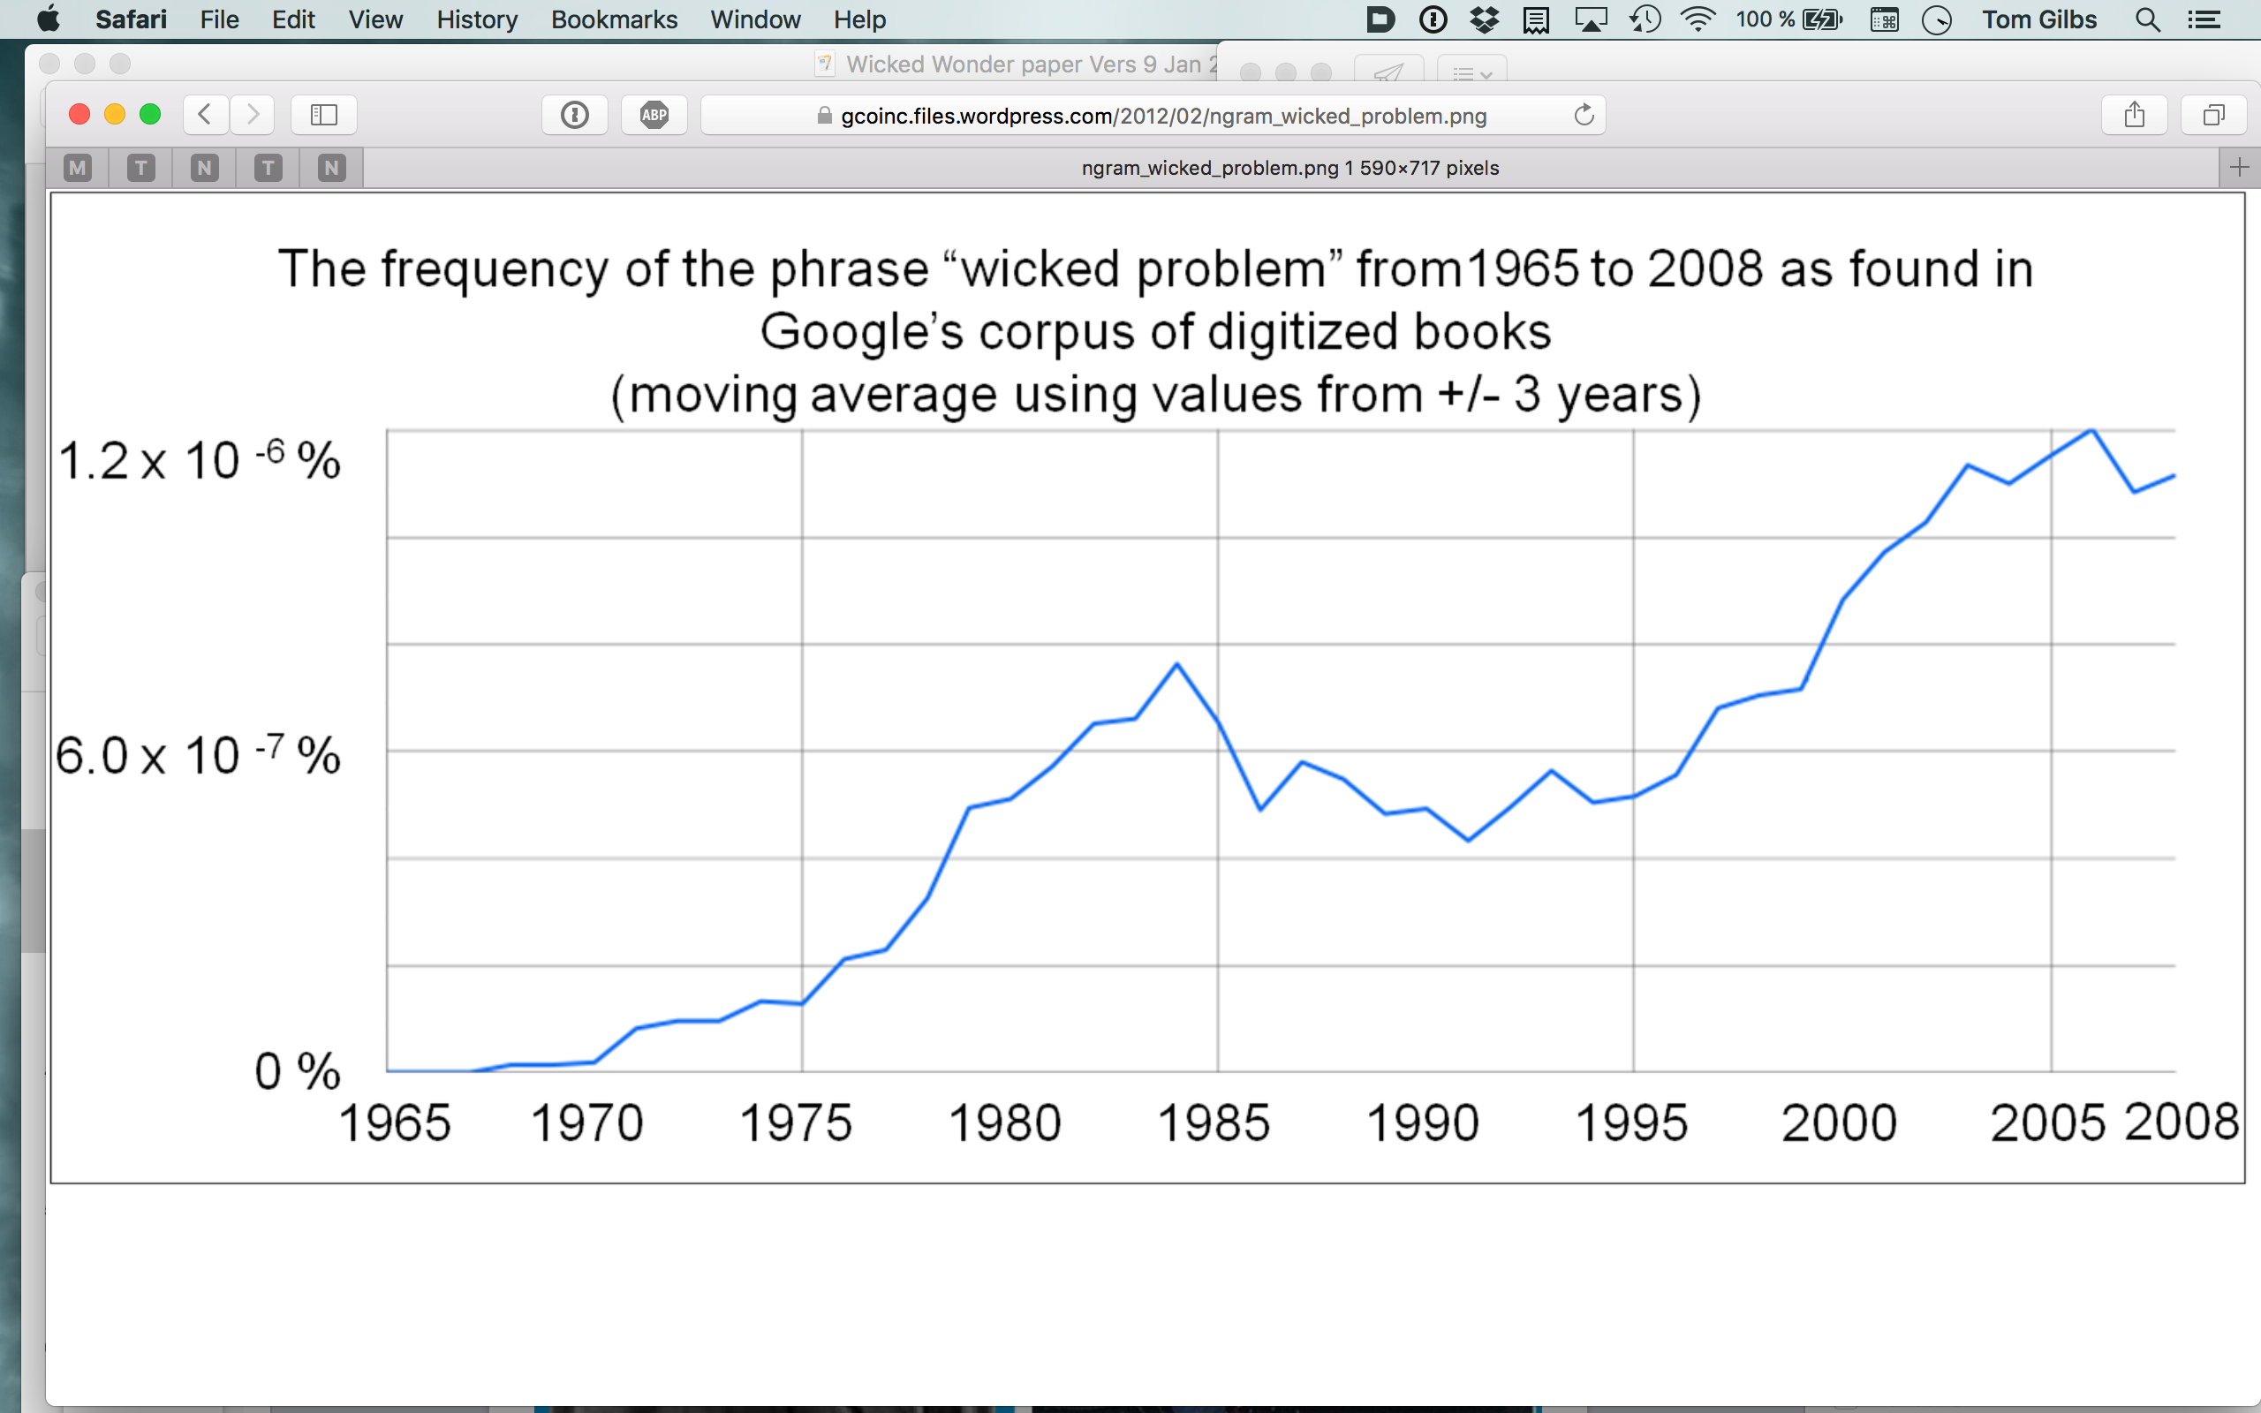

Slide 15
How ‘Planguage’ Helps deal with Wicked Software engineering Problems
1. by viewing the problem from a high ‘stakeholder values’ level (avoiding all complex innards)
2. by dealing with design and costs incrementally
3. by contracting for results, not work
4. by being lean: early, preventive
5. by using scale free methods: scale does not matter

Slide 16
Dimensions of Stakeholder Value
Timing
Productivity / Efficiency /
Resources Savings
Environmental
Legal
Organizational Fit
Strategic /
Competitive Advantage
Stakeholder Value
Financial Gain
Innovation
Opinion / Intuition /
Bias
Financial Penalty
Values Fit
Cost
Risk
Other
Any change is evaluated against several dimensions of stakeholder value
© Lindsey Brodie 2010

Slide 17
Niels Malotaux
Notes:
“What has an Architect to do with planning?”
www.malotaux.nl/doc.php?id=98
added 11 sept 2015

Slide 18
From Scales to Solutions
Solution 1
Solution 2
Solution n
Total Impacts
Impact on Objective
Impact on Objective
Impact on Objective
Total Impact on Objective
Objective
Impact on Budget
Impact on Budget
Impact on Budget
Total Impact on Budget
Resources
Benefits-to-Cost Ratio
Ratio
Ratio
Ratio
Courtesy Rolf Goetz
Notes:
Courtesy Rolf Goetz 2016 for his audio https://voice.adobe.com/a/P0BaZ/
yodaearth@googlemail.com

Slide 19
Impacts on Objectives
Facebook
Profiler
Umantis BM
Total Impacts on Objectives
Attract Talents
271 -> 700
70%
± 10%
0% ±10%
50% ±5%
120% ±25%
Win Talents
53 -> 100
30%
± 20%
50%
± 10%
30%
± 10%
110% ±40%
Perfect Match
25% -> 75%
10%
± 10%
30%
± 10%
30%
± 10%
70% ±30%
Total Impact of Solutions
110%
± 40%
80%
± 30%
110%
± 25%
Courtesy Rolf Goetz
Notes:
Courtesy Rolf Goetz 2016 for his audio https://voice.adobe.com/a/P0BaZ/
yodaearth@googlemail.com

Slide 20
Impacts on Resources and Totals
Facebook
Profiler
Umantis BM
Total Impacts on Objectives
Money
100.000€
70%
± 10%
0% ±10%
50% ±5%
120% ±25%
Time
12 months
30%
± 20%
50%
± 10%
30%
± 10%
110% ±40%
Total Impact of Solutions
100%
± 30%
50%
± 20%
80%
± 15%
110/100
=1.1
Best 2.1
Worst 0.5
80 / 50
= 1.6
Best 3.7
Worst 0.7
110 / 80
= 1.4
Best 2.1
Worst 0.9
Benefit/Cost
Courtesy Rolf Goetz
Notes:
Courtesy Rolf Goetz 2016 for his audio https://voice.adobe.com/a/P0BaZ/
yodaearth@googlemail.com

Slide 21
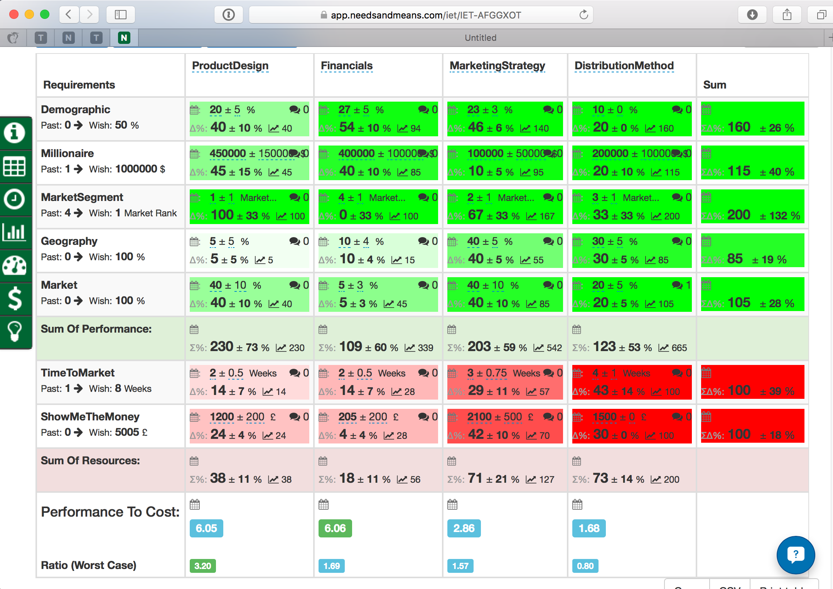
157/49 = 3.2
Notes:
MyBusinessPerspective
IET-AFGGXOT
BCS Geoff Cooper Cyber startup project 12 November 2015 London
Non Confidential Student Planning work on BCS Startup Planning Course
Led by Tom Gilb

Slide 22
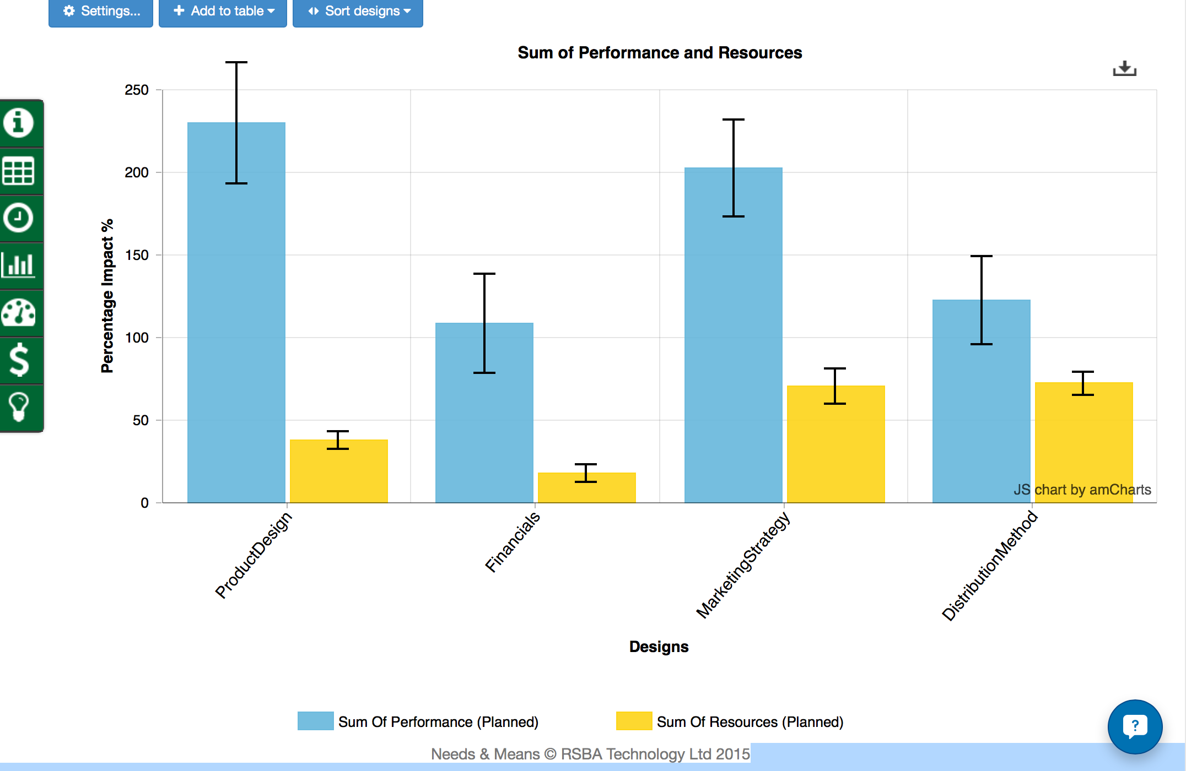
Notes:
MyBusinessPerspective
IET-AFGGXOT
BCS Geoff Cooper Cyber startup project 12 November 2015 London
Non Confidential Student Planning work on BCS Startup Planning Course
Led by Tom Gilb

Slide 23
2. by dealing with design and costs incrementally
clearer cause and effect
easier to correct early

Slide 24
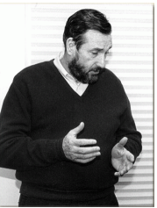
Cleanroom - for software
(don’t have to explain that idea to Intel people)
Harlan Mills
2016
Copyright Tom@Gilb.com 2016
Notes:
Mills, H. 1980. The management of software engineering: part 1: principles of software engineering. IBM Systems Journal 19, issue 4 (Dec.):414-420.
http://trace.tennessee.edu/utk_harlan/18/
Mills, Harlan D.; Dyer, M.; and Linger, R. C., "Cleanroom Software Engineering" (1987). The Harlan D. Mills Collection. http://trace.tennessee.edu/utk_harlan/18
Photo
race.tennessee.edu/utk_harlan/?utm_source=trace.tennessee.edu%2Futk_harlan%2F18&utm_medium=PDF&utm_campaign=PDFCoverPages
http://trace.tennessee.edu/cgi/viewcontent.cgi?article=1017&context=utk_harlan
http://trace.tennesssee.edu/cgi/view?article=1004&content=utk_harlan

Slide 25
The first guarantee of quality
“The first guarantee of quality in design is in well-informed, well-educated, and well-motivated designers.
Quality must be built into designs, and cannot be inspected in or tested in.
Nevertheless, any prudent development process verifies quality through inspection and testing.
Inspection by peers in design, by users or surrogates, by other financial specialists concerned with cost, reliability, or maintainability not only increases confidence in the design at hand, but also provides designers with valuable lessons and insights to be applied to future designs.
The very fact that designs face inspections motivates even the most conscientious designers to greater care, deeper simplicities, and more precision in their work.”
http://trace.tennessee.edu/cgi/viewcontent.cgi?article=1004&context=utk_harlan
Notes:
inIBM sj 4 80 p.419
In
Mills, H. 1980. The management of software engineering: part 1: principles of software engineering. IBM Systems Journal 19, issue 4 (Dec.):414-420.
Direct Copy
http://trace.tennessee.edu/cgi/viewcontent.cgi?article=1004&context=utk_harlan
Library header
http://trace.tennessee.edu/utk_harlan/5/

Slide 26
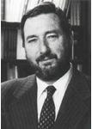
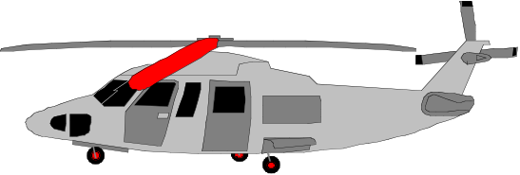
In the ‘Cleanroom Method’, developed by IBM’s Harlan Mills (IBM SJ No. 4/1980) they reported:
“Software Engineering began to emerge in FSD” (IBM Federal Systems Division, from 1996 a part of Lockheed Martin Marietta) “some ten years ago [Ed. about 1970] in a continuing evolution that is still underway:
Ten years ago general management expected the worst from software projects – cost overruns, late deliveries, unreliable and incomplete software
Today [Ed. 1980!], management has learned to expect on-time, within budget, deliveries of high-quality software.
A Navy helicopter ship system, called LAMPS, provides a recent example. LAMPS software was a four-year project of over 200 person-years of effort, developing over three million, and integrating over seven million words of program and data for eight different processors distributed between a helicopter and a ship in 45 incremental deliveries [Ed. Note 2%!]s.
Every one of those deliveries was on time and under budget
A more extended example can be found in the NASA space program,
- Where in the past ten years, FSD has managed some 7,000 person-years of software development, developing and integrating over a hundred million bytes of program and data for ground and space processors in over a dozen projects.
There were few late or overrun deliveries in that decade, and none at all in the past four years.”
August 16, 2014
© Gilb.com 2011
Notes:
A time or cost estimate, once it becomes a deadline or a budget respectively, is a ‘limited resource’. One of the smartest ways to deal with limited resources is intelligent prioritization (Gilb and Maier 2005). Instead of implementing all your designs in a ‘big bang’ manner, and hoping to meet all the requirements and resource (time and cost) estimates, we suggest you deliver the project value a little bit at a time, and see how each of the designs actually works, and what they each actually cost. ‘A little bit at a time’ should be interpreted as delivering evolutionary steps of approximately 2% of the overall project timescales (say weekly, fortnightly or monthly cycles), and hopefully about 2% of the project financial budget.
Planguage’s impact estimation (IE) method (Gilb 1988; Gilb 2005) is helpful in identifying the designs that give the estimated best stakeholder value for their costs. We implement designs incrementally so that we can get acceptable feedback on costs, and value delivery (in terms of meeting requirements). With a bit of luck, stakeholders then receive interesting value very early, and what works and what doesn’t is learned in practice. If a deadline is hit, or if the budget runs out (possibly because of a deadline being moved up earlier or a budget cut!), then at least there is still a complete live real system with delivered high-value. In such situations, the whole concept of the project-level estimates, the deadlines and the budgets is not so important any more.
Nobody does it better! Harlan Mills told me that they had to solve the persistent problem of cost overruns, in relation to the contracted estimates, because the government was getting smarter, and using fixed-price contracts (as opposed to cost plus). If the project ran over, IBM lost its own profit. If IBM did not find a better way, they could just as well leave the business (Personal Communication).
Notice the “45 deliveries” Mills cites. That means 2% delivery cycles. IBM was using intelligent feedback and learning. They actually had very sophisticated estimation technology based on a thorough collection of experiences (Walston and Felix 1977). But this did not give them the accuracy they needed to avoid losing money. Lets us say they had a 40% profit margin, and they could be wrong by 40% to 200% (The NASA range, see earlier Figure 3). They would still lose money on most contracts. So, they had to compensate for their estimation inaccuracy by incremental feedback, and necessary change, to come in ‘on time and under budget every time’. Mills’ colleague, Quinnan describes their process of intelligent dynamic prioritization in detail in (Mills 1980 in IBM SJ 4-1980).
A thorough explanation of systems development processes helping achieve intelligent prioritization is found in (Gilb 2005). See also Figure 9. Nothing less will suffice for large and complex systems (that is, for project involving hundreds of staff, years of effort, and sometimes $100 million or more in cost). For smaller systems (small teams over a few months), several organizations have made good simple practical adaptations (Upadhyayula 2001 (Study of Evo at HP in 1990s); Johansen and Gilb 2005) of the essential ‘Evo’ development process ideas (Evo itself predating later ‘Agile’ methods)[Denning 2010, p.129] & [Gilb 2010c].
The agile community has adopted small iterative cycles (Gilb 2010c), but they have failed to adopt the notion of measurement of value and quality – which is essential for larger projects, and some smaller ones. Without explicit absolute quality requirement and design impact metrics, the value prioritization is ambiguous and too subjective (Gilb 2010c; Gilb and Brodie 2010).

Slide 27
In the Cleanroom Method, developed by IBM’s Harlan Mills (1980) they reported:
“Software Engineering began to emerge in FSD” (IBM Federal Systems Division, from 1996 a part of Lockheed Martin Marietta) “some ten years ago [Ed. about 1970] in a continuing evolution that is still underway:
Ten years ago general management expected the worst from software projects – cost overruns, late deliveries, unreliable and incomplete software
Today [Ed. 1980!], management has learned to expect on-time, within budget, deliveries of high-quality software. A Navy helicopter ship system, called LAMPS, provides a recent example. LAMPS software was a four-year project of over 200 person-years of effort, developing over three million, and integrating over seven million words of program and data for eight different processors distributed between a helicopter and a ship in 45 incremental deliveries [Ed. Note 2%!]s. Every one of those deliveries was on time and under budget
A more extended example can be found in the NASA space program,
- Where in the past ten years, FSD has managed some 7,000 person-years of software development, developing and integrating over a hundred million bytes of program and data for ground and space processors in over a dozen projects.
- There were few late or overrun deliveries in that decade, and none at all in the past four years.”
in 45 incremental deliveries
were few late or overrun deliveries in that decade, and none at all in the past four years
August 16, 2014
© Gilb.com 2011
Notes:
A time or cost estimate, once it becomes a deadline or a budget respectively, is a ‘limited resource’. One of the smartest ways to deal with limited resources is intelligent prioritization (Gilb and Maier 2005). Instead of implementing all your designs in a ‘big bang’ manner, and hoping to meet all the requirements and resource (time and cost) estimates, we suggest you deliver the project value a little bit at a time, and see how each of the designs actually works, and what they each actually cost. ‘A little bit at a time’ should be interpreted as delivering evolutionary steps of approximately 2% of the overall project timescales (say weekly, fortnightly or monthly cycles), and hopefully about 2% of the project financial budget.
Planguage’s impact estimation (IE) method (Gilb 1988; Gilb 2005) is helpful in identifying the designs that give the estimated best stakeholder value for their costs. We implement designs incrementally so that we can get acceptable feedback on costs, and value delivery (in terms of meeting requirements). With a bit of luck, stakeholders then receive interesting value very early, and what works and what doesn’t is learned in practice. If a deadline is hit, or if the budget runs out (possibly because of a deadline being moved up earlier or a budget cut!), then at least there is still a complete live real system with delivered high-value. In such situations, the whole concept of the project-level estimates, the deadlines and the budgets is not so important any more.
Nobody does it better! Harlan Mills told me that they had to solve the persistent problem of cost overruns, in relation to the contracted estimates, because the government was getting smarter, and using fixed-price contracts (as opposed to cost plus). If the project ran over, IBM lost its own profit. If IBM did not find a better way, they could just as well leave the business (Personal Communication).
Notice the “45 deliveries” Mills cites. That means 2% delivery cycles. IBM was using intelligent feedback and learning. They actually had very sophisticated estimation technology based on a thorough collection of experiences (Walston and Felix 1977). But this did not give them the accuracy they needed to avoid losing money. Lets us say they had a 40% profit margin, and they could be wrong by 40% to 200% (The NASA range, see earlier Figure 3). They would still lose money on most contracts. So, they had to compensate for their estimation inaccuracy by incremental feedback, and necessary change, to come in ‘on time and under budget every time’. Mills’ colleague, Quinnan describes their process of intelligent dynamic prioritization in detail in (Mills 1980 in IBM SJ 4-1980).
A thorough explanation of systems development processes helping achieve intelligent prioritization is found in (Gilb 2005). See also Figure 9. Nothing less will suffice for large and complex systems (that is, for project involving hundreds of staff, years of effort, and sometimes $100 million or more in cost). For smaller systems (small teams over a few months), several organizations have made good simple practical adaptations (Upadhyayula 2001 (Study of Evo at HP in 1990s); Johansen and Gilb 2005) of the essential ‘Evo’ development process ideas (Evo itself predating later ‘Agile’ methods)[Denning 2010, p.129] & [Gilb 2010c].
The agile community has adopted small iterative cycles (Gilb 2010c), but they have failed to adopt the notion of measurement of value and quality – which is essential for larger projects, and some smaller ones. Without explicit absolute quality requirement and design impact metrics, the value prioritization is ambiguous and too subjective (Gilb 2010c; Gilb and Brodie 2010).

Slide 28
Mills on Design to Cost
“To meet cost/schedule commitments based on imperfect estimation techniques, a software engineering manager must adopt a manage-and-design-to-cost/schedule process.
That process requires a continuous and relentless rectification of design objectives with the cost/schedule needed to achieve those objectives.”
in IBM Systems Journal, 4/80 p.420
Notes:
in IBM sj 4 80 p.420
In
Mills, H. 1980. The management of software engineering: part 1: principles of software engineering. IBM Systems Journal 19, issue 4 (Dec.):414-420.
Direct Copy
http://trace.tennessee.edu/cgi/viewcontent.cgi?article=1004&context=utk_harlan
Library header
http://trace.tennessee.edu/utk_harlan/5/

Slide 29
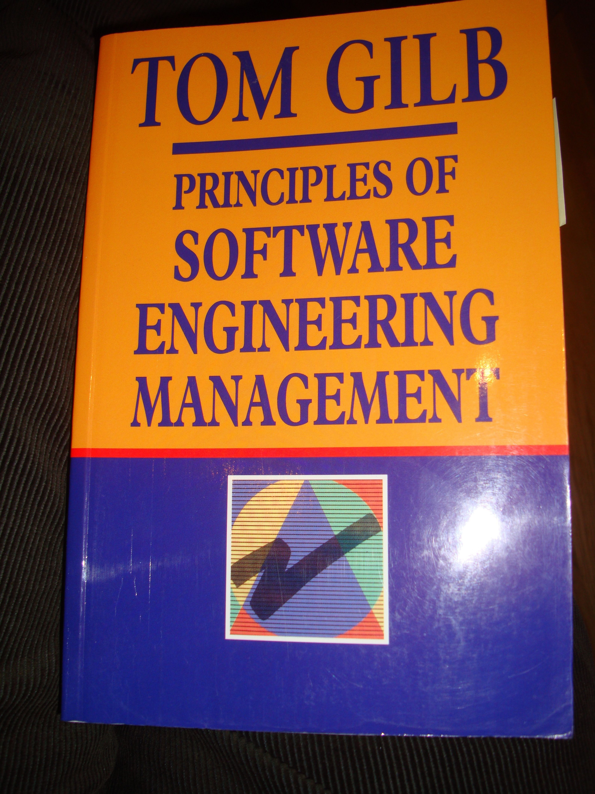
Quinnan: IBM FSD Cleanroom Dynamic Design to Cost
Quinnan describes the process control loop used by IBM FSD to ensure that cost targets are met.
'Cost management. . . yields valid cost plans linked to technical performance. Our practice carries cost management farther by introducing design-to-cost guidance. Design, development, and managerial practices are applied in an integrated way to ensure that software technical management is consistent with cost management. The method [illustrated in this book by Figure 7.10] consists of developing a design, estimating its cost, and ensuring that the design is cost-effective.' (p. 473)
He goes on to describe a design iteration process trying to meet cost targets by either redesign or by sacrificing 'planned capability.' When a satisfactory design at cost target is achieved for a single increment, the 'development of each increment can proceed concurrently with the program design of the others.'
'Design is an iterative process in which each design level is a refinement of the previous level.' (p. 474)
It is clear from this that they avoid the big bang cost estimation approach. Not only do they iterate in seeking the appropriate balance between cost and design for a single increment, but they iterate through a series of increments, thus reducing the complexity of the task, and increasing the probability of learning from experience, won as each increment develops, and as the true cost of the increment becomes a fact.
'When the development and test of an increment are complete, an estimate to complete the remaining increments is computed.' (p. 474)
Source: Robert E. Quinnan, 'Software Engineering Management Practices', IBM Systems Journal, Vol. 19, No. 4, 1980, pp. 466~77
This text is cut from Gilb: The Principles of Software Engineering Management, 1988
16 August 2014
Copyright Tom@Gilb.com 2013
Notes:
Slide developed Oct 6 2013 tsg for London Software Architecture Conference Talk 9 Oct 2013
15.1.18 Quinnan
Source: Robert E. Quinnan, 'Software Engineering Management Practices', IBM Systems Journal, Vol. 19, No. 4, 1980, pp. 466~77
Robert E. Quinnan: The Management of Software Engineering. Part V: Software Engineering Management Practices. IBM Systems Journal 19(4): 466-477 (1980)
Quinnan describes the process control loop used by IBM FSD to ensure that cost targets are met.
'Cost management. . . yields valid cost plans linked to technical performance. Our practice carries cost management farther by introducing design-to-cost guidance. Design, development, and managerial practices are applied in an integrated way to ensure that software technical management is consistent with cost management. The method [illustrated in this book by Figure 7.10] consists of developing a design, estimating its cost, and ensuring that the design is cost-effective.' (p. 473)
He goes on to describe a design iteration process trying to meet cost targets by either redesign or by sacrificing 'planned capability.' When a satisfactory design at cost target is achieved for a single increment, the 'development of each increment can proceed concurrently with the program design of the others.'
'Design is an iterative process in which each design level is a refinement of the previous level.' (p. 474)
It is clear from this that they avoid the big bang cost estimation approach. Not only do they iterate in seeking the appropriate balance between cost and design for a single increment, but they iterate through a series of increments, thus reducing the complexity of the task, and increasing the probability of learning from experience, won as each increment develops, and as the true cost of the increment becomes a fact.
'When the development and test of an increment are complete, an estimate to complete the remaining increments is computed.' (p. 474)
This article is far richer than our few selected quotations can show, with regard to concepts of cost estimation and control.

Slide 30
Quinnan: IBM FSD Cleanroom Dynamic Design to Cost
Quinnan describes the process control loop used by IBM FSD to ensure that cost targets are met.
'Cost management. . . yields valid cost plans linked to technical performance. Our practice carries cost management farther by introducing design-to-cost guidance. Design, development, and managerial practices are applied in an integrated way to ensure that software technical management is consistent with cost management. The method [illustrated in this book by Figure 7.10] consists of developing a design, estimating its cost, and ensuring that the design is cost-effective.' (p. 473)
He goes on to describe a design iteration process trying to meet cost targets by either redesign or by sacrificing 'planned capability.' When a satisfactory design at cost target is achieved for a single increment, the 'development of each increment can proceed concurrently with the program design of the others.'
'Design is an iterative process in which each design level is a refinement of the previous level.' (p. 474)
It is clear from this that they avoid the big bang cost estimation approach. Not only do they iterate in seeking the appropriate balance between cost and design for a single increment, but they iterate through a series of increments, thus reducing the complexity of the task, and increasing the probability of learning from experience, won as each increment develops, and as the true cost of the increment becomes a fact.
'When the development and test of an increment are complete, an estimate to complete the remaining increments is computed.' (p. 474)
Source: Robert E. Quinnan, 'Software Engineering Management Practices', IBM Systems Journal, Vol. 19, No. 4, 1980, pp. 466~77
This text is cut from Gilb: The Principles of Software Engineering Management, 1988
of developing a design, estimating its cost, and ensuring that the design is cost-effective
16 August 2014
Copyright Tom@Gilb.com 2013
Notes:
Slide developed Oct 6 2013 tsg for London Software Architecture Conference Talk 9 Oct 2013
15.1.18 Quinnan
Source: Robert E. Quinnan, 'Software Engineering Management Practices', IBM Systems Journal, Vol. 19, No. 4, 1980, pp. 466~77
Robert E. Quinnan: The Management of Software Engineering. Part V: Software Engineering Management Practices. IBM Systems Journal 19(4): 466-477 (1980)
Quinnan describes the process control loop used by IBM FSD to ensure that cost targets are met.
'Cost management. . . yields valid cost plans linked to technical performance. Our practice carries cost management farther by introducing design-to-cost guidance. Design, development, and managerial practices are applied in an integrated way to ensure that software technical management is consistent with cost management. The method [illustrated in this book by Figure 7.10] consists of developing a design, estimating its cost, and ensuring that the design is cost-effective.' (p. 473)
He goes on to describe a design iteration process trying to meet cost targets by either redesign or by sacrificing 'planned capability.' When a satisfactory design at cost target is achieved for a single increment, the 'development of each increment can proceed concurrently with the program design of the others.'
'Design is an iterative process in which each design level is a refinement of the previous level.' (p. 474)
It is clear from this that they avoid the big bang cost estimation approach. Not only do they iterate in seeking the appropriate balance between cost and design for a single increment, but they iterate through a series of increments, thus reducing the complexity of the task, and increasing the probability of learning from experience, won as each increment develops, and as the true cost of the increment becomes a fact.
'When the development and test of an increment are complete, an estimate to complete the remaining increments is computed.' (p. 474)
This article is far richer than our few selected quotations can show, with regard to concepts of cost estimation and control.

Slide 31
Quinnan: IBM FSD Cleanroom Dynamic Design to Cost
Quinnan describes the process control loop used by IBM FSD to ensure that cost targets are met.
'Cost management. . . yields valid cost plans linked to technical performance. Our practice carries cost management farther by introducing design-to-cost guidance. Design, development, and managerial practices are applied in an integrated way to ensure that software technical management is consistent with cost management. The method [illustrated in this book by Figure 7.10] consists of developing a design, estimating its cost, and ensuring that the design is cost-effective.' (p. 473)
He goes on to describe a design iteration process trying to meet cost targets by either redesign or by sacrificing 'planned capability.' When a satisfactory design at cost target is achieved for a single increment, the 'development of each increment can proceed concurrently with the program design of the others.'
'Design is an iterative process in which each design level is a refinement of the previous level.' (p. 474)
It is clear from this that they avoid the big bang cost estimation approach. Not only do they iterate in seeking the appropriate balance between cost and design for a single increment, but they iterate through a series of increments, thus reducing the complexity of the task, and increasing the probability of learning from experience, won as each increment develops, and as the true cost of the increment becomes a fact.
'When the development and test of an increment are complete, an estimate to complete the remaining increments is computed.' (p. 474)
Source: Robert E. Quinnan, 'Software Engineering Management Practices', IBM Systems Journal, Vol. 19, No. 4, 1980, pp. 466~77
This text is cut from Gilb: The Principles of Software Engineering Management, 1988
iteration process trying to meet cost targets by either redesign or by sacrificing 'planned capability’
16 August 2014
Copyright Tom@Gilb.com 2013
Notes:
Slide developed Oct 6 2013 tsg for London Software Architecture Conference Talk 9 Oct 2013
15.1.18 Quinnan
Source: Robert E. Quinnan, 'Software Engineering Management Practices', IBM Systems Journal, Vol. 19, No. 4, 1980, pp. 466~77
Robert E. Quinnan: The Management of Software Engineering. Part V: Software Engineering Management Practices. IBM Systems Journal 19(4): 466-477 (1980)
Quinnan describes the process control loop used by IBM FSD to ensure that cost targets are met.
'Cost management. . . yields valid cost plans linked to technical performance. Our practice carries cost management farther by introducing design-to-cost guidance. Design, development, and managerial practices are applied in an integrated way to ensure that software technical management is consistent with cost management. The method [illustrated in this book by Figure 7.10] consists of developing a design, estimating its cost, and ensuring that the design is cost-effective.' (p. 473)
He goes on to describe a design iteration process trying to meet cost targets by either redesign or by sacrificing 'planned capability.' When a satisfactory design at cost target is achieved for a single increment, the 'development of each increment can proceed concurrently with the program design of the others.'
'Design is an iterative process in which each design level is a refinement of the previous level.' (p. 474)
It is clear from this that they avoid the big bang cost estimation approach. Not only do they iterate in seeking the appropriate balance between cost and design for a single increment, but they iterate through a series of increments, thus reducing the complexity of the task, and increasing the probability of learning from experience, won as each increment develops, and as the true cost of the increment becomes a fact.
'When the development and test of an increment are complete, an estimate to complete the remaining increments is computed.' (p. 474)
This article is far richer than our few selected quotations can show, with regard to concepts of cost estimation and control.

Slide 32
Quinnan: IBM FSD Cleanroom Dynamic Design to Cost
Design is an iterative process
Quinnan describes the process control loop used by IBM FSD to ensure that cost targets are met.
'Cost management. . . yields valid cost plans linked to technical performance. Our practice carries cost management farther by introducing design-to-cost guidance. Design, development, and managerial practices are applied in an integrated way to ensure that software technical management is consistent with cost management. The method [illustrated in this book by Figure 7.10] consists of developing a design, estimating its cost, and ensuring that the design is cost-effective.' (p. 473)
He goes on to describe a design iteration process trying to meet cost targets by either redesign or by sacrificing 'planned capability.' When a satisfactory design at cost target is achieved for a single increment, the 'development of each increment can proceed concurrently with the program design of the others.'
'Design is an iterative process in which each design level is a refinement of the previous level.' (p. 474)
It is clear from this that they avoid the big bang cost estimation approach. Not only do they iterate in seeking the appropriate balance between cost and design for a single increment, but they iterate through a series of increments, thus reducing the complexity of the task, and increasing the probability of learning from experience, won as each increment develops, and as the true cost of the increment becomes a fact.
'When the development and test of an increment are complete, an estimate to complete the remaining increments is computed.' (p. 474)
Source: Robert E. Quinnan, 'Software Engineering Management Practices', IBM Systems Journal, Vol. 19, No. 4, 1980, pp. 466~77
This text is cut from Gilb: The Principles of Software Engineering Management, 1988
16 August 2014
Copyright Tom@Gilb.com 2013
Notes:
Slide developed Oct 6 2013 tsg for London Software Architecture Conference Talk 9 Oct 2013
15.1.18 Quinnan
Source: Robert E. Quinnan, 'Software Engineering Management Practices', IBM Systems Journal, Vol. 19, No. 4, 1980, pp. 466~77
Robert E. Quinnan: The Management of Software Engineering. Part V: Software Engineering Management Practices. IBM Systems Journal 19(4): 466-477 (1980)
Quinnan describes the process control loop used by IBM FSD to ensure that cost targets are met.
'Cost management. . . yields valid cost plans linked to technical performance. Our practice carries cost management farther by introducing design-to-cost guidance. Design, development, and managerial practices are applied in an integrated way to ensure that software technical management is consistent with cost management. The method [illustrated in this book by Figure 7.10] consists of developing a design, estimating its cost, and ensuring that the design is cost-effective.' (p. 473)
He goes on to describe a design iteration process trying to meet cost targets by either redesign or by sacrificing 'planned capability.' When a satisfactory design at cost target is achieved for a single increment, the 'development of each increment can proceed concurrently with the program design of the others.'
'Design is an iterative process in which each design level is a refinement of the previous level.' (p. 474)
It is clear from this that they avoid the big bang cost estimation approach. Not only do they iterate in seeking the appropriate balance between cost and design for a single increment, but they iterate through a series of increments, thus reducing the complexity of the task, and increasing the probability of learning from experience, won as each increment develops, and as the true cost of the increment becomes a fact.
'When the development and test of an increment are complete, an estimate to complete the remaining increments is computed.' (p. 474)
This article is far richer than our few selected quotations can show, with regard to concepts of cost estimation and control.

Slide 33
Quinnan: IBM FSD Cleanroom Dynamic Design to Cost
Quinnan describes the process control loop used by IBM FSD to ensure that cost targets are met.
'Cost management. . . yields valid cost plans linked to technical performance. Our practice carries cost management farther by introducing design-to-cost guidance. Design, development, and managerial practices are applied in an integrated way to ensure that software technical management is consistent with cost management. The method [illustrated in this book by Figure 7.10] consists of developing a design, estimating its cost, and ensuring that the design is cost-effective.' (p. 473)
He goes on to describe a design iteration process trying to meet cost targets by either redesign or by sacrificing 'planned capability.' When a satisfactory design at cost target is achieved for a single increment, the 'development of each increment can proceed concurrently with the program design of the others.'
'Design is an iterative process in which each design level is a refinement of the previous level.' (p. 474)
It is clear from this that they avoid the big bang cost estimation approach. Not only do they iterate in seeking the appropriate balance between cost and design for a single increment, but they iterate through a series of increments, thus reducing the complexity of the task, and increasing the probability of learning from experience, won as each increment develops, and as the true cost of the increment becomes a fact.
'When the development and test of an increment are complete, an estimate to complete the remaining increments is computed.' (p. 474)
Source: Robert E. Quinnan, 'Software Engineering Management Practices', IBM Systems Journal, Vol. 19, No. 4, 1980, pp. 466~77
This text is cut from Gilb: The Principles of Software Engineering Management, 1988
but they iterate through a series of increments,
thus reducing the complexity of the task,
and increasing the probability of learning from experience
16 August 2014
Copyright Tom@Gilb.com 2013
Notes:
Slide developed Oct 6 2013 tsg for London Software Architecture Conference Talk 9 Oct 2013
15.1.18 Quinnan
Source: Robert E. Quinnan, 'Software Engineering Management Practices', IBM Systems Journal, Vol. 19, No. 4, 1980, pp. 466~77
Robert E. Quinnan: The Management of Software Engineering. Part V: Software Engineering Management Practices. IBM Systems Journal 19(4): 466-477 (1980)
Quinnan describes the process control loop used by IBM FSD to ensure that cost targets are met.
'Cost management. . . yields valid cost plans linked to technical performance. Our practice carries cost management farther by introducing design-to-cost guidance. Design, development, and managerial practices are applied in an integrated way to ensure that software technical management is consistent with cost management. The method [illustrated in this book by Figure 7.10] consists of developing a design, estimating its cost, and ensuring that the design is cost-effective.' (p. 473)
He goes on to describe a design iteration process trying to meet cost targets by either redesign or by sacrificing 'planned capability.' When a satisfactory design at cost target is achieved for a single increment, the 'development of each increment can proceed concurrently with the program design of the others.'
'Design is an iterative process in which each design level is a refinement of the previous level.' (p. 474)
It is clear from this that they avoid the big bang cost estimation approach. Not only do they iterate in seeking the appropriate balance between cost and design for a single increment, but they iterate through a series of increments, thus reducing the complexity of the task, and increasing the probability of learning from experience, won as each increment develops, and as the true cost of the increment becomes a fact.
'When the development and test of an increment are complete, an estimate to complete the remaining increments is computed.' (p. 474)
This article is far richer than our few selected quotations can show, with regard to concepts of cost estimation and control.

Slide 34
Quinnan: IBM FSD Cleanroom Dynamic Design to Cost
Quinnan describes the process control loop used by IBM FSD to ensure that cost targets are met.
'Cost management. . . yields valid cost plans linked to technical performance. Our practice carries cost management farther by introducing design-to-cost guidance. Design, development, and managerial practices are applied in an integrated way to ensure that software technical management is consistent with cost management. The method [illustrated in this book by Figure 7.10] consists of developing a design, estimating its cost, and ensuring that the design is cost-effective.' (p. 473)
He goes on to describe a design iteration process trying to meet cost targets by either redesign or by sacrificing 'planned capability.' When a satisfactory design at cost target is achieved for a single increment, the 'development of each increment can proceed concurrently with the program design of the others.'
'Design is an iterative process in which each design level is a refinement of the previous level.' (p. 474)
It is clear from this that they avoid the big bang cost estimation approach. Not only do they iterate in seeking the appropriate balance between cost and design for a single increment, but they iterate through a series of increments, thus reducing the complexity of the task, and increasing the probability of learning from experience, won as each increment develops, and as the true cost of the increment becomes a fact.
'When the development and test of an increment are complete, an estimate to complete the remaining increments is computed.' (p. 474)
Source: Robert E. Quinnan, 'Software Engineering Management Practices', IBM Systems Journal, Vol. 19, No. 4, 1980, pp. 466~77
This text is cut from Gilb: The Principles of Software Engineering Management, 1988
an estimate to complete the remaining increments is computed.
16 August 2014
Copyright Tom@Gilb.com 2013
Notes:
Slide developed Oct 6 2013 tsg for London Software Architecture Conference Talk 9 Oct 2013
15.1.18 Quinnan
Source: Robert E. Quinnan, 'Software Engineering Management Practices', IBM Systems Journal, Vol. 19, No. 4, 1980, pp. 466~77
Robert E. Quinnan: The Management of Software Engineering. Part V: Software Engineering Management Practices. IBM Systems Journal 19(4): 466-477 (1980)
Quinnan describes the process control loop used by IBM FSD to ensure that cost targets are met.
'Cost management. . . yields valid cost plans linked to technical performance. Our practice carries cost management farther by introducing design-to-cost guidance. Design, development, and managerial practices are applied in an integrated way to ensure that software technical management is consistent with cost management. The method [illustrated in this book by Figure 7.10] consists of developing a design, estimating its cost, and ensuring that the design is cost-effective.' (p. 473)
He goes on to describe a design iteration process trying to meet cost targets by either redesign or by sacrificing 'planned capability.' When a satisfactory design at cost target is achieved for a single increment, the 'development of each increment can proceed concurrently with the program design of the others.'
'Design is an iterative process in which each design level is a refinement of the previous level.' (p. 474)
It is clear from this that they avoid the big bang cost estimation approach. Not only do they iterate in seeking the appropriate balance between cost and design for a single increment, but they iterate through a series of increments, thus reducing the complexity of the task, and increasing the probability of learning from experience, won as each increment develops, and as the true cost of the increment becomes a fact.
'When the development and test of an increment are complete, an estimate to complete the remaining increments is computed.' (p. 474)
This article is far richer than our few selected quotations can show, with regard to concepts of cost estimation and control.

Slide 35
3. by contracting for results, not work

Slide 36
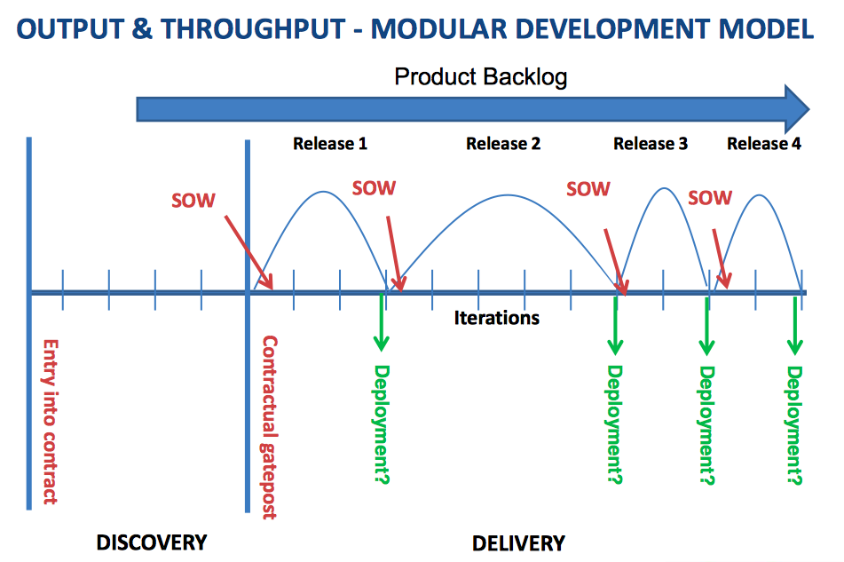
Agile code stuff and pray
29 October 2014
Tom@Gilb.com
Notes:
http://static.squarespace.com/static/52c7ec69e4b0b1f6fe574925/t/52cbe4e8e4b044c86b7f7271/1389094120966/2012%20Intellect%20-%20How%20to%20contract%20for%20Agile.pdf

Slide 37
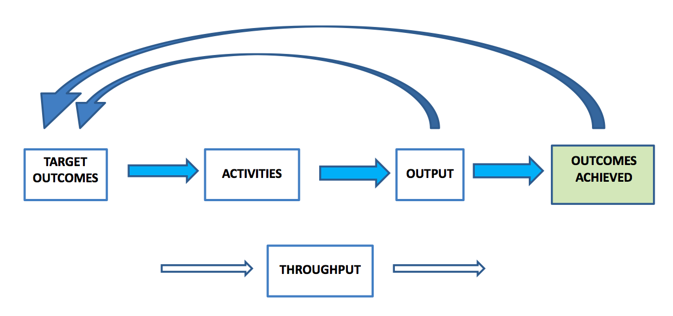
Outcome-driven view of contract metrics: If you didn’t really deliver value, try again
29 October 2014
Tom@Gilb.com
Notes:
The Problem with Agile & Contracts Agile Business Conference 9 October 2013
Susan Atkinson Keystone Law
Downloaded from
www.flexiblecontracts.com

Slide 38
An overview of the Flexible Contract (part 1) www.flexiblecontracts.com
Modular delivery – To increase contractual flexibility.
Outcome-based delivery - The supplier is free to develop the optimum solution within the constraints to deliver the target outcomes which will achieve the business objectives:
➢ Business objectives– The opportunity(s) to address and/or the problem(s) to solve and how they will deliver tangible value to the customer.
➢ Target outcomes – The business results aligned with the business objectives that the customer wishes to pursue. These must be objective and either quantified or qualified.
➢ Constraints – The constraints outside of which the solution must not deviate.
➢ Options – Potential solutions which facilitate measurable progress towards the target outcomes.
29 October 2014
Tom@Gilb.com
Notes:
The Problem with Agile & Contracts Agile Business Conference 9 October 2013
Susan Atkinson Keystone Law
Downloaded from
www.flexiblecontracts.com

Slide 39
An overview of the Flexible Contract (part 2) www.flexiblecontracts.com
Outcome-based metrics – Any potential solution must be measured against the target outcomes.
Outcome-based fees – At least part of the fees should be payable on the achievement of target outcomes.
No contractual sanction if the outcome-based metrics are not achieved –
It is an empirical process to explore whether the target outcomes are achievable,
and when enough has been done to achieve them.
29 October 2014
Tom@Gilb.com
Notes:
The Problem with Agile & Contracts Agile Business Conference 9 October 2013
Susan Atkinson Keystone Law
Downloaded from
www.flexiblecontracts.com

Slide 40
Pros and cons of the Flexible Contract
Pros:
➢ ▪A structured approach for focusing on the customer’s strategic plan
➢ ▪The creation of shared goals helps to align the interests and motivation of the parties
➢ ▪The supplier is motivated to achieve the target outcomes in the most cost-effective way
➢ ▪Outcomes are less susceptible to change, than output
➢ ▪The parties can learn rapidly what works and what doesn’t by measuring progressively the outcome delivery
Cons:
➢ ▪Lack of familiarity
➢ ▪Outcomes are not as straightforward as other contract metrics and require some training
29 October 2014
Tom@Gilb.com
Notes:
The Problem with Agile & Contracts Agile Business Conference 9 October 2013
Susan Atkinson Keystone Law
Downloaded from
www.flexiblecontracts.com

Slide 41
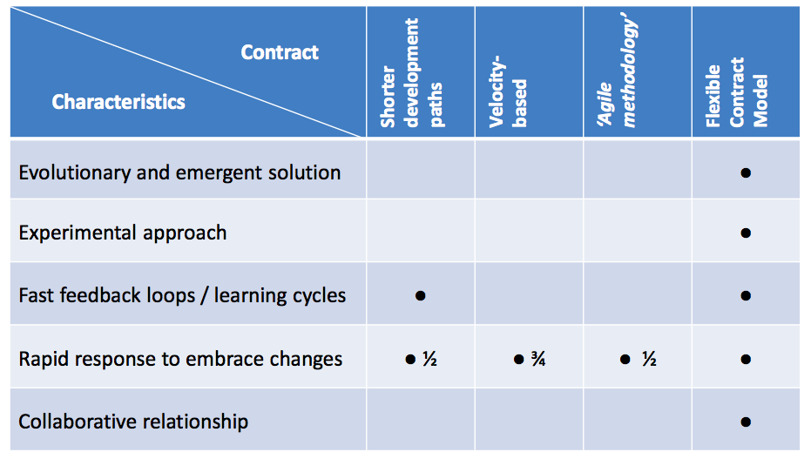
The Flexible Contract is more tuned in to agile
29 October 2014
Tom@Gilb.com
Notes:
The Problem with Agile & Contracts Agile Business Conference 9 October 2013
Susan Atkinson Keystone Law
Downloaded from
www.flexiblecontracts.com

Slide 42
Contract Templates available for free (Norwegian tuning needed)
29 October 2014
Tom@Gilb.com
Notes:
www.flexiblecontracts.com

Slide 43
WHAT IS A FLEXIBLE CONTRACT? These details are in the contract template
WHAT IS A FLEXIBLE CONTRACT?
A ‘flexible contract’ is an adaptive, outcome-based contract, which is intended to maximize the delivery of customer value. It achieves this in several ways:
The contract focuses on outcomes (that is, business objectives), which are less susceptible to change than output (such as features). By focusing on outcomes the contract also creates shared goals between the customer and supplier, which helps to align their interests and motivation.
The supplier is given the freedom to achieve the target outcomes in any way it deems effective as long as it honors the terms of the contract and stays within any constraints specified by the customer.
The fees (or at least part of the fees) should be payable on the achievement of target outcomes. The supplier is incentivized to achieve the target outcomes in the most cost-effective way, which is also of benefit to the customer.
The contract is structured as a master services agreement for the full version, or the ‘lite’ version using the Terms and Conditions, under which short-term statements of target outcomes (SOTOs) are called off. SOTOs work in the same way as a Statement of Work, but instead of ‘work’ in the form of outputs and activities, we measure outcomes achieved. The parties can respond to acquired knowledge and changes in the environment in subsequent SOTOs.
In respect of each SOTO the supplier addresses each target outcome by means of short feedback cycles. So the parties can learn rapidly what works and what doesn’t by measuring outcomes achieved progressively.
The contract adopts lightweight contractual provisions. This is made possible because the parties only commit to one SOTO at a time, so the financial exposure of the customer to the supplier is minimized. This in turn means that the contract is easier to understand and requires less administrative cost, both to create and to manage. The contract is deliberately NOT focused on the activities of the supplier or the technical processes by which this value is delivered.
29 October 2014
Tom@Gilb.com
Notes:
www.flexiblecontracts.com

Slide 44
WHAT IS A FLEXIBLE CONTRACT?
Define what you want, as you go, in small increments.
Learn what works
Focus on business results, not ‘code’
Pay for real value delivered
Prioritize high value results early.
Very low risk
Not tied in to suppliers who cannot deliver
WHAT IS A FLEXIBLE CONTRACT?
A ‘flexible contract’ is an adaptive, outcome-based contract, which is intended to maximize the delivery of customer value. It achieves this in several ways:
The contract focuses on outcomes (that is, business objectives), which are less susceptible to change than output (such as features). By focusing on outcomes the contract also creates shared goals between the customer and supplier, which helps to align their interests and motivation.
The supplier is given the freedom to achieve the target outcomes in any way it deems effective as long as it honors the terms of the contract and stays within any constraints specified by the customer.
The fees (or at least part of the fees) should be payable on the achievement of target outcomes. The supplier is incentivized to achieve the target outcomes in the most cost-effective way, which is also of benefit to the customer.
The contract is structured as a master services agreement for the full version, or the ‘lite’ version using the Terms and Conditions, under which short-term statements of target outcomes (SOTOs) are called off. SOTOs work in the same way as a Statement of Work, but instead of ‘work’ in the form of outputs and activities, we measure outcomes achieved. The parties can respond to acquired knowledge and changes in the environment in subsequent SOTOs.
In respect of each SOTO the supplier addresses each target outcome by means of short feedback cycles. So the parties can learn rapidly what works and what doesn’t by measuring outcomes achieved progressively.
The contract adopts lightweight contractual provisions. This is made possible because the parties only commit to one SOTO at a time, so the financial exposure of the customer to the supplier is minimized. This in turn means that the contract is easier to understand and requires less administrative cost, both to create and to manage. The contract is deliberately NOT focused on the activities of the supplier or the technical processes by which this value is delivered.
29 October 2014
Tom@Gilb.com
Notes:
www.flexiblecontracts.com

Slide 45
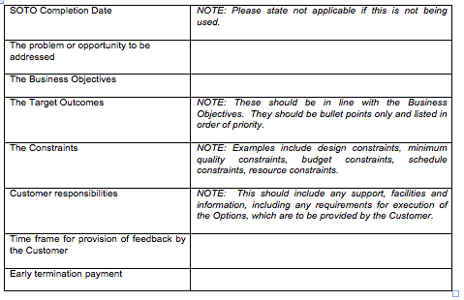
SOTO Specification (from contract template) short-term Statements Of Target Outcomes
29 October 2014
Tom@Gilb.com
Notes:
www.flexiblecontracts.com

Slide 46
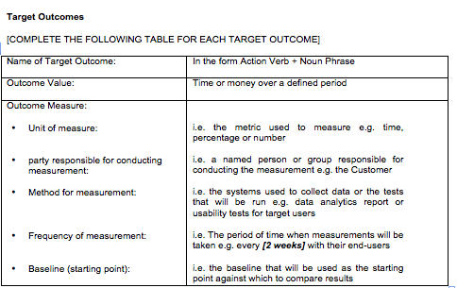
(from contract template)
29 October 2014
Tom@Gilb.com
Notes:
www.flexiblecontracts.com

Slide 47
4. by being lean: early, preventive

Slide 48
What is Specification Quality Control?
Specification Quality Control (SQC) is a method for ensuring specifications meet established quality goals according to objective, measured standards
SQC prevents poor-quality specifications from moving downstream
Specification Quality Control emphasizes
Cost and TTM reduction
Defect prevention
Resource efficiency
Early learning
Author confidentiality
Quantified specification quality
Specification: A written or electronic representation of information used to design, architect, construct, or test a system or its parts.
Copyright © 2014 Intel Corporation. All rights reserved. No part of this presentation may be reproduced without written permission of Intel Corporation.
Notes:
SQC is part of Competitive Engineering, along with Planguage, Impact Estimation (IE), and Evolutionary Delivery (Evo)

Slide 49
What is Specification Quality Control?
SQC is similar to traditional techniques for reviews, walkthroughs, and inspections, but has important differences and improvements:
SQC’s goal is to measure defect density, not to “clean up” the specification by finding every defect in it
SQC saves time by checking only samples of the specification rather than the entire thing
SQC focuses on major defects – those that will take at least 10x more to correct later than now
SQC follows a rigorous process with trained participants to help guarantee consistently good results
Specification Quality Control forms the backbone of an effective, efficient review structure
Copyright © 2014 Intel Corporation. All rights reserved. No part of this presentation may be reproduced without written permission of Intel Corporation.

Slide 50
SQC At a Glance
Initial
Review
Periodic Additional Reviews
Final
Quality
Assessment
…
0%
(Rev 0)
100%
(Rev 1)
Specification Completeness
Specification Quality Control consists of a series of short, intense reviews that measure the defect density of a specification
Copyright © 2014 Intel Corporation. All rights reserved. No part of this presentation may be reproduced without written permission of Intel Corporation.

Slide 51
SQC is Data-Driven
SQC tracks defect density over time to ensure good quality in the work products:
Process failure
Defect Density
Acceptable quality
0%
(Rev 0)
100%
(Rev 1)
Specification Completeness
Early evidence of specification quality allows for timely corrective action, before rework costs go unbearably high
Copyright © 2014 Intel Corporation. All rights reserved. No part of this presentation may be reproduced without written permission of Intel Corporation.

Slide 52
Example
A team in Client BIOS used SQC to reduce requirements defect density by 98% over six cycles:
20
Defect Density
10
1
0.0
0.3
0.5
0.6
0.7
0.8
Rev 1.0
This effort had significant benefits to downstream work, including improved productivity, time to test, and customer quality
Copyright © 2014 Intel Corporation. All rights reserved. No part of this presentation may be reproduced without written permission of Intel Corporation.
Notes:
Defect density decreased from 10 majors per page of requirements at revision 0.3 to 0.22 defects per page at revision 1.0. More details of this work are found in the SQC Case Studies module.

Slide 53
SQC Review Cycles
Each SQC review cycle follows the same simple process:
9. Identify causes
1. Identify checkers
8. Decide actions
2. Select rules
7. Analyze results
3. Sample specification
6. Report results
4. Instruct checkers
5. Check sample
Typical time investment for one cycle: 60-120 minutes, depending on sample size
Copyright © 2014 Intel Corporation. All rights reserved. No part of this presentation may be reproduced without written permission of Intel Corporation.

Slide 54
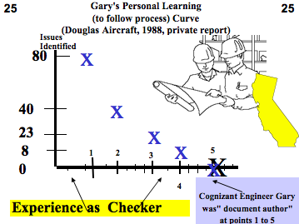
We saw that the individual defect rate went down by about 50% every time a new drawing was Inspected for an individual engineer.

Slide 55
A Recent Example
Application of Specification Quality Control by a SW team resulted in the following defect density reduction in requirements over several months:
Rev. | # of Defects | # of Pages | Defects/ Page (DPP) | % Change in DPP
0.3 | 312 | 31 | 10.06
0.5 | 209 | 44 | 4.75 | -53%
0.6 | 247 | 60 | 4.12 | -13%
0.7 | 114 | 33 | 3.45 | -16%
0.8 | 45 | 38 | 1.18 | -66%
1.0 | 10 | 45 | 0.22 | -81%
Overall % change in DPP revision 0.3 to 1.0: |  |  |  | -98%
Downstream benefits:
Scope delivered at the Alpha milestone increased 300%, released scope up 233%
SW defects reduced by ~50%
Defects that did occur were resolved in far less time on average
Notes:
I’ve asked the team, and there were no explicit numeric quality levels enforced for the interim versions or the final version. This case, which was the particular team’s first foray into SQC, it was seen as an experiment with the technique. The results, even after a few revisions had been completed, were so strong that no one bothered to make explicit levels known. They just kept doing what they were doing, with the goal of not reverting to poorer quality than the previous iteration. The team relates they were comfortable with the quality levels after “a couple” of versions had been reviewed.
Start to finish, the table you have represents about 13 months of work.
BTW, I see this phenomenon in many teams here with SQC. The first pass reduced defect density by at least 50%, and after that, teams just continue to perform it without trying to predict a numeric target a priori. I think they get indirect feedback on the quality and completeness of the requirements from places like architecture teams and planning forums, and that evidence is more tangible to them than any numeric target. I suspect that with more time and practice, that pragmatic notion of “good enough” will be correlated with numeric density, and then we’ll see more targets established up front.
In my work, teams typically exit with densities ranging from 5 majors per page (600 words) to 1 defect in a couple of pages. The final density in John’s case study is particularly low; the best I have seen here so far. But it’s interesting that the teams don’t set numeric targets and then gun for them. They seem to rely on the use of the data and its reception in stakeholder groups for applied work to judge true quality.
But that gives me (and my colleagues) food for thought. We need to consider placing some sort of targets in place that are justified by how the requirements are used.
Thanks,
e
From: Tom Gilb [mailto:tomsgilb@gmail.com] Sent: Wednesday, November 02, 2011 4:04 PM To: Simmons, Erik Subject: Exit
can you tell me what exit levels were in force for the case
over what time period were the 0.2 0.x to 1.0 done

Slide 56
Prevention + Pre-test Detection is the most effective and efficient
100%
Use
95% cumulative detection
by Inspection (state of the art limit)
90%
80%
Test
70% Detection
by Inspection
70%
"Detected
Cheaply"
<- Mays 1993, 70% prevented
\
50%
"Prevented"
<-Mays & Jones 50% prevented(IBM) 1990
1
2
3
4
5
6
Prevention data based on state of the art prevention experiences (IBM RTP), Others (Space Shuttle IBM SJ 1-95) 95%+ (99.99% in Fixes)
Cumulative Inspection detection data based on state of the art Inspection (in an environment where prevention is also being used, IBM MN, Sema UK, IBM UK)
These slides are at
http://www.gilb.com/dl821
19 August 2014
Copyright Tom@Gilb.com 2014

Slide 57
IBM MN & NC DP Experience
2162 DPP Actions implemented
between Dec. 91 and May 1993 (30 months)<-Kan
RTP about 182 per year for 200 people.<-Mays 1995
1822 suggested ten years (85-94)
175 test related
RTP 227 person org<- Mays slides
130 actions (@ 0.5 work-years
34 causal analysis meetings @ 0.2 work-years
19 action team meetings @ 0.1work-years
Kickoff meeting @ 0.1 work-years
TOTAL costs 1% of org. resources
ROI DPP 10:1 to 13:1, internal 2:1 to 3:1
Defect Rates at all stages 50% lower with DPP
Research
Triangle
Park
These slides are at
http://www.gilb.com/dl821
Copyright Tom@Gilb.com 2016

Slide 58
5. by using
scale free methods:
scale does not matter

Slide 59
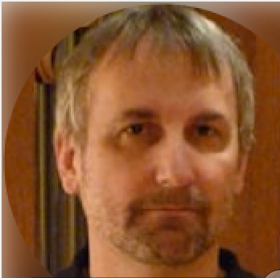
Erik Simmons, Intel Scaling
I’m deeply interested in scale-free practices.
I’m also interested in specific practices tuned to large, small, complicated, and complex projects,
but I find particular power in scale-free practices.
Your work for decades has been focused on a very good set of these.
SQC, for example, works on any size specification. It does not (need to) scale.
SQC: (Specification Quality Control).see next slide
BTW, I think the agile principles are also quite scale-free. But most Scrum practices are definitely not.
So, perhaps you can chart a better course by advocating for use of scale-free core practices,
augmented with a set of specific, tailored practices
that are effective for the size of the project in question.

Slide 60
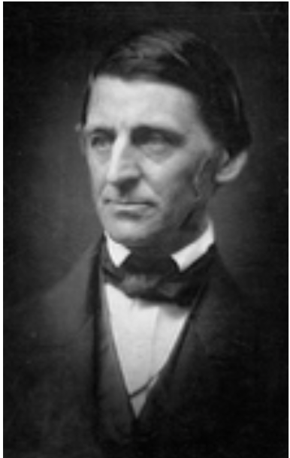
Scale-free Principles
Keep focus on measurable delivery of critical values and their costs. [3, 4, 5, 6, 9, 10, 12, VP (20) Part 1, VP 10.6 ]
Deliver value early, quickly and regularly: in roughly 2% increments. [14, 11, VP Ch.4, 2, 5 ]
Do NOT focus on code delivery; focus on overall system value and costs. [ VP Ch.4, 10D, 10F, 13, VP 3.4, VP 2.10, VP 9.8, 4, 12]
Focus on quantified critical stakeholder values. [19, VP 3.4, VP 3.7, VP 3.9, VP 3.10 VP 4.2, 10 ]
Synchronize all teams in terms of measurable value delivery. [VP 3.3, VP 3.4, VP Part 1, VP 3.6, VP 3.8, VP 8.4 , 11, 12, 13 ]
Solve big problems through ingenious architecture; not through coding faster. [VP 4.5, VP 5.1, VP 5.3, VP 7.2, 15 ]
Decompose the large problems by incremental value deliveries: not code deliveries. [7, VP Ch. 5, VP 5.1, VP 5.6 , 10, 11, 13, 15]
The software component needs to be integrated into the total system of hardware, data, people, culture. [ VP 5.2, 10 ]
If your team cannot deliver small increments of real value early, frequently, and predictably; they are incompetent and need to be abandoned for those who can deliver. [7, VP 2.8, 10]
Never commit to contacts for work done or code delivered alone: there must always be a sufficiently large contractual protection, of paying for measurable value delivered. [12, 15 ].

Slide 61
Methods
Quantification of Values [10, VP 1.1].
Quantification of short term and long term costs [VP 3.4, VP 4.5, VP 6.7 ].
Design to Cost: Top Level Architecture [ VP 7.9, 10 ].
Dynamic Design to Cost: Each Delivery Cycle [12 C, VP 4.5, VP 2.5, VP 2.3, 5, 10, 12 ].
Quality Control of Plans, Contracts, Code and all written artifacts [VP Part 2, VP Part 4, VP 7.7 ].
Flexible Contracting [12, VP 4.5].
Value delivery Cycle Measurable Feedback, Learning and Change [4, VP 7.3, VP 9.8, VP 6.7, VP 8.6, 2, 9, 10, 11, 14 ].
Value Decision Tables (Impact Estimation Tables) [9, VP 2.3, VP 4.4, VP 5.3, 13 ].
Risk Management in all aspects of planning and Management [ VP Ch. 7], 12.
Intelligent Prioritization Policies: for short term and long term [ VP Ch. 6, 12, 13, 14].

Slide 62
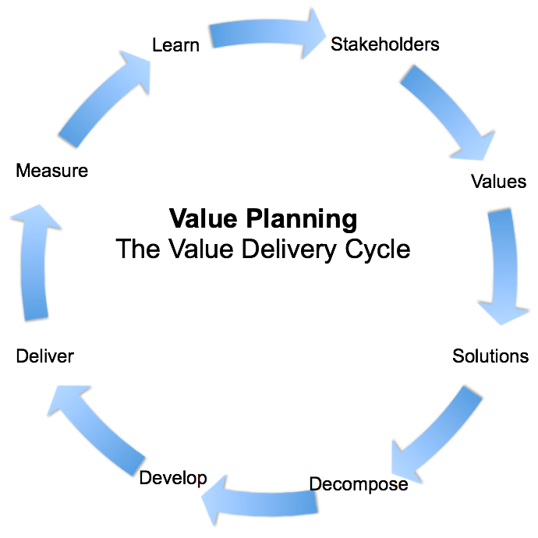
Value Planning Cycle = ‘Evo’
Cycle of Value delivery of any size project
7. Value delivery Cycle Measurable Feedback, Learning and Change [4, VP 7.3, VP 9.8, VP 6.7, VP 8.6, 2, 9, 10, 11, 14 ].

Slide 63
Top Level View of Any Size Project
a Model of Relation between
Requirements and Architecture
8. Value Decision Tables (Impact Estimation Tables) [9, VP 2.3, VP 4.4, VP 5.3, 13 ].

Slide 64
Engineering Tools
The Planning language: ‘Planguage’ [ 22, VP, 8, 9].
The 111111 Decomposition Method [7B, 7C, 3 ].
Flexible Contracts [12 ].
The ‘Needs and means Planning’ tool [16, 9 ].
Quantification of Values processes: Scales, Meters, Past, Tolerable, Wish, Goal. [VP 10.7 ].
The Agile Spec QC measurement process, Exit Processes, Rules [VP 10.4, VP Part 4 ].
Multiple Relationship Management technology [9, VP Ch.3, VP Ch. 6, 13 ].
Continuous Architecture adjustment based on delivery cycle feedback (Cleanroom) [ 5, 14, 8].
Graphic Visibility of Values, Costs, and Risks [16 ].
Design to Cost Practices: initially and continuously [14, 12 C, VP 4.5, VP 2.5, VP 2.3, 5 ].

Slide 65
My Own Project Development Process:
delegation of design to implementors and programmers
Competitive Engineering: Book 2005
http://tinyurl.com/CEset2015
Is a dropbox set of Full Glossary
Chapter By Chapter pdfs and full pdf
Make developers responsible
for delivery of the ‘quantified’ critical requirements levels
(Performance, Qualities, cost, deadline)
Give them the freedom to decide the ‘right’ designs
With immediate responsibility to measure that they are delivering the results
Get the ‘unprofessional’ users and customers ‘off their backs’
Avoid receiving features and stories; avoid ‘architecture from managers’.
which are usually amateur design, by people who have no overview or responsibility or design ability (users and customers, and managers)
Elevate your talent by becoming a real ‘software ENGINEER’
With coding-expert craftsmanship, as your basic talent
Cases and real examples
‘Value Driven Project Management’ slides
Includes ‘Confirmit’ Case, slide 70 on.
http://www.gilb.com/dl152
These slides are at
http://www.gilb.com/dl821
19 August 2014
Copyright Tom@Gilb.com 2014
Notes:
A Chinese scholar was lecturing when all the lights in the auditorium went out. He asked members of the audience to raise their hands. As soon as they had all complied, the lights went on again. He then said, "Prove wisdom of Old Chinese saying: 'Many hands make light work."
http://eeas.europa.eu/delegations/un_geneva/press_corner/focus/events/2013/20130226_hrc22_poew.htm
In "Women's Hands", an artwork by the artist Clara Garesio, was handed over by the EU Head of Delegation Mrs. Mariangela Zappia to the UN Office in Geneva, represented by the Director-General Mr. Kassym-Jomart Tokayev. The three diameter round-shaped colourful piece of art will be permanently located close to the room of the UN Human Rights Council. As Ambassador Mariangela Zappia said: "It is a special day for the European Union - as we offer the very first donation to the United Nations - and it is special for me as a woman since this beautiful piece of art is about the beauty, the simplicity and strength of women as positive transformative forces of our societies."
Old joke
Many Hands make light work

Slide 66
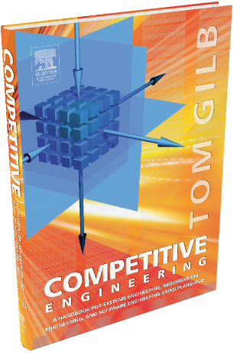
Conclusion
We need to take these scale-free engineering ideas seriously
if we are to get better control over large-scale software and systems engineering projects.
The ideas have serious practical international experience,
and can be tried out one-by-one.
They can be added to any other practices, that are, or will be successful for you,
They are free ideas.
‘This stuff works!”
(Erik Simmons, Intel, [22, 25])
Experience 1999 to 2016 for 20,000 engineers
Just do it!

Slide 67
end of 45 minute talk
if you cannot afford the cheap version of
leanpub.com/ValuePlanning
or the discounted copy
Value Planning (digital manuscript)
https://www.gilb.com/store?tag=books
Purchase Offer Coupon Code: VP20 (€20 off)
Then I’ll send you a free copy if you promise to read it in a month and send me a review
tom@gilb.com
Russian and german editions available
leanpub.com/ValuePlanningDeutsch
leanpub.com/valueplanning russian
Weekly Blog (Based on Value Planning book): www.Gilb.com/blog
Weekly Principles Videos (free first 4)
https://www.gilb.com/p/principles
See my TEDx Talk Quantify the un-quantifiable
Check out the Value Requirements Workshops in Linz, London, Amsterdam
Free London BCS courses

Slide 68
below is a set of slides which go deeper into handling complexity than we can deal with in the 45 minutes. but I include them for advanced study.
They are based on my paper
CONFRONTING WICKED PROBLEMS:
and some Planguage Tools to deal with them.
http://www.gilb.com/dl866

Slide 69
WICKED PROBLEMS ARE POSSIBLY SIMPLE; IF YOU KNOW HOW
Tom’s Personal View of Evil
23 June 2016, GilbFest

Slide 70
“CONFRONTING WICKED PROBLEMS:
and some Planguage Tools to deal with them”
BASED ON T GILB PAPER
10 January 2016,
gilb.com/dl866

Slide 71
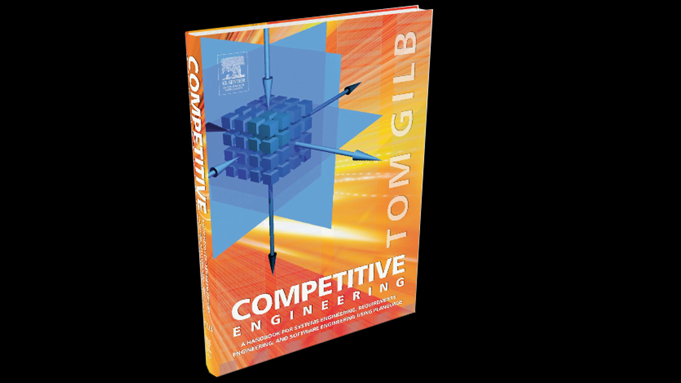
How Planguage Tools
Help Whack Wickedness.

Slide 72
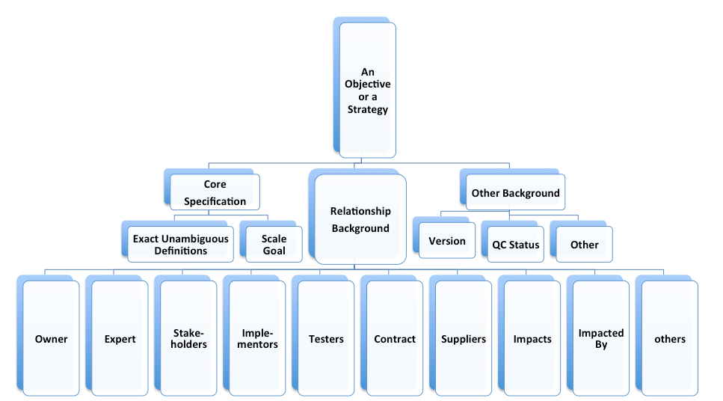
W1. There is no definitive formulation
of a wicked problem.
Planguage (The Planning Language) does not need or expect a ‘definitive formulation’ of a problem.
Planguage allows you to specify any set of problem statements (value objectives, constraints, assumptions, constrained strategies, budgets, deadlines, stakeholders) that might be useful.
They can all be modified at any time. They can be versioned. They can be officially sanctioned or approved, until further notice. They can be quality controlled. The quality , relevance, correctness and usefulness of any class of problem statement can be gradually enhanced.
Problem statements can easily be integrated with each other, and their relationship to solutions (strategies, designs, architectures) can easily and automatically be mapped and tracked.
Problem statements can be directly and measurably related to emerging value delivery, and costs: giving real time feedback to the planning model.
A rich set of background specifications is expected and encouraged for all problem statements. These include such items as issues, assumptions, constraints, sources, evidence, risks, stakeholders, and very much more [VP 2.2, 3.1, 4.2 for detail].
The background specification for a problem statement (like an ‘objective’) does not change the core problem specification. But it enables us to sense the larger and more complex relationships involved (for example multiple risks and stakeholders for every single problem statement).
Background specification triggers and motivates us to analyze deeper and improve our view or model of the problem space.

Slide 73
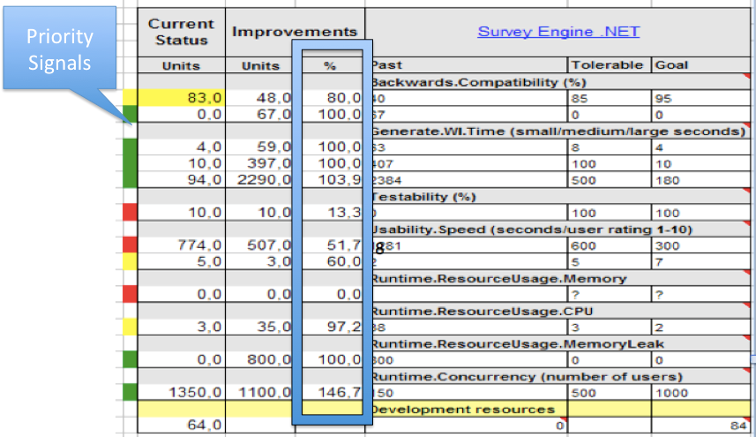
W2. Wicked problems have no stopping rule.
Planguage makes no assumptions about stopping a development, or the existence of a ‘final state’.
Planguage assumes that the systems it is planning for, already have a life in the real world, and will continue to have a life for the foreseeable future.
Planguage is all about high-priority incremental improvement, towards the current long-term objectives, using resources actually available.
The Planguage planning process is merely a tool for keeping track of concerns, and solution ideas.
The tool is used to keep track of the current state of the system, from any interesting, and all useful emerging, multiple viewpoints.
Planguage assumes conflict and change are normal, and natural: and tries to make the best decisions in that light.
The nearest thing we have to ‘stopping rules’ (knowing when to quit planning, or investing in change) are locally formulated policies, such as:
Stop when the next cycle of change is not profitable enough (VP 4.7, 5.9). Stop when no credible solutions are on the table. (VP 4.9, 4.8, 5.8) Stop when planned results have repeatedly not been delivered (VP 4.5).
W E Deming taught me that the Plan Do Study Act cycle (PDSA) was expected to continue, ‘as long as there is competition’. We do not think in terms of any ‘big stop’: just focus on smart prioritization.
Planguage is unusually quantified regarding problem statements (VP Part 1, Chapter 1). All values and qualities are normally quantified. No management BS allowed [10].
So the quantified worst-case levels,and target levels of a desired value, give us a very specific device to know when to stop: when to stop planning, when to stop inventing, when to stop delivering improvements, when to stop and NOT deliver changes at all.
Planguage has a rich variety of tools and specifications for stopping, when that is appropriate. For a rich variety of reasons and conditions. But it has a ‘lust for life’ to try to keep delivering value to stakeholders. And it makes that possible by quickly stopping low-priority activity. (VP Chapter 6).
Your own culture needs to decide on your own values and priorities regarding when to stop and go.
Planguage has rich built-in specifications that even automatically point out red lights and green lights. Planguage specifications can compute what to prioritize (Green) and what to stop (Red Light). (VP 6.7 )

Slide 74
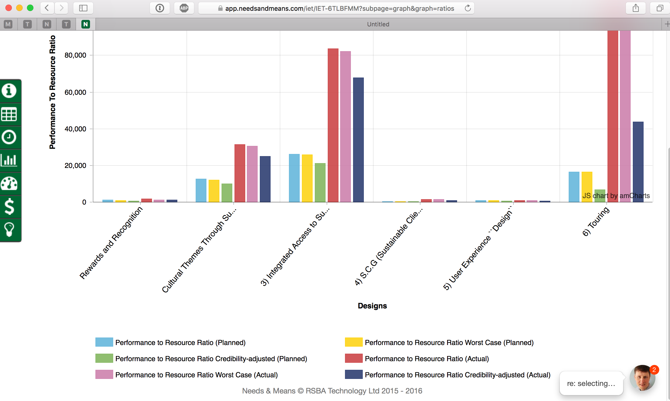
W3. Solutions to wicked problems are not true-or-false, but good-or-bad.
Planguage has no preconceived notion that solutions are ‘correct or good’ or not. It explicitly recognizes that: • Problems (objectives, constraints) are the best currently available subjective stakeholder compromise. • Problem specification is subject to constant change pressure.
• Solutions (strategies, architecture) are the best available ‘hypothesis’ as to how to solve a set of problems (‘solve’ = delivery sufficient [Target level] overall value delivery, within constraints,
at lowest budgeted resource costs; with regard to risk-of-deviation from expectations (estimates). The degree of solution ‘goodness’ is directly related to the current problem specification.
• The degree of goodness is numerically computed in the Planguage tool ‘Impact Estimation table” (sample IET in above VP [8] Figure 6.7). This can be supported by automation as in the example below.
I conclude that Planguage is well suited to this ‘good or bad’ aspect of Wicked Problems.

Slide 75
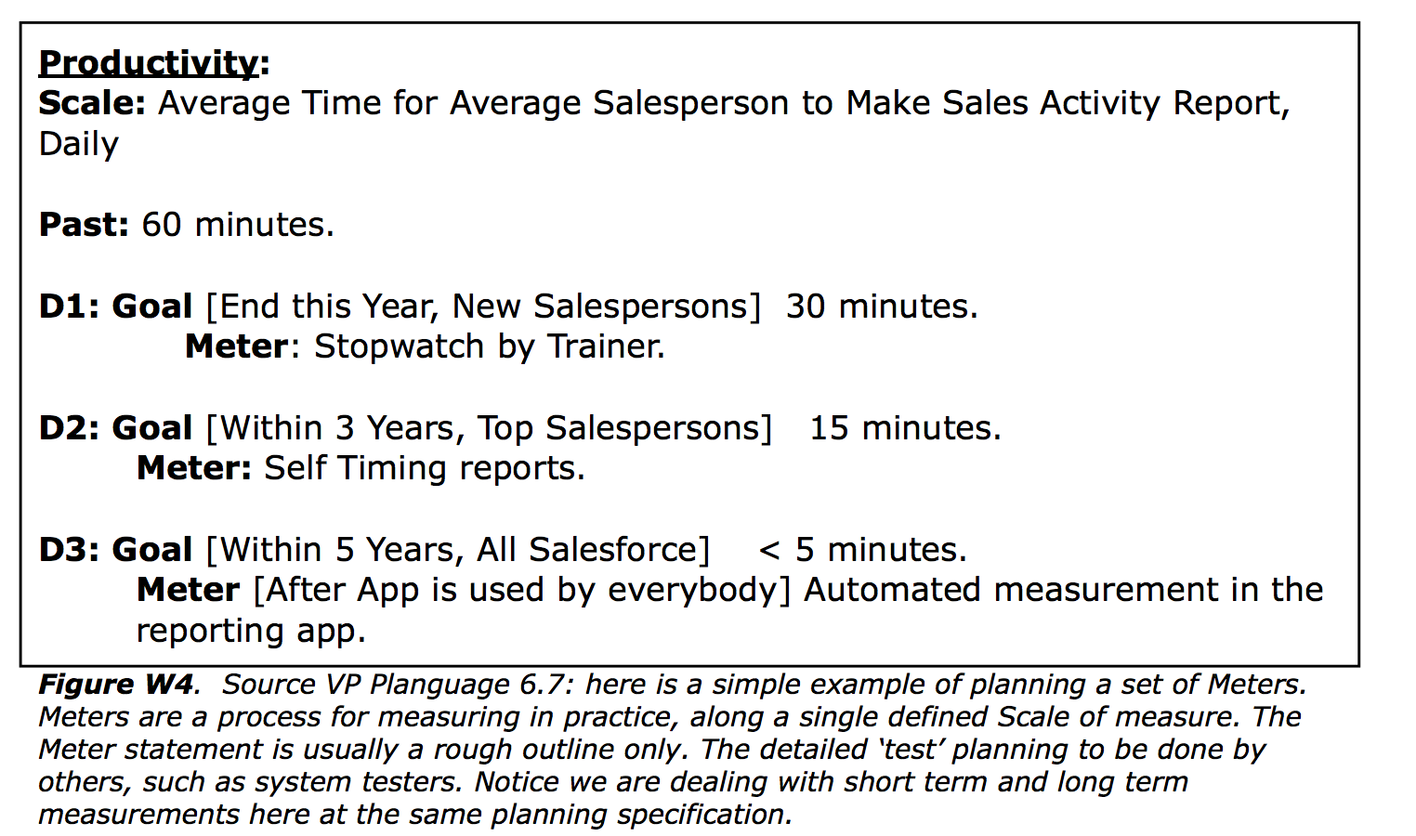
W4. There is no immediate and no ultimate test of a solution to a wicked problem.
This problem is not particular for Wicked Problems. It applies to all problems, all efforts, all changes. Butterfly Effect: the sensitive dependence on initial conditions in which a small change in one state of a deterministic nonlinear system can result in large differences in a later state. It is tough to make predictions, especially about the future (Yogi Berra et al).
In Planguage, using the Project management subset ‘Evo’ Value Delivery [7], we do in fact measure, in the short term (typically weekly, as in Confirmit example above [Figure W2], the impacts on all the critical factors that interest us.
In this Confirmit case, we estimate and later measure on a set of critical top level Performance Values, and we estimate and later measure time and effort needed to do the change.[See VP [8] Section 8.6 Getting early short-term feedback.]
Later, for example at quarterly release, addition measurements are made. This takes into account the changes made after the earlier changes. It accounts for the parallel changes made by other teams. it typically is more sophisticated testing and measurement (pre release to world market).
After a release of changes we can continue to measure the factors of interest, as they affect real world users of a system. We can certainly expect feedback if they are unhappy!
Finally, in the next round of changes, the critical performance values will again be measured, as demonstration that they have held up, or not, over time.
We do not need ‘ultimate tests in infinite time’. We need to keep reasonable track of reality in a cost effective manner, and Planguage [Evo] gives us rich numeric opportunity to do so.
All critical problems (of improvement) are always quantified in Planguage, or at least ‘testable’ for presence: that is the basic idea of Planguage.
Reasonable and sufficient measurement and testing is invariably possible.

Slide 76
W4 (continued) I believe one central reason that ‘Wicked Problems’ appear to be so wicked, is because we have such a poor culture of quantification of critical factors.
Words and ‘poetry’ (‘state of the art competitiveness’, ‘end world hunger’) substitute for clear thinking and clear problem specification.
This quantification, and background clarification, does not itself, and alone solve the problem central to Wicked problems (the very complex and voluminous nature of real systems).
But lack of quantification of critical system performance problems makes even short-term and real- time understanding of the problem impossible. But that is NOT a Wicked Problem; it is simply our professional incompetence.
We then falsely blame our lack-of-understanding on the ‘system complexity’: when we in fact have not even taken very basic steps to clear the fog in front of our faces (to quantify critical variables).
In conclusion:
1. we can normally get immediate and continuous, tests and measurements, of solutions, in relation to clear problem statements, if we want them.
2. we do not need to worry about unrealistic ideas like ‘ultimate test’ of a solution.
‘Ultimate tests’ would be nice, of course, but they are not necessary, and they are never possible in the real world.

Slide 77
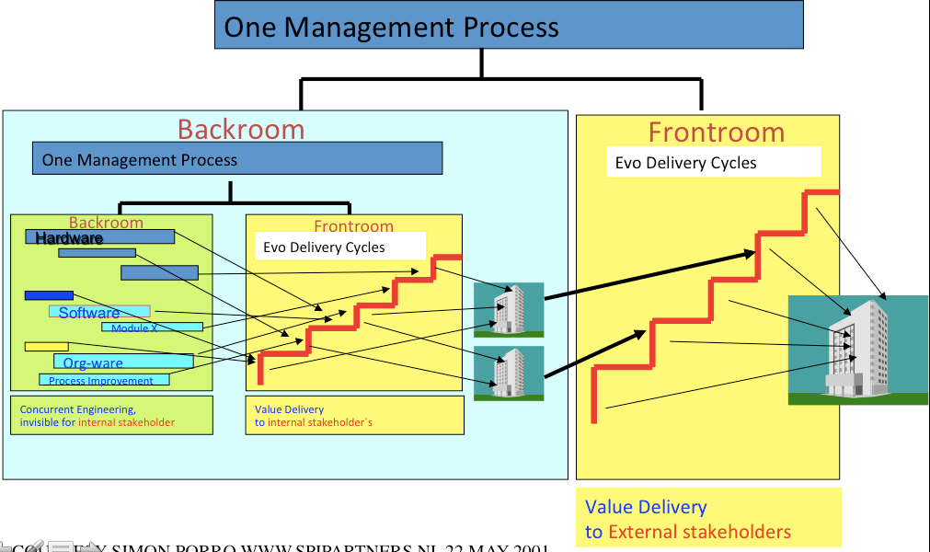
W5. Every solution to a wicked problem is a "one-shot operation"; because there is no opportunity to learn by trial-and-error, every attempt counts significantly.
This is another example of a possibly ‘artificial’ problem which is not inevitably inherent in complex systems.
It might be, but another possibility is that the planner has simply not learned to decompose ‘big strategies’ into smaller, deliverable and possibly retractable ‘experiments.
I view this widespread inability do decompose big strategies as ‘professional incompetence’. The incompetence is caused by lack of knowledge, and training, in decomposition.
Notice that decomposing solutions into simple experimental components is fundamental to both scientific experiment and to engineering. And there are some very big hairy problems they tackle. Think ‘Space’ and ‘Universe’.
Planguage tries to deal with this problem of decomposition, at length, with constructive and teachable methods. [8, Evo. and VP Chapter 5. Decomposition (by value, by responsibility) page 363 to p. 415].
Imagination, intelligence, experience, motivation will allow professionals to figure out how to decompose. I had to learn it by practical experience over decades. But most professionals have not learned such methods explicitly. Half of them are in illogical denial (it ‘cannot’ be composed). So it is time to teach the methods, rather than hope people will figure it out in a few decades, personally.
I conclude that some problems appear more ‘Wicked’ than they really are, because people are not trained in decomposition methods, which would allow us to avoid the ‘every attempt counts significantly’ problem.

Slide 78
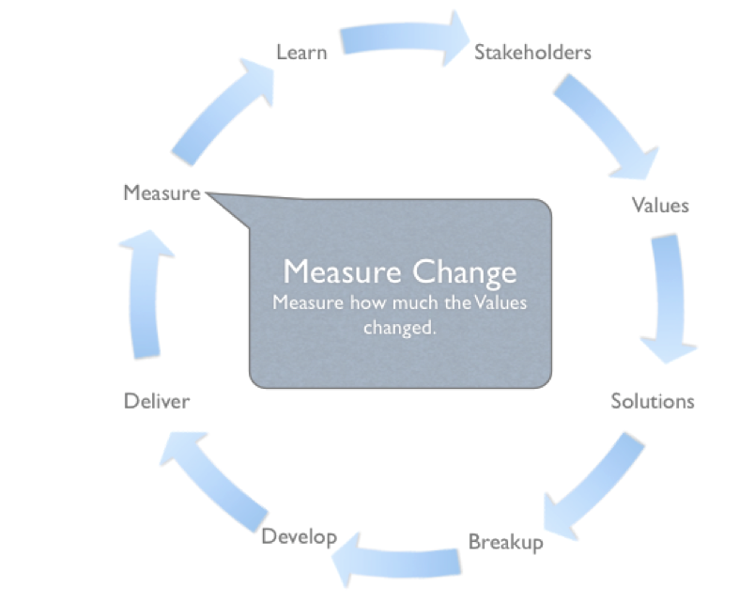
W6. Wicked problems do not have an enumerable
(or an exhaustively describable) set of potential solutions,
nor is there a well-described set of permissible operations
that may be incorporated into the plan.
Well, with this point of view, absolutely all real life problems, about people, culture and technology are ‘Wicked’. Again this is an unnecessary and unrealistic expectation (‘exhaustively describable’) to real world problem solving.
Unrealistic and Unnecessary:
Even in chess, where the solution space is theoretically exhaustively describable using a computer, there is a time limitation, and even a constraint n real players not using computers in real play. There is too often far too many combinations of play. And this is irrelevant, as long as you either win, or sometimes ‘draw’. You do not need all possible solutions, you need a ‘pretty good’ or ‘good enough’, on time, to meet your deadline (chess clock).
Planguage as a planning tool has a large number of tools to support this concept of ‘good enough, on time’. We will explain a few, as a sample of the toolset.
The first concept is what we call a ‘scalar constraint’. It is used in problem formulation. For example “The room temperature must be at least 15 degrees C”. One Planguage term we use is to call this a Tolerable Level of theValue.
So if at least one potential solution, to the temperature problem are estimated to give us ‘at least 15 degrees C’, then the solution is theoretically sufficient. There is not need to look for 1,000+ other possible solutions. This logic is built into the Impact Estimation table in Planguage. And you se it in Figure W4 above. If the level delivered is at or above the Tolerable level, we get a ‘yellow’ light signal. The solution is ‘sufficient’, to meet minimum requirements.
In the next stage of deciding we have enough solutions, we ask in Planguage is the solutions will potentially (later when applied, ‘really reach the target levels) reach our Target levels (a formal numeric definition of success and sufficient problem solving). If any set of solutions will reach our success, sufficiency, levels that there is hotpoint is considering the entire solution space exhaustively. That would cost far more than any benefit. it would delay delivery of benefits to the real world in good time. it is silly to even hint that this is ‘necessary’, to exhaust the solution space at all. Can we use common sense here , please?
of course the above explanation is a simplification, to show the principles involved. Even fairly simple (not especially Wicked) problems require us to think about many other factors, when considering if we have explored the solution space sufficiently. For example costs, interaction between solutions, changes in the stakeholder space, poor implementation of otherwise theoretically good solutions, and much more. I can assure you that these factors are all systematically considered, and we have tools for them built into basic Planguage.
See for yourself. VP Part 1 to 5 (50 pages, free book sample [8,]) and really most detailed in the larger books [8, 7]
Wicked Problems
I conclude that this ‘Enumerable Solutions’ Wicked Problem characteristic [W6] is artificial, academic theory, of no practical use in the real world. A waste of time to worry about at all. The real problem is finding sufficient for defined purpose solutions.

Slide 79
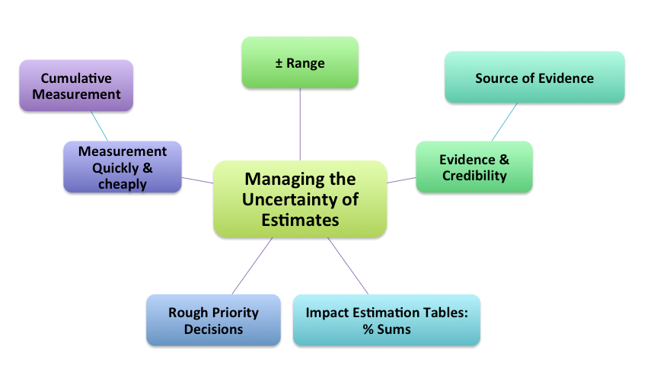
W7.1 Every wicked problem
is essentially unique.
‘Wickedness’: needs an improved definition.
Again, I am getting a bit tired of the fact that these Wickedness characteristics are not especially for ‘Wicked’ problems. Maybe I need to define ‘Wicked’ to my own satisfaction?
One immediate thought is that ‘Wickedness’ is not about the problem itself. It is the combination of ‘the problem’ and ‘the methods-we-know-about; and are willing to use to deal with the problem set’.
And maybe, we need to include, some other factors like resources, constraints and motivations.
The essential ideas are that it is about our real-life current ability to solve the problem; not about the problem itself. Maybe Wicked projects’, or ‘Wicked processes’ (eternal cycles) better capture what we are dealing with here.

Slide 80
W7.2 Every wicked problem
is essentially unique.
‘ Uniqueness is the norm. ‘Identity’ is an impractical
ideal.
Let us bring in ‘obvious common sense’ again.
Surely absolutely every problem we humans deal with is in some senses unique.
So what. Absolutely identical problems are not really very interesting. The implication of W7 is that if the problem were identical, we might know the solution. So what?
Identical problems, that have already been successfully solved, do not guarantee that the solution used is known, or knowable to us - in time. An earlier solution may be secret, hidden, undocumented, or even misunderstood (what the real solution was, as opposed to a publicly documented solution).
Anyway, nothing is really identical. And we need to find workable solutions if possible anyway. And it does not really matter if there was another known solution that worked once. it may be easier for us to just ‘get something to work’, and move on, than to research, at unknown costs and success of finding it, the ‘real solution used in the past by someone’.
Planguage has no such notion as identical problems, and corresponding solutions. Why waste time asking if there is an ‘identical problem’, anyway. Focus on solving the problem.
Planguage does have well-articulated concepts of asking for evidence of past values and costs for any proposed solution [ VP Part 2, 4.4]. The solutions and problems are never identical. We know that. But they do not have to be identical. Just good enough.
We are not trying to be identical, but we are trying to improve the probability that we will discover, prioritize, use, and measure - pretty good solutions quickly.

Slide 81
W7.3 Every wicked problem
is essentially unique.
In conclusion:
‘Unique problems’ is not a useful concept.
It is not a clear and useful distinguishing characteristic of a problem.
‘Uniqueness of identical problems’ is not a helpful concept.
We need to
focus on finding a solution stream,
cumulating to a useful potential set, of solutions:

Slide 82
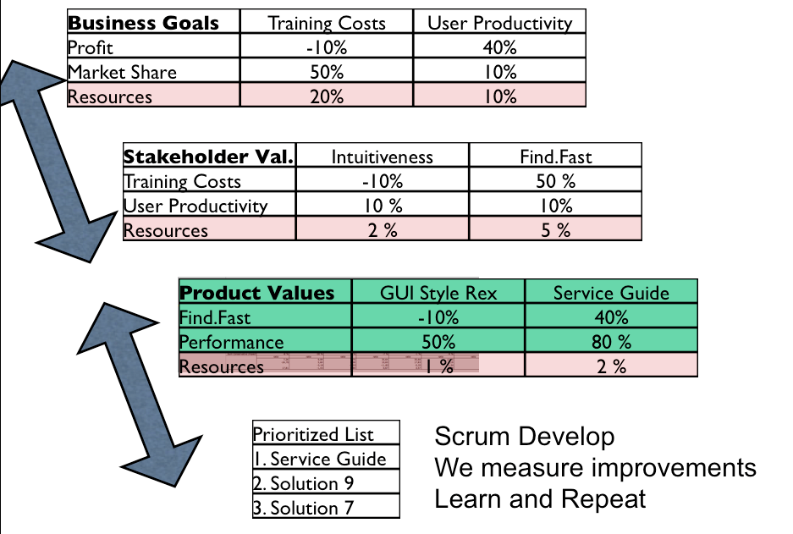
W8.1 Every wicked problem can be considered to be a symptom of another problem.
Again, we do not need to bring in ‘Wicked’ at all.
Every problem is a symptom of another problem.
That is just the way things are at any level of complexity.
My boss’ solution becomes my problem, and my solution becomes my teams problem.
Planguage explicitly acknowledges many related levels of concern.
Stakeholder levels.
Planguage ties these related stakeholder levels together, in a variety of ways.
The most interesting method in Planguage is using Impact Estimation tables to model, quantitatively, the relationships between any set of problems: any above, any below, or any sideways stakeholder levels.

Slide 83
W8.2 Every wicked problem can be considered to be a symptom of another problem.
1practical application of this was by Kai Gilb at the Transport Company ‘Bring’ [11].
Figure W8. [11] in order to save a large IT Scrum project that failed initially, (the new system drastically killed sales!). Kai modelled the (obviously, ‘it failed’) ‘wicked system’. He built one Impact Estimation Table (aka Value Decision Table) for the top level of the Bring (Norwegian Post Office essentially) organization. This succeeded to resurrect the system, because it mapped the connection between technology and the higher levels of organizational objectives. The IT Development team was then instructed to focus on developing things that led to business (sales!) success. An extremely simplified example is above [For more detail see 11].
Business Goals: The top management stakeholder level has problems, like Increase Profit and Market Share. Solutions have been identified (reduce Training Costs, and improve User Productivity). The expected, estimated, impact of these solutions on the (elsewhere, see Figure W4 for ‘how it looks’) quantified Problems, is given by the numbers estimated (later ‘measured as a result) at their intersection. For example Training Costs reduction, if the solution works as expected, promised to move us 50% of the way towards our Market Share objective (the Problem,
Stakeholder Value: These solutions become the the Problem at the next level. The Stakeholder level. Think of these as the 30 or so individual transport companies that had been bought and merged to form Bring. It looks like the Solution named ‘Intuitiveness’ is estimated to contribute 10% of the progress we need towards the User Productivity problem objective. All objectives are, of course, quantified, elsewhere.
Product Val.: At the third level (Product Values), ‘Find.Fast’ (one of the Stakeholder solutions, is considered an IT System objective (a problem statement).
It looks like ‘Service Guide’ is a solution that is expected to contribute 40% towards the ‘Find.Fast’ Problem solution. And ‘Service Guide’ also is expected to contribute 80% towards a Performance problem.
Scrum Level: The Service Guide solution will be developed and implemented by the Scrum Team. Hopefully its impact will be approximately as expected, and will impact several levels up towards the Business Goals.

Slide 84
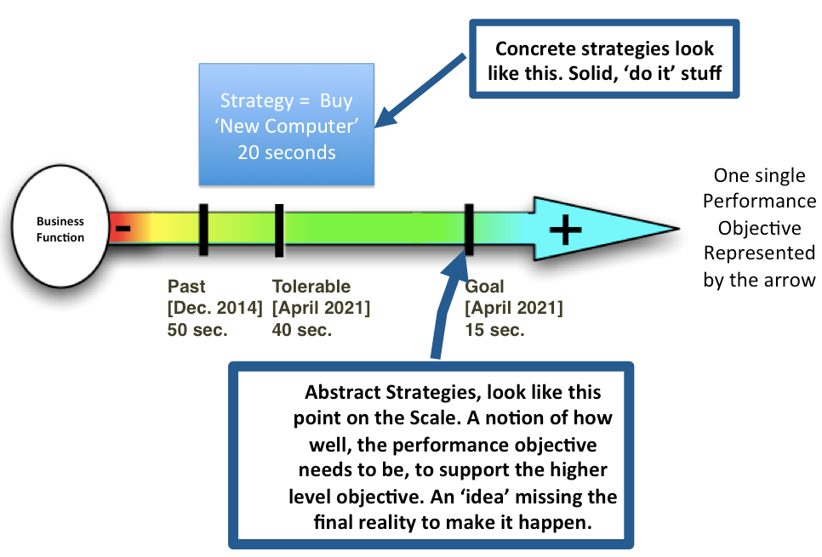
W9.1 The existence of a discrepancy
in representing a wicked problem
can be explained in numerous ways.
The choice of explanation
determines the nature of the problem's resolution.
This is confusingly written up in the literature [1]. Let me try to suggest what it means.
If there is more than one way any people can identify, to solve a problem,
that alone allows you to classify the problem as ‘wicked’. (W9 says)
The actual choice of solution, to a Wicked Problem is arbitrary,
and based on the point of view of the planner.
Normal scientific methods of evaluating

Slide 85
W9.2 The existence of a discrepancy
in representing a wicked problem
can be explained in numerous ways.
The choice of explanation
determines the nature of the problem's resolution.
In Planguage:
1. any solution that works, delivers value for money, and does not violate any constraints, is ‘acceptable’. It does not matter that it is one of many possibilities, or that it is a subjective, comfortable, choice by an arbitrary planner.
2. we are happy to document the points of view (stakeholders, sources), and to analyze their ‘credibility’. But, if it is legal and it works, we will use it.
3. there are many notions of ‘priority’. This in clouds value for money, cultural power, riskiness, credibility, and pleasing other people. We can make these priority explicit, or documented and accepted. The important thing is to aware of acceptable and official priorities. And to be able to question and change priorities, because of other priorities [12].
Conclusion:
This characteristic does not give me any useful insight.
But that could be because I do not understand it yet.

Slide 86
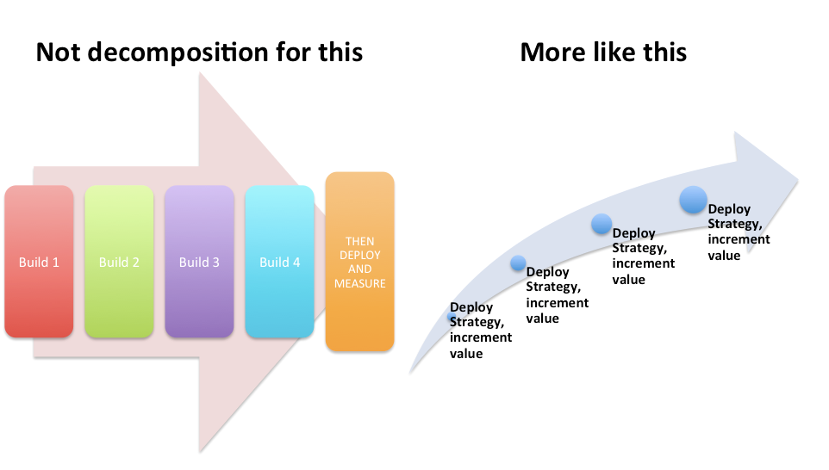
W10. The ‘planner’ (designer)
has no ‘right to be wrong’.
My interpretation, based on [1].
• A scientist can live with a wrong hypothesis, if the refutation process leads to greater knowledge and truth.
• A Planner cannot afford the luxury of this scientific process.
• Planning is not about ‘finding the truth’
• Planning is about making thing better for people.
• The planning consequences of a ‘bad’ hypothesis has real, and possibly very negative, impacts on real people.
• So, planners cannot ethically have ‘philosophical fun’ with possibly bad hypothesis.
• They have to get their solution (and problem) right enough to do no damage, and hopefully right enough, to do good, for people.

Slide 87
W10. The ‘planner’ (designer)
has no ‘right to be wrong’.
. Planguage very much supports this process, do-gooding, rather than truth-finding.
It does so in a large number of large-and-small tools, principles, methods, and processes.
One of many examples of this is
• the primary Evo process
of trying to deliver the largest possible stream of value improvement as early and continuously as possible,
while learning through feedback how to improve on this process itself.

Slide 88
Talk Summary
I think the ‘Wicked Problem” ideas are more misleading than useful.
There are a wide variety of methods for handling large and complicated systems in reasonable ways, in addition to the ones I have presented [5 is constructive], here and in my books.
Most intelligent professionals that I encounter, do not seem trained in these methods, and are not aware of the many tools they can use to tackle complicated (‘Wicked’) systems.
I think we need to focus our attention on mastering a variety of methods for delivering stakeholder value. We are nowhere near good enough, with extremely high failure rates. Failure rates which should shame any professionals with responsibility and pride.
The conditions telling us that we are good enough, or much better are:
more than 95% of our projects result in the value improvements we have promised, on time and within budget. We already have the knowledge to do that. Do you ? [F1]
no excuses about ‘Wicked Problems’

