Slide 1

How to Model Qualitative aspects of software requirements, software architecture, and project progress – quantitatively
3.5 Hour Seminar
Quality Days Vienna, Tuesday 14 January 2014
By
Tom Gilb
Gilb.com
@ImTomGilb
Tom@Gilb.com

Slide 2

Some assertions
Most specification and modelling languages are
  Completely without a way to model qualities
    UML
  Or
  Model in unclear and almost useless ways
    QFD, Balanced Scorecard
  Or
    SAY you should specify qualities, but give no particular ‘good’ (clear) way to do so.

Slide 3

I Offer you a solution
Which you can simply ADD to any language or modelling method, where you want to express quality ideas.
It is based on my invention ‘Planguage’ ( a Planning Language) as best documented in my book Competitive Engineering
  You will get a free digital copy
  This is Common Usage ware requiring no permission, license, fee
Your job is
  To recognize you do not have a good enough modelling and specification capability yet
  That you need that capability, badly!
  Take action. Add quality specification capability

Slide 4
Why are modelling and specification languages missing good ways to specify qualities ?
My Opinions and Theories:
  The Software/IT business is quite immature regarding quality management
  Most IT/Sw people do not know how to treat qualities quantitatively (like engineers and scientists do)
  Our ‘model’ of reality is too strongly based on programming, logic, algorithms: no programming language ever considerers and quality directly
    But we can ‘program’ things (designs) that result in qualities

Slide 5
Why do we need to model/spec qualities (at all)?
And do it quantitatively too!
to specify critical qualities in contracts, proposals & RFPs
To inform testers what they need to measure
To inform Architects what they need to design towards
To be competitive in a marketplace
To justify your costs
Any many more
Notes:
RFP Request For Proposals

Slide 6

Enthoven on Numbers
“Numbers are a part of our language.
Where a quantitative matter is being discussed,
  the greatest clarity of thought is achieved by using numbers
  instead of avoiding them,
  even when uncertainties are present.
This is not to rule out judgment and insight.
  Rather, it is to say, that
  judgments and insights need,
  like everything else,
  to be expressed with clarity
  if they are to be useful.”
Alain Enthoven, June 1963, Naval War College, Newport Rhode Island (see note for more detail), Hughes98, Rescuing Prometheus p164
See the note for more detail on Enthoven
Notes:
Deputy asst secr for systems analysis under McNamara DoD.
Alain C. Enthoven, ‘Choosing Strategies and Selecting Weapon Systems, in Samuel A. Tucker, ed., A Modern Design for Defense Decision: A McNamara-Hitch-Enthoven Anthology (Wash DC: Industrial College of the Armed Forces, 1966), pp12627, cited in Hughest: Rescuing Prometheus, 1998 page 164
Goolgle.com search
Alain C. Enthoven
Marriner S. Eccles Professor of Public and Private Management, Emeritus;
BA, Stanford Univ., 1952; MPhil, Oxford Univ., 1954; PhD, M.I.T., 1956; LHD (Hon.), Sierra Nevada College, 1987. Winner of the Baxter Prize for Health Services Research, 1994; Clifton Latiolais Honor Medal, 1994; Health Care Financial Management Assn. Directors' Award, 1995. Instructor, M.I.T., 1955-56; Economist, RAND Corp., 1956-60; Deputy Comptroller and Deputy Asst. Secretary of Defense, U.S. Dept. of Defense, 1961-65, Asst. Secretary of Defense for Systems Analysis, 1965-69; Vice President for Economic Planning, Litton Industries, 1969-71; President, Litton Medical Products, 1971-73; Visiting Prof., Univ. of Paris, and Visiting Fellow, St. Catherine's College, Oxford Univ., Spring 1985; Visiting Professor, London School of Hygiene and Tropical Medicine 1998-99; Visiting Fellow, New College, Oxford 1998; 1999 Rock Carling Fellow, Nuffield Trust, London. At Stanford since 1973.
Research Interests
Current projects include, the search for an improving National Health Sevice in the United Kingdom.
Research Papers
1292: Health Plan Purchasing Cooperatives (HPPCs) and Reform of The Small Group Health Insurance Market
1023: A Consumer Choice Health Plan For The 1990s: Cost And Budget Estimates And Supporting Detail
751: Will the Prospective Payment System Solve Medicare's Financial Problem?
1411: Reforming Medicare Before It's Too Late
Publications
The Managed Care Backlash and the Task Force in California, Health Care, 17:4, 1998
Markets and Collective Action in Regulating Managed Care, Health Affairs, 16:26-32, 1997
The Clinton Health Care Plan: A Single Payer System in Jackson Hole Clothing, Health Affairs, 1994
Managed Competition: History and Principles, Health Affairs, supplement 24-48, 1993
The Jackson Hole Initiatives for a Twenty-First Century American Health Care System, Health Economics, 1:149-168, 1992
A Consumer-Choice Health Plan for the 1990s: Universal Health Insurance in a System Designed to Promote Quality and Economy, New England Journal of Medicine, 320:29-37 and 94-101, 1989
Health Plan: The Only Practical Solution to the Soaring Cost of Medical Care, Addison-Wesley, 1980
Affiliations
Chairman: Managed Health Care Improvement Task Force
Board of Directors: PCS Inc., 1986-90; Jackson Hole Group, 1992-98.
Consultant: Kaiser Foundation Health Plan
Member: Institute of Medicine of the National Academy of Sciences
Fellow: American Academy of Arts and Sciences
Board of Directors: Caresoft.com 1998-
Courses
MBA E331 Political Economy of Health Care in the United States
MBA E332 Analysis of Costs, Risks, and Benefits in Health Care
News Releases
(07/01) Stanford Health Policy Experts Offer New Health Insurance Proposal
(11/99) Managed Care: What Went Wrong? Can It Be Fixed?
(1/98)Enthoven Commission Offers Prescription for Managed Health Care in California
(6/97)Alain Enthoven named to California's Managed Health Care Improvement Task Force
(3/97) Managed Care for Medicare
Enthoven Receives Healthcare Financial Management Award
(11/00) The Chronic Search for a Health Care Cure
Media Mentions
Group Promotes Its Health Agenda, Los Angeles Times, January 22, 2002
Aetna Plans to Cut 6,000 More Jobs, Los Angeles Times, December 14, 2001
Fewer Choices for Workers on Benefits, New York Times, November 9, 2001
Group Seeks to Counteract Drugmakers New York Times June 30, 2000
Pitching Health Care for All Kids, San Jose Mercury, June 12, 2000
HMO Love Affair Over? USA Today, October 20, 1999
Time to Pull the Plug on Managed Care? The Boston Globe, September 19, 1999
Rx for the Health Care System, Wall Street Journal, October 8, 1998
Panel Seeks H.M.O. Overseer for the Bellwether California, The New York Times, January 6, 1998
Copyright © 2002 Stanford University - Graduate School of Business
This is the image: gobi.stanford.edu/facultybios/ fapictures/fenthovena.gif

Slide 7
Some examples of Ignoring Qualities, Totally in ‘Universal’ Modelling
User Stories Languages
Programming Languages
Use Cases
UML
OCL Object Constraint Language

Slide 8

User Stories Examples. Mike Cohn
Can you spot the unidentified quality? Is this ‘design’ for unidentified quality ?
As a user, I can backup my entire hard drive.
As a power user, I can specify files or folders to backup based on file size, date created and date modified.
As a user, I can indicate folders not to backup so that my backup drive isn't filled up with things I don't need saved.
As a vice president of marketing, I want to select a holiday season to be used when reviewing the performance of past advertising campaigns so that I can identify profitable ones.
http://www.mountaingoatsoftware.com/agile/user-stories
Ppt note = Cohn & Russell on Gilb
Notes:
http://www.mountaingoatsoftware.com/blog/non-functional-requirements-as-user-stories/
Mike Cohn • 2 years ago
−
Hi Adam-- Thanks for sharing this. I agree with much of what you've written, in particular that most thresholds do not need to be viewed as absolutes. We don't lose all users/customers if performance is 4 seconds instead of 3. Incidentally, "Mountain Goat Software" is named after the "Mountain Goat Principle" on p. 99 of Tom Gilb's "Principles of Software Engineering Management" book, which is one of my favorites.
Detail could be added to that user story example by adding the following conditions of satisfaction:
Make sure it works with major retail holidays: Christmas, Easter, President’s Day, Mother’s Day, Father’s Day, Labor Day, New Year’s Day.
Support holidays that span two calendar years (none span three).
Holiday seasons can be set from one holiday to the next (such as Thanksgiving to Christmas).
Holiday seasons can be set to be a number of days prior to the holiday.
(the vp mkt last user story)
Adam Russell • 2 years ago
−
I had the gilb epiphany on NFR's many years ago and it has been a key guiding framework since then. I am now working to operationalise this approach into a practical process that integrates User Centred Design, product-level User Stories and agile development with a more traditional enterprise governance environment. my interpretation of Gilb's work is that NFR's are a set of scalar ranges along one or more dimensions that are important to your particular product space. Btw, Tom has elaborated a very well defined set of quality scales that are applicable to most software systems into a nicely self-contained and complete hierarchy, but I haven't worked in many teams that can "get" that level of sophistication Nonetheless there will be a finite set of quality dimensions that make sense to your application area (even though they may be less perfectly integrated with each other than Tom's hierarchy). it's important to realise that (except in rare cases) these values are on a continuum and not isolated discrete values which are interpreted as "good" or "bad". For example the dimension of response time to a user action. You may define 3 secs as minimum acceptable and 5 secs as full production target. That sense of absolutism might be fine for the system owner, but for an end user in a population you are going to have a large range of groups who have very different levels of sensitivity to this quality dimension. You might capture 100% of your target market at 3 secs and 95 % at 5 secs, but there will be a large percentage for whom 8 or 10 secs is acceptable, and another group for whom 15 secs is ok etc. So, the aggregate effect of defining multiple quality dimensions is to define an ecosystem in which your target users will live: quantitative ranges of availability, performance, usability and the sub-dimensional quality scales that exist within each of these. this is not a binary scenario (except in rare cases) but a set of statistical aggregates that will affect your market take up. at this level it is perfect for Business Case development: e.g. if you build it with 3secs response time and 6 9's availability, it will cost you $30m and you'll capture 20% of the market. But if you build it with 3 secs response time and 95% availability, it'll cost you $10m and you'll capture 15% of the market. Only your business guys can tell you whether the extra $20m is worth the extra 5%, and so forth. as you start to set your first target and minimum acceptable values on these dimensions, you focus the team's attention on this ecosystem; initially indirectly (I dare myself to use the word "ecosystem" in the first workshop - not) In a long-range product development program it's important to realise that the target, minimum acceptable, stretch and ideal values on these scales will change, as you learn more about the market and more about the technology. It is absolutely critical to lay down the initial scales and target levels early to start the process of focusing your attention on what qualities are valued in your target user population, and developing the team vocabulary to describe and analyse them. In recent days I've had some fairly visceral responses to the suggestion that we start to establish these frameworks: essentially "how can I set a response time when I don't even know what hardware is being used to host the application, or where it will be located". as (I think) Tom Gilb said in one of his books (and i'm going completely from memory here): "I can implement any functional requirement you ask as long as you relax sufficiently the non-functional requirements with which i must comply when doing so" (or words to that effect). Unfortunately it's all too easy for teams to have a mental "fingers crossed" approach when confronting these qualities: "well of course I can provide *instant* response as long as *instant* means 12 seconds" or "...if we disregard the cellular network latency" ... etc. if you don't start trying to define the target ecosystem quantitatively and explicitly, you will never get full alignment on what you are trying to define and build. on the specifics of "how to do it" my 10c worth is as follows: 1) i think it depends on your team's level of sophistication and experience whether you start with a "public" and explicitly defined NFR framework at the start, or build it up from the user stories (see below), but you must always start with a private framework in place: one that you understand intimately and can act as your assurance framework. 2) I think starting with the phrasing of these NFR's in the user stories (as per Mike's old post above) with a user's target value is a good one: "as a user, I want to see my news stories appear within 10 seconds so that my security lockout doesn't invoke due to non-activity". This gets the scale onto the agenda and we can focus on the benefit(s). not every user story has to have this but you are trying to expose the targets that are valued by your key users. 3) once you have built up a set of stories that have value descriptors, you can start to extract them and integrate them into an NFR framework - refining the definitions of each of the values and consolidating, where appropriate, multiple descriptions of the same thing. 4) at this stage, if you haven't had your full framework public, this is the time to use your framework to make sure you aren't missing anything. 5) finally (in terms of this stage) you attack the dimensions to explore the continumum of values and set your various points: minimum acceptable, target (on date) etc. there is much furhter refinement that comes later when you have to start costing these, but the idea is to carry these scales all the way through your sprints and testing (at which time you start recording actual values on dates) and then into your early stage deployments, user testing, etc.
sFor example the dimension of response time to a user action. You may define 3 secs as minimum acceptable and 5 secs as full production target. That sense of absolutism might be fine for the system owner, but for an end user in a population you are going to have a large range of groups who have very different levels of sensitivity to this quality dimension. You might capture 100% of your target market at 3 secs and 95 % at 5 secs, but there will be a large percentage for whom 8 or 10 secs is acceptable, and another group for whom 15 secs is ok etc.
So, the aggregate effect of defining multiple quality dimensions is to define an ecosystem in which your target users will live: quantitative ranges of availability, performance, usability and the sub-dimensional quality scales that exist within each of these. this is not a binary scenario (except in rare cases) but a set of statistical aggregates that will affect your market take up.
at this level it is perfect for Business Case development: e.g. if you build it with 3secs response time and 6 9's availability, it will cost you $30m and you'll capture 20% of the market. But if you build it with 3 secs response time and 95% availability, it'll cost you $10m and you'll capture 15% of the market. Only your business guys can tell you whether the extra $20m is worth the extra 5%, and so forth.
as you start to set your first target and minimum acceptable values on these dimensions, you focus the team's attention on this ecosystem; initially indirectly (I dare myself to use the word "ecosystem" in the first workshop - not)
In a long-range product development program it's important to realise that the target, minimum acceptable, stretch and ideal values on these scales will change, as you learn more about the market and more about the technology.
It is absolutely critical to lay down the initial scales and target levels early to start the process of focusing your attention on what qualities are valued in your target user population, and developing the team vocabulary to describe and analyse them.
In recent days I've had some fairly visceral responses to the suggestion that we start to establish these frameworks: essentially "how can I set a response time when I don't even know what hardware is being used to host the application, or where it will be located".
as (I think) Tom Gilb said in one of his books (and i'm going completely from memory here): "I can implement any functional requirement you ask as long as you relax sufficiently the non-functional requirements with which i must comply when doing so" (or words to that effect).
Unfortunately it's all too easy for teams to have a mental "fingers crossed" approach when confronting these qualities: "well of course I can provide *instant* response as long as *instant* means 12 seconds" or "...if we disregard the cellular network latency" ... etc.
if you don't start trying to define the target ecosystem quantitatively and explicitly, you will never get full alignment on what you are trying to define and build.
on the specifics of "how to do it" my 10c worth is as follows:
1) i think it depends on your team's level of sophistication and experience whether you start with a "public" and explicitly defined NFR framework at the start, or build it up from the user stories (see below), but you must always start with a private framework in place: one that you understand intimately and can act as your assurance framework.
2) I think starting with the phrasing of these NFR's in the user stories (as per Mike's old post above) with a user's target value is a good one: "as a user, I want to see my news stories appear within 10 seconds so that my security lockout doesn't invoke due to non-activity". This gets the scale onto the agenda and we can focus on the benefit(s). not every user story has to have this but you are trying to expose the targets that are valued by your key users.
3) once you have built up a set of stories that have value descriptors, you can start to extract them and integrate them into an NFR framework - refining the definitions of each of the values and consolidating, where appropriate, multiple descriptions of the same thing.
4) at this stage, if you haven't had your full framework public, this is the time to use your framework to make sure you aren't missing anything.
5) finally (in terms of this stage) you attack the dimensions to explore the continumum of values and set your various points: minimum acceptable, target (on date) etc.
there is much furhter refinement that comes later when you have to start costing these, but the idea is to carry these scales all the way through your sprints and testing (at which time you start recording actual values on dates) and then into your early stage deployments, user testing, etc.

Slide 9

Programming Languages
$ rails console
>> first_user = User.first
=> #<User id: 1, name: "Michael Hartl", email: "michael@example.org",
created_at: "2013-03-06 02:01:31", updated_at: "2013-03-06 02:01:31">
>> first_user.microposts
=> [#<Micropost id: 1, content: "First micropost!", user_id: 1, created_at:
"2013-03-06 02:37:37", updated_at: "2013-03-06 02:37:37">, #<Micropost id: 2,
content: "Second micropost", user_id: 1, created_at: "2013-03-06 02:38:54",
updated_at: "2013-03-06 02:38:54">]
>> exit
http://ruby.railstutorial.org/chapters/a-demo-app
Notes:
In Chapter 10 and Chapter 11, we will use the association of users and microposts both to display all a user’s microposts and to construct a Twitter-like micropost feed. For now, we can examine the implications of the user-micropost association by using the console, which is a useful tool for interacting with Rails applications. We first invoke the console with rails console at the command line, and then retrieve the first user from the database using User.first (putting the results in the variable first_user):7
$ rails console
>> first_user = User.first
=> #<User id: 1, name: "Michael Hartl", email: "michael@example.org",
created_at: "2013-03-06 02:01:31", updated_at: "2013-03-06 02:01:31">
>> first_user.microposts
=> [#<Micropost id: 1, content: "First micropost!", user_id: 1, created_at:
"2013-03-06 02:37:37", updated_at: "2013-03-06 02:37:37">, #<Micropost id: 2,
content: "Second micropost", user_id: 1, created_at: "2013-03-06 02:38:54",
updated_at: "2013-03-06 02:38:54">]
>> exit
(I include the last line just to demonstrate how to exit the console, and on most systems you can Ctrl-d for the same purpose.) Here we have accessed the user’s microposts using the code first_user.microposts: with this code, Active Record automatically returns all the microposts with user_id equal to the id of first_user (in this case, 1). We’ll learn much more about the association facilities in Active Record in Chapter 10 and Chapter 11.

Slide 10
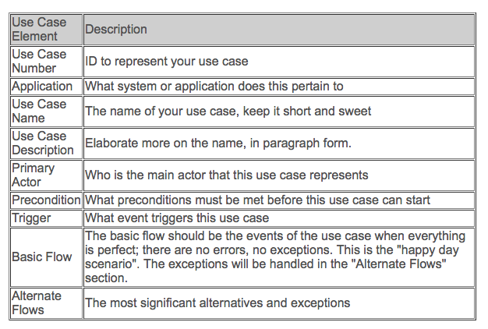
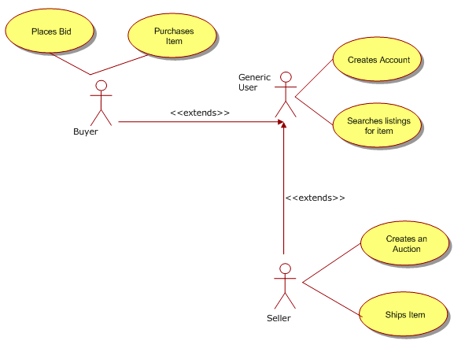
Use Cases:
Nothing about quality here!
“The success measurement for an effective written use case is one that is easily understood, and ultimately the developers can build the right product the first time.” <- Darren Levy (www below)
http://www.gatherspace.com/static/use_case_example.html
Notes:
http://www.gatherspace.com/static/use_case_example.html
By Darren Levy updated on June 12, 2013
+84 Recommend this on Google
Your use cases are only as effective as the value someone's deriving from them. What seems obvious to you may not be to your developers or customers. The success measurement for an effective written use case is one that is easily understood, and ultimately the developers can build the right product the first time.

Slide 11
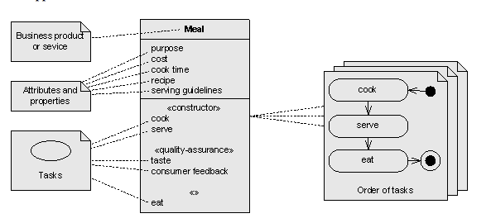
UML:
Can’t Even mention a real quality under Attributes and Properties
Source see Note: Pavel Hruby
Can you list some quality attributes of a meal (hint: tasty, healthy)
Notes:
http://jeffsutherland.org/oopsla99/Hruby/hruby.html
Object-Oriented Architecture of Business Process Catalogue
Extended abstract, version 15 September 1999
Pavel Hruby Navision Software Frydenlunds Allé 6 2950 Vedbæk, Denmark E-mail: ph@navision.com Tel.: +45 45 65 50 00 Fax: +45 45 65 50 01
Abstract. Many contemporary business process models are focused on a description of business activities. Business processes are seen as activities that can be decomposed into subactivities and then again decomposed into tasks and subtasks. This approach is similar to structured programming, where programs consist of procedures that are decomposed into subprocedures and sub-subprocedures until the atomic level of programming instructions is reached. In contrast to this approach, this position paper suggests a different, object-oriented approach for business process modeling that focuses on a description of work results rather than activities and refinement rather than decomposition. In this approach, business products and services are seen as objects with various responsibilities, methods and attributes. Tasks are modeled as object methods and business activities as collaborations between the objects. This object-oriented approach can deal with the complexity of business processes in a better way than approach focused on the decomposition of activities.

Slide 12
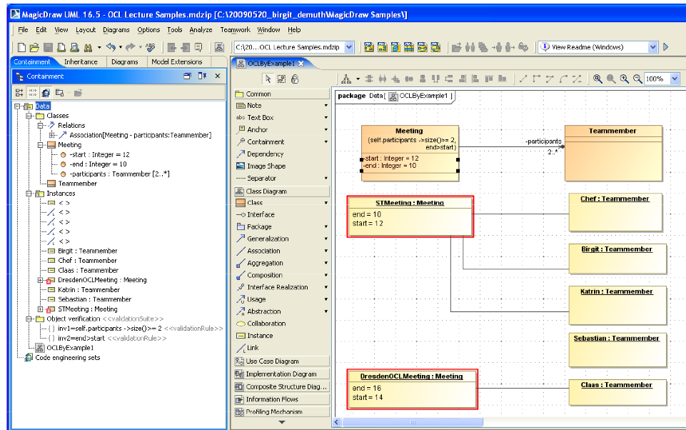
OCL (Object Constraint Language)
A UML Cousin:
Nothing about Quality or Cost etc.
http://st.inf.tu-dresden.de/files/general/OCLByExampleLecture.pdf

Slide 13
Some Examples of
Badly done qualities
Goal Question Metric (GQM, Basili)
The Horror Project
QFD
BSC
Dean Lefiingers Agile
User Stories Non Functional
Scrum

Slide 14
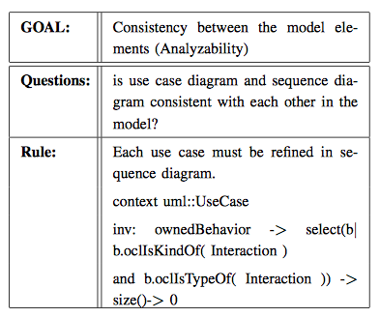
GQM:
Naming Qualities, without definition.
Then Designing for an Undefined Quality Requirement
Notes:
http://www.taibahu.edu.sa/iccit/alliccitpapers/pdf/p248-jalbani.pdf
See http://citeseerx.ist.psu.edu/viewdoc/download?doi=10.1.1.10.5567&rep=rep1&type=pdf
For an interesting paper on metrics for consistency

Slide 15
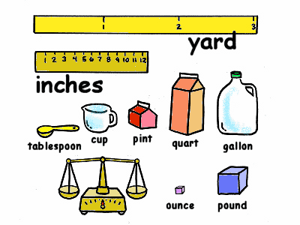
Summary of Top ‘8’ Project Objectives
Real Example of Lack of Scales
Defined Scales of Measure:
  Demands comparative thinking.
  Leads to requirements that are unambiguously clear
  Helps Team be Aligned with the Business
1. Central to The Corporations business strategy is to be the world’s premier integrated <domain> service provider.
2. Will provide a much more efficient user experience
3. Dramatically scale back the time frequently needed after the last data is acquired to time align, depth correct, splice, merge, recompute and/or do whatever else is needed to generate the desired products
4. Make the system much easier to understand and use than has been the case for previous system.
5. A primary goal is to provide a much more productive system development environment than was previously the case.
6. Will provide a richer set of functionality for supporting next-generation logging tools and applications.
7. Robustness is an essential system requirement (see rewrite in example below)
8. Major improvements in data quality over current practices
This lack of clarity cost them $100,000, 000
Notes:
http://www.chariho.k12.ri.us/curriculum/MIsmart/matter/matter.html

Slide 16
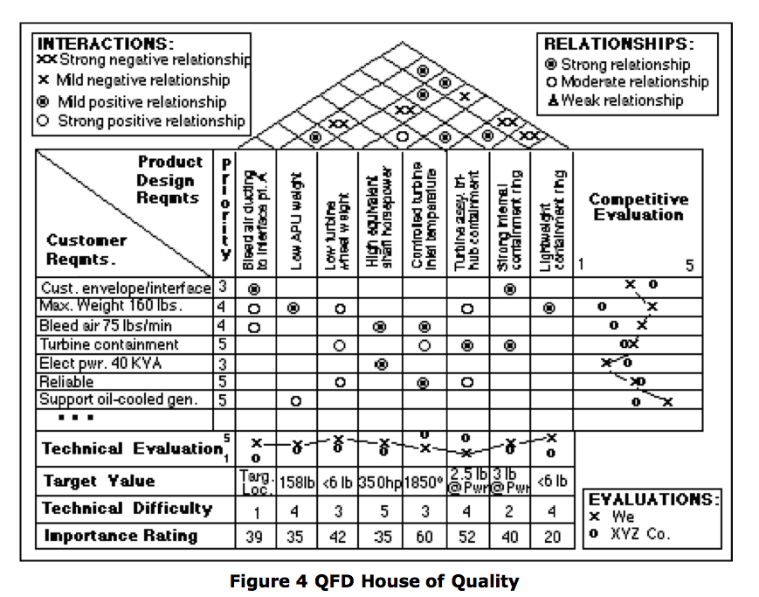
Quality Function Deployment QFD for Comparison
Much less well defined and objective quantification than Impact Estimation
How 'Strong'
is Strong?
Stakeholder
Need
How
'Reliable'?
What is this
"importance'
rating?
Notes:
Added Feb 11 2006
Source= http://www10.edacafe.com/nbc/articles/view_weekly.php?articleid=209200

Slide 17
Real Example: of Fuzzy BSC
Notes:
http://www.tib.wa.gov/Performance/document/Balanced%20Scorecard%20web.png
Found by google of balanced scorecard images June 28 2006 tg.

Slide 18
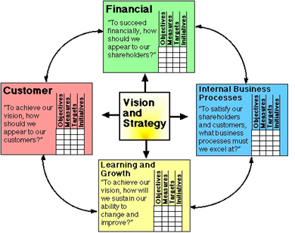
What are some of the weaknesses of Balanced Scorecard?
The objectives are not clear.
  They are highly ambiguous
  They are not quantified - numeric
  They are not measurable - trackable
The objectives do not have additional information to help us deal with them:
  Rationale or Justification
  Authority
  Impacts (on higher level objectives)
  Supported By (other objective or strategies)
  Stakeholders
Notes:
Made Jan 12 2014 for Quality Days Vienna Talk TsG

Slide 19
User Stories Non-Functional:
Mike Cohn
(quality specification exists, but not very clear or complete)
As a customer, I want to be able to run your product on all versions of Windows from Windows 95 on.
As the CTO, I want the system to use our existing orders database rather than create a new one, so that we don't have one more database to maintain.
As a user, I want the site to be available 99.999 percent of the time I try to access it, so that I don't get frustrated and find another site to use.
As someone who speaks a Latin-based language, I might want to run your software someday.
As a user, I want the driving directions to be the best 90 percent of the time, and reasonable 99 percent of the time.
http://www.mountaingoatsoftware.com/blog/non-functional-requirements-as-user-stories/
Nov 21 2008
Notes:
USER STORIES AND PRODUCT BACKLOG
NOV 21, 2008 BY MIKE COHN 62 COMMENTS
A common challenge with writing user stories is how to handle a product's non-functional requirements. These are requirements that are not about specific functionality (“As a user of a word processor, I want to insert a table into my document.”), but are rather about an attribute or characteristic of the system. Examples include reliability, availability, portability, scalability, usability, maintainability. As you can see from that list, non-functional requirements are often referred to as “-ilities.” Of course, not all non-functional requirements end in “-ility.” We also have security, performance, robustness and so on.
Thinking back into the dark ages, I can remember when I first read about “non-functional requirements.” The term threw me for a loop. If it's non-functional, why do I care about it? I'm sure the author of that book clarified this for me a page later, but the term has always seemed an odd one to me. I prefer to think of non-functional requirements as “constraints” we put on the system. When a product owner says, “this system must perform adequately with 100,000 concurrent users,” the product owner is putting a constraint on the development team.
The product owner is effectively saying, “Develop this software any way you'd like as long as you achieve 100,000 concurrent users.” Each constraint we put on a system narrows the design choices a bit; calling these “constraints” rather than “non-functional requirements” helps us remember this. Fortunately constraints/non-functional requirements can be easily handled as user stories. Here are a couple of examples:

Slide 20

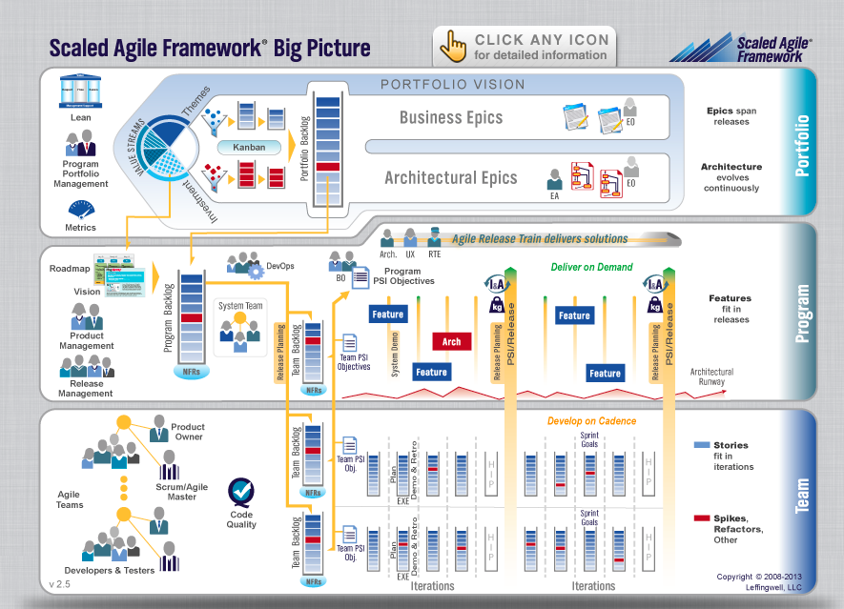
What About ScaledAgileFramework.com ?
Notes:
The Big Picture Graphic
Notice: You have permission, with respect to unmodified versions of this graphic, to (1) download and print one or more copies of the graphic for use in your company setting, and (2) download, include in your materials, and distribute (solely in hardcopy form as part of your materials), this graphic. You may not otherwise copy or distribute (in whole or in part) without the express written permission of the copyright holder, Leffingwell, LLC.

Slide 21
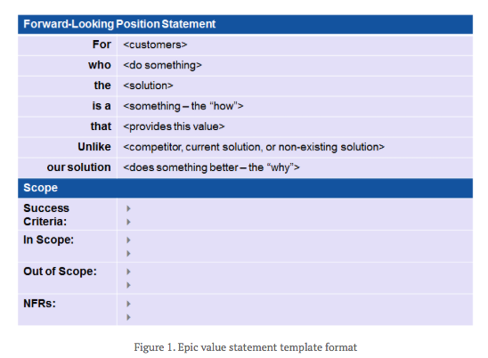
Epic value Statement Format

Slide 22
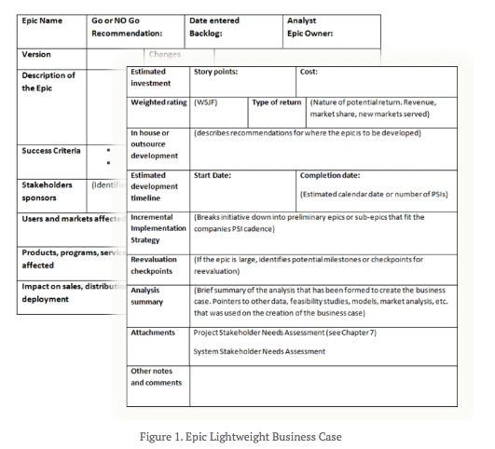
Epic Lightweight Business Case
Notes:
http://scaledagileframework.com/epics/

Slide 23
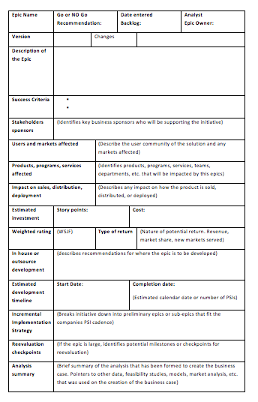
Template
Notes:
http://scaledagileframework.com/epics/
1o and 12 Jan 2014 tsg

Slide 24
Initial Take
Is moving in the direction of Planguage for specification
But, does not go near the concepts of managing value by means of quantified value and quality directly
Does not understand dynamic prioritization via values and costs (see the weighting scheme)

Slide 25
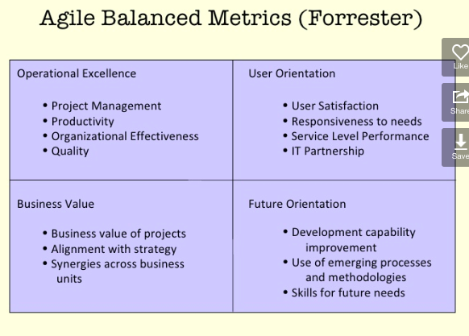
Scrum: http://www.slideshare.net/rsrivastava91/agile-metrics-v6
http://www.slideshare.net/rsrivastava91/agile-metrics-v6

Slide 26
Examples of Pretty Good Quality Modelling

Slide 27
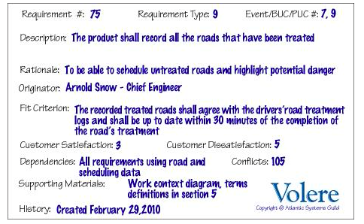
Volare http://volere.co.uk/template.htm
Eighty percent of a test panel of 11-year-old children shall be able to successfully complete [list of tasks] within [specified time].
One month’s use of the product shall result in a total error rate of less than 1 percent.
An anonymous survey shall show that 75 percent of the intended users are regularly using the product after a three-week familiarization period.
Notes:
An engineer shall produce a [specified result] within [specified time] of beginning to use the product, without needing to use the manual.
After receiving [number of hours] training a clerk shall be able to produce [quantity of specified outputs] per [unit of time].
[Agreed percentage] of a test panel shall successfully complete [specified task] within [specified time limit].
The engineers shall achieve [agreed percentage] pass rate from the final examination of the training.

Slide 28

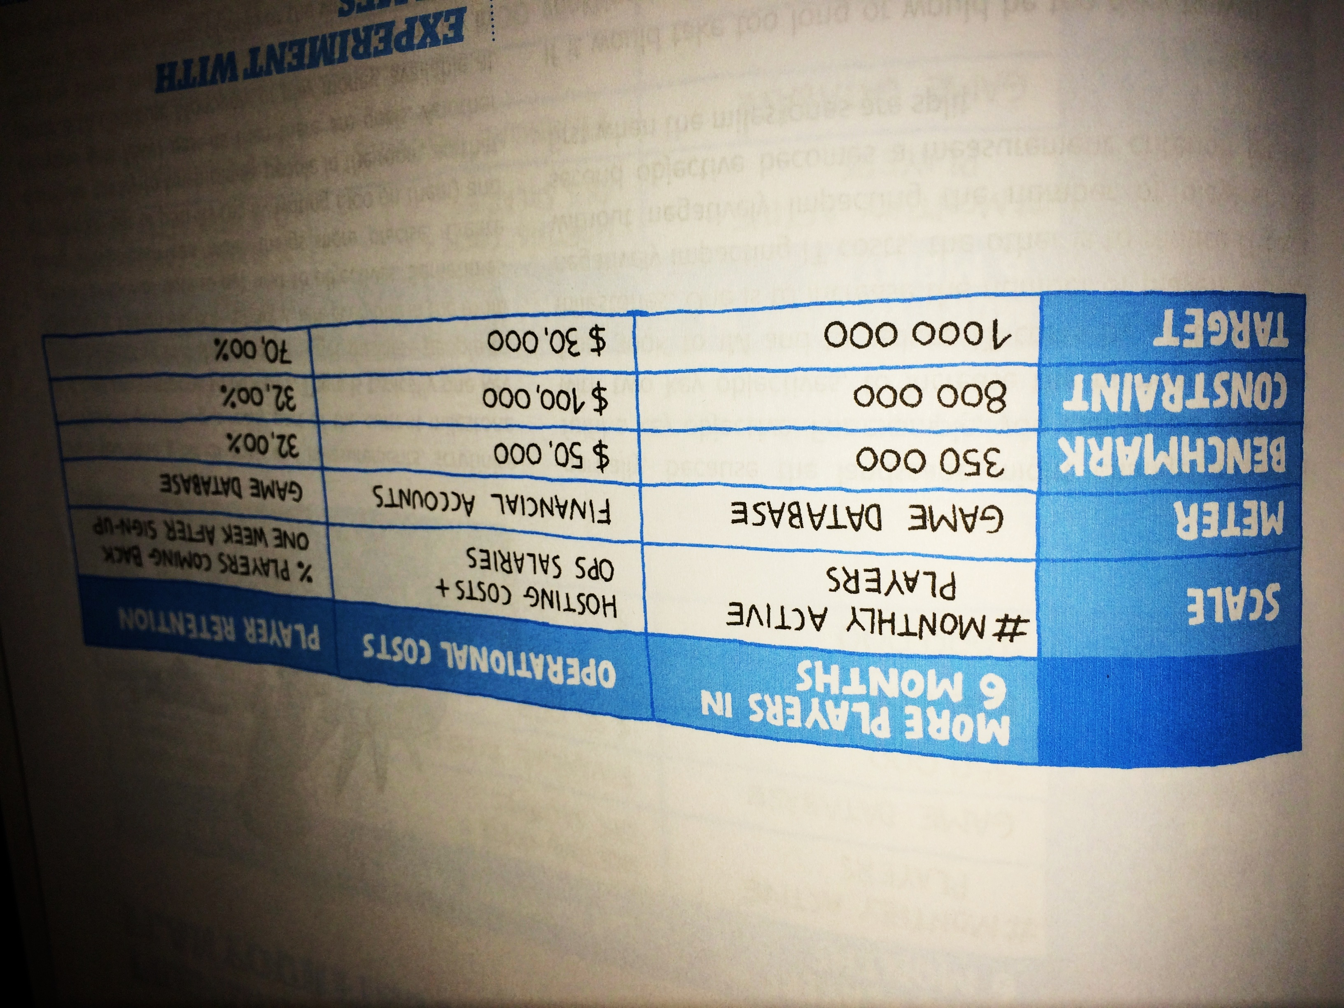
Impact Mapping http://impactmapping.org/site/impact_mapping_20121001_sample.pdf
Notes:
I’m a big fan of Tom Gilb’s work. I few years ago, in Norway, we had a long argument on quantifying product qualities. Tom’s position was that anything can be quantified, just that people don’t bother doing it. I used usability as an example of something that is fluffy and not quantifiable. He won (If you’ve ever seen Tom in person, you’d know that there is only one possible winner of such an argument) saying that usability is quantifiable by how long it takes an inexperienced person to do some typical tasks. That metric is reliable, comparable, and directly relevant. Since then, I’ve started seeing opportunities to quantify lots of similar concepts that people said would not be reasonably measurable.
References (by Example earlier book)
Mike Cohn, User Stories Applied for Agile Software Development Gerald Weinberg, Quality Software Management
Gojko Adzic, Specification by Example
Scott Berkun, Art of Project Management
Mark Denne, Jane Cleland-Huang, Software by numbers Tom Gilb, Competitive Software Engineering

Slide 29
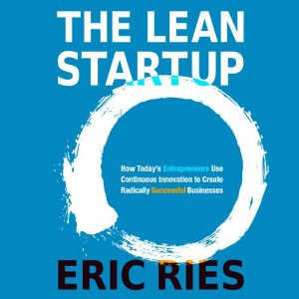

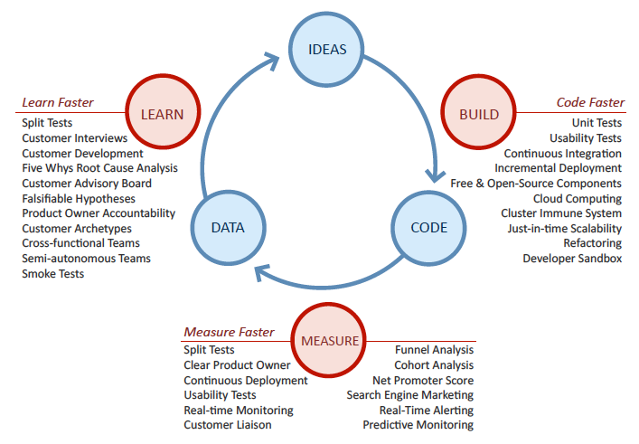
Lean Startup

Slide 30
State of The Art: Planguage
Doing a Better Job on Qualities

Slide 31
Example from Large Failed Industrial Project

Slide 32
Summary of Top ‘8’ Project Objectives
Real Example of Lack of Scales
Defined Scales of Measure:
  Demands comparative thinking.
  Leads to requirements that are unambiguously clear
  Helps Team be Aligned with the Business
1. Central to The Corporations business strategy is to be the world’s premier integrated <domain> service provider.
2. Will provide a much more efficient user experience
3. Dramatically scale back the time frequently needed after the last data is acquired to time align, depth correct, splice, merge, recompute and/or do whatever else is needed to generate the desired products
4. Make the system much easier to understand and use than has been the case for previous system.
5. A primary goal is to provide a much more productive system development environment than was previously the case.
6. Will provide a richer set of functionality for supporting next-generation logging tools and applications.
7. Robustness is an essential system requirement (see rewrite in example below)
8. Major improvements in data quality over current practices
This lack of clarity cost them $100,000, 000
Notes:
http://www.chariho.k12.ri.us/curriculum/MIsmart/matter/matter.html

Slide 33

7. Rock solid robustness
While robustness is an essential HORROR requirement in all its uses, it is especially critical in MINING applications where the much longer job durations afford software defects (e.g. memory leaks) a greatly expanded opportunity to surface.
In this regard,
HORROR will provide the following features or attributes:
  Minimal down-time
A critical HORROR objective is to have minimal downtime due to software failures.
This objective includes:
  Mean time between forced restarts > 14 days
HORROR’s goal for mean time between forced restarts is greater than 14 days.
Comment: This figure does not include restarts caused by hardware problems, e.g. poorly seated cards or communication hardware that locks up the system. MTBF for these items falls under the domain of the hardware groups.
  Restore system state < 10 minutes
Log scripts and test scripts, subsystem tests
  Built-in testability
HORROR will provide the following features and attributes to facilitate testing.
  Tool simulators
GILB COMMENT:
  For once a reasonable attempt was made to quantify the meaning of the requirement!
  But is could be done much better
  As usual the set of designs to meet the requirement do not belong here.
  And none of them make any assertion about how well (to what degree) they will meet the defined numeric requirements.
  And as usual another guarantee of eternal costs on pursuit of a poorly defined requirements is most of the content.
Notes:
http://www.megware.de/img/seiten/cluster/hoch_verfuegbar.jpg
While robustness is an essential HORROR requirement in all its uses, it is especially critical in drilling applications where the much longer job durations afford software defects (e.g. memory leaks) a greatly expanded opportunity to surface. In this regard, HORROR will provide the following features or attributes:

Slide 34


Rock Solid Robustness
Rock Solid Robustness:
Type: Complex Product Quality Requirement.
Includes: { Software Downtime, Restore Speed, Testability, Fault Prevention Capability, Fault Isolation Capability, Fault Analysis Capability, Hardware Debugging Capability}.
Notes:
http://img2.travelblog.org/Photos/17776/71146/t/761917-Some-of-the-famous-granite-rocks-1.jpg

Slide 35


Software Downtime:
Software Downtime:
Type: Software Quality Requirement.
Ambition: to have minimal downtime
due to software failures <- HFA 6.1
Issue: does this not imply that there is a system wide downtime requirement?
Scale: <mean time between forced restarts for defined [Activity], for a defined [Intensity].>
Fail [Any Release or Evo Step, Activity = Recompute, Inrensity = Peak Level] 14 days <- HFA 6.1.1
Goal [By 2008?, Activity = Data Acquisition, Intensity = Lowest level] : 300 days ??
Stretch: 600 days

Slide 36
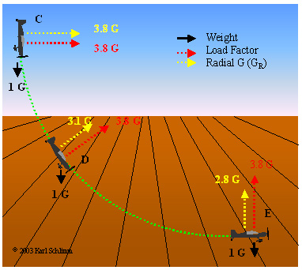

Restore Speed:
Restore Speed:
Type: Software Quality Requirement.
Ambition: Should an error occur (or the user otherwise desire to do so), Horizon shall be able to restore the system to a
previously saved state in less than 10 minutes. <-6.1.2 HFA.
Scale: Duration from Initiation of Restore to Complete and verified state of a defined [Previous: Default = Immediately Previous]] saved state.
Initiation: defined as {Operator Initiation, System Initiation, ?}. Default = Any.
Goal [ Initial and all subsequent released and Evo steps] 1 minute?
Fail [ Initial and all subsequent released and Evo steps] 10 minutes. <- 6.1.2 HFA
Catastrophe: 100 minutes.
Notes:
http://www.apstraining.com/images/69.jpg

Slide 37
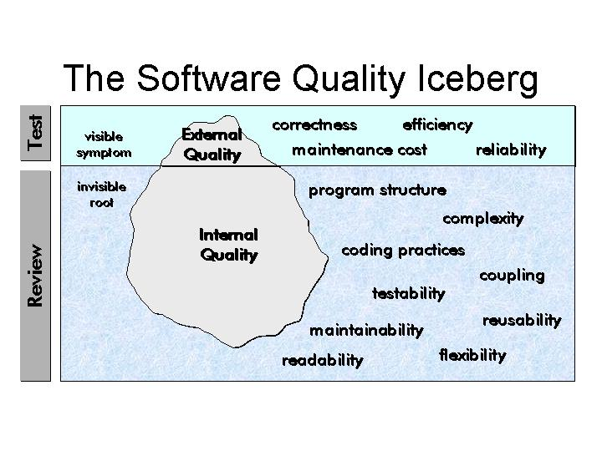

Testability:
Testability:
Type: Software Quality Requirement.
Version: 20 Oct 2006-10-20
Status: Demo draft,
Stakeholder: {Operator, Tester}.
Ambition: Rapid-duration automatic testing of <critical complex tests>, with extreme operator setup and initiation.
Scale: the duration of a defined [Volume] of testing, or a defined [Type], by a defined [Skill Level] of system operator, under defined [Operating Conditions].
Goal [All Customer Use, Volume = 1,000,000 data items, Type = WireXXXX Vs DXX, Skill = First Time Novice, Operating Conditions = Field, {Sea Or Desert}. <10 mins.
Design Hypothesis: Tool Simulators, Reverse Cracking Tool, Generation of simulated telemetry frames entirely in software, Application specific sophistication, for drilling – recorded mode simulation by playing back the dump file, Application test harness console <-6.2.1 HFA
Notes:
http://users.skynet.be/ronnydewinter/SQA-img/TheSoftwareQualityIceberg.jpg
So once again, what is testability, exactly? Although testability is mentioned in the abstract of the recent WCAG 2.0 working draft documents and expanded in the “Conformance” section, a full definition sits not in the glossary but in the Requirements for WCAG 2.0 Checklists and Techniques, dated 7 February, 2003. Within this document, you will find the only definition of testability as it applies to WCAG 2.0. Here’s that definition:Definition: Testable: Either Machine Testable or Reliably Human Testable.Definition: Machine Testable: There is a known algorithm (regardless of whether that algorithm is known to be implemented in tools) that will determine, with complete reliability, whether the technique has been implemented or not. Probabilistic algorithms are not sufficient.Definition: Reliably Human Testable: The technique can be tested by human inspection and it is believed that at least 80% of knowledgeable human evaluators would agree on the conclusion. The use of probabilistic machine algorithms may facilitate the human testing process but this does not make it machine testable.Definition: Not Reliably Testable: The technique is subject to human inspection but it is not believed that at least 80% of knowledgeable human evaluators would agree on the conclusion.

Slide 38

Example from improving Balanced Scorecard for US Bank
Situation
The management of the bank was very frustrated with their attempt to plan using Balanced Scorecard
I pointed out that this was probably due to the fact that the concepts is the BSC planning were unclear and badly defined
We helped them define things properly, using Planguage, and this is a sample

Slide 39
L2: Develop competencies, technical knowledge, critical skills:
A ‘COMPLEX’ OBJECTIVE
Gist:
    OCS will ensure that all our training and development programs, job descriptions, and hiring priorities are aligned with critical knowledge, skills, and abilities needed to achieve our strategic objectives.
    Timely alignment of development with objectives
    Continuing and timely evolution of KSA (Knowledge, Skills, Abilities) to meet the dynamics of the market. <--David S
Assumption: leadership is a competency <-Larry
Stakeholders
  Direct: {Operations Employees, Training & Development, HR,}
  Indirect: Customers
Type: Complex Objective: See detail following.
  Anticipation
    Gist: how well we foresee when what we need to build up
  Currency
    Gist: how well we have managed to keep up with our needs, avoiding shortfalls
  Effectiveness
    Gist: how good we are at successfully deploying our skills in practice
  Alignment
    Gist: how well we align our skills with real current objectives
  Employee Morale??
Develop Competencies
Anticipation
Currency
Culture Capability (L3)
I7: Value Delivery
L1 (Build and refine strategic alignment)
Effectiveness
Alignment
Employee Morale
L1 (Build and refine strategic alignment)

Slide 40
L2.Anticipation
Gist: how well we foresee when & what we need to build up
Stakeholders see L2, Ops Employees
Scale: % of critical actually needed CTK {Competencies, Technical Knowledge, Critical Skills} which we correctly foresaw in a timely manner as judged with hindsight.
CTK: Defined as: Competencies, Technical Knowledge and Critical Skills
<Meter [Monthly Report to WE]
  Self identification against a pre-described list of CTKs <-Larry & Team
    Rationale: helps individual feedback and learning
    Problem: is the list current needs, not the old set? >
Benchmarks============ “What’s the situation?”
Our Past: Past [Competency 200x, End May 200x] 50% to 90% ?.
  <- Group guesses “ No comparable measures, these are educated guesses.”
[Federal Highways Administration, 1996]<Ray will supply> %<- Ray, Public Domain
[Center for Creative Leadership, Personal Skills Measurement] ___% <--Larry
See Measuring Value of human assets/Capital: Harvard, Bruce,
Record <[{GE , Xerox, Motorola, FDIC Bank Examiner Program <-David Sxxxx} ???]>
Trend [End 200z] Our Past - some %
  Rationale: the firm is going into markets we are not really aware of <-Larry
=========Targets ======== What results do stakeholders want? =====
Ideal: 100%
Wish [ End 200q, Operations] 98% <-- David Sxx
  Rationale: allows us to immediately react to changes in the market.. See Objectives like {I2, C2}
Goal [End 200z, Our Corp., CTKs necessary to process the current business] 100%<--Larry
============= Constraints ==============
Fail [End 200y, Operations] 80% <-- Con
  Assumption: if we can’t get 80% then we must question whether the strategies we are employing are any good <-Con
  Assumption: our business is going to change steadily at 10% per year <- Con
  Rationale: we need 100% of CTKs necessary to process the current portfolio
  Note there is a method for backing into this number <-Larry
  Rationale: < if bad then employee dissatisfaction, losses, wasted days of training…….> <- Con
Best Bank: Generic Constraint: must be better % than any other known bank Record in USA.
Notes:
Anticipation is a continuous activity throughout the project life. By looking ahead, and considering probable barriers to success, we can develop pre-arranged processes and structures to solve unforeseen problems.Anticipation allows us to plan how we handle problems, who is involved, and who is responsible for the various decisions and choices. Decision makers might be the team itself (using consensus, compromise, or voting), the team leader (using experience, advice, authority, or risk taking), the sponsor (see leader, or with advisement from others), or the higher level management members. Anticipation goes hand in hand with negotiation.
SOURCE: www.geocities.com/Athens/2921/mgrtk006.html
First Google hit for ‘anticipation management objective’

Slide 41
How to quantify any ‘qualitative’ management objective.
Decompose complex objectives into elementary objectives (see example L2 above).
Define a ‘Scale’ of measure
  Use common sense
  Try Google for ideas
  Collect corporate Scale ideas and reuse
Define a practical ‘Meter’
  How to measure progress in practice
  Maybe several different ones for different purposes
Define Numeric Points on the Scale
  Benchmarks (Past, Record, Trend)
  Constraints (Fail, Survival)
  Targets (Goal, Wish, Stretch, Ideal)

Slide 42
Real Bank Project : Project Progress Testability
Quantification of the most-critical project objectives on day 1
P&L-Consistency&T P&L: Scale: total adjustments btw Flash/Predict and Actual (T+1) signed off P&L. per day. Past 60 Goal: 15
Speed-To-Deliver: Scale: average Calendar days needed from New Idea Approved until Idea Operational, for given Tasks, on given Markets.
Past [2009, Market = EURex, Task =Bond Execution] 2-3 months ?
Goal [Deadline =End 20xz, Market = EURex, Task =Bond Execution] 5 days
Operational-Control: Scale: % of trades per day, where the calculated economic difference between OUR CO and Marketplace/Clients, is less than “1 Yen”(or equivalent).
Past [April 20xx] 10% change this to 90% NH Goal [Dec. 20xy] 100%
Operational-Control.Consistent: Scale: % of defined [Trades] failing full STP across the transaction cycle. Past [April 20xx, Trades=Voice Trades] 95%
Past [April 20xx, Trades=eTrades] 93%
Goal [April 20xz, Trades=Voice Trades] <95 ± 2%>
Goal [April 20xz, Trades=eTrades] 98.5 ± 0.5 %
Operational-Control.Timely.End&OvernightP&L Scale: number of times, per quarter, the P&L information is not delivered timely to the defined [Bach-Run].
Past [April 20xx, Batch-Run=Overnight] 1 Goal [Dec. 20xy, Batch-Run=Overnight] <0.5> Past [April 20xx, Batch-Run= T+1] 1 Goal [Dec. 20xy, Batch-Run=End-Of-Day, Delay<1hour] 1
Operational-Control.Timely.IntradayP&L Scale: number of times per day the intraday P&L process is delayed more than 0.5 sec.
Operational-Control.Timely.Trade-Bookings Scale: number of trades per day that are not booked on trade date. Past [April 20xx] 20 ?
Front-Office-Trade-Management-Efficiency Scale: Time from Ticket Launch to trade updating real-time risk view
Past [20xx, Function = Risk Mgt, Region = Global] ~ 80s +/- 45s ??
Goal [End 20xz, Function = Risk Mgt, Region = Global] ~ 50% better?
Managing Risk – Accurate – Consolidated – Real Time
Risk.Cross-Product Scale: % of financial products that risk metrics can be displayed in a single position blotter in a way appropriate for the trader (i.e. – around a benchmark vs. across the curve).
Past [April 20xx] 0% 95%. Goal [Dec. 20xy] 100%
Risk.Low-latency Scale: number of times per day the intraday risk metrics is delayed by more than 0.5 sec. Past [April 20xx, NA] 1% Past [April 20xx, EMEA] ??% Past [April 20xx, AP] 100% Goal [Dec. 20xy] 0%
Risk.Accuracy
Risk. user-configurable Scale: ??? pretty binary – feature is there or not – how do we represent?
Past [April 20xx] 1% Goal [Dec. 20xy] 0%
Operational Cost Efficiency Scale: <Increased efficiency (Straight through processing STP Rates )>
Cost-Per-Trade Scale: % reduction in Cost-Per-Trade
Goal (EOY 20xy, cost type = I 1 – REGION = ALL) Reduce cost by 60% (BW)
Goal (EOY 20xy, cost type = I 2 – REGION = ALL) Reduce cost by x %
Goal (EOY 20xy, cost type = E1 – REGION = ALL) Reduce cost by x %
Goal (EOY 20xy, cost type = E 2 – REGION = ALL) Reduce cost by 100%
Goal (EOY 20xy, cost type = E 3 – REGION = ALL) Reduce cost by x %
Notes:
These are real 20xx one page summary objectives. They were made from scratch ib 2 days and this set was extracted from about 10 pages of detailed objectives to give a one page summary. They were evolved in the next few months, and these no longer represent current objectives. This is a non confidential set. Some numbers are changed at random, but the example is the same.

Slide 43
Detailed Example
Operational-Control.Consistent :
  Scale: % of defined [Trades] failing full STP across the transaction cycle.
  Past [April 20xx, Trades=Voice Trades] 95%
  Past [April 20xx, Trades=eTrades] 93%
  Goal [April 20xz, Trades=Voice Trades] <95 ± 2%>
  Goal [April 20xz, Trades=eTrades] 98.5 ± 0.5 %
Notes:
Added detail 2 dec 2013 cph nordea

Slide 44
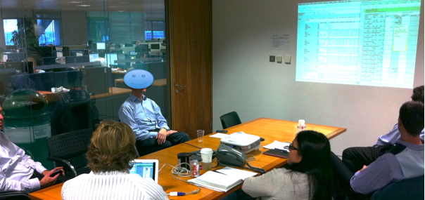
Focus
Goals IE Table

Slide 45
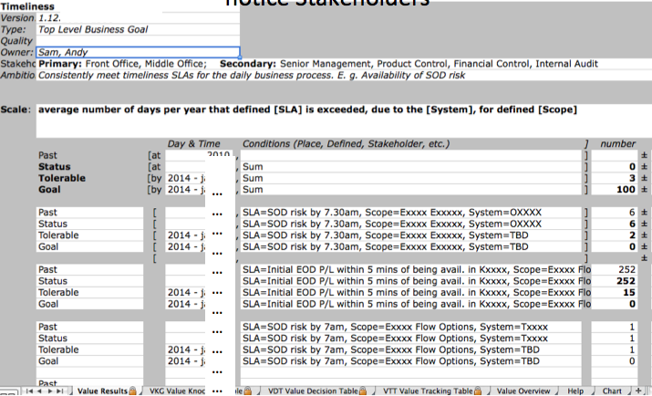
Quantified Objective in Kai’s Planguage Tool: notice Stakeholders
……………………………
Notes:
From Dec 20xx non confidential example, using Kais Planguage Tool

Slide 46
Defining a Design/Solution/Architecture/Strategy (Planguage, CE Design Template)
1. enough detail to estimate, 2. some impact assertion, 3. Assumptions, Risks, Issues
See enlarged view of this slide in following slides. This is a 1-page overview
Orbit Application Base: (formal Cross reference Tag)
Type: Primary Architecture Option
============ Basic Information ==========
Version: Nov. 30 20xx 16:49, updated 2.Dec by telephone and in meeting. 14:34
Status: Draft
Owner: Brent Barclays
Expert: Raj Shell, London
Authority: for differentiating business environment characteristics, Raj Shell, Brent Barclays(for overview)
Source: <Source references for the information in this specification. Could include people>. Various, can be done later BB
Gist: risk and P/L aggregation service, which also provides work flow/adjustment and outbound and inbound feed support. Currently used by Rates ExtraBusiness, Front Office and Middle Office, USA & UK.
Description: <Describe the design idea in sufficient detail to support the estimated impacts and costs given below>.
  D1: ETL Layer. Rules based highly configurable implementation of the ETL Pattern, which allows the data to be onboarded more quickly. Load and persist new data very quickly. With minimal development required. -> Business-Capability-Time-To-Market, Business Scalability
  D2: high performance risk and P/L aggregation processing (Cube Building). -> Timeliness, P/L Explanation, Risk & P/L Understanding, Decision Support, Business Scalability, Responsiveness.
  D3: Orbit supports BOTH Risk and P/L -> P/L Explanation, Risk & P/L Consistency, Risk & P/L Understanding, Decision Support.
  D4: a flexible configurable workflow tool, which can be used to easily define new workflow processes -> Books/Records Consistency, Business Process Effectiveness, Business Capability Time to Market.
  D5: a report definition language, which provides 90+% of the business logic contained with Orbit, allows a quick turnaround of new and enhanced reports with minimal regression testing and release procedure impact. -> P/L Explanation, Risk & P/L Understanding, Business Capability Time to Market, Business Scalability.
  D6: Orbit GUI. Utilizes an Outlook Explorer metaphor for ease of use, and the Dxx Express Grid Control, to provide high performance Cube Interrogation Capability. -> Responsiveness, People Interchangeability, Decision Support, Risk & P/L Understanding.
  D7: downstream feeds. A configurable event-driven data export service, which is used to generate feeds . -> Business Process Effectiveness, Business Capability Time to Market.
===================== Priority and Risk Management =====================
Assumptions: <Any assumptions that have been made>.
  A1: FCCP is assumed to be a part of Orbit. FCxx does not currently exist and is Dec 20xx 6 months into Requirements Spec. <- Picked up by TsG from dec 2 discussions AH MA JH EC.
    Consequence: FCxx must be a part of the impact estimation and costs rating.
  A2: Costs, the development costs will not be different. All will base on a budget of say $nn mm and 3 years. The o+
  costs may differ slightly, like $n mm for hardware. MA AH 3 dec
  A3:Boss X will continue to own Orbit. TSG DEC 2
  A4: the schedule, 3 years, will constrained to a scope we can in fact deliver, OR we will be given additional budget. If not “I would have a problem” <- BB
  A5: the cost of expanding Orbit will not be prohibitive. <- BB 2 dec
  A6: we have made the assumption that we can integrate Oribit with PX+ in a sensible way, even in the short term <- BB
Dependencies: <State any dependencies for this design idea>.
  D1: FCxx replaces Px+ in time. ? tsg 2.12
Risks: <Name or refer to tags of any factors, which could threaten your estimated impacts>.
  R1. FCxx is delayed. Mitigation: continue to use Pxx <- tsg 2.12
  R2: the technical integration of Px+ is not as easy as thought & we must redevelop Oribit
  R3: the and or scalability and cost of coherence will not allow us to meet the delivery.
  R4: scalability of Orbit team and infrastructure, first year especially <- BB. People, environments, etc.
  R5: re Cross Desk reporting Requirement, major impact on technical design. Solution not currently known. Risk no solution allowing us to report all P/L
Issues: <Unresolved concerns or problems in the specification or the system>.
  I1: Do we need to put the fact that we own Orbit into the objectives (Ownership). MA said, other agreed this is a huge differentiator. Dec 2.
  I2: what are the time scales and scope now? Unclear now BB
  I3: what will the success factors be? We don’t know what we are actually being asked to do. BB 2 dec 20xx
  I4: for the business other than flow options, there is still a lack of clarity as to what the requirements are and how they might differ from Extra and Flow Options. BB
  I5: the degree to which this option will be seen to be useful without Intra Day. BB 2 dec
Notes:
Based on real solution spec Done Dec 20xx London, but modified here for confidentiality. Tom Gilb

Slide 47
Design Spec Enlarged 1 of 2
Spec Headers
Detailed Description and -> Impacted Objectives
Orbit Application Base: (formal Cross reference Tag)
Type: Primary Architecture Option
==== Basic Information ==========
Version: Nov. 30 20xx 16:49, updated 2.Dec by telephone and in meeting. 14:34
Status: Draft (PUBLIC EXAMPLE EDIT)
Owner: Brent Barclays
Expert: Raj Shell, London
Authority: for differentiating business environment characteristics, Raj Shell, Brent Barclays(for overview)
Source: <Source references for the information in this specification. Could include people>. Various, can be done later BB
Gist: risk and P/L aggregation service,
which also provides work flow/adjustment and outbound and inbound feed support. Currently used by Rates Extra Business, Front Office and Middle Office, USA & UK.
Description: <Describe the design idea in sufficient detail to support the estimated impacts and costs given below>.
D1: ETL Layer. Rules based highly configurable implementation of the ETL Pattern, which allows the data to be onboarded more quickly. Load and persist new data very quickly. With minimal development required. -> Business-Capability-Time-To-Market, Business Scalability
D2: high performance risk and P/L aggregation processing (Cube Building). -> Timeliness, P/L Explanation, Risk & P/L Understanding, Decision Support, Business Scalability, Responsiveness.
D3: Orbit supports BOTH Risk and P/L -> P/L Explanation, Risk & P/L Consistency, Risk & P/L Understanding, Decision Support.
D4: a flexible configurable workflow tool, which can be used to easily define new workflow processes -> Books/Records Consistency, Business Process Effectiveness, Business Capability Time to Market.
D5: a report definition language, which provides 90+% of the business logic contained with Orbit, allows a quick turnaround of new and enhanced reports with minimal regression testing and release procedure impact. -> P/L Explanation, Risk & P/L Understanding, Business Capability Time to Market, Business Scalability.
D6: Orbit GUI. Utilizes an Outlook Explorer metaphor for ease of use, and the Dxx Express Grid Control, to provide high performance Cube Interrogation Capability. -> Responsiveness, People Interchangeability, Decision Support, Risk & P/L Understanding.
D7: downstream feeds. A configurable event-driven data export service, which is used to generate feeds . -> Business Process Effectiveness, Business Capability Time to Market.
The Detailed description is useful,
• to understand costs
• to understand impacts on your objectives
• to permit separate implementation and value delivery, incrementally

Slide 48
Design Spec Enlarged 2 of 2
==== Priority & Risk Management ========
Assumptions: <Any assumptions that have been made>.
A1: FCCP is assumed to be a part of Orbit. FCxx does not currently exist and is Dec 20xx 6 months into Requirements Spec. <- Picked up by TsG from dec 2 discussions AH MA JH EC.
  Consequence: FCxx must be a part of the impact estimation and costs rating.
A2: Costs, the development costs will not be different. All will base on a budget of say $ nn mm and 3 years. The ops costs may differ slightly, like $n mm for hardware. MA AH 3 dec
A3:Boss X will continue to own Orbit. TSG DEC 2
A4: the schedule, 3 years, will constrained to a scope we can in fact deliver, OR we will be given additional budget. If not “I would have a problem” <- BB
A5: the cost of expanding Orbit will not be prohibitive. <- BB 2 dec
A6: we have made the assumption that we can integrate Oribit with PX+ in a sensible way, even in the short term <- BB
Dependencies: <State any dependencies for this design idea>.
  D1: FCxx replaces Px+ in time. ? tsg 2.12
Risks: <Name or refer to tags of any factors, which could threaten your estimated impacts>.
R1. FCxx is delayed. Mitigation: continue to use Pxx<- tsg 2.12
R2: the technical integration of Px+ is not as easy as thought & we must redevelop Oribit
R3: the and or scalability and cost of coherence will not allow us to meet the delivery.
R4: scalability of Orbit team and infrastructure, first year especially <- BB. People, environments, etc.
R5: re Cross Desk reporting Requirement, major impact on technical design. Solution not currently known. Risk no solution allowing us to report all P/L
Issues: <Unresolved concerns or problems in the specification or the system>.
I1: Do we need to put the fact that we own Orbit into the objectives (Ownership). MA said, other agreed this is a huge differentiator. Dec 2.
I2: what are the time scales and scope now? Unclear now BB
I3: what will the success factors be? We don’t know what we are actually being asked to do. BB 2 dec 20xx
I4: for the business other than flow options, there is still a lack of clarity as to what the requirements are and how they might differ from Extra and Flow Options. BB
I5: the degree to which this option will be seen to be useful without Intra Day. BB 2 dec
Risks specification:
• shares group risk knowhow
• permits redesign to mitigate the risk
• allows relistic estimates of cost and impacts
ASSUMPTIONS:
• broadcasts critical factors for present and future re-examination
• helps risk analysis
• are an integral part of the design specifiction
Issues:
• when answered can turn into a risk
• shares group knowledge
• makes sure we don’t forget to analyze later
DEPENDENCIES:

Slide 49

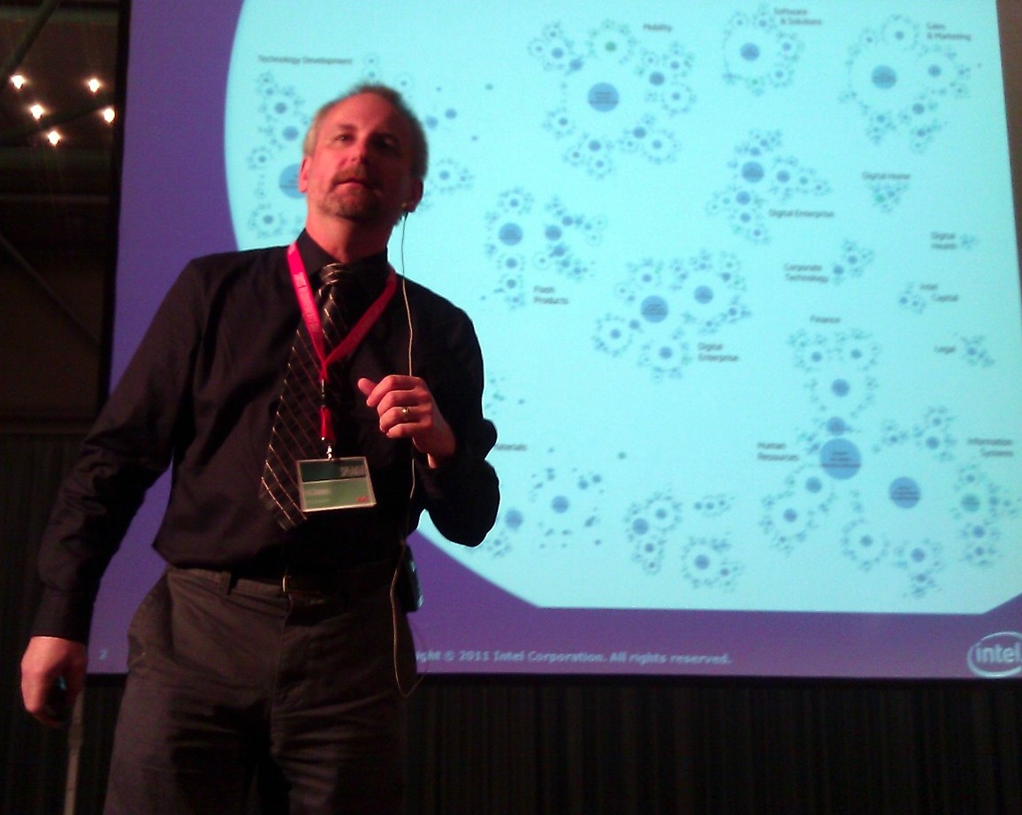
Competitive Engineering at Intel
Champion: Erik Simmons
Implementation began in 1999
Since then, more than 15,000 Intel students have seen training on elements of CE (mainly Planguage and SQC, with some Evo and Impact Estimation)
CE used on both full systems and SW projects
Work continues to spread adoption and improve use of the methods

Slide 50

A Recent Example: Intel
http://selab.fbk.eu/re11_download/industry/Terzakis.pdf
Application of Specification Quality Control by a SW team resulted in the following defect density reduction in requirements over several months:
Rev. | # of Defects | # of Pages | Defects/ Page (DPP) | % Change in DPP
0.3 | 312 | 31 | 10.06
0.5 | 209 | 44 | 4.75 | -53%
0.6 | 247 | 60 | 4.12 | -13%
0.7 | 114 | 33 | 3.45 | -16%
0.8 | 45 | 38 | 1.18 | -66%
1.0 | 10 | 45 | 0.22 | -81%
Overall % change in DPP revision 0.3 to 1.0: |  |  |  | -98%
Downstream benefits:
Scope delivered at the Alpha milestone increased 300%, released scope up 233%
SW defects reduced by ~50%
Defects that did occur were resolved in far less time on average
Notes:
The Impact of a Requirements Specification on Software Defects and Other Quality Indicators
John Terzakis
http://selab.fbk.eu/re11_download/industry/Terzakis.pdf
I’ve asked the team, and there were no explicit numeric quality levels enforced for the interim versions or the final version. This case, which was the particular team’s first foray into SQC, it was seen as an experiment with the technique. The results, even after a few revisions had been completed, were so strong that no one bothered to make explicit levels known. They just kept doing what they were doing, with the goal of not reverting to poorer quality than the previous iteration. The team relates they were comfortable with the quality levels after “a couple” of versions had been reviewed.
Start to finish, the table you have represents about 13 months of work.
BTW, I see this phenomenon in many teams here with SQC. The first pass reduced defect density by at least 50%, and after that, teams just continue to perform it without trying to predict a numeric target a priori. I think they get indirect feedback on the quality and completeness of the requirements from places like architecture teams and planning forums, and that evidence is more tangible to them than any numeric target. I suspect that with more time and practice, that pragmatic notion of “good enough” will be correlated with numeric density, and then we’ll see more targets established up front.
In my work, teams typically exit with densities ranging from 5 majors per page (600 words) to 1 defect in a couple of pages. The final density in John’s case study is particularly low; the best I have seen here so far. But it’s interesting that the teams don’t set numeric targets and then gun for them. They seem to rely on the use of the data and its reception in stakeholder groups for applied work to judge true quality.
But that gives me (and my colleagues) food for thought. We need to consider placing some sort of targets in place that are justified by how the requirements are used.
Thanks,
e
From: Tom Gilb [mailto:tomsgilb@gmail.com] Sent: Wednesday, November 02, 2011 4:04 PM To: Simmons, Erik Subject: Exit
can you tell me what exit levels were in force for the case
over what time period were the 0.2 0.x to 1.0 done

Slide 51
Planguage Overview as a Modelling Language

Slide 52
Planguage
A defined Planning Language for
Systems Engineering Modelling
Notes:
Monday, November 25, 2002 added Enthoven quote
Version 0.1 July 1 2002
Great credit is due to Lindsey Brodie, London, my Competitive Engineering book editor for very much of the material, especially diagrams, and good editing of other material. Almost all diagrams are taken from the CE book.

Slide 53
Detailed Tutorial Outline:
Planguage: a quantified planning language.
Integrating benchmarks and requirement targets
Quantified Quality Control of specifications
Impact Estimation Tables for quantified evaluation of design
Evolutionary Project Management
Notes:
Source CE 4.0 July 2002

Slide 54
Engineering Hierarchy
Engineering *224
Systems Engineering *223
Other Engineering
Systecture (Systems Architecture) *564
Program Management
Data Structures Strategy
Application Portfolio Strategy
Project
Platform Strategy
Engineering
Concepts
Methods
Strategy
Standards
Development
Architecture
Process *499
Processes
Requirements
Process
*612
Design
Engineering
*501
Evolutionary
Project Management
(Evo) *355
Design Process
*046
Impact Estimation
*283
Specification Types
(The)
Architecture
*192
(Artifacts)
Architecture
Specification
*617
Standards *138
- Security Standards
Interface Standards
Requirement
Specification
Standards
- Other
Requirement
Specification
*508
Design
Specification
*586
Impact
Estimation
Table
Evo Step
Specification
*370
Evo
Plan
*322
Notes:
INITIAL DIAGRAM MAY 5 2003 L BRODIE FOR CE BOOK
EDITED BY TOM MAY 5 03 ADDED NEW CONCEPT *612 REQUIREMENTS PROCESS, changes *192 to The (not systems arch)
FROM LB MAY 5 2003
This is very off the top of my head, but just thinking through the Glossary concepts and how they relate!
- Three Tiers: Higher-level concepts, Processes and Specifications
Duplication between Design Engineering and Design Process?
TG: NO. THE PROCESS CAN BE INFORMAL. ENGINEERING IMPLIES FORMALITY
Requirement Specification is just the ‘document’! Need the Process concept as well. = New Concept. = *612
I don’t understand if there is a duplication between Systems Architecture *192 and Architecture Specification *617? I WOULD SAY CLEAR DIFFERENCE, SEE BELOW WHERE I ADDED TYPE AND CHANGED DATE ONLY
=================================================
Architecture Specification: Concept *617 May 5, 2003
The Architecture Specification is the written and illustrated formal description of a system architecture.
Related Terms [Architecture Specification, *617]
Architecture (collective noun), *192 this is the observable architecture in a defined system. The spec may be describing desired future states of that system. Some parts of that spec might never be implemented in practice, since it serves as a vehicle to discuss architecture possibilities and options.
Architecture (the process) , *499. This process would normally have as an output an architecture specification.
Architecture Description, *618 can be broader than a specification, and include models, prototypes, and real systems to aid in describing a real or projected architecture.
Synonyms : [Architecture Specification *617
Architectural Specification, ] *617
Type [Architecture Specification *617]: Document [Specification].
========================================================
I am ignoring Software Engineering *572 in this diagram.
WHY? TG

Slide 55
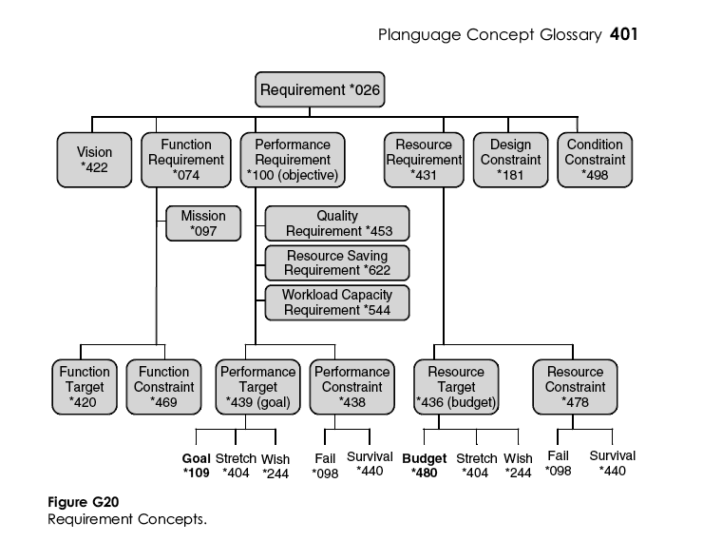
Part 1: Planguage: a quantified planning language.
A Planning Language - an engineering language
A systems engineering language (software, management)
Concept Glossary
Graphical Language
Control of Multiple dimensions: Performance, Costs, Constraints
Extendible, Tailorable, Open
Rich views, traceability, configuration management
Risk Management
Priority Management
Notes:
Figure 1.4: Diagram of a simple process showing its sub-processes and the key process-related inputs. A
rectangle is the symbol for a ‘written document.’ A rectangle with arrow is a ‘process’ symbol. An example 463
of such a process could be ‘Requirement Specification.’

Slide 56
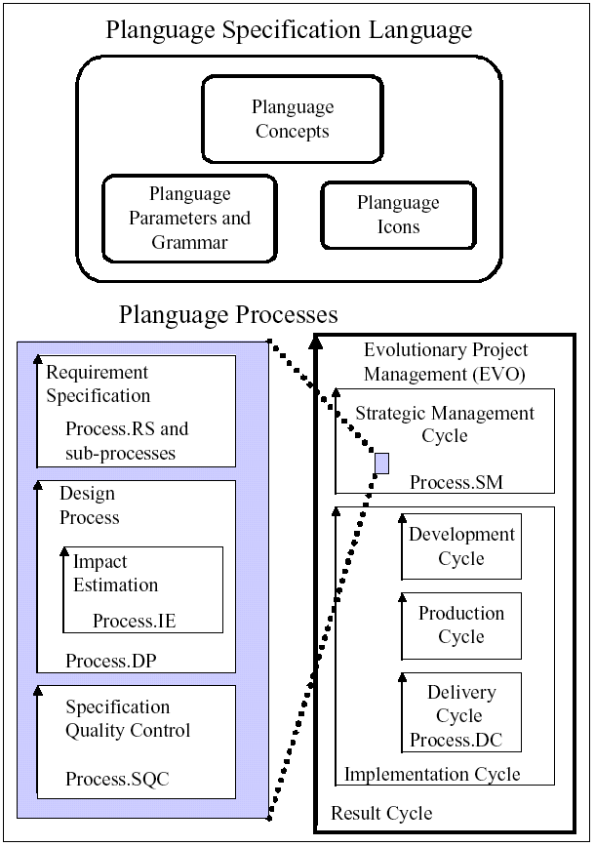
A Planning Language - an engineering language
Uses =
  Systems Analysis
  Requirements
  Contracting specs
  Design - Architecture
  Presentation
  Spec Quality Control
  Project Management
Notes:
Figure 1.3: Diagram of the components of Planguage, including one simple possible dotted line
relationship between them. Even more detailed, and more correct (as a consequence of being able to use
the feedback from practical experience and, from any information being up-to-date) specification of the
requirements and design ideas is likely to occur within the frequent Development Cycles. Detailed
explanation of the Evo Result Cycles can be found in Chapter 10 (and in the Glossary).

Slide 57
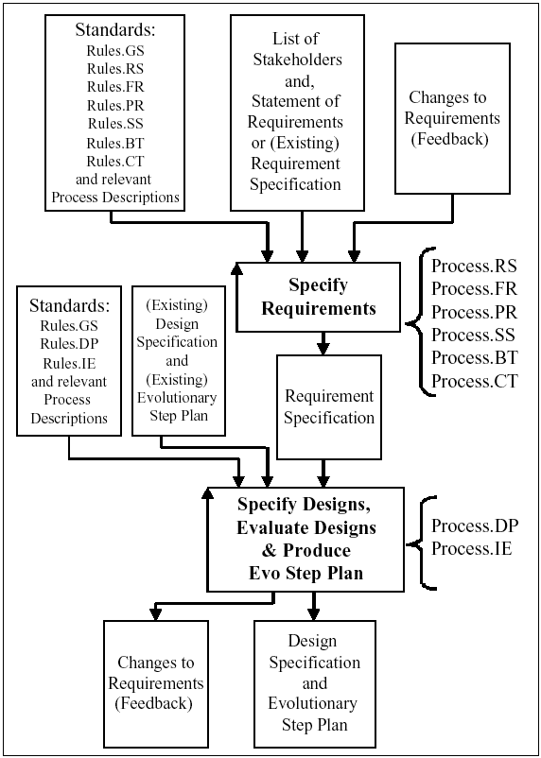
A systems engineering language
(also software, management)
Generic Ends-Means process
Well-defined standards
  Specification rules
  Requirements and design processes
  One page - modules
  Reuse of generic standards
Suitable for
  Top management strategy
  Marketing product plans
  Software engineering
  Systems engineering
  Specific engineering
    Aircraft for example
Planguage standards
Notes:
Figure 1.5: An overview of the Planguage-defined requirement and design processes.
Note: Iteration of the processes has been allowed for by including existing specifications as potential 534
inputs. Brackets have been used around descriptive words, which are added to assist understanding. 535
The aim is to show how the rules and process descriptions discussed in this book fit together. This diagram
shows steps P1 to P5 of the Generic Project process (Process.GP).

Slide 58
Requirements and Design
Standards:
Rules.GS
Rules.DS
Rules.IE
and relevant
Process
Descriptions
Standards:
Rules.GS
Rules.RS
Rules.FR
Rules.SR
Rules.SD
and relevant
Process Descriptions
List of
Stakeholders
and,
Statement of
Requirements
or Requirement
Specification
[Current]
Requirement
Specification
[Updated]
Design
Specification
[Current]
and
Evolutionary
Plan
[Current]
Changes to
Requirements
(Feedback)
Specify Requirements
(Requirement Specification)
Process.RS
Process.FR
Process.PR
Process.SD
Process.RR
Determine Design (Design Process)
{Analyze Requirements,
Find & Specify Design Ideas,
Evaluate Design Ideas (Impact Estimation),
Select Design Ideas & Produce Evo Plan}
Process.DP
Process.IE
Others
Changes to
Requirements
(Feedback)
Requirement
Specification
[Updated]
Design
Specification
[Updated]
and
Evolutionary
Plan
[Updated]
Notes:
April 27 2003 Lindsey Brodie from CE book manus

Slide 59
Generic Standards Overview
Engineering
Standards
Glossary
Concepts
Rules
Templates
Entry/Exit
Conditions
Clarity
Rules
Content
Rules
Engineering Policy
Requirement
Specification
Rules
Requirement
Content
Rules
Procedure
Definition
Design
Specification
Rules
Architecture
Content
Rules
Evo
Specification
Rules
Design
Content
Rules
Other
Specification
Rules
Other
Content
Rules
Notes:
Drafted July 20, 02
See Content Rules *
Edited by Simon Porro so that Requirement C or S Rules was at top of list
Used in Glossary work process std *138 and
Content rule *543
And clarity rules *129
And hopefully in Requirements slides about 126 Tuesday section

Slide 60
Standard *138
Rule
*609
Concept
*595
Policy
*111
Process
*113
Specification
*137
Others
(For example:
Interface)
Template
*254
Form
*068
Other
Generic Specification Rule
Concept Rule
Policy Rule
Entry Condition
*056
Process Rule
Process Structure
Procedure
*115
Specification Rule
Exit Condition
*064
Other Rules
Notes:
There are many different types of standards. For each standard type there is at least one set of rules that apply. The rules govern the structure of the content of the standards and are used in quality control.
For each standard type, there will be many instances of the standard. For example, there will be a set of standard templates and a set of standard processes. In this diagram, many different instances of rule are shown.
LB 22Feb 03 for CE

Slide 61
Concept Glossary
    Glossary Purpose.
The central purpose of this Planguage glossary is to define ‘Concepts’ – not words.
These concepts have many ‘names’ (or ‘tags’ in Planguage) and attributes.
The ‘names’ function as ‘pointers’ to the concept, but names do not change or determine the concept itself.
Names, numbers and icons merely cross-reference the concept.
The central, universal identification tag of a concept is its unique number, prefaced by an asterisk (*001 etc.).
This device is designed to allow and enable full or partial translation to various international languages, and to corporate dialects.

Slide 62
Graphical Modelling Language
PLANGUAGE TERM Keyed ICON
Planguage Concept
Gist: ∑
Ambition Level: @.∑
Scale: -|-|-
Meter: -|?|-
TARGETS
Goal: >
Stretch: >+
Wish: >?
CONSTRAINTS
Fail: >>
Survival Limit: [ ]
SYSTEM SPACE CONDITIONS
Time, Place & Event [qualifier conditions]
Background Information:
Source: <-
Comment: “text.”
BENCHMARKS
Past: <
Record: <<
Trend: ?<
For many concepts we have defined graphical symbols
Keyed Icons:
  So that symbols can be keyed in combination with text specification
  Similar to corresponding drawn icons
Drawn icons:
  Suitable for graphical presentation
Why?
  International language
  Avoids debates over word choice
  Short notation
Notes:
Figure 4.7: Icons for Scalar Attribute Requirements

Slide 63
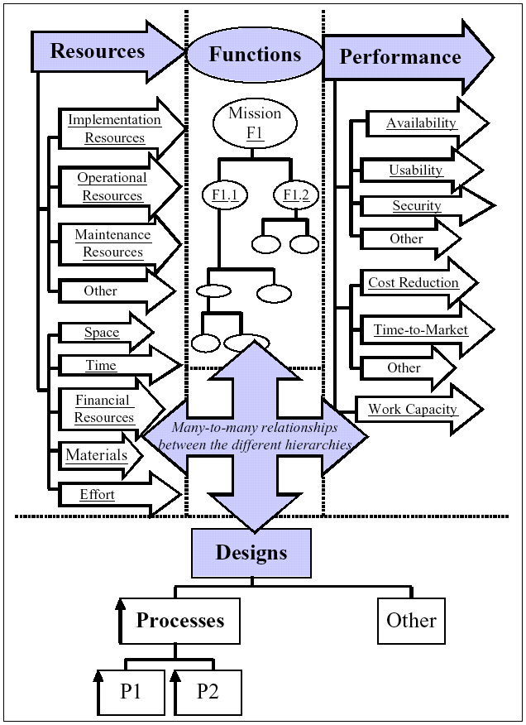
Control of Multiple dimensions:
Performance, Costs, Constraints
Planguage specializes in
  trying to get control over
    multiple and
    dynamically changing
    critical system attributes,
  through quantified
    requirement specification,
    design impact analysis and
    measurement tactics.
Notes:
Figure 3.3: This shows the four main system attribute types: resource, function, performance and design. It
also shows the processes, which implement the functions. Using Planguage, the complex relationships 932
amongst these four different types can be specified. For example, a specific performance level might apply
only to a handful of functions rather than the entire system or, a function might be implemented by several 934
processes or, different resources can be specifically allocated to different functions.

Slide 64
Extendible, Tailorable, Open
Planguage:
  Free of cost, & royalties
  Easy to extend
  Easy to modify locally
    Corporate
    Project level
    National language
  Designed for re-use and tailoring of reused elements
Notes:
Figure 1.9:
I. At the top of the diagram, the two main, generic components of Planguage, the specification language and the process descriptions are shown. (These two components correspond to the version of Planguage presented in this book.)
II) In the middle of the diagram, the specific version of Planguage (Project Language and specific process descriptions) selected for use by a project is shown. This specific version will have been tailored by the project. The Project Language consists of the Product Language and the (Project) Specific Specification Language, which includes the (Project) Specific Process Language. The Product Language will always be unique to a project, as it comprises the actual values and variables of the project specifications.
III) The bottom of the diagram shows a generic model of a project process and how the various components of Planguage map onto it.

Slide 65
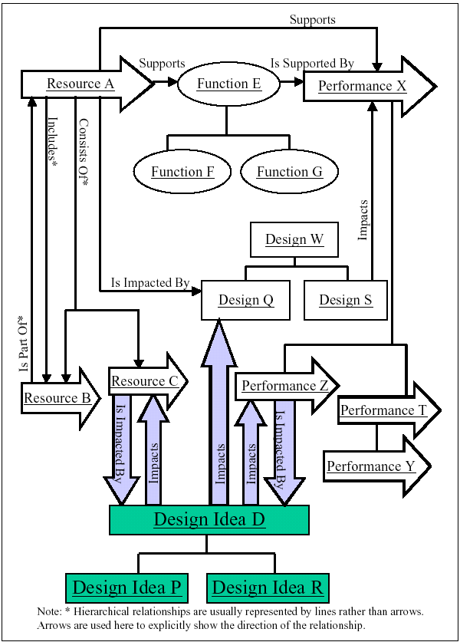
Rich views, traceability, configuration management
Some Planguage parameters which define relationships.
  Authority
  Source
  Owner
  Author
  Implementer
  Impacts
  Supports
  Supported By
  Version
  Derived From
  Sub-component of
  Sub-components {list}
  Dependencies
  Contract
  Test Case
  Scenario
  Model
  And more!
Notes:
Figure 2.5: Diagram showing how to express the relationships amongst attributes, between attribute and
design idea and, amongst design ideas.
Note: Simplified icons are shown for resource and performance (In ‘true’ icons, the block arrows should 1369
each be linked to an oval, representing function).
The ‘linking’ terms include: Consists Of, Includes, Impacts, Is Impacted By, Supports, Is Supported By and, Is Part Of.
Note: Not all relationships are shown.

Slide 66
Specification Structure
Examples:
Requirement Specification,
Design Specification
Specification *137
Examples:
Parameter Statements for
Goal, Gist, Type
Statement *224
Expression *302
Examples:
Qualifier Conditions, Sets,
Scale Qualifiers
Standard
Language
Example:
Text in Comments
Defined Term *253
Metric *095
Examples:
60, 15
User-Defined
Term *530
Planguage
Term *211
Examples:
Goal, Scale, Function
Examples:
Usability,
Service Costs
Standard
Icon
Planguage
Icon
Graphical Icon *127
Example:
An Oval for Function
Keyed Icon *144
Examples:
> -|-|- O % ±
Notes:
BY LINDSEY BRODIE JAN 29 2003

Slide 67
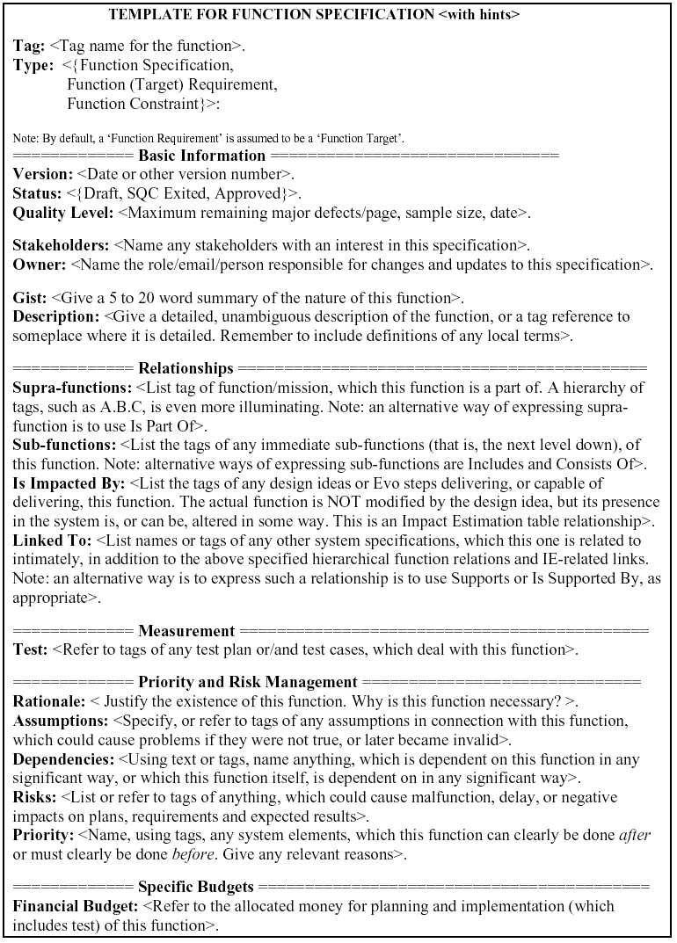
Risk Management
Planguage integrates specific tools for risk specification
  with more general tools for risk recognition and risk analysis
  in a single integrated specification language.
  Risk Management: A practical toolkit for identifying, analyzing and coping with project risks.
    http://www.gilb.com/tiki-download_file.php?fileId=20
Notes:
Source CE 3.8 July 2002
See Gilb paper on Risk Management

Slide 68
Priority Management
Priority is
  Claim on scarce or limited resources
Is a function of
  Constraint type (Survival, ..)
  Target type (Goal, ..)
  Remaining gap to constraint or target level & [qualifiers]
  Remaining budgeted resources; and their constraint and target levels
Priority is dynamically computable!
Priority is also related to other specification parameters such as
  Authority
  Sponsor
  Source
Managing Priority Paper
http://www.gilb.com/dl60
Notes:
Figure 4.9: Example of using some of the scalar icons: Two performance target levels and two constraint levels compared to one benchmark level
http://www.gilb.com/dl48
Choice and Priority paper
Managing Priority Paper
http://www.gilb.com/dl60

Slide 69
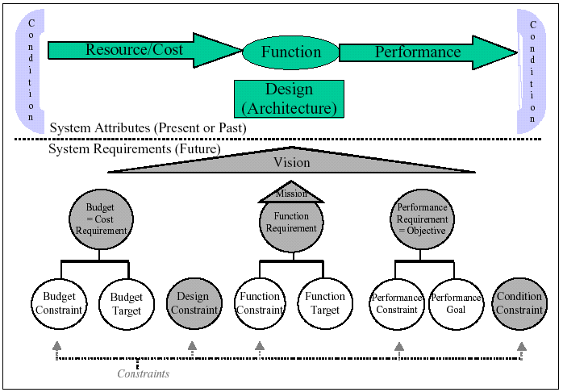
Part 2: Integrating benchmarks and requirement targets
Systems analysis benchmarks are integrated with setting future requirements.
This improves Competitive Analysis and Competitive Engineering Specification
Scales: powerful flexible measures to compete with
Meters: practical ways to measure performance levels
Benchmarks: Past, Record, Trend
Targets: Goal, Stretch, Wish, Ideal
Constraints: Fail , Survival (Tolerable)
Notes:
Figure 2.1: Mapping of system attributes to requirements. (See also Chapter 6, for further discussion of
Constraints.)

Slide 70
Systems analysis benchmarks are integrated with setting future requirements.
Adaptability:
Type: Quality Requirement.
Scale: the calendar time in hours needed to re-configure the defined [Base Configuration] to any
other defined [Target Configuration] using defined [Methods] and defined [Reconfiguration Staff].
Expert Reconfiguration: Defined As:
{Base Configuration = Novice Setup,
Target Configuration = Expert Setup,
Methods = Selection of Library Reconfiguration Process,
Reconfiguration Staff = Qualified Expert}.
======== Benchmarks ==================================
Past [Expert Reconfiguration, Version 0.3, Asian Market]: < 1 hour.
========= Goals (Performance Targets)===================
Authority [Goals]:Federal Drug Administration.
Goal [Expert Reconfiguration, Deadline = Version 1.0]: < 0.5 hours.
Goal [Expert Reconfiguration, Deadline = Version 2.0]: < 0.1 hours.
========== Constraints ================================
Fail [All USA Products]: < 0.7 hours.
Fail [Expert Reconfiguration, Deadline = Version 2.0]: < 0.5 hours.
Survival [Expert Reconfiguration, European Market]: < 1 working day.
Fail: edge of failure range
!
Some pain or distress
Notes:
Diagram is from CE 4.3
2.1 Quality Requirement
A quality requirement expresses how well a system performs.
Example: (slide above)
This quality is a measure of how well a system is designed to adapt to reconfiguration needs in the future.
Note:
This is a quality requirement even though it has a Scale that involves measurement of a resource. The reason that this is not a resource saving is that a specific level of resource saving is not being requested. The resource measurement is simply a convenient way of capturing the adaptability of the system. This is also not a budget (cost requirement) as the level is not set up primarily to monitor the expenditure of resource. These are important distinctions, because as a consequence of them, you will be forced to react in different ways to the problems arising in meeting these requirements.

Slide 71
Scalar Level Types
Fail do: a level constraint needed for avoiding some pain, loss, discomfort
Goal: the target level needed for satisfaction, happiness, joy and 100% full payment!
Wish: a target level desired by someone, but which might not be feasible. Project is not committed to it.
?
Stretch: a motivational target, but a difficult target
+
[ ]
Survival: an extremely strong constraint level: Failure point
Benchmarks:
Past: any useful reference point. Your old product, a competitors organization, or a quality achieved in same discipline but different branch of business.
Record: best in some class, state of the art. Something to beat. A challenge for you. An extreme Past.
?
Trend: a future guess based on Past.

Slide 72
This improves Competitive Analysis and Competitive Engineering Specification
Competitive Analysis
  Make sure your own and competitor levels are
    analyzed and specified
    together with future requirements
Competitive Engineering
  Make sure you not only specify the balanced ‘goal’
  but that marketing information about ‘wishes’ is captured.
  Make sure that the engineer is challenged by a ‘stretch’ goal
Notes:
Source CE Figure 4.5: Requirement Specification Hierarchy for a Quality Requirement

Slide 73
Scales: Units of measure - a foundation
  Scale -|-|- Concept *132 January 9, 2003
A ‘Scale’ parameter is used to define a ‘scale of measure’.
All elementary scalar attribute definitions require a defined Scale.
A Scale states the fundamental and precise operational definition for a specific scalar attribute.
It is used as the basis for expressing many of the parameters within the scalar attribute definition (for example, Meter, Goal and Budget):
  all scalar estimates or measurements are made with reference to the Scale.
  The Scale states the units of measurement, and any required scalar qualifiers.
User Friendly:
Type: Quality Requirement.
Ambition: To consistently exceed Competitor’s ease of learning.
Scale: Time to Master
a defined [Task]
by defined [Learner].
Meter: <Use good academic practice, do at least 10 Tasks, with at least 5 Learner Types and at least 50 people>.
Record [Competitor AA, Product XYZ, Task = Dial Out, Learner = Novice]: 2 minutes <- Our current tests.
Goal [Our Company, Product ABC, Task = Dial Out, Learner = Novice]: < 10 seconds <- Marketing Requirement 4.5.7.
Master: Defined as: ability to pass a suitable approved test.
Notes:
Scale -|-|- Concept *132 January 9, 2003
A ‘Scale’ parameter is used to define a scale of measure. All elementary scalar attribute definitions require a defined Scale.
A Scale states the fundamental and precise operational definition for a specific scalar attribute. It is used as the basis for expressing many of the parameters within the scalar attribute definition (for example, Meter, Goal and Budget): all scalar estimates or measurements are made with reference to the Scale. The Scale states the units of measurement, and any required scalar qualifiers.
Notes:
1. A Scale is not a numeric level along the defined Scale (It is not a benchmark, target or constraint).
2. A Scale is not the measuring instrument (that is specified by the Meter parameter).
A Scale describes something, which is variable, trackable, observable, and countable in nature. A Meter specification is the definition of the means of measuring the ‘level of capability’ expressed by a Scale. For example, a Meter is the ‘voltmeter’ for measuring on a scale of ‘volts’. A Scale is abstract, while a Meter is a real-world, practical means of obtaining measurements. A specific Meter itself has multiple performance and cost attributes. These are the basis for selecting a particular Meter.
There is a big distinction between units of measure (Scale) and a measuring tool (Meter or Test). Units of measure can be used to express clear ideas, like requirements, quite independently of the possibilities and problems of measurement itself. I can express a clear idea: “I want to get to the moon and back in one second” quite clearly. The fact that I cannot really do it, or measure it, is beside the point. I stress this because I have discovered that many people waste their energy arguing against a particular quantification, when all their arguments are only related to the difficulty of its’ accurate measurement.
3. Many Scales are specified as ‘generic scales.’ A generic scale is a Scale that requires final specification of ‘scale qualifiers’ (in the Scale definition) by means of ‘scale variables’ (in a target, or constraint specification), in order to have an operationally precise definition.
Example:
Scale: Time to Master defined [Tasks] by defined [Learner Type].
There are two scale qualifiers in the above generic scale definition, which require definition by scale variables. For example, ‘Goal [Tasks = Update, Learner Type = Novices]: 30%’.
Related Concepts [Scale *132]:
Scale Qualifier *381. Scale qualifiers are terms within a scale definition, which need to be specifically defined by scale variables, when the scale definition is used in scalar level specifications, like ‘Goal’, is later used.
Example:
Scale: The defined [Time Units] needed to do a defined [Task] by defined [Employee Type].
‘Time Units’, ‘Task’ and ‘Employee Type’ are all scale qualifiers.
Scale Variable *446.
Example:
Goal [Task = Update, People = Naval Officer, Places = At Sea]: 99%.
‘Update’, ‘Naval Officer’ and ‘At Sea’ are all scale variables assigned to the scale qualifiers.
Meter *094. The specified measuring process, or test, to determine, for a real system, where we are on a defined scale of measure (Scale).
Example:
User Friendly:
Type: Quality Requirement.
Ambition: To consistently exceed Competitor’s ease of learning.
Scale: Time to Master a defined [Task] by defined [Learner Type].
Meter: <Use good academic practice, do at least 10 Tasks, with at least 5 Learner Types and at least 50 people>.
Record [Competitor AA, Product XYZ, Task = Dial Out, Learner Type = Novice]: 2 minutes <- Our current tests.
Goal [Our Company, Product ABC, Task = Dial Out, Learner Type = Novice]: < 10 seconds <- Marketing Requirement 4.5.7.
Master: Defined as: ability to pass a suitable approved test.
The Scale includes two scale qualifiers (Tasks and Learner Type). These are reused as scale variables in the benchmark (Record) and target (Goal), in order to tailor the meaning to particular sets of Tasks and Learner Type. The scale variables are usually local to the specific specification (in this case, User Friendly).
Synonym [Scale *132]: Scale of Measure.
Keyed Icon [Scale *132]: -|-|-
Type: Parameter, Metrics Concept.
“To leave [soft considerations] out of the analysis simply because they are not readily quantifiable or to avoid introducing “personal judgments,” clearly biases decisions against investments that are likely to have a significant impact on considerations as the quality of one’s product, delivery speed and reliability, and the rapidity with which new products can be introduced”
<- R. H. Hayes et al “Dynamic Manufacturing,” page 77 in [MINTZBERG94, page124]
“Aligning Rewards with Measurements
“You have to get this one right. … a universal problem: What you measure is what you get – what you reward is what you get. Static measurements get stale. Market conditions change, new businesses develop, new competitors show up. I always pounded home the question ‘Are we measuring and rewarding the specific behavior we want?’ “
Jack Welch, former CEO General Electric [WELCH01, page 387]

Slide 74
Scale Parameter Concepts
<
<
Past Level
Past Level
Resource Benchmarks
Performance Benchmarks
[
!
]
[
!
]
Survival Fail Survival
Level Level Level
Survival Fail Survival
Resource Constraints
Performance Constraints
>
>
>
>
>
>
?
+
+
?
Wish Stretch Goal
Goal Stretch Wish
Resource Targets
Performance Objective
Specification
Performance Targets
Notes:
Version 1.0 april 22 2002 LB
Version 1.1 April 23 TG
V 1.2 feb 4 03 correct >> to !
Feb 4 corrected 3x Budget -> Resource

Slide 75
Meters: practical ways to measure performance levels
  Meter -|?|- Concept *093 April 18, 2003
A Meter parameter is used to
  identify, or specify,
  the definition of a practical measuring device, process, or test
  that has been selected for use in measuring a numeric value (level) on a defined Scale.
Repair:
Ambition: Improve the speed of repair of faults substantially, under given conditions.
Scale: Hours to repair or replace, from fault occurrence to when customer can use faultlessly, where they intended.
Meter [Product Acceptance]: A formal test in field with at least 20 representative cases,
[Field Audit]: Unannounced field testing at random.
================ Benchmarks ============================
Past [Product = Phone XYZ, Home Market, Qualified Dealer Shop]:
{0.1 hours at Qualified Dealer Shop +
0.9 hours for the Customer to transit to/from Qualified Dealer Shop}
Record [Competitor Product XX]: 0.5 hours average.
"Because they drive a spare to the customer office."
Trend [USA Market, Large Corporate Users]: 0.3 hours. "As on-site spares for large customers."
=========== Targets =======================================
Goal [Next New Product Release, Urban Areas, Personal Users]: 0.8 hours in total,
[Next New Product Release, USA Market, Large Corporate Users]: 0.2 hours
<-Marketing Requirement, 3 February This Year.
=========== Constraints ====================================
Fail [Next New Product Release, Large Corporate Users]: 0.5 hours or less on average
<-Marketing Requirement, 3 February This Year.
Notes:
Meter -|?|- Concept *093 April 18, 2003
A Meter parameter is used to identify, or specify, the definition of a practical measuring device, process, or test that has been selected for use in measuring a numeric value (level) on a defined Scale.
“… there is nothing more important for the transaction of business than use of operational definitions.”
W. Edwards Deming, “Out of the Crisis” [DEMING86]
Example:
Satisfaction:
Scale: Percentage of <satisfied> Customers.
Meter [New Product, After Launch]: On-site survey after 30 days use for all Customers.
Past [This Year, USA]: 30%.
Meter [Past]: Sample of 306 out of 1,000+ Customers.
Record [Last Year, Euro]: 44%.
Meter [Record]: 100% of Customers.
Goal [After Launch]: 99% <- Marketing Director.
In the above example, the first Meter specification is the one that will be assumed, in default of any other specification, particularly for use in validating the achievement of Goal targets. Both the benchmarks (Past, Record) have local Meter specifications, which tell us more exactly the measuring process used to gather their data. Of course this implies that these benchmark and target numbers are not as comparable as we would like them to be. But that is the way it often is, and our local Meter specifications at least allows us to judge whether this difference is significant for our current purposes.
Keyed Icon [Meter *093]: -|?|-
“The explanation of the icon is that it is a ‘?’ on top of a Scale icon, -|-|-.”
Type: parameter, metrics concept.

Slide 76
Benchmarks: Past, Record, Trend
Past: A relevant benchmark level already achieved by an existing system (our own, competitive, or any other system) that is worth consideration.
Record: A ‘Past’, which is the best known result [in some defined area]. A 'state-of-the-art' value.
Trend: An extrapolation of past data, trends and emerging technology to a defined [time and place].
  Aside from our own project’s plans to improve this level, what future levels are likely to be achieved by others?
  What will we be competing with?
Usability [New Product Line, Major Markets]:
Ambition: To achieve a low average time-to-learn to use our telephone answerer, under various conditions.
Scale: Average number of minutes for defined [representative user and all their household family members over 5 years old] to learn to use defined [basic daily use functions] correctly.
Meter [Product Acceptance]: A formal test in field with at least 20 representative cases,
[Field Audit]: Unannounced field testing at random.
========= Benchmarks ==========
Past [Product XYZ, Home Market, People between 30 and 40 years old, in homes in Urban Areas, <For one explanation & demo>]: 10 minutes.
Record [Competitor Product XX, Field Trials]: < 5 minutes?> <- one single case reported,
Trend [USA Market, S Corporation, By Initial Release]: 10 seconds <- Public Market Intelligence Report.
======== Constraint =====================
Must [Next New Product Release, Children over 10]: 5 minutes
<- Marketing Requirements 3 February Last Year.
========= Targets ================
Plan [Next New Product Release, Urban Areas, Personal Users]: 5 minutes total,
[Next New Product Release, USA Market, Large Corporate Users]: 5 minutes <- Marketing Requirements 3 February Last Year.
Stretch [Next Year]: (Record - 10%).
Notes:
Benchmark Concept *007 February 20, 2003 22:51
A benchmark is a specified reference point, or baseline. There are two main types: scalar and binary benchmarks.
Notes:
1. A scalar benchmark is a reference level for a performance or resource attribute. It is usually used for comparison purposes in requirement specification, design and implementation.
2. A scalar benchmark is normally defined using the benchmark parameters {Past, Record, Trend}.
Example:
Usability:
Ambition: Order of magnitude better than future competitors.
Scale: Average time needed to learn to do Typical Tasks for Typical User.
Trend [Best Competitors, During New Product Lifetime, Europe Market & USA Market]: 5 minutes.
Fail [New Product, All Markets]: 2 minutes.
Goal [New Product, Initial Release]: 1 minute.
Goal [New Product, 1 Year After Initial Release]: 30 seconds.
‘Trend’ is the benchmark specification.
3. Function and design attributes are specified as binary benchmarks: binary attributes are either present or absent in a system.
Related Concepts [Benchmark *007]:
Baseline *351
Past *106
Record *127
Trend *155
Type [Benchmark *007]: Specification Type.

Slide 77
Targets: Goal, Stretch, Wish, Ideal
Usability [New Product Line, Major Markets]:
Ambition: To achieve a low average time-to-learn to use our telephone answerer, under various conditions.
Scale: Average number of minutes for defined [representative user and all their household family members over 5 years old] to learn to use defined [basic daily use functions] correctly.
Meter [Product Acceptance]: A formal test in field with at least 20 representative cases,
[Field Audit]: Unannounced field testing at random.
========= Benchmarks ========================
Past [Product XYZ, Home Market, People between 30 and 40 years old, in homes in Urban Areas, <For one explanation & demo>]: 10 minutes.
Record [Competitor Product XX, Field Trials]: < 5 minutes?> <- one single case reported,
[USA Market, S Corporation]: 10 seconds <- Public Market Intelligence Report.
======== Constraint =====================
Fail [Next New Product Release, Children over 10]: 5 minutes
<- Marketing Requirements 3 February Last Year.
========= Targets ================
Goal [Next New Product Release, Urban Areas, Personal Users]: 5 minutes total,
[Next New Product Release, USA Market, Large Corporate Users]: 5 minutes <- Marketing Requirements 3 February Last Year.
Stretch [Next Year]: (Record - 10%).
Wish [Ultimately] <few seconds>
Ideal: 0 seconds.
Goal: A future required level under [defined conditions], which at least has to be achieved to claim success in meeting a requirement. A signal to stop investing in levels better than this level; because the value gained is insufficient to justify additional costs.
Budget: a ‘Goal’ level for costs.
Stretch: A future desired and valued level, under [defined conditions], which is designed to challenge people to exceed Plan levels.
Wish: A future desired level, which is valued by a stakeholder. The requirement is not planned or promised yet; due to technical or cost reasons – or lack of evaluation, but it is recorded, and kept in the requirement database (even if not acceptable now), so that it can be borne in mind as a future competitive opportunity.
Ideal: a future desired level which is perfect.
Notes:
Target Concept *048 March 14, 2003
A target is a specified stakeholder-valued requirement, which you are aiming to deliver under specified conditions.
There are two kinds of target: ‘scalar’ and ‘binary’.
Scalar targets are specified using the parameters {Goal, Budget, Stretch, Wish}.
A performance target is known as a ‘goal’ and a resource target is known as a ‘budget’.
Binary targets are function targets.
Notes:
1. A target is not a constraint. Targets specify the success levels for scalar requirements, and any stakeholder-desired binary requirements. Constraints by contrast specify any failure and/or survival levels for scalar requirements, and any mandatory requirements for binary requirements.
2. Function targets, valued functions, are subtly different from function constraints. Function constraints are mandatory. If a function constraint is not met then some degree of failure will occur, or even total system catastrophe. Function targets do not have implied penalties – but can have specified ones (‘Rationale’ and other attached specs): nevertheless, they are considered required by some stakeholder.
3. A scalar target specification consists of a numeric value (its target level) and its relevant [qualifiers]. As well as Goal, Budget, Stretch and Wish; ‘Ideal’ is a target parameter, but it is rarely used except to point out that it is unrealistic.4. Target can also be used as a collective noun, applied to a set of function targets and variable scalar targets with their individual qualified levels.
Related Concepts [Target *048]: Goal *439: a performance target Budget *421: a resource target
Benchmark *007
Constraint *218
Function Target *420
Scalar Target *470
Keyed Icon [Target *048]: @
Figure [*048] Scalar targets can be specified for both performance and resource requirements.
Type [Target *048]: Specification Type.

Slide 78
Targets
Notes:
Figure [*048] Scalar targets can be specified for both performance and resource requirements <-CE Glossary 5May 03 tg

Slide 79
Constraints: Fail, Survival
Fail Concept *098 April 21, 2003
  ‘Failure’ signals an undesirable and unacceptable system state.
  A Fail parameter is used to specify a Fail level constraint; it sets up a failure condition.
  A Fail level specifies a point at which a system or attribute failure state can occur.
  A single specified number (like Fail: 90%) is assumed to be the leading edge of a Failure Range.
Survival Concept *440 March 3, 2003
  Survival is a state where the system can exist.
  Outside the survival range is a ‘dead’ system caused by a specific attribute level being outside the survival range.
    For example, ‘frozen to death’ or ‘suffocated’.
  A Survival parameter specifies the upper or lower acceptable limits under specified conditions [time, place, event], for a scalar attribute.
  It is a constraint notion used to express the attribute levels, which define the survival of the entire system.
Usability [New Product Line, Major Markets]:
Ambition: To achieve a low average time-to-learn to use our telephone answerer, under various conditions.
Scale: Average number of minutes for defined [representative user and all their household family members over 5 years old] to learn to use defined [basic daily use functions] correctly.
Meter [Product Acceptance]: A formal test in field with at least 20 representative cases,
[Field Audit]: Unannounced field testing at random.
========= Benchmarks ========================
Past [Product XYZ, Home Market, People between 30 and 40 years old, in homes in Urban Areas, <For one explanation & demo>]: 10 minutes.
Record [Competitor Product XX, Field Trials]: < 5 minutes?> <- one single case reported,
[USA Market, S Corporation]: 10 seconds <- Public Market Intelligence Report.
======== Constraints=====================
Fail [Next New Product Release, Children over 10]: 5 minutes
<- Marketing Requirements 3 February Last Year.
Survival [Next New Product Release, Children over 10]: 10 minutes
========= Targets ================
Goal [Next New Product Release, Urban Areas, Personal Users]: 5 minutes total,
[Next New Product Release, USA Market, Large Corporate Users]: 5 minutes <- Marketing Requirements 3 February Last Year.
Stretch [Next Year]: (Record - 10%).
Notes:
Constraint Concept *218 March 31, 2003
A constraint is a requirement that explicitly and intentionally tries to directly restrict any system or process.
A key property of a constraint is that a penalty or loss of some kind applies if the constraint is not respected.
Constraints include limitations on the engineering process, a system’s operation, or its lifecycle.
A constraint is "something that restricts" <-The American Heritage Dictionary (Dell).
Notes:
1. There are two kinds of constraints: Binary and Scalar.
Binary constraints are statements that tend to include the words ‘must’ or ‘must not’: that is, they tend to make demands about what is mandatory for the system or what is prohibited for the system. Binary constraints are declared either by using a Constraint parameter or by specifying ‘Type: Constraint.’
Examples:
C1: Constraint: A design idea must not be made of material, components or products only produced outside the European Market, if there is any EU material which can be used.
C2: Constraint: The design must contain ideas based on our own patents whenever possible.
C3:
Type: Constraint.
Defined As: All stakeholder critical qualities must be planned and delivered so that they are viewed as obviously and significantly better than any competitor in the same price range.
From an attribute viewpoint, binary constraints are function constraints, design constraints or condition constraints.
Scalar constraints are specified for performance or resource attributes. They are specified using Fail and Survival parameters, which set the constraint levels on a scale of measure.
2. All engineering specifications (requirements and design) and management plans, once stated, potentially and probably have some constraining influence on the rest of the planning or engineering process. So all specifications and plans are ‘constraints’ in this sense.
However, we can clearly distinguish between specifications where the primary intent is to constrain (like a mandatory constraint or a level for Survival), and those specifications where the primary idea is not to constrain, but to motivate positively (for example, a binary function target or, a scalar performance target, such as a Goal or Stretch level). We could classify the former as ‘intentional and direct constraints’ and the latter as ‘unintentional and indirect constraints’.
So, we only classify specifications and concepts as ‘constraints’ when the clear intent and primary purpose is to restrain, limit, restrict constrain, or stop.
3. You have to look at constraints from a ‘stakeholder’ viewpoint. As with any requirement or design, what is a requirement for one level of system stakeholder, is a constraint as viewed by sub-ordinate stakeholder levels.
One stakeholder’s requirement is another stakeholder’s constraint.
4. All constraints are valid for their associated defined conditions. Sometimes the constraint conditions are stated explicitly, sometimes they are implied or inherited from more global specifications.
A ‘global’ constraint is usually imposed by higher levels of authority, or by earlier planning processes. For example: by company policy, law, contract, strategic planning or systems architecture.
Examples:
An example of a global constraint:
Availability Criteria: Constraint: No Company Product shall ever be designed with less than 99.5% availability.
A corresponding local constraint setting a higher constraint level:
Fail [US Market, Military Systems]: 99.98%.
5. Constraints can be classified by the ‘relative level of organization’ they apply to, as proposed by Ralph Keeney [KEENEY92]:
Fundamental Constraints: handed down to us from higher authority
Strategic Constraints: ones we have imposed at our own level, over which we have control
Means Constraints: constraints imposed at levels supporting us, which we can therefore overrule.
6. All requirements, including all constraints, have different ‘priority’. This priority (or ‘power’) is determined by the conditions (the qualifiers) and by their related specifications (for example, by parameters like ‘Authority’). It is a complex process to determine constraint priority, and the ‘answer’ is dynamically changing. There is probably no absolute constraint that must be respected ‘no matter what’. That is, there might always be a higher priority consideration that overrides a given constraint. For example, ‘Thou shalt not kill (except in self defense)’.
7. Constraints always represent, in some way, some of the values of some stakeholders. But a given constraint does not necessarily agree with the values of all stakeholders. The constraint of one stakeholder might be in direct conflict with the requirements of another stakeholder.
8. Any set of categories (including no categories!) can be specified for classifying constraints. System, performance, budget and design are an arbitrary few such categories.
9. I view constraints as borders around a problem. We can do anything we like within the borders, but we must not wander outside them.
Figure *218: Constraints impose restrictions on both other requirements and designs. But the remaining space (‘OK’) gives considerable freedom to set more-exact requirements, and to specify more-exact designs.
10. A requirement is a ‘constraint on succeeding engineering processes’ in fact, if and only if it has an authority, or other form of priority, which in fact means that:
you must stay within its guidelines (when making later decisions or specifications)
you cannot change it yourself (in order to avoid obeying it), without authority to do so.
Related Concepts [Constraint *218]:
Requirement *026
Function Constraint *469
Performance Constraint *438
Resource Constraint *478
Design Constraint *181
Condition Constraint *498
Survival *440
Fail *098
Figure *218a: Drawn Icons for Constraints
Keyed Icons [Constraint *218]:
For Survival: [ and/or ]
For Fail: !
In context: ----[-------!---]---->O---[----------!---]----->
Type [Constraint *218]: Requirement Class, Parameter.

Slide 80
Constraint Graphics
Notes:
From glossary CE May 5 2003 Constraint

Slide 81
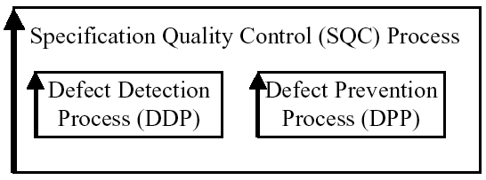
Part 3: Quantified Quality Control of specifications
Quality Control of Specification (SQC)
The quantified Exit and Entry controls
Reviewing the Quality of a specification’s ‘Competitiveness’
How does Planguage help QC?
How does Planguage help Reviews?
How does QC impact competitiveness?
Notes:
Ill. Source CE 8.2

Slide 82
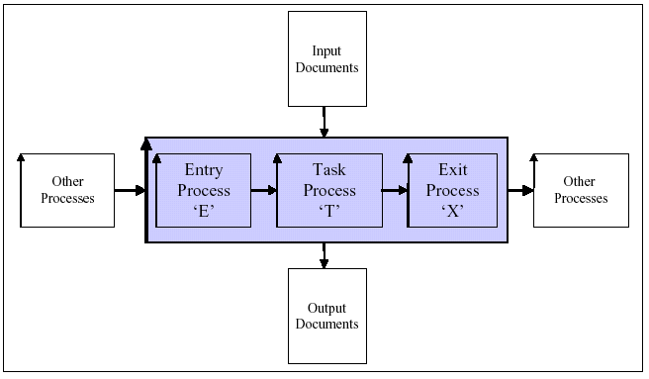
Quality Control of Specification Models (SQC)
Spec QC is done
  when the input (other) work process meets entry conditions (E)
  According to a defined QC process (T)
  And is released to other process when exit conditions are met (X)
  And is done by comparison with other related documents and spec rules (Input)
  Producing reports and process control statistics (Output)

Slide 83
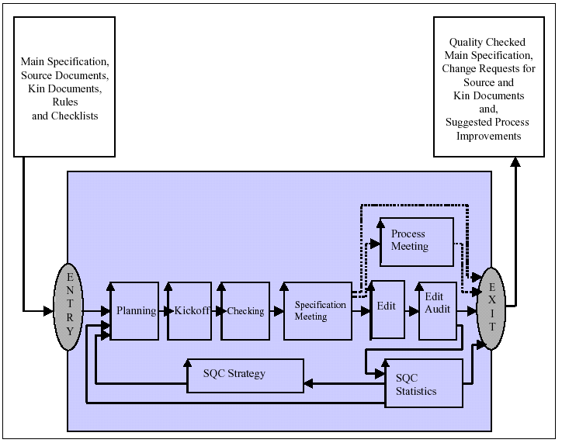
Quality Control of Specification: Detail (2)
Notes:
Figure 8.2: Diagram of the SQC Process showing the sub-processes.
The ‘Process Meeting’ sub-process is exclusively a part of Defect Prevention Process (DPP). All the rest is
Defect Detection Process (DDP), although there may be a small component of DPP within some of these
processes.

Slide 84
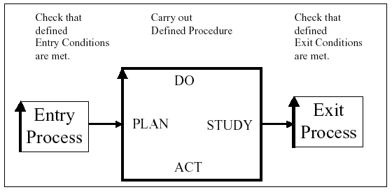
The quantified Exit and Entry controls
Entry and Exit Condition example:
Maximum estimated 1.0 Major defects per logical page remaining.
Notes:
Figure 1.7: A simplified PDSA process cycle diagram, as a basis for work process control, consisting of an
entry process, a procedure and an exit process.

Slide 85
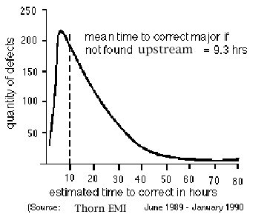
The quantified Exit and Entry controls (2)
Assumptions:
1) 30 major defects/page have been found during SQC.
2) Your SQC effectiveness is 60% and your SQC is a statistically stable process).
3) One sixth of your attempts to fix defects fail (One sixth is average failure to fix.)
4) New defects are injected during your attempts to fix defects at 5%.
5) The uncertainty factor in the estimation of remaining defects is ± 30%.
Probably remaining major defects in each (logical) page =
‘probably unidentified majors’ + ‘bad fix majors’ + ‘majors Injected’
Let E = Effectiveness expressed as a percentage (%) = 60%
Probably unidentified majors = major defects acknowledged-by-editor for each page at Edit * (100 – E) / E
= 30 major defects/page found * (100 - 60) / 60 = 20 major defects/page.
Bad Fix Majors = One sixth of fixed majors = So, of 30 attempted fixes,
5 major defects in each page are not fixed.
Majors Injected = 5% of majors attempted to be fixed = 1.5 major defects/page.
Probably remaining major defects/page = 20 + 5 + 1.5 = 26.5 remaining major defects/page
Taking into account the uncertainty factor of ± 30% and rounding down to the nearest whole
number gives 26 ± 7 Remaining Major Defects/Page
(Minimum = 19, Maximum = 33 remaining major defects/page).
Notes:
Source CE Figure 8.3: Estimating Remaining Major Defect Density: the main specification exit condition.

Slide 86
Reviewing the Quality of a specification’s ‘Competitiveness’
Entry Condition:
  Low-defect exit from Specification Rules QC
    So it is complete, clear, consistent, correct
Different people (Senior)
  Different Rules, ask
    About idea value
    About other investments
    About competition
    About economics
    About risks
Different Evaluation
  Not ‘defects’
  Go or no go to next stage of development
  Responsible recommendations
  Status set (Approved, …)
QC & Spec Rules
Performance requirements must be quantified
Sources must be specified for all details
Unambiguous to readership
Clear enough to test
Consistent with sources and siblings
Competitiveness Rules.
Number one in market performance levels
Number one in cost levels
Number one in service levels
Number one in distribution capability

Slide 87
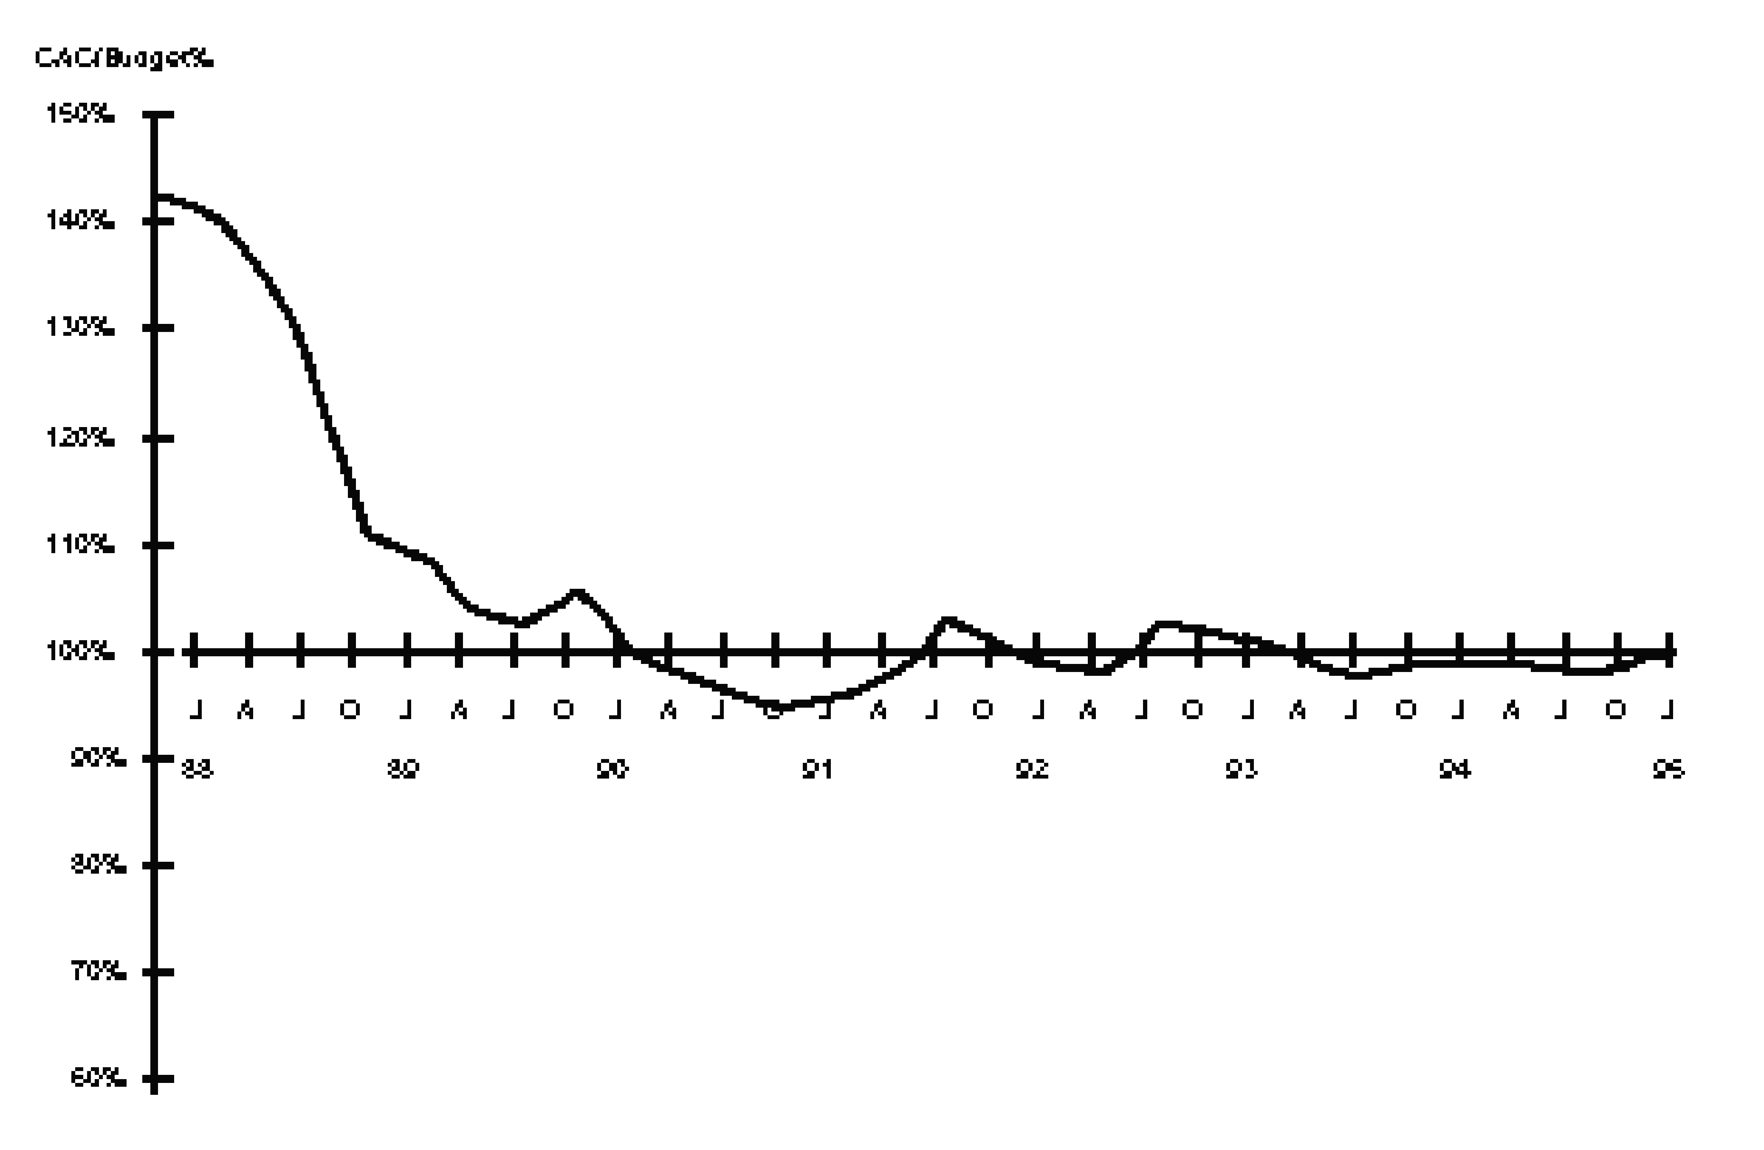
How does Planguage help Spec Quality Control?
Planguage:
  Provides specific standards to check for defects (rules, exit conditions, entry conditions)
  Provides well defined and integrated processes for QC and all related processes of specification and project management
  Contains structures which enable efficient cross checking of information by people and computers.
  Contains a consistent set of standards and concepts for all types of specification - ‘once learned applies to all’
Cost at Completion as a % of Budget
150%
140%
From 43% overrun …
… to 3% plus-or-minus
130%
120%
110%
100%
1988 89 90 91 92 93 94 95
Achieving Project Predictability at Raytheon
Notes:
In 1988, Raytheon were a typical Level 1 company: they reliably missed their budgetary and schedule targets. Typically by a 40% or higher overrun.
By 1990, they were delivering product within 3% of both budget and schedule, an achievement that they sustained over the next five years.
This is life at Level 2!
NOTE RAYTHEON WAS NOT USING PLANGUAGE AS SUCH: THEY WERE USING INSPECTION, DEFECT PREVENTION PROCES AND IMPROVED REQUIREMENTS SPECIFICATION. I ASSERT THAT PLANGUAGE PLUS SQC CAN GIVE RESULTS LIKE THIS. SOME CUSTOMERS HAVE REPORTED SIMILAR RESULTS (HP, INTEL, ERICSSON) USING OUR METHODS. (IN PUBLIC WITH NUMBERS, AVAILABLE ON REQUEST TOM@GILB.COM)

Slide 88
How does Planguage help Reviews?
It ensures
  intelligible and consistent specifications
  Numeric exit from SQC before review
  so that reviews are based on a solid foundation - and do not waste senior people’s time, with sloppy work

Slide 89
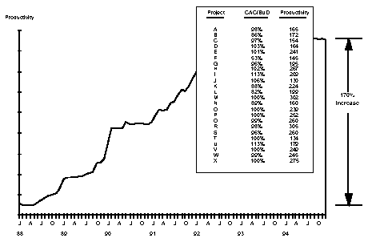
How does Spec QC impact competitiveness?
Indirectly
  By avoiding rework (40%+ of total project cost if you are not careful!)
  Speeds up projects by factor 2 to 3 (ex. Raytheon 95 SEI, below))
Productivity
170%
Increase
88 89 90 91 92 93 94 95
Notes:
Programmer productivity was measured as the monthly rate with which tested and debugged lines of code were delivered. Over the 5 years from the date at which Inspections were started, this rate increased by 170%. That high rate was then sustained for two more years until the report was written.
“Our process mandates 100% inspection coverage, so convinced are we of the importance of this scrutiny.”
“Inspections have played the principal role in allowing us to identify defects at a stage where they are easy and relatively inexpensive to fix, thereby causing our process to avoid the heavy rework penalties associated with problem detection at later integration and test stages.”
Here is a list of some of Raytheon’s achievements. Most of these were attained within two years and sustained over the following four, though some took three or four years to realise.
Rework costs down by as much as 90%.
Programmer productivity improved by 170%.
Software consistently delivered on-time, within budget.
Bugginess down over 70%.
And a big fat ROI …
SEE TR0017 1995 Dion et al, Software Engineering Institute website www.sei.cmu.edu

Slide 90
POSSIBLE PURPOSES FOR USING SQC
- Reducing Time-to-Delivery
- Measuring the Quality of a Document
- Measuring the Quality of the Process producing the Document
- Enabling Estimation of the Number of Remaining Defects
- Identifying Defects
- Removing Defects
- Preventing additional ‘Downstream’ Defects being generated by removing existing Defects
- Improving the Engineering Specification Process
- Improving the SQC Process
- On-the-Job Training for the Checkers
- Training the SQC Team Leader
- Certifying the SQC Team Leader
- Peer Motivation
- Motivating the Managers
- Helping the Specs Writer
- Reinforcing Conformance to Standards
- Capturing and Re-using Expert Knowledge (by use of Rules and Checklists)
- Reducing Costs
- Team Building
- Fun – a Social Occasion
Notes:
Source CE Table 8.1: Possible purposes for using SQC. Any one or several can apply at anytime

Slide 91
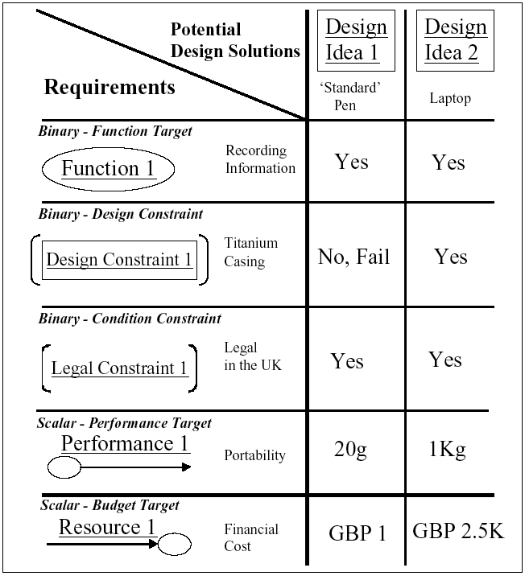
Part 4: Impact Estimation Tables for quantified evaluation of design
What is a ‘design’? (architecture, solution)
What are the principles of evaluating a design?
How do we evaluate a single dimension of impact?
How can we evaluate all dimensions of impact?
What uses can we put impact estimation to?
How does Impact Estimation relate to Planguage?
How do we specify a design with impacts?
Notes:
Figure 2.2: This is a modified form of Impact Estimation (IE) table showing an arbitrary set of
requirements and two potential design ideas.
Note:
1. Additionally, it includes the binary requirements, which are not normally shown. (Usually, all the design
ideas are informally screened against the binary requirements before drawing up an IE table, which shows
only the scalar requirements.)
2. The table is without the scalar baseline information that states the quantitative requirements and
benchmarks, which permit percentage comparisons and improved design idea evaluation (See Chapter 9, 880
Impact Estimation, for further explanation).

Slide 92
What is a ‘design’? (architecture, solution)
  SCALAR REQUIREMENT SPECIFICATION
Participation: Scale: % of worldwide membership participating. Goal: 10%.
Representation: Scale: % of worldwide membership represented within defined <groups>.
Goal [Age under 25 or equating to <student status>]: 10%.
Information: Scale: % of talks rated as ‘good’ or better (5+ on feedback sheet scale). Goal: 50%.
Conviction: Scale: % participants wanting to return next conference. Goal: 80%.
Influence: Scale: % participants who <improve as result of the conference>.
Past: 90%, Goal: 95%.
Fun: Scale: % participants rating the conference-city quality as ‘good’ or better (5+ on feedback sheet scale).
Past: 45%. Plan: 60%.
Cost: Resource Budget: Scale: total cost for an individual participant including travel costs.
Fail: $2,000. Goal: $1,200 or less.
  Design Idea Concept *047 March 15, 2003
A design idea is anything that will satisfy some requirements.
A set of design ideas is usually needed to solve a ‘design problem’.
A design is a specific idea about how to solve a defined design problem.
A design (or design idea: synonym) may be in our minds, spoken aloud, found to exist in existing systems, and it may be formally or informally specified (design specification).
A Design is a ‘consciously selected means’ to reach defined ‘ends’.
A design idea must be consistent with a set of requirements, all at once.
It must positively serve the improvement of at least one item towards specified requirements.
But it must also not violate any other constraint (function, condition constraint, scalar constraint ) which it can impact.
A design is different from a requirement in that it can in principle be changed at any time for a better design, which better meets the requirements.
Design is not holy and fixed.
DESIGN SPECIFICATION (simple version)
Central: Choose a location in the membership center of gravity (New York?)
Youth: Suggest and support local campaigns to finance ‘sending’ a young representative to conference.
Facts: Review all submitted papers on <content>.
London: Announce that the conference is to be in London next time.
Diploma: Give diplomas for attendance, and additional diplomas for individual tutorial courses.
Events: Have entertainment activities organized every evening: river tours, etc.
Discounts: Get discounts on airfare and hotels.
Notes:
From CE 7.1 Simple example

Slide 93
Defining a Design/Solution/Architecture/Strategy (Planguage, CE Design Template)
1. enough detail to estimate, 2. some impact assertion, 3. Assumptions, Risks, Issues
See enlarged view of this slide in following slides. This is a 1-page overview
Orbit Application Base: (formal Cross reference Tag)
Type: Primary Architecture Option
============ Basic Information ==========
Version: Nov. 30 20xx 16:49, updated 2.Dec by telephone and in meeting. 14:34
Status: Draft
Owner: Brent Barclays
Expert: Raj Shell, London
Authority: for differentiating business environment characteristics, Raj Shell, Brent Barclays(for overview)
Source: <Source references for the information in this specification. Could include people>. Various, can be done later BB
Gist: risk and P/L aggregation service, which also provides work flow/adjustment and outbound and inbound feed support. Currently used by Rates ExtraBusiness, Front Office and Middle Office, USA & UK.
Description: <Describe the design idea in sufficient detail to support the estimated impacts and costs given below>.
  D1: ETL Layer. Rules based highly configurable implementation of the ETL Pattern, which allows the data to be onboarded more quickly. Load and persist new data very quickly. With minimal development required. -> Business-Capability-Time-To-Market, Business Scalability
  D2: high performance risk and P/L aggregation processing (Cube Building). -> Timeliness, P/L Explanation, Risk & P/L Understanding, Decision Support, Business Scalability, Responsiveness.
  D3: Orbit supports BOTH Risk and P/L -> P/L Explanation, Risk & P/L Consistency, Risk & P/L Understanding, Decision Support.
  D4: a flexible configurable workflow tool, which can be used to easily define new workflow processes -> Books/Records Consistency, Business Process Effectiveness, Business Capability Time to Market.
  D5: a report definition language, which provides 90+% of the business logic contained with Orbit, allows a quick turnaround of new and enhanced reports with minimal regression testing and release procedure impact. -> P/L Explanation, Risk & P/L Understanding, Business Capability Time to Market, Business Scalability.
  D6: Orbit GUI. Utilizes an Outlook Explorer metaphor for ease of use, and the Dxx Express Grid Control, to provide high performance Cube Interrogation Capability. -> Responsiveness, People Interchangeability, Decision Support, Risk & P/L Understanding.
  D7: downstream feeds. A configurable event-driven data export service, which is used to generate feeds . -> Business Process Effectiveness, Business Capability Time to Market.
===================== Priority and Risk Management =====================
Assumptions: <Any assumptions that have been made>.
  A1: FCCP is assumed to be a part of Orbit. FCxx does not currently exist and is Dec 20xx 6 months into Requirements Spec. <- Picked up by TsG from dec 2 discussions AH MA JH EC.
    Consequence: FCxx must be a part of the impact estimation and costs rating.
  A2: Costs, the development costs will not be different. All will base on a budget of say $nn mm and 3 years. The o+
  costs may differ slightly, like $n mm for hardware. MA AH 3 dec
  A3:Boss X will continue to own Orbit. TSG DEC 2
  A4: the schedule, 3 years, will constrained to a scope we can in fact deliver, OR we will be given additional budget. If not “I would have a problem” <- BB
  A5: the cost of expanding Orbit will not be prohibitive. <- BB 2 dec
  A6: we have made the assumption that we can integrate Oribit with PX+ in a sensible way, even in the short term <- BB
Dependencies: <State any dependencies for this design idea>.
  D1: FCxx replaces Px+ in time. ? tsg 2.12
Risks: <Name or refer to tags of any factors, which could threaten your estimated impacts>.
  R1. FCxx is delayed. Mitigation: continue to use Pxx <- tsg 2.12
  R2: the technical integration of Px+ is not as easy as thought & we must redevelop Oribit
  R3: the and or scalability and cost of coherence will not allow us to meet the delivery.
  R4: scalability of Orbit team and infrastructure, first year especially <- BB. People, environments, etc.
  R5: re Cross Desk reporting Requirement, major impact on technical design. Solution not currently known. Risk no solution allowing us to report all P/L
Issues: <Unresolved concerns or problems in the specification or the system>.
  I1: Do we need to put the fact that we own Orbit into the objectives (Ownership). MA said, other agreed this is a huge differentiator. Dec 2.
  I2: what are the time scales and scope now? Unclear now BB
  I3: what will the success factors be? We don’t know what we are actually being asked to do. BB 2 dec 20xx
  I4: for the business other than flow options, there is still a lack of clarity as to what the requirements are and how they might differ from Extra and Flow Options. BB
  I5: the degree to which this option will be seen to be useful without Intra Day. BB 2 dec
Notes:
Based on real solution spec Done Dec 20xx London, but modified here for confidentiality. Tom Gilb

Slide 94
Design Spec Enlarged 1 of 2
Spec Headers
Detailed Description and -> Impacted Objectives
Orbit Application Base: (formal Cross reference Tag)
Type: Primary Architecture Option
==== Basic Information ==========
Version: Nov. 30 20xx 16:49, updated 2.Dec by telephone and in meeting. 14:34
Status: Draft (PUBLIC EXAMPLE EDIT)
Owner: Brent Barclays
Expert: Raj Shell, London
Authority: for differentiating business environment characteristics, Raj Shell, Brent Barclays(for overview)
Source: <Source references for the information in this specification. Could include people>. Various, can be done later BB
Gist: risk and P/L aggregation service,
which also provides work flow/adjustment and outbound and inbound feed support. Currently used by Rates Extra Business, Front Office and Middle Office, USA & UK.
Description: <Describe the design idea in sufficient detail to support the estimated impacts and costs given below>.
D1: ETL Layer. Rules based highly configurable implementation of the ETL Pattern, which allows the data to be onboarded more quickly. Load and persist new data very quickly. With minimal development required. -> Business-Capability-Time-To-Market, Business Scalability
D2: high performance risk and P/L aggregation processing (Cube Building). -> Timeliness, P/L Explanation, Risk & P/L Understanding, Decision Support, Business Scalability, Responsiveness.
D3: Orbit supports BOTH Risk and P/L -> P/L Explanation, Risk & P/L Consistency, Risk & P/L Understanding, Decision Support.
D4: a flexible configurable workflow tool, which can be used to easily define new workflow processes -> Books/Records Consistency, Business Process Effectiveness, Business Capability Time to Market.
D5: a report definition language, which provides 90+% of the business logic contained with Orbit, allows a quick turnaround of new and enhanced reports with minimal regression testing and release procedure impact. -> P/L Explanation, Risk & P/L Understanding, Business Capability Time to Market, Business Scalability.
D6: Orbit GUI. Utilizes an Outlook Explorer metaphor for ease of use, and the Dxx Express Grid Control, to provide high performance Cube Interrogation Capability. -> Responsiveness, People Interchangeability, Decision Support, Risk & P/L Understanding.
D7: downstream feeds. A configurable event-driven data export service, which is used to generate feeds . -> Business Process Effectiveness, Business Capability Time to Market.
The Detailed description is useful,
• to understand costs
• to understand impacts on your objectives
• to permit separate implementation and value delivery, incrementally

Slide 95
Design Spec Enlarged 2 of 2
==== Priority & Risk Management ========
Assumptions: <Any assumptions that have been made>.
A1: FCCP is assumed to be a part of Orbit. FCxx does not currently exist and is Dec 20xx 6 months into Requirements Spec. <- Picked up by TsG from dec 2 discussions AH MA JH EC.
  Consequence: FCxx must be a part of the impact estimation and costs rating.
A2: Costs, the development costs will not be different. All will base on a budget of say $ nn mm and 3 years. The ops costs may differ slightly, like $n mm for hardware. MA AH 3 dec
A3:Boss X will continue to own Orbit. TSG DEC 2
A4: the schedule, 3 years, will constrained to a scope we can in fact deliver, OR we will be given additional budget. If not “I would have a problem” <- BB
A5: the cost of expanding Orbit will not be prohibitive. <- BB 2 dec
A6: we have made the assumption that we can integrate Oribit with PX+ in a sensible way, even in the short term <- BB
Dependencies: <State any dependencies for this design idea>.
  D1: FCxx replaces Px+ in time. ? tsg 2.12
Risks: <Name or refer to tags of any factors, which could threaten your estimated impacts>.
R1. FCxx is delayed. Mitigation: continue to use Pxx<- tsg 2.12
R2: the technical integration of Px+ is not as easy as thought & we must redevelop Oribit
R3: the and or scalability and cost of coherence will not allow us to meet the delivery.
R4: scalability of Orbit team and infrastructure, first year especially <- BB. People, environments, etc.
R5: re Cross Desk reporting Requirement, major impact on technical design. Solution not currently known. Risk no solution allowing us to report all P/L
Issues: <Unresolved concerns or problems in the specification or the system>.
I1: Do we need to put the fact that we own Orbit into the objectives (Ownership). MA said, other agreed this is a huge differentiator. Dec 2.
I2: what are the time scales and scope now? Unclear now BB
I3: what will the success factors be? We don’t know what we are actually being asked to do. BB 2 dec 20xx
I4: for the business other than flow options, there is still a lack of clarity as to what the requirements are and how they might differ from Extra and Flow Options. BB
I5: the degree to which this option will be seen to be useful without Intra Day. BB 2 dec
Risks specification:
• shares group risk knowhow
• permits redesign to mitigate the risk
• allows relistic estimates of cost and impacts
ASSUMPTIONS:
• broadcasts critical factors for present and future re-examination
• helps risk analysis
• are an integral part of the design specifiction
Issues:
• when answered can turn into a risk
• shares group knowledge
• makes sure we don’t forget to analyze later
DEPENDENCIES:

Slide 96
Design Specification Template <with Hints>
    Tag: <Tag name for the design idea>.
    Type: {Design Idea, Design Constraint}.
    ============ Basic Information ========================
    Version: <Date or version number>.
    Status: <{Draft, SQC Exited, Approved}>.
    Quality Level: <Maximum remaining major defects/page, sample size, date>.
    Owner: < Role/e-mail/name of person responsible for changes and updates>.
    Expert: < Name and contact information for a technical expert, in our organization or otherwise available to us, on this design idea>.
    Authority: <Name and contact information for the leading authorities, in our organization or elsewhere, on this technology or strategy. This can include references to papers, books and websites>.
    Source: <Source references for the information in this specification. Could include people>.
    Gist: <Brief description>.
    Description: <Describe the design idea in sufficient detail to support the estimated impacts and costs given below>.
    Stakeholders: <Prime stakeholders concerned with this design>.
    ============= Design Relationships =========================
    Reuse of Other Design: <If a currently available component or design is specified, then give its tag or reference code here to indicate that a known component is being reused>.
    Reuse of This Design: <If this design is used elsewhere in another system or used several times in this system, then capture the information here>.
    Design Constraints: <If this design is a reflection of attempting to adhere to any known design constraints, then that should be noted here with reference one or more of the constraint tags or identities>.
    Sub-Designs: <Name tags of any designs, which are subsets of this one, if any>.
    ============== Impacts Relationships =======================
    Impacts [Functions]: <list of functions and subsystems which this design impacts attributes of>.
    Impacts [Intended]: <Give a list of the performance requirements that this design idea will impact in a major way, good or bad. The positive impacts are the main justification for the existence of the design idea!>.
    Impacts [Side Effects]: <Give a list of the performance requirements that this design idea will impact in a more minor way, good or bad>.
    Impacts [Cost]: <Give a list of the budgets that this design idea will impact in a major way>.
    Impacts [Other Designs]: <Does this design have any consequences with respect to other designs? Name them at least>.
    Value: <Name or quantify value produced, and stakeholders affected by this design. Use Qualifiers>
    ============== Impact Estimation/Feedback ==================
    For each Scalar Requirement in Impacts [Intended] (see above):
    Tag: <Tag of a scalar requirement listed in Impacts [Intended]>.
    Scale: <Scale for the scalar requirement>.
    Scale Impact: <Give estimated or real impact, when implemented, using the defined Scale. That is, given current baseline numeric value, what numeric value will implementing this design idea achieve or what numeric value has been achieved?>.
    Scale Uncertainty: <Give estimated optimistic/pessimistic or real ± error margins>.
    Percentage Impact: <Convert Scale Impact to Percentage Impact. That is, what percentage of the way to the planned target, relative to the baseline and the planned target will implementing this design idea achieve or, has been achieved? 100% means meeting the defined Plan level on time>.
    Percentage Uncertainty: <Convert Scale Uncertainty to Percentage Uncertainty ± deviations>.
    Evidence: <Give the observed numeric values, dates, places and other relevant information where you have data about previous experience of using this design idea>.
    Source: <Give the person or written source of your evidence>.
    Credibility: <Credibility 0.0 low to 1.0 high. Rate the credibility of your estimates, based on the evidence and its source>.
    ============== Priority and Risk Management ==================
    Assumptions: <Any assumptions that have been made>.
    Dependencies: <State any dependencies for this design idea>.
    Risks: <Name or refer to tags of any factors, which could threaten your estimated impacts>.
    Priority: <List the tag names of any design ideas that must be implemented before or after this design idea>.
    Issues: <Unresolved concerns or problems in the specification or the system>.
    ============= Implementation Control =======================
    Supplier: < Name actual supplier or list supplier requirements>
    Responsible: <Who in or organization is responsible for managing the supplier relation?>
    Contract: <Refer to the contract if any, or the contract template>
    Test Plan: <Refer to specific test pan for this design>
    Implementation Process: <Name any special needs during implementation>
    ============== Location of Specification ========================
    Location of Master Specification: <Give the intranet web location of this master specification>.
See next 3 slides for detail
Notes:
Source of design template chapter 7.8 CE on May 5 2003

Slide 97
CE Book Design Template <WITH HINTS> 1 of 3
Tag: <Tag name for the design idea>.
Type: {Design Idea, Design Constraint}.
============ Basic Information ========================
Version: <Date or version number>.
Status: <{Draft, SQC Exited, Approved}>.
Quality Level: <Maximum remaining major defects/page, sample size, date>.
Owner: < Role/e-mail/name of person responsible for changes and updates>.
Expert: < Name and contact information for a technical expert, in our organization or otherwise available to us, on this design idea>.
Authority: <Name and contact information for the leading authorities, in our organization or elsewhere, on this technology or strategy. This can include references to papers, books and websites>.
Source: <Source references for the information in this specification. Could include people>.
Gist: <Brief description>.
Description: <Describe the design idea in sufficient detail to support the estimated impacts and costs given below>.
Stakeholders: <Prime stakeholders concerned with this design>.
============= Design Relationships =========================
Reuse of Other Design: <If a currently available component or design is specified, then give its tag or reference code here to indicate that a known component is being reused>.
Reuse of This Design: <If this design is used elsewhere in another system or used several times in this system, then capture the information here>.
Design Constraints: <If this design is a reflection of attempting to adhere to any known design constraints, then that should be noted here with reference one or more of the constraint tags or identities>.
Sub-Designs: <Name tags of any designs, which are subsets of this one, if any>.

Slide 98
CE Book Design Template 2 of 3
============== Impacts Relationships =======================
Impacts [Functions]: <list of functions and subsystems which this design impacts attributes of>.
Impacts [Intended]: <Give a list of the performance requirements that this design idea will impact in a major way, good or bad. The positive impacts are the main justification for the existence of the design idea!>.
Impacts [Side Effects]: <Give a list of the performance requirements that this design idea will impact in a more minor way, good or bad>.
Impacts [Cost]: <Give a list of the budgets that this design idea will impact in a major way>.
Impacts [Other Designs]: <Does this design have any consequences with respect to other designs? Name them at least>.
Value: <Name or quantify value produced, and stakeholders affected by this design. Use Qualifiers>
============== Impact Estimation/Feedback ==================
For each Scalar Requirement in Impacts [Intended] (see above):
Tag: <Tag of a scalar requirement listed in Impacts [Intended]>.
Scale: <Scale for the scalar requirement>.
Scale Impact: <Give estimated or real impact, when implemented, using the defined Scale. That is, given current baseline numeric value, what numeric value will implementing this design idea achieve or what numeric value has been achieved?>.
Scale Uncertainty: <Give estimated optimistic/pessimistic or real ± error margins>.
Percentage Impact: <Convert Scale Impact to Percentage Impact. That is, what percentage of the way to the planned target, relative to the baseline and the planned target will implementing this design idea achieve or, has been achieved? 100% means meeting the defined Plan level on time>.
Percentage Uncertainty: <Convert Scale Uncertainty to Percentage Uncertainty ± deviations>.
Evidence: <Give the observed numeric values, dates, places and other relevant information where you have data about previous experience of using this design idea>.
Source: <Give the person or written source of your evidence>.
Credibility: <Credibility 0.0 low to 1.0 high. Rate the credibility of your estimates, based on the evidence and its source>.

Slide 99
CE Book Design Template 3 of 3
============== Priority and Risk Management ==================
Assumptions: <Any assumptions that have been made>.
Dependencies: <State any dependencies for this design idea>.
Risks: <Name or refer to tags of any factors, which could threaten your estimated impacts>.
Priority: <List the tag names of any design ideas that must be implemented before or after this design idea>.
Issues: <Unresolved concerns or problems in the specification or the system>.
============= Implementation Control =======================
Supplier: < Name actual supplier or list supplier requirements>
Responsible: <Who in or organization is responsible for managing the supplier relation?>
Contract: <Refer to the contract if any, or the contract template>
Test Plan: <Refer to specific test pan for this design>
Implementation Process: <Name any special needs during implementation>
============== Location of Specification ========================
Location of Master Specification: <Give the intranet web location of this master specification>.

Slide 100
What are the principles of evaluating a design?
Avoid violating constraints
Meet Target and Function requirements
Notes:
I found this in CE Glossary under Design

Slide 101
How do we evaluate a single dimension of impact?
We must estimate or measure the numeric cumulative impact of the design
  on a defined Scale,
  using a defined Meter,
  with respect to target and constrain t levels.

Slide 102
How can we evaluate all dimensions of impact?
We can use an Impact (Estimation) Table
Notes:
Table from CE 7.1 Practical example

Slide 103
What uses can we put impact estimation to?
IE can be used for a wide variety of purposes including:
1. Evaluating a single design idea. How good is the idea for us?
2. Comparing two or more design ideas to find a winner, or set of winners. Use IE, if you want to set up an argument against a prevailing popular, but weak design idea!
3. Gaining an architectural overview of the impact of all the design ideas on all the objectives and budgets. Are there any negative side effects? What is the cumulative effect?
4. Obtaining systems engineering views of specific components, or specific performance aspects.
Are we going to achieve the reliability levels?
5. Analyzing risk: evaluating a design with regard to ‘worst case’ uncertainty and minimum credibility.
6. Planning evolutionary project delivery steps with regard to value and cost.
7. Monitoring, for project management accounting purposes, the progress of individual evolutionary project delivery steps and, the progress to date compared against the requirement specification or management objectives.
8. Predicting future costs, project timescales and performance levels.
9. Understanding organizational responsibility in terms of performance and budgets by organizational function.
  In 1992, Steve Poppe pioneered this use at executive level while at British Telecom, North America.
10. Achieving rigorous quality control of a design specification prior to management reviews and approval.
11. Presenting ideas to committees, management boards, senior managers, review boards and customers for approval.
12. Identifying which parts of the design are the weakest (risk analysis). If there are no obvious alternative design ideas, any ‘weak links’ should be tried out earliest, in case they do not work well (risk management). This impacts scheduling.
13. Enabling configuration management of design, design changes, and change consequences.
14. Permitting delegation of decision-making to teams. Teams can achieve better internal progress control using IE, than they can from repeatedly making progress reports to others, and acting on others’ feedback.
15. Presenting overviews of very large, complex projects and systems by using hierarchical IE tables. Aim for a one page top-level IE view for senior management.
16. Enabling cross-organizational co-operation by presenting overviews of how the design ideas of different projects contribute towards corporate objectives. Any common and conflicting design ideas can be identified. This is important from a customer viewpoint; different projects might well be delivering to the same customer interface.
17. Controlling the design process. You can see what you need, and see if your idea has it by using an IE table. For example, which design idea contributes best to achieving usability? Which one costs too much?
18. Strengthening design. You can see where your design ideas are failing to impact sufficiently on the objectives; and this can provoke thought to discover new design ideas or modify existing ones.
19. Helping informal reasoning and discussion of ideas by providing a framework model in our minds of how the design is connected to the requirements.
20. Strengthening the specified requirements. Sometimes, you can identify a design idea, that has a great deal of popular support, but doesn’t appear to impact your requirements. You should investigate the likely impacts of the design idea with a view to identifying additional stakeholder requirements. This may provide the underlying reason for the popular support. You might also identify additional types of stakeholders.
Notes:
Source CE Figure 9.1: Purposes for the use of Impact Estimation. IE can have a wide variety of uses for a systems engineer, planner or manager: it can help from the earliest stages of evaluating potential ideas, strategies, architectures and purchases, to formally presenting proposals to management, to assessing the results of project delivery. [July 2002]

Slide 104
How does Impact Estimation relate to Planguage?
Learning:
Ambition: Make it substantially easier for our users to learn tasks <- Marketing.
Scale: Average time for a defined [User Type: default UK telesales trainee] to learn a defined [User Task: default Response] using <our product’s instructional aids>.
Response: Task: Give correct answer to simple request.
Past [last year]: 60 minutes.
GN: Goal [By start of next year]: 20 minutes.
GA: Goal [By start of year after next]: 10 minutes.
Picture Handbook: Gist: Produce a radically changed handbook that uses pictures and concrete
examples to instruct, without the need for any other text.
Notes:
Source CE 9.1. A Simple Practical Example of Impact Estimation [July 3 2002]

Slide 105
How do we specify a design with impacts?
Design Specification Template with Annotation
Tag: <Unique Name Capitalized>
Type: Design Idea.
Version: <date and or version number of last change>
Owner: < originator, champion, expert, maintainer, architect, systems engineer>
Description: <describe the design in a dozen, or more, words. The detail should be sufficient to guarantee the expected impacts and costs estimated below>.
Reuse: <if a currently available component or design is specified, then give it’s tag or reference code here to indicate that a known component is being applied>
Constraint: <if this design is a reflection of attempting to adhere to any known design constraints, then that should be noted here with reference one or more of the constraint tags or identities>.
============== Real Expected Impact Section ================
Primary Impacts: <give the main impact or impacts which this design is expected to have on an objective . These are its main justification for existence!>.
Secondary Impacts: <list expected secondary impacts, good or bad>.
Cost Impacts: <give at least rough impacts on defined budget constraints>.
============== More Formal Impact Estimation =================
Real Impact on defined Scale: <give expected impact result on the Scale defined, when implemented>
%Impact on Specific Goal: <Convert real impact to % impact relative to the main planned level: 100% means meets defined Plan level on time>.
± %Uncertainty: <give optimistic/pessimistic % deviation, like ±20%, based on best and worst real observations>.
Evidence: <give the observed numbers, facts, dates, places where you have data about this designs impact>
Source: <give the person or written source of your evidence>
Credibility: <Credibility 0.0 low to 1.0 high. Rate the quality of your estimates, based on the historic data you have>
--------- Repeat this sequence for any other major impact objectives you believe justify the specification effort here.
============== Other Useful Parameters for Design Specification =========
Risks: <name any factors, which can threaten your estimated impact or bring it to the lowest levels specified>
Assumptions: <state any implied unvoiced, threatening assumptions which if false could threaten your estimates>
Expert: < name and give contact (email?) a useful technical expert in our company or otherwise available to us on this design idea>.
Authority: <name and give contact information to the leading authorities in our co. or elsewhere on this technology. Reference papers or books for example and websites>
Web Location of Master Specification: <give intranet web location of this master specification>.

Slide 106
Part 5: Evolutionary Project Management
The fundamentals of an Evo step
How does Planguage support Evo project management?
How do you plan an Evo step in Planguage?
How does Evo relate to requirements?
How does Evo relate to Design?
How does Evo relate to Risk?
How does Evo relate to process improvement?
How does Evo relate to competitiveness?
Notes:
Source CE [July 3 2002] Figure 10.1: The Result Cycle for an Evo Plan.

Slide 107
The fundamentals of an Evo step
An Evo step must
  Deliver some planned function and/or performance values to some stakeholders
  Maximize the efficiency (value to cost ratio) of the delivery
  Give useful feedback before scaling up (risk management)
  Give project teams practical experience in technology, engineering processes, and stakeholder feedback
How to decompose systems into small evolutionary steps: (a list of practical tips)
1 Believe there is a way to do it, you just have not found it yet!
  I have never seen an exception in 33 years of doing this within many varied cultures.
2 Identify obstacles, but don't use them as excuses: use your imagination to get rid of them!
3 Focus on some usefulness for the stakeholders: users, salesperson, installer, testers or customer. However small the positive contribution, something is better than nothing.
4 Do not focus on the design ideas themselves, they are distracting, especially for small initial cycles. Sometimes you have to ignore them entirely in the short term!
5 Think one stakeholder. Think ‘tomorrow’ or ‘next week.’ Think of one interesting improvement.
6 Focus on the results (You should have them defined in your targets. Focus on moving towards the Plan levels).
7 Don't be afraid to use temporary-scaffolding designs. Their cost must be seen in the light of the value of making some progress, and getting practical experience.
8 Don't be worried that your design is inelegant; it is results, that count, not style.
9 Don't be afraid that the stakeholders won't like it. If you are focusing on the results they want, then by definition, they should like it. If you are not, then do!
10 Don't get so worried about "what might happen afterwards" that you can make no practical progress.
11 You cannot foresee everything. Don't even think about it!
12 If you focus on helping your stakeholder in practice, now, where they really need it, you will be forgiven a lot of ‘sins’!
13 You can understand things much better, by getting some practical experience (and removing some of your fears).
14 Do early cycles, on willing local mature parts of your user/stakeholder community.
15 When some cycles, like a purchase-order cycle, take a long time, initiate them early, and do other useful cycles while you wait. This is called ‘backroom concurrent engineering’.
16 If something seems to need to wait for ‘the big new system’, ask if you cannot usefully do it with the ‘awful old system’, so as to pilot it realistically, and perhaps alleviate some 'pain' in the old system.
17 If something seems too costly to buy, for limited initial use, see if you can negotiate some kind of ‘pay as you really use’ contract. Most suppliers would like to do this to get your patronage, and to avoid competitors making the same deal.
18 If you can't think of some useful small cycles, then talk directly with the real ‘customer’, stakeholders, or end user. They probably have dozens of suggestions.
19 Talk with end users and other stakeholders in any case, they have insights you need.
20 Don't be afraid to use the old system and the old ‘culture’ as a launching platform for the radical new system. There is a lot of merit in this, and many people overlook it.
Notes:
Source CE [July 3 2002] Figure 10.5: Ideas to assist identifying steps.

Slide 108
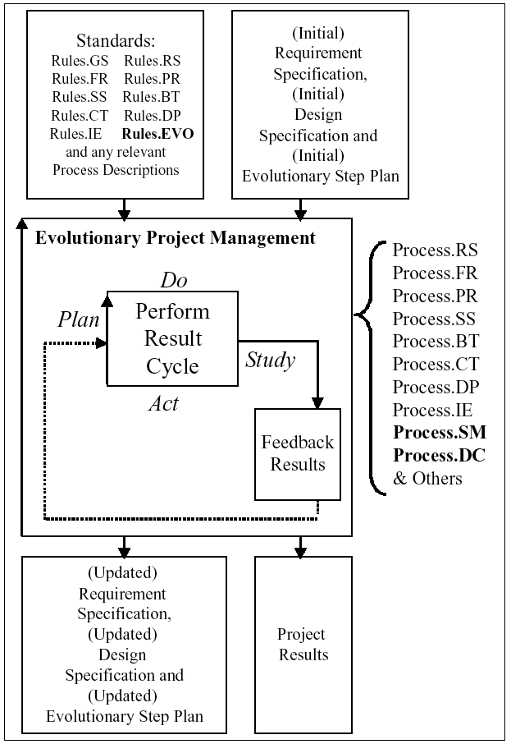
How does Planguage support Evo project management?
Well-defined requirements are the project management
  result delivery targets and
  constraints
Well-defined designs, and quantified impact estimates help control
  the delivery and
  implementation process
Notes:
Figure 1.6: An overview of the defined Planguage process, which supports Evolutionary project
management, Process.GP.P6 or in more detail, Process.EVO in Chapter 10.

Slide 109
How do you plan an Evo step in Planguage?
Step Name: Tutorial [7777, Basic].
Stakeholder: Marketing, XX (<agreed, Next Friday>).
Step Implementor: <XX>.
Step Content: HCTD :<Hard Copy Text document> <- Can do 1 week MMM.
. Basic minimal functions
. Step by Step Instructions, in English
. Focus on sales aspects, not how to do it (not yet, in this step)
. Go to specific web sites
. Pinpoint some characteristics of what we see on the terminal
. Compared with what we see on a PC or other terminal
. What instructions should be on the terminal to begin
. Questionnaire for Stakeholder
. Intended audience: Marketing
. Process for Testing with Stakeholder (example observation, times)
. No illustrations, just text.
Step Value: Stakeholder: TTT: Saleability: <some possibility of value>.
Stakeholder: Developers: <value of feedback on a tutorial>.
Step Cost: 10 hours per page, < 10 hours <-MMM.
Step Constraints: Must be deliverable within 1 calendar week.
At Least 3 hours of TTT’s time for input and trial feedback.
Step Dependencies: <Feature list of WWW and 7777 WWW Browser> <-MMM.
Notes:
Source CE [July 3 2002] Figure 10.4: An example of using the specification template for an Evo Step Plan.
TEMPLATE FOR EVO STEP PLAN SPECIFICATION
Step Name: <a tag> [more detail such as <which product>, <which area of application>].
Gist: <step gist>.
Stakeholder: <who are you going to give value to? >.
Step Implementor: <who is in charge of implementing this step>.
Step Owner: <who is taking responsibility for the step in terms of specification>.
Step Version: <date or version of last step specification update>.
Step Validation: Specification Quality Control (SQC): <when, outcome>, Pre-Delivery Test: <when, outcome>, Post Delivery Results: <problems, stakeholder feedback>.
Step Content: <Step Elements> {Design Ideas, Functions, Tasks, Reused Step definitions}.
Step Value:
<numeric or rough estimate of value to stakeholder in terms of formal objectives planned level and
scales>, at least value on scale 0 (none) to 9 (highest).
Step Cost:
<Estimates of time and other costs (engineering hours)
which are budgeted or constrained by the Evo 2% policy>
At least cost on scale 0 (dirt cheap) to 9 (high and unpredictable).
Step Constraints: < any legal, political, economic, security constraints imposed on implementation>.
Step Dependencies:
<anything which must be in place, finished, working properly, for us to be able to start this Evo step or to complete it> <- <Source (who says this is true?)>.
Figure 10.9: A possible specification template for a one page Evo step plan.

Slide 110
How does Evo relate to requirements?
Evo relates directly, measurably, testably, early and frequently to unfulfilled requirements.
Evo is always seeking the most efficient way to close the requirements gap and complete a project
The primary measure of Evo project progress is the degree of stakeholder satisfaction (in terms of agreed requirements) as a result of delivered Evo steps.
Notes:
Source CE [July 3 2002] Table 10.1: This is an artificial example. Three goals (performance targets) and two budget targets are having their real impacts tracked, as steps are delivered. The same IE table is also being used to specify the impact estimates for the future planned steps. So at each step, the project can learn from the reality of the step’s deviation from plan. Plans can then be adjusted and improved from early stage of the project.

Slide 111
How does Evo relate to Design?
Evo implements designs selectively depending on priority.
Designs can be implemented partially (example in one geographic market or system component) in a single step.
Evo allows us to be sure that the designs give maximum value/cost
Evo allows us to verify
  by measurement
  that designs deliver value/cost estimated
  before we commit on a large scale
Notes:
Source CE [July 2002] Figure 10.3: An Evo Plan and the System: The diagram shows the steps being sequenced for delivery. Each step delivers a set of performance attributes (a subset of the longer term planned results), and consumes a set of resources (a subset of the longer term budgets), in a particular place {location, system component} and at a particular time (for delivering the benefits). The point of this diagram is to show that each Evo step is a sub-component of the larger future system vision and plan.

Slide 112
How does Evo relate to Risk?
Evo reduces risk of deviation from plans
  By doing projects in early and small increments
  By ‘learning’ from practical experience
  And correcting bad specifications
  By grasping and integrating new opportunities outside the project (technology, customer, economics)
BASIC EVO PLANNING PolICY
1:Financial Budget: No project cycle shall exceed 2% of total financial budget before delivering some measurable, required results to the user.
2:Deadline: No project cycle will exceed 2% of total project time (one week for a one year project) before delivering some measurable, required results to the user.
3:Priority: Project cycles which provide the best ratio of required results to utilized resources (highest benefit-to-cost ratios), must be delivered first to the stakeholders.

Slide 113
How does Evo relate to process improvement?
Evo can measure
  the success of current processes against expectations,
  or new experimental ones against expectations
Evo can signal the need for process improvement and verify that such improvement has taken place
Evo can help you
  early in the project,
  continuously,
  and helps to train new people
    in the adopted processes
    by frequent cycles of practice and feedback
Notes:
Source CE [July 3 2002]Figure 10.6: Backroom and Frontroom Activities: Diagram showing the relationship between backroom and frontroom activities. The step components are developed and assembled in the backroom and then delivered in steps to the frontroom. A frequency of step delivery is maintained. Step 4 is actually ready ahead of its delivery time and is held back. Note, given when the system components were ready for delivery, there were several choices about the delivered step content.

Slide 114
How does Evo relate to competitiveness?
Evo is focused on delivery of quantified specified stakeholder value
Evo is ‘agile’
  and can change plans, designs, processes, and requirements -
  in order to deliver the most competitive solutions
  early, gradually, and with smart priorities.
Notes:
Source CE [July 3 2002] Figure 10.7: Dynamic Priority.
After Step 1, Performance has priority because it is not at ‘fail’ level yet. Reliability is above ‘Must’.
After Step 2, Reliability now has priority because it has not reached ‘satisfaction’ level (Plan) yet.

Slide 115

ROC: Resource Oriented Computing
Modelling without Artificial Models
What if, the real system was easier to build than the model?
What if the real system gave more reliable information about expected performance and quality than any modelling language?
What if the real system solved many of the problems we want to solve by modelling?
  (Scalability, Legacy, Maintainability, Availability, Connectivity)?
What is your system is highly self-optimizing based on experience?
Would this change our current view of modelling?
If the map and the terrain disagree, trust the terrain.
  Swiss Army Aphorism
Notes:
13 1 14 tsg http://pages.cs.wisc.edu/~param/quotes/wise.html
If the map and the terrain disagree, trust the terrain.
Swiss Army Aphorism

Slide 116
Reaping the Economic Dividend
• Architecture is 100% decoupled (not simply loose coupling) ∘ Hot-swappable
∘ Legacy coexistence
∘ Genuine reuse
∘ Unlimited evolvability
• Cheaper to develop
∘ 80% of a problem is solved by composition of existing tools ∘ Cheap to change - recomposition.
• Focus entirely on the domain problem
∘ Engineering levers available (eg throttle)
∘ Audit is orthogonal
∘ Configuration Management: "Everything is a resource"
∘ Logging "in case it goes wrong" is redundant "execution state is a resource" Visualizer
• Constraints are spacial boundary conditions ∘ Trust and non-repudiation
∘ Validation, Semantic integrity
...and higher performance too...

Slide 117
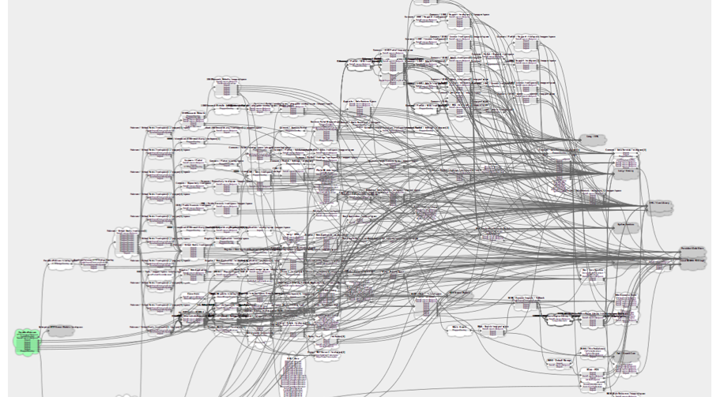
ROC Architecture Model

Slide 118
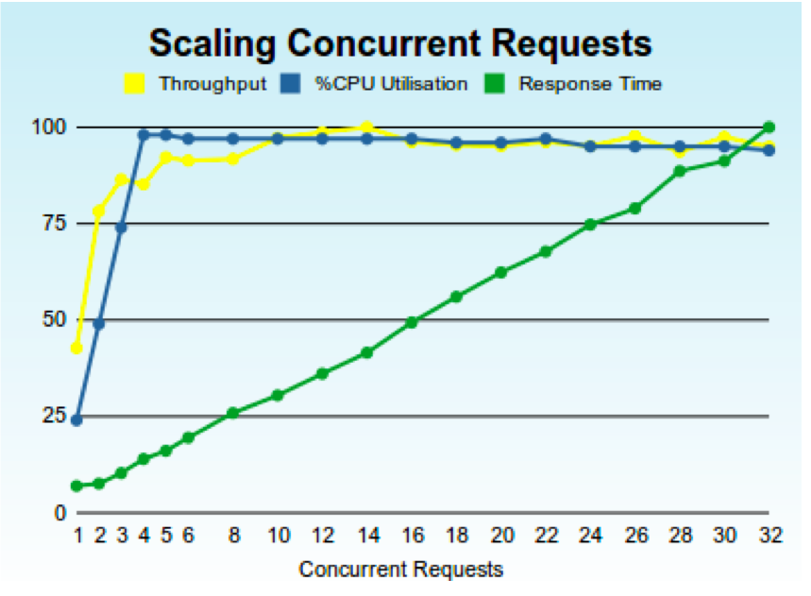
Scalability

Slide 119
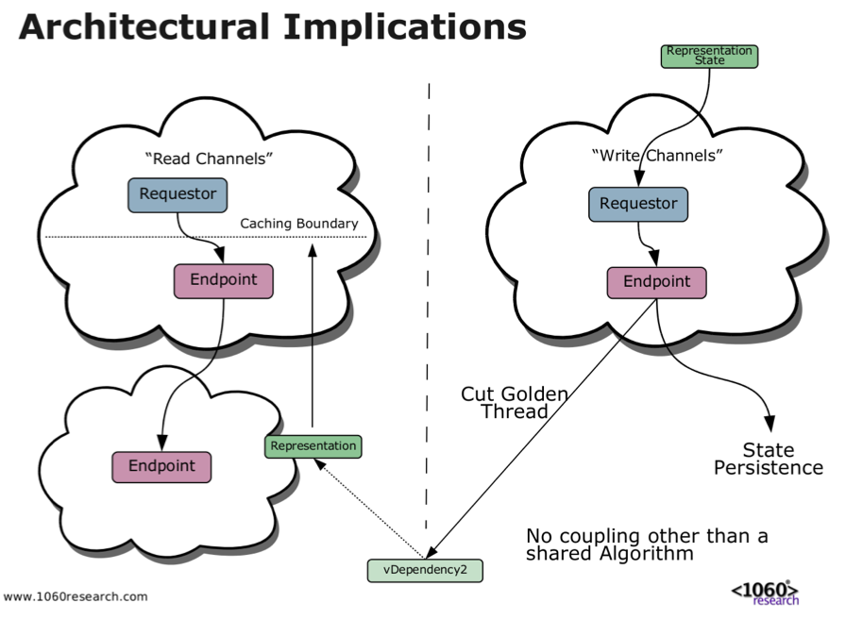
No Coupling

Slide 120
NetKernel v5.2.1
The Resource Oriented Computing platform ∘ General Standalone Application Server ∘ Embeddable as "ROC Engine"
Proven with hard-core, carrier-class deployments
∘ Telecoms
∘ Black Friday Retail
∘ Huge dot-com platforms
∘ Core Web Instracture - PURLs, Dublin Core
∘ Government Open Linked Data
Separates Architecture from Code - brings engineering control to systems.
Systemic Memoisation (Caching) and Async Linear Scaling = Huge Performance Gains.
Changes Attainable Scale of Software
Changes Economics of Software - Eliminates Saw-Tooth
Brings the Web Inside and makes it general purpose.
NKP takes ROC back out to enable amazing cloud architectures.
Notes:
Not sure if this should be infrastructure, I asked PR 13 1 4

Slide 121

Summary
Free digital copy of CE on request to
Tom @ Gilb . com
Tom Gilb
  Planguage gives you MODELLING tools to be more competitive
  The entire set of Planguage modelling tools also apply to software engineering and top management

Slide 122
Back up, you advanced the slides too far

