Slide 1
Power Planning Principles
Tom Gilb
Methods Inventor, Grandfather of Agile
gilb.com
45 minute talk
immediately followed by a talk discussion session
Version 19 April 2016 2223 PST tsg
Notes:
TAG: 2ND DRAFT KEYNOTE TALK BY TOM GILB
FOR: APRIL, ERIK, Kai
VERSION 2.1 30 MARCH 2016 23:54 CET (ES feedback)
STATUS: Radical pivot based on feedback about focussing on fewer points
Purpose: to give April something to put in the announcement, but I am flexible for change and tuning after further feedback.
Title: ‘Power-Planning Principles’.
Subtitle: Or, ‘
‘Way-out Widgets With Wicked Wattage for Wonder-engineers’.
Major Points:
CRYSTAL CLEAR CONCERNS
1. It is possible to identify, and define quantitatively, all critical success factors. Failure to do so is guaranteed failure of your project. But, you cannot expect to know them all when you start your project, so your development life cycle must be adaptable to what you learn.
DECISIVE DECOMPOSITION
2. It is possible to decompose both improvement objectives, and design or architecture, into smaller, incrementally deliverable components. This results in ability to schedule high value early, and to measure technical effects on objectives early.
ELEGANT EFFECT ESTIMATION
3. It is possible to estimate multiple effects on multiple objectives and costs, of any design ideas. This results in better ability to prioritize incremental delivery by ‘value for money’.
REALLY RELIABLE RISK WRANGLING
4. It is possible to, quickly and clearly, annotate risk information for all estimates, of both requirement levels, and design impact estimates. This makes it possible to take engineering decisions with regard to risk.
DESIGN DATA DRIVES DECISIONS
5. Decision-Making about technology can be based on the best available set of facts about requirements and designs; combined with a value policy about how to make decisions. This leads to smarter faster decisions,combined with decision transparency for learning and correction of the decision process.

Slide 2
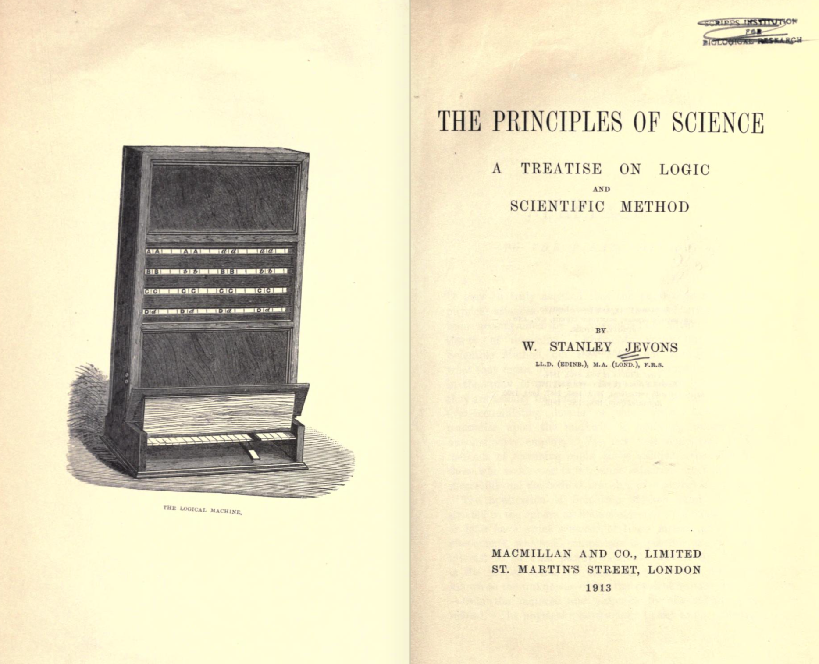
Why Principles?

Slide 3
1. Crystal Clear Concerns
2. Decisive Decomposition
3. Elegant Effect Estimation
4. Really Reliable Risk Wrangling
5. Design Data Drives Decisions

Slide 4
1. Crystal Clear Concerns
Principles
Practices

Slide 5
Power Planning Principles. Clarity
1. Crystal Clear Concerns
Poor Plans Pollute Purpose
Perfect Product Plans Presume Quantification
Quantification Cannot Clarify Content Completely
Crystal-Clear Clarity Can Be Calculated
Poor Plan Perfectness can be Profitably Pulverized
Cartesian cut-ups can cumulate clarity

Slide 6
Real Example: Main Objectives
Rationalize into a smaller number of core processing platforms. This cuts technology spend on duplicate platforms, and creates the opportunity for operational saves. Expected 60%-80% reduction in processing cost to Fixed Income Business levies.
International Securities on one platform, Fixed Income and Equities (Institutional and PB).
Global Processing consistency with single Operations In-Tray and associated workflow.
Consistent financial processing on one Accounting engine, feeding a single sub-ledger across products.
First step towards evolution of “Big Ideas” for Securities.
Improved development environment, leading to increased capacity to enhance functionality in future.
Removes duplicative spend on two back office platforms in support of mandatory message changes, etc.
Improved development environment

Slide 7
Development Capacity
Improved development environment
Administration:
Version: 3 Sept 2009 16:26 Owner: Tim Fxx
Type: Main <Complex/Elementary> Objective for a project.
Ambition Level: radically increase the capacity for developers to do defined tasks. <- Tsg
Scale: the Calendar-Time for defined [Developers] to Successfully carry out defined [Tasks].
Calendar-Time: defined as: full working days within the start to delivery time frame.
Past [2009, {Bxx, Lxx, Gxx}, If QA Approved Processes used, Developer = Architect, Task = Draft Architecture] 15 days ±4 ?? <- Rob
Goal [2011, {Bxx, Lxx, Gxx}, If QA Approved Processes used, Developer = Architect, Task = Draft Architecture] 1.5 days ± 0.4 ?? <- Rob
Justification: Really good architects are very scarce so we need to optimize their use.
Risks: we use effort that should be directed to really high volume or even more critical areas (like Main Objective).
Past 15 days
Goal 1.5 days

Slide 8
Key Principle
Perfect Product Plans Presume Quantification

Slide 9
1. Crystal Clear Concerns
Principles
Practices

Slide 10
Power Planning Practices - Clarity
1. Crystal Clear Concerns
Tag the Plan Element: for reuse, and detail
Classify the Plan Element so it knows its place: Type
Summarize the Idea (Ambition,Gist) but that is not enough
Define the Idea sufficiently for purpose
Define variables with a Scale
Decompose Compound ideas to explicit sets of ideas
Estimate the current level for you and competitors
Determine the worst acceptable leveler delivery
Determine the success level: for various stakeholders and conditions
Chip.Layer.Design Reusability:
Type: Critical Chip Quality Requirement.
Ambition: The basic design can easily be reused
for the widest variety of customer variations.
Scale: % of new designs from defined [Sphere]
that can Economically reuse the Initial design.
Past [2016, Sphere = Phones] 10%
Tolerable [2017, Sphere = Phones] 20%
Goal [2019, Sphere = Phones] 70%

Slide 11
Power Planning Practices - Clarity
1. Crystal Clear Concerns
Tag the Plan Element: for reuse, and detail
Classify the Plan Element so it knows its place: Type
Summarize the Idea (Ambition,Gist) but that is not enough
Define the Idea sufficiently for purpose
Define variables with a Scale
Decompose Compound ideas to explicit sets of ideas
Estimate the current level for you and competitors
Determine the worst acceptable leveler delivery
Determine the success level: for various stakeholders and conditions
Chip.Layer.Design Reusability:
Type: Critical Chip Quality Requirement.
Ambition: The basic design can easily be reused
for the widest variety of customer variations.
Scale: % of new designs from defined [Sphere]
that can Economically reuse the Initial design.
Past [2016, Sphere = Phones] 10%
Tolerable [2017, Sphere = Phones] 20%
Goal [2019, Sphere = Phones] 70%

Slide 12
Power Planning Practices - Clarity
Chip.Layer.Design Reusability:
Type: Critical Chip Quality Requirement.
Ambition: The basic design can easily be reused
for the widest variety of customer variations.
Scale: % of new designs from defined [Sphere]
that can Economically reuse the Initial design.
Past 10%
Goal 70%
Tolerable 20%
Past [2016, Sphere = Phones] 10%
Tolerable [2017, Sphere = Phones] 20%
Goal [2019, Sphere = Phones] 70%

Slide 13
Power Planning Practices - Clarity
One Takeaway Point
s
Quantify Variables with
Scale, Past, Tolerable, Goal

Slide 14
2. Decisive Decomposition
Principles
Practices

Slide 15
Power Planning Principles. Decomposition
2. Decisive Decomposition
Decompose by independently deliverable value
Decompose into small value delivery steps (weekly, 2% of time to deadline)
Don’t decompose the entire old system: use the old system as a base. Decompose the new value added increments.
Don’t decompose all the new architecture at once. Focus on extracting the best value you can identify, for the next value delivery.
Don’t give up when problems or objections are presented. Find solutions. Find clever ways around the problems. They are always there.

Slide 16
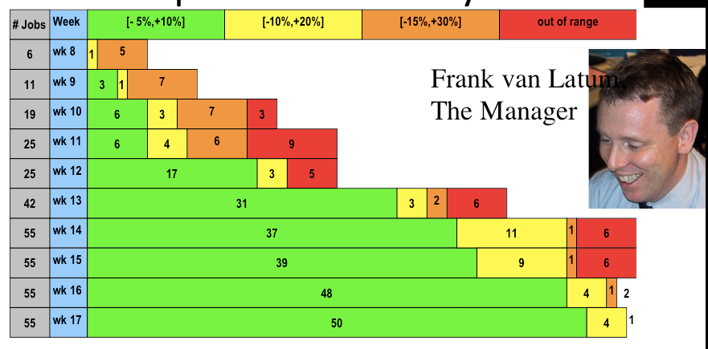
Case: Logic Board Manufacture: Philips
no progress made, stuck
in production timing prediction algorithm
but evolutionary weekly increments made real progress
much to directors surprise
Notes:
Figure 5.6 [F1, for more details] for a Philips client presentation, where the attribute delivered was ‘fraction of predictions made’ accuracy of pre-production prediction of production job run-time for a complex Philips production machine. We experienced great scepticism from Frank’s Director about delivering small increments of results. But Frank persisted, and his results were received with spontaneous applause, even by the sceptical director. The project had been stuck without results for a long time previously.

Slide 17
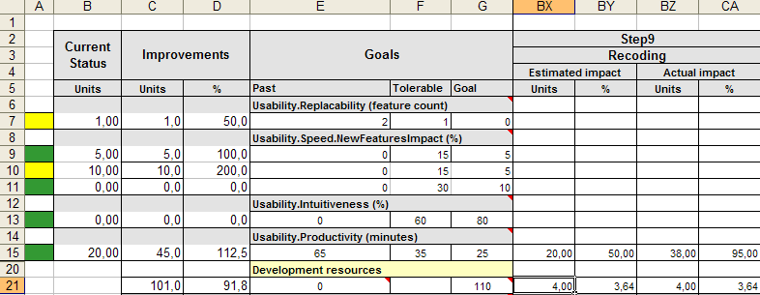
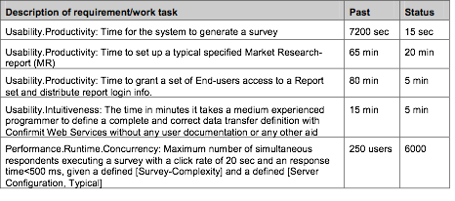
Case: Confirmit
11 design suggestions ‘Recoding’ had best effect.
4 days later the ‘Recoding’ design measured by MS Usability Labs as giving 95% to Goal
10
66
20
40
40
Notes:
of all product quality improvement needs, 25 measurable qualities were defined for the coming 12 weeks (‘Plan’)
the 25 quality requirements were allocated to 4 parallel teams of 4 software engineers (‘Plan’)
the teams tackled a quality of their choice each week (in this case Usability.Productivity) (‘Plan’)
the teams brainstormed, and estimated effect of several designs (here, ‘Recoding, at 50% of Goal) selecting the best effect design (‘Plan’)
the team then implemented the most promising design (‘Do’)
the effect of the design was measured (‘Study’)
the overall result was analyzed (‘Study’)
the team could then see what was left to do on the next week delivery cycle (‘Act’)

Slide 18
Key Principle
Decompose into small value delivery steps (weekly, 2% of time to deadline)

Slide 19
2. Decisive Decomposition
Principles
Practices

Slide 20
Power Planning Practices - Decomposition
2. Decisive Decomposition
‘Value Decision Tables’ decompose by about 100 to 1 value opportunities.
‘Value Decision Tables’ point out the best 1% opportunities for value, costs and risks.
The ‘111111 Decomposition Method’ pushes you to think simple, 1 is better than 0. Do it. Get the value. Learn.
The ’20 Principles of Decomposition’ give more tools to trigger constructive decomposition ideas.
The Tolerable levels, and the Goal levels of value give you 2 stages of decomposition to focus on. Go for the tolerable levels first.

Slide 21
Power Planning Practices - Decomposition
‘Value Decision Tables’ decompose by about 100 to 1 value opportunities.
‘Value Decision Tables’ point out the best 1% opportunities for value, costs and risks.
The ‘111111 Decomposition Method’ pushes you to think simple, 1 is better than 0. Do it. Get the value. Learn.
The ’20 Principles of Decomposition’ give more tools to trigger constructive decomposition ideas.
The Tolerable levels, and the Goal levels of value give you 2 stages of decomposition to focus on. Go for the tolerable levels first.

Slide 22
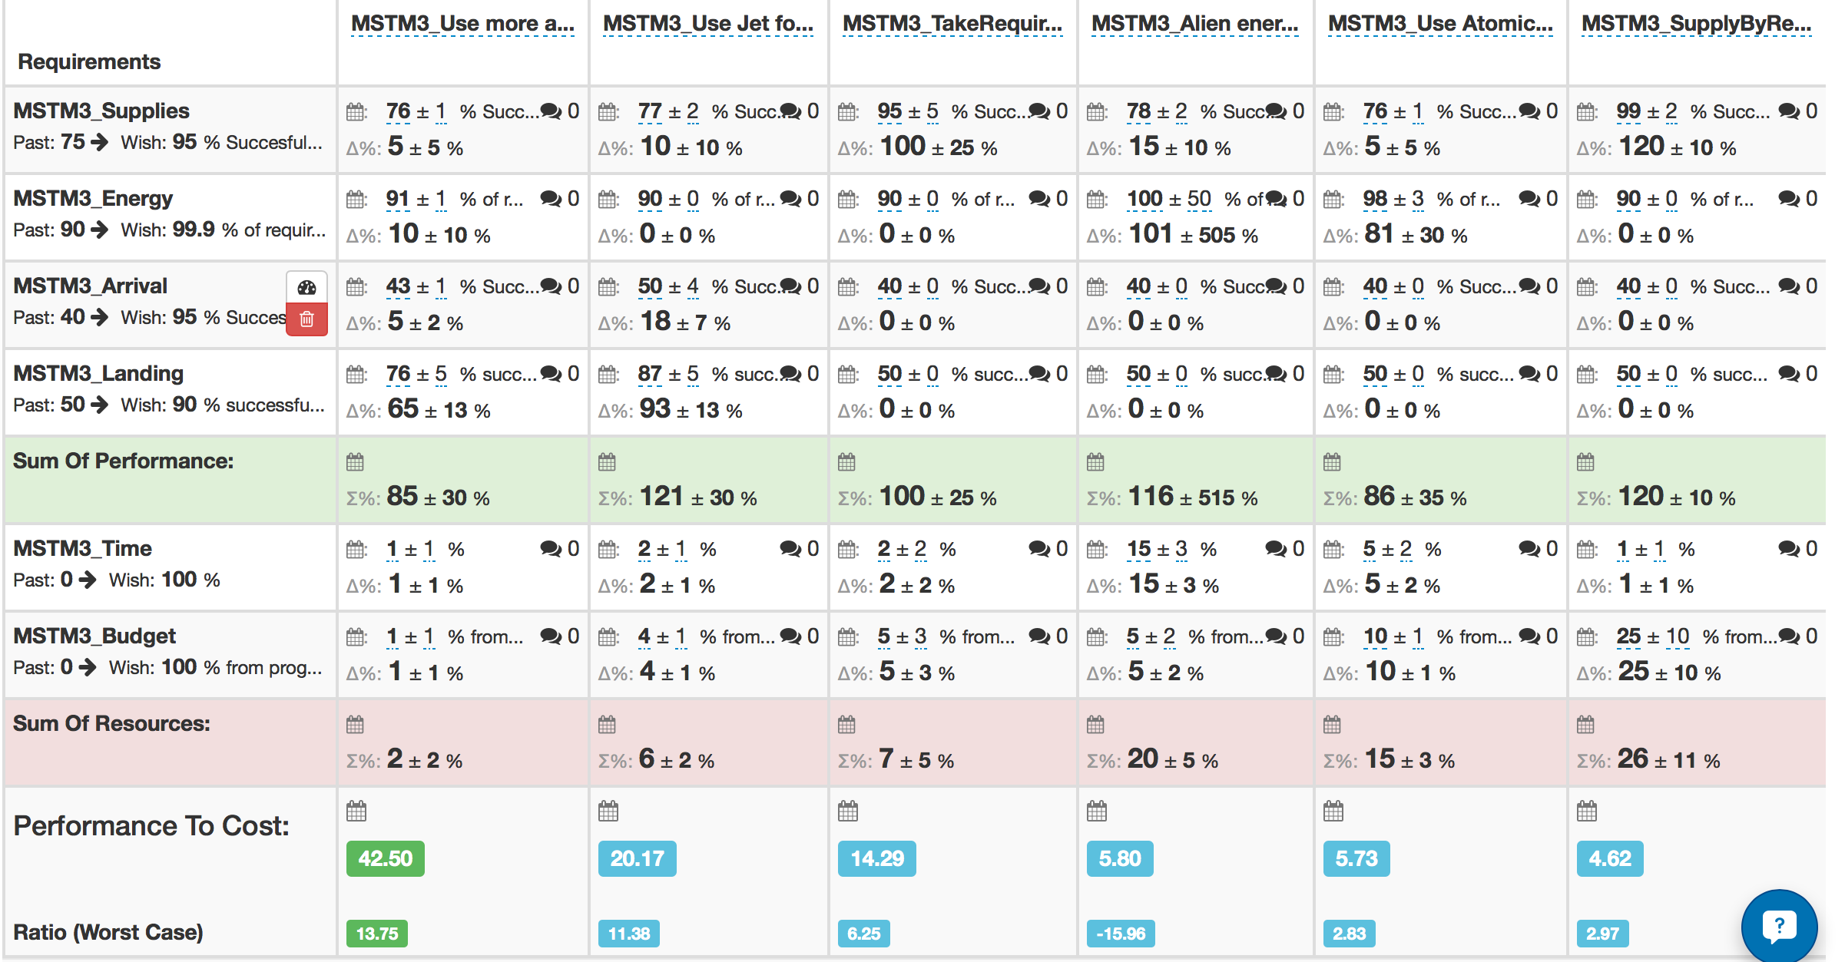
Mars Mission Planning: Lviv Business School
2. Decisive Decomposition
Power Planning Practices - Decomposition
Value Decision Table

Slide 23
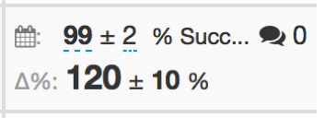
Mars Mission Planning: Lviv Business School
Power Planning Practices - Decomposition
Value Decision Table
Design Evaluation
and
Risk Evaluation
for all pairs of ‘Design & Performance-or-Cost’.
‘Whole-system’ analysis.
This ‘decomposition’ points to value opportunities.

Slide 24
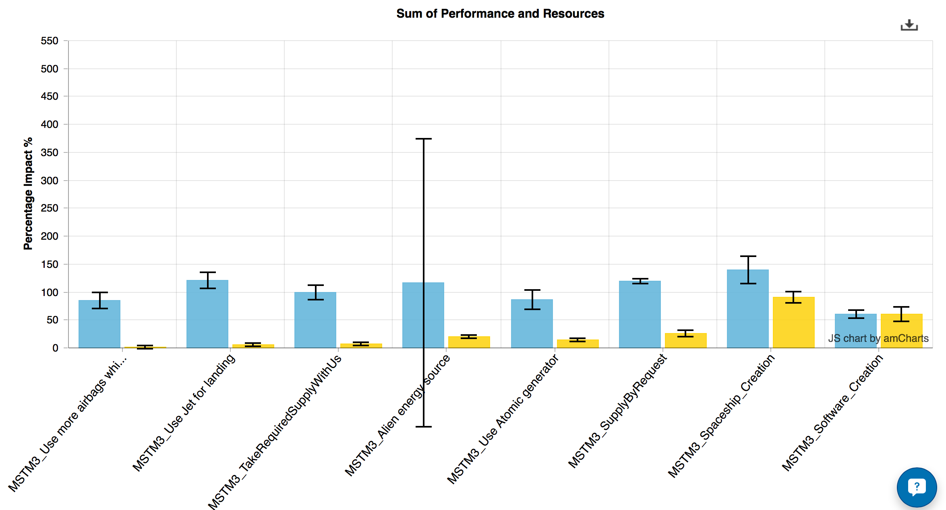
Value Decision Table
Winner
Sequenced by
Highest Value to Cost Ratio
Sequenced by
Highest Value to Cost Ratio
Sequenced by
Highest Value to Cost Ratio

Slide 25
Power Planning Practices - Decomposition
the 1 1 1 1 1 1 method
1
100% Improvement
75 stakeholders
43 different values
2 year deadline
100 functions
2500 solution ideas
% increase ‘at least’
stakeholder
value
week delivery cycle
function
solution

Slide 26
Power Planning Practices - Decomposition
1
the 1 1 1 1 1 1 method
100% Improvement
75 stakeholders
43 different values
2 year deadline
100 functions
2500 solution ideas
% increase ‘at least’
stakeholder
value
week delivery cycle
function
solution

Slide 27
1
the 1 1 1 1 1 1 method
100% Improvement
75 stakeholders
43 different values
2 year deadline
100 functions
2500 solution ideas
% increase ‘at least’
stakeholder
value
week delivery cycle
function
solution

Slide 28
1
the 1 1 1 1 1 1 method
100% Improvement
75 stakeholders
43 different values
2 year deadline
100 functions
2500 solution ideas
% increase ‘at least’
stakeholder
value
week delivery cycle
function
solution

Slide 29
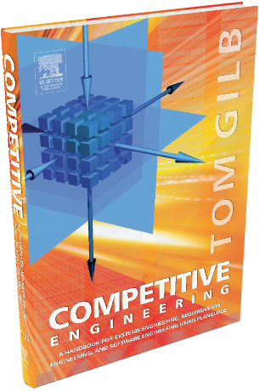
Power Planning Practices - Decomposition
Decomposition Principles: A Teachable Discipline
From Competitive Engineering Book
How to decompose systems into small evolutionary steps:
Believe there is a way to do it, you just have not found it yet!
Identify obstacles, but don't use them as excuses: use your imagination to get rid of them!
Focus on some usefulness for the user or customer, however small.
Do not focus on the design ideas themselves, they are distracting, especially for small initial cycles. Sometimes you have to ignore them entirely in the short term!
Think; one customer, tomorrow, one interesting improvement.
Focus on the results (which you should have defined in your goals, moving toward target levels).
Don't be afraid to use temporary-scaffolding designs. Their cost must be seen in the light of the value of making some progress, and getting practical experience.
Don't be worried that your design is inelegant; it is results that count, not style.
Don't be afraid that the customer won't like it. If you are focusing on results they want, then by definition, they should like it. If you are not, then do!
Don't get so worried about "what might happen afterwards" that you can make no practical progress.
You cannot foresee everything. Don't even think about it!
If you focus on helping your customer in practice, now, where they really need it, you will be forgiven a lot of ‘sins’!
You can understand things much better, by getting some practical experience (and removing some of your fears).
Do early cycles, on willing local mature parts of your user community.
When some cycles, like a purchase-order cycle, take a long time, initiate them early, and do other useful cycles while you wait.
If something seems to need to wait for ‘the big new system’, ask if you cannot usefully do it with the ‘awful old system’, so as to pilot it realistically, and perhaps alleviate some 'pain' in the old system.
If something seems too costly to buy, for limited initial use, see if you can negotiate some kind of ‘pay as you really use’ contract. Most suppliers would like to do this to get your patronage, and to avoid competitors making the same deal.
If you can't think of some useful small cycles, then talk directly with the real ‘customer’ or end user. They probably have dozens of suggestions.
Talk with end users in any case, they have insights you need.
Don't be afraid to use the old system and the old ‘culture’ as a launching platform for the radical new system. There is a lot of merit in this, and many people overlook it.
I have never seen an exception in 33 years of doing this with many varied cultures. Oh Ye of little faith!

Slide 30
Power Planning Practices - Decomposition
Decomposition Principles: A Teachable Discipline
From Competitive Engineering Book
How to decompose systems into small evolutionary steps:
Believe there is a way to do it, you just have not found it yet!
Identify obstacles, but don't use them as excuses: use your imagination to get rid of them!
Focus on some usefulness for the user or customer, however small.
Do not focus on the design ideas themselves, they are distracting, especially for small initial cycles. Sometimes you have to ignore them entirely in the short term!
Think; one customer, tomorrow, one interesting improvement.
Focus on the results (which you should have defined in your goals, moving toward target levels).
Don't be afraid to use temporary-scaffolding designs. Their cost must be seen in the light of the value of making some progress, and getting practical experience.
Don't be worried that your design is inelegant; it is results that count, not style.
Don't be afraid that the customer won't like it. If you are focusing on results they want, then by definition, they should like it. If you are not, then do!
Don't get so worried about "what might happen afterwards" that you can make no practical progress.
You cannot foresee everything. Don't even think about it!
If you focus on helping your customer in practice, now, where they really need it, you will be forgiven a lot of ‘sins’!
You can understand things much better, by getting some practical experience (and removing some of your fears).
Do early cycles, on willing local mature parts of your user community.
When some cycles, like a purchase-order cycle, take a long time, initiate them early, and do other useful cycles while you wait.
If something seems to need to wait for ‘the big new system’, ask if you cannot usefully do it with the ‘awful old system’, so as to pilot it realistically, and perhaps alleviate some 'pain' in the old system.
If something seems too costly to buy, for limited initial use, see if you can negotiate some kind of ‘pay as you really use’ contract. Most suppliers would like to do this to get your patronage, and to avoid competitors making the same deal.
If you can't think of some useful small cycles, then talk directly with the real ‘customer’ or end user. They probably have dozens of suggestions.
Talk with end users in any case, they have insights you need.
Don't be afraid to use the old system and the old ‘culture’ as a launching platform for the radical new system. There is a lot of merit in this, and many people overlook it.
I have never seen an exception in 33 years of doing this with many varied cultures. Oh Ye of little faith!

Slide 31
Power Planning Practices - Decomposition
Decomposition Principles: A Teachable Discipline
From Competitive Engineering Book
How to decompose systems into small evolutionary steps:
Believe there is a way to do it, you just have not found it yet!
Identify obstacles, but don't use them as excuses: use your imagination to get rid of them!
Focus on some usefulness for the user or customer, however small.
Do not focus on the design ideas themselves, they are distracting, especially for small initial cycles. Sometimes you have to ignore them entirely in the short term!
Think; one customer, tomorrow, one interesting improvement.
Focus on the results (which you should have defined in your goals, moving toward target levels).
Don't be afraid to use temporary-scaffolding designs. Their cost must be seen in the light of the value of making some progress, and getting practical experience.
Don't be worried that your design is inelegant; it is results that count, not style.
Don't be afraid that the customer won't like it. If you are focusing on results they want, then by definition, they should like it. If you are not, then do!
Don't get so worried about "what might happen afterwards" that you can make no practical progress.
You cannot foresee everything. Don't even think about it!
If you focus on helping your customer in practice, now, where they really need it, you will be forgiven a lot of ‘sins’!
You can understand things much better, by getting some practical experience (and removing some of your fears).
Do early cycles, on willing local mature parts of your user community.
When some cycles, like a purchase-order cycle, take a long time, initiate them early, and do other useful cycles while you wait.
If something seems to need to wait for ‘the big new system’, ask if you cannot usefully do it with the ‘awful old system’, so as to pilot it realistically, and perhaps alleviate some 'pain' in the old system.
If something seems too costly to buy, for limited initial use, see if you can negotiate some kind of ‘pay as you really use’ contract. Most suppliers would like to do this to get your patronage, and to avoid competitors making the same deal.
If you can't think of some useful small cycles, then talk directly with the real ‘customer’ or end user. They probably have dozens of suggestions.
Talk with end users in any case, they have insights you need.
Don't be afraid to use the old system and the old ‘culture’ as a launching platform for the radical new system. There is a lot of merit in this, and many people overlook it.
I have never seen an exception in 33 years of doing this with many varied cultures. Oh Ye of little faith!

Slide 32
Power Planning Practices - Decomposition
One Takeaway Point
s
‘Value Decision Tables’ point out the best 1% opportunities for value, costs and risks.

Slide 33
3. Elegant Effect Estimation
Principles
Practices

Slide 34
Power Planning Principles. Estimation
3. Elegant Effect Estimation
A Design ideas’ impact on a performance Value can be estimated with useful accuracy.
If you cannot estimate design effects at all, then the design risk is unacceptably high.
The impact accuracy just has to be order-of-magnitude, so that efficient decisions can be made, as to what to do next.
Good estimates are based on ‘good evidence’ and ‘good sources’
Bad estimates should at least be transparently bad.

Slide 35
A Design idea’s impact on a performance Value can be estimated with useful accuracy.
Value Effect
Design A = 28 sec. faster
Design B = 17 s.
Tolerable [April 2017] 37 sec.
Past [April. 2016] 52 sec.
Goal [April 2017] 18 sec.

Slide 36
Key Principle
A Design idea’s impact on a performance Value can be estimated with useful accuracy.

Slide 37
3. Elegant Effect Estimation
Principles
Practices

Slide 38
Power Planning Practices - Design Estimation
3. Elegant Effect Estimation
The Value Decision (Impact Estimation) Table is the best tool we know of to collect estimates systematically
The Needs & Means (gilb.com/p/needs-means) tool is great for collecting estimates and applying them to prioritization decisions.
‘Planguage’ suggests a number of practical tools for collecting individual estimates and for making sense of a set of them together.
± uncertainty, evidence, source, credibility, safety factor, total effect, effect in relation to total costs

Slide 39
From Objectives to Solutions
Solution 1
Solution 2
Solution n
Total Impacts
Impact on Objective
Impact on Objective
Impact on Objective
Total Impact on Objective
Objective
Impact on Budget
Impact on Budget
Impact on Budget
Total Impact on Budget
Resources
Benefits-to-Cost Ratio
Ratio
Ratio
Ratio
Courtesy Rolf Goetz
Notes:
Courtesy Rolf Goetz 2016 for his audio https://voice.adobe.com/a/P0BaZ/
yodaearth@googlemail.com

Slide 40
Power Planning Practices - Estimation
One Takeaway Point
s
‘Planguage’ suggests a number of practical tools, for collecting individual estimates;
and for making sense, of a set of them, together.

Slide 41
4. Really Reliable Risk Wrangling
Principles
Practices

Slide 42
Power Planning Principles. Risk
4. Really Reliable Risk Wrangling
All detailed elements of planning contain risk
Risk management is the job of every engineer at all times. (Ericsson Policy)
Risks need to be captured, integrated with all planning, made transparent, and ultimately mitigated by further planning or actions.
Risks occur at all stages of planning, development, integration, delivery, external changes and life cycle.
± Uncertainty
or
Range
EVIDENCE
SOURCE
Estimate

Slide 43
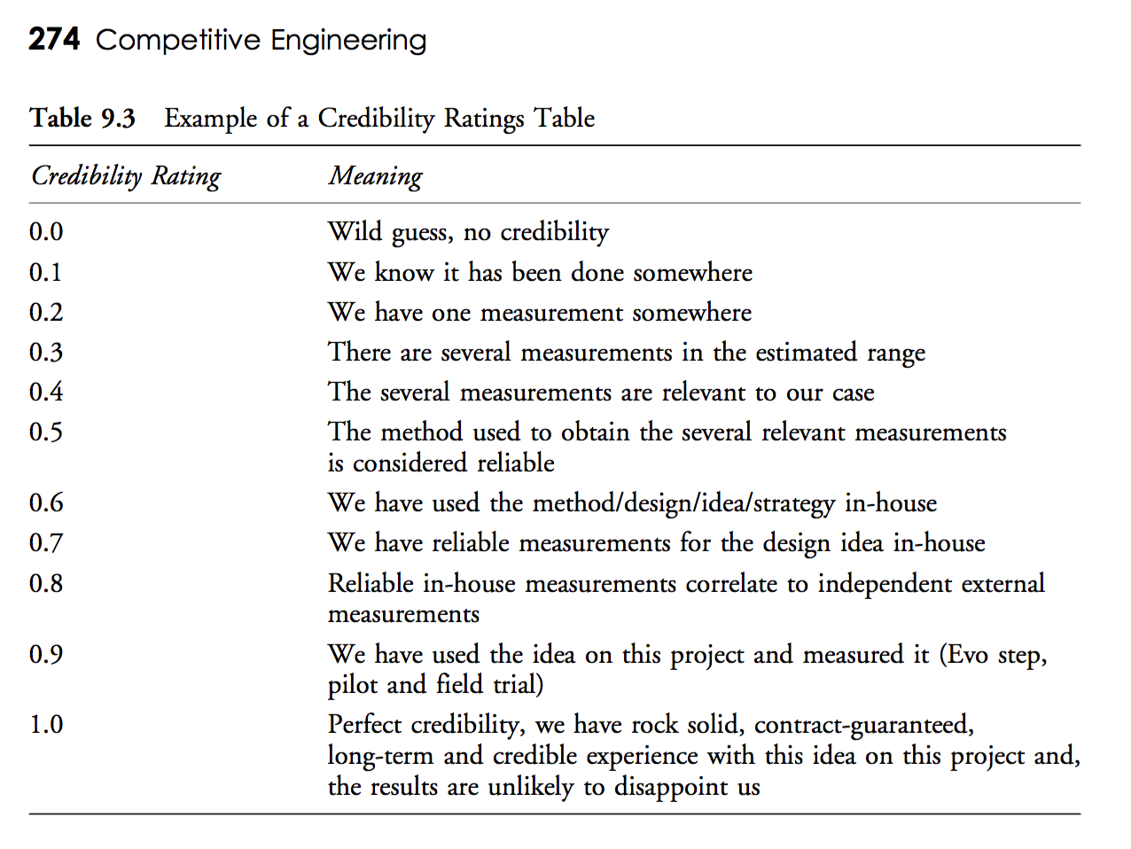
Every estimate will have a different ‘credibility’
but we can document the level of credibility
and use it to understand risk levels

Slide 44
A 2011 Intel Example
Application of Specification Quality Control by a SW team resulted in the following defect density reduction in requirements over several months:
‘ | # of Defects | # of Pages | Defects/ Page (DPP) | % Change in DPP
0.3 | 312 | 31 | 10.06
0.5 | 209 | 44 | 4.75 | -53%
0.6 | 247 | 60 | 4.12 | -13%
0.7 | 114 | 33 | 3.45 | -16%
0.8 | 45 | 38 | 1.18 | -66%
1.0 | 10 | 45 | 0.22 | -81%
Overall % change in DPP revision 0.3 to 1.0: |  |  |  | -98%
Scope delivered at the Alpha milestone increased 300%, released scope up 233%
SW defects reduced by ~50%
Defects that did occur were resolved in far less time on average

Slide 45
Key Principle
Risks need to be captured, integrated with all planning, made transparent, and ultimately mitigated by further planning or actions.

Slide 46
4. Really Reliable Risk Wrangling
Principles
Practices

Slide 47
Power Planning Practices - Risks
4. Really Reliable Risk Wrangling
‘Planguage’ is a massive set of risk annotation tools
Value Decision Tables help bring out specific risk clusters by requirement, by design.
Evo: Evolutionary value delivery is a tool for practical risk discovery and early mitigation.
SQC: Spec Quality Control, reduces the risks of project pollution at the earliest stages by 100 to 1
EVIDENCE
Estimate
± Uncertainty
or
Range
SOURCE
Credibility
Lowest
Range
Level
Credibility
Level
Credibility and Lowest Range
Level

Slide 48
Power Planning Practices - Risks
4. Really Reliable Risk Wrangling
EVIDENCE
Estimate
‘Planguage’ is a massive set of risk annotation tools
Value Decision Tables help bring out specific risk clusters by requirement, by design.
Evo: Evolutionary value delivery is a tool for practical risk discovery and early mitigation.
SQC: Spec Quality Control, reduces the risks of project pollution at the earliest stages by 100 to 1
± Uncertainty
or
Range
SOURCE
Credibility
Lowest
Range
Level
Credibility
Level
Credibility and Lowest Range
Level
Notes:
4. It is possible to, quickly and clearly, annotate risk information for all estimates, of both requirement levels, and design impact estimates.
This makes it possible to take engineering decisions with regard to risk.

Slide 49
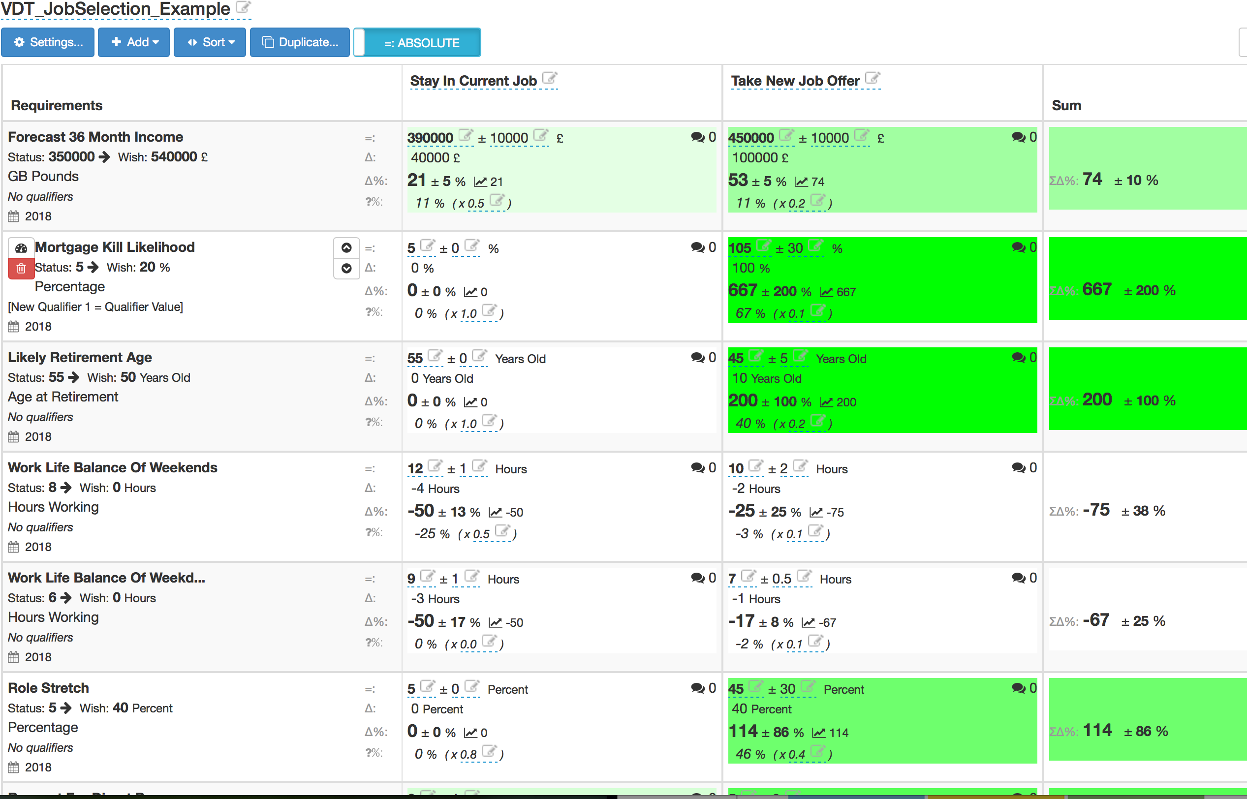
‘Real’ Job-option analysis March 2016:
Risk of Known Unknowns
Better Credibility
0.5
Low Credibility
0.2
Notes:
Courtesy Rolf Goetz 2016 for his audio https://voice.adobe.com/a/P0BaZ/
yodaearth@googlemail.com

Slide 50
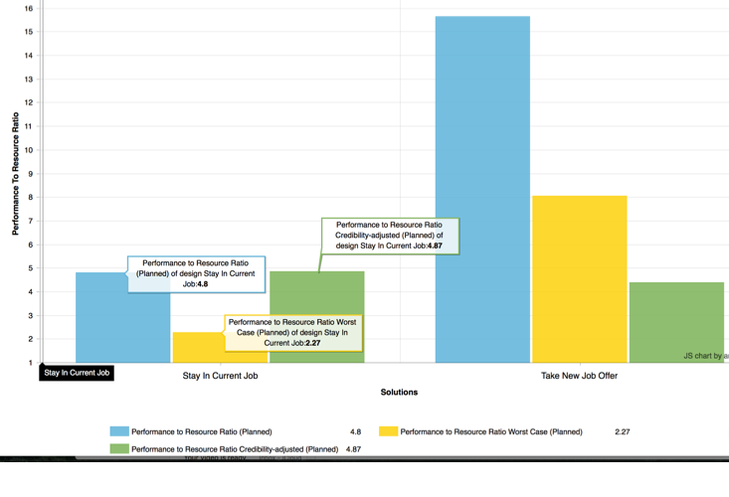
Job Selection ‘Bottom Line’, Worst Case
New job looks great, in theory
But, there are lots of risks
Notes:
A’s Job Selection real exercise
The New job had a lot of uncertainty, the old job had a lot of ‘knowns’
Case from A in London. Successful Tech Job Manager continuation vs Internet Bank Startup Challenge

Slide 51
12 Tough Management Questions for Avoiding Risks
1. NUMBERS: Why isn’t the improvement quantified?
2. RISK: What’s the risk or uncertainty and why?
3. DOUBT: Are you sure? If not, Why not?
4. SOURCE: Where did you get that from? How can I check it out?
5. IMPACT: How does your idea affect my goals?
6. ALL CRITICAL FACTORS: Did we forget anything critical?
7. EVIDENCE: How do you know it works that way?
8. ENOUGH: Have we got a complete solution?
9. PROFITABILITY FIRST: Are we going to do the profitable things first?
10. COMMITMENT: Who’s Responsible?
11. PROOF: How can we be sure the plan is working?
12. NO CURE: Is it no cure, no pay?
Notes:
https://www.enisa.europa.eu/activities/risk-management/current-risk/risk-management-inventory/files/octave_like.jpg

Slide 52
10 Tough Requirement Risk Questions for Intel Engineers
Have you agreed a set of top 10 critical value objectives for the product?
Are those objectives unambiguously clear to all who might have to understand them (the intended readership?)
Is it clear which stakeholders support and are interested in the requirement?
Are the requirements really values, qualities and results: not the technology we think will get us there?
Is it clear what the worst acceptable value delivery level is?
Is it clear what the success/wish level is, and that this is not a ‘Goal’ commitment yet: until we find technology and resources to reach it
Is it clear what the requirement value is, for example ‘economic’, or in terms of higher level objectives, if we reach the Wish/Goal level, for each stakeholder type? What is it worth?
Do we know the defect density of our specifications, and are they good enough to Exit the process? (Example Max. 0.2 Majors/600 words)
Do we have other major stakeholder levels that need a separate specification of requirements? (Product Division, Product Range, Product, Sub-market)
Is there any requirement arguably more-critical than the top-ten, that we failed to include or specify? Now that we think we have a complete set: what is missing?
Notes:
https://www.enisa.europa.eu/activities/risk-management/current-risk/risk-management-inventory/files/octave_like.jpg

Slide 53
10 Tough Design Risk Questions for Intel Engineers
11. Have you estimated the short term and life cycle costs, in both time and money for each major solution idea?
12. Have you looked at the ratio of a solution impacts (all 10) over the costs: so you envisage the most efficient solutions?
13. Have you looked at the worst-worst case (credibility and uncertainty) for all value impacts and all resource impacts?
14. Can you consider implementing the most efficient (effects/costs) solutions early to get feedback, leaning and possibly real value delivery to the field?
15. Is there a smart way of decomposing any design idea, into smaller independently implementable sub-solutions? Some of much higher value then the solution average?
16. Have you invited competitive imaginative engineers to come up with far more cost-effective solutions than you can show the on your Impact Estimation Tables? Using the impact Estimation Table as a provocative baseline for discussion.
17. Is it possible to improve the quality of impact evidence, and improve certainty by better research on existing experience of the solutions, or by experiments, or pilots? Better credibility before prioritization.
18. Can we conduct simple short term, this week, A/B experiments to get better data and experience on some of the promising solutions?
19. What can we do to motivate the best design engineers to analyze our ideas and come up with better ones?
20. Are the designs/solutions specified unambiguously clearly, so that nobody can inadvertently misunderstand what to estimate and what to implement? Can the design spec exit from a demanding Spec Quality Control process? Max. 0.2 Defects/600 words?
Notes:
https://programsuccess.files.wordpress.com/2011/04/risk_management_process.jpg
vital found 11 April 2016 tsg, Intel Talk

Slide 54
Power Planning Practices - Risks
One Takeaway Point
Evo: Evolutionary value delivery is a tool for practical risk discovery,
and for early risk-mitigation

Slide 55
5. Design Data Drives Decisions
Principles
Practices

Slide 56
Power Planning Principles. Decision Policies
5. Design Data Drives Decisions
The key drivers of decision making are:
the Value Requirement Goals
the limited resource budgets (time, $, space)
The ‘next step’ decision making is driven by feedback:
the values achieved to date: versus goals
the resources consumed to date: versus budgets
The risk levels (±, Credibility) can be used to determine good decisions with regard to risks.

Slide 57
Key Principle
The key drivers of decision making are:
the Value Requirement Goals
the limited resource budgets (time, $, space)

Slide 58
5. Design Data Drives Decisions
Principles
Practices

Slide 59
Power Planning Practices - Decision-Making
5. Design Data Drives Decisions
Cleanroom Method - Dynamic Design to Cost
Notes:
5. Decision-Making about technology can be based on the best available set of facts about requirements and designs;
combined with a value policy about how to make decisions.
This leads to smarter faster decisions,combined with decision transparency for learning and correction of the decision process.

Slide 60
In the Cleanroom Method
developed by IBM’s Harlan Mills (1980) they reported:
“Software Engineering began to emerge in FSD” (IBM Federal Systems Division, from 1996 a part of Lockheed Martin Marietta) “some ten years ago [Ed. about 1970] in a continuing evolution that is still underway:
Ten years ago general management expected the worst from software projects – cost overruns, late deliveries, unreliable and incomplete software
Today [Ed. 1980!], management has learned to expect on-time, within budget, deliveries of high-quality software. A Navy helicopter ship system, called LAMPS, provides a recent example. LAMPS software was a four-year project of over 200 person-years of effort, developing over three million, and integrating over seven million words of program and data for eight different processors distributed between a helicopter and a ship in 45 incremental deliveries [Ed. Note 2%!]s. Every one of those deliveries was on time and under budget
A more extended example can be found in the NASA space program,
- Where in the past ten years, FSD has managed some 7,000 person-years of software development, developing and integrating over a hundred million bytes of program and data for ground and space processors in over a dozen projects.
- There were few late or overrun deliveries in that decade, and none at all in the past four years.”
… in 45 incremental deliveries
… few late or overrun deliveries in that decade, and none at all in the past four years

Slide 61
Mills on Design to Cost
“To meet cost/schedule commitments based on imperfect estimation techniques, a software engineering manager must adopt a manage-and-design-to-cost/schedule process.
That process requires a continuous and relentless rectification of design objectives with the cost/schedule needed to achieve those objectives.”
in IBM Systems Journal, 4/80 p.420
Notes:
in IBM sj 4 80 p.420
In
Mills, H. 1980. The management of software engineering: part 1: principles of software engineering. IBM Systems Journal 19, issue 4 (Dec.):414-420.
Direct Copy
http://trace.tennessee.edu/cgi/viewcontent.cgi?article=1004&context=utk_harlan
Library header
http://trace.tennessee.edu/utk_harlan/5/

Slide 62
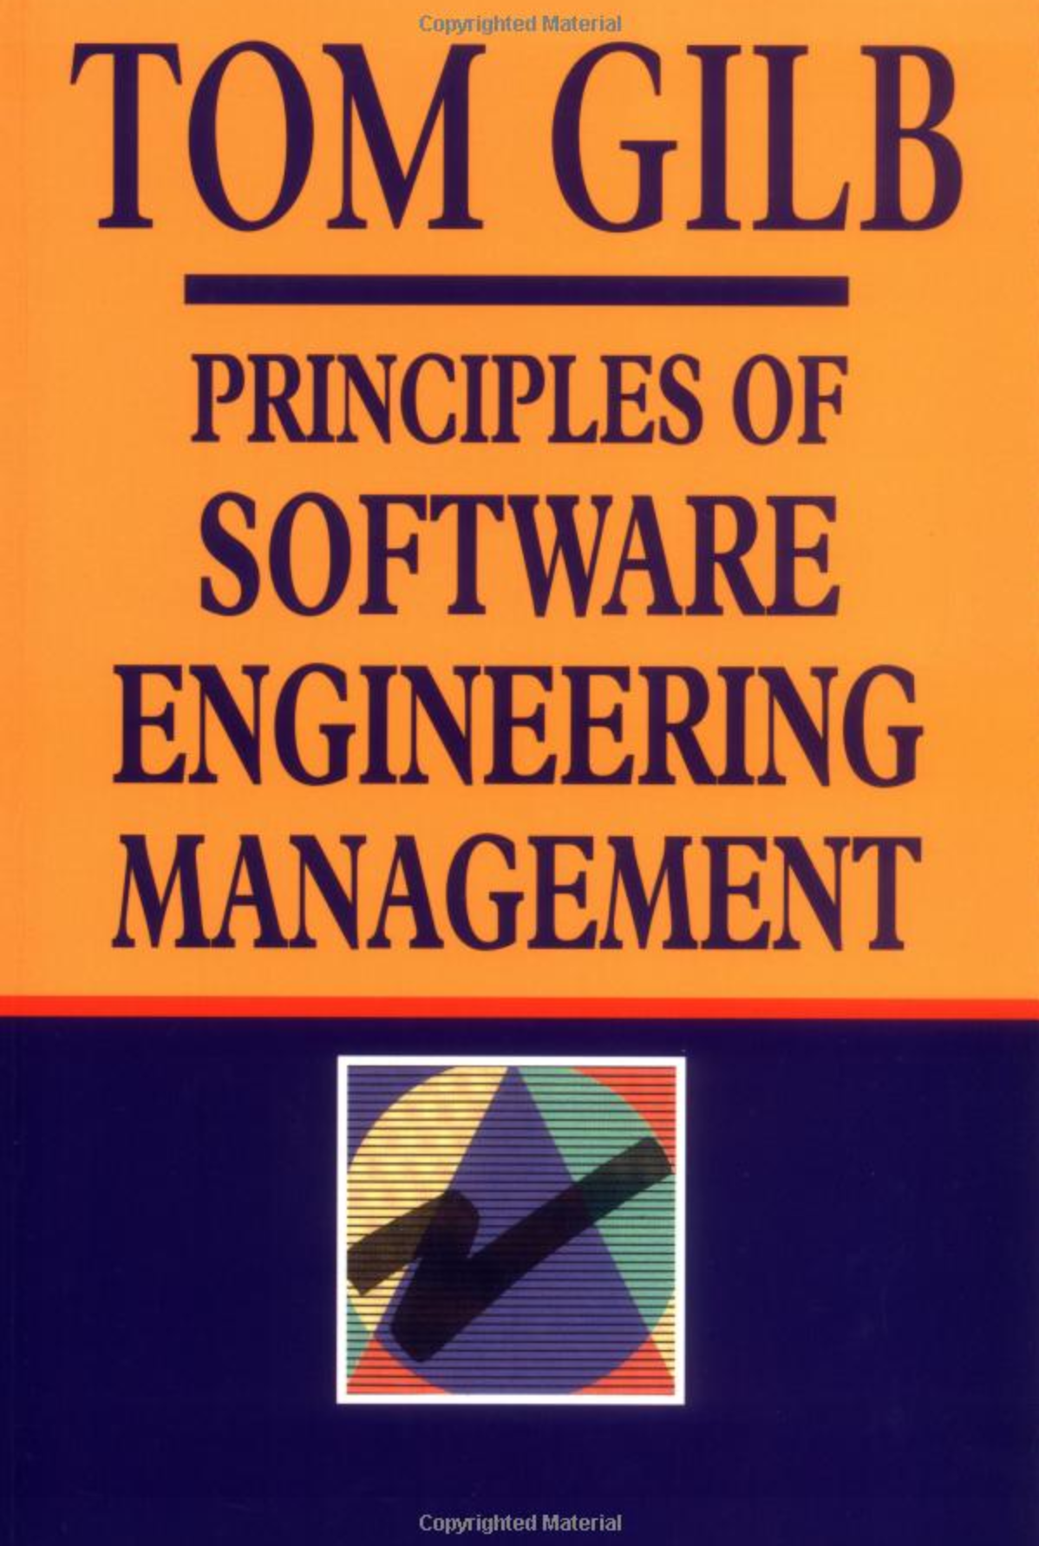
Quinnan:
IBM FSD Cleanroom Dynamic Design to Cost
Quinnan describes the process control loop used by IBM FSD to ensure that cost targets are met.
'Cost management. . . yields valid cost plans linked to technical performance. Our practice carries cost management farther by introducing design-to-cost guidance. Design, development, and managerial practices are applied in an integrated way to ensure that software technical management is consistent with cost management. The method [illustrated in this book by Figure 7.10] consists of developing a design, estimating its cost, and ensuring that the design is cost-effective.' (p. 473)
He goes on to describe a design iteration process trying to meet cost targets by either redesign or by sacrificing 'planned capability.' When a satisfactory design at cost target is achieved for a single increment, the 'development of each increment can proceed concurrently with the program design of the others.'
'Design is an iterative process in which each design level is a refinement of the previous level.' (p. 474)
It is clear from this that they avoid the big bang cost estimation approach. Not only do they iterate in seeking the appropriate balance between cost and design for a single increment, but they iterate through a series of increments, thus reducing the complexity of the task, and increasing the probability of learning from experience, won as each increment develops, and as the true cost of the increment becomes a fact.
'When the development and test of an increment are complete, an estimate to complete the remaining increments is computed.' (p. 474)
Source: Robert E. Quinnan, 'Software Engineering Management Practices', IBM Systems Journal, Vol. 19, No. 4, 1980, pp. 466~77
This text is cut from Gilb: The Principles of Software Engineering Management, 1988
Notes:
Slide developed Oct 6 2013 tsg for London Software Architecture Conference Talk 9 Oct 2013
15.1.18 Quinnan
Source: Robert E. Quinnan, 'Software Engineering Management Practices', IBM Systems Journal, Vol. 19, No. 4, 1980, pp. 466~77
Robert E. Quinnan: The Management of Software Engineering. Part V: Software Engineering Management Practices. IBM Systems Journal 19(4): 466-477 (1980)
Quinnan describes the process control loop used by IBM FSD to ensure that cost targets are met.
'Cost management. . . yields valid cost plans linked to technical performance. Our practice carries cost management farther by introducing design-to-cost guidance. Design, development, and managerial practices are applied in an integrated way to ensure that software technical management is consistent with cost management. The method [illustrated in this book by Figure 7.10] consists of developing a design, estimating its cost, and ensuring that the design is cost-effective.' (p. 473)
He goes on to describe a design iteration process trying to meet cost targets by either redesign or by sacrificing 'planned capability.' When a satisfactory design at cost target is achieved for a single increment, the 'development of each increment can proceed concurrently with the program design of the others.'
'Design is an iterative process in which each design level is a refinement of the previous level.' (p. 474)
It is clear from this that they avoid the big bang cost estimation approach. Not only do they iterate in seeking the appropriate balance between cost and design for a single increment, but they iterate through a series of increments, thus reducing the complexity of the task, and increasing the probability of learning from experience, won as each increment develops, and as the true cost of the increment becomes a fact.
'When the development and test of an increment are complete, an estimate to complete the remaining increments is computed.' (p. 474)
This article is far richer than our few selected quotations can show, with regard to concepts of cost estimation and control.

Slide 63
Quinnan:
IBM FSD Cleanroom Dynamic Design to Cost
Quinnan describes the process control loop used by IBM FSD to ensure that cost targets are met.
'Cost management. . . yields valid cost plans linked to technical performance. Our practice carries cost management farther by introducing design-to-cost guidance. Design, development, and managerial practices are applied in an integrated way to ensure that software technical management is consistent with cost management. The method [illustrated in this book by Figure 7.10] consists of developing a design, estimating its cost, and ensuring that the design is cost-effective.' (p. 473)
He goes on to describe a design iteration process trying to meet cost targets by either redesign or by sacrificing 'planned capability.' When a satisfactory design at cost target is achieved for a single increment, the 'development of each increment can proceed concurrently with the program design of the others.'
'Design is an iterative process in which each design level is a refinement of the previous level.' (p. 474)
It is clear from this that they avoid the big bang cost estimation approach. Not only do they iterate in seeking the appropriate balance between cost and design for a single increment, but they iterate through a series of increments, thus reducing the complexity of the task, and increasing the probability of learning from experience, won as each increment develops, and as the true cost of the increment becomes a fact.
'When the development and test of an increment are complete, an estimate to complete the remaining increments is computed.' (p. 474)
Source: Robert E. Quinnan, 'Software Engineering Management Practices', IBM Systems Journal, Vol. 19, No. 4, 1980, pp. 466~77
This text is cut from Gilb: The Principles of Software Engineering Management, 1988
of developing a design, estimating its cost, and ensuring that the design is cost-effective
Notes:
Slide developed Oct 6 2013 tsg for London Software Architecture Conference Talk 9 Oct 2013
15.1.18 Quinnan
Source: Robert E. Quinnan, 'Software Engineering Management Practices', IBM Systems Journal, Vol. 19, No. 4, 1980, pp. 466~77
Robert E. Quinnan: The Management of Software Engineering. Part V: Software Engineering Management Practices. IBM Systems Journal 19(4): 466-477 (1980)
Quinnan describes the process control loop used by IBM FSD to ensure that cost targets are met.
'Cost management. . . yields valid cost plans linked to technical performance. Our practice carries cost management farther by introducing design-to-cost guidance. Design, development, and managerial practices are applied in an integrated way to ensure that software technical management is consistent with cost management. The method [illustrated in this book by Figure 7.10] consists of developing a design, estimating its cost, and ensuring that the design is cost-effective.' (p. 473)
He goes on to describe a design iteration process trying to meet cost targets by either redesign or by sacrificing 'planned capability.' When a satisfactory design at cost target is achieved for a single increment, the 'development of each increment can proceed concurrently with the program design of the others.'
'Design is an iterative process in which each design level is a refinement of the previous level.' (p. 474)
It is clear from this that they avoid the big bang cost estimation approach. Not only do they iterate in seeking the appropriate balance between cost and design for a single increment, but they iterate through a series of increments, thus reducing the complexity of the task, and increasing the probability of learning from experience, won as each increment develops, and as the true cost of the increment becomes a fact.
'When the development and test of an increment are complete, an estimate to complete the remaining increments is computed.' (p. 474)
This article is far richer than our few selected quotations can show, with regard to concepts of cost estimation and control.

Slide 64
Quinnan:
IBM FSD Cleanroom Dynamic Design to Cost
Quinnan describes the process control loop used by IBM FSD to ensure that cost targets are met.
'Cost management. . . yields valid cost plans linked to technical performance. Our practice carries cost management farther by introducing design-to-cost guidance. Design, development, and managerial practices are applied in an integrated way to ensure that software technical management is consistent with cost management. The method [illustrated in this book by Figure 7.10] consists of developing a design, estimating its cost, and ensuring that the design is cost-effective.' (p. 473)
He goes on to describe a design iteration process trying to meet cost targets by either redesign or by sacrificing 'planned capability.' When a satisfactory design at cost target is achieved for a single increment, the 'development of each increment can proceed concurrently with the program design of the others.'
'Design is an iterative process in which each design level is a refinement of the previous level.' (p. 474)
It is clear from this that they avoid the big bang cost estimation approach. Not only do they iterate in seeking the appropriate balance between cost and design for a single increment, but they iterate through a series of increments, thus reducing the complexity of the task, and increasing the probability of learning from experience, won as each increment develops, and as the true cost of the increment becomes a fact.
'When the development and test of an increment are complete, an estimate to complete the remaining increments is computed.' (p. 474)
Source: Robert E. Quinnan, 'Software Engineering Management Practices', IBM Systems Journal, Vol. 19, No. 4, 1980, pp. 466~77
This text is cut from Gilb: The Principles of Software Engineering Management, 1988
iteration process trying to meet cost targets by either redesign or by sacrificing 'planned capability’
Notes:
Slide developed Oct 6 2013 tsg for London Software Architecture Conference Talk 9 Oct 2013
15.1.18 Quinnan
Source: Robert E. Quinnan, 'Software Engineering Management Practices', IBM Systems Journal, Vol. 19, No. 4, 1980, pp. 466~77
Robert E. Quinnan: The Management of Software Engineering. Part V: Software Engineering Management Practices. IBM Systems Journal 19(4): 466-477 (1980)
Quinnan describes the process control loop used by IBM FSD to ensure that cost targets are met.
'Cost management. . . yields valid cost plans linked to technical performance. Our practice carries cost management farther by introducing design-to-cost guidance. Design, development, and managerial practices are applied in an integrated way to ensure that software technical management is consistent with cost management. The method [illustrated in this book by Figure 7.10] consists of developing a design, estimating its cost, and ensuring that the design is cost-effective.' (p. 473)
He goes on to describe a design iteration process trying to meet cost targets by either redesign or by sacrificing 'planned capability.' When a satisfactory design at cost target is achieved for a single increment, the 'development of each increment can proceed concurrently with the program design of the others.'
'Design is an iterative process in which each design level is a refinement of the previous level.' (p. 474)
It is clear from this that they avoid the big bang cost estimation approach. Not only do they iterate in seeking the appropriate balance between cost and design for a single increment, but they iterate through a series of increments, thus reducing the complexity of the task, and increasing the probability of learning from experience, won as each increment develops, and as the true cost of the increment becomes a fact.
'When the development and test of an increment are complete, an estimate to complete the remaining increments is computed.' (p. 474)
This article is far richer than our few selected quotations can show, with regard to concepts of cost estimation and control.

Slide 65
Quinnan:
IBM FSD Cleanroom Dynamic Design to Cost
Quinnan describes the process control loop used by IBM FSD to ensure that cost targets are met.
'Cost management. . . yields valid cost plans linked to technical performance. Our practice carries cost management farther by introducing design-to-cost guidance. Design, development, and managerial practices are applied in an integrated way to ensure that software technical management is consistent with cost management. The method [illustrated in this book by Figure 7.10] consists of developing a design, estimating its cost, and ensuring that the design is cost-effective.' (p. 473)
He goes on to describe a design iteration process trying to meet cost targets by either redesign or by sacrificing 'planned capability.' When a satisfactory design at cost target is achieved for a single increment, the 'development of each increment can proceed concurrently with the program design of the others.'
'Design is an iterative process in which each design level is a refinement of the previous level.' (p. 474)
It is clear from this that they avoid the big bang cost estimation approach. Not only do they iterate in seeking the appropriate balance between cost and design for a single increment, but they iterate through a series of increments, thus reducing the complexity of the task, and increasing the probability of learning from experience, won as each increment develops, and as the true cost of the increment becomes a fact.
'When the development and test of an increment are complete, an estimate to complete the remaining increments is computed.' (p. 474)
Source: Robert E. Quinnan, 'Software Engineering Management Practices', IBM Systems Journal, Vol. 19, No. 4, 1980, pp. 466~77
This text is cut from Gilb: The Principles of Software Engineering Management, 1988
Design is an iterative process
Notes:
Slide developed Oct 6 2013 tsg for London Software Architecture Conference Talk 9 Oct 2013
15.1.18 Quinnan
Source: Robert E. Quinnan, 'Software Engineering Management Practices', IBM Systems Journal, Vol. 19, No. 4, 1980, pp. 466~77
Robert E. Quinnan: The Management of Software Engineering. Part V: Software Engineering Management Practices. IBM Systems Journal 19(4): 466-477 (1980)
Quinnan describes the process control loop used by IBM FSD to ensure that cost targets are met.
'Cost management. . . yields valid cost plans linked to technical performance. Our practice carries cost management farther by introducing design-to-cost guidance. Design, development, and managerial practices are applied in an integrated way to ensure that software technical management is consistent with cost management. The method [illustrated in this book by Figure 7.10] consists of developing a design, estimating its cost, and ensuring that the design is cost-effective.' (p. 473)
He goes on to describe a design iteration process trying to meet cost targets by either redesign or by sacrificing 'planned capability.' When a satisfactory design at cost target is achieved for a single increment, the 'development of each increment can proceed concurrently with the program design of the others.'
'Design is an iterative process in which each design level is a refinement of the previous level.' (p. 474)
It is clear from this that they avoid the big bang cost estimation approach. Not only do they iterate in seeking the appropriate balance between cost and design for a single increment, but they iterate through a series of increments, thus reducing the complexity of the task, and increasing the probability of learning from experience, won as each increment develops, and as the true cost of the increment becomes a fact.
'When the development and test of an increment are complete, an estimate to complete the remaining increments is computed.' (p. 474)
This article is far richer than our few selected quotations can show, with regard to concepts of cost estimation and control.

Slide 66
Quinnan:
IBM FSD Cleanroom Dynamic Design to Cost
Quinnan describes the process control loop used by IBM FSD to ensure that cost targets are met.
'Cost management. . . yields valid cost plans linked to technical performance. Our practice carries cost management farther by introducing design-to-cost guidance. Design, development, and managerial practices are applied in an integrated way to ensure that software technical management is consistent with cost management. The method [illustrated in this book by Figure 7.10] consists of developing a design, estimating its cost, and ensuring that the design is cost-effective.' (p. 473)
He goes on to describe a design iteration process trying to meet cost targets by either redesign or by sacrificing 'planned capability.' When a satisfactory design at cost target is achieved for a single increment, the 'development of each increment can proceed concurrently with the program design of the others.'
'Design is an iterative process in which each design level is a refinement of the previous level.' (p. 474)
It is clear from this that they avoid the big bang cost estimation approach. Not only do they iterate in seeking the appropriate balance between cost and design for a single increment, but they iterate through a series of increments, thus reducing the complexity of the task, and increasing the probability of learning from experience, won as each increment develops, and as the true cost of the increment becomes a fact.
'When the development and test of an increment are complete, an estimate to complete the remaining increments is computed.' (p. 474)
Source: Robert E. Quinnan, 'Software Engineering Management Practices', IBM Systems Journal, Vol. 19, No. 4, 1980, pp. 466~77
This text is cut from Gilb: The Principles of Software Engineering Management, 1988
but they iterate through a series of increments,
thus reducing the complexity of the task,
and increasing the probability of learning from experience
Notes:
Slide developed Oct 6 2013 tsg for London Software Architecture Conference Talk 9 Oct 2013
15.1.18 Quinnan
Source: Robert E. Quinnan, 'Software Engineering Management Practices', IBM Systems Journal, Vol. 19, No. 4, 1980, pp. 466~77
Robert E. Quinnan: The Management of Software Engineering. Part V: Software Engineering Management Practices. IBM Systems Journal 19(4): 466-477 (1980)
Quinnan describes the process control loop used by IBM FSD to ensure that cost targets are met.
'Cost management. . . yields valid cost plans linked to technical performance. Our practice carries cost management farther by introducing design-to-cost guidance. Design, development, and managerial practices are applied in an integrated way to ensure that software technical management is consistent with cost management. The method [illustrated in this book by Figure 7.10] consists of developing a design, estimating its cost, and ensuring that the design is cost-effective.' (p. 473)
He goes on to describe a design iteration process trying to meet cost targets by either redesign or by sacrificing 'planned capability.' When a satisfactory design at cost target is achieved for a single increment, the 'development of each increment can proceed concurrently with the program design of the others.'
'Design is an iterative process in which each design level is a refinement of the previous level.' (p. 474)
It is clear from this that they avoid the big bang cost estimation approach. Not only do they iterate in seeking the appropriate balance between cost and design for a single increment, but they iterate through a series of increments, thus reducing the complexity of the task, and increasing the probability of learning from experience, won as each increment develops, and as the true cost of the increment becomes a fact.
'When the development and test of an increment are complete, an estimate to complete the remaining increments is computed.' (p. 474)
This article is far richer than our few selected quotations can show, with regard to concepts of cost estimation and control.

Slide 67
Quinnan:
IBM FSD Cleanroom Dynamic Design to Cost
Quinnan describes the process control loop used by IBM FSD to ensure that cost targets are met.
'Cost management. . . yields valid cost plans linked to technical performance. Our practice carries cost management farther by introducing design-to-cost guidance. Design, development, and managerial practices are applied in an integrated way to ensure that software technical management is consistent with cost management. The method [illustrated in this book by Figure 7.10] consists of developing a design, estimating its cost, and ensuring that the design is cost-effective.' (p. 473)
He goes on to describe a design iteration process trying to meet cost targets by either redesign or by sacrificing 'planned capability.' When a satisfactory design at cost target is achieved for a single increment, the 'development of each increment can proceed concurrently with the program design of the others.'
'Design is an iterative process in which each design level is a refinement of the previous level.' (p. 474)
It is clear from this that they avoid the big bang cost estimation approach. Not only do they iterate in seeking the appropriate balance between cost and design for a single increment, but they iterate through a series of increments, thus reducing the complexity of the task, and increasing the probability of learning from experience, won as each increment develops, and as the true cost of the increment becomes a fact.
'When the development and test of an increment are complete, an estimate to complete the remaining increments is computed.' (p. 474)
Source: Robert E. Quinnan, 'Software Engineering Management Practices', IBM Systems Journal, Vol. 19, No. 4, 1980, pp. 466~77
This text is cut from Gilb: The Principles of Software Engineering Management, 1988
an estimate to complete the remaining increments is computed.
Notes:
Slide developed Oct 6 2013 tsg for London Software Architecture Conference Talk 9 Oct 2013
15.1.18 Quinnan
Source: Robert E. Quinnan, 'Software Engineering Management Practices', IBM Systems Journal, Vol. 19, No. 4, 1980, pp. 466~77
Robert E. Quinnan: The Management of Software Engineering. Part V: Software Engineering Management Practices. IBM Systems Journal 19(4): 466-477 (1980)
Quinnan describes the process control loop used by IBM FSD to ensure that cost targets are met.
'Cost management. . . yields valid cost plans linked to technical performance. Our practice carries cost management farther by introducing design-to-cost guidance. Design, development, and managerial practices are applied in an integrated way to ensure that software technical management is consistent with cost management. The method [illustrated in this book by Figure 7.10] consists of developing a design, estimating its cost, and ensuring that the design is cost-effective.' (p. 473)
He goes on to describe a design iteration process trying to meet cost targets by either redesign or by sacrificing 'planned capability.' When a satisfactory design at cost target is achieved for a single increment, the 'development of each increment can proceed concurrently with the program design of the others.'
'Design is an iterative process in which each design level is a refinement of the previous level.' (p. 474)
It is clear from this that they avoid the big bang cost estimation approach. Not only do they iterate in seeking the appropriate balance between cost and design for a single increment, but they iterate through a series of increments, thus reducing the complexity of the task, and increasing the probability of learning from experience, won as each increment develops, and as the true cost of the increment becomes a fact.
'When the development and test of an increment are complete, an estimate to complete the remaining increments is computed.' (p. 474)
This article is far richer than our few selected quotations can show, with regard to concepts of cost estimation and control.

Slide 68
Power Planning Practices - Decision-Making
One Takeaway Point
Dynamic Design to Cost

Slide 69
1. Crystal Clear Concerns
2. Decisive Decomposition
3. Elegant Effect Estimation
4. Really Reliable Risk Wrangling
5. Design Data Drives Decisions

Slide 70
Thanks!
get 6 months free access to
‘Weekly Principles with Kai & Tom Gilb’
StakeholderValues.com/Intel
Signup to our list and get:
This slide set
Decomposition Paper
Confirmit Paper
The Green Week Slides
Paper on 111111 ‘Unity’ Method
Decomposition Principles
Intel Case
12 tough questions paper
Tom@Gilb.com
Gilb.com
Notes:
http://www.methodsandtools.com/archive/archive.php?id=112 = Decomposition Paper
co author Trond Johansen Confirmit case paper
http://www.gilb.com/tiki-download_file.php?fileId=32
The Green Week Slides
http://www.gilb.com/dl660
http://www.gilb.com/dl826
Paper on 111111 ‘Unity’ Method
The Unity method of Decomposition
Column 2 of Gilb’s Mythodology
in Agile Record
http://www.gilb.com/dl826
Decomposition Principles
Paper is at www.gilb.com/dl41
Intel Case
http://selab.fbk.eu/re11_download/industry/Terzakis.pdf
12 tough questions paper
http://www.gilb.com/dl24

