Slide 1
The tribal wisdom of the Dakota Indians
passed on from generation to generation, says that,,
“When you discover you are riding a dead horse
the best strategy is
to dismount"!
© Tom Gilb, Gilb.com May 2012
Notes:
http://kenhomer.wordpress.com/2008/11/12/riding-a-dead-horse-the-wisdom-of-the-dakota-indians/
And many other web sites, google dead horses.
This set of slides was made by Tom Gilb, Kolbotn, Norway May 24 2012
And may be used with credit.
See also variation
http://www.tonycooke.org/free_resources/stories_illustrations/25_ways.html

Slide 2
However, in government,
more advanced strategies are often employed, such as:
Notes:
http://www.google.com/imgres?um=1&hl=en&client=safari&sa=N&rls=en&biw=1024&bih=670&tbm=isch&tbnid=ywVyLEgqc1KDUM:&imgrefurl=http://bishopalan.blogspot.com/2010/04/ride-dead-horse.html&docid=_5XlOfoyx5ImDM&imgurl=http://3.bp.blogspot.com/_ZItgL_ILBMc/S7WyZg51JMI/AAAAAAAAJjY/m8cu4qNyZcU/s320/dead%252Bhorse&w=240&h=320&ei=fUa-T6D7HsHdtAam0qy4DQ&zoom=1&iact=rc&dur=464&sig=114085099373486771714&page=2&tbnh=162&tbnw=126&start=14&ndsp=20&ved=1t:429,r:15,s:14,i:140&tx=74&ty=54

Slide 3
Buying a stronger whip.

Slide 4
2. Changing riders.
Notes:
http://www.google.com/imgres?um=1&hl=en&client=safari&sa=N&rls=en&biw=1024&bih=670&tbm=isch&tbnid=RNbPPy8LmyE-wM:&imgrefurl=http://www.owen.org/blog/62&docid=xhzCjLnejPAwvM&imgurl=http://www.owen.org/wp-content/uploads/horses1.png&w=321&h=409&ei=X0i-T7uoPI_ItAattOC3DQ&zoom=1&iact=hc&vpx=801&vpy=277&dur=1187&hovh=253&hovw=199&tx=147&ty=103&sig=114085099373486771714&page=1&tbnh=158&tbnw=127&start=0&ndsp=14&ved=1t:429,r:8,s:0,i:91

Slide 5
3. Appointing a committee to study the horse.
Notes:
http://www.google.com/imgres?um=1&hl=en&client=safari&sa=N&rls=en&biw=1024&bih=670&tbm=isch&tbnid=BUZKYiZf58CPuM:&imgrefurl=http://www.destructoid.com/why-bioware-should-change-the-mass-effect-3-ending-225222.phtml&docid=CfzU5kg1H46LoM&imgurl=http://www.necro-equine-sadism.com/beating-a-dead-horse.jpg&w=364&h=242&ei=gUi-T9W0KY_csgblkOjyDQ&zoom=1&iact=rc&dur=73&sig=114085099373486771714&page=1&tbnh=158&tbnw=224&start=0&ndsp=14&ved=1t:429,r:4,s:0,i:83&tx=169&ty=73

Slide 6
Francisco Goya's The constable Lampinos stitched inside a dead horse. Photograph: Christie's/PA
4. Arranging to visit other countries to see how other cultures ride dead horses.
Notes:
http://www.google.com/imgres?start=219&um=1&hl=en&client=safari&sa=N&rls=en&biw=1024&bih=670&tbm=isch&tbnid=UADvU-FnUg8NOM:&imgrefurl=http://blogs.guardian.co.uk/art/category/art/&docid=r_deInZNgckHUM&imgurl=http://image.guardian.co.uk/sys-images/Arts/Arts_/Pictures/2008/05/27/goya5.jpg&w=460&h=276&ei=Z0m-T7CwIMrbtAaxnZjhDQ&zoom=1&iact=hc&vpx=307&vpy=278&dur=6192&hovh=174&hovw=290&tx=137&ty=85&sig=114085099373486771714&page=13&tbnh=119&tbnw=198&ndsp=19&ved=1t:429,r:11,s:219,i:74
http://www.guardian.co.uk/artanddesign/jonathanjonesblog/2008/may/27/goyasgrotesquethemesstillr

Slide 7
5. Lowering the standards
so that dead horses can be included.
Notes:
http://www.google.com/imgres?start=356&um=1&hl=en&client=safari&sa=N&rls=en&biw=1024&bih=670&tbm=isch&tbnid=J0WUQRblxhdi9M:&imgrefurl=http://www.dailytech.com/Apple%2BAdmits%2BIts%2BMacs%2BHave%2Ba%2BMalware%2BProblem/article24451.htm&docid=tU03pZjGD4MUrM&imgurl=http://images.dailytech.com/nimage/Trojan_Horse_Wide.jpg&w=500&h=336&ei=Rk2-T_mHF9HLswbEldy5DQ&zoom=1&iact=rc&dur=457&sig=114085099373486771714&page=21&tbnh=149&tbnw=214&ndsp=16&ved=1t:429,r:12,s:356,i:190&tx=121&ty=109

Slide 8
6. Reclassifying the dead horse as living-impaired.
Notes:
http://www.google.com/imgres?start=178&um=1&hl=en&client=safari&sa=N&rls=en&biw=1024&bih=670&addh=36&tbm=isch&tbnid=KZ0HXAevhPWsmM:&imgrefurl=http://www.horseandhound.co.uk/news/397/268372.html&docid=T1mQdRLAZUSpqM&imgurl=http://www.horseandhound.co.uk/imageBank/h/HorseSculpture.JPG&w=450&h=303&ei=ok6-T_OpC4jOswaIo9HTDQ&zoom=1&iact=hc&vpx=534&vpy=341&dur=3482&hovh=184&hovw=274&tx=146&ty=77&sig=114085099373486771714&page=11&tbnh=139&tbnw=198&ndsp=19&ved=1t:429,r:35,s:178,i:253

Slide 9
7. Hiring outside contractors to ride the dead horse.
Notes:
http://www.google.com/imgres?um=1&hl=en&client=safari&sa=N&rls=en&biw=1024&bih=670&tbm=isch&tbnid=kQuc37F-lDopkM:&imgrefurl=http://www.hello-online.ru/content.php%3Fcontid%3D2100&docid=atNbfxKMzDnuGM&imgurl=http://www.hello-online.ru/img/130/rider.gif&w=250&h=200&ei=Rk--T7OXC4jLswbZo6T-DQ&zoom=1&iact=hc&vpx=651&vpy=186&dur=123&hovh=160&hovw=200&tx=93&ty=49&sig=114085099373486771714&page=1&tbnh=157&tbnw=200&start=0&ndsp=15&ved=1t:429,r:3,s:0,i:80

Slide 10
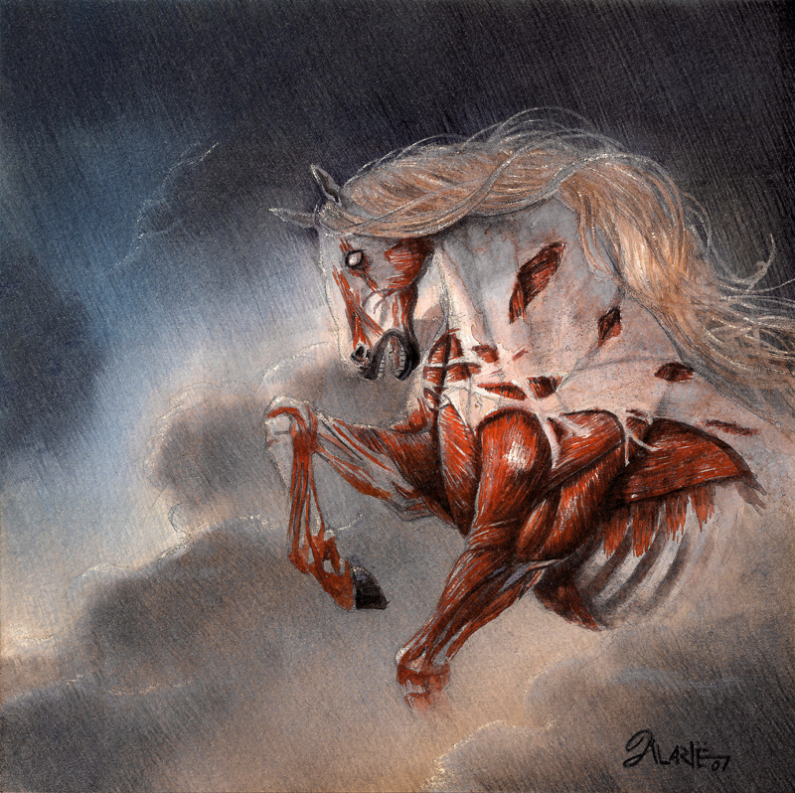
8. Harnessing several dead horses together
to increase speed.
Notes:
http://alarie-tano.deviantart.com/art/Saddle-Up-A-Dead-Horse-II-70868253

Slide 11
9.. Providing additional funding and/or training
to increase the dead horse's performance.
Notes:
http://www.google.com/imgres?um=1&hl=en&client=safari&sa=N&rls=en&biw=1024&bih=670&tbm=isch&tbnid=b9Z2d7MmWRzymM:&imgrefurl=http://theweek.com/section/cartoon/82/219679/world-economy&docid=TJ5h2LSzkdEJJM&imgurl=http://2.images.theweek.com/img/dir_0066/33309_cartoon_main/beating-the-dead-horse.jpg%253F84&w=625&h=470&ei=zVO-T48DkcSyBtan5NcN&zoom=1&iact=hc&vpx=535&vpy=195&dur=2474&hovh=195&hovw=259&tx=151&ty=114&sig=114085099373486771714&page=2&tbnh=141&tbnw=227&start=13&ndsp=17&ved=1t:429,r:2,s:13,i:109

Slide 12
10. Doing a productivity study
to see if lighter riders
would improve the dead horse's performance.
Notes:
http://www.google.com/imgres?start=687&um=1&hl=en&client=safari&sa=N&rls=en&biw=1348&bih=667&tbm=isch&tbnid=ZHwrCWq_LZkJUM:&imgrefurl=http://obsidianwings.blogs.com/obsidian_wings/2011/07/what-sex-specific-selection-reveals-about-the-purpose-of-children.html&docid=UXystAXcLprXjM&imgurl=http://obsidianwings.blogs.com/.a/6a00d834515c2369e2014e8994d741970d-500wi&w=500&h=456&ei=Mlm-T_W-HIzfsga1iJ2XDw&zoom=1&iact=hc&vpx=714&vpy=153&dur=3920&hovh=214&hovw=235&tx=98&ty=101&sig=114085099373486771714&page=30&tbnh=142&tbnw=153&ndsp=23&ved=1t:429,r:15,s:687,i:37
http://dougbelshaw.com/blog/2010/05/24/establishing-your-productivity-endgame/#.T75YXY7pbqU

Slide 13
11. Declaring that
as the dead horse does not have to be fed,
it is less costly,
carries lower overhead
and therefore contributes substantially more to the bottom line of the economy
than do some other horses.
Notes:
http://www.equisearch.com/horses_care/avoid-big-vet-bills/

Slide 14
12. Rewriting the expected performance requirements for all horses.
Notes:
http://ambassadors.net/features2.htm

Slide 15
And of course....

Slide 16
13 Promoting the dead horse to a supervisory position.
Notes:
http://www.ehow.com/info_8489722_wild-horses-mating-habits.html

Slide 17
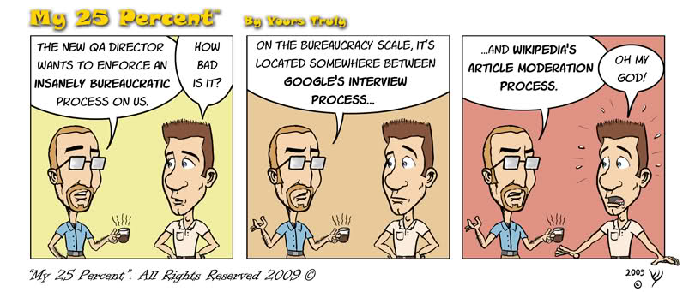
If you don't understand these strategies yet, chances are you don't work for the government, but you will see them employed sooner than later!
Notes:
http://www.my25percent.com/2009/10/bureacratic-control.html

