Slide 1
What’s Wrong With Requirements Methods?
An analysis of the fundamental failings of conventional thinking about software requirements, and some suggestions for getting it right.
Talk 27 June 2011 London SPIN
6.15 p.m. Presentation by Tom Gilb (30 minutes total incl. discussion)
Major edit 25 June 2011

Slide 2
Talk Background Data
Evening 25-30 minute London SPIN talk 6:15 to 6:45
Paper , Publication
    http://www.coremag.eu/fileadmin/Papers/RQNG_tom_gilb_core_ENG.pdf
    http://www.gilb.com/tiki-download_file.php?fileId=443 (Journal Sw Eng version)
    http://www.testingexperience.com/testingexperience11_09_10.pdf (Test exp version)
      Registration required
Presented by Tom Gilb, Independent Consultant, Author, Teacher
  Tom@Gilb.com
  www.Gilb.com
  @ImTomGilb on twitter
Notes:
Earlier Presentation, approximately same slides, 2nd International Workshop on Requirements Analysis, London, Middlesex U, Trent Campus, Paper in Proceedings
Second Presentation ACCU 2011 April 2010
Published Paper in Core Magazine Poland (English and also Polish), http://www.coremag.eu/fileadmin/Papers/RQNG_tom_gilb_core_ENG.pdf
And in Testing Experience (testingexperience.com Berlin Sept, 2010) http://www.testingexperience.com/testingexperience11_09_10.pdf
Copies of both slides and the papers are generally at gilb.com downloads, or on request from tomsgilb@gmail.com

Slide 3
What is wrong with Requirements Practice?
Lack of
  Critical
  Value
  Requirements
Notes:
Background:
We know our IT projects fail, and disappoint. We know bad ‘requirements’
is at the root, but not the only cause. But, it is my opinion that almost no
one has openly discussed or dealt with the real problem. It is my opinion
that no widely-known and widely-taught methods are anywhere near
identifying the critical problems. In a nutshell: we think like
programmers, not engineers or managers. We do not concentrate on
value delivery, but instead on code function, on use-cases and on code
delivery. Management is not taking its responsibility to make things
better.

Slide 4
Talk Outline
Time permitting, then see slides at www.gilb.com
1. Requirement definition: ‘Stakeholder Prioritized End State’
2. Ten Reasons Why Requirements Methods Fail
3. Top Level Critical Objectives: the missing link
4. Don’t Mix Ends and Means
5. Requirements are not always ‘Required’: Intelligent Dynamic Prioritization
6. Stakeholders: not just users and customers!
7. Value Delivery: leading to Systems Thinking, not Software Silos
8. Quantification: not ‘Software Poetry’ – a basis for real Software Engineering – not mere ‘Softcrafting’
9. Rich Specification: Requirement specifications need far more info than the requirement itself!
10. Ten Principles for Successful Requirements Methods.
11. Who or What will Change things?
12. Summary

Slide 5

“Requirement” is
“Stakeholder Valued
End State”
Source: Gilb, Planguage Concept Glossary 2011 version
http://www.gilb.com/tiki-download_file.php?fileId=386
Notes:
blog.redemtech.com tree source via Google sept 16 2010
Notice that I am distinguishing between:
• A ‘requirement’ (stakeholder-prioritizedend state)
• A requirement specification my Concept *508, [1]
• A an actually implemented requirement
• A ‘design’ in partial or full service of implementing a
requirement.

Slide 6
Requirement Types: <-CE, PL
Notes:
Source: Competitive Engineering, book, Glossary ‘Requirement’

Slide 7
Ten Reasons
Why Requirements Methods Fail
1. Focus, not stakeholders
2. Designs, not values
3. Poetry, not clear
4. Function, not quality
5. Testable, not constraints
6. Requirement, not background
7. Single Requirement, not the set
8. Assumptions, not rigorous definitions
9. Blind acceptance, no real QC
10. single level, not multiple levels
Notes:
2.1. They are narrowly focussed on a user or customer need, and not the much broader area of stakeholder values.
2.2 They are formulated in terms of designs to satisfy the stakeholder values, but the stakeholder value itself is absent or vague.
Example: Password, instead of a Security Level requirement
2.3 Clearly scalar (variable level) requirements are formulated as nice words, with no attempt to clarify them numerically.
Example “High Usability”
2.4 Far too much attention to what the system must do (Function) and far too little attention to how well it should do it (qualities) – in spite of the fact that quality improvements tend to be the major drivers for new projects.
2.5 Far too much attention to testable attributes of a system, and too little attention to the constraint type of requirement.
Example: Constraint:” Must not violate European Union Laws or politics.”
2.6 Far too much emphasis on the requirement itself; and far too little concurrent information about its ‘background’ (*507). Who wants it and why?
Example of Background:
Availability: Scale: % Planned Uptime.
Past [Previous Product] 99.90% <- 2010 Study
Trend [Major Competitors, 2015] 99.99+% <- Mkt Est.
2.7 Far too much focus on the individual requirement alone, and far too little on the valid set of requirements, needing simultaneous satisfaction
2.8 Far too little formal and agreed definition of critical or key concepts.
BAD: Availability: 99.90%
BETTER: Availability:
Scale: % Average Planned Uptime Daily for defined [Users] and defined [Tasks]
Planned: by Operations.
Uptime: capacity to allow specific Users to Perform specified Tasks at Defined Performance levels.
Daily: during opening hours
Goal [Users = Cashiers, Task = Checkout] 99.90%
2.9 There is far too little quality control of requirements, against decent standards [See 3, ‘Rules’ for good examples of decent standards] for requirements, before the requirements are exited to next processes.
For example it is typical that we can identify 80 to 200+ words per 300 words of requirement text as ambiguous or unclear to intended readers! [4]
2.10 There is far too little systematic work and specification about the related levels of requirements. If you look at some methods and processes, all requirements are ‘at the same level’ (keyword = Burn Rate, Agile Methods).
At the very least we need to distinguish between
Corporate Requirements
Top Level Critical Few Project or Product Requirements
Other Stakeholder Requirements
System Requirements
Software Requirements
We need to clearly document the level and the relationships between these: for example
Availability:
Type: Product Line System Level Requirement.
Stakeholders: {Systems Engineering, Marketing, Architecture}.
Constrained By: Product Quality Policy, EU Safety Standards
Impacts: Product Sales, Corporate Image, Competitiveness
Impacted By: {Software Availability, Data Availability, Network Availability, Server Availability, Handset Availability}.
By the way, this and earlier examples make use of a requirements planning language, I call ‘Planguage’ [3, 5]. One Planguage convention is that all ‘Capitalized Terms’ are properly defined, somewhere.

Slide 8
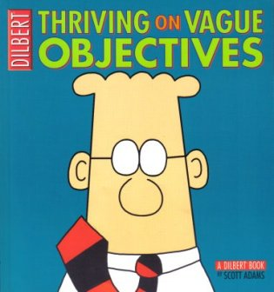
The Worst Problem
Real Case
Bad Quality
for the
Top Level
Critical
Requirements
“Make the system much easier to understand and use”
“Robustness’
  (See next slide )
“Richer set of tools for supporting next generation tools and applications”
Notes:
Note that:
All requirements are qualities, but they were not specified quantitatively, so that they would be crystal clear, and could be tracked.
Management themselves (CEO, CTO, CIO level) did not take the trouble to clarify these critical objectives. The CEO actively rejected the idea of clarification, the CIO told me!
None of the technical ‘experts’ reacted to the situation. They happily spent $100 million on all the many suggested architecture solutions (see Design Hypothesis in the example below for some designs) that were mixed in with the objectives.

Slide 9
A Complex Requirement
“Robustness”
Robustness
Software Downtime
Restore Speed
Testability
Fault Prevention Capability
Fault Isolation Capability
Fault Analysis Capability
Hardware Debugging Capability
Notes:
7. Rock Solid Robustness:
Type: Complex Product Quality Requirement.
Includes: {Software Downtime, Restore Speed, Testability, Fault Prevention Capability, Fault Isolation Capability, Fault Analysis Capability, Hardware Debugging Capability}.

Slide 10
Testability (part of “Robustness”)
Scale: the duration of
a defined [Volume] of testing,
of a defined [Type],
by a defined [Skill Level] of system operator,
under defined [Operating Conditions]
Fail ..
20 minutes
Goal….
< 10 minutes
Stretch
…
1 minute
Notes:
Testability:
Type: Software Quality Requirement.
Version: 20 Oct 2006-10-20
Status: Demo draft,
Stakeholder: {Operator, Tester}.
Ambition: Rapid-duration automatic testing of <critical complex tests>, with extreme operator setup and initiation.
Scale: the duration of a defined [Volume] of testing, or a defined [Type], by a defined [Skill Level] of system operator, under defined [Operating Conditions].
Goal [All Customer Use, Volume = 1,000,000 data items, Type = WireXXXX Vs DXX, Skill = First Time Novice, Operating Conditions = Field, {Sea Or Desert}. <10 mins.
Design Hypothesis: Tool Simulators, Reverse Cracking Tool, Generation of simulated telemetry frames entirely in software, Application specific sophistication, for drilling – recorded mode simulation by playing back the dump file, Application test harness console <-6.2.1 HFA

Slide 11
Previous Case: Observation
Management lost over $100 million on this project, and 8 years time,
Because they failed to clarify (quantify!) critical requirements
1 days work
Notes:
Management has lost control at the beginning
But it takes 8 years delay and a loss of $100 million to make management aware something is wrong (must be those programmers, right?)
The technical staff is no better, and happily spends management’s money. “A fool and their money will soon part company, for they have more dollars than sense (variant, Tussler)”
Neither managers nor nerds have culture or training to quantify qualitative requirements. They act like nice-sounding words are good enough.
There was, I found, a 3 cm. high stack of paper with some very detailed ‘requirements’, and 80 developers, but nobody had ever delivered what management wanted 8 years earlier.

Slide 12
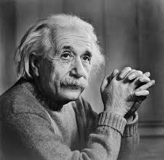
4. Don’t Mix Ends and Means
“Perfection of means
and confusion of ends
seem to characterize our age.”
Albert Einstein. 1879-1955

Slide 13
Why do people specify a Means as if they were their real Ends?
Means = concrete
Ends = abstract
Lack of training/education
  Hopper: Puritan Gift
Notes:
The problem of confusing ends and means is clearly an old one, and deeply rooted.
We specify a solution, design, architecture, instead of what we really value – our real requirement [7].
There are explanatory reasons for this – for example solutions are more concrete, and what we went (qualities) are more abstract for us (because we have not learned to make them measurable and concrete).
The problem is, if we do confuse them: if we do specify the means, not our true ends
“be careful what you ask for, you might just get it” (unknown source)
you might not get what you really want
the solution you have specified might cost too much or have bad side effects, even if you do get what you want
there may be much better solutions you don’t know about yet

Slide 14
Finding the right level
Why?
Why?
Why?
Why?
Why?
Notes:
So how to we find the ‘right requirement’, the ‘real requirement’? [7]
Assume that there probably is a better formulation, a more accurate expression of our real values and needs
Search for it by asking ‘Why?’
Why do I want X, because I really want Y, and assume I will get it through X. But, then why do I want Y? Because I really want Z and assume that is the best way to get X. Continue the process until it seems reasonable to stop. (the 5 Whys’ Method)
Assume that our stakeholders will usually state their values in terms of some perceived means to get what they really value.
Help them identify (Why? Process) and acknowledge what they really want, and make that the ‘official’ requirement.
Don’t insult them by telling them they don’t know what they want.
But explain that you will help them more-certainly get what they more deeply want, with better and cheaper solutions, perhaps new technology, if they will go through the ‘Why?’ process with you

Slide 15
Why? Example
Why do you require a ‘password’ for Security!
What kind of security do you want?
Against stolen information
How strong security against stolen info are you willing to pay for?.
At least 99% chance they cannot break in within 1 hour
So that is your real requirement ?
Yep.
Can we make that official?
Of course!
That’s what I asked for!
Notes:
Why do you require a ‘password’?
for Security!
What kind of security do you want?
Against stolen information
How strong security against stolen info are you willing to pay for.
At least 99% chance they cannot break in within 1 hour of trying! Whatever that costs up to € 1 million.
So that is your real requirement ?
Yep.
Can we make that the official requirement, and leave the security design to both our security experts, and leave it to proof by measurement to decide what is really the right design?
Of course!

Slide 16
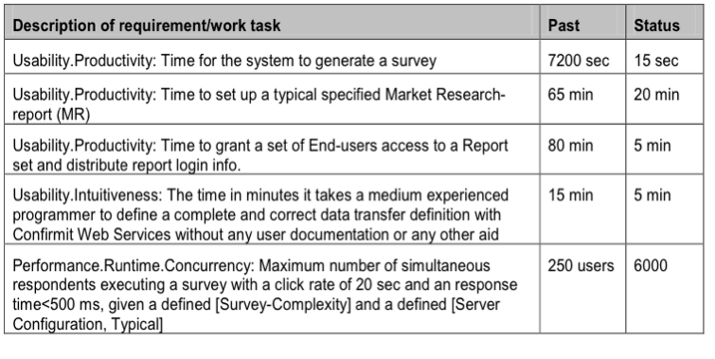
Our Client, Real Results
Real Immediate Stakeholder value
Notes:
Case study [9] The best improved 5 of 25 quantified required results in 3 months of development. A client of ours, who directly specified as requirements, what they really wanted (like ‘intuitiveness’) and then quantified it, making it fairly simple to measure after each iterative week of Evo method development. They did not make the mistake of letting the ‘users’ design the system. In fact they consciously REFUSED to allow such ‘requirements’ from their customers! They let the developers do the design, and let developers measure the results of their designs. They got so good so fast that they wiped out, bought up, their competition.

Slide 17
Value Delivery: leading to Systems Thinking, not Software Silos
Stake-holders
Stake-holders
Plan Do
Act Study
Realized
Value
Potential Value
Perceived Value Info
Realized Value Information
Stake-holders
Stake-holders
Stake-holders
Stake-holders
Other
Critical
Factors
Notes:
Requirements are ‘stakeholder valued future states’. The whole point is VALUE. Not function, not stories. The whole point is value to STAKEHOLDERs, not just users or customers alone!
Value (*269, [1]) is:
“Value is perceived benefit: that is, the benefit we think we get from something.” [3, page 435]
One problem with conventional requirements thinking is that it is not closely enough coupled with ‘value’.
If requirements are NOT closely tied to value then:
We risk failure to deliver the value expected, even if ‘requirements’ are satisfied.
We risk having a failure to think about all the things to do that are necessary prerequisites to actually delivering full value to real stakeholders on time, systems thinking – not just programming.
We need to keep in mind that we ‘softcrafters’ [2] (‘engineers’, is too pretentious a title, for such unpredictable and poor results) have a terrible failure rate for IT projects (Standish Chaos report etc.). Part of the reason for this, many analysts agree, is the poor state of requirements methods and practice. Failure is ‘failure to deliver expected value’.

Slide 18
Value Requirements
If requirements are NOT closely tied to value then:
  We risk failure to deliver the value expected, even if ‘requirements’ are satisfied.
Value
Req 1
Req 2
Req 3

Slide 19
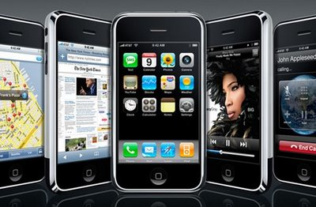
How can we articulate and document notions of value in a requirement specification?
Initial Definitions: to base levels requirement levels on
(this is how the spec looks in ‘Planguage’)
Usability.Intuitiveness:
Type: Marketing Product Requirement.
Stakeholders: Marketing Director, Support Manager, Training Center
Impacts: Product Sales, Support Costs, Training Effort, Documentation Design.
Supports: Corporate Quality Policy 2.3
Ambition: Any potential user, any age, can immediately discover and correctly use all functions of the product, without training, help from friends, or external documentation
Scale: % chance that defined [User] can successfully complete defined [Tasks] Immediately, with no External help.
Meter [Consumer Reports] tests all tasks for all defined user types, and gives public report.

Slide 20
How can we articulate and document notions of value in a single requirement specification?
Graphic of previous slide: here are some “Value relationships”
Usability.Intuitive-ness:
Type: Marketing Product Requirement.
Stakeholders: Marketing Director, Support Manager, Training Center
Impacts: Product Sales, Support Costs, Training Effort, Documentation Design.
Supports: Corporate Quality Policy 2.3
Ambition: Any potential user, any age, can immediately discover and correctly use all functions of the product, without training, help from friends, or external documentation
Scale: % chance that defined [User] can successfully complete defined [Tasks] Immediately, with no External help.
Meter [Consumer Reports] tests all tasks for all defined user types, and gives public report.

Slide 21
More Requirement Info?
What values are we competing against?
In ‘Planguage’
Analysis
  Trend [Market = Asia, User = {Teenager, Early Adopters}, Product = Main Competitor, Projection = 2013] 95%±3% <- Market Analysis
  Past [ Market = USA, User = Seniors, Product = Old Version, Task = Photo Tasks Set, When = 2010] 70% ±10% <- Our Labs Measures
  Record [Market = Finland, User = {Android Mobile Phone, Teenagers}, Task = Phone+SMS Task Set, Record Set = January 2010] 98% ±1% <- Secret Report

Slide 22
Graphic of previous slide
“What values are we competing against?” (analysis)
Analysis
Trend [Market = Asia, User = {Teenager, Early Adopters}, Product = Main Competitor, Projection = 2013] 95%±3% <- Market Analysis
Past [ Market = USA, User = Seniors, Product = Old Version, Task = Photo Tasks Set, When = 2010] 70% ±10% <- Our Labs Measures
Record [Market = Finland, User = {Android Mobile Phone, Teenagers}, Task = Phone+SMS Task Set, Record Set = January 2010] 98% ±1% <- Secret Report

Slide 23
Requirement-Level Priority Specs
& who, where, when for ‘Value’
Our Product Plans
Goal [ Market = USA, User = Seniors, Product = New Version, Task = Photo Tasks Set, When = 2012] 80% ±10% <- Draft Marketing Plan
Tolerable [Market = Asia, User = {Teenager, Early Adopters}, Product = Our New Version, Deadline = 2013] 97%±3% <- Mkt Dir. Speech
Fail [Market = Finland, User = {Android Mobile Phone, Teenagers}, Task = Phone+SMS Task Set, Product Release 9.0] Less Than 95%
Notes:
Decoding a single statement – where is the value delivered?
The Goal (80%) specifies which market (USA) it is intended for, which set of tasks are valued (the ‘Photo Tasks set’), and when it would be valuable to get it delivered (2012). This ‘qualifier’ information in all the statements, helps document when, where, who, what, when the value of the quality level applies to.
Relating One Statement to Others, regarding value.
The Record statement gives information about the known state of the art. So any requirement to beat that (Goal, Tolerable, Fail) would be saying there is value in being the best. In this case the plan is to avoid being significantly worse (Fail level is set at less than 95%). There does not seem to be any value worth paying for in beating the record.
Hopefully no you can figure out the other value, and relative value, assertions. A more common specification of requirement, that we often see, like:
------------------ Our Product Plans -----------------
Goal [ Market = USA, User = Seniors, Product = New Version, Task = Photo Tasks Set, When = 2012] 80% ±10% <- Draft Marketing Plan
Tolerable [Market = Asia, User = {Teenager, Early Adopters}, Product = Our New Version, Deadline = 2013] 97%±3% <- Mkt Dir. Speech
Fail [Market = Finland, User = {Android Mobile Phone, Teenagers}, Task = Phone+SMS Task Set, Product Release 9.0] Less Than 95%

Slide 24
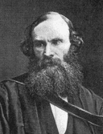
Quantification: not ‘Software Poetry’ – a basis for real Software Engineering – not mere ‘Softcrafting’
In physical science the first essential step in the direction of learning any subject is to find principles of numerical reckoning and practicable methods for measuring some quality connected with it.
I often say that when you can measure what you are speaking about, and express it in numbers, you know something about it;
but when you cannot measure it, when you cannot express it in numbers, your knowledge is of a meagre and unsatisfactory kind;
it may be the beginning of knowledge, but you have scarcely in your thoughts advanced to the state of Science, whatever the matter may be.”
[PLA, vol. 1, "Electrical Units of Measurement", 1883-05-03]
Lord Kelvin, Sir William Thompson

Slide 25
"If you can not measure it, you can not improve it.”
Notes:
The most frequent and critical reasons for software projects are to improve them qualitatively compared to their predecessors (which may or may not be automated logic).
But, we seem to have totally avoided the practice of quantifying these qualities, so as to make them clearly understood, and also so as to lay the basis for measuring our progress in improvement towards our quality level requirements.
This art of quantification of any quality requirement should be taught as fundamental to university students of management and software disciplines. It seems to be somewhat more taken for granted in other sciences and engineering. One problem seems to be that the teachers themselves do not appreciate quality dimensions and requirements are numeric, and cannot teach it.
The problem is not that managers and software people cannot and do not quantify. They do. It is the lack of ‘quantification of the qualitative’ that is the problem.
Perhaps we need an agreed definition of ‘quality’/’qualitative’ before we proceed, since the common interpretation is too narrow, and not well agreed. Most software developers when they say ‘quality’ are only thinking of bugs (logical defects) and little else. Managers speaking of the same software do not have a broader perspective. They speak and write often of qualities, but do not usually refer to the broader set of ‘-ilities’ as qualities, unless pressed to do so. They may speak of improvements, benefits instead.
I believe that the concept of ‘quality’ is simplest explained as ‘how well something functions’. I prefer to specify that it is necessarily, since there are degrees of how well, a ‘scalar’ attribute [3, 1].
This contrasts with other requirement-related concepts such as Capacity (how much performance), Cost (how much resource), Function (what we do), design (how we might do function well, at a given cost) [3,1]

Slide 26
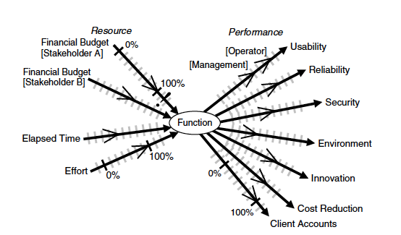

Many Qualities and costs
Function
Notes:
Source [3] p. 163. A way of visualizing qualities in relation to function and cost. Qualities, like costs, are scalar variables, so we can define scales of measure in order to discuss them numerically. The →-- arrows on the scales represent interesting points such as requirement levels. The requirement is not, security, but a defined and provable degree of security.
Chakra image
http://www.suzanneliephd.com/images/chakra3.gif

Slide 27
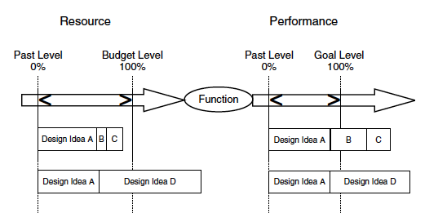
Quantitative Design
Notes:
Source [3] p. 192. A graphical way of understanding performance attributes (which include all qualities) in relation to function, design and resources. Design ideas cost some resources, and design ideas deliver performance for given functions.

Slide 28
Quality Quantification in ‘Planguage’
Usability.Intuitiveness:
Type: Marketing Product Quality Requirement.
Ambition: Any potential user, any age, can immediately discover and correctly use all functions of the product, without training, help from friends, or external documentation
Scale: % chance that defined [User] can successfully complete defined [Tasks] Immediately, with no External help.
Meter [Consumer Reports] tests all tasks for all defined user types, and gives public report.
Goal [ Market = USA, User = Seniors, Product = New Version, Task = Photo Tasks Set, When = 2012] 80% ±10% <- Draft Marketing Plan
Notes:
Explanation of the example above.
1. Usability.Intuitiveness is a cross reference name tag. A hierarchy of defined Usability requirements is implied. One subset of Usability is Intuitiveness. The Capital letters indicate formally defined concepts.
2. Type: the declaration ‘Quality Requirement’ by our definitions, demand that we define this numerically (using Scale, or other devices).
3. Ambition: is a high level ‘poetic’ summary of the requirement. One that is easy to agree to, and understand roughly. The Scale and Goal following it MUST correlate to this Ambition statement.
4. Scale: is the formal definition of our chosen scale of measure. The parameters [User] and [Task] allow us to generalize here, while becoming more-specific in detail below (see earlier example). They also encourage and permit reuse of the Scale, a sort of ‘Pattern’.
5. Meter: is a defined measuring process. There can be more than one for different occasions. Notice the Kelvin quotation above, how he twice in the same sentence distinguishes carefully between numeric definition (scale), and measurement process or instrument (Meter). Many people, I hope you are not one, think they are the same thing. Km/hour is NOT a Speedometer. A Voltmeter is not a Volt.
6. Goal: is one of many possible requirement levels (see earlier detail for some others; Fail, Tolerable, Stretch, Wish, are other requirement levels). We are defining a stakeholder valued future state (state = 80% ± 10%).
One stakeholder is ‘USA Seniors’. The future is 2012. The requirement level type ‘Goal’ is defined [1,3] as a very high priority, promise of delivery. Higher than a Stretch or Wish level. But, other priorities may conflict and prevent this particular requirement from being delivered in practice.

Slide 29


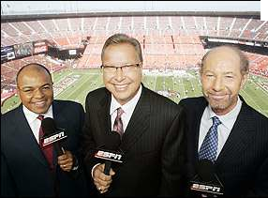

Rich Specification:
Requirement specifications need far more info, than the ‘requirement’ itself!
Rich Specification
Background
Commentary
Core
Notes:
There is a persistent bad habit in requirements methods and practices. We seem to specify the ‘requirement itself’, and we are finished with that specification. I think our requirement specification job might be less than 10% done with the ‘requirement itself’.
Website for this imagethedesignersniche.com
Website for this imagecybermonday.com
Website for this imagessreporters.wordpress.com
I believe that it is absolutely necessary, and should be a corporate standard, to include a great deal of other related information, intimately and immediately tied into the spec of the requirement itself. I have a word for this, ‘Background’ specification.

Slide 30
Core Specs
Core Specification Parameters include:
Scale
Meter
Goal
Definitions
Constraint

Slide 31
Commentary Specs
Commentary
Notes
Comments
"Texts in quotes"
Sources

Slide 32
“Background” Specs
(often, “Relationships”)
Background parameters include:
Benchmarks {Past, Record, Trend}
Owner
Version
Stakeholders
Gist
Ambition
Impacts
Supports

Slide 33
Why do the background specification elements need to be included?
Here are some functions of the background information:
1. Value
2. Prioritization
3. Risks
4. Detail Level
5. Updating
6. Level Synchro
7. Quality Control
8. Clarity
9. etc.
Notes:
So, why do the background specification elements need to be included?
Here are some function of the background information:
1. help judge value of the requirement
2. help prioritize the requirement
3. help understand risks with the requirement
4. help present the requirement in more or less detail to various audiences and purposes
5. to give us help when updating a requirement
6. to synchronize the relationships between different but related levels of the requirements
7. to assist in quality control of the requirements
8. to improve the clarity of the requirement
9. any many more purposes..

Slide 34
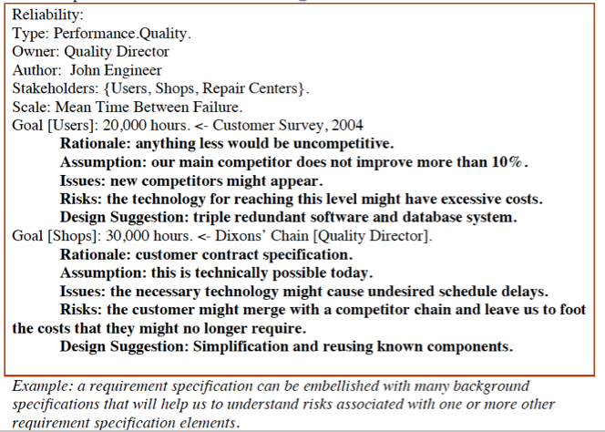
Background for Core Specs
Notes:
Source: [13]
[13] Gilb, “Rich Requirement Specs:
The use of Planguage to clarify requirements”. http://www.gilb.com/tiki-download_file.php?fileId=44

Slide 35
10. Ten Principles for Successful Requirements Methods.
Here is a summary of my advice for more successful requirement methods in the form of some principles, or ‘admonishments’:
1. Quality requirements must be quantified.
2. Requirement specifications must be rich with relevant background
3. Requirements must be finally developed based on incremental feedback from stakeholders, as to their real value
4. Requirements need to be accompanied by many types of signals about their priority, and value
5. Requirements must represent the stakeholders’ real and core values, not a perceived means of delivering those values

Slide 36
10. Ten Principles for Successful Requirements Methods.
Here is a summary of my advice for more successful requirement methods in the form of some principles, or ‘admonishments’:
6. The top-level most-critical-few project requirements, are the major focus; all others are supporting details
7. Requirements are not ‘required’: they are merely valued
8. The top ten critical requirements for any project can be quantified and put on a single page.
9. A good first draft of the top ten critical requirements for any project can be made in a day’s work.
10. Requirements will forever change, because our world is changing, so don’t ask to get final stable requirements from anyone ever.

Slide 37

The Teachable Details
Classic Ideas
  Principles
  Measures
  Processes
  Concept Glossary
Cases
Systems Engineering Level
60% of book is about Requirements
Free digital copy?
  Email Tom@Gilb.com
    Request “BOOK”
    And/or request “SLIDES”
    And/or request “PAPER”

Slide 38
End of SPIN lecture
The following slides are included to give more realistic detail from recent work we have done in London (2010)
We have no illusions of presenting them in the SPIN 30 minute time frame , unless a speaker falls away!

Slide 39


Setting and Tracking
Project Objectives
The Tom Gilb Approach.
Tuesday 7 Dec 20xx
At BCS London
Reused for ACCU 15 April 2011
Included for SPIN 27 June 2011 London
as extra examples
Notes:
Setting and Tracking Project Objectives - The Tom Gilb Approach
Take advantage of this rare opportunity to hear it from one of the leading lights in project management on this important topic. Tom will present
the theory and practice of his Evo method for project management
, together with his Planguage (Planning Language).
The Evo method (also known as Value Delivery Method VDM) is a radical simplification (Lean!) from a project management view. Long-range and short-term focus is on real proven delivery of tangible stakeholder value. The method has been successfully used worldwide in IT, Software Product, Aircraft, and Telecomms situations and even Charity Planning Projects.
Tom will sweep through the stages of his model from:
value clarity,
solution responsibility,
value reporting and
just-in-time planning.
He will illustrate with case studies of real projects with details, and results.
Make friends by delivering results.
Shock your boss!
Tom Gilb has been consulting on management problems, for top management since 1962. As a result he has developed and refined his own powerful methods for management planning. He has worked for many of these years with his son Kai Gilb. These methods are jointly called Planguage, a Planning Language. They are unique in helping managers to think quantitatively about the qualitative aspects of their decisions. For example how to quantify engineering productivity, or general product quality for large organisations. Tom does not profile himself as a management consultant. In fact, he works at the grass roots of advanced engineering, systems, software, aircraft, IT, telecoms and electronics. His expertise and reputation are significant and Tom has been invited to lecture at over 100 universities worldwide. He has published nine books. The latest is Competitive Engineering.
And then join us afterwards for a networking opportunity and light refreshments including a glass of festive mulled wine.
Event Logistics
Date: Tuesday 7 Dec 20xx Time: 18:30 (refreshments available 30 minutes before)
Venue: BCS, 1st Floor The Davidson Building 5 Southampton Street LondonWC2E 7HA
Event Full.
------------------------ ORGINAL SUGGESTION BY TOM -------
SUGGESTED TITLE
Lean Project Management: Extreme Quantified Focus on Your Project Stakeholders’ Top Ten Objectives – Project Success Aligned with Business.
CONTENT
• VALUE CLARITY: Quantify the most-critical project objectives on day 1
• SOLUTION RESPONSIBILITY: Quantify impact of all suggested strategies, architectures, on all critical objectives, deadline, and budget.
• VALUE REPORTING: Measure project progress early, continuously, in terms of top ten objectives
• JUST-IN-TIME PLANNING: Dynamic intelligent do-next prioritisation: Value/cost based
• FACTS AND RESULTS: Case studies of real projects with details, and results. Proven method large-scale world wide.
• DARE WE? Getting your boss on board – ‘do you want early results boss?’
• BUT ‘STANDARDS’? Can we use some of this in our current environment?
What is this all about? Sounds ‘unconventional!’
Tom will present the theory and practice of his ‘Evo’ method for project management, together with his ‘Planguage’ (Planning Language). Check out detail now at gilb.com.
The method has been successfully used worldwide in IT, Software Product, Aircraft, and Telecomms situations – even Charity Planning Projects!
The Evo (aka Value Delivery Method VDM) method is a radical simplification (Lean!) from a project management view. Long-range and short-term focus is on real proven delivery of tangible stakeholder value.
Make friends by delivering results. Shock your boss!
(187 words below title)

Slide 40
The entire talk, for those who like simple slides
Quantify all improvement requirements
Estimate quantified impact of all ´means´
Do the project in small 2% increments
  Highest value for stakeholder first
  Measure real value delivered (Goals reached)
  Learn from deviations and successes
  Modify all requirements and designs as experience and environment dictates

Slide 41
The details
If you like simplified slides and unfounded generalisations
  Leave now, or fall asleep, or check messages and news on your phone.
I personally prefer concrete details, and real examples★
  So if you choose to stay on, there is going to be a lot of detail
  In fact – you will not be able to study and get explained all detail
  But the slides are now at gilb-com/downloads
  So, if they seem interesting you can study them at your leisure
  In addition, if you need detailed explanation you will find it in the book Competitive Engineering. If you ask me at tom@gilb.com I´ll be happy to send you a free digital copy.
  If you are too shy to ask, then copies can be acquired the usual way, and there is plenty of detail free at gilb.com
Last chance to escape is NOW
★ I want to show examples as realistic as possible, but in order to maintain client confidentiality I have:
  not revealed client names, person names, project names, site location, application names.
  I have also randomly changed numbers. It is the principles of realistic use I want to share.

Slide 42
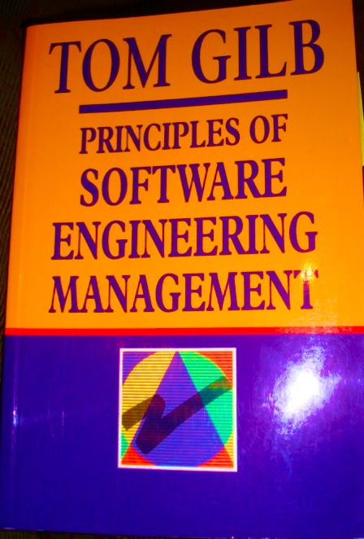
The theory and practice of our `Evo´ method for project management
2005
1983

Slide 43
Planguage (Planning Language).
A Planning Language - an engineering language
A systems engineering language (software, management)
Concept Glossary
Graphical Language
Control of Multiple dimensions: Performance, Costs, Constraints
Extendible, Tailorable, Open
Rich views, traceability, configuration management
Risk Management
Priority Management

Slide 44
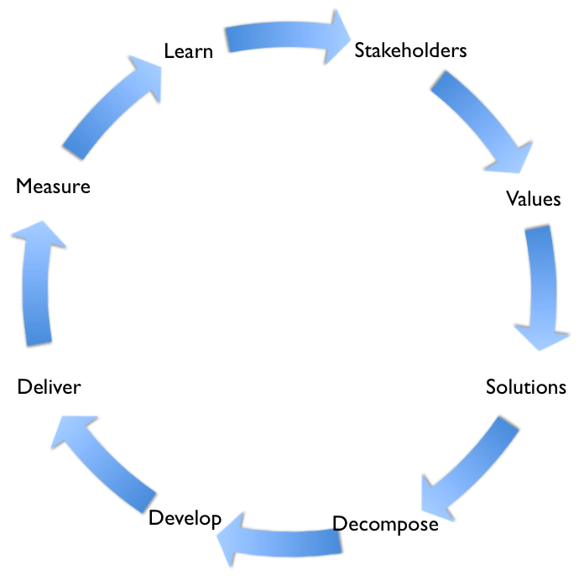
The Evo method (also known as Value Delivery Method VDM) is a radical simplification (Lean!) from a project management view.
VALUE CLARITY: Quantify the most-critical project objectives on day 1
SOLUTION RESPONSIBILITY: Quantify impact of all suggested strategies, architectures, on all critical objectives, deadline, and budget.
VALUE REPORTING: Measure project progress early, continuously, in terms of top ten objectives
JUST-IN-TIME PLANNING: Dynamic intelligent do-next prioritisation: Value/cost based
Evo
Original diagram by Kai Gilb

Slide 45
Lack of clear top level project objectives has seen real projects fail for $100+ million: personal experience, real case
Bad Objectives, for 8 years
Quantified Objectives (in Planguage),
1. Central to The Corporations business strategy is to be the world’s premier integrated <domain> service provider.
2. Will provide a much more efficient user experience
3. Dramatically scale back the time frequently needed after the last data is acquired to time align, depth correct, splice, merge, recompute and/or do whatever else is needed to generate the desired products
4. Make the system much easier to understand and use than has been the case for previous system.
5. A primary goal is to provide a much more productive system development environment than was previously the case.
6. Will provide a richer set of functionality for supporting next-generation logging tools and applications.
7. Robustness is an essential system requirement (see partial rewrite in example at right)
8. Major improvements in data quality over current practice
Robustness.Testability:
Type: Software Quality Requirement.
Version: 20 Oct 2006-10-20
Status: Demo draft,
Stakeholder: {Operator, Tester}.
Ambition: Rapid-duration automatic testing of <critical complex tests>, with extreme operator setup and initiation.
Scale: the duration of a defined [Volume] of testing, or a defined [Type], by a defined [Skill Level] of system operator, under defined [Operating Conditions].
Goal [All Customer Use, Volume = 1,000,000 data items, Type = WireXXXX Vs DXX, Skill = First Time Novice, Operating Conditions = Field, {Sea Or Desert}. <10 mins.
Notes:
Design Hypothesis: Tool Simulators, Reverse Cracking Tool, Generation of simulated telemetry frames entirely in software, Application specific sophistication, for drilling – recorded mode simulation by playing back the dump file, Application test harness console <-6.2.1 HFA

Slide 46
VALUE CLARITY:
Quantify the most-critical project objectives on day 1
P&L-Consistency&T P&L: Scale: total adjustments btw Flash/Predict and Actual (T+1) signed off P&L. per day. Past 60 Goal: 15
Speed-To-Deliver: Scale: average Calendar days needed from New Idea Approved until Idea Operational, for given Tasks, on given Markets.
Past [2009, Market = EURex, Task =Bond Execution] 2-3 months ?
Goal [Deadline =End 20xz, Market = EURex, Task =Bond Execution] 5 days
Operational-Control: Scale: % of trades per day, where the calculated economic difference between OUR CO and Marketplace/Clients, is less than “1 Yen”(or equivalent).
Past [April 20xx] 10% change this to 90% NH Goal [Dec. 20xy] 100%
Operational-Control.Consistent: Scale: % of defined [Trades] failing full STP across the transaction cycle. Past [April 20xx, Trades=Voice Trades] 95%
Past [April 20xx, Trades=eTrades] 93%
Goal [April 20xz, Trades=Voice Trades] <95 ± 2%>
Goal [April 20xz, Trades=eTrades] 98.5 ± 0.5 %
Operational-Control.Timely.End&OvernightP&L Scale: number of times, per quarter, the P&L information is not delivered timely to the defined [Bach-Run].
Past [April 20xx, Batch-Run=Overnight] 1 Goal [Dec. 20xy, Batch-Run=Overnight] <0.5> Past [April 20xx, Batch-Run= T+1] 1 Goal [Dec. 20xy, Batch-Run=End-Of-Day, Delay<1hour] 1
Operational-Control.Timely.IntradayP&L Scale: number of times per day the intraday P&L process is delayed more than 0.5 sec.
Operational-Control.Timely.Trade-Bookings Scale: number of trades per day that are not booked on trade date. Past [April 20xx] 20 ?
Front-Office-Trade-Management-Efficiency Scale: Time from Ticket Launch to trade updating real-time risk view
Past [20xx, Function = Risk Mgt, Region = Global] ~ 80s +/- 45s ??
Goal [End 20xz, Function = Risk Mgt, Region = Global] ~ 50% better?
Managing Risk – Accurate – Consolidated – Real Time
Risk.Cross-Product Scale: % of financial products that risk metrics can be displayed in a single position blotter in a way appropriate for the trader (i.e. – around a benchmark vs. across the curve).
Past [April 20xx] 0% 95%. Goal [Dec. 20xy] 100%
Risk.Low-latency Scale: number of times per day the intraday risk metrics is delayed by more than 0.5 sec. Past [April 20xx, NA] 1% Past [April 20xx, EMEA] ??% Past [April 20xx, AP] 100% Goal [Dec. 20xy] 0%
Risk.Accuracy
Risk. user-configurable Scale: ??? pretty binary – feature is there or not – how do we represent?
Past [April 20xx] 1% Goal [Dec. 20xy] 0%
Operational Cost Efficiency Scale: <Increased efficiency (Straight through processing STP Rates )>
Cost-Per-Trade Scale: % reduction in Cost-Per-Trade
Goal (EOY 20xy, cost type = I 1 – REGION = ALL) Reduce cost by 60% (BW)
Goal (EOY 20xy, cost type = I 2 – REGION = ALL) Reduce cost by x %
Goal (EOY 20xy, cost type = E1 – REGION = ALL) Reduce cost by x %
Goal (EOY 20xy, cost type = E 2 – REGION = ALL) Reduce cost by 100%
Goal (EOY 20xy, cost type = E 3 – REGION = ALL) Reduce cost by x %
Notes:
These are real 20xx one page summary objectives. They were made from scratch ib 2 days and this set was extracted from about 10 pages of detailed objectives to give a one page summary. They were evolved in the next few months, and these no longer represent current objectives. This is a non confidential set. Some numbers are changed at random, but the example is the same.

Slide 47
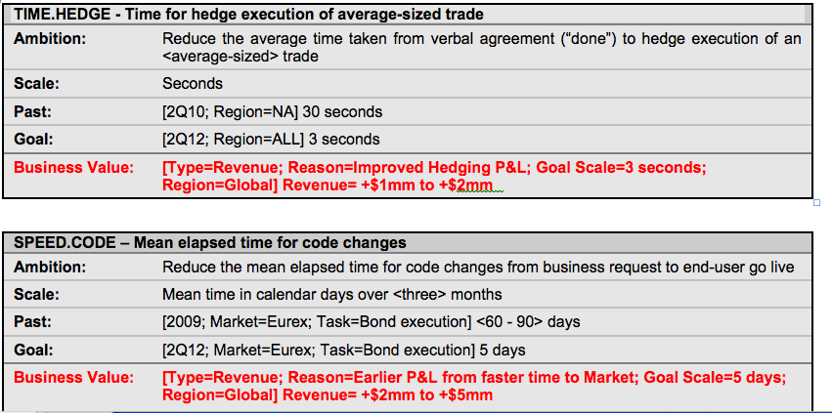
Example of Estimating the Value of a Technical IT System Improvement (20xx)
This is an example made to reason about specification standards and is not supposed to be a real spec. Just realistic.
Notes:
By DH for B (his idea to add value). This is an example made to reason about specification standards and is not supposed to be a real spec. Just realistic.

Slide 48
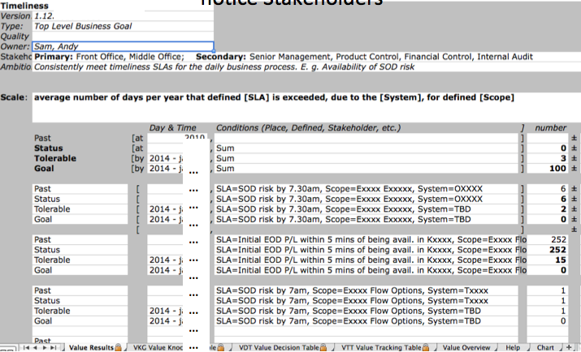
Quantified Objective in Planguage Tool: notice Stakeholders
……………………………
Notes:
From Dec 20xx non confidential example, using Kais Planguage Tool

Slide 49
SOLUTION RESPONSIBILITY:
Quantify impact of all suggested strategies, architectures, on all critical objectives, deadline, and budget.
NOT ☹
YES ! ☺
Just name an idea/design
Assert the design is good
Fail to explain how you know
Fail to take responsibility
Fail to measure results
Fail to consider all requirements
Fail to even estimate costs
“Tool Simulators, Reverse Cracking Tool, Generation of simulated telemetry frames entirely in software, Application specific sophistication, for <our domain>– recorded mode simulation by playing back the dump file, Application test harness console” <-6.2.1 HFA
Describe detail for estimation
Estimate the impact on Goals
Estimate the ± uncertainty
Specify the estimate evidence
Estimate all objectives
Estimate all resources

Slide 50
Don´t we need more detail to estimate costs and other attributes of a design?
Simple design description
Ask the following questions about such brief design descriptions
Design Spec:
  Risk and P/L aggregation service
What will it cost to develop?
What will it cost to operate?
Will we deliver any or all of the quality and performance Goal levels on time?
What are the critical assumptions, that might fail or be untrue?
What are the known risks?
Do we actually understand anything of consequence from such a short design specification?

Slide 51
Defining a Design/Solution/Architecture/Strategy (Planguage, CE Design Template)
1. enough detail to estimate, 2. some impact assertion, 3. Assumptions, Risks, Issues
See enlarged view of this slide in following slides. This is a 1-page overview
Orbit Application Base: (formal Cross reference Tag)
Type: Primary Architecture Option
============ Basic Information ==========
Version: Nov. 30 20xx 16:49, updated 2.Dec by telephone and in meeting. 14:34
Status: Draft
Owner: Brent Barclays
Expert: Raj Shell, London
Authority: for differentiating business environment characteristics, Raj Shell, Brent Barclays(for overview)
Source: <Source references for the information in this specification. Could include people>. Various, can be done later BB
Gist: risk and P/L aggregation service, which also provides work flow/adjustment and outbound and inbound feed support. Currently used by Rates ExtraBusiness, Front Office and Middle Office, USA & UK.
Description: <Describe the design idea in sufficient detail to support the estimated impacts and costs given below>.
  D1: ETL Layer. Rules based highly configurable implementation of the ETL Pattern, which allows the data to be onboarded more quickly. Load and persist new data very quickly. With minimal development required. -> Business-Capability-Time-To-Market, Business Scalability
  D2: high performance risk and P/L aggregation processing (Cube Building). -> Timeliness, P/L Explanation, Risk & P/L Understanding, Decision Support, Business Scalability, Responsiveness.
  D3: Orbit supports BOTH Risk and P/L -> P/L Explanation, Risk & P/L Consistency, Risk & P/L Understanding, Decision Support.
  D4: a flexible configurable workflow tool, which can be used to easily define new workflow processes -> Books/Records Consistency, Business Process Effectiveness, Business Capability Time to Market.
  D5: a report definition language, which provides 90+% of the business logic contained with Orbit, allows a quick turnaround of new and enhanced reports with minimal regression testing and release procedure impact. -> P/L Explanation, Risk & P/L Understanding, Business Capability Time to Market, Business Scalability.
  D6: Orbit GUI. Utilizes an Outlook Explorer metaphor for ease of use, and the Dxx Express Grid Control, to provide high performance Cube Interrogation Capability. -> Responsiveness, People Interchangeability, Decision Support, Risk & P/L Understanding.
  D7: downstream feeds. A configurable event-driven data export service, which is used to generate feeds . -> Business Process Effectiveness, Business Capability Time to Market.
===================== Priority and Risk Management =====================
Assumptions: <Any assumptions that have been made>.
  A1: FCCP is assumed to be a part of Orbit. FCxx does not currently exist and is Dec 20xx 6 months into Requirements Spec. <- Picked up by TsG from dec 2 discussions AH MA JH EC.
    Consequence: FCxx must be a part of the impact estimation and costs rating.
  A2: Costs, the development costs will not be different. All will base on a budget of say $nn mm and 3 years. The o+
  costs may differ slightly, like $n mm for hardware. MA AH 3 dec
  A3:Boss X will continue to own Orbit. TSG DEC 2
  A4: the schedule, 3 years, will constrained to a scope we can in fact deliver, OR we will be given additional budget. If not “I would have a problem” <- BB
  A5: the cost of expanding Orbit will not be prohibitive. <- BB 2 dec
  A6: we have made the assumption that we can integrate Oribit with PX+ in a sensible way, even in the short term <- BB
Dependencies: <State any dependencies for this design idea>.
  D1: FCxx replaces Px+ in time. ? tsg 2.12
Risks: <Name or refer to tags of any factors, which could threaten your estimated impacts>.
  R1. FCxx is delayed. Mitigation: continue to use Pxx <- tsg 2.12
  R2: the technical integration of Px+ is not as easy as thought & we must redevelop Oribit
  R3: the and or scalability and cost of coherence will not allow us to meet the delivery.
  R4: scalability of Orbit team and infrastructure, first year especially <- BB. People, environments, etc.
  R5: re Cross Desk reporting Requirement, major impact on technical design. Solution not currently known. Risk no solution allowing us to report all P/L
Issues: <Unresolved concerns or problems in the specification or the system>.
  I1: Do we need to put the fact that we own Orbit into the objectives (Ownership). MA said, other agreed this is a huge differentiator. Dec 2.
  I2: what are the time scales and scope now? Unclear now BB
  I3: what will the success factors be? We don’t know what we are actually being asked to do. BB 2 dec 20xx
  I4: for the business other than flow options, there is still a lack of clarity as to what the requirements are and how they might differ from Extra and Flow Options. BB
  I5: the degree to which this option will be seen to be useful without Intra Day. BB 2 dec
Notes:
Based on real solution spec Done Dec 20xx London, but modified here for confidentiality. Tom Gilb

Slide 52
Design Spec Enlarged 1 of 2
Spec Headers
Detailed Description and -> Impacted Objectives
Orbit Application Base: (formal Cross reference Tag)
Type: Primary Architecture Option
==== Basic Information ==========
Version: Nov. 30 20xx 16:49, updated 2.Dec by telephone and in meeting. 14:34
Status: Draft (PUBLIC EXAMPLE EDIT)
Owner: Brent Barclays
Expert: Raj Shell, London
Authority: for differentiating business environment characteristics, Raj Shell, Brent Barclays(for overview)
Source: <Source references for the information in this specification. Could include people>. Various, can be done later BB
Gist: risk and P/L aggregation service,
which also provides work flow/adjustment and outbound and inbound feed support. Currently used by Rates Extra Business, Front Office and Middle Office, USA & UK.
Description: <Describe the design idea in sufficient detail to support the estimated impacts and costs given below>.
D1: ETL Layer. Rules based highly configurable implementation of the ETL Pattern, which allows the data to be onboarded more quickly. Load and persist new data very quickly. With minimal development required. -> Business-Capability-Time-To-Market, Business Scalability
D2: high performance risk and P/L aggregation processing (Cube Building). -> Timeliness, P/L Explanation, Risk & P/L Understanding, Decision Support, Business Scalability, Responsiveness.
D3: Orbit supports BOTH Risk and P/L -> P/L Explanation, Risk & P/L Consistency, Risk & P/L Understanding, Decision Support.
D4: a flexible configurable workflow tool, which can be used to easily define new workflow processes -> Books/Records Consistency, Business Process Effectiveness, Business Capability Time to Market.
D5: a report definition language, which provides 90+% of the business logic contained with Orbit, allows a quick turnaround of new and enhanced reports with minimal regression testing and release procedure impact. -> P/L Explanation, Risk & P/L Understanding, Business Capability Time to Market, Business Scalability.
D6: Orbit GUI. Utilizes an Outlook Explorer metaphor for ease of use, and the Dxx Express Grid Control, to provide high performance Cube Interrogation Capability. -> Responsiveness, People Interchangeability, Decision Support, Risk & P/L Understanding.
D7: downstream feeds. A configurable event-driven data export service, which is used to generate feeds . -> Business Process Effectiveness, Business Capability Time to Market.

Slide 53
Design Spec Enlarged 2 of 2
==== Priority & Risk Management ========
Assumptions: <Any assumptions that have been made>.
A1: FCCP is assumed to be a part of Orbit. FCxx does not currently exist and is Dec 20xx 6 months into Requirements Spec. <- Picked up by TsG from dec 2 discussions AH MA JH EC.
  Consequence: FCxx must be a part of the impact estimation and costs rating.
A2: Costs, the development costs will not be different. All will base on a budget of say $ nn mm and 3 years. The ops costs may differ slightly, like $n mm for hardware. MA AH 3 dec
A3:Boss X will continue to own Orbit. TSG DEC 2
A4: the schedule, 3 years, will constrained to a scope we can in fact deliver, OR we will be given additional budget. If not “I would have a problem” <- BB
A5: the cost of expanding Orbit will not be prohibitive. <- BB 2 dec
A6: we have made the assumption that we can integrate Oribit with PX+ in a sensible way, even in the short term <- BB
Dependencies: <State any dependencies for this design idea>.
  D1: FCxx replaces Px+ in time. ? tsg 2.12
Risks: <Name or refer to tags of any factors, which could threaten your estimated impacts>.
R1. FCxx is delayed. Mitigation: continue to use Pxx<- tsg 2.12
R2: the technical integration of Px+ is not as easy as thought & we must redevelop Oribit
R3: the and or scalability and cost of coherence will not allow us to meet the delivery.
R4: scalability of Orbit team and infrastructure, first year especially <- BB. People, environments, etc.
R5: re Cross Desk reporting Requirement, major impact on technical design. Solution not currently known. Risk no solution allowing us to report all P/L
Issues: <Unresolved concerns or problems in the specification or the system>.
I1: Do we need to put the fact that we own Orbit into the objectives (Ownership). MA said, other agreed this is a huge differentiator. Dec 2.
I2: what are the time scales and scope now? Unclear now BB
I3: what will the success factors be? We don’t know what we are actually being asked to do. BB 2 dec 20xx
I4: for the business other than flow options, there is still a lack of clarity as to what the requirements are and how they might differ from Extra and Flow Options. BB
I5: the degree to which this option will be seen to be useful without Intra Day. BB 2 dec

Slide 54



Value Delivery Cycle: Measure
Learn
Stakeholders
Measure
Values
Measure Change
Measure how much the Values changed.
Deliver
Solutions
Develop
Decompose
Copyright: Kai@Gilb.com
54

Slide 55


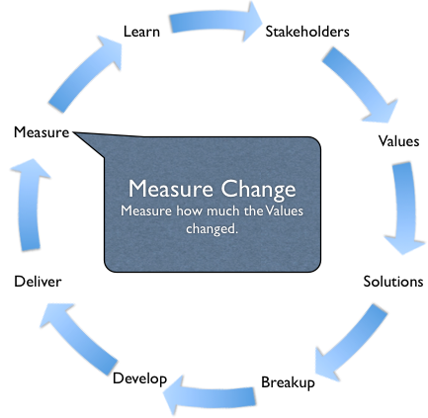
The impact of a solution, on a single improvement objective
?
Solution
ABC
20 seconds
Function
Attribute
Past
[Dec. 2010]
50 sec.
Tolerable
[April 2015]
40 sec.
Goal
[April 2016]
15 sec.
55

Slide 56
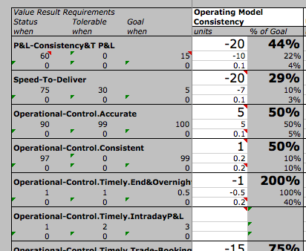
Impact Estimation Tables
Improvement
Estimate
Units & %
± Uncertainty
Worst Case range
Credibility
Adjustment 0.0 to 1.0
Based on tool built by Kai Gilb
Notes:
Slide Made 6 Dec 20xx for BCS PROMS G
BASED on real table made April 20xx
Non-confidential
If you need more information on Impact Estimation concepts then refer to the Impact Estimation chapter in the Competitive Engineering book 2005.

Slide 57
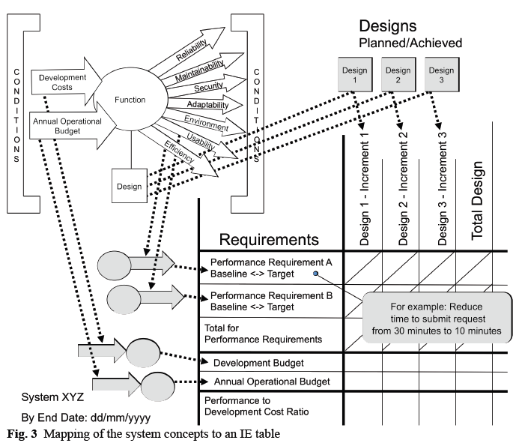
Impact Estimation Concepts
SOURCE
Using Metrics within System Requirements to
Express Quality and Derive Stakeholder Value
Lindsey Brodie •
Notes:
3.3 Mapping of the system concepts to an IE table
See Figure 3, which shows how the Planguage system concepts, discussed earlier in Section 3.1,
are captured within an IE table. The detailed mapping of the concepts between the Planguage
system model and the IE table is shown by the dotted arrows. The key point is that the IE table
includes all the main system concepts.
Regarding the time, place and event conditions, an IE table captures a ‘snapshot’ of a system
(or part of a system) at a specific point in time. So, typically, the time and event conditions for all
the attributes in the table are assumed to default to the conditions stated for the specific IE table.
Place conditions are very varied and tend to be dealt with by a combination of specific
requirements and the choice of the proposed designs. Functionality is also considered in the choice
of proposed designs in so far as the designs are chosen by their suitability to address some aspect
of the required functionality and any unsuitable ones are filtered out. If required, the functions can
also be added at the top of the requirements column, but typically this is not necessary. So the
prime focus of an IE table is on the required levels of the performance attributes (that is the
quality, resource saving and workload capacity attributes), and the contribution of the proposed
designs towards meeting them.
3.4 Creating an IE table
To create an IE table, the performance requirements are placed down the left-hand column. Each
performance requirement shows its current baseline (Past) level and the required target (Goal)
level. Beneath the performance requirements, the resource requirements are listed. Typically this is
the development budget. Then across the top row, the designs are listed with any dependent
designs being placed to the right-hand side of the design it is dependent on. If the designs are
complementary, then the sequencing should be roughly in the proposed implementation order
showing a series of increments. If the designs are alternatives then order is not important
SOURCE
Using Metrics within System Requirements to
Express Quality and Derive Stakeholder Value
Lindsey Brodie • Mark Woodman
Middlesex University e-Centre
School of Engineering & Information Sciences
The Burroughs, Hendon,
London NW4 4BT
l.brodie@mdx.ac.uk & m.woodman@mdx.ac.uk

Slide 58
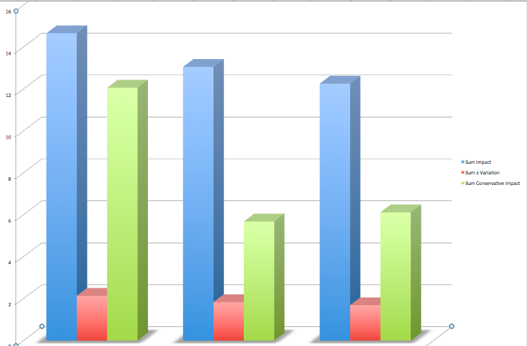
Summary of Options wrt Risk (2010)
Sum
Conservative Impact
“worst worst case”
Sum Impact
Of strategy on all goals
Sum ± Variation or Range of uncertainty
Based on work done by Kai Gilb
Notes:
From Real Example (disguised here) London Dec 1 20xx by Kai Gilb gilb.com

Slide 59
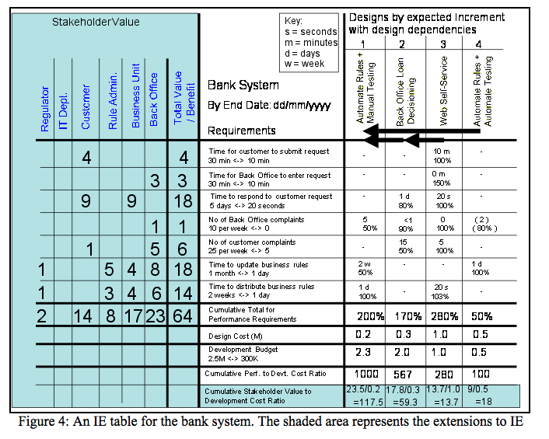
lindseybrodie@btopenworld.com
Notes:
Using Metrics to Express Quality
Lindsey Brodie & Mark Woodman
Middlesex University e-Centre
School of Engineering & Information Sciences
The Burroughs, Hendon,
London NW4 4BT
l.brodie@mdx.ac.uk & m.woodman@mdx.ac.uk

Slide 60
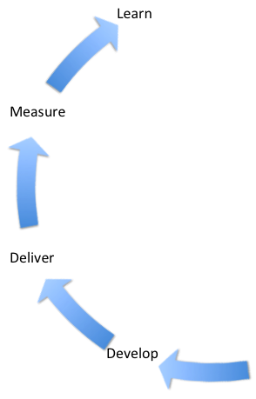
VALUE REPORTING:
Measure project progress early, continuously, in terms of top ten objectives
Basic idea
  Estimate expected value next cycle
    Based on a specific design for that increment
    Design Hypothesis
  Measure the actual effect, roughly, pilot,
    Confirm or deny the effect hypothesis
  If reasonable result compared to need and expectation, then take another cumulative cycle
  Measure the cumulated value later, and better, before scaling up and major release
  If bad result: learn change, try again

Slide 61
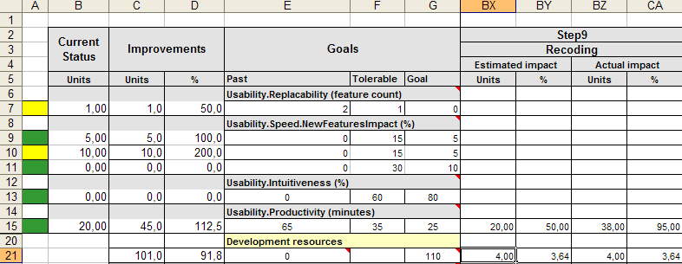


Real client example (Confirmit): weekly design impact estimates, and same-week measurement,
Weekly Feedback to the development team about cumulative progress toward critical numeric performance and quality targets
Estimates
Weekly
Testing
Priority
Next week
Warning
metrics based
Cumulative
weekly
progress
metric
Constraint
Target

Slide 62
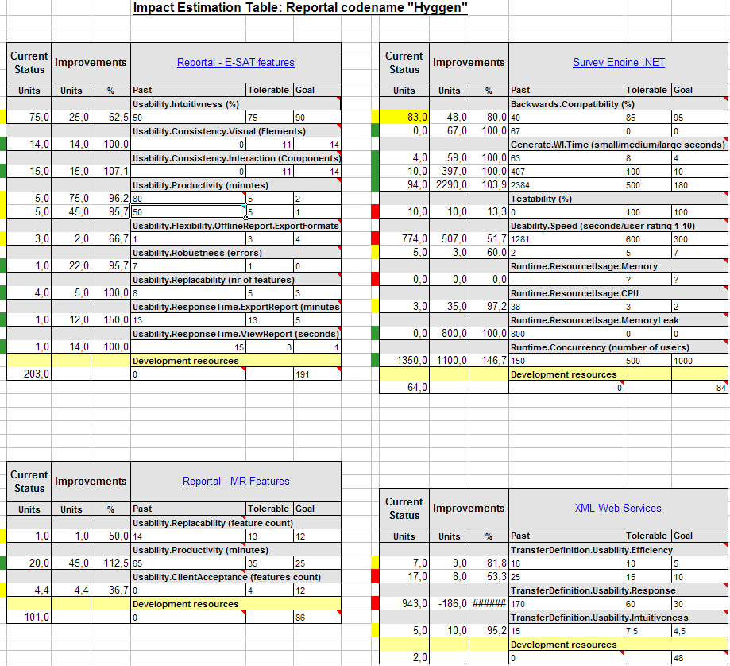
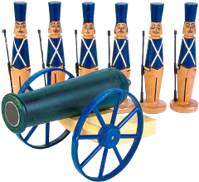

Evo Plan Confirmit 8.5
4 product areas were attacked in all: 25 Qualities concurrently, one quarter of a year. Total development staff = 13
Sum impact after 9 deivery cycles
9
8
3
3
Trond Johansen

Slide 63
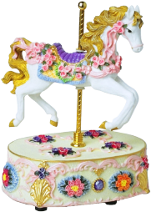

Confirmit Evo-week cycle: Measure Progress Weekly
Notes:
“This was to give the solution time to mature.”
Answer to question Sept 9 2006 to Cecilia Vik about why Thursday Version N-2

Slide 64
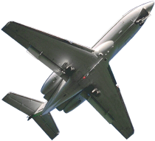
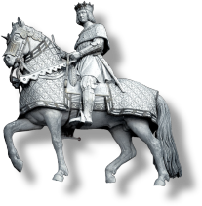

Evo’s impact on Confirmit product qualities
Only 5 highlights of the 25 impacts are listed here
Release 8.5

Slide 65
JUST-IN-TIME PLANNING:
Dynamic intelligent do-next prioritisation:
Value/cost based
Can you buy into this planning policy?
  Do, in the next value delivery cycle, that which is estimated to give most value, to all objectives, with regard to risk

Slide 66
Notice the automatically computed priority colours, after each delivery and measurement cycle
Sum impact after NINE deivery cycles
9
8
3
3
Trond Johansen

Slide 67
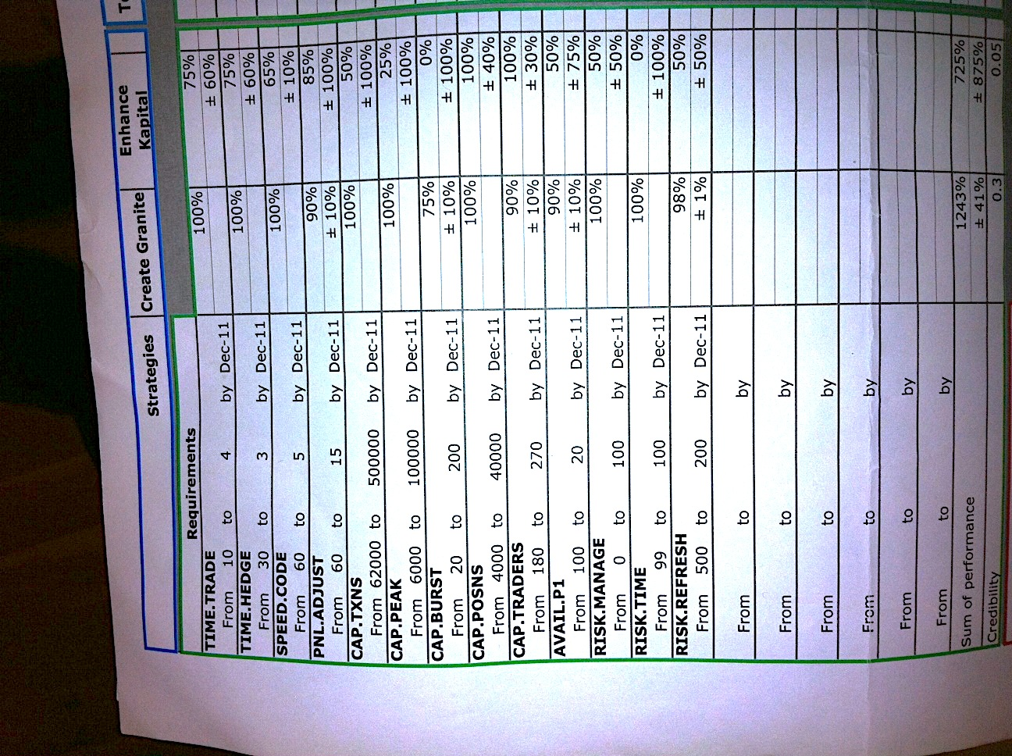
Example: Impact Estimations
B was, as you see, done with great uncertainty
Opt A Opt B
Notes:
Fall 20xx Practice via DH, Permission to use via B

Slide 68
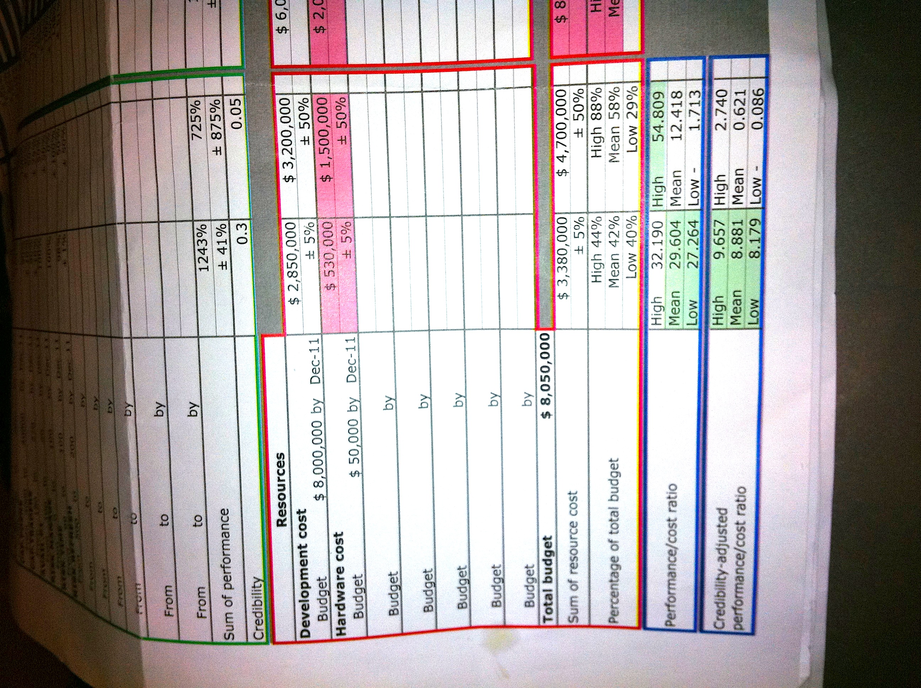
The Bottom Line
………………………………………………………………………
…
Notes:
Fall 20xx Practice via DH, Permission to use via B

Slide 69
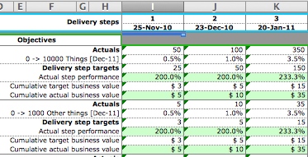
Tracking 3 delivery-steps, for 2 Objectives
(teaching example, not real)
Notes:
Based on a spreadsheet 20xx by DH

Slide 70
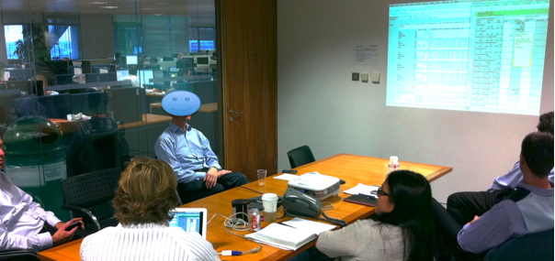
It is fascinating how focused and creative the dialogue becomes between domain experts when they are guided by quantified goal sets, the need to estimate , give evidence, state uncertainty and assign credibility.
All culminating in decision documentation which is auditable reviewable. Improvable and transparent! <- TG 12-20xx
Goals IE Table

Slide 71
Make friends by delivering results.
Get out of the Nerd Mode of delivering functions/stories to a user
Get into the mode of delivering real measurable results, the highest value, to stakeholders

Slide 72
Shock your boss!
Insist on being stakeholder-value oriented, rather than IT oriented

Slide 73
The end
What is wrong with requirements
Notes:
Which case
And add ref to and a slide on user stories analysis

