Slide 1
What are the dangers of current Agile Practices?
Tom@Gilb.com
3 Nov 2010 Unicom
Agile Testing Conference London
18:05 to 18:20

Slide 2
So, what are Agile methods missing?
Stakeholder Focus
Real projects have dozens of stakeholders
Not just a customer in the next room
Not just a user with a use case or story
Results Focus
It is not about writing code, it is about delivering value to stakeholders
It is not about programming, it is about making systems work, for real people
Systems Focus
It is not about coding – (again ☺)
It is about reuse, data, hardware, training, motivation, sub-contracting, Outsourcing, help lines, user documentation, user interfaces, security, etc.
So, a systems engineering scope is necessary to deliver results.
Systems Engineering needs quantified performance and quality objectives
To synchronize all necessary disciplines, so that they deliver the results.
Notes:
Substantial edit, underlining June 2010

Slide 3
Value-Driven Scrum (one of your options for smart Product Ownership)
Defined As:
The real world interface to the Scrum Product Owner
The Businesses ‘Organizational Value’ Management
The Business Function Management
The Technical Architecture Management
All in a pipeline to the Scrum Product Owner (PO)
Fully designed, from the organizational point of view
Allowing additional design at the level of programming, chunking, and data
By the Scrum Team
Prioritized from the Organizational Point of View
Notes:
Edited June 8 2010 for NDS Oslo

Slide 4
What is new? What is Value-Planning (VP) ?
Dominant focus on Value Delivery Management –
Not from a programming point of view
But from a business and management non technical point of view
Which critical value improvements do we need first, and next
Stakeholder Values-and-Priorities Integration*
Of management, marketing, IT, Systems Engineering,
Including Sales, Customer Service and ALL Critical Stakeholders
Systems View – Systems Architecture – Systems Engineering
* integration: defined as: Alignment and reasonable balance of competing interests, through intelligent dynamic prioritization.
See ppt note for depth papers on priority, including:
http://www.gilb.com/tiki-download_file.php?fileId=60
Notes:
http://www.gilb.com/tiki-download_file.php?fileId=48
Choice and priority Paper
http://www.gilb.com/tiki-download_file.php?fileId=60
Managing Priorities paper

Slide 5
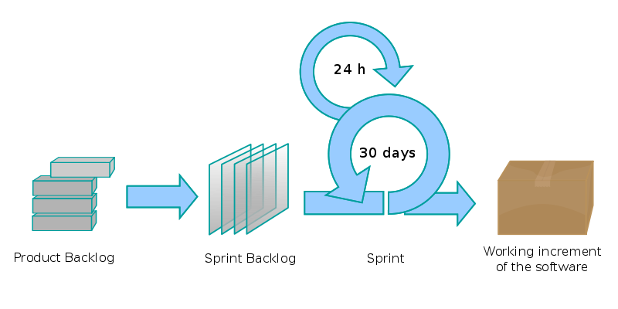
Value Decision Tables
Jeffsutherland Twitter: Very cool product backlog management
by Tom and Kai Gilb http://ad.vu/2h4d Sat 28 March 2009
Business Goals | Training Costs | User Productivity
Profit | -10% | 40%
Market Share | 50% | 10%
Resources | 20% | 10%
Stakeholder Val. | Intuitiveness | Performance
Training Costs | -10% | 50 %
User Productivity | 10 % | 10%
Resources | 2 % | 5 %
Product Values | GUI Style Rex | Code Optimize
Intuitiveness | -10% | 40%
Performance | 50% | 80 %
Resources | 1 % | 2 %
Prioritized List
1. Code Optimize
2. Solution 9
3. Solution 7
Scrum Develops
We measure improvements
Learn and Repeat
Copyright: Kai@Gilb.com
Notes:
developing a large web portal www.bring.no dk/se/nl/co.uk/com/ee at Posten Norge
Jeffsutherland Twitter: Very cool product backlog management
by Tom and Kai Gilb http://ad.vu/2h4d Sat 28 March 2009

Slide 6
Jeffsutherland Twitter: Very cool product backlog management
by Tom and Kai Gilb http://ad.vu/2h4d Sat 28 March 2009
Copyright: Kai@Gilb.com
6
Notes:
developing a large web portal www.bring.no dk/se/nl/co.uk/com/ee at Posten Norge
Photo Kai 2009 at OC4 Kolbotn w Jeff
Photo Sutherland 2010 April from Digerud Cabin

Slide 7
Gilb’s Ten Key Agile Principles to avoid bureaucracy and give creative freedom
Control projects by quantified critical-few results. 1 Page total !
(not stories, functions, features, use cases, objects, ..)
Make sure those results are business results, not technical
Align your project with your financial sponsor’s interests!
3. Give developers freedom, to find out how to deliver those results
4. Estimate the impacts of your designs, on your quantified goals
5. Select designs with the best impacts in relation to their costs, do them first.
6. Decompose the workflow, into weekly (or 2% of budget) time boxes
7. Change designs, based on quantified experience of implementation
8. Change requirements, based in quantified experience, new inputs
9. Involve the stakeholders, every week, in setting quantified goals
10. Involve the stakeholders, every week, in actually using increments
http://homepage.mac.com/tomgilb/filechute/Gilb%20Agile%20Principles%202010%20agilerecord03_Gilb.pdf
http://www.gilb.com/tiki-download_file.php?fileId=436
(the Agile Values Paper part 2, Agile Testing.com Summer 2010)
Copyright 2004-8 Gilb, may be used citing source
Notes:
Created Thursday, November 25, 2004 during XP conf London lecture by Tom@Gilb.com
Photo taken at Art of Living Ashram Bad Antogast Germancy June 2003, in file tom photos miniatures and in ARL iphoto subfile

