Slide 1
REAL QA
“Real Software and System Quality Assurance”
MASTER on 1 Oct 2009
A One Day Tutorial
Notes:
Initial version completed 30 Sept 2009 for Berlin Conference

Slide 2
What is ‘Quality’ ?
Can ‘Quality’ be measured?

Slide 3
What is the smartest way to get quality?
What is the role of TEST?
What does QA mean?
How does it differ from QC?

Slide 4
Name 10 Important IT System Technical Qualities
Security

Slide 5
Name Ten, Business or Organizational, Qualities
Customer Service Satisfaction

Slide 6
Quality Manifesto
Notes:
Source
2008 Test Experience Paper on Real QA http://www.gilb.com/tiki-download_file.php?fileId=288
A Quality Manifesto, by Tom Gilb
Details are in the paper.

Slide 7
Proposition
Excellent system qualities
are a continuous management and engineering challenge,
with no perfect solutions

Slide 8
Corollary
When management and engineering
fail to execute their quality responsibilities professionally,
the quality levels are accidental;
and probably unsatisfactory to most stakeholders

Slide 9
Quality Manifesto/Declaration
System Quality can be viewed as a set of quantifiable performance attributes, that describe how well a system performs for stakeholders, under defined conditions, and at a given time.
System Stakeholders judge past, present, and future quality levels; in relationship to own their perceived needs/values.
System Engineers can analyze necessary, and desirable, quality levels; and plan, and manage to deliver, a set of those quality levels, within given constraints, and available resources.
Quality Management is responsible for prioritizing the use of resources, to give a satisfactory fit, for the prioritized levels of quality: and for trying to manage the delivery of a set of qualities - that maximize value for cost - to defined stakeholders.

Slide 10
System Quality
can be viewed as a set of quantifiable ‘performance attributes’,
that describe how well a system performs for stakeholders,
under defined conditions, and at a given time.

Slide 11
System Stakeholders
judge
past, present, and future quality levels;
in relationship to own their perceived needs/values.

Slide 12
System Engineers
can analyze
necessary, and desirable, quality levels;
and plan, and manage to deliver,
a set of those quality levels,
within given constraints,
and available resources.

Slide 13
Quality Management
is responsible for prioritizing the use of resources,
to give a satisfactory fit,
for the prioritized levels of quality:
and for trying to manage the delivery of a set of qualities -
that maximize value for cost - to defined stakeholders.

Slide 14
End of Quality Manifesto
Now the detail of the course

Slide 15
All Real Stakeholders:
Many (30-40) multiple stakeholders to consider in QA:
not just 'user' and 'customer'.
This is a Scrum 'Product owner' responsibility:
but how well is it done in practice?
We believe it is done badly,
and have constructive advice for doing it better.
Notes:
http://www.tutor2u.net/blog/files/stakeholder.jpg

Slide 16
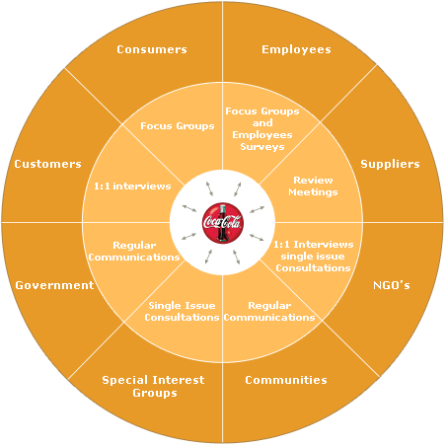
Stakeholder: Concept *233 .
‘Stakeholders’ are:
Any person, group or thing
that can determine our systems degree of success or failure,
by having an opinion about
system performance characteristics and
system lifecycle constraints

Slide 17
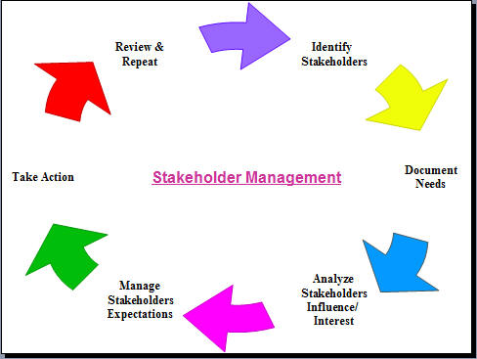
Stakeholder Interests
For example they might have an interest in
1. Setting the objectives for a process.
2. Evaluating the quality of the product
3. Using the product or system, even indirectly
4. Avoiding problems for themselves as a result of our product or system.
.Being compatible with another machine or software component.
.Determining constraints on development, operation or retirement of the system.

Slide 18
Stakeholder Map
Suzanne Robertson & James Robertson
Copyright The Atlantic Systems Guild, Used with Kind Permission.
http://www.requirementsnetwork.com/sites/requirementsnetwork.com/files/Volere_Requirements-A_Socio_Technical_Discipline.pdf
Notes:
Requirements – A Socio Technical Discipline
This is the fourth article in a series that explains the
thinking behind the Volere1 requirements techniques.
Subsequent articles will explore various aspects of
applying these techniques in your environment.
by
Suzanne Robertson & James Robertson
The Atlantic Systems Guild
February 2009
A Combination of Perspectives
On 8 Apr 2009, at 11:00, Suzanne Robertson wrote:Tom,Yes, with the usual copyright acknowledgements. What do you want to use it for?Have a happy EasterSuzanne

Slide 19
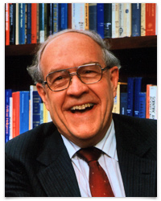
Fred Brooks, Jr. on Stakeholder specs
“The larger and more amorphous the user set, the more necessary it is to define it explicitly if one is to achieve conceptual integrity.
Each member of the design team will surely have an implicit mental image of the users, and each designer’s image will be different.
Since an architect’s image of the user consciously or subconsciously affects every architectural decision, it is essential for a design team to arrive at a single shared image.
And that requires writing down the attributes of the expected user set, including:
• Who they are
• What they need
• What they think they need
• What they want “
The Mythical Man-Month,
Anniversary Edition 1995, pp 258-9
Notes:
The Mythical Man-month Anniversary Edition1995 Addison Wesley page 258-9
There is more advice page 259 on analyzing user frequency and profiles
“It is far better to be explicit and wrong than to be vague” (page 259)
Copyright Addison Wesley

Slide 20
‘Requirement’: Defined
Concept *026 Version January 23rd 2008
A ‘requirement’ is a
“stakeholder-prioritized future state”.
Some consequences of this definition:
requirements are not ‘absolute’
a requirement’s effective priority’ is variable, and depends on many factors, like
Value of doing it, cost of doing it, related constraints,
stakeholder power, formal requirement inclusion.
Planguage helps you intelligently manage requirement priorities, so that you get maximum value for your limited resources ( = ‘competitiveness’).
Some
Formally
Defined
Requirement
Concepts and
types
Notes:
Edited by Tom Gilb March 14 2008 flight London GAT to Houston, on route Seattle (nearer heaven?)

Slide 21
Priority Determination Process
Establish and specify Stakeholder values and authority/power structure
Determine project stakeholders
Internal and External
Determine stakeholder values (requirements) and specify them in detail and to a high standard of testability and intelligibility
Document the relationships for the values (requirements) to levels of authority
(law, architect, product planned, contract)
Determine resource assumptions
(which resources will be available and when)?
Determine relative priority (immediate claim on resources)
Select a viewpoint level to judge priority from
(project, product line, engineer)
Consider all relevant defined constraints and dependencies at this decision-point moment.
(what must you do, what can’t you do)
Select prioritization policy.
(what do we want to do next? Value, Value / cost, Politics?)
Select the next priority investment based on framework and values.
Do an Evolutionary result to stakeholder delivery step and update information about everything.
Carry out an Evo delivery cycle. Measure values delivered, costs incurred.
Update all long term cumulative values delivered and costs incurred. levels
Note any changed or new resources, values, technologies, stakeholders
Notes:
Version Wednesday, December 26, 2001

Slide 22
Stakeholders: How to find out about, and confirm, their requirements
1. Identify all critical and profitable STAKE-HOLDERS
2. Identify All critical and profitable stakeholder REQUIRE-MENTS
3. Detail and clarify requirements (Scale +Benchmarks+Targets)
4. Validate and agree these requirements with stakeholders
5. Select most profitable requirements to deliver first (Evolutionary delivery)
6. Learn new requirements evolutionarily as result of experience feedback and time (new technology, markets and cost levels)

Slide 23
1. Exercise in specifying a requirement 10 minutes each point (1.1 etc.)
As a team: (5 MINUTES?)
1.1 Name 4 critical Requirements for each Stakeholder. Draw Quality Arrows
1.2 Name 4 critical Quality attributes for the Product. Draw Quality Arrows
Each team member: (5 MINUTES?)
1.3 Either: Detail at least one important Requirement for each Stakeholder
Or: 1.4 Detail at least one important Requirement for the Product
1.5 Each team member explains their effort to the others. (5 min.)
Availability
Errors-Committed
Product
1.2
Speed
End-User
1.1
Work-Efficiency
User-Friendliness
Fun
Water-Proof
Ability-to-Focus

Slide 24
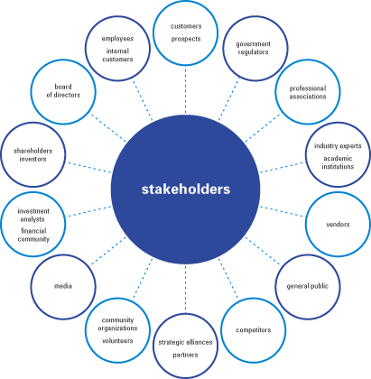
No Stakeholder?
No Stakeholder: no requirements
No requirements: nothing to do
No requirements: nothing to test
If you find a requirement without a Stakeholder:
Either the requirement isn’t a requirement
Or, you haven’t determined the Stakeholder yet
If you don’t know the Stakeholder:
Who’s going to pay you for your work?
How do you know that you are doing the right thing?
When are you ready?
Notes:
http://macinnismarketing.files.wordpress.com/2009/07/stakeholders.gif

Slide 25
Value Management (Evo) with Scrum development
developing a large web portal www.bring.no/dk/se/nl/co.uk/com/ee at Posten Norge
Copyright: Kai@Gilb.com
25

Slide 26
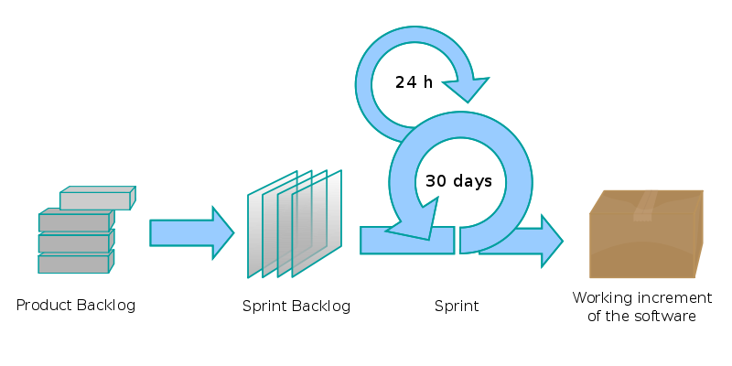
Value Management
Copyright: Kai@Gilb.com
26

Slide 27
Value Decision Tables
 | Stakeholder Value 1 | Stakeholder Value 2
Business Value 1 | -10% | 40%
Business Value 2 | 50% | 10%
Resources | 20% | 10%
 | Product Value 1 | Find.Fast
Stakeholder Value 1 | -10% | 50 %
Stakeholder Value 2 | 10 % | 10%
Resources | 2 % | 5 %
 | Solution 1 | Service Guide
Find.Fast | -10% | 40%
Product Value 2 | 50% | 80 %
Resources | 1 % | 2 %
Prioritized List
1. Service Guide
2. Solution 9
3. Solution 7
Scrum Develop
We measure improvements
Learn and Repeat
Copyright: Kai@Gilb.com
27

Slide 28
Wargame Value Decision Table
Copyright: Kai@Gilb.com
28

Slide 29
Value Management Process (Evo)
Identify Stakeholders
Specify Stakeholder Value and Product Quality Requirements
Find, Evaluate & Prioritize Solutions to satisfy Requirements.
Break the Solutions down into ‘weekly’ evolutionary delivery cycles.
Develop the next cycle, Deliver, Measure, Learn, Change.
Product Owner
Scrum
Copyright: Kai@Gilb.com
29

Slide 30
Stakeholders: Quality
In order to understand QUALITY
You have to understand STAKEHOLDERS
And the qualities they prioritize
Notes:
http://www.tutor2u.net/blog/files/stakeholder.jpg

Slide 31
Do List: Stakeholders
Policy
All projects will thoroughly analyze their critical stakeholders, the stakeholder needs, and their priorities.
Rules (for Specification)
The key stakeholders for major requirements will be specified explicitly, along with priority information or reference.
Example:
Requirement x: <- {Stakeholder X, Y, Z}, See X Economics.

Slide 32
All Quality Requirements Quantified
Quantified multidimensional quality requirements
to define the project-relevant 'Q' in QA.
Quality is far more than bug-freeness!

Slide 33
Assertions: Qualities require Quantification
Compare
Don’t drive too fast
Or The speed limit is 60 (mph kmh)
Your speed is 65 (or “you drove too fast”)
More Qualitatively:
The system must be more robust,
The system must not fail more than once a year
Or:
The System must be secure
Less than 1% expert hacker attacks succeed

Slide 34
You cannot ‘Assure’ Qualities that are vaguely defined!
Quantification is an ABSOLUTE PREREQUISITE
For Quality Control
All quality ideas (‘how well’) can always be expressed numerically
There are many possible quality ‘scales of measure’
Some can be quite useful
Some are useless
Some are worse than useless (damaging)

Slide 35
Which Quantification is ‘best’?
Maximum 5 bugs/1000 lines of code/year
99.98% availability of the system for the user
Application can be learned by user in 5 minutes
User can successfully complete basic tasks within 60 seconds

Slide 36
Some quantification advice
Quantify the primary and critical qualities
Quantify results, not means
Quantify the critical dimensions, not the ‘easy to measure’ dimensions
Quantification is NOT = ‘measurement’
There are several ‘levels’, in space and time, that you will want to put numbers on – not just one number

Slide 37
Quantification Policy
Quality Requirements and Impacts will ALWAYS be expressed numerically.
The defined quantification scales will be about the critical values and results, not about easily measurable indirect indicators.
Lack of quantification is regarded as:
Incompetent
Unprofessional
High Risk
Not ‘quality’ work
Unacceptable, not worth paying for

Slide 38
Quantification ‘Rules’
Rules for correct (defect free) specification:
All Qualities will be defined by one, or a set of, ‘Scales of measure’
Requirements will be expressed as numbers on the scale, and as either Constraints (Fail, Survival levels) or Targets (Wish, Goal, Stretch, Ideal)
Requirement levels will clarify the ‘qualifiers’ [when, where, if].
Numeric requirements will be accompanied by related critical information including: source, justification, acceptable ranges.
Quality Estimates (of a design) will be made with information of source, uncertainty, evidence, credibility, risks, issues.
Notes:
See Competitive Engineering book, for more detail on these rules and their practice.

Slide 39
Quantification of Quality. Summary
Conventional methods – non-quantified, are not a serious approach to quality assurance.
People who do not understand that should not be employed in QA and QC.
But maybe they can test the functionality ☺
Your organization probably needs leadership, training and coaching to move to the quantified culture.
The culture change (function -> Quality) does not happen accidentally
Testing of functions, use cases and stories is in no way related to the real and critical qualities, that we all are responsible for.
We need to measure numeric quality (Quality Test)
And we should measure it early, frequently – Evolutionarily – learning and adapting to realities and opportunities.*
* Harlan Mills, IBM FSD, Flight Software, Highest availability, each incremental step.

Slide 40
Requirement Types

Slide 41
Quality: the concept, the noun Planguage Concept *125, Version: March 20, 2003
A ‘quality’ is
a scalar attribute -|-|-|-|- (Scale symbol)
reflecting ‘how well’ ------Past Level<----------->
a system functions. (Fn)------Past Level<-------->
How good
How well
How much
How much saved

Slide 42
Multiple Required Performance and Cost Attributes are the basis for architecture selection and evaluation
Notes:
Sept 12 2002 added to slides , drawn by Lindsey Brodie for CE book

Slide 43
What can we do better (or ‘at all’), if we quantify quality ideas?
Evaluation solutions/designs/architectures against the quantified quality requirements (Impact Estimation)
Test and measure the degree to which solutions meet quality and cost expectations ( when they were chosen)
Measure evolutionary project progress towards quality goals
And get early & continuous improved estimates for time to completion
Communicate quality goals much better to all parties (users, customers, developers, testers, lawyers)
Contract for results
Pay for results only (not effort expended)
Reward teams for results achieved
Motivate technical people to focus on real business results
Simplify requirements ( the top few quantified- everything else is design)
Collect numeric data about designs, processes, organizational structures, to learn and use in future.
Permits systematic corporate or academic research of a development environment
Notes:
This slide was originally generated 15 oct 2004 Berlin Objectnet seminar by Tom Gilb

Slide 44
Real Examples of Requirements (Oct 2004) 37 Page Detailed “Functional” (!) Requirement
Projected benefits of this include
reduced time lost in planning,
quicker identification of actual and potential operational problems-
reduced time in vehicle tracking for customers and internal purposes,
better matching of operational costs and effort to sales contracts,
better information for future contract negotiations & renegotiation
-----------------
The perceived benefits of better planning and management of high & heavy cargo are:
reduced manual effort in planning movements,
better performance to target delivery dates for high & heavy,
better terminal planning for the cargo,
better terminal operation from better information about handling,
better customer management from better information on progress.
The perceived benefits of better planning and management of high & heavy cargo are:
reduced manual effort in planning movements,
better performance to target delivery dates for high & heavy,
better terminal planning for the cargo,
better terminal operation from better information about handling,
better customer management from better information on progress.
===============================Consolidated, consistent and timely planning information will:
reduce the incidence of wrong booking and loading of cargo,
reduce double handling and recording of information,
give visibility of planning data along the full distribution chain,
allow marketing to give more accurate information to customers,
increase utilization of COMPANY’s own transport, and
reduce the amount of emergency third party charter.

Slide 45
What is wrong with this (previous slide) picture?
Some more detail in the same ‘functional’ requirements: (is this a design?)
1. It must be possible to select any cargo, including High & Heavy and MAFI, based on any of:
- VIN (either complete or a subset, typically the last 5, 6, 8 or 10 characters)
- tracking number
- serial number
- multiple VINs (eg cut & paste input),
- movement,
- customer’s batch number,
- transport ID (rail wagon no or MAFI, lorry, vessel),
- customer code
- customer’s sales order number
- customer’s manufacturing order no (also called Commission or ED no)
- at location on date (by destination)
- dealer code
- model type & make
No identification of the main benefits (just bullet points)
No definition of the quantification ( no ‘Scale’ specification)
No benchmark to help define ‘better’.
No target to define ‘better’
No dates to define when ‘better’
No evidence that the ‘designs’ in the requirements will give any of the cited results
No specification of the long term value or costs of the suggested designs (in the requirements)
AND MANY MORE PROBLEMS
Sources
Authority
Risks
Priorities

Slide 46
Quality is characterized by these traits
Quality describes ‘how well’ a function is done.
Quality describes the partial effectiveness of a function (as do all other performance attributes).
Quality is valued to some degree by some stakeholders of the system
More quality is generally valued by stakeholders; especially if the increase is free, or lower cost, than the value of the increase.
Quality attributes can be articulated independently of the particular means (designs) used for reaching a specific quality level –
even though all quality levels depend on the particular designs used to achieve them.
A particular quality can be a described in terms of a complex concept, consisting of multiple elementary quality concepts.
Quality is variable (along a definable scale of measure: as are all scalar attributes).
Quality levels are capable of being specified quantitatively (as are all scalar attributes).
Quality levels can be measured in practice.
Quality levels can be traded off to some degree; with other system attributes valued more by stakeholders.
Quality can never be perfect (100%), in the real world.
There are some levels of a particular quality that may be outside the state of the art; at a defined time and circumstance.
When quality levels increase towards perfection, the resources needed to support those levels tend towards infinity.
Notes:
Added Feb 8 2003 after edit in CE book glossary ”Quality’

Slide 47
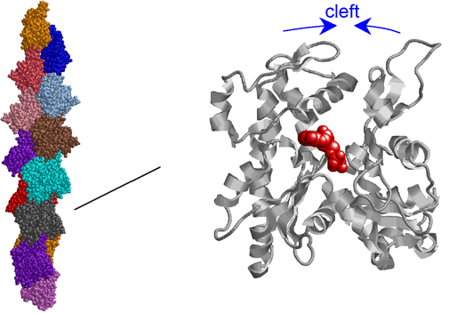
Principles for Quality Quantification.
Some hopefully deep and useful guidelines
to help you quantify quality ideas
The Decomposition Principle
Notes:
http://www.spring8.or.jp/en/current_result/press_release/2009/090122_fig/fig3.png
Slide updated23 April 2009

Slide 48
0. THE PRINCIPLE OF 'BAD NUMBERS BEAT GOOD WORDS’
Poor quantification is more useful than none; 66±8
at least it can be improved systematically. 65±2
State of the Art Flexibility
Enhanced Usability
Improved Performance
Not Clear!
Notes:
Slide updated23 April 2009

Slide 49
1. THE PRINCIPLE OF 'QUALITY QUANTIFICATION’
All qualities can be expressed quantitatively,
'qualitative' does not mean un-measurable.
Notes:
Slide updated23 April 2009

Slide 50
Dogbert the Quantifier
Notes:
Used without permission
Slide updated23 April 2009

Slide 51
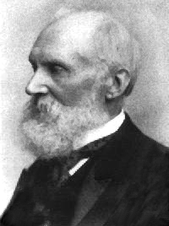
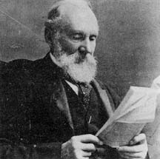
THE PRINCIPLE OF 'QUALITY QUANTIFICATION'
All qualities can be expressed quantitatively,
'qualitative' does not mean unmeasurable.
"In physical science the first essential step in the direction of learning any subject is to find principles of numerical reckoning and practicable methods for measuring some quality connected with it.
I often say that when you can measure what you are speaking about, and express it in numbers, you know something about it;
but when you cannot measure it, when you cannot express it in numbers, your knowledge is of a meagre and unsatisfactory kind;
it may be the beginning of knowledge, but you have scarcely in your thoughts advanced to the state of Science, whatever the matter may be.”
Lord Kelvin, 1893
From http://zapatopi.net/kelvin/quotes.html
Notes:
Thank you for the lecture you gave at OGI. It gave me much food for thought
and action, particularly in the realm of requirements specification. Much
to learn, much to apply.
As for your Lord Kelvin quote, it prompted an immediate google search. I
found a fuller version of the quote at
http://zapatopi.net/kelvin/quotes.html, which reads,
"In physical science the first essential step in the direction of learning any subject is to find principles of numerical reckoning and practicable methods for measuring some quality connected with it.
I often say that when you can measure what you
are speaking about, and express it in numbers, you know something about it;
but when you cannot measure it, when you cannot express it in numbers, your
knowledge is of a meagre and unsatisfactory kind; it may be the beginning of
knowledge, but you have scarcely in your thoughts advanced to the state of
Science, whatever the matter may be." While his full quote is more narrow
in scope (physical science) I think your extension of the idea to
"requirements science" arena equally applicable.
Benjamin Ward
---Benjamin Ward-----
Work: 503.232.7053 / mailto:benjamin.ward@tek.com
Home: 503.232.7053 / mailto:ben_ward@northwest.com
------------------------- June 1 contribution Michael Jackson, London
George Miller, the psychologist
> usually credited with the magic number seven, plus or minus
> two, wrote: "In truth, a good case could be made that if
> your knowledge is meagre and unsatisfactory, the last thing
> in the world you should do is make measurements. The chance
> is negligible that you will measure the right thing
> accidentally." Meagre and unsatisfactory knowledge about
> separability can't be improved by measuring anything, or
even by thinking about what you might measure.
=========== end MJ quote

Slide 52
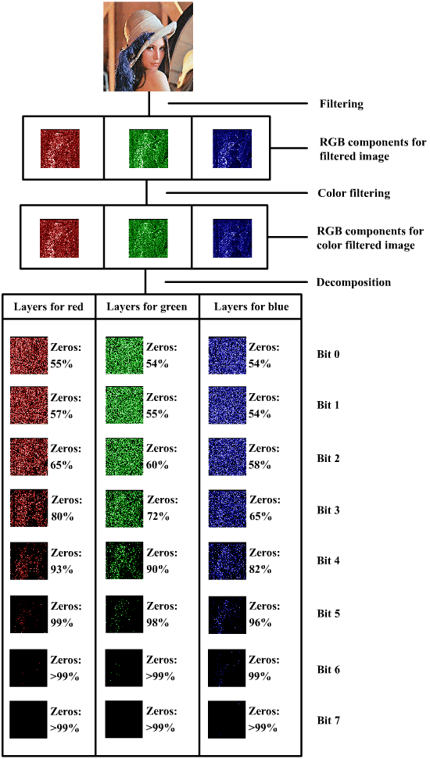
2. THE PRINCIPLE OF 'MANY SPLENDORED THINGS’
Most quality ideas
are usefully broken down into several
measures of goodness.
Usability: Includes:
Entry Qualification: Scale: IQ, …….
Learning Effort: Scale: Hours to learn, …..
Productivity: Scale: Tasks per hour,…….
Error Rate: Scale: Faults per 100 tasks, …..
Like-ability: Scale: % Users who like the system, ….
Notes:
http://www.researchandtechnology.net/pcif/algorithm_decomposition.php
Slide updated23 April 2009

Slide 53
Quantifying Usability (Erieye C&C System)
QUALITY
USABILITY
AVAILABILITY
ADAPTABILITY
WORK-CAPACITY
INTUITIVENESS
INTELLIGIBILITY
AND MORE!
Intelligibility
GIST: Super ease of immediate understanding
SCALE:% OK interpretations.
METER: 10 ops., 100 infos, 15 mins.
P:PAST[20 ops., 300 info, 30 min.]99%
RECORD [P] 99.0%
Fail [DELIVERY[1]]99.0%<-MAB
[ACCEPTANCE] 99.5%
Goal [M1] 99.9% <-LN
Intuitiveness
GIST: Great intuitive capability
SCALE: Probability that intuitive guess right.
METER: <100 observations.>
PAST [GRAPES] 80% <-LN
RECORD [MAC] 9%?<-TG
Fail [TRAINED, RARE] 50-90%
Goal [TASKS] 99% <-LN
TRAINED: DEFINED:C&Ctl. operator, approved course, 200 hours duration.
RARE: DEFINED: types of tasks performed less than once a week per op.
TASKS: DEFINED: onboard operator distinct tasks carried out.
ACCEPTANCE: DEFINED: formal acceptance testing via customer contract.
DELIVERY: DEFINED: Evolutionary delivery cycle, integrated and useful.
Notes:
Slide updated23 April 2009

Slide 54
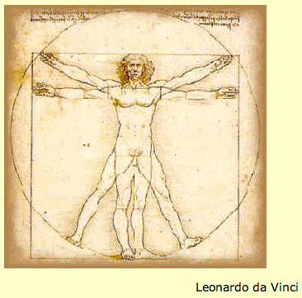
3. THE PRINCIPLE OF 'SCALAR DEFINITION’
A Scale of measure is a powerful practical definition of a quality
Flexibility:
Scale: Speed of Conversion to New Computer Platform
Notes:
http://www.chem1.com/acad/webtext/matmeasure/mm1.html
Slide updated23 April 2009

Slide 55
(Quality) Requirements Specification Template with <hints> HOW WE SPECIFY SCALAR ATTRIBUTE PRIORITY: Constraints, Targets
<name tag of the objective>
Ambition: <give overall real ambition level in 5-20 words>
Version: <dd-mm-yy each requirements spec has a version, at least a date>
Owner: <the person or instance allowed to make official changes to this requirement>
Type: <quality|objective|constraint>
Stakeholder: { , , } “who can influence your profit, success or failure?”
Scale: <a defined units of measure, with [parameters] if you like>
Meter [ <for what test level?>]
====Benchmarks ============= the Past
Past [ ] <estimate of past> <--<source>
Record [ <where>, <when >, <estimate of record level> ] <-- <source of record data>
Trend [ <future date>, <where?> ] <prediction of level> <-- <source of prediction>
===== Targets ============= the future needs
Wish [ ] <-- <source of wish>
Goal […] <target level> <-- Source
Value [Goal] <refer to what this impacts or how much it creates of value>
Stretch [ ] <motivating ambition level> <-- <source of level>
========== Constraints ========================
Fail [ ] <-- <source> ‘Failure Point’
Survival [ ] <- <source of limit> ‘Survival Point’
Notes:
Slide updated23 April 2009

Slide 56
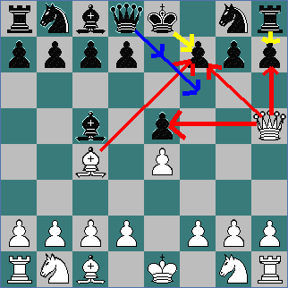
4. THE PRINCIPLE OF 'THREATS ARE MEASURABLE’
If lack of quality can destroy your project
then you can measure it sometime;
the only discussion will be 'how early?'.
Notes:
http://www.chesskids.com/kids/threat7.gif
Slide updated23 April 2009

Slide 57
5. THE PRINCIPLE OF 'LIMITS TO DETAIL’
There is a practical limit to the number of facets of quality you can define and control,
which is far less than the number of facets that you can imagine might be relevant.
Notes:
http://www.galaxyzooblog.org/wp-content/uploads/2008/06/ngc3861s.jpg
Slide updated23 April 2009

Slide 58
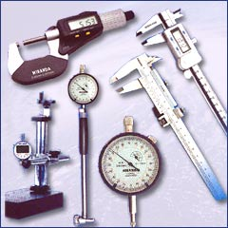
6. THE PRINCIPLE OF 'METERS MATTER’
Practical measuring instruments
improve
the practical understanding
and application of ‘Scales of measure’.
Portability:
Scale: Cost to convert/Module
Meter [Data] measure/1,000 words converted
Meter [Logic] measure/1,000 Function Points Converted
Notes:
Slide updated23 April 2009

Slide 59
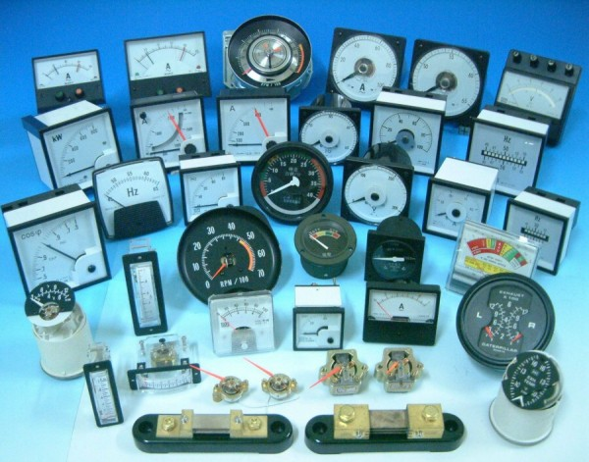
7. THE PRINCIPLE OF 'HORSES FOR COURSES'
Different quality-Scale measuring processes
will be necessary
for different points in time, different events and different places.
Availability:
Scale: % Uptime for System
Meter [USA, 2011] Test X
Meter [UK, 2012] Test Y
Notes:
Slide updated23 April 2009

Slide 60
8. THE PRINCIPLE OF 'BENCHMARKS’
Past history, and future trends,
help define words,
like ‘improve’ and ‘reduce’.
Reliability:
Scale: Mean Time To Failure
Past [US DoD, 2008] 30,000 Hours
Trend [Nato Allies, 2012] 50,000 Hours
Goal [UK MOD, 2011] 60,000 Hours
improve
Notes:
Slide updated23 April 2009

Slide 61
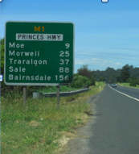
9. THE PRINCIPLE OF 'NUMERIC FUTURE’
Numeric future requirement levels
{Wish, Stretch, Goal, Ideal}
complete a clear quality definition of relative terms like 'improved’.
Usability:
Scale: Time to learn average task.
Past [Old product, 2008] 20 minutes
Wish [New product, 2011] 1 minute
Stretch [End 2012, Students] 2 minutes
Goal [End 2013, Teachers] 5 minutes
Notes:
Slide updated23 April 2009

Slide 62
Some Planguage ‘Quality Quantification’ Concepts
PAST: any useful reference point. Your old product, a competitors organization, a quality achieved in same discipline but different branch of business.
RECORD: best in some class, state of the art. Something to beat. A challenge for you. An extreme PAST.
?
TREND: a future guess based on the PAST.
[-----]
Survival : a level needed for survival of the entire system.
Goal: the level needed for satisfaction, happiness, joy and 100% full payment!
Wish: a level desired by someone, but which might not be feasible. Project is not committed to it.
?

Slide 63
Managing Designs that give Qualities:
Estimated impact of designs and architectures on requirement levels
as the basis for assuring
that we have later reached planned quality levels.
How to manage multiple qualities quantitatively.

Slide 64
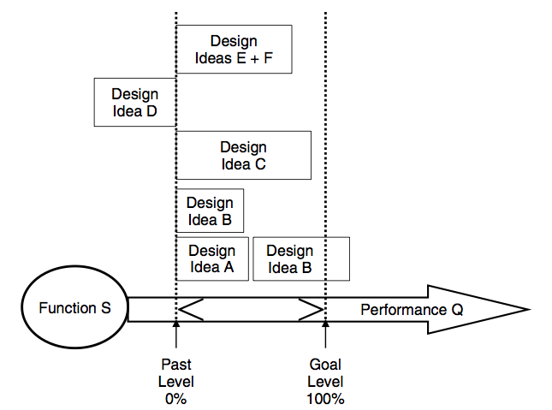
How do we evaluate, for a single quality dimension, the impact of a design ?
We must estimate
(or measure)
the numeric cumulative impact
of the design
on a defined Scale (units),
using a defined Meter (test process),
with respect to requirement levels.

Slide 65
Assertions about Understanding Design and Architecture
Design/Architecture/Strategies/Solutions/Means
Are chosen for their impacts on performance, qualities and costs
The design set we choose, needs to meet our numeric target,s for performance, qualities, and costs
We need to be able to estimate, reasonably, the impacts on ALL Critical Requirements, of each design, and a set of designs
Failure to ‘be numeric’ about the design impacts is
A sign of incompetence, a lack of professionalism
Unless you admit, up front and in writing, that you do not know the impacts, on critical requirements, of proposed designs (and resign your job) – then you are not professional
It is quite OK, even necessary, to be uncertain of the resulting design impacts, in some or even many areas. As long as the degree and reasons for uncertainty are specified, and action is taken to mitigate the risks; i.e. to reduce the negative deviation from planned requirement levels

Slide 66
The Point: Simplified
We need to assure that designs
Meet our quality requirements (quantitatively)
And do not destroy or hurt any other types of requirements, like:
Operational Performance
Costs (investment, maintenance, decommissioning)
Conditions (legal, Policy)
If we can’t do this, we can’t assure delivery of necessary qualities

Slide 67
Policy: Design Quality
All professionals, who propose or promote solutions,
Will at least, quantify expected impact, on primary critical quality requirements
and will attempt to estimate impact on other critical performance, quality, and cost requirements.
and will freely document, and admit, lack of knowledge about impacts, on any and all, critical requirements.

Slide 68
Rules: Design Quality
Use an Impact Estimation table, so that we are able to see all relationships, and especially those we have not yet estimated.
Estimate and specify the designs’ impact on the top ten critical objectives:
Estimate the incremental contribution to the entire design
Estimate ± uncertainty or range
Give basis for your estimate (source, evidence)
Specify credibility level (0.0 nix -> 1.0 for sure)

Slide 69
Summary: Design Quality
Quality from Designs
Should not be an accident, or disappointment
Should be a result of conscious ‘engineering’
‘Fact-based Design’
We have to TRY to estimate expected quality impacts on our critical quality objectives.
This is part of quality assurance
You get quality by designing it in, NOT BY TESTING IT IN

Slide 70
Figure 1: Real (NON-CONFIDENTIAL version) example of an initial draft of setting the objectives that engineering processes must meet.
Business
Values
Quantified

Slide 71
Strategy Impact Estimation: for a $100,000,000 Organizational Improvement Investment
Technical Strategies
Objectives
Defined
In earlier slide
Strategy
Impacts
on
Objectives
"Benefits"
Cost
358 !
Notes:
Figure 2: an ‘Impact Estimation Table’ (see ‘CE’ book) Benefit A set of 12 proposed Engineering Processes, with about $100,000,000 in total investment projected over time, are evaluated theoretically for their impact on 13 business objectives (defined in Fig. 1 above).

Slide 72
‘Lite’ Measurement of Requirements and Specs:
Agile Quality Control (QC) of Specifications (Spec QC).
Applies to Requirements, Designs, Codes, Tests
to give strong motivation
to follow best standards practices
better by factor of 100.

Slide 73
Assertions: QC of Specs
Quality Control needs to start early (requirements, design)
Half of your bugs are created before coding (GIGO)
Inspection and Test only find half of the problems
So, ‘quality’ by ‘defect removal’ is neither effective, nor cost-effective.
The only cost-effective way to ‘get quality’ is to
Design it in
Prevent defects occurring – by motivation to practice quality development work
Specification QC (aka ‘static testing’) can help you ‘get quality’

Slide 74
Agile Spec QC: what is it?
Critical documents are checked for conformance to ‘rules’
Rule violation = ‘defects’ (law violation = illegal acts)
We sample large documents, to avoid high cost of measurement
We try to measure ‘defect density’
Major defects per page
We accept documents that meet our ‘exit conditions’
Like: “Maximum 1.0 Majors/page remaining”
The result is ‘no garbage out’, ‘no garbage in’
Not because we remove ‘garbage’!
But because people are really strongly motivated to follow the best practices, in the rules.
Otherwise they are clearly Not doing acceptable professional work. (and they want to feed their kids)

Slide 75
Expectations: SQC
Defects reduced by about 10 x in 6 months
By another 10 x by concerted long term effort in 2-3 years
Individuals will go through a steep learning curve
50% reduction in their injected defects per cycle of learning
The organization will begin to take their standards (rules) seriously

Slide 76
Policy: SQC This is the most important thing I wish managers would implement.
All critical specifications will be measured for defects
Defective work, over the exit level, will not be released for others to use

Slide 77
Summary: SQC
Spec QC – ‘static’ test is more far cost effective than testing
With testing, the stream of injected defects is constant, test finds a small percentage of them
With Spec QC – we drive the defect injection down towards zero

Slide 78
Quality Control:
How should we organise quality control inspections
of requirements and test planning
so as to drive people to better practices,
and to avoid wasting time on bad inputs?

Slide 79
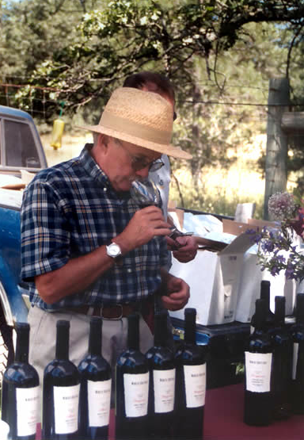
The direct answer?
we should organise quality control inspections
of requirements and test planning
according to the following management policy.

Slide 80
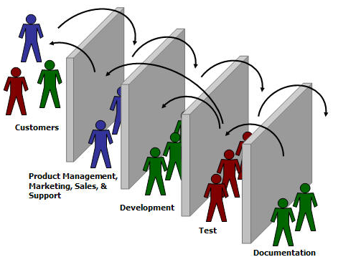
Test QC Policy for Test Inputs and Outputs
All test process inputs (like requirements), and all test process human outputs (like test scripts, test plans, and test strategies) will be subject to strict, numeric Entry and Exit control.
The primary numeric Entry/Exit Condition will be based on the specifications’ degree-of-conformance to agreed standards.
As measured by Inspections, and consequent Major Defect Density Remaining Calculations
The Generic Acceptable level of major defects is maximum estimated 1.0 Majors/Logical Page (300 words)
We will demand such a standard from our input suppliers, and we will demand that standard from ourselves.
Notes:
http://scrumone.typepad.com/photos/uncategorized/barriers.jpg

Slide 81
The 30 minute agile review for requirements: how to measure defect density of requirements !
How to measure requirement quality levels
Cheaply ( 15-60 minutes, 2 to 4 reviewers)
Reliably (accurately enough to sort out unacceptable work)
An ‘Agile form of Inspections
The requirement specification QC (Quality Control)
In simple terms, SQC measures the density of serious malpractice (Major defects) in relation to official written rules for good practice

Slide 82
Here is a real case example of such a static test, of a requirement specification

Slide 83
Case: Real Agile Spec QC
of System Requirements Specification (SRS) of 82 pages for a major US corporation.

Slide 84
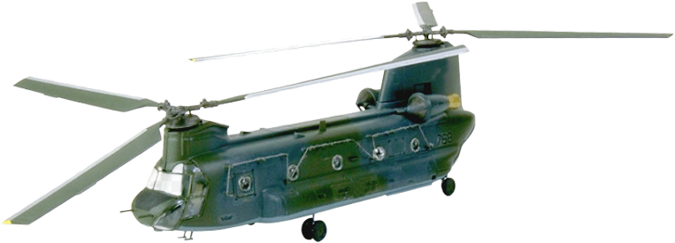
Framework
Demonstration of power of Agile Inspection
8 Managers
2 hours
4 real requirements specifications offered ,
One 82 page ‘System Requirements Specification’ actually used

Slide 85
We Introduced best-practice Rules
for Requirements
1. Unambiguous to intended Readership
2. Clear enough to test.
3. No unintentional Design

Slide 86
We explained the definition of Spec Defect (1)
A ‘Specification Defect’ is a violation of a Specification Rule
(violation of a ‘standard’)
Note: If there are 10 ambiguous terms in a single requirement
then there are 10 defects!

Slide 87
We further explained the definition of Spec Defect (2)
A ‘Specification Defect’ is a also a ‘Potential Defect’
In the next level of specification
Like in Design, test plans, code or test scripts.
With about 1/3 chance (potential) of becoming a downstream real defect.
In ‘code’ we call this a ‘bug’ (a potential malfunction).
If we discover the bug in test or operation we call it a ‘malfunction’

Slide 88
The definition of Major defect
Major:
a Defect that potentially
costs more
to find and fix
later in the development process
than it would cost now.
We need to get rid of it NOW!

Slide 89
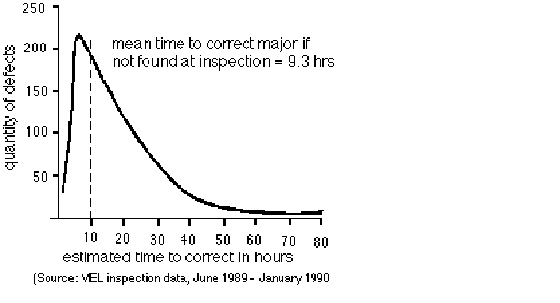
The downstream alternative cost of quality at a UK Defence Electronics Factory. 9 to 1 more (all types of documents for electronics).
Number of defects of the 1,000 sampled Majors ------>
That we
manually estimated
downstream costs to fix
Mean time to find and correct a Major if not fixed at Inspection was 9.3 Hours.
It cost about 1 hour to find and fix a Major at time of Inspection
0 10 30 50 70
Estimated hours to find and correct later in test, or in field
Trevor Reeve
Source: Trevor Reeve, Case Study Chapter in "Software Inspection”, Gilb client.
Philips MEL became "Thorn EMI", then Racal. Crawley UK. 1999 Raytheon
Half-day Inspection Economics. Gilb@acm.org
Notes:
24
trevorreeve@mail.com

Slide 90
Agree with Management on Exit level
Is 1,000 Majors per page OK
100, 10, 1
?
• Exit Conditions: (when Requirements can go forward to Design, Test, etc. with little risk)
Maximum 1 Major Defect/ (Logical) Page, estimated remaining
Logical Page = 300 Non-commentary words.

Slide 91
The notion of ‘numeric exit’: When are requirements ‘good enough’ to build tests on ?
A major defect in requirements has 33% chance of causing a bug or worse.
Most IT shops are ‘uncontrolled’: have no standards enforced, no QC of requirements
They have about 100 ±50 major defects per page
33 ± 10 potential bugs per page
This is deemed completely unacceptable by managements, and in relation to cost and quality options
This (max. 1 major/page) should be your requirements process exit standard, and also your test planning entry standard

Slide 92
The assigned checking process
You have up to 30 minutes
check 1 sample requirements page (from an 82 page document)
Count all potential Rule Violations
= Defects
Classify Defects as Major or minor

Slide 93
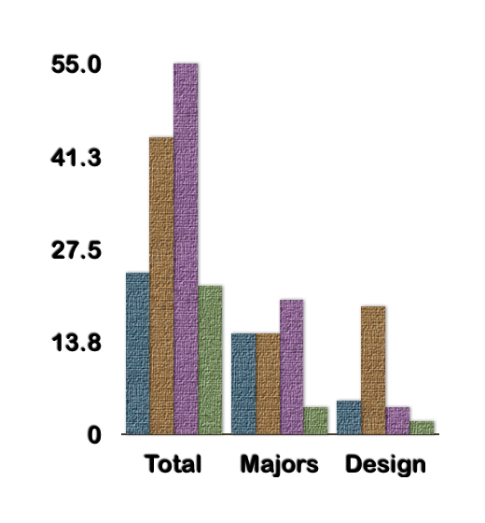
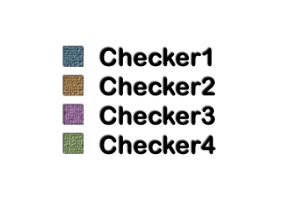
Report Page 81
Total, Majors, Design
24, 15, 5
44, 15, 19
55, 20, 4
22, 4, 2

Slide 94
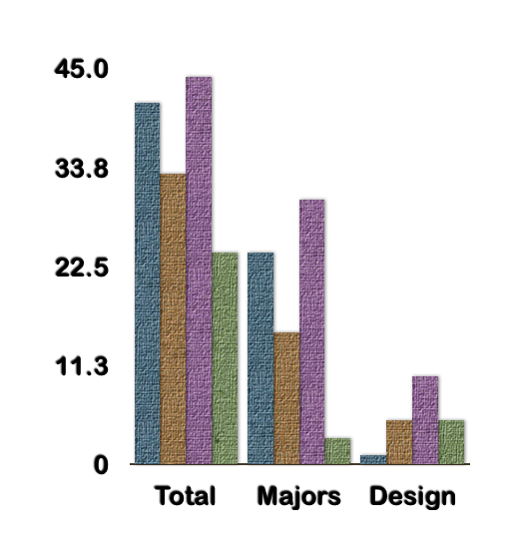
Report Page 82
Total, Majors, Design
41, 24, 1
33, 15, 5
44, 30, 10
24, 3, 5

Slide 95
Defect Density Estimation
Total for group (page 82)
Rough Est. 30 x 2 = 60 Majors
assume 60 ±10 are unique.
If checking is 33.33% effective,
total in page = 3 x 60 = about 180±30 Of which 2/3 (or 120) were not yet found.
. If we fix all we found (60),
then the estimated remainder of Majors would be 120 (not found)
+10 “not fixed correctly”
= 130 Majors remaining.
Total, Majors, Design
41, 24, 1
33, 15, 5
44, 30, 10
24, 3, 5
60
180
120
Notes:
Team would (we estimate) log unique Majors about 2x30=60 actually found
Which is 1/3rd of total existing , so estimated total this page is about 180 Majors
About 2/3, = 120 Majors , were not found by the team during the agile spec QC process.
Not all 180 spec defects (only 25%-35%) would actually become product defects, before testing.
We don’t know which ones in advance: it depends on human interpretation, on the day.
Many (only 25%-35%) of these Major spec defects would cause product defects (bugs in product, not just spec)
These would be found later in test,and product use as bugs or major defects
The product defect rework would cause serious project (product development) delay
No human review process is better, even when continuously improved for years, than 60% (source code record) to 88% (the ‘logic spec’ record) at defect identification. <- IBM MN.
If we attempt to fix the 60 defects we logged, and correctly fix 5/6 of them; then 10 defects are ‘failed fixes’, so:
The total remaining after inspection and editing = 10+120 =130 Majors per page.
10 failed fixed +
120 not detected major defects
= 130 Major defects per page ( 300 non commentary words) remaining after the review and fixing process - before text.

Slide 96
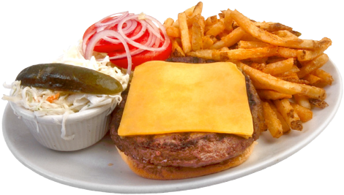
Conclusions
Human defect removal by Inspections/reviews/SQC is
a hopeless cause: not worth it.
Spec QC can be used, in spite of imperfect effectiveness,
to ‘accurately enough’ estimate ‘major-defect-level’ density.
EXPERIENCE AND CONSEQUENCES:
This measurement can be used to motivate engineers to
dramatically (100x! Over about 7 learning cycles)
reduce their defect insertion (rule violation)
to a practical exit level
(like less than 1.0 Majors/page)

Slide 97
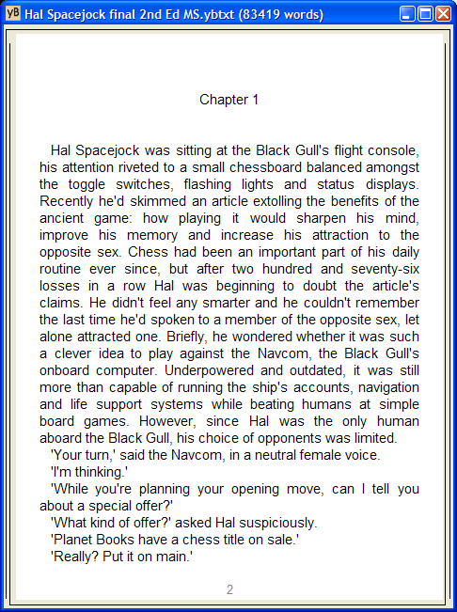
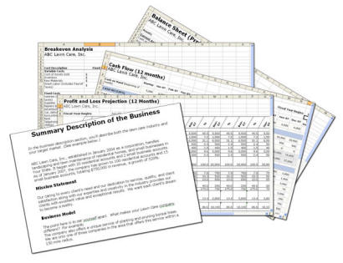
Extrapolation to Whole Document
Average: 150 Majors/page
Page 81: 120 majors/page
Page 82: 180 Majors/page
Total in whole document:
12,300 Majors
150 Majors/page x 82 pages.

Slide 98
Estimated Project Loss
If a Major has
1/3 chance of causing loss
And each loss caused by a Major is
avg. 10 hours
then total project Rework cost is
about 41,000 hours loss.
(This project was over a year late)
1 year = 2,000 hours x 10 people

Slide 99
Agile Spec QC Procedure
P1: Identify Checkers: Two people, maybe more, should be identified to carry out the checking.
P2: Select Rules: The group identifies about three rules to use for checking the specification. (My favorites are clarity (‘clear enough to test’), unambiguous (‘to the intended readership’) and completeness (‘compared to sources’). For requirements, I also use ‘no optional design’.)
P3: Choose Sample(s): The group then selects sample(s) of about one ‘logical’ page in length (300 non-commentary words). Choosing such a page at random can add credibility – so long as it is representative of the content that is subject to quality control. The group should decide whether all the checkers should use the same sample, or whether different samples are more appropriate.
P4: Instruct Checkers: The SQC team leader briefly instructs the checkers about the rules, the checking time, and how to document any defects, and then determine if they are major defects (majors).
P5: Check Sample: The checkers use between 10 and 30 minutes to check their sample against the selected rules. Each checker should ‘mark up’ their copy of the document as they check (underlining issues, and classifying them as ‘major’ or not). At the end of checking, each checker should count the number of ‘possible majors’ (spec defects, rule violations) they have found in their page.
P6: Report Results: The checkers each report to the group their number of ‘possible majors.’ Each checker determines their number of majors, and reports it.
P7: Analyze Results: The SQC team leader extrapolates from the findings the number of majors in a single page (about 6 times** the most majors found by a single person, or alternatively 3 times the unique majors found by a 2 to 4 person team). This gives the major-defect density estimate. If using more than one sample, you should average the densities found by the group in different pages. The SQC team leader then multiplies the ‘average major defects per page density’ by the ‘total number of pages’ to get the ‘total number of major defects in the specification’ (for dramatic effect!).
P8: Decide Action: If the number of majors per page found is a large one (ten majors or more), then there is little point in the group doing anything, except determining how they are going to get someone to write the specification ‘properly’, meaning to acceptable exit level. There is no economic point in looking at the other pages to find ‘all the defects’, or correcting the majors already found. There are simply too many majors not found.
P9: Suggest Cause: The team then chooses any major defect and thinks for a minute why it happened. Then the team agrees a short sentence, or better still a few words, to capture their verdict.
Formal SQC Procedure

Slide 100
Agile SQC Process Controls
Entry Conditions
A group of two, or more, suitable people* to carry out Agile SQC is assembled in a meeting.
The people have sufficient time to complete an Agile SQC. Total Elapsed Time: 30 to 60 minutes.
There is a trained SQC team leader at the meeting to manage the process.
Exit Conditions
Exit if less than 5 majors per page extrapolated total density, or if an action plan to ‘rewrite’ the specification has been agreed.

Slide 101
The formal Agile SQC Process Sources
Cutter 5 pg Paper
http://www.gilb.com/tiki-download_file.php?fileId=64
INCOSE SQC Paper http://www.gilb.com/tiki-download_file.php?fileId=57
Agile SQC Slides with Standard for Process
http://www.gilb.com/tiki-download_file.php?fileId=239

Slide 102
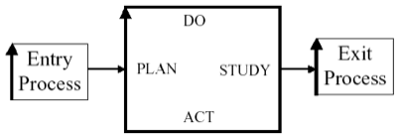
Quality Gateways to the Work
Process Entry and Exit numeric standards
100x improvement
for compliance to specification standards:
no Garbage In Please.

Slide 103
Assertions: Exit/Entry
Numeric Process Exit (and Entry) control is one of the simplest, yet most powerful, quality control ideas, in practice
IBM’s experience (Ron Radice – CMM/Inspection)
Almost nobody has managed to learn and apply this simple universal idea
Most all organizations have terrible Garbage Out problems, like 100 majors/page out
But they don’t know that!
No measurement. No control.

Slide 104
Basics: Exit Entry
Process Exit (example from a test planning process)
Depends on a set of Exit Conditions
The key condition is ‘remaining defect density’ (<1/p ?)
The exit level is ultimately set ‘economically’
It pays off to exit now
The short term effect (today) is to prevent bad stuff happening
The long term (next week) is to motivate people to do their job professionally
And radically (100x !) reduce their defects injected

Slide 105
Expectations: Exit
If you apply numeric, quality level, exit conditions to a process – you can expect:
Drastic reduction in defective work (10x, then 100x)
Developers will bother to learn, and to apply correctly – basic ‘rules’ (like ‘clear’)
Each individual will have to go through a gradual process of learning the ‘rules’
Getting 50% better each time they try to met the exit level

Slide 106
Policy: Exit .
All important work processes will be managed by formal written exit conditions
The most powerful and objective condition will be based on the level of major defect density
The minimal standard will be ‘less than 10 majors per 300 words (a virtual page)’, but ultimately < 1 major/page
A defect is violation of your written ‘rules’
A ‘Major’ defect, is a rule violation potentially impacting quality of the final product.
Managers will be held personally responsible for all bad quality, and for and schedule slippage; due to work they have accepted, which is worse than this standard.

Slide 107
Policy: Entry Conditions
Each work process (example test planning, using requirements as inputs) must ‘defend’ themselves against ‘garbage’ input by a formal set of entry conditions.
One entry condition is the level of major defect density.
Anything over 10 majors/page is always unacceptable
But most of you now start at the 8o-280 M/pg level!
Ultimately, ‘high quality’, means less than 1 Major/page
The Entry Process is not obliged to accept claims from the Exit process proceeding it.
If necessary it should at least do random 1 page sample Spec QC to check quality levels.

Slide 108
Summary: Exit/Entry
Numeric quality level control, Exit/Entry processes are necessary, in all work processes, to motivate serious professional work; and to manage the work.
The effect is to motivate individuals to work to a high, written, standard (‘rules’) - which the organization has learned are necessary.
Experience demonstrates that no other known method is as powerful in effecting such rapid improvement in quality.
You will quickly experience ( days and weeks) this, measurably, yourself.
It is not about rejecting bad work.
It is all about motivating individuals to learn to ‘do it right the first time’.

Slide 109
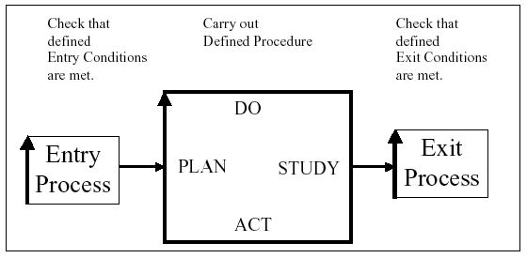
You should have NUMERIC exit and entry quality levels from both test processes and related development processes
Entry and Exit Condition example:
Maximum estimated 1.0 Major defects per logical page remaining.
This was the MOST important lesson IBM learned about software processes (source Ron Radice, co-inventor Inspections, Inventor of CMM)
No ‘Garbage In’ to Test Planning!
Notes:
Figure 1.7: A simplified PDSA process cycle diagram, as a basis for work process control, consisting of an
entry process, a procedure and an exit process.
Added radice oct 06 tg
Added No Garbage in and Header text 10 sept 2008 for SQC London

Slide 110
Practical Defect Prevention Process ‘DPP’:
Real Process Improvement
early, frequently, measurably,
in all projects.

Slide 111
Assertions about DPP
DPP is similar in principle to Deming’s Plan Do Study Act – Statistical Process Control (SPC), and to Six Sigma (GE, Motorola).
DPP has a return on investment of about 13 to 1
DPP will reduce injected defects for any work process by 2/3 in the first year or two, and far more in the longer term (approaching zero defects)
DPP is far more cost effective than any known form of Inspection or Testing – in delivering quality

Slide 112
What is DPP?
Grass roots developers (checkers, testers) analyze frequent-type real bugs – concrete detailed instances that they have first hand knowledge about - or major defects
They develop local personal or group opinions about root causes, and potential ‘cures’ (changes in process, or anything that might reduce occurrence)
They try out their ideas in practice, locally (their project or product, and their process, as practiced by them)
Ideas that work, are picked up at a higher level of corporate process change, and implemented corporate wide
Story: Tom and the young Douglas Aircraft Engineers – the cut outs solution. Simple!

Slide 113
How does DPP work?
After an Inspection Process, Major defects are examined by the checking team. Half an hour sessions.
They are looking at a colleagues work, colleague is there (the source of defects: knows why)
They arbitrarily select one, of a small group of recurrent types of defects, to work on (3 minutes each). 10 in 30 minutes.
They brainstorm root causes (organizational, not personal)
Like: misleading training course information
They brainstorm possible ‘cures’
Like: enhance slides, and tests to make the point clearer.
They may themselves, carry out the proposed changes and try them to see if they work. Keep it simple – prove concept works.
Successful changes are picked up at corporate quality level and instituted more widely and more properly.

Slide 114
Effects of DPP: Grass roots wisdom
Systemic (due to ‘common cause’) defects are reduced quickly and in volume (2/3 in year)
The inside knowledge of local teams is exploited – how things really work in the real world – why the defects really occurred
The inside local understanding of socially acceptable changes is used: people will not suggest changes they would hate to do themselves
The feeling of ‘empowered creativity’ to find process improvements that really work, is very motivating to the grass roots professionals!
Big costly ideas that never work, as often suggested by management, architects, and interested suppliers, are not imposed on the developers.
Ideas that don’t work are discarded quickly, or re-tuned to work better.
Many small but practical improvements, quickly and cheaply deployed, 200-2,000 annually, add up to major measurable change in quality.
Any one group (like ‘test’, or a 4 person development team) can use this method on their own work, to prove how well it works – improving quality.

Slide 115
DPP Policy
All interested teams will be given regular opportunities to analyze their own defects using the DPP process.
They will be given the opportunity to try out their solutions; and measure the effects of their solutions.
Local successful solutions will be adopted more widely, by groups responsible for change and improvement (CTO level)
Local groups responsible for initially finding, and successfully trying out improvements will be suitably honoured and rewarded.
The minimum amount of annual investment in this activity is 5% of total work hours.
Failure to successfully invest in this each year, irrespective of excuses*, will be considered a serious management failure.
* ‘meeting deadlines’ is an invalid excuse. Deadlines are a major reason for doing this properly. Defects destroy deadlines!
Investments early in critical projects can easily save those projects.

Slide 116
Summary DPP
Defect Prevention is the smartest way to improve quality and to reduce time to market.
DPP is applicable to all work processes
DPP results are highly measurable
DPP results happen in the short term (this month) but take a few years to get full harvest. DPP should be continued eternally, in changing environments.
DPP avoids ‘great management failure’ changes
Management exploits local know how and creativity forever
People love to be listened to, and to see their ideas work and get spread to a larger organization.

Slide 117
Systematic Reduction of Defect Injection:
The Defect Prevention Process:
how can we organise ourselves at the test level
to analyse recurrent problems
and implement practical changes to avoid them?

Slide 118
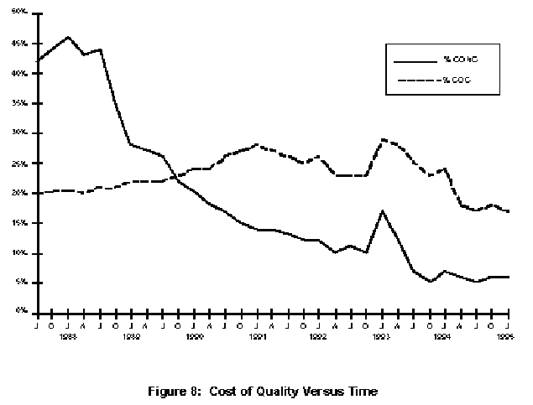
Cost of Quality over Time: Raytheon 95
43%
Start of Effort
The individual learning curve ??
Cost of Conformance
Bad
Process
Change
Cost of Rework
(non-conformance)
5%
End 1988
End 1994

Slide 119
‘Avoidable’ Costs of Non-conformance Items
Re-reviews
Re-tests
Fixing Defects (code, documentation)
Reworking any document.
Engineering Changes
Lab Equipment Costs of Retests
Updating Source Code
Patches to Internal Code
Patches to Delivered Code
External Failures
from Philip Crosby’s Model according to Raytheon95 Fig. 7
Source : Raytheon Report 1995
http://www.sei.cmu.edu/pub/documents/95.reports/pdf/tr017.95.pdf
Notes:
Source : Raytheon Report 1995
http://www.sei.cmu.edu/pub/documents/95.reports/pdf/tr017.95.pdf

Slide 120
Improving the Reliability Attribute Primark, London (Gilb Client) see case study Dick Holland, “Agent of Change” from Gilb.com Using, Inspections, Defect Prevention, and Planguage for Management Objectives
Errors/
Customer/
Year
50
minors
Majors
5
1995
1998
Notes:
17
17
17

Slide 121
Defect Rates in 2003 Pilot Financial Shop, London, Gilb Client Spec QC/Extreme Inspection + Planguage Requirements
Across 18 DV (DeVelopment) Projects using the new requirements method, the average major defect rate on first inspection is 11.2.
4 of the 18 DV projects were re-inspected after failing to meet the Exit Criteria of 10 major defects per page.
A sample of 6 DV projects with requirements in the ‘old’ format were tested against the rules set of:
The requirement is uniquely identifiable
All stakeholders are identified.
The content of the requirement is ‘clear and unambiguous’
A practical test can be applied to validate it’s delivery.
The average major defect rate in this sample was 80.4.
Major defects/page
on 1st Quality Control

Slide 122
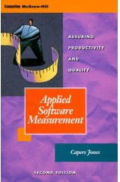
Defect Removal Effectiveness Inspections and Tests
Capers Jones
Capers Jones,
http://www.spr.com/
Table 9: Software Defect Removal Effectiveness Ranges (Capers Jones)
Defect Removal Activity Ranges of Defect
Removal Effectiveness
Informal design reviews …………………………………………………………….25% to 40%
Formal design inspections ---------------------------------------------------- 45% to 65%
Informal code reviews 20% to 35%
Formal code inspections ------------------------------------------------------- 45% to 70%
Unit test ------------------------------------------------------------------------------15% to 50%
New function test 20% to 35%
Regression test 15% to 30%
Integration test 25% to 40%
Performance test 20% to 40%
System test ---------------------------------------------------------------25% to 55%
Acceptance test (1 client) 25% to 35%
Low-volume Beta test (< 10 clients) 25% to 40%
High-volume Beta test (> 1000 clients) 60% to 85%
Notes:
CONFLICT AND LITIGATION
BETWEEN SOFTWARE CLIENTS AND DEVELOPERS
Version 10 – April 13, 2001
By Capers Jones, Cjones@spr.com
It is obvious that no single defect removal operation is adequate by itself. This explains why “best in class” quality results can only be achieved from synergistic combinations of defect prevention, reviews or inspections, and various kinds of test activities. Between eight and 10 defect removal stages are normally required to achieve removal efficiency levels > 95%.
Jones, Capers; Applied Software Measurement; McGraw Hill, 2nd edition 1996; ISBN 0-07-032826-9; 618 pages.
Jones, Capers; Assessment and Control of Software Risks; Prentice Hall, 1994; ISBN 0-13-741406-4; 711 pages.
Jones, Capers; Patterns of Software System Failure and Success; International Thomson Computer Press, Boston, MA; December 1995; 250 pages; ISBN 1-850-32804-8; 292 pages.
Jones, Capers; Software Quality – Analysis and Guidelines for Success; International Thomson Computer Press, Boston, MA; ISBN 1-85032-876-6; 1997; 492 pages.
Jones, Capers; Estimating Software Costs; McGraw Hill, New York, NY; ISBN 0-07-9130941; 1998; 724 pages.
Jones, Capers; “Sizing Up Software;” Scientific American Magazine; December 1998; Vol. 279, No. 6; pp 74-79.
Jones, Capers; Software Assessments, Benchmarks, and Best Practices; Addison Wesley Longman, Boston, MA; May 2000; ISBN 0-201-48542-7; 700 pages.

Slide 123
No ‘Silver Bullet’ Solution Machine Guns Kill Defects
Capers
Jones
“It is obvious that no single defect removal operation is adequate by itself.
This explains why
“best in class” quality results can only be achieved from
synergistic combinations of
defect prevention,
reviews or
inspections,
and various kinds of test activities.
Between eight and 10 defect removal stages are normally required to achieve removal efficiency (he means ‘effectiveness’) levels > 95%”.
Jones, Capers; Applied Software Measurement; McGraw Hill, 2nd edition 1996; ISBN 0-07-032826-9; 618 pages.
Notes:
CONFLICT AND LITIGATION
BETWEEN SOFTWARE CLIENTS AND DEVELOPERS
Version 10 – April 13, 2001
By Capers Jones, Cjones@spr.com
It is obvious that no single defect removal operation is adequate by itself. This explains why “best in class” quality results can only be achieved from synergistic combinations of defect prevention, reviews or inspections, and various kinds of test activities. Between eight and 10 defect removal stages are normally required to achieve removal efficiency levels > 95%.
Jones, Capers; Applied Software Measurement; McGraw Hill, 2nd edition 1996; ISBN 0-07-032826-9; 618 pages.
Jones, Capers; Assessment and Control of Software Risks; Prentice Hall, 1994; ISBN 0-13-741406-4; 711 pages.
Jones, Capers; Patterns of Software System Failure and Success; International Thomson Computer Press, Boston, MA; December 1995; 250 pages; ISBN 1-850-32804-8; 292 pages.
Jones, Capers; Software Quality – Analysis and Guidelines for Success; International Thomson Computer Press, Boston, MA; ISBN 1-85032-876-6; 1997; 492 pages.
Jones, Capers; Estimating Software Costs; McGraw Hill, New York, NY; ISBN 0-07-9130941; 1998; 724 pages.
Jones, Capers; “Sizing Up Software;” Scientific American Magazine; December 1998; Vol. 279, No. 6; pp 74-79.
Jones, Capers; Software Assessments, Benchmarks, and Best Practices; Addison Wesley Longman, Boston, MA; May 2000; ISBN 0-201-48542-7; 700 pages.

Slide 124
Positive Motivation: Personal Improvement
“We find an hour of doing Inspection is worth ten hours of company classroom training.”
A McDonnell-Douglas line manager
“Even if Inspection did not have all the other measurable quality and cost benefits which we are finding, then it would still pay off for the training value alone.”
A McDonnellDouglas Director
Defects/Page
100
“Gary” at McDonnell-Douglas
80
80 Majors Found
(~160-240 exist!)
60
40
40
20
23
8
0
0
0
1
2
3
4
5
February
April
Inspections of Gary’s Designs
Notes:
Early defect removal also pays dividends in terms of personal skills. Take the case of “Gary” at McDonald Douglas. From a standing start, he participated in 5 successive Inspections of his own software designs (ignore the hard hat!). Note that, as Author of the 5 documents, he was required to join the Inspection team that was looking for his errors.
The first document revealed an average defect density of 80 majors per page – a frightening number, but actually quite typical. By the time he’d fixed them all, though, Gary had learnt so much about how to write good design documents, that his second Inspected design was only half as buggy. Each successive document was only half as buggy as its predecessors, and by the fifth – well, I had to cheat there, because the graphing tool wouldn’t let me graph an observation of zero, so I had to put in one spurious defect!
Here’s how McDonald-Douglas felt about the personal value of Inspections:

Slide 125
Individual learning Curve
Marie Lambertsson’s Learnability Curve,
Ericsson, Stockholm, 1997
Individual Learning Curve
The speed which the individual learns to follow the Rules,
As measured by reduced Major Defects found in Inspections
Notes:
Faster, earlier and more dramatic than “process improvement”
Never mentioned in literature as a measurable
30
28
25
25
Number of
20
estimated
remaining
Major
15
13
defects
10
3
5
4
5
3
0
1st doc
2nd doc
3rd doc
4th doc
5th doc
6th doc
7th doc
Order of documents submitted to Inspection
See also the Raytheon Learning Curve
Notes:
Gary's learning Curve
Douglas Aircraft 1988

Slide 126
Defect Detection strategies versus Defect Prevention strategies
Defect detection
(inspection, test, customer reports)
Is ineffective for getting high bug-freeness into systems
It is better than nothing
Inspection is cheaper than test-and-debug
Defect Prevention - is at 2 levels
process improvement
(CMMI Level 5)
individual capability improvement
(50% per motivated cycle)
Defect prevention is BY FAR the smartest one

Slide 127
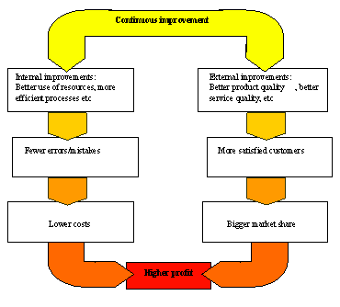
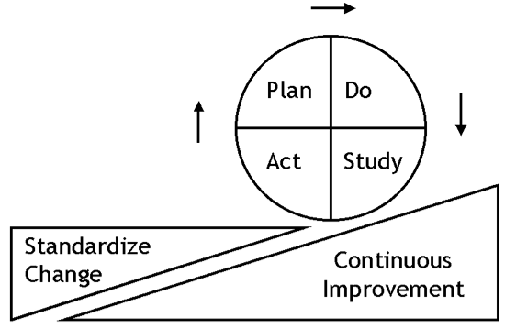
Prevention Costs
Deming Cycle
5%, stable at 5%
of development costs
(Raytheon 1993)
0.5 % of development costs
(Mays 1995)
Half-day Inspection Economics. Gilb@acm.org
Notes:
58

Slide 128
Defect Prevention Experiences: Most defects can be prevented from getting in there at all
Cleanroom levels: approach zero def.
IBM MN 99.99%+ fixes:Key= "DPP"
90%
80%
70%
Mays 1993, User 1996 "72% in 2 years" <-tg
50%
Mays & Jones (IBM) 1990
% of usual defects prevented
1
2
3
4
5
6
Years of continuous improvement effort
North Carolina
IBM Research Triangle Park Networking Laboratory
Half-day Inspection Economics. Gilb@acm.org
Notes:
59

Slide 129
Prevention + Pre-test Detection is the most effective and efficient
\
100%
Use
95% cumulative detection
by Inspection (state of the art limit)
90%
80%
Test
70% Detection
by Inspection
70%
"Detected
Cheaply"
<- Mays 1993, 70% prevented
50%
"Prevented"
<-Mays & Jones 50% prevented(IBM) 1990
1
2
3
4
5
6
Prevention data based on state of the art prevention experiences (IBM RTP), Others (Space Shuttle IBM SJ 1-95) 95%+ (99.99% in Fixes)
Cumulative Inspection detection data based on state of the art Inspection (in an environment where prevention is also being used, IBM MN, Sema UK, IBM UK)
Half-day Inspection Economics. Gilb@acm.org
Notes:
60

Slide 130
IBM MN & NC DP Experience
2162 DPP Actions implemented
between Dec. 91 and May 1993 (30 months)<-Kan
RTP about 182 per year for 200 people.<-Mays 1995
1822 suggested ten years (85-94)
175 test related
RTP 227 person org<- Mays slides
130 actions (@ 0.5 work-years
34 causal analysis meetings @ 0.2 work-years
19 action team meetings @ 0.1work-years
Kickoff meeting @ 0.1 work-years
TOTAL costs 1% of org. resources
ROI DPP 10:1 to 13:1, internal 2:1 to 3:1
Defect Rates at all stages 50% lower with DPP
Half-day Inspection Economics. Gilb@acm.org
Notes:
61

Slide 131
Rapid Evolutionary iteration: ‘Evo’
do real QA weekly,
and incrementally.
Incremental value delivery, data collection, feedback, analysis and change:
for early value delivery,
or cost control,
for intelligent prioritization,
for team and process validation of effectiveness.

Slide 132
Evo: Assertions
Evo is the best iterative method for QA because it measures stakeholder-delivered quality each iteration
Evo is completely ‘quality’ oriented – and routinely managed many quality dimensions simultaneously
Evo gives quantified information about all quality levels
Evo manages quality at several levels of concern: business, stakeholder, product

Slide 133
Evo: Basics
Free Book on it by Kai Gilb:
http://www.gilb.com/tiki-download_file.php?fileId=27
Prefers weekly increments, week after start week.
Focus on real useful value delivery to real stakeholders
Priority always for highest value each iteration
Case studies show amazing increase in quality in short term

Slide 134
Evo: Advanced
Evo uses Impact Estimation tables to plan and manage qualities and costs incrementally
Evo deals with several organizational levels of quality
Business, organization, stakeholders, products, systems
Evo can be used to manage results while using Scrum or other iterative methods for ‘programming’
Evo works at the ‘systems level’. Not just software.

Slide 135
Evo: What to Expect
Short learning and coaching time (1 day, 1 week)
Delivers real measurable quality improvements immediately (next week and every week)
‘Programmers’ do not care – they want to code
Evo must be driven from outside programming by management, marketing, CTO, IT Director etc.

Slide 136
Evo: What it is NOT
Evo is not merely iteration, or incremental
The key difference is direct management of all critical qualities quantified
Evo is a business result management method, not a programming method (like most Agile methods are primarily about programming)

Slide 137
Evo: History
Developed by Gilbs, practiced since 1960
Credited as earliest recorded literature on the subject of Evolutionary software development (1976, Gilb: Software Metrics) by several researchers
Craig Larman, Southampton University
Adopted Corporate-Wide by HP (1988-on) as Evo
Serious studies and publications (HP Journal, MIT Sharma)
Used on 25+ aircraft design projects DAC 1989

Slide 138
Evo: and QA
Evo leads directly to early testing of all kinds weekly
Quality has to be good enough for release to real stakeholders
Quality has to be maintained for all incrementents
Any bad requirements or designs, or work processes will quickly be discovered and corrected

Slide 139
Evo: Summary
Evo is a project management method designed to deliver qualities to stakeholders
Evo always quantifies the various critical qualities
Evo uses early and rapid weekly iterations to deliver regular and real progress towards quantified quality goals

Slide 140
Primary Evo Concept: Deliver Potential Value
Plan Do
Act Study
Stake-holders
Potential Value
The Evo Cycle:
Viewed as a Deming PDSA Cycle
Incremental Value Delivery to Stakeholders

Slide 141
Deliver the highest value for resources
Plan Do
Act Study
Stake-holders
Potential Value

Slide 142
Evo Concept: Potential Value to Many
Stake-holders
Potential Value
Plan Do
Act Study
Stake-holders
Potential Value
Stake-holders
Potential Value
Incremental Value Deliveries to Many Stakeholders

Slide 143
Evo Concept: Short Term Feedback “This looks like a change I can get value from!”
Stake-holders
Plan Do
Act Study
Potential Value
Perceived Value
Initial Feedback from Stakeholders, after Evo Cycle delivery

Slide 144
Long-Term Real Value Feedback “This is the real value we have gotten to date, and what we expect to get in the future!”
Stake-holders
Stake-holders
Plan Do
Act Study
Realized
Value
Potential Value
Perceived Value Info
Realized Value Information
2 Kinds of Feedback from Stakeholders, when value increment is really exploited in practice after delivery

Slide 145
Study critical factors in your environment “Budget cut, Deadline nearer, New CEO, Cheaper Technology”
Stake-holders
Stake-holders
Plan Do
Act Study
Realized
Value
Potential Value
Perceived-Value Info
Realized-Value Information
Stake-holders
Stake-holders
Stake-holders
Stake-holders
Other
Critical
Factors
2 Kinds of Feedback from Stakeholders, when value increment is really exploited in practice after delivery.
Combined with other information from the relevant environment. Like budget, deadline, technology, politics, laws, marketing changes.

Slide 146
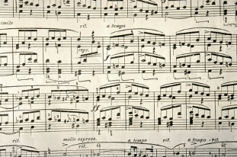
The Simplest and Best Agile Project Method; ‘Evo’
1
Process Description
1. Gather from all the key stakeholders the top few (5 to 20) most critical goals that the project needs to deliver.
Give each goal a reference name (a tag).
2. For each goal, define a scale of measure and a ‘final’ goal level.
For example: Reliable: Scale: Mean Time Before Failure, Goal: 1 month.
3. Define approximately 4 budgets for your most limited resources
(for example, time, people, money, and equipment).
4. Write up these plans for the goals and budgets
(Try to ensure this is kept to only one page).
5. Negotiate with the key stakeholders to formally agree the goals and budgets.
6. Plan to deliver some benefit
(that is, progress towards the goals)
in weekly (or shorter) increments (Evo steps).
7. Implement the project in Evo steps.
Report to project sponsors after each Evo step (weekly, or shorter) with your best available estimates or measures, for each performance goal and each resource budget.
On a single page, summarize the progress to date towards achieving the goals and the costs incurred.
8. When all Goals are reached: ‘Claim success and move on’
a. Free remaining resources for more profitable ventures
2
3
4
5
6
7
8

Slide 147
Agile project Management; Evo Policy
Policy
The project manager, and the project, will be judged exclusively on
the relationship of progress towards achieving the goals
versus the amounts of the budgets used.
The project team will do anything legal and ethical to deliver the goal levels within the budgets.
The team will be paid and rewarded for
benefits delivered
in relation to cost.
The team will find their own work process and their own design.
As experience dictates, the team will be free to suggest to the project sponsors (stakeholders) adjustments to ‘more realistic levels’ of the goals and budgets.

Slide 148
Quantify Maintainability Requirements:
Long term thinking
about maintenance and change capabilities:
avoid short sightedness.

Slide 149
Assertions: Maintainability
There are many quantifiable aspects of maintainability: adaptability, changeability, portability, scalability.
The need for these qualities is economic and practical, and varies from system to system
Architecture must develop suitable solutions to serve the stated quality requirements
The architecture can be developed evolutionarily – it does not have to be finished up front

Slide 150
Current Malpractice: Maintainability
No quantified Maintainability requirements at all
“Architecture” based on no quantified Maintainability requirements
Maintainability given low priority compared to deadline, function, bug-freeness
No serious analysis of long term costs of ‘legacy’ systems – which are not designed to be easy to maintain

Slide 151
Basics: Maintainability
The multiple maintenance concerns are identified at all: clear conceptual differences.
Like: Portability, Scalability, Maintainability, Adaptability, Testability
The concepts are exploded/detailed to appropriate sub-concepts:
Example: Maintainability to about 10 subconcepts
Example: Portability for Code, Data, User Manual Language, User Interface tex
The Maintainability concepts are defined using scales of measure
Example: Code Maintainability: Scale: Average Time to correctly repair a bug (potential fault), from existence in live system, to confirmed non-existence, in clock hours.
Future Target and Constraint Levels (numeric requirements) are set for each concept – and for defined times, places and conditions.
Example: Goal [2012, Sweden, If USA in Iraq Occupation] 6 minutes.

Slide 152
Advanced Maintainability 1
Benchmarks: a number of benchmark numbers are derived from analysis and measurement for our present systems, the trends, competitors
Example: Past [2009, Oslo, System x] 60 days.
Justification: for all required levels (Goal, Fail) a written justification for the numeric level will be given.
Example: Justification: Corp. Policy 23B, Lean Systems

Slide 153
Advanced Maintainability 2
The Proposed Architecture for reaching the required levels will be cross referenced, along with any impact assessments.
Example: Code Maintainability:
Impacted by : Dynamic Interfaces Architecture.
Allocate one week iteration each month to let your development team work towards delivering the Maintainability level improvements
Like Confirmit, Norway did (2005)

Slide 154
Effects of Maintainability Engineering
Specific Maintainability requirements will be met earlier, and at all
The temptation to not take this seriously initially will be removed – the reasons for doing so will be justified
The short term improvement will probably pay for itself during an initial development period,
And repay itself many times over in the lifetime of the system

Slide 155
Summary Maintainability
Maintainability
Can be treated as a serious engineering subject
Quantified requirements, and estimable/measurable results of the engineering design to get it
It probably costs more, even under short term deadline pressure to NOT do something like this, than to invest in it.
These conclusions are my intuition, and we do not have really quantitative case studies to back this up!
Let me know when you do! I’d love to help.
Confirmit did this, but did not give me good measures of the Maintainability factors. They were satisfactory, and did not feel the need to measure in an academic sense.

Slide 156
A ‘Bad’ Requirement “Rock solid robustness”
While robustness is an essential HORROR requirement in all its uses, it is especially critical in MINING applications where the much longer job durations afford software defects (e.g. memory leaks) a greatly expanded opportunity to surface.
In this regard,
HORROR will provide the following features or attributes:
Minimal down-time
A critical HORROR objective is to have minimal downtime due to software failures.
This objective includes:
Mean time between forced restarts > 14 days
HORROR’s goal for mean time between forced restarts is greater than 14 days.
Comment: This figure does not include restarts caused by hardware problems, e.g. poorly seated cards or communication hardware that locks up the system. MTBF for these items falls under the domain of the hardware groups.
Restore system state < 10 minutes
Log scripts and test scripts, subsystem tests
Built-in testability
HORROR will provide the following features and attributes to facilitate testing.
Tool simulators
GILB COMMENT:
For once a reasonable attempt was made to quantify the meaning of the requirement!
But is could be done much better
As usual the set of designs to meet the requirement do not belong here.
And none of the designs make any assertion about how well (to what degree) they will meet the defined numeric requirements.
And as usual another guarantee of eternal costs in pursuit of a poorly defined requirement is most of the content.
Real case of requirement for project costing over $100,000,000 without delivering testable results
Notes:
http://www.megware.de/img/seiten/cluster/hoch_verfuegbar.jpg
While robustness is an essential HORROR requirement in all its uses, it is especially critical in OUR applications where the much longer job durations afford software defects (e.g. memory leaks) a greatly expanded opportunity to surface. In this regard, HORROR will provide the following features or attributes:

Slide 157
Better Testable Definition of the Requirement:
Rock Solid Robustness:
Type: Complex Product Quality Requirement.
Includes: { Software Downtime, Restore Speed, Testability, Fault Prevention Capability, Fault Isolation Capability, Fault Analysis Capability, Hardware Debugging Capability}.
Notes:
http://img2.travelblog.org/Photos/17776/71146/t/761917-Some-of-the-famous-granite-rocks-1.jpg

Slide 158
Defining One Component Clearly:
Software Downtime:
Type: Software Quality Requirement.
Ambition: to have minimal downtime due to software failures <- HFA 6.1
Issue: does this not imply that there is a system wide downtime requirement
Scale: <mean time between forced restarts for defined [Activity], for a defined [Intensity].>
Fail [Any Release or Evo Step, Activity = Recompute, Intensity = Peak Level] 14 days <- HFA 6.1.1
Goal [By 2008?, Activity = Data Acquisition, Intensity = Lowest level] : 300 days ??
Stretch: 600 days

Slide 159
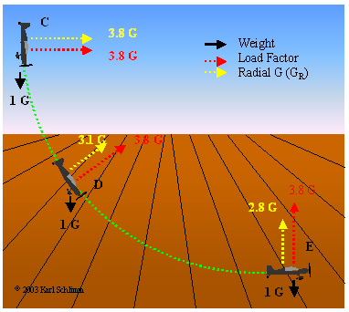
Defining a Second Component Clearly:
Restore Speed:
Type: Software Quality Requirement.
Ambition: Should an error occur (or the user otherwise desire to do so), Horizon shall be able to restore the system to a previously saved state in less than 10 minutes. <-6.1.2 HFA.
Scale: Duration, from Initiation of Restore, to Complete and verified state of a defined [Previous: Default = Immediately Previous]] saved state.
Initiation: defined as {Operator Initiation, System Initiation. Default = Any.
Goal [ Initial and all subsequent released and Evo steps] 1 minute?
Fail [ Initial and all subsequent released and Evo steps] 10 minutes. <- 6.1.2 HFA
Catastrophe: 100 minutes.
Notes:
http://www.apstraining.com/images/69.jpg

Slide 160
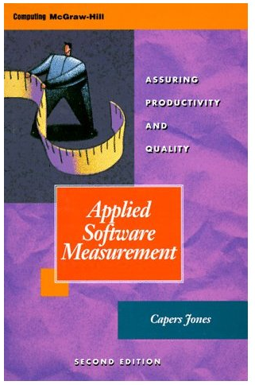
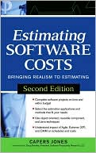
System Lifetime Expectancy: Capers Jones: Think 18-25 Years
Notes:
Tom,Not many people know the sizes of software in function point form so I added 150 size examples to the end of my set of tables.The sizes are from my "Software Risk Master" prototype, which can size any application in less than a minute. It does lines of code too, but I cut out those columns because they were not relevant to the overall theme of function point metrics.Best Regards,Capers Jones
CJonesIII@cs.com
OVERVIEW OF THE UNITED STATES SOFTWARE INDUSTRY RESULTS CIRCA 2008 15/04/2008 Copyright © 2008 by Capers Jones & Associates LLC. All rights reserved.
File Name = Matrix49.xls (store by Tom Gilb in Papers/Metrics/Capers jones
Received 14 April 2008
Tom,You have my permission to use the materials. The book cover and photo are OK - I don't look much different today, except that I've probably gained weight.You have a lot of interesting materials associated with what you are doing - thanks for sending them.Yesterday I got copies of the 3rd edition of "Applied Software Measurement" from McGraw Hill. Let me know where you want a copy mailed and I'll have McGraw Hill send you one.Best Regards,Capers Jones

Slide 161
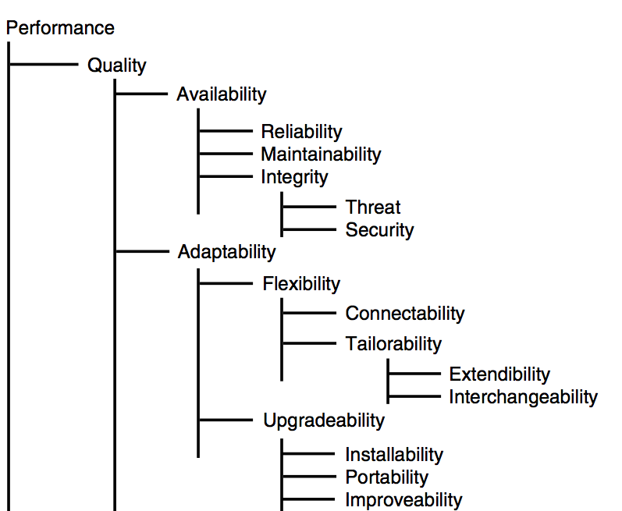
Broader Maintainability Concepts
Maintainability in the strict engineering sense is usually taken to mean bug fixing.
I have however been using it thus far to describe any software change activity or process.
We could perhaps better call it ‘software change ability’.
Different classes of change, will have different requirements related to them,
and consequently different technical solutions.
It is important that we be very clear
in setting requirements,
and doing corresponding design,
exactly what types of change we are talking about.

Slide 162
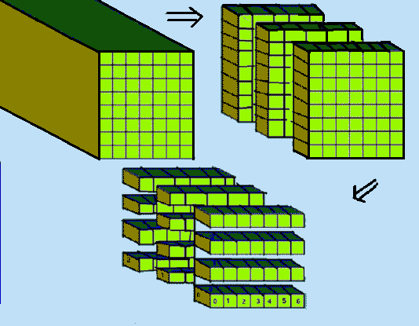
The ‘Maintainability’ Breakdown into Sub-problems
Problem Recognition Time.
How can we reduce the time from bug actually occurs until it is recognized and reported?
2. Administrative Delay Time:
How can we reduce the time from bug reported, until someone begins action on it?
3. Tool Collection Time.
How can we reduce the time delay to collect correct, complete and updated information to analyze the bug: source code, changes, database access, reports, similar reports, test cases, test outputs.
4. Problem Analysis Time.
Etc. for all the following phases defined, and implied, in the Scale scope above.
5. Correction Hypothesis Time
6. Quality Control Time
7. Change Time
8. Local Test Time
9. Field Pilot Test Time
10. Change Distribution Time
11. Customer Installation Time
12. Customer Damage Analysis Tim
13. Customer Level Recovery Time
14. Customer QC of Recovery Time

Slide 163
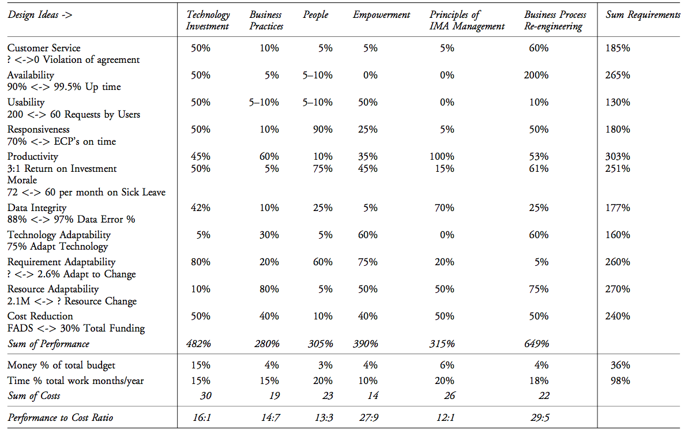
DoDef. Persinscom Impact Estimation Table:
Designs
Requirements
R→ D Impacts
Notes:
Source CE book page 284. Persinscom US Army Personnel System.

Slide 164
General ‘Change Attribute’ Tailoring
The following slides will give a general set of patterns for
defining and distinguishing different classes of ‘maintenance’.
But in your real world, you will want to tailor the definitions to your domain.
You can initially tailor using the ‘Scale’ of measure definition.
And continued tailoring can be done by defining [conditions] in the requirement level qualifier.
Scale:
% of transactions
successfully completed
by defined [Person]
doing defined [Task].
Goal [Task = Update,
Person = New Hire,
Deadline = Phase 3]
60%

Slide 165
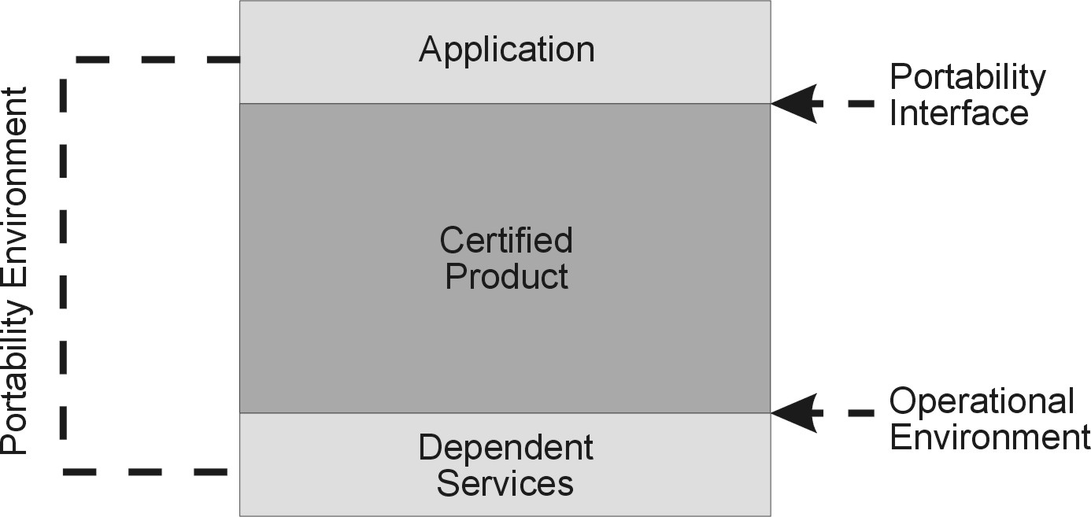
A generic set of performance measures, including several related to change.
For example:
Code Portability:
Scale:
Effort in Hours needed to Port
each 1000 Non-Commentary Lines of Code
from a defined [Home Environment]
to a defined [Target Environment],
using defined [Tools]
and defined [Personnel].
Goal
[Home Environment = {.net, Oracle,} ,
Target Environment = {Java++, Open Source, Linux},
Tools = Convert Open ,
Personnel = {Experienced Experts, India}] 60 hours.
Notes:
http://www.mc.com/uploadedimages/PAS-icon_news.jpg
http://www.opengroup.org/openbrand/Certification_Guide/ifaces.jpg

Slide 166
A Generic Set of Performance measures – including several related to ‘change’

Slide 167
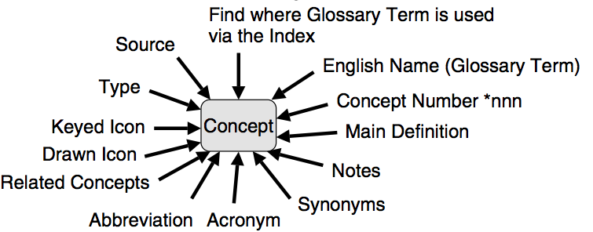
The attribute names used are arbitrary choices by the author.
They only start to take on meaning when defined,
with a Scale of measure.
There are no accepted or acceptable standards here,
and certainly not for software.
Even in hardware engineering, there is an accepted pattern – such as “Scale: Mean Time to Repair”.
But it is accepted that we have to further define such concepts locally,
such as the meaning of ‘Repair’.

Slide 168
Maintainability Measures
Here are some of the general patterns we can use to define and distinguish the different classes of change processes on software.
First the ‘Bug Fixing’ pattern (from which we derived the example at the beginning of this talk).

Slide 169
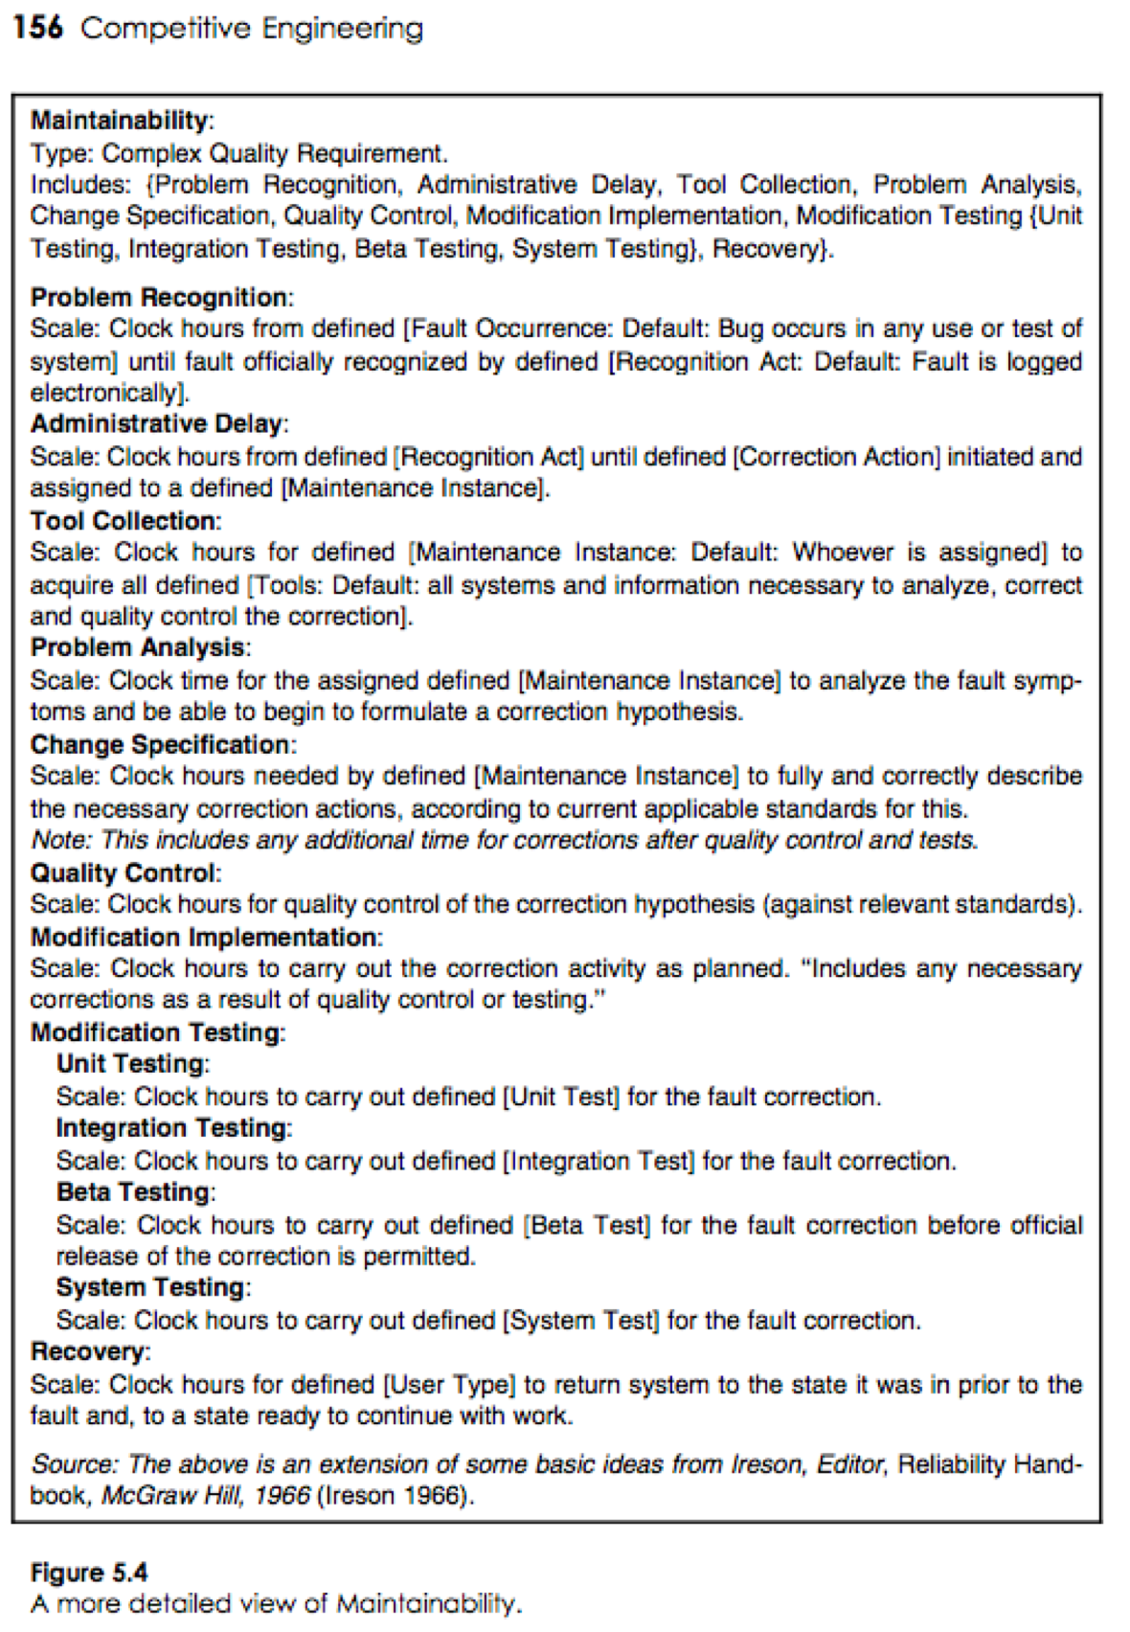
Maintainability components, derived from a hardware engineering view, adopted for software.
Notes:
http://johnhasson.com/blog/images/1/r_dilbert2.gif

Slide 170
Notice that Maintainability in the narrow sense (fix bugs) is quite separate from other ‘Adaptability’ concepts.
This is normal engineering,
Which places fault repair together with reliability and availability;
Those 3 determine the immediate operational characteristics of the system.
The other forms of adaptability are more about potential future upgrades to the system, change, rather than repair.
Change and repair, have in common that
our system architecture has to make it easy to change, analyze and test.
The system itself is unaware of
whether we are correcting a fault or improving the system.
The consequence is that
much of the maintenance-impacting ‘design’ or ‘architecture’
benefits
most of the types of maintenance (fix and adapt).
Notes:
http://www.startingnowitsgoingtobeok.com/images/change.jpg

Slide 171
Here are a generic set of definitions for the ‘Adaptability’ concepts.
Adaptability: ‘The efficiency with which a system can be changed.’
Gist: Adaptability is a measure of a system’s ability to change.
Includes: { a set of scalar variables, such as Portability}.
Note: probably not simple enough to define with a single Scale.
Type: Complex Quality Attribute.
Since,
if given sufficient resource, a system can be changed in
almost any way,
the primary concern is with the amount of
resources
(such as time, people, tools and finance)
needed to bring about specific changes
(the change ‘cost’).

Slide 172
The Adaptive Cycle
http://www.resalliance.org/564.php
Notes:
http://www.resalliance.org/564.php

Slide 173
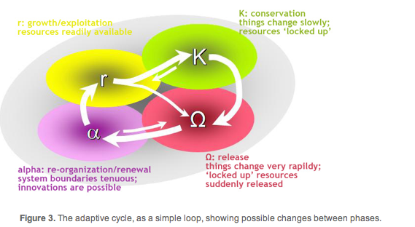
Adaptability: Viewed as Elementary or Complex concept..
Adaptability:
Type: Elementary Quality Requirement.
Scale: Time needed to adapt a defined [System] from a defined [Initial State] to another defined [Final State] using defined [Means].
Adaptability:
Type: Complex Quality Requirement.
Includes: {Flexibility, Upgradeability}.
Notes:
http://z.about.com/d/africanhistory/1/0/D/5/stencil-AdinkraDenkyem.gif
http://www.resalliance.org/564.php
4. Adaptability Adaptability is the capacity of a SES to manage resilience in relation to alternate regimes (sometimes called adaptive capacity). It involves either or both of two abilities: i) The ability to determine the trajectory of the system state - the position within its current basin of attraction; ii) The ability to alter the shape of the basins, that is move the positions of thresholds or make the system more or less resistant to perturbation. The abilities to effect both of these are determined by a combination of attributes of both the social domain and the ecosystem.

Slide 174
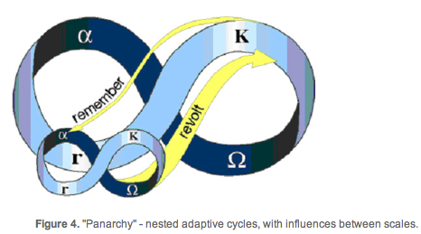
“No system can be understood or managed by focusing on it at a single scale.”
Multiple scales and cross-scale effects - "Panarchy" No system can be understood or managed by focusing on it at a single scale.
All systems (and SESs especially) exist and function at multiple scales of space, time and social organization,
and the interactions across scales are fundamentally important in determining the dynamics of the system at any particular focal scale.
This interacting set of hierarchically structured scales has been termed a "panarchy" (Gunderson and Holling 2003).
http://www.resalliance.org/564.php
Notes:
http://www.resalliance.org/564.php

Slide 175
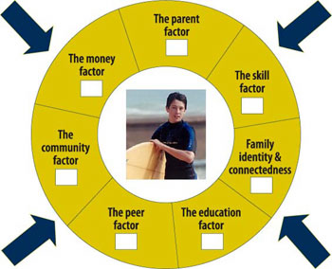
Flexibility:
Gist: ‘Flexibility’ concerns the
‘in-built’ ability of the system
to adapt,
or to be adapted,
by its users,
to suit conditions
(without any fundamental system modification
by system development).
Type: Complex Quality Requirement.
Includes: {Connectability, Tailorability}.
See next 2 slides!
Possible Synonyms: Resilience, Robustness
Notes:
Source doughnut diagram
http://www.aifs.gov.au/afrc/pubs/newsletter/newsletter4.html
Resilience is... the ability to absorb disturbances, to be changed and then to re-organise and still have the same identity (retain the same basic structure and ways of functioning). It includes the ability to learn from the disturbance. A resilient system is forgiving of external shocks. As resilience declines the magnitude of a shock from which it cannot recover gets smaller and smaller. Resilience shifts attention from purely growth and efficiency to needed recovery and flexibility. Growth and efficiency alone can often lead ecological systems, businesses and societies into fragile rigidities, exposing them to turbulent transformation. Learning, recovery and flexibility open eyes to novelty and new worlds of opportunity.The aim of resilience management and governance is... either, to keep the system within a particular configuration of states (system 'regime') that will continue to deliver desired ecosystem goods and services (preventing the system from moving into an un-desirable regime from which it is either difficult or impossible to recover) or, to move from a less desirable to a more desirable regime.The basic concepts underpinning a resilience approach to policy and management are: non-linearity, alternate regimes and thresholds; adaptive cycles; multiple scales and cross-scale effects - "panarchy"; adaptability; transformability; general versus specified resilience.
Figure 1. A "ball-in-the-basin" representation of resilience. The state of this two dimensional system is the ball. Its dynamics cause it to move to the 'attractor' - the bottom of the basin. The system can change regimes either by the state changing, or through changes in the shape of the basin (ie, through changes in processes and system function), as shown in (b).Alternate regimes are separated by thresholds that are marked by levels of controlling (often slowly changing) variables where there is a change in feedbacks. It is the changed feedbacks that lead to the changes in function and therefore structure.We define resilience, formally, as the capacity of a system to absorb disturbance and reorganize while undergoing change so as to still retain essentially the same function, structure and feedbacks - and therefore the same identity.
http://www.resalliance.org/564.php
rs.resalliance.org/ page/2/?s=holling

Slide 176
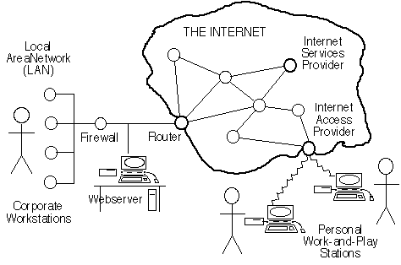
Connectability: ‘The cost to interconnect the system to its environment.’
Gist: The cost of connecting one set of interfaces to defined environments with other interfaces
Part Of: Flexibility.
Scale: the Effort needed
to connect a defined [Home Interface]
to a defined [Target Interface]
using defined [Methods]
with minimum allowed system [Degradation].
Notes:
http://escience.anu.edu.au/lecture/comp1710/internet/import/OzI041.gif
Diagram source internet
1.2.1.1
Scale is original T Gilb 26 March 2008 (not found un CE book or corresponding paper. The Gist is a cleanup too.

Slide 177
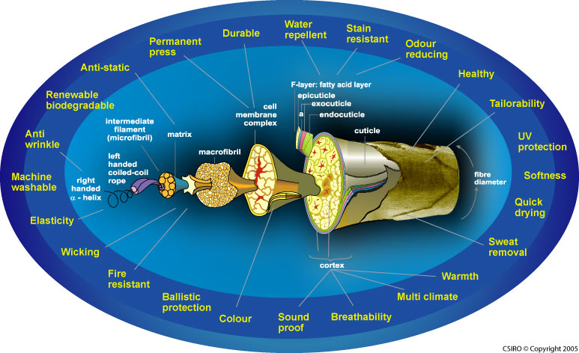
Tailorability:
Gist: The cost to modify the system to suit defined future conditions.
Part Of: Flexibility.
Type: Complex Quality Requirement.
Includes: {Extendibility, Interchangeability}.
Multiple Attributes of Wool Fiber !
Notes:
1.2.1.2
http://www.merinoinnovation.com/wps/wcm/resources/file/ebbf4a4f5276c47/WOOLFIBRE.jpg
Wool fibre

Slide 178
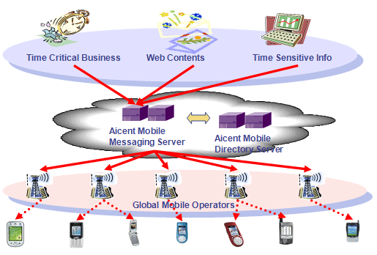
Extendibility: Scalability
Extendibility:
Part Of: Tailorability.
Synonym: Scalability.
Scale: The cost to add to
a defined [System]
a defined [Extension Class]
and defined [Extension Quantity]
using a defined [Extension Means].
‘‘In other words, add such things as a new user or
a new node.’’
Type: Complex Quality Attribute.
Includes: {Node Addability,
Connection Addability,
Application Addability,
Subscriber Addability}.
Notes:
1.2.1.2.1
http://www.aicent.net/products_services/images/mobile_messaging.gif

Slide 179
Interchangeability: ‘The cost to modify use of system components.’
Interchangeability
Gist: This is concerned with the ability to modify
the system, to switch from using a certain set of
system components, to using another set.
Part Of: Tailorability.
Type: Elementary Quality Attribute.
“For example, this could be a daily occurrence
switching system mode from day to night use.”
Scale: the Effort needed to
Successfully,
without Intolerable Side Effects,
replace a defined [Initial Set] of components,
with a defined [Replacement Set] of system components,
using defined [Means].
Notes:
1.2.1.2.2
http://www.telegraph.co.uk/motoring/graphics/2005/11/12/mrmay12.jpg
Major change, adding Scale by T Gilb 26 March 2008

Slide 180
Upgradeability 1/2: ‘The cost to modify the system fundamentally; either to install it, or to change out system components.’
Upgradeability:
Gist: This concerns the ability of the system to be modified by the system developers or system support in planned stages (as opposed to unplanned maintenance or tailoring the system).
Type: Complex Quality Requirement.
Includes: {Installability, Portability, Improveability}.
Notes:
1.2.2
http://www.intel.com/technology/itj/2006/v10i3/5-communications/figures/figure_2.gif

Slide 181
Upgradeability 2/2 : ‘The cost to modify the system fundamentally; either to install it, or to change out system components.’
Portability:
Gist: The cost to move from location to location.
Scale: The cost to transport a defined [System] from a defined [Initial Environment] to a defined [Target Environment] using defined [Means].
Type: Complex Quality Requirement.
Includes: {Data Portability, Logic Portability, Command Portability, Media Portability}.
Improveability: ‘The cost to enhance a system.
Installability
Gist: The ability to replace system components with others, which possesses improved (function, performance, cost and/or design) attributes. ‘The cost to install the system in defined conditions.’
Scale: The cost to add to a defined [System] a defined [Improvement] using a defined [Means].
Notes:
1.2.2
http://www.intel.com/technology/itj/2006/v10i3/5-communications/figures/figure_2.gif

Slide 182
This Basic ‘Adaptability’ Pattern above Was Successfully Applied
Hopefully this set of patterns
gives you a departure point
for defining those maintenance attributes
you might want to control, quantitatively.
The above slides “adaptability” definition
was use to co-ordinate the work
of 5,000 software engineers,
and 5,000 hardware engineers,
in UK, at TsG client
in bringing out a new product line at a computer manufacturer.
Where ‘Adaptability’ was the Number One Product Characteristic
The Company became profitable for the next 14 years.
Notes:
http://www.coresecuritypatterns.com/patterns_clip_image002.jpg

Slide 183
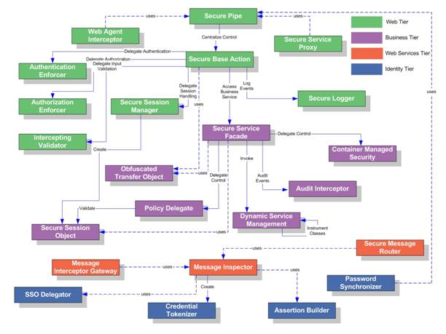
Security Patterns

Slide 184
The Software Architect Role in Maintainability
The role of the software architect is:
• to participate in clarification of the requirements that will be used as inputs to their architecture process.
• to insist that the requirements are testably clear: that means with defined and agreed scales of measure, and defined required levels of performance.
• to then discover appropriate architecture,
capable of delivering those levels of performance, hopefully within resource constraints, and
• define the architecture in such detail , that we can
estimate the probable impact of the architecture,
on the requirements (Impact Estimation) so that the intent cannot be misunderstood by implementers,
and the desired effects are bound to be delivered.
• then later, monitor the developing system as the architecture is applied in practice,
• and make necessary adjustments.
• finally monitor the performance characteristics throughout the lifetime of the system,
and make necessary adjustments to requirements
and to architecture,
in order to maintain needed system performance characteristics.
Notes:
http://godzdogz.op.org/uploaded_images/GodArchitect-731710.jpg

Slide 185
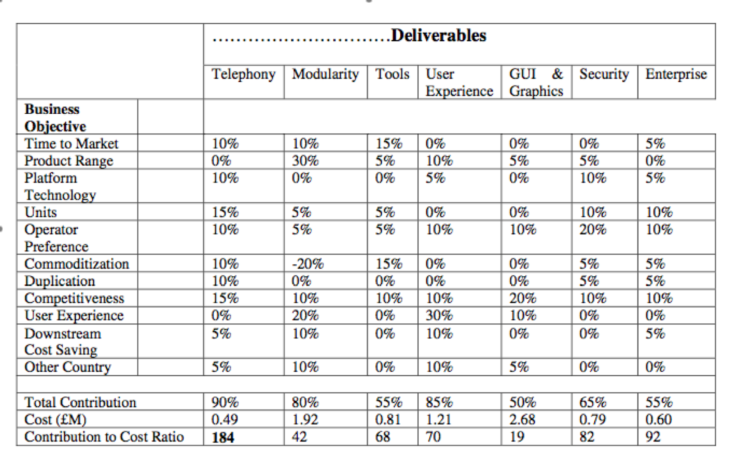
Architecture Level Impact Estimation Table
See PPT Notes
Notes:
Figure 4: an architectural level Impact Estimation table to try to understand the relationship between a set of high level objectives, and a set of architecture strategies (‘deliverables’). 10% means an estimate that 10% of the level required would hopefully be delivered by means of that particular architectural element.
The architect can use the same basic method (Impact estimation) at a higher level of objectives and architecture, in order to understand the larger long term perspectives for the current architecture, to see the most promising architecture overall (for many objectives, and with regard to cost), and to ‘sell’ the architecture to management (what results are you going to get for the budget envisaged). This covers both the maintainability aspects and all other system performance aspects. We are a long way from having specialized software maintainability engineers, but it might be necessary one day.

Slide 186
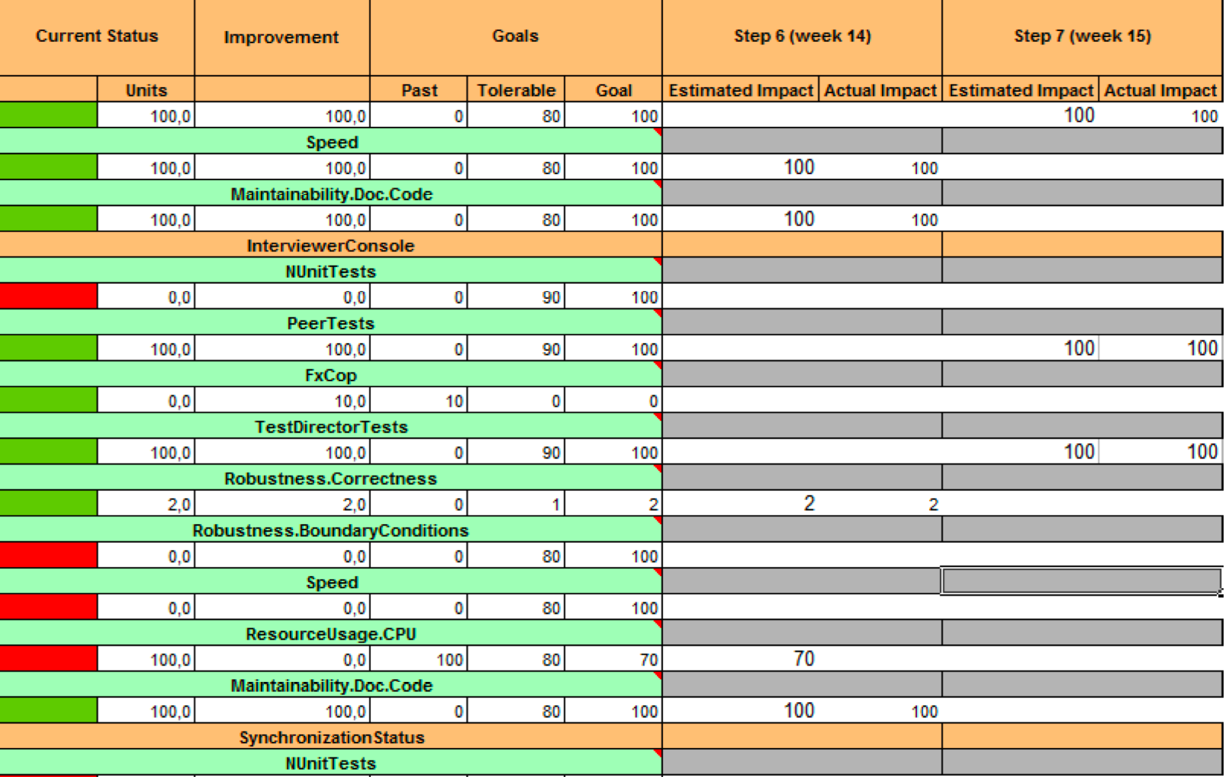
Engineering “Maintainability”: Green Week Weekly ‘Refactoring’ at Confirmit
Notes:
Figure 5: One client of ours decided to use one week a month, every month to re-engineer the maintainability characteristics of their main software product (250 customers in 50 countries.)
The ‘Green Week”.
One client of ours, after trying to use one day a week to re-factor their software for about 2 years, decided to make use of a full week cycle, in a directly similar way that they developed the other quality characteristics of their product. The development team had a set of Scale-defined numeric targets (see “Goal” , figure 5) and constraints (“Tolerable”). They picked some of these to work towards, during one week each month. They did as well as they could, finding designs or processes that measurably gave them the levels of maintainability factors they required.
They thrived in an environment they called ‘empowered creativity”.
Permission to use Potshots in my slides was granted by A Brilliant to Tom Gilb in writing.

Slide 187
Case Study of Real QA:
Confirmit, Norway:
Quantified Quality driven,
up front,
including their testing practices,
using our ‘Evo’ method.

Slide 188
The “Confirmit” Case study of a successful application of many of the Real QA principles (2003-2009)
Oslo, Norway

Slide 189
Confirmit Presentation Text: Trond Johnsen
Notes:
Tom Gilb Version
May 7 2005
Updated with 9.0 2006
Updated 19 June 06 $$ Results
Updated Sept 2006 Estimation, OCT INTUITIVENESS
Graphical Improvement Nov 8 2006, Oct 10 2007

Slide 190
Customer Successes in Corporate Sector

Slide 191
Confirmit R&D department initially 2003
Developers (13)
Management/(CSO) (2)
Tech Support NY (1)
Microsoft .NET framework, SQL
SEPG group (3) with responsibility of process improvement and quality assurance (QA).
Configuration Management, setup ++
Testing
Software Process Improvement (SPI)

Slide 192
Requirements - 3, Real Example of Spec
Usability.Productivity (taken from Confirmit 8.5 development)
Scale for quantification: Time in minutes to set up a typical specified Market Research-report
Past Level [Release 8.0]: 65 mins.,
Tolerable Limit [Release 8.5]: 35 mins.,
Goal [Release 8.5]: 25 mins.
Note: end result was actually 20 minutes ☺
Meter [Weekly Step]: Candidates with Reportal experience, and with knowledge of MR-specific reporting features, performed a set of predefined steps, to produce a standard MR Report.
Our new focus is on the day-to-day operations of our Market Research users,
not a list of features that they might or might not like. 50% never used!
We KNOW that increased efficiency, which leads to more profit, will please them.
The ‘45 minutes actually saved x thousands of customer reports’
= big $$$ saved
After one week we had defined more or less all the requirements for the next version (8.5) of Confirmit.
Trond Johansen

Slide 193
Confirmit (Future Information Research Management, Norway) project step planning and accounting: using an Impact Estimation Table
IET for MR Project – Confirmit (<-Confirmit Product Brand) 8.5
Solution: Recoding
Make it possible to recode variable on the fly from Reportal.
Estimated effort: 4 days
Estimated Productivity Improvement: 20 minutes (50% way to Goal)
actual result 38 minutes (95% progress towards Goal)
Trond Johansen
66.7

Slide 194
Real client example: weekly design impact estimates, and same week measurement, Weekly Feedback to the development team about cumulative progress toward critical numeric performance and quality targets
Estimates
Weekly
Testing
Priority
Next week
Warning
metrics based
Cumulative
weekly
progress
metric
Constraint
Target

Slide 195
EVO Plan Confirmit 8.5 4 product areas were attacked in all: 25 Qualities concurrently, one quarter of a year. Total development staff = 13
9
8
3
3
Trond Johansen

Slide 196
Confirmit EVO-week cycle
Notes:
“This was to give the solution time to mature.”
Answer to question Sept 9 2006 to Cecilia Vik about why Thursday Version N-2

Slide 197
Code quality – ”green” week
In these ”green” weeks, some of the deliverables will be less visible for the end users, but more visible for our QA department.
We manage code quality through an Impact Estimation table.
Speed
Maintainability
Nunit Tests
PeerTests
TestDirectorTests
Robustness.Correctness
Robustness.Boundary Conditions
ResourceUsage.CPU
Maintainability.DocCode
SynchronizationStatus
Notes:
I think he said these were every 4th or 5th week, TG May 7 2005

Slide 198
EVO’s impact on Confirmit product qualities - 2
Only highlights of the impacts are listed here
Release 8.5

Slide 199
Initial Experiences and conclusions
We launched our first major release based on Evo in May 2004 (Rel. 8.5)
and we have already gotten feedback from users on some of the leaps in product qualities.
E.g. the time for the system to generate a complex survey has gone from 2 hours (=wait for the system to do work) to 15 seconds!
EVO has resulted in
increased motivation and
enthusiasm amongst developers,
it opens up for empowered creativity
Developers
embraced the method and
saw the value of using it,
even though they found parts of Evo difficult to understand and execute
Project leaders feel:
Defining good requirements can be hard.
It was hard to find meters which were practical to use, and at the same time measure real product qualities.
Sometimes we would like to spend more than a day on designs, but this was not right according to our understanding of Evo. (Concept of backroom activity was new to us)
Sometimes it takes more than a week to deliver something of value to the client. (Concept of backroom activity was new to us)
Trond Johansen

Slide 200
Experiences and conclusions Initially 1st Quarter, after 1 day briefing, before several days training
Team members (developers)
“Sometimes it felt like we were rushing to the next weekly step, before we had finished the current step”
Testing was sometimes ‘postponed’
in order to start next step,
some of these test delays were not compensated for, in later testing.
Trond Johansen
Notes:
30 sept 1009 changed heading sub

Slide 201
Evo’s impact on Confirmit product qualities - 1
The impact described is based on:
Internal usability test, productivity tests ++
Performance tests carried out at Microsoft Windows ISV laboratory in Redmond USA
Direct customer feedback
“I just wanted to let you know how appreciative we are of the new “entire report” export functionality you recently incorporated into the Reportal.
It produces a fantastic looking report, and the table of contents is a wonderful feature.
It is also a HUGE time saver.” <- Customer
“These leaps in product qualities would not have been achieved without Evo”. <- TJ
Trond Johansen

Slide 202
Conclusions - 1
Trond Johansen
The method’s positive impact on Confirmit product qualities has convinced us that
Evo is a better suited development process than our former waterfall process, and
we will continue to use Evo in the future.
What surprised us the most was
the method’s power of focusing on delivering value for clients versus cost of implementation.
Evo enables you to re-prioritize the next development-steps based on the weekly feedback.
What seemed important
at the start of the project
may be replaced by other solutions
based on knowledge gained from previous steps.
The method has
high focus on measurable product qualities, and
defining these clearly and testably, requires training and maturity.
It is important to believe that everything can be measured,
and to seek guidance if it seems impossible.

Slide 203
Conclusions - 2
Trond Johansen
A pre-requisite related to the method for using Evo is an open architecture.
Another pre-requisite is management support for changing the work process, and this is important in any software process improvement initiative.
The concept of Continuous Integration (CI)/daily builds
was valuable
with respect to delivering new versions of the software every week.
Evo,
as most other software processes,
requires continuous focus
and learning about the methodology.

Slide 204
The way ahead
Trond Johansen
Overall, the whole organization has embraced EVO.
We all think it has great potential,
and we will work hard to utilize it to the full.
In June 2004
we had Tom and Kai Gilb for a 4 days course for the whole R&D department and related resources
The next version of Confirmit, Confirmit 9.0, will prove whether we have matured in our understanding and execution of EVO
Confirmit 9.0 is due to be released Q4 2004, here is a sneak preview…

Slide 205
Confirmit 9.0 and product qualities
Theme for 9.0:
Extend usage in large corporations,
hence focus on usability, intuitiveness, easy to learn
Market Research:
Support for large panels, up to 200 000 panellists.
Improve productivity in general for those who work with such large panels
Improve throughput
for users that receive reports with more than 1 000 000 responses
(important for large corporations; HP, Microsoft, Accenture etc)
Description of requirement/work task | Past | Status 11.09 | Goal
Usability.Intuitiveness: Probability that a defined User can intuitively figure out how to do a defined Task correctly (without any errors needing correction) | 30% | 45% | 80%
Panel.Scalability: Maximum number of panelists that the system can support within a timeframe of 120 seconds for creating a sample of 50 000, with all components of the panel system performing acceptably. | 30,000 | 500,000 | 200,000
Performance.DataVolume: Numbers of survey responses that can be handled by Reportal. Tables should be generated within 5 seconds. | 20,000 | 500,000 | 500,000

Slide 206
Initial Customer Feedback on the new Confirmit 9.0
November 24th, 2004
Notes:
You may assume so :-)
-----Original Message-----From: Tom Gilb [mailto:tom@gilb.com] Sent: 25. november 2004 17:54To: Kjell ｯystein ｯksendalCc: Trond JohansenSubject: Re: Initial customer feedback on Confirmit 9.0may I assume I can show this to conferences like this Friday? :)Best Wishes Tom

Slide 207
Initial perceived value of the new release (Base 73 people)
Base: 73
Notes:
You may assume so :-) -----Original Message-----From: Tom Gilb [mailto:tom@gilb.com] Sent: 25. november 2004 17:54To: Kjell ｯystein ｯksendalCc: Trond JohansenSubject: Re: Initial customer feedback on Confirmit 9.0may I assume I can show this to conferences like this Friday? :)Best Wishes Tom

Slide 208
ACTUAL RESULTS IN SECOND 12 WEEKS OF USING THE NEW METHOD Evo’s impact on Confirmit 9.0 product qualities
Product quality
Description
Customer value
Intuitiveness
Probability that an inexperienced user can intuitively figure out how to set up a defined Simple Survey correctly.
Probability increased by 175%
Productivity
Time reduced by 38%
Time in minutes for a defined advanced user, with full knowledge of 9.0 functionality, to set up a defined advanced survey correctly.
Product quality
Description
Customer value
Productivity
Time (in minutes) to test a defined survey and identify 4 inserted script errors, starting from when the questionnaire is finished to the time testing is complete and is ready for production. (Defined Survey: Complex survey, 60 questions, comprehensive JScripting.)
Time reduced by 83%
and error tracking increased by 25%

Slide 209
MORE ACTUAL RESULTS IN SECOND 12 WEEKS OF USING THE NEW METHOD Evo’s impact on Confirmit 9.0 product qualities
Product quality
Description
Customer value
Performance
Max number of panelists that the system can support without exceeding a defined time for the defined task, with all components of the panel system performing acceptable.
Number of panelists increased by 1500%
Scalability
Ability to accomplish a bulk-update of X panelists within a timeframe of Z sec.
Number of panelists increased by 700%
Performance
Number of responses a database can contain if the generation of a defined table should be run in 5 seconds.
Number of responses increased by 1400%

Slide 210
Initial qualitative feedback on the new release
" ... keep up the good work."
"It looks like you have listened to the people that actually use the software daily and aimed to make it easier for them ... "
“I was very impressed with the version 9.0”
Seminar observations
On several occasions, customers gave spontaneous "WOWs" and applauses!
The training room in London was literally packed with people eager to test the new version.
Several clients asked if they could access the test server from home as well.
Great participation rate; 95% of all registered people showed up.
Notes:
You may assume so :-) -----Original Message-----From: Tom Gilb [mailto:tom@gilb.com] Sent: 25. november 2004 17:54To: Kjell ｯystein ｯksendalCc: Trond JohansenSubject: Re: Initial customer feedback on Confirmit 9.0may I assume I can show this to conferences like this Friday? :)Best Wishes Tom

Slide 211
Press Release from Confirmit New version of Confirmit increases user productivity up to 80 percent NOVEMBER 29th, 2004
Confirmit, the world’s leading provider of online survey & reporting software, today announced the release of a new version of Confirmit delivering substantial value to customers including increased user productivity of up to 83 percent.
Confirmit is using Evolutionary (EVO) development to ensure the highest focus on customer value through early and continuous feedback from stakeholders.
A key component in EVO is measuring the effect new and improved product qualities have on customer value.
Increased customer value in Confirmit 9.0 includes
Up to 175 percent more intuitive user interface*･
Up to 80 percent increased user productivity in questionnaire design and testing*･
Up to 1500 percent increased performance in Reportal and Panel Management*
Features delivering increased customer value include:
A completely new and state-of-the-art user interface･
Random Data Generator enabling automated testing of questionnaires･
Real-time Script Checker for on-the-fly script validation･
Block Randomization of questions to avoid respondent bias･
Reportal BitStream for fast online tabulation on high volume of responses-
We are very pleased to see major improvements in Confirmit 9.0, including updates to both the user interface and survey engine. We plan to deploy this new version when it becomes available to server customers, stated Alex Grinberg, Greenfield Online's Chief Information Officer. -
We believe the improvements in Confirmit 9.0 will benefit Greenfield Online's survey programming, data collection and data delivery capabilities, helping us to bring even more value to our clients.
Confirmitﾕs VP of Marketing, Kjell Øksendal, comments; - Confirmit, through evolutionary development, is able to substantially increase customer value by focusing on key product qualities important for clients and by continuously asking for their feedback throughout the development period.
Confirmit is used by the leading market research agencies worldwide and Global 1000 companies, and together, we have defined the future of online surveying and reporting, represented with the Confirmit 9.0. Confirmit 9.0 was released onto Confirmitﾕs ASP environments in London and New York on November 27th. The new version will be available for server customers in January 2005. * Measured in Confirmitﾕs TestLab by monitoring internal and external stakeholders executing predefined test scenarios.Press contact:･ Kjell ｯksendal, FIRM's VP of Marketing +1 646 229 5655
Notes:
Hei Tom, Her er en link til en pressemelding om den nye versjonen av Confirmit. http://www.confirmit.com/news/release_20041129_confirmit_9.0_mr.asp trond

Slide 212
Confirmit Results Since Evo Method
http://www.newsweb.no/index.asp?symbol=Confirmit&melding_ID=132091
Notes:
http://www.newsweb.no/index.asp?symbol=Confirmit&melding_ID=132091

Slide 213
Retrospective with Trond
Has Confirmit found their estimation values have become more accurate over time and experience?
Yes, the estimation gets better. However, after working with Evo for some time now, we are not estimating each step as detailed as before, and we run fewer formal measurements.
Evo has gotten into our veins,
we feel more confident and hence can spend less of our time with formal project management tasks and still get the huge benefits from Evo.
We find that we normally can quite easily tell which solutions will bring us closest to the goal after practicing Evo for a while.
"how closely have those estimations actually been realised" and "how valuable has estimation value accuracy been".
The importance of estimation accuracy will depend a bit on your business (product/project related work), but we are now in a position where usually don't significantly miss with our estimates. This makes it easier to roughly plan at least 2-3 steps ahead (I.e we can set up a monthly plan containing the heading of each step and some bullet points on each solution.
As new to Evo, I would suggest that you try to follow Evo as "strictly" as you can.
This will give you the experience and confidence to later pay more attention to some parts of Evo, and less on other parts, while keeping the overall benefits.
I would say it's harder for us now to create killer-slides containing measurements than it was the first couple of releases, but the value for the clients (which is more important..) is still the same or better. (This is based on customer satisfaction measurements amongst our clients, using our own software and our gut-feeling.)
Trond Johansen
Notes:
RE: Thanks Trond. I assume I can quote this (edited now) in a slide to summarize experiences.
Hei Tom, Dette er greit. Bare s� det er sagt, vi er ikke blitt slepphendte heller. Her er to teasers fra p携憩nde prosjekter: (kan ikke deles med andre enn�
That's all I have time for, it's very busy these days. Best trond
Trond Johansen Software Development Manager Trond.Johansen@confirmit.com

Slide 214
Test at Confirmit

Slide 215
Goals
Description: Reduce integration effort, i.e. effort for each developer to get the latest build to work on his/hers pc, in order to code on the latest code platform
Scale: Time in minutes to upgrade from a previous code platform to the latest code platform on a developer pc
Past: 180 minutes
Goal: 2 minutes
?? Other goals: Peter?

Slide 216
Continuous Integration (CI)
An important part of any software development process is getting reliable builds of the software
EVO with it’s focus on frequent deliveries, often every week, requires a build, test and deployment process that is highly effective
CI includes a fully automated build and test process that allows a team to build and test their software many times a day
Daily builds are a minimum, continuous means ideally every hour
Benefits
Bugs manifest themselves hours after they were introduced and hence reduces the scope of the search for the bug
Reducing the time spent chasing down integration bugs
Fully automated
Self-testing code

Slide 217
CI tools
Many of the tools we use can be found on: http://sourceforge.net SourceForge.net is the world's largest open Source software development website
The tools we currently use, in addition to our licensed source control system Starteam, are:
NUnit
FxCop
NAnt
CruiseControl.NET

Slide 218
Overview of CI process

Slide 219
Continuous Integration
How
CruiseControl is controlling the CI process. CruiseControl checks for changed files in Starteam every 2 hours (configurable)
If files are changed, CruiseControl initiates a new build in Nant
Check-in triggers a build
Automated build process (check-out, compile, test, document, code-check )
Web site with build history
Mail notifications
on build fail
and build fixed
to those who were responsible for injecting the error

Slide 220
CruiseControl
CruiseControl is a framework for a continuous build process. It includes a web interface to view the details of the current and previous builds.
Integration with NAnt (build system) and NUnit (automatic test framework)
Integration with major open source and proprietary Source Control systems: CVS
Subversion
VSS
Perforce
StarTeam
PVCS
Rational ClearCase
Vault

Slide 221
FxCop
FxCop is a code analysis tool that checks .NET managed code assemblies for conformance to the Microsoft .NET Framework Design Guidelines. It uses reflection, MSIL parsing, and callgraph analysis to inspect assemblies for more than 200 defects in the following areas:
Library design
Localization
Naming conventions
Performance
Security!
FxCop includes both GUI and command line versions of the tool, as well as an SDK to create custom rules

Slide 222
NUnit (Automatic tests) & NAnt
NUnit
NUnit is a unit-testing framework for all .Net languages. Initially ported from JUnit.
It is written in C# and has been redesigned to take advantage of many .NET language features,
for example custom attributes and other reflection related capabilities.
Confirmit Policy: NUnit test code should be written at the same time as the code itself
NAnt
Automatic build system

Slide 223
Cruise Control example

Slide 224
Confirmit Test Effort with Evo 2006
1. does evo change the load of testing?
In our experience - evo does not change the load of testing
- but more testing can be done in an earlier part of the project.
If you allow your stakeholders access to a test server (which you should do), you will get some "free" test resources.
(This is the case in our Panel project, where the customer will probably test the system more than we would have had resources to do.)
Nevertheless, we can't test less ourselves, this is just a bonus which will undoubtedly decrease the error density and increase the quality
2. to what degree does it change the types of testing
Regression testing still has to be done at the end of the project to make sure all parts of the integrated application still works.
We can't just test the new qualities/modules/features,
But we have to regression test the rest of the application as well.
Best,Cecilie
(Cecile is Test Manager at Confirmit, Norway)
From: Tom Gilb [mailto:Tom@Gilb.com] Sent: 11. april 2006 18:04To: Cecilie H. Vik; Trond JohansenSubject: Tester

Slide 225
Software Process Improvement at Raytheon
Source : Raytheon Report 1995
http://www.sei.cmu.edu/pub/documents/95.reports/pdf/tr017.95.pdf
Search “Dion & Raytheon”
An excellent example of process improvement driven by measurement of improvement
Main Motor:
“Document Inspection”, Defect Detection
Main Driver:
“Defect Prevention Process” (DPP)

Slide 226
Cost of Quality over Time: Raytheon 95
43%
Start of Effort
The individual learning curve ??
Cost of Conformance
Bad
Process
Change
Cost of Rework
(non-conformance)
5%
End 1988
End 1994

Slide 227
Rework Cost: Making a plan
Ambition:
reduce by-half wasted development effort due to avoidable errors, if process improved.
Scale:
% of total effort which is applied to handling {identifying, correcting, re-testing, reissuing} avoidable errors.
Past [Our test process, 2006]
45%
Goal
[Us, 2007 end] 30%,
[End 2008] 20%,
[End 2009] 10%,
End 2010] 5%

Slide 228
Project Cost
Cost of Quality
Cost of Performance
Cost of Conformance
Cost of NON-Conformance
see next slide
Appraisal Costs
Prevention Costs
Reviews, Inspections, Testing 1st time, IV&V (1st), Audits
Training, Methodologies, Policy & Procedures, Planning, Quality Improvement Projects, Data Gathering and Analysis, Fault Analysis, Root Cause Analysis, Quality Reporting.

Slide 229
Costs of Non-conformance Items
Re-reviews
Re-tests
Fixing Defects (code, documentation)
Reworking any document.
Engineering Changes
Lab Equipment Costs of Retests
Updating Source Code
Patches to Internal Code
Patches to Delivered Code
External Failures
from Crosby’s Model according to Raytheon95 Fig. 7

Slide 230
Raytheon 95 Software Productivity 2.7X better
Productivity
+
170%
1988
1994

Slide 231
Achieving Project Predictability: Raytheon 95
Cost At Completion / Budget %
140%
100%
1988
1990
1994
SEE PPT NOTE FOR DEFINITION.
Notes:
7.3 Cost Performance Index
Another concern we had was whether we were really performing on projects. This issue was
addressed by collecting data on the project’s budgeted (predicted) cost and its actual cost at
completion (CAC). This cost performance index ratio (CAC/Budget) for each project was then
used to compute the monthly weighted average (again using the same approach as the cost
of quality) to yield a plot of this time-variant measure. The results were encouraging, showing
that the cost performance index was improved dramatically from about the 40% overrun range
prior to the start of the Initiative to the +3% range by late 1991 (when we achieved SEI Level
3) and continuing through the present time (see Figure 10). Recognizing that we would ideally
like this to be a 0% fluctuation, we are convinced that software process maturity carries with it
a fair amount of schedule and cost predictability, which is a fundamental goal of our process!

Slide 232
Examples of Process Improvements: Raytheon 95
Process Improvements Made
Erroneous interfaces during integration and test -
Increased the detail required for interface design during the requirements analysis phase and preliminary design phase - Increased thoroughness of inspections of interface specifications
Lack of regression test repeatability -
Automated testing - Standardized the tool set for automated testing - Increased frequency of regression testing
Inconsistent inspection process -
Established control limits that are monitored by project teams - Trained project teams in the use of statistical process control - Continually analyze the inspection data for trends at the organisation level
Late requirements up-dates -
Improved the tool set for maintaining requirements traceability - Confirm the requirements mapping at each process phase
Unplanned growth of functionality during Requirements Analysis
- Improved the monitoring of the evolving specifications against the customer baseline - Continually map the requirements to the functional proposal baseline to identify changes in addition to the passive monitoring of code growth - Improved requirements, design, cost, and schedule tradeoffs to reduce impacts

Slide 233
Overall Product Quality: Definition at Raytheon
Overall Product Quality
The primary measure used to assess overall product quality is the defect density in the final software products.
We measure this factor in “number of software trouble reports (STRs) per thousand lines of delivered source code (STRs/KDSI)” on an individual project basis.
The project defect densities are then combined to compute the monthly weighted average (using the same approach as the cost of quality described above) thus yielding a time-variant plot of our overall product quality measure.
As shown in next slide, data collected over the period of the initiative shows an improvement from an average of 17.2 STRs/KDSI to the current level of 4.0 STRs/KDSI.

Slide 234
Overall Product Quality: Raytheon 95 Defect Density Versus Time

Slide 235
Return On Investment at Raytheon about $10,000 per programmer/year
$7.70 per $1 invested at Raytheon
Sell your improvement program to top management on this basis
Set a concrete target for it
Goal [Our Division, 2 years hence] 8 to 1

Slide 236
Fault Density versus Checking Rate: Raytheon 95
Defects Found/Kdsi
This area is the ‘illusion of quality”
Most defects escape detection
But many more could be detected if we slowed down the checking rate.
People are only human!
Too-quick reviews and inspections will not find the defects early, thus creating lots of work for testers later.
Over 1,000 Statements
Checked per hour
by a single checker
Real Optimum
Checking Rate

Slide 237
Quality Principles (Gilb)
Notes:
Source
2008 Test Experience Paper on Real QA http://www.gilb.com/tiki-download_file.php?fileId=288
A Quality Manifesto, by Tom Gilb
Details are in the paper.

Slide 238
Purpose [of Quality Manifesto]
To promote a healthy view of software quality.
Gap Analysis: To help people get to where they really need to be
in order to meet their stakeholders expectations, as well as resources permit.
Justifications [for positions taken here
1. We must take a systems-centric, not a programming-centric view of quality.
Because: Software only has quality attributes in relation to people, hardware, data, networks, values.
It cannot be isolated from the related world that decides which quality dimensions are of interest (critical)
and which quality levels are of value to a given set of stakeholders.
2. We must take a ‘Stakeholder View’ not customer or user or any much-too-limited limited set of stakeholders.
Because: the qualities that must be engineered and finally present in a software system depend on the entire set of critical stakeholders, not a on a limited few.
3. We must make a clear distinction between various defect types, as good IEEE engineering standards already do.
Because; we cannot afford to confuse specification defects, with their potential product faults, and product faults with potential product malfunctions. See these definitions.
Notes:
Source
2008 Test Experience Paper on Real QA http://www.gilb.com/tiki-download_file.php?fileId=288
A Quality Manifesto, by Tom Gilb
Details are in the paper.

Slide 239
References
2008 Test Experience Paper on Real QA http://www.gilb.com/tiki-download_file.php?fileId=288

Slide 240
W. Edwards Deming (as I knew him)
1984, London
Out Of Crisis , p. 417
Any rule, if it is to be practicable, must be simple in administration.
Notes:
Photo taken by Tom Gilb during my class with WED London 1984. Original photo is stored in my copy of his book OOC. He is then 83, and would teach 10 more years.

Slide 242
Deming’s Wisdom
Pages 28-29
Inspect Early, Don’t Test
<Testing> is …. unreliable, costly, ineffective.
It I important to carry out <QC> at the right point for minimum cost.
You cannot <QC> quality into a product <-Harold F. Dodge

Slide 243
Details

Slide 244
Tom Gilb
Tom Gilb (born 1940, California) has lived in UK since 1956, and Norway since 1958.
He is the author of 9 published books, including “Competitive Engineering: A Handbook For Systems Engineering, Requirements Engineering, and Software Engineering Using Planguage”, 2005.
He has taught and consulted world-wide for decades, including having direct corporate methods-change influence at major corporations such as Intel, HP, IBM, Nokia.
He has had documented his founding influence in Agile Culture, especially with the key common idea of iterative development.
He coined the term 'Software Metrics' with his 1976 book of that title.
He is co-author with Dorothy Graham of the static testing method book 'Software Inspection' (1993).
He is known for his stimulating and advanced presentations, and for consistently avoiding the oversimplified pop culture that regularly entices immature programmers to waste time and fail on their projects.
More detail at www.Gilb.com

Slide 245
End slide Real QA
Tom Gilb
(TOM@GILB.COM, WWW.GILB.COM)

