Slide 1
Evo The Confirmit experience Trond Johansen Head of R&D Confirmit Norway

Slide 2
Agenda
Introduction to Confirmit
Development history
The shift of focus, from waterfall to Evo
Evo
Requirements
Solutions
EVO planning, IET, Evo cycle
Evo’s impact on Confirmit product qualities

Slide 3
Confirmit – the company
Established in 1996
250 employees (Oslo, London, NY, SF, Moskva and Yaroslavl,)
We deliver Confirmit, software that enables organizations to conduct Customer Feedback, Employee Feedback, and Market Research programs

Slide 4
Agile development – according to Dilbert

Slide 5
Confirmit – R&D
People
R&D Oslo: 29
R&D Moscow & Yaroslavl: 60
Technology
Microsoft .NET framework, Microsoft TFS
C#, ASP.NET, MS SQL Server
Continuous Integration (CI)

Slide 6
Development history
In the very beginning, when Confirmit only had a couple of clients, our development was ad-hoc and customer driven.
As our client base grew, we felt a need to introduce more formal processes in order to increase our quality standards. Larger clients started to ask questions regarding our development processes..
We formalised the development process according to a waterfall model and started climbing the CMM ladder.

Slide 7
Our electronic waterfall based process guide

Slide 8
Development history
We were unhappy with several aspects of the waterfall model:
Document-based verification until late stages
Attempt to “freeze”unstable requirements too early
Operational problems discovered too late
Lengthy modification cycles and much rework
+..
The requirements had high focus on functionality, not on quality.

Slide 9
The shift of focus
Peter Myklebust, Confirmit CTO, and I heard Tom Gilb speak about evolutionary project management (Evo) at a software conference autumn 2003.
We found the ideas very interesting, and Tom and Kai offered to give a more detailed introduction to the concept.
They spent one day in our offices teaching and preaching Evo.
After this session we decided to use Evo as best as we could for the next release, with a development phase of 3 months.

Slide 10
Evo @ Confirmit
Find stakeholders (End users, super-users, support department, IT operations, marketing etc) – focus on the most important ones
Define the stakeholders real needs and what product qualities that can fulfill these needs.
Identify past/status of product qualities and your goal (how much you want to improve).
Identify possible designs/solutions for meeting your goals
Develop a step-by-step plan for delivering improvements to Product Qualities
Deliveries every second week on test server
“Measure”: are we moving towards our goals?

Slide 11
Defining requirements & product qualities
We define our requirements according to a basic standard (in Competitive Engineering, Rules):
Clear & Unambiguous
Testable
Measurable
No Solutions (Designs)
Stakeholder Focus

Slide 12
Deriving product quality requirements
When faced with a design/feature request ( “I want this button to do this and that”), the project team need to understand the underlying business reason for the request.
An effective way is to ask: “Why do you want that?” This question must be repeated until the underlying business reason is revealed. (E.g. a replacement of a manual work process which aims to improve productivity)
The “buttons” are designs/features to achieve business reasons, and there may be more effective designs than the ones that are imposed on the project team in a software specification
Function requirements is allowed, and should follow the same rules

Slide 13
Product quality – example 1
Usability.Productivity
Scale: Time in minutes to set up a typical specified MR-report (what to measure)
Past: 65 min, Tolerable: 35 min, Goal: 25 min (end result was 20 min ☺)
Meter: Candidates with Reportal experience and with knowledge of MR-specific reporting features performed a set of predefined steps to produce a standard MR Report (how to measure)
The focus is on the day-to-day operations of our users, not a list of features that they might or might not like.

Slide 14
Product quality – example 2
Theme: new interface for ad-hoc users of Confirmit
Usability.Intuitivity
Scale: The time it takes for [First time users] to create a defined [Basic Survey]
”Past”: 16,5 min (Competitor’s test result)
Tolerable: 11 min
Goal: 10 min
Meter: People with no experience in using survey tools was tasked to create a pre-defined survey with our new interface and a competing tool.
End result: 9 min ☺

Slide 15
Design Ideas
For every quality requirement we look for possible Design Ideas
E.g. for Quality Requirement: Usability.Productivity we identified the following Design Ideas:
DesignIdea.Recoding
DesignIdea.MRTotals
DesignIdea.TripleS
..and many more
We evaluated all these, and specified in more detail those we believed would add the most value (take us closer to the goal)
A chosen Design Idea = Solution

Slide 16
Solutions
A Solution is defined as a code change with the intention of improving a product quality. Such code changes are in most cases new features or tuning of existing code. A Solution can also be implementation of a core functional requirement.
A Solution is a work item with defined attributes. The most important attributes for a Solution is:
Summary: WHAT the solution does
Rationale: WHY this is a smart thing to do
A description of what the Solution consist of. It should be detailed enough for your peer to understand.
GUI tasks (UI components: new screens, buttons etc)
Database tasks (new tables, columns etc)
New classes, methods etc
Tests (Automated and manual)

Slide 17
Evo planning
We collect the most promising Solutions and include them in an Evo plan (also called Impact Estimation Table: IET)
The IET is our tool for controlling the qualities and deliver improvements to real stakeholders
Evo cycle = 2 weeks
Each developer has typically 1 Solution assigned
Each Solution is defined as a work item in our source control system (Microsoft TFS)

Slide 18
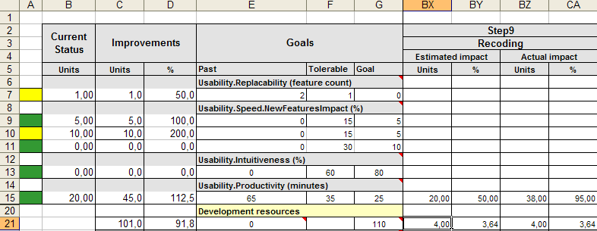
Evo planning - example
IET for MR Project – Confirmit
Solution: Recoding
Make it possible to recode variable on the fly from Reportal.
Estimated effort: 4 days

Slide 19
Evo planning – value vs. cost
Evo Step Planning and Review Meeting
The purpose of these meetings is:
Review last step, demo and initial feedback
To refine requirements and to take design decisions. These will be most frequent in the early phase of the project.
Agree on content of next step (Solutions, Function Requirements etc). Possible new Solutions are discussed and weighted against each other: Most value for development resources

Slide 20
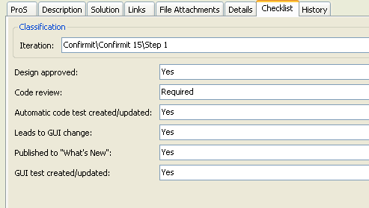
Product quality versus code quality
Evo is focusing on delivering improvements to product qualities
These product qualities materialize themselves as designs/Solutions, often as new features/functionality
To control the code quality of these new features we have put together a simple checklist in TFS

Slide 21
Quality status meeting
Short meetings, 30 minutes. Every second week.
Focus in these meetings are the code quality of each step
We have created a report in TFS that extracts the checklists for all work related to each team

Slide 22
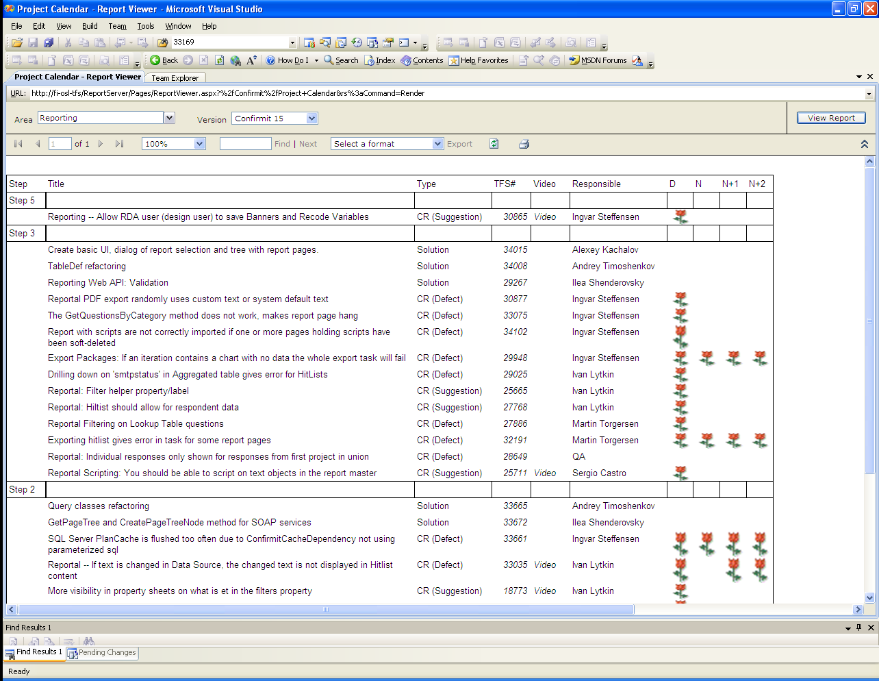
Quality status meeting – TFS report
Notes:
Explain n, n+1 etc

Slide 23
From concepts to day to day operations
Confirmit’s Evo implementation has the following attributes
Product Qualities
Design Ideas
Solutions
Evo Step
IET
Project Management Meetings
Design Review Meetings
How are these connected in order to form our Evo development process?

Slide 24
Evo cycles
Thursday & Friday | Maintenance & Evo step planning meeting: Review the quality of last Evo step and discuss design ideas for next step. New build & setup >> test server updated
Monday | Write detailed Solutions and present them in design review meeting. Short debrief meeting with project team
Tuesday - Friday | Development
Monday | Development & get feedback from all stakeholders.
Tuesday | Development
Wednesday | Development, finalize Evo step

Slide 25
Evo and Quality: what drives quality in Confirmit
Product Quality focus ➔ business value
Software product companies v.s Consultants and projects
Direct client wins related to PQs (ScalabilityThroughput, Usability)
After 6 years of practicing Evo, our mindset has drifted from features to quality – this may be the single most important factor for us
Feedback
Frequent feedback on new ”versions” of Confirmit provide product guidance as well as identifying defects
Both internal and external feedback

Slide 26
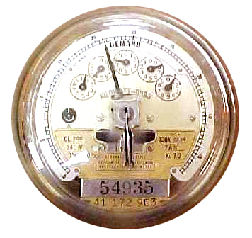
Evo and Quality: what drives quality in Confirmit
Measurements
Hard and sometimes costly, but give great pleasure
Numbers are the sort of truth that we engineers like..
Less formal with experience
Great for marketing

Slide 27
Evo and Quality: what drives quality in Confirmit
Design
Design reviews before coding starts (On Solution level)
Design review checklist – continuously updating
Code checklists
Applicable for all work items: Solutions, Defects
Tailored in Microsoft TFS, according to our Evo process
CI
Continuous integration and execution of automatic tests
Too many failing tests ➔ No check in before ”all” tests are green again

Slide 28
Evo and Quality: what drives quality in Confirmit
Testing
Automatic unit and integration tests, web tests
Manual testing by QA department – each product team has dedicated testers
Performed after each step – the test-backlog is not huge when entering the release-period.
Mostly focus on code quality and finding defects

Slide 29
Evo measurements
Product quality | Past | End state
Usability.Productivity: Time for the system to generate a defined complex survey | 7200 s | 15 s
Usability.Productivity: Time to set up a typical specified Market Research report | 65 min | 20 min
Usability.Productivity: Time to grant a set of end-users access to a report set and distribute report login info | 80 min | 5 min
Usability.Intuitiveness: The time it takes a medium experienced programmer to create a complete and correct data transfer definition with Confirmit web services without any user documentation or other aid | 15 min | 5 min
Performance.Runtime.Concurrency: Maximum number of simultaneously respondents executing a survey with a click rate of 20 seconds and a response time <500 ms given a defined [Survey complexity] and a defined [Server configuration, Typical] | 250 users | 6000 users

Slide 30
Evo measurements
Product quality | Customer value
Intuitiveness: Probability that an inexperienced user can intuitively figure out how to set up a defined Simple Survey correctly | Probability increased by 175%
Productivity: Time in minutes for a defined advanced user, with full knowledge of 9.0 functionality, to set up a defined advanced survey correctly | Time reduced by 38%
Productivity: Time (in minutes) to test a defined survey and identify 4 inserted script errors, starting from when the questionnaire is finished to the time testing is complete and is ready for production. (Defined Survey: Complex survey, 60 questions, comprehensive JScripting.) | Time reduced by 83% and error tracking increased by 25%

Slide 31
Summary
Evo focus on what separates us from our competitors: product qualities
Frequent deliveries and feedback is important in order to deliver that the clients what: Results
No free lunch, Evo requires discipline, maturity and tailoring.

Slide 32
Thanks for listening

